Slide 1

Secondary Training - Module 9
Special Warehouse
Worker Hazards
in Structural Steel
Fabricating and
Supply Companies
Photo from OSHA 3686-09 2010

Slide 2
Secondary Training - Module 9
Learning Assessment
Participants shall take the in-class Learning Assessment Test

Slide 3
Secondary Training - Module 9
OSHA Grant Information
This material was produced under grant number
SH-26316-SH4 from the Occupational Safety and Health Administration, U.S. Department of Labor. It does not necessarily reflect the views or policies of the U.S. Department of Labor, nor does mention of trades names, commercial products, or organizations imply endorsement by the U.S. Government.

Slide 4




Secondary Training – Module 9
Program Development
This program was developed by faculty and students in the School of Planning, Design and Construction at Michigan State University in conjunction with
the American Institute of Steel Construction - Safety Committee and the University of Puerto Rico
June 2015

Slide 5
Secondary Training Procedures Module 9
Module 9 Schedule
3:30- 4:00 Learning Assessment
4:00- 4:15 Secondary Training Procedures and Adult Learning
4:15-4:30 Instructor Closing Comments, Issue Certificates
Program Assessment Survey

Slide 6
Secondary Training Procedures
Module 9
Content
Secondary Training Goals
Secondary Training Process
Training Documentation and Reporting Requirements
Website
Available Materials - Presentations
Forms
Adult Learning Tips
Questions

Slide 7
Secondary Training - Module 9
Secondary Training Objectives
We are asking you as trained trainers to take this information back to your companies and employees and train and document secondary trainings with your workers
Train a minimum of five employees in your company
Document attendance through sign up sheets
Report information to Michigan State University

Slide 8
Secondary Training - Module 9
Secondary Training Processes
Programs can be day long or conducted in 1-2
hour trainings over several days or weeks
It is intended that programs should cover all
learning modules
We are targeting that secondary trainings be completed and reported by August 15, 2015

Slide 9
Secondary Training - Module 9
Secondary Training Processes
Step 1 Obtain management commitment to carry out
the training for workers – you can also invite other shops or companies
Step 2 Decide on day long program or modules spread
out over multiple sessions
Step 3 Contact Michigan State University via email to indicate you will be conducting a training in your company and to receive guidance

Slide 10
Secondary Training - Module 9
Secondary Training Processes
Step 3 Go to the training website and download worker
training day long program or individual modular
presentations and instructions
Step 4 Download attendance sign-in/sign-out forms
Step 5 Download trainee packet (PDF format)
Step 6 Schedule trainings
Step 7 Review all materials before training
Step 8 Use the attendance sign-in sheets for all
trainings

Slide 11
Secondary Training - Module 9
Secondary Training Processes
Step 9 Deliver trainings including pretest, training
  presentations, training activities, post training
  tests and program evaluations
Step10 Mail, fax, or scan and email the program
documentation to Michigan State University

Slide 12
Secondary Training - Module 9
Secondary Training Documentation and Reporting
Mail, fax, or scan and email the following information to Michigan State University:
Program sign-in/sign-out sheets with instructor
and program information completed
Use program forms from website

Slide 13
Secondary Training - Module 9
Voluntary Information (non-mandatory)
Voluntary information may be requested of a limited number of programs to help evaluate program effectiveness and to improve the curriculum:
Pre-tests for each trainee
Copies of activities sheets
Trainee post-tests
Trainee evaluations of program
Please retain copies
Redact any individual worker names from voluntary material
Notes:
Some trainers may be contacted by the program developers for voluntary program information. This will help to evaluate the effectiveness of the program and to make improvements. Willingness to provide this information will be greatly appreciated.

Slide 14

Secondary Training - Module 9
All training resources will be available at:
http://www.spdc.msu.edu/training_workshops

Slide 15

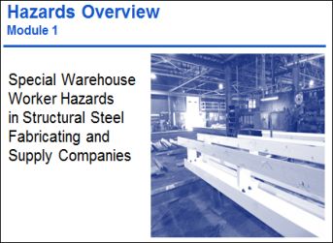
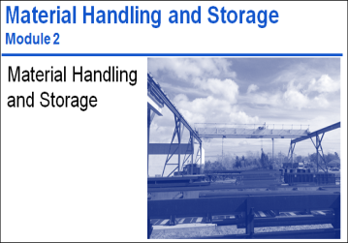


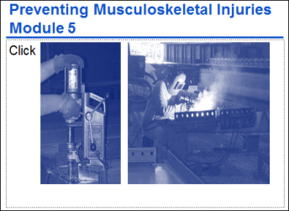

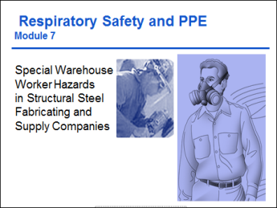



Secondary Training Materials- Module 9
Modular Presentations
Day long Program
Forms
Attendee Training Packet
http://www.spdc.msu.edu/training_workshop

Slide 16
Secondary Training - Module 9
For Additional Help and Information
You are invited to ask training questions!
Contact the following:
Tim Mrozowski: mrozowsk@egr.msu.edu, for Program Materials and Website Questions
Dr. Dennis Welch: welchd@msu.edu, for English Version training questions
Dr. Carla Lopez: carla.lopezdelpuerto@upr.edu, for Spanish Version training questions

Slide 17
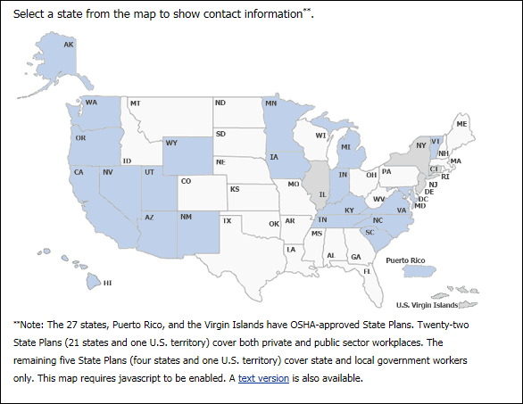
Secondary Training - Module 9
Remember to address State Plans!
https://www.osha.gov/dcsp/osp/index.html
Date visited December 7, 2013

Slide 18

Secondary Training Procedures
Module 9
Adult Learning Tips:
Andragogy –
What is it?
Andragogy is a term which consists of teaching strategies geared towards adults and how adults learn. A process commonly used is engaging the adult learner, resulting in a learning experience.
Photo and content source: OSHA 3686-09 2010

Slide 19

Secondary Training Procedures
Module 9
How adults learn:
Adults are voluntary learners
They learn needed information quickly
They should share life experiences that relate
They need to be treated with mutual respect
Photo and content from OSHA 3686-09 2010
Notes:
https://www.osha.gov/dte/sharwood/best-practices-booklet.pdf

Slide 20
Secondary Training Procedures
Module 9
How adults learn:
They learn best when they learn “by doing”
Need to know what the “end goal” is
Best when information is reinforced and repeated
Best when information is presented in a variety of ways
Source: OSHA 3686-09 2010

Slide 21
Secondary Training Procedures
Module 9
How adults learn:
Adults are self-motivated
Expect to gain information that has immediate application to their lives
Learn best when actively engaged
Source: OSHA 3686-09 2010
Notes:
https://www.osha.gov/dte/sharwood/best-practices-booklet.pdf

Slide 22
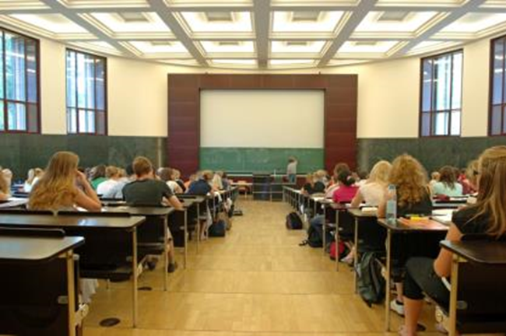
Secondary Training Procedures
Module 9
How adults learn:
Best when they have time to interact, with the instructor and each other
Best when asked to share personal experiences at work and elsewhere
Photo from OSHA 3686-09 2010
Source: OSHA 3686-09 2010

Slide 23
Secondary Training Procedures
Module 9
What does that mean?
Adults learn best in an environment of their peers, whom they are respected by
Best when participating in relevant activities to the situation, and when continuing activities or learning over a period of time

Slide 24
Secondary Training Procedures
Module 9
Helpful Learning Exchanges
Participant-to-Participant
Participant-to-Facilitator
Facilitator-to-Participant
Source: OSHA 3686-09 2010
Notes:
https://www.osha.gov/dte/sharwood/best-practices-booklet.pdf
Learning Exchanges
Participant-to-Participant: “Participant-to-participant” learning exchange recognizes that participants can learn from one another’s experiences. Participant-to-participant exchanges should be a key feature of the training.
Participant-to-Facilitator: Facilitators can learn as much from training sessions as participants do. On many subjects, a group of participants
may have more extensive knowledge and experience in certain areas than a facilitator.
Facilitator-to-Participant: Classroom learning needs structure. A facilitator’s role is to guide discussions, encourage participation, draw out
and/or add information as needed, and highlight key issues and points

Slide 25

Secondary Training Procedures
Module 9
Conducting Trainings
Use words that are easy to understand
Define technical terms or jargon.
Keep sentences short and simple
Use a conversational style and active voice, such as the kind of language that the particpants use
Photo from OSHA 3686-09 2010
Source: OSHA 3686-09 2010

Slide 26
Secondary Training Procedures
Module 9
Using PowerPoint - Delivery
Slides should serve as a focal point for issues
Do not read from the slides!
Review the speaker notes before the presentation
Remember: questions and discussion are part of the learning experience
Practice using PowerPoint before you use it in a class
Make sure you are comfortable moving between slides and between information on slides
Source: OSHA 3686-09 2010

Slide 27
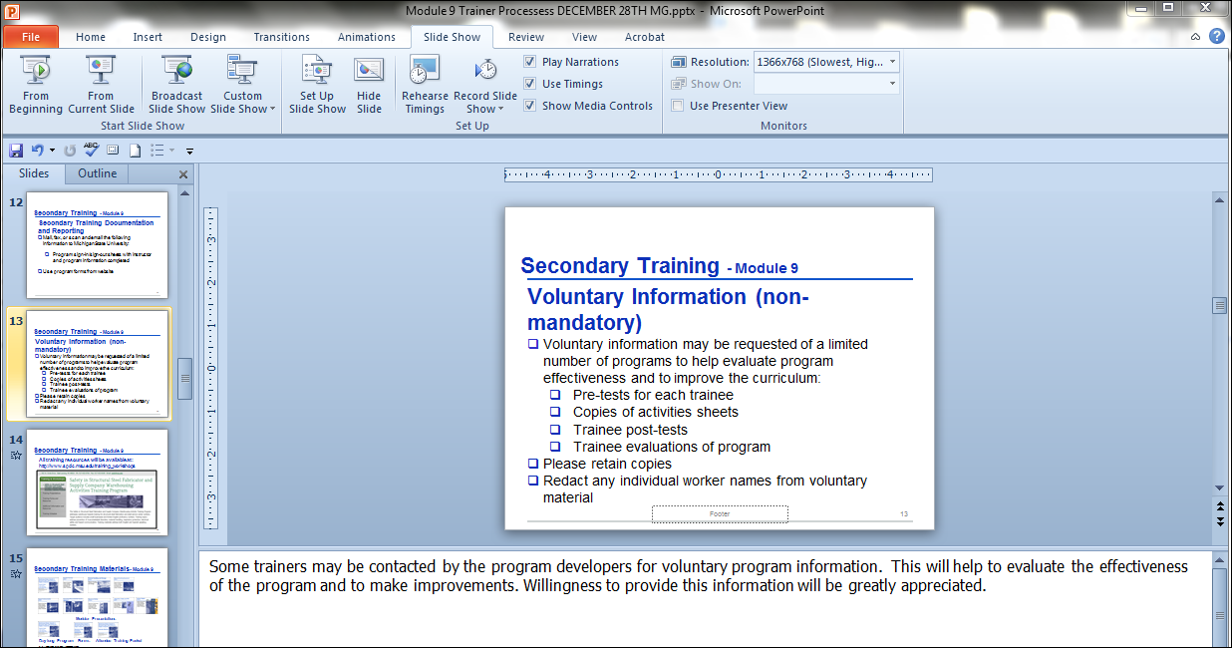
Secondary Training Procedures
Module 9
PowerPoint Speaker Notes
Some slides have speaker notes*
You can end the presentation and see the notes at the bottom of the screen or view the notes page.
Speaker note
Source: OSHA 3686-09 2010
Notes:
* Speaker notes help to provide additional background information for the presenter. They should be reviewed before delivering the program.

Slide 28
Secondary Training Procedures
Module 9
Flip Charts
Use dark marker colors, such as black, dark brown, or dark blue for the main text
Using many colors on a flip chart will catch your audience’s eye
Print in large block letters
Do a “test” flip chart page before the workshop and make sure it can be read from the back of the room
Be sure not to crowd the flip chart with too much information. Only key points should be written.
Source: OSHA 3686-09 2010

Slide 29
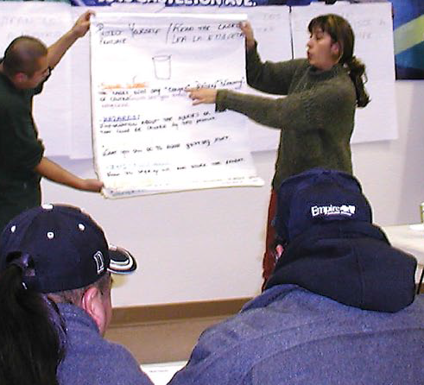
Secondary Training Procedures
Module 9
Flip Charts
Watch your spelling
If you have problems with spelling, memorize correct spelling of words you are likely to use
But do not let spelling limit
use of a flip chart
Creating a “spell-free” zone will help to take some pressure off both you and the participants
Photo from OSHA 3686-09 2010
Source: OSHA 3686-09 2010

Slide 30
Secondary Training Procedures
Module 9
Training Assessments & Evaluation*
Adminster the assessment “Pre-test” before the training
Adminsiter assessment “Post-test” at end of program
Adminster the overall training evaluation
Notes:
*Learning assessments: measure the skills, knowledge, or attitude that the trainee retains as a result of the training. Using both Pre- and Post- tests in training will show the knowledge gained during training.
*Program evaluations: provide information for trainers and program developers to get feed back on the program

Slide 31
Secondary Training Procedures
Module 9
Resources and Current Training Programs
OSHA Outreach Training Program Materials:
https://www.osha.gov/dte/outreach/ (has specific resources for trainers - and can also be separated by industry).
Susan Harwood Training Materials (separated by topic)
https://www.osha.gov/dte/grant_materials/material_listing_topic.html

Slide 32
Secondary Training Procedures
Module 9
Sources
https://www.osha.gov/dte/sharwood/best-practices-booklet.pdf
Noorie, N., “Application of an Andragogical Model in Developing a Michigan Residential Energy Code Training Curriculum for Building Inspectors and Officials in Michigan”, Masters Thesis, Michigan State University (2004).

Slide 33
Secondary Training Procedures
Module 9
Secondary Training Programs
Q and A

Slide 34
Secondary Training Procedures
Module 9
Speaker Closing Comments

Slide 35
Secondary Training Procedures
Module 9
Issue Certificates

Slide 36
Secondary Training Procedures
Module 9
Thank you!
and
Q and A

