Slide 1
Fundamentals of Steel Bridge Engineering
Lesson 1 – Introduction to Bridges and Bridge Steels
Notes:
This presentation is part of the "Fundamentals of Steel Bridge Engineering" teaching aid, available at aisc.org/teachingaids. This set of (14) lessons was prepared by Frank Russo, PE, PhD and Michael Grubb, PE with support from the National Steel Bridge Alliance (NSBA) and AISC University Programs.
For questions or comments on these presentations, please contact:
AISC University Programs
universityprograms@aisc.org

Slide 2
Reference Materials
NSBA Steel Bridge Design Handbook (SBDH)
  Vol 1 – Bridge Steels and Their Mechanical Properties
  Vol 2 – Steel Bridge Fabrication
  Vol 3 – Structural Steel Bridge Shop Drawings
  Vol 19 – Corrosion Protection of Steel Bridges
ASTM A709/A709M Standard Specification for Structural Steel for Bridges
AASHTO LRFD Steel Bridge Fabrication Specifications
AASHTO/AWS D1.5M/D1.5 Bridge Welding Code and FHWA Bridge Welding Reference Manual
NSBA Uncoated Weathering Steel Reference Guide
Accelerated Steel – Achieving Speed in Steel Bridge Fabrication (NSBA)
AASHTO/NSBA Steel Bridge Collaboration Guideline documents G1.1, G1.2, G1.4, G2.2, and G12.1 and Specification documents S8.1, S8.2, and S8.3.
Notes:
This lesson incorporates materials found in in the various references listed on this slide. This lesson will provide a fundamental introduction to steel-girder bridges and the basic bridge design and construction process. This lesson will also provide detailed information on bridge steels and the steel-girder bridge fabrication process.
The following acronyms are used frequently throughout this lesson and the entire course:
AASHTO = American Association of State Highway and Transportation Officials
ASTM = American Society for Testing and Materials
AWS = American Welding Society
CVN = Charpy V-Notch
HPS = High Performance Steel
LRFD = Load and Resistance Factor Design
NSBA = National Steel Bridge Alliance
SBDH = Steel Bridge Design Handbook
Other less frequently used acronyms are defined on the slide and/or in the slide notes where they first appear.

Slide 3
Lesson 1 Roadmap
Introduction to Bridges and Bridge Steels
Steel-Girder Bridge Components
  General
  Superstructure
  Substructure
  Decks
  Bracing
  Field Splices, Web Stiffeners & Shear Connectors
  Bearings and Joints
Bridge Design and Construction Process
Bridge Steels
  Product Specifications
  Steel Manufacturing
  Mechanical Properties
  Corrosion Resistance
Notes:
Lesson 1 of this course provides a basic introduction to steel-girder bridges, the bridge design and construction process, bridge steels, and the steel-girder bridge fabrication process.
Topics to be covered in this lesson include the definition and discussion of basic steel-girder bridge components, including the superstructure, substructure, deck, bracing, field splices, web stiffeners, shear connectors, bearings, and joints. The design of all these components (except for substructures) will be covered in this course.
The basics of the bridge design and construction process will be covered next from the preliminary design through final construction, followed by a detailed discussion of bridge steels, including product specifications (e.g., the various grades of steel that may be used in steel-girder bridges), the basics of the steel manufacturing process, the mechanical properties of steel (i.e., tensile strength, fracture toughness, fatigue resistance, ductility, residual stresses, hardness, etc.), and the corrosion resistance of steel.

Slide 4
Lesson 1 Roadmap - continued
Introduction to Bridges and Bridge Steels
Steel Bridge Fabrication
  Pre-Fabrication Preparation
  Welding Processes and Procedures
  Cutting, Machining, & Plate Bending
  Member Fabrication
  Shop Assembly
  Surface Preparation and Coating
  Shipping
Notes:
Finally, Lesson 1 will conclude with a detailed discussion of the steel-girder bridge fabrication process. This discussion will cover all aspects of the pre-fabrication preparation process, including bidding and contracting, estimating, planning and scheduling, shop drawing production and approval, and material procurement. Basic welding processes and procedures will be covered next, followed by a description of the various processes that fabricators typically use for cutting, machining, and bending (and curving) of steel.
Once the pre-fabrication process is completed, the basic methods used to process the material into bridge parts; i.e., to fabricate steel plate girders, rolled beams, and the cross-frames and diaphragms will be reviewed next, along with a brief discussion of post-fabrication repairs. The types, uses and need for shop assembly will next be discussed, followed by a discussion of the surface preparation of the steel for the various coating options that may be employed. A brief discussion regarding the surface preparation of uncoated weathering steel is also included. This lesson will conclude with a discussion of various shipping concerns and considerations and shipping options for the fabricated steel.

Slide 5
steel-girder bridge components general
Notes:
The first topic in this lesson will provide a general discussion of the basic components of a steel-girder bridge.

Slide 6
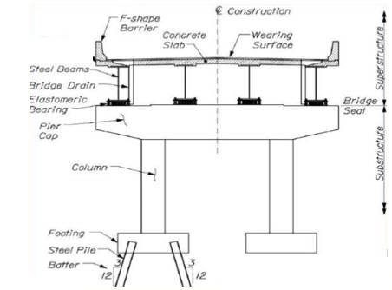
Steel-Girder Bridge Components - General
Notes:
This slide shows the basic components of a steel-girder bridge. In this case, the substructure, which represents all the components below the “bridge seat”, consists of a two-column concrete pier resting on pile-supported concrete footings. The superstructure in this case, which represents all the components above the “bridge seat”, consists of four steel beams (or girders) supporting a concrete deck slab, i.e., the riding surface, which may or may not have a wearing surface on top, and two concrete barriers at the edges of the deck slab. The steel beams are each resting on bearings, in this case elastomeric bearings, which rest on top of the pier cap. The bearings transmit loads from the superstructure to the substructure while also facilitating translations and/or rotations.
This course will focus solely on the design of the superstructure components of a steel-girder bridge. The design of the substructure components will not be covered.

Slide 7
steel-girder bridge components superstructure
Notes:
The next topic in this lesson will describe the various types of steel I-girder bridge superstructures, along with the primary components of a typical steel welded plate (I-) girder.

Slide 8
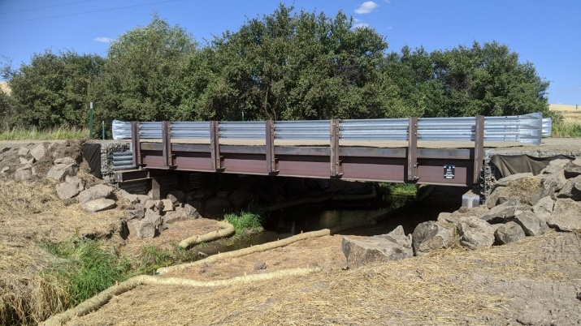
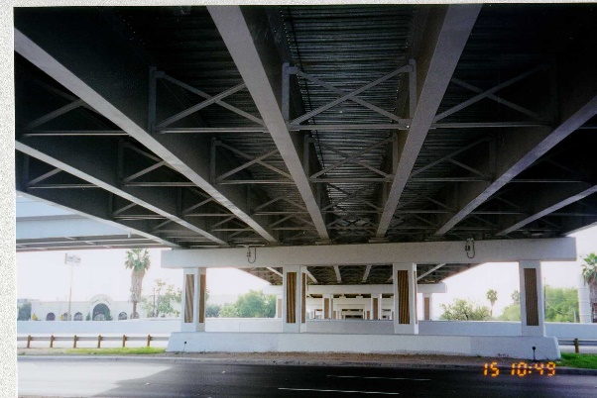
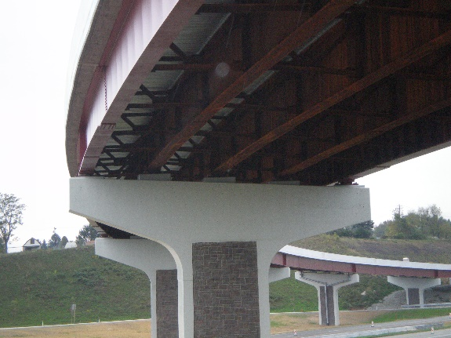

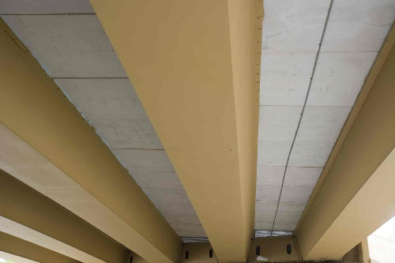
Steel-Girder Bridge Components - Superstructure
Straight rolled-beam superstructure
Straight plate-girder superstructure
Horizontally curved plate-girder superstructure
Straight and horizontally curved box (tub) girder superstructures
Notes:
Different types of steel-girder bridge superstructures are shown on this slide.
The photo in the upper left-hand corner of this slide shows a typical straight rolled-beam superstructure; that is, a superstructure in which the longitudinal members consist of rolled wide-flange (W) sections. Such sections are typically used in shorter-span steel-girder bridge superstructures. The photo in the upper right-hand corner of this slide shows a typical straight (welded) plate-girder superstructure, which is the most common steel-girder bridge type. The photo in the bottom left-hand corner of this slide shows a typical horizontally curved (welded) plate-girder superstructure, which is commonly used on grade separation structures. The two photos in the bottom right-hand corner of this slide show straight and horizontally curved steel box (or tub) girder superstructures, which are favored over I-girder systems by a few State DOTs for their aesthetic appeal and larger torsional resistance.
This course will primarily cover the design of straight rolled-beam and (welded) plate girder superstructures. Some important aspects of horizontally curved plate-girder superstructure design will also be covered in this course. The design of straight and horizontally curved box (tub) girder superstructures will not be covered in this course.
Photo Credits: HDR and AISI

Slide 9
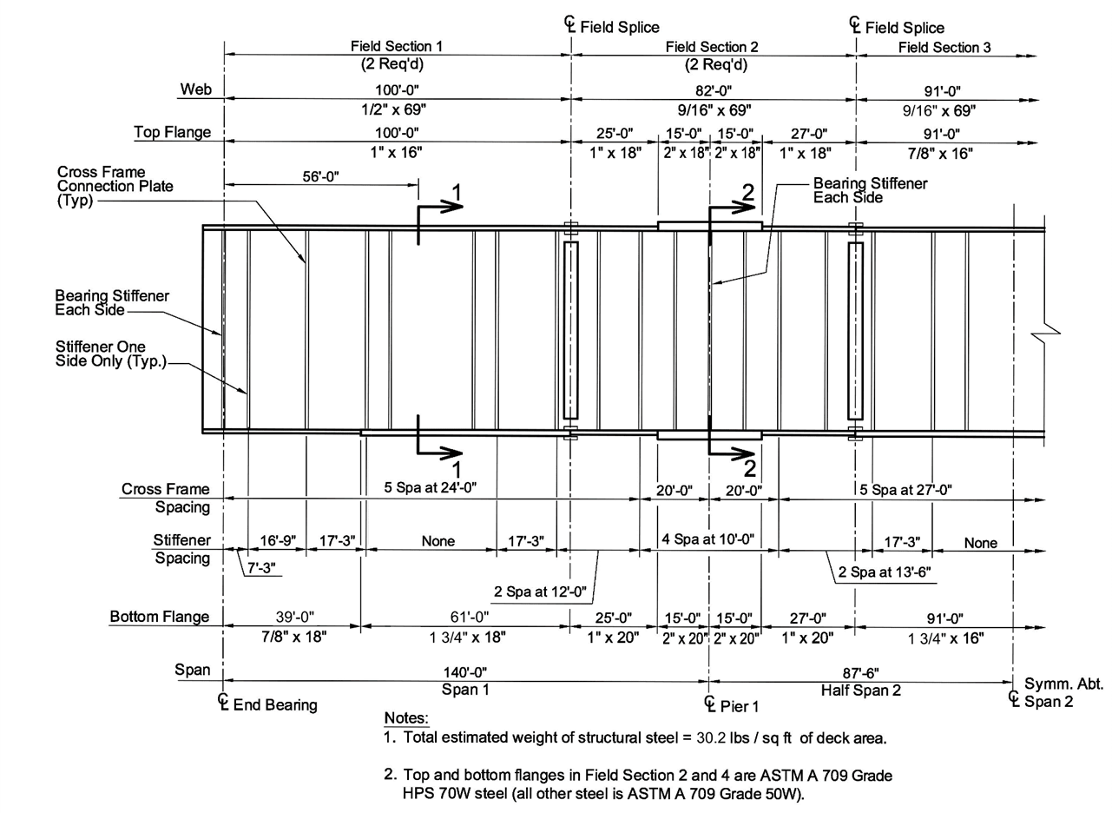
Steel-Girder Bridge Components – Superstructure - continued
Shear connector
Bolted field splice
Flange
Web
Flange
Welded shop splice
Notes:
This slide shows some of the primary components of a typical steel welded plate (I-) girder. The girder consists of a web plate and top and bottom flange plates, which are welded together in a steel fabrication shop using fillet welds. Welded shop splices are typically placed in the web and flange plates at different locations along the length of girder where a plate-thickness change is introduced and/or due to length limitations of the steel plates. The shop splices are made with complete joint penetration (CJP) groove welds.
Vertical bearing stiffener plates are typically fillet welded to both sides of the girder web and to both flanges at each bearing location to stiffen the girder web and resist the loads at bearing locations and at other locations subjected to concentrated loads where the loads are not transmitted through a deck or deck system. Intermediate vertical stiffener plates are typically fillet welded to one side of the web at calculated intervals along the length to assist the web in resisting the higher shear forces near the supports. These stiffeners are either tight fit or attached to the compression flange and attached, tight fit, or cut short from the tension flange. Vertical stiffeners positively attached to both flanges also serve as connection plates for transverse bracing (i.e., cross-frames or diaphragms) in-between the girders. Connection plates are typically placed on one side of the web on fascia girders and on both sides of the web on interior girders. Stud shear connectors are typically welded to the top flange to ensure composite action with the concrete deck.
The process of steel-girder bridge fabrication is discussed in detail later in the lesson. The design of the beam or girder section for flexure according to the AASHTO LRFD Bridge Design Specifications will be covered in Lessons 6 through 9 of this course. The design of the bearing stiffeners, shear stiffeners, and connection plates will be covered in Lesson 5. The design of the stud shear connectors will be covered in Lesson 9. The design of the fillet-welded and complete joint penetration groove-welded connections will be covered in Lesson 11.

Slide 10
steel-girder bridge components substructure
Notes:
The next topic in this lesson will describe the various types of steel I-girder bridge substructures that are typically employed.

Slide 11

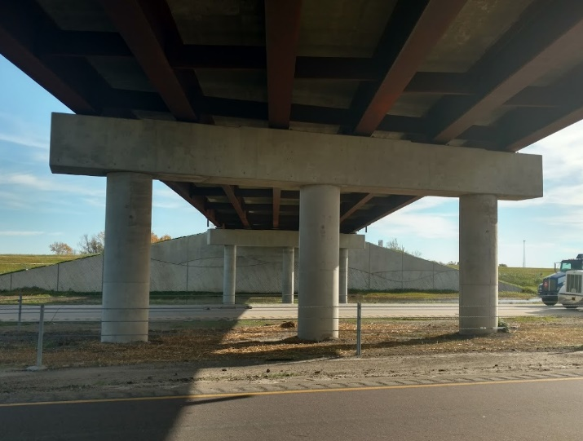
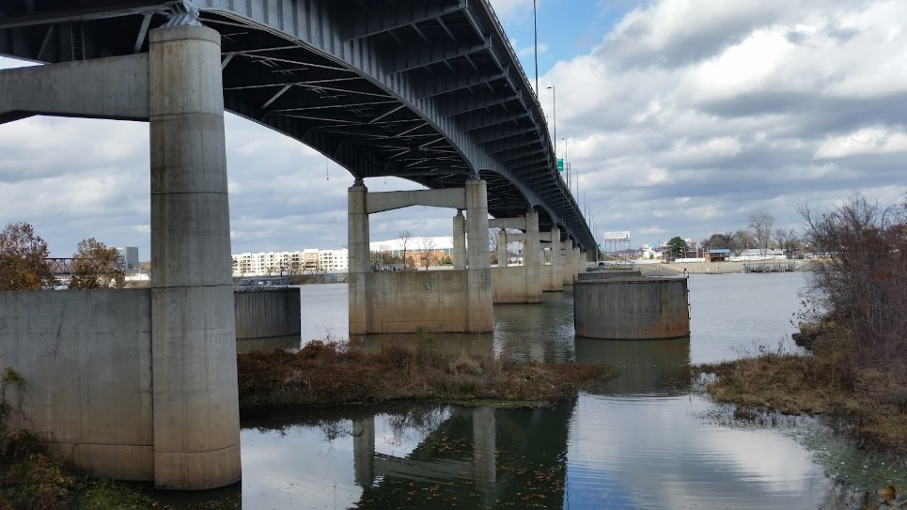
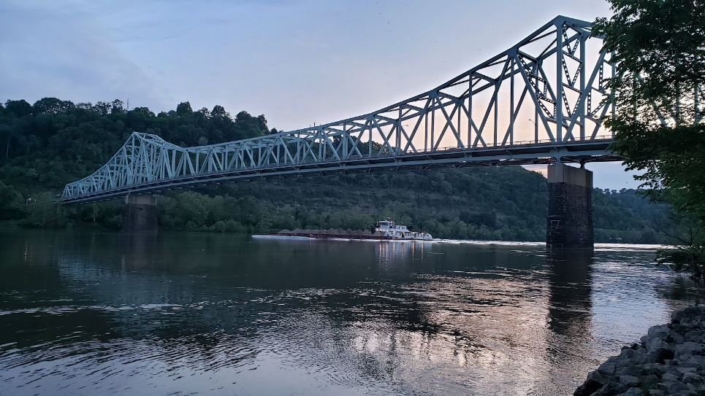
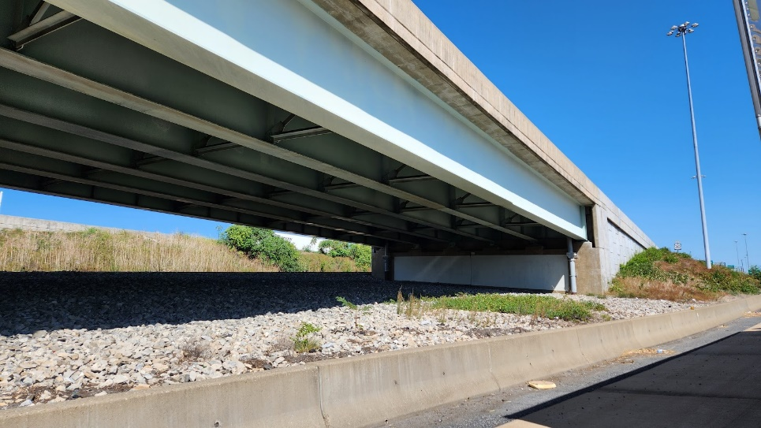
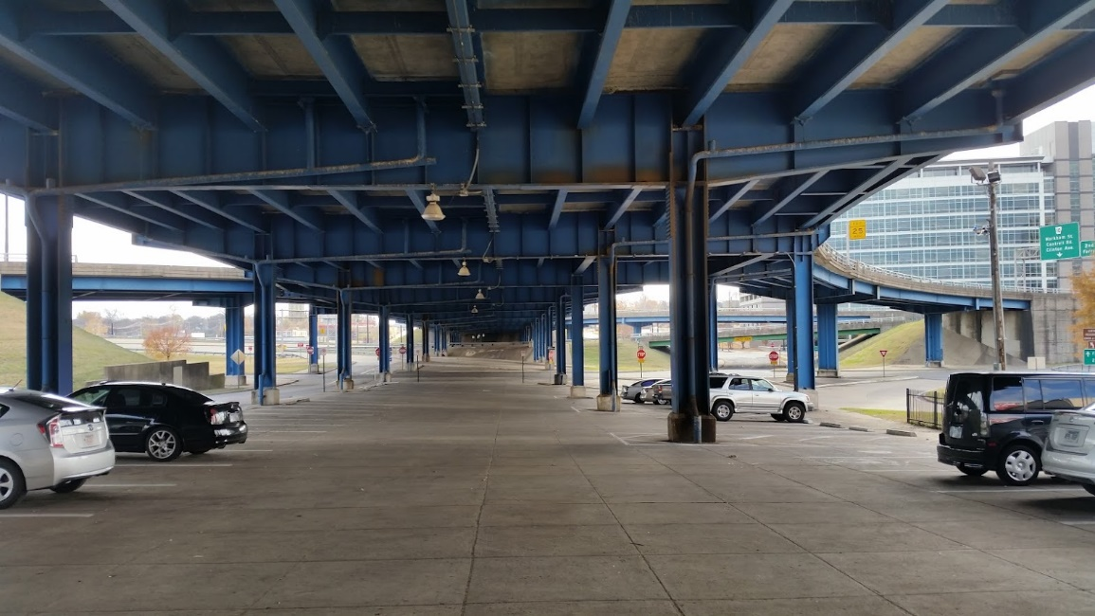
Steel-Girder Bridge Components - Substructure
Multi-column concrete piers
Concrete hammerhead piers
Concrete wall piers
Concrete abutment
Steel straddle bent caps
Notes:
Different types of typical steel-girder bridge substructures are shown on this slide.
The photos in the upper left-hand corner of this slide show some typical multi-column concrete piers. The photo in the upper right-hand corner of this slide show some typical concrete hammerhead piers, which consist of a large concrete pier cap supported on a narrow wall pier or a single concrete column. Concrete wall piers (without a pier cap) are shown in the photo in the bottom left-hand corner of this slide. Solid walls support the girders in-between the end supports.
Depending on the underlying soil conditions, pier columns or walls either rest on concrete footings supported on rock or supported on steel or concrete piles, or in some cases where there is deep water or soft soils, rest on large caissons (drilled shafts), which are large watertight cylinders sunk into the ground and filled with concrete. The photo in the middle at the bottom of this slide shows a typical concrete abutment, which supports the girders at the ends of the span. The photo at the bottom right of this slide shows a steel straddle bent cap which may be used when roadways or railroads cross beneath the bent, typically at large skew angles when the feature carried, and the feature crossed, have nearly parallel alignments. In this unique case a straddle bent was used to preserve open-space under a bridge for urban parking.
Photo Credits: Russo Structural Services

Slide 12
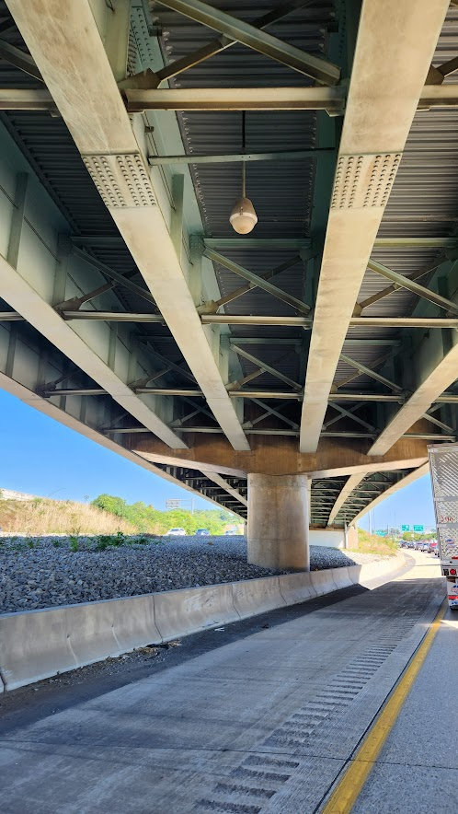

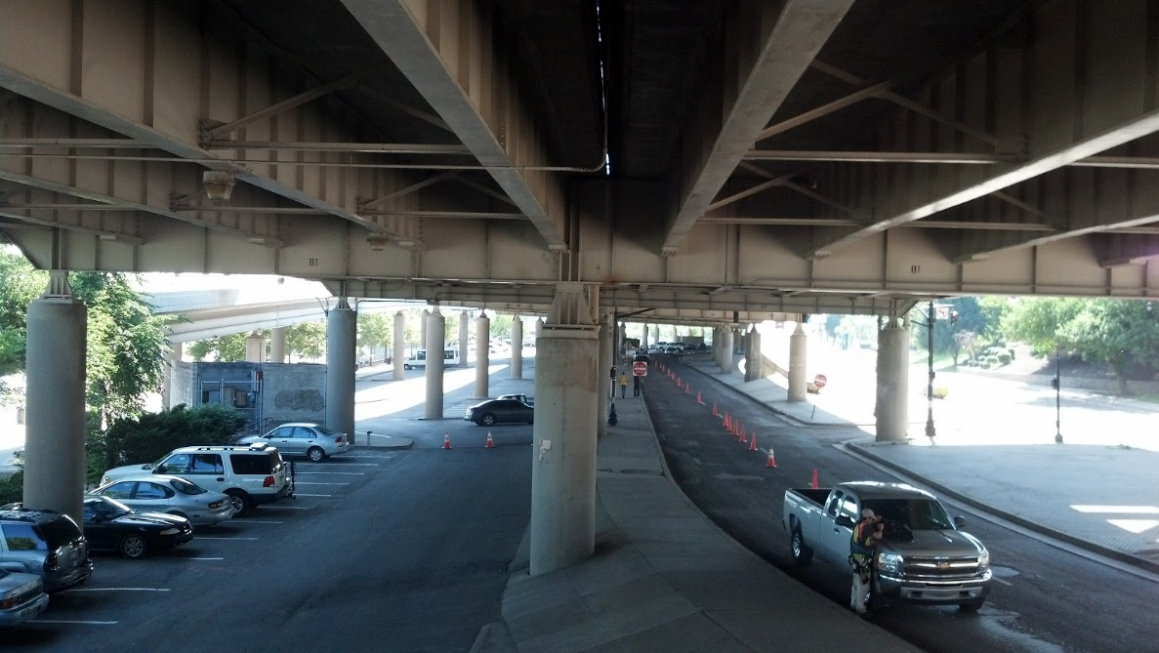
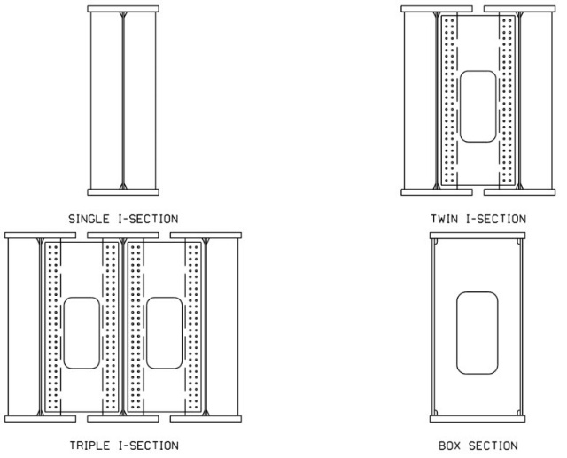
Steel-Girder Bridge Components – Substructure
Steel Hammerhead Bent Cap
Integral Steel Straddle Bent Cap
Integral Steel Bent Cap Cross-Sections
Post-Tensioned Concrete Integral Pier Cap
Notes:
Where underclearance is limited, hammerhead pier caps can be designed integral with the steel girders. Or, to avoid the use of a skewed pier, an integral pier cap in conjunction with a single-shaft pier can be utilized.
Girders may be supported with several types of integral piers. The girders may penetrate a post-tensioned concrete pier cap on a pier column as shown in the left-hand photo on this slide. Another type of support are steel hammerhead and straddle bent caps shown in the right-hand photos on this slide with the girders connected to and through the steel bent cap. The integral configuration means that the longitudinal girders frame into the outer faces of the bent cap webs, with a full moment connection. Steel straddle bent caps are typically configured as one of four cross-sections: single I-section; twin I-section; triple I-section; or box section, as shown in the bottom right figure on this slide. The box section is a typical configuration though each of the steel caps shown on this slide is an I-shaped cap beam. Triple I-section bent caps are a relatively recent innovation and have system redundancy, avoiding the designation as a nonredundant steel tension member (formerly known as a fracture critical member), and are easier to fabricate than box-shaped bent caps.
The type of substructure is defined by considering its many functions and the existing soil conditions. They may be supported by spread footings (exerting bearing pressures on soil or rock), or by various deep foundations such as driven steel, concrete, or timber piles; drilled concrete piles; or large diameter concrete drilled shafts. Engineers must choose the foundation type, orientation, and size based on soil and rock properties as well as consideration for how potentially large foundations might be built in challenging site conditions such as in rivers, steep hillsides, or close to adjacent traffic. The substructures are designed for various specified combinations of the resulting vertical and lateral load effects from dead loads, vehicle loads, and various other loads such as wind, seismic, thermal-induced forces, stream or ice-flow forces, and others. Each situation presents unique challenges to the design engineer. To achieve a truly efficient steel design, the superstructure and substructure type must be viewed in unison with respect to economic, structural and aesthetic demands. As mentioned previously, the design of substructures will not be covered in this course.
Photo Credits: Russo Structural Services

Slide 13
steel-girder bridge components decks
Notes:
The next topic in this lesson will discuss the different types of decks and deck systems that may be used on steel-girder bridges.

Slide 14
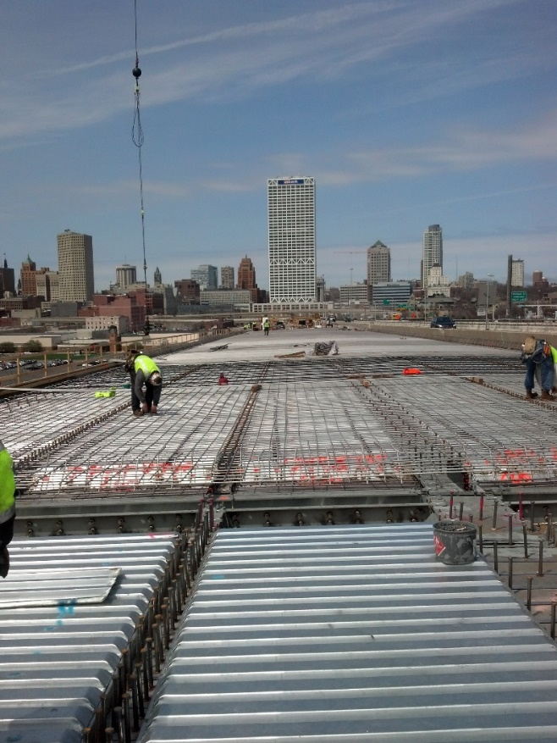
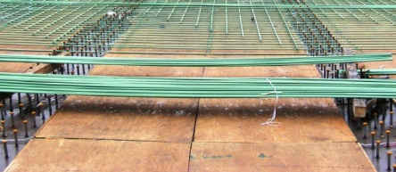
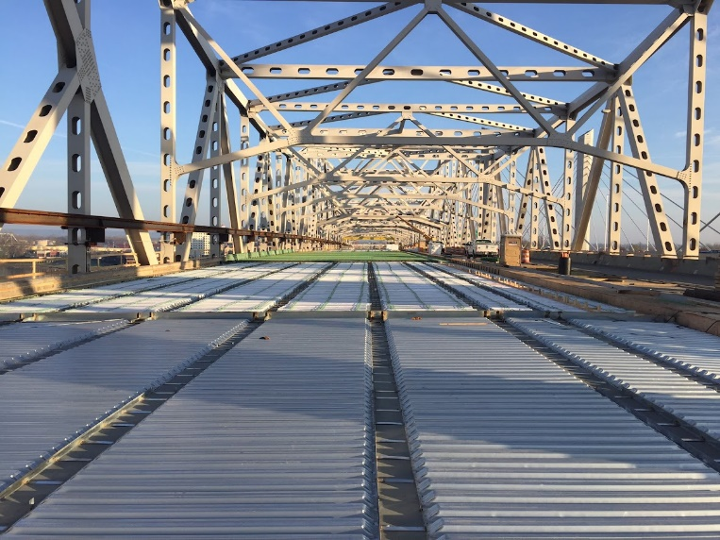
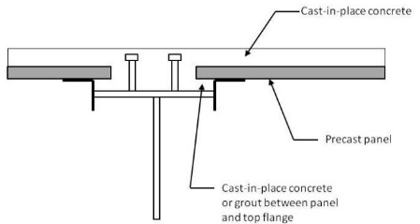
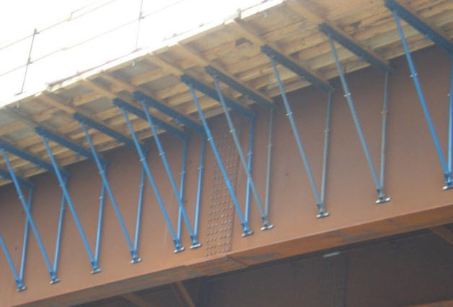
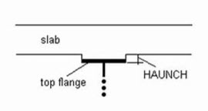
Steel-Girder Bridge Components - Decks
Removable wood deck forms
Steel stay-in-place (SIP) deck forms
Partial-depth precast concrete deck panels
Deck overhang brackets
Cast-in-place (CIP) reinforced concrete deck
Concrete deck haunch
Notes:
Different types of decks for steel-girder bridge superstructures will be covered next. Generally, cast-in-place (CIP) reinforced concrete deck slabs are the most often used type of deck for steel bridges (see the photo on the left-hand side of this slide). These decks typically include mild steel reinforcement in the longitudinal and transverse directions. Permanent or temporary formwork can be used to construct cast-in-place concrete bridge deck slabs. Permanent formwork, also referred to as stay-in-place (SIP) formwork, can either be constructed from steel or concrete components, while temporary formwork typically consists of wood elements. States typically specify whether it is acceptable to use stay-in-place formwork.
A photo of temporary wood formwork constructed in between the girder top flanges of a steel I-girder bridge is shown at the top center of this slide. A benefit of using temporary wood formwork is that the bottom of the concrete deck slab is visible after removal, and any signs of distress can be noted during routine bridge inspections. A disadvantage of using temporary formwork is the fact that removing the forms will require additional construction time. A photo of steel stay-in-place formwork installed on a steel I-girder bridge, prior to the placement of the deck slab steel reinforcement, is shown in the top right photo on this slide. The Engineer is typically not responsible for the design of the steel stay-in-place formwork, which is instead the responsibility of the contractor or steel stay-in-place formwork provider. However, the designer must consider the additional weight of the steel stay-in-place formwork in the design of the bridge. A customary allowance of 0.015 ksf is often used by designers, which accounts for the weight of the steel formwork and the additional concrete in the “valleys” of the stay-in-place forms. The stay-in-place steel deck forms are often attached to an angle, which is attached to the girder top flange by welding or via mechanical attachment, such as a hanger or strap over the top flange of the girder. Partial-depth precast concrete panels span between girders and can act as stay-in-place forms for cast-in-place concrete that is placed on top of the panels and also act as the bottom reinforcing for the deck, creating a composite full-depth deck (see the center photo in the middle of this slide). Since partial-depth panels span between the girders, the overhangs must still be constructed with conventional cast-in-place concrete. The partial-depth panels are typically prestressed with strands located at the mid-depth, oriented in the bridge’s transverse direction, which is in the direction of the deck design span. The prestressing serves as the bottom layer of reinforcing steel in the deck. Deck overhang brackets, such as those shown in the bottom right photo on this slide, are typically required to construct the CIP cantilever portion of the deck slab that extends beyond the exterior girders. The deck overhang brackets are typically selected from manufacturer catalogues and prefabricated components. The contractor is responsible for selecting the proper deck overhang bracket and spacing, as well as the design of any additional formwork. The concrete deck haunch in a steel girder bridge is typically referred to as the distance from the top of the steel girder web to the bottom of the concrete deck slab (see the bottom photo in the middle of this slide). The haunch depth is usually set to accommodate all variations in top flange thickness, along with consideration of the deck cross slope, deck forming method, and splice-plate thickness.

Slide 15
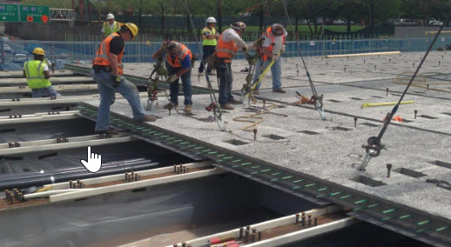
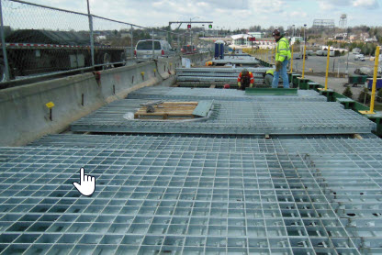
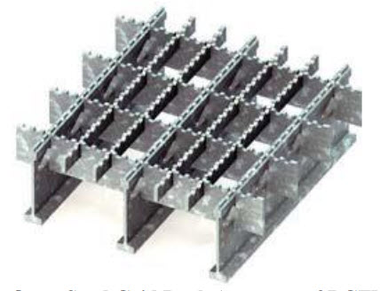
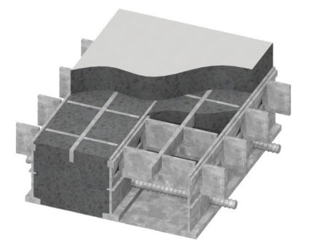
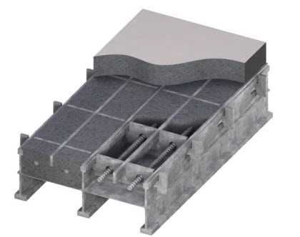
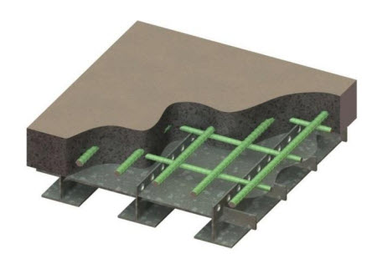
Steel-Girder Bridge Components – Decks - cont.
Full-depth precast deck panels
Open steel grid deck
Unfilled steel grid deck composite with concrete slab (ExodermicTM)
Filled steel grid deck
Partially-filled steel grid deck
Notes:
Full-depth concrete deck panels (see the top left photo on this slide) can be used as an alternative to cast-in-place concrete decks, as they may reduce construction times associated with placing the deck in new bridge construction and deck reconstruction. Precast concrete deck panels are typically fabricated offsite at a pre-casting plant that can provide optimal casting and curing conditions. As such, precast concrete deck panels are often more durable and more uniformly constructed than their cast-in-place counterparts. Also, precast concrete deck panels have little or no shrinkage cracking since they are allowed to shrink and cure in an unrestrained condition. Full-depth precast concrete panels typically span the width of a bridge or a stage for staged construction and are placed longitudinally adjacent to one another. The transverse joints between adjacent panels are often grouted, and post-tensioning may also be used to keep the transverse joint in compression. The deck panels are made composite with the steel girders with stud shear connectors. Block-outs in the panels are provided to allow for the placement of shear studs onto the top flange of the steel girder. Composite action between the deck and the girders is provided by shear studs that extend out of the girder and into the block-outs in the panels, once the block-outs are filled with grout.
A steel grid deck consists of primary (main) members that span between adjacent beams, stringers, or cross beams and secondary members (often referred to as distribution bars or cross bars) that interconnect and span between the primary members. The primary and secondary members of the grid deck typically form a rectangular pattern, although diagonal patterns can also be used. The primary and secondary members must be securely joined together. Steel grid decks are typically comprised of steel members forming the grid and can be open (as shown in the photo and figure in the top right-hand side of this slide), filled or partially filled with reinforced concrete, or unfilled and composite with a reinforced concrete slab (a so-called “Exodermic” deck referring to the trademark name given to this grid deck system), as shown in the bottom figures on this slide. Open steel grid decks are often used on movable steel bridges and older steel truss bridges due to the resulting weight savings.

Slide 16
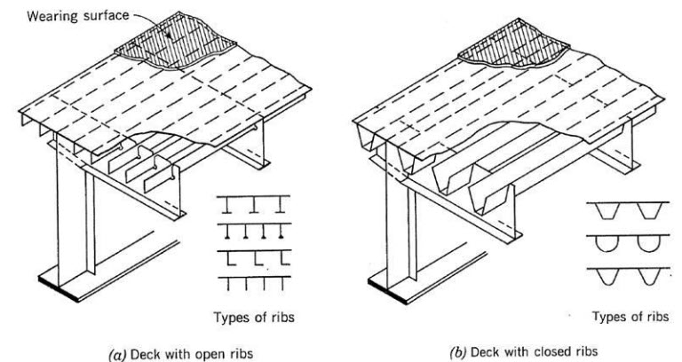
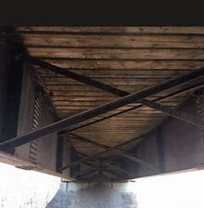
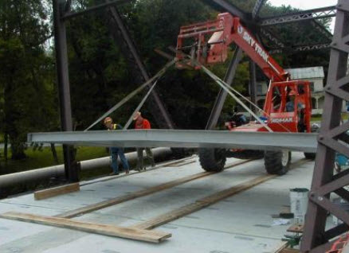
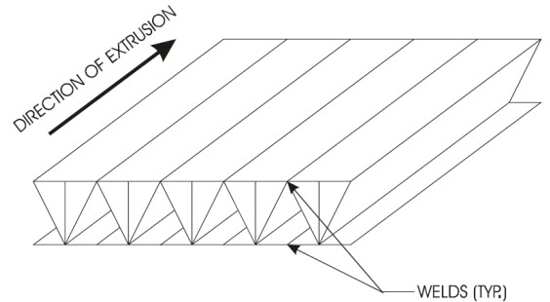
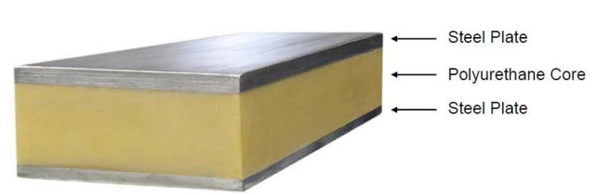
Steel-Girder Bridge Components – Decks - cont.
Orthotropic steel deck
Wood deck
Fiber reinforced polymer (FRP) deck panels
Aluminum deck panels
Sandwich deck panels
Notes:
An orthotropic steel deck consists of a flat, thin steel plate which is stiffened by a series of closely spaced longitudinal ribs that run parallel to traffic, placed orthogonal to transverse floor beams (see the top left figure on this slide). The deck stiffness is considerably different in the longitudinal and transverse direction, hence orthotropic steel decks are structurally anisotropic. Typically, an orthotropic steel deck is made integral with the supporting superstructure component, such as the top flanges of girders or floor beams. Orthotropic steel decks are typically classified as either open-rib or closed-rib systems. In either case, the ribs are arranged in the longitudinal direction of the bridge and distribute wheel loads to the intermediate floor beams, while also providing increased flexural stiffness to the primary structural component. In an orthotropic steel deck system, live loads are transferred through the wearing surface and top steel deck plate, to the longitudinal ribs, and then to the transverse floor beams. The load in the floor beam is then transferred to the main load carrying system, such as a longitudinal plate girder. Orthotropic bridge cross-sections are good candidates for suspended span bridges such as suspension, cable-stayed, and tied-arch bridges, and for movable bridges, minimizing the dead load on the entire bridge system.
The top right photo on this slide shows a wood deck system. The use of wood deck systems on steel girders is typically limited to structures in special environments (forests, bike trails, etc.), or structures with severe weight restrictions. There are several different types of wood deck systems that have been used.
Other lightweight deck systems have been developed including fiber reinforced polymer (FRP) deck panels, aluminum deck panels, and sandwich deck panels, as shown on the bottom row of this slide. The use of these deck systems has been limited however due to the high initial costs and general unfamiliarity with the systems. Also not shown are corrugated metal decks with gravel riding surfaces, which have been more commonly used than these systems on many rural bridges.
These deck systems and the design of reinforced CIP concrete decks will be discussed further in Lesson 14 of this course. The design of the steel girders for deck overhang loads will be discussed in Lesson 7.

Slide 17
steel-girder bridge components bracing
Notes:
The next topic in this lesson will discuss the different types of bracing used on steel-girder bridges; namely, cross-frames, diaphragms, and lateral bracing, along with their basic functions.

Slide 18
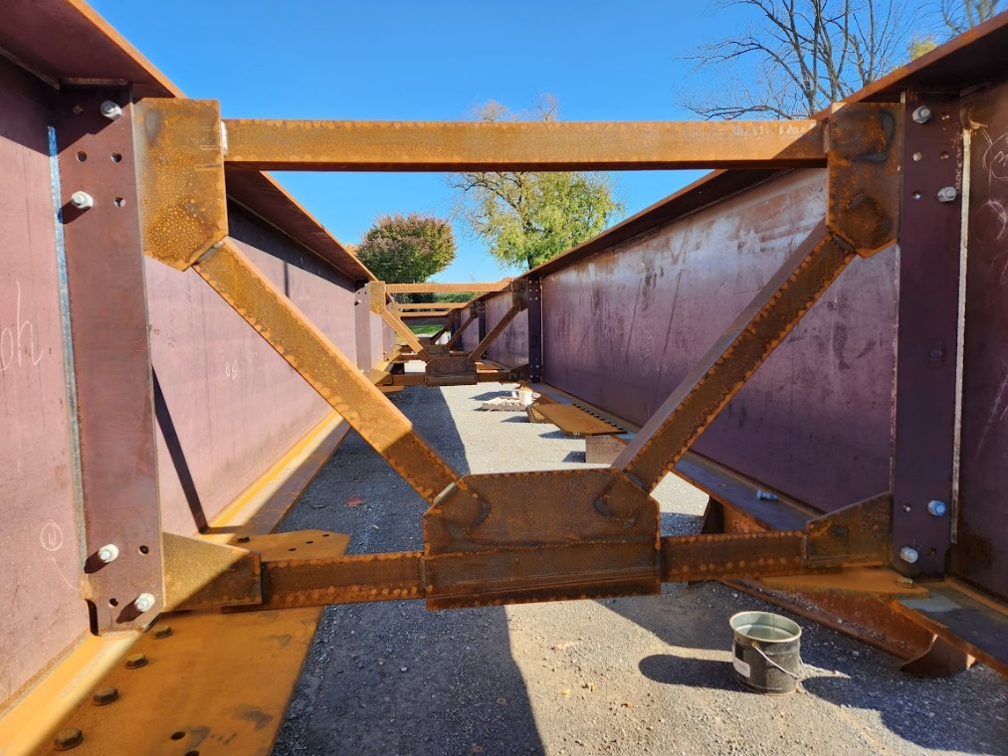
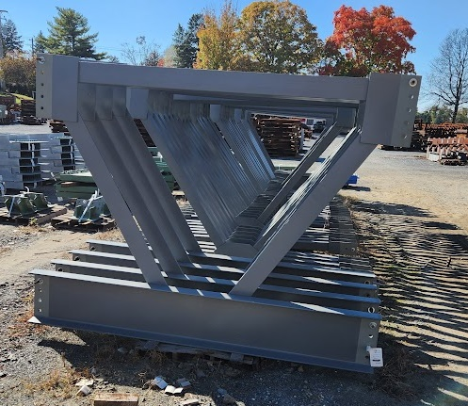
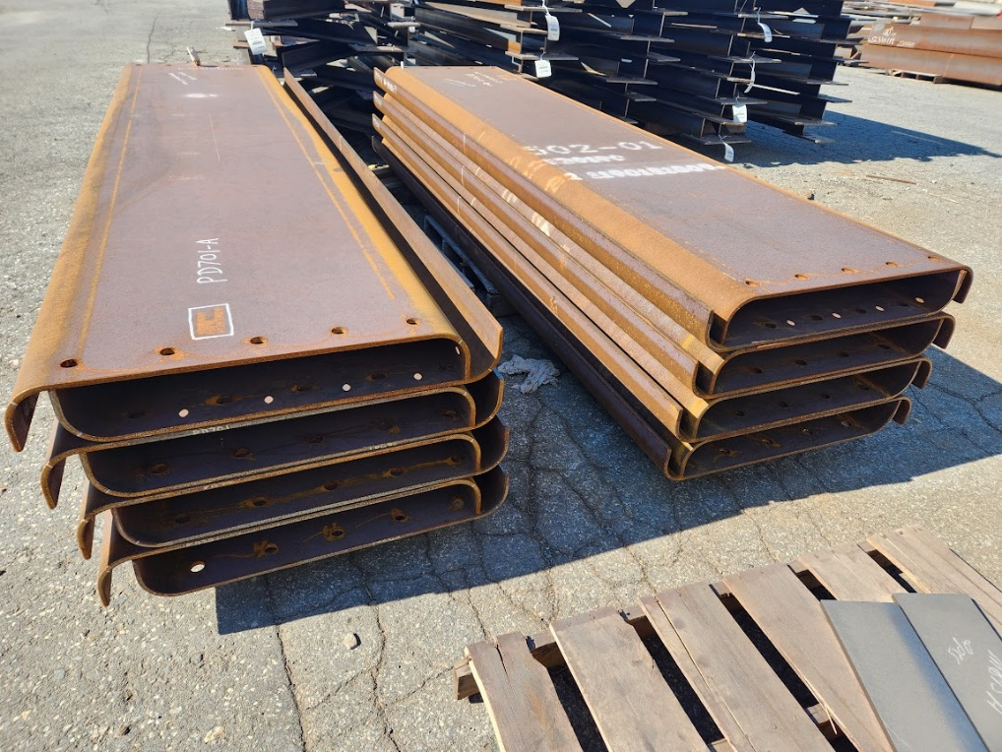
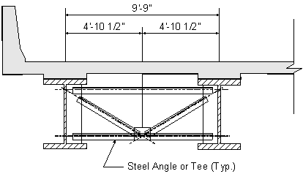
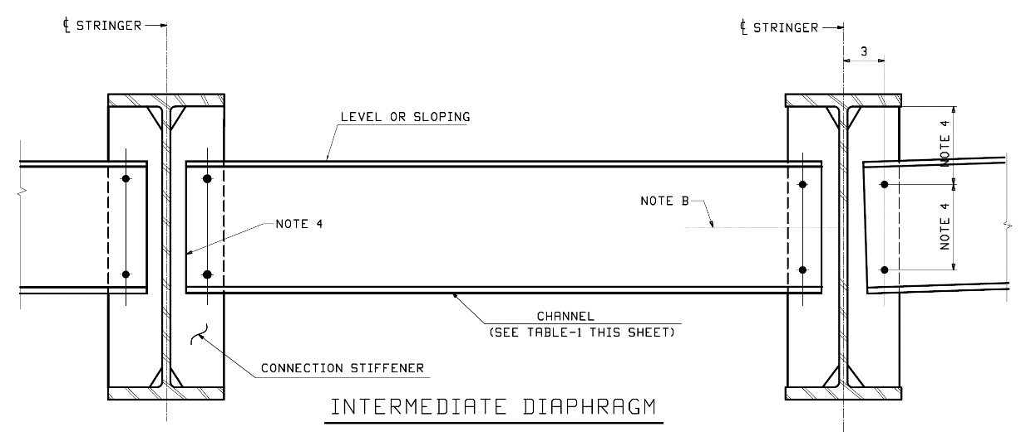
Steel-Girder Bridge Components – Bracing
Cross-frames
Diaphragms
Notes:
Different types of bracing for steel-girder bridge superstructures will be discussed next.
Cross-frames are transverse truss frameworks connecting adjacent longitudinal flexural components (or inside a closed box or tub section) that are used to transfer vertical and lateral loads and to provide stability to the compression flanges. See the photos and figure on the left-hand side of this slide.
Diaphragms are vertically oriented solid transverse members connecting adjacent longitudinal flexural components (or inside a closed box or tub section) that are used to transfer vertical and lateral loads and to provide stability to the compression flanges. See the photo and figure on the right-hand side of this slide.
Cross-frames and diaphragms are examples of torsional point bracing (also referred to as “nodal braces” or “discrete braces”) that limit the movement of the brace point without direct interaction with adjacent brace points. Although the brace point at the cross-frame or diaphragm is able to displace laterally, it is still considered a brace point because twist of the member is prevented at that point. A torsional brace is differentiated from a lateral brace in that twist of the cross-section is restrained directly.
The functions, spacing, configuration, detailing, and design considerations for cross-frames and diaphragms in steel I-girder bridges will be discussed in Lesson 10 of this course. The design of the end connections will be discussed in Lesson 11 and the design of the cross-frame members for tension and compression will be discussed in Lesson 12.
Photo Credits: Russo Structural Services

Slide 19

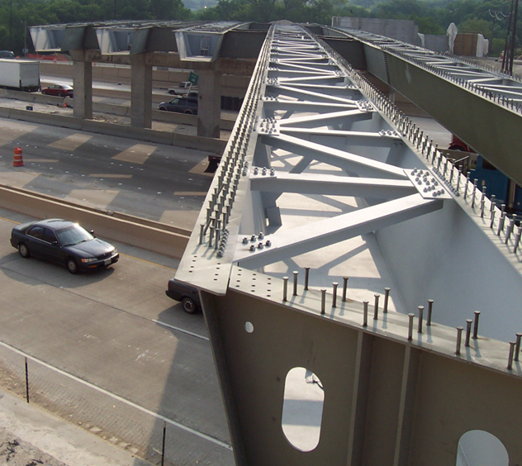
Steel-Girder Bridge Components – Bracing - cont.
I-beam bottom flange bracing
Tub girder internal bracing
Notes:
Lateral bracing is defined as a truss placed in the horizontal plane between two I-girders (or between the two top flanges of a tub girder) to maintain cross-sectional geometry and provide additional stiffness and stability to the bridge system. Lateral bracing is also effective in helping to resist lateral wind load deflections and stresses in the fully effected steel frame during construction in longer-span I-girder bridges.
Lateral bracing, which is also referred to as “panel bracing” or “relative bracing”, limits the angular deviation of a segment of the braced member between brace points; i.e., the lateral displacement of one end of the segment relative to the other. The effectiveness of the lateral brace is related to the degree that twist of the cross-section is restrained.
Lateral bracing can be placed in the horizontal plane between the top flanges (as shown in the steel tub-girder bridge in the top right photo on this slide), the horizontal plane between the bottom flanges (as shown in a steel I-girder bridge in the top left photo on this slide), or in both horizontal planes (of an I-girder bridge only) if deemed necessary. The bracing can either be full- or partial-length.
The functions, configuration, and detailing of lateral bracing will be discussed in Lesson 10 of this course. The design of the end connections will be discussed in Lesson 11 and the design of the lateral bracing members for tension and compression will be discussed in Lesson 12.
Photo Credit: Tub girder bracing, HDR

Slide 20
steel-girder bridge components field splices, web stiffeners & shear connectors
Notes:
The next topic in this lesson will discuss the field splices, web stiffeners, and shear connectors and their basic functions in steel I-girder bridges.

Slide 21
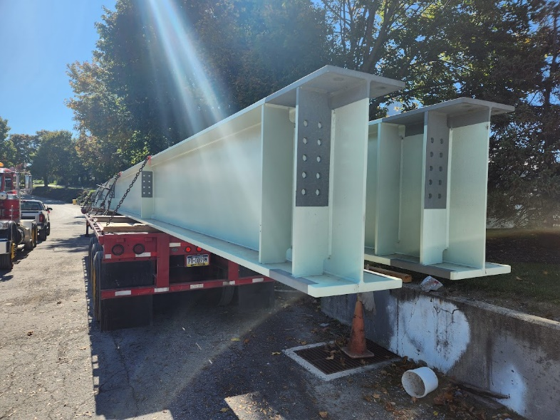
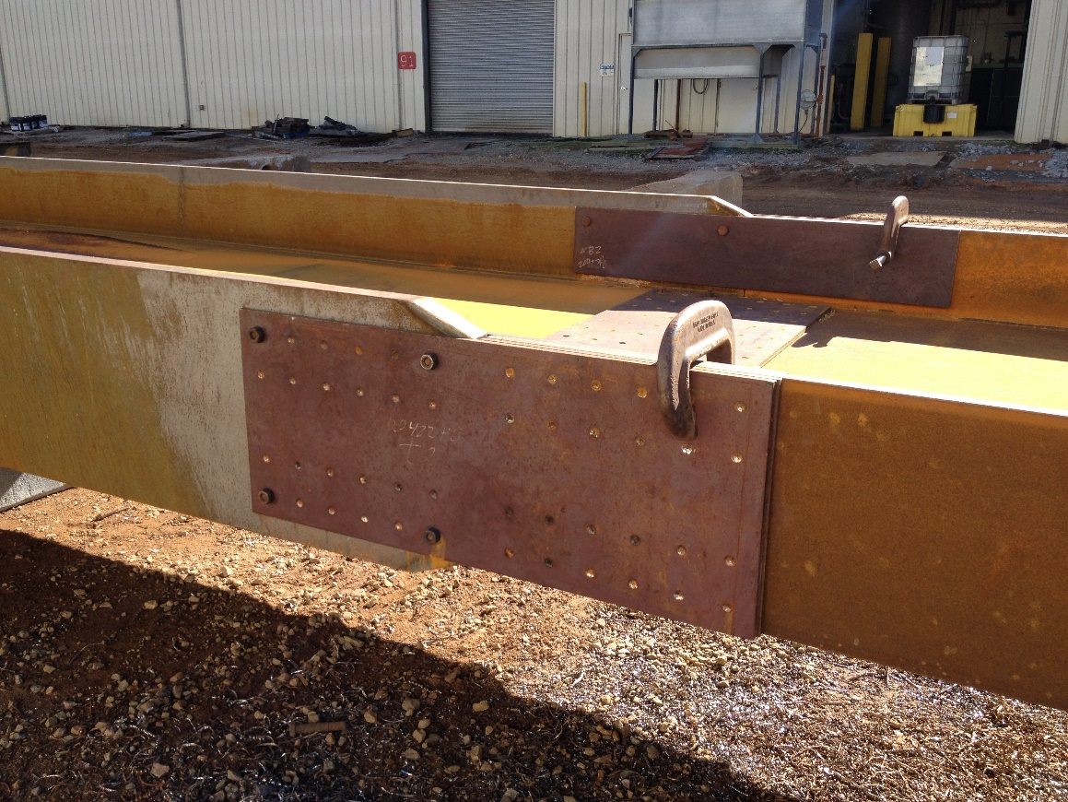
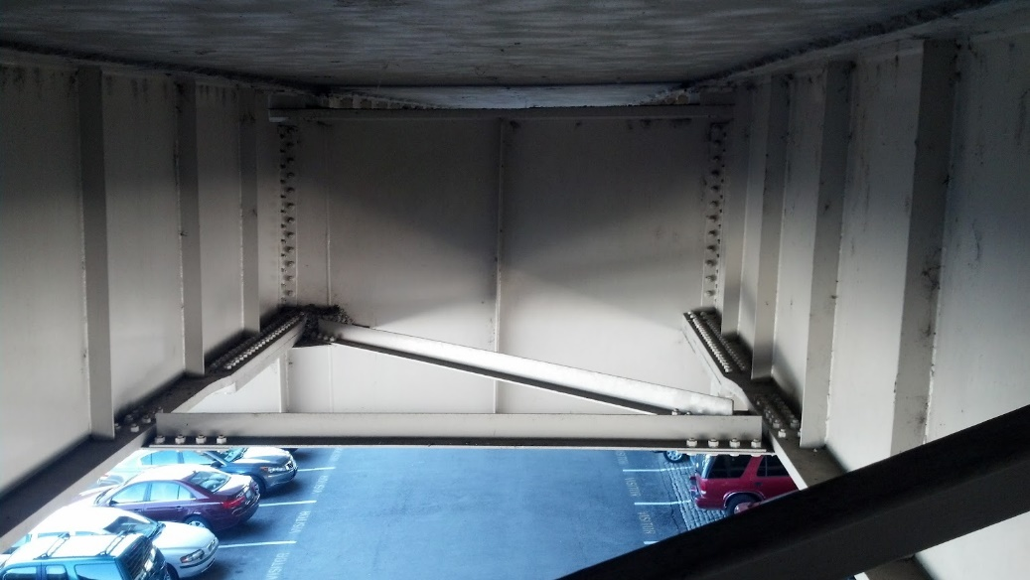
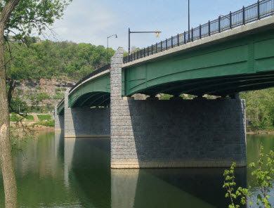
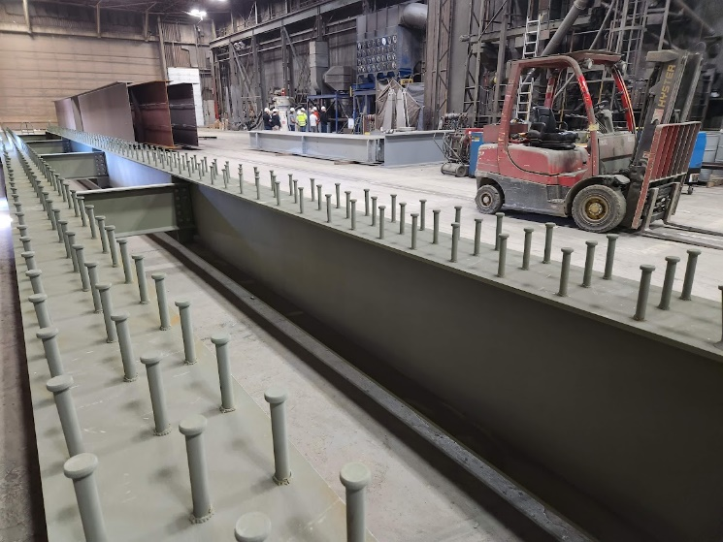
Steel-Girder Bridge Components – Field Splices, Web Stiffeners & Shear Connectors
Bearing stiffeners
Transverse web stiffeners
Bolted field splice
Shear connectors
Longitudinal web stiffeners
Notes:
A bolted splice is a group of bolted connections sufficient to transfer the moment, shear, axial force, or torque between two structural elements joined at their ends to form a single, longer element. Field sections are pieces of a bridge girder that are fabricated as a unit and shipped to the bridge site in that manner, and then are erected and joined together by field splices. Splices are often required for steel girder bridges due to limitations in the girder shipping lengths. A photo of a typical bolted field splice on a steel girder is shown on the left-hand side of this slide. This splice is being checked for fit-up and holes are being drilled / reamed in the shop yard prior to shipment to the jobsite. Welded field splices have been used but are no longer common as the pool of skilled welders and welding inspectors equipped and experienced in accomplishing full penetration field welding of large and/or thick steel elements is limited. The design of bolted field splices will be covered in Lesson 11 of this course.
Transverse web stiffeners are used to increase the shear resistance of a girder and are aligned vertically on vertical webs, or along the slope of inclined webs. Transverse web stiffeners consist of plates or angles welded or bolted to either one or both sides of the web (refer to the top photo at the center of this slide). The term connection plate is given to a transverse stiffener to which a cross-frame or diaphragm is connected. A connection plate can serve as a transverse stiffener for shear design calculations. Bearing stiffeners, which are aligned vertically on the web (or preferably on internal diaphragms in the case of box girders with inclined webs), are designed as columns to resist the loads at bearing locations and at other locations subjected to concentrated loads where the loads are not transmitted through a deck or deck system (refer to the top right photo on this slide). Bearing stiffeners must consist of one or more plates or angles welded or bolted to both sides of the web, with the connections to the web designed to transmit the full factored bearing force. The stiffeners must extend the full depth of the web and as closely as practical to the outer edges of the flanges. The design of transverse web stiffeners and bearing stiffeners will be covered in Lesson 5 in this course. Longitudinal web stiffeners are aligned horizontally on the web along the length of the girder and divide the web panel into smaller sub-panels (refer to the bottom right figure on this slide). Longitudinal stiffeners are used to provide additional bend-buckling resistance to the webs of deeper girders. Since longitudinal web stiffeners are less commonly used, the design of these stiffeners is not covered in this course.
The composite action between the concrete deck and the steel girder in composite construction is ensured by using welded mechanical shear connectors between the girder and the deck (refer to the bottom photo at the center of this slide). The primary function of the shear connectors is to transfer the horizontal shear between the deck and the girder forcing the steel girder and concrete deck to act together as a structural unit by preventing slip along the concrete-steel interface, which increases the flexural resistance of the superstructure. The design of shear connectors will be covered in Lesson 9 of this course.
Photo Credit: girder splice, HDR; all others, Russo Structural Services

Slide 22
steel-girder bridge components bearings and Joints
Notes:
The last topic in this lesson on steel-girder bridge components will discuss the types and basic functions of the various types of bearings and joints using on steel-girder bridges. A brief discussion will also be included on jointless bridges.

Slide 23
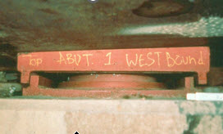

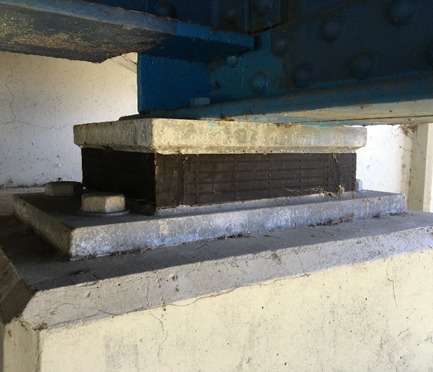
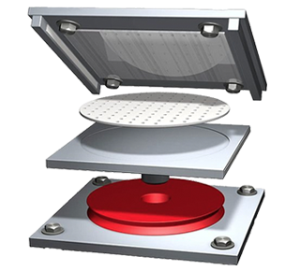
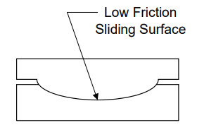
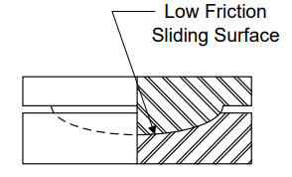
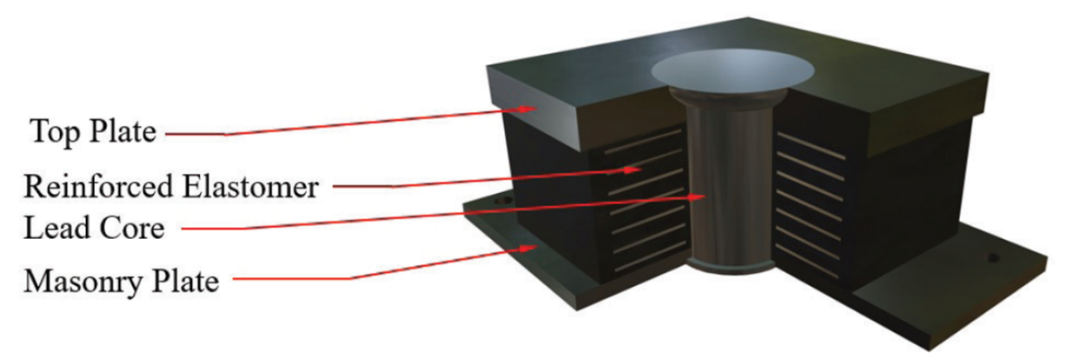
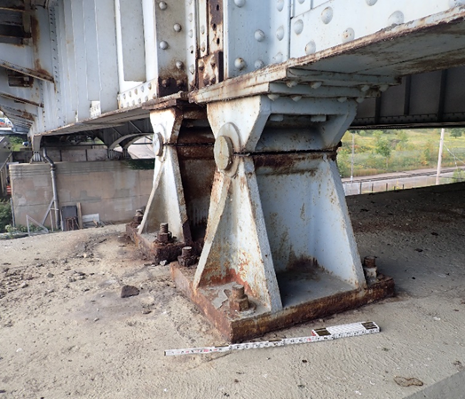
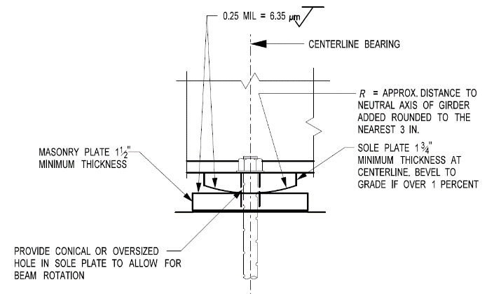
Bearings
Pot bearing
Cylindrical bearing
Spherical bearing
Elastomeric bearing
Disc bearing
Seismic isolation bearing
High-profile steel bearing
Contemporary fixed steel bearing
Notes:
Bearings are located between the superstructure and the substructure of a bridge. They transmit loads from the superstructure to the substructure while also facilitating translations and/or rotations. Bearings come in a variety of types and sizes, but they all perform the same basic function. The bearing type and size is simply a function of the design requirements and the magnitudes of the loads and movements. The design of bearings will be covered in Lesson 13 of this course.
A commonly used bearing on steel bridges is an elastomeric bearing shown in the upper left photo on this slide. An elastomeric bearing can made from an elastomer only or made from alternate laminates of steel and elastomer bonded together during vulcanization – a so-called steel-reinforced elastomeric bearing. Vertical loads are carried by compression of the elastomer. Movements parallel to the reinforcing layers and rotations are accommodated by deformation of the elastomer. High-load multi-rotational (HLMR) bearings accommodate larger loads and rotations and are typically used on horizontally curved bridges and severely skewed bridges. Pot bearings and disc bearings are the most common type. Pot bearings carry vertical load by compression of an elastomeric disc confined in a steel cylinder that also accommodates rotation by deformation of the disc. Disc bearings accommodate rotation by deformation of a single elastomeric disc molded from a urethane compound. The bearing may be guided, unguided, or fixed. Movement is accommodated by sliding of polished stainless steel on polytetrafluorethylene (PTFE). There are other HLMR bearing types such as cylindrical and spherical bearings that are very infrequently used but have a role when extremely high vertical reactions and large rotations need to be accommodated. HLMR bearings are shown in the figures and photos in the top right of the slide.
Historically there were many older bearing types such as the steel rocker and roller bearings used for steel bridges. These were cast or built up and relied on various mating parts to permit movement, rotation, and transmit vertical loads. These older rocker or shoe bearings have been maintenance problems for owners and are no longer common. The bottom center photo on this slide shows an older high-profile steel bearing. Some owners still use steel bearings for their structures but no longer the high-profile version. In the contemporary version of a fixed steel bearing shown in the figure in the bottom right of this slide, an upper radiused plate is in line bearing/contact with the lower plate. This assembly permits rotation but the presence of the anchor bolts passing from the beam flange down to the substructure restricts translation.
Some bridges require special bearing considerations such as those in high seismic zones where it is advantageous to decouple the mass of the superstructure from the substructure and foundations. One type of seismic isolation bearing is shown in the bottom left figure on this slide; a lead core isolation bearing. Borrowing from the general principles of elastomeric bearings, the addition of the lead core significantly adds to the damping provided by the bearings.
Photo Credits: provided in Lesson 13

Slide 24





Joints
Sliding plate
Compression seal
Strip seal
Finger joint
Modular joint
Notes:
Joints are located within bridge decks to accommodate the translation and rotation of the structure at the joint. Joints cannot significantly impair the riding characteristics of the roadway, nor can they cause damage to vehicles crossing the bridge. Deck joints must also be carefully detailed to prevent damage to the structure from water, deicing chemicals, and roadway debris. The design of joints will also be covered in Lesson 13 of this course.
Joint types that permit low to moderate movement are shown at the top of this slide and include the sliding plate, compression seal, and strip seal. The sliding plate was very common for older structures and is still used for some modern, smaller structures. A sliding plate is anchored on one side of the joint and simply slides over an open gap into a slab recess on the opposite side. In order to waterproof the joint, a trough or some other gland needs to be installed under the deck. A compression seal is a preformed elastomeric expansion device that is compressed and pushed into a joint gap, frequently with adhesive to help hold it in place, sometimes with a notch or a stopper below the joint to help set its depth. These joints are used for spans in which the expected total range of movement is less than two inches. A strip seal is a sealed joint with an extruded elastomeric seal retained by edge beams that are anchored to the structural elements (deck, abutment, etc.). Strip seals are typically used for expected total movement ranges from 1.5 to 4.0 inches.
Larger movement joints are commonly of two types, a joint known as a finger joint shown in the photo at the bottom left of this slide, or a more modern expansion joint known as a modular joint, or modular bridge joint system (MJBS). Each of these two joint types is still used for modern bridges while the finger joint was a very common joint system for many older bridges.
Photo Credits: from Lesson 13

Slide 25


Jointless Bridges
Notes:
Jointless bridges are the best solution for many structures because the joint, and the common deterioration of the beam ends and the substructures, is eliminated at the beam end. This does not mean that these bridges do not expand and contract. This slide shows an example of what is known as an integral abutment. An integral abutment is one where the beams, the abutment, and the piles, are all made monolithic. There is no working joint and there are no working bearings at these abutment locations. Expansion and contraction of the bridge, and rotation, are all accommodated by longitudinal movement and rotation of this integral connection. Provisions for movement are usually made in the approach pavement that leads up to the bridge. A detail of this abutment taken from the Pennsylvania Department of Transportation is shown on this slide. Many states have decades of experience building bridges of this type and they have proven to be robust and reliable.
Semi-integral abutments have also been used. In a semi-integral abutment, there is still no joint at the end of the bridge but there is a working bearing between the abutment and the beam that allows for rotation as well as expansion and contraction. Again, the movement of the bridge will ultimately be accommodated with an expansion joint in an approach slab that leads up to the end of the bridge.
The design of jointless bridges will be discussed in greater detail in Lesson 13 of this course.

Slide 26
Bridge Design and Construction Process
Notes:
The next topic in this lesson will be a brief overview of the bridge design and construction process from preliminary design up through final construction.

Slide 27
Bridge Design and Construction Process
Prelim
Design
Final
Design
Construction
Inspection
Maintenance
Rehab
Notes:
This slide summarizes the steps in the basic bridge design and construction process from preliminary and final design up through the awarding and completion of the bridge construction. Also included are the post-construction steps that begin after the bridge is opened and placed into service and continue throughout the design life of the bridge, which involve the inspection, maintenance, and rehabilitation of the bridge structure (i.e., bridge or asset management). Each of these steps will be briefly reviewed in greater detail on subsequent slides.

Slide 28
TS&L / Preliminary Design
TS&L / Prelim Design
Preliminary Design:
  Type, Size & Location (TS&L) Phase:
    Typically results in a design that is about 10-30% complete (varies)
    Provides a range of solutions to the bridge problem, including multiple superstructure types, pier placements, and substructure types
    At the TS&L phase, geotechnical and hydraulic information may not be available or is very basic
    Provides a very rough cost estimate for budgeting purposes
Notes:
The first phase in the bridge design and construction process is the preliminary design. The first phase in preliminary design is typically known as the Type, Size & Location (TS&L) phase. The TS&L phase will typically result in a design that is about 10-30% complete, but this will vary with the size of the project. On some projects, the TS&L phase may have narrowed down the solutions to only one viable type or location. Essentially, the design has now advanced nearer to 30%. On others, a wide range of options will require further deliberation in which case the progress is nearer the 10% mark.
A TS&L phase report will provide a range of solutions to a bridge problem, including multiple superstructure types, pier placements and substructure types. At the TS&L phase, geotechnical and hydraulic information may not be available or is very basic. Because of this, a bridge proposal will be based on other similar projects and good engineering judgement. The report will also typically include a very rough estimate on the cost of the structure for budgeting purposes. The estimate at this stage will be conservative, owing to the range of unknowns at this point in the design.

Slide 29
Preliminary Design
TS&L / Prelim Design
Preliminary Design – cont.:
  Preliminary Plan Phase:
    Follows the approved TS&L. Typically results in a design which is about 30% complete (varies)
    Differs from the TS&L phase in that all the bridge particulars, excluding the substructure, are known and laid out
    Preliminary plan for a bridge will include the final geometry of the bridge
    The superstructure type will be decided, along with clearances, profiles, and curves
    With completion of the preliminary plan, the geometric layout of the bridge, the structure type and the pier placement will be established.
    A revised cost estimate will typically be provided
Notes:
The second phase of preliminary design is the Preliminary Plan Phase. This phase will result in a design which is about 30% complete (which again may vary) and differs from the TS&L phase in that all the bridge particulars, excluding the substructure, are known and laid out. The preliminary plan for a bridge will include the final geometry of the bridge. Number of lanes, shoulder widths, sidewalks and barrier will all be decided upon in this phase. The superstructure type will be decided, along with clearances, profiles, and curves.
Vertical clearances are important to the bridge engineer, as they will determine the method of construction that can be used and the susceptibility of being struck by overheight loads. The roadway profile, or the line representing the vertical elevation of the top of the deck for the bridge, is usually controlled by the roadway engineers. Preliminary bridge design can be an iterative process when it comes to clearance, sometimes requiring a revised profile to achieve minimum clearances. Once an acceptable profile is determined, pier elevations can be set, superstructure type can be determined, and the minimum vertical clearances can be calculated.
Once the preliminary plan phase is complete, the geometric layout of the bridge, the structure type, and the pier placement will be established. A revised cost estimate will typically be provided that will more accurately reflect the cost of the actual bridge to be built. The preliminary plan is used to start geotechnical work, with soil borings being taken at each pier using the pier stations provided by the preliminary plan. Hydraulic design will also begin once the preliminary plan is finalized.

Slide 30
Final Design
Final Design
Final Design:
  Plans, Specifications & Estimate (PS&E) Phase:
    Completion and checking of the detailed final design of all the bridge superstructure and substructure components.
    Coordination of all the plan elements, including the construction plans.
    Review and coordination of the specifications used to control the work.
    Up-to-date estimate of the bid items, quantities, and unit prices.
Notes:
The complete Preliminary Plan is the beginning of the final design. Since the preliminary plan usually includes the plan, elevation and typical section of the bridge, these views are usually incorporated verbatim into the final design plan set.
The Plans, Specifications, & Estimate (PS&E) phase involves the preparation of the plans, specifications, and estimates for the bridge construction project to facilitate construction, provide contract control, estimate construction costs, and provide a uniform basis for bidding purposes. This phase involves the completion and checking of the detailed final design of all the bridge superstructure and substructure components. It also involves the coordination of all the plan elements, including the construction plans, along with the review and coordination of the specifications used to control the work. Finally, up-to-date estimates of the bid items, quantities, and unit prices are provided.

Slide 31

Construction (Design-Bid-Build)
Construction
Construction:
  Design-Bid-Build (D-B-B) Project-Delivery Method:
    Traditional method of project delivery
    The D-B-B method is a linear process where one task follows completion of another with no overlap.
    The design team is selected separately and reports to the Owner. Plans and specifications are completed by the designer, and then bids are submitted by contractors.
    Construction does not begin until the design process is complete, and a bid is accepted, so there is no overlap between design and construction.
    D-B-B contracts are typically awarded as “low-bid”.
    The steel Fabricator is typically a subcontractor to the selected Contractor.
Notes:
Once the final design is completed, all environmental impact studies have been completed, and the funds are available/secured, the project is ready to go to construction. There are several possible project delivery methods that may be used by Owners to manage the awarding and completion of bridge construction projects. The three most common methods for bridge project delivery will be discussed on this slide and subsequent slides.
The traditional method of project delivery is the Design-Bid-Build (D-B-B) project delivery method. The D-B-B method is a linear process where one task follows completion of another with no overlap. The design team is selected separately and reports to the Owner. Plans and specifications are completed by the designer, and then bids are submitted by contractors. In the D-B-B method, construction does not begin until the design process is complete, and a bid is accepted, so there is no overlap between design and construction. D-B-B contracts are typically awarded as “low-bid”.
Steel fabrication and erection are included in the construction phase. Regardless of the project-delivery method, the steel Fabricator is typically a subcontractor to the selected general Contractor. The steel Erector is also a typically a subcontractor to the selected general Contractor, unless the Fabricator has the capability in-house to also perform the steel erection. Certain pre-fabrication steps must be completed before fabrication of the steel can begin including estimating, planning and scheduling, shop drawing production and approval, and material procurement. Each of these steps will be discussed in greater detail later in the lesson.

Slide 32

Design and Construction (Design-Build)
Design & Construction
Construction – cont.:
  Design Build (D-B) Project-Delivery Method:
    Combines the design and construction phases of a project into one contract managed by the Owner.
    The designer and contractor work together from the beginning as a team.
    Construction can begin while the plans are still being developed.
    Since the Design-Builder is responsible for both design and construction activities, this delivery method can potentially reduce the need for cost increases due to design errors.
    D-B contracts can be awarded as either “low-bid” or “best-value.” Best-value selection permits the consideration of additional factors other than price.
Notes:
In the Design-Build (D-B) project delivery method (also known as the alternate delivery method), the Owner manages only one contract with a single point of responsibility. The designer and contractor work together from the beginning, as a team, providing unified project recommendations to fit the Owner's schedule and budget. Compared with the traditional Design-Bid-Build (D-B-B) project delivery method, the D-B project delivery method can offer potential time and cost savings. As mentioned above, D-B projects combine the design and construction phases of a project into a single contract. This can potentially reduce costs without reducing quality, since construction can begin while the plans are still being developed. Since the Design-Builder is responsible for both design and construction activities, this delivery method can potentially reduce the need for cost increases due to design errors, and/or for discrepancies between design plans and construction activities.
D-B contracts can be awarded as either "low-bid" or "best-value," which is an important advantage. While low-bid is used for most traditional contracts, best-value selection permits the consideration of additional factors, such as experience, qualifications, innovation, technical approach, quality control methods and project management. Often this can reduce costs as well as increase quality.
An alternative form of the D-B project delivery method sometimes used on very large, complex projects is the Design-Build-Finance-Operate-Maintain (DBFOM) method, also known as a Public-Private-Partnership (PPP or P3) method. This method considers both the development and long-term operation of the project, in which life-cycle responsibilities (including operation and maintenance) are bundled and awarded to a private partner or consortium following an extensive procurement and negotiation process.

Slide 33

Design and Construction (CM/GC)
Construction – cont.:
  Construction Manager/General Contractor (CM/GC) Project-Delivery Method:
    Consists of two phases – design & construction
    The Owner hires a construction manager (contractor) to provide feedback on the design and constructability during the design phase prior to construction.
    Allows the Owner to be an active participant during the design process and make informed decisions on design options based on the contactor’s expertise
    If the Owner, designer, and an independent cost estimator agree that the construction manager has submitted a fair price, the owner issues a construction contract, and the construction manager then becomes the general contractor and construction can proceed.
Design & Construction
Notes:
The Construction Manager/General Contractor (CM/GC) project delivery method consists of two phases - design and construction. Under the CM/GC process, the Owner hires a construction manager (contractor) to provide feedback on the design and constructability of the project during the design phase prior to the start of construction. The construction manager/contractor can identify risks based on the contractor's established means and methods. This process also allows the Owner to be an active participant during the design process and make informed decisions on design options based on the contractor's expertise. The owner has a separate and independent contract with an engineering firm who prepares a complete design with guidance from the CM/GC contractor partner.
When the Owner considers the design to be complete, the construction manager then has an opportunity to solely bid on the project based on the completed design and schedule. If the owner, designer and an independent cost estimator agree that the construction manager has submitted a fair price, the owner issues a construction contract, and the construction manager then becomes the general contractor and construction can proceed. Otherwise, the completed design can be advertised and competitively bid.

Slide 34

Life Cycle Activities
Inspection, Maintenance, and Rehab:
  Bridge Management:
    Methodologies and procedures for making informed asset management decisions.
    Federal regulations for bridge inspections in the U.S. are provided in the National Bridge Inspection Standards (NBIS). Common inspection interval 24 months
      Based on risk, intervals could be shorter, or as long as 48 months
    Bridge load rating computes a bridge's ability to carry a given live load (see the AASHTO MBE).
Notes:
After the bridge is opened and placed into service, inspection, maintenance, and rehabilitation of the structure fall under the umbrella of bridge or asset management. Bridge management is a set of methodologies and procedures established by the Owner for making informed and effective decisions on the operation, maintenance, preservation, replacement, and improvement/rehabilitation of the bridges within the bridge inventory.
Federal regulations for bridge inspections in the U.S. are provided in the National Bridge Inspection Standards (NBIS). Routine bridge inspections are to be carried out every 24 months (for bridges over 20 feet in length). More in-depth inspections on bridges containing nonredundant steel tension members (formerly known as fracture critical members) are also to be carried out every 24 months. Underwater inspections are to be carried out every 60 months. While U.S. federal regulations lay out basic guidelines, these rules are actually enforced by the Departments of Transportation (DOTs) in each state, who are responsible to implement these standards. States often include additional conditions for bridge inspections. For example, states may choose to expand the types of bridges that must be inspected (i.e., while NBIS standards may require inspections for bridges of 20 feet or longer, state guidelines may require them for even shorter bridges). States may require bridge inspections to take place more frequently than NBIS guidelines mandate. States may also vary the types of inspections required over a period of time, requiring, for example, several less in-depth inspections over a shorter period of time followed by an in-depth inspection every two years.
Bridge load rating is the measure of a bridge's ability to carry a given live load expressed by a simple factor called the Rating Factor (RF) or referred to as Tonnage for Legal and Permit load rating. Basically, this is the assessment of bridges in their current condition to carry live loads to assist in the bridge management process and determine if the structure needs to be posted. Bridge load rating can also help determine what rehabilitation of the structure may be necessary to increase the rating. Procedures for bridge management, inspection, and load rating are spelled out in the AASHTO Manual for Bridge Evaluation (or MBE).

Slide 35
Bridge Steels
Product specifications
Notes:
The next topic in this lesson will discuss bridge steels. First, product specifications for structural plate and rolled shapes, hollow structural sections (HSS), bolts, rivets and anchor rods, wires and cables, castings, and pins, rollers and rockers will be reviewed. A brief discussion on historical steels is also included.

Slide 36
Product Specifications
Two organizations publish standards for bridge steels in the U.S.:
  American Society for Testing and Materials (ASTM) – Committee A01 and Subcommittee A01.02
  American Association of State Highway and Transportation Officials (AASHTO) – Materials Committee
AASHTO and ASTM standards are similar for bridge steel products.
AASHTO maintains the right to modify the ASTM requirements if it is determined to be in the public's interest.
The counterparts to the ASTM A709/A709M standards for structural steels for bridges are the AASHTO M270M/M270 standards – some ASTM standards do not have an AASHTO counterpart.
Notes:
There are two organizations that publish standards for structural steel in the United States. The first, the American Society for Testing and Materials (ASTM), is a non-profit voluntary standards organization that develops consensus standards for steel products. ASTM Committee A01 and Subcommittee A01.02 have the primary responsibility for structural steel standards, including bridge steels. Membership is comprised of experts from industry, end users, government, and academia to provide a balance of perspectives. The second, the American Association of State Highway Transportation Officials (AASHTO) publishes a separate volume of standards that also include structural steel standards for bridge applications. These standards are developed by committees comprised solely of government officials responsible for construction and maintenance of the highway system. In most cases, the AASHTO standards are very similar or identical to the corresponding ASTM standards. This is particularly true for bridge steel products. By maintaining independent standards, AASHTO maintains the right to modify the ASTM requirements if it is determined to be in the public's interest. The counterparts to the ASTM A709/A709M standards for structural steels for bridges are the AASHTO M270M/M270 standards.
Most bridge owners specify adherence to the AASHTO material specifications in their construction documents. Some specify adherence to the ASTM specifications. As mentioned above, in most cases, the two are identical for steel products. Some of the ASTM standards do not have an AASHTO counterpart.

Slide 37
Product Specifications
Structural Plate and Rolled Shapes:
  ASTM A709/A709M Standard Specification for Structural Steel for Bridges
  ASTM A709 specification includes the additional toughness requirements specified for bridge steels (Lesson 7).
  Mechanical properties of the more commonly used ASTM A709 structural steels are specified in Table 6.4.1-1 of the AASHTO LRFD Bridge Design Specifications.
  Thickness limitations relative to rolled shapes and groups are to satisfy the provisions of the ASTM A6/A6M Specification.
Notes:
The ASTM A709/A709M Standard Specification for Structural Steel for Bridges was established in 1974 as a separate specification covering all domestically produced structural grades approved for use for structural plate and rolled shapes in bridge structures. The ASTM A709M specification is the metric version of ASTM A709. Many of the ASTM A709 provisions are identical to those in the individual structural steel specifications applicable for more general use; however, the ASTM A709 specification includes the additional toughness requirements specified for bridge steels, which are discussed later in this lesson and in Lesson 7. Mechanical properties of the more commonly used ASTM A709 structural steels are specified in Table 6.4.1-1 of the AASHTO LRFD Bridge Design Specifications. Thickness limitations relative to rolled shapes and groups are to satisfy the provisions of the ASTM A6/A6M Specifications.

Slide 38

Product Specifications
Notes:
The table shown on this slide provides an overview of the various steel grades covered by the ASTM A709 specification (and also the corresponding AASHTO M270 specification). The various grades are listed in the first column of the table and will be discussed further on subsequent slides. The individual structural steel specifications for more general use of each grade, where applicable, are indicated in the second column of the table for informational purposes only. The number in the grade designation indicates the nominal yield strength in ksi. The “W” indicates that the steel is a so-called “weathering steel” with improved atmospheric corrosion resistance. Descriptions of each grade are provided in the third column of the table (refer to the footnotes for the definitions of the various acronyms). Available product categories for each grade are summarized in the last four columns of the table.

Slide 39
Product Specifications
Grade 36
Grade 50
ASTM A36 adopted in 1960 as the final evolution of weldable carbon-manganese structural steel.
Modern steel production consistently produces steels that exceed the A36 minimum properties.
The steels being delivered today as Grade 36 may have strengths closer to 50 ksi.
Grade 50 is the most common grade of structural steel available today.
ASTM A572 specification was originally adopted in 1966 to introduce this higher strength grade of weldable structural steel.
Increased strength was obtained through chemistry changes.
The increased strength more than offsets the increased cost of adding alloy to the steel.
Notes:
The ASTM A36 specification was originally adopted in 1960 as the final evolution of weldable carbon-manganese structural steel. Of all the steels in the ASTM A709 specification, Grade 36 is the easiest and cheapest to produce in steel mills that produce steel by melting iron ore in a blast furnace. Much of the steelmaking practice in the U.S. has now switched to electric furnace production where a large percentage of scrap is used to produce structural steel. Since scrap steel has higher residual elements than iron ore, the resulting steel strength can be much higher. The steels being delivered today as Grade 36 may have strengths closer to 50 ksi than 36 ksi.
Grade 50 is the most common grade of structural steel available today. The ASTM A572 specification was originally adopted in 1966 to introduce this higher strength grade of weldable structural steel. The increase in strength was obtained by adding small amounts of columbium, vanadium, and sometimes titanium to the basic carbon-manganese chemistry of ASTM A36 steel. The resulting increase in structural efficiency provided by the higher strength more than offset the increased cost of adding alloy to the steel. Grade 50 rapidly became the material of choice for primary bridge members that are to be painted, galvanized, or metallized in service.

Slide 40
Product Specifications
Grade 50S
QST Grades 50, 50S, 65 and 70
ASTM A992 specification was introduced in 1998 to keep pace with changes in rolled shape production practices in the U.S.
Steels under the ASTM A992 specification are dual-certified to qualify for Grade 36 or Grade 50. Grade 50S in the ASTM A709 specification is equivalent to ASTM A992 but includes the additional toughness requirements specified for bridge steels.
Non-weathering steel rolled I-shapes and structural tees should be specified as Grade 50S. Other non-weathering rolled shapes (e.g., angles and channels) are typically only available as either Grade 36 or Grade 50 and should be specified as such.
ASTM A913 specification was introduced into the standards in 1993 and was added more recently into A709 to offer more options for rolled I-shapes.
The shapes have enhanced brittle fracture resistance, increased ductility, and improved weldability.
Projects utilizing these grades for rolled I-shapes would require special provisions for fabrication, particularly welding, based on recommendations from the manufacturer.
Notes:
The ASTM A992 specification was introduced in 1998 to keep pace with changes in rolled-shape production practices in the U.S. As was previously discussed for Grade 36, the shift to scrap-based production made Grade 36 materials somewhat obsolete. Steels under the ASTM A992 specification are dual-certified to qualify for Grade 36 or Grade 50. It is more difficult to precisely control the chemical composition of scrap-based steel production since many alloys may be present in scrap steel. Therefore, the ASTM A992 specification allows a wide range of steel chemistry. Grade 50S in the ASTM A709 specification is equivalent to ASTM A992 but includes the additional toughness requirements specified for bridge steels. Non-weathering steel rolled I-shapes and structural tees should be specified as Grade 50S. Other non-weathering rolled shapes (e.g., angles and channels) are typically only available as either Grade 36 or Grade 50 and should be specified as such.
The ASTM A913 Specification was introduced into the standards in 1993 and was added more recently into A709 to offer more options for rolled I-shapes; four grades – 50, 50S, 65, and 70 – are available according to the standard. Grade QST 50S has an upper limit of 65 ksi on the yield strength similar to Grade 50S, whereas Grade QST 50 has no upper limit. The shapes are produced by an in-line heat treatment and cooling-rate control process comprised of three primary stages: rapid water cooling of the shape, interruption of the cooling before the core is quenched, and self-tempering of the outer layers from the retained heat within the core. The rapid cooling leads to refinement of the microstructure and the attainment of higher yield and tensile strengths. The self-tempering maintains the ductility and toughness of the steel. Since these grades have not yet been included in the AASHTO specifications or in the AASHTO/AWS D1.5 Bridge Welding Code, projects utilizing these grades for rolled I-shapes would require special provisions for fabrication, particularly welding, based on recommendations from the manufacturer.

Slide 41
Product Specifications
Grade 50W
Grade 50CR
Developed to have enhanced atmospheric corrosion resistance. Grade 50W has been shown to perform well without paint or other coatings in many bridge applications.
Achieves its corrosion resistance through the development of a tightly adhered layer of rust (“patina”) that acts to inhibit further corrosion.
There is a small added cost for Grade 50W compared to Grade 50, but this cost is often offset by the savings realized by eliminating the need to coat the steel.
Grade 50CR is a dual phase stainless steel with a 10.5-12.5% chromium content. It has been shown to have greatly enhanced corrosion resistance compared to weathering steel grades.
Projects will require special provisions for fabrication, particularly welding, and may require supplemental testing at the discretion of the engineer.
Grade 50CR steel has a much higher initial cost compared to conventional bridge steels.
Consider 50CR for use where the higher initial cost can be overcome by the anticipated lack of future maintenance over the structure’s service life.
Notes:
Grade 50W is a special version of 50 ksi steel that was developed to have enhanced atmospheric corrosion resistance. Grade 50W, commonly referred to as "weathering" steel, has been shown to perform well without paint or other coatings in many bridge applications. Weathering steel achieves its corrosion resistance through the development of a tightly adhered layer of rust (“patina”) that acts to inhibit further corrosion of the steel beneath. Different steel companies initially developed competing proprietary grades that were included in the ASTM A588 specification in 1968. The added corrosion resistance was achieved by adding different combinations of copper, chromium, and nickel to the Grade 50 chemistry to provide enhanced corrosion resistance. There is an added cost for Grade 50W compared to Grade 50, but this cost is often offset by the savings realized by eliminating the need to coat the steel.
ASTM A709 Grade 50CR, a dual phase stainless steel with a 10.5-12.5% chromium content, which was previously specified as ASTM A1010 prior to its incorporation into the ASTM A709 specification. The product has been shown to have greatly enhanced corrosion resistance compared to weathering steel grades and can provide adequate performance without paint in higher chloride bridge environments. Grade 50CR is currently available in thicknesses up to 2 inches. Although the ASTM A1010 specification has been used in the past for bridges, specifying ASTM A709 50CR for bridge applications is more appropriate than ASTM A1010 because the ASTM A709 specification includes the bridge-steel toughness requirements. Since Grade 50CR has yet to be included in the AASHTO specifications or the AASHTO/AWS D1.5 Bridge Welding Code, projects will require special provisions for fabrication, particularly welding, and may require supplemental testing at the discretion of the engineer. Also, since Grade 50CR steel has a higher initial cost compared to conventional bridge steels, engineers should consider its use in applications where the higher initial cost can be overcome by the anticipated lack of future maintenance funds spent over the structure’s service life. Examples of these applications include areas where uncoated weathering steel is not expected to perform well or where future maintenance could incur significant owner or user cost.

Slide 42
Product Specifications
Grades HPS 50W, HPS 70W, and HPS 100W
High-performance steel (HPS) grades were developed in the 1990s through a cooperative agreement between FHWA, the U.S. Navy, and the American Iron and Steel Institute.
HPS grades have essentially eliminated base metal weldability concerns.
HPS grades provide enhanced fracture toughness compared to non-HPS grades. Rolled shapes are not currently available in HPS grades.
HPS steels come with a cost premium and additional lead-time is typically required.
HPS use can result in more efficient bridges with lower first cost.
Hybrid girders utilizing Grade HPS 70W steel for the flanges and Grade 50W steel for the web have been shown to be a particularly economical option for continuous spans in regions of negative flexure.
Since Grade HPS 50W is a higher cost material compared to Grade 50W, engineers should carefully consider the need for higher toughness before specifying Grade HPS 50W.
Notes:
The high-performance steel (HPS) grades were developed in the 1990s through a cooperative agreement between the Federal Highway Administration, the U.S. Navy, and the American Iron and Steel Institute. The goal was to enhance weldability and toughness compared to previous versions of Grade 70 and 100 steel. Prior to HPS, steels with yield strengths greater than 50 ksi (i.e., ASTM A852 and A514) were very sensitive to welding conditions and fabricators often encountered welding problems. The HPS grades have essentially eliminated base metal weldability concerns. In addition, HPS grades provide enhanced fracture toughness compared to non-HPS grades. Rolled shapes are not currently available in HPS grades. All the HPS grades are “weathering steel” grades.
The properties of HPS are largely achieved by dramatically lowering the percentage of carbon in the steel chemistry. Since carbon is traditionally one of the primary strengthening elements in steel, the composition of other alloying elements must be more precisely controlled to meet the required strength and compensate for the reduced carbon content. There are also stricter controls on steelmaking practice and requirements for thermal and/or mechanical processing to meet the required strength, as discussed later in this lesson. These refinements in steelmaking practice result in a very high-quality product. However, this also limits the number of steel mills that have the capability of producing HPS steels in the U.S. As a result, HPS steels come with a cost premium and additional lead-time is typically required in ordering versus non-HPS grades. In addition to these two items, there is a minimum tonnage required for ordering HPS material per thickness. The fabricator may be able to combine tonnages from several projects to obtain the minimum tonnage required for ordering.
HPS steels, due to their higher strength, can result in more efficient bridges with lower first cost. This benefit generally is greater as the size and span length of bridges increase. Hybrid girders utilizing Grade HPS 70W steel for the flanges and Grade 50W steel for the web have been shown to be a particularly economical option for continuous spans in regions of negative flexure. Because it costs more than conventional steel, use of HPS should be carefully considered by the designer to verify that the benefits outweigh the additional cost of the product. Grade HPS 50W is an as-rolled steel produced to the same chemical composition requirements as Grade HPS 70W. Similar to the higher strength HPS grades, Grade HPS 50W has enhanced weldability and toughness compared to Grades 50, 50W, and 50S. However, the need for enhanced weldability is questionable at this strength level since few weldability problems are reported for the non-HPS grades. The primary advantage of Grade HPS 50W is that it can be delivered with high toughness that exceeds the current AASHTO specification requirements for Grades 50 and 50W. Since Grade HPS 50W is a higher cost material compared to Grade 50W, engineers should carefully consider the need for higher toughness before specifying Grade HPS 50W. Among the HPS Grades, HPS 70W is the most common. Grades HPS 50W and HPS 100W are rarely used.
Further information on the HPS grades and on Grade 50CR may be found in Volume 1 of the NSBA Steel Bridge Design Handbook (available for free download from the NSBA website www.aisc.org/nsba).

Slide 43

Product Specifications
Hollow Structural Sections (HSS):
  HSS has been used to fabricate trusses used for pedestrian bridges that are subject to lower fatigue loading.
  ASTM A1085 provides HSS with improved performance for dynamically loaded structures. Shapes are available in square, round, and rectangular sections.
  ASTM A1085 standard specifies a single minimum yield stress of 50 ksi and a maximum yield stress of 70 ksi. ASTM A1085 further prescribes that all HSS is to meet a minimum toughness value. A minimum corner bend radius is included in the specification.
  AASHTO/AWS D1.5 Bridge Welding Code currently excludes tubular members and tubular joints. Therefore, it is incorrect to specify the use of this Code for these members, including for bridges, since it fails to provide the appropriate information for welding.
Notes:
Hollow structural sections (HSS) are commonly used in building construction, and they can be considered as an option for some bridge members. Increased lateral bending and torsional resistance can make them an attractive option for cross-bracing and other secondary members subjected to compression. HSS have also been used to fabricate trusses used for pedestrian bridges that are subject to lower fatigue loading.
The suitability of traditional HSS grades for bridge members subjected to the fatigue and fracture limit states has not been well established, and cold bending of the corners of rectangular shapes can lead to reduced notch toughness in the corner regions. In 2013, a new ASTM specification for HSS was released titled ASTM A1085, which has since been included in the AASHTO LRFD BDS. The ASTM A1085 specification provides an HSS with improved performance for dynamically loaded structures. Shapes are available in square, round, and rectangular sections. ASTM A1085 has more stringent wall tolerances and the addition of a mass tolerance which means that the full nominal wall thickness can be used for design of HSS. This means that designers no longer need to reduce the nominal wall thickness by 0.93 as prescribed in Article 6.12.1.2.4 of the AASHTO LRFD BDS for HSS produced to the other standards specified in Article AASHTO LRFD 6.4.1.
The ASTM A1085 standard specifies a single minimum yield stress of 50 ksi and a maximum yield stress of 70 ksi. ASTM A1085 further prescribes that all HSS is to meet a minimum Charpy V-notch toughness value of 25 ft-lb at 40° Fahrenheit. A minimum corner bend radius is also included in the specification. The AASHTO/AWS D1.5 Bridge Welding Code currently excludes tubular members and tubular joints. Therefore, it is incorrect to specify the use of this Code for these members, including for bridges, since it fails to provide the appropriate information for welding. Provisions for the inclusion of tubular materials in the Code is underway and is anticipated for a future edition of the Code. Further information on HSS may be found in Volume 1 of the NSBA Steel Bridge Design Handbook.

Slide 44


Bolts, Rivets, Anchor Rods
Bolts
  High-strength bolts are heavy hexagonal-head bolts or round-head bolts used with heavy semi-finished hexagonal nuts.
  The threaded portion of high-strength bolts is limited in length / controlled reducing the probability of having the threads present in the shear plane.
  High-strength bolts used as structural fasteners on bridges are to conform to the ASTM F3125 or ASTM F3148 Specification.
  ASTM F3125 is a combined structural bolt specification that replaced six separate bolt specifications: ASTM A325, 325M, A490, A490M, F1852, and F2280. Grades within ASTM F3125 are still referred to by familiar designations, e.g., an A325 bolt is now designated as a Grade A325 bolt.
  ASTM F3148 bolts, which were first introduced in 2015, look like a twist-off bolt, however, the splined end is not intended to shear off and its presence is for torque reaction for one-side tensioning, which is a distinct advantage.
ASTM F3125 Bolts
ASTM F3148 Bolts
Notes:
High-strength bolts are heavy hexagonal-head or round-head bolts used with heavy semi-finished hexagonal nuts. The threaded portion of high-strength bolts is shorter than for bolts used for nonstructural applications, which reduces the probability of having the threads present in the shear plane. High-strength bolts produce large and predictable tension when tightened. Initial tensioning of high-strength bolts results in more rigid joints and greater assurance against nut loosening in connections subjected to slip or vibration.
High-strength bolts used as structural fasteners on bridges are to conform to the ASTM F3125 or ASTM F3148 Specification. ASTM F3125 is a combined structural bolt specification that was approved and published by ASTM in 2015. The specification replaced six separate bolt specifications: ASTM A325, 325M, A490, A490M, F1852, and F2280. The intent of the ASTM F3125 specification was to streamline and unify language for structural bolts, and to simplify specification maintenance moving forward. Grades within ASTM F3125 are still referred to by familiar designations, e.g., an A325 bolt is designated as a Grade A325 bolt and simply resides within the combined specification. One important change in the F3125 specification is an increase in the specified minimum tensile strength of 1-1/8 in. diameter and larger Grade A325 bolts from 105 ksi to 120 ksi .
ASTM F3148 high-strength torque-and-angle bolts first became an ASTM Standard in 2015. ASTM F3148 bolts look like a twist-off bolt, however, the splined end is not intended to shear off and its presence is for torque reaction for one-side tensioning, which is a distinct advantage. Additionally, these bolts are meant to be tensioned via a torque-and-angle method only – also referred to as the so-called “combined method” of installation. The specified minimum tensile strength of ASTM F3148 bolts of 144 ksi is in-between the strength levels of ASTM F3125 Grade A325 (120 ksi) and A490 bolts (150 ksi).
ASTM F3125 and ASTM F3148 high-strength bolts will be discussed further in Lesson 11. The discussions will include coating options, various installation methods, and nuts and washers used with these bolts.
Photo credit: C.M. Larsen, LeJeune Bolt Company

Slide 45

Bolts, Rivets, Anchor Rods
Bolts - cont.
  Low-strength steel bolts used as structural fasteners, also referred to as unfinished, common, machine, ordinary, or rough bolts, manufactured from low-carbon steel are to conform to ASTM A307 Grade A or B or an equivalent alternative subject to the approval of the Engineer.
  These bolts should not be used in connections subject to slip, vibration, or fatigue in axial tension because they are not pretensioned and there is a tendency of the nuts to loosen.
Notes:
Low-strength steel bolts used as structural fasteners, also referred to as unfinished, common, machine, ordinary, or rough bolts, manufactured from low-carbon steel are to conform to ASTM A307 Grade A or B or an equivalent alternative subject to the approval of the Engineer. The specified minimum tensile strength of ASTM A307 bolts (Grade A and B) is to be taken as 60 ksi. These bolts are typically tightened using long-handled manual wrenches (i.e., they are not pretensioned) and hardened steel washers are not generally used. These bolts should only be used for connecting relatively light auxiliary components or members subject to light static loads or for temporary fit-up. These bolts should not be used in connections subject to slip, vibration, or fatigue in axial tension because they are not pretensioned and there is a tendency of the nuts to loosen.
Photo Credit: Perine Danforth

Slide 46

Bolts, Rivets, Anchor Rods
Rivets
  Rivets are rarely used today for new construction. However, a significant number of bridges with riveted construction still exist.
  The ASTM A502 specification provides three rivet grades with different chemistry requirements. The Grade 1, 2, and 3 chemistries correspond to basic carbon steel, HSLA steel, and weathering steel chemistries, respectively.
Notes:
Rivets are rarely used today for new construction. However, a significant number of bridges with riveted construction still exist. The ASTM A502 specification provides three rivet grades with different chemistry requirements. The Grade 1, 2, and 3 chemistries correspond to basic carbon steel, HSLA steel, and weathering steel chemistries, respectively. However, many riveted bridge structures were built prior to this specification and the exact rivet grade and strength may be unknown. Further information on the strength of riveted connections is provided in Article 6A.6.12.5 of the AASHTO Manual for Bridge Evaluation.
Photo Credit: Russo Structural Services

Slide 47

Bolts, Rivets, Anchor Rods
Anchor Rods
  Anchor rods used to connect steel components to concrete foundations with diameters up to 4 in. are required to comply with the ASTM F1554 specification. Three grades are available (36, 55, and 105) corresponding to the yield strength of the rod in ksi.
  The ASTM F1554 specification has supplemental provisions for notch toughness that can be invoked by the engineer for anchor rods loaded in tension, if needed.
Notes:
Anchor rods used to connect steel components to concrete foundations with diameters up to 4 in. are required to comply with the ASTM F1554 specification. Three grades are available (36, 55, and 105) corresponding to the yield strength of the rod in ksi. Like structural bolts, anchor rods are required to be used with compatible nuts and washers. Both galvanized and nongalvanized options are available. The ASTM F1554 specification has supplemental provisions for notch toughness that can be invoked by the engineer for anchor rods loaded in tension, if needed. Most commercially available all-thread rod that satisfies ASTM A307 will not satisfy ASTM F1554 Grade 36.
Photo Credit: Shutterstock

Slide 48

Wires & Cables
Cables used in bridge construction are generally referred to as bridge strand (ASTM A586) or bridge rope (ASTM A603).
  They are constructed from individual cold-drawn wires that are spirally wound around a wire core.
  The nominal diameter can be specified between 1/2 in. and 4 in. depending on the intended application.
Because cables are an assemblage of wires, it is difficult to define a yield strength for the assembly.
  The capacity is defined as the minimum breaking strength that depends on the nominal diameter of the cables.
Notes:
Cables used in bridge construction are generally referred to as bridge strand (ASTM A586) or bridge rope (ASTM A603). They are constructed from individual cold-drawn wires that are spirally wound around a wire core. The nominal diameter can be specified between 1/2 in. and 4 in. depending on the intended application. Strands and cables are almost always galvanized for use in bridges where internal corrosion between the wires is a possibility. Because cables are an assemblage of wires, it is difficult to define a yield strength for the assembly. Therefore, the capacity is defined as the minimum breaking strength that depends on the nominal diameter of the cables. Since cables are axial tension members, the axial stiffness needs to be accurately known for most bridge applications. Because relative deformation between the individual wires will affect elongation, bridge strand and rope are pre-loaded to about 55% of the breaking strength after manufacturing to "seat" the wires and stabilize the deformation response. Following pre-loading, the axial deformation becomes linear and predictable based on an effective modulus for the wire bundles. Bridge rope has an elastic modulus of 20,000 ksi. The elastic modulus of bridge strand is 24,000 ksi (23,000 ksi for diameters greater than 2-9/16 in.).
Photo Credit: Shutterstock

Slide 49

Wires & Cables
Seven-wire steel strand (ASTM A416) is used in some structural steel applications although its primary use is for prestressed concrete. Possible uses include cable stays, hangers, and post-tensioning of steel components.
Seven-wire strands consist of seven individual cold drawn round wires spirally wound to form a strand with nominal diameters between 0.25 and 0.60 in. Two grades are available (250 and 270) where the grade indicates the tensile strength of the wires (f_{pu}).
High-strength steel bars (ASTM 722) are another product that has applications for steel construction although their primary use is in prestressed concrete.
Notes:
Seven-wire steel strand (ASTM A416), shown in the top picture on this slide, is used in some structural steel applications although its primary use is for prestressed concrete. Possible uses include cable stays, hangers, and posttensioning of steel components. Seven-wire strands consist of seven individual cold drawn round wires spirally wound to form a strand with nominal diameters between 0.25 and 0.60 in. Two grades are available (250 and 270) where the grade indicates the tensile strength of the wires (f_{pu}). Because of the voids between wires, the cross-sectional area of the strand will be less than that calculated based on the nominal diameter. The standard strand type is classified as low-relaxation. When a strand is stretched to a given length during tensioning, relaxation is an undesirable property that causes a drop in strand force over time. Strands are usually loaded by installing wedge-type chucks at the ends to grip the strand. The tensile strength is calculated by dividing the breaking load by the cross-sectional area of the strand wires. Compared to structural steels, strands do not exhibit a yield plateau and there is a gradual rounding of the stress-strain curve beyond the proportional limit. The yield strength (f_{py}) is determined by the 1% extension under load method where the strand elongates 1% during testing. Strands loaded to the yield stress will therefore experience increased permanent elongation compared to other structural steel products. AASHTO defines the yield strength as f_{py} = 0.90 f_{pu} for low relaxation strands. The elastic modulus of strands (E = 28,500 ksi) is lower than the modulus for the individual wires due to the bundling effect.
High-strength steel bars (ASTM 722), shown in the bottom picture on this slide, are another product that has applications for steel construction although their primary use is in prestressed concrete. The bars are available in diameters ranging from 5/8 to 1-3/8 in. and can either be undeformed (Type 1) or have spiral deformations (Type 2) along their length that serve as a coarse thread for installing anchorage and coupling nuts. The nuts act like the wedge anchors used for prestressing strand. Similar to seven-wire strands, high-strength steel bars are specified based on their tensile strength (commonly f_{pu} = 150 ksi). AASHTO defines the yield strength as f_{py} = 0.80f_{pu} for deformed bars and the modulus is E = 30,000 ksi.
Photo Credit: Bekaert

Slide 50

Castings
Cast iron castings are to conform to ASTM A48, Class 30. In bridges, the use of cast iron is generally limited to bearings, machine parts for movable bridges, and other parts that are primarily loaded in compression.
Cast iron can provide strength similar to mild structural steel and can be poured into molds to produce parts with complex geometries. The disadvantage is that the material tends to be brittle with little ductility.
Steel castings can have compositions and mechanical properties similar to those of structural steel grades. In bridges, steel castings can be used to create nodes or member end connectors to which conventional steel shapes can be joined by welding or bolting.
Notes:
Cast iron castings are to conform to ASTM A48, Class 30. In bridges, the use of cast iron is generally limited to bearings, machine parts for movable bridges, and other parts that are primarily loaded in compression. Cast iron is primarily made from pig iron with carbon and silicon as the main alloying elements. It can provide strength similar to mild structural steel and can be poured into molds to produce parts with complex geometries. The disadvantage is that the material tends to be brittle with little ductility.
Steel castings can have compositions and mechanical properties similar to those of structural steel grades. In bridges, steel castings can be used to create nodes or member end connectors to which conventional steel shapes can be joined by welding or bolting. Steel castings are also commonly employed as connectors and deviators in various wire, cable, and rod systems. They are often used in bearing applications and also as machine parts for movable bridges. Steel castings need to be engineered, which includes the definition of geometric shaping and tolerances and the specification of production requirements including material selection and nondestructive examination requirements, at a minimum, to provide adequate strength, ductility, weldability, and toughness for the intended application. Several ASTM specifications apply to steel casting manufacturing and non-destructive testing.

Slide 51

Pins, Rockers, Rollers
Steel for pins, rollers, and rockers is to conform to the requirements specified in AASHTO LRFD BDS Table 6.4.2-1 or 6.4.1-1, or in AASHTO LRFD BDS Article 6.4.7 (stainless steel), as applicable.
Pin
Notes:
Steel for pins, rollers, and rockers is to conform to the requirements specified in AASHTO LRFD BDS Table 6.4.2-1 or 6.4.1-1, or in AASHTO LRFD BDS Article 6.4.7 (stainless steel), as applicable.
Photo Credits: Russo Structural Services

Slide 52
Historical Steels
Steel bridge materials have evolved from 1901 when ASTM A7 steel, with a specified minimum yield strength of 33 ksi, was first introduced into the ASTM Specifications until the present day with the advent of HPS.
Historical dimensions and section properties for rolled shapes produced from 1870 until 2010 are available in the AISC-Shapes-Database.
If proprietary alloys are identified on bridge plans, engineers should consult the manufacturer’s original literature for mechanical and chemical properties.
Notes:
Steel bridge materials have evolved from 1901 when ASTM A7 steel, with a specified minimum yield strength of 33 ksi, was first introduced into the ASTM Specifications until the present day with the advent of HPS. For further information on historical steels, refer to AISC Design Guide 15: Rehabilitation and Retrofit, and the FHWA publication entitled “Historical Changes to Steel Bridge Design, Composition, and Properties”. Historical dimensions and section properties for rolled shapes produced from 1870 until 2010 are available in the AISC-Shapes-Database. From roughly 1900 to the mid-1960s, individual steel producers marketed their own grades of steel and many unique shapes and rolled products. Sometimes these grades were loosely based on an ASTM specification or were the precursor to an ASTM specification. Regardless, they were proprietary, and sometimes the specific names of the alloys were written on bridge plans. The companies that produced these steels no longer exist or have been purchased by other companies, and these names are no longer used. If proprietary alloys are identified on bridge plans, engineers should consult the manufacturer’s original literature for mechanical and chemical properties.

Slide 53
Bridge Steels
Steel Manufacturing
Notes:
Next, the basics of structural steel manufacturing will be discussed. Included will be a general discussion on steelmaking, a review of the chemistry of bridge steels and the various alloys that are added to increase strength, hardness, corrosion resistance, etc., the steel casting, rolling, and heat treatment processes that are employed, and quality control of the steel that is produced.

Slide 54

Steel Manufacturing
Structural steels are produced by combining iron, carbon, and other alloying elements in a molten state, casting the steel into semi-furnished products, and processing these ingots, blooms, billets, or slabs through rollers to form finished plates or structural shapes.
The chemical composition of steel along with the casting, rolling, and possible post-rolling heat treatment operations determines the mechanical properties, uniformity, and quality of the final product.
Notes:
Structural steels are produced by combining iron, carbon, and other alloying elements in a molten state, casting the steel into solidified semi-furnished products, and processing these ingots, blooms, billets, or slabs through rollers to form finished plates or structural shapes. This basic process for steelmaking has been in existence for hundreds of years, but modern refinements have steadily improved the quality of modern structural steels. The chemical composition of steel along with the casting, rolling, and possible post-rolling heat treatment operations determines the mechanical properties, uniformity, and quality of the final product.

Slide 55
Steel Chemistry
Steel is primarily a combination of iron (Fe), carbon (C), and manganese (Mn). Other alloying elements are added to improve strength, toughness, ductility, for quality control purposes or to enhance corrosion resistance.
ASTM A709 and other steel specifications provide tables indicating the allowable range of elemental composition for each grade.
Carbon is the principal hardening element in steel and is a relatively low-cost alloy for this purpose. Carbon has a moderate tendency to segregate in casting resulting in non-uniformity. It can also degrade ductility, toughness, and weldability in high concentrations.
Manganese is also a hardening element in steel though it has a lesser impact than carbon. Aluminum and silicon are the primary deoxidizing elements in the traditional manufacture of carbon and alloy structural steels.
Notes:
The chemical composition of steel is the starting point for steel production. Modern structural steels are primarily a combination of iron (Fe), carbon (C), and manganese (Mn). Many grades specify additional alloying elements to improve strength, toughness, and ductility. Alloy elements may also be added for quality control purposes or to enhance corrosion resistance. The effects of the various alloying elements on the steel are summarized in the table on the next slide. There is considerable interaction between the effects of the various alloying elements and the chemical composition of steel must be tightly controlled to obtain the required properties. The ASTM A709 and other steel specifications provide tables indicating the allowable range of elemental composition for each grade. The limits may be expressed as minimums, maximums, or a range between a minimum and maximum depending on the effect of the individual elements.
Carbon is the principal hardening element in steel and is a relatively low-cost alloy for this purpose. However, carbon has a moderate tendency to segregate in casting resulting in non-uniformity. It can also degrade ductility, toughness, and weldability in high concentrations. For these reasons, the new HPS grades were developed with carbon levels significantly lower than conventional structural steels. Manganese is also a hardening element in steel though it has a lesser impact than carbon. It tends to combine with sulfur to form manganese sulfides, with potentially detrimental effects to material toughness and fatigue resistance. Aluminum and silicon are the primary deoxidizing elements in the traditional manufacture of carbon and alloy structural steels. The need for deoxidization will be discussed later in this lesson under quality control measures.

Slide 56

Steel Chemistry
Notes:
The table shown on this slide summarizes the effects of various alloying elements on the steel.

Slide 57

Steel Casting
Pour molten steel into molds and cast it into ingots.
Remove ingots from their molds, reheat, and roll into rectangular cross-sections called slabs, blooms, or billets.
The chemical composition of steel ingots varies due to segregation of the elements during solidification.
Steel products produced from ingots have an inherent variability in chemical composition at different locations.
Notes:
The traditional method of steelmaking is to pour molten steel into molds and cast it into ingots. These ingots are then removed from their molds, reheated, and rolled into rectangular cross-sections called slabs, blooms, or billets as the first step in processing them into the final product shapes. Traditionally, steel scrap and molten pig iron from a blast furnace made by combining processed iron ore, coke, and limestone is charged into a basic oxygen furnace (BOF), in which oxygen is blown through the molten pig iron to melt the scrap steel and lower the carbon content of the alloy, to create low-carbon molten steel. Alloys are later added after the steel is tapped from the BOF into a ladle furnace. The electric arc furnace (EAF) process, in which electricity is used to melt scrap steel and other sources of metallic iron such as direct-reduced iron or hot metal, is also now commonly used in modern steelmaking to produce molten steel more efficiently and cost-effectively.
The chemical composition of steel ingots tends to vary due to segregation of the elements during solidification. The cooling rate is higher where the ingot is in contact with the cooler mold and decreases toward the center. The solidification of the various elements in steel is dependent on the cooling rate. At high cooling rates, around the mold edge, segregation does not have time to occur, and the composition is relatively uniform. In the center, the slower cooling rate allows iron to solidify first, and some elements migrate into the still molten regions of the ingot. The final portions to solidify therefore have higher concentrations of sulfur, phosphorous, carbon, and other elements with a higher tendency to segregate than iron. As a result, steel products produced from ingots have an inherent variability in chemical composition at different locations. Ingot variability has been historically controlled by changing the ingot size and shape and cropping off portions of the ingot prior to rolling.
Photo credit: iStock Photos

Slide 58

Steel Casting
Most steelmaking today is done by the process of continuous casting. Steel is directly cast into semi-finished slabs, blooms, billets, or beam blanks (also referred to as “dog bones”) bypassing the ingot stage.
Continuous casting creates a higher cooling rate and minimizes segregation compared to the ingot process.
It eliminates the intermediate step of rolling slabs/sections from ingots.
Notes:
Most steelmaking today is done by the process of continuous casting. Continuous casting machines were developed to directly cast molten steel into semi-finished slabs, blooms, billets, or beam blanks (also referred to as “dog bones”) thereby bypassing the ingot casting stage. The molten steel is poured into an oscillating, water-cooled mold at a controlled rate and a continuous slab or section emerges from the mold. The continuous slab/section is water cooled and cut to the required lengths for product rolling operations.
Continuous casting creates a higher cooling rate and minimizes segregation compared to the ingot process. Another advantage is that the intermediate step of rolling slabs/sections from the ingots is eliminated. Consequently, continuous casting produces more uniform steel products and improves the cost-effectiveness of steelmaking.
Photo credit: Alamy stock photos

Slide 59

Rolling
Hot rolling is the conventional method and is still widely utilized.
Cast slabs/sections are reheated and passed through rollers to form the final sizes of structural plates or shapes.
If enhanced properties are needed, post-rolling heat treatments (i.e., normalizing and quenching & tempering) can be applied to alter the strength, ductility, and fracture toughness of the steel.
Notes:
Hot rolling is the conventional method of steel processing and is still widely utilized in steelmaking. The cast slabs/sections are reheated and passed through rollers to form the slabs/sections into the final sizes of structural plates or shapes. Traditional hot-rolled products are heated, rolled to shape, and allowed to air cool. The relative temperature versus time history of hot rolling is illustrated in the left-hand side of the figure under “Hot Rolling” on this slide. It shows that the slabs are heated to about 2,350°F, passed under rollers at relatively high temperature to plastically deform the plate to final dimensions, and allowed to air cool. The zigzag portion of the line indicates where the rolling occurs in the temperature cycle.
If enhanced properties are needed, post-rolling heat treatments (i.e., normalizing and quenching and tempering) can be applied to alter the strength, ductility, and fracture toughness of the steel. These heat treatment options are discussed further on the next slide.
The need for, and specifics of, heat-treatment procedures should generally not be specified by the designer when ordering steel products. The need for heat treatment should be determined by the mill to meet the required mechanical properties and requirements of the applicable ASTM grade. Any products that rely on Q&T to achieve mechanical properties will list the tempering temperature on the mill report. As addressed in the AASHTO/AWS D1.5 Bridge Welding Code, fabrication heating options are not allowed to exceed the tempering temperature, thus avoiding degradation of the steel mechanical properties. It is also important to consider the tempering temperature when evaluating heat treated steel products after exposure to fire. The post-fire residual strength and toughness may be significantly altered depending on the fire duration, temperature, and quenching effects of water application from emergency responders.

Slide 60
Rolling / Heat Treatment
Normalizing
  Plates are reheated after rolling to a temperature between 1,650°F and 1,700°F followed by slow cooling in air.
  This process refines grain size and improves uniformity of the microstructure, leading to improvements in ductility and toughness.
Quenching and Tempering (Q&T)
  After rolling, the steel is reheated to about 1,650°F and held at this temperature until the desired changes occur in the microstructure.
  Steel is then rapidly quenched with water to create a rapid cooling rate.
  Quenching is followed by tempering, where the steel is reheated to between 1,050°F and 1,300°F, held at this temperature for a designated amount of time, and cooled under slower rate-controlled conditions to obtain the desired properties.
Notes:
Heat treatment can be applied to steel during or following the rolling process to alter mechanical properties. For a given chemical composition, the final microstructure of steel is greatly influenced by the heating and cooling history. Mechanical properties can be enhanced or degraded depending on how heat treatment is applied. The hardenability of steel is a property determined by the alloy composition that indicates the ability to increase hardness (and thereby tensile strength) through heat treatment. For structural steels in the ASTM A709 specification, Grades 36, 50, and 50S have relatively low hardenability. The weathering elements in Grade 50W increase hardenability and it is possible to boost strength to 70 ksi through heat treatment. Grades HPS 70W and HPS 100W rely on their hardenability and heat treatment to achieve their required strength properties.
Normalizing, and quenching and tempering (Q&T) are the conventional methods of heat treatment shown in the figure on the preceding slide. These methods are performed in a furnace and are applied to steel products after rolling is completed.
Normalizing is a process where the plates are reheated after rolling to a temperature between 1,650°F and 1,700°F followed by slow cooling in air (refer to the left side of the figure under “Heat Treatment Options” on the bottom right of the preceding slide). This process refines grain size and improves uniformity of the microstructure, leading to improvements in ductility and toughness. Normalized plates tend to also have low variability of mechanical properties. Because normalizing requires reheating in a furnace, plate lengths are limited to the available furnace size at the mill, usually between 50 and 60 ft.
The traditional method of hardening structural steel and boosting strength is quenching and tempering (Q&T) (refer to the right side of the figure under “Heat Treatment Options” on the bottom right of the preceding slide). After rolling, the steel is reheated to about 1,650°F and held at this temperature until the desired changes occur in the microstructure. The steel is then rapidly quenched by immersion in water to create a rapid cooling rate. Quenching results in steel with high hardness and strength, but the steel tends to be brittle and have low ductility. Therefore, quenching is followed by tempering, where the steel is reheated to between 1,050°F and 1,300°F depending on Grade requirements, held at this temperature for a designated amount of time, and cooled under slower rate-controlled conditions to obtain the desired properties. Tempering tends to reduce strength but restores and enhances fracture toughness and ductility lost in the quenching operation. The net result of Q&T processing is a steel with elevated strength, good ductility, and good fracture toughness. Because Q&T processing requires plates to be uniformly heated in a furnace, plate lengths are limited by the furnace size (typically 50 to 60 ft).

Slide 61

Thermo-Mechanical Controlled Processing (TMCP)
Some modern steel mills employ TMCP methods as a more cost-effective alternative to heat treatment for plates. TMCP introduces more precise control of temperature during the rolling process.
Controlled Rolling is a TMCP method for plates that adds control of temperature and cooling rate during the rolling process.
Notes:
Some modern steel mills employ thermo-mechanical controlled processing (TMCP) methods as a more cost-effective alternative to conventional post-rolling heat treatment for plates. TMCP introduces more precise control of temperature during the rolling process. This can be achieved by introducing hold times, water spray cooling, or possible reheating to optimize temperature at various stages of the rolling process. Controlled rolling and accelerated cooling are TMCP methods that incorporate heating and cooling directly during the rolling process.
Controlled rolling is a TMCP method for plates that adds control of temperature and cooling rate during the rolling process. This is accomplished by introducing hold times into the rolling schedule to allow cooling to occur (see the left-hand side of the figure on this slide). The thickness reduction rate with each pass is varied depending on plate temperature during the rolling process. High reduction rates are applied when steels are over 1,800°F when the steel has higher workability. Final rolling is performed at lower temperatures between 1,500°F and 1,300°F. This can involve hold-periods during the rolling process to allow plates to cool before rolling is resumed. Controlled rolling can increase strength, refine grain size, improve fracture toughness, and may eliminate the need for normalizing. However, if plate temperatures are not uniform, controlled rolling can lead to property variability between different regions of the plate. Because high roll pressures are required for thick plates at low rolling temperatures, controlled rolling is usually limited to plates less than 2 in. thick.

Slide 62
Thermo-Mechanical Controlled Processing (TMCP)
Accelerated Cooling is an advanced process that involves much more precise control of the plate temperature and reduction rates during the rolling operation.
It is accomplished through water spray to precisely control the uniformity of temperature during the rolling process.
Notes:
Accelerated cooling is a more advanced TMCP process of controlled rolling that involves much more precise control of the plate temperature and reduction rates during the rolling operation. Modern TMCP facilities have the capability of accurately measuring plate temperature at multiple locations, applying localized heating, and performing accelerated cooling through water spray to precisely control the uniformity of temperature during the rolling process (see the right-hand side of the figure on this slide). The rate of accelerated cooling can be varied to provide a quenching and hardening effect to the steel as needed. TMCP processing with accelerated cooling can provide plates and shapes with a very refined and uniform grain structure leading to increases in strength, toughness, and ductility. In many cases, properties can be achieved with lower alloy chemistries helping to reduce cost. This may be offset, however, by the time delays and cost of the TMCP equipment. Like controlled rolling, TMCP processing with accelerated cooling is usually limited to plates less than 2 in. thick. Because all heating and cooling occurs in the rolling operation, TMCP plates are not subject to the plate-length limits of Q&T and normalized plates.

Slide 63
Quality Control - General
ASTM A6 specification specifies that structural products are to be free of injurious defects and are to have a workmanlike finish.
  Visual inspection is used.
  Tolerances on plate thickness and flatness are prescribed along with tolerances on rolled shapes.
The specification allows for repairs to remove defects prior to delivery.
The specification also acknowledges that some defects may be hidden by mill scale and not apparent until the mill scale is removed in fabrication.
It is important to minimize the presence of trapped gasses in the molten steel and to minimize segregation of alloy elements during solidification and rolling of the steel products.
  Trapped gasses can lead to crack-like defects in plates. Segregation can lead to variability in mechanical properties.
Notes:
The ASTM A6 specification specifies that structural products are to be free of injurious defects and are to have a workmanlike finish. Visual inspection is the usual requirement for inspection of the surface of plates, although the definition of injurious defects is vague. Surface roughness and dimples due to rolling in the mill scale may or may not be acceptable based on aesthetics. The specification allows plates to be conditioned by welding and/or surface grinding repairs to remove defects prior to delivery. The specification also acknowledges that some defects may be hidden by mill scale and not apparent until the mill scale is removed in fabrication.
It is impossible to produce plates that are perfectly flat or shapes that are perfectly straight and free from cross-sectional distortions. Residual stresses are always present that affect plate distortion. The ASTM A6 specification limits have been established to verify steel products are dimensionally and aesthetically adequate for use in bridges. Tolerances on plate thickness and flatness are prescribed, along with tolerances on rolled shapes. These tolerances are discussed further in NSBA SBDH Chapter 1 Bridge Steels and Their Mechanical Properties (available for free download from the NSBA website www.aisc.org/nsba).
Many different quality control measures are employed in the production of bridge steels to minimize defects and promote uniformity of the final products. It is important to minimize the presence of trapped gasses in the molten steel and to minimize segregation of alloy elements during solidification and rolling of the steel products. Trapped gasses can lead to crack-like defects in plates. It is particularly important to control these defects in bridge steels to obtain adequate performance with respect to the fatigue and fracture limit state. Segregation can lead to variability in mechanical properties.

Slide 64
Quality Control - Deoxidation
Dissolved oxygen combines with carbon to form carbon dioxide and carbon monoxide gas in the molten steel. During solidification, the solubility of these gasses and other gasses decreases, and they come out of solution causing non-uniformity and porosity in the solidified ingots.
Aluminum and silicon additions reduce the amount of oxygen available, thereby reducing or eliminating gas evolution while the ingots are solidifying. Such steels are called "killed" since they lie quietly in the mold without gas evolution during cooling. In the ASTM A709 specification, for all grades, the steel is to be “killed”
Grades 50W, QST 65, QST 70, HPS 50W, HPS 70W, and HPS 100W are required to be produced to fine grain practice. This is defined as achieving a fine austenitic grain size as specified in ASTM A6.
Grades HPS 50W, HPS 70W, and HPS 100W are required to be produced using a low-hydrogen practice such as vacuum degassing. For the non-HPS grades, the need for low-hydrogen practice is determined by the individual mills to avoid rejectable defects in their products.
Notes:
Dissolved oxygen combines with carbon to form carbon dioxide and carbon monoxide gas in the molten steel. During solidification, the solubility of these gasses and other gasses decreases, and they come out of solution causing non-uniformity and porosity in the solidified ingots. This leads to undesirable defects and strength variability in the final rolled products. Aluminum and silicon additions reduce the amount of oxygen available, thereby reducing or eliminating gas evolution while the ingots are solidifying. Such steels are called "killed" since they lie quietly in the mold without gas evolution during cooling. In the ASTM A709 specification, for all grades, the steel is to be “killed”.
Grades 50W, QST 65, QST 70, HPS 50W, HPS 70W, and HPS 100W are required to be produced to fine grain practice. This is defined as achieving a fine austenitic grain size as specified in ASTM A6. The methods to achieve fine grain size, such as aluminum additions, also have the effect of binding oxygen and nitrogen.
Grades HPS 50W, HPS 70W, and HPS 100W are required to be produced using a low-hydrogen practice such as vacuum degassing. Hydrogen trapped during steel solidification tends to eventually migrate to the surface by breaking the bonds between grains, thereby creating cracklike defects in the steel. This is also a concern for welding where moisture control is important to prevent hydrogen cracking in weld metal. Hydrogen control is particularly important for bridge steels since crack-like defects can reduce the fatigue and fracture resistance. For the non-HPS grades, the need for low-hydrogen practice is determined by the individual mills to avoid rejectable defects in their products.

Slide 65

Quality Control - Segregation
Low resistance to lamellar tearing (Slide 81) is an adverse consequence of segregation during the rolling process. Metallic and non-metallic elements tend to segregate to the mid-thickness location of the finished product.
In plates, this tends to form a planar inclusion at mid thickness that is parallel to the rolling direction of the plate. The same effect can be seen in rolled shape flanges in the "k" line region where the flanges meet the web.
Notes:
Low resistance to lamellar tearing (discussed further on Slide 81 in this lesson) is an adverse consequence of segregation during the rolling process. As plates and shapes are processed through the rolls, they undergo higher cooling rates and plastic deformation strains at the surface. Metallic and non-metallic elements tend to segregate to the mid-thickness location of the finished product. In plates, this tends to form a planar inclusion at mid-thickness that is parallel to the rolling direction of the plate. The same effect can be seen in rolled shape flanges in the "k" line region where the flanges meet the web. Refer to the figure on this slide.
The planar inclusions create a weak layer at the mid-thickness location of the plates or elements of shapes. Weathering steels, due to the added alloy elements such as copper, tend to have more pronounced segregation layers in some cases. This layer has no effect on mechanical properties unless the plates are loaded to create a through-thickness stress in the plate that may potentially result in lamellar tearing.

Slide 66
Quality Control – Stress Relieving
Welding, cold bending, normalizing, cutting, and machining can introduce internal residual stresses in steel products (Slides 85 and 86).
  Stress relieving involves heating to temperatures between 1,000°F and 1,300°F, holding at that temperature for sufficient time to allow relaxation of stress, followed by very slow cooling.
Stress relieving is not usually required for structural plates and shapes in bridge applications.
aisc.org/vr
Notes:
Welding, cold bending, normalizing, cutting, and machining can introduce internal residual stresses in steel products. Stress relieving involves heating to temperatures between 1,000°F and 1,300°F, holding at that temperature for sufficient time to allow relaxation of stress, followed by very slow cooling. This process is not intended to alter microstructure or mechanical properties. Stress relieving is not usually required for structural plates and shapes in bridge applications. It may be indicated as an option to control distortions in welded fabrication or to prevent distortion of large parts due to hot-dip galvanizing.
In summary, click on the link at the bottom of this slide to view an approximately 6-minute virtual reality tour of the Nucor-Yamato steelmaking facility in Blytheville, AR.

Slide 67
Bridge Steels mechanical properties
Notes:
Next will be an in-depth discussion of the mechanical properties of bridge steels. Testing requirements will be reviewed including tension testing to determine the specified minimum yield strength, tensile strength, and percent elongation of the steel, and Charpy V-notch testing to determine the fracture toughness of the steel. This topic will also discuss lamellar tearing, fatigue resistance of the steel, ductility, residual stresses, hardness, plastic deformation and strain aging, and the shear strength of the steel.

Slide 68
Testing Requirements
Steel plates and shapes used for bridges are required to have Mill Certificates documenting the test procedures performed according to the ASTM A6 specification.
  The default tension testing requirements are performed on the steel heat (H frequency) and one set of test results is used to qualify all plates produced from the heat.
  Some applications require additional testing to be performed on each plate (P frequency) invoking supplemental requirement S60 in the ASTM A709 specification.
Charpy V-Notch (CVN) testing is covered in supplemental requirement S5 of ASTM A6 and is required for structural products ordered for use as tension components of load path redundant members or LPRMs (formerly referred to as nonfracture-critical members) or of nonredundant steel tension members or NSTMs (formerly referred to as fracture-critical members or FCMs) in steel bridges according to the ASTM A709 specification.
Notes:
Steel plates and shapes used for bridges are required to have Mill Certificates documenting the test procedures performed according to the ASTM A6 specification. The default tension testing requirements are performed on the steel heat (H frequency) and one set of test results is used to qualify all plates produced from the heat. Some applications require additional testing to be performed on each plate (P frequency) invoking supplemental requirement S60 in the ASTM A709 specification.
Charpy V-Notch (CVN) testing is covered in supplemental requirement S5 of ASTM A6 and is required for structural products ordered for use as tension components of load path redundant members or LPRMs (formerly referred to as nonfracture-critical members) or of nonredundant steel tension members or NSTMs (formerly referred to as fracture-critical members or FCMs) in steel bridges according to the ASTM A709 specification.
At a minimum, the mill certificates are required to report the following information: specification designation; heat number; chemical analysis (i.e., chemical composition of the heat); nominal plate sizes; tension test results (i.e., yield strength, tensile strength, and percent elongation, including gage length); heat treatments (Including final tempering temperature if applicable); and supplementary testing requirements (most commonly CVN testing).

Slide 69



Tension Testing
Tension testing procedures are prescribed in the ASTM A370 specification for application of the ASTM E8 tension-testing procedures for determining the strength of steel products. The test procedures only require determination of the yield strength, tensile strength, and percent elongation for each test.
Notes:
Tension testing procedures are prescribed in the ASTM A370 specification for application of the ASTM E8 tension-testing procedures for determining the strength of steel products. The test procedures only require determination of the yield strength, tensile strength, and percent elongation for each test.
A typical test apparatus containing a fractured tensile-test specimen is shown in the photograph on this slide. According to the ASTM A370 specification, the test specimens can either be standard rectangular flat plate-type specimens with a “dogbone” shape, as shown in the photograph, which are the most common type of specimens when the material is available, or standard round specimens (often referred to as “505” specimens), which require less material. The gauge length of the specimens, denoted as “G” in the figures, is specified in the ASTM A370 specification, along with the other dimensions shown in the two figures.
Photo: iStock Photos

Slide 70
Tension Testing
For H-frequency sampling
  Orient test coupons so the longitudinal axis of the test specimens is transverse to the primary rolling direction of the plate for plates wider than 24 in.
  Perform one tension test on the thickest plate, and one test on the thinnest plate produced from the heat to characterize all plates or shapes within the heat.
For shapes
  Test parallel to the longitudinal axis of the shape.
Heat treated steel grades in the ASTM A709 specification are required to have an individual tension test performed on each plate (P-frequency).
  Grades requiring P-frequency testing are Grade HPS 100W and quenched and tempered (i.e., heat treated) versions of Grades 50CR, HPS 50W and HPS 70W.
Notes:
For H-frequency sampling, the test coupons are oriented so the longitudinal axis of the test specimens is transverse to the primary rolling direction of the plate for plates wide than 24 in. (which is typically the case). The sampling location is selected at one corner of the plate. One tension test is performed on the thickest plate, and one on the thinnest plate produced from the heat to characterize all plates or shapes within the heat.
For shapes, the axis of the test specimens is parallel to the longitudinal axis of the shape. The sample location for W and HP shapes is in the flanges, 2/3 of the distance between the web and flange tip. The sample location for other shapes is taken from the web, or from one of the legs for angles, as applicable.
Heat treated steel grades in the ASTM A709 specification are required to have an individual tension test performed on each plate (P-frequency). This recognizes that the final properties are dependent on the specific heat treatments applied to each plate. Grades requiring P-frequency testing are Grade HPS 100W and quenched and tempered (i.e., heat treated) versions of Grades 50CR, HPS 50W and HPS 70W.
There is a small chance that a given tension test result will fall below the nominal specification requirements. Recognizing this, the ASTM A6 specification allows one re-test from a different location as long as the failed test is within 1 ksi of the nominal yield strength, 2 ksi of the nominal tensile strength, or 2% of the required percent elongation.

Slide 71



Tension Testing
An engineering stress-strain curve can be produced by recording the load and elongation during the test.
Stress is calculated based on the undeformed cross-sectional area of the specimen.
During loading the cross-section narrows. The true stress can be calculated using the contracted area. This is rarely needed / used.
Notes:
Although not included with the Mill Certificate, a complete engineering stress-strain curve such as the one shown on this slide can be measured by graphically or digitally recording the load and elongation of an extensometer during the duration of the test. Such a stress-strain curve can be useful in refined finite-element models.
Tension-test results are usually presented by engineering stress-strain curves where stress is calculated based on the undeformed cross-sectional area of the specimen within the gauge length. As the specimen is loaded, the cross-sectional area is constantly being reduced by the Poisson contraction of the specimen.
The true stress at any given point can be calculated with respect to the contracted area within the gauge length at that point in time. The area reduction can be directly measured during testing, but it requires use of transverse extensometers, making it impractical except for research purposes. For some purposes, such as non-linear structural analysis, true stress-strain curves are required by the engineer. Lacking direct data, these can be calculated from the engineering stress strain curves by equations that approximate the Poisson contraction effect.
Eventually, the plastic strain becomes localized in a small region of the gauge length, and the specimen begins to neck locally (as shown in the bottom figure on this slide), with a corresponding decrease in the total stress until the specimen eventually fractures.

Slide 72

Tension Testing
E, or Young’s modulus, is the slope of the elastic portion of the stress-strain curve as shown in the figure. It is commonly taken as E = 29,000 ksi.
Determine F_{y} using the 0.2% offset method. A line originating at 0.2% (0.002) strain intersecting the stress-strain curve defines the yield strength.
Notes:
The elastic modulus or Young’s modulus for steel is the slope of the elastic portion of the stress-strain curve as shown in the figure. It is conservatively taken as E = 29,000 ksi for structural calculations for all structural steels used in bridge construction. The ASTM E8 tension-testing procedures are usually not capable of producing accurate measurements of Young’s modulus. Modulus values are extremely sensitive to the accuracy of the extensometer used in testing. The ASTM E111 standard provides special procedures for modulus measurement involving multiple, high accuracy extensometers to counteract bending effects and multiple load cycles with a data averaging procedure. Modulus measurement by less rigorous procedures can result in considerable error. Experimental studies have reported modulus values between 29,000 and 30,000 ksi; however much of this variability can be attributed to variations in experimental techniques, and not material variability.
The yield strength, F_{y}, is typically determined by the 0.2% offset method. A line is constructed parallel to the elastic portion of the stress-strain curve below the proportional limit with an x-axis offset of 0.2% (0.002) strain. The intersection of the offset line with the stress-strain curve defines the yield strength. The figure on this slide shows the 0.2% offset method applied to steels that exhibit a yield plateau, which are the more common structural steels utilized in plates and shapes.

Slide 73

Tension Testing
Steels with Fy ≤ 70 ksi exhibit an upper yield point that is greater than the yield strength.
Following first yield, steels with Fy ≤ 70 ksi undergo plastic deformation at a relatively constant load level defining the yield plateau. The length of this plateau varies for different steels but ε_{st} ≈ 10ε_{y} is a typical value.
Strain hardening begins at the end of the yield plateau and continues until the maximum load is achieved corresponding to the tensile strength, F_{u}. The tangent slope of the curve at the onset of strain hardening is E_{st}.
Notes:
Steels with F_{y} less than or equal to 70 ksi exhibit an upper yield point that is greater than the yield strength. When yielding first occurs, there is typically a slight drop in load before the steel plastically deforms along the yield plateau. The magnitude of the upper yield point is highly dependent on loading rate. Therefore, the upper yield point cannot be counted on for design purposes. The 0.2% offset method effectively excludes the upper yield point effect from yield strength determination.
Following first yield, steels with F_{y} less than or equal to 70 ksi undergo plastic deformation at a relatively constant load level defining the yield plateau. The length of this plateau varies for different steels but ε_{st} ≈ 10ε_{y} is a typical value. There is typically some small load variation along the yield plateau, and it may exhibit a slight upward or downward slope. This is typically approximated by a horizontal line for structural analysis that defines perfect elastic-plastic behavior.
Strain hardening begins at the end of the yield plateau with the stress increasing with strain, which continues until the maximum load is achieved corresponding to the tensile strength, F_{u}, before the test specimen gradually unloads and eventually fractures. The slope of the stress-strain curve constantly varies during strain hardening. The tangent slope of the curve at the onset of strain hardening (E_{st}) is often used for analysis of steel behavior at high strain levels. The maximum stress exhibited by the engineering stress-strain curve corresponds to the tensile strength of the given steel.

Slide 74

Tension Testing
The figure on this shows typical stress-strain curves for steels in the ASTM A709 specification. Steels with Fy ≤ 70 ksi show definite yield plateaus with similar ductility.
The Grade HPS 100W steel does not have a clearly defined yield plateau and shows slightly lower ductility compared to the lower strength grades. The amount of strain hardening decreases with increasing yield strength.
Notes:
The figure on this slide shows typical stress-strain curves for steels in the ASTM A709 specification. Steels with F_{y} less than or equal to 70 ksi show definite yield plateaus with similar ductility.
The Grade HPS 100W steel does not have a clearly defined yield plateau. Instead, the test specimen exhibits a smooth deviation from linearity with the stress continuously increasing to a maximum value before decreasing until the specimen fractures. Grade HPS 100W steel also shows slightly lower ductility compared to the lower strength grades. The amount of strain hardening decreases with increasing yield strength.
Steels loaded at higher strain rates have elevated stress-strain curves. Yielding is a time-dependent process. At higher loading rates, the yielding slip planes do not have sufficient time to develop and there is an apparent elevation in strength. ASTM A370 specifies that the loading rate of tension test specimens must be between 10 and 100 ksi/min until the specimens have yielded. After yield, the strain rate must be maintained between 0.05 and 0.5 in./in./min. The resulting measured yield strength is typically a few percent higher at the upper bound loading rate versus the lower bound. The difference can be even greater between the upper bound ASTM rate and quasi-static tests (which can be used to determine the so-called “static yield strength”). The load rate effect must be considered when comparing test results reported in mill reports, which are presumably performed close to the ASTM upper bound loading rate, to supplemental product tests.

Slide 75

Tension Testing
Notes:
The table on this slide shows the minimum specified (nominal) yield strength, F_{y}, and tensile strength, F_{u}, for steel grades included in the ASTM A709 specification (see also AASHTO LRFD Table 6.4.1-1). Plates with thickness up to 4 inches are available in all grades for which plates are available (except for Grade 50CR). As mentioned previously, rolled shapes are not currently available in the HPS grades or in Grade 50CR. Like any material, steel properties are not always uniform at all locations within a steel plate, nor are they always uniform between different plates. The AASHTO LRFD BDS is based on the nominal yield and tensile strength "minimum" requirements. Most steel products are delivered with strength that exceeds the nominal minimums since steelmakers target higher strengths in production to account for variability. Plate variability is an inherent consequence of steel manufacturing, and it has been considered when calibrating the resistance factors in the AASHTO LRFD BDS (Lesson 3).
Structural steels undergo a dramatic decrease in strength at high temperatures, such as during fires or other extreme heating events. Both the yield strength and tensile strength start to significantly decrease when temperatures exceed about 400°F. This loss of strength reduces the factor of safety for structures at high temperatures and can cause yielding and permanent deflections in structures under load. Young’s modulus also decreases at higher temperatures leading to an increase in elastic deflections. Additionally, creep can also occur at high temperatures leading to a time-dependent increase in deflections. In general, structural steels can be expected to have about a 50% reduction in yield strength at temperatures of 1,100°F. There is also a corresponding reduction in tensile strength and about a 30% reduction in Young’s Modulus. Bridge structures exposed to temperatures exceeding about 1,100°F can be expected to experience possible large deformations or possible collapse. Post-fire evaluation of damage involves assessment of the residual strength of structural steel after cooling. Methodologies for post-fire inspection of bridge structures were developed in NCHRP Project 12-85. For most fire heating situations, carbon and HSLA steels retain most of their original strength properties after cooling. Special consideration is required for heat-treated steels when the fire temperature exceeds the heat treatment temperatures.

Slide 76

Toughness (CVN) Testing
Charpy V-Notch
The Charpy V-Notch (CVN) test is commonly utilized to indirectly measure the fracture toughness for structural bridge steels.
A 10 x 10 mm specimen with a machined notch is impacted by a hammer and the energy required to initiate fracture is measured.
Empirical relationships exist to correlate the measurement to the fracture toughness.
ASTM A673 specification governs the CVN sampling and testing requirements.
Notes:
Steels for use in primary bridge members are required to have sufficient fracture toughness to reduce the probability of brittle failure in the presence of a fatigue crack or other notch-like defect. The Charpy V-Notch (CVN) test is commonly utilized as a measure of fracture toughness for structural bridge steels. A small 10 x 10 mm bending specimen with a machined notch is impacted by a hammer and the energy required to initiate fracture is measured (refer to the photographs on this slide). The CVN test is an indirect measurement of the fracture toughness of the steel. The test measures the absorbed energy (i.e., the impact resistance) and empirical relationships exist to correlate the measurement to the fracture toughness.
The ASTM A673 specification governs the CVN sampling and testing requirements. Like the tension test sampling requirements, CVN testing is required to be performed at either H or P frequency depending on the grade and application. In addition, P frequency sampling is required at two locations (each end) in some plates depending on grade and heat treatment. This requirement is added for grade and heat treatment combinations that were determined to be subject to property variability at different locations. The sampling and testing requirements are summarized on the next slide.

Slide 77

Toughness / CVN Testing
LOAD PATH REDUNDANT MEMBERS (LPRMs)
NONREDUNDANT STEEL TENSION MEMBERS (NSTMs)
Notes:
The table on this slide summarizes the CVN sampling frequency requirements that are specified in the ASTM A709 specification for nonredundant steel tension members or NSTMs (formerly referred to as fracture-critical members or FCMs) and load path redundant members or LPRMs (formerly referred to as nonfracture-critical members).
The specimen orientation and sample location requirements are also specified in ASTM A673. Unless otherwise specified, specimens are taken with LT orientation, meaning the longitudinal axis of the specimen is parallel to the rolling direction and the notch is transverse to the rolling direction. Since bridge plates are generally loaded with tension parallel to the rolling direction, this places the notch perpendicular to the expected tension stress field. The engineer may decide that TL orientation is more appropriate for some applications. The through-thickness location of the centerline of the 10 mm x 10 mm specimens is located at the 1/4 thickness for thicker plates.
In the ASTM A673 specification, a CVN impact test is defined as testing three replicate CVN specimens from the same location at the same testing temperature (see the tables shown on the next slide). Per ASTM A709, if the yield point of the structural steel exceeds the specified minimum value by 15 ksi or more, the testing temperature is to be reduced by 15 degrees for each increment or fraction of 10 ksi above the 15 ksi exceedance of the specified minimum value. The average of the three specimens must be greater than the specified minimum average requirements shown in the bottom table on the next slide. In addition, there are limits placed on how much an individual specimen can fall below the specified minimum. This prevents acceptance of plates that have large variability between individual CVN tests.

Slide 78


Toughness / CVN Testing
Notes:
The AASHTO LRFD BDS divides the U.S. into three temperature zones for specifying fracture toughness of bridge steels. The zones are delineated by the lowest anticipated service temperature as shown in the top table on this slide (AASHTO LRFD Table 6.6.2.1-2). The required fracture toughness increases as the minimum expected service temperature for the bridge decreases.
The bottom table on this slide shows the CVN toughness requirements for bridge steels given in AASHTO LRFD Table C6.6.2.1-1. These requirements are subject to periodic change and the current specification edition should always be consulted before using these values. Fracture toughness requirements for the various bridge steels are given in terms of the energy (in foot-pounds) absorbed by the CVN specimens at the specified test temperatures for the three different temperature zones. The bridge fabricator is required to purchase plate that meets the applicable requirements shown in this table. As discussed further in Lesson 7, AASHTO LRFD Article 6.6.2.1 states that unless otherwise indicated on the contract plans, CVN testing is required for primary members or components that are subject to a net tensile stress, or for portions thereof located in designated tension zones, under Strength Load Combination I, except for diaphragm and cross-frame members and mechanically fastened or welded cross-frame gusset plates in horizontally curved bridges. Certain primary members or portions thereof subject to tension may be further designated as nonredundant steel tension members or NSTMs (formerly referred to as fracture critical members or FCMs) and are subject to more stringent CVN testing requirements. As mentioned previously, it is the responsibility of the design engineer to designate which members or components are NSTMs on the contract plans. Once members or components are designated as either load path redundant members or LPRMs (formerly referred to as nonfracture-critical members) (T), or as NSTMs (F), steel is required to be ordered by the fabricator with the corresponding suffix (T or F) according to the ASTM A709 specification. The suffix (T or F) followed by the temperature zone (1, 2, or 3) must be designated by the fabricator to invoke the proper requirements from the table. NSTMs are subject to FC Practice requirements, which will be discussed further in Lesson 7.
Experience has shown that thick plates are more vulnerable to brittle fracture, hence the CVN toughness requirements are increased for thicker plates for some steel grades. Note that the CVN test temperatures do not correspond with the lowest anticipated service temperatures shown in the top table on this slide. This difference generally reflects the temperature shift discussed further on Slide 80 of this lesson, although adjustments have been made based on experience. Another feature of the requirements is that higher CVN toughness is specified for higher strength steels. The permissible design stress and possible residual stress in higher strength steel members will both increase in relative proportion to the yield strength. Therefore, higher material toughness is required at higher stress levels to maintain the same critical crack size tolerance in structural members. The CVN toughness values for the HPS grades are identical for all three temperature zones; that is, they are required to meet more stringent Zone 3 requirements in all three temperature zones. The actual toughness of HPS typically exceeds the specification requirements by a large margin.

Slide 79

Toughness / CVN Testing
Linear-elastic fracture mechanics analysis is the basis for predicting brittle fracture in structural steels. Conventional stress analysis cannot be applied to crack-like defects since the theoretical stress concentration factor is infinite.
The material fracture resistance is characterized by the critical stress intensity factor, K_{Ic}, that can be sustained without fracture. When the applied stress intensity equals or exceeds the material fracture resistance K_{Ic}, fracture is predicted.
For a given material toughness, fracture is predicted for any combination of stress and crack size that plots above the curve shown on this slide.
Notes:
Linear-elastic fracture mechanics analysis is the basis for predicting brittle fracture in structural steels. Conventional stress analysis cannot be applied to crack-like defects since the theoretical stress concentration factor is infinite. This led to development of the stress intensity factor as a means to characterize the crack-tip singularity. For a given plate geometry, the stress intensity present at a crack tip is a function of the crack size and the applied stress. The material fracture resistance is characterized by the critical stress intensity factor, K_{Ic}, that can be sustained without fracture. When the applied stress intensity equals or exceeds the material fracture resistance, K_{Ic}, fracture is predicted. K_{1c} is given by the equation shown on the slide, where Y is a geometry factor.
This relationship is schematically shown in the plot shown on this slide of applied stress versus the crack size, 2a. For a given material toughness, a fracture prediction curve can be constructed to represent the possible combinations of stress and crack size that are expected to cause fracture. Fracture is predicted for any combination of stress and crack size that plots above the curve.

Slide 80

Toughness / CVN Testing
* 0.75
Notes:
Like yield strength, the fracture toughness is dependent on the temperature and loading rate; that is, the toughness increases with increasing temperature and decreasing strain rate. However, the relationship is quite different. The figure on this slide shows that the basic relationship can be defined by a sigmoid curve. At high and low temperatures, the fracture toughness can be characterized by the relatively constant "upper shelf" and "lower shelf" toughness levels. The metallurgical fracture mode transitions from brittle cleavage on the lower shelf to ductile tearing on the upper shelf. Mixed mode fracture is expected in the transition region. The transition from brittle to ductile behavior begins at lower temperatures for specimens tested at slow loading rates, compared with specimens tested at impact loading rates used in CVN tests. The shift in transition curves between bridge loading (intermediate, with approximately 1.0 second loading to fracture) and impact (less than 0.001 second to fracture) is about 75 percent of the shift between the static and impact curves. The test temperature used for the dynamic CVN temperature is the lowest anticipated service temperature of the structure plus 0.75T_{shif}t, where T_{shift} is given by 215 – 1.5σ_{ys} for steels with a yield strength less than or equal to 130 ksi, where σ_{ys} is the yield strength of the steel.
The CVN test cannot directly predict the K_{Ic} fracture toughness of steel. More elaborate fracture mechanics tests are required using fatigue cracked specimens with measurement of the load and displacement during testing to determine K_{IC}. These tests are too expensive to use for quality control in steel production. However, correlations have been developed to predict the K_{Ic} fracture toughness from CVN test data. The first step is to calculate the dynamic toughness, K_{Id} using the equation shown on the left-hand side of this slide to scale the CVN data (Ref: Barsom, J.M., and Rolfe, S.T. Fracture and Fatigue Control in Structures - Applications of Fracture Mechanics. s.l. Prentice Hall, 1999). The second step is to calculate a temperature shift between the intermediate and impact transition curves using 75 percent of T_{shift}. K_{Ic} is equal to K_{Id} at the shifted temperature. Both of the equations on this slide are unit sensitive, K_{Id} is in psi-in.^{1/2}, E is in psi, CVN is in ft-lb, and T is in °F.
The dashed line in the plot on this slide represents the K_{Ic} fracture initiation toughness as a function of temperature under the intermediate (1.0 sec.) loading rate typically caused by live load on bridges. The figure illustrates how point B on the K_{Ic} curve can be calculated from point A on the CVN curve using the two-step correlation procedure described above. Although the two curves are shown including the upper shelf behavior, the two-step correlation procedure is only valid for lower shelf and transition behavior. The K_{Ic} toughness at the temperature of interest can be used as shown in the figure on the preceding slide to predict when fracture will initiate from a structural flaw. The CVN requirements for load path redundant members (formerly referred to as nonfracture-critical members) were set to keep the K_{Ic} fracture toughness above the lower shelf at bridge service temperatures. The requirements for nonredundant steel tension members (formerly referred to as fracture-critical members) were set higher in the transition region to provide added resistance to brittle fracture. The use of the temperature shift concept results in CVN test temperatures that are higher than the actual service temperatures in bridges.
The solid curve in the plot represents the CVN transition curve developed from testing multiple CVN specimens at different temperatures. The CVN test is performed at dynamic "impact" loading rates that are much higher than the loading rate experienced by bridges due to live load. The constraint around the fracture zone of the CVN specimen is also typically more severe than found in bridges. Although plates thicker than the thickness of a CVN specimen are used in bridges, a minimum level of fracture toughness is reached in the CVN test, as the test represents a plane-strain condition. No further reduction in fracture toughness than the level attained in the CVN test is realized with increasing plate thickness.

Slide 81

Lamellar Tearing
Lamellar tearing is a possible failure mode when welded steel plates are loaded in the transverse, through-thickness direction.
Significant planar inclusions can create a plane of weakness. Thicker plates are more susceptible to this phenomenon compared to thinner plates.
Generally, not a concern for steel bridges since most plates are loaded in the planar direction.
High constraint, high through-thickness loading conditions rarely occur in bridge structures. This behavior could occur in certain non-typical connections.
Notes:
Lamellar tearing is a possible failure mode when welded steel plates are loaded in the transverse, through-thickness direction. Steel is generally considered to be an isotropic material with identical properties with respect to all directions of loading. However, as shown in the figure on this slide and as discussed previously in this lesson, plates and shapes can sometimes have planar inclusions along the centerline as a byproduct of steelmaking practices. This does not present a problem for mechanically fastened or welded plates subjected to in-plane loading. It is possible in welded structures, however, to load plates in the through-thickness direction as shown in the figure.
If significant inclusions are present, they can create a plane of weakness that can cause a plate to fail along the lamellar plane. Thicker plates are more susceptible to this phenomenon compared to thinner plates. Fortunately, modern steelmaking practices have greatly reduced mid-plane segregation for Grades 36, 50, and 50S compared to older vintage steels. Grade 50W weathering steel has shown some increased propensity for segregation due to the additions of copper and other alloying elements added for corrosion resistance.
Lamellar tearing is generally not a concern for steel bridges since most plates are loaded in the planar direction. Most lamellar tearing problems have occurred during fabrication of highly constrained connections with thick plates due to weld shrinkage. Problems have also occurred in welded beam-column moment connections in building structures exposed to high forces and strains during seismic events. These high constraint, high through-thickness loading conditions rarely occur in bridge structures, but the possibility of lamellar tearing should be considered when designing certain non-typical connections. Lamellar tearing resistance is not addressed in the ASTM A6 and A709 specifications for bridge steels. The reduction in area (i.e., necking) that occurs in a round tension-test specimen can provide some measure of lamellar tearing resistance. If a designer has special concerns for steel to be used in highly constrained connections, this should be discussed with the fabricator and steel producer.

Slide 82
Fatigue Resistance
For bridge structures, all structural steel grades are considered to have equivalent fatigue resistance corresponding to AASHTO Category A (Lesson 7). This category is set for smooth base metal without any geometric stress concentrations from notches, welds, or holes.
This has no practical significance for bridge structures where almost all members are governed by fatigue Categories B through E’ (Lesson 7).
Fatigue data generated on bridge members shows that there is no significant difference in fatigue resistance between Grade 36 and Grade 100 steels. The stress concentration effects created by welded and bolted details overshadow any small differences in the base metal fatigue resistance.
Therefore, fatigue design is governed by the nominal fatigue resistance for the applicable fatigue category, irrespective of steel grade. All bridge steel grades are therefore considered to have equivalent fatigue resistance.
Notes:
For bridge structures, all structural steel grades are considered to have equivalent fatigue resistance corresponding to AASHTO Category A (Lesson 7). This category is set for smooth base metal without any geometric stress concentrations from notches, welds, or holes. Fatigue specifications in other industries recognize that different steel grades have slightly different base metal fatigue resistance.
This has no practical significance for bridge structures where almost all members are governed by fatigue Categories B through E′ (Lesson 7). Fatigue data generated on bridge members shows that there is no significant difference in fatigue resistance between Grade 36 and Grade 100 steels. The stress concentration effects created by welded and bolted details overshadow any small differences in the base metal fatigue resistance.
Therefore, fatigue design is governed by the nominal fatigue resistance for the applicable fatigue category, irrespective of steel grade. All bridge steel grades are therefore considered to have equivalent fatigue resistance. Fatigue resistance will be discussed further in Lesson 7. Further information on fatigue resistance is also provided in NSBA’s SBDH Chapter 12: Design for Fatigue (available for free download from the NSBA website www.aisc.org/nsba).

Slide 83
Ductility
Ductility is a required mechanical property that is not directly used in structural steel design.
  A709 specification requires that structural steels for bridges have an adequate level of material ductility to perform well in structural applications.
Ductility is measured as the percent elongation that occurs before rupture in a standard tension test. This is an indicator of the maximum strain capacity of steel members without holes, notches, or other stress concentrating effects.
Material ductility does not automatically translate into structural ductility. The designer makes many decisions about connections, section transitions, and bracing that can make steel members fail in a relatively brittle mode relative to the overall structure.
Any time a hole or other notch is placed in a structural member it creates a reduced net section where localized yielding is expected to occur first under increasing loads. Without strain hardening, the localized material at the net section will yield and reach the rupture strain before the gross section of the member yields.
Notes:
Ductility is a required mechanical property that is not directly used in structural steel design. However, it is an important property for steel members and connections to perform as required in structural systems. From a designer’s perspective, the ASTM A709 specification requires that structural steel for bridges have an adequate level of material ductility to perform well in structural applications.
For steel products, relative ductility is measured as the percent elongation that occurs before rupture in a standard tension test. This is an indicator of the maximum strain capacity of steel members without holes, notches, or other stress concentrating effects. The percent elongation is somewhat dependent on the test specimen geometry and the gage length used to measure elongation during testing.
Material ductility does not automatically translate into structural ductility. The designer makes many decisions about connections, section transitions, and bracing that can make steel members fail in a relatively brittle mode relative to the overall structure. Any time a hole or other notch is placed in a structural member it creates a reduced net section where localized yielding is expected to occur first under increasing loads. Without strain hardening, the localized material at the net section will yield and reach the rupture strain before the gross section of the member yields. Since the plastic strain only occurs at the localized net section, the overall elongation of the structural member is very small at rupture and the member fails in a brittle manner from a structural perspective. To provide structural ductility, the steel must have sufficient strain-hardening capability to increase the local net section strength sufficiently to allow the gross section to reach yield before rupture occurs at the net section.

Slide 84
Ductility
The most significant parameter to verify structural ductility is the yield-tensile ratio (YT ratio) defined as: YT = F_{y} / F_{u}.
A study concluded that the strength equations in the AASHTO LRFD BDS are valid to predict behavior for steels with YT ≤ 0.93. A separate study showed that Grade 50 and 50W structural plates produced in North American mills have YT ratios varying between 0.63 and 0.81.
At higher strengths, the YT ratio typically increases, approaching YT ≈ 0.93 for Grade HPS 100W. The current AASHTO LRFD BDS does not allow use of an inelastic strength basis for steel with F_{y} greater than 70 ksi.
Since there is no clear consensus, there are no requirements for YT ratio in the ASTM A709 specification. Steels not covered by A709 should be appropriately evaluated by the engineer for their intended use. In addition, there may be special applications where limits may be required on the YT ratio.
Notes:
The most significant parameter to verify structural ductility is the yield-tensile ratio (YT ratio) defined as: YT = F_{y} / F_{u}. In general, the rotational capacity of flexural members decreases with increasing YT ratios. Similarly, higher YT ratios tend to increase the likelihood of the rupture limit state controlling bolted connection behavior.
A study concluded that the strength equations in the AASHTO LRFD BDS are valid to predict behavior for steels with YT ≤ 0.93 (Ref: Brockenbrough, R.L. “Effect of Yield-Tensile Ratio on Structural Behavior”. American Iron and Steel Institute, Washington, DC, 1995). A separate study showed that Grade 50 and 50W structural plates produced in North American mills have YT ratios varying between 0.63 and 0.81 (Ref: Suwan, S., Manual, L., and Frank, K. “Statistical Analysis of Structural Plate Mechanical Properties”. Ferguson Structural Engineering Laboratory, University of Texas, Austin, TX, 2003, Report No. 03-1).
At higher strengths, the YT ratio typically increases, approaching YT ≈ 0.93 for Grade HPS 100W. The current AASHTO LRFD BDS does not allow use of an inelastic strength basis for steel with F_{y} greater than 70 ksi.
Since there is no clear consensus, there are no requirements for YT ratio in the ASTM A709 specification. Steels not covered by A709 should be appropriately evaluated by the engineer for their intended use. In addition, there may be special applications where limits may be required on the YT ratio. For example, steel can be ordered under the ASTM A992 specification with a supplemental provision limiting YT to be less than or equal to 0.80 for seismic applications where enhanced structural ductility is required.

Slide 85

Residual Stress
The processes of rolling steel products naturally introduce internal residual stresses due to plastic deformation and differential cooling effects during their production.
The resulting residual stress distribution has both tensile (+) and compressive (-) stresses that are always in static equilibrium.
Welding, flame cutting, and hole drilling will alter the residual stress pattern for fabricated members.
Notes:
The processes of rolling steel products naturally introduce internal residual stresses due to plastic deformation and differential cooling effects during their production. The resulting residual stress distribution has both tensile (+) and compressive (-) stresses that are always in static equilibrium.
Figures (a) and (c) on this slide show some typical residual stress distributions for hot-rolled W-sections and for plates with rolled edges, respectively. Welding, flame cutting, and hole drilling will alter the residual stress pattern for fabricated members. Figure (d) shows a typical residual stress pattern for a plate with flame-cut edges. Figures (b) and (e) show typical residual stress distributions for built-up boxes and I-sections.
Determining the exact distribution and magnitude of residual stress in fabricated members is a complicated process that depends on the shape geometry, processing, and the sequence of fabrication operations. It is possible to measure residual stresses through destructive sectioning and hole drilling techniques and through non-destructive X-ray diffraction and neutron diffraction techniques. However, these techniques are impractical except in a research environment.

Slide 86
Residual Stress
Residual stress results in distortion of fabricated products. Fabrication operations that alter the residual stress pattern will also alter the shape of the steel members.
Steel producers often subject plates to leveling and straightening operations to meet the required dimensional tolerances specified in ASTM A6. In some cases, fabricators must straighten fabricated members after welding using heat straightening and mechanical bending techniques to meet the required tolerances.
From the designer's perspective, residual stresses do not need to be known when calculating the strength of bridge members. There has been extensive research studying the effect of residual stress on strength, particularly for compression members (Lesson 12).
Likewise, residual stresses are inherently embedded in the data used to establish the S-N curves used to define fatigue resistance (Lesson 7).
Notes:
One consequence of residual stress is to induce distortion during fabrication. The plate flatness, twist, and straightness of steel products are influenced and must be compatible with the internal residual stress distribution. Fabrication operations that alter the residual stress pattern will also alter the shape of the steel members. Experienced fabricators have learned to compensate for distortional changes in many cases to verify that the proper tolerances are met for fabricated steel members.
Steel producers often subject plates to leveling and straightening operations to meet the required dimensional tolerances specified in ASTM A6. In some cases, fabricators must straighten fabricated members after welding using heat straightening and mechanical bending techniques to meet the required tolerances. The use of such techniques should be subject to agreement between the bridge owners and fabricators.
From the designer's perspective, residual stresses do not need to be known when calculating the strength of bridge members. There has been extensive research studying the effect of residual stress on strength, particularly for compression members (Lesson 12). The buckling equations in the AASHTO LRFD BDS for flexural and compression members all consider residual stresses in their formulation. Likewise, residual stresses are inherently embedded in the data used to establish the S-N curves used to define fatigue resistance (Lesson 7). There are, however, some situations where designers require knowledge of residual stresses to evaluate localized issues and details.

Slide 87
Hardness
Hardness is the property of steel to resist indentation in the presence of a localized concentrated force.
Hardness is not a directly useful property for structural engineers, but hardness can be used as an indirect measure to help approximate the tensile strength, ductility, and wear resistance of steels. Higher hardness generally indicates higher tensile strength and reduced ductility.
Hardness is too inaccurate to use as a quality control test for steel mechanical properties. It is more commonly used to assess the heat-treated condition of high strength steels, e.g., the strength increase, when the heating history is not precisely known.
Hardness testing can therefore be useful as a screening tool to estimate the properties of steels that have been exposed to different heating conditions in service or in fabrication. Hardness testing is commonly used to assess the residual properties of structural steel that has been exposed to fire.
Notes:
Hardness is the property of steel to resist indentation in the presence of a localized concentrated force. There are a number of different hardness testing methods, including the Brinell, Vickers, and Rockwell methods. The most accurate methods employ a laboratory testing apparatus, but portable techniques have been developed for measuring hardness on large components. In general, all the methods involve pressing an indenter ball or pin into the material surface under a known force and measuring the resulting indentation. Hardness is not a directly useful property for structural engineers, but hardness can be used as an indirect measure to help approximate the tensile strength, ductility, and wear resistance of steels. Higher hardness generally indicates higher tensile strength and reduced ductility.
Hardness is too inaccurate to use as a quality control test for steel mechanical properties. It is more commonly used to assess the heat-treated condition of high strength steels, e.g., the strength increase, when the heating history is not precisely known. Hardness testing can therefore be useful as a screening tool to estimate the properties of steels that have been exposed to different heating conditions in service or in fabrication. Examples in fabrication include evaluation of thermally cut edges, weld heat affected zones, and plates that have been heat curved. Hardness testing is commonly used to assess the residual properties of structural steel that has been exposed to fire. Hardness measurement is also useful to assess the heat-treated condition of high strength fasteners.

Slide 88

Plastic Deformation
The mechanical properties of steel change when the material is subjected to high levels of plastic strain. The residual properties of steel will be somewhat different compared to elastic material.
When the maximum strain is below the strain where strain hardening begins (ε_{st}), there will be a reduction in ductility (percent elongation) under future loadings.
If the maximum strain exceeds ε_{st}, the steel will have a residual increase in both the yield and ultimate strength under future loadings. There will also be a greater decrease in ductility.
From a strength perspective, strain aging is beneficial and increases the elastic capacity of the member to resist future loadings. However, the material ductility is greatly reduced compared to the original material. If needed, the original properties can be restored by applying a heat treatment to the steel.
Notes:
The mechanical properties of steel change when the material is subjected to high levels of plastic strain. Normally bridge structures are designed to prevent large inelastic deformation of material under the strength and service loading conditions. However, it is possible that some members will experience large plastic strain under extreme event loading. It is also possible that high plastic strains can be introduced through cold bending in fabrication.
The effects of plastic strain are conceptually illustrated in the figure on this slide. A steel loaded to failure will follow the path along the original stress-strain curve, A1-B-C-D-E and the failure strain is A5 – A1. Now consider what happens if the material is loaded to point F on the yield plateau, i.e., below the strain where strain hardening begins (ε_{st}) and unloaded following path A1-B-F-A2. The steel will have permanent plastic strain, A2 – A1. In addition, the stress-strain curve for future loadings to failure will be altered, following path A2-F-C-D-E and the failure strain will be reduced to A5 – A2. The material will have the same yield strength with a reduced length yield plateau, the same tensile strength, and slightly reduced ductility.
Now consider what happens when the material is loaded to produce strain beyond the onset of strain hardening, i.e., exceeding ε_{st}, and then unloaded following path A1-B-C-D-A3. If the material is immediately reloaded to failure, it will follow path A3-D-E and the failure strain is A5 – A3. The material returns to the original stress-strain curve and continues along the original path to failure at point E. However, if there is a delay before reloading (months), the material strain ages and reloading to failure will follow path A3-G-H-I. Strain aging permanently changes the material properties resulting in an elevation of both the yield and tensile strength along with restoration of a yield plateau on the stress-strain curve. However, the failure strain will be reduced to A4 – A3 indicating a notable loss of ductility.
From a strength perspective, strain aging is beneficial and increases the elastic capacity of the member to resist future loadings. However, the material ductility is greatly reduced compared to the original material. If needed, the original properties can be restored by applying a heat treatment to the steel.

Slide 89



Shear Strength
The Von Mises yield criterion is usually used to predict the onset of yielding in steel subject to multi-axial states of stress:
For the state of pure shear in one direction, five of the six stress components reduce to zero and the shear yield strength, F_{yv}, is defined as:
The shear modulus, G, based on Young’s modulus, E, and Poisson’s ratio (ν = 0.3 for steel) is given as:
$$F_{y}=\sqrt{\frac{{\left(σ_{x}−σ_{y}\right)}^{2}+{\left(σ_{y}−σ_{z}\right)}^{2}+{\left(σ_{z}−σ_{x}\right)}^{2}+6\left({τ_{xy}}^{2}+{τ_{yz}}^{2}+{τ_{zx}}^{2}\right)}{2}}$$
$$F_{yv}=\frac{1}{\sqrt{3}}F_{y}≅0.58F_{y}$$
$$G=\frac{E}{2\left(1+ν\right)}=11,200 ksi$$
Notes:
The Von Mises yield criterion, given by the top equation on this slide, is usually used to predict the onset of yielding in steel subject to multi-axial states of stress. For the state of pure shear in one direction, five of the six stress components in the top equation reduce to zero and the shear yield strength, F_{yv}, is defined as 0.58F_{y}.
The shear modulus, G, based on Young’s modulus, E, and Poisson’s ratio (ν = 0.3 for steel) is given by the bottom equation on this slide and is equal to 11,200 ksi.

Slide 90
Bridge Steels corrosion resistance
Notes:
The last topic under bridge steels will be a brief discussion on the corrosion resistance of steel. Uncoated weathering steel will be covered first followed by a brief review of other potential corrosion protection options.

Slide 91
Uncoated Weathering Steel
Steel grades with the "W" suffix are called "weathering" steels because they demonstrate enhanced atmospheric corrosion resistance. In many environments, weathering steels can be used without paint or other protective coatings in bridge structures.
The typical weathering steel is referred to as A709 Grade 50W. HPS grades, with strengths of 50, 70, and 100 ksi, are all weathering grade. The HPS grades within A709 have essentially the same corrosion resistance as Grade 50W.
Under a wide range of exposure conditions, weathering steels rust but form oxides that remain tightly adherent to the steel substrate and develop a much more stable oxide layer than non-weathering steel.
Shortly after blast cleaning to remove mill scale, weathering steel turns “rusty” in appearance, but as the stable “patina” (oxide) develops over many wet and dry cycles, the oxide layer will stabilize to a deep brown, almost purple color when the patina is fully developed.
Notes:
Steel grades with the "W" suffix are called "weathering" steels because they demonstrate enhanced atmospheric corrosion resistance. In many environments, weathering steels can be used without paint or other protective coatings in bridge structures. The typical weathering steel is referred to as A709 Grade 50W. Also, within A709 are the “high performance steels”, or HPS grades, with strengths of 50, 70, and 100 ksi, all weathering grade. The HPS grades have essentially the same corrosion resistance as Grade 50W. It can generally be said that the rate of section loss for weathering steel grades is between 2 and 4 times lower than non-weathering Grades 36 and 50. However, corrosion rates are very dependent on the local environment. This can vary widely, even in the same structure, considering that details can trap local moisture and concentrations of chloride from road salts. It is therefore difficult to establish a performance-based requirement for corrosion resistance in terms of section loss.
Alloying the steel can enhance its corrosion resistance. For instance, alloying with small amounts of copper, nickel, chromium, silicon, and phosphorus creates this class of corrosion-resistant steels referred to as “weathering” steels. Under a wide range of exposure conditions, weathering steels also rust but form oxides that remain tightly adherent to the steel substrate and develop a much more stable oxide layer than non-weathering steel. Shortly after blast cleaning to remove mill scale, weathering steel turns “rusty” in appearance, but as the stable “patina” (oxide) develops over many wet and dry cycles (usually between 6 and 24 months depending on environment), the oxide layer will stabilize to a deep brown, almost purple color when the patina is fully developed.

Slide 92

Uncoated Weathering Steel
Although classification of a steel as "weathering“ indicates enhanced atmospheric corrosion resistance, weathering steel may not perform well in bridge locations subjected to high time-of-wetness or exposure to high levels of chlorides.
It is important for the designer to follow the available usage and detailing guidance when weathering steels are specified in bridge structures.
In general, there is no need to specify weathering steel grades if they are going to be used with a coating system.
Other classes of corrosion-resistant alloys are the so-called “stainless” alloys. A steel is generally considered stainless provided its chromium content exceeds 10.5 percent (e.g., A709 Grade 50CR).
Notes:
Although classification of a steel as "weathering" indicates enhanced atmospheric corrosion resistance, weathering steel may not perform well in bridge locations subjected to high time-of-wetness or exposure to high levels of chlorides. It is important for the designer to follow the available usage and detailing guidance when weathering steels are specified in bridge structures, such as the NSBA Uncoated Weathering Steel Reference Guide shown on this slide (available from free download from the NSBA website www.aisc.org/nbsa).
In general, there is no need to specify weathering steel grades if they are going to be used with a coating system. Some owners have specified weathering steel for painted structures as a back-up if the coating system fails at some time in the future. The benefits, if any, from using weathering steel with coating systems has not been established. Coatings with a color similar to the brown patina may be used over weathering steels for a short distance underneath deck joints to provide some additional corrosion resistance at those locations.
Other classes of corrosion-resistant alloys are the so-called “stainless” alloys. A steel is generally considered stainless provided its chromium content exceeds 10.5 percent; e.g., A709 Grade 50CR steel. The A709 Grade 50CR steel has roughly 100 times the corrosion resistance of ASTM A709 Grade50W. Despite this enhanced corrosion resistance, a weathered A709 Grade 50CR surface will develop a rust-colored patina similar to weathering steel. However, as discussed previously, since Grade 50CR has yet to be included in the AASHTO specifications or the AASHTO/AWS D1.5 Bridge Welding Code, projects will require special provisions for fabrication, particularly welding, and may require supplemental testing at the discretion of the engineer. Additionally, the only product available in A709 Grade 50CR is hot-rolled plate. Since cross-frames are typically made from rolled-shape product, a different grade of steel must be used for them, or A709 Grade 50CR plate must be bent to make equivalent shapes. Also, since Grade 50CR steel has a higher initial cost compared to conventional bridge steels, engineers should consider its use in applications where the higher initial cost can be overcome by the anticipated lack of future maintenance funds spent over the structure’s service life.

Slide 93


Other Corrosion Protection Options
Applications that are not suitable for use of uncoated weathering steels require other corrosion protection options. Paint coatings are the most common solution. Other options are available, including hot-dip galvanizing and thermal sprayed coatings (i.e., metallizing).
References (www.aisc.org/nsba):
  AASHTO/NSBA Steel Bridge Collaboration:
    S8.1 Guide Specification for Application of Coating Systems
    S8.2 Specification for Application of Thermal Sprayed Coatings for Steel Bridges
    S8.3 Hot-Dip Galvanizing Specification
  NSBA SBDH Chapter 19 Corrosion Protection of Steel Bridges
Notes:
Applications that are not suitable for use of uncoated weathering steels require other corrosion protection options. Paint coatings are the most common solution. Paint coating options include a one-coat inorganic zinc coating system, which is a relatively thin silicate coating that has performed well in marine atmospheric conditions; a two-coat system typically consisting of a zinc-rich primer followed by a polyaspartic, polysiloxane, or acrylic finish coat; or a three-coat system traditionally consisting of a zinc-rich primer followed by an epoxy mid-coat and a polyurethane topcoat. Other coating options are available for certain applications, including hot-dip galvanizing and thermal sprayed coatings (i.e., metallizing).
Further detailed discussion of these other corrosion protection options is provided on Slides 148 to 151 of this lesson under Steel Bridge Fabrication. Additional more detailed information is available in the AASHTO/NSBA Steel Bridge Collaboration Specifications S8.1, S8.2, and S8.3 listed on this slide, and in NSBA SBDH Chapter 19 Corrosion Protection of Steel Bridges (available for free download on the NSBA website www.aisc.org/nsba). The NSBA website also contains additional corrosion protection and durability resources under the ‘Design and Estimating’ tab on the website.
Photo Credit: High Steel

Slide 94
Steel bridge fabrication pre-fabrication preparation
Notes:
The last topic in this lesson will provide a detailed review of the steel-girder bridge fabrication process. First, the steps in the pre-fabrication preparation will be discussed, including bidding and contracting, estimation, planning and scheduling, shop drawing production and approval, and material procurement. These steps must all be completed before the actual fabrication can proceed.

Slide 95
Bidding and Contracting
Fabricators work as subcontractors to general contractors.
Fabricators use the time between advertisement and the bid date to produce estimates and provide prices to general contractors.
The general contractor will not sign contracts with fabricators and other suppliers until the general contractor has a contract with the owner, and this will not happen until after the owner has reviewed and approved the bid.
Although the identity of the general contractor and fabricator on the project are known on the bid date, a contract between the general contractor and fabricator will not be in place for weeks or even months. Work done before contracts are in place is performed at risk.
Notes:
Fabricators work as subcontractors to general contractors. Fabricators monitor owners’ project advertisements and download plans when they see projects that have steel bridges they are interested in producing. Owners publicize the names of the parties who download plans; therefore, from this information, fabricators, and contractors each know who has interest in the project.
Usually there is a month or longer between the project advertisement and the bid date; this interval provides time for fabricators to produce estimates and provide prices to general contractors. After bids are open, the winning general contractor and fabricator will begin contract negotiations with each other.
Although discussion of terms may begin, the general contractor will not sign contracts with fabricators and other suppliers until the general contractor has a contract with the owner, and this will not happen until after the owner has reviewed and approved the bid.
Therefore, although the identity of the general contractor and fabricator on the project are known on the bid date, a contract between the general contractor and fabricator will not be in place for weeks or even months. Work done before contracts are in place is performed at risk.

Slide 96
Estimating
The fabricator’s estimate for a steel-bridge job includes costs for labor; inspection and testing; materials; shop drawings; CAD/CAM programs; consumables such as welding supplies and paint; shipping; margin; and overhead expenses for equipment, training, certifications, utilities, and company overhead.
Anything that a person can be seen doing in the shop or yard in association with the fabrication of a bridge is labor.
A key to facilitating a good estimate is clear, understandable presentation of design information. The key to achieving this is to use standard practices for design presentation and follow customary practices in design (see AASHTO/NSBA Collaboration Guidelines G1.2 & G1.4).
Notes:
Fabricators compete for work and therefore must bring their best price to the market. The fabricator’s estimate includes costs for shop and yard labor; inspection and testing; materials, including plate, shapes, and smaller items like fasteners; shop drawings; CAD/CAM programs; consumables such as welding consumables and paint; shipping; margin; and overhead expenses for such items as tools and equipment, training, certifications, power, maintenance, and management.
Labor is often thought of in terms of the common value-added operations associated with fabrication, such as cutting, drilling, fitting, welding, cleaning, and painting. These certainly apply, but there are also many others, including unloading and loading materials; moving materials and fabricated products; measuring and marking; and inspection, including visual inspection and nondestructive examination (NDE). Anything that a person can be seen doing in the shop or yard in association with the fabrication of a bridge is labor.
The best practice when writing project specifications is to use performance specifications which prescribe the desired outcome and to avoid using process specifications that prescribe practice requirements. For example, fabricators know how much shop assembly is needed based on their equipment, skill, and experience. Further, the fabricator is responsible for fit (notwithstanding field conditions that affect fit) regardless of specification requirements for assembly, so it is better not to include special assembly requirements in the project. Use of process specifications instead of performance specifications can adversely affect any fabrication step, from cutting and drilling to welding, cleaning, or painting. In best practice, use performance specifications to the extent possible and only specify processes or process limitations when absolutely necessary.
Another key to facilitating a good estimate is clear, understandable presentation of design information. The key to achieving this is to use standard practices for design presentation and follow customary practices in design. Where unusual details or practices are necessary, it is a good idea to check with fabricators in advance of the project to ensure such items are presented in a way that will be clearly understood later. Consult the AASHTO/NSBA Collaboration Guideline documents G1.2 Design Drawings Presentation Guidelines and G1.4 Guidelines for Design Details, which are both available from the NSBA website (www.aisc.org/nsba).

Slide 97
Planning and Scheduling
Planning begins pre-bid as estimates are prepared.
The fabricator must consider if they can handle the quantity of work and be able to handle the weight and the shipping length of the anticipated field pieces on the project.
Can the fabricator meet the production schedule?
  The fabricator must be able to meet the GC’s erection schedule
Even simple projects require some planning.
  Complex projects require more planning, particularly when components are large or complicated, or connections are complex.
Notes:
Planning refers to the multitude of decisions the fabricator makes to execute a job. To some extent, planning begins pre- bid, particularly for large and complex projects. Before bidding, the fabricator considers whether they have the capability to produce the project. Most especially, the fabricator must be able to handle the weight and the shipping length of the anticipated field pieces on the project.
The fabricator’s scheduling is closely tied to the fabricator’s capacity. Fabricators have finite production capacity that is dependent on the size of their workforce and physical plant. Once the fabricator has the job, the fabricator balances several factors to manage the fabrication schedule including the general contractor’s delivery schedule and sequence, the arrival of mandatory fabrication deliverables (e.g., approved shop drawings, approved welding procedures, etc.), and fit of the project in the schedule with other work going on in the shop.
Fabrication planning includes determining which facility will be used if the fabricator has multiple facilities, the alignment of workforces, including any special skills training needed, the identification and handling of any special material or processing needs, particularly processing that might require subcontracted work, the determination of the equipment that will be used for various operations like cutting and drilling, the sequence in which plates and, if applicable, shapes will be joined to produce the fabricated assemblies, which welding processes and equipment will be used for the various types of joints, how the material will be prepared for welding, such as beveling for groove welds, and what level of shop assembly will be used, considering both what the fabricator determines is necessary and any requirements in the contract.
Even the simplest projects require some planning. More complex projects require more planning, particularly when components are large or complicated, or connections are complex. When projects have complex assemblies, the fabricator may use welding mock-ups to establish the best approach for welding process, preparation, sequence, and NDE of complex weldments, or the fabricator may use scaled cardboard or 3D-printed mock-ups to help establish the best fabrication sequence for the component. The results of the plan will be reflected in the fabricator’s shop drawings, welding procedures, other shop instructions and schedule.

Slide 98
Shop Drawing Production
  Shop drawings translate the design information in the bridge plans into the details needed to fabricate the bridge.
  Shop drawings provide fabrication instructions to the shop.
  Shop drawings also:
    Confirm that the geometric information in the design is correct or, as needed, they facilitate its correction
    Translate and adjust the geometry of the final design into the geometry needed in the shop
    Facilitate the production of bills of materials for ordering the steel.
Notes:
Complete and accurate shop drawings are essential to the effective execution of steel bridge fabrication projects. The shop drawings translate the design information in the bridge plans into the details needed to fabricate the bridge. The primary purpose of shop drawings is to provide fabrication instructions to the shop. These instructions include dimensional information for cutting and preparing plates and shapes, joint details for welding and bolting, surface preparation instructions, welding information including weld types and sizes, weld inspection information, including radiograph and ultrasonic testing requirements, processing requirements related to drilling and assembly, cleaning and painting requirements, supplemental holes for temporary attachments such as erection bracing and lifting devices, and shop assembly information.
Shop drawings also play two other key roles: first, they confirm that the geometric information in the design is correct or, as needed, facilitating its correction, and second, they facilitate the production of bills of materials for ordering the steel. Shop drawings translate the geometry of the final design into the geometry needed in the shop. These two geometries are not the same due to camber and the influence of deflections; the design geometry reflects the geometry of the steel in its final deflected condition, under its own weight and the weight of other dead loads. The geometry in the shop drawings is adjusted to reflect the fact that the steel is not yet deflected during fabrication because these weights are not yet present. Also, the geometry presented in the shop drawings is adjusted to reflect the fact that the geometry of the steel changes as it progresses through the shop due to the expansion, shrinkage, and residual stress changes associated with cutting and welding the steel.

Slide 99
Shop Drawing Production
Fabricators use deflection information from the plans to camber the bridge components
Shop drawings are produced by “detailers” on behalf of the fabricator. Bridges are highly specialized, and not every structural steel detailer has the experience to provide bridge shop drawings.
Detailers check and adjust the bridge geometry, as needed. Once the geometry is correct, the detailer can proceed with working through the rest of the project details.
The detailer can produce a bill of materials for advance material ordering.
Designers must support shop drawing production by answering requests for information (RFIs) in a timely manner.
Notes:
The anticipated deflection of the bridge is communicated to the fabricator through the camber diagrams in the plans. During design, the engineer predicts how the bridge will deflect from the no-load, or fully cambered, condition through the steel dead load, or erected, condition, where the steel is under its own weight, to the fully loaded, or final, condition, with all dead loads present. These deflection predictions are reflected in the camber diagrams. The fabricator combines the deflection information with manufacturing behavior and allowable tolerances to arrive at the fabrication geometry reflected in the shop drawings. In association with camber and deflections, the fabricator will also detail the bridge in accordance with the fit condition indicated on the plans. The engineer chooses the desired fit condition for skewed and/or curved I-girder bridges based on the anticipated bridge deflection behavior. The fit condition will be discussed in greater detail in Lesson 10.
Shop drawings are produced by “detailers” on behalf of the fabricator. The detailer may be in-house at the fabricator or may be a subcontractor. There are only a handful of firms that provide third-party bridge detailing in North America. Especially due to the deflection behavior described above, bridge detailing is very different from detailing for other steel structures. Bridges are highly specialized, and not every structural steel detailer has the experience to provide bridge shop drawings.
The first step in producing shop drawings is checking and as needed, correcting the bridge geometry. Geometry discrepancies in bridge plans are not uncommon. Most detailers use their own unique applications to produce the fabrication geometry from the design geometry. The bridge geometry is input into their application, and then the application runs a check. It is from the application output that most geometry discrepancies are discovered. Common discrepancies include items such as incorrect haunch depth, incorrect geometric camber, inaccurate bearing pad elevations, and incorrect vertical curve. Once the fabrication geometry is known to be correct, the detailer can proceed with working through the rest of the project details. Note the importance of this sequence—because the geometric information throughout the bridge is interrelated, work cannot proceed until the geometry is correct. Also, once the geometry is set, the detailer can produce a bill of materials for advance material ordering.
The detailer will query the designer through a request for information (RFI) to reconcile the discrepancies in the geometry. At this point, the entire progress of the fabrication project hinges on the responses to such RFIs, so timely responses to these RFIs by the designer are crucial for the fabrication schedule. If possible, answer, or give an indication of an answer, within a day and If there is any confusion about the RFI, call the fabricator.
Further information on shop drawings is provided in NSBA SBDH Chapter 3 Structural Steel Bridge Shop Drawings (available for free download from the NSBA website www.aisc.org/nsba).

Slide 100

Shop Drawing Approval
Most owners require that shop drawings be reviewed and approved (or accepted) by the engineer before fabrication begins to confirm that the shop drawings conform with the design intent.
The review is not intended as a check of all the fabricator’s dimensions and calculations.
The accuracy of the shop drawings is not the engineer’s responsibility.
A timely review is crucial for effective steel bridge fabrication.
Notes:
Most owners require that shop drawings be reviewed and approved (or accepted) by the engineer before fabrication begins. Performing the correct level of review, without going into too much detail, is important for achieving a good project schedule. The review provides the engineer with the opportunity to confirm that the shop drawings conform with the design intent. Therefore, the review is properly conducted at a high level, as needed for this confirmation. The review is not intended as a check of all the fabricator’s dimensions and calculations. In fact, many of the details in the drawings are based on geometric calculations and geometric manufacturing assumptions that are not provided with the drawings. Further, the accuracy of the shop drawings is not the engineer’s responsibility.
Regardless of the shop drawing review, the fabricator is responsible for the conformance of the shop drawings and, ultimately, the fabricated bridge with the shop drawing. A timely review is crucial for effective steel bridge fabrication: due to the requirement for review and approval, the project cannot be kept on schedule if the drawings are not returned on time. Accepting partial submittals, providing partial approvals, and use of “approved as noted” for minor concerns are good strategies for helping the project schedule. Consult the AASHTO/NSBA Guideline document G1.1, Shop Detail Drawing Review/Approval Guidelines for Fabricated Structural Steel (available for free download from the NSBA website www.aisc.org/nsba) for further information on the shop drawing review/approval process.

Slide 101
Material Procurement
Steel plate is the primary material used in steel bridges.
Angles, tees and sometimes W-shapes are common in cross-frames, and larger W-shapes are sometimes used as stringers in smaller bridges or as part of a floor system in large bridges like truss, cable- stayed, or arch spans.
Steel can be purchased directly from the mill or from a service center. Service centers maintain inventory of some common plates and shapes.
Mills have minimum order requirements of 20 tons to 300 tons. Bridge projects typically satisfy these minimum requirements. The plates needed for girder webs and flanges will not be commonly found at service centers.
Notes:
Steel plate is the primary material used in steel bridges. Plate girder webs, flanges, and stiffeners are all made from plate, as are splice plates, cross-frame and diaphragm connection plates, and gusset plates. Angles, tees and sometimes W-shapes are common in cross-frames, and larger W-shapes are sometimes used as stringers in smaller bridges or as part of a floor system in large bridges like truss, cable-stayed, or arch spans. Steels manufactured domestically for bridge structures are generally specified to conform to either ASTM A709 or AASHTO M270. Although ASTM A709 is specified more frequently, the owner stipulates which specification to use. As discussed previously, material requiring CVN testing and FCMs (or NSTMs) should be noted as such on the contract documents.
There are two choices when purchasing material: buy directly from a steel mill or buy the steel at a service center. Service centers purchase common sizes of plate and shapes from mills and keep them in stock. Unlike the plate purchased by fabricators, plate at service centers is usually delivered by coil. The coils are leveled and cut into standard lengths that the service centers keep in stock.
Mills have minimum order requirements of 20 tons to 300 tons, depending upon the product and the mill, so purchasing from services centers is suitable for some fabricators in other industries who produce smaller projects, but quantities for bridge projects typically satisfy these minimum requirements. Further, the plates needed for girder webs and flanges will not be commonly found at service centers. Therefore, bridge fabricators purchase most girder material on a custom basis for each job directly from steel mills. On a plate girder project, the webs and flanges are large and highly customized compared to the other components on the bridge, so ordering web and flange material is an important step in the project schedule. The order for these materials is commonly known as the “advanced bill of materials” or the “advanced bills.”

Slide 102
Material Procurement
Due to the lead times associated with structural steel, material must be ordered in advance of fabrication. These lead times vary depending upon the grade, thickness and market conditions.
For large W-shapes, such as those that might be used as bridge stringers, lead times can be longer than those of plate.
Material cannot effectively be ordered directly from design plans. There are many fabrication factors that affect material dimensions. This is especially the case for web material regarding camber. The shop drawings define the order requirements.
Notes:
Due to the lead times associated with structural steel (i.e., the time the fabricator will wait to receive material once it is ordered), material required for the structure typically must be ordered in advance of fabrication. These lead times range from a few days to eight to sixteen weeks depending upon the grade, thickness and market conditions. Plates made of ASTM A709 Grades 50 and 50W are usually available in eight to ten weeks. HPS grades, which require special processing and are not as common, usually take longer, typically twelve to sixteen weeks. Generally, plate material for primary members (i.e., webs, flanges, etc.) is ordered per specific project requirements. Fabricators do keep small quantities of commonly used plate thicknesses in the stock but procure most of the steel needed on a bridge project on a custom basis. Plate material for stiffeners, gusset plates, etc. will more likely come from a steel service center. Most project schedules can accommodate typical lead times, but lead times are significant for projects on tight schedules. When speed is desired on a girder bridge, the key is to get flange and web material ordered as soon as possible.
For large W-shapes, such as those that might be used as bridge stringers, lead times can be much longer than those of plate. Structural shapes are rolled on a schedule. This may lead to longer lead times if the order is not placed when the mill is rolling that shape, and the next rolling will not be for awhile. Additionally, due to the minimal tonnage of shapes required for secondary members, it is more likely the shapes will be purchased from a steel service center. Steel service centers often have large stocks of structural steel shapes. in some cases, plate girders can be fabricated more quickly than rolled beams used as stringers. Therefore, when rolled beams are used in the design as stringers and the schedule is tight, it is a good practice to include an equivalent plate girder in the design as an option and be aware of the rolling schedule or be receptive to a substitution request from the fabricator.
As discussed previously under shop drawing production, material cannot effectively be ordered directly from design plans. There are many fabrication factors that affect material dimensions. This is especially the case for web material regarding camber. Girders must be built in the no-load condition with consideration of camber tolerances. Camber curves and tolerances run from support to support, and except for shorter simple span bridges, girder field pieces do not directly align with camber curves. Thus, to properly order web material, the fabricator, through a shop drawing detailing process, must complete the processes of checking and correcting the bridge geometry and then incorporating camber, manufacturing, and tolerance information into the girders.

Slide 103
Material Procurement
To keep material shipping cost effective, plates must fit on one rail car. Rail flat cars are commonly 60 and 89 ft feet long, the usable shipping length is several feet shorter. The 89 ft flat car can carry between 75 – 100 tons.
Fabricators often use welded shop splices to help fit ordered plates to lengths that will fit on one rail car. In some cases, flange thickness transitions facilitate shipping. Adding shop splices for web material is very common.
All material for steel bridges must be marked with the grade, specification, and heat number as a minimum. The material will arrive from the mill with the heat numbers stenciled on the plate. Chemical composition and testing results are recorded by heat number.
Notes:
Material is generally delivered to fabricators by rail car. Material can also be delivered by truck, but this is less practical and more costly. For the most cost-effective shipping, plates should fit on one rail car. Common rail flatcars are 60 and 89 ft long (the usable shipping length is several feet shorter) and can carry loads between 75 - 100 tons. If the ordered plates exceed this length, special considerations are needed to support the load over more than one flatcar. Fabricators often use welded shop splices to help fit ordered plates to lengths that will fit on one rail car. Designers should consider the location of their as-designed flange transitions along with the available plate lengths. If flange thickness transitions are closer together than available plate lengths, the fabricator will not need to add shop splices for shipping (but might need to add shop splices due to material availability—i.e., not all grades and thicknesses are available in lengths even up to the rail car length). Adding shop splices for web material is very common.
All material for steel bridges must be marked with the grade, specification, and heat number as a minimum. The material will arrive from the mill with the heat numbers stenciled on the plate. Chemical composition and testing results are recorded by heat number. These are two main criteria that are reviewed by the owner’s representatives. The fabricator needs to record this heat number and the piece it is consumed into so each component of the bridge can be traced back to the heat it was produced from. The heat numbers must remain traceable throughout the fabrication process.

Slide 104
Material Procurement
Plate Availability Chart: Minimum Composite – Length in inches based on thickness and slab width
 | Plate Width, in.
Plate Thickness | 72 | 78 | 84 | 90 | 96 | 102 | 108 | 114 | 120
3/8" | 972 | 972 | 972 | 972 | 972 | 800 | 972 | 972 | 750
1/2" | 972 | 972 | 972 | 972 | 972 | 972 | 972 | 680 | 680
9/16" | 972 | 972 | 972 | 972 | 972 | 972 | 972 | 680 | 680
5/8" | 972 | 972 | 972 | 972 | 972 | 960 | 960 | 680 | 680
3/4" | 1,100 | 1,100 | 1,100 | 1,100 | 1,100 | 1,030 | 980 | 680 | 680
7/8" | 1,100 | 1,100 | 1,100 | 1,100 | 1,100 | 1,030 | 980 | 680 | 680
1" | 1,100 | 1,100 | 1,100 | 1,058 | 992 | 933 | 882 | 680 | 680
1-1/4" | 1,100 | 994 | 907 | 846 | 793 | 747 | 705 | 668 | 635
1-1/2" | 1,077 | 828 | 756 | 705 | 661 | 622 | 588 | 557 | 529
1-3/4" | 924 | 710 | 648 | 604 | 567 | 533 | 504 | 477 | 453
2" | 808 | 621 | 567 | 529 | 496 | 467 | 441 | 418 | 397
2-1/4" | 718 | 552 | 504 | 470 | 441 | 415 | 392 | 371 | 353
2-1/2" | 646 | 110 | 453 | 423 | 397 | 373 | 353 | 334 | 317
2-3/4" | 588 | 452 | 412 | 385 | 361 | 339 | 321 | 304 | 288
3" | 539 | 414 | 378 | 353 | 331 | 311 | 294 | 278 | 264
Notes:
The table shown on this slide is one the NSBA periodically updates and is a composite of the shortest slab in a given thickness and slab width available from four major plate mills in the United States who serve the bridge industry. An example data point is chosen, 1 in. thick plate in an 84 in. wide slab. Since steel is purchased in wide slabs that are then broken down for instance into a series of flanges, a value like 6 – 10 ft is common for the slab width. From an 84 in. slab, a fabricator could easily obtain 4 @ 20 in. flanges as an example with several inches being used up for trimming of the slab and loss at each burn line where the flanges are cut from the slab. A slab 1,100 in. long (91 ft – 8 in.) is commonly available. However, reviewing the source data for this table, the range of available lengths varies from 1,100 – 1,525 in (127 ft) but these extra-long plates require special shipping. Designers should be aware of common plate length availability and understand how plates are sourced and delivered to help in preparing an economical layout for the beams.

Slide 105

Material Procurement
Minimizing the number of different steel grades, thicknesses and structural shapes on a project is the most cost-effective. Size webs and flanges so they are readily cut from commonly available slab lengths and widths (common slab widths range from 6 to 12 ft). Do not restrict the location or addition of shop butt splices.
In design, follow the practices discussed in the AASHTO/NSBA Collaboration Guideline document G12.1 Guidelines to Design for Constructability and Fabrication to optimize material use and provide economical fabrication.
Notes:
Minimizing the number of different steel grades, thicknesses and structural shapes on a project is the most cost-effective. Size webs and flanges so they are readily cut from commonly available slab lengths and widths (common slab widths range from 6 to 12 ft). Do not restrict the location or addition of shop butt splices.
In design, it is also helpful to follow the practices discussed in the AASHTO/NSBA Collaboration Guideline document G12.1 Guidelines to Design for Constructability and Fabrication (shown on this slide), which is available for free download from the NSBA website (www.aisc.org/nsba).

Slide 106
Steel bridge fabrication
Welding Processes & Procedures
Notes:
Next will be a brief overview of welding processes and procedures, including a discussion of welding standards and welding procedure specifications (WPS). More detailed information on welding and the design of welded details will be covered in Lesson 11 of this course.

Slide 107
Welding Processes
Welding began to replace rivets for the fabrication of bridge parts in the 1950s.
Most welding in bridges is arc welding. The following arc welding processes are used:
  Shielded metal arc (SMAW) welding—known as “stick” welding; is popular for small welds, tack welds, welds done “out of position” (i.e., vertical or overhead welding), and field welding.
  Flux-cored Arc Welding (FCAW) and Gas Metal Arc Welding (GMAW)—known as “flux-core” and “MIG”; is commonly used for smaller welds and tacking; is usually hand-held but can be mechanized; and is popular when automated (i.e., robotic) welding is used.
  Submerged Arc Welding (SAW)—known as “subarc”; is usually mechanized; and is used for butt splicing and longer fillet welding; and is the workhorse of the steel fabrication industry.
Notes:
Welding began to replace rivets for the fabrication of bridge parts in the 1950s, and the use of rivets died completely in the 1970s. Thus, welding has been an essential part of steel bridges for many decades. Modern steel bridge components are welded assemblies of plates and shapes. Welding has evolved considerably over the past 100 years, originating with stick welding done by hand, and evolving to wire-fed, mechanized, and automated processes. Most welding in bridges is arc welding, and the following arc welding processes are used: 1) shielded metal arc (SMAW) welding known as “stick” welding, which is popular for small welds, tack welds, welds done “out of position” (i.e., vertical or overhead welding), and field welding; 2) flux-cored arc welding (FCAW) and gas metal arc welding (GMAW) know as “flux-core” and “MIG” (MIG is short for metal inert gas, and MAG is short for metal active gas, but “MIG” is often used to describe GMAW regardless of the gas type), which is commonly used for smaller weld and tack welds, is usually hand-held but can be mechanized, and is popular when automated (i.e., robotic) welding is done; and 3) submerged arc welding (SAW) know as “subarc”, which is usually mechanized and is used for butt splicing and longer welds like web-to-flange welds.
SAW is the workhorse of the steel bridge fabrication industry. This is primarily because bridges are made of large structural members that have a lot of welding, and generally SAW is more productive than the other processes. SAW wires are much larger than other wires and run at a much higher amperage, thus providing much higher deposition, which is essential given the amount of welding and the size of welds used in bridges. Virtually all bridge web-to-flange welding and stiffener-to-web welding is done with mechanized SAW; most splicing is done with mechanized SAW.

Slide 108

Welding Standards
AASHTO/AWS D1.5, Bridge Welding Code (BWC), standardized requirements throughout the country.
BWC is maintained by a joint AASHTO/AWS committee
Changes are approved by both organizations
A key aspect of the BWC is that it prescribes which welding consumables (i.e., electrodes and, for SAW, fluxes) to use with various steels.
Notes:
In the 1980s, the American Association of State Highway Transportation Officials (AASHTO) formed a partnership with the AWS to establish the AASHTO/AWS D1.5, Bridge Welding Code (BWC), with the goal of standardizing requirements throughout the country. First published in 1988, the BWC has evolved through several editions, changing over time to keep up with technology advancements and practice improvements in the industry. The BWC is maintained by a joint AASHTO/AWS committee, and changes are approved both through all levels of the AWS and up through the AASHTO Committee on Bridges and Structures. The BWC covers every aspect of welding needed to fabricate highway and railroad bridges, including requirements for: welding procedures and testing to support welding procedures; welder qualifications; suitable welded joints (e.g., prequalified joints); welding processes to be used with bridge steels; welding practices for hydrogen control, such as preheat and consumables controls; weld quality, including visual weld quality and non-destructive (NDE) testing requirements; weld repairs; and special practices for nonredundant steel tension member welding (formerly referred to as fracture critical members). Fabricators are intimately familiar with the BWC requirements, their personnel and procedures are qualified accordingly, and thereby use of the BWC consistently leads to high-quality fabrication.
A key aspect of the BWC is that it prescribes which welding consumables (i.e., electrodes and, for SAW, fluxes) to use with various steels. If typical materials are to be used in the bridge, such as ASTM A709 Grades 50 and 50W, then use of the BWC is suitable. However, if an unusual material is used in the bridge, i.e., a material that is not found in the BWC, then special language is needed in the contract documents to address welding requirements for the material.

Slide 109
Welding Procedure Specifications (WPS)
The BWC states that all welding must be performed in conformance with the provisions of an approved Welding Procedure Specification (WPS), which is based upon successful test results as recorded in a Procedure Qualification Record (PQR).
Basically, a WPS is a set of welding instructions and the PQR is a checklist to ensure those instructions were actually met.
If the BWC is specified on the project, then the welding procedures must be approved in accordance with the requirements of the BWC. This includes procedures for all types of welding, including tack welding, production welding, and repair welding.
When reviewing procedures for approval, the procedures can be reviewed in and of themselves. It is not necessary to match the procedures to specific applications on the bridge; rather, the procedures are defined for specific scopes, and then may be used for any application suitable to this scope.
Welding procedures do not need to be approved for particular jobs or owners. Standardization under the BWC facilitates reciprocity of welding procedure approval among owners and associated standardization in the shop.
Notes:
The BWC states that all welding must be performed in conformance with the provisions of an approved Welding Procedure Specification (WPS), which is based upon successful test results as recorded in a Procedure Qualification Record (PQR). Basically, a WPS is a set of welding instructions and the PQR is a checklist to ensure those instructions were actually met. If the BWC is specified on the project, then the welding procedures must be approved in accordance with the requirements of the BWC. This includes procedures for all types of welding, including tack welding, production welding, and repair welding. Thus, welding procedures and their approval are on the fabricator’s critical path.
When reviewing procedures for approval, the procedures can be reviewed in and of themselves. It is not necessary to match the procedures to specific applications on the bridge; rather, the procedures are defined for specific scopes, and then may be used for any application suitable to this scope. For example, an SAW procedure developed for single-pass 5/16-in. fillet welds (i.e., a very common procedure) can be used for welding stiffeners to webs, webs to flanges, angles to gussets, or any other place that the drawings call out a 5/16-in. fillet weld.
Further to this point, welding procedures do not need to be approved for particular jobs or, for that matter, for particular owners. Most bridge owners allow the same procedure to be used time and again, without resubmittal on each job, provided it has been properly, originally approved, and local owners often allow use of procedures approved by the State DOT without additional review and approval. These practices are logical considering that most welding procedures rarely change. Fabricators generally prefer to stay with the same equipment, processes, and consumables, continuously over time. Further, at any given time, there may be projects from multiple owners in the same shop. Standardization under the BWC facilitates reciprocity of welding procedure approval among owners and associated standardization in the shop, which in turn facilitates quality and efficiency, helping achieve project schedules.
If procedures must be submitted for approval, then they should be approved and returned expeditiously; a two-week turn-around is reasonable. If questions or concerns come up during review, the fabricator should be contacted to discuss them in process. Also, in design, when a partial or complete joint penetration weld is required, allow the fabricator to choose the specific weld detail from the collection of prequalified weld details in the BWC.

Slide 110

Welding References
Lesson 11 will cover additional information on welding, including some general considerations, types of welds, types of welded joints, control of distortion, potential weld defects, inspection and control (i.e., QA/QC), fatigue resistance of welded joints, and the design of groove- and filet-welded joints.
More in-depth information on welding is contained in the Federal Highway Administration (FHWA) Bridge Welding Reference Manual, which is a comprehensive resource on all aspects of bridge welding and is a valuable reference to supplement and expand on the material provided in this course.
Notes:
Lesson 11 of this course will cover additional information on welding, including some general considerations, types of welds, types of welded joints, control of distortion, potential weld defects, inspection and control (i.e., QA/QC), fatigue resistance of welded joints, and the design of groove- and filet-welded joints.
More in-depth information on welding is contained in the Federal Highway Administration (FHWA) Bridge Welding Reference Manual shown on this slide (available from free download at www.fhwa.dot.gov/bridge/steel.cfm), which is a comprehensive resource on all aspects of bridge welding and is a valuable reference to supplement and expand on the material provided in this course.

Slide 111
Steel bridge fabrication
Cutting, machining, & plate bending
Notes:
Next will be a discussion of the typical procedures that fabricators employ to cut, machine and bend (or curve) the steel. First will be a discussion on the layout of cut lines, orientation marks, and hole locations on the steel. This will be followed by a discussion of thermal cutting and other cutting methods that may be employed, machining (i.e., the making of bolt holes), and plate bending including heat curving of horizontally curved I-girders.

Slide 112
Layout
There are two common methods utilized to layout steel components. The first is a manual layout process, and the second is utilizing computer-numerically-controlled (CNC) machines.
The manual method of layout uses the shop detail drawings to lay out the cut lines, orientation marks, and hole locations on the steel.
Many fabricators utilize CNC machinery in the fabrication process. The tool moves along a path which is controlled by a computer.
Notes:
There are two common methods utilized to layout steel components. The first is a manual layout process, and the second is utilizing computer-numerically-controlled (CNC) machines.
The manual method of layout uses the shop detail drawings to lay out the cut lines, orientation marks, and hole locations on the steel.
Many fabricators utilize CNC machinery in the fabrication process. The tool, be it a cutting, marking, drilling, punching or milling head, moves along a path which is controlled by a computer. This reduces the chance for error and increases the effectiveness and efficiency of the fabricator. Many CNC machines have the capability to lay out the cut lines, orientation marks and hole locations on the steel. The more common methods of marking are stamping, zinc marking and plasma marking. Generally, stamping is allowed but there are limitations on the depth permitted by state specifications. Zinc marking is allowed and is very common. Plasma marking is not allowed by some states, as depth of marking is a concern.
The program to run the CNC machines can be generated at the machine, by the detailer or the fabricator’s own CNC group. The operator then downloads the code to drive the machine. The CNC programs are produced based on the information shown in the drawings. In some cases, such as in cutting large parts to be welded, the programmers may introduce slight dimensional adjustments to accommodate the heat from cutting and welding in the final product. The types of programs and associated machine language vary depending on the type of equipment being used. Programming is not done until the shop drawings are approved.

Slide 113

Thermal Cutting
All structural steels in the ASTM A709 specification are suitable for thermal cutting.
Oxy-Fuel Cutting
  Oxy-fuel is the standard cutting process for most steel bridges. This process is capable of cutting all plate thicknesses used in bridge fabrication.
Plasma Arc Cutting
  In plasma arc cutting, an electrical arc, which liquefies the steel, superheats a high-pressure stream of gas, and the gas pressure “cuts” the steel. Due to the increased speed, less heat is transferred to the steel, resulting in less distortion.
Notes:
All structural steels in the ASTM A709 specification are suitable for thermal cutting. The oxy-fuel gas process is the most widely used process since this process is capable of cutting all plate thicknesses used in bridge fabrication. The top figure on this slide shows oxy-fuel torches burning in tandem. Due to the increased duration of high temperatures from the burning operation, some grinding of the burned edges may be required for coatings to adhere.
Plasma arc cutting is one of the most efficient means of cutting steel. An electrical arc, which liquefies the steel, superheats a high-pressure stream of gas, and the gas pressure “cuts” the steel. Due to the increased speed, less heat is transferred to the steel, resulting in less distortion experienced throughout the fabrication process. The bottom figure on this slide shows thermal cutting of a plate using the plasma arc process performed by a CNC machine. Plasma arc cutting is used in some cases for thinner plates.
Oxy-fuel cutting is somewhat slower than plasma arc cutting. The effect of thermal cutting on Grade A36, A572, and A588 plate was studied in the 1980s (Ref: Wilson, A.D. “Thermal Cutting of HSLA Bridge Steels”. American Iron and Steel Institute, Washington, DC, 1987). No visual edge cracking was observed for the oxy-fuel or plasma arc cutting processes. Bend tests were performed on the cut edges to investigate the effect of material properties. Lower edge hardness, higher CVN toughness, and lower carbon levels in the plates had the effect of elevating the bend test rating. However, the absence of visual cracking indicated that thermal cutting did not degrade the fitness for service of the plates.
Laser cutting is another thermal cutting method that is gaining attention due to potentially high cutting speeds. However, laser cutting is limited to relatively thin plates. This limits the usefulness of laser cutting for bridge fabrication where flange plates up to 4 in. thick are sometimes required.

Slide 114

Other Cutting Methods
Shearing
  Utilizes hydraulic “knife edges” to shear the steel.
Saw Cutting
  Generally reserved for structural shapes. The saw is shaped similar to a large band saw or circular saw, with the saw head moving through the steel.
Waterjet Cutting
  Uses a high-pressure jet of water and an abrasive substance to cut materials. Permitted for hole making.
Notes:
Other cutting methods that are used include shearing, saw cutting and waterjet cutting.
Shearing of steel is an effective way to cut straight lines. It utilizes hydraulic “knife edges” to shear the steel where the two edges meet.
Saw cutting is generally reserved for structural shapes. The saw is shaped similar to a large band saw or circular saw, with the saw head moving through the steel, rather than the steel moving through the saw. The photo on this slide shows the saw cutting of a structural shape.
Waterjet cutting directs a high-pressure jet of water and an abrasive substance to cut materials. The waterjet cutting process is permitted for hole making in the AASHTO LRFD Steel Bridge Fabrication Specifications (refer to the next slide in this lesson).

Slide 115
Machining
All structural steels can be considered machinable using standard shop practices, including grinding, milling, and drilling.
Bolt holes may be made by drilling, punching, plasma arc cutting, or waterjet cutting (AASHTO LRFD Steel Bridge Fabrication Specifications – Article 17.1.2).
  Bolt holes may be made full-size by punching, plasma-cutting, or water-jetting only under the following circumstances: 1) the holes are in fillers, cross-frames, lateral bracing components, or in connection plates between girders and cross frames; 2) all geometric and finish requirements are met; and 3) the material in any given ply is not thicker than the nominal diameter of the fastener.
  Bolt holes in any other locations, including longitudinal primary load-carrying members, transverse floor beams, and any components designated as nonredundant steel tension members (or fracture-critical members), are not to be punched full-size. Instead, they are to be made by either: 1) drilling full-size; or 2) punching, plasma-cutting, or water-jetting 3/16 in. smaller than the required size and then drilling or reaming to full size.
Notes:
All structural steels can be considered machinable using standard shop practices, including grinding, milling, and drilling.
The AASHTO LRFD Steel Bridge Fabrication Specifications govern the fabrication of vehicular steel bridges to include the furnishing and fabrication of steel structures and the structural steel portions of other structures. According to Article 17.1.2 of these specifications, bolt holes may be made by drilling, punching, plasma arc cutting or waterjet cutting. Punching is where a steel cylinder is hydraulically pressed into a die, thus creating the hole in the material. Bolt holes may be made full-size by punching, plasma-cutting, or water-jetting only under the following circumstances: 1) the holes are in fillers, cross-frames, lateral bracing components, or in connection plates between girders and cross frames; 2) all geometric and finish requirements are met; and 3) the material in any given ply is not thicker than the nominal diameter of the fastener. Many fabricators prefer to punch bolt holes full-size in bracing members.
Bolt holes in any other locations, including longitudinal primary load-carrying members, transverse floor beams, and any components designated as nonredundant steel tension members (formerly known as fracture-critical members), are not to be punched full-size. Instead, they are to be made by either: 1) drilling full-size; or 2) punching, plasma-cutting, or water-jetting 3/16 in. smaller than the required size and then drilling or reaming to full size. Bolt holes for field splices are required to be either drilled full-size or subpunched and reamed to full size.
Certain holes, generally larger diameter holes not associated with bolts, may be thermally cut. Depending upon the thickness and equipment possessed by the fabricator, the hole may be placed by plasma arc or oxy-fuel cutting.

Slide 116
Plate Bending
Steel may be straightened, curved, or bent by force, by heat, or by a combination of both. The maximum temperatures specified in AASHTO LRFD Steel Bridge Fabrication Specification Article 14.2.1 are not to be exceeded to avoid overheating the steel.
Heat assisted mechanical forming (bending or straightening) is used typically on thick plates and when bending with the grain of the material. Approved procedures must be followed when heat-assisted mechanical forming is performed (AASHTO LRFD Steel Bridge Fabrication Specification Article 14.4).
Cold bending is generally faster and less expensive than heat bending. The piece that is to be bent will either be placed into a hydraulic press brake or into a series of rollers. The steel is then incrementally formed to the required shape.
Notes:
Steel may be straightened, curved, or bent by force, by heat, or by a combination of both. The maximum temperatures specified in AASHTO LRFD Steel Bridge Fabrication Specification Article 14.2.1 are not to be exceeded to avoid overheating the steel.
Heat assisted mechanical forming (bending or straightening), which refers to first applying heat and then sufficient force to bend or straighten a plate, is used typically on thick plates and when bending with the grain of the material. Approved procedures must be followed when heat-assisted mechanical forming is performed (AASHTO LRFD Steel Bridge Fabrication Specification Article 14.4). A typical application of heat-assisted bending is forming flanges for haunched girders.
Cold bending is generally faster and less expensive than heat bending. The piece that is to be bent will either be placed into a hydraulic press brake or into a series of rollers. The steel is then incrementally formed to the required shape.

Slide 117

Plate Bending
The following minimum plate bending radii for cold bending, measured to the concave face of the plate, are specified in AASHTO LRFD Steel Bridge Fabrication Specification Article 10.2:
Web splice plates, fillers, gusset plates not serving as chord splices, connection plates, and web stiffeners are not included in the rolling direction requirement.
Notes:
AASHTO LRFD Steel Bridge Fabrication Article 10.2 prescribes the minimum permissible plate bending radii for cold bending, measured to the concave face of the plate. These minimum bend radii requirements are summarized in the table given on this slide. Research showed that by imposing these minimum radii requirements, the relatively small strains that result do not significantly degrade the mechanical properties of the material (Ref: Keating, P. B. and L. C. Christian. Effects of Bending and Heat on the Ductility and Fracture Toughness of Flange Plate. FHWA/TX-10/0-4624-2. Texas Transportation Institute, Texas A&M University, Austin, TX, 2012).
Web splice plates, fillers, gusset plates not serving as chord splices, connection plates, and web stiffeners are not included in the rolling direction requirement.

Slide 118

Heat Curving
Fabricators utilize heat curving techniques to introduce camber, sweep, and correct distortion of fabricated bridge members.
Curvature is usually introduced into horizontally curved welded steel I-girders by one of two methods: 1) Cut curving in which the flanges are cut from plates to a curve and are then welded to the web plate; or 2) Heat curving in which a straight girder is first fabricated in the conventional manner and then a controlled continuous or intermittent heat is applied to the flanges.
The primary advantages of cut curving are that there is no limit on the radius of curvature, and it allows for more efficient scheduling through the shop. Disadvantages are that special fixtures are often needed for fit-up; significant amounts of scrap are typically generated; and extra care must often be required to handle the curved girders during fabrication.
Notes:
Fabricators utilize heat curving techniques to introduce camber, sweep, and correct distortion of fabricated bridge members.
Curvature is usually introduced into horizontally curved welded steel I-girders by one of two methods: 1) Cut curving in which the flanges are cut from plates to a curve and are then welded to the web plate; or 2) Heat curving in which a straight girder is first fabricated in the conventional manner and then a controlled continuous or intermittent heat is applied to the flanges. The break-even point on radius for choosing between cut and heat curving varies between fabricators and with the price of plate. Cold bending in which curvatures can be induced using proprietary roller-assembly devices is not widely used and may not be permitted by some State DOTs.
The primary advantages of cut curving are that there is no limit on the radius of curvature, and it allows for more efficient scheduling through the shop. Disadvantages are that special fixtures are often needed for fit-up; significant amounts of scrap are typically generated; and extra care must often be required to handle the curved girders during fabrication.

Slide 119

Heat Curving
The primary advantages of heat curving are that fabrication and handling of straight girders prior to heat curving is easier; less scrap is typically generated than when cut curving; and costly special jigs and fixtures are not required.
The primary disadvantages of heat curving are that the amount of curving possible is limited by the radius and flange width; as curvature increases, the time necessary to perform the curving increases; the process may tie up too much shop floor space for an extended period of time; and successful heat curving remains more of an art than a science.
Heat curving can be accomplished by either continuous (strip) heating of the flanges near their edges along their length, or by heating the flanges in triangular or wedge-shaped spots toward the web at evenly spaced increments along their length – a process known as spot or V- (vee-) heating.
Notes:
The primary advantages of heat curving are that fabrication and handling of straight girders prior to heat curving is easier; less scrap is typically generated than when cut curving; and costly special jigs and fixtures are not required. The primary disadvantages of heat curving are that the amount of curving possible is limited by the radius and flange width (see the next slide); as curvature increases, the time necessary to perform the curving increases; the process may tie up too much shop floor space for an extended period of time; and successful heat curving remains more of an art than a science.
Heat curving can be accomplished by either continuous (strip) heating of the flanges near their edges along their length, or by heating the flanges in triangular or wedge-shaped spots toward the web at evenly spaced increments along their length – a process known as spot or V- (vee-) heating. See the bottom photo on the previous slide (refer also to the bottom figure on this slide). In general, V-heating is used for larger radius curves because better control can be exercised in the more delicate operation to induce longer curves. As specified in AASHTO LRFD Article 6.7.7.1, most of the grades of steel in the ASTM A709 specification are suitable for heat curving. The induced heat must not exceed 1100○F to 1200○F depending on the grade of steel, as measured by temperature-indicating crayons or other suitable means. As long as these temperatures are not exceeded and the minimum radius of curvature recommendations discussed on the next slide are satisfied, the mechanical properties of the steel will not be adversely affected. Girders may be heat-curved with the web in either the vertical or the horizontal position. When the web is in the horizontal position, the girder’s weight may be used to contribute to the curving process. If this technique is used, limiting supports should be used to make sure the girder will remain within the required curve. When heat-curving is conducted on members in the vertical position, supports are vital because as the member changes shape, its center of gravity moves.
With either heating method, the heated side of the girder lengthens causing the girder to become convex on the heated side. The movement of the heated portions of the flanges is restrained by the adjacent cooler portions, which results in non-uniform expansion of the girder. This also causes the material in the heated portions to be upset, or to become thicker, upon cooling. The heated material not only becomes thicker, but also becomes shorter causing the flange to curve with the heated side becoming the concave side. Note that the figure on this slide shows the girders in position after cooling.

Slide 120



Heat Curving
Heat curving is to be performed in accordance with Article 14.3.2 of the AASHTO LRFD Steel Bridge Fabrication Specifications.
Minimum radii for heat curving are specified in Article 14.3.2.2 of the AASHTO LRFD Steel Bridge Fabrication Specifications. Curving outside of these limits will likely result in distorted members or may not be possible.
AASHTO LRFD Article 6.7.7.2 specifies that for each field section of a horizontally-curved rolled beam or welded section I-girder, the Engineer is to indicate on the contract documents whether heat curving is permitted according to the calculated minimum radii.
Notes:
Heat curving is to be performed in accordance with Article 14.3.2 of the AASHTO LRFD Steel Bridge Fabrication Specifications. Minimum radii for heat curving are specified in Article 14.3.2.2 of the AASHTO LRFD Steel Bridge Fabrication Specifications. Curving outside of these limits will likely result in distorted members or, in the case of curving members with very thick flanges, will not be possible. When flanges are very thick (i.e., over 3 in.), the heat tends to escape through the member too quickly to realize an effective localized heat zone. When the radius is too tight for heat curving according to these limits, the curve is required to be accomplished by cut curving. Any final adjustments of cut-curved flanges by heat are not subject to the radius limitations on heat-curving.
AASHTO LRFD Article 6.7.7.2 specifies that for each field section of a horizontally-curved rolled beam or welded section I-girder, the Engineer is to indicate on the contract documents whether heat curving is permitted according to the calculated minimum radii.
Evaluation and interpretation of the minimum radii equations in Article 14.3.2.2 of the AASHTO LRFD Steel Bridge Fabrication Specifications can be challenging. To help simply the task, NSBA provides a Heat Curve Calculator spreadsheet to assist with this task. The spreadsheet is available for free download from the NSBA website (www.aisc.org/nsba).

Slide 121
Steel bridge fabrication member fabrication
Notes:
Next will a discussion of the processing of the material into bridge parts once all the pre-fabrication steps have been successfully completed. The typical steps used to fabricate plate girders, rolled beam stringers, cross-frames and diaphragms will be reviewed. This topic will conclude with a brief discussion on post-fabrication repairs.

Slide 122
Plate Girders
The actual processing of material into bridge parts can begin once: 1) shop drawings are approved; 2) the required material is procured; and 3) the necessary welding procedure specifications (WPS) are approved.
Plate girders comprise the majority of longitudinal members in steel superstructures. They consist of a web and two flange assemblies, fabricated from a series of flat plates that are welded together. The length of plate girders is generally constrained by shipping and erection limitations.
Notes:
The actual processing of material into bridge parts can begin once: 1) shop drawings are approved; 2) the required material is procured; and 3) the necessary welding procedure specifications (WPS) are approved.
Plate girders comprise the majority of longitudinal members in steel superstructures. They consist of a web and two flange assemblies, fabricated from a series of flat plates that are welded together. The length of plate girders is generally constrained by shipping and erection limitations.

Slide 123
Webs
Webs are cut from the ordered material to the intended configuration shown in the shop drawings, including the desired camber, reflecting the no-load condition and tolerances.
Generally, the cutting is done by CNC burning machines, but some fabricators still utilize a manual layout and mechanically guided burning equipment.
As needed for length, webs are spliced by welding. Alternately, parent web material may be spliced before cutting. A complete joint penetration (CJP) groove weld is used (Lesson 11).
Notes:
Webs are cut from the ordered material to the intended configuration shown in the shop drawings, including the desired camber, reflecting the no-load condition and tolerances. Generally, the cutting is done by CNC burning machines, but some fabricators still utilize a manual layout and mechanically guided burning equipment.
As needed for length, webs are spliced by welding. Alternately, parent web material may be spliced before cutting. A complete joint penetration (CJP) groove weld is used (Lesson 11). Fabricators have different facilities, so the maximum length of raw plate varies. Certain fabricators can receive and handle plates as long as the mill can roll them; others will introduce welded shop splices if the plate is longer than they can handle. The fabricator will designate on the shop drawings proposed welded shop splice locations.

Slide 124

Flanges
Flanges of desired thickness are cut from the ordered plate into the desired segments.
Preferably, if the design facilitates it, slabs are welded together first, and then the flanges are cut (“stripped”) from the welded slabs (a process known as “slab welding”); or if flange segments are unique, flanges are stripped first and then welded. Complete joint penetration (CJP) groove welds are again used.
Notes:
Flanges of desired thickness are cut from the ordered plate into the desired segments. Preferably, if the design facilitates it, slabs are welded first, and then the flanges are cut (“stripped”) from the welded slabs (a process known as “slab welding”); or if flange segments are unique, flanges are stripped first and then welded. Complete joint penetration (CJP) groove welds are again used. The photo on this slide shows the groove (butt) welding of larger steel plate slabs together (i.e., slab welding) prior to cutting the flanges. A schematic of the slab welding process for a field section (i.e., a section of the girder in-between bolted field splices) is shown on the next slide.
All flange and web welded shop splices are tested by non-destructive testing (NDT) methods; i.e., radiographic testing (RT) or ultrasonic testing (UT). These NDT methods will be discussed in greater detail in Lesson 11. If defects are discovered, the welds are repaired and retested.

Slide 125

Flanges
Slab welding can only be used if in the design, the flange thickness transitions are consistent between adjacent girders and if girder shop welded splices transition in thickness but not in width. It is recommended that the flange dimensions remain consistent between adjacent girders within a field section.
Flange widths should be constant within a field section. Varying flange widths do not permit slab welding. If necessary, change flange widths at a bolted field splice.
Notes:
Slab welding is the process of butt-welding wide plates of different thicknesses together from which individual flanges may be stripped. The decision to utilize slab welding will depend on shop crane capacity, hook height and other individual shop preferences, in addition to the number of plates having the same dimensions in the design. Stripping the individual flange plates from a single wide plate allows for fewer weld starts and stops and fewer run-out tabs at the slab edges (to prevent issues at the weld terminations) than when welding shop splices in individual flanges after cutting them to width.
This slide shows a schematic of the slab welding process for a girder field section; i.e., the section of the girder in-between bolted field splices. This process is most often employed for interior-pier sections. In the slab welding process, the individual plates of different thickness (i.e., Plates “A”, “B”, and “C”) are first blasted, at least in part. The edges of the plates to be complete joint penetration (CJP) groove welded are prepared and the plates flattened to butt properly. The abutting plates of different thickness are then tack welded and run-out tabs are installed at the ends of the welds. Multi-pass groove welds are then laid. The individual flanges are then cut out with a flame or laser. Flange ends are cut to length.
Slab welding can only be used if in the design the flange thickness transitions are consistent between adjacent girders and if girder shop welded splices transition in thickness but not in width. It is recommended that the flange dimensions remain consistent between adjacent girders within a field section. Flange widths should be constant within a field section. Varying flange widths do not permit slab welding. If necessary, change flange widths at a bolted field splice. There is little need to maintain a constant flange width between individual field sections.

Slide 126

Girder Assembly
After the individual web and flange assemblies are welded and all non-destructive testing (NDT) has been completed, they are ready to be assembled into girders. The two most common methods to build a girder are with the web either horizontal or vertical.
  When building a girder with the web vertical, one of the flanges is blocked to the proper camber, and the web is brought into the flange. It is centered on the flange, and then tack welded to the flange. The other flange is set on the web and tack welded to the web.
  When building a girder with the web horizontal as shown in the photo, the web is supported on blocks, the flanges are brought into the web and tack welded in place.
Notes:
After the individual web and flange assemblies are welded and all non-destructive testing (NDT) has been completed, they are ready to be assembled into girders. The two most common methods to build a girder are with the web either horizontal or vertical.
When building a girder with the web vertical, one of the flanges is blocked to the proper camber, and the web is brought into the flange. It is centered on the flange, and then tack welded to the flange. Tack welds are small welds that are just intended to hold the flanges and webs together until final welding. The other flange is set on the web and tack welded to the web.
When building a girder with the web horizontal as shown in the photo on this slide, the web is supported on blocks, the flanges are brought into the web and tack welded in place.
There are many variations of machinery that automate this building process. The machinery can build the girders web horizontal or web vertical. The machines also incorporate the next step (welding) into the process. Moving the pieces necessary to build a girder requires several cranes. Not only are the pieces heavy, but they are also flexible. It is only after the girder is assembled that some level of rigidity is attained.
Photo Credit: High Steel

Slide 127

Girder Assembly
After the webs and flanges have been tack welded to each other, they are welded together (i.e., final welding). Generally, this is accomplished using the submerged arc welding (SAW) process, which remelts and incorporates the tack welds into the finished weld.
  Single pass welds are the most economical.
  Fillet welds rather than complete joint penetration (CJP) welds are preferred.
Notes:
After the webs and flanges have been tack welded to each other, they are welded together. Generally, this is accomplished using the submerged arc welding (SAW) process as shown in the photo on this slide, which remelts and incorporates the tack welds into the finished weld.
Single pass welds are the most economical, as the equipment travels the length of the girder only once. Multiple pass welds should be avoided where possible to minimize the cost and duration of fabrication.
Where design stresses permit, fillet welds rather than complete joint penetration (CJP) welds (Lesson 11) should be used to make the web-to-flange connection. Fillet welds are inspected visually and by magnetic particle (MT) testing (Lesson 11). With CJP welds, additional preparation of the base metal, additional welding passes, back gouging of the weld root, and non-destructive testing (NDT) are required to complete the joint, adding time and cost to the product. CJP welds are sometimes used however on railroad girders. If CJP welds are used, the web is beveled for welding before the flange is tacked to it.
Photo Credit: High Steel

Slide 128

Fitting of Stiffeners
After the girder has been assembled and welded, the transverse stiffeners are installed.
  Connection plates (which connect cross-frames to the girders) and transverse stiffeners are generally detailed to fit tight between flanges
  Connection plates and stiffeners are fillet-welded to the web. Connection plates and possibly stiffeners are fillet welded to the flange.
Notes:
After the girder has been assembled and welded, the transverse stiffeners are installed as shown in the photo on this slide. They are laid out and placed in the proper position, and fillet welded into place. If a certain fit is required between the stiffener and flange, it is accomplished at this point. Due to the equipment used to weld the stiffener in place, it is generally desirable to maintain 8" minimum between adjacent stiffeners.
Connection plates, which connect cross-frames to the girders and typically have bolt holes in them, and transverse stiffeners are generally detailed to fit tight between flanges; therefore, the fabricator will slightly jack the flanges apart to install the plates. Connection plates and stiffeners are fillet-welded to the web. Connection plates and possibly stiffeners are fillet welded to the flanges.
The design of transverse stiffeners and connection plates will be covered in Lesson 5.

Slide 129
Bearing Stiffeners / Finishing
Fitting of Bearing/Jacking Stiffeners (Lesson 5)
  Bearing stiffeners and, if present, jacking stiffeners are installed; there are a number of distinctions between these and other connection plates and stiffeners
    They are generally thicker;
    They are generally oriented to be plumb under final conditions;
    They are connected to both flanges as finish-to-bear with fillet welds (preferred) or connected with CJP welds;
    Jacking stiffeners may be partial-depth (preferred) instead of full-depth.
Finishing
  After the stiffeners have been welded, any ancillary pieces are added to the girder (e.g., drip bars, handrails, etc.). Once all fabrication and non-destructive testing (NDT) of the girders has been completed, a final geometry check is completed to ensure conformance with fabrication tolerances (specified in Article 16 of the AASHTO LRFD Steel Bridge Fabrication Specifications).
Notes:
Bearing stiffeners and, if present, jacking stiffeners are installed next. The design of these stiffeners will be covered in Lesson 5. Jacking stiffeners are used to stiffen the web at locations near a support where the girder may need to be jacked for future replacement of a bearing.
There are a number of distinctions between these and other connection plates and stiffeners: they are generally thicker; they are generally oriented to be plumb under final conditions, rather than being oriented normal to the flanges; at the flanges, they are either connected as finish-to-bear with fillet welds (preferred) or connected with CJP welds; and jacking stiffeners may be partial-depth (preferred) instead of full-depth.
After the stiffeners have been welded, any ancillary pieces are added to the girder (e.g., drip bars, handrails, etc.). Once all fabrication and non-destructive testing (NDT) of the girders has been completed, a final geometry check is completed to ensure conformance with fabrication tolerances. Fabrication tolerances are specified in Article 16 of the AASHTO LRFD Steel Bridge Fabrication Specifications.

Slide 130

Rolled Beam Stringers
The fabrication of rolled-beam stringers is straightforward.
Cover plates were historically common but are no longer commonly used.
Stiffeners are installed and field splice holes are made.
Notes:
The fabrication of rolled-beam stringers is straightforward. A beam is brought into the shop, where camber and sweep are introduced into the beam. This is done by heating the beam or cold bending the beam depending on the specifications. It may be more economical for the fabricator to build a welded girder due to the camber and sweep required on a rolled beam stringer. The fabricator should be allowed to substitute a girder for a stringer in these circumstances.
Cover plates were common in older beams but are no longer commonly used. These are put on after some camber has been introduced. If cover plates are required, thought should be given to the configuration of the cover plate on the stringer to allow the longitudinal weld between the cover plate and beam flange to be completed efficiently. Generally, a minimum of 1" from the edge of the cover plate to the edge of the beam is required to efficiently weld a cover plate to the beam. Additionally, the use of cover plates requires specific considerations regarding fatigue design by the Engineer. Historically, many end-welded cover plates had fatigue cracking issues. A cover plate end-bolted detail is provided in the AASHTO LRFD BDS to avoid the fatigue concerns at the ends.
The stiffeners (if required) and field splice hole patterns are then laid out on the beam. The stiffeners are welded, and the holes are drilled. Any necessary non-destructive testing (NDT) is completed, and a final geometry check is made to ensure conformance with the shop drawings.
Photo Credit: Russo Structural Services

Slide 131

Cross-Frames
Cross-frames are small trusses
Cross-frame gusset plates are cut and holes are punched or drilled.
Cross-frame member shapes (typically single angles or structural tees) are cut to length.
Cross-frames are assembled in a “jig” and tack welds hold the components in place.
Final fillet welding is then accomplished. Fit-up and detailing of cross-frames will be discussed further in Lesson 10.
Notes:
Cross-frames are essentially small truss panels that frame transversely between primary longitudinal girders. Cross-frame gusset plates are cut, and holes are punched or drilled, typically using CNC processing. Cross-frame member shapes (typically single angles or structural tees) are then cut to length.
Cross-frames are then assembled (typically in a “jig” as shown on this slide) and tack-welded together. The fabricator will employ some means of geometry control such that the cross-frame will fit properly when, in the field, they are joined to the girder at the connection plates. That is, the cross-frames are "jigged" to match the geometry (e.g., no dead load, steel dead load or full dead load) anticipated in the field. The associated cross-frame members are then welded (preferred) or bolted to the gusset plates, which are eventually bolted to the connection plates in the field. With cross-frames built-up in this manner, there is one fabricated assembly per cross-frame location, meaning there are fewer pieces to ship and erect. Less variation in the connection stiffeners occurs because the gusset plates generally have a consistent hole pattern. This is opposed to so-called “knock-down” cross-frames in which the individual cross-frame members would be shipped to the field and bolted directly to the connection plates. Knock-down cross-frames are less costly to fabricate, but there are more pieces to track, ship and erect, as typically there are 4 or more pieces at each cross-frame location. Additionally, the connection stiffeners are unique to each cross-frame location. When variations in the cross-frame geometry occur, different connection stiffeners result.
Final fillet welding is then accomplished. Fit-up and detailing of cross-frames will be discussed further in Lesson 10.
Photo Credit: Russo Structural Services

Slide 132


Solid Diaphragms
Diaphragms are solid-web members that frame transversely between primary longitudinal girders, typically used with shallow girder or stringer bridge structures. Diaphragms can be rolled channel diaphragms, bent-plate diaphragms, or rolled-beam or welded plate-girder diaphragms (Lesson 10).
Rolled-beam diaphragms can be fabricated by either cutting them to size first with the holes then placed or by cutting the diaphragms after the holes are placed.
When a rolled-beam diaphragm bolts directly to a connection plate, the flanges of the shape must be trimmed to allow the web of the shape to mate flat against the stiffener by eliminating the fillet at the web and flange interface. The two methods used to accomplish this are "coping" and "cutting flush“.
Notes:
Diaphragms are solid-web members that frame transversely between primary longitudinal girders, typically used with shallow girder or stringer bridge structures. Diaphragms can be rolled channel diaphragms, bent-plate diaphragms, or rolled-beam or welded plate-girder diaphragms (Lesson 10).
Generally, there are two methods to fabricate a rolled-beam diaphragm. It is the fabricator's preference, based on their equipment and personnel, as to which method to choose. Rolled-beam diaphragms can be fabricated by either cutting them to size first with the holes placed in a second operation or by cutting the diaphragms after the holes are placed. The latter method is generally preferred if the fabricator has a CNC drill line which allows the fabricator to process longer pieces with CNC accuracy. The fabricator can linearly nest the diaphragms into the larger ordered piece, and then cut them apart later.
When a W-shape diaphragm bolts directly to a connection plate, the flanges of the shape must be trimmed to allow the web of the shape to mate flat against the stiffener by eliminating the fillet at the web and flange interface. The two methods used to accomplish this are "coping" and "cutting flush“. When coping, the fabricator cuts the flange and portion of the web as shown in the top right photo on this slide, allowing the shape to mate to the stiffener. When cutting flush, the fabricator cuts one side of the flange flush to the web of the shape, creating a planar surface to mate to the stiffener as shown in the bottom right photo on this slide. Again, it is the fabricator's preference which method to use.
Photo Credit: Russo Structural Services

Slide 133

Solid Diaphragms
Plate-girder diaphragms may be used. This is rare.
A more common bent-plate diaphragm is made by using a press brake to create a channel shape of thin plate material.
Notes:
Plate-girder diaphragms may be used when a diaphragm is needed but there are no rolled sections that will satisfy the design criteria or when the configuration will not allow a cross-frame to be used efficiently. Plate-girder diaphragms are essentially small welded girders. Their use is not common.
There are two basic methods of fabrication of plate-girder diaphragms. The first is to cut the webs and flanges to size, and then weld the pieces together, similar to a girder. The flanges may need to be jigged to the web to maintain critical dimensions (e.g., holes in flanges for a moment connection). The other method is to build a longer girder and cut the diaphragms to length after fabrication is complete. Coping of plate diaphragms is generally more efficient than cutting the flange flush due to the web to flange welds. If cut flush is to be used with plate diaphragms, generally a partial joint penetration (PJP) groove weld (Lesson 11) is used in the cut flush area in lieu of a fillet weld. This weld increases fabrication time and requires additional non-destructive testing (NDT).
Bent-plate diaphragms (shown on this slide) may be efficient alternatives to plate-girder diaphragms or rolled channel diaphragms on deeper girders where a rolled channel section of sufficient depth may not be available. A bent-plate diaphragm is made by using a comparatively thin plate (i.e., ⅜" or ½"), which is then formed via a press brake to create a channel shape. The depth of the plate may be variable, and holes are then placed in the plate for connection to stiffeners. No coping or cutting flush is necessary due to the planar surface created by the shape. Lengths of bent plate diaphragms should be monitored, as many fabricators do not have a large press brake capable of handling plates exceeding approximately eight feet in length.
Photo Credit: Russo Structural Services

Slide 134
Fabrication Repairs
Repairs are occasionally needed and are normal in bridge fabrication. Properly executed repairs do not compromise the structural integrity of the bridge.
Repairs may be divided into two categories: repairs to remediate a condition to its originally intended state, and repairs that might have design implications. Repairs that have design implications require approval by the Engineer.
Note that even though some repairs require the Engineer’s approval, they are routine. Most bridge owners allow the fabricator to submit standard repair procedures that have prior approval, and that the fabricator can use without consulting the engineer each time.
Notes:
Repairs are occasionally needed and are normal in bridge fabrication. Repairs range from minor weld and base metal repairs to significant repairs requiring the replacement of material. Properly executed repairs do not compromise the structural integrity of the bridge. While it is not desirable to need to make repairs, they are not uncommon, and properly executed repairs do not compromise the structural integrity of the bridge.
Repairs may be divided into two categories: repairs to remediate a condition to its originally intended state, and repairs that might have design implications. For the first category, support from the owner is generally not needed because these repairs can be executed within the allowance of the project specifications and/or are permitted by the BWC. Other repairs require approval by the Engineer. The BWC has many limitations related to the type of repair, allowable final conditions, and inspection. When the Engineer’s approval is required, proposed repair procedures will be submitted through the communication process established for the project. Repair requests should be returned expeditiously, preferably with a response or indication of a response within a day.
Note that even though some repairs require the Engineer’s approval, they are routine. Therefore, most bridge owners allow the fabricator to submit standard repair procedures that have prior approval, and that the fabricator can use without consulting the engineer each time. Typically, preapproved repairs do have limits; for example, a preapproved procedure for repairing gouges may be acceptable for gouges up to 1 in.; for deeper gouges, the fabricator would have to request repair approval on a case-by-case basis.

Slide 135

Fabrication Repairs
When called upon to review and approve repairs, understand that the design is generally insensitive to most minor repairs. Strive for the “leave as-is” condition.
Use repair practices that align with the AASHTO/NSBA Steel Bridge Collaboration Guideline document G2.2 Guidelines for Resolution of Steel Bridge Fabrication Errors.
Generally, all work completed by the fabricator is inspected and signed off in process by the fabricator’s Quality Control (QC) department.
Notes:
When called upon to review and approve repairs, understand that the design is generally insensitive to most minor repairs. Strive for the “leave as-is” condition.
Use repair practices that align with the AASHTO/NSBA Steel Bridge Collaboration Guideline document G2.2 Guidelines for Resolution of Steel Bridge Fabrication Errors (available for free download from the NSBA website www.aisc.org/nsba). The guide addresses a broad variety of routine repairs, including bolt holes that are too close to intersecting plates, errant holes through misaligned bearing stiffeners and miscut webs, and mislocated stiffeners and sole plates, to name just a few of the numerous conditions covered. It is an industry standard and accepted resource for the oversight and approval of repairs. The document also clarifies misconceptions. For example, repairing an errant hole, which is a normal and sound practice using the guide’s recommendations, is not the same thing as plugging a hole, which is not a good practice.
Generally, all work completed by the fabricator is inspected and signed off in process by the fabricator’s Quality Control (QC) department. The QC department documents information needed during fabrication, assembly, painting and shipment. This includes material test reports (MTR). They also will serve as liaison between the owner’s representative and the fabrication group. To help ensure quality is achieved and to conform with AISC certification requirements, fabricators develop and maintain quality control manuals; these manuals are controlled by the shop QC department.

Slide 136
Steel bridge fabrication shop assembly
Notes:
The next topic on steel-girder bridge fabrication will discuss the types, uses, and needs of shop assembly to check girder-to-girder connections. The types of shop assembly to be discussed include line assembly (also referred to as “lay down” or “progressive assembly”), unit assembly (also referred to as “full shop assembly” or “special complete structure assembly”), and check assembly (also referred to as “one line assembly”).

Slide 137
Shop Assembly – General Practices
Shop assembly refers to the practice of putting fabricated components together to either produce or check field connections. Field connections include the following:
  Girder to girder connections, also known as girder field splices—assuming these are bolted splices (which is typical), shop assembly to produce or check these connections is common but not always used; and
  Girder to cross-frame connections—assuming these are bolted connections, shop assembly to verify the fit of these connections is rare, and shop assembly to check these connections is uncommon (Lesson 10).
Fabricators are the best judge of how much assembly is needed to facilitate fit. The fabricator is responsible for the proper fit of the steel, assuming there is no issue with supports in the field.
Notes:
Shop assembly refers to the practice of putting fabricated components together to either produce or check field connections. Field connections include the following: 1) girder to girder connections, also known as girder field splices—assuming these are bolted splices (which is typical), shop assembly to produce or check these connections is common but not always used; and 2) girder to cross-frame connections—assuming these are bolted connections, shop assembly to verify the fit of these connections is rare, and shop assembly to check these connections is uncommon. The reasons for this will be discussed further in Lesson 10.
For practical reasons, field welded connections are no longer very common for main member field splices. From a technical standpoint, if the use of field welded connections is desired, there is not a technical reason why these should be avoided provided the welding activity is shielded from the elements and properly-qualified welders and inspectors are available. If groove welds are to be used in the field, shop assembly is usually necessary to assure proper field fit-up will be achieved so that the field welds can be made effectively.
Fabricators are the best judge of how much assembly is needed to facilitate fit. Further, regardless of how the connections are produced and regardless of how much fit checking is done through assembly, the fabricator is responsible for the proper fit of the steel, assuming there is no issue with supports in the field. Usually, State DOT standard specifications address reasonable assembly requirements. As discussed previously, further requirements are generally unnecessary and should be avoided because requiring additional shop assembly adds time and cost to the project. In some cases, the additional time could be weeks or even months.

Slide 138

Shop Assembly – General Practices
Shop assembly is performed in the no-load condition. There are two common orientations
  Girder webs horizontal, shored to eliminate sweep (shown in photo)
  Girders web vertical, shored to proper camber
Assembly in the steel-dead-load condition is not practical.
  Girder assemblies would only be supported at bearing points.
  Girders standing in a fabricator’s yard would not be stable.
Notes:
Shop assembly is performed in the no-load condition. This can be in one of two orientations: with the girders horizontal (i.e., laying down with webs horizontal as shown in the photo on this slide), or with the girders vertical, or standing up. Because girders themselves are built in the no-load condition, the girders are in the no-load condition if they are assembled in the horizontal position. When girders are assembled vertically, they are supported at multiple locations and at suitable frequency such that the no-load camber condition is replicated.
If assembly is done with the girders vertical, reaching the steel dead load condition is not practical. To do so, girder assemblies would only be supported at bearing points, with no other supports present. Consider, for example, a bridge with a 150-ft span and with a length of at least 150 ft, with only two supports present, one at each bearing. Such girders standing in a fabricator’s yard would not be stable. Moving the steel to the steel dead-load camber orientation if the assembly is done with the girders in the horizontal position is simply not practical. Very significant and associated reactions would be needed to move the steel to the steel dead-load camber orientation. Irrespective of the practicality and safety issues, there is no need to assemble girders in any condition other than no-load.
Photo Credit: Russo Structural Services

Slide 139

Girder to Girder Connections
Common bolt hole drilling methods include:
  Use of a splice plate as a one-time template (shown in photo)
  Use of templates with hardened bushing to drill parts. Bushings allow template reuse
  Use of precise measuring technology to accurately locate holes
  Use computer-numerically controlled (CNC) equipment to drill the holes in the parts full-size.
Notes:
In earlier days of fabrication, the most popular process for producing bolted connections was to make sub-size holes in the parts by punching or drilling (a.k.a., subdrilling), to assemble the parts using the sub-size holes for alignment, and then to ream the holes to full-size. Although not the only method, it is still sometimes used today. Any connection made using this process is made in assembly.
Making holes by reaming in assembly has the inefficiency of processing each hole twice. Thus, fabricators have adopted other means of making connections to improve efficiency over time. There are many, including the following: use of a splice plate as a one-time template—i.e., predrill one splice plate full size, assemble the other parts of the splice blank to the correct line and elevation, and then carefully drill through the splice plate to make the holes in the other parts while assembled; use of templates with hardened bushing to drill parts, either assembled or not. Bushings allow the templates to be used over and again without compromising the hole shape; use of precise measuring technology: for example, drill holes in girders full size, then measure the holes and use the measurements to produce the splice plates; or use computer-numerically controlled (CNC) equipment to drill the holes in the parts full-size.
Article 17.5 of the AASHTO LRFD Steel Bridge Fabrication Specifications covers permissible methods for alignment of bolted connections.
In the photo on this slide, a repair plate is being installed on a steel bridge. The repair plate was shop-drilled, and these holes were used to position a drill for drilling into the material to be repaired.
Photo Credit: Russo Structural Services

Slide 140
Shop Assembly – Line Assembly
Also known as “lay down” and “progressive assembly”, line assembly is the assembly of girder field sections, end-to-end
  To make or check connections
  To check geometry and fit-up
Often done with the webs flat, i.e., “laying down”.
For long bridges, individual pieces are assembled then disassembled progressively
Historically three sections were assembled (and /or at least 150 ft) prior to drilling or reaming. Two sections can be assembled in the same way.
Notes:
Whether or not shop assembly is needed and how much of the bridge needs to be in assembly depends on the nature of the bridge and the fabricator’s means and methods (refer to Article 17.6 of the AASHTO LRFD Steel Bridge Fabrication Specifications). There are three common types of shop assembly that may be used: line assembly, unit assembly, and check assembly.
Line assembly, also known as “lay down” and “progressive assembly”, is the assembly of girder field sections, end-to-end, for either (1) making the connections, and thereby also checking the connections, or (2) putting the field sections together to check the connections, having drilled the holes full-size independently. Line assembly is often done with the field sections in the horizontal condition and hence they are “laying down”. This is the origin of the term “lay down” but lay down has come to be a general term used both for line assembly in either orientation or for shop assembly in general.
For longer bridges, line assembly is done progressively. For example, if a bridge girder line has seven field sections, then assembly might first include girder field sections 1, 2, and 3, then 3, 4, and 5, then 5, 6, and 7. Hence, line assembly is sometimes called “progressive assembly”, when multiple groups of field sections are assembled.
There is no particular number of field sections that need to be included in a progressive assembly; the correct number for the fabricator depends upon the fabricator’s means and methods for assuring proper geometry. In some bridges, it is only possible to assemble two field sections at a time. Consider the assembly of two 150’ field sections on a curved bridge in laydown. The point of interest, i.e., the actual connection, would be in the middle of the two field sections, close to the floor, where it can be readily worked on as needed. This would put the other ends of the two girders high up in the shop; how would it be possible to add a third section? Conversely, if the girder is not curved, or if the girders are assembled vertically, the fabricator could assemble the entire girder line if the fabricator has the space.
AASHTO/NSBA Steel Bridge Collaboration Guideline document G12.1-2020 Guidelines to Design for Constructability and Fabrication Section 2.2.1.2 has an explanation of the choices a fabricator has for maintaining geometry control and ensuring proper fit-up at bolted field connections for girders as well as more complicated structures like truss or arch members.

Slide 141

Shop Assembly – Line Assembly
①
②
③
④
⑤
Notes:
An example of progressive assembly is shown using a detail from the NSBA G12.1-2020 publication Guidelines to Design for Constructability and Fabrication. In this sketch the concept of progressive assembly is shown. Starting with two segments, ① and ②, they are “erected” to the proper vertical alignment and the final check of the camber and fit at the splices is verified. Then, segment ① is removed while segment ② becomes the starting point for the next stage of the progressive assembly. Segments ③ and ④ are added and the geometry is checked along with fit of the bolted splices or drilling of the splices in assembly. Subsequently, segment ② and ③ will be removed and segment ④ will start the next assembly. This process continues along the length of the beam line verifying the geometry and fit of the structure.

Slide 142

Shop Assembly – Unit Assembly
Unit assembly is an assembly that includes both girders and cross-frames—i.e., the entire unit.
Unit assembly is not very common and for most bridges is not necessary.
Fabrication of cross-members without assembly is satisfactory since most I-girder bridges have enough flexibility to accommodate normal shop tolerances.
Fabricators will include cross-frames and diaphragms in shop assembly if there is not enough flexibility in the system to ensure fit otherwise, or if required by the Owner specifications.
Notes:
Unit assembly, also known as “full shop assembly” or “special complete structure assembly,” is the name given to an assembly that includes both girders and cross-frames—i.e., the entire unit. Such unit assemblies might include the entire bridge, for shorter and narrower bridges, or progressive units for longer bridges or very wide bridges. The units are “erected” to the proper line and elevation in the fabrication shop or yard. Refer to the photo on this slide showing the unit assembly of a steel I-girder bridge structure.
Unit assembly is not very common and for most bridges is not necessary. Fabrication of cross-members without assembly is satisfactory since most I-girder bridges have enough flexibility to accommodate normal shop tolerances.
Fabricators will include cross-frames and diaphragms in shop assembly if there is not enough flexibility in the system to ensure fit otherwise, or if required by the Owner specifications. Take, for example, a situation where the bridge includes a frame-through (integral) bent cap. At the bent cap, the orientation of the girders relative to each other is highly restrained by the bent cap. Therefore, at the first and perhaps second cross-frame away from the cap, the girders may not be flexible enough for cross-frames to fit at normal shop tolerances; if the fabricator thinks that this is the case, the fabricator may choose to include the first one or two cross-frames in the assembly with the girders and cap. Elevated intersections may represent another exception. Such structures often include short, stiff members that do not offer much play. In such situations, the fabricator may choose to include some or all the members in a unit assembly. There is no simple way to define the limits of what may be needed in a unit assembly, particularly since this depends both on the stiffness of the structure and the fabricator’s abilities, means, and equipment. Therefore, it is best to leave the need for unit assembly to the discretion of the fabricator.
Photo Credit: High Steel

Slide 143
Shop Assembly – Check Assembly
Process used when the fabricator has the means to drill the holes in girder-to-girder connections accurately enough that there is no need to put all the girders into shop assembly.
A sample of the girders consisting of at least three contiguous field sections can be used in a check assembly.
If the fit is correct, do not put others into assembly. If there are fit issues, correct the fabrication procedures before proceeding.
The key to successful check assembly is the hole drilling accuracy. Article 17.5.3 of the AASHTO LRFD Steel Bridge Fabrication Specifications allows such a reduction (and requires a check assembly unless otherwise stated in the contract documents) if CNC equipment is used to produce the holes.
Notes:
Check assembly, also known as “one line assembly”, is a process used when the fabricator has the means to drill the holes in girder-to-girder connections accurately enough that there is no need to put all the girders into shop assembly. Instead, a sample of the girders consisting of at least three contiguous field sections can be used in a check assembly.
One practice is to put the girders from one of the girder lines into the check assembly. Then, if this group checks out, do not put others into assembly. Conversely, if a fit issue is indeed discovered in the check assembly, then it may be necessary to increase the number of girders in assembly.
The key to reducing to a check assembly is the drilling of holes accurately enough such that only a check is needed. Article 17.5.3 of the AASHTO LRFD Steel Bridge Fabrication Specifications allows such a reduction (and requires a check assembly unless otherwise stated in the contract documents) if CNC equipment is used to produce the holes. On complex projects, check assemblies provide the fabricator and contractor with the opportunity to discuss any specifics that will be needed in the field, such as pinning locations at each connection or the most effective assembly sequence in the field.

Slide 144
Steel bridge fabrication surface Preparation and coating
Notes:
The next topic on steel-girder bridge fabrication will discuss surface preparation of the steel to prepare the steel for coating and to remove any mill scale or fabrication markings for aesthetic reasons. Surface preparation considerations for uncoated weathering steel will also be discussed. The topic will conclude with a discussion of the various coating options for the steel, including painting, hot-dip galvanizing, and the use of a thermal-sprayed coating (or metallizing).

Slide 145

Surface Preparation
All members receive some level of surface preparation
Cleaning in preparation for shop coating application is done by blasting. Various levels of blast cleaning are required depending on the final steel condition
  SP 1 - solvent cleaning: removal of all soluble substances from steel
  SP 6 - commercial blast: all foreign matter and mill-scale removed, with 33% staining (or shadows). Common for weathering steel.
  SP 10 - near-white metal blast: all dust, coating, and mill scale removed, with maximum 5% staining. SP 10 has become the standard recommended by most bridge coating manufacturers. Common for painted bridges.
Notes:
All members of a steel superstructure receive some level of surface preparation to prepare the steel for coating, and to remove any mill scale or fabrication markings for aesthetic reasons.
Cleaning in preparation for shop coating application is done by blasting. The Association for Materials Protection and Performance (AMPP) publishes standards for cleaning structural steel, including blast cleaning, and each of these standards describes a different level of blast cleaning based primarily upon the shadows that may be present after blast cleaning and before coating. The most common AMPP standards used in bridges are as follows: SP 1 - solvent cleaning: removal of all soluble substances from steel; SP 6 - commercial blast: all foreign matter and mill-scale removed, with 33% staining (or shadows); and SP 10 - near-white metal blast: all dust, coating, and mill scale removed, with maximum 5% staining. The staining in the SP 6 and SP 10 standards refers to how many shadows of rust may be present after blast cleaning. As rust is removed during blast cleaning, the color of steel gradually turns from brown/orange to white, and the time and effort needed to reach a completely white surface increases disproportionately as completely white is approached. After considerable study and practice, near-white has been established as satisfactory for providing long life with coatings and SP 10 has become the standard recommended by most bridge coating manufacturers.
The level of blast cleaning can also be defined by the anchor pattern of the blasted surface. Blasting creates micro peaks and valleys of metal on the surface of the steel, and the sharpness and height of the peaks is known as the anchor pattern or blast profile of the blasted surface. The character of the blast cleaning can be defined by the resulting anchor pattern. The anchor pattern facilitates the adherence of the coating to the steel, and sometimes specific anchor patterns are specified with some coatings. A standard profile for paint adherence is a “dimpled” surface with the dimples varying in depth from 1.0 to 3.0 mils. The cleaning of steel afforded by blasting before coating greatly improves the performance of coatings over time.
Photo Credit: Russo Structural Services

Slide 146

Blast Cleaning
Grinding is generally used to prepare the edges of members for blast cleaning.
Blast cleaning in a bridge shop is usually done in a blast cabinet (bottom right photo). Blast media removes the surface layer of the steel and associated impurities and markings.
Depending on the configuration of the girder, it can take one or two passes of the girder through the cabinet to properly clean it.
Blast cleaning can take anywhere from an hour or two for small beams up to an entire shift for very large girders.
Notes:
Grinding is generally used to prepare the edges of members for blast cleaning. Blast cleaning in a bridge shop is usually done in a blast cabinet (refer to the bottom right photo on this slide). Most bridge girder shops have blast cabinets that girders can fit through. The cabinets have wheels inside them that pummel the steel with blast media, typically shot, which removes the surface layer of the steel and associated impurities and markings.
Depending on the configuration of the girder, it can take one or two passes of the girder through the cabinet to properly clean it. Depending on the size and configuration of the girder and the associated number of passes needed through the cabinet, blast cleaning can take anywhere from an hour or two for small beams up to an entire shift for very large girders. The top photo on this slide shows a girder in fabrication but before blasting and the bottom photo shows a girder during / after blasting.
Photo Credit: Russo Structural Services

Slide 147

Surface Preparation
Weathering steel can be used with no cleaning other than SP-1 to remove oils and grease such as cutting and drilling fluids.
For a uniform appearance, SP-6 preparation is used to remove mill scale and give a uniform appearance.
Sometimes uncoated weathering steel is painted in areas underneath open joints; this is commonly referred to as “end painting.” When the ends of beams are cast integral with the abutment backwall, the encased portion of the beam should be coated with a protective primer.
Notes:
Use of uncoated weathering steel is certainly the fastest and most cost-effective durability solution to process in the shop. Superstructures built of weathering steel can be processed with no cleaning or coating whatsoever. However, an SP 1 is advisable if the steel is to look clean; otherwise, cutting and drilling fluid will be present on the steel for years to come. Further, if a uniform look is desired, such as on fascia surfaces, it is advisable to require cleaning to remove mill scale. If not removed, mill scale will give the steel a mottled look, which is generally undesirable. Mill scale has been known to remain present on bridges in service for decades. To achieve mill-scale removal and achieve a pleasing, uniform finish, an SP 6 is sufficient and is recommended. After blast cleaning it will take some time for the steel to reach a uniform rust-colored appearance; this is usually a matter of days if the steel is rained on or weeks otherwise, where rusting is driven by humidity. It is not necessary to spray the steel with water to reach a uniform appearance. Spraying will speed the oxidation process; however, for some shops spraying steel is restricted by environmental regulations.
Sometimes uncoated weathering steel is painted in areas underneath joints; this is commonly referred to as “end painting.” When the ends of beams are cast integral with the abutment backwall, the encased portion of the beam should be coated with a protective primer. The primer or primed and painted coating must project past the backwall-beam interface for sufficient distance to protect against moisture buildup (sweating) caused by the temperature differential between the backwall and beam exposed to the atmosphere.
Although rusting on weathering steel begins in the shop, rusting continues in the field and therefore can stain concrete substructure. Where substructure is exposed, staining can be mitigated by wrapping the substructure during construction and using drip bars and drip pans. Consult the NSBA Uncoated Weathering Steel Reference Guide (Slide 92 of this lesson) for further information.
Photo Credit: Russo Structural Services

Slide 148

Painting
Two common paint systems:
  Organic-zinc primer (OZ) plus topcoats
  Inorganic zinc primer (IOZ) plus topcoats.
Single-coat inorganic zinc (SIOZ) systems are also now being used.
Zinc provides cathodic protection to steel
Girders may be shop primed, topcoat in the field, or all coats applied in the shop.
Shop primers must be applied as soon as possible (within a few hours) after blasting so that the primer is applied before the steel begins to rust and shadows begin to appear.
Notes:
There are two general paint systems that are popular for painting bridges: organic-zinc primer (OZ) plus topcoats and inorganic zinc primer (IOZ) plus topcoats. Single-coat inorganic zinc (SIOZ) systems are also now being used. Zinc is popular because it provides cathodic protection to steel: the zinc oxidizes before the steel does, thereby protecting the underlying steel. The coatings also provide barrier protection, keeping oxygen and oxidizing enhancing agents away from the steel. The zinc oxide that forms from the coating over time becomes part of this barrier.
There are two fundamental options associated with painting: either apply the primer in the shop and then the topcoats in the field or apply all three coats in the shop with just splices top-coated in the field. Bridge fabricators have the in-house capability to paint although they might also subcontract painting out, particularly if they need additional painting capacity.
In the shop, the prime coat is applied as soon as possible after blasting so that the primer is applied before the steel begins to rust and shadows begin to appear. Fabricators prefer to begin painting as soon as possible after cleaning, and usually application of the prime coat begins within an hour or so following blast cleaning. When girders are kept indoors, a blast clean condition can reasonably be expected to hold for a day. As mentioned previously, it can take as long as a shift to clean a very large girder; it can further take many hours to prime coat such girders. Thus, considering the cycle time of cleaning and painting and the fact that neither cleaning nor painting happen all at once, for very large girders, the time it takes from beginning to clean the girder to finish prime coating it can be the better part of an entire day.
Photo Credit: Russo Structural Services

Slide 149


Painting
Paint is applied by spraying
Hard-to-reach areas painted by hand
Paint has three layers
  Primer;
  Epoxy intermediate coat; and
  Urethane topcoat.
OZ primers can cure when it has been coated.
IOZ primers requires moisture to cure. Intermediate coats are delayed until the primer cures.
Notes:
Paint is applied by spraying (see the top photo on this slide), but certain areas do not provide enough clearance to be sprayed and the paint must be applied by brush. Most paint systems have a range of thicknesses that are acceptable per coat, which may be measured when the paint is wet or dry. Target ranges (i.e., min/max film thickness) need to be defined in accordance with the product data sheets. The bottom photo on this slide shows painted members in a fabrication shop (note the masked area on the girder is for a prime coat only).
The most common means of topping primer is the use of an epoxy intermediate coat followed by a urethane topcoat. Two-coat systems consisting of a zinc-rich primer followed by a polyaspartic, polysiloxane, or acrylic finish coat are also used. As mentioned previously, a one-coat inorganic zinc coating system, which is a relatively thin silicate coating has also been used.
In the case of OZ, the primer can cure when it has been coated, so if topcoats are to be applied in the shop, the epoxy intermediate coat can be applied as soon as the primer is dry. Conversely, IOZ requires moisture to cure, and so the epoxy intermediate coat, which seals the IOZ from moisture, cannot be applied until the IOZ has cured. The curing of IOZ can take one or several days, depending upon the availability of moisture, so if IOZ is used and topcoats are to be applied in the shop, waiting for curing of the primer increases the time it takes to paint the steel, sometimes significantly. Depending upon the volume of painting in the shop and space available in the paint shop, waiting can be a significant challenge. If girders are to receive all three coats in the shop, use of IOZ greatly increases the cleaning and painting cycle time compared to the use of OZ, and this can have a significant impact on the project schedule.
Photo Credit: High Steel

Slide 150

Hot-Dip Galvanizing
Involves dipping acid-cleaned steel into a kettle of molten zinc.
Most bridge fabricators do not have in-house galvanizing capability. Work commonly outsourced.
Galvanizing kettles are large, but they are not large enough for most bridge plate girders. Double-dipping is commonly needed (alternating ends).
Heat absorbed may alter the camber of the beam or induce some distortion or twisting of the web.
Vent and drain holes are required to allow the free flow of the molten zinc to and from all parts of the member.
Notes:
Hot-dip galvanizing is the process by which the steel is cleaned chemically in acid and flux baths and then dipped into a kettle of molten zinc. The temperature of the zinc in the kettle is 820 °F to 860 °F, which is well below the transition temperature of the steel, and so this heating has no deleterious effect on the steel. In the bath, iron diffuses from the steel to form three zinc-iron layers and a layer of pure of zinc on top. These layers of galvanizing protect the steel from corrosion. The effectiveness of the protection depends upon the thickness of the coating and the environments where the bridge is located, but generally galvanizing can be expected to perform for many decades without further maintenance.
Most bridge fabricators do not have in-house galvanizing capability; rather, this work is performed by a subcontractor. Thus, the cycle time for galvanizing, from the bridge fabricator’s point of view, is highly dependent upon availability in the galvanizer’s schedule.
When galvanizing is considered, the size of the bridge members is an essential factor. Galvanizing kettles are large, but they are not large enough for most bridge plate girders. The American Galvanizers Association (AGA, www.galvanizeit.org) maintains published online information about the size of members that can be galvanized. The AGA also provides a wealth of other guidance, including important guidelines for designing bridges to facilitate galvanizing.
The heat absorbed by the member during this process may alter the camber of the beam or induce some distortion or twisting of the web. This requires subsequent measurements to ensure that the piece remains within acceptable fabrication tolerances after galvanizing. Vent and drain holes are required to allow the free flow of the molten zinc to and from all parts of the member. The fabricator should coordinate the exact size and location of these details with the galvanizer and the Engineer.

Slide 151

Thermal Spray Metallizing
Thermal spray coating (metallizing) is the spraying of molten zinc onto the blast-cleaned steel.
Zinc provides cathodic protection.
Some bridge fabricators have in-house metallizing capability. Others send the steel to a subcontractor metallizing applicator or bring a subcontractor in to do the metallizing at their facility.
Metallizing is better suited to large surfaces than smaller surfaces. In the case of bridges, therefore, when considering metallizing, a good strategy is to metallize the girders and galvanize the cross-frames.
Notes:
Metallizing, also known as thermal spray, refers to the operation of spraying molten zinc onto the blast-cleaned steel where the zinc provides cathodic protection for the steel. The zinc can be sprayed on in layers about two to three mils thick; heavier applications would sag before the zinc solidifies. However, solidification only takes moments, so additional mils can be added fairly quickly to build the coating up. Metallizing has been used on steel structures for decades, but in the last decade it has gained more popularity for protecting steel bridges. A few bridge fabricators have in-house metallizing capability. Others send the steel to a subcontractor metallizing applicator or bring a subcontractor in to do the metallizing at their facility.
Metallizing requires a deeper anchor pattern in the blast profile than paint to achieve proper adhesion, and, therefore, blast cleaning takes much longer. Small to moderate sized girders will require a shift to clean; very large girders can take multiple shifts. As with paint, it is desirable to begin thermal spray soon after cleaning but beginning metallizing any time within a day after cleaning is fine providing girders are reasonably protected.
Because only thin layers of zinc can be sprayed at one time, metallizing is applied with spray guns that form a wide spray pattern; this pattern helps the layers apply uniformly and facilitates productivity. Consequently, metallizing is better suited to large surfaces than smaller surfaces. In the case of bridges, therefore, when considering metallizing, a good strategy is to metallize the girders and galvanize the cross-frames. The hot dipping of galvanizing is excellently suited to getting into and coating all the crevices found on cross-frames and places where metallizing may not be able to reach as well. However, if cross-frames are also to be painted, metallizing cross frames may be better than galvanizing to facilitate the surface preparation for painting.

Slide 152

Achieving Speed in Steel Bridge Fabrication
When it comes to increasing the speed of steel fabrication, cutting, fitting, welding, drilling, cleaning, and coating are only part of the equation.
Steel fabrication can be made faster by optimizing what goes on outside the shop, like getting materials, facilitating routine procedures, and coordinating inspection.
The key to accelerated steel bridge fabrication is seamless teamwork between the fabricator, owner, engineer, and contractor.
The helpful Guide on this slide describes how each of these roles affects critical shop support activities, which can make or break the fabrication schedule.
Notes:
When it comes to increasing the speed of steel fabrication, cutting, fitting, welding, drilling, cleaning, and coating are only part of the equation. Steel fabrication can be made faster by optimizing what goes on outside the shop, like getting materials, facilitating routine procedures, and coordinating inspection.
The key to accelerated steel bridge fabrication is seamless teamwork between the fabricator, owner, engineer, and contractor.
The helpful NSBA guide document, Accelerated Steel: Achieving Speed in Steel Bridge Fabrication, shown on this slide describes how each of these roles affects critical shop support activities, which can make or break the fabrication schedule. The guide also describes the ideal schedule for every step of fabrication as well as the responsibilities for owners, designers, and general contractors. The guide is available for free download from the NSBA website (www.aisc.org/nsba).

Slide 153
Steel bridge fabrication shipping
Notes:
The last topic on steel-girder bridge fabrication, and the final topic in Lesson 1 of this course, will be a discussion of the various shipping concerns and considerations and shipping options for the fabricated steel.

Slide 154

Shipping
Girder sections are commonly over 100 ft or even over 150 ft long; most girders weigh 20 to 30 tons, but large ones can weigh 60 or 80 tons or even up to 100 tons.
  Common shipping limits are 140 ft and 50 tons
Girders can be shipped by truck, rail, or barge. These options are related to fabricator and site access.
Most steel bridge components are shipped via truck.
Notes:
Girder sections are commonly over 100 ft or even over 150 ft long; most girders weigh 20 to 30 tons, but large ones can weigh 60 or 80 tons or even up to 100 tons. Thus, delivery of girders safely and on time takes extraordinary skill and equipment. Common shipping limits are 140 ft and 50 tons.
There are three options available to ship steel – rail, truck or barge (refer to the photos on this slide). These options are then limited by the destination of the structure and the geographic location and facilities available to the fabricator. Most steel bridge components are delivered by truck. Rail delivery is also a possibility but is usually not advantageous for shipping bridge members, particularly because most bridge girders are too long to fit on one rail car. Longer girders can be shipped by rail using a triple-set rail car arrangement but doing so gets particularly expensive. Further, most bridge projects are not located at or near the railroad, which means that if girders are shipped by rail to a location near the bridge, they must be loaded onto trucks for the balance of the trip. Truck shipping provides the fabricator with more flexibility than rail. With truck shipping, girders can usually leave the shop in the morning any day of the week and be on the jobsite that same day, but with rail, the fabricator would need to work to the railroad’s schedule.
For bridges crossing navigable waterways, the contractor may seek opportunities to have select components delivered via barge. The necessity for and feasibility of this alternative should be evaluated carefully. Again, the components may need to be loaded onto a truck to maneuver the pieces to their final destination.

Slide 155

Shipping
Girders shipped vertically are preferred by fabricators and easier to handle by contractors.
Equipment and overhead clearances dictate girder orientation
Comfortable girder height limit for shipping vertically is about 10 to 11 feet.
Where girders taller than 10 -11 feet are considered, it is advisable to consult with local fabricators about the viability of using them based on shipping constraints.
Notes:
Fabricators prefer to ship girders vertically because doing so avoids the need of laying the girder over and the girders are easier to handle this way. Also, contractors prefer to receive girders in the vertical orientation for the same reasons. For curved bridges, sweep is a consideration; loads get wider as radii get smaller while lengths grow, but generally sweep is not a fundamental limiting shipping factor since field splices can be introduced to manage shipping widths.
The primary limiting factor regarding whether a girder can be shipped vertically is that the girder will have to pass under bridges along the way. On each girder job, the fabricator will study the route to the jobsite, consider the height of the girder loads and the bridge clearances along the way, and determine if some or all the girders can be shipped vertically. Thus, the suitability for shipping vertically depends on the route and the available equipment; a reasonable girder height limit for shipping vertically is about 10 to 11 feet. Beyond this height, girders probably will be shipped laying down. Recent decades have seen shipment of girders in heights of 12 feet, 14 feet, and 17 feet, but on any project where girders taller than 10 feet are considered, it is advisable to consult with local fabricators about the viability of using them based on shipping constraints.
There is no specific girder height limit in shipping with girders laying down; primarily, limits vary depending upon local site constraints. For example, delivery of wide loads to urban areas can be constricted if there is no space to make needed vehicle turns along the way.
Photo Credit: High Steel

Slide 156
Shipping
Girder length is also a shipping constraint. Site or shipping constraints may require splices to be moved.
For truck shipping, weight is a significant constraint on the shipping of field sections. Many girders require overweight / oversize permits granted by the State DOT.
Some girders are so large they classify as superloads. These require escort, and in some cases, police escort.
Stability is an issue especially when shipping curved girders. Fabricators will prepare stability and stress calculations to prove the feasibility of the shipping configuration. Special rigging may be required to maintain this stability.
https://www.aisc.org/why-steel/virtual-reality/
Notes:
Girder length is also a shipping constraint. Depending upon the site conditions and the route taken to get to the job site, the maximum length that can be shipped may be shorter than the maximum length that can be fabricated. The turning radius of the power unit and trailer combined with the overhang of the girder may prevent the vehicle combination from clearing objects along the side of the route when sharp turns are made. Additionally, severe grade changes may cause the load to bottom out or exceed underpass clearances due to the long wheelbase. However, because field splices can be readily added or moved to accommodate length constraints, girder length generally is not an issue. Shipping piece lengths of up to 150 ft or greater are common.
For truck shipping, weight is a significant constraint on the shipping of field sections. Depending upon the states that the load is going to go through, there is a weight limit that can be shipped without a permit. If the load exceeds this weight, the fabricator must obtain shipping permits. The prospect of large girders being permitted as superloads is another constraint with regards to shipping. A superload is a load that is so large that a police escort is required to ship it. There is no specific length, width, or weight that makes a load a superload, but the superload designations would probably not come into play on girders that can be shipped vertically. The key constraint associated with superloads is that some states limit the number of superload permits they issue, such as perhaps only three or four per week.
Stability is an issue when shipping curved girders. Stability and stress calculations may be required to prove the feasibility of the shipping configuration. Additional fixtures in the shipping rigging may be required to maintain this stability. A Transportation Plan may be required.
In summary, click on the link at the bottom of this slide to view an approximately 14-minute virtual reality tour of the High Steel Structures bridge fabrication facility in Lancaster, PA.

Slide 157
Lesson 1 Summary
Introduction to Bridges and Bridge Steels
Steel-Girder Bridge Components
  General
  Superstructure
  Substructure
  Decks
  Bracing
  Field Splices, Web Stiffeners & Shear Connectors
  Bearings and Joints
Bridge Design and Construction Process
Bridge Steels
  Product Specifications
  Steel Manufacturing
  Mechanical Properties
  Corrosion Resistance
Notes:
This slide and the next summarize the various topics that were covered in Lesson 1. This lesson covered a basic introduction to bridges including the definition and discussion of basic steel-girder bridge components, namely the superstructure, substructure, deck, bracing, field splices, web stiffeners, shear connectors, bearings, and joints, along with a brief discussion of the basics of the bridge design and construction process from the preliminary design through final construction.
This was followed by a detailed discussion of bridge steels, including product specifications (e.g., the various grades of steel that may be used in steel-girder bridges), the basics of the steel manufacturing process, the mechanical properties of steel (i.e., tensile strength, fracture toughness, fatigue resistance, ductility, residual stresses, hardness, etc.), and the corrosion resistance of steel.

Slide 158
Lesson 1 Summary - continued
Introduction to Bridges and Bridge Steels
Steel Bridge Fabrication
  Pre-Fabrication Preparation
  Welding Processes and Procedures
  Cutting, Machining, & Plate Bending
  Member Fabrication
  Shop Assembly
  Surface Preparation and Coating
  Shipping
Notes:
Lesson 1 concluded with a detailed discussion of the steel-girder bridge fabrication process that covered the pre-fabrication preparation process, basic welding processes and procedures, the various processes that fabricators typically use for cutting, machining, and bending (and curving) of steel, the basic methods used to process the material into bridge parts, the types, uses and need for shop assembly, the surface preparation of the steel for the various coating options that may be employed, and various shipping concerns and considerations and shipping options for the fabricated steel.

Slide 159
END

