Slide 1
Fundamentals of Steel Bridge Engineering
Lesson 3
Part 1 – The AASHTO Specifications and
Part 2 – Determination of Loads
Notes:
This presentation is part of the "Fundamentals of Steel Bridge Engineering" teaching aid, available at aisc.org/teachingaids. This set of (14) lessons was prepared by Frank Russo, PE, PhD and Michael Grubb, PE with support from the National Steel Bridge Alliance (NSBA) and AISC University Programs.
For questions or comments on these presentations, please contact:
AISC University Programs
universityprograms@aisc.org

Slide 2
Reference Materials
SBDH Vol 7 – Loads & Load Combinations and Vol 10 – Limit States
Topics include
  Permanent and transient loads
  Reliability theory
  Limit states
  Load factors
  Load modifiers
  Load combinations
Notes:
This lesson is a companion to SBDH Volume 7 – Loads and Load Combinations and Volume 10 – Limit States. It begins by introducing the AASHTO Specifications and outlines the role it plays in bridge design. Focus is on loads for this lesson.

Slide 3
Lesson Roadmap
Introduction to AASHTO LRFD
Evolution of specifications
Reliability-based specifications
Loads, load factors, load modifiers
Load combinations and limit states
Review of influence lines
Sample load calculations
Notes:
The following topics are covered in this lesson.

Slide 4
Introduction to the AASHTO LRFD Bridge Design Specifications

Slide 5

The AASHTO Specifications
AASHTO Load and Resistance Factor Design (LRFD) Bridge Design Specifications
First published 1994
Current edition (as of 2020) is the 9th edition
  Note: course includes pending changes that will make up the 10th edition, when released
Updates every few years, generally a three-year cycle
Notes:
This course focuses on design using the AASHTO LRFD Bridge Design Specifications (BDS). Introduced in 1994, these specifications are updated on a three-year basis and serve as the minimum requirements for the design of highway bridges. The LRFD BDS replaces the AASHTO Standard Specifications for Highway Bridges, first officially published in 1931 and maintained in some form until 2002. Through a total of 17 editions, and periodic interim revisions, the Standard Specifications promoted Allowable Stress Design methods (ASD) until the early 1970s at which point the Load Factor Design (LFD) provisions were added as an alternate approach. LRFD is a natural extension of the LFD principles, but LRFD rigorously considers aspects of variability in load and resistance, provides more rational treatment of uncertainty, requires explicit consideration of Strength, Service, Fatigue and Extreme Event limit states, and does so with a statistically rigorous treatment of structural reliability as the backbone to the BDS approach.
Starting with the eighth edition of the BDS, AASHTO no longer publishes interim specifications and instead updates the entire manual on a three-year cycle. Approval of the manual, and its changes, requires approval of 2/3 of the members of the AASHTO Committee on Bridges and Structures whose members include one voting member from each state, plus the District of Columbia and Puerto Rico.

Slide 6
AASHTO LRFD - Roadmap
Introduction
General Design and Location Features
Loads and Load Factors
Structural Analysis and Evaluation
Concrete Structures
Steel Structures
Aluminum Structures
Wood Structures
Decks and Deck Systems
Foundations
Abutments, Piers and Walls
Buried Structures and Tunnel Liners
Railings
Joints and Bearings
Design of Sound Barriers
Course will focus on aspects of the highlighted chapters
Notes:
The BDS is arranged in Chapter form, each covering a specific topic like loads or analysis, or being devoted to the design of certain materials (steel, concrete, aluminum as examples) or specific bridge components (decks, bearings, foundations, etc.). It is common in any bridge design project for an engineer to use nearly half the chapters of the BDS. For a common steel bridge, the engineer will rely on elements of:
Chapter 1 – for overall design philosophy
Chapter 2 – for coverage of topics like design objectives and philosophy, site / hydraulic consideration, and other general features
Chapter 3 – for the loads that are to be used in design
Chapter 4 – for help determining the forces in specific structural components like decks and beams
Chapter 5- for the design of concrete components wherever they might be used in the bridge
Chapter 6 – for any steel components
Chapter 9 – for the design of the deck
Chapter 10 – for the design of the foundation
Chapter 11 – for the design of substructure components like piers and abutments or retaining walls
Chapter 13 – for bridge barriers / railings
Chapter 14 – for the design of joints and bearings
Thus, each Chapter is a logical ordering of the various AASHTO requirements and guidance on design of specific bridge elements.
This lesson will explore elements of Chapter 3 – Loads and Load Factors in greater detail.

Slide 7
The Role / Goal of the Specifications
Excerpts from BDS 1.1
  intended for the design, evaluation, and rehabilitation of both fixed and movable highway bridges
  Provisions not intended for bridges used solely for railway, rail-transit, or public utilities
Notes:
Section 1.1 of the BDS clearly defines the intent of what is and is not covered. It defines the intended use as being for design and rehabilitation of various bridge types but not bridges design exclusively for use in non-highway applications, e.g., rail or pedestrian bridges.

Slide 8
The Role / Goal of the Specifications
Excerpts from BDS 1.1
  not intended to supplant proper training or the exercise of judgment
  state only the minimum requirements necessary to provide for public safety
  Owner or the Designer may require the sophistication of design or the quality of materials and construction to be higher than the minimum requirements
Notes:
The role of a specification, any specification, is not to supersede good engineering judgement. Experience and judgement must be gained over time, working for more senior engineers who can provide the proper training and oversight of bridge analysis and design work. The Specification provides only the minimum requirements for public safety but does not cover all possible aspects of bridge design, construction, use, rehabilitation, demolition, all of which can have safety risks that an engineer must be able to evaluate. The BDS also serves as only a minimum requirement; owners commonly make exceptions to the BDS in their own bridge design manuals, which exist in each state. A State BDM defines specific state preferences such as when AASHTO may allow for optional approaches, dictates the specific minimum materials to be used for design, gives preference for certain bridge types depending on circumstances, and they serve as an addendum to the BDS.

Slide 9
The Role / Goal of the Specifications
Excerpts from BDS 1.1
  concepts of safety through redundancy and ductility and of protection against scour and collision are emphasized
Notes:
Safety of bridges is provided by the Specifications. It encourages and gives preference to structures that behave in a ductile manner. This means members that can undergo significant yielding, cracking, displacement, and redistribution of forces, prior to reaching their capacity. Protection from scour is required, that is the possible loss of support due to the flow of water eroding a stream bed for instance. Similarly, bridges that are susceptible to collision from vehicles, trains, or vessels, are required to be designed for special loadings so that collapse can be prevented in an extreme event.

Slide 10
The Role / Goal of the Specifications
Excerpts from BDS 1.1
  The design provisions of these Specifications employ the Load and Resistance Factor Design (LRFD) methodology. The factors have been developed from the theory of reliability based on current statistical knowledge of loads and structural performance.
  More on this later…
Notes:
The fundamental theme to the BDS is one that emphasizes structural reliability concepts in the application of load and resistance factors. AASHTO requires that engineers consider not only the strength of members, called the Strength Limit State, but also various Service Limit State Requirements which govern things like cracking, deflection, movement, fatigue, and other more routine or what can be thought of as day-to-day behaviors. But for the Strength Limit State, specific combinations of loads, and corresponding factors that are applied to the loads, are combined in what are deemed Load Combinations. This summation of loads is compared to a strength which reflects the variability in member resistance and incorporates strength reduction factors. More will be presented on this in further lessons, but the concept of reliability-based design is at the heart of the BDS.

Slide 11

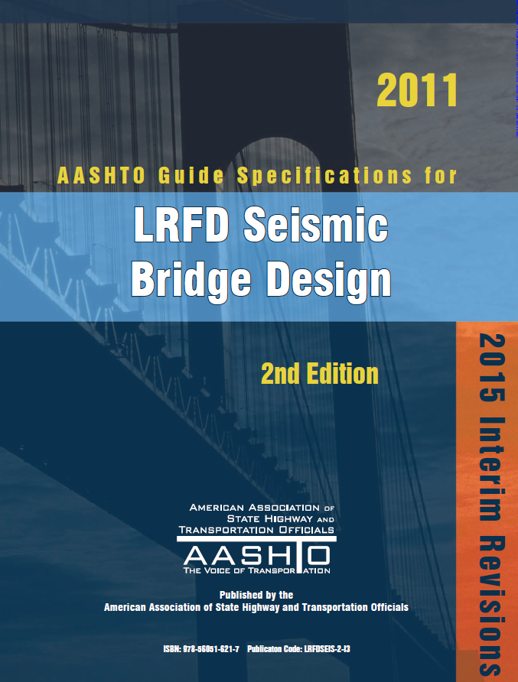



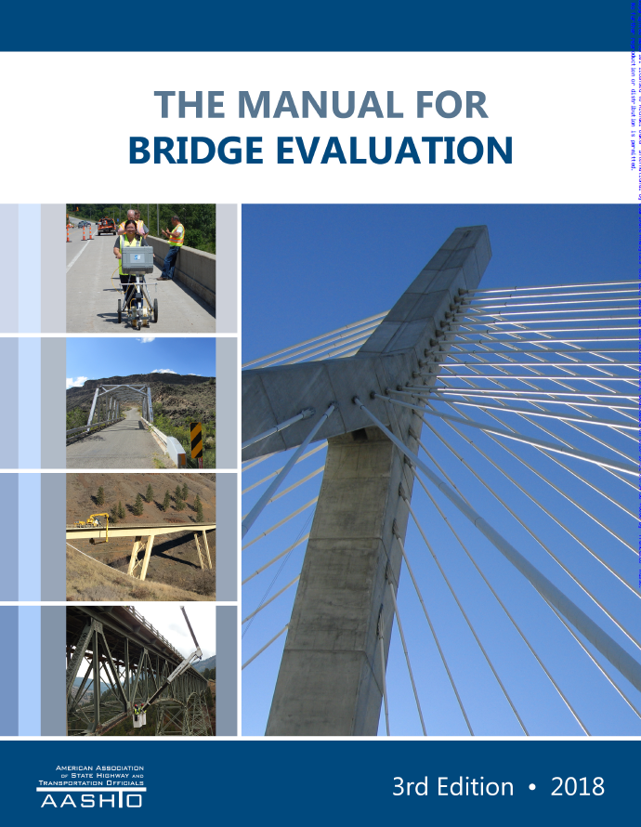
Other AASHTO Bridge Specifications
Notes:
In addition to the LRFD BDS, AASHTO publishes dozens of other specifications, manuals, and guides that are used by bridge engineers in their practice. Examples of just some of those additional guides are provided. Many of these additional documents are referred to as Guide Specifications. The role of the LRFD BDS is to provide guidance for the most common design elements but intentionally does not cover all possible topics. As an example, movable bridges, though common in some parts of the country, are not covered in the LRFD BDS. They have their own specifications which not only cover the structural elements but also components such as machinery and electrical system design. When the capacity of an existing bridge is to be determined, known as load rating, engineers use the AASHTO Manual for Bridge Evaluation (the MBE) in conjunction with the BDS to do so. Special topics such as bridges designed for mass transit and light rail have their own special treatment. Special topics such as bridges designed to withstand wind and storm surge events in coastal locations and even bridges subjected to tsunami loading are all covered in various Guide Specifications, which in turn rely on the main body of the BDS for much of the supporting information needed for special designs.

Slide 12
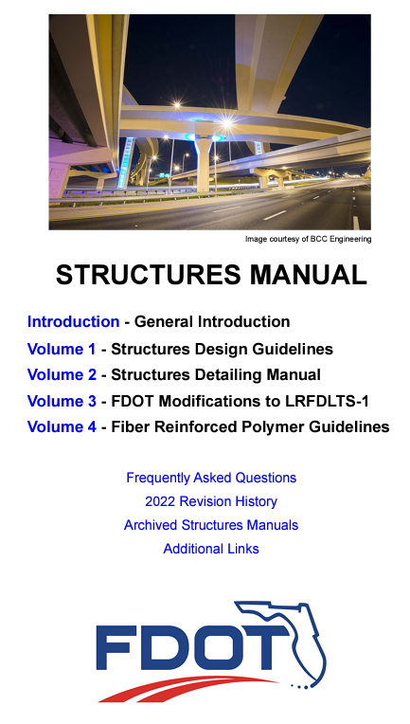


State Policies
Notes:
States commonly have their own bridge and structures design manuals that supplement and provide substantial additional guidance above and beyond what is found in the BDS. The AASHTO BDS can be thought of as a specific set of rules whereas the state design manuals express specific preferences of the various states. Topics such as preliminary and final design are covered in detail. Various interpretations of AASHTO are provided and state-specific criteria are enforced. In addition to the technical requirements are additional requirements about plans preparation, requirements for document submissions, QAQC requirements, and many other important aspects of bridge project delivery. Engineers must be familiar with the design manuals in the various states they provide services for, and it is common for there to be significant differences between agencies as to preferences and interpretations of the BDS requirements.

Slide 13
Evolution of Specifications

Slide 14
Evolution of Specifications
ASD
LFD
LRFD
Specifications have evolved over time
Allowable Stress Design, the oldest (1931)
Load Factor Design, an intermediate step (1973)
Load and Resistance Factor Design, the modern standard (1994)
Notes:
The development of the first versions of the AASHTO bridge design specifications dates to a ten-year period from 1921 – 1931 with the printing of the first edition of the AASHTO Standard Specifications for Highway Bridges in 1931. Though now nearly 100 years old, it is remarkable that many of the early concepts of those specifications still exist in some form in modern design principles. The Standard Specifications were revised numerous times with the final version, the 17th edition, being published in 2002. At that time, AASHTO had made the decision to no longer update or promote the use of the Standard Specifications and instead the LRFD BDS was the modern standard of the profession.
The specifications evolved over time from the simplest allowable stress design provisions starting in 1932, to the inclusion of the alternate load factor design provisions, first added to the Standard Specifications in 1973, and then to the LRFD BDS, introduced in 1994 in both US Customary and SI units. Subsequent slides briefly describe the fundamental concepts of each method of design.

Slide 15

Allowable Stress Design, ASD
$$ΣQ_{i} ≤ {R_{e}}/{FS}$$
Q – various loads
R_{e} – an elastic resistance
FS – a factor of safety
Notes:
In allowable stress design, all loads are computed and summed together at what are termed working stress, service, or unfactored levels, all terms being interchangeable. These loads are based on assumed material weights for self weight and prescribed values for other loads like vehicle force effects, wind loads, etc. There are various load combinations to consider and not all loads are present, or present to the the full effect, in the various combinations.
On the resistance side, a specified resistance is provided always one in which the member remains elastic. Modern concepts of post-yield behavior, plastic strength, etc., are not a part of ASD resistance approaches. All uncertainties in material strength AND in the ability to compute the loading are lumped together in a single Factor of Safety. The Factor of Safety is either expressed as a fraction, a number greater than 1.0 in the denominator, or alternately as a decimal value less than 1.0 in front of the resistance. For instance, the bending strength of a steel beam expressed in ASD terms is commonly taken as 0.55 Fy, the 0.55 term expressing all aspects of safety for load and resistance variability in one term.

Slide 16
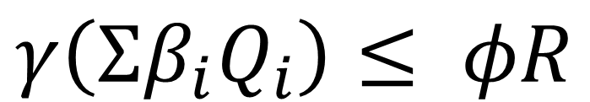
Load Factor Design, LFD
$$γ\left(Σβ_{i}Q_{i}\right)≤ φR$$
Q – various loads
γ and β are load factors associated with loads and how they are combined
φR – a resistance
Notes:
Load Factor Design, introduced to AASHTO in 1973, was described as follows by AASHTO
Load Factor design is an alternate method for design of simple and continuous beam and girder structures of moderate length. It is a method of proportioning structural members for multiples of the design loads. To ensure serviceability and durability, consideration is given to the control of permanent deformations under overloads, to the fatigue characteristics under service loadings and to the control of live load deflections under service loadings.
Note that in Load Factor Design (LFD) the equations begin to look like a modern design specification with various factors applied on both the load and resistance side of the equation. Factors such as β were introduced as specific factors applying to various load types (dead, live, wind, etc.) and a load factor γ applies as an additional load factor to the entire summation of loads. On the resistance side of the equation, strength is no longer limited to elastic values but inelastic, plastic, or “ultimate strengths” are computed with a corresponding resistance factor, φ, introduced to capture member strength variability.
The format of the LFD approach is nearly the same as the modern LRFD approach, but the shortcoming of ASD and LFD were similar, they produced bridges that were safe, but inconsistently so, and their design approaches were rooted in research and understanding that were decades old.

Slide 17
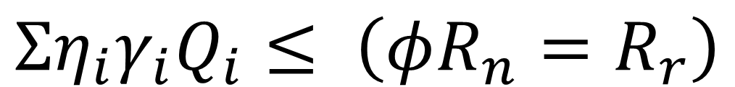
Load and Resistance Factor Design, LRFD
$$Ση_{i}γ_{i}Q_{i}≤ \left(φR_{n}=R_{r}\right)$$
Q – various loads
γ – a load factor
η – a load modifier related to ductility, redundancy, and importance
φR_{n} = R_{r} = a resistance
Notes:
In 1994, the LRFD BDS was introduced and for some time was published in US and SI units. The LRFD BDS has its origins with the Ontario Highway Bridge Design Code, one of the first modern LRFD design approaches for bridges. Beginning in 1986, AASHTO began investigating the idea of developing an LRFD formatted specification for US bridge practice and an NCHRP Research Project (20-7/31) was undertaken to (a) review other specifications, (b) review other AASHTO documents for inclusion in a modern bridge design specification, (c) assess the feasibility of probability-based design specifications, and (d) prepare an outline for a new AASHTO Specification. Work began on a follow-on NCHRP Project (12-33) in 1988 to develop the Specifications we have today.
Key to the LRFD approach is the equation provided on this slide. Like the LFD equation shown previously, loads are treated with various factors and compared to a factored nominal resistance. In the LRFD approach, some new terms are introduced.
The term η was introduced to add or take away from load, reflecting unique aspects of members as related to characteristics of ductility, importance, or redundancy
The term γ is used to represent the various load factors that apply to different load types.
Resistance is similar with the nominal strength, Rn, being reduced by a factor, φ, introduced to capture member strength variability.

Slide 18
What is Unique About LRFD?
It is a probability-based specification
What does that mean?
  Load factors, resistance factors, and how loads are combined (load combinations) are based on statistical properties of load and resistance and a target level of safety, known as reliability
Notes:
The AASHTO LRFD BDS is based upon the theory of structural reliability, and the strength load combinations are developed to achieve uniform reliability of structural components regardless of the type of material used. When the load factors and the resistance factors of the AASHTO LRFD BDS are applied in design, a uniform level of reliability or safety is achieved. The magnitudes of the factors derived to achieve this uniform safety are the major difference between the Load and Resistance Factor Design (LRFD) method used in the AASHTO LRFD BDS and Load Factor Design (LFD) method used in the previous Standard Specifications. Further details, including the basis of the LRFD calibration, can be found in NCHRP Report 368.

Slide 19
Reliability-Based Specifications

Slide 20
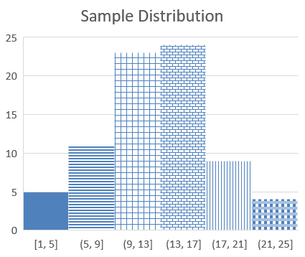
LRFD i.e. Probability-Based Specifications
Assume we sample the strength of a material, or the weight density of common materials
We will have a distribution, shown here as a histogram
There will be maximum, minimum, and average values
How do we handle this variability? Pick the highest, average, some other value?
Notes:
Using this illustration helps describe the statistical basis of the LRFD BDS reliability approach to design. Assume instead of these fictitious values, one samples the yield strength of a given grade of steel, or the compressive strength of a specific concrete, or any similar exercise. If done hundreds, or thousands of times, a database of material characteristics can be developed. This database would contain the high and low value, average values (the mean), the most common value (the mode), and other characteristic like the standard deviation and the coefficient of variation
Now a similar exercise could be conducted for load.
Once the characteristics for load and resistance are understood, values for load factors (most commonly greater than 1) and resistance factors (1.0 or lower than 1.0) can be chosen to provide an expected level of safety in design. This is what is called calibration, the selection of load and resistance factors, and load and resistance models (equations, formulations) that lead to uniform and safe outcomes across a wide range of materials and bridge types. It was not until the AASHTO LRFD BDS was developed that such a uniform reliability approach to bridge design was practiced in the United States.

Slide 21
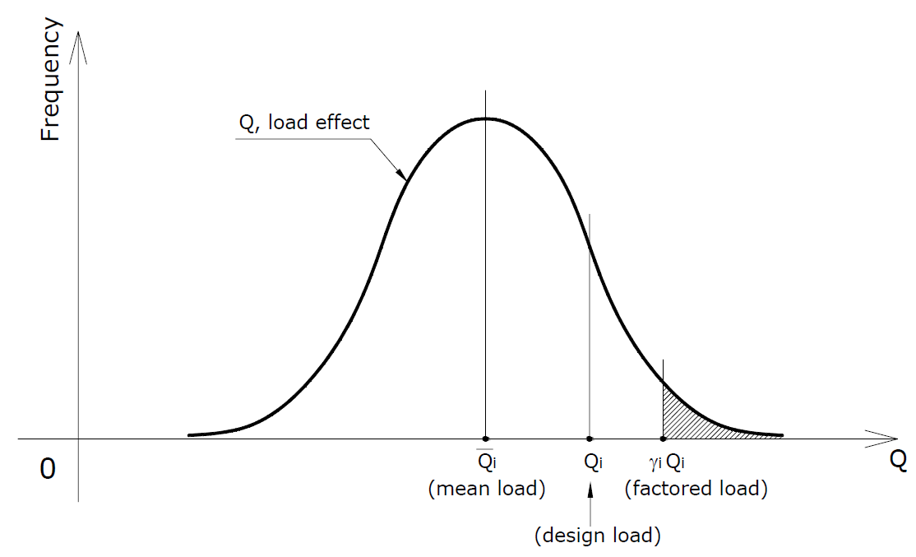
Load
Notes:
Instead of presenting the data in bins or as a histogram as on the previous slide, instead let’s present the data as a normal distribution curve. For a normal distribution curve, or bell curve using a common name, the probability that certain values will be exceeded or not exceeded is related to their relationship to areas under the curve. A normal distribution curve has a mean, that is the mean of all data in the distribution, and extends to plus and minus infinity. However, most of the data is contained in plus / minus approximately three standard deviations on either side of the mean.
A specific load in the BDS does not represent what the mean load is expected to be but rather the load is biased to some value higher than the mean, designated the design load or nominal load. This point can be thought of as representing a specified value, such as weight of steel or concrete for self weight, or the weight of a vehicle for live loads. It is somewhat higher than the mean. The specifications then apply an additional amplification, applying load factors, γ, that expect in a few cases are always in excess of 1.0. This is what is called the factored load.

Slide 22
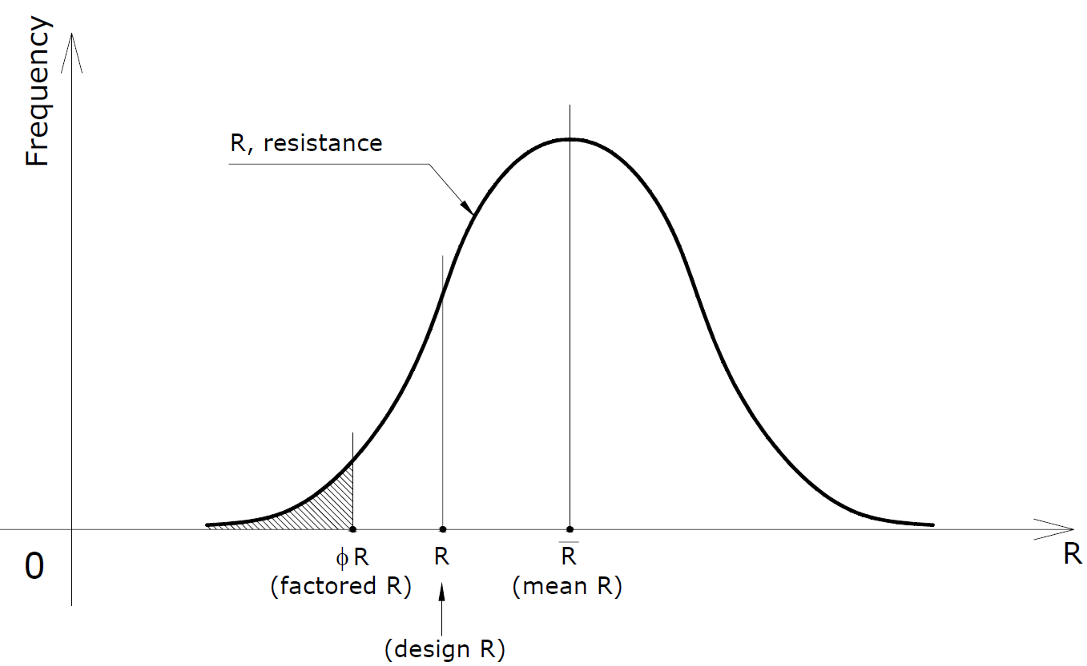
Resistance
Notes:
Similar to the prior slide, the data for resistance can be plotted. This can be thought of simply as a plot of basic material strengths like yield, tensile, or compressive strength of materials but in a similar way could represent predicted strengths based on equations or other empirical approaches. The trend is the same, a mean resistance is lowered to a point called the design resistance (or the nominal resistance) and then lowered again using Φ factors to the value used as the permissible strength for design.
Having established a factored load and a factored resistance, the calibration process determines how many times the factored load exceeds the factored resistance and determines if this is acceptable. If the number of “failures” does not meet the targeted value, adjustments are made to the load or resistance factors until a target level of reliability, or safety, is achieved.
To determine the target level of reliability for the LRFD BDS, researchers first computed the inherent reliability in many bridges previously designed using the older AASHTO Standard Specifications. Once the inherent reliability in these existing bridges was determined, and they were generally deemed to be safe, target levels of reliability were chosen for the LRFD BDS.

Slide 23
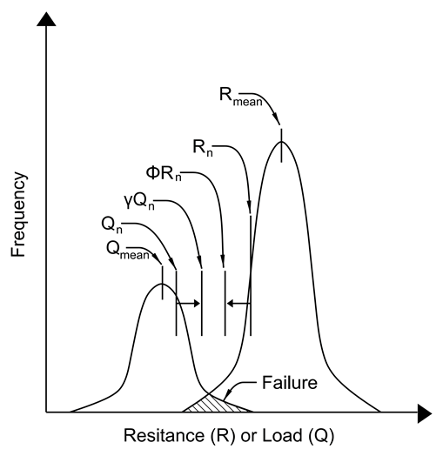
Load and Resistance Combined
Resistance (R) or Load (Q)
Notes:
Plotting assumed normally distributed loads and resistances together, it can be seen there are regions of overlap. These are regions of “failure” where a scenario exists where a high load could exceed a low resistance. Regardless of how high the design load is set, and the load factor applied to it, there is always a non-zero chance that it will exceed the nominal resistance times an applicable strength reduction factor. The goal of reliability-based calibration is to determine how often such exceedances can be tolerated. Much of this work related to acceptable exceedance rates came from surveys of several hundred modern bridges, design to the AASHTO Standard Specifications.
This figure is from SBDH Vol 10 – Limit States

Slide 24
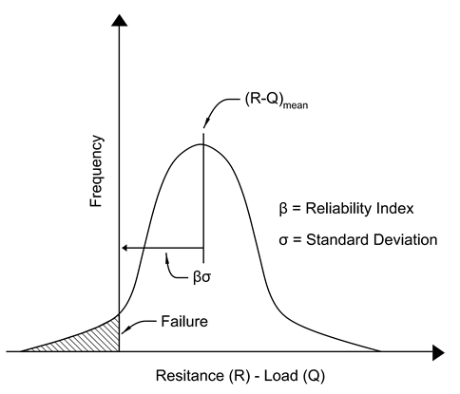
Load and Resistance Combined
Resistance (R) or Load (Q)
Notes:
Finally, plotting the data one additional way, the concept of failure becomes more obvious. In this plot, a combined distribution function equal to R-Q is plotted, i.e. resistance (R) minus load (Q). When resistance minus load is a negative value, i.e. load is greater in magnitude than resistance, we have a failure point. The number of these failures, or the percent of all possible outcomes, is represented by the shaded tail of this distribution function.
The standard deviation of R-Q is then offset by a factor, β, to minimize the number of times that load exceeds resistance. According to Mertz, Background to the Specifications, Aspire, winter 2007…“The reliability indices represented by the bridges designed by the Standard Specifications range from about 1.5 to 4.7. This represents a huge range of probability of failure ranging from 7 in 100 to 3 in 1,000,000. The bridges of the LRFD Specifications are more uniformly reliable with a limited range of about 3.3 to 3.8, centered about the target reliability index of 3.5. The probability of failure associated with a reliability index of 3.5 is about 2 in 10,000. Thus, the LRFD Specifications yields bridges of much more uniform reliability.”
Thus, an examination of the back-calculated reliability of bridges designed by the older Standard Specifications was widely varying and an examination of the spread lead to a target level of reliability. There were many sources for the large range in reliability values. These included: errors arising from the old HS-20 live load model; errors arising from the older live load distribution factors; errors arising from load factors, load combination, and limit states; and errors arising from nominal strength models. The uniform reliability in the LRFD Specifications comes about from many changes that are inherent to the BDS. No direct application of statistical methods is required, it is implicit in the direct application of the BDS approach.
This figure is from SBDH Vol 10 – Limit States

Slide 25
loads, Load Factors, and Load Modifiers

Slide 26
Loads
Permanent Loads
Transient Loads
Permanent load examples
  Self weight of materials (commonly called dead loads)
Transient load examples
  Vehicle loads (commonly called live loads)
  Environmental loads (wind, ice, stream flow)
  Forces due to restrained expansion and contraction
Notes:
AASHTO BDS describes how to account for various loads in Chapter 3. Broadly they are grouped in sections based on whether the loads are permanent (3.5) or transient (3.6 – 3.15). Section 3.4 defines how to combine these various loads into combinations and for checking specific behaviors, or limit states.
Permanent loads are defined by AASHTO as “loads and forces that are, or are assumed to be, either constant upon completion of construction or varying only over a long time interval.” The AASHTO LRFD BDS specifies 10 types of permanent loads, which include direct gravity loads, loads indirectly caused by gravity loads, “locked-in” loads resulting from the construction process, and certain loads due to superimposed deformations.
Transient loads are defined by AASHTO as “loads and forces that can vary over a short time interval relative to the lifetime of the structure.” The AASHTO LRFD BDS recognizes 18 transient loads. The transient loads include loading effects associated with vehicular or pedestrian loading (LL, IM, BR, CE, LS, PS), environmental conditions such as thermal, wind, and water loading (TG, TU, WS, WL, WA, IC), friction in sliding bearings (FR), settlement (SE), and various extreme event conditions (BL, CT, CV, EQ).

Slide 27
Loads
Permanent Loads
Transient Loads
Occur continuously
Load factors reflect uncertainty in their calculation
Have maximum / minimum load factors
Maximum generally used except when minimum might be more critical, i.e. checking uplift
Occur intermittently and may be zero, i.e. no trucks on the bridge or wind not blowing
More variable than permanent loads and thus higher load factors to handle uncertainty
Notes:
Loads within the context of the AASHTO LRFD BDS are categorized as permanent or transient loads. This categorization is necessary because the AASHTO LRFD BDS represents a “reliability-based” design methodology which evaluates the statistical probability of occurrence of the loading effects (and the statistical reliability of the resistance effects). In other words, the specifications recognize there is some uncertainty associated with the estimated values of the loading effects; loads can be larger than the nominal value (the value of load calculated as specified in the AASHTO LRFD BDS) or smaller than the nominal value. The load factors specified in the AASHTO LRFD BDS reflect this uncertainty by adjusting the nominal estimated value of various loads.
Transient loads occur intermittently, and thus the smallest value of a transient load is, by definition, zero. Permanent loads occur continuously, and generally any variation in the magnitude of a permanent load from its estimated value is due to either an intentional change in conditions or a misestimation of the value. However, in some cases permanent loads can cause relieving force effects in the structure, so it is necessary to consider a minimum estimate of the load in addition to considering a maximum estimate. Thus, for permanent loads there are maximum load factors (generally greater than 1.0) and minimum load factors (generally less than 1.0).

Slide 28
Permanent Loads – BDS 3.5
Dead loads, DC, DW, EV
  DC – dead load of structural components and nonstructural attachments
    Think of this as self weight
  DW – dead load of wearing surfaces and utilities
  EV – vertical pressure from dead load of earth fill
Notes:
DC represents the dead load of structural components, as well as any non-structural attachments.
DW represents the dead load of additional non-integral wearing surfaces, future overlays, and any utilities supported by the bridge.
EV represents the vertical earth pressure from fill. Examples include the weight of soil over buried structures like footings or culverts.

Slide 29
Common Unit Weights
Material | Unit Weight (kcf)
Steel | 0.490
Concrete, normal weight | 0.145
Bituminous wearing surfaces | 0.140
Aluminum alloys | 0.175
Note: for reinforced concrete, a value of 0.15 kcf is common to include an allowance for reinforcing steel
Notes:
For the calculation of permanent loads due to self weight effects, AASHTO BDS Ta 3.5.1-1 provides representative unit weights for these and other materials that engineers use to determine the weight of various structural components. Some common materials include steel for main beams and for reinforcing steel; concrete for decks, beams, and piers / abutment elements; bituminous wearing surfaces either applied at the time of construction or as a future wearing surface (commonly abbreviated as FWS); and even aluminum is sometimes used for railings, sign or light structures. The value for concrete is unreinforced concrete. Engineers typically use a number of 0.15 kcf for reinforced concrete to include an allowance for the weight of reinforcing steel.

Slide 30
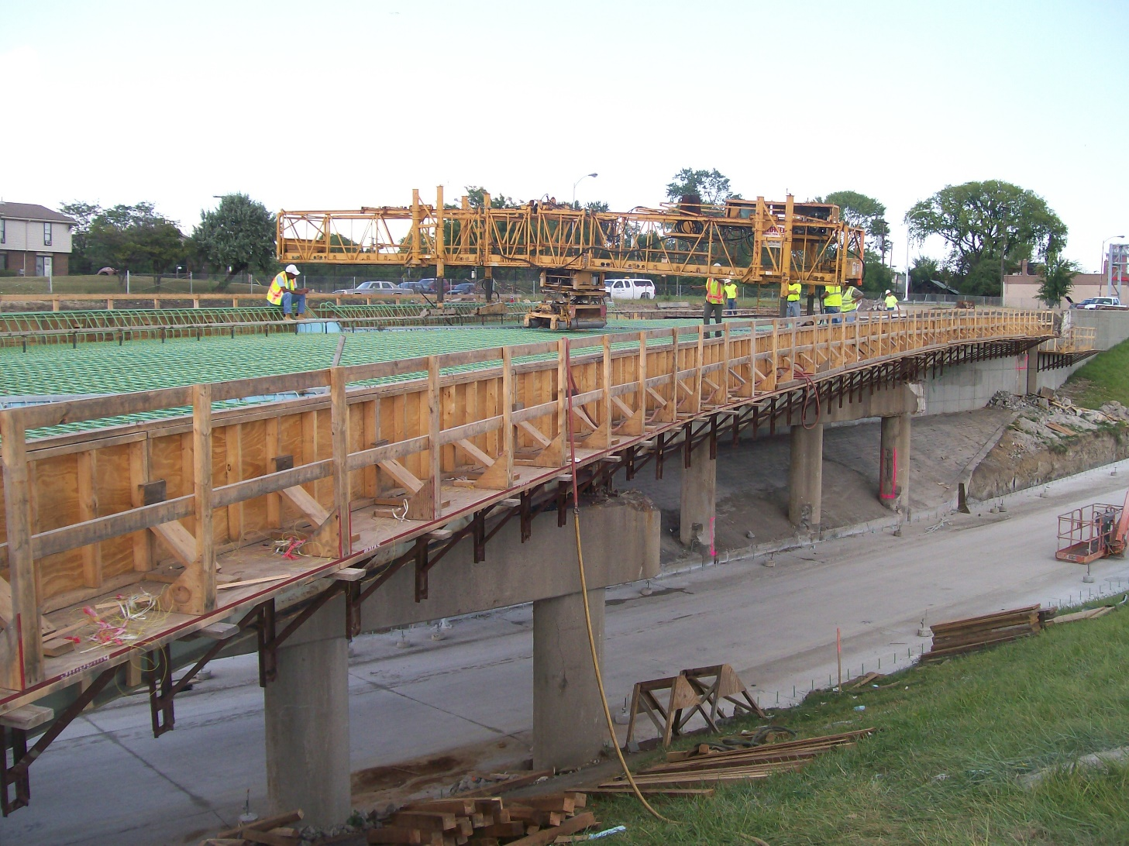
DC – Further Exploration
DC is commonly further divided as DC₁ and DC₂
DC₁ is used to capture force effects carried by the girder alone in a noncomposite condition
  Self weight of girder, slab formwork, weight of deck, bracing, utilities placed before the slab is cast
Notes:
DC represents the dead load of structural components, as well as any non-structural attachments.
Component dead loads associated with composite girder-slab bridges consist of non-composite and composite components, typically termed DC1 and DC2, respectively. Dead loads applied to the non-composite cross section (i.e., the girder alone) include the self-weight of the girder and the weight of the wet concrete, forms and other construction loads typically required to place the deck. The concrete dead load should include allowances for haunches over the girders. Where steel stay-in-place formwork is used, the designer shall account for the steel form weight and any additional concrete in the flutes of the formwork. When calculating the distribution of the weight of plastic concrete (i.e., concrete prior to hardening) to the girders, including that of any integral sacrificial wearing surface, the formwork is typically assumed to be simply supported between beams and cantilevered beyond the exterior beams.
Photo Credit: Genesis Structures

Slide 31
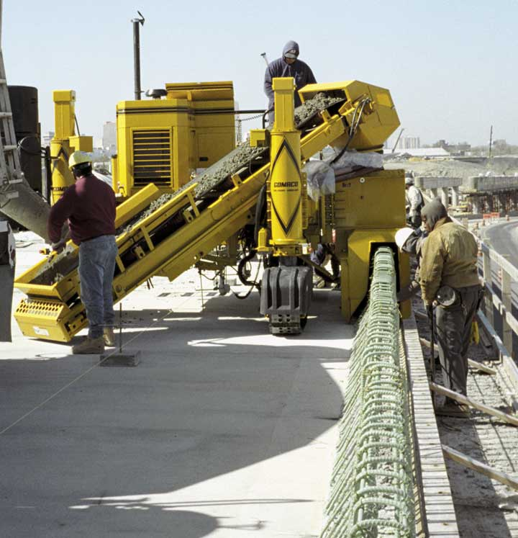
DC – Further Exploration
DC₂ is used to represent permanent loads placed after the slab hardens
  Barrier rails, sidewalk, fences / railings, etc.
https://www.gomaco.com/resources/gt3600barrier.html
Notes:
Component dead loads applied to the composite cross section (i.e., the girder with the composite slab) include the weight of any curb, rail, sidewalk or barrier placed after the deck concrete has hardened, as well as any appurtenances such as lights, signs, walls, etc.

Slide 32
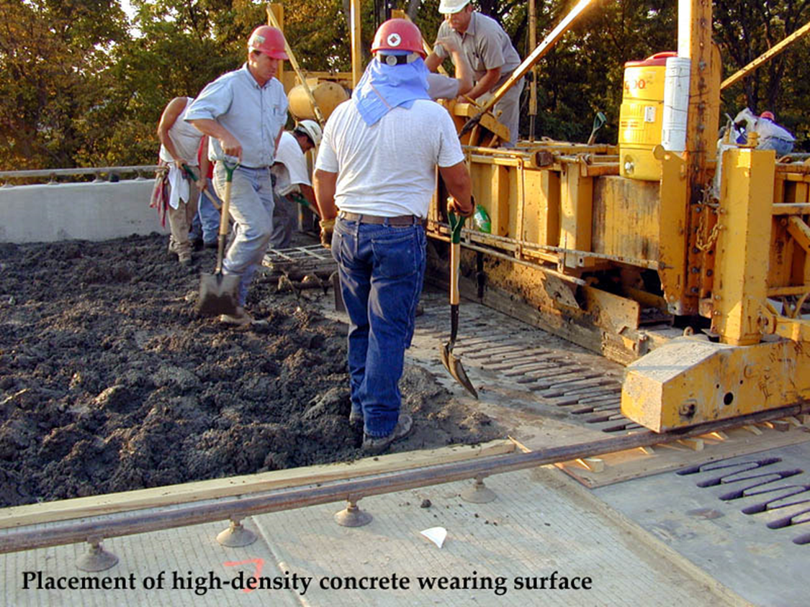
DW
DW – permanent load force effects from additional deck wearing surfaces (overlays), as well as an allowance for utilities
Notes:
DW represents the dead load of additional non-integral wearing surfaces, future overlays, and any utilities supported by the bridge.
An allowance for a future wearing surface over the entire deck area between the gutter lines is typically included as a composite dead load. Owner design manuals specify the value of the future wearing surface allowance.
Photo Credit: Genesis Structures

Slide 33
Permanent Loads Revisited
Noncomposite Dead Loads
Composite Dead Loads, i.e. Superimposed
DC₁
DC₂
DW
Notes:
It is important to recognize that loads applied before and after the deck hardens are resisted in different ways. Loads placed so that only the steel beam can carry them are applied in a noncomposite condition, the beam and the slab do not yet act as a system or in a composite way. Loads applied after the deck hardens are either accounted for as part of permanent loads, those that can be accurately accounted for during design, DC2, or those that account for some future allowance for loading from a future wearing surface, or an allowance for a future utility load, DW.
Permanent loads which occur more or less uniformly over the width of the bridge deck, such as wearing surfaces, are typically assumed to be distributed equally among all girders. Concentrated permanent loads, such as the self-weight of barrier rails, sidewalks, median barriers, etc. are typically assumed to be distributed among a limited number of nearby girders. For example, it is common to assume that the self-weight of a barrier rail is distributed to only the exterior girder, or to a small number of nearby girders, rather than being uniformly distributed among all girders; many Owner-agencies design policies provide guidance on acceptable assumptions for the distribution of the self-weight of barrier rails. In some cases, such as wider bridges, staged construction, or heavier barrier rails, walls, or utilities, the bridge designer may consider performing a refined analysis to more accurately determine the distribution of superimposed dead loads.

Slide 34
Other Loads
3.6 – Live load
3.7 – Water load, WA
3.8 – Wind load, WL and WS
3.9 – Ice load – IC
3.10 – Earthquake, EQ
3.11 – Earth pressure, EH, ES, LS, DD
3.12 – Superimposed deformations – TU, TG, SH, CR, SE, PS
3.13 – Friction, FR
3.14 – Vessel collision, CV
3.15 – Blast, BL
Notes:
This slide indicates the various types of loads for which minimum requirements are provided in the BDS. In this course we are focusing mainly on the design of the bridge superstructure, elements like the main beams, the deck, and the bearings which support the beams. As a result, not all of these loads will apply, for instance, loads associated with earth pressure, hydraulics, vessel collision, blast, and others. However, the design of even a simple bridge involves the following transient loads and load effects
Live load
Wind load
Superimposed deformations

Slide 35
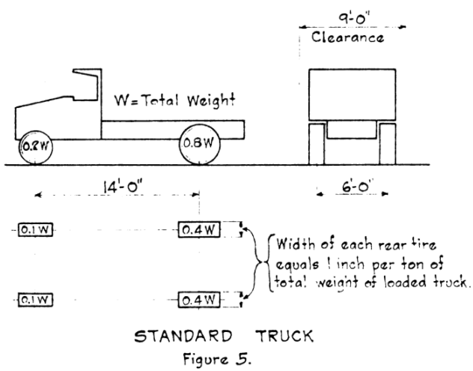
A Look Back at the Evolution of Live Loads
1927 – AASHO (no T yet) publishes the Standard Specifications for Highway Bridges and Incidental Structures
Trucks weighing between 10 – 20 tons were specified as the design loads
Notes:
The early 1900s are the origin of the loads used to design even modern highway bridges. As far back as 1912, Henry B Seaman stated in the Transactions of the American Society of Civil Engineers that “it would thus seem that 80 lb./sf would be a maximum load, if indeed it should not be much less, for long spans.”
In 1916, renowned engineer J A Waddell concluded that a crowd of people weighs more than a herd of cattle, whose weight was estimated at 60 psf.
Previously in 1914, Manville and Gastmeyer suggested that older wagon type loads used to design bridges should be replaced with modern trucks. They suggested a 2-axle truck, axles spaced 12’ apart, the front axle weighing 12 kips and the rear, 28 kips. Over 100 years later, variations of this load are still part of modern bridge design and load rating.
The 1923 American Railway Engineering Association (AREA – now AREMA) is the first to suggest what would become the H20 loading, a 20T truck with an 8 kip and 32 kip axle, spaced 14 ft apart.
In 1927, AASHTO publishes what would come to be known as the H-family of loads, a number in tons being added to describe the vehicle, i.e. H20 being a 20-ton truck with axels weights, spacings as shown in the figure above.

Slide 36
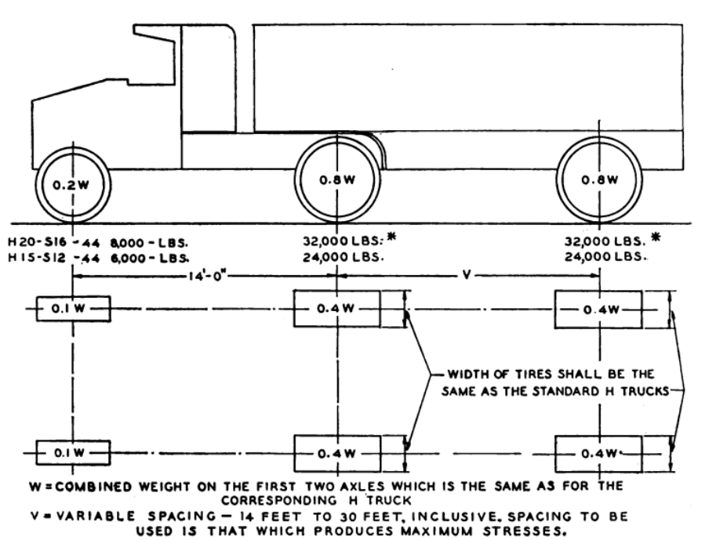
A Look Back at the Evolution of Live Loads
By 1944, the H20-S16-44 loading was introduced (commonly HS20) and remained the design loading used for another 50 years
  H20 (20 ton) tractor
  S16 (16 ton) trailer axle
Notes:
In 1944, the more modern three-axle truck was introduced while still retaining the older H-20 loading. This new loading, now more commonly known as the HS-20 loading, is a three-axle truck with axle weights of 8 - 32 – 32 kips and axles fixed at 14-ft centers. This is the basic load for bridge design used from the 1940s until the introduction of the LRFD BDS in 1994, and subsequent adoption over the next decade by the states. This load is still used in LRFD as a component of total live load force effects.

Slide 37
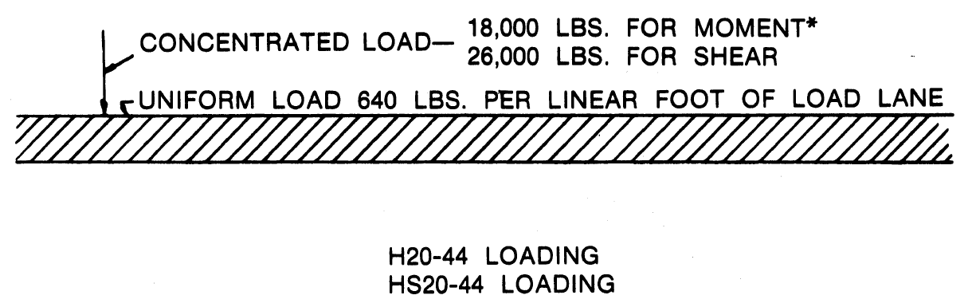
A Look Back at the Evolution of Live Loads
In addition to the truck loads, a lane load model is also provided
Engineers use the governing (more conservative) forces
Notes:
In addition to the truck loads is a lane load model. Note it uses a uniformly distributed load of 640 plf (0.64 klf) along with a variable intensity point load depending on whether shear or moment is being investigated. For determination of negative moment and reactions at interior piers, the asterisk associated with the 18-kip moment value indicates that two such point loads are permitted in adjacent spans to maximize forces in continuous spans.

Slide 38
A Look Back at the Evolution of Live Loads
One additional live load was included, the Alternate Military Loading
24 kip axles
4 ft spacing
Notes:
Also note that one additional loading is included. This Alternate Military Loading, though weighing less in total than the HS-20 truck, 48 kips compared to 72 kips, provides a much more concentrated load effect. This highly concentrated loading was critical for short spans where both axles could be placed in critical locations. Examples would be shear at the end of a short span or moment in the center of a short span where this concentrated load effect is a much greater influence than the three axles HS vehicle spread over a length of 28 ft.

Slide 39
Live Load Observations
The older AASHTO Standard Specifications included
  A 3-axle truck, axle weights of 8-32-32 kips
  A lane load of 0.64 klf and floating point loads
  An alternate live load of 2 @ 24 kip axles spaced 4-ft on center
Notes:
This slide summarizes the AASHTO live loads used in the Standard Specifications. It is important to recognize these load models as they resurface in the LRFD BDS as pieces of what becomes known as the HL-93 load model for live load.

Slide 40
THE LRFD HL-93 Live Loads
Notes:
Having introduced the historical H and HS load models used in the Standard Specifications, the live load model used in LRFD, the HL-93 live load will be presented.

Slide 41
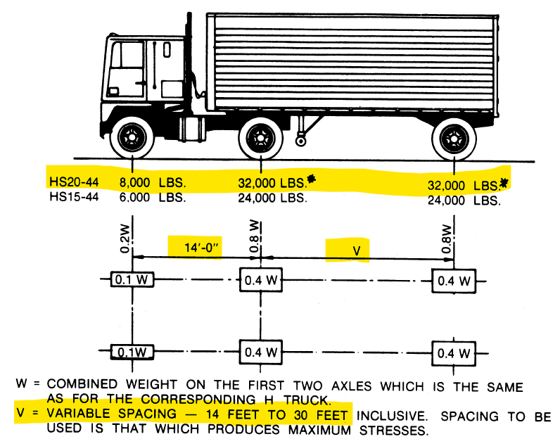
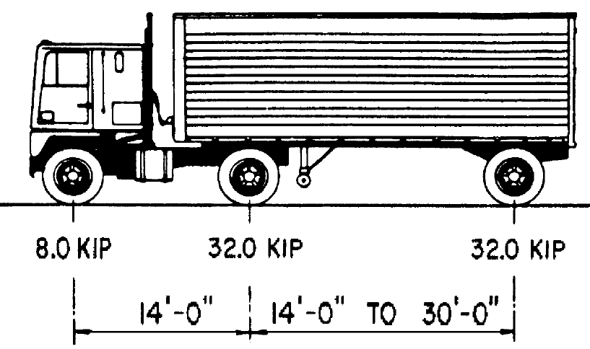
AASHTO HL-93 Loading
HL93 Truck – BDS 3.6.1.2.2
HS20-44 Truck
Notes:
The HL-93 loading consists of a truck and a lane load component. These are summed whereas in the Standard Specifications the live load was simply the greater of a truck or lane load model. First a comparison is made between the HL-93 truck live load component and the HS-20 live load truck. Notice that the design truck used in the HL-93 loading has the exact axle spacing and weights as the older HS-20 truck.

Slide 42
AASHTO HL-93 Loading
HL93 Tandem – BDS 3.6.1.2.3
Alternate Military Load
25 kip axles
4 ft spacing
24 kip axles
4 ft spacing
Notes:
The HL-93 live load also includes a live load tandem model. Notice that the design tandem is virtually identical to the older alternate military loading, the only change being an increase in axle weights from 24 to 25-kips

Slide 43

AASHTO HL-93 Loading
HS20 Lane Load
HL93 Lane Load – BDS 3.6.1.2.4
Notes:
The HL-93 live load model also includes a lane load component. Notice that the same lane load of 0.640-klf (640-plf) is used in each load model. In the Standard Specifications, the lane load also carried additional point loads of varying magnitude whereby in the LRFD BDS the lane load is simply the uniform load shown.

Slide 44
Live Load Comparison
Prior slides show the following
  The truck load is exactly the same
  The tandem load is virtually the same
  The lane load is the same but point loads are no longer used
So what is the difference?
Notes:
The previous slides demonstrated that the truck component of live load in the HL-93 load model is in fact the older HS-20 truck load which has been used since 1944. The tandem load is within 1 kip of matching the older alternate military load. The most significant differences are in the lane load where the Standard Specifications include a 640 plf lane load and an additional, variable point load, depending on which force effects were computed; LRFD does not use the point loads.
The difference is not in the individual components but rather how they are used where the differences arise. The following slides introduce the LRFD HL-93 loading as a collection of common components but uniquely different application.

Slide 45
Live Load Comparison
In the Standard Specifications we computed force effects from the truck, the tandem, or the lane load models and chose the largest.
In LRFD, we take the greater of the truck or tandem and ADD them to the lane.
Notes:
In the Standard Specifications the engineer chose from the governing of truck or lane-type load models. In LRFD these are combined.
When the force effects (moment and shear) from the HS-20 loading were compared to moments and shears from actual legal vehicles in the United States in load studies performed in the 1980s, the force effects of the traditional HS-20 truck alone are less than that of many legal vehicles in operation. Thus, when the LRFD Specifications were developed, a heavier vehicle was deemed appropriate for design. Originally, a longer 57-ton vehicle (termed the HTL-57) was developed to model the force effects of trucks on our nation’s highways at the time of the development of early drafts of the 1st Edition of the AASHTO LRFD BDS. Ultimately, however, it was deemed objectionable to specify a super-legal truck in the national design specifications. Instead, the concept of superimposing the design vehicle force effects and the design lane force effects to produce moments and shears representative of real trucks on the highways was developed for later drafts and subsequent editions of the AASHTO LRFD BDS. The moments and shears produced by the HL-93 notional load model are essentially equivalent to those of the more realistic 57-ton truck.

Slide 46
AASHTO HL-93 Loading
Consists of the following components
  A design truck, or a design tandem
  A design lane load
Notes:
In the Standard Specifications, live load was the greatest of either (a) truck loads, (b) alternate military loads, or (c) the lane loads with floating point loads. These same components exist in the HL-93 load model except that they are not treated individually but rather as a whole.
The HL-93 load model is either (a) the truck load and lane load combined, or (b) the tandem and lane load combined. The effect of this combination is to provide lane loads at all locations where they contribute to the force effects of interest with a heavy truck (or tandem) in the traffic stream at the same time. This results in HL-93 design moments and shears being quite higher than if the components were chosen alone, one at a time, as governing effects. This higher shear, moment, reaction produced by HL-93 is consistent with truck weight surveys and analysis demonstrating the older HS-20 load models produced forces that were significantly less than those expected in typical traffic streams.

Slide 47
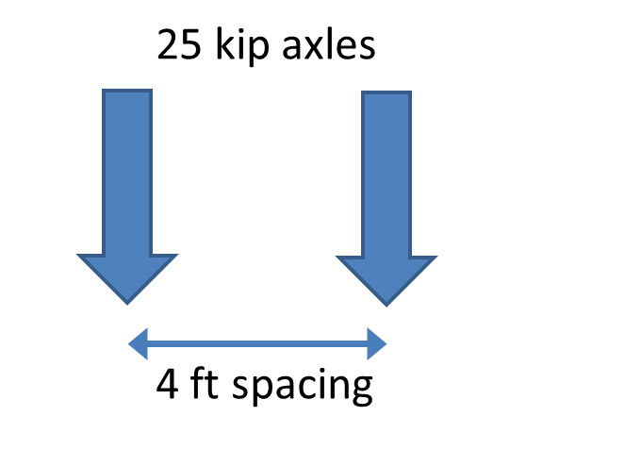
HL-93 Loading – BDS 3.6.1.2.1
Greater of truck or tandem
Added to the lane load
Notes:
The HL-93 live-load model is a notional load in that it is not a true representation of actual truck weights. Instead, the force effects (i.e., the moments and shears) due to the superposition of vehicular and lane load within a single design lane are considered to be a reasonably accurate representation of the force effects due to actual trucks. Recall the prior discussion of an equivalent 57-ton single vehicles as being needed to envelope legal loads operating as far back as the 1980’s.
The components of the HL-93 notional load are:
• a vehicle, either a 72-kip three-axle design truck (equivalent to the historical HS20-44 truck of the AASHTO Standard Specifications for Highway Bridges (referred to herein as the Standard Specifications) or a 50-kip design tandem (equivalent to the Alternate Loading of the Standard Specifications); and
• a 0.64 k/ft uniformly distributed lane load (similar to the lane load of the Standard Specifications but acting concurrently with the vehicle without any of the previous associated concentrated loads).
The AASHTO LRFD BDS retains the traditional design lane width of 12 ft and the traditional spacing of the axles and wheels of the HS 20 truck. Both vehicles (the design truck and design tandem) and the lane load occupy a 10-ft width placed transversely within the design lane for maximum effect, as specified in Article 3.6.1.3.

Slide 48
Dynamic Load Allowance (Impact) – BDS 3.6.2.1
To account for the impact, or dynamic amplification of wheel loads due to moving loads, AASHTO applies an increase to the truck load portion of loading, only
Component | IM
Deck joints – all limit states | 75%
All other components: Fatigue and fracture limit state All other limit states | 15% 33%
Notes:
IM represents the dynamic load allowance to amplify the force effects of statically applied vehicles to represent moving vehicles, traditionally called impact. Note that the dynamic load allowances (IM) specified in Article 3.6.2.1 is applicable only to the design trucks, the design tandems, and the fatigue truck load, excluding centrifugal and braking forces. The dynamic load allowance should not be applied to the uniformly distributed lane load. Note also that the dynamic load allowance need not be applied to foundation components that are entirely below ground.
Impact is attributed to two sources: (a) a hammering effect attributed to a rough riding surface due to potholes, poorly aligned deck joints, sags in approach pavements, etc., and (b) the dynamic response of the bridge, which is a vertical spring, subjected to rolling truck loads, trucks bouncing / moving vertically due to undulations in the approach pavement, and characteristics of the truck suspension.
Field tests show that except for deck joints, measured impact does not exceed 25%. However, since IM is only applied to the truck load, a 4/3 increase to 33% is included in the specifications

Slide 49
Multiple Presence – BDS 3.6.1.1.2
Consider each possibility of the number of loaded design lanes multiplied by a multiple presence factor
Factors generally do not apply when using AASHTO live load distribution factors (LLDF)
  covered in Lesson 4
Number of loaded lanes | Multiple presence factor
1 | 1.20
2 | 1.00
3 | 0.85
>3 | 0.65
Notes:
The multiple presence factor of 1.0 for two loaded lanes, as given in Table 3.6.1.1.2-1, is the result of the AASHTO LRFD BDS calibration for the notional load, which has been normalized relative to the occurrence of two side-by-side, fully correlated, or identical, vehicles. The multiple presence factor of 1.2 for one loaded lane should be used where a single design tandem or single design truck governs, such as in overhangs, decks, etc.
The multiple presence factors have been included in the approximate equations for distribution factors that will be discussed in Lesson 4. Those equations are based on evaluation of several combinations of loaded lanes with their appropriate multiple presence factors and are intended to account for the worst-case scenario. Where use of the lever rule is specified as part of the AASHTO Load distribution provisions of Article 4.6.2.2 and 4.6.2.3, the Engineer must determine the number and location of vehicles and lanes, and, therefore, must include the multiple presence. Stated another way, if a sketch is required to determine load distribution, the Engineer is responsible for including multiple presence factors and selecting the worst design case.

Slide 50
Number of Design Lanes – BDS 3.6.1.1.1
A design lane is considered to be 12-ft wide
Divide the clear roadway width by 12-ft and take the integer part
Example – 40-ft between barriers
40/12 = 3.33, use 3 lanes
Notes:
In the BDS, a design lane is considered to be 12-ft wide. The number of design lanes is the clear roadway width divided by this 12-ft distance, taking the integer / whole number part of the answer. Fractional lanes are not considered. For an example bridge with 40-ft clear between the barriers, a maximum of three lanes could be considered. An engineer would study whether one, two, or three lanes governs the design of certain elements of the structure.

Slide 51
HL-93 Loading - Modifications
Modifications for negative moment between points of contraflexure and reactions at interior piers - BDS 3.6.1.3.1
  Take 90% of lane
  Add 90% of two trucks, spaced at least 50 ft apart.
  Fix the axle spacing of the trucks at 14-ft.
  Place trucks in adjacent spans
Notes:
The combination of the lane load and a single vehicle (either a design truck or a design tandem) does not always adequately represent the real-life loading effect in negative-moment regions for a variety of span lengths. Thus, a special load case has been specified in the AASHTO LRFD BDS to calculate these effects. 90 percent of the effect of two design trucks, with a fixed rear axle spacing of 14 ft and a clear distance not less than 50 ft between the lead axle of one truck and the rear axle of the other truck, superimposed upon 90 percent of the effect of the lane load, all within a single design lane approximates a statistically valid representation of negative moment and interior reactions due to heavy trucks. This sequence of highway loading is specified for negative moment and interior reactions only. This sequence is not extended to other structures or portions of structures. While not explicitly mentioned, it is generally assumed that “interior reactions” includes piers and supports at joint locations. While each individual bearing support is a simple reaction, similar to that of an abutment, two trucks can still be present on either side of the joint, causing increased reactions similar to pier supports at continuous span locations. The Owner’s interpretation of these provisions should be verified during design.

Slide 52
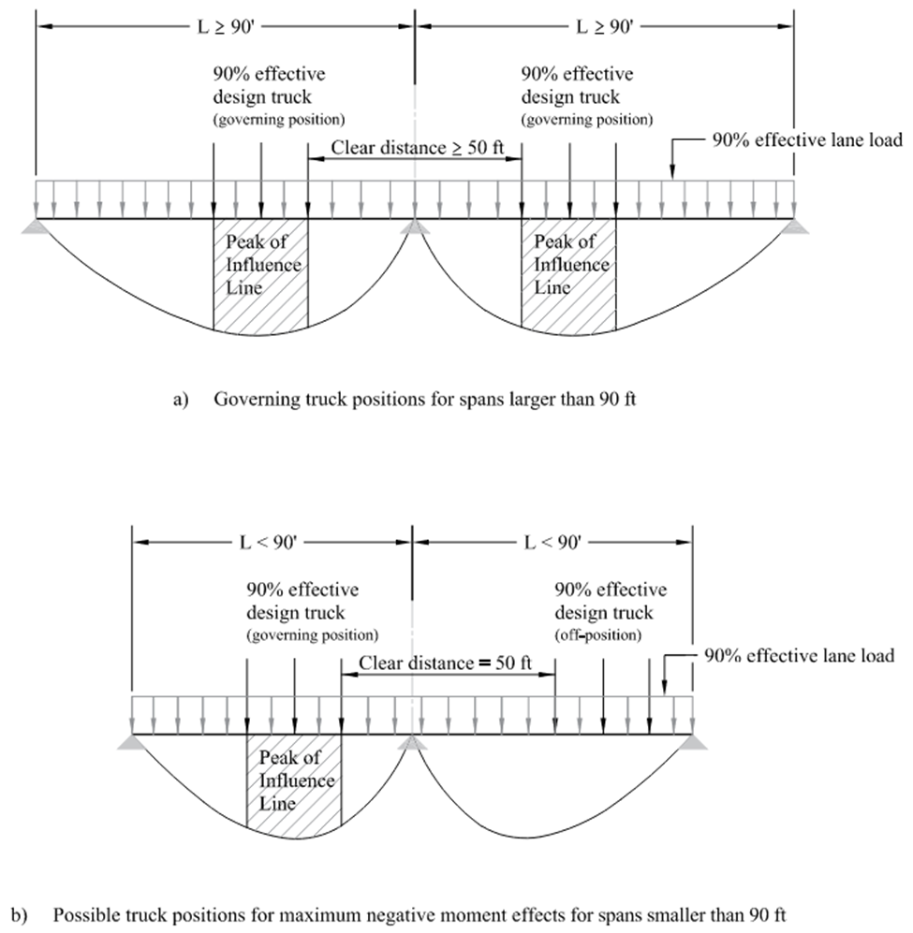
For spans > 90-ft, trucks will be near the peaks of –M influence lines.
For shorter spans, they will be offset. Maintain the 50-ft requirement.
Notes:
In positioning the two trucks to calculate negative moment or the interior reaction over an interior support, spans should be at least approximately 90 ft in length to be able to position a truck in each span’s governing position (over the peak of the influence line, see Figure 1a). If the spans are larger than 90 ft in length, the trucks remain in the governing positions but, if they are smaller than 90 ft, the maximum force effect can only be attained by trial-and-error with either one or both trucks in off-positions (i.e., non-governing positions for each individual span away from the peak of the influence line, see Figure 1b). This is not to say that the special two-truck load case does not govern, just that the trucks will not be positioned over the maximum influence-line ordinate. The truck in the first span of the two-span continuous bridge (in Figure 1b) is in the governing position for the span; the truck in the second span falls to the right of the spans governing position based upon the influence line for negative moment over the pier.

Slide 53

Fatigue Live Load – BDS 3.6.1.4
Fatigue does not include lane load
Truck is used alone with fixed rear axle spacing
IM = 15%
Only a single truck in a single lane is on the bridge
More on this in Lesson 9
30’ fixed for fatigue
Notes:
The AASHTO LRFD BDS defines the notional live load for fatigue for a particular bridge component by specifying both a magnitude and a frequency. The magnitude of the fatigue load is consistent with the design truck or axles specified in Article 3.6.1.2.2, but with a constant spacing of 30 ft between the 32.0 kip axles. The frequency of the fatigue load is taken as the greatest single-lane average daily truck traffic (ADTTSL) and is used for all components of the bridge, even though some lanes may carry a lesser number of trucks. When information regarding the directionality of truck traffic is unavailable, designing for 55% of the bi-directional ADTT is recommended.

Slide 54
Special Live Load for Deflections – BDS 2.5.2.6.2
Checking live load deflection is optional in the LRFD BDS, but is commonly invoked by owner bridge design manuals
Common suggested limits
  L/800 – bridges without pedestrians
  L/1000 – bridges with pedestrians
Loading – BDS 3.6.1.3.2
  Truck load alone
  Lane + 25% truck
Notes:
The design live load applied for checking strength, service and fatigue limits is not the same configuration used for checking the optional AASHTO LRFD BDS live load deflections limits in Article 2.5.2.6.2. Unless dictated otherwise by the Owner, the live load for the optional deflection check is specified in Article 3.6.1.3.2, which uses the maximum result of the design truck alone or 25% of the design truck combined with the design lane load. Per Article 2.5.2.6.2, the live load should include the dynamic load allowance, IM, and multiple presence factors per Article 3.6.1.1.2. The limit of L/1000 for bridges with pedestrians is commonly interpreted to apply to bridges with dedicated sidewalks for pedestrians but not to all bridges with an occasional pedestrian crossing.

Slide 55
Reminder - Other Loads
3.6 – Live load
3.7 – Water load, WA
3.8 – Wind load, WL and WS
3.9 – Ice load – IC
3.10 – Earthquake, EQ
3.11 – Earth pressure, EH, ES, LS, DD
3.12 – Superimposed deformations – TU, TG, SH, CR, SE, PS
3.13 – Friction, FR
3.14 – Vessel collision, CV
3.15 – Blast, BL
Notes:
At this point, we have only introduced permanent loads and live loads. Many other loads, those shown in a lighter font, are not discussed in this course as they do not affect the design of routine bridge superstructure components. We will touch on wind loads and thermal expansion and contraction on the following slides.

Slide 56
Wind Loads
AASHTO specifies two different types of wind loads
  Wind on Structure (WS)
  Wind on Live Load (WL)
WS loads are a product of wind pressures, a function of multiple inputs, and exposed areas
WL loads are a prescribed value
Notes:
WS represents the horizontal and vertical pressure on superstructure or substructure due to wind.
WL represents the horizontal pressure on vehicles due to wind.
For most routine bridges, transverse wind loads are distributed among substructure units based on tributary span length assumptions, while longitudinal wind loads are distributed in a manner similar to that described for braking forces in SBDH Vol 7, Section 2.2.2. For more complicated designs, a more refined analysis may be warranted to determine distribution of wind loads to the various substructure units.

Slide 57

Wind on Live Load – BDS 3.8.1.3
WL is an interruptible force of magnitude 0.1 klf acting 6-ft above the deck
It is transmitted to the structure
The longitudinal and transverse components depend on the wind direction skew to the axis of the bridge
Notes:
WL is a line load representing wind on live load. For load cases that do not involve live load, WL is taken as zero. WL is a force that has both transverse (shown) and potentially longitudinal components. The various transverse and longitudinal component forces are used to find maximum forces due to wind on live load, the skewed wind forces being needed to maximize forces transmitted through bearings to piers and abutments. For the design of superstructures, the focus of this course, WL be a force that is considered again in week 13 which covers the design of bearings.

Slide 58
WL continued
BDS TA 3.8.1.3-1
Alternate approach
Skew (degrees) | Transverse component (klf) | Longitudinal component (klf)
0 | 0.100 | 0.000
15 | 0.088 | 0.012
30 | 0.082 | 0.024
45 | 0.066 | 0.032
60 | 0.034 | 0.038
For girder and slab bridges with span < 150-ft and maximum height above the ground < 33-ft, the following can be used
  0.10 klf, transverse
  0.04 klf, longitudinal
Notes:
The WL forces from AASHTO BDS are presented on this slide. When the wind load acts normal to traffic, the intensity is 0.1 klf. As the wind is skewed to the traffic, but maybe to line up with the skew of the substructure units, or to create longitudinal forces in fixed bearings and substructures, the transverse component decreases with the addition of a non-zero longitudinal wind load component.
Although AASHTO specifies these wind loads as acting 6-ft above the top of deck, there is no practical way to transmit the moments applied by the eccentric load (above the deck) through the wheels / tires of a truck. It is common to therefore assume the wind on live load is a lateral force between the truck tires and deck of the given magnitude. Some use of tributary lengths / areas is required to apportion the transverse and longitudinal wind loads to the locations where fixed bearings can bring those loads down into the piers and abutments supporting the bridge.

Slide 59
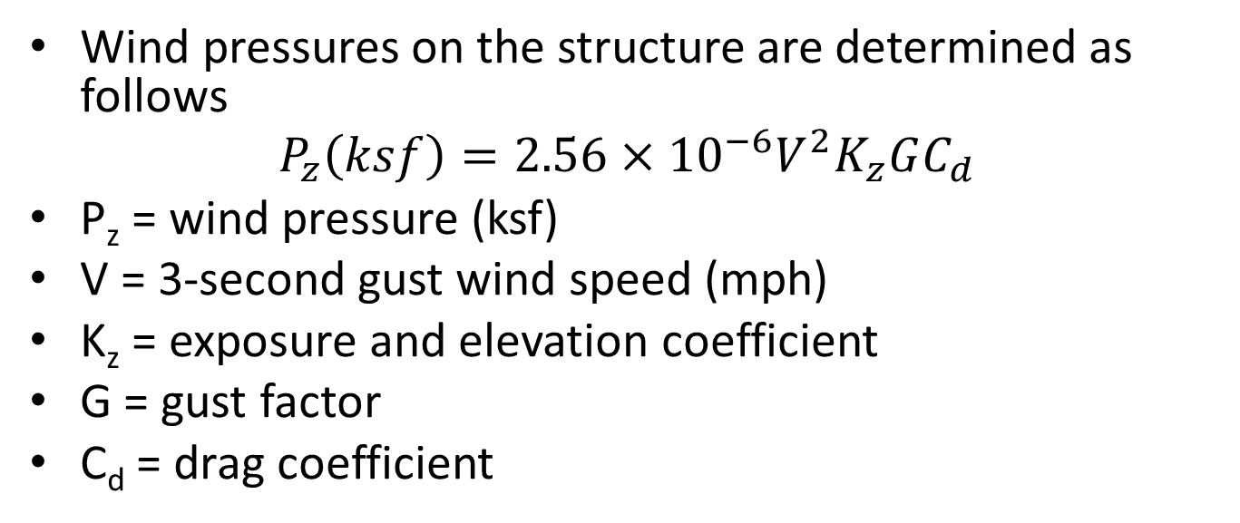
Wind on Structure, WS – BDS 3.8.1.2
Wind pressures on the structure are determined as follows
$$P_{z}\left(ksf\right)=2.56×{10}^{−6}V^{2}K_{z}GC_{d}$$
P_{z} = wind pressure (ksf)
V = 3-second gust wind speed (mph)
K_{z} = exposure and elevation coefficient
G = gust factor
C_{d} = drag coefficient
This is the approach to wind loads for what is called the Strength III Load Combination. We will discuss that later in this lesson. For other load combinations, this approach differs.
Notes:
Wind on structure is a load that applies to exposed portions of the bridge; this includes components such as noise walls mounted on bridges, barrier rails, the exposed beams and slab, and then the heights of piers. These wind loads eventually become critically important forces for the design of bearings, as well as piers and abutments, as these forces must eventually find their way to the ground and the bridge foundation.
The AASHTO approach to wind is a Bernoulli-form equation whereby pressure is expressed as a square of the wind speed, V, coefficients that convert wind speeds in MPH to pressures in KSF, and various factors that relate to height of the structure and topography surrounding the structure, Kz, and factors related to the type of structural element, G and Cd.
The velocities, V, used in design, are based on the 3-second gust speed at an elevation of 33-ft for what is referred to in AASHTO as Exposure Category C (see BDS 3.8.1.1.5). The coefficient Kz then modifies these wind speeds for elevation and terrain characteristics.

Slide 60
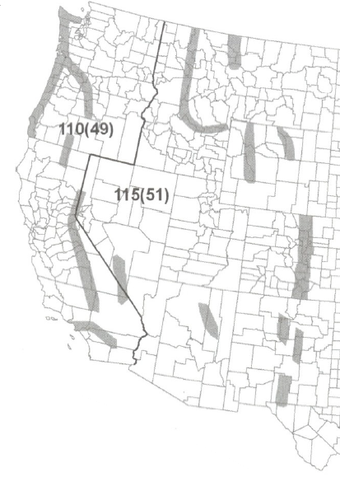
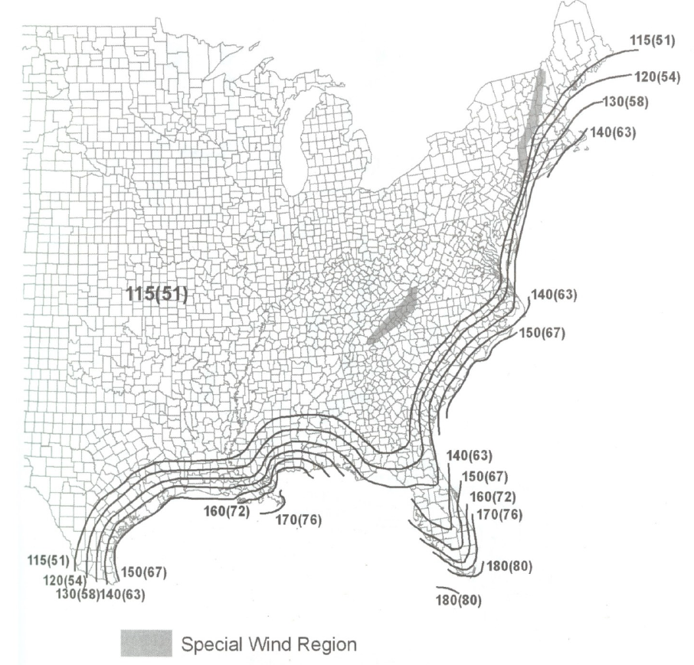



3-Second Wind Gust
Note, much of the country has a 3-second gust wind speed of 115 mph. Velocities increase near coastal regions.
Notes:
This map, from AASHTO BDS, provides the 3-second wind gust, measured at 33-ft above ground, for Exposure Category C. It is the basic value entered into the wind pressure calculation procedures. Note that a large portion of the country is classified as having a 3-second wind gust of 115 mph. It will be shown later that when these high wind speeds are present, there is no live load, nor wind on live load, considered to be acting on the bridge as live load could not be concurrent with such wind speeds. When WL is introduced, again this will be shown later in the discussion on load combinations, these wind speeds are dramatically reduced.

Slide 61
Exposure and Height Coefficient - K_{z}
Depends on ground surface roughness
  Ground Surface Roughness B
    Urban, suburban or wooded areas, i.e. wind is broken
  Ground Surface Roughness C
    Open terrain with scattered low obstructions, i.e. rural farmland
  Ground Surface Roughness D
    Flat, unobstructed areas, structures adjacent to or crossing water
Notes:
Kz is called a pressure exposure and elevation coefficient. It depends on surface roughness values and how prevalent certain topographies are surrounding the structure. It is dependent on the Exposure Category described in BDS 3.8.1.1.5

Slide 62
Exposure and Height Coefficient - K_{z}
K_{z} also depends on exposure category
  Exposure category combines the surface roughness, how prevalent that surface roughness is around the structure, and the structure height itself
  Structures are classified as Exposure B, C, or D
  The exposure category, and the height of the structure determines the factor, K_{z}
Notes:
Kz also depends on the exposure category, in other words, how prevalent the given terrain characteristics are surrounding a structure. Engineers use maps, photos, and site visits to best characterize the nature of the surrounding terrain and density of obstructions. They can then use the exposure category and height above ground to determine the factors Kz that are used to compute pressures at specific elevations.

Slide 63
Exposure and Height Coefficient - K_{z}
Structure Height, Z (ft) | Exposure Category B | Exposure Category C | Exposure Category D
<=33 | 0.71 | 1.00 | 1.15
40 | 0.75 | 1.05 | 1.20
50 | 0.81 | 1.10 | 1.25
60 | 0.85 | 1.14 | 1.29
.
.
300 | 1.30 | 1.57 | 1.68
Notes:
This table is an excerpt of the table of values provided in AASHTO BDS Ta C3.8.1.2.1-1 which provides the values for Kz for Exposure Category B – D, and heights ranging from <33 ft up to 300 ft. Additionally equations are provided in the BDS for the value Kz to be computed for any intermediate height.

Slide 64
Gust Factor, G and Drag Coefficient, Cd
Structure Type | Gust Factor, G
Sound barriers | 0.85
All other structures | 1.00
 |  | Drag Coefficient, Cd
Component |  | Windward | Leeward
I-girder and Box-girder bridge superstructures |  | 1.3 | NA
Trusses, columns and arches | Sharp-edged member | 2.0 | 1.0
 | Round member | 1.0 | 0.5
Bridge substructure |  | 1.6 | NA
Sound Barriers |  | 1.2 | NA
Notes:
Additional terms are needed to compute the wind loads. A gust factor, determined from a site-specific study or from BDS Ta 3.8.1.2.1-1 is used. That table is repeated on this slide. For this class, focusing on the design of steel bridge superstructures, the gust factor is 1.0. The gust factor is related to the size and dynamic characteristics of structures including their natural frequency and inherent damping characteristics.
Additionally, a drag coefficient is needed. This can also be determined from a structure specific study (like a wind tunnel test), or more commonly for routine bridges from BDS Ta 3.8.1.2.1-2, repeated on this slide. The drag coefficient reflects the resistance a body provides to the flow of fluid (in this case air moving past a bridge). It is related to the shape of an object and the surface roughness of the materials. The table reflects this with elements like round columns being treated more favorably than sharp edged open members like truss components.

Slide 65
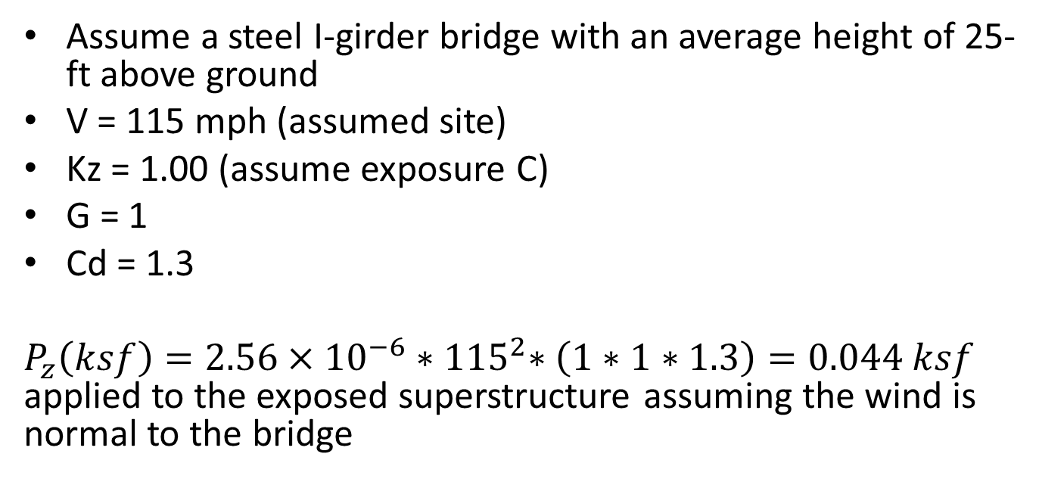
WS Sample Calculation
Assume a steel I-girder bridge with an average height of 25-ft above ground
V = 115 mph (assumed site)
Kz = 1.00 (assume exposure C)
G = 1
Cd = 1.3
$P_{z}\left(ksf\right)=2.56×{10}^{−6}{∗115}^{2}∗\left(1∗1∗1.3\right)=0.044 ksf$ applied to the exposed superstructure assuming the wind is normal to the bridge
Notes:
A sample calculation is provided for common parameters. Using a velocity of 115 mph, a bridge less than 33-ft from the ground surface, assuming exposure category C, and other parameters for gust and drag as shown, the wind pressure corresponding to the Strength III limit state is found to be 0.044 ksf (44 psf). This wind pressure would be applied to all exposed faces of the bridge. For instance, a beam with a height of 5-ft, plus a 1-ft slab, and a 3.5-ft tall barrier rail would be subjected to this pressure as would exposed portions of piers like the columns and caps. This pressure is converted to a line load acting along the edge of the superstructure. It must be carried by the superstructure to the substructure units, through the bearings, and eventually to the ground.
This approach to wind, at the Strength III limit state, is for a high wind event with no live load on the bridge. It is generally not critical to beam design at all but may be critical to bracing members which have to transmit the wind load from the superstructure to the bearings at the pier and abutment supports. Other, lesser wind loads, are used when live load is also present on the bridge.

Slide 66
WS Sample Calculation
Notes:
For a range of elevations, an assumed exposure category C, and a base wind speed of 115 mph, this is the variation in pressure as a function of elevation. Note that below 33 ft, the height above ground of many common structures, the wind load is a constant value. It increases on a natural logarithmic basis as the structure height above ground or water increases. This figure is used to illustrate the dramatic change in wind pressures at increasing height.

Slide 67
Uniform Temperature, TU – BDS 3.12.2
Two procedures are provided
  Procedure A or B
Procedure A will be illustrated, both are permitted for steel beams with concrete decks
Intent of either procedure is to compute the thermal movements associated with temperature changes
Notes:
TU represents the uniform temperature change due to seasonal variation. There are two procedures provided in the BDS, Procedure A (like historical approaches) and applicable to all bridge types, and Procedure B, a procedure that can only be used for steel or concrete beam bridges with concrete decks. They yield similar results for common bridge types. For simplicity, only procedure A is presented herein.

Slide 68

TU – Procedure A
Climate | Steel / Aluminum | Concrete | Wood
Moderate | 0 to 120 °F | 10 to 80 °F | 10 to 75 °F
Cold | -30 to 120 °F | 0 to 80 °F | 0 to 75 °F
$$∆_{T}= αL\left(T_{MaxDesign} − T_{MinDesign}\right)$$
Moderate climate < 14 days of average temperatures below freezing
Movements computed based on
  α = coefficient of thermal expansion, i.e. 6.5 x 10⁻⁶ for steel or 6.0 x 10⁻⁶ for concrete
  L = expansion length
  T_{MaxDesign} – T_{MinDesign} = range of temperature from the table
Notes:
Procedure A is a historic and traditional way of computing temperature ranges and associated movements and forces. A moderate climate has less than 14 freezing days a year. Freezing days are when the daily average temperature is less than 32 F. Temperature changes do not happen in a bridge uniformly. The north and south faces experience differential heating and cooling due to the rise and fall of the sun. The deck and underlying beams do not heat together as the deck provides a shield to the beams and thus a lag or time shift in temperature changes. Despite these inaccuracies, expansion and contraction are traditionally computed by these methods. The movement associated with temperature change is used to design and size elements like expansion joints, and expansion bearings. Similarly, if a structure is restrained from moving, these temperature ranges cause forces in elements like bearings and piers that must be included in the design. Wide bridges, curved bridges, and skewed bridges are also sensitive to thermal movements as bridge do not expand in one direction only. Consideration to the fixity of bridge bearings, their orientation, and the consequences on forces in design are all important factors related to the design temperature ranges.

Slide 69
limit states and load combinations

Slide 70
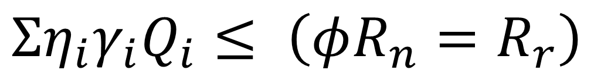
Limit States
AASHTO has 4 limit states
  Service – BDS 1.3.2.2
  Fatigue – BDS 1.3.2.3
  Strength – BDS 1.3.2.4
  Extreme Event – BDS 1.3.2.5
  “Each component and connection shall satisfy (equation below) for each limit state, unless otherwise specified.”
Limit states will be rearranged on subsequent slides
$$Ση_{i}γ_{i}Q_{i}≤ \left(φR_{n}=R_{r}\right)$$
Notes:
AASHTO BDS defines a limit state as “A condition beyond which the bridge or component ceases to satisfy the provisions for which it was designed.” It provides four separate limit states: service, fatigue and fracture, strength, and extreme event. These are described in BDS 1.3.2 and its subsections. BDS 1.3.2 is the first location where the intent of the BDS is defined, the summation of loads, modified by load factors, γ, and load modifiers, η, must be less than or equal to a factored resistance.
References – SBDH Vol 7 and Vol 10

Slide 71
Load Combinations
The limit states are invoked / enforced through a series of load combinations related to certain underlying loading conditions
  Strength Limit State – 5 combinations (STR I-V)
  Service Limit State – 4 combinations (SER I-IV)
  Fatigue Limit State – 2 combinations (FAT I-II)
  Extreme Event Limit State – (EXT I-II)
Notes:
To satisfy the intent of the limit states, various load combinations are included in the BDS. These are explained in the following slides.

Slide 72
Strength Limit State – BDS 1.3.2.4
“Strength limit state shall be taken to ensure that strength and stability, both local and global, are provided to resist the specified statistically significant load combinations that a bridge is expected to experience in its design life.”
Notes:
The strength limit state is provided to control what may be thought of as “ultimate” behaviors, those that correspond to the member or connection reaching its maximum strength. The maximum strength of a member can correspond to basic failures of material strength like tensile yield or rupture, crushing, or stability failures like buckling of a column or the unbraced length of a beam. Exceeding the strength limit state capacities is deemed to be member failure. The design approach to failure as related to member capacity is a conservative one as significant force redistribution capability exists in most bridges. Failure of a member does not generally result in failure of a bridge. However, this conservative approach is used since the approach to bridge design is one that examines forces and resistances on a member-by-member or connection-by-connection basis. Large deformations, significant cracking, are all expected at the strength limit state load levels, yet collapse is likely to be prevented.
For the strength limit states, the AASHTO LRFD BDS is basically a hybrid design code in that, for the most part, the force effect on the left-hand side of the LRFD Equation is based upon elastic structural response, while resistance on the right-hand side of the LRFD Equation can take advantage of inelastic response principles. The AASHTO LRFD BDS has adopted the hybrid nature of strength design on the assumption that the inelastic aspects of structural performance are generally relatively insignificant because of non-critical redistribution of force effects. This non-criticality is developed by providing adequate redundancy and ductility of the structures.

Slide 73
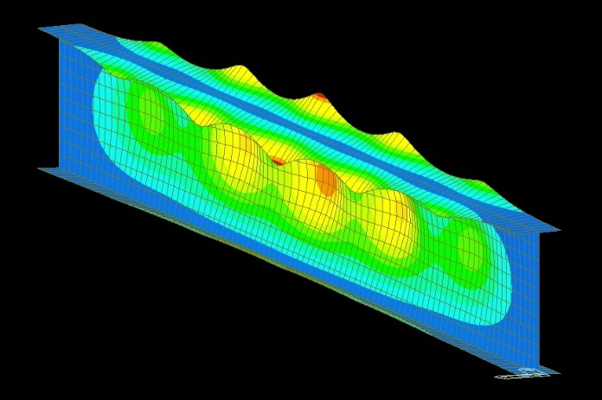
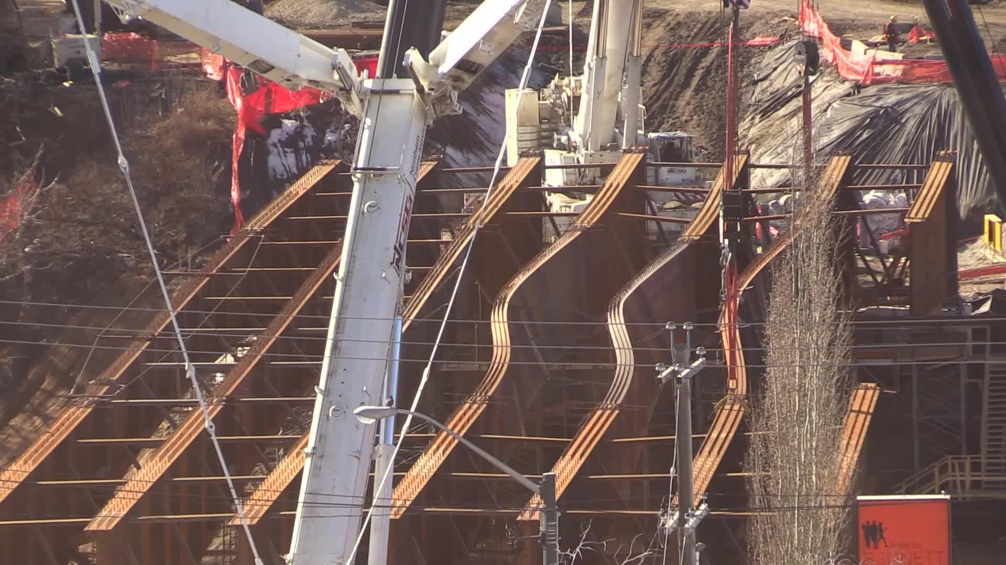
Strength Limit State - Illustrated
Examples of the strength limit state
Notes:
Examples of the strength limit state include local buckling of steel girder flanges or overall buckling of long unbraced lengths. Other examples could be the failure of a beam in bending, shearing of bolts in a connection, rupture or yielding of steel tension members, and buckling of steel compression members like columns or members of a truss.

Slide 74
Strength Limit State
Strength Limit State | Description
I | Normal vehicular use of the bridge in its 75-year design life. During this live-load event, the effect of wind is considered to be negligible.
II | For owner-specified permit loads.
III | For bridge structures exposed to the design wind speed at the location of the bridge. No live load.
IV | For superstructures where the unfactored dead load exceeds seven times the unfactored live load. For additional safety, LRFD BDS has arbitrarily increased the load factor for DC to 1.5. Typically for spans greater than 200 feet in length.
V | Normal vehicular use of the bridge and a 80 mph wind event, with load factors of 1.35 and 1.0 respectively.
Notes:
Various strength load combinations are used and govern the design of different components. All bridge components are designed to satisfy the STR I load combination. The STR I load combination has dead and live load forces at their highest magnitude, but other loads, like wind load, are not included. This is a common governing load combination for elements like deck and beam design.
STR II is a specific combination that is used to design a new bridge for routine permit loads that operate in a jurisdiction. It is also commonly used in load rating, which is the process of determining the capacity of an exiting bridge, to carry routine or special permit loads.
STR III is a load combination in which live load is excluded. It might be used in superstructure design to compute wind load forces in bracing members. It is a commonly a governing load in the design of substructures. In this load combination, no live load is on the structure, making it the lightest it will ever be, yet simultaneously subjected to high lateral forces. It can govern aspects of substructure design and foundation stability like sliding / lateral load or overturning checks.
STR IV is a special load case for structures where the DL / LL ratio is high, i.e., taken as seven or more. In this case, only the factored DL is present and may not provide the level of safety desired. AASHTO provided an increase in the load factor based on judgement and limited studies.
STR V is a load case with DL, LL, wind loads, and many other forces acting together. Again, this is generally a load case used for substructure and foundation design.
AASHTO never specifically says what to use or not use but instead explains its intent in text describing each load combination. With experience, designers quickly learn which load combinations are used for specific bridge components.

Slide 75
Service Limit State – BDS 1.3.2.2
“The service limit state shall be taken as restrictions on stress, deformation, and crack width under regular service conditions.”
Notes:
The service limit state controls certain behaviors that are determinantal to long-term performance. They are generally empirical limits, experiential, and are not always derived from statistical characteristics though in some cases there is a mathematical basis for their limit. Examples of behaviors that are checked at the service limit state include the vertical live load deflection of bridges, cracking of concrete, yielding of steel under routine loads, expansion and contraction movements, some loads and movements for bearings, and other routine behaviors, that if a limit is exceeded, could lead to a lessened service life or perceived performance concerns.

Slide 76
Service Limit State
Service Limit State | Description
I | Normal operational use of the bridge, with a 70 mph wind and all loads taken at their nominal values. Service I is also related to deflection control and to control crack width in reinforced concrete structures.
II | For controlling permanent deformations of steel sections and the “slip” of slip-critical (i.e., friction-type) bolted steel connections due to vehicular live load.
III | Applicable to the longitudinal analysis of tensile stresses in prestressed concrete superstructure components. The objective of Service III is to control cracking.
IV | Applicable for tensile stresses in prestressed concrete columns, with the intent to control cracking.
Notes:
Ser I is used in multiple ways in steel bridge design. It is how live load deflections are evaluated, is a check in the design of reinforced concrete elements like decks or substructure components and is an important load combination in bearing design.
Ser II applies to steel structures only. It represent a level of live load between routine service and the strength limit state. The intent of Ser II is to prevent premature yielding of steel beams under the passage of periodic heavier-than-normal loads and to prevent the slipping of connections in steel structures.
Ser III is like Ser II but applies to concrete beams. The intent of Ser III is to prevent cracking of the precompressed tensile region of prestressed concrete beams. Cracking, and repeated crack opening under service loads, is detrimental to the long-term performance of prestressed concrete beams and is prevented in Ser III.
Ser IV relates to checking prestressed concrete substructure and foundation elements. Examples include prestressed concrete piles used in pile bent structures or precast and post-tensioned pier columns / substructure elements.

Slide 77
Fatigue Limit State – BDS 1.3.2.3
“The fatigue limit state shall be taken as restrictions on stress range as a result of a single design truck occurring at the number of expected stress range cycles.”
“The fracture limit state shall be taken as a set of material toughness requirements of the AASHTO Materials Specifications.”
Notes:
The fatigue limit state limits crack growth under repetitive loading so that cracks can not grow to such a size that fracture is possible. The fracture limit state is one that imposes a set of material toughness requirements, and use of approved materials, to prevent brittle fracture. Additional controls are enforced during material manufacturing and fabrication (cutting, welding, drilling, etc.) to also prevent the introduction of “discontinuities” into the fabricated steel that could lead to brittle fracture under a certain combination of loading, loading rate, stress, and temperature conditions.

Slide 78
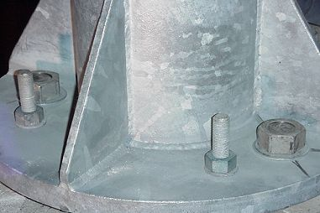
Fatigue Limit State
Examples of cracking from fatigue
Notes:
Examples of details which are checked as part of the fatigue limit state include simple and common details such as a stiffener welded to the web and flanges. The placement of the weld serves as a location where an initial discontinuity due to welding is introduced. If this weld is subjected to a repeating tensile stress, some discontinuities can grow under repeating stress and a high number of cycles. Another common fatigue detail occurs on light poles and sign structures, the connection of the pole to the base plate with stiffeners. Under wind loads, these structures vibrate, and these details can be subject to millions of cycles of highly variable loading.

Slide 79
Fatigue Limit State
Examples of cracking from fatigue
Notes:
Additional fatigue sensitive details include gaps between connection plates and flanges, which if subjected to an out-of-plane load can cause cracks in the gap region between the end of the stiffener and the flanges. This type of detail is no longer permitted but is still common on older structures and has caused numerous fatigue cracks through the years. An additional older and problematic detail is shown on the right. When rolled shapes are used for primary bending members, a way of increasing their strength in regions of high bending moments was to weld a cover plate to the tension flange. Although meeting the strength demands in a simple way, these details are susceptible to cracking and have been the cause of field cracking problems. Still permitted, but with strict requirements on the stresses at the termination of the cover plate, this is shown as another detail type for which we can perform a design and evaluation using the BDS provisions.

Slide 80
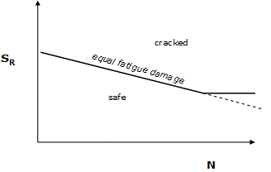
Fatigue Limit State
Fatigue Limit State | Description
I | For checking if a detail satisfies infinite life requirements
II | For checking if a detail meets finite life requirements
Notes:
The fatigue-and-fracture limit state is treated separately from the strength and service limit states since it represents a more severe consequence of failure than the service limit states, but not necessarily as severe as the strength limit states. Fatigue cracking is certainly more serious than loss of serviceability, as unchecked fatigue cracking can lead to brittle fracture, yet many passages of trucks are required to cause a critically-sized fatigue crack while only one heavy truck can lead to a strength limit state failure. The fatigue and fracture limit state is only applicable where the detail under consideration experiences a net applied tensile stress, as specified in Article 6.6.1.2.1 of the AASHTO LRFD BDS.
The figure demonstrates a relationship between stress range (the vertical axis) and life (the horizontal axis). It is noted that there is a region where changing the stress range, Sr, results in a change of life, N. This is the sloping region of the graph. At the right side, there is a limit, known as the constant amplitude fatigue limit (CAFL) or constant amplitude fatigue threshold (CAFT) where infinite life can be achieved if stress ranges are kept below a specified value.
Fatigue I Load Combination - This fatigue and fracture load combination is related to infinite load-induced fatigue life. This is the plateau region where stresses under a limiting value result in infinite life.
Fatigue II Load Combination - This fatigue and fracture load combination is related to finite load-induced fatigue life. This is the sloping region of the stress versus number of cycles curve. It is a region of finite life. Increasing and decreasing the stress ranges in this region results in differing lives.

Slide 81
Extreme Event Limit State – BDS 1.3.2.5
“The extreme event limit state shall be taken to ensure the structural survival of a bridge during a major earthquake or flood, or when collided with by a vessel, vehicle, or ice floe, possibly under scoured conditions.”
Notes:
Extreme event loads are unique to each structure and circumstances. For forces like vessel collision and earthquake loading particularly, these loads may have a return period that far exceeds the lifespan of the structure, yet their occurrence could cause significant damage or collapse and must be considered.
The design objective of the extreme event limit state is life safety, i.e., non-collapse. Significant yielding, spalling, bending, distortion, etc. of steel and concrete members is expected. Meeting the extreme event limit state does not mean a structure will be useable after the event, the goal is simply not to collapse. Multiple extreme events at one time are not to be considered, i.e. joint probability. The engineer should not envision a bridge being struck by a barge at the same time as an earthquake is occurring. One exception is scour. The commentary to BDS C3.4.1 discusses where some joint consideration to loss of streambed and loss of foundation support due to scour can optionally be considered as coincident with other extreme event loads.

Slide 82
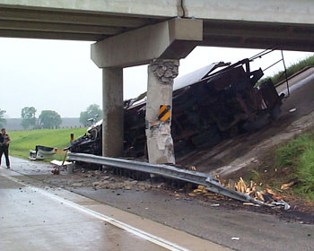
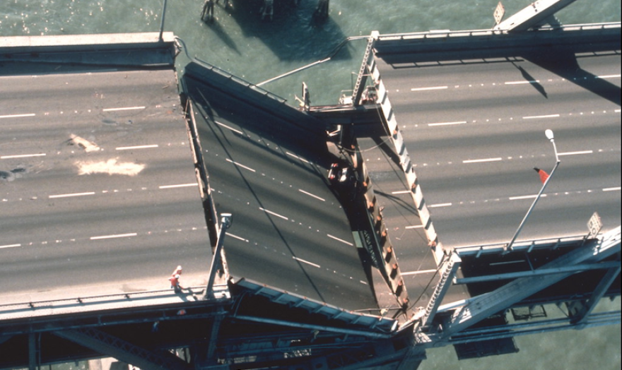
Extreme Event Limit State - Illustrated
Notes:
Loads such as earthquake, collision of vehicles with bridge substructures, collision with barrier rails, vessel collision to bridge superstructure or substructure components, and large ice floes, are all considered as part of the Extreme event limit state. Some examples of bridges subjected to extreme event loading are shown.

Slide 83
Extreme Event Limit State
Extreme Event Limit State | Description
I | Load combination including earthquake, EQ, loads.
II | This load combination is applied to various types of collisions, as well as to check floods and certain hydraulic events with a reduced live load other than that which is part of the vehicular collision load, CT. These collisions are typically from a vessel, vehicle, or ice impacting the bridge’s substructure.
Notes:
The extreme event limit states for earthquakes (Extreme Event I), and vessel, vehicle or ice-floe collisions and certain hydraulic events (Extreme Event II), while strength-type provisions, are very different from the strength limit states as the return period of these extreme events far exceeds the design life of the bridge. The strength limit states are calibrated for events with 75-year return periods; in other words, events which are expected to occur at least once during the design life of the bridge. The extreme event limit-states, on the other hand, are intended to address events which are not statistically likely to occur within the design life of the bridge but if they did occur would potentially result in catastrophic failure (i.e., collapse) of the structure.
These limit states represent loads or events of such great magnitude that to design for the levels of reliability or failure rates of the strength limit states would be economically prohibitive. Thus, at these limit states, more risk is accepted along with more potential structural damage. The return period of the extreme event is typically much greater than the 75-year design life of the bridge. The AASHTO LRFD BDS approach to seismic design is based on a stepwise approach where bridges are designed to resist small to moderate earthquakes within the elastic range of the structural components without significant damage and are designed to resist exposure to larger earthquakes without suffering collapse, preferably in a manner where damage that does occur is readily detectable and accessible for inspection and repair. The AASHTO LRFD BDS are based on a uniform risk model where the probability that a given seismic coefficient will not be exceeded at a given project site during a 75-year period is about 93%, which reflects a return period of about 1000 years.
The AASHTO LRFD BDS approach to vessel collision features a probabilistic approach that considers typical navigation traffic for determining the design vessel. The procedures are written such that the probability of collapse is limited to a certain value. A minimum impact vessel is also considered. For unique situations, site-specific vessel collision studies, including consideration of vessel-structure interaction, may be warranted.
The AASHTO LRFD BDS approach to vehicle and ice floe impacts are simpler and are typically based on equivalent static loads which are either directly specified or relatively easy to calculate.
The load effects associated with the extreme event limit state load combinations typically have a more significant impact on the design of bridge substructures since most of the typical extreme event load events involve significant horizontal loading. However, in higher seismic regions, certain elements of the superstructure are to be designed with sufficient capacity to transmit seismic loads to the substructure.

Slide 84
LRFD Basic Equation – Load Modifiers
$$Ση_{i}γ_{i}Q_{i}≤ \left(φR_{n}=R_{r}\right)$$
Q – various loads
γ – a load factor
η – a load modifier related to ductility, redundancy, and importance
φR_{n} = R_{r} = a resistance
Notes:
From earlier in this lesson, the term η was introduced to add or take away from load, reflecting unique aspects of members as related to characteristics of ductility, importance, or redundancy. It will be explained on the following slides.

Slide 85
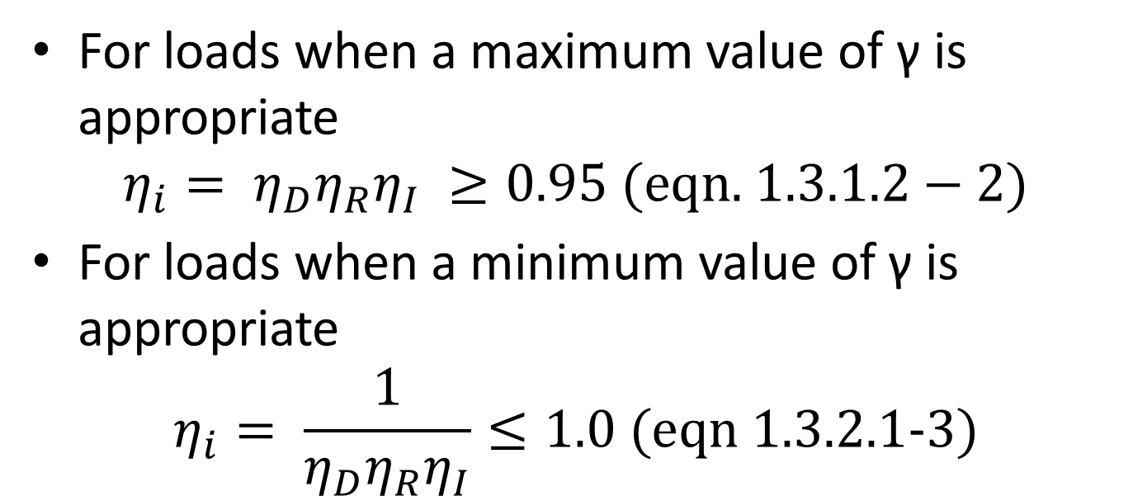
Load Modifier, η – BDS 1.3.2.1
For loads when a maximum value of γ is appropriate
$$η_{i}= η_{D}η_{R}η_{I} ≥0.95 (\text{eqn}\text{. }1.3.1.2−2)$$
For loads when a minimum value of γ is appropriate
$$η_{i}= \frac{1}{η_{D}η_{R}η_{I}}≤1.0 \text{(}\text{eqn}\text{ 1.3.2.1−3)}$$
Notes:
The load modifier ηi relates the factors ηD, ηR and ηI to ductility, redundancy and operational importance, respectively. The location of ηi on the load side of the AASHTO Equation may appear counterintuitive as ductility, redundancy, and operational importance seem to be more related to resistance than to load. However, ηi is on the load side for a logical reason. When ηi modifies a maximum load factor, it is the product of the factors as indicated in Equation 1.3.2.1-2; when ηi modifies a minimum load factor, it is the reciprocal of the product as indicated in Equation 1.3.2.1-3. The AASHTO LRFD BDS factors, ηD, ηR and ηI are based on a 5% stepwise positive or negative adjustment, reflecting unfavorable or favorable conditions. These factors are somewhat arbitrary; their significance is in their presence in the AASHTO LRFD BDS and not necessarily in the accuracy of their magnitude. The AASHTO LRFD BDS factors reflect the desire to promote redundant and ductile bridges.
In practice, ηi values of 1.00 are generally used for all limit states, because bridges designed in accordance with the AASHTO LRFD BDS demonstrate traditional levels of redundancy and ductility. Rather than penalize less redundant or less ductile bridges, such bridges are typically not acceptable. On a case-by-case basis, the Owner can designate a bridge to be of operational importance and specify an appropriate value of ηI. Some Owners may also designate certain structure types as having reduced redundancy or ductility and specify appropriate values of ηD or ηR, again on a case-by-case basis.
The load modifier accounting for Operational Importance (ηI), as specified in Article 1.3.5, should not be confused with the importance categories for vessel collision of Article 3.14 nor the bridge category classifications for seismic design of Article 3.10.

Slide 86
Load Modifier, η_{D} – BDS 1.3.3
η_{D} (ductility) is specified as
1.05 | For nonductile components and connections
1.00 | For conventional designs and details
0.95 | For components and connections for which additional ductility-enhancing measures have been specified
Notes:
The underlying strength design process in the BDS encourages ductile member designs. Some materials however can fail in a brittle manner. For instance, most modern carbon and glass fiber reinforced composites do not yield and exhibit inelastic deformation like steel members, or those made of reinforced or prestressed concrete. They are an example of brittle failure for which a nonductile modification might be necessary. If a design makes use of some extraordinary methods to achieve even better than usual ductility, a credit of up to 5% reduction in load is permitted. In common practice, these values are nearly always taken as 1.0.

Slide 87
Load Modifier, η_{R} – BDS 1.3.4
η_{R} (redundancy) is specified as
1.05 | For nonredundant members
1.00 | For conventional levels of redundancy
0.95 | For exceptional levels of redundancy beyond girder continuity and a trigonally-closed cross-section
Notes:
Redundancy of members relates to the behavior of an overall system though most member design considers them as isolated components in a bridge of many interconnected pieces. The calibration of the load factors, load combinations, all aspects of the BDS, is fundamentally arranged around the idea of redundant structures. Thus, for bridges with nonredundant components, some increase in load through the redundancy factor is suggested to bring the reliability of a nonredundant member to be more in line with a redundant member. Examples of nonredundant members would be a pier cap spanning between two columns, the loss of which results in loss of support of an entire span. A column, in a one or two-column pier whose loss could result in collapse of the pier, members of a steel truss which by default is a nonredundant system if any of the members of the triangular truss is lost, or cables / hangers of a suspension or cable stayed bridge.

Slide 88
Load Modifier, η_{I} – BDS 1.3.5
η_{I} (importance) is specified as
1.05 | For essential or critical bridges
1.00 | For typical bridges
0.95 | For relatively less important bridges
Notes:
Selection of the importance factor should be done by personnel responsible for the performance of a transportation network. The definition of operational importance is assigned by the Owner, commonly in their bridge design manuals and policies. Examples of essential bridges are those that must stay open as emergency lifelines, are essential for emergency services, or are important economic corridors. Selection of essential, ordinary, and less essential is subjective and based on the above criteria along with other factors like traffic volumes, detour lengths, and other criteria specified by an owner.

Slide 89
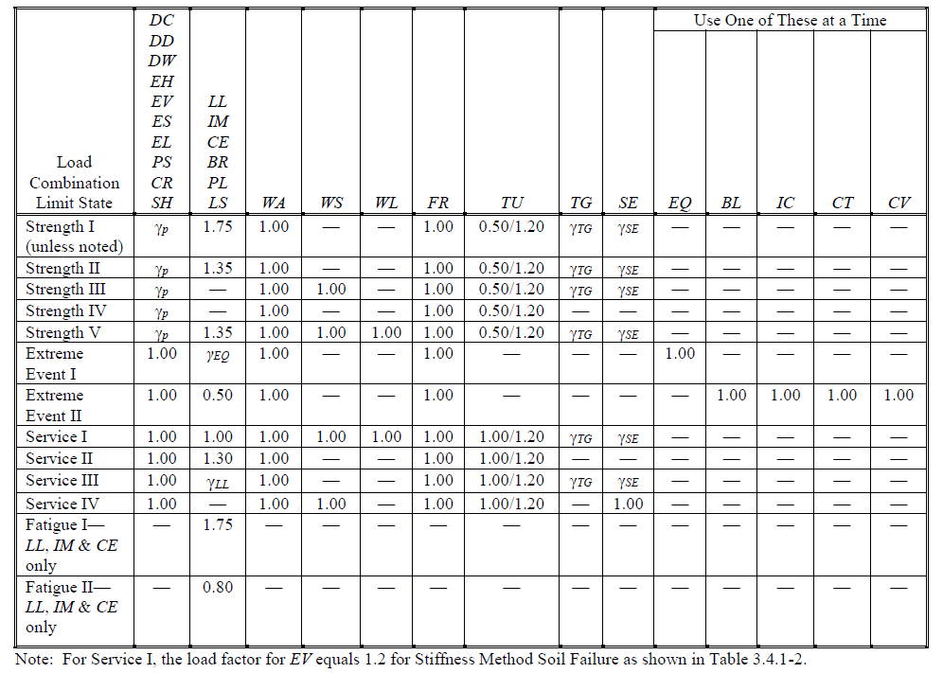
Load Factors – BDS TA 3.4.1-1
Notes:
This table, from BDS 3.4.1, includes limit states, the load combinations, and the load factors, in one table. This table is the basis for the calculation of loads. For some loads, like permanent loads, a specific number is not given. For thermal loads, a range of values is provided. For locations with a (-) shown, this load does not apply in the specific combination and is to be ignored. For each critical design point in a structure, these various loads and combinations are computed. An envelope of governing forces results, this is the basis of member design in the BDS.

Slide 90
Permanent Load Factors – BDS 3.5
Notes:
The first column of loads addresses various permanent load force effects. We will only address the few permanent loads that are relevant to this class, namely the DC and DW loads introduced earlier in this lesson.

Slide 91
Permanent Load Factors, γ_{p}
 | Load Factor
 | Maximum | Minimum
DC: Components and attachments | 1.25 | 0.90
DC: Strength IV only | 1.50 | 0.90
DW: Wearing surface and utilities | 1.50 | 0.65
Note: many other permanent loads that might act on other bridge components are not considered in this course such as downdrag (DD), horizontal earth pressure (EH), and others
Notes:
For the strength limit state, load factors for DC and DW have upper and lower bounds. The upper bound is when the maximum value contributes to a force effect. For instance, bending at midspan of a simply supported beam would use the maximum load factors. However, let’s say uplift at a bearing is a consideration for a continuous span. If the presence of DC loads causes a positive compressive reaction but live load produces uplift, then for checking uplift the engineer will use the 0.9 DC factor along with a maximum value for the LL factor to check if uplift occurs.
The permanent load factors for the service and extreme event limit states is 1.0. There is no permanent load considered in the fatigue and fracture limit states, no value is provided or needed.

Slide 92
Live Load Factors – BDS 3.6
Notes:
Factors for live load are provided. Only a maximum factor is given as the minimum is zero by default. For the STR I limit state, the LL factor is 1.75 and applies to the truck (and impact) and lane components of loading. It also applies to other live load force effects that are common to some bridges, forces like centrifugal force in curved bridges (CE), braking forces (BR), pedestrian live load force effects such as for bridges with sidewalks (PL), and live load surcharge force effects for buried structures (LS).

Slide 93
Wind Load Factors – BDS 3.8
Notes:
Factors for wind on structure (WS) and wind on live load (WL) are provided. For the STR III limit state, wind load forces are determined as previously shown using the wind speed maps.
For STR V and SER I, the wind speeds are replaced by those shown in the following table. So, although the load factors are all 1.0, the loads differ greatly in magnitude due to the adjusted wind speeds used in the governing wind load equations
Load combination STR III – wind speeds from the maps previously shown
Str V – use 80 mph
Ser I – use 70 mph
Ser IV – use 75% of the STR III speed

Slide 94
Thermal Load / Movement – BDS 3.12
Notes:
In the column for TU, two values are provided. The larger of the two values, i.e., 1.20, is used for computing deformations and the smaller values, i.e., 0.50 or 1.0 for other effects. The calculation of displacements using a factor greater than 1.0 is intentional and is provided by AASHTO to avoid under sizing expansion joint openings and movements at expansion bearings. The smaller value can be used for other force effects like restrained forces in systems due to expansion and contraction. The value of 0.5 at the strength limit state reflects that temperature changes in the specifications are seasonal and take a long time to develop. There is an element of relief of these forces owing to creep and “relaxation” of the structure that takes place. It also reflects that computation of forces in restrained systems is commonly done with computer models that have uncracked and short-term elastic modulus values. Behaviors like cracking, creep, footing rotation, etc. all tend to relieve the elastically computed forces and a value of 0.50 is accepted as a correction factor for these various behaviors.

Slide 95
Common Steel Bridge Load Combinations
Strength I
  1.25DC+1.5DW+1.75(LL+IM)
Service I
  DC+DW+(LL+IM) + possibly TU
Service II
  1.0DC+1.0DW+1.3(LL+I)
Fatigue I and II
  1.75 or 0.8 LL+I
Notes:
Though there are many loads and load combinations that can be computed, the goal is to choose those that control / govern certain aspects of the design and ensure the structure meets the specification requirements. Some example load combinations that are commonly used for steel bridge design, and design of components for steel bridges, are shown. This does not mean that other load combinations or loads not shown absolutely do not apply. The combinations highlighted on this slide are common for superstructure design of steel girder bridges and will be used in many lessons throughout this class. Many other load combinations exist to maximize the effects of forces such as wind loads, and other lateral forces. These most commonly govern the design of elements of substructures and foundations. Some combinations, eg Service III and IV, do not apply to steel components but are used to check cracking in prestressed concrete bridge elements.
Strength I – This is the basic combination for the design of members subjected to dead loads and the HL93 design live loads. The factors chosen for DC, DW, and LL+IM are all shown at their maximum value, assuming all forces add together / have the same sense and direction. The load factors for dead load also have minimum values, these are chosen when the dead and live load forces counter each other. An example would be checking for uplift in a continuous span. If the dead load reaction is compressive, but live load could cause uplift, then a factor of 0.9 would be applied to DC and 0.65 to DW (if present) while the maximum factor of 1.75 is applied to live load. This is a “worst case scenario” check where the compressive loads are minimized, and the uplift load is maximized.
Service I – This combination is used to check for live load deflections. The “possibly TU” is provided to highlight that one common element of a steel bridge are the bearings. These must be designed to accommodate movement from thermal, as well as other loads. The displacement of a bearing is a design consideration. The displacements would be computed with the Service I limit state and load combination.
Service II – This is used to check for permanent deformation (yielding) of steel structures in flexure. It is also used to check for slip in high strength slip-critical bolted connection.
Fatigue I and II – These are used to check if a detail has infinite life (Fatigue I) or adequate finite life (Fatigue II) under repeated live load.

Slide 96
Review of influence lines

Slide 97
Influence Lines
Depict the variation of a specific force in a structure due to a moving unit load
Can be used for trusses, beams, cables, all structural elements
Commonly used for forces but can also be used for movements
Notes:
Influence lines are used in structural analysis of beams, trusses and frames to visually depict the variation in a specific force effect as a moving unit load crosses the structure. They are commonly used in bridge analysis and design to understand the variation in critical force effects such as reactions, shear, and moments due to moving loads. Most commonly used for force effects, it is also possible but less common to develop influence lines for other actions such as vertical displacement or rotation.

Slide 98
Muller–Breslau Principle
Remove the structure’s resistance for a force of interest
  For reaction, remove the reaction
  For shear, insert a vertical roller
  For moment, insert a hinge
Impose a unit displacement
The resulting shape is the influence line
Notes:
The Muller-Breslau concept is a visual one that is based on the displaced shape of a released structure. This is illustrated on the next slide. For an influence line for a specific point of interest and action, e.g. reaction at a beam end or shear / moment at an intermediate point, the point of interest is released and displaced a unit value at the point of interest. The resulting displaced shape is the influence line.

Slide 99
Muller–Breslau Principle
1.0
1.0
1.0
Notes:
Three examples of the Muller-Breslau principle for influence lines are shown.
In the upper image the influence line for reaction is constructed by removing the constraint at the reaction and displacing the resulting structure a unit distance in the direction of the released constraint. The influence line has a peak of 1.0. The units are reaction (say kips) per kip of applied load. The magnitude of the reaction at the left end is equal to the applied load (i.e. 1.0P) for a load applied at the left end, zero for a load at the right end, and varies linearly between the supports.
The influence line for shear at an intermediate point is provided in the center image. The resistance of the beam to shear is removed and replaced with a “vertical roller” that maintains equal slopes of the two beam segments and a total vertical offset of the two segments of 1.0. A load left of the point of interest produces negative shear. A load right of the point of interest produces positive shear. The units are kips of shear per kip of applied load.
The influence line for moment is provided in the bottom image. The resistance to moment is released and replaced with a hinge. End moments are introduced at the hinge causing the segments to rotate and the released structure to rotate upwards. A relative rotation of 1 radian is induced at the hinge and the results in ordinate of the influence line being established. The units are foot-kips per kip of applied point load.

Slide 100
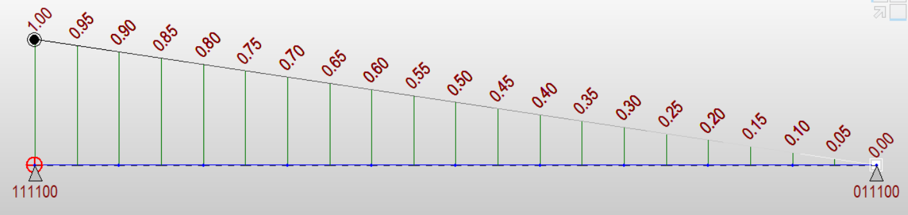
Influence Line, Reaction 0.0L
Notes:
The influence line for the vertical reaction at the left end of a simply supported beam is shown. This is an assumed 100 ft simple span but the shape of the influence line for reactions of a statically determinate structure is unrelated to span length or beam stiffness. An influence line shows the variation in the force at a particular point as a unit load moves across the structure. The influence line has a vertical ordinate of 1.0 at the left end. This means that a load placed at the left end of the beam produces a reaction equal to 1.0 times the magnitude of the load. Similarly, a load at midspan would produce a reaction at the left end equal to 0.5 times the magnitude of the load. This is simply the statics of a simply supported beam with a point load at midspan. Finally, a load at the right end of the beam produces no reaction at the left end. For a simply supported beam, the influence line for the reaction at the right end is simply a mirror image.

Slide 101
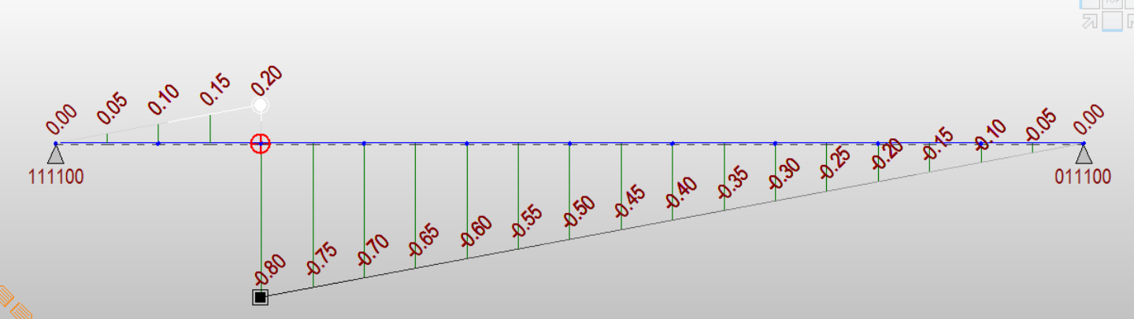
Influence Line, V @ 0.2L
P
P
V=+0.2P
V=-0.8P
R=0.8P
R=0.8P
Notes:
The influence line for shear at 0.2 of the span is shown. The influence line for shear in a simply supported beam is characterized by two straight, sloping lines having a difference in their ordinates of 1.0. Two possibilities are illustrated with this slide. A unit load P placed just slightly to the left of the 0.2L location generates a reaction of 0.8P at the left support. Sum of the forces in the Y direction equals zero requires that the shear at 0.2L, with a load P slightly to the left of 0.2L, is +0.2P, i.e. sum of forces in Y, 0.8P – 1.0P requires a upward (called positive) shear of 0.2P. This computer program and example are based on an upward force at the right side of a free-body-diagram being called positive. This may be counter to other sign conventions that would call this a negative shear.
Similarly, if the load is shifted to the right, slightly past 0.2L, the shear at the point of interest is simply the magnitude of the reaction at the left end but with the sign reversed for sum of forces in Y equals zero.

Slide 102
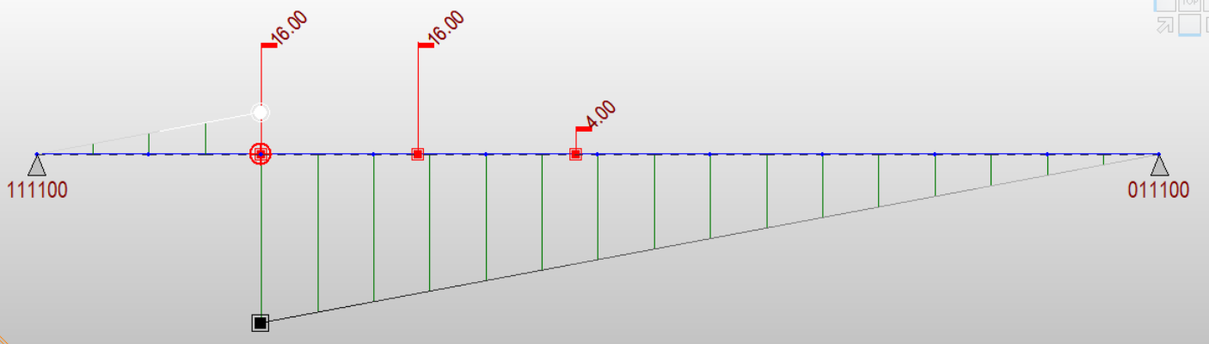
Minimum V @ 0.2L
Notes:
AASHTO truck loads applied to the influence line are shown. For a multi-load condition, the shear at the point of interest is simply the sum of the magnitude of the point loads times the height (the ordinate) of the influence line. For each tenth point in this beam, the influence line can be loaded as shown to generate the maximum negative (i.e. minimum) shears at any tenth point. If uniform loads were applied, the shear generated at 0.2L would be found by taking the area under the curve, positive or negative, and multiplying by the intensity of the uniform load. For the AASHTO live loading, a lane load 0.64 klf is used.
Max +V due to lane loads
Area = 0.5 * 20ft * 0.2 kips per applied kip (kips/kip) = 2 kips*ft/kips = 2 ft
Load = 0.64 kip / ft
V = A * Load = 2 ft * 0.64 kip / ft = 1.28 kips
Max – V
A = 0.5* 80 * (-0.8) = -32 ft
Load = 0.64 kips / ft
V = -32 * 0.64 = -20.48 kips

Slide 103
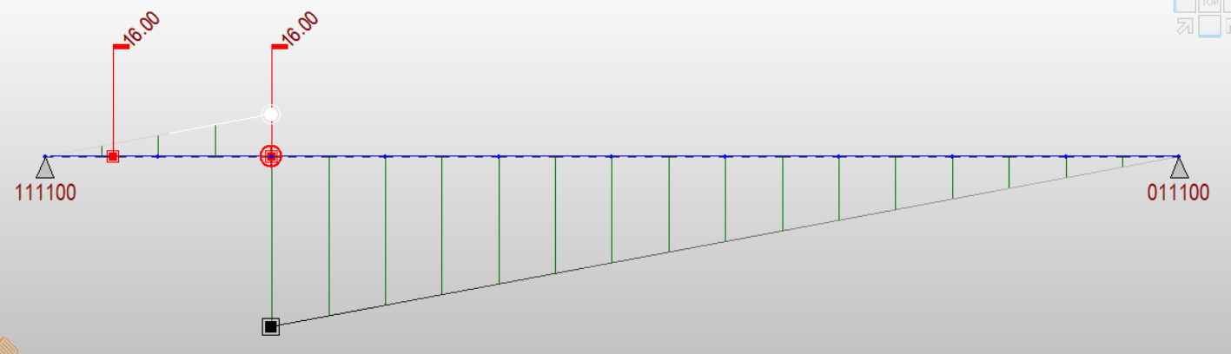
Maximum V @ 0.2L
Notes:
Similarly, the influence can be loaded for the maximum positive shear. Note that for maximum positive shear, the direction of the trucks was reversed so that the largest point loads are placed at the highest ordinates. For this sample beam, a 100-ft long simple span, the third axle of a design truck would not be on the span. Axles which do not load the span, or do not contribute to maximizing certain force effects, are permitted to be ignored.

Slide 104
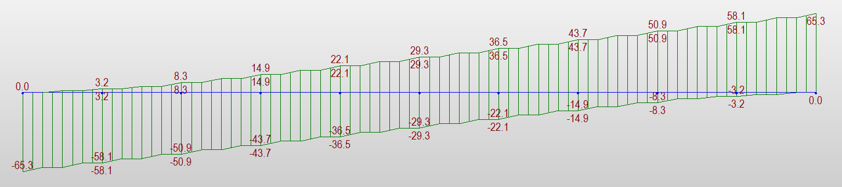
Shear Envelope
Notes:
If this process of moving the truck to every tenth point and reversing its direction as needed is repeated for all tenth points, an envelope of maximum and minimum force effects is produced. This is essential in design. This envelope of live loads is considered along with dead loads, to produce the largest magnitude forces (positive and negative) for every tenth point in the span or for other points of interest such as where plate or section transitions might exist in the structure. The envelope for shear in a simple span due to the three-axle AASHTO truck load is shown. This is not the complete HL93 loading, only the truck portion. This example is simply to illustrate how influence lines and moving loads are considered. This is not the complete AASHTO HL93 loading, but it is the older HS-20 truck loading.

Slide 105
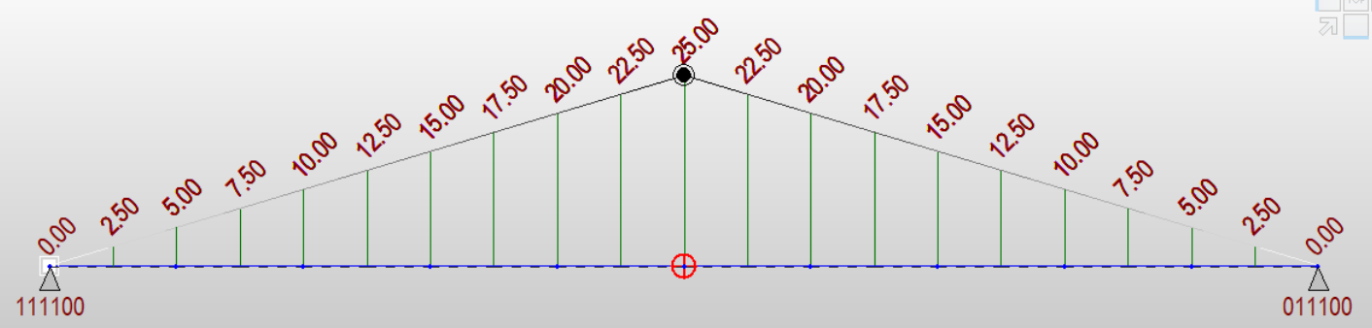
Influence Line, M @ 0.5L
Notes:
Influence lines for moment are also needed. The influence line for moment is produced by assuming a hinge is present at the point of interest and a moment producing a relative beam end rotation of the two segments of 1 radian is produced. The hinged beam would deflect upwards at this location to a height of 25 units. The units of the ordinate are ft-kips of bending moment at the point of interest (0.5L) for each unit load P applied anywhere in the span. A load P applied at the span quarter point would produce a bending moment of 12.5P at midspan. The influence line demonstrates the variation of the bending moment at midspan, i.e. at a fixed point, as the loads move throughout the span. The influence line is not the bending moment diagram. A bending moment diagram shows the bending moments everywhere for a fixed position of load. The influence line shows how the moment at this point of interest varies as loads move throughout the span.
The peak ordinate is easily verified by considering the statics of a simply supported 100-ft span with a load P at midspan. M = PL/4 = P (100) / 4 = 25P.

Slide 106
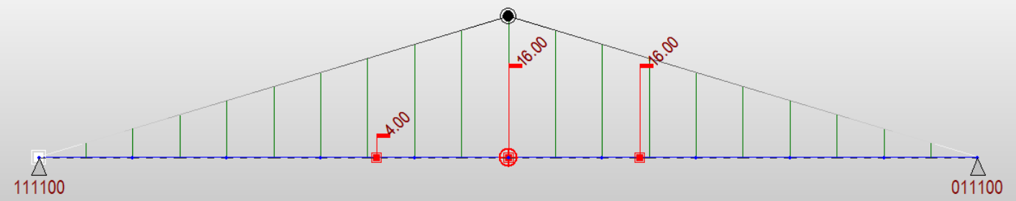
Maximum @ 0.5L
25
18
18
Notes:
The position of the three-axle AASHTO HS-20 truck, or the truck portion of the HL-93 loading, is shown. The highest moments are found by locating the center axle at the peak ordinate and each other axle 14 ft away.
The maximum bending moment at midspan would be found as follows
M = 4k * (36/50) * 25 + 16k * 25 + 16k * (36/50) * 25 = 760 ft–kips per line of wheels * 2 = 1520 ft-kips for the full vehicle.

Slide 107
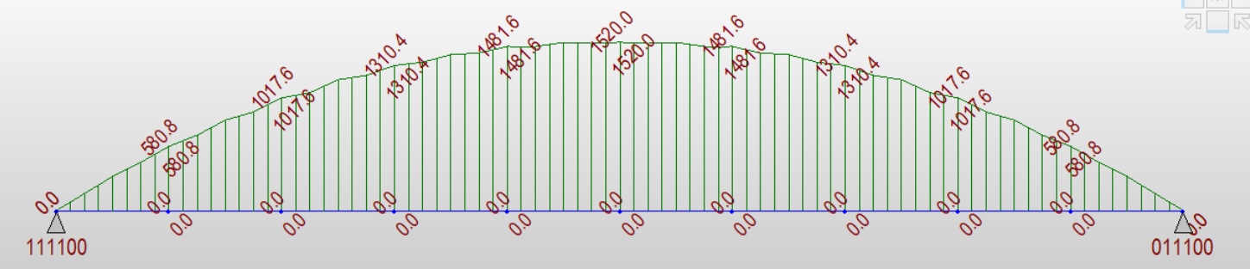
Moment Envelope
Notes:
The moment envelope for each tenth point in the span is shown. Like shear, these forces represent the maximum and minimum live load bending moments at the points of interest. Since the minimum moment in a simple span can never be negative, the minimum live load moment is simply found when no vehicles are on the bridge; a series of zero values is shown. Recall the prior slide demonstrated the calculation of the midspan moment for the full AASHTO HS-20 truck, 1520 ft-kips. It is verified by this envelope.

Slide 108
Influence Line, +M @ 0.4L
Notes:
The ordinates for a nondimensionalized influence line for bending moment at the 0.4L location in Span 1 are plotted for the specific case of a two-span continuous beam having equal spans. The influence line shows that the highest positive bending moment that can be generated at 0.4L Span 1 is with a point load at 0.4L Span 1. An ordinate of 0.2064 is plotted. This ordinate is normalized to span length, meaning to determine the true bending moment generated by a load at this location you have multiply the ordinates by span length. For continuous beams the influence line is no longer a series of straight segments. Continuity of the spans results in a curved shape.
For example, 20 kips at 0.4L for a 100 ft span produces a bending moment of 20 * 100 * 0.2064 = 413 ft-kips.
Also notice that if we apply loads in span 2 they produce negative bending moments in span 1. This has significance in the eventual study of fatigue, in deck design, in checking serviceability of the structure, and in other aspects of design. It is by moving loads along the length of the structure that envelopes of forces are generated, i.e., the maximum and minimum force effects vary due to the moving loads.

Slide 109
Influence Line, +M @ 0.4L
Loading for Maximum Positive Live Load Moment
Notes:
A critical load position for the HL-93 loading to produce positive bending moments in Span 1 is shown. The HL-93 truck is a 3-axle vehicle with axle loads of 8 – 32 – 32 kips. Typically, the peak moment is found with the center axle (32 kips) over the peak of the influence line. The decision about whether the truck is driving left-to-right or right-to-left then depends on the slopes of the influence line trailing away from the peak. At this point of interest, the ordinates to the right of the peak are higher than the ordinates to the left of the peak so the critical live load position has the other 32-kip axle to the right of 0.4L and the 8-kip axle to the left of 0.4L.
In addition, the lane load is applied only to Span 1 since that is the only portion of the influence line that produces positive bending.

Slide 110
Influence Line, +M @ 0.4L
Loading for Maximum Negative Live Load Moment
Notes:
This slide illustrates the critical position for producing negative live load bending moments in Span 1. Lane load is placed in Span 2 and the truck is positioned over the highest negative ordinates. Note the influence line is relatively flat in the region of interest and undue precision is not necessary is determining precise locations of the truck. The same is not true for the positive moment case, however where the curve is steep and has a kink / inflection point.

Slide 111
Influence Line, -M @ Pier
Notes:
The ordinates for a nondimensionalized negative moment influence line are shown for a case of two equal spans and the beams having uniform inertia. The influence line shows that the greatest negative moments can be generated with loads placed around midspan, the highest ordinate being at 0.6L of span 1 and symmetrically at 0.4L of Span 2.
Like the previous discussion of the positive bending moment influence line, these have been nondimensionalized. To determine the moment at the pier caused by a point load anywhere in the span, multiply the intensity of the point load, by the height of the ordinate, and by the span length.
Example – assume 2 spans @ 100 ft each and a 20-kip point load that can be placed anywhere. The maximum bending moment that could be generated would be 20 kips * 100 ft * (-0.096) = 192 ft-kips. If instead we had the three axles of the AASHTO HL-93 truck we would simply sum the individual axle contributions.
To determine force effects from uniformly distributed loads using influence lines, the intensity of the load is multiplied by the area under the curve.

Slide 112
Influence Line, -M @ Pier
50-ft min.
Notes:
To maximize bending moments at the pier, recall AASHTO specifies a load case that includes two trucks (at 90% of their total weight) spaced a minimum of 50 ft apart. To this is added a lane load of 0.64 klf (again reduced to 90% of the specified value). Because for this example of a two-span bridge negative moments can be generated with uniform loads in either span, the lane load is placed in both spans. Trucks are positioned so that their axles are the peaks of the influence lines. Whether the trucks are driving right-to-left or left-to-right always depends on the span configuration. In this case the trucks have simply been located near points of maximum effect to demonstrate their general placement.
If this was greater than a two-span bridge, the influence line for moment at this pier would have both negative and positive ordinates. In that case, only the negative spans would be loaded to produce the negative moment. The positive ordinates would be loaded to generate live load positive bending moments over the pier, a possible situation for all but two-span continuous bridges.

Slide 113
Sample load calculations

Slide 114
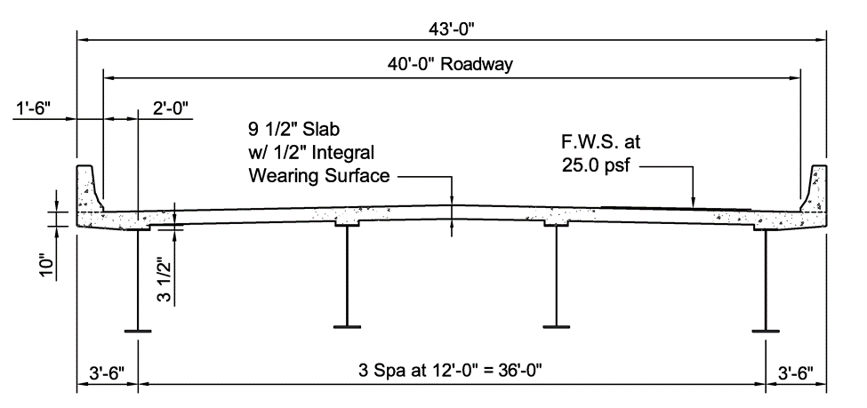
Sample Load Calculations – SBDH Example 1 – Volume 20
Notes:
Using the three-span sample design from SBDH Vol 20, various components of dead loads and live loads will be demonstrated.

Slide 115
DC1 Loads
Notes:
Concrete deck – 43 ft wide, 9.5 inches thick, assumed density of reinforced concrete (concrete @ 145 pcf plus an allowance for reinforcing steel density) = 150 pcf. Total weight = 5.106 kips / ft.
The overhang typically does not have the same constant thickness as the interior portion of the slab. It tapers from a thickness of 10 inches at the tip of the overhang to become flush with the underside of the top flange, the top of the web. This results in the slab being 13.5 inches thick at the tip of the flange. The top flange has been assumed to be 16 inches wide. The net weight of the tapered portion of the slab is 0.142 kips / ft.
A haunch weight is computed. A haunch is both a dimension and a thin pad of concrete over top of each beam flange. Haunches are used to prevent flanges from being embedded in the slab, to accommodate variations in beam camber from a theoretical value, to allow for cross-slope of the deck, and in general are used to provide a location to field adjust the deck relative to the as-erected profile of the beams. For this bridge, the haunch is specified as a 3.5 inch height measured from the top of web / underside of the top flange, to the underside of the slab. This is a common way of specifying the haunch. The haunch measures 16 in. wide, the width of the flange, and because the specified 3.5-inch height also includes a portion of height occupied by the top flange, the net haunch height is 2.75-in assuming a 3/4-in. thick top flange at the thinnest flange location. The weight is computed as 0.183 kips / ft for the total of four haunches on four beam lines.
Stay-in-place steel forms are anticipated in this design. The deck form itself weighs several pounds per square foot. The deck forms are corrugated and concrete fills the corrugations, or flutes, in the forms. A common assumption is that the form plus the concrete in the flutes weighs 15 psf.
Finally, an allowance for crossframes between the beam lines is provided. This weight comes from experience, from determining the weight of a standard crossframe provided in a client's standard detail drawings, or maybe just as an allowance. Engineers will commonly use values like 20 – 30 plf as a first estimate of the weight of miscellaneous steel, items like crossframes, connection plates, shear studs, etc. whose weight is not known at the outset of the design.
The total weight is the added up and assigned evenly to all beams. The example does this because the use of diaphragms / crossframes between the beams tends to force them to deflect together and share the load evenly. Other engineers may choose to assign the loads based on tributary width. Because an interior beam has a different tributary width of slab than an exterior beam, some owners / engineers assign the loads based on tributary width. In that case the overhang loads would have been applied directly to the exterior beams. Different slab weights would be assigned based on tributary width. A different miscellaneous steel allowance would apply for exterior and interior beams. The net result would not be much different than this “equal loading” assumption and is used in the examples.

Slide 116
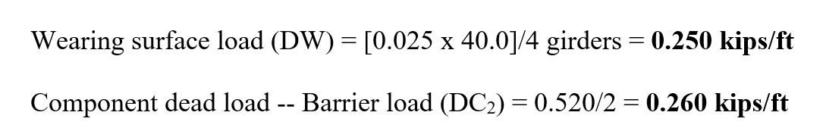
DC2 and DW Loads
Notes:
The wearing surface is an allowance for a future overlay that might be needed to restore the riding surface due to deterioration, potholes, etc. over time. An allowance of 25 psf is provided across the clear deck width, 40 ft. This is evenly distributed to all four girders.
For this example, the owner has a policy that allows the weight of a barrier rail to be evenly distributed to the exterior and first interior beams evenly. Since the barrier rail weighs 0.52 klf, it is divided evenly to two beams. Since this is a four-beam bridge, all beams carry the same share of the DC2 loading. If this was a much wider bridge, beams near the center would not carry this share of load. An engineer would not design those since they would be non-controlling members. One of the more heavily loaded interior beams, and an exterior beam would be designed. One of these will be the controlling member.
Owner policies vary regarding the distribution of the barrier rail load. AASHTO does allow for all composite dead loads to be evenly shared. Though this is rational for a uniform load like the wearing surface, many owners take exception to the practice for barrier rails and assign the load more locally to the first interior beam and the exterior, or fascia beam, in some proportion.

Slide 117
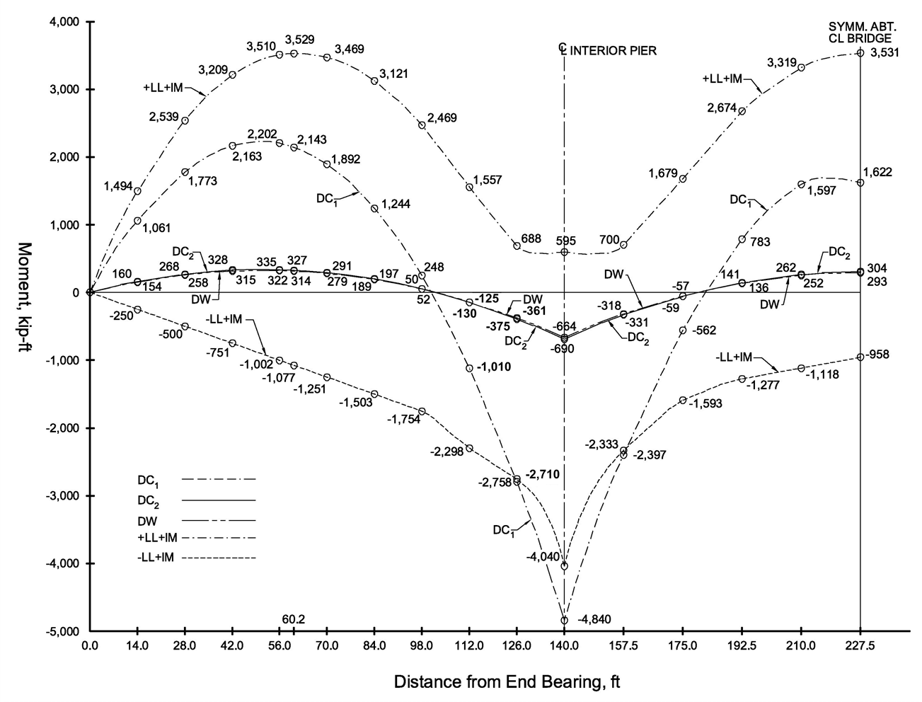
DL and LL Moment Envelopes
Notes:
A structural analysis of a typical beam line is conducted to then determine the moments, shears, and reactions in a beam. Only the moments are shown here.
The DC1, DC2, and DW bending moment diagrams correspond to the load previously shown and to the three-span conditions of the bridge. The bridge in Example 1 has spans of 140 – 175 – 140 ft. An additional complication is that the beam is not prismatic, i.e., the plates are not all the same size for the length of the beam / bridge. A computer program is required for this analysis given the complexities of continuity and changing stiffness. Generating these forces is an iterative process. At the beginning of the design, some estimate of plate sizes is needed even to obtain a first estimate of the beam self weight, a large portion of DC1, and also to model the varying stiffness. Several rounds of iteration are common with changing plate sizes, and small changes in forces occurring each cycle. The design forces are not overly sensitive to plate size changes since a large portion of the DC1 loading is the deck, which doesn’t change, and loads like DC2 and DW are also unchanged. Therefore, only a reasonable estimate of beam weight is needed to get started in design. Recall in Lesson 2, guidance was provided on obtaining estimates of initial girder weight as a function of span length and girder spacing. This is a good way to estimate an initial beam weight for the first beam sizing runs.
The live load forces are shown as both a positive and negative envelope. Recall the presentation of influence lines showed it is possible to generate positive and negative bending moments at various points of interest along the girder length simply by moving live loads between the spans. That moving live load analysis was conducted and the governing forces at tenth points, splices, and plate change locations, are generally stored and in this case, plotted. The live load forces shown reflect an additional consideration, the use of live load distribution factors, which is covered in Lesson 4.

Slide 118
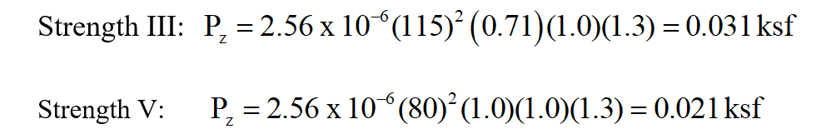
Wind Load, WS
For a bridge assumed in western PA, Exposure Category B, the wind loads are as follows
Notes:
These wind pressures are computed for an Exposure Category B and a bridge assumed to be 28-ft above ground level. Therefore, the wind speed for the Strength III load combination is taken as 115 mph, the Kz value is 0.71, the gust factor is 1.0, and the drag coefficient is 1.3. The resulting wind pressure for the maximum wind case is computed to be 0.031 ksf (31 psf).
For Strength V, this load combination assume wind loads on the bridge and the presence of simultaneous live load. A maximum wind speed for which vehicles are assumed to be possibly still on the structure is specified in AASHTO as 80 mph. The wind pressure calculations are repeated with the 80mph wind speed, and the Str V wind pressure drops to 0.021 ksf (21 psf) due to the squared relationship of wind speed and pressure.

Slide 119
Lesson 3 Summary
Introduction to AASHTO LRFD
Evolution of specifications
Reliability-based specifications
Loads, load factors, load modifiers
Load combinations and limit states
Review of influence lines
Sample load calculations
Notes:
The following topics were covered in this lesson.

Slide 120
END

