Slide 1
Fundamentals of Steel Bridge Engineering
Lesson 8 – Flexure Part 3
Strength Limit State: Noncomposite Sections and Composite Sections in Negative Bending
Notes:
This presentation is part of the "Fundamentals of Steel Bridge Engineering" teaching aid, available at aisc.org/teachingaids. This set of (14) lessons was prepared by Frank Russo, PE, PhD and Michael Grubb, PE with support from the National Steel Bridge Alliance (NSBA) and AISC University Programs.
For questions or comments on these presentations, please contact:
AISC University Programs
universityprograms@aisc.org

Slide 2
Lesson 8 Roadmap – Flexure Part 3
Strength Limit State: Noncomposite Sections and Composite Sections in Negative Bending
Introduction
Section Classifications
Discrete vs. Continuous Bracing
Discretely Braced Compression Flanges
Discretely Braced Tension Flanges
Continuously Braced Flanges
Flexural Resistance: One-Third Rule Equations
Examples
Reference Materials – SBDH Vol 4 Sec 6.3.5
Notes:
Lesson 8 is the third of five lessons dealing with the design of steel-bridge I-section flexural members. This lesson deals with the flexural design requirements for noncomposite I-sections during construction and at the strength limit state and composite I-sections in negative bending (i.e., composite I-sections in negative bending regions of continuous spans) at the strength limit state. The flexural design requirements for composite I-sections in positive bending (i.e., composite I-sections in simple spans and in positive bending regions of continuous spans) at the strength limit state will be covered in Lesson 9.
Topics to be covered in this lesson include: 1) an introduction to the flexural resistance components for determining the resistance of noncomposite I-sections during construction and at the strength limit state, and composite I-sections subject to negative bending at the strength limit state; 2) the section classifications for noncomposite I-sections and composite I-sections in negative bending, which determine the maximum potential flexural resistance, F_{max} or M_{max}, of the section and also which design provisions in the AASHTO LRFD Specification may be used to determine the nominal flexural resistance of the section; 3) the distinction between discrete and continuous bracing of a flange; 4) the computation of the nominal flexural resistance for discretely and continuously braced flanges (subject to compression or tension); and 5) the checking of the flexural resistance of the section for the combined effects of I-girder major-axis bending, minor-axis bending, and torsion (i.e., flange lateral bending) due to any source using the so-called ‘one-third rule equations’.
Lastly, the application of the various requirements to a noncomposite I-section in positive bending during construction and to composite I-sections in negative bending at the strength limit state within critical unbraced lengths of a straight I-girder bridge will be illustrated using excerpts from NSBA Steel Bridge Design Handbook Design Example 1.
Portions of this lesson, namely the discussion on the determination of the nominal lateral-torsional buckling (LTB) resistance of a discretely braced compression flange, refer for informational purposes to new provisions for LTB that will be appearing in the 10th Edition AASHTO LRFD BDS when released. More detailed discussion on the background of the design provisions described in this lesson may be found in Section 6.3.5 of Chapter 4 of the NSBA Steel Bridge Design Handbook.

Slide 3
INTRODUCTION
Notes:
The first topic in this lesson will introduce the components of the cross-section included in the determination of the flexural resistance of noncomposite I-sections during construction and at the strength limit state and composite I-sections subject to negative bending at the strength limit state.

Slide 4
Flexural Resistance Components
Noncomposite Sections
No shear connectors
Noncomposite during construction and at the strength limit state
Flexural resistance components:
  Bottom flange
  Web
  Top flange
With shear connectors
Noncomposite during construction only
Notes:
As discussed previously in Lesson 6, a noncomposite beam or girder is a steel flexural member that is not connected to a hardened cast-in-place concrete deck by shear connectors. Therefore, slip occurs between the two components. Although permitted by specification, it is not recommended when using a concrete deck. Steel flexural members that are noncomposite along their entire length were generally built prior to composite design being widely employed in bridge construction starting in the late 1950s and early 1960s. Such members are not commonly used today, except possibly on very short spans or if a unique deck like an open grid is used such as may be found on some movable bridges to limit the deck weight. Some rural bridges also have timber decks and steel deck pans filled with asphalt or gravel, but these are limited in number and not the focus of the bridge types discussed in this course; however, these would all be considered noncomposite systems. Some owners specify that shear connectors be omitted in regions of negative flexure in continuous spans resulting in portions of the member being noncomposite in those regions. In the preceding cases, the beam or girder section is to be designed as a noncomposite section during construction and at the strength limit state. In both cases, the section is typically doubly symmetric.
A composite steel flexural member with shear connectors along its entire length that supports a wet cast-in-place concrete deck during the deck placement is also considered to be a noncomposite beam or girder during this temporary construction condition (Lesson 7). In this case, the beam or girder is to be designed as a noncomposite section during construction only, and as a composite section at the strength limit state. Since the member is composite after the deck hardens, the section is typically singly symmetric with a smaller top flange than bottom flange.
The flexural resistance components for determining the resistance of noncomposite sections at the strength limit state include the bottom flange, web, and top flange of the steel girder.

Slide 5
Flexural Resistance Components
Composite Sections in Negative Bending
With shear connectors
Composite with the concrete deck longitudinal reinforcement at the strength limit state
Concrete deck and haunch considered to be ineffective in tension at the strength limit state
Flexural resistance components:
  Bottom flange
  Web
  Top flange
  Concrete deck longitudinal reinforcing steel
Notes:
When the section is composite in regions of negative bending in a continuous span, i.e., if shear connectors are present, the longitudinal reinforcement may be included with the steel girder in the computation of the section properties (Lesson 6). The concrete deck and concrete deck haunch are considered to be ineffective in tension at the strength limit state. As specified in AASHTO LRFD Article 6.10.1.1.1c, only the reinforcement within the appropriate effective width of the deck is to be considered acting with each girder. The computation of the effective width of the concrete deck and the required minimum 1 percent longitudinal concrete deck reinforcement to control concrete deck cracking in regions of negative bending was discussed previously in Lesson 6. The design of the required number of shear connectors for the fatigue and strength limit states will be discussed in Lesson 9. Since the member is composite after the deck hardens and the longitudinal reinforcement is included in the section properties, the section is again typically singly symmetric with a smaller top flange than bottom flange.
The flexural resistance components for determining the resistance of composite sections subject to negative bending at the strength limit state include the bottom flange, web, and top flange of the steel girder, along with the concrete deck longitudinal reinforcing steel. The areas of the concrete deck and concrete deck haunch are not considered in the computation of the flexural resistance; the haunch depth may be considered, however, if permitted by the Owner.
The nominal flexural resistance of noncomposite sections during construction and at the strength limit state and composite sections in negative bending at the strength limit state is calculated using the same set of equations in the AASHTO LRFD BDS since the behavior of these sections is similar, with the only difference being the inclusion of the longitudinal deck reinforcement in the calculation of the section properties for composite sections in negative bending at the strength limit state.

Slide 6
Cross-Section Proportion Limits
Web:
Flanges:
t_{w}
D
Notes:
As discussed previously in Lesson 2, flanges and web of the steel girder alone are subject to the basic proportioning requirements for I-section flexural members specified in AASHTO LRFD Articles 6.10.2.1 and 6.10.2.2. The web slenderness limit of 150 applies to webs without longitudinal stiffeners and the web slenderness limit of 300 applies to webs with longitudinal stiffeners (AASHTO LRFD Article 6.10.2.1).
The flange proportioning limits apply to both the compression and tension flanges (AASHTO LRFD Article 6.10.2.2). The upper limit of 12.0 on the projecting flange slenderness, b_{f}/2t_{f}, is a practical upper limit to control flange distortion due to welding. The cross-section aspect ratio, D/b_{f}, has a significant effect on the strength and moment-rotation characteristics of I-girders. Tests on I-sections with very narrow flanges have indicated nominal flexural and shear resistances below those given by the specifications. Limiting the aspect ratio, D/b_{f}, to 6 also helps to ensure that post-buckling shear resistance due to tension-field action can be developed (Lesson 5). In many cases, a wider flange will be required based on other criteria. A minimum width of 12 inches is suggested to prevent flange distortion and cupping due to welding. Typically, somewhat larger minimum flange widths will often be desired for curved girders. The minimum flange thickness of 1.1t_{w} ensures that the boundary conditions assumed at the web-flange juncture in the compression-flange local buckling and web bend buckling formulations within the AASHTO LRFD Specifications are reasonably accurate. This relationship also ensures that the flanges will provide some level of restraint against web shear buckling. This is only a lower limit but is often exceeded. The flange thickness should never be less than ¾ inches. The ratio of the moment of inertia of the compression flange about its strong axis to the moment of inertia of the tension flange about its strong axis is limited to a value between 0.1 and 10. This provision prevents the design of unusually unsymmetrical girders where the yield moment, M_{y}, may in fact be larger than the plastic moment, M_{p}. Sections with an I_{yc}/I_{yt} ratio beyond the specified limits behave more like tee sections with the shear center located at the intersection of the larger flange and the web. Such sections may be particularly difficult to handle.
Also, the guideline shown at the bottom of this slide that was previously discussed in Lesson 7 (Slide 60) should be checked for the noncomposite steel girder to ensure that individual field sections will be more stable and easier to handle during lifting, erection, and shipping without the need for special stiffening trusses or falsework; i.e., the width of the smallest top flange within an individual unspliced girder field section, b_{tfs}, should be greater than or equal to the length of the individual unspliced girder field section, L_{fs}, divided by 85. This guideline should be checked regardless of the final location of each field section in the bridge as the top flange of each noncomposite girder field section is subject to compression over the majority of its length during lifting, erection, and shipping.

Slide 7
Section classifications
Notes:
The next topic in this lesson will discuss the section classifications for noncomposite I-sections during construction and at the strength limit state and composite I-sections in negative bending at the strength limit state. The maximum potential flexural resistance, F_{max} or M_{max}, for each of these section classifications will also be discussed. The section classification also determines which provisions in the AASHTO LRFD BDS (i.e., Article 6.10.8. or Appendix A6) may be employed in determining the nominal flexural resistance. Terms such as ‘compact’, ‘noncompact’, and ‘slender’ will be used to characterize aspects of slenderness for webs, flanges, and bracing spacing. The degree of slenderness will be shown to have a significant influence on the calculated resistance of the section with the resistance decreasing as slenderness increases.

Slide 8
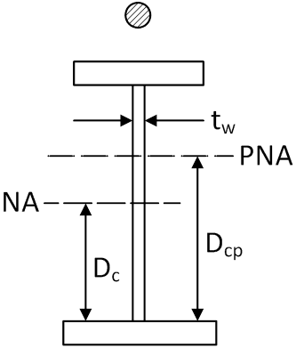
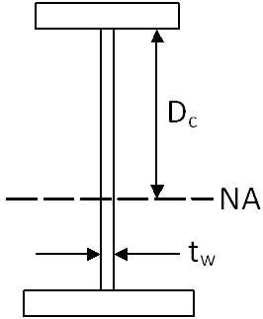
Section Classifications
Compact Web Sections
Noncompact Web Sections
Slender Web Sections
Notes:
This slide presents the criteria used to determine the section classifications for noncomposite I-sections (see bottom right figure – section is assumed subject to positive bending during construction) and composite I-sections in negative bending (see top right figure – section is assumed subject to negative bending at the strength limit state).
Compact web sections, noncompact web sections, and slender web sections are defined based on the equations shown in the table on this slide. The terminology for compact web sections is defined as illustrated in the top figure. The terminology for noncompact and slender web sections is defined as illustrated in either figure, as applicable. D_{cp} is the depth of the web in compression at the plastic moment, and D_{c} is the elastic depth of the web in compression. The calculation of D_{cp} and D_{c} was discussed previously in Lesson 6. The λ terms used in these equations will be defined on the next few slides.

Slide 9
Section Classifications
Compact Web Sections (Appendix A6):
Definition―a noncomposite section or a composite section in negative bending that has a web with a slenderness at or below which the section can achieve a maximum flexural resistance, M_{max}, equal to the plastic moment, M_{p}, prior to web bend buckling having a statistically significant influence on the response.
F_{yc} (ksi) | λ_{pw(Dcp)} for M_{p}/M_{y} = 1.12 | λ_{pw(Dcp)} for M_{p}/M_{y} = 1.30
36 | 107 | 76
50 | 91 | 64
70 | 77 | 54
90 | 68 | 48
100 | 54 | 45
Compact web sections are typically shallower sections with thicker webs; that is, rolled beams and welded girder sections with proportions similar to rolled beams that are typically used on bridges with shorter spans (i.e., spans less than or equal to about 100 feet).
Notes:
A compact web section is defined as a noncomposite section or a composite section in negative bending that has a web with a slenderness at or below which the section can achieve a maximum flexural resistance, M_{max}, equal to the plastic moment, M_{p}, prior to web bend buckling having a statistically significant influence on the response. Sections with compact webs are able to develop M_{max} equal to M_{p} provided that specific steel grade, ductility, flange and web slenderness and lateral bracing requirements are satisfied (to be discussed later in this lesson).
To qualify as a compact web section, the web slenderness, 2D_{cp}/t_{w}, based on the depth of the web in compression at the plastic moment, D_{cp} (Lesson 6), must not exceed the limiting value, λ_{pw(Dcp)}, given by the equation shown on this slide, which is found in AASHTO LRFD Article A6.2.1 (Appendix A6). This equation accounts for the larger demands on the web required to develop the cross-section plastic moment in singly symmetric cross sections with larger shape factors, or ratios of M_{p}/M_{y}. Because the use of compact web sections is fairly uncommon for most new steel bridge designs, the provisions for the strength design of sections with compact webs have been placed in an Appendix (i.e., AASHTO LRFD Appendix A6).
The table on this slide shows the limiting value of λ_{pw(Dcp)} for different yield strengths, F_{y}, and for a shape factor equal to 1.12, which is the typical shape factor for a doubly symmetric rolled beam section, and for a shape factor equal to 1.30, which is representative of the shape factor for a singly symmetric composite welded I-girder section with proportions similar to a rolled beam section. Homogeneous sections are assumed (i.e., the hybrid factor, R_{h} (Lesson 6), is assumed equal to 1.0). The values for F_{y} equal to 50 ksi are shaded in gray. Compact web sections are typically shallower sections with thicker webs; that is, rolled beams and welded girder sections with proportions similar to rolled beams that are typically used on bridges with shorter spans (i.e., spans less than or equal to about 100 feet).
The upper limit of λ_{rw}(D_{cp}/D_{c}) in the equation is to protect against extreme cases with a large compression flange where D_{c}/D is significantly less than 0.5. In such cases, D_{cp}/D is typically smaller than D_{c}/D. As such, in certain situations, the web slenderness associated with the elastic cross-section, 2D_{c}/t_{w}, may be larger than λ_{rw} (refer to Slide 11 in this lesson), while the slenderness associated with the plastic cross-section, 2D_{cp}/t_{w}, may be smaller than λ_{pw(Dcp)}. In other words, the elastic web would be classified as slender at the same time the plastic web would be classified as compact. To guard against such situations and the possibility of theoretical bend buckling of the web prior to reaching M_{p}, the upper limit of λ_{rw}(D_{cp}/D_{c}) is placed on λ_{pw(Dcp)}.

Slide 10
Section Classifications – Compact Web Sections
Notes:
This slide shows the qualitative bending moment versus rotation relationship shown previously in Lesson 6 for a homogeneous compact web section. The section is taken from a member satisfying the following conditions: 1) the member is subject only to transverse loads perpendicular to one principal axis; 2) the loads all pass through the shear center of the cross-section, and thus, the member is not subject to torsion; 3) the member has sufficient lateral support along its length to prevent lateral-torsional buckling; and 4) the section has been proportioned to prevent local buckling of the compression flange prior to reaching its maximum potential flexural resistance, M_{max}. Lateral-torsional buckling and local buckling will be discussed later in this lesson.
Proceeding along the actual curve, the initial Stage I behavior represents completely elastic behavior. As the section approaches the theoretical yield moment M_{y} , the presence of residual stresses will result in some inelastic behavior in the outer fibers of the cross-section before the calculated M_{y} is reached (in the girder cross-sections shown, black indicates nominal yielding). At Stage II, yielding continues and begins to progress throughout the section as the section approaches M_{p}. The actual curve assumes the presence of a moment gradient along the length of the member with peak moments occurring at individual cross-sections. Under moment gradient conditions, the formation of a local buckle causing a decline in the flexural resistance requires yielding of the flange over a portion of the length of the member. Before such a local buckle can form, there may be significant strain hardening in the region of maximum moment. In such cases, as illustrated in the figure, compact web sections are typically able to exceed M_{p} due to the strain hardening before eventually unloading due to local buckling of the compression flange; the stresses in the flanges and upper and lower portions of the web shown in Stage II would continue to increase beyond the nominal yield strength, F_{y} (Stage III would not apply in this case). However, because this excess flexural resistance is difficult to accurately predict, it is ignored in design. Also, under uniform moment conditions, local buckling will invariably occur before there is any significant increase in the flexural resistance attributable to strain hardening. Under these conditions, the resistance essentially plateaus at M_{p} before unloading eventually occurs.
As a result, the idealized curve shown on this slide is assumed for design. Because the residual stresses do not reduce the plastic moment, the section is assumed elastic up to M_{p}, and is then assumed to rotate inelastically at a constant moment equal to M_{p}. At this stage, the entire cross-section has yielded (refer to the cross-section shown for Stage III); that is, each component of the cross-section is assumed to be at F_{y}.
The dotted line on the plot illustrates the behavior of a member that is loaded with a moment greater than M_{y} and then unloaded. Note that elastic behavior is observed both during the unloading and subsequent reloading and a small residual curvature will remain in the member. Also, because the member behaves elastically during unloading and subsequent reloading, the effect of residual stresses is only observed during the initial application of the load as long as the moment due to any subsequent loads does not exceed the previously applied moment.

Slide 11
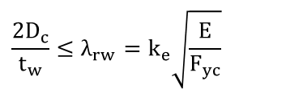
Section Classifications
Noncompact Web Sections (Appendix A6):
Definition―a noncomposite section or a composite section in negative bending that has a web satisfying specific steel grade requirements and with a slenderness at or below which theoretical web bend-buckling does not occur at elastic stress levels, computed according to beam theory, smaller than the maximum flexural resistance.
$$\frac{2D_{c}}{t_{w}}≤λ_{rw}=k_{e}\sqrt{\frac{E}{F_{yc}}}$$
F_{yc} (ksi)
36 | 130 | 162
50 | 111 | 137
70 | 94 | 116
90 | 82 | 102
100 | 78 | 97
in which:
Noncompact web sections are typically sections of intermediate depth used over a fairly broad range of spans.
Notes:
A noncompact web section is defined as a noncomposite section or a composite section in negative bending that has a web satisfying specific steel grade requirements and with a slenderness at or below which theoretical web bend-buckling does not occur at elastic stress levels, computed according to beam theory, smaller than the maximum flexural resistance.
To qualify as a noncompact web section, the web slenderness, 2D_{c}/t_{w}, based on the elastic depth of the web in compression, D_{c} (Lesson 6), must not exceed the limiting value, λ_{rw}, given by the equation shown on this slide, which is taken from AASHTO LRFD Article 6.10.6.2.3. The λ_{rw} limit is the value of 2D_{c}/t_{w} at which an I-section member that does not have web longitudinal stiffening is able to develop M_{max} = R_{h}M_{yc}, or a nominal compression flange yield stress F_{max} = R_{h}F_{yc}, just prior to the onset of local web buckling in flexural compression. This type of web local buckling is referred to generally as web bend buckling, as discussed previously in Lesson 7. Because web bend buckling is assumed not to occur, the web load-shedding factor, R_{b} (Lesson 6), is taken equal to 1.0 for these sections.
The coefficient, k_{e}, in the equation for λ_{rw} is an edge condition coefficient. The upper limit on k_{e} of 5.7 corresponds to a web bend buckling coefficient of k = 36. For a doubly symmetric I-section without longitudinal stiffeners, the constant k = 36 is approximately equal to k_{ss} + 0.8(k_{sf} – k_{ss}), where k_{ss} = 23.9 and k_{sf} = 39.6 are the bend buckling coefficients for simply supported and fully-restrained longitudinal edge conditions, respectively. The lower limit on k_{e} of 4.6 corresponds to a web bend buckling coefficient of k = k_{ss} = 23.9. Value of k_{e} in-between the lower and upper limits of 4.6 and 5.7 depend on the ratio of two times the area of the web in compression to the area of the compression flange, a_{wc}. The table on this slide shows the limiting value of λ_{rw} for different yield strengths based on the lower and upper limits on k_{e} of 4.6 and 5.7. The values for F_{y} equal to 50 ksi are shaded in gray.
Noncompact web sections are common over a fairly broad range of spans. For noncompact web sections, M_{max} decreases linearly as a function of 2D_{c}/t_{w} between the compact- and noncompact-web limits λ_{pw(Dc)} and λ_{rw}. The maximum potential flexural resistance of a noncompact web section will be discussed further on a subsequent slide and is also computed using the provisions of AASHTO LRFD Appendix A6 (as discussed on the next few slides).

Slide 12
Appendix A6
Accounts for the ability of I-sections with nonslender webs (i.e., compact or noncompact webs) to develop flexural resistances exceeding M_{y} and potentially reaching M_{p}.
Flexural resistance is expressed in terms of bending moment rather than stress.
Applies to all spans, but most efficiently and economically applies to shorter span straight steel rolled beam and welded I-girder bridges.
The web load-shedding factor, R_{b}, is equal to 1.0 for all sections with nonslender webs.
Notes:
AASHTO LRFD Appendix A6 accounts for the ability of many noncomposite I-section and composite I-sections in negative bending in straight bridges with nonslender (i.e., compact or noncompact) webs to develop flexural resistances exceeding the moment at first yield, M_{y} and potentially reaching the plastic moment, M_{p}. The provisions of Appendix A6 are a direct extension of and are fully consistent with the provisions of AASHTO LRFD Article 6.10.8 for slender-web noncomposite sections and composite sections in negative bending. The provisions of Appendix A6 are used for strength limit state checks, and as discussed later on in this lesson, in some cases for constructibility checks for lateral-torsional bucking of unbraced lengths with nonslender I-sections (where unbraced lengths may be larger and where it may be desirable to consider the St. Venant torsional constant, J).
For compact web and noncompact web sections in which the maximum potential flexural resistance equals or exceeds M_{y}, expressing the flexural resistance in terms of stress would generally result in stress limits greater than the yield stress for cases where the resistance exceeds M_{y}. Therefore, the resistance equations are more conveniently written in terms of bending moment for these sections. As discussed previously in Lesson 6, for sections in which the flexural resistance is expressed in terms of moment, moments acting on the noncomposite, long-term composite and short-term composite sections may be directly summed for comparison to the nominal resistance. Effects of partial yielding within the cross-section and the sequence of application of loads acting on the different sections need not be considered. The provisions of Article 6.10.8 presume slender-web behavior, and therefore, limit the nominal flexural resistance to be less than or equal to the nominal moment at first yield, M_{y}. However, it is considered more appropriate to express the flexural resistance in terms of stress for sections in which the maximum resistance is always less than or equal to M_{y}. In composite construction, the combined effects of the loadings acting on different states of the member cross-section (i.e., noncomposite, long-term composite, and short-term composite) are better handled by working with flange stresses rather than moments. Bridge engineers are also generally more accustomed to working with stresses.
The provisions of Appendix A6 apply to all spans but most efficiently and economically apply to shorter-span straight steel rolled beam and welded I-girder bridges. These bridges more efficiently utilize compact and noncompact web sections in regions of negative bending at the strength limit state.
When applying the provisions of Appendix A6, the web load-shedding factor, R_{b} (Lesson 6), is always implicitly taken as 1.0 for all sections with nonslender webs, as web bend-buckling is not a consideration for these sections.

Slide 13
Appendix A6 Requirements
2D_{c}/t_{w} ≤ λ_{rw}; i.e., compact or noncompact web section
Girders are straight I-girders; Supports are skewed ≤ 20○ from normal; Cross-frames are contiguous
Flange strengths, F_{y} ≤ 70 ksi
Flanges satisfy, , where I_{yc} = t_{fc}b_{fc}³/12 and I_{yt} = t_{ft}b_{ft}³/12
Notes:
AASHTO LRFD Article 6.10.6.2.3 specifies the requirements for a noncomposite section or a composite section in negative bending to optionally be proportioned according to the provisions of AASHTO LRFD Appendix A6. These four requirements are simple restrictions intended to limit the use of a nominal flexural resistance exceeding the moment at first yield to designs for which the use of this resistance is supported by test data. The first restriction is that the web slenderness based on 2D_{c}/t_{w} must be less than or equal to the limiting slenderness, λ_{rw}; i.e., the section must be a compact or noncompact web section.
The use of Appendix A6 is limited to straight I-girder design in the AASHTO LRFD BDS. For noncomposite sections and composite sections in negative bending with compact or noncompact webs, the use of Appendix A6 is further limited to straight I-girder design in bridges with skews less than or equal to 20 degrees from normal and with contiguous cross-frame lines. These restrictions are due to the lack of a comprehensive understanding of the implications of significant member yielding and the resulting inelastic redistribution on the forces and moments in horizontally curved bridges and in straight bridges with more severely skewed supports and/or with discontinuous cross-frame lines at the time that these provisions were implemented. Sections in all kinked (chorded) continuous or horizontally-curved steel girder bridges must be proportioned according to the provisions specified in Article 6.10.8.
I-section members with a specified minimum yield strength of the flanges greater than 70 ksi are more likely to be limited by the equation given in the 1st bullet item on this slide and are likely to be controlled by design conditions other than the strength limit state conditions. In cases where this equation is satisfied with F_{yc} greater than 70 ksi, the implications of designing such members at the strength limit state using a nominal flexural resistance greater than M_{y} have not been sufficiently studied to allow the use of AASHTO LRFD Appendix A6.
If the compression flange of noncomposite I-sections is substantially smaller than the tension flange such that I_{yc}/I_{yt} is less than 0.3, where the compression and tension flange moments of inertia are taken about the vertical axis in the plane of the web, the flexural resistance must be conservatively based on the slender-web section equations of Article 6.10.8. This restriction guards against the use of extremely monosymmetric sections where analytical studies indicate a significant loss in the influence of the St. Venant torsional rigidity, GJ, on the lateral-torsional buckling resistance due to cross-section distortion. If the flanges are of equal thickness, this limit is equivalent to b_{fc} < 0.67b_{ft}.

Slide 14
Appendix A6 - Web Plastification Factors
Compact Web Sections (Article A6.2.1):
Noncompact Web Sections (Article A6.2.2)
Notes:
The web plastification factors, R_{pc} and R_{pt}, in AASHTO LRFD Appendix A6 are essentially effective shape factors that define a smooth linear transition in the maximum flexural resistance between M_{y} and M_{p}. By using R_{pc} and R_{pt} in the flexural resistance equations, separate flexural resistance equations are not required for compact and noncompact web sections.
For a compact web section, or a section with a web with a slenderness, 2D_{c}/t_{w}, less than or equal to the limiting slenderness, λ_{pw(Dcp)}, the web plastification factors are equivalent to the cross-section shape factors, M_{p}/M_{y}, as shown in the equations at the top of this slide (AASHTO LRFD Article A6.2.1). Thus, whenever R_{pc} and R_{pt} given by these equations are used in the appropriate flexural resistance equations, the maximum flexural resistance of a compact web section, M_{max}, will equal the plastic moment, M_{p}.
For a noncompact web section, or a section with a web slenderness, λ_{w} = 2D_{c}/t_{w}, greater than the limiting value of λ_{pw(Dcp)}, but not exceeding the web slenderness limit for a noncompact web section, λ_{rw}, the web plastification factors are given by the equations shown at the bottom of this slide. These equations define a linear transition in the maximum potential flexural resistance, M_{max}, of a noncompact web section between M_{y} and M_{p} as a function of the web slenderness. As 2D_{c}/t_{w} approaches the noncompact web section limit, λ_{rw}, the web plastification factors approach values equal to the hybrid factor, R_{h}, and therefore, M_{max} within the appropriate flexural resistance equations approaches a limiting value of R_{h}M_{yc} or R_{h}M_{yt}, as applicable. As 2D_{cp}/t_{w} approaches the compact web section limit, λ_{pw(Dcp)}, the web plastification factors approach the cross-section shape factors, and therefore, M_{max} within the appropriate flexural resistance equations approaches a limiting value of M_{p}. As discussed previously, the equation for λ_{pw(Dc)} at the bottom right of this slide converts the web compactness limit λ_{pw(Dcp)} defined in terms of D_{cp}, to a value that can be used consistently in these equations with the web slenderness, λ_{w}, which is expressed in terms of D_{c}. Upper limits of M_{p}/M_{yc} and M_{p}/M_{yt} are placed on R_{pc} and R_{pt}, respectively, in these equations. These upper limits will limit the larger of the base resistances, R_{pc}M_{yc} or R_{pc}M_{yt}, to M_{p} for the rare case of an extremely monosymmetric section in which M_{yc} or M_{yt} is greater than M_{p}. However, the base AASHTO LRFD flange-proportioning limits shown previously in this lesson (Slide 6) will generally tend to prevent the use of such sections.

Slide 15
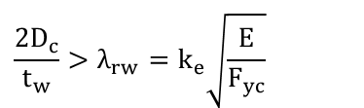
Section Classifications
Slender Web Sections (Article 6.10.8)
Definition―a noncomposite section or a composite section in negative bending that has a web with a slenderness at or above which the theoretical bend-buckling stress is reached in the web prior to reaching the yield moment, M_{y}.
$$\frac{2D_{c}}{t_{w}}>λ_{rw}=k_{e}\sqrt{\frac{E}{F_{yc}}}$$
F_{yc} (ksi)
36 | 130 | 162
50 | 111 | 137
70 | 94 | 116
90 | 82 | 102
100 | 78 | 97
in which:
The majority of steel bridge I-sections utilize either slender webs or noncompact webs that approach the slenderness limit, λ_{rw}.
Notes:
A slender web section is defined as a noncomposite section or a composite section in negative bending that has a web with a slenderness at or above a limit in which the theoretical bend-buckling stress is reached in the web prior to reaching the yield moment, M_{y}.
For a slender web section, the web slenderness, 2D_{c}/t_{w}, based on the elastic depth of the web in compression, D_{c} (Lesson 6), exceeds the limiting value, λ_{rw}. The λ_{rw} limit was described on the preceding slide. Sections with slender webs rely upon significant web post bend-buckling resistance at the strength limit state. In the case of a slender web section, a web load-shedding factor R_{b} < 1 (Lesson 6) accounts for the reduction in M_{max} or F_{max} due to shedding of flexural stresses to the compression flange associated with the post-bend buckling response of the web. The hybrid factor, R_{h} (Lesson 6), must also be introduced to account for the redistribution of stress to both flanges resulting from local yielding of the web in a hybrid section. The redistribution of the stress to the flanges resulting from the local yielding of the web is ignored whenever the nominal flexural resistance exceeds the yield moment M_{y}. Therefore, R_{h} is not applied to M_{p} for compact web sections. M_{max} for a slender web section is given by the expression R_{b}R_{h}F_{yc}S_{xc} as will be shown on a subsequent slide (F_{max} = R_{b}R_{h}F_{yc}). The nominal flexural resistance of slender web sections is computed according to the provisions of AASHTO LRFD Article 6.10.8.
The majority of steel bridge I-sections utilize either slender webs or noncompact webs that approach the slenderness limit, λ_{rw}.

Slide 16
Section Classifications – Slender Web Sections
Notes:
This slide shows a qualitative moment versus rotation relationship for a homogeneous slender web section taken from a member satisfying the previously stated conditions for the compact web section moment-rotation curve (refer to Slide 10 in this lesson). A slender web section has a web slenderness whereby a web reaches its theoretical bend-buckling stress prior to the section reaching M_{y}. Unlike a compact web section, a slender web section has little or no inelastic rotation capacity after reaching M_{max} as the web deformations in the compression zone of the web begin to dramatically increase, and the flexural resistance decreases rapidly, as shown in the curve on this slide. Therefore, the nominal flexural resistance is limited to be at or slightly below M_{y}.
The moment-rotation behavior of a noncompact web section falls somewhere in-between the behavior shown on this slide and the behavior of a compact web section shown on the previous slide, depending on the web slenderness.

Slide 17
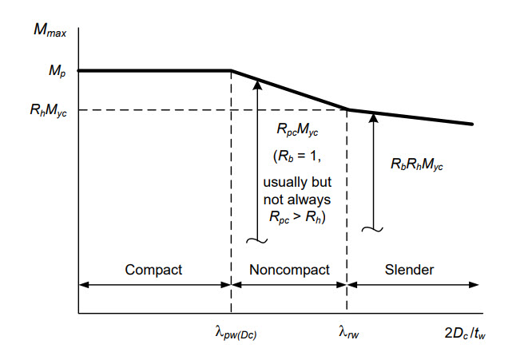
Section Classifications – Variation of M_{max} vs. 2D_{c}/t_{w}
Notes:
The plot on this slide illustrates the basic relationship between the maximum potential flexural resistance, M_{max} (or equivalently F_{max}), and the web slenderness, 2D_{c}/t_{w}, for all three types of sections; compact web, noncompact web and slender web (assuming yielding with respect to the compression flange controls and that lateral-torsional buckling and local buckling are prevented).
As previously discussed, M_{max} is equal to the cross-section plastic moment capacity, M_{p}, for sections with compact webs. However, for sections with noncompact or slender webs, M_{max} (or F_{max}), varies as a function of the web slenderness, 2D_{c}/t_{w}. For noncompact web sections, M_{max} decreases linearly as a function of 2D_{c}/t_{w} between the compact- and noncompact-web slenderness limits λ_{pw(Dc)} and λ_{rw}, as shown in the plot. Note in this plot that the compact web section limit, λ_{pw(Dcp)}, is converted from its fundamental form associated with the plastic depth of the web in compression, D_{cp}, to the form associated with the elastic depth of the web in compression, D_{c}, by multiplying the limit by the ratio of (D_{c}/D_{cp}). This is necessary so that a consistent web slenderness parameter, 2D_{c}/t_{w}, may be employed for the linear interpolation between the anchor points (λ_{pw}, M_{p}) and (λ_{rw}, R_{h}M_{yc}).
The linear interpolation between (λ_{pw(Dc)}, M_{max} = M_{p}) and (λ_{rw}, M_{max} = R_{h}M_{yc}) shown in the plot is represented by the web plastification factor, R_{pc}. This parameter is simply equal to the cross-section shape factor, M_{p}/M_{yc}, for a compact web section. It may be considered as an effective shape factor that varies linearly between M_{p}/M_{yc} and R_{h} for noncompact web sections. The equations for R_{pc} are shown on a previous slide in this lesson. One should note that R_{pc} is greater than one in most situations for girders with noncompact webs. However, M_{yc} can be greater than M_{p} for some extreme singly symmetric sections having a large flange in compression and a neutral axis close to the compression flange (this is because earlier yielding in tension is generally neglected in the calculation of M_{yc} = F_{yc}S_{xc}). In these cases, R_{pc} can be less than one. The resistance tends to be governed by tension flange yielding (TFY) in these situations.
M_{max} is equal to R_{b}R_{h}M_{yc} for slender web sections at the limit λ_{rw} and decreases with increasing 2D_{c}/t_{w} as R_{b} decreases below 1.0.

Slide 18
Section Classifications – Variation of M_{max} vs. 2D_{c}/t_{w}
Appendix A6
Article 6.10.8
Notes:
The design of noncomposite I-sections and composite I-sections subject to negative bending at the strength limit state is covered in either AASHTO LRFD Article 6.10.8 or AASHTO LRFD Appendix A6. The majority of steel bridge I-sections utilize either slender webs or noncompact webs that approach the slenderness limit, λ_{rw}. Therefore, for the design of these sections, the simpler and more streamlined provisions of Article 6.10.8 are the most appropriate for determining the nominal flexural resistance at the strength limit state. The provisions of Article 6.10.8 presume slender-web behavior, and therefore, limit the nominal flexural resistance to be less than or equal to the nominal moment at first yield, M_{y}.
AASHTO LRFD Appendix A6 may optionally be applied to compact web and noncompact web sections satisfying specific steel grade and web and flange proportioning requirements in straight I-girder bridges with limited skews (discussed previously on Slide 13 of this lesson). In Appendix A6, the nominal flexural resistance is permitted to exceed M_{y}. Since the types of sections that would qualify for the use of AASHTO LRFD Appendix A6 are less commonly used, the somewhat more complex provisions for their design have been placed in an appendix in the specification in order to streamline and simplify the main provisions of the specification. Girder proportioning based on Appendix A6 cannot be used for sections with slender webs. However, the slender web provisions of AASHTO LRFD Article 6.10.8 may be applied to sections in bridges utilizing compact webs or noncompact webs that are nearly compact, but at the expense of some economy with the potential loss in economy increasing with decreasing web slenderness, as indicated in the plot on this slide. It is strongly recommended though that compact web sections and noncompact web sections that are nearly compact be designed according to the provisions of AASHTO LRFD Appendix A6 in order to minimize the potential loss in economy when these sections are used.
Noncomposite I-sections and composite I-sections in negative bending in all kinked (chorded) continuous and horizontally curved I-girder bridges, and in straight I-girder bridges whose supports are skewed more than 20° from normal and/or utilize discontinuous cross-frame lines, must always be treated as slender web sections, regardless of their web slenderness, in applying the specifications. Thus, the nominal flexural resistance of these sections in these bridges is not permitted to exceed M_{y}. As a result, the optional provisions of AASHTO LRFD Appendix A6 may not be applied to compact web or noncompact web sections in these bridges.

Slide 19
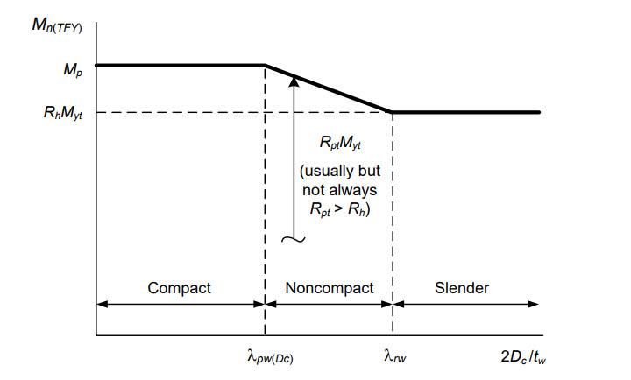
Tension Flange Yielding (TFY) – Variation of M_{max} vs. 2D_{c}/t_{w}
Appendix A6
Article 6.10.8
Notes:
The plot on this slide illustrates the basic relationship between the nominal tension flange yielding (TFY) resistance, M_{n(TFY)} (or equivalently F_{n(TFY)}), and the web slenderness, 2D_{c}/t_{w}, for all three types of sections; compact web, noncompact web and slender web (assuming yielding with respect to the tension flange controls).
The AASHTO LRFD nominal TFY resistance varies with the web slenderness in a fashion similar to the variation of M_{max} and F_{max}. However, the web load-shedding factor, R_{b}, factor is not applied in determining the TFY resistance of slender-web sections since the tension flange stress is not increased significantly by the shedding of the web compressive stresses due to web bend buckling (Lesson 6).
AASHTO LRFD Article 6.10.8.3 defines the nominal TFY resistance of slender-web sections as the nominal first yielding of the tension flange reduced by any hybrid web effects, R_{h}F_{yt} in terms of the tension flange stress, or R_{h}F_{yt}S_{xt} = R_{h}M_{yt} in terms of the member bending moment. However, AASHTO LRFD Articles A6.2 and A6.3 define a nominal TFY resistance that varies linearly from R_{h}M_{yt} to the section plastic moment, M_{p}, as the web slenderness 2D_{c}/t_{w} varies from λ_{rw} to λ_{pw(Dc)}. Finally, for compact-web sections, the TFY resistance is equal to M_{p}.
Similar to the web plastification factor, R_{pc} used in defining M_{max} for FLB and LTB of noncompact and compact-web I-sections, a web plastification factor, R_{pt}, is used that corresponds to the TFY limit state. Similar to R_{pc}, R_{pt} is simply equal to the cross-section shape factor, M_{p}/M_{yt}, for compact-web sections, and it may be considered as an effective shape factor for noncompact-web sections. The equations for R_{pt} are shown in a subsequent slide in this lesson. Also, similar to R_{pc}, R_{pt} can be less than one for extremely monosymmetric I-sections, basically sections that have a significantly larger tension flange causing the neutral axis to be very close to the tension flange (in these sections, M_{yt} can be greater then M_{p} due to the neglect of earlier yielding in compression when writing M_{yt} = F_{yt}S_{xt}). However, in these cases, R_{pc} will be greater than R_{h} and the FLB or LTB resistance equations will usually govern.
For sections in which M_{yt} > M_{yc}, TFY never governs and does not need to be checked.

Slide 20
Discrete vs. continuous bracing
Notes:
The next topic in this lesson will introduce the concept of discrete vs. continuous bracing of a flange and the limit states of concern for each case at the strength limit state.

Slide 21
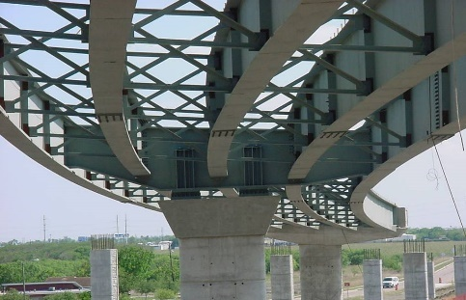
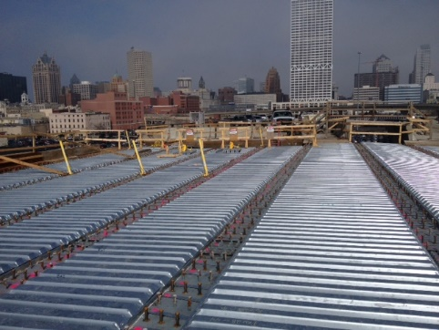
Discrete vs. Continuous Bracing
Discretely braced tension flange
Discretely braced compression flange
Notes:
A discretely braced flange is defined as a flange supported at discrete intervals by bracing sufficient to restrain lateral deflection of the flange and twisting of the entire cross section at the brace points.
In regions of positive bending, sections are typically noncomposite during construction and composite at the strength limit state. For noncomposite sections in regions of positive bending, the top flange in the fully erected steel frame and prior to and during the placement of the concrete deck is a discretely braced compression flange and the bottom flange is a discretely braced tension flange, as indicated in the photographs on this slide. As indicated in AASHTO LRFD Article 6.7.4.1, metal stay-in-place deck forms, shown in the photograph on the bottom right of this slide, are not assumed to provide adequate bracing/stability to the top flange in compression prior to curing of the deck and so the flange must be treated as a discretely braced flange.
For sections in negative bending that are noncomposite during construction, the top flange in the fully erected steel frame and prior to and during the placement of the concrete deck is a discretely braced tension flange and the bottom flange is a discretely braced compression flange.

Slide 22
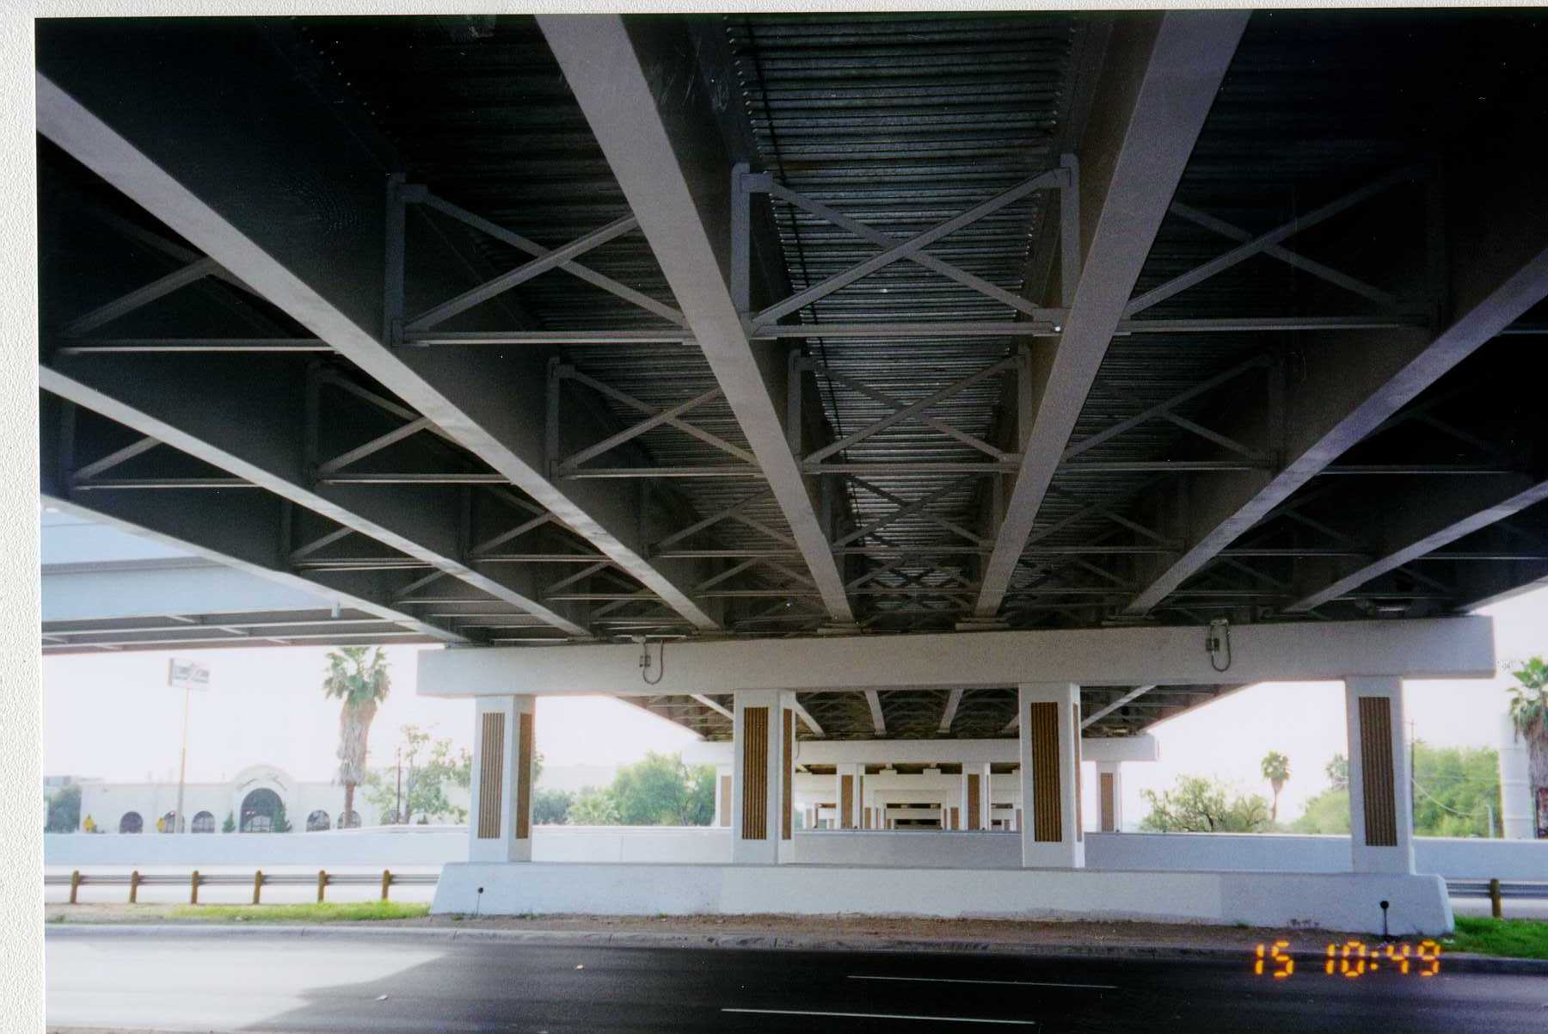
Discrete vs. Continuous Bracing
Discretely braced tension flange
Discretely braced compression flange
Continuously braced flange
Notes:
A continuously braced flange is defined as a flange encased in concrete or anchored by shear connectors for which flange lateral bending effects need not be considered. The lateral resistance of the composite concrete deck is sufficient to compensate for the neglect of any initial and locked-in lateral bending stresses in the flange, and prevents any additional lateral bending stresses after the deck hardens. A continuously braced flange in compression is also assumed not to be subject to local or lateral–torsional buckling. For a continuously braced compression flange, one side of the flange is effectively prevented from local buckling, or else both sides of the flange must buckle in the direction away from the concrete deck, resulting in highly restrained boundary conditions at the web-flange juncture.
For composite sections in positive bending at the strength limit state, the top (compression flange) is continuously braced by the composite concrete deck, and the bottom flange remains a discretely braced tension flange.
As discussed previously, in regions of negative flexure, when stud shear connectors are provided, the section may be considered composite with the longitudinal reinforcement at the strength limit state after the concrete deck hardens. Although the concrete in tension is ignored in the strength limit state design calculations, the top (tension) flange is still considered to be continuously braced by the concrete deck. The bottom flange in regions of negative flexure remains a discretely braced compression flange.

Slide 23
Limit States of Concern
Discretely Braced Compression Flanges
  Flange local buckling (FLB)
  Lateral-torsional buckling (LTB)
  Flange lateral bending
Discretely Braced Tension Flanges
  Tension flange yielding (TFY)
  Flange lateral bending
Continuously Braced Flanges
  Nominal flange yielding
Notes:
Discretely braced compression flanges in flexural members are subject to the limit states of flange local buckling (FLB) and lateral-torsional buckling (LTB).
Discretely braced tension flanges in flexural members are subject to the limit state of tension flange yielding (TFY); buckling of the flange is not a consideration.
Flange lateral bending due to torsion must also be considered for discretely braced flanges in compression or tension. Discretely braced compression flanges are also subject to potential amplification of the first-order flange lateral bending stresses, as discussed in more detail later in this lesson. Torsion and the computation of flange lateral bending stresses was discussed previously in Lesson 6.
Continuously braced flanges in compression or tension in flexural members are subject only to the limit state of nominal yielding; buckling of the flange and flange lateral bending need not be considered because the flange is continuously braced by the composite concrete deck, as discussed previously in this lesson.
The flexural design of discretely and continuously braced flanges for each of the applicable limit states is discussed further on the following slides.

Slide 24
DISCRETELY BRACED COMPRESSION FLANGES
Notes:
The next topic in this lesson will discuss the design of discretely braced compression flanges for the limit states of concern at the strength limit state. The subjects to be covered in this topic include the determination of the nominal flexural resistance of a discretely braced compression flange for the flange local buckling (FLB) and lateral-torsional buckling (LTB) limit states, and the potential amplification of first-order flange lateral bending stresses due to torsion in a discretely braced compression flange.

Slide 25
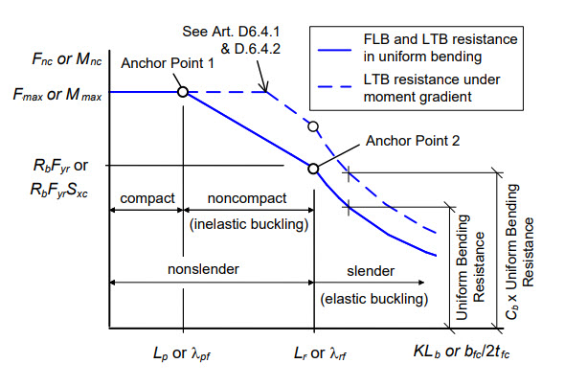
Flange Local Buckling (FLB) & Lateral-Torsional Buckling (LTB) Limit States
Notes:
The nominal flexural resistance, F_{nc} or M_{nc}, of discretely braced compression flanges of noncomposite I-section members and composite I-section members in negative bending is governed by the most critical of the compression-flange local buckling (FLB) and lateral-torsional buckling (LTB) limit states.
All the AASHTO LRFD FLB and LTB resistance equations are based consistently on the logic of identifying the two anchor points for the case of uniform major-axis bending, which are highlighted on the graph on this slide. Anchor point 1 is located at the projecting flange slenderness, b_{fc}/2t_{fc} = λ_{pf} for FLB or the effective unbraced length KL_{b} = L_{p} for LTB corresponding to development of the maximum potential flexural resistance, or so-called “plateau” resistance, labeled as F_{max} or M_{max} in the figure. The plateau resistance, F_{max} or M_{max} depends on the section classification as discussed previously in this lesson. Anchor point 2 is located at the projecting flange slenderness b_{fc}/2t_{fc} = λ_{rf} or effective length KL_{b} = L_{r} at which the elastic FLB or LTB resistances are equal to R_{b}F_{yr} in terms of stress or R_{b}F_{yr}S_{xc} in terms of moment. The term F_{yr} is the nominal compression flange stress at the onset of significant yielding including residual stress effects, and R_{b} is the web load-shedding strength reduction factor (Lesson 6 - equal to 1.0 for sections with compact or noncompact webs). F_{yr} will be discussed further on subsequent slides in this lesson. The inelastic FLB and LTB resistances are expressed simply and accurately by linear interpolation between the above two anchor points. For b_{fc}/2t_{fc} > λ_{rf} or KL_{b} > L_{r}, the FLB and LTB resistances are governed by the theoretical elastic buckling resistance curves.
The coordinates of the anchor points shown the figure in terms of the bending moment are (λ_{pf}, M_{max}) and (λ_{rf}, R_{b}F_{yr}S_{xc}) for FLB and (L_{p}, M_{max}) and (L_{r}, R_{b}F_{yr}S_{xc}) for LTB. The specific terms associated with these anchor points are discussed in detail on the following slides. Also, since the compression flange slenderness limit, λ_{rf}, and bracing limit, L_{r}, are associated with the theoretical elastic buckling equations, the base elastic buckling formulas are also presented where applicable. For a more detailed discussion of these terms and equations, consult Section 6.3.5 of Chapter 4 of the NSBA Steel Bridge Design Handbook.

Slide 26
Flange Local Buckling (FLB)
FLB occurs when the width-to-thickness ratio of a discretely braced compression flange is such that the flange may buckle locally out of its original plane.
The projecting compression- flange slenderness is the controlling parameter for FLB in a flexural member:
t_{fc}
b_{fc}/2
Notes:
Both rolled and built-up steel I-sections are composed of flat plate elements. When these elements are compressed, for example a discretely braced flange, they may buckle locally out of their original planes, as illustrated in the photograph on this slide. The photograph shows an experimental test of a two-span two-girder composite I-girder system in which a distinct local buckle formed in the discretely braced bottom (compression) flange of the near girder adjacent to the section at the interior support.
The projecting compression-flange slenderness, λ_{f} = b_{fc}/2t_{fc}, is the controlling parameter for FLB in a flexural member, where b_{fc} is the full width of the compression flange and t_{fc} is the thickness of the compression flange. As shown in the figure on the bottom right of this slide, the projecting compression-flange width, b_{fc}/2, is divided by the compression-flange thickness, t_{fc}, to compute λ_{f}.

Slide 27
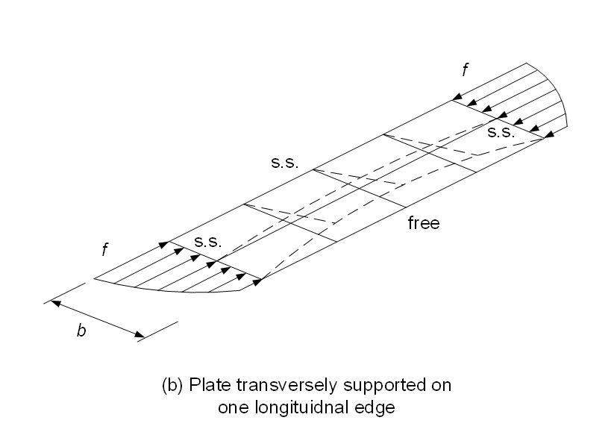
Flange Local Buckling (FLB)
Compact Flange:
Definition― for a noncomposite section or a composite section in negative bending, a discretely braced compression flange with a slenderness at or below which the flange can sustain sufficient strains such that the maximum potential flexural resistance is achieved prior to flange local buckling having a statistically significant influence on the response, provided that sufficient lateral bracing requirements are satisfied to develop the maximum potential flexural resistance.
F_{yc} (ksi) | λ_{pf}
36 | 10.8
50 | 9.2
70 | 7.7
90 | 6.8
100 | 6.5
Notes:
For the FLB limit state, a compact flange is defined for a noncomposite section or a composite section in negative bending as a discretely braced compression flange with a slenderness at or below which the flange can sustain sufficient strains such that the maximum potential flexural resistance is achieved prior to flange local buckling having a statistically significant influence on the response. This is provided that the lateral bracing requirements are satisfied such that lateral-torsional buckling (LTB) is prevented and the maximum potential flexural resistance for FLB can be developed.
A compact flange is a discretely braced compression flange with a projecting flange slenderness, λ_{f}, less than or equal to the limiting slenderness for a compact flange, λ_{pf}, which is given in the AASHTO LRFD BDS (Articles 6.10.8.2.2 and A6.3.2) by the equation shown on this slide, where F_{yc} is the specified minimum yield strength of the compression flange. The table on this slide shows the values of the limiting slenderness, λ_{pf}, for different values of F_{yc}; the value for F_{yc} equal to 50 ksi is shown shaded in gray.

Slide 28
Flange Local Buckling (FLB)
Noncompact Flange:
Definition― for a noncomposite section or a composite section in negative bending, a discretely braced compression flange with a slenderness at or below the limit at which localized yielding within the member cross-section associated with a hybrid web, residual stresses and/or cross-section monosymmetry has a statistically significant effect on the nominal flexural resistance.
Article A6.3.2 (Appendix A6):
Built-up Sections:
Rolled Shapes: k_{c} = 0.76
Article 6.10.8.2.2:
Notes:
For the FLB limit state, a noncompact flange is defined for a noncomposite section or a composite section in negative bending as a discretely braced compression flange with a slenderness at or below the limit at which localized yielding within the member cross-section associated with a hybrid web, residual stresses and/or cross-section monosymmetry has a statistically significant effect on the member resistance.
A noncompact flange is a discretely braced compression flange with a projecting compression-flange slenderness, λ_{f}, exceeding the limiting slenderness for a compact flange, λ_{pf}, given on the previous slide, but less than or equal to the limiting flange slenderness for a noncompact flange, λ_{rf}. λ_{rf} is obtained by equating the critical elastic buckling stress for a perfectly flat plate with no residual stress subjected to a uniform uniaxial compressive stress,
$F_{e}=k_{c}π^{2}E/12\left(1−ν^{2}\right){\left({b_{fc}}/{2t_{fc}}\right)}^{2}$, to the compression flange stress at the nominal onset of yielding, F_{yr}, where ν is Poisson’s Ratio (commonly taken as 0.3 for steel) and k_{c} is the flange local-buckling coefficient. The resulting equation is given in AASHTO LRFD Article A6.3.2 (Appendix A6) as shown on this slide. The values of k_{c} assumed for built-up sections and for rolled shapes in Article A6.3.2 are also shown. The expression for built-up sections accounts for the fact that thinner webs in built-up sections tend to offer less rotational restraint to prevent flange local buckling. The calculated value of k_{c} from this expression must fall between the range of 0.35 and 0.76. The lower-bound value of 0.35 (which controls at D/t_{w} values greater than approximately 130) is back-calculated by equating the local buckling resistances given in the AASHTO LRFD BDS to measured resistances from tests with D/t_{w} values ranging from 72 to 245. The upper-bound value of 0.76 corresponds to the traditional value that has been assumed for rolled shapes.
Substituting the lower-bound value of k_{c} equal to 0.35 into the general Article A6.3.2 equation for λ_{rf} gives the expression for λ_{rf} given in Article 6.10.8.2.2 (as shown on this slide), which presumes slender-web behavior. The fact that the lower-bound value of k_{c} equal to 0.35 is less than 0.425 (which assumes idealized simply-supported boundary conditions along the web-flange juncture) is indicative of the fact that web local buckling in more slender webs tends to destabilize the compression flange.
The values of F_{yr} shown on this slide for the FLB limit state are discussed further on the next slide.

Slide 29
Flange Local Buckling (FLB)
Article A6.3.2 (Appendix A6):
Article 6.10.8.2.2:
Slender Flange:
Definition― for a noncomposite section or a composite section in negative bending, a discretely braced compression flange with a slenderness at or above which the nominal flexural resistance is governed by elastic flange local buckling, provided that sufficient lateral bracing requirements are satisfied.
Notes:
The term, F_{yr}, is the nominal compression flange stress at the onset of significant yielding including residual stress effects. For the FLB limit state, the AASHTO LRFD BDS specifies F_{yr} = 0.7F_{yc} (which corresponds to an assumed nominal compression flange residual stress effect of 0.3F_{yc}) with the exception of (1) highly monosymmetric compact-web and noncompact-web cross sections with the larger flange in compression, where the neutral axis is so close to the compression flange that nominal tension flange yielding occurs prior to reaching a stress of 0.7F_{yc} at the compression flange, and (2) hybrid web members in general where F_{yw} < 0.7F_{yc}. To address these cases, AASHTO LRFD Article A6.3.2 (Appendix A6) specifies the value of F_{yr} for the FLB limit state as shown on this slide. The product R_{h}F_{yt}S_{xt} in the second term of this equation is the moment, R_{h}M_{yt}, corresponding to nominal yielding at the tension flange. This value, divided by the section modulus to the compression flange, S_{xc}, is the compression flange stress corresponding to the onset of nominal yielding at the tension flange. The third term interprets the web yield stress as the limit corresponding to the onset of significant inelastic stability effects for hybrid sections with unusually low values of F_{yw} relative to F_{yc}. In extreme cases where F_{yt}S_{xt}/S_{xc} or F_{yw} is less than 0.5F_{yc}, the AASHTO LRFD BDS uses a minimum value of F_{yr} = 0.5F_{yc}.
For slender-web sections (Article 6.10.8.2.2), the second-term in Article A6.3.2 equation for F_{yr} is not considered. This simplification is possible because the TFY resistance of slender-web members is defined as the nominal first yielding of the tension flange reduced by any hybrid web effects, R_{h}F_{yt}. However, since the TFY resistance for compact- and noncompact-web sections is generally larger than R_{h}M_{yt}, the second term is necessary in the Appendix A6 equation to avoid significant violation of the assumption of elastic member behavior when using the AASHTO LRFD BDS equations based on elastic LTB or FLB.
For the FLB limit state, a slender flange is defined for a noncomposite section or a composite section in negative bending as a discretely braced compression flange with a slenderness at or above which the nominal flexural resistance is governed by elastic flange local buckling, provided that sufficient lateral bracing requirements are satisfied to prevent LTB. A slender flange is a discretely braced compression flange with a projecting compression-flange slenderness, λ_{f}, exceeding the applicable limiting slenderness for a noncompact flange, λ_{rf}, given on the previous slide.

Slide 30
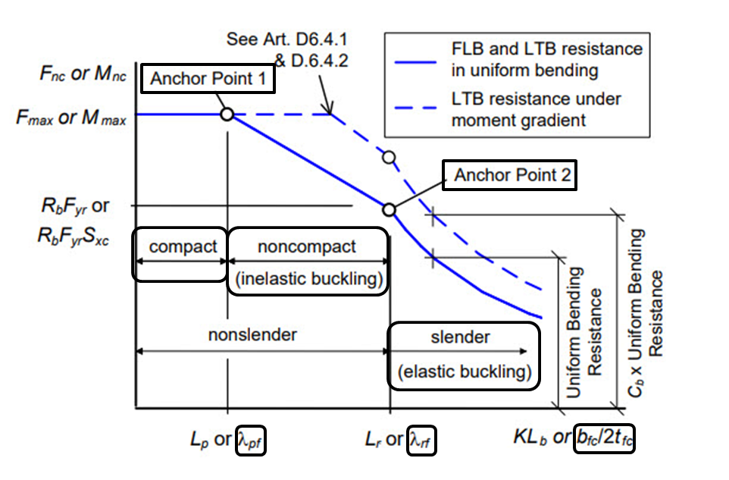
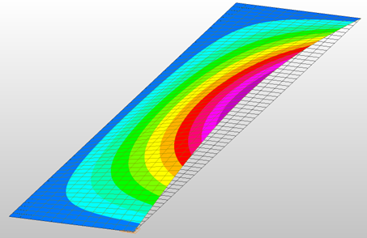
Flange Local Buckling (FLB)
Notes:
Depending on which of the three regions that the projecting flange slenderness, λ_{f} = b_{fc}/2t_{fc}, falls in, delineated by the Anchor Points 1 and 2 shown in the figure on this slide, the discretely braced compression flange is referred to as compact, noncompact or slender under flexure.
Cross sections with compact compression flanges are able to develop the “plateau strength”, F_{max} or M_{max}, cross sections with noncompact compression flanges have their flexural resistance limited by inelastic FLB, and cross sections with slender flanges have their flexural resistance governed by theoretical elastic FLB, assuming that the LTB or TFY resistances are not smaller. Actually, the AASHTO LRFD BDS does not explicitly provide any elastic FLB equations. This is because the proportioning limit b_{f}/2t_{f} ≤ 12.0 in Article 6.10.2.2 (refer to Slide 6 in this lesson) precludes elastic FLB for all steel I-section members with F_{yc} ≤ 90 ksi. The AASHTO LRFD BDS simply uses the inelastic FLB expressions into the elastic FLB range for the minor extent that b_{f}/2t_{f} can potentially exceed λ_{rf} for F_{yc} > 90 ksi. This is justified given the approximations invoked in determining the flange local buckling resistance. The relatively minor influence of moment gradient effects (discussed later on in this lesson) is also neglected for FLB; therefore, only the solid blue curve in the figure on this slide applies for FLB.
The AASHTO LRFD BDS equations given in Articles 6.10.8.2.2 and A6.3.2 (Appendix A6) for determining the nominal flexural resistance, F_{nc} or M_{nc}, of compact and noncompact discretely braced compression flanges for the FLB limit state are shown on the next slide.

Slide 31
Flange Local Buckling (FLB)
Article 6.10.8.2.2:
If , then:
Otherwise:
Article A6.3.2 (Appendix A6):
If , then:
Otherwise:
Notes:
For the FLB limit state, the equations defining the nominal local buckling resistance of the compression flange, F_{nc}, in AASHTO LRFD Article 6.10.8.2.2 are expressed in terms of stress as shown in the top two equations on this slide. The first equation defines the plateau strength, F_{nc} = F_{max}, for a compact flange, and the second equation defines F_{nc} for a noncompact flange with intermediate values of b_{fc}/2t_{fc} between λ_{pf} and λ_{rf}, for which residual stresses and initial imperfections give rise to inelastic local buckling, represented in the AASHTO LRFD BDS by a linear transition curve. As mentioned previously, an elastic local buckling equation is not provided for a slender compression flange. The computation of the web load-shedding factor, R_{b}, and the hybrid factor, R_{h}, was discussed previously in Lesson 6.
Similarly, the equations defining the nominal flexural resistance based on compression flange local buckling, M_{nc}, in AASHTO LRFD Article A6.3.2 (Appendix A6), which are expressed in terms of bending moment, are shown in the bottom two equations on this slide. Note that these equations contain the web plastification factor, R_{pc}, discussed previously in this lesson (Slide 19). S_{xc} is the elastic section modulus about the major axis of the section to the compression flange taken as M_{yc}/F_{yc}. As discussed previously in this lesson, when applying the provisions of Appendix A6, the web load-shedding factor, R_{b}, is always implicitly taken as 1.0 for all sections with nonslender webs, as web bend-buckling is not a consideration for these sections.

Slide 32
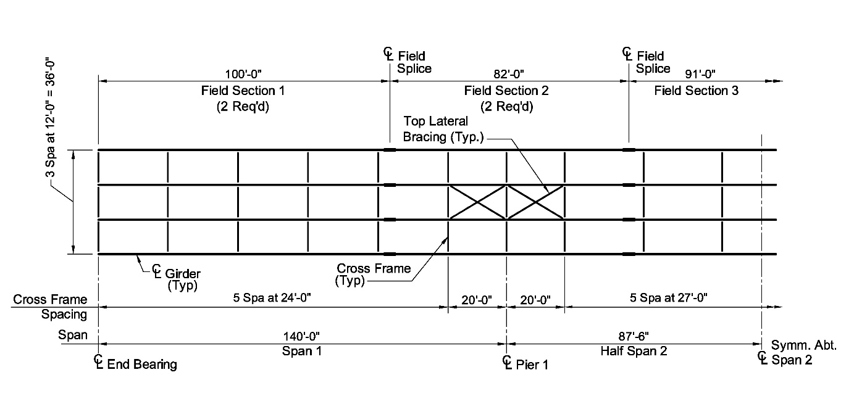
Lateral-Torsional Buckling (LTB)
LTB occurs when the lateral support of a discretely braced compression flange is such that lateral buckling of the flange is accompanied by the twisting of the entire cross section.
The unbraced length, L_{b}, is the controlling parameter for LTB in a flexural member:
L_{b}
Notes:
An I-section flexural member may deflect laterally in a torsional mode before the compressive bending stress reaches the yield stress if the compression flange does not have adequate lateral support. The bracing must be sufficient to restrain lateral deflection of the flange and twisting of the entire cross-section at the brace points for a compression flange to be considered adequately braced. The figure on this slide shows a doubly symmetric I-section member in pure bending, simply supported, and held against twisting at both ends. It is assumed that the compression (top) flange is sturdy enough that it will not buckle locally, and that the cross-section will not distort prior to buckling of the entire member between points of lateral support of the compression flange. Under uniform compression, the top flange would buckle downward in its weak direction if this motion were not prevented by the web. Instead, if the force in the compression flange is large enough, the flange will tend to buckle horizontally, or in the only direction that it is free to move. The bottom flange, which is in tension, tends to remain straight. Therefore, the top flange tending to buckle, bends further than the bottom flange, which tends to remain straight. As a result, the entire cross-section rotates as one rigid unit, as shown.
The principal variable affecting the lateral-torsional buckling (LTB) resistance is the distance between the points of lateral support, or the unbraced length, L_{b}. However, other variables affect the resistance as well including, but not limited to, the end restraints, type and position of the loads, material properties, residual stresses, initial imperfections and cross-section distortion.

Slide 33
Lateral-Torsional Buckling (LTB)
Compact Unbraced Length (6.10.8.2.3):
Definition― for a noncomposite section or a composite section in negative bending, the limiting unbraced length of a discretely braced compression flange at or below which the maximum potential flexural resistance can be achieved prior to lateral–torsional buckling having a statistically significant influence on the response, provided that sufficient flange slenderness requirements are satisfied to develop the maximum potential flexural resistance.
10th Edition: 1.0 1.1
for prismatic unbraced lengths only
Notes:
For the LTB limit state, a compact unbraced length is defined for a noncomposite section or a composite section in negative bending as the limiting unbraced length of a discretely braced compression flange at or below which the maximum potential flexural resistance can be achieved prior to lateral-torsional buckling having a statistically significant influence on the response. This is provided that sufficient flange slenderness requirements are satisfied such that flange local buckling (FLB) is prevented and the maximum potential flexural resistance for LTB can be developed.
A compact unbraced length of a discretely braced compression flange is an unbraced length, KL_{b}, that is less than or equal to the limiting unbraced length to achieve the maximum potential flexural resistance for LTB under uniform bending, L_{p}, which is given in the AASHTO LRFD BDS by the equation shown on this slide. Note that in the 10th Edition Specification, the coefficient in this equation will be increased slightly from 1.0 to 1.1. The equation with a coefficient of 1.1 was found to give a nearly uniform reliability index throughout the compactly- and noncompactly-braced ranges for all types of I-section members. F_{yc} is the specified minimum yield strength of the compression flange and r_{t} is the radius of gyration for LTB at the governing cross-section given by the equation shown at the bottom of this slide. The meaning of the term ‘governing cross-section’ will be discussed later in this lesson.
For rehabilitation design or in extraordinary circumstances, the Engineer may consider modifying L_{b} by an elastic effective length factor, K (< 1.0), for lateral-torsional buckling, which accounts for the restraint provided to the ends of an unbraced length by adjacent unbraced lengths that are less critically loaded. However, in most design situations, common practice is to take L_{b} as the actual unsupported length between the brace points corresponding to the cross-frame locations (i.e., K = 1). Article C6.10.8.2.3 recommends a simple hand method for determining LTB effective length factors, K, in cases where the additional calculation effort is merited. The method is described in more detail in Section 6.3.5.13 of Chapter 4 of the NSBA SBDH and the application of this method is demonstrated in Appendix A of NSBA SBDH Design Example 1.
This equation for r_{t} applies for prismatic unbraced lengths only, or unbraced lengths between cross-frames in which the member cross-section does not vary along the length (nonprismatic unbraced lengths will be discussed later on in this lesson). The equation is precisely equal to the radius of gyration of the compression flange plus one-third of the depth of the web in compression. The web area term D_{c}t_{w} in the equation, where D_{c} is the elastic depth of the web in compression (Lesson 6), accounts for the destabilizing effect of the flexural compression in the web on the member lateral-torsional stability. A more exact equation for r_{t} is given in Article C6.10.8.2.3 if a more precise calculation of the elastic LTB resistance is desired. The equation for r_{t} given on this slide is a simplification of the more exact equation obtained by assuming D = h = d. For sections with thick flanges, this equation can be as much as three to four percent conservative relative to the exact equation.

Slide 34
Lateral-Torsional Buckling (LTB)
Noncompact Unbraced Length:
Definition― for a noncomposite section or a composite section in negative bending, the limiting unbraced length of a discretely braced compression flange at or below the limit at which the onset of yielding in either flange of the cross-section with consideration of compression–flange residual stress effects has a statistically significant effect on the nominal flexural resistance.
Article A6.3.3 (Appendix A6):
10th Edition:
h = depth between the centerline of the flanges (in.)
For welded sections: F_{yr} = 0.5F_{yc}
For rolled sections: F_{yr} = 0.7F_{yc}
Notes:
For the LTB limit state, a noncompact unbraced length is defined for a noncomposite section or a composite section in negative bending as the limiting unbraced length of a discretely braced compression flange at or below the limit at which the onset of yielding in either flange of the cross-section with consideration of compression-flange residual stress effects has a statistically significant effect on the nominal flexural resistance.
A noncompact unbraced length of a discretely braced compression flange is an unbraced length, KL_{b}, that exceeds the limiting unbraced length to achieve the maximum potential flexural resistance for LTB under uniform bending, L_{p}, given on the previous slide, but is less than or equal to the limiting unbraced length corresponding to the nominal onset of yielding effects under uniform bending with consideration of compression-flange residual stresses and geometric imperfections, L_{r}. The noncompact bracing limit, L_{r}, is obtained by equating the exact beam-theory based solution for the elastic LTB resistance for uniform bending, F_{cr}, (refer to Slide 36 in this lesson) to the compression flange stress at the nominal onset of yielding, F_{yr}. The resulting expression for L_{r} is given in AASHTO LRFD Article A6.3.3 (Appendix A6) as shown on this slide. The equation for the St. Venant torsional constant, J, shown on this slide, provides an accurate approximation of the constant neglecting the effect of any web-to-flange fillets. For a compression or tension flange with a ratio, b_{f}/t_{f}, greater than 15, the term in parentheses given in the equation for that flange may be taken equal to 1.0. For rolled sections, the tabulated values of J given for rolled shapes in the AISC Manual of Steel Construction, which include the effect of the web-to-flange fillets, should be used instead. h is the vertical depth between the centerline of the two flanges. S_{xc} is the elastic section modulus about the major axis of the section to the compression flange taken as M_{yc}/F_{yc}.
The value of F_{yr} for LTB in Appendix A6 is the same as that discussed previously for FLB (refer to Slide 29 in this lesson). In the 10th Edition of the AASHTO LRFD BDS, the value of F_{yr} for welded sections for the LTB limit state will be changed from the variable value shown here to 0.5F_{yc} to account for the combined effects of residual stresses and geometric imperfections on the LTB resistance and to provide a more uniform level of reliability consistent with the target level in the AASHTO Specifications. The previous value of 0.7F_{yc} will be retained for rolled sections.

Slide 35
Lateral-Torsional Buckling (LTB)
Noncompact Unbraced Length:
Article 6.10.8.2.3:
10th Edition:
For longitudinally unstiffened webs: F_{yr} = 0.5F_{yc}
For longitudinally stiffened webs: F_{yr} = min(0.5F_{yc}, F_{crw})
Notes:
The noncompact bracing limit, L_{r}, given in Article 6.10.8.2.3, which presumes slender-web behavior, is obtained by equating the exact beam-theory based solution for the elastic LTB resistance for uniform bending, F_{cr}, with the St. Venant torsional constant, J, taken equal to zero (given on the next slide in this lesson) to the compression flange stress at the nominal onset of yielding, F_{yr}. The resulting expression for L_{r} is given in AASHTO LRFD Article 6.10.8.2.3 as shown on this slide.
The value of F_{yr} for LTB in Article 6.10.8.2.3 is the same as that discussed previously for FLB (refer to Slide 29 in this lesson). In the 10th Edition of the AASHTO LRFD BDS, for longitudinally unstiffened webs, F_{yr} will be taken equal to 0.5F_{yc} to account for the combined effects of residual stresses and geometric imperfections on the LTB resistance and to provide a more uniform level of reliability consistent with the target level in the AASHTO Specifications. For longitudinally stiffened webs, F_{yr} will be taken as the smaller of 0.5F_{yc} and the web bend-buckling resistance, F_{crw} (Lesson 7).

Slide 36
Lateral-Torsional Buckling (LTB)
Slender Unbraced Length:
Definition― for a noncomposite section or a composite section in negative bending, the limiting unbraced length of a discretely braced compression flange at or above which the nominal flexural resistance is governed by elastic lateral–torsional buckling.
Article A6.3.3 (Appendix A6):
for prismatic unbraced lengths only
Article 6.10.8.2.3:
Notes:
For the LTB limit state, a slender unbraced length is defined for a noncomposite section or a composite section in negative bending as the limiting unbraced length of a discretely braced compression flange at or above which the nominal flexural resistance is governed by elastic lateral-torsional buckling. A slender unbraced length of a discretely braced compression flange is an unbraced length, KL_{b}, that exceeds the limiting unbraced length corresponding to the nominal onset of yielding effects under uniform bending with consideration of compression-flange residual stresses and geometric imperfections, L_{r}, given on previous slides.
For slender unbraced lengths, the equation given in Article A6.3.3 (Appendix A6) for the elastic lateral-torsional buckling stress at the governing cross-section, F_{cr}, as shown on this slide, is effectively the exact beam-theory based solution for elastic lateral-torsional buckling of a doubly symmetric I-section for the case of uniform bending, when r_{t} is defined by the exact equation given in Article C6.10.8.2.3b. It is recommended, however, that the simpler equation for r_{t} shown previously on Slide 33 of this lesson be used unless a more precise calculation of F_{cr} is desired. This equation for F_{cr} also gives an accurate approximation of the exact beam-theory based solution for elastic lateral-torsional buckling of singly symmetric I-section members. For unusual cases with I_{yc}/I_{yt} > 1.5 and with D/b_{fc} < 2 or D/b_{ft} < 2 or b_{ft}/t_{ft} < 10, the St. Venant torsional constant, J, shown on a previous slide may be factored by 0.8 to account for the tendency of this equation to overestimate the LTB resistance in such cases. For constant depth compact-web and noncompact-web I-section members, the 10th Edition Specification will provide equations in the Commentary to allow the designer to take advantage of the torsional restraint provided by the concrete deck to compute the elastic lateral distortional buckling stress, F_{e.LDB}, of the bottom compression flange of a composite unbraced length in negative bending, which may be employed in place of F_{cr} (note that in the 10th Edition, ‘F_{cr}’ will be replaced by ‘F_{e}’). The effects of this restraint are reduced in general by web distortion, and for typical I-girder bridges with slender-web sections, the benefits of this restraint are judged not to be worth the additional effort associated with a distortional buckling solution.
The equation shown at the bottom of this slide for F_{cr} at the governing cross-section given in Article 6.10.8.2.3, which presumes slender web behavior, is obtained by neglecting the contribution from the radical in the Appendix A6 equation due to the reduction in the effective St. Venant torsional stiffness associated with web distortional flexibility (i.e., the deformation of the web into an S shape upon twisting of the cross section, and the corresponding reduction in the twist rotation of the flanges).
Both equations for F_{cr} shown on this slide apply for prismatic unbraced lengths only, or unbraced lengths between cross-frames in which the member cross-section does not vary along the length (nonprismatic unbraced lengths will be discussed later in this lesson). In cases where an effective length factor, K (<1.0), for LTB is computed as discussed on a previous slide in this lesson, F_{cr} is to be multiplied by (1/K²).

Slide 37
Lateral-Torsional Buckling (LTB)
Notes:
Depending on which of the three regions that the unbraced length, KL_{b}, falls in, delineated by the Anchor Points 1 and 2 shown in the figure on this slide, the unbraced length is referred to as compact, noncompact or slender under flexure.
Compact unbraced lengths are able to develop the plateau strength, F_{max} or M_{max}, noncompact unbraced lengths have their flexural resistance limited by inelastic LTB, and slender unbraced lengths have their flexural resistance governed by theoretical elastic LTB, assuming that the FLB or TFY resistances are not smaller.
The AASHTO LRFD BDS equations given in Articles 6.10.8.2.3 and A6.3.3 (Appendix A6) for determining the nominal flexural resistance, F_{nc} or M_{nc}, of compact, noncompact, and slender prismatic unbraced lengths for the LTB limit state will be shown on subsequent slides in this lesson.

Slide 38
Lateral-Torsional Buckling (LTB) – Moment Gradient
For prismatic unbraced lengths only
Notes:
It is important to note that the LTB resistance of unbraced lengths subjected to a moment gradient (i.e., nonuniform bending along the length) can be increased significantly due to the moment gradient effects. For LTB, a moment gradient condition is much less severe than uniform bending along the unbraced length. As such, the plateau strength, F_{max} or M_{max}, can be achieved at much larger unbraced lengths than the compact limit, L_{p}, as indicated by the dashed line shown on this plot. Thus, it is unwise in general to select unbraced lengths or a spacing of the cross frames to enforce L_{b} < L_{p}.
For unbraced lengths subjected to moment gradient, the calculated LTB resistance may be modified by the moment gradient modifier, C_{b} (>1.0), as illustrated by the dashed line. In these cases, the uniform bending elastic and inelastic LTB resistances are simply scaled by C_{b}, with the exception that the resistance is capped by F_{max} or M_{max}. The calculation of C_{b} will be discussed further on the next slide.
When C_{b} is greater than 1.0, indicating the presence of a significant beneficial moment-gradient effect, the AASHTO LRFD BDS permits the LTB resistances to alternatively be computed by the equivalent procedures specified in Articles D6.4.1 and D6.4.2 (Appendix D6). The equivalent procedures of Articles D6.4.1 and D6.4.2 may be alternatively applied for prismatic unbraced lengths only, as indicated on this slide. The equivalent procedures permit the plateau strength, F_{max} (Article D6.4.1) or M_{max} (Article D6.4.2), as applicable, to be reached at larger unbraced lengths when C_{b} is greater than 1.0, as again shown by the dashed line on the plot. The compact unbraced length limit, L_{p}, is effectively shifted to the right under a moment gradient when these equivalent procedures are employed.

Slide 39
Lateral-Torsional Buckling (LTB) – Moment Gradient
Moment Gradient Modifier, C_{b}:
For prismatic unbraced lengths only (see Slide 43 for nonprismatic unbraced lengths)
When the variation in moment along the entire length between the brace point is concave in shape:
Otherwise:
The definition of the terms f_{o}, f₁, f₂, and f_{mid} may be found in AASHTO LRFD Article 6.10.8.2.3.
Notes:
As discussed on the preceding slide, the effect of any variation in the moment along an unbraced length is accounted for in the AASHTO LRFD BDS via the moment gradient modifier, C_{b}. The C_{b} modifier has a base value of 1.0 when the moment and the corresponding compression flange major-axis bending stresses are uniform along the length between the brace points. Furthermore, C_{b} may be conservatively taken equal to 1.0 for all cases, if desired, with the exception of: 1) situations involving significant top flange loading either on unbraced cantilevers or on members with no intermediate bracing in the entire span, and 2) general unbraced cantilevers with less than essentially rigid warping restraint at their fixed end due to flexible end connections or continuity with a flexible back-span. Recommended procedures for determining the LTB resistance in these situations are provided in Article C6.10.8.2.3b. If one or more intermediate braces are provided within either an ordinary span or a cantilever span in which the ends are prevented from twisting, load height effects do not need to be considered in the calculation of C_{b}. Cases in which the ends of a span are not prevented from twisting require special consideration regardless of the loading and span type.
The form of the C_{b} equation provided in AASHTO LRFD Article 6.10.8.2.3, which presumes slender-web behavior, is shown on this slide. The equation applies only for prismatic unbraced lengths; for nonprismatic unbraced lengths, see Slide 43 in this lesson. The terms shown on this slide are defined in AASHTO LRFD Article 6.10.8.2.3. When the variation in moment along the entire unbraced length is concave in shape, such as when checking the unbraced lengths adjacent to interior piers of continuous spans for LTB at the strength limit state, the stress f₁ in the equation is to be taken as f_{o}. For such cases, the calculated value of C_{b} will typically be significantly greater than 1.0. As a minimum, it is recommended that C_{b} be calculated and applied when checking the LTB resistance of unbraced lengths adjacent to interior piers at the strength limit state (when permitted to do so). The stresses f₂ and f₀ at each end of the unbraced length under consideration, as defined in Article 6.10.8.2.3, are to be substituted into the equation. Careful attention should be paid to the sign convention for these stresses, as indicated in the definitions. An equivalent equation for C_{b} expressed in terms of the major-axis bending moments is provided in AASHTO LRFD Article A6.3.3 (Appendix A6). Note that for unbraced lengths subject to reverse curvature bending, the upper limit on the calculated value of C_{b} from this equation is 2.3. Consult Articles 6.10.8.2.3 and C6.10.8.2.3, and Section 6.3.5.11 of Chapter 4 of the NSBA SBDH, for further information on the proper application of this form of the C_{b} equation to other cases. Sample illustrations of the calculation of C_{b} for such cases are provided in AASHTO LRFD Article C6.4.10 (Appendix C6). Note that when the stress at the middle of the unbraced length is larger than f₂ as defined in Article 6.10.8.2.3, Article 6.10.8.2.3 permits C_{b} to be taken equal to 1.0.
Strict application of the C_{b} provisions would require the consideration of the concurrent moments along the unbraced length. However, since concurrent moments are not normally tracked in the analysis, it is convenient and considered acceptable to utilize the factored worst-case moments from the live load moment envelopes in conjunction with other factored moment diagrams for the calculation of C_{b}.

Slide 40
Lateral-Torsional Buckling (LTB) – Moment Gradient
Moment Gradient Modifier, C_{b} (10th Edition):
For prismatic unbraced lengths only (see Slides 44 and 45 for nonprismatic unbraced lengths)
where:
M_{A}, M_{B}, M_{C} = absolute value of the factored major-axis bending moment at one-quarter, one-half and three-quarters of the unbraced length under consideration (points A, B and C), respectively, calculated from the moment envelope values that produce the largest flexural compression in the flange under consideration at these points, or the smallest flexural tension in this flange if the flange is never in compression at the point (kip-in.)
M_{max} = absolute value of the factored maximum major-axis bending moment in the unbraced length, calculated from the moment envelope value that produces the largest flexural compression in the flange under consideration (kip-in.)
Notes:
In the 10th Edition AASHTO LRFD BDS, the quarter-point formula employed in the AISC Specification and shown on this slide will be introduced for the calculation of C_{b} for prismatic unbraced lengths (only) to replace the equation shown on the preceding slide. The equation is applicable for: 1) prismatic composite or noncomposite unbraced lengths subjected to single-curvature bending, 2) prismatic noncomposite unbraced lengths of doubly-symmetric members subjected to reverse-curvature bending, and 3) prismatic composite unbraced lengths subjected to reverse-curvature bending. For prismatic noncomposite unbraced lengths of singly symmetric members subject to reverse-curvature bending, the Commentary will provide suggested adjustments to C_{b}. The upper limit on the calculated value of C_{b} for unbraced lengths subject to reverse curvature bending from this equation is 3.0. For the application of C_{b} to nonprismatic unbraced lengths in the 10th Edition, refer to Slides 44 and 45 of this lesson.
For locations A, B, and C in unbraced lengths of noncomposite or composite section members where the flange under consideration is subjected to compression and is continuously braced within either quarter portion of the unbraced length adjacent to the point under consideration, the moment corresponding to that point, A, B, or C, is to be taken equal to zero in the equation for C_{b}.

Slide 41
Lateral-Torsional Buckling (LTB)
Article 6.10.8.2.3:
If , then:
If , then:
If , then:
for prismatic unbraced lengths only
Notes:
For the LTB limit state, the equations defining the nominal lateral-torsional buckling resistance of the compression flange, F_{nc}, in AASHTO LRFD Article 6.10.8.2.3 are expressed in terms of stress as shown on this slide. The equations implicitly assume an effective length factor, K, for LTB equal to 1.0. The first equation defines the plateau strength, F_{nc} = F_{max}, for a compact unbraced length. The second equation defines F_{nc} for a noncompact unbraced length with intermediate values of L_{b} between L_{p} and L_{r}, for which residual stresses and initial imperfections give rise to inelastic local buckling, represented in the AASHTO LRFD BDS by a linear transition curve. The last equation defines F_{nc} for a slender unbraced length with L_{b} exceeding L_{r}, which is simply taken equal to elastic LTB stress, F_{cr}, times the web load-shedding factor, R_{b}. The computation of the web load-shedding factor, R_{b}, and the hybrid factor, R_{h}, was discussed previously in Lesson 6. All these equations apply for prismatic unbraced lengths only (nonprismatic unbraced lengths will be discussed on subsequent slides in this lesson).

Slide 42
Lateral-Torsional Buckling (LTB)
Article A6.3.3 (Appendix A6):
If , then:
If , then:
If , then:
for prismatic unbraced lengths only
Notes:
Similarly, the equations defining the nominal flexural resistance based on lateral-torsional buckling, M_{nc}, in AASHTO LRFD Article A6.3.3 (Appendix A6), which are expressed in terms of bending moment, are shown on this slide. Again, these equations apply for prismatic unbraced lengths only. Note that these equations contain the web plastification factor, R_{pc}, discussed previously in this lesson. S_{xc} is the elastic section modulus about the major axis of the section to the compression flange taken as M_{yc}/F_{yc}. As discussed previously in this lesson, when applying the provisions of Appendix A6, the web load-shedding factor, R_{b}, is always implicitly taken as 1.0 for all sections with nonslender webs, as web bend-buckling is not a consideration for these sections.
Note that if a member has a slender-web section at any location along the unbraced length under consideration, the member is to be considered as a slender-web member along the entire length and the LTB equations of Article 6.10.8.2.3 (shown on the preceding slide) are to be applied instead.

Slide 43
Lateral-Torsional Buckling (LTB) – Nonprismatic Unbraced Lengths
If L₂ ≤ 0.20L_{b}, I_{y2} ≥ 0.5I_{y1}, and the larger magnitude of moment occurs within the section with the largest resistance, then ignore the cross-section transition and design the unbraced length for LTB as a prismatic unbraced length (see the previous slides) using the larger section. May use K < 1.0 and C_{b} > 1.0.
Otherwise, design the unbraced length for LTB as a prismatic unbraced length using the smaller section, with C_{b} and K taken equal to 1.0.
Notes:
Consider the nonprismatic unbraced length shown on this slide adjacent to an interior pier of a continuous span. The elevation view of the constant-depth girder shows a single cross-section transition within this unbraced length, with the transition located in the bottom (compression) flange.
AASHTO LRFD Articles 6.10.8.2.3 and A6.3.3 state that for unbraced lengths containing a single cross-section transition to a smaller section at a distance less than or equal to 20 percent of the unbraced length from the brace point with the smaller magnitude of the moment, and where the larger magnitude of the moment occurs within the section with the largest resistance, and where the ratios of the lateral moments of inertia, I_{y} = t_{f}b_{f}³/12, of the adjacent flanges of each section at the transition as indicated are greater than or equal to 0.5 (which is strongly recommended), the LTB resistance, F_{nc} or M_{nc}, may be determined assuming the unbraced length is prismatic (see the previous slides) using the larger section (i.e., ignoring the cross-section transition altogether and assuming the flanges of the larger section are extended to the brace point with the smaller magnitude of moment). In this case, the moment-gradient modifier, C_{b} (>1,0), should be calculated and applied where applicable, and L_{b} may also be modified by an effective length factor, K (<1.0), if desired. Studies have shown that if these conditions are satisfied, the reduction in the LTB resistance due to the introduction of a cross-section transition is typically less than 5 percent. This is strongly recommended for new designs, particularly in the negative bending regions.
Otherwise, the unbraced length must be designed for LTB as a prismatic unbraced length using the smaller section, with the moment-gradient modifier, C_{b}, and the effective length factor for LTB, K, both taken equal to 1.0. If the cross section within the unbraced length that gives the smallest uniform bending resistance is used, and the calculated resistance is not exceeded at any section along the unbraced length, a conservative solution is obtained. For an unbraced length with more than one cross-section transition, any single transition satisfying the preceding conditions may be ignored, with the LTB resistance of the remaining nonprismatic unbraced length calculated as the smallest resistance based on the remaining sections.

Slide 44
Lateral-Torsional Buckling (LTB) – Nonprismatic Unbraced Lengths
10th Edition:
Calculate F_{e} for use in the base LTB equations as follows:
Calculate r_{t} for LTB at the governing cross-section as follows:
Article 6.10.8.2.3:
Article A6.3.3:
Take C_{b} = 1.0 in the base LTB equations.
Notes:
In lieu of the conservative approximate procedure to address LTB of nonprismatic unbraced lengths that do not satisfy the conditions described on the preceding slide (including an additional condition to be added that the member must be a constant web-depth member), the 10th Edition AASHTO LRFD Specifications will address the extension of the more conventional elastic LTB calculation procedures for prismatic unbraced lengths to the handling of LTB in general nonprismatic unbraced lengths. This extension is grounded in the approach documented in AISC Design Guide 25 but is configured in the form of an “equivalent r_{t}” for LTB shown on this slide that allows the direct use of the base LTB equations for prismatic unbraced lengths (as shown on previous slides) for the calculations. The equivalent r_{t} is calculated given the elastic lateral-torsional buckling load ratio, γ_{e}, which is a constant by which the calculated design moments and stresses at the governing section would need to be scaled to reach the theoretical elastic LTB load level, as illustrated in the figure on this slide (note that the top figure shows the scaling of the design stresses. The scaling of the design moments would be similar). γ_{e} is used to calculate the elastic buckling stress, termed F_{e}, at the governing cross-section by multiplying the calculated factored flange compressive stress at the governing cross-section, f_{bu}, by γ_{e} . The determination of the governing cross-section for LTB is discussed on Slide 65 in this lesson.
Procedures for estimating γ_{e} will be provided in a new Article D6.6 in the 10th Edition, as described on the next slide. For cases where the elastic LTB resistance is calculated directly from an elastic eigenvalue buckling analysis, γ_{e} is taken as the smallest, or controlling, eigenvalue obtained from the buckling solution. Since moment-gradient effects are considered directly in the calculation of γ_{e}, the moment-gradient modifier, C_{b}, is to be taken equal to 1.0 in the base LTB equations whenever the procedure described on this slide is employed.

Slide 45
Lateral-Torsional Buckling (LTB) – Nonprismatic Unbraced Lengths
Article D6.6 (Appendix D6 - 10th Edition) – Elastic Lateral-Torsional Buckling Load Ratio, γ_{e}, for Nonprismatic Unbraced Lengths of I-Section Members
METHOD A (Article D6.6.2)
Based generally on procedures in AISC Design Guide 25 (2nd Edition) with some modifications. Can also be used as an alternative for investigating reverse-curvature bending in a more refined manner in certain cases. Can be used for constant and variable web depths.
METHOD B (Article D6.6.3)
Based on the use of a weighted-average section approach; i.e., using a prismatic unbraced length with effective section properties to “replace” the nonprismatic unbraced length. Can be used for constant and variable web depths.
METHOD C (Article D6.6.4)
Refined analysis – estimate γ_{e} as the eigenvalue from an elastic buckling analysis using a thin-walled open-section member model or an elastic three-dimensional shell-element model that captures the significant effects of the nonprismatic geometry (e.g., SABRE2 or ABAQUS). Use where Method A or B are not applicable or to get a more refined (and likely less conservative) estimate of the member resistance.
Notes:
The new AASHTO LRFD Article D6.6 in the 10th Edition will provide three alternative methods for the estimation of the elastic lateral-torsional buckling load ratio, γ_{e}, for nonprismatic unbraced lengths of I-section members, including variable web-depth members.
Method A (Article D6.6.2) is based generally on the procedures given in AISC Design Guide 25 with some modifications. The method can also be used as an alternative for investigation of reverse-curvature bending for prismatic noncomposite unbraced lengths of singly symmetric I-section members subject to reverse curvature bending and prismatic composite unbraced lengths of I-section members subject to reverse-curvature bending in a more refined manner. Method B (Article D6.6.3) is based on the use of a weighted-average section approach; i.e., using a prismatic unbraced length with effective section properties to replace the nonprismatic unbraced length. Both methods can be used for constant and variable web depths within the unbraced length. To use Method A or Method B, steps in the cross-section are limited to a change in the lateral moment of inertia of the flanges of no more than 2.0 at any step. Adjacent steps closer than 25% of the unbraced length are also limited to a total change in the lateral moment of inertia of the flanges of no more than a factor of 2.0. Method C (Article D6.6.4), which uses a refined analysis approach (i.e., an elastic eigenvalue buckling analysis or a refined finite-element analysis) to calculate γ_{e}, is used to evaluate situations in which the specified conditions for the application of Method A or B are not met, or cases where a more refined estimate of γ_{e} may be desired.
There will be no particular favor given to any of the alternative methods to calculate γ_{e}. The designer is free to evaluate each method and choose which one is easier to use, better suited to the situation at hand, etc. The methods should give reasonably comparable results in most cases. The more approximate Methods A and B were determined to be viable and are just different approaches to investigate a very complex problem in a reasonable fashion. The methods do not supersede each other. Detailed discussion of the details and application of these three methods is considered beyond the scope of this course. It is anticipated that industry publications and design examples will eventually be made available to demonstrate the application of these three methods.

Slide 46
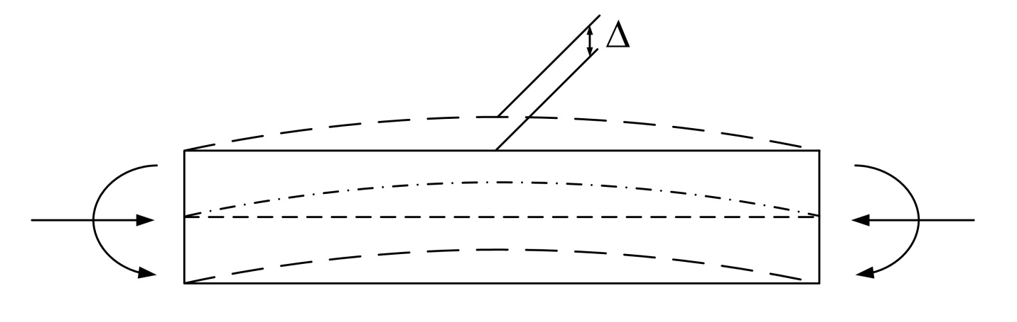
Amplification of Flange Lateral Bending Stresses
In beam-column members subject to axial compression, secondary bending moments arise equal to the compression force times the lateral deflection of the member. Therefore, internal bending moments are amplified.
In an analogous fashion, first-order flange lateral bending stresses in discretely braced compression flanges may need to be amplified to guard against large unbraced lengths in which second-order lateral bending effects may be significant.
Notes:
In beam-column members subject to axial compression, secondary bending moments arise equal to the compression force times the lateral deflection of the member. Therefore, internal bending moments are amplified. In an analogous fashion, first-order flange lateral bending stresses due to potential sources of torsion in discretely braced compression flanges may need to be amplified to guard against large unbraced lengths in which second-order lateral bending effects may be significant (torsion and the computation of first-order flange lateral bending stresses was discussed previously in Lesson 6).
As shown on the figure in this slide, as the compression flange curvature increases under load, additional lateral moment occurs due to the axial force in the compression flange acting through the lateral deflection of the flange (similar to the P-delta effect or amplification effect in beam-columns). This effect occurs in both straight and horizontally curved discretely braced compression flanges. Consideration must therefore be given to amplifying the compression-flange first-order lateral bending stresses in discretely braced compression flanges in certain situations. The amplification effect is considered negligible in discretely braced tension flanges as the lateral deflections of such flanges tend to be much smaller.

Slide 47
Amplification of Flange Lateral Bending Stresses
For unbraced lengths where Article 6.10.8.2.3 is applied to determine the LTB resistance:
For unbraced lengths where Article A6.3.3 (Appendix A6) is applied to determine the LTB resistance:
Article 6.10.1.6
10th Edition: 1.2 1.1
If the applicable equation above is not satisfied, first-order compression flange lateral bending stresses must be amplified; otherwise, amplification of these stresses is not required.
In the left equation, f_{bu}, R_{b} and F_{yc} are taken at the cross-section where f_{bu} is maximum in the unbraced length, including the end cross-sections (i.e., the ‘governing cross-section’).
In the right equation, M_{u} and M_{yc} are taken at the cross-section where M_{u} is maximum in the unbraced length, including the end cross-sections (i.e., the ‘governing cross-section’). R_{b} is taken equal to 1.0.
Notes:
AASHTO LRFD Article 6.10.1.6 specifies that for discretely braced compression flanges, if the applicable equation shown on this slide is not satisfied, then second-order elastic compression-flange lateral bending stresses must be determined (i.e., first-order compression-flange lateral bending stresses must be amplified). The right-hand side of these equations is the limiting value of the unbraced length, L_{b}, for which the amplification factors shown on the next slide are equal to 1.0 (i.e., f = f_{1}). Note that in the 10th Edition AASHTO LRFD Specifications, the coefficient in both of these equations will be changed from 1.2 to 1.1.
The equation on the left-hand side of this slide applies for unbraced lengths in which the equations of Article 6.10.8.2.3 are applied to determine the LTB resistance, and the equation on the right-hand side of this slide applies for unbraced lengths in which the equations of Article A6.3.3 (Appendix A6) are applied to determine the LTB resistance. In the left equation, f_{bu}, R_{b} and F_{yc} are taken at the cross-section where f_{bu} is maximum in the unbraced length, including the end cross-sections (i.e., the so-called ‘governing cross-section’). In the right equation, M_{u} and M_{yc} are taken at the cross-section where M_{u} is maximum in the unbraced length, including the end cross-sections (i.e., the ‘governing cross-section’). R_{b} is always implicitly taken equal to 1.0 whenever the equations of Appendix A6 are applied as web bend-buckling is not a concern for compact-web and non-compact web sections. The appropriate values of the limiting unbraced length, L_{p}, and the moment-gradient modifier, C_{b}, (discussed on previous slides in this lesson) are also substituted into the equations.
In typical cases, the unbraced length, L_{b}, will exceed the limiting value on the right-hand side of the applicable equation, and amplification of the first-order flange lateral bending stresses will be required, as discussed on the next slide.

Slide 48
Amplification of Flange Lateral Bending Stresses
For unbraced lengths where Article 6.10.8.2.3 is applied to determine the LTB resistance:
For unbraced lengths where Article A6.3.3 (Appendix A6) is applied to determine the LTB resistance:
Article 6.10.1.6
In the equations, f_{bu}, M_{u} and S_{xc} are taken at the ‘governing cross-section’.
In the left equation, the elastic LTB resistance, F_{e}, is not limited to R_{b}R_{h}F_{yc} and in the right equation, F_{cr}S_{xc} is not limited to R_{pc}M_{yc}.
The first-order flange lateral bending stress, f_{1}, is taken as the compression-flange lateral bending stress at the section under consideration for FLB, and as the maximum compression-flange lateral bending stress within the unbraced length under consideration for LTB.
Notes:
The additional lateral bending in the compression flange due to the amplification effect may be estimated directly from a geometric nonlinear (i.e., elastic large deflection or second-order) analysis of the superstructure, or more simply and conveniently, by amplifying first-order compression-flange lateral bending stresses by the approximate amplification factors shown on this slide, as given in AASHTO LRFD Article 6.10.1.6. In bridge members, it is generally impractical to calculate second-order flange lateral bending stresses directly for the case of moving live loads. These equations represent an established form of the amplification equation used to estimate maximum second-order elastic moments in braced beam-column members whose ends are restrained by other framing. The purpose of these equations is to guard conservatively against large unbraced lengths in which second-order flange lateral bending effects are significant; for example, in certain construction situations such as when determining the effect of eccentric concrete deck overhang loads acting on exterior-girder flanges. For cases where the amplification of construction dead-load stresses is large, an additional alternative would be to consider conducting a direct geometric nonlinear analysis to more accurately determine the second-order effects. In the final constructed condition, the amplification factor need only be considered for the bottom flange in negative-bending regions in continuous spans. In these cases, however, F_{cr} is increased significantly due to the moment gradient that exists in these regions, through the moment-gradient modifier C_{b}.
The equation on the left-hand side of this slide applies for unbraced lengths in which the equations of Article 6.10.8.2.3 are applied to determine the LTB resistance, and the equation on the right-hand side of this slide applies for unbraced lengths in which the equations of Article A6.3.3 (Appendix A6) are applied to determine the LTB resistance. In the equations, f_{bu}, M_{u} and S_{xc} are taken at the ‘governing cross-section’, as defined on the previous slide. Similar to the established practice when computing the amplification factor for beam-columns, in the left equation, the elastic LTB resistance, F_{cr}, is not limited to R_{b}R_{h}F_{yc} and in the right equation, F_{cr}S_{xc} is not limited to R_{pc}M_{yc} as it would be when calculating the elastic LTB resistance for the design of the compression flange. The first-order flange lateral bending stress, f_{1}, in the equations is taken as the compression-flange lateral bending stress at the section under consideration for FLB, and as the maximum compression-flange lateral bending stress within the unbraced length under consideration for LTB. Amplification factors from these equations on the order of 1.5 to 2.5 are typical.
The equations tend to be significantly conservative for larger unbraced lengths in which f_{bu} also approaches F_{cr}. In cases where the amplification resulting from this equation is large, consideration may be given to using an effective length factor K less than 1.0 in the calculation of the elastic LTB resistance to appropriately increase F_{cr} as discussed previously in this lesson. Another (simpler) alternative of course is to widen the compression flange, which should decrease the amplification factor significantly.

Slide 49
Amplification of Flange Lateral Bending Stresses
In horizontally curved I-girders with L_{b}/R ≥ 0.5, replace L_{b} with KL_{b} = 0.5L_{b} in the determination of the elastic LTB resistance, F_{cr}, when determining the amplification factor using the left equation on the preceding slide to prevent a possible unwinding stability failure.
Notes:
As indicated in AASHTO LRFD Article C6.10.1.6, when determining the amplification of f_{1} in horizontally-curved I-girders with L_{b}/R ≥ 0.05, the elastic LTB resistance, F_{cr}, in the amplification factor equation shown on the left-hand side of the previous slide (recall that the equations of Appendix A6 cannot be used to determine the LTB resistance of horizontally curved I-girders) may be determined by replacing L_{b} with KL_{­b} = 0.5L_{b}. For girders with L_{b}/R < 0.05, L_{b} may be used.
The use of KL­_{b} = 0.5L_{b} for L­_{b}/R ≥ 0.05 gives a better estimate of the amplification of the bending deformations in horizontally curved I-girders associated with the boundary conditions for the flange lateral bending at intermediate cross-frame locations, which are approximately symmetrical, and assumes that an unwinding stability failure of the compression flange is unlikely for this magnitude of the girder horizontal curvature. The figure on this slide illustrates qualitatively, using a straight elastic member for simplicity, the amplified second-order elastic flange lateral deflections associated with horizontal curvature effects, as well as the unwinding stability failure mode.
For nonprismatic unbraced lengths, when using the procedure to appear in the 10th Edition AASHTO LRFD Specification (described on Slides 44 and 45 of this lesson), the substitution of L_{b} with KL_{­b} = 0.5L_{b} should be made in the determination of the elastic lateral-torsional buckling stress used in the computation of the elastic lateral-torsional buckling load ratio, γ_{e}, that is then subsequently used to calculate F_{e}.

Slide 50
DISCRETELY BRACED Tension FLANGES
Notes:
The next topic in this lesson will discuss the design of discretely braced tension flanges for the limit state of concern at the strength limit state; that is, the determination of the nominal flexural resistance of a discretely braced tension flange for the tension flange yielding (TFY) limit state. Flange lateral bending due to torsion must also be considered in the design of a discretely braced tension flange; however, as discussed previously in this lesson, amplification of first-order flange lateral bending stresses is considered negligible in discretely braced tension flanges as the lateral deflections of such flanges tend to be much smaller. The FLB and LTB limit states are also not a consideration for tension flanges.

Slide 51
Tension Flange Yielding (TFY)
The nominal flexural resistance of a discretely braced tension flange based on the limit state of tension flange yielding (TFY) is taken as:
Article 6.10.8.3:
Article A6.4 (Appendix A6):
For sections in which M_{yt} > M_{yc}, tension flange yielding (TFY) does not control and need not be checked.
Notes:
The nominal flexural resistance of a discretely braced tension flange based on the limit state of tension flange yielding (TFY) at the strength limit state expressed in terms of stress, F_{nt}, as given in Article 6.10.8.3 which presumes slender-web behavior, is equal to the hybrid factor, R_{h} (Lesson 6), times the specified minimum yield strength of the tension flange, F_{yt}. As mentioned previously in this lesson, the web load-shedding factor, R_{b} (Lesson 6), is not applied in determining the TFY resistance of slender-web sections since the tension flange stress is not increased significantly by the shedding of the web compressive stresses due to web bend-buckling.
The nominal flexural resistance of a discretely braced tension flange based on the limit state of TFY at the strength limit state expressed in terms of moment, M_{nt}, as given in Article A6.4 (Appendix A6), is equal to the web plastification factor for the tension flange, R_{pt} , times the yield moment with respect to the tension flange, M_{yt}, determined as specified in Article D6.2 (Appendix D6 – Lesson 6). As illustrated previously in Slide 16 of this lesson, this equation implements a linear transition in the flexural resistance between M_{p} and M_{yt} as a function of the web slenderness, 2D_{c}/t_{w}, through the use of R_{pt}, for monosymmetric sections with a larger tension flange and for composite sections in negative flexure where first yielding occurs in the top flange or in the longitudinal reinforcing steel. In the limit that 2D_{c}/t_{w} approaches the noncompact web limit, λ_{r}, this equation reduces to the TFY limit specified in Article 6.10.8.3.
Note again that for sections in which M_{yt} > M­_{yc}, where M_{yc} is the yield moment with respect to the compression flange (Lesson 6), TFY does not control and need not be checked.

Slide 52
continuously BRACED FLANGES
Notes:
The next topic in this lesson will discuss the design of continuously braced flanges in tension or compression for the limit state of concern at the strength limit state; that is, the determination of the nominal flexural resistance of a continuously braced flange for the limit state of nominal flange yielding. As discussed previously in this lesson, flange lateral bending due to torsion, along with the limit states of FLB and LTB, are not a consideration for continuously braced flanges.

Slide 53
Nominal Flange Yielding
The nominal flexural resistance of a continuously braced flange in tension or compression based on the limit state of nominal flange yielding is taken as:
Article 6.10.8.1.3:
Article A6.1.3 (Appendix A6):
Article A6.1.4 (Appendix A6):
Notes:
The nominal flexural resistance of a continuously braced flange in tension or compression based on the limit state of nominal flange yielding at the strength limit state expressed in terms of stress, F_{n}, as given in Article 6.10.8.1.3 which presumes slender-web behavior, is equal to the hybrid factor, R_{h} (Lesson 6), times the specified minimum yield strength of the flange under consideration, F_{yf}. The specification considers the effects of any potential web bend buckling to be negligible for continuously braced flanges, and therefore, the web load-shedding factor, R_{b}, is not included in the equation.
The nominal flexural resistance of a continuously braced flange in compression based on the limit state of nominal flange yielding at the strength limit state expressed in terms of moment, M_{nc}, as given in Article A6.1.3 (Appendix A6), is equal to the web plastification factor for the compression flange, R_{pc} (discussed previously in this lesson), times the yield moment with respect to the compression flange, M_{yc}, determined as specified in Article D6.2 (Appendix D6 – Lesson 6). Similarly, the nominal flexural resistance of a continuously braced flange in tension, M_{nt}, as given in Article A6.1.4 (Appendix A6), is equal to the web plastification factor for the tension flange, R_{pt}, times the yield moment with respect to the tension flange, M_{yt}, determined as specified in Article D6.2 (Appendix D6 – Lesson 6).

Slide 54
Flexural Resistance: One-Third Rule Equations
Notes:
The next topic in this lesson will introduce the base strength limit state flexural resistance equations in the AASHTO LRFD BDS, referred to generically as the “one-third rule equations”. These equations provide a unified approach for considering the combined effects of I-girder major-axis bending, minor-axis bending, and torsion (i.e., flange lateral bending) due to any source. The equations address the combined major-axis and flange lateral bending effects basically by handling the flanges as equivalent beam-columns. The equations can be applied to check the flexural resistance of noncomposite sections, composite sections subject to negative bending, and composite sections subject to positive bending (Lesson 9).

Slide 55
Flexural Resistance: One-Third Rule Equations
Discretely Braced Flanges:
  For members in which the major-axis bending resistance is expressed in terms of the corresponding flange stress:
where:
φ_{f} = resistance factor for flexure (= 1.0)
f_{bu} = factored elastically computed flange major-axis bending stress (ksi). f_{bu} is always taken as positive.
f = factored elastically computed flange lateral bending stress (ksi). f is always taken as positive.
F_{n} = nominal flexural resistance in terms of the flange major-axis bending stress (ksi)
Notes:
The stress form of the one-third rule equation shown on this slide addresses the checking of discretely braced flanges (in compression or tension) for members in which the major-axis bending resistance is expressed in terms of the corresponding flange stress. This equation is targeted specifically at checking of members with slender-web noncomposite sections, slender-web composite sections in negative bending, and noncompact composite sections in positive bending. The slender-web classification was discussed previously in this lesson, and the noncompact section classification for composite sections in positive bending is described in Lesson 9.
In the limit that the flange lateral bending stress f is equal to zero, the equation reduces to the basic member check f_{bu} ≤ φ_{f}F_{n} for major-axis bending alone. The maximum potential value of the nominal flexural resistance, F_{n}, is the flange yield strength F_{yf}, but F_{n} can be less than F_{yf} due to slender-web bend buckling and/or hybrid-web yielding effects (refer to the discussion of the flange-stress reduction factors, R_{b} and R_{h}, in Lesson 6), or due to the compression flange lateral-torsional (LTB) or local buckling (FLB) limit states, which were discussed previously in this lesson. The calculation of F_{n} for noncompact composite sections in positive bending is discussed in Lesson 9.
The sign of f_{bu} and f is always taken as positive in the equation. However, when summing dead and live load stresses to obtain the total factored major-axis and lateral bending stresses, f_{bu} and f, to apply in the equation, the signs of the individual dead and live load stresses must be considered. The calculation of f due to various potential sources of torsion was discussed previously in Lesson 6.

Slide 56
Flexural Resistance: One-Third Rule Equations
Discretely Braced Flanges:
  For members in which the major-axis bending resistance is expressed in terms of the bending moment:
where:
φ_{f} = resistance factor for flexure (= 1.0)
M_{u} = factored member major-axis bending moment (kip-in.). M_{u} is always taken as positive.
f = factored elastically computed flange lateral bending stress (ksi). f is always taken as positive.
S_{x} = elastic section modulus about the major-axis of the section to the flange under consideration (in.³)
M_{n} = nominal flexural resistance in terms of the member major-axis bending moment (kip-in.)
Notes:
The moment form of the one-third rule equation shown on this slide addresses the checking of discretely braced flanges (in compression or tension) for members in which the major-axis bending resistance is expressed in terms of the bending moment. This equation is targeted specifically at checking of members with noncomposite sections and composite sections in negative bending that have compact or noncompact webs, and compact composite sections in positive bending. The compact web and noncompact web classifications were discussed previously in this lesson, and the compact section classification for composite sections in positive bending is described in Lesson 9. The moment format is used because for these types of sections, the major-axis bending moment is physically a more meaningful quantity than the elastically computed flange bending stress. Also, the nominal flexural resistance of these sections is generally greater than the yield moment, M_{y} (Lesson 6). If desired, the equation could be considered in a stress format by dividing both sides of the equation by S_{x}.
In the limit that the flange lateral bending stress f is equal to zero, the equation reduces to the basic member check M_{u} ≤ φ_{f}M_{n} for major-axis bending alone. For the above member types, the nominal flexural resistance, M_{n}, can be as large as M_{p}, where M_{p} is the section plastic moment resistance (Lesson 6). The computation of M_{n} for noncomposite sections and composite sections in negative bending that have compact or noncompact webs was discussed previously in this lesson. The computation of M_{n} for compact composite sections in positive bending will be discussed in Lesson 9.
The sign of M_{u} and f is always taken as positive in the equation. However, when summing dead and live load moment/stresses to obtain the total factored major-axis bending moments and lateral bending stresses, M_{u} and f, to apply in the equation, the signs of the individual dead and live load moments/stresses must be considered.

Slide 57
Flexural Resistance: One-Third Rule Equations
Notes:
For a conceptual explanation of the one-third rule equations, consider an isolated flange of an I-girder with width, b_{f}, and thickness, t_{f}, subjected to combined major-axis and lateral bending, as shown at the top of this slide. If the flange behaves compactly, it can be assumed to develop the strengths associated with the idealized fully-plastic stress distribution shown in the right-hand figure at the top of this slide. Within this idealized stress distribution, the lateral moment is generated by the strips of width c at the tips of the flange, and the remaining width, (b_{f} – 2c), develops the flange force associated with the major-axis bending. By equating the elastic flange force due to the major-axis bending, f_{bu}b_{f}t_{f}, to this fully-plastic flange force, F_{y}(b_{f} – 2c)t_{f}, the elastically-computed major-axis bending stress associated with the flange fully-plastic resistance may be expressed by the equation shown at the bottom left of this slide.
Similarly, by equating the flange lateral moment related to the elastically-computed lateral bending stress, f, to the lateral moment associated with idealized stress distribution shown on the upper right of this slide, the resulting quadratic equation can be solved for the width c, which is given by the equation at the bottom right of this slide.

Slide 58
Flexural Resistance: One-Third Rule Equations
for f ≤ 0.6F_{y}
Notes:
Substituting the width c from the equation given on the preceding slide into the equation for the elastically-computed major-axis bending stress associated with the flange fully-plastic resistance, f_{bu}, also taken from the preceding slide, gives the equation for f_{bu} as a function of the elastically-computed lateral bending stress, f, shown at the bottom left of this slide.
If one considers practical bridge I-girders, where f is typically much smaller than F_{y}, e.g., f ≤ 0.6F_{y}, this equation is approximated accurately by the simple linear equation, f_{bu} = F_{y} – 1/3f.

Slide 59
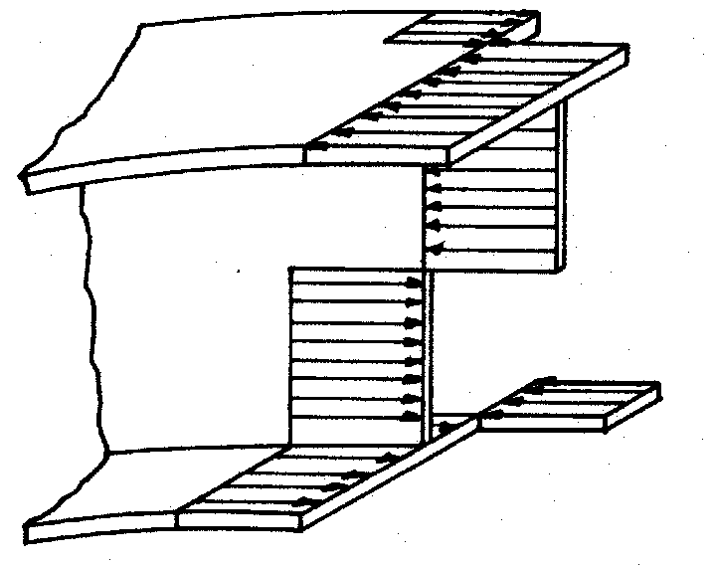
Flexural Resistance: One-Third Rule Equations
For finite A_{w}/A_{f}:
REF: White, D. W., and M. A. Grubb. Unified Resistance Equations for Design of Curved and Tangent Steel Bridge I‑Girders. Proc., 2005 TRB Bridge Engineering Conference, Transportation Research Board, Washington, DC, July 2005.
Notes:
The preceding discussion considers only the theoretical plastic strength of an isolated flange. However, the web also provides a minor but significant contribution to the flexural resistance in general. Consider the idealized fully-plastic stress distribution for a doubly symmetric noncomposite compact-web, compact-flange cross-section shown on this slide. The specific stress distribution shown in the figure is associated with equal and opposite lateral bending in each of the equal-size flanges (i.e., warping of the flanges due to nonuniform torsion – refer to Lesson 6). The solution is the same if one considers equal flange lateral bending moments due to minor-axis bending.
The equation at the top right of this slide represents the ratio of the reduced plastic major-axis bending moment for this section accounting for the flange lateral bending, M_{p}*, to the yield moment in major-axis bending alone, M_{y}. The derivation of this equation based on an integration of the stresses over the cross-section and equilibrium is given in the reference below. The values given by this equation are plotted versus the ratio of f/F_{y} for various ratios of the area of the web, A_{w}, to the area of a single flange, A_{f}. In the limit that A_{w}/A_{f} approaches zero, this equation is equivalent to the equation for f_{bu} given at the bottom left of the preceding slide. Furthermore, this equation is approximated conservatively for finite A_{w}/A_{f} by the equation shown at the bottom left of this slide. This conservatism tends to be minor for practical geometries. The approximate equation may be written in terms of the applied major-axis bending moment by substituting M_{u} for M_{p}*. The graph on this slide illustrates the relationship between this approximate equation and the theoretical fully-plastic cross-section strength for several values of A_{w}/A_{f} up to a ratio of f/F_{y} equal to 0.6.
REF: White, D. W., and M. A. Grubb. Unified Resistance Equations for Design of Curved and Tangent Steel Bridge I‑Girders. Proc., 2005 TRB Bridge Engineering Conference, Transportation Research Board, Washington, DC, July 2005.

Slide 60
Flexural Resistance: One-Third Rule Equations
F_{y} = 50 ksi
REF: White, D. W., and M. A. Grubb. Unified Resistance Equations for Design of Curved and Tangent Steel Bridge I‑Girders. Proc., 2005 TRB Bridge Engineering Conference, Transportation Research Board, Washington, DC, July 2005.
Notes:
The preceding derivations are useful in understanding the conceptual background of the one-third rule equations. However, cross-section yield interaction relationships are limited in their ability to fully characterize the combined influence of distributed yielding along member lengths with the various stability effects (e.g., flange local buckling, lateral-torsional buckling, and web bend buckling). Also, yield interaction equations generally do not reduce to the resistance equations for straight members subjected only to major-axis bending in the limit that f = 0. Fortunately, the equations can be extended to address the influence of general member yielding and stability limit states on the maximum strength by changing M_{p} to the factored flexural resistance, φ_{f}M_{n}, in the moment form of the equation and by changing F_{y} to the factored flexural resistance, φ_{f}F_{n}, in the stress form of the equation. The 1/3 coefficient accurately captures the strength interaction including the various yielding and stability effects. This extension is ad hoc but is similar in many respects to the development of the AISC and AASHTO general beam-column interaction equations. That is, the shape of the interaction equation (i.e., the slope of the line relating M_{u} or f_{bu} and f­ ) is based on curve fitting to analytical, numerical and experimental results. The equations are thus semi-analytical and semi-empirical. In the final form of the equations in the AASHTO LRFD BDS, the flange lateral bending stress terms, 1/3f and 1/3fS_{x}, are brought over to the left-hand side of the equations since they represent a load effect.
The figure on this slide shows a representative example of the maximum flexural resistances obtained from refined finite-element analyses compared to the prediction using the stress form of the one-third rule equation. This figure corresponds to 117 noncompact- and slender-web noncompact-flange (b_{fc}/2t_{fc} = 12.5) I-section members in which the nominal flexural resistance is governed by flange local buckling. The amplification factor, AF, discussed previously in this lesson, and the web load-shedding factor R_{b} (Lesson 6) are both taken equal to one in this figure to simplify the presentation. The R_{b} factor varied from 0.98 to 1.00 for the doubly-symmetric I-sections and 0.89 to 0.97 for the singly symmetric I-sections considered in the finite-element analyses. The AF was equal to one in 84 of these tests but was as large as 2.16 in a few of these studies. The resistances from the refined finite-element analyses are predicted accurately to somewhat conservatively by the one-third rule equation, even with R_{b} and AF taken equal to one.

Slide 61
Flexural Resistance: One-Third Rule Equations
Continuously Braced Flanges:
0
0
Notes:
For continuously braced flanges (in compression or tension), the term in the one-third rule equations containing the flange lateral bending stress, f, is taken equal to zero since, as mentioned previously in this lesson, for a continuously braced flange the lateral resistance of the composite concrete deck is generally sufficient to compensate for the neglect of any initial lateral bending stresses in the flange, as well as any additional lateral bending stresses that may be induced in the flange after the deck hardens.

Slide 62
Flexural Resistance: One-Third Rule Equations
Noncomposite I-Sections during Construction (Article 6.10.3.2):
  Discretely Braced Compression Flanges:
  Discretely Braced Tension Flanges:
Nominal Flange Yielding
FLB and LTB
Tension Flange Yielding (TFY)
Notes:
This slide discusses the application of the one-third rule equations to check the flexural resistance of noncomposite I-sections during construction (AASHTO LRFD Article 6.10.3.2). As illustrated previously in this lesson (Slide 21), both flanges along the entire length of the girder are considered to be discretely braced flanges for the noncomposite steel I-girder during construction. AASHTO LRFD Article 6.10.3.1 states that nominal yielding or reliance on post-buckling resistance is not to be permitted for main load-carrying members during the critical stages of construction. An exception is permitted for the localized yielding of the web that may occur in hybrid members. Since nominal yielding is not permitted during construction, the equations of Appendix A6 are not applicable during construction (except as noted below).
The top equation on this slide ensures that the maximum combined factored major-axis bending and lateral bending stress (after any required amplification) in a discretely braced compression flange during construction will not exceed the specified minimum yield strength of the flange times the hybrid factor, R_{h}. As such, this equation is a nominal yielding limit state check. For members subject to significant lateral bending stresses and for members with compact or noncompact webs, this equation will often control. The equation does not need to be checked for slender-web sections when f is equal to zero. In categorizing the web as compact, noncompact or slender for these checks, the properties of the noncomposite steel section are used. A similar equation applies to check the tension flange yielding (TFY) limit state for the tension flange (see the bottom equation on this slide). Note that for sections that are composite in the final condition, but noncomposite during construction, different values of R_{h} must be computed for the checks in which the member is noncomposite and for the checks in which the member is composite. For hybrid sections in which f_{bu} during construction does not exceed the specified minimum yield strength of the web, F_{yw}, the hybrid factor is to be taken equal to 1.0.
The second equation on this slide ensures that the member has sufficient strength with respect to flange local buckling (FLB) and lateral-torsional buckling (LTB) under the maximum combined factored vertical and lateral bending stress in the discretely braced compression flange during construction. The equation uses the stress-based form of the one-third rule equation since the nominal flexural resistance for constructibility is always expressed in terms of the flange stress. This equation will generally control for members with noncompact flanges having large unsupported lengths during construction in combination with zero or small values of f .The computation of F_{nc} for FLB and LTB was discussed previously in this lesson. Note that for sections in straight I-girder bridges with compact or noncompact webs, Article 6.10.3.2.1 permits the LTB resistance to be determined from the provisions of Article A6.3.3 (Appendix A6), which include the beneficial effect of the St. Venant torsional constant, J. For straight members having larger unbraced lengths during construction that utilize such sections, the additional LTB resistance obtained by including the contribution of J may be beneficial. The resulting LTB resistance, M_{nc}, must be divided by S_{xc} (taken equal to M_{yc}/F_{yc}) to express the resistance in terms of stress for application in the one-third rule equation. The calculated resistance F_{nc} may exceed F_{yc} in some cases, however the first equation on this slide will control in that case ensuring that the combined factored stress in the flange will not exceed F_{yc} during construction.

Slide 63
Flexural Resistance: One-Third Rule Equations
Limitations on the use of the one-third rule equations:
Article 6.10.1.6:
Article 6.7.4.2:
Final Constructed Condition
(horizontally curved I-girder bridges only)
where:
f = factored elastically computed flange lateral bending stress (ksi)
F_{yf} = specified minimum yield strength of the flange under consideration (ksi)
L_{b} = unbraced length (ft)
L_{r} = limiting unbraced length beyond which the base lateral-torsional buckling limit state is elastic (ft)
R = minimum girder radius with the panel under consideration (ft)
Notes:
The AASHTO LRFD BDS specifies some practical limitations on the use of the approximate one-third rule equations. Article 6.10.1.6 specifies that the sum of the factored elastically computed flange lateral bending stresses due to all sources, f, is not to exceed 0.6F_{yf}. The limit is to be applied after any necessary amplification of the first-order flange lateral bending stresses. Amplification of the flange lateral bending stresses was discussed previously in this lesson. For cases in which the elastically computed flange lateral bending stress is larger than 0.6F_{yf}, the reduction in the major-axis bending resistance due to flange lateral bending tends to be greater than that determined based on the approximate one-third rule equations (see the graphs on Slides 59 and 60).
For horizontally curved I-girder bridges in their final constructed condition, Article 6.7.4.2 specifies the limits given by the second equation on this slide. Limiting the unbraced length to L_{r} (discussed previously in this lesson) theoretically precludes elastic lateral–torsional buckling of the compression flange. At unbraced lengths beyond L_{r}, significant flange lateral bending is likely to occur and the amplification factor for flange lateral bending will tend to become large. The R/10 limit is a practical upper bound for the subtended angle between the cross-frame locations (for constant R) based on past practice. It ensures that the I-girder webs will not have a d_{o}/R larger than 0.1, where d_{o} is the spacing of the transverse stiffeners. The unbraced length in curved I-girder bridges is further limited to 30 feet. A similar limit does not exist for straight I-girder bridges in the AASHTO LRFD BDS.

Slide 64
Flexural Resistance: One-Third Rule Equations
Application of the one-third rule equations (Article 6.10.1.6):
  For design checks where the flexural resistance is based on lateral-torsional buckling (LTB):
  Article 6.10.8.2.3 -> f_{bu} shall be determined as the largest value of the factored compressive stress throughout the unbraced length under consideration, including the end cross-sections (referred to as the ‘governing cross-section’).
  Article A6.3.3 -> M_{u} shall be determined as the largest value of the factored major-axis bending moment throughout the unbraced length under consideration, including the end cross-sections (referred to as the ‘governing cross-section’).
  The stress, f, shall be determined as the largest value of the stress due to lateral bending throughout the unbraced length in the flange under consideration.
Notes:
The proper application of the one-third rule equations depends on whether the flexural resistance is based on lateral-torsional buckling (LTB), or whether the flexural resistance is based on yielding, flange local buckling (FLB), or web bend-buckling (AASHTO LRFD Article 6.10.1.6).
As indicated on this slide, for design checks where the flexural resistance is based on the provisions of Article 6.10.8.2.3 for lateral-torsional buckling (LTB), which presume slender-web behavior, f_{bu} in the stress-based form of the one-third rule equation is to be determined as the largest value of the factored compressive stress throughout the unbraced length under consideration, including the end cross-sections. As mentioned several times previously in this lesson, this cross-section is referred to as the ‘governing cross-section’.
For design checks where the flexural resistance is based on the provisions of Article A6.3.3 (Appendix A6) for lateral-torsional buckling (LTB), M_{u} in the moment-based form of the one-third rule equation is to be determined as the largest value of the factored major-axis bending moment throughout the unbraced length under consideration, including the end cross-sections, which again is referred to as the ‘governing cross-section’.
In either case, the flange lateral bending stress, f, in the applicable one-third rule equation is to be taken as the largest value of the stress throughout the unbraced length in the flange under consideration.
The use of maximum values within the unbraced length, when the resistance is governed by member stability, i.e., LTB, is consistent with established practice in the proper application of beam-column interaction equations.
For unbraced lengths where the member consists of noncomposite monosymmetric sections and is subject to reverse-curvature bending, the LTB resistance is to be checked for both flanges, unless the top flange is considered to be continuously braced.

Slide 65
Flexural Resistance: One-Third Rule Equations
Application of the one-third rule equations (Article 6.10.1.6 - 10th Edition):
  For design checks where the flexural resistance is based on lateral-torsional buckling (LTB):
  Article 6.10.8.2.3 -> f_{bu} shall be determined as the value of the factored compressive stress at the cross-section where f_{bu}/R_{b}R_{h}F_{yc} is maximum in the unbraced length under consideration, including the end cross-sections (referred to as the ‘governing cross-section’).
  Article A6.3.3 -> M_{u} shall be determined as the value of the factored major-axis bending moment at the cross-section where M_{u}/R_{pc}M_{yc} is maximum in the unbraced length under consideration, including the end cross-sections (referred to as the ‘governing cross-section’).
  The stress, f, shall be determined as the largest value of the stress due to lateral bending throughout the unbraced length in the flange under consideration.
Notes:
In the 10th Edition AASHTO LRFD Specification, the governing cross-section for design checks where the flexural resistance is based on LTB will be determined slightly differently. As indicated on this slide, for design checks where the flexural resistance is based on the provisions of Article 6.10.8.2.3 for lateral-torsional buckling (LTB), which presume slender-web behavior, f_{bu} in the stress-based form of the one-third rule equation will be determined as the value of the factored compressive stress at the cross-section where f_{bu}/R_{b}R_{h}F_{yc} is maximum in the unbraced length under consideration, including the end cross-sections.
For design checks where the flexural resistance is based on the provisions of Article A6.3.3 (Appendix A6) for lateral-torsional buckling (LTB), M_{u} in the moment-based form of the one-third rule equation will be determined as the value of the factored major-axis bending moment at the cross-section where M_{u}/R_{pc}M_{yc} is maximum in the unbraced length under consideration, including the end cross-sections.
In either case, the flange lateral bending stress, f, in the applicable one-third rule equation will still be taken as the maximum value of the stress throughout the unbraced length in the flange under consideration.
For noncomposite unbraced lengths subjected to reverse-curvature bending, the maximum f_{bu}/R_{b}R_{h}F_{yc} or M_{u}/R_{pc}M_{yc}, as applicable, is to be determined considering both flanges. For unbraced lengths subjected to reverse-curvature bending in which one of the flanges is continuously braced, the maximum f_{bu}/R_{b}R_{h}F_{yc} or M_{u}/R_{pc}M_{yc}, as applicable, is to be determined considering only the flange that is not continuously braced.

Slide 66
Flexural Resistance: One-Third Rule Equations
Application of the one-third rule equations (Article 6.10.1.6):
  For design checks where the flexural resistance is based on yielding, flange local buckling (FLB), or web bend-buckling:
  f_{bu}, M_{u}, and f may be determined as the corresponding values at the section under consideration.
Notes:
As indicated on this slide, for design checks where the flexural resistance is based on yielding (e.g., tension flange yielding (TFY) or nominal flange yielding), flange local buckling (FLB), or web bend-buckling, f_{bu}, M_{u}, and f in the applicable equation may be determined as the corresponding values at the section under consideration. The web bend-buckling limit state was discussed previously in Lesson 7.
Yielding, flange local buckling (FLB), and web bend-buckling are considered as cross-section limit states. Hence, the Engineer is allowed to use coincident cross-section values of f_{bu} and f_{ℓ} or M_{u} when checking these limit states. Generally, this approach necessitates checking of the limit states at various cross sections along the unbraced length. When the maximum values of f_{bu} and f_{ℓ} or M_{u} occur at different locations within the unbraced length, it is conservative to use the maximum values in a single application of the applicable one-third rule equation for checking yielding and FLB. Flange lateral bending is not considered in the web bend-buckling resistance equations as the flange lateral bending stress is approximately zero in the vicinity of the web-flange juncture.

Slide 67
EXAMPLES
Notes:
Next, the application of the preceding requirements to a noncomposite I-section in positive bending during construction and to composite I-sections in negative bending at the strength limit state within critical unbraced lengths of a straight I-girder bridge will be illustrated using excerpts from NSBA Steel Bridge Design Handbook Design Example 1.

Slide 68
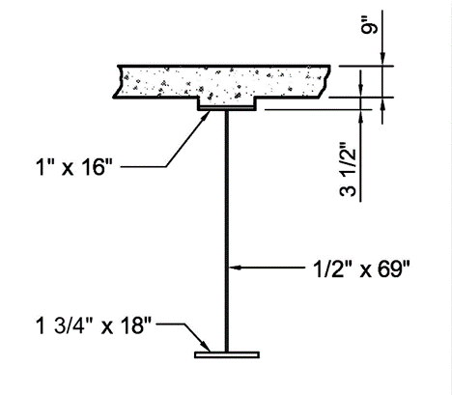
Example – Noncomposite Section during Construction
Example – taken from NSBA SBDH Design Example 1 (positive moment section – exterior girder)
Check the flexural resistance of the noncomposite section within the unbraced length shown on the next slide during construction (i.e., during the deck placement )
Use a load factor = 1.4 (AASHTO LRFD Article 3.4.2.1)
F_{yt} = F_{yc} = F_{yw} = 50 ksi
D_{c} = 41.26 in. (Lesson 6 – Slide 17)
Notes:
In this example, the flexural resistance of the noncomposite steel section shown on this slide, within the critical unbraced length shown on the next slide, will be checked during construction (i.e., during the deck placement). The section shown is taken from Design Example 1 of the NSBA Steel Bridge Design Handbook (SBDH). The girder is an exterior girder, and the section is in a positive moment region in the end span of the three-span continuous girder (at 0.4L). Unshored construction is assumed. The section is a homogeneous section with a specified minimum yield strength of the tension (bottom) flange, F_{yt}, of 50 ksi. The specified minimum yield strength of the compression (top) flange and the web is also 50 ksi. The elastic depth of the web in compression, D_{c}, for the noncomposite steel section alone is determined from the elastic section property calculations for this section given previously on Slide 17 of Lesson 6; i.e., (d_{top of steel} – t_{fc}) = (42.26 in. – 1.0 in.) = 41.26 in.
A load factor of 1.4 will be applied to the loads during the deck placement. AASHTO LRFD Article 3.4.2.1 specifies that in addition to the applicable strength load combinations, primary steel superstructure components are to be investigated for an additional load combination equal to 1.4 times the component dead loads, DC, and any construction loads that are applied to the fully erected steelwork (refer to Slide 15 in Lesson 7). The load modifier η is assumed to be 1.0. This load combination controlled over the Strength I and Strength III load combinations that were investigated separately for this case – refer to NSBA SBDH Design Example 1 for those calculations.

Slide 69
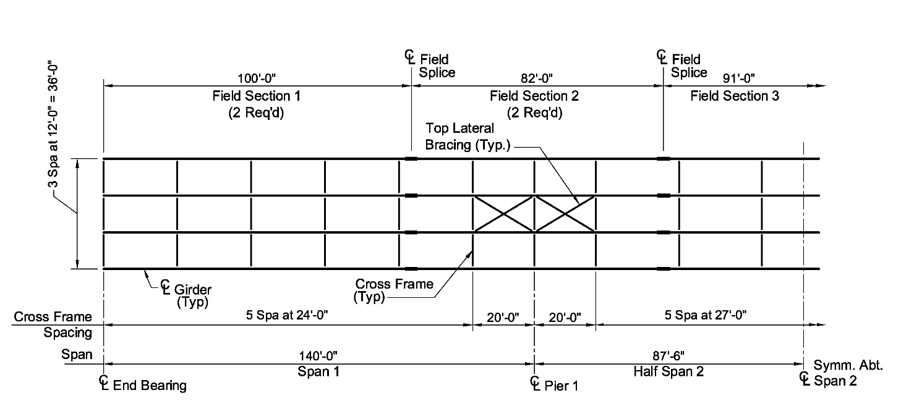
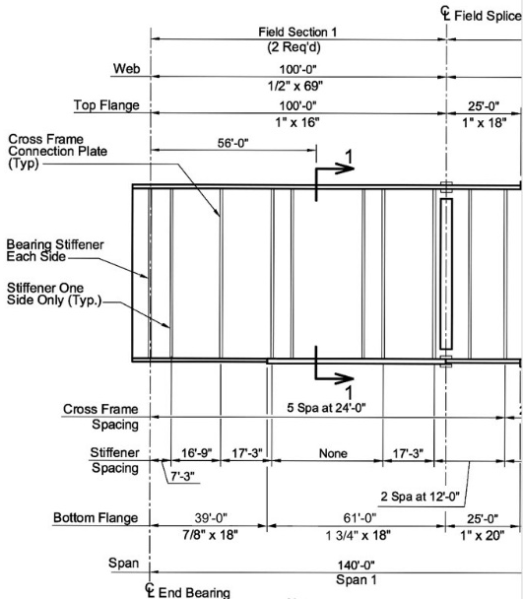
Example – Noncomposite Section during Construction
L_{b} = 24’-0”
Deck Placement Sequence (Lesson 7 – Slide 35)
Top (compression) flange: f_{bu} = -29.74 ksi
Bottom (tension) flange: f_{bu} = 20.75 ksi
Factored
Deck Overhang Loads (Lesson 6 – Slides 94-99)
Top flange: f_{1} = 8.26 ksi
Bottom flange: f_{1} = 3.73 ksi
Factored
Notes:
A plan view of the framing plan for the example bridge is shown at the top of this slide. The bridge has four girders in the cross section spaced at 12′-0”. The framing plan shown is symmetrical about the centerline of Span 2. The top lateral bracing members adjacent to Pier 1 are shown only for reference in the NSBA Design Example and were not included in the final design. The critical unbraced length of interest in the end span (Span 1) is indicated; the unbraced length, L_{b}, or distance between the cross-frames is 24′-0”. As pointed out in the partial girder elevation of the end span shown at the bottom of this slide, the girder is prismatic within this unbraced length; i.e., the member cross-section does not vary within the unbraced length.
The maximum factored major-axis bending stresses, f_{bu}, in the top (compression) and bottom (tension) flanges of the noncomposite steel section during the deck placement are shown. These stresses were computed previously in Slide 35 of Lesson 7. The factored compressive stress in the top flange is -29.74 ksi and the factored tensile stress in the bottom flange is 20.75 ksi. The maximum factored first-order flange lateral bending stresses, f_{1}, at the cross-frames at each end of this unbraced length due to the deck overhang loads are also shown. The computation of the factored top-flange first-order lateral bending stress was illustrated previously in Lesson 6 (Slides 94 to 99) and was computed to be 8.26 ksi. The computation of the factored bottom-flange first-order lateral bending stress is similar and is computed separately to be 3.73 ksi, as the bottom flange is wider (and larger) than the top flange.

Slide 70
Example – Noncomposite Section during Construction
Determine the section classification:
Check the noncompact web slenderness limit (Slide 11):
Section is a slender-web section
Notes:
The first step is to determine the section classification. The web slenderness, 2D_{c}/t_{w}, of the noncomposite section will be checked against the noncompact slenderness limit, λ_{rw}, given by the equation shown at the top of this slide (refer to Slide 11 in this lesson). The calculated edge coefficient, k_{e}, in this case is computed to be 5.04, which is in-between the limits on k_{e} of 4.6 and 5.7. Therefore, the noncompact web slenderness limit, λ_{rw}, based on k_{e} = 5.04 is equal to 121.4. The calculated value of 2D_{c}/t_{w} for the noncomposite section is 165.0, which is greater than λ_{rw} =121.4. Thus, the section is a slender-web section.
As a result, for the discretely braced top (compression) flange within this unbraced length, the LTB resistance of the unbraced length must be computed using the provisions of Article 6.10.8.2.3, the nominal yielding check given by the 1st equation on Slide 62 of this lesson must be made since the top-flange lateral bending stress, f_{1}, is greater than zero, and web bend-buckling must also be checked since the section is a slender-web section (refer to Slides 64 and 65 in Lesson 7 for an illustration of this check).

Slide 71
Example – Noncomposite Section during Construction
Determine the top-flange local buckling resistance, (F_{nc})_{FLB}:
(Slide 27)
Compact flange
Notes:
Next, the top-flange local buckling resistance, (F_{nc})_{FLB}, will be determined. The projecting slenderness, λ_{f}, of the top (compression) flange is computed to be 8.0. The limiting slenderness for a compact flange, λ_{pf} (refer to Slide 27 of this lesson), is computed to be 9.2 (Anchor Point 1). Since λ_{f} is less than λ_{pf}, the FLB resistance is equal to the plateau strength, F_{max}, given as R_{b}R_{h}F_{yc} (refer to the figure at the bottom of this slide). The top flange is a compact flange for FLB.
Since a separate explicit check is made to prevent web bend-buckling during construction (Lesson 7), the web load-shedding factor, R_{b}, is always taken equal to 1.0 for the constructibility checks in the AASHTO LRFD BDS since if web bend-buckling is prevented, there can be no shedding of the web compressive stresses to the compression flange. The section is homogeneous and so the hybrid factor, R_{h} is also equal to 1.0. Therefore, the top-flange local buckling resistance, (F_{nc})_{FLB}, computed from the equation for the plateau strength given in Article 6.10.8.2.2 is equal to F_{max} = 50.0 ksi.

Slide 72
Example – Noncomposite Section during Construction
Determine the lateral-torsional buckling resistance, (F_{nc})_{LTB}, of the unbraced length:
(Slide 33)
$$F_{yr}=\min{(}0.7F_{yc}, F_{yw})≥0.5F_{yc}=0.7F_{yc}=0.7(50)=35.0 ksi>0.5(50)=25.0 ksi$$
(Slide 35)
Assume K = 1.0
Noncompact Unbraced Length
Notes:
Next, determine the lateral-torsional buckling resistance, (F_{nc})_{LTB}, of the unbraced length. As mentioned previously, the unbraced length under consideration is prismatic. Therefore, compute the radius of gyration for LTB, r_{t}, from the top equation shown on this slide (refer to Slide 33 of this lesson), which is equal to 3.86 in. Given r_{t}, the limiting unbraced length to achieve the maximum potential flexural resistance for LTB under uniform bending, L_{p} (refer also to Slide 33), is computed to be 7.75 feet (Anchor Point 1).
The compression flange stress at the nominal onset of yielding, F_{yr}, is taken as 0.7F_{yc} (refer to Slide 35 of this lesson) or 35.0 ksi. Given r_{t} and F_{yr}, the limiting unbraced length corresponding to the nominal onset of yielding effects under uniform bending with consideration of compression-flange residual stresses and geometric imperfections, L_{r} (refer also to Slide 35), is computed to be 29.09 feet (Anchor Point 2).
Assuming for this example that the effective length factor for LTB, K, is equal to 1.0 (which is typically done), KL_{b} of 24 feet falls in-between the two anchor points, L_{p} and L_{r}, indicating that the unbraced length is a noncompact unbraced length, as shown graphically on the next slide.

Slide 73
Example – Noncomposite Section during Construction
Determine the lateral-torsional buckling resistance, (F_{nc})_{LTB}, of the unbraced length - cont.:
Since f_{mid} > f₂, C_{b} = 1.0 (Slide 39)
(Slide 41)
Noncompact Unbraced Length
$${\left(F_{nc}\right)}_{LTB}=1.0\left[1−\left(1−\frac{35.0}{(1.0)(50)}\right)\left(\frac{24.0−7.75}{29.09−7.75}\right)\right](1.0)(1.0)(50)=38.58 ksi<(1.0)(1.0)(50)=50.0 ksi$$
Notes:
Referring to the figure shown on this slide, the unbraced length, KL_{b} = 24.0 feet, falls in-between the two anchor points, L_{p} and L_{r}. Therefore, the unbraced length is a noncompact unbraced length for which residual stresses and initial imperfections give rise to inelastic lateral-torsional buckling, represented in the AASHTO LRFD BDS by a linear transition curve.
For this example, since the unbraced length under consideration contains the section of maximum positive moment during the deck placement, the factored major-axis bending stress at the middle of the unbraced length, f_{mid}, is greater than the larger compressive stress at either end of the unbraced length, f₂, by inspection. Therefore, as specified in Article 6.10.8.2.3, C_{b} for this unbraced length is to be taken equal to 1.0 (refer to Slide 39 in this lesson). Since C_{b} is taken equal to 1.0, the equivalent procedures of Article D6.4.1 (discussed on Slide 38 of this lesson) will provide no increase in the LTB resistance.
Again, since a separate explicit check is made to prevent web bend-buckling during construction (Lesson 7), the web load-shedding factor, R_{b}, is always taken equal to 1.0 for the constructibility checks in the AASHTO LRFD BDS. The section is homogeneous and so the hybrid factor, R_{h} is also equal to 1.0. Therefore, the lateral-torsional buckling resistance of this unbraced length, computed from the linear equation given in Article 6.10.8.2.3 (refer to Slide 41 in this lesson) is computed to be 38.58 ksi.
(Note that the LTB resistance for this unbraced length computed using the revised provisions in the 10th Edition AASHTO LRFD Specifications that were described previously in this lesson is (F_{nc})_{LTB} = 35.74 ksi. The difference is primarily due to the changes in the values of L_{p} and F_{yr} to be implemented in the 10th Edition.)

Slide 74
Example – Noncomposite Section during Construction
Determine if amplification of the first-order flange lateral bending stresses in the top (compression) flange is required:
Check the limiting unbraced length for amplification (Slide 47):
Amplification of the top-flange f_{1} is required
(Slide 48)
(Slide 36)
Notes:
Next, determine if amplification of the first-order flange lateral bending stresses in the discretely braced top (compression) flange due to the deck overhang loads is required. Referring to Slide 47 in this lesson, the limiting unbraced length above which amplification of the first-order flange lateral bending stresses, f_{1}, is required for unbraced lengths where Article 6.10.8.2.3 is applied to determine the LTB resistance is given by the top equation on this slide (Article 6.10.1.6). In the equation, f_{bu} is to be taken as the largest value throughout the unbraced length, including the end cross-sections (i.e., the ‘governing cross-section’), which in this case is at the section of maximum positive moment during the deck placement; therefore, f_{bu} = -29.74 ksi (refer to Slide 69 in this lesson). Substituting in the remaining values computed previously in this example, the limiting unbraced length is 12.06 ft, which is less than the unbraced length, L_{b}, of 24.0 ft; therefore, amplification of the first-order top-flange lateral bending stresses is required.
Referring to Slide 48 in this lesson, the amplification factor for unbraced lengths where Article 6.10.8.2.3 is applied to determine the LTB resistance is given by the parenthetical expression within the equation shown in the middle of this slide (Article 6.10.1.6). F_{cr} is the elastic lateral-torsional buckling stress given by the equation shown at the bottom left of this slide (refer to Slide 36 in this lesson). Substituting into this equation gives F_{cr} equal to 51.41 ksi, which exceeds R_{b}R_{h}F_{yc} equal to 50 ksi. However, as discussed previously in this lesson, when computing the amplification factor, F_{cr} is not limited to R_{b}R_{h}F_{yc} as it would be when calculating the elastic LTB resistance for the design of the compression flange.

Slide 75
Example – Noncomposite Section during Construction
Determine if amplification of the first-order flange lateral bending stresses in the top (compression) flange is required - cont.:
Amplification of the bottom-flange f_{1} is not required (i.e., AF = 1.0)
Notes:
Substituting the values of f_{bu} and F_{cr} into the equation for the amplification factor, AF, shown on the previous slide gives an amplification factor of 2.02. This factor will be applied to the first-order flange lateral bending stresses in the discretely braced top (compression) flange due to the overhang bracket loads. Since the bottom flange within this unbraced length is a discretely braced tension flange, amplification of the bottom-flange first-order lateral bending stresses due to the deck overhang loads is not required as discussed previously in this lesson (i.e., AF = 1.0).
For the FLB flexural resistance checks, f_{1} may be taken as the first-order flange lateral bending stress at the section under consideration. However, in this example, f_{1} will conservatively be taken as the maximum value within the unbraced length, which is at the cross-frames. The maximum value of f_{1} must be used for the LTB flexural resistance checks.
The calculation of the amplified flange lateral bending stress in each flange, f, due to the deck overhang loads for the flexural resistance checks is shown at the bottom of the slide. The amplified f in the top (compression) flange is equal to 16.69 ksi and the amplified f in the bottom (tension) flange is equal to 3.73 ksi. Both of these amplified flange lateral bending stresses are less than the specified upper limit on f of 0.6F_{yf} = 30.00 ksi (Article 6.10.1.6 – refer to Slide 63 in this lesson). As discussed previously, this represents a practical upper limit on f for the use of the approximate one-third rule equations for determining the flexural resistance under combined major-axis and lateral bending.

Slide 76
Example – Noncomposite Section during Construction
Check the flexural resistance (Slide 62):
  Discretely Braced Top (Compression) Flange
Nominal Yielding Check
FLB and LTB Strength Check
Slide 71
Slide 73
Notes:
With all the data now assembled, check the flexural resistance of the noncomposite section during the deck placement (refer to Slide 62 in this lesson). The discretely braced top (compression) flange will be checked first. In this case, the maximum values of f_{bu} and f within the unbraced length are conservatively used in all of the checks, including in the FLB and nominal yielding and tension flange yielding (TFY) checks. The size of the top flange and the cross-frame spacing in regions of positive bending is typically controlled by these constructibility checks.
The nominal yielding check ensures that the factored tip stress in the flange due to the combined major-axis bending stress from the sequential deck placement plus the amplified flange lateral bending stress due to the deck overhang loads does not exceed the specified minimum yield strength of the flange, F_{yc}, times the hybrid factor, R_{h}. The resistance factor for flexure, φ_{f}, is equal to 1.0 (AASHTO LRFD Article 6.5.4.2). Since f is greater than zero in this case, this equation must be checked. The flange tip stress is compression on one tip and tension on the other tip, but the magnitude of the stresses is the same; therefore, the absolute value of the stresses may be summed. The factored tip stress of 46.43 ksi is less than φ_{f}R_{h}F_{yc} equal to 50 ksi.
The strength check for FLB and LTB uses the stress-based form of the one-third rule equation. For FLB, the factored major-axis bending stress due to the sequential deck placement plus one-third of the factored amplified flange lateral bending stress due to the deck overhang loads of 35.30 ksi is less than φ_{f} times (F_{nc})_{FLB} of 50.00 ksi (Slide 71 in this lesson). For LTB, the combined factored stress of 35.30 ksi is just below φ_{f} times (F_{nc})_{LTB} of 38.58 ksi (Slide 73 in this lesson). The discretely braced top flange satisfies the flexural resistance checks.

Slide 77
Example – Noncomposite Section during Construction
Check the flexural resistance (Slide 62) - cont.:
  Discretely Braced Bottom (Tension) Flange
Tension Flange Yielding (TFY) Check
For the web bend-buckling and web shear buckling checks during construction, refer to Lesson 7.
Notes:
The discretely braced bottom (tension) flange is subject only to a tension flange yielding (TFY) check (refer to Slide 62 in this lesson); FLB and LTB are not a consideration for tension flanges.
The factored tip stress in the bottom flange of 24.48 ksi is significantly less than φ_{f}R_{h}F_{yt} equal to 50 ksi. The discretely braced bottom flange satisfies the flexural resistance check. The bottom flange of the noncomposite section in positive bending regions typically does not control during construction. The bottom flange is generally wider (and larger) than the top flange in these regions, plus amplification of the first-order flange lateral bending stresses is not required for tension flanges. In straight I-girder bridges, the bottom flange size is typically controlled by service or fatigue limit state criteria (Lesson 7).
Finally, for slender-web sections, web bend buckling during construction must also be checked (AASHTO LRFD Article 6.10.3.2.1). Web bend buckling does not need to be checked for compact-web and noncompact-web sections. Web shear buckling during construction must also be checked for all sections. These checks were demonstrated previously in Lesson 7. The noncomposite section in this example also satisfied both of these checks.

Slide 78
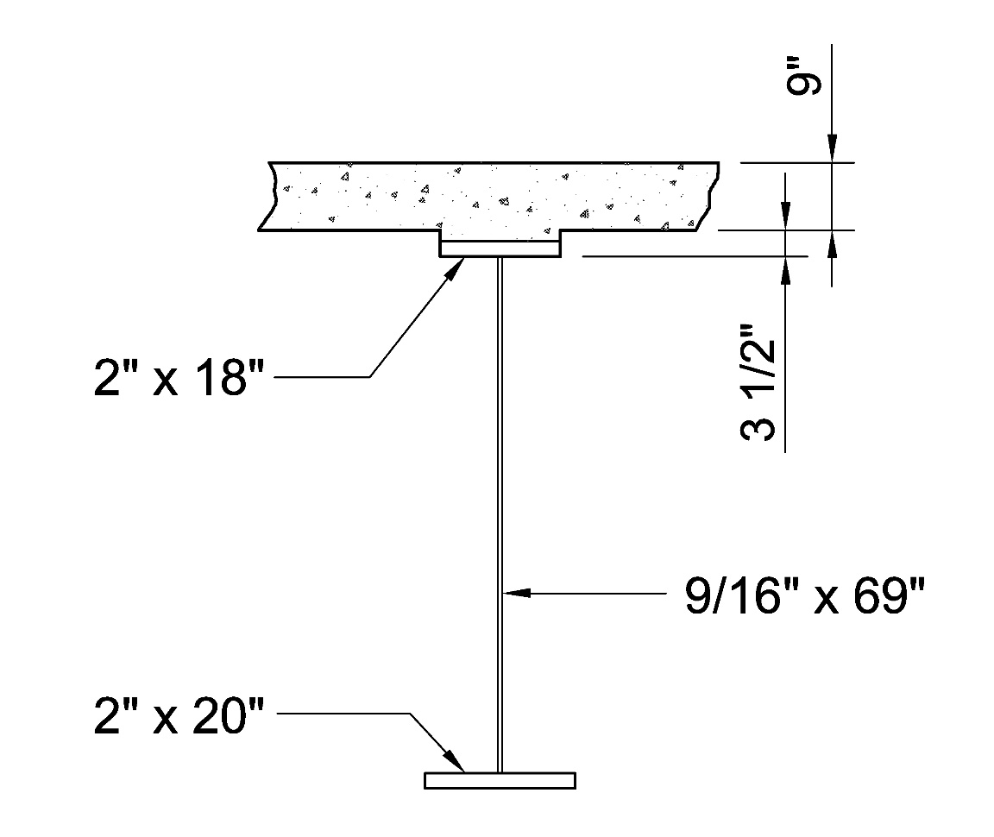
Example – Composite Sections in Negative Bending Strength Limit State
Example – taken from NSBA SBDH Design Example 1 (interior-pier section – negative moment - exterior girder – hybrid section)
Check the flexural resistance of the composite sections in negative bending within the unbraced length shown on the next slide for the Strength I load combination.
The concrete in tension is ignored at the strength limit state
A_{rs} = 10.56 in.²; F_{yc} = F_{yt} = 70 ksi; F_{yw} = 50 ksi
Centroid of A_{rs} is 4.63 in. from the bottom of the deck.
D_{c} = 36.96 in. (Lesson 6 – Slide 36)
Notes:
In this example, the flexural resistance of the composite sections in negative bending within the critical unbraced length shown on the next slide, will be checked at the strength limit state. The sections are taken from Design Example 1 of the NSBA Steel Bridge Design Handbook (SBDH). The girder is an exterior girder, and the section shown on this slide is at an interior pier, which is in a negative moment region of a three-span continuous girder (at 1.0L). Unshored construction is assumed. The section is a hybrid section with a specified minimum yield strength of the compression (bottom) flange, F_{yc}, and tension (top) flange, F_{yt}, of 70 ksi. The specified minimum yield strength of the web, F_{yw}, is 50 ksi. The longitudinal reinforcement is included in the calculation of the composite section properties and the concrete in tension is ignored at the strength limit state. The area of the minimum 1 percent longitudinal reinforcement was computed previously to be 10.56 in.², and the centroid of the longitudinal reinforcement (assumed placed in two layers) was computed previously to be 4.63 in. from the bottom of the structural concrete deck (refer to Slide 34 of Lesson 6). The elastic depth of the web in compression, D_{c}, for the steel section plus the longitudinal reinforcement (which is to be used at the strength limit state – refer to Slide 54 of Lesson 6) is determined from the elastic section property calculations for this section given previously on Slide 36 of Lesson 6; i.e., (d_{bot of steel} – t_{fc}) = (38.96 in. – 2.0 in.) = 36.96 in.
The check will be made for the Strength I load combination. The load modifier η is assumed to be 1.0. The Strength I load combination and load modifier were previously discussed in Lesson 3. This load combination controlled over the Strength III, Strength IV, and Strength V load combinations that were investigated separately for this case – refer to NSBA SBDH Design Example 1 for those calculations.

Slide 79
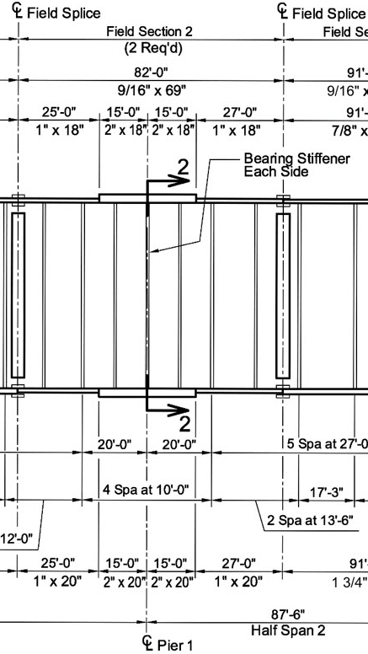
Example – Composite Sections in Negative Bending Strength Limit State
L_{b} = 20′-0”
Strength I – interior pier (Lesson 6 – Slide 48)
Top (tension) flange: f_{bu} = 52.81 ksi
Bottom (compression) flange: f_{bu} = -55.25 ksi
Factored
Noncomposite steel section: S_{bot of steel} = 3,149 in.³
Steel section + long. reinf.: S_{bot of steel} = 3,327 in.³
(20.0 – 15.0) ft/20.0 ft = 0.25L_{b} > 0.20L_{b}
Notes:
A plan view of the framing plan for the example bridge is shown at the top of this slide. The bridge has four girders in the cross section spaced at 12’-0”. The framing plan shown is symmetrical about the centerline of Span 2. The top lateral bracing members adjacent to Pier 1 are shown only for reference in the NSBA Design Example and were not included in the final design. The critical unbraced length of interest in the end span (Span 1) adjacent to the interior pier (Pier 1) is indicated; the unbraced length, L_{b}, or distance between the cross-frames is 20′-0”. As pointed out in the partial girder elevation adjacent to Pier 1 on the right-hand side of this slide, the girder is nonprismatic within this unbraced length; i.e., a section change is located at 15′-0” from Pier 1. The bottom (compression) flange transitions from 2” x 20” to 1” x 20” and the top (tension) flange transitions from 2” x 18” to 1” x 18”. For constant-width flanges, the maximum 50 percent reduction in the flange thickness at the welded flange transitions is recommended.
The factored major-axis bending stresses, f_{bu}, in the bottom (compression) and top (tension) flanges of the composite section for the Strength I load combination at the interior pier (Pier 1) are shown, along with the section moduli to the bottom flange for the noncomposite steel section and the steel section plus the longitudinal reinforcement. The computation of the bottom-flange stress was illustrated previously on Slide 48 of Lesson 6. Similar computations were used to compute the top-flange stress. The factored compressive stress in the bottom flange is -55.25 ksi and the factored tensile stress in the top flange is 52.81 ksi.
Since the cross-section transition is located further than 20 percent of the unbraced length from the brace point with the smaller moment in this case (i.e., 25 percent), as shown at the bottom right of this slide, the unbraced length must be designed for LTB as a prismatic unbraced length using the smaller section, with C_{b} and K taken equal to 1.0 (refer to Slide 43 in this lesson). Therefore, it will be necessary to compute the section properties of the smaller section and the factored major-axis bending stresses in the smaller section at the flange transition.

Slide 80
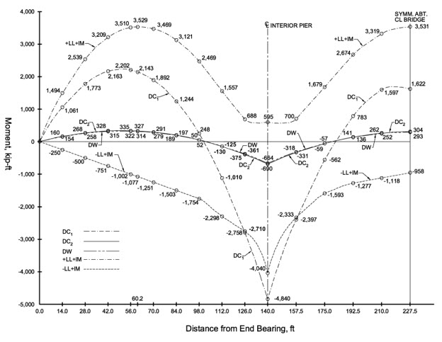
Example – Composite Sections in Negative Bending Strength Limit State
Calculate the maximum factored bending stress at 0.89L (i.e., at 125 ft from Abutment 1 in Span 1). The unfactored bending moments at this point are as follows:
M_{DC1} = -2,589 kip-ft
M_{DC2} = -358 kip-ft
M_{DW} = -344 kip-ft
M_{-LL+IM} = -2,709 kip-ft
The section moduli to the bottom flange are:
Noncomposite steel section: S_{bot of steel} = 1,789 in.³
Steel section + long. reinf.: S_{bot of steel} = 1,995 in.³
Notes:
The unfactored negative moments at the cross-section transition in Span 1 located 15′-0” from Pier 1 (or 125′-0” into Span 1 from Abutment 1) are summarized on the slide. Also summarized are the section moduli to the bottom flange of the smaller section at this location for the noncomposite steel section and for the steel section plus the longitudinal reinforcement. The section property calculations are similar to those described previously on Slides 17 and 36 in Lesson 6.

Slide 81
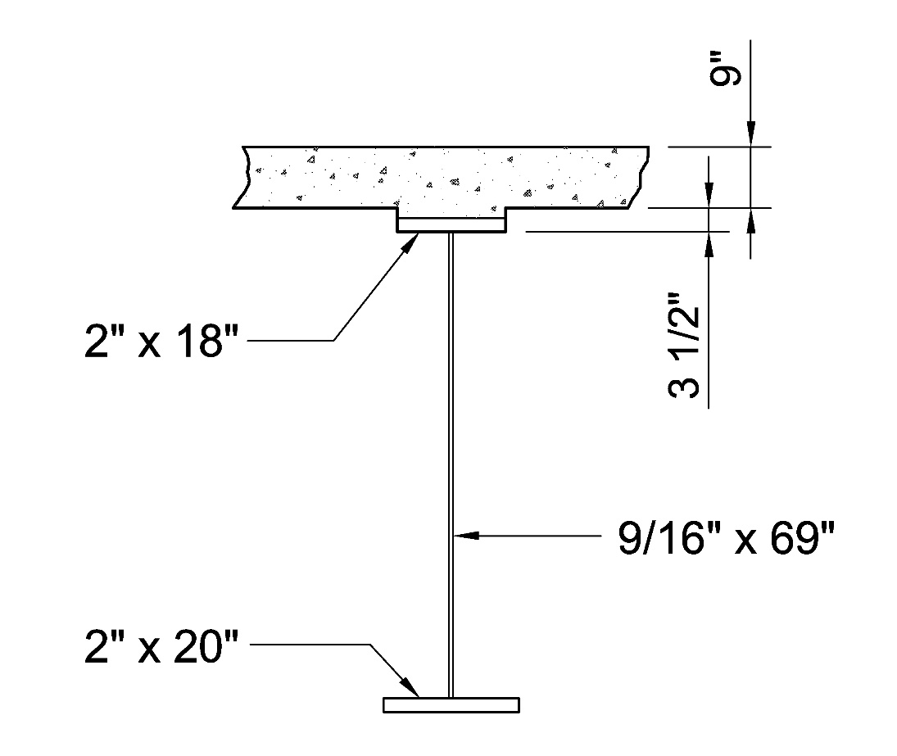
Example – Composite Sections in Negative Bending Strength Limit State
1
1
Bottom (compression) flange:
D_{c} = 38.85 in.
Top (tension) flange: f_{bu} = 49.67 ksi
Notes:
The calculation of the maximum factored bending stress, f_{bu}, in the bottom (compression) flange of the smaller section at the cross-section transition for the Strength I load combination is illustrated for each of the loads: DC₁, DC₂, DW and +LL+IM. The stress is equal to the moment divided by the appropriate section modulus to the bottom of the girder. Again, the load modifier, η, in each case is taken equal to 1.0. For the Strength I load combination, the load factor for DC₁ and DC₂ is taken equal to 1.25, the load factor for DW is taken equal to 1.50, and the load factor for +LL+IM is taken equal to 1.75. The DC₁ moment is applied to the noncomposite steel section, and the DC₂, DW, and LL+IM moments are each applied in this case to the composite section consisting of only the steel section plus the longitudinal reinforcement; the concrete in tension is assumed cracked and ineffective at the strength limit state. The ‘(12)’ included in each equation provides for a unit conversion to ‘ksi’. The factored stresses sum to a compressive stress of -56.02 ksi, which is less than the specified minimum yield strength of the compression (bottom) flange of 70 ksi. Therefore, it is appropriate to sum the factored stresses. From separate (similar) calculations, the factored Strength I tensile stress in the top flange at the cross-section transition is 49.67 ksi.
The elastic depth of the web in compression, D_{c}, for the smaller steel section plus the longitudinal reinforcement at the cross-section transition is determined from the elastic section property calculations for this section; i.e., (d_{bot of steel} – t_{fc}) = (39.85 in. – 1.0 in.) = 38.85 in.

Slide 82
Example – Composite Sections in Negative Bending
Strength Limit State
Determine the section classification for the smaller section at the cross-section transition:
Check the noncompact web slenderness limit (Slide 11):
Section is a slender-web section
Notes:
The first step is to determine the section classification for the smaller section at the cross-section transition. The web slenderness, 2D_{c}/t_{w}, of the composite section will be checked against the noncompact slenderness limit, λ_{rw}, given by the equation shown at the top of this slide (refer to Slide 11 in this lesson). The calculated edge coefficient, k_{e}, in this case is computed to be 5.39, which is in-between the upper limits on k_{e} of 4.6 and 5.7. Therefore, the noncompact web slenderness limit, λ_{rw}, based on k_{e} = 5.39 is equal to 109.7. The calculated value of 2D_{c}/t_{w} for the composite section is 138.1, which is greater than λ_{rw} = 109.7. Thus, the section is a slender-web section. Separate calculations show that the section at the interior pier is also a slender-web section (refer to Slide 110 of Lesson 6).
As a result, the flexural resistance of the discretely braced bottom (compression) flange and continuously braced top (tension) flange within this unbraced length at the strength limit state must be computed using the provisions of AASHTO LRFD Article 6.10.8; i.e., the stress-based form of the one-third rule equations. The provisions of AASHTO LRFD Appendix A6 cannot be used.

Slide 83
Example – Composite Sections in Negative Bending
Strength Limit State
Calculate the hybrid factor, R_{h}, for the smaller section at the cross-section transition:
Calculate D_{n} or the larger of the distances from the elastic neutral axis of the cross-section to the inside face of either flange. From previous calculations:
Distance from N.A. to top flange = 30.15 in.
Distance from N.A. to bot. flange = 38.85 in.
D_{n} = 38.85 in.
Calculate A_{fn} or the sum of the area of the flange elements on the side of the neutral axis corresponding to D_{n}: A_{fn} = 20(1) = 20.0 in.² (bottom flange)
f_{n} is taken as the largest of the specified minimum yield strengths of each flange element included in the calculation of A_{fn}: f_{n} = 70 ksi (bottom flange)
Notes:
Next, calculate the hybrid factor, R_{h}, for the smaller section at the cross-section transition (refer to Slides 101 through 106 of Lesson 6). First, calculate D_{n} or the larger of the distances from the elastic neutral axis of the cross-section to the inside face of either flange. For composite sections in negative flexure at the strength limit state, use the section consisting of the steel girder plus the longitudinal reinforcement to calculate D_{n}. From separate section property calculations for this section similar to those illustrated in Lesson 6, the distance from the neutral axis to the inside face of the top flange is 30.15 in. and to the inside face of the bottom flange is 38.85 in. Therefore, D_{n} is 38.85 in.
Next, calculate A_{fn} or the sum of the area of the flange elements on the side of the neutral axis corresponding to D_{n}. Since there are no cover plates and D_{n} is measured to the bottom flange, the only flange element contributing to A_{fn} is the bottom flange. Therefore, A_{fn} = 20(1) = 20.0 in². β is then calculated to be 2.185.
Since the flanges are the same yield strength, nominal yielding will occur first on the side of the neutral axis corresponding to D_{n} (separate calculations show that the 60-ksi longitudinal reinforcement does not yield first). For sections where nominal yielding occurs first in a flange element on the side of the neutral axis corresponding to D_{n}, f_{n} is taken as the largest of the specified minimum yield strengths of each flange element included in the calculation of A_{fn}. Therefore, f_{n} = 70.0 ksi. ρ is then calculated to be 0.714 and R_{h} is calculated to be 0.970.

Slide 84
Example – Composite Sections in Negative Bending
Strength Limit State
Calculate the web load-shedding factor, R_{b}, for the smaller section at the cross-section transition:
(Slide 82)
For the larger section at Pier 1: R_{h} = 0.984 (Lesson 6 – Slide 106)
R_{b} = 0.989 (Lesson 6 – Slide 110)
Notes:
Next, calculate the web load-shedding factor, R_{b}, for the smaller section at the cross-section transition (refer to Slides 107 through 110 of Lesson 6). It was previously determined that this section is a slender-web section (refer to Slide 82 in this lesson); therefore, the web load-shedding factor, R_{b}, must be calculated. a_{wc} is the ratio of two times the area of the web in compression to the area of the compression flange and was previously determined to be 2.185 for this section. The web slenderness based on the elastic depth of the web in compression, 2D_{c}/t_{w}, was previously determined to be 138.1, which exceeds the noncompact web slenderness limit for this section, λ_{rw} = 109.7. Substituting the previously calculated values of a_{wc}, 2D_{c}/t_{w}, and λ_{rw} (Slide 82) into the expression for R_{b} gives an R_{b} equal to 0.967.
For the larger section at the interior pier (Pier 1), the hybrid factor, R_{h}, was computed on Slide 106 of Lesson 6 to be 0.984, and the web load-shedding factor, R_{b}, was computed on Slide 110 of Lesson 6 to be 0.989.

Slide 85
Example – Composite Sections in Negative Bending
Strength Limit State
Determine the local buckling resistance, (F_{nc})_{FLB}, of the smaller bottom (compression) flange at the cross-section transition:
(Slide 27)
(Slide 28)
Noncompact flange
Notes:
Next, the local buckling resistance, (F_{nc})_{FLB}, of the smaller bottom (compression) flange at the cross-section transition will be determined. The projecting slenderness, λ_{f}, of the 1” x 20” bottom (compression) flange is computed to be 10.0. The limiting slenderness for a compact flange, λ_{pf} (refer to Slide 27 of this lesson), is computed to be 7.73 (Anchor Point 1). Since λ_{f} is greater than λ_{pf}, the limiting slenderness for a noncompact flange, λ_{rf}, must be computed (refer to Slide 28 of this lesson). To calculate λ_{rf}, the compression flange stress at the nominal onset of yielding, F_{yr}, must first be computed (refer to Slide 28). As shown on this slide, F_{yr} is computed to be 49.0 ksi, which results in a value of λ_{rf} equal to 13.62 (Anchor Point 2). Since λ_{f} is in-between λ_{pf} and λ_{rf} (refer to the graph on this slide), the smaller bottom flange at the cross-section transition is a noncompact flange for FLB.
For a noncompact flange, residual stresses and initial imperfections give rise to inelastic local buckling, represented in AASHTO LRFD Article 6.10.8.2.2 by the linear transition equation shown on this slide. Substituting the appropriate values into this equation, (F_{nc})_{FLB}, is equal 58.62 ksi.

Slide 86
Example – Composite Sections in Negative Bending
Strength Limit State
Determine the local buckling resistance, (F_{nc})_{FLB}, of the larger bottom (compression) flange at Pier 1:
(Slide 27)
Compact flange
Notes:
Next, the local buckling resistance, (F_{nc})_{FLB}, of the larger bottom (compression) flange at Pier 1 will be determined. The projecting slenderness, λ_{f}, of the 2” x 20” bottom (compression) flange is computed to be 5.0. The limiting slenderness for a compact flange, λ_{pf} (refer to Slide 27 of this lesson), is computed to be 7.73 (Anchor Point 1). Since λ_{f} is less than λ_{pf}, the FLB resistance is equal to the plateau strength, F_{max}, given as R_{b}R_{h}F_{yc} (refer to the figure at the bottom of this slide). The larger bottom flange at Pier 1 is a compact flange for FLB.
Substituting the appropriate values into the equation for the plateau strength given in AASHTO LRFD Article 6.10.8.2.2 as shown on this slide, (F_{nc})_{FLB} is equal to F_{max} = 68.12 ksi.

Slide 87
Example – Composite Sections in Negative Bending
Strength Limit State
Determine the lateral-torsional buckling resistance, (F_{nc})_{LTB}, of the prismatic unbraced length using the smaller section at the cross-section transition:
(Slide 33)
(Slide 35)
K = 1.0 (Slide 43)
Noncompact Unbraced Length
Notes:
Next, determine the lateral-torsional buckling resistance, (F_{nc})_{LTB}, of the unbraced length using the smaller section at the cross-section transition assuming the unbraced length under consideration is prismatic (refer to Slide 43 in this lesson). Compute the radius of gyration for LTB, r_{t}, from the top equation shown on this slide (refer to Slide 33 in this lesson), which is equal to 4.94 in. Given r_{t}, the limiting unbraced length to achieve the maximum potential flexural resistance for LTB under uniform bending, L_{p} (refer also to Slide 33), is computed to be 8.36 feet (Anchor Point 1).
The compression flange stress at the nominal onset of yielding, F_{yr}, is taken as 0.7F_{yc} (refer to Slide 35 in this lesson) or 49.0 ksi. Given r_{t} and F_{yr}, the limiting unbraced length corresponding to the nominal onset of yielding effects under uniform bending with consideration of compression-flange residual stresses and geometric imperfections, L_{r} (refer also to Slide 35), is computed to be 31.46 feet (Anchor Point 2).
As shown on Slide 43 in this lesson, when the unbraced length under consideration is designed for LTB as a prismatic unbraced length using the smaller section, the effective length factor for LTB, K, must be taken equal to 1.0. Therefore, KL_{b} of 20 feet falls in-between the two anchor points, L_{p} and L_{r}, indicating that the unbraced length is a noncompact unbraced length, as shown graphically on the next slide.

Slide 88
Example – Composite Sections in Negative Bending
Strength Limit State
Determine the lateral-torsional buckling resistance, (F_{nc})_{LTB}, of the prismatic unbraced length using the smaller section at the cross-section transition - cont.:
C_{b} = 1.0 (Slide 43)
(Slide 41)
Noncompact Unbraced Length
Notes:
Referring to the figure shown on this slide, the unbraced length, KL_{b} = 20.0 feet, falls in-between the two anchor points, L_{p} and L_{r}. Therefore, the unbraced length is a noncompact unbraced length for which residual stresses and initial imperfections give rise to inelastic lateral-torsional buckling, represented in the AASHTO LRFD BDS by a linear transition curve.
As shown on Slide 43 in this lesson, when the unbraced length under consideration is designed for LTB as a prismatic unbraced length using the smaller section, the moment-gradient modifier, C_{b}, must be taken equal to 1.0. Since C_{b} is taken equal to 1.0, the equivalent procedures of Article D6.4.1 (discussed on Slide 38 of this lesson) will provide no increase in the LTB resistance.
Substituting in the appropriate values from the preceding slides, the lateral-torsional buckling resistance of this unbraced length, computed from the linear equation given in Article 6.10.8.2.3 (refer to Slide 41 in this lesson) is computed to be 56.46 ksi.
(Note that the LTB resistance for this unbraced length computed using the preceding approximate approach in conjunction with the revised provisions in the 10th Edition AASHTO LRFD Specifications for prismatic unbraced lengths that were described previously in this lesson is (F_{nc})_{LTB} = 53.42 ksi. The difference is primarily due to the changes in the values of L_{p} and F_{yr} to be implemented in the 10th Edition. The use of the 10th Edition provisions for directly computing the LTB resistance of nonprismatic unbraced lengths that violate the conditions listed on Slide 43 of this lesson, that were briefly described on Slides 44 and 45, should provide a more accurate estimate of the LTB resistance of this unbraced length than the approximate approach utilized in this example.)

Slide 89
Example – Composite Sections in Negative Bending
Strength Limit State
For illustration, assume the cross-section transition was located 17′-0” from Pier 1 instead of 15′-0”:
(20.0 – 17.0) ft/20.0 ft = 0.15L_{b} < 0.20L_{b} I_{y2} = 0.5I_{y1} (Slide 43)
Therefore, design the unbraced length for LTB as a prismatic unbraced length using the larger section and C_{b} > 1.0.
(Slide 39)
f₂ = 55.25 ksi (Slide 79)
From separate calculations: f_{o} = 31.09 ksi
Notes:
For illustration purposes, assume the cross-section transition was located 17′-0” from Pier 1 instead of 15′-0”. Since: 1) the cross-section transition is now located less than 20 percent of the unbraced length from the brace point with the smaller moment in this case (i.e., 15 percent), as shown at the top of this slide; 2) the lateral moment of inertia of the flanges of the smaller section at the cross-section transition, I_{y2}, is equal to 0.5 times the lateral moment of inertia of the flanges of the larger section, I_{y1}; and 3) the larger magnitude of moment occurs within the section with the largest resistance, the cross-section transition may be ignored and the unbraced length may be designed for LTB as a prismatic unbraced length using the larger section. Also, C_{b} > 1.0 and K < 1.0 may be used if desired (refer to Slide 43 in this lesson).
The effective length factor for LTB, K, will be assumed equal to 1.0 (which is typically done). However, the moment-gradient modifier, C_{b}, will be calculated using the equation given on Slide 39 of this lesson that is used when the variation in moment along the entire unbraced length is concave in shape, which is the case for this unbraced length. In this equation, f₂ is the largest factored compressive stress without consideration of lateral bending at either end of the unbraced length of the flange under consideration, calculated from the critical moment envelope value. The bottom-flange stress at the end of the unbraced length at Pier 1 is the largest factored compressive stress, which was given previously on Slide 79 of this lesson as 55.25 ksi. f₀ is the factored stress without consideration of lateral bending at the brace point opposite to the one corresponding to f₂. From separate calculations, using the section properties of the larger section within the unbraced length given on Slide 79 and the bending moments at the first brace point away from Pier 1 in Span 1 (120 ft from the end support) taken from the moment diagram on Slide 80 of this lesson, the factored compressive stress, f₀, is computed to be 31.09 ksi. The compressive stresses, f₂ and f₀, are to both be taken as positive for application in this form of the C_{b} equation. Substituting the values of f₂ and f₀ into the equation gives a C_{b} of 1.25, which is less than the upper limit of 2.3.
(Note that the quarter-point formula for C_{b} to be introduced in the 10th Edition AASHTO LRFD BDS – Slide 40 of this lesson – gives a C_{b} value of 1.28 for this case.)

Slide 90
Example – Composite Sections in Negative Bending
Strength Limit State
Determine the lateral-torsional buckling resistance, (F_{nc})_{LTB}, of the prismatic unbraced length using the larger section at the cross-section transition:
(Slide 33)
(Slide 35)
Assume K = 1.0
Noncompact Unbraced Length
Notes:
Next, determine the lateral-torsional buckling resistance, (F_{nc})_{LTB}, of the unbraced length using the larger section at the cross-section transition assuming the unbraced length under consideration is prismatic (refer to Slide 43 of this lesson). Compute the radius of gyration for LTB, r_{t}, from the top equation shown on this slide (refer to Slide 33 of this lesson), which is equal to 5.33 in. The elastic depth of the web in compression, D_{c}, for this section was given on Slide 78 of this lesson (D_{c} = 36.96 in.). Given r_{t}, the limiting unbraced length to achieve the maximum potential flexural resistance for LTB under uniform bending, L_{p} (refer also to Slide 33), is computed to be 9.04 feet (Anchor Point 1).
The compression flange stress at the nominal onset of yielding, F_{yr}, is taken as 0.7F_{yc} (refer to Slide 35 in this lesson) or 49.0 ksi. Given r_{t} and F_{yr}, the limiting unbraced length corresponding to the nominal onset of yielding effects under uniform bending with consideration of compression-flange residual stresses and geometric imperfections, L_{r} (refer also to Slide 35), is computed to be 33.95 feet (Anchor Point 2).
Assuming for this example that the effective length factor for LTB, K, is equal to 1.0 (which is typically done), KL_{b} of 20 feet falls in-between the two anchor points, L_{p} and L_{r}, indicating that the unbraced length is a noncompact unbraced length, as shown graphically on the next slide.

Slide 91
Example – Composite Sections in Negative Bending
Strength Limit State
Determine the lateral-torsional buckling resistance, (F_{nc})_{LTB}, of the prismatic unbraced length using the larger section at the cross-section transition - cont.:
C_{b} = 1.25 (Slide 89)
(Slide 41)
Noncompact Unbraced Length
Notes:
Referring to the figure shown on this slide, the unbraced length, KL_{b} = 20.0 feet, falls in-between the two anchor points, L_{p} and L_{r}. Therefore, the unbraced length is a noncompact unbraced length for which residual stresses and initial imperfections give rise to inelastic lateral-torsional buckling, represented in the AASHTO LRFD BDS by a linear transition curve.
As shown on Slide 43 in this lesson, when the unbraced length under consideration is designed for LTB as a prismatic unbraced length using the larger section, the moment-gradient modifier, C_{b}, may be applied. For this unbraced length, C_{b} was computed previously on Slide 89 of this lesson to be 1.25.
Substituting in the appropriate values from the preceding slides, the lateral-torsional buckling resistance of this unbraced length, computed from the linear equation given in Article 6.10.8.2.3 (refer to Slide 41 in this lesson) is computed to be 74.34 ksi. However, this value exceeds the computed plateau strength, F_{max} = R_{b}R_{h}F_{yc} = 68.12 ksi. Therefore, (F_{nc})_{LTB} for this unbraced length is equal to the plateau strength, F_{max}, or 68.12 ksi (refer to the dashed curve on the plot on this slide). For values of C_{b} greater than 1.0, the equivalent procedures of AASHTO LRFD Article D6.4.1 (Appendix D6) allow the maximum lateral torsional buckling resistance, F_{nc} = F_{max} = R_{b}R_{h}F_{yc}, to be reached at larger unbraced lengths. However, as shown by the dashed curve, since F_{max} is already reached at L_{b} = 20.0 feet in this case, it is not necessary to utilize these provisions.
As indicated in this illustration, locating the cross-section transition just 2 feet closer to the brace point with the lower moment resulted in an approximately 21 percent increase in the LTB resistance of the unbraced length in this case (i.e., 56.46 ksi to 68.12 ksi). As a result, the flange sizes in this unbraced length could potentially be reduced. As mentioned previously, locating cross-section transitions within 20 percent of the unbraced length from the brace point with the smaller moment is recommended for new designs, along with ensuring that for the adjacent flanges at the transition, I_{y2} ≥ I_{y1} (Slide 43), particularly in negative bending regions.

Slide 92
Example – Composite Sections in Negative Bending
Strength Limit State
Check the flexural resistance at the strength limit state:
  Discretely Braced Bottom (Compression) Flange
FLB and LTB Strength Check
(Slide 55)
FLB (flange transition):
Slide 85
FLB (Pier 1):
Slide 86
LTB:
Slide 88
Notes:
With all the data now assembled, check the flexural resistance of the composite sections in negative bending within the unbraced length under consideration at the strength limit state. The discretely braced bottom (compression) flange will be checked first. For the FLB checks at the flange transition and at Pier 1, the value of f_{bu} at the section under consideration is used in the checks (refer to Slide 66 in this lesson). For the LTB check, the maximum value of f_{bu} within the unbraced length is used in the check (refer to Slide 64 in this lesson), which in this case the factored compressive stress in the smaller bottom flange at the cross-section transition. The size of the bottom flange in regions of negative bending is typically controlled by these strength limit state checks.
The flange lateral bending stress, f, is not a consideration in the checks. There is no torsion due to horizontal curvature or skew in this case, and the flange lateral bending stress due to wind load is not a consideration for the Strength I load combination (Lesson 3). Also, the effect of torsion due to deck overhang brackets during construction is not a consideration at the strength limit state.
The strength check for FLB and LTB uses the stress-based form of the one-third rule equation (refer to Slide 55 in this lesson). The resistance factor for flexure, φ_{f}, is equal to 1.0 (AASHTO LRFD Article 6.5.4.2). For FLB of the smaller bottom flange at the cross-section transition, the absolute value of f_{bu} = 56.02 ksi in the smaller flange at the transition is less than φ_{f} times (F_{nc})_{FLB} of 58.62 ksi (Slide 85 in this lesson). For FLB of the larger bottom flange at Pier 1, the absolute value of f_{bu} = 55.25 ksi in the flange at Pier 1 is less than φ_{f} times (F_{nc})_{FLB} of 68.12 ksi (Slide 86 in this lesson). For LTB, the absolute value of the maximum f_{bu} = 56.02 ksi within the unbraced length (in the smaller bottom flange at the cross-section transition) is just below φ_{f} times (F_{nc})_{LTB} of 56.46 ksi (Slide 88 in this lesson). The discretely braced bottom flange satisfies the flexural resistance checks.

Slide 93
Example – Composite Sections in Negative Bending
Strength Limit State
Check the flexural resistance at the strength limit state - cont.:
  Continuously Braced Top (Tension) Flange
Nominal Yielding Check (Slides 53 and 61)
Flange transition:
Pier 1:
Notes:
The continuously braced top (tension) flange is only subject to a nominal yielding check; FLB, LTB, and flange lateral bending are not a consideration for continuously braced flanges (refer to Slides 53 and 61 in this lesson). For the nominal yielding checks at the flange transition and at Pier 1, the value of f_{bu} at the section under consideration is used in the checks (refer to Slide 66 in this lesson).
At the flange transition, the factored tensile stress, f_{bu}, of 49.67 ksi (Slide 81 of this lesson) in the top flange of the smaller section at the cross-section transition is significantly less than φ_{f}R_{h}F_{yf} equal to 67.90 ksi. At Pier 1, the factored tensile stress, f_{bu}, of 52.81 ksi (Slide 79 of this lesson) in the top flange at Pier 1 is also significantly less than φ_{f}R_{h}F_{yf} equal to 68.88 ksi. The continuously braced top flange satisfies the flexural resistance checks.

Slide 94
Lesson 8 Summary – Flexure Part 3
Strength Limit State: Noncomposite Sections and Composite Sections in Negative Bending
Introduction
Section Classifications
Discrete vs. Continuous Bracing
Discretely Braced Compression Flanges
Discretely Braced Tension Flanges
Continuously Braced Flanges
Flexural Resistance: One-Third Rule Equations
Examples
Notes:
This slide summarizes the various topics that were covered in Lesson 8. This lesson covered the flexural design requirements for noncomposite I-sections during construction and at the strength limit state and composite I-sections in negative bending (i.e., composite I-sections in negative bending regions of continuous spans) at the strength limit state. The topics that were covered in this lesson included: 1) an introduction to the flexural resistance components for determining the resistance of noncomposite sections during construction and at the strength limit state, and composite sections subject to negative bending at the strength limit state; 2) the section classifications for noncomposite I-sections and composite I-sections in negative bending, which determine the maximum potential flexural resistance, F_{max} or M_{max}, of the section and also which design provisions in the AASHTO LRFD Specification may be used to determine the nominal flexural resistance of the section; 3) the distinction between discrete and continuous bracing of a flange; 4) the computation of the nominal flexural resistance for discretely and continuously braced flanges (subject to compression or tension); and 5) the checking of the flexural resistance of the section for the combined effects of I-girder major-axis bending, minor-axis bending, and torsion (i.e., flange lateral bending) due to any source using the so-called ‘one-third rule equations’.
Lastly, the application of the various requirements to a noncomposite I-section in positive bending during construction and to composite I-sections in negative bending at the strength limit state within critical unbraced lengths of a straight I-girder bridge were illustrated using excerpts from NSBA Steel Bridge Design Handbook Design Example 1.
.

Slide 95
END

