Slide 1
Fundamentals of Steel Bridge Engineering
Lesson 9 – Flexure Part 4
Strength Limit State: Composite Sections in Positive Bending and Shear Connectors
Notes:
This presentation is part of the "Fundamentals of Steel Bridge Engineering" teaching aid, available at aisc.org/teachingaids. This set of (14) lessons was prepared by Frank Russo, PE, PhD and Michael Grubb, PE with support from the National Steel Bridge Alliance (NSBA) and AISC University Programs.
For questions or comments on these presentations, please contact:
AISC University Programs
universityprograms@aisc.org

Slide 2
Lesson 9 – Flexure Part 4
Strength Limit State: Composite Sections in Positive Bending and Shear Connectors
Lesson Roadmap
  Composite Sections in Positive Bending
    Introduction
    Compact Sections
    Noncompact Sections
    Ductility Requirement
    Concrete Deck Stresses
  Shear Connectors
Reference Materials
  SBDH Vol 4
    Section 6.3.3
    Section 6.3.4
    Section 6.3.9
Notes:
Lesson 9 is the fourth of five lessons dealing with the design of steel-bridge I-section flexural members. This lesson deals with the design of composite sections in positive bending at the strength limit state; namely, composite sections in simple spans and composite sections in positive bending regions of continuous spans, and the design of shear connectors for composite girders in both positive and negative bending regions.
Topics to be covered in this lesson include an introduction to the flexural resistance components for determining the resistance of composite sections subject to positive bending at the strength limit state and the classification of such sections; i.e., compact versus noncompact sections. The requirements that must be met to qualify as a compact or noncompact section are then reviewed, along with the flexural design requirements for the design of each type of section. This will be followed by a brief discussion of the ductility requirement and concrete deck stress requirement for these sections.
Lastly, this lesson will cover the design of shear connectors for composite girders in positive and negative bending regions according to new provisions appearing in the 10th Edition of the AASHTO LRFD BDS. The application of the various design requirements will be illustrated throughout the lesson using excerpts from NSBA Steel Bridge Design Handbook Design Example 1. More detailed discussion on the background of the design provisions described in this lesson may be found in Sections 6.3.3, 6.3.4, and 6.3.9 of Chapter 4 of the NSBA Steel Bridge Design Handbook.
2

Slide 3
INTRODUCTION
Notes:
Composite sections are subject to positive bending in simple-span girders and over significant portions of each span in continuous-span girders. The first topic in this lesson will introduce the components of the cross-section included in the determination of the flexural resistance of composite sections subject to positive bending at the strength limit state. The classification of these sections for determining the flexural resistance will also be discussed.

Slide 4
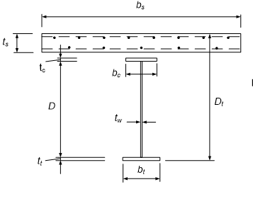
Flexural Resistance Components
Composite Sections in Positive Bending
  Bottom flange
  Web
  Top flange
  Concrete deck
  Concrete deck longitudinal steel
Notes:
The flexural resistance components for determining the resistance of composite sections subject to positive bending at the strength limit state include the bottom flange, web, and top flange of the steel girder, along with the concrete deck and the concrete deck longitudinal steel (if desired). Typically, the area of the concrete deck haunch is not considered in the computation of the flexural resistance; the haunch depth may be considered, however, if permitted by the Owner.
Assuming adequate shear connection is provided between the concrete deck and the top flange of the steel girder, the concrete deck area based on the effective deck width, which is subject to compression in positive bending regions, may be considered acting with the steel girder in the determination of the flexural resistance. The computation of the effective width of the concrete deck was discussed previously in Lesson 6. The design of the required number of shear connectors for the fatigue and strength limit states will be discussed later in this lesson.
Top (compression) flanges of composite sections in positive bending are continuously braced flanges. For a continuously braced compression flange, one side of the flange is effectively prevented from local buckling, or else both sides of the flange must buckle in the direction away from the concrete deck, resulting in highly restrained boundary conditions at the web-flange juncture. The concrete deck also helps restrain lateral deflections of the flange associated with local and lateral-torsional buckling. As a result, continuously braced compression flanges need not be checked for local or lateral-torsional buckling according to the AASHTO LRFD Specifications. Lateral flange bending stresses also need not be considered for continuously braced flanges, including any lateral flange bending stresses induced in the noncomposite flange before it becomes continuously braced. The lateral resistance of the composite concrete deck is generally sufficient to compensate for the neglect of any initial lateral bending stresses in the flange, as well as any additional lateral bending stresses that may be induced after the deck has been placed.

Slide 5
Cross-Section Proportion Limits
Web:
Flanges:
t_{w}
D
Notes:
A reminder that the flanges and web of the steel girder alone are subject to the basic proportioning requirements for I-section flexural members specified in AASHTO LRFD Articles 6.10.2.1 and 6.10.2.2 and discussed previously in Lesson 2. These requirements are repeated on this slide. Recall that the web slenderness limit of 150 applies to webs without longitudinal stiffeners and the web slenderness limit of 300 applies to webs with longitudinal stiffeners (AASHTO LRFD Article 6.10.2.1).
Also, the guideline shown at the bottom of this slide that was previously discussed in Lesson 7 (Slide 60) should be checked for the noncomposite steel girder to ensure that individual field sections will be more stable and easier to handle during lifting, erection, and shipping without the need for special stiffening trusses or falsework; i.e., the width of the smallest top flange within an individual unspliced girder field section, b_{tfs}, should be greater than or equal to the length of the individual unspliced girder field section, L_{fs}, divided by 85. This guideline should be checked regardless of the final location of each field section in the bridge as the top flange of each noncomposite girder field section is subject to compression over the majority of its length during lifting, erection, and shipping.

Slide 6
Compact vs. Noncompact Sections
Compact Section - A composite section in positive bending satisfying specific steel grade, web slenderness, and ductility requirements that is capable of developing a nominal flexural resistance exceeding the moment at first yield, but not to exceed the plastic moment.
Noncompact Section - A composite section in positive bending for which the nominal flexural resistance is not permitted to exceed the moment at first yield.
Notes:
In the AASHTO LRFD Specifications, the nominal flexural resistance of composite sections in straight girders subject to positive bending that satisfy specific steel grade, web slenderness, and ductility requirements is permitted to exceed the moment at first yield at the strength limit state, but not to exceed the plastic moment. The yield moment and plastic moment were introduced previously in Section 6. Sections meeting these requirements are termed ′compact sections.′ The nominal flexural resistance of sections not meeting one or more of these requirements, termed ′noncompact sections,′ is not permitted to exceed the moment at first yield. The design of compact sections is covered in AASHTO LRFD Article 6.10.7.1. The design of noncompact sections is covered in AASHTO LRFD Article 6.10.7.2. The design requirements for each type of section will be described further on the subsequent slides.

Slide 7
Compact Sections
Notes:
The next topic in this lesson will cover the design requirements for compact sections in positive bending at the strength limit state, including the requirements to qualify as a compact section and the flexural resistance requirements for the design of compact sections.

Slide 8
Compact Section Requirements
Girders are straight
Flange strengths, F_{y} ≤ 70 ksi
Web slenderness, D/t_{w} ≤ 150
Web slenderness based on depth of web in compression at the plastic moment,
Notes:
AASHTO LRFD Article 6.10.6.2.2 specifies the requirements for a composite section in positive bending to qualify as a compact section at the strength limit state. These four requirements are simple restrictions intended to limit the use of a nominal flexural resistance exceeding the moment at first yield to designs for which the use of this resistance is supported by test data.
The restriction that the girders must be straight is due to the limited data on the influence of partial cross-section yielding on the distribution of forces and moments within curved I-girder bridges. The second limit on flange strengths is specified to avoid potential crushing of the deck concrete prior to reaching the calculated flexural resistance. For F_{y} = 70 ksi, the yield strain of the steel ε_{y} = F_{y}/E = 0.0024 is slightly beyond the level of strain corresponding to the peak compressive stress for typical deck concrete. For F_{y} = 100 ksi, the yield strain of the steel is 0.0034, which is somewhat beyond the nominal concrete crushing strain. The third limit is the web slenderness ratio beyond which longitudinal stiffeners are required. Since members with longitudinally stiffened webs tend to be deeper and are typically used in longer spans with corresponding larger dead load stresses, they often have large elastic 2D_{c}/t_{w} values. These large web slenderness values may result in significant web bend buckling prior to development of flexural yielding, even if the last limit, discussed below, is satisfied at the theoretical plastic limit state. The last limit is the basic AASHTO/AISC compact-web limit corresponding to the plastic depth of web in compression, D_{cp}. The calculation of D_{cp} was described previously in Lesson 6. Although the derivation of this limit originates from the consideration of doubly symmetric noncomposite I-section members, it has been commonly applied to composite I-section members in the AISC and AASHTO Specifications as a conservative simplification. Webs exceeding this limit are interpreted to be unable to develop the large inelastic strains necessary for the cross-section to achieve the plastic moment, M_{p}. As discussed previously in Lesson 6, often the plastic neutral axis (PNA) for these sections will be located either in the concrete deck or in the top flange of the steel girder. As a result, D_{cp} is equal to zero in either case and the last requirement may be considered automatically satisfied.

Slide 9
Flexural Resistance Equation
Compact Sections
where:
f = factored lateral bending stress in the tension flange (ksi). f is always taken as positive.
M_{n} = nominal flexural resistance of the section determined as specified in AASHTO LRFD Article 6.10.7.1.2 (kip-in.)
M_{u} = member major-axis bending moment due to the factored loads at the section under consideration (kip-in.). M_{u} is always taken as positive.
S_{x} = elastic section modulus about the major-axis of the section to the tension flange taken as M_{yt}/F_{yt}
Notes:
Most composite sections in positive bending without longitudinal stiffeners in straight bridges will qualify as compact according to the requirements on the preceding slide. Since the majority of the web is in tension in these sections, there is typically significant available reserve capacity. For sections that do qualify as compact sections, consideration may always be given to conservatively treating the section as a noncompact section, which simplifies the calculations somewhat and should not result in a significant loss of economy as other limit-state criteria (e.g., service limit state or fatigue limit state criteria – Lesson 7) are likely to control the design of a composite compact section in positive bending.
AASHTO LRFD Article 6.10.7.1.1 specifies that at the strength limit state, compact sections in positive bending must satisfy the one-third rule equation expressed in terms of bending moment as shown on this slide. The one-third rule equations were introduced in Lesson 8. φ_{f} is the resistance factor for flexure specified in AASHTO LRFD Article 6.5.4.2 (= 1.0). The sign of M_{u} and f is always taken as positive in the equation. However, when summing dead and live load moment/stresses to obtain the total factored major-axis bending moments and lateral bending stresses, M_{u} and f, to apply in the equation, the signs of the individual dead and live load moments/stresses must be considered. The moment format is used because for these types of sections, the major-axis bending moment is physically a more meaningful quantity than the elastically computed flange bending stress. Also, the nominal flexural resistance of these sections is generally greater than the yield moment with respect to the tension flange, M_{yt}. If desired, the equation could be considered in a stress format by dividing both sides of the equation by S_{xt}.
This flexural resistance equation is a conservative but accurate representation of a section analysis in which a pair of fully-yielded widths are discounted from the tension flange to accommodate flange lateral bending, with the remainder of the flange assumed to resist the vertical loads. Note that only lateral bending in the bottom (tension) flange is considered in this equation. Since the bottom (tension) flange is not continuously supported, lateral bending must be considered in flexural resistance computations for the tension flange. Amplification of the flange lateral bending stresses (Lesson 8) is not required in this case since the bottom flange is in tension. As mentioned previously, lateral bending does not need to be considered in the top (compression) flange of these sections at the strength limit state because that flange is continuously supported by the concrete deck.

Slide 10
Nominal Flexural Resistance, M_{n}
Compact Sections – Simple Spans
where:
D_{p} = distance from the top of the concrete deck to the neutral axis of the composite section at the plastic moment (in.)
D_{t} = total depth of the composite section (in.)
M_{p} = plastic moment of the composite section (kip-in.)
Notes:
AASHTO LRFD Article 6.10.7.1.2 specifies that the nominal flexural resistance, M_{n}, of compact composite sections in positive bending in simple spans depends on the ratio of the depth of the plastic neutral axis below the top of the deck, D_{p}, to the total depth of the composite section, D_{t}. Sections with a ratio of D_{p}/D_{t} less than or equal to 0.1 can reach the plastic moment, M_{p}, of the composite section as a minimum without any ductility concerns. The computation of M_{p} for composite sections in positive bending was illustrated previously in Lesson 6. When the ratio of D_{p}/D_{t} exceeds 0.1, the nominal flexural resistance is reduced from M_{p} as a linear function of D_{p}/D_{t} to provide an additional margin of safety against premature crushing of the concrete deck for members with larger D_{p}/D_{t}. The increase in the margin of safety, relative to the theoretical resistance determined from a strain-compatibility analysis at crushing of the deck concrete, varies linearly from 1.0 at D_{p}/D_{t} = 0.1 to approximately 1.3 at D_{p}/D_{t} = 0.42. Strain-compatibility analyses of a wide range of practical composite sections indicate only a slight decrease in the cross-section moment below M_{p} when the top of the slab reaches the theoretical crushing strain of 0.003. However, composite members with large D_{p}/D_{t} tend to have significantly smaller plastic curvature prior to crushing of the deck concrete and thus less ductility.
AASHTO generally requires that the separate effects of noncomposite, short-term composite, and long-term composite loadings be considered in calculating the factored flexural stresses and M_{n}. However, for compact composite sections in positive bending, the effect of these different types of loadings on the flexural stresses and on partial yielding of the cross-section need not be considered. Therefore, the factored moments due to the various loadings may simply be summed to compute the total factored moment, M_{u}. Also, since these cross-section types are able to sustain inelastic curvatures sufficient to develop their nominal full plastic moment, the effect of the different loadings is negligible with respect to the section maximum strength. AASHTO LRFD Article 6.10.1.5 still requires an analysis of the structure separately for the noncomposite, short-term composite, and long-term composite loadings. The relative proportion of the three types of loadings typically will have some effect on the distribution of the moments and forces in the structure.

Slide 11
Nominal Flexural Resistance, M_{n}
Compact Sections – Continuous Spans
where:
M_{n} = nominal flexural resistance for simple spans (see preceding slide) (kip-in.)
R_{h} = hybrid factor
M_{y} = yield moment of the composite section (kip-in.)
Notes:
For compact composite sections in positive bending in straight continuous-span girders, AASHTO LRFD Article 6.10.7.1.2 limits the nominal flexural resistance, M_{n}, to the smaller of M_{n} for simple spans, calculated as shown on the preceding slide, and 1.3R_{h}M_{y}, unless specific AASHTO LRFD Appendix B6 requirements are satisfied as spelled out in AASHTO LRFD Article 6.10.7.1.2 that ensure ductility of the adjacent pier sections. M_{y} is the yield moment of the composite section calculated as illustrated previously in Lesson 6. R_{h} is the hybrid factor taken equal to 1.0 for homogeneous sections and calculated as illustrated previously in Lesson 6 for hybrid sections.
The equation on this slide is intended to limit the yielding in positive moment regions of continuous-span girders, where the shape factor M_{p}/M_{y}, i.e., the ratio of the composite section plastic moment to its yield moment, can be larger than 1.5, when the inelastic rotation capability of the pier sections is somewhat limited or undefined. This equation guards against significant partial yielding of the cross section, resulting in a reduction in the composite stiffness over a relatively large length within the positive moment region where the moment diagrams and envelopes are relatively flat. This helps restrict inelastic redistribution of positive moments to pier sections that may have limited ability to sustain these additional uncalculated moments. The shedding of moment to adjacent interior-pier sections could potentially result in incremental collapse under repeated live loads if the interior-pier sections do not have the additional capacity needed to sustain these larger moments; for example, interior-pier sections with slender webs and moment-rotation curves that unload rapidly once the peak moment resistance is exceeded (refer to Slide 16 in Lesson 8). The factor of 1.3 in the equation was established based on engineering judgment. Additional flexural resistance beyond that determined from this equation is usually not needed at the strength limit state as the size of the bottom flange of these compact sections will most often be controlled by fatigue or service limit state design criteria (Lesson 7).
In many cases, compact-web interior-pier sections in straight I-girder bridges (e.g., rolled-beam sections) satisfy the Appendix B6 requirements without any special modification, and thus, the 1.3R_{h}M_{y} limit need not be applied. However, the support skew must be less than 10 degrees and the ratio of the lateral unbraced length to the compression flange width, L_{b}/b_{fc}, at the pier sections must be approximately 10 or less (in addition to other requirements that must be satisfied as specified in AASHTO LRFD Article 6.10.7.1.2). Compact-web sections were discussed previously in Lesson 8.

Slide 12
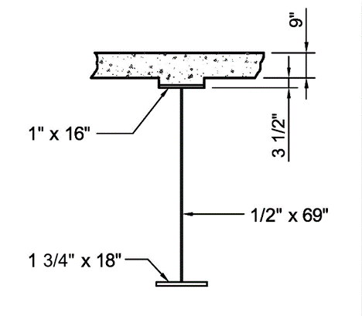
Nominal Flexural Resistance, M_{n}
Example – taken from NSBA SBDH Design Example 1 (positive moment section – exterior girder)
Determine if the section qualifies as a compact section
Calculate the nominal flexural resistance, M_{n}, and check the flexural resistance equation for the Strength I load combination
F_{yt} = F_{yc} = 50 ksi; R_{h} = 1.0
f = 0
Notes:
In this example, for the composite section shown, which is taken from Design Example 1 of the NSBA Steel Bridge Design Handbook (SBDH), determine if the section qualifies as a compact section, calculate the nominal flexural resistance, M_{n}, of the section at the strength limit state, and check the flexural resistance equation (i.e., the one-third rule equation) for the Strength I load combination. The girder is an exterior girder, and the section is in a positive moment region in the end span of the three-span continuous girder (at 0.4L). The load modifier η is assumed to be 1.0. Recall that the Strength I load combination and the load modifier, η, were discussed previously in Lesson 3. The section is a homogeneous section with a specified minimum yield strength of the tension (bottom) flange, F_{yt}, of 50 ksi. The specified minimum yield strength of the compression (top) flange and the web is also 50 ksi. Therefore, the hybrid factor, R_{h}, is equal to 1.0. The bridge is a straight bridge with no skew. Wind load is not considered for the Strength I load combination. Hence, the bottom-flange lateral bending stress, f, due to torsion is equal to zero.
12

Slide 13
Section Properties
From previous calculations in Lesson 6:
Entire web is in tension at M_{p}
Notes:
From previous calculations in Lesson 6, the plastic moment, M_{p}, and yield moment, M_{y}, for this section were computed to be 16,464 kip-ft and 12,278 kip-ft, respectively. Further, it was determined that the plastic neutral axis (PNA) was located in the top flange at a distance of 0.383 inches from the top of the top flange. As a result, the entire web of the section is in tension at M_{p} and the depth of the web in compression at the plastic moment, D_{cp}, is therefore equal to zero. The web slenderness, D/t_{w}, of the section is computed to be 138.
13

Slide 14
Compact Section Requirements
Girders are straight YES
Flange strengths, F_{y} ≤ 70 ksi YES
Web slenderness, D/t_{w} ≤ 150 YES
Web slenderness based on depth of web in compression at the plastic moment,
SATISFIED
Notes:
Checking the requirements for a compact section discussed previously on Slide 8 in this lesson, the girders in the bridge are straight, the flange yield strengths are both less than 70 ksi, the computed web slenderness of 138 is less than 150, which indicates that longitudinal web stiffeners are not required, and the web slenderness requirement based on the depth of the web in compression at the plastic moment, D_{cp}, is automatically satisfied because the entire web is in tension at M_{p} and D_{cp} is equal to zero. Therefore, the section qualifies as a compact section for the determination of the nominal flexural resistance at the strength limit state.

Slide 15
Nominal Flexural Resistance, M_{n}
D_{p} = distance from the top of the concrete deck to the neutral axis of the composite section at the plastic moment (in.)
D_{t} = total depth of the composite section (in.)
Notes:
To calculate the nominal flexural resistance, M_{n}, of the compact composite section, first calculate D_{p}, which is the distance from the top of the concrete deck to the neutral axis of the composite section at the plastic moment (or PNA). Referring to the information and sketch given previously on Slide 13 of this lesson, D_{p} is computed to be 11.88 inches. Next, calculate D_{t}, which is the total depth of the composite section calculated to be 83.25 inches. The depth of the concrete haunch is considered in the calculation of both D_{p} and D_{t} in this example. Since D_{p} exceeds 0.1D_{t}, M_{n} is initially computed from the second equation shown on Slide 10 of this lesson. The computed value of 15,972 kip-ft would be the value of M_{n} to be used if this were a simple-span bridge. However, since this section is in the positive-moment region of a continuous-span bridge, and the interior-pier sections in this bridge are slender-web sections (as described previously in Lesson 8), the nominal flexural resistance is to be taken as the smaller of M_{n} and 1.3R_{h}M_{y} for reasons discussed previously in this lesson (Slide 11). The computed value of 1.3R_{h}M_{y} is 15,961 kip-ft, which is smaller than the previously computed value of M_{n}. Therefore, the 1.3R_{h}M_{y} limit controls and M_{n} for this section is to be taken as 15,961 kip-ft.

Slide 16
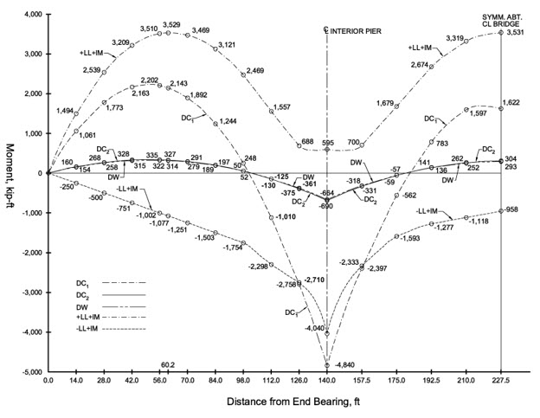
Factored Moment Calculation, M_{u}
Calculate the maximum factored bending moment, M_{u}, at 0.4L in the end span for the Strength I load combination. The unfactored bending moments at this point are as follows:
M_{DC1} = +2,202 kip-ft
M_{DC2} = +335 kip-ft
M_{DW} = +322 kip-ft
M_{+LL+IM} = +3,510 kip-ft
Notes:
The unfactored bending moments for the three-span continuous girder are shown on this slide at each span tenth point. The moments at the point of maximum positive LL + IM moment in the end span are also shown The moments were determined using a line-girder analysis as discussed previously in Lesson 4. The moments are shown for one-half of the girder; the moments are symmetrical about the centerline of the bridge (which is located at the right-hand side of the plot). Moments are plotted for the DC₁, DC₂, and DW loads. Since the live load is a moving load, moment envelopes are plotted for the LL + IM loads; the envelopes represent the maximum (+) and minimum (-) live-load plus impact moment values at each point.
The unfactored positive moments at the four-tenths point (0.4L) in the end span are summarized on the slide. As shown at the bottom of the slide, the factored bending moment, M_{u}, for the Strength I load combination at this point is computed to be 9,797 kip-ft.
16

Slide 17
Flexural Resistance Equation
Compact Sections
The section is satisfactory. Demand-to-capacity ratio = 0.614
Notes:
As discussed previously, the flexural resistance equation for compact sections is the one-third rule equation expressed in terms of bending moment. Lateral bending due to torsion is only considered in the bottom (tension) flange in this equation. Lateral bending does not need to be considered in the top (compression) flange of these sections at the strength limit state because the top flange is continuously supported by the concrete deck. In this example, the bottom flange lateral bending stress, f, is equal to zero. According to the resulting equation then, the factored moment, M_{u}, of 9,797 kip-ft is less than the computed nominal flexural resistance, M_{n}, of 15,961 kip-ft times the resistance factor for flexure, φ_{f}, equal to 1.0. Therefore, the section is satisfactory at the strength limit state. The demand-to-capacity ratio is 0.614. There is significant available reserve capacity at the strength limit state. However, additional flexural resistance is not needed in this case as the size of the bottom flange is controlled by fatigue limit state design criteria (described previously in Lesson 7).
NSBA SBDH Design Example #1 presents the resistance calculation for a compact section. Many steel bridges satisfy these requirements for sections in positive flexure but for the remainder that are classified as noncompact, e.g., sections in positive flexure in horizontally curved girders or in deeper girders with longitudinal web stiffeners, their resistance is computed as described on the following slides.

Slide 18
NonCompact Sections
Notes:
This topic will cover the design requirements for noncompact sections in positive bending at the strength limit state, including the requirements to qualify as a noncompact section and the flexural resistance requirements for the design of noncompact sections.

Slide 19
Noncompact Section Requirements
Girders are horizontally curved
Girders are kinked (chorded) continuous
Girders are straight and do not satisfy one or more of the compact section requirements (Slide 8)
Notes:
AASHTO LRFD Article 6.10.6.2.2 specifies that composite sections in positive flexure in horizontally curved bridges and in kinked (chorded) continuous bridges (which behave similarly to horizontally curved bridges) must be classified and designed as noncompact sections at the strength limit state, regardless of whether the sections satisfy all the compact section requirements given on Slide 8 of this lesson. Sufficient research has not yet been conducted to support the design of the sections in these bridges as compact sections with flexural resistances exceeding the moment at first yield. Composite sections in positive flexure in straight bridges that do not satisfy one or more of the compact section requirements given on Slide 8 must also be classified and designed as noncompact sections. As mentioned previously, such sections that do meet all of the compact section requirements may be conservatively treated as noncompact sections, if desired, to simplify the calculations somewhat without a significant loss of economy.
For noncompact sections, the nominal flexural resistance is not permitted to exceed the moment at first yield. The nominal flexural resistance in these cases is therefore more appropriately expressed in terms of the elastically computed flange stress. The use of stresses is considered more appropriate in members within which the maximum resistance is always less than or equal to the yield moment, M_{y}, in major-axis bending. This is due to the nature of the different types of loadings that contribute to the member flexural stresses: noncomposite, long-term composite, and short-term composite. The combined effects of the loadings on these different states of the member cross-section are better handled by working with flange stresses rather than moments. Engineers also tend to have a better sense of the efficiency of their design when working with stresses rather than moments.

Slide 20
Flexural Resistance Equations
Noncompact Sections
where:
f_{bu} = factored flange major-axis bending stress (ksi)
f = factored lateral bending stress in the tension flange (ksi). f is always taken as positive.
F_{nc} = nominal flexural resistance of the compression flange determined as specified in AASHTO LRFD Article 6.10.7.2.2 (ksi)
F_{nt} = nominal flexural resistance of the tension flange determined as specified in AASHTO LRFD Article 6.10.7.2.2 (ksi)
Notes:
AASHTO LRFD Article 6.10.7.2.1 specifies that at the strength limit state, the factored major-axis bending stress, f_{bu}, in the compression (top) flange of composite noncompact sections in positive bending must not exceed the nominal flexural resistance of the compression flange, F_{nc}, times the resistance factor for flexure, φ_{f}, specified in AASHTO LRFD Article 6.5.4.2 (= 1.0). The computation of F_{nc} is discussed on the next slide in this lesson. Again, flange lateral bending is not considered for the compression flange because at the strength limit state, the flange is continuously supported by the concrete deck.
The tension (bottom) flange of composite noncompact sections in positive bending must satisfy the one-third rule equation expressed in terms of the flange stresses as shown on this slide. The computation of F_{nt} is discussed on the next slide in this lesson. The one-third rule equations were introduced in Lesson 8. The sign of f_{bu} and f is always taken as positive in this equation. However, when summing dead and live load moment/stresses to obtain the total factored major-axis bending stresses and lateral bending stresses, f_{bu} and f, to apply in the equation, the signs of the individual dead and live load stresses must be considered.
The stress format is more appropriate in members for which the maximum resistance is always less than or equal to the yield moment in major-axis bending. Since the bottom (tension) flange is not continuously supported, lateral bending must be considered in flexural resistance computations for the tension flange. Amplification of the flange lateral bending stresses (Lesson 8) is not required in this case since the bottom flange is in tension. This flexural resistance equation is a conservative but accurate representation of a section analysis in which a pair of fully-yielded widths are discounted from the tension flange to accommodate flange lateral bending, with the remainder of the flange assumed to resist the vertical loads.

Slide 21
Nominal Flexural Resistance, F_{n}
Noncompact Sections
where:
F_{yc} = specified minimum yield strength of the compression flange (ksi)
F_{yt} = specified minimum yield strength of the tension flange (ksi)
R_{b} = web load-shedding factor
R_{h} = hybrid factor
Notes:
AASHTO LRFD Article 6.10.7.2.2 specifies that the nominal flexural resistance of the compression (top) flange, F_{nc}, is to be taken as the specified minimum yield strength of the compression flange, F_{yc}, times the flange-stress reduction factors, R_{b} and R_{h}. The computation of these flange-stress reduction factors was described previously in Lesson 6. Local and lateral buckling of the top flanges is not a concern because the flanges are continuously braced; therefore, the nominal flexural resistance is based on nominal yielding, neglecting residual stress effects but including the influence of load shedding from a slender and/or hybrid web. Note that for composite sections in positive bending with D/t_{w} ≤ 150 (i.e., no longitudinal web stiffeners), R_{b} is to be taken equal to 1.0 because web bend buckling, and subsequent load shedding, are unlikely for these sections at the strength limit state.
The nominal flexural resistance of the tension (bottom) flange, F_{nt}, is to be taken as the specified minimum yield strength of the tension flange, F_{yt}, times the flange-stress reduction factor, R_{h}. As discussed previously in Lesson 6, load shedding of the web compressive stresses to the tension flange as a result of bend buckling of the web is considered insignificant; therefore, the R_{b} factor is not included in this equation.

Slide 22
Ductility requirement
Notes:
This topic briefly covers a ductility requirement that must be satisfied by both compact and noncompact sections in positive bending at the strength limit state.

Slide 23
Ductility Requirement
Compact & Noncompact Sections
where:
D_{p} = distance from the top of the concrete deck to the neutral axis of the composite section at the plastic moment (in.)
D_{t} = total depth of the composite section (in.)
Notes:
AASHTO LRFD Article 6.10.6.2.2 specifies that both compact and noncompact composite sections in positive bending must also satisfy the ductility requirement specified in AASHTO LRFD Article 6.10.7.3 and shown on this slide. This requirement is intended to ensure significant yielding of the bottom flange, and therefore, significant inelastic bending curvature, prior to reaching the nominal crushing strain at the top of the deck. Satisfying this requirement also helps permit the web bend buckling check to be neglected for composite sections in positive bending without longitudinal stiffeners after the deck hardens. This limit is consistent with a former maximum reinforcement limit for concrete design in the AASHTO specifications.
Although noncompact sections in positive bending are not permitted to exceed the moment at first yield, this ductility requirement must still be satisfied to ensure a ductile failure, and to prevent premature crushing of the deck for sections that may utilize up to 100-ksi steel and/or that are utilized in shored construction. Shored construction was discussed previously in Lesson 6.
The D_{p}/D_{t} ratio is limited to 0.42 to ensure significant yielding of the bottom flange when the crushing strain is reached at the top of the concrete deck. D_{t} should be computed using a lower-bound estimate of the thickness of the concrete haunch, or it may be determined conservatively by neglecting the thickness of the haunch. This limit is not likely to control for typical sections that are utilized in unshored construction. In the preceding design example, D_{p} of 11.88 inches is well below the limit of 0.42D_{t} = 0.42(83.25) = 34.96 inches.

Slide 24
Concrete deck stresses
Notes:
This topic briefly covers a concrete deck stress requirement that must be satisfied by noncompact composite sections in positive bending at the strength limit state.

Slide 25
Concrete Deck Stresses
Noncompact Sections Only
where:
f_{c} = maximum factored longitudinal compressive stress in the concrete deck (ksi)
f’_{c} = specified minimum 28-day compressive strength of the concrete (ksi)
Notes:
AASHTO LRFD Article 6.10.7.2.1 specifies that the maximum factored longitudinal compressive stress in the deck at noncompact composite sections in positive bending at the strength limit state, f_{c}, is to be limited to 0.6 times the specified minimum 28-day compressive strength of the concrete, f’_{c}, to ensure linear behavior of the concrete, which is assumed in the computation of the steel flange stresses. The computation of the concrete deck stresses was illustrated previously in Lesson 6.
This check is unlikely to control except in cases involving: 1) shored construction, or unshored construction where the noncomposite steel dead load stresses are low, combined with 2) geometries causing the neutral axis of the short-term and long-term composite section to be significantly below the bottom of the concrete deck. This check ensures that noncompact composite I-sections in positive bending with a relatively large F_{yt}/f′_{c} or F_{yc}/f′_{c} and a relatively small concrete deck, resulting in a location of the neutral axis well below the concrete deck, will not be permitted. In such rare cases, this check may be satisfied by increasing the concrete f′_{c}, the slab thickness, the size of the steel top flange, and/or the girder spacing.

Slide 26
Shear connectors
Notes:
The last topic in this lesson covers the design of shear connectors for composite members in both positive and negative bending regions, which ensure composite action between the concrete deck and the steel girder. This topic will cover the design of the shear connectors according to new provisions appearing in the 10th Edition of the AASHTO LRFD BDS.

Slide 27
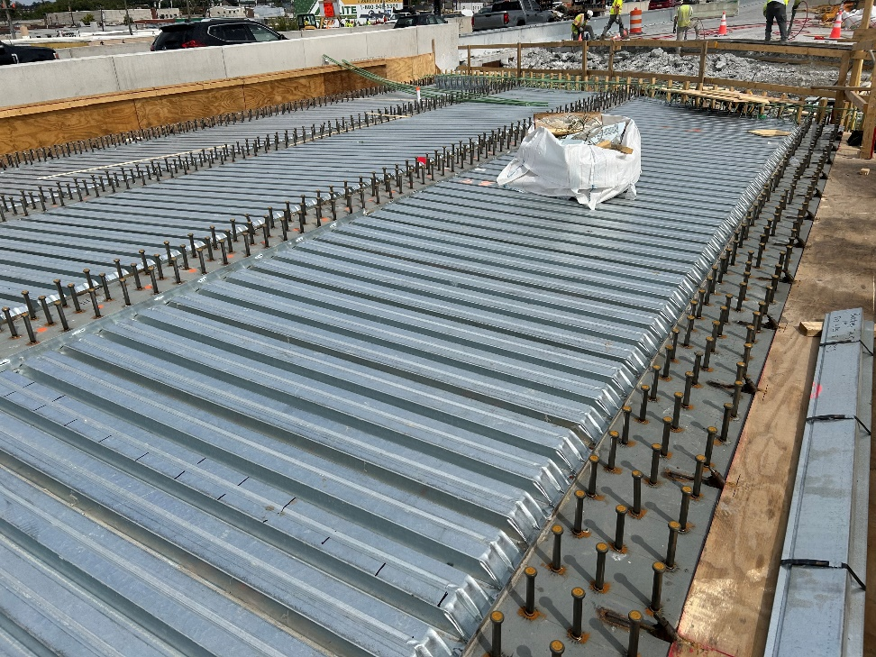
Shear Connectors
Transfer the horizontal shear between the concrete deck and the steel girder
Force the concrete deck and steel girder to act as a structural unit by preventing slip along the concrete-steel interface
Help control deck cracking in regions of negative flexure in regions where the deck is in tension and has longitudinal reinforcement present
Stud shear connectors are typically used
Notes:
The composite action between the concrete deck and the steel girder in composite construction is ensured by using welded mechanical shear connectors between the girder and the deck. The primary function of the shear connectors is to transfer the horizontal shear between the deck and the girder forcing the steel girder and concrete deck to act together as a structural unit by preventing slip along the concrete-steel interface, which increases the flexural resistance of the superstructure. Shear connectors also help control deck cracking in regions of negative flexure in regions where the deck is subject to tensile stress and has longitudinal reinforcement present.
The shear connectors must be capable of resisting both horizontal and vertical movement between the concrete deck and the steel and allow compaction of the concrete around them so that their entire surfaces are in contact with the concrete. Typically, stud shear connectors, which are shown in the photographs on this slide, are used, but in older bridges connectors like spirals and channel shear connectors were used. These older forms of connectors are no longer used on modern bridges. Common sizes of studs may be found in manufacturer’s catalogs.
Shear connectors should normally be provided throughout the length of the bridge and must be provided when the longitudinal reinforcement is included in the section properties in negative bending regions. If shear connectors are omitted in negative bending regions, additional connectors must be provided at points of permanent load contraflexure, as discussed later in this lesson. This is not permitted, however, for horizontally curved girders or for tub girders.
The design of shear connectors for steel bridges is covered in AASHTO LRFD Article 6.10.10. This lesson will describe significant changes to these provisions appearing in the 10th Edition of the AASHTO LRFD BDS.
Photo credit: Buckley and Company

Slide 28
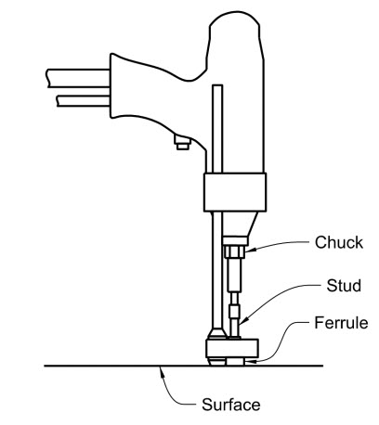
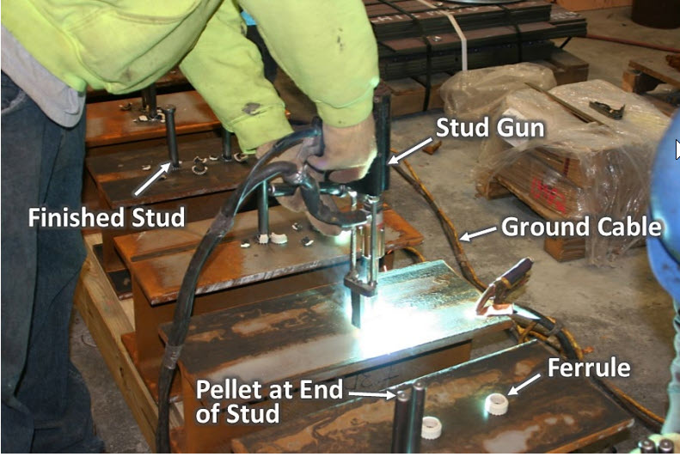
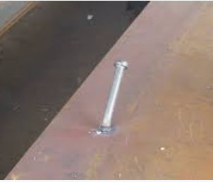
Shear Connectors
Installation
Notes:
Stud shear connectors are typically arc welded onto the top flange using a stud welding gun as shown in the figures on the left-hand side and on the upper right-hand side of this slide. The stud gun operator places the stud and a ceramic ferrule at the intended location and then pulls the trigger to initiate the arc, simultaneously pressing the stud into the weld pool that is created. Much of the molten metal and any contamination are expelled from the weld area as the stud is mechanically forced into the weld pool. The welding operation takes only a few seconds. Afterwards, welded studs are visually inspected to ensure that weld flash surrounds the perimeter. When current is too low, or time too short, the flash typically will not extend around the whole stud. Conversely, when the current is too high, or the time too long, the flash may extend a long way beyond the ferrule or may undercut. The flash is not a fillet weld and quality requirements for fillet welds do not apply.
To ensure that proper procedures are used, the AASHTO/AWS D1.5M/D1.5 Bridge Welding Code requires that at the beginning of a production shift, or before welding with a given equipment setup, the first two studs are tested by mechanically bending them over to an approximate 30-degree angle from the original stud axis. A photograph of a single bent stud is shown on the lower right-hand side of this slide. This testing is performed by striking the stud with a hammer or by inserting a pipe or other hollow device around the stud and bending it. A good weld will allow for such deformation and will not break. Poor procedures will typically result in the stud breaking from the beam in the weld region. Successfully tested studs are not straightened afterwards because the studs will be encased in concrete, and they perform effectively as bent.
SOURCE: FHWA Bridge Welding Reference Manual

Slide 29
Shear Connectors
Minimum Total Height-to-Shank Diameter Ratio
Stud Height
Stud Diameter
Normal-Weight Concrete: Ratio ≥ 5.0
Lightweight Concrete: Ratio ≥ 7.0
Notes:
AASHTO LRFD Article 6.10.10.1.1 specifies that the ratio of the total height to the shank diameter of a stud shear connector is not to be less than 5.0 when embedded in normal-weight concrete and 7.0 when embedded in lightweight concrete. Analysis of shear connector strength tests found that for ratios at or above these limits, the shear resistance of the connector at the strength limit state is controlled solely by a proportion of the connector tensile strength. Experimental testing used to the develop the specification on shear studs was conducted using headed shear studs with a shank diameter of 1.25 inches or smaller.

Slide 30
Shear Connectors
Cover and Penetration
Concrete Deck
Cover
Penetration
Cover ≥ 2.0 inches
Penetration ≥ 2.0 inches
Notes:
AASHTO LRFD Article 6.10.10.1.4 specifies that the clear depth of concrete cover over the tops of shear connectors should not be less than 2.0 inches. Shear connectors should also be detailed to penetrate through the haunch between the bottom of the deck and the top flange, if present, and at least 2.0 inches into the concrete deck. Otherwise, the haunch should be reinforced to contain the stud connector and develop its load into the deck. The Engineer should be aware that steep cross-slopes and wide flanges on curved girder bridges may result in little or no haunch above the flange on the low side of the slope if not properly accounted for when setting the initial haunch dimensions. It is recommended that the specified cover and penetration minimums be shown in the contract documents, with the stud height to be detailed based on field measurements of the actual girder elevations.
Shear connectors on members in structures that are not load-path redundant are to be detailed to penetrate at least above the bottom mat of deck reinforcement to provide additional ductility. Also, when shear connectors are clustered together, e.g., in pockets of precast deck panels, it is recommended they extend beyond the bottom mat of deck reinforcement so they are anchored into to the deck core to better resist the elevated forces from clustering the studs closely together.
Shear connector clusters are defined as repeated groupings of three or more equally spaced rows of shear stud connectors spaced at intervals along the longitudinal axis of the girder. Regularly spaced shear connectors are defined as shear connectors placed in approximately equidistant intervals within one or more regions along the longitudinal axis of the girder.

Slide 31
Shear Connectors
Transverse Spacing and Clear Distance
Clear Distance
Transverse Spacing
Transverse Spacing ≥ 4.0 x (Stud Diameter)
Clear Distance ≥ 1.0 inch
Notes:
AASHTO LRFD Article 6.10.10.1.3 specifies that stud shear connectors placed transversely across the flange of the steel section are not to be closer than 4.0 stud diameters center-to-center transverse to the longitudinal axis of the supporting member. Large- and small-scale experimental testing has shown that shear studs can be spaced at a 4.0d center-to-center transverse spacing with no reduction in fatigue or strength resistance. The clear distance between the edge of the top flange and the edge of the nearest shear connector is not to be less than 1.0 inch.

Slide 32
Shear Connectors
Pitch
P
i
t
c
h
D = web depth (in.)
Maximum Pitch: ≤ 48.0 inches for D ≥ 24.0 inches
≤ 24.0 inches for D < 24.0 inches
Minimum Pitch: ≥ 4.0 x (Stud Diameter)
Notes:
The pitch is defined as the distance between the centers of shear connectors along the line of force. AASHTO LRFD Article 6.10.10.1.2 specifies that the center-to-center pitch of regularly spaced shear connectors or shear connector clusters is not to exceed 48.0 inches for members having a web depth, D, greater than or equal to 24.0 inches. For members with a web depth less than 24.0 inches, the center-to-center pitch is not to exceed 24.0 inches. Tests have shown that placing shear connectors at a pitch of up to 48.0 inches has no negative effect on the global flexural resistance of composite steel members. The research did not test shallow web depths with long pitches, so the maximum pitch is limited to 24.0 inches for web depths less than 24.0 inches to ensure that designs stay within the bounds that have proven satisfactory in experiments.
For all web depths, the center-to-center pitch of regularly spaced shear connectors or the center-to-center pitch between studs within a shear connector cluster is not to be less than 4.0d. Large- and small-scale experimental testing has shown that shear connectors may be placed at a minimum center-to-center pitch of 4.0d without any reduction in fatigue or strength resistance.
The shear connector pitch is to be determined to satisfy the fatigue limit state design requirements. The resulting number of shear connectors is not to be less than the number required to satisfy the strength limit state design requirements. The 10th Edition AASHTO LRFD BDS fatigue and strength limit state design requirements will be described on the subsequent slides.

Slide 33
Shear Connectors
Pitch – Fatigue Limit State Design
Regularly Spaced Shear Connectors:
P
i
t
c
h
In this case, n_{t} = 2
where:
n_{t} = number of shear connectors in a transverse cross-section
V_{sr} = horizontal fatigue shear range per unit length (kips/in.)
Z_{r} = fatigue shear resistance of an individual shear connector determined as specified in AASHTO LRFD Article 6.10.10.2 (kips)
Notes:
AASHTO LRFD Article 6.10.10.1.2 specifies that for regularly spaced shear connectors, which have historically been used for most applications, the center-to-center pitch, p, between shear connectors at the fatigue limit state must not exceed the value given by the equation shown on this slide, which is based on the horizontal fatigue live load shear range per unit length, V_{sr}, between the deck and top flange of the girder. In straight girders, if torsion is ignored, the shear range is due only to major-axis bending. However, in certain cases, skew can introduce significant torsion. Curvature and other conditions can also introduce torsion. The shear connector design provisions in the AASHTO LRFD Specifications allow for flexural and torsional components of the shear to be considered in these cases and to be added vectorially, as discussed in more detail in a subsequent slide.
n_{t} is the number of shear connectors in a transverse cross-section; in the figure shown on the slide, n_{t} is equal to 2. The computation of the fatigue shear resistance of an individual shear connector, Z_{r}, will also be discussed on a subsequent slide.

Slide 34
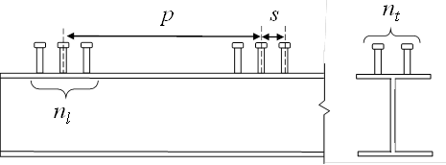
Shear Connectors
Pitch – Fatigue Limit State Design
For shear connector clusters:
In this case, n = 3
where:
n = number of stud rows in a shear connector cluster along the longitudinal axis
s = center-to-center spacing between studs within a shear connector cluster (in.)
Notes:
Shear connector clusters, such as those shown in the figure on this slide, are commonly used in accelerated bridge construction applications with precast concrete decks but can also be used in conventional construction. AASHTO LRFD Article 6.10.10.1.2 specifies that for shear connector clusters, the center-to-center pitch between clusters, p, at the fatigue limit state must not exceed the value given by the equation shown on this slide. Research has indicated an increased shear demand in the outer rows of clustered configurations that is captured by this equation.
n is the number of stud rows in a shear connector cluster along the longitudinal axis; in the figure shown on the slide, n is equal to 3. s is the center-to-center spacing between the studs within a shear connector cluster. The other terms in this equation were described on the preceding slide.

Slide 35
Shear Connectors
Pitch – Fatigue Limit State Design
Horizontal Fatigue Shear Range per Unit Length, V_{sr}:
where:
V_{fat} = longitudinal fatigue shear range per unit length (kips)
F_{fat} = radial fatigue shear range per unit length (kips)
Notes:
AASHTO LRFD Article 6.10.10.1.2 specifies that the horizontal fatigue shear range per unit length, V_{sr}, is to be taken as the vector sum of the longitudinal and radial fatigue shear ranges per until length, V_{fat} and F_{fat}, respectively, as given by the equation on this slide. The computation of V_{fat} and F_{fat} will be discussed on the slides that follow. For curved and/or skewed bridges, it is recommended that V_{sr}, and the resulting pitch, p, for the fatigue limit state, be determined at each cross-frame.

Slide 36
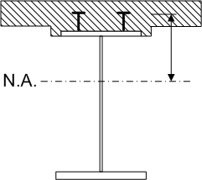
Shear Connectors
Pitch – Fatigue Limit State Design
Longitudinal Fatigue Shear Range per Unit Length, V_{fat}:
where:
V_{f} = vertical shear force range due to the fatigue live load under the applicable Fatigue load combination (kips)
Q = first moment of the transformed short-term area of the concrete deck about the neutral axis of the short-term composite section (in.³)
I = moment of inertia of the short-term composite section (in.⁴)
Notes:
AASHTO LRFD Article 6.10.10.1.2 specifies that the longitudinal fatigue shear range per unit length, V_{fat}, is to be calculated from the equation shown on this slide. V_{f} is the range of vertical shear force caused by the passage of the fatigue live load and factored according to the applicable fatigue load combination. As discussed previously in Lessons 3 and 7, the fatigue live load is specified to be a single truck, weighing 72 kips, with a constant rear-axle spacing of 30 feet. For the Fatigue I load combination, which is used for infinite life design, a load factor of 1.75 is applied to the vertical shears resulting from the single design truck. For the Fatigue II load combination, which is used for finite life design, a load factor of 0.80 is applied to the vertical shears resulting from the single design truck. A dynamic load allowance (impact factor) of 1.15 is also to be applied. The appropriate Fatigue load combination to use will be discussed in a subsequent slide describing the computation of the shear fatigue resistance of an individual shear connector, Z_{r}.
Q is the first moment of the transformed short-term (n) area of the concrete deck taken as the short-term area of the concrete deck times the distance from the neutral axis of the short-term composite section to the centroid of the concrete deck, as illustrated in the figure on this slide. I is the moment of inertia of the short-term composite section. The transformed short-term composite section was described previously in Lesson 6. Q and I preferably should be determined using the effective width of the concrete deck. V_{fat} is produced by placing the factored fatigue live load immediately to the left and right of the point under consideration. When loading the influence line for maximum and minimum shears it is common that the truck has to be reversed to produce maximum force effects. Of course this does not happen in real life and results in one source of conservatism, of many, in the design of shear studs for fatigue. With the load in these positions, positive moments are produced over significant portions of the girder length. As a result, it is reasonable to assume that the concrete deck within the effective width is fully effective along the entire span in determining the stiffness used in the analysis to determine the shear range. In addition, the horizontal shear force in the deck is typically assumed to be effective along the entire span in the analysis. In order to satisfy this assumption, the shear force in the deck should be developed along the entire span. It should be noted that In negative bending regions of straight girders only, Q and I are permitted to be determined using only the longitudinal reinforcement within the effective deck width, unless the concrete is considered effective in tension in determining stress ranges for checking fatigue as permitted in AASHTO LRFD Article 6.6.1.2.1 and discussed previously in Lesson 7.

Slide 37
Shear Connectors
Pitch – Fatigue Limit State Design
Radial Fatigue Shear Range per Unit Length, F_{fat}, taken as the larger of:
Torsion due to Curvature
Torsion due to Effects Other than Curvature; e.g., Skew
Notes:
Curvature, skew and other conditions may cause torsion, which introduces a radial component of the horizontal shear. The radial shear range, F_{fat}, is typically computed with the fatigue live load positioned to produce the largest positive and negative major-axis bending moments in the span. The longitudinal shear range, V_{fat}, is produced by placing the fatigue live load immediately to the left and to the right of the point under consideration. Therefore, vector addition of the longitudinal and radial components of the shear range is conservative because the longitudinal and radial shears are not produced by concurrent loads.
F_{fat1} is used to determine the radial fatigue shear range due to curvature between brace points, and is taken as zero for straight spans or segments. F_{fat2} is the radial fatigue shear range where significant torsion is caused by effects other than curvature, such as skew. F_{fat2} is likely to control when discontinuous cross-frames are used in conjunction with skew angles exceeding 20 degrees in either a straight or a horizontally curved bridge. For all other cases, F_{fat2} may be taken equal to zero.
These two equations are provided to ensure that a load path is provided through the shear connectors to satisfy equilibrium at a section through the girders, deck and cross-frame. The equations yield approximately the same value if the span or segment is curved and there are no other sources of torsion. The terms in these two equations will be discussed further on the next two slides.

Slide 38
Shear Connectors
Pitch – Fatigue Limit State Design
Radial Fatigue Shear Range per Unit Length due to Curvature, F_{fat1}:
Notes:
F_{fat1} is the radial fatigue shear range resulting from the effect of any curvature between brace points. The shear range is taken as the radial component of the longitudinal range of force, A_{bot}σ_{flg}, in the bottom flange under the applicable Fatigue load combination (i.e., Fatigue I or Fatigue II) without consideration of flange lateral bending. The range of force in the bottom flange, σ_{flg}, is used as a measure of the major-axis bending moment due to the fatigue load. σ_{flg} is preferably computed at a cross-frame and also at the mid-thickness of the bottom flange since it is being used to compute a flange force, F. A_{bot} is the cross-sectional area of the bottom flange.
The radial component of flange force due to curvature can be assumed to act as a radial distributed force, q, over the length of a flange segment, and is given by the first equation on this slide. Although the radial force, q, actually varies along the flange as a function of the axial flange force, F, due to major-axis bending, for a small segment of the flange, both q and F may be considered constant. Multiplying q from the first equation by the cross-frame spacing, , and distributing the resulting radial shear range over an effective length of deck, w, gives F_{fat1} in kips/inch. w is taken as 48.0 inches, except at end supports where w is halved to 24.0 inches. This length is considered representative of the effective length of the deck assumed acting with the flange in the transverse direction. As mentioned previously, F_{fat1} may be taken equal to zero for straight spans or segments.

Slide 39
Shear Connectors
Pitch – Fatigue Limit State Design
Radial Fatigue Shear Range per Unit Length due to Effects Other than Curvature (e.g., Skew), F_{fat2}:
where:
F_{rc} = net range of horizontal cross-frame force at the top flange due to the factored fatigue load (kips)
Notes:
F_{fat2} is the radial fatigue shear range where significant torsion is caused by effects other than curvature, such as skew. F_{fat2} is computed from the net range of cross-frame force at the top flange under the applicable Fatigue load combination, F_{rc}. F_{rc} is to be taken as the resultant range of horizontal force at the level of the top chord from all members and/or cross-frames at the point under consideration that are resisted by the shear connectors, as shown in the top figure on this slide. F_{rc} is then distributed over the effective length of deck, w, shown on the previous slide to give F_{fat2} in kips/inch.
As shown in the bottom figure on this slide, at skewed cross-frames, the normal (radial) component of the resultant range of force in the skewed cross-frame at the level of the top chord must be computed. Should a normal (radial) cross-frame intersect the skewed cross-frame at the point under consideration, the normal (radial) component of the skewed cross-frame resultant force range should then be appropriately combined with the resultant range of horizontal force at the level of the top chord in the normal (radial) cross-frame to determine F_{rc}.
In lieu of a refined analysis, F_{rc} may be taken equal to 25.0 kips for an exterior girder, which is typically the critical girder. This is typically a conservative value so more accurate determination of this value via refined analysis is suggested. As mentioned previously, F_{fat2} is most likely to control when discontinuous cross-frame lines are used in conjunction with skew angles exceeding 20 degrees. For all other cases, F_{fat2} may be taken equal to zero.

Slide 40
Shear Connectors
Pitch – Fatigue Limit State Design
Fatigue Shear Resistance of an Individual Stud Shear Connector, Z_{r}:
where:
(ΔF)_{n} = nominal fatigue resistance determined as specified in Article 6.6.1.2.5 using the applicable values specified for Condition 9.2 in Table 6.6.1.2.3-1 (ksi)
A_{sc} = cross-sectional area of a stud shear connector (in.²)
Notes:
AASHTO LRFD Article 6.10.10.2 (10th Edition) specifies that the fatigue shear resistance of an individual stud shear connector, Z_{r} (kips), used to determine the required pitch at the fatigue limit state from either of the equations shown earlier in this lesson be computed from the equation shown on this slide. (ΔF)_{n} is the nominal fatigue resistance of the shear connector (in ksi) determined as specified in AASHTO LRFD Article 6.6.1.2.5 using the applicable values specified for Condition 9.2 in AASHTO LRFD Table 6.6.1.2.3-1. The computation of (ΔF)_{n} will be discussed on the following two slides. A_{sc} is the cross-sectional area of the stud shear connector.

Slide 41
Shear Connectors
Pitch – Fatigue Limit State Design
Nominal Fatigue Resistance of the Shear Connector, (ΔF)_{n}:
Condition 9.2 – Table 6.6.1.2.3-1 (10th Edition):
Where the projected 75-year single-lane Average Daily Truck Traffic (ADTT)_{SL} is greater than 11,320 trucks per day, the Fatigue I load combination is to be used and the nominal fatigue of the shear connector for infinite life is to be taken as:
Notes:
Condition 9.2 of AASHTO LRFD Table 6.6.1.2.3-1 (10th Edition) specifies the value of the 75-year single-lane Average Daily Truck Traffic (ADTT)_{SL} Equivalent to Infinite Life above which the detail is to be designed for fatigue using the Fatigue I load combination in conjunction with the nominal fatigue resistance for infinite life. For stud shear connectors, this value is 11,320 trucks per day. The computation of the projected single-lane 75-year (ADTT)_{SL} was discussed previously in Lesson 7. AASHTO LRFD Article 6.6.1.2.5 specifies that the nominal fatigue resistance for infinite life is to be taken as the constant-amplitude fatigue threshold, (ΔF)_{TH}, which was also described previously in Lesson 7. According to Condition 9.2 of AASHTO LRFD Table 6.6.1.2.3-1 (10th Edition), (ΔF)_{TH} for stud shear connectors is to be taken as 7.0 ksi.

Slide 42
Shear Connectors
Pitch – Fatigue Limit State Design
Nominal Fatigue Resistance of the Shear Connector, (ΔF)_{n}:
Condition 9.2 – Table 6.6.1.2.3-1 (10th Edition):
Where the projected 75-year single-lane Average Daily Truck Traffic (ADTT)_{SL} is less than or equal to 11,320 trucks per day, the Fatigue II load combination is to be used and the nominal fatigue of the shear connector for finite life is to be taken as:
n = number of stress range cycles per truck passage (Table 6.6.1.2.3-1)
Notes:
Where the projected 75-year single-lane (ADTT)_{SL} is less than or equal to 11,320 trucks per day, the shear connectors are to be designed for fatigue using the Fatigue II load combination in conjunction with the nominal fatigue resistance for finite life. AASHTO LRFD Article 6.6.1.2.5 specifies that the nominal fatigue resistance for finite life is to be computed from the equation shown on this slide.
The detail category constant, A, was discussed previously in Lesson 7. Condition 9.2 of AASHTO LRFD Table 6.6.1.2.3-1 (10th Edition) specifies that A for stud shear connectors is to be taken as 1040 x 10⁸ ksi⁵. The value of m is a fatigue growth constant, which is taken as 5 for stud shear connectors according to Table 6.6.1.2.3-1. The exponent of 1/m in the equation represents a slope of 1 to 5 in the finite-life region of the fatigue S-N curve for stud shear connectors plotted in a log-log format. All other fatigue details in Table 6.6.1.2.3-1 are assigned a slope of 1 to 3 (i.e., m = 3) in this region on a log-log plot. The shallower slope for stud shear connectors is primarily because they fail in fatigue due to shear stresses rather than tensile stresses. N is the total number of stress cycles in a single lane over a 75-year fatigue design life. If a fatigue design life other than 75 years is sought, a number other than 75 may be inserted in the equation for N. n is the number of stress range cycles per truck passage taken from AASHTO LRFD Table 6.6.1.2.3-1 (10th Edition), which is usually equal to 1.0 or 1.5 depending on if it is a simple or continuous span and the region of a continuous span in which the studs are located.
The specified value of the 75-year (ADTT)_{SL} Equivalent to Infinite Life (i.e., 11,320 trucks per day for studs) is calculated from AASHTO LRFD Eq. C6.6.1.2.3-1 assuming a 75-year fatigue design life and one stress range cycle per truck passage (i.e., n = 1.0). For other values of the fatigue design life, the specified value of 11,320 trucks/day should be modified by multiplying the value by the ratio of 75 divided by the fatigue life sought in years. For other values of n, the value should be divided by the appropriate value of n.

Slide 43
Shear Connectors
Pitch – Fatigue Limit State Design
Special Requirements for Points of Permanent Load Contraflexure:
where:
A_{s} = total area of longitudinal reinforcement over the interior support within the effective concrete deck width (in.²)
f_{sr} = stress range in the longitudinal reinforcement at the interior support under due to the factored fatigue live load under the applicable Fatigue load combination (ksi)
Z_{r} = fatigue shear resistance of an individual stud shear connector (kips)
Notes:
In straight continuous composite I-girder bridges, AASHTO LRFD Article 6.10.10.1 permits the elimination of shear connectors in the negative moment regions between permanent-load contraflexure points in cases where the longitudinal reinforcement is not included in the computation of the section properties for negative bending. Thus, since there are no shear connectors within the regions between points of permanent-load contraflexure in this case, the member must be considered noncomposite when subjected to positive or negative bending within these regions. AASHTO LRFD Article 6.10.10.3 requires that for this case, additional shear connectors be provided in the region of points of permanent load contraflexure. The number of additional connectors, n_{ac}, that must be provided is given by the equation on this slide. The purpose of the additional shear connectors is to develop the fatigue force in the longitudinal reinforcement due to the negative factored fatigue live load moment at the interior support and is not related to girder shear in the normal sense.
The additional connectors are to be placed within a distance equal to one-third of the effective concrete deck width from each side of the point of permanent load contraflexure (i.e., preferably centered about the point within the specified distance), with field splices placed so as not to interfere with the connectors. The center-to-center pitch of all the connectors within that distance must satisfy the maximum and minimum pitch requirements discussed previously in this lesson.
The elimination of shear connectors in negative moment regions between permanent-load contraflexure points is not recommended. Field tests have confirmed that the deck continues to act compositely without shear connection in these regions. When it ceases to act compositely, a tell-tail rust line often develops between the deck and the girder flange that is evident in inspections. This situation may be followed with the deterioration of the deck. Points of permanent load contraflexure should not be related to shear connector design. Over most of the region of negative moment due to permanent load, the live load to obtain the maximum shear range produces positive moment, and not negative moment.

Slide 44
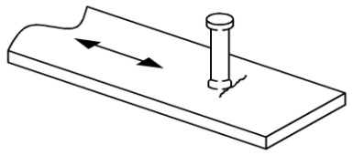
Shear Connectors
Fatigue Limit State Design
Load-induced Fatigue: Condition 9.1 (Table 6.6.1.2.3-1)
Fatigue Category C
Notes:
In addition to determining the required pitch at the fatigue limit state based on the fatigue shear resistance of the individual shear connectors as described previously in this lesson, the base metal at shear connectors attached to top flanges by fillet welds or automatic stud welding that are subject to net tension must also be checked for load-induced fatigue for Detail Category C, as specified in Condition 9.1 in AASHTO LRFD Table 6.6.1.2.3-1 (10th Edition). The checking of details subject to net tension for load-induced fatigue was discussed previously in Lesson 7.

Slide 45
Shear Connectors
Strength Limit State Design
where:
P = total nominal shear force within the region under consideration (kips)
Q_{r} = factored shear resistance of one shear connector (kips)
Notes:
The resulting number of shear connectors determined to satisfy the fatigue limit state must then be checked against the number required to satisfy the strength limit state. The design requirement at the strength limit state computes the minimum number of shear connectors, n, necessary to develop a specified nominal longitudinal force, P, within specified regions on either side of the point of maximum positive design live load plus impact moment (i.e., the HL-93 design live load plus impact moment) at the strength limit state. The regions are defined off the point of maximum design live load plus impact moment because it applies to the composite section and is easier to locate than a maximum of the sum of all the moments acting on the composite section. The equation for determining n in each region, given in AASHTO LRFD Article 6.10.10.4.1, is shown on this slide. Similar to V_{sr} for the fatigue limit state, P is computed as the vector sum of both a longitudinal and a radial component. Since P is in terms of total nominal shear force over a specified region, and Q_{r} is in terms of the factored shear resistance per shear connector, it is clear that n will result in the required number of shear connectors over the specified region. The calculation of P and Q_{r} will be discussed further on subsequent slides.
Composite beams with either regularly spaced shear connectors or shear connector clusters have exhibited similar ultimate strength and deflection at service loads in large-scale experimental tests. Only a slight deformation in the concrete and the more heavily stressed connectors are needed to redistribute the horizontal shear to other less heavily stressed connectors. The important consideration is that the total number of connectors be sufficient to develop the nominal longitudinal force, P, on either side of the point of maximum design live load plus impact moment.

Slide 46
Shear Connectors
Strength Limit State Design
Simple Spans & Continuous Spans that are Noncomposite for Negative Bending:
P = total nominal shear force between the point of maximum positive design live load plus impact moment and each adjacent point of zero moment (kips) taken as:
P_{p} = total longitudinal force in the concrete deck at the point of maximum positive design live load plus impact moment (kips) taken as the lesser of:
Notes:
AASHTO LRFD Article 6.10.10.4.2 specifies that for simple spans and for continuous spans that are noncomposite for negative bending, P is to be taken as the total nominal shear force between the point of maximum positive design live load plus impact moment and each adjacent point of zero moment. For simple spans, this defines the force in the regions extending from the point of maximum positive design live load plus impact moment to each abutment. For continuous spans that are noncomposite for negative bending, this defines the force in the region extending from the point of maximum positive design live load plus impact moment to the adjacent abutment, and the force in the region extending from the point of maximum positive design live load plus impact moment to the adjacent point of permanent load contraflexure in the span under consideration.
P_{p} is the total longitudinal force in the concrete deck at the point of maximum positive design live load plus impact moment taken as the lesser of the forces based on either the ultimate-strength properties of the concrete deck (P_{1p}), or the ultimate-strength properties of the steel girder (P_{2p}), as given by the equations shown at the bottom of this slide. In the equation for P_{1p}, b_{s} is the effective width of the concrete deck and t_{s} is the structural thickness of the deck.

Slide 47
Shear Connectors
Strength Limit State Design
Simple Spans & Continuous Spans that are Noncomposite for Negative Bending:
F_{p} = total radial force in the concrete deck at the point of maximum positive design live load plus impact moment (kips) taken as :
where:
L_{p} = arc length between an end of the girder and an adjacent point of maximum positive design live load plus impact moment (ft)
R = minimum girder radius over the length, L_{p} (ft)
Notes:
F_{p} is the total radial force in the concrete deck at the point of maximum positive design live load plus impact moment and is given by the equation shown on this slide. F_{p} is provided to account for the radial effect of curvature and is required for curved spans or segments to bring the smallest of the longitudinal forces in either the deck or the girder (i.e., P_{1p} or P_{2p} from the previous slide) into equilibrium. The resulting longitudinal force, P_{p}, is assumed to be constant over the length, L_{p}, when computing the radial component, F_{p}. Note that for straight spans or segments, F_{p} may be taken equal to zero. The arc length, L_{p}, for simple and continuous spans is defined as shown in the figure on this slide.

Slide 48
Shear Connectors
Strength Limit State Design
Continuous Spans that are Composite for Negative Bending:
P = total nominal shear force between the point of maximum positive design live load plus impact moment and an adjacent end of the member (kips) taken as:
P = total nominal shear force between the point of maximum positive design live load plus impact moment and the centerline of an adjacent interior support (kips) taken as:
Notes:
AASHTO LRFD Article 6.10.10.4.2 specifies that for continuous spans that are composite for negative bending, the total nominal shear force, P, between the point of maximum positive design live load plus impact moment and an adjacent end of the member is to be computed as the vector sum of the forces P_{p} and F_{p}, as described on the previous slides. This defines the force in the regions extending from the point of maximum positive design live load plus impact moment to each abutment in the end spans. The total nominal shear force, P, between the point of maximum design live load plus impact moment and the centerline of an adjacent interior support is to be computed as the vector sum of the forces P_{T} and F_{T}, as given by the equation shown at the bottom of this slide. This defines the force in the region extending from the point of maximum positive design live load plus impact moment to the adjacent interior support in the end spans, and from the point of maximum positive design live load plus impact moment to each adjacent interior support in the interior spans. The calculation of the forces P_{T} and F_{T} will be discussed further on subsequent slides.

Slide 49
Shear Connectors
Strength Limit State Design
Continuous Spans that are Composite for Negative Bending:
P_{T} = total longitudinal force in the concrete deck between the point of maximum positive design live load plus impact moment and the centerline of an adjacent interior support (kips) taken as:
P_{n} = total longitudinal force in the concrete deck over an interior support (kips) taken as the lesser of:
Notes:
P_{T} is the total longitudinal force in the concrete deck between the point of maximum positive design live load plus impact moment and the centerline of an adjacent interior support taken as the sum of the force P_{p}, computed as discussed on previous slides, and the force P_{n}, which is described further below. The number of shear connectors required between points of maximum positive design live load plus impact moment and the centerline of an adjacent interior support is computed from the sum of the critical forces at the maximum positive and negative moment locations. The sum of the critical forces at the maximum moment locations is conservatively used in order to provide adequate shear resistance for any live load position. Many shear connectors in this region resist reversing forces in the concrete deck depending on the live load position since there is no one point where the moment always changes sign.
P_{n} is the total longitudinal force in the concrete deck over an interior support taken as the lesser of the forces based on either the ultimate-strength properties of the steel girder (P_{1n}), or a conservative approximation of the combined contribution of both the longitudinal reinforcement and the concrete that remains effective in tension based on its modulus or rupture (P_{2n}), as given by the equations shown at the bottom of this slide. In the equation for P_{2n}, b_{s} is the effective width of the concrete deck and t_{s} is the structural thickness of the deck.
In this region, sufficient shear connectors are necessary to transfer the ultimate tensile force in the longitudinal reinforcement from the concrete deck to the steel section. The tension force, P_{2n}, is a conservative approximation using 45 percent of the specified 28-day compressive strength of the concrete to account for the combined contribution of the longitudinal reinforcement and the concrete deck that remains effective in tension based on its modulus of rupture. AASHTO LRFD Article C6.10.10.4.2 permits a more precise value to be substituted for P_{2n}.

Slide 50
Shear Connectors
Strength Limit State Design
Continuous Spans that are Composite for Negative Bending:
F_{T} = total radial force in the concrete deck between the point of maximum positive design live load plus impact moment and the centerline of an adjacent interior support (kips) taken as :
where:
L_{n} = arc length between the point of maximum positive design live load plus impact moment and the centerline of an adjacent interior support (ft)
R = minimum girder radius over the length, L_{p} (ft)
Notes:
F_{T} is the total radial force in the concrete deck between the point of maximum positive design live load plus impact moment and the centerline of an adjacent interior support and is given by the equation shown on this slide. F_{T} is provided to account for the radial effect of curvature and is required for curved spans or segments to bring the longitudinal force P_{T} into equilibrium. P_{T} is assumed to be constant over the length, L_{n}, when computing the radial component, F_{T}. Note that for straight spans or segments, F_{T} may be taken equal to zero. The arc length, L_{n} is defined as shown in the figure on this slide.

Slide 51
Shear Connectors
Strength Limit State Design
Factored Shear Resistance of One Shear Connector, Q_{r} :
where:
φ_{sc} = resistance factor for shear connectors = 1.0 (Article 6.5.4.2)
Q_{n} = nominal shear resistance of one shear connector (kips)
Nominal Shear Resistance of One Shear Connector, Q_{n} :
where:
A_{sc} = cross-sectional area of a stud shear connector (in.²)
F_{u} = specified minimum tensile strength of a stud shear connector = 60 ksi (Article 6.4.4)
Notes:
With the total nominal force, P, now computed in each region, the factored shear resistance of a single shear connector, Q_{r}, at the strength limit state must be determined in order to calculate the minimum required number of studs, n, to develop that force in each region at the strength limit state.
AASHTO LRFD Article 6.10.10.4.1 (10th Edition) specifies that Q_{r} is to be determined as the resistance factor for shear connectors, φ_{sc}, which is taken equal to 1.0 (AASHTO LRFD Article 6.5.4.2), times the nominal shear resistance of a single shear connector, Q_{n}. AASHTO LRFD Article 6.10.10.4.3 (10th Edition) specifies that Q_{n} is to be determined as 0.70 times the cross-sectional area of the stud shear connector, A_{sc}, times the specified minimum tensile strength of the stud shear connector, F_{u}. F_{u} is equal to 60 ksi for a typical stud shear connector (AASHTO LRFD Article 6.4.4).
Prior editions of the specifications relied upon a two-part shear connector strength equation based on the minimum of the steel tensile strength and the bearing strength of the connector on the concrete. An analysis of shear connector strength tests found that once the total height-to-shank diameter ratio of a stud is 5.0 or greater for normal-weight concrete or 7.0 or greater for lightweight concrete, the shear resistance of a connector is controlled solely by a proportion of the connector tensile strength. The 0.70 factor accounts for a shear-to-tensile strength factor found in the analysis along with an adjustment to experimental database values to attain a target reliability. The analysis showed that if a shear-to-tensile strength factor of 0.70 was used, then using ϕ_{sc} = 1.0 is appropriate.

Slide 52
Shear Connectors
Pitch - Strength Limit State Design
where:
n = minimum number of shear connectors over the region under consideration at the strength limit state
n_{t} = number of shear connectors in a transverse cross-section
Regularly Spaced Shear Connectors:
Notes:
To determine the required maximum pitch, p, of the shear connectors over the region under consideration at the strength limit state, first determine the number of rows of shear connectors within that region, n_{rows}, by dividing the calculated value of n for that region by the number of shear connectors in a transverse cross-section, n_{t}. For regularly spaced shear connectors, the required maximum pitch can then be computed as the length L_{p} or L_{n}, as applicable (in feet - for straight spans or segments, use the tangent length for this distance rather than the arc length), times 12 to convert the length to inches, divided by (n_{rows} – 1). The resulting pitch in each region is then to be compared to the calculated pitch for the fatigue limit state at various discrete points within that region to determine the governing pitch (i.e., the smaller pitch) at each point.
Note that the effective width of the concrete deck is likely to be different for the interior and exterior girders in the cross-section, which in conjunction with different fatigue shear ranges in the girders and different total nominal shear forces in the girders at the strength limit state, may result in slightly different pitches for each girder. However, for practical purposes, unless the differences are deemed significant, it is recommended that the same pitches be used on all the girders. Also, once the governing pitch is determined at each discrete point along a member, an examination of the pitches along the entire girder should be made to see if the pitches can be practically grouped over several longer ranges along the member rather than changing the pitch at each discrete point.

Slide 53
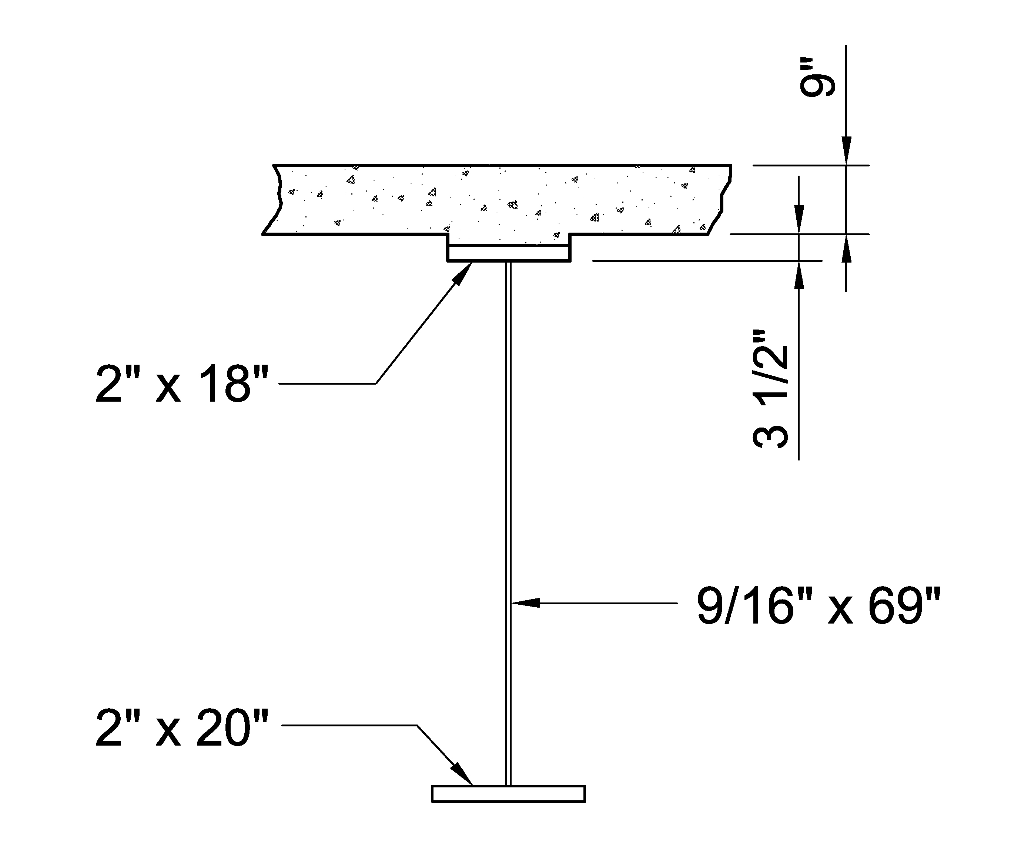
Shear Connectors
Example – taken from NSBA SBDH Design Example 1 (interior-pier section – negative moment - exterior girder – hybrid section)
Check the shear stud proportion, spacing, and cover and penetration requirements
Determine the required maximum pitch of the shear connectors at the interior pier for the fatigue and strength limit states (using the 10th Edition requirements)
I_{n} = 227,766 in.⁴; Effective deck width = 114.0 in.
N.A. is 14.65 in. below the top of the top flange
f’_{c} = 4.0 ksi
75-year (ADTT)_{SL} = 1,600 trucks per day
(Lesson 6)
Notes:
In this example, the calculation of the required maximum pitch of the shear connectors at the interior pier for the fatigue and strength limit states using the AASHTO LRFD 10th Edition requirements will now be illustrated for the composite section shown, which is taken from Design Example 1 of the NSBA Steel Bridge Design Handbook (SBDH). The girder is an exterior girder, and the section is at an interior pier, which is in a negative moment region of a three-span continuous girder (at 1.0L). The shear connectors in this example are regularly spaced and are to be provided along the entire length of the continuous span, including in the negative moment regions, which is strongly recommended. The calculation of the required maximum pitch will be similar for sections in the positive moment regions of the member (not shown in this example). The shear stud proportion, spacing, and cover and penetration requirements will also be checked in this example.
The interior-pier section is a hybrid section with a specified minimum yield strength of the compression (bottom) flange, F_{yc}, of 70 ksi. The specified minimum yield strength of the tension (top) flange is also 70 ksi and the specified minimum yield strength of the web is 50 ksi. The effective width of the concrete deck for the exterior girder in this example was calculated previously in Lesson 6 to be 114.0 in. Separate calculations similar to those illustrated previously in Lesson 6 result in a moment of inertia of the short-term (n) composite section, I_{n}, of 227,766 in.⁴ The contribution of the longitudinal deck reinforcement is conservatively ignored. The elastic neutral axis of the short-term (n) composite section is located 14.65 inches below the top of the top flange. The specified 28-day compressive strength of the concrete, f’_{c}, is equal to 4.0 ksi. As illustrated previously in Lesson 7, the projected 75-year single-lane Average Daily Truck Traffic, (ADTT)_{SL}, for this example is calculated to be 1,600 trucks per day.
53

Slide 54
Shear Connectors
Cover and Penetration
Thinnest top flange = 7/8 in.
Thickest top flange = 2 in.
Terminate studs at approximately the mid-thickness of the concrete deck.
Concrete Deck
Cover
Penetration
Penetration:
Cover:
Notes:
As discussed previously in this lesson, AASHTO LRFD Article 6.10.10.1.4 specifies that shear connectors should be detailed to penetrate through the haunch and at least 2.0 inches into the concrete deck. For the girder in NSBA SBDH Design Example 1, the thinnest top flange is 7/8 inches in the positive moment region of the center span, and the thickest top flange is 2 inches over the interior piers. Terminating the studs at approximately the mid-thickness of the concrete deck will place them well within the specified limits for cover and penetration and will also clear the reinforcing steel. Using the thinnest top flange, as illustrated on this slide, a stud length of 7.125 inches will place the stud right at the mid-thickness of the deck. This is well above the required minimum penetration of 2.0 inches. Therefore, 7-inch-long studs will be used.
The clear depth of concrete cover over the tops of shear connectors should also not be less than 2.0 inches. Using the thickest top flange over the interior piers and assuming 7-inch-long studs, the minimum concrete cover over the tops of the shear connectors is calculated to be 3.5 inches, as illustrated on this slide, which exceeds the requirement minimum cover of 2.0 inches. Depending on the size of the top mat of deck reinforcement, a check should also be made to ensure the studs do not interfere with the reinforcement in this region.

Slide 55
Shear Connectors
Minimum Total Height-to-Shank Diameter Ratio
Stud Height
Use 7/8-inch diameter studs
Stud Diameter
Notes:
AASHTO LRFD Article 6.10.10.1.1 specifies that the ratio of the total height to the shank diameter of a stud shear connector is not to be less than 5.0 when embedded in normal-weight concrete.
7/8-inch diameter studs will be assumed for this example. These are the most common diameter studs in use. The height-to-shank diameter ratio, h/d, is therefore equal to 8.0, as illustrated on this slide, which exceeds the minimum specified value of 5.0.

Slide 56
Shear Connectors
Transverse Spacing and Clear Distance
Minimum width of top flange = 16.0 in.
n_{t} = 3 studs/row
Clear Distance
Transverse Spacing
Use a Transverse Spacing of 5.0 in. > 4.0d = 4.0(0.875) = 3.5 in. ok
Clear Distance = [16.0 – 2(5.0) – 0.875]/2 = 2.5625 in. > 1.0 in. ok
Notes:
AASHTO LRFD Article 6.10.10.1.3 specifies that stud shear connectors placed transversely across the flange of the steel section are not to be closer than 4.0 stud diameters center-to-center transverse to the longitudinal axis of the supporting member. The minimum width of the top flange in NSBA Design Example 1 is 16.0 inches. The number of shear connectors in a transverse cross-section, n_{t}, is assumed to be 3 studs/row in the example design. A center-to-center transverse spacing of the studs of 5.0 inches is assumed, which exceeds the minimum spacing of 4.0 stud diameters, or 3.5 inches for a 7/8-inch-diameter stud.
The clear distance between the edge of the top flange and the edge of the nearest shear connector is not to be less than 1.0 inch. Based on the 16.0 inch minimum top-flange width, the clear distance on each side of the flange is computed to be 2.5625 inches, as illustrated on this slide, which exceeds the minimum clear distance of 1.0 inch.

Slide 57
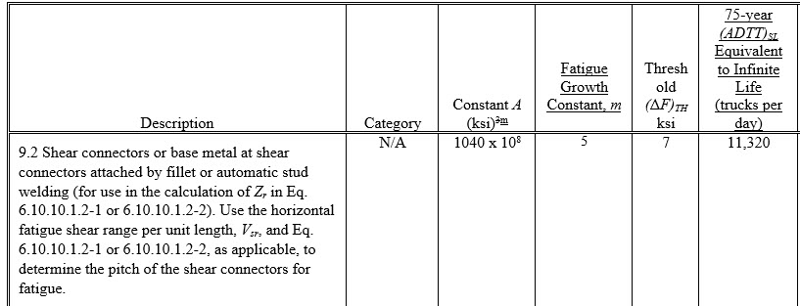
Shear Connectors
Pitch – Fatigue Limit State
Determine which Fatigue load combination applies:
Notes:
Next, determine the required maximum pitch of the shear connectors at the interior pier for the fatigue limit state (using the 10th Edition requirements). First, determine which Fatigue load combination applies. According to Condition 9.2 in AASHTO LRFD Table 6.6.1.2.3-1 (10th Edition), the 75-year (ADTT)_{SL} Equivalent to Infinite Life for shear connectors is equal to 11,320 trucks per day. Again, this value is calculated from AASHTO LRFD Eq. C6.6.1.2.3-1 assuming a 75-year fatigue design life and one stress range cycle per truck passage (i.e., n = 1.0). For other values of the fatigue design life, the specified value of 11,320 trucks/day should be modified by multiplying the value by the ratio of 75 divided by the fatigue life sought in years. For other values of n, the value should be divided by the appropriate value of n.
57

Slide 58
Shear Connectors
Pitch – Fatigue Limit State
For continuous spans, the number of stress cycles per truck passage, n, is equal to 1.5 at sections near the interior pier and 1.0 elsewhere (AASHTO LRFD Table 6.6.1.2.5-1)
The Fatigue II load combination is to be used (load factor = 0.80), and the nominal fatigue resistance of the shear connector, (ΔF)_{n}, is to be determined for finite life.
Notes:
For continuous spans, the number of stress cycles per truck passage, n, is equal to 1.5 at sections near the interior pier and 1.0 elsewhere (AASHTO LRFD Table 6.6.1.2.5-1 – 10th Edition). Sections ‘near the interior pier’ are defined as sections within a distance of one-tenth of the span on each side of the interior support. Therefore, the adjusted value of the 75-year (ADTT)_{SL} Equivalent to Infinite Life is equal to 11,320/1.5 = 7,547 trucks/day for the shear connectors ‘near the interior pier”. The specified value of 11,320 trucks/per day is to be used for the shear connectors located elsewhere along the member where n is equal to 1.0.
Since the projected 75-year (ADTT)_{SL} of 1,600 trucks/day for this example is less than 7,547 trucks/day (and also less than 11,320 trucks per day), the Fatigue II load combination is to be used (i.e., a load factor of 0.80) for the design of the shear connectors along the entire member, and the nominal fatigue resistance of the shear connector, (ΔF), is to be determined for finite life, as will demonstrated later in this example.
58

Slide 59
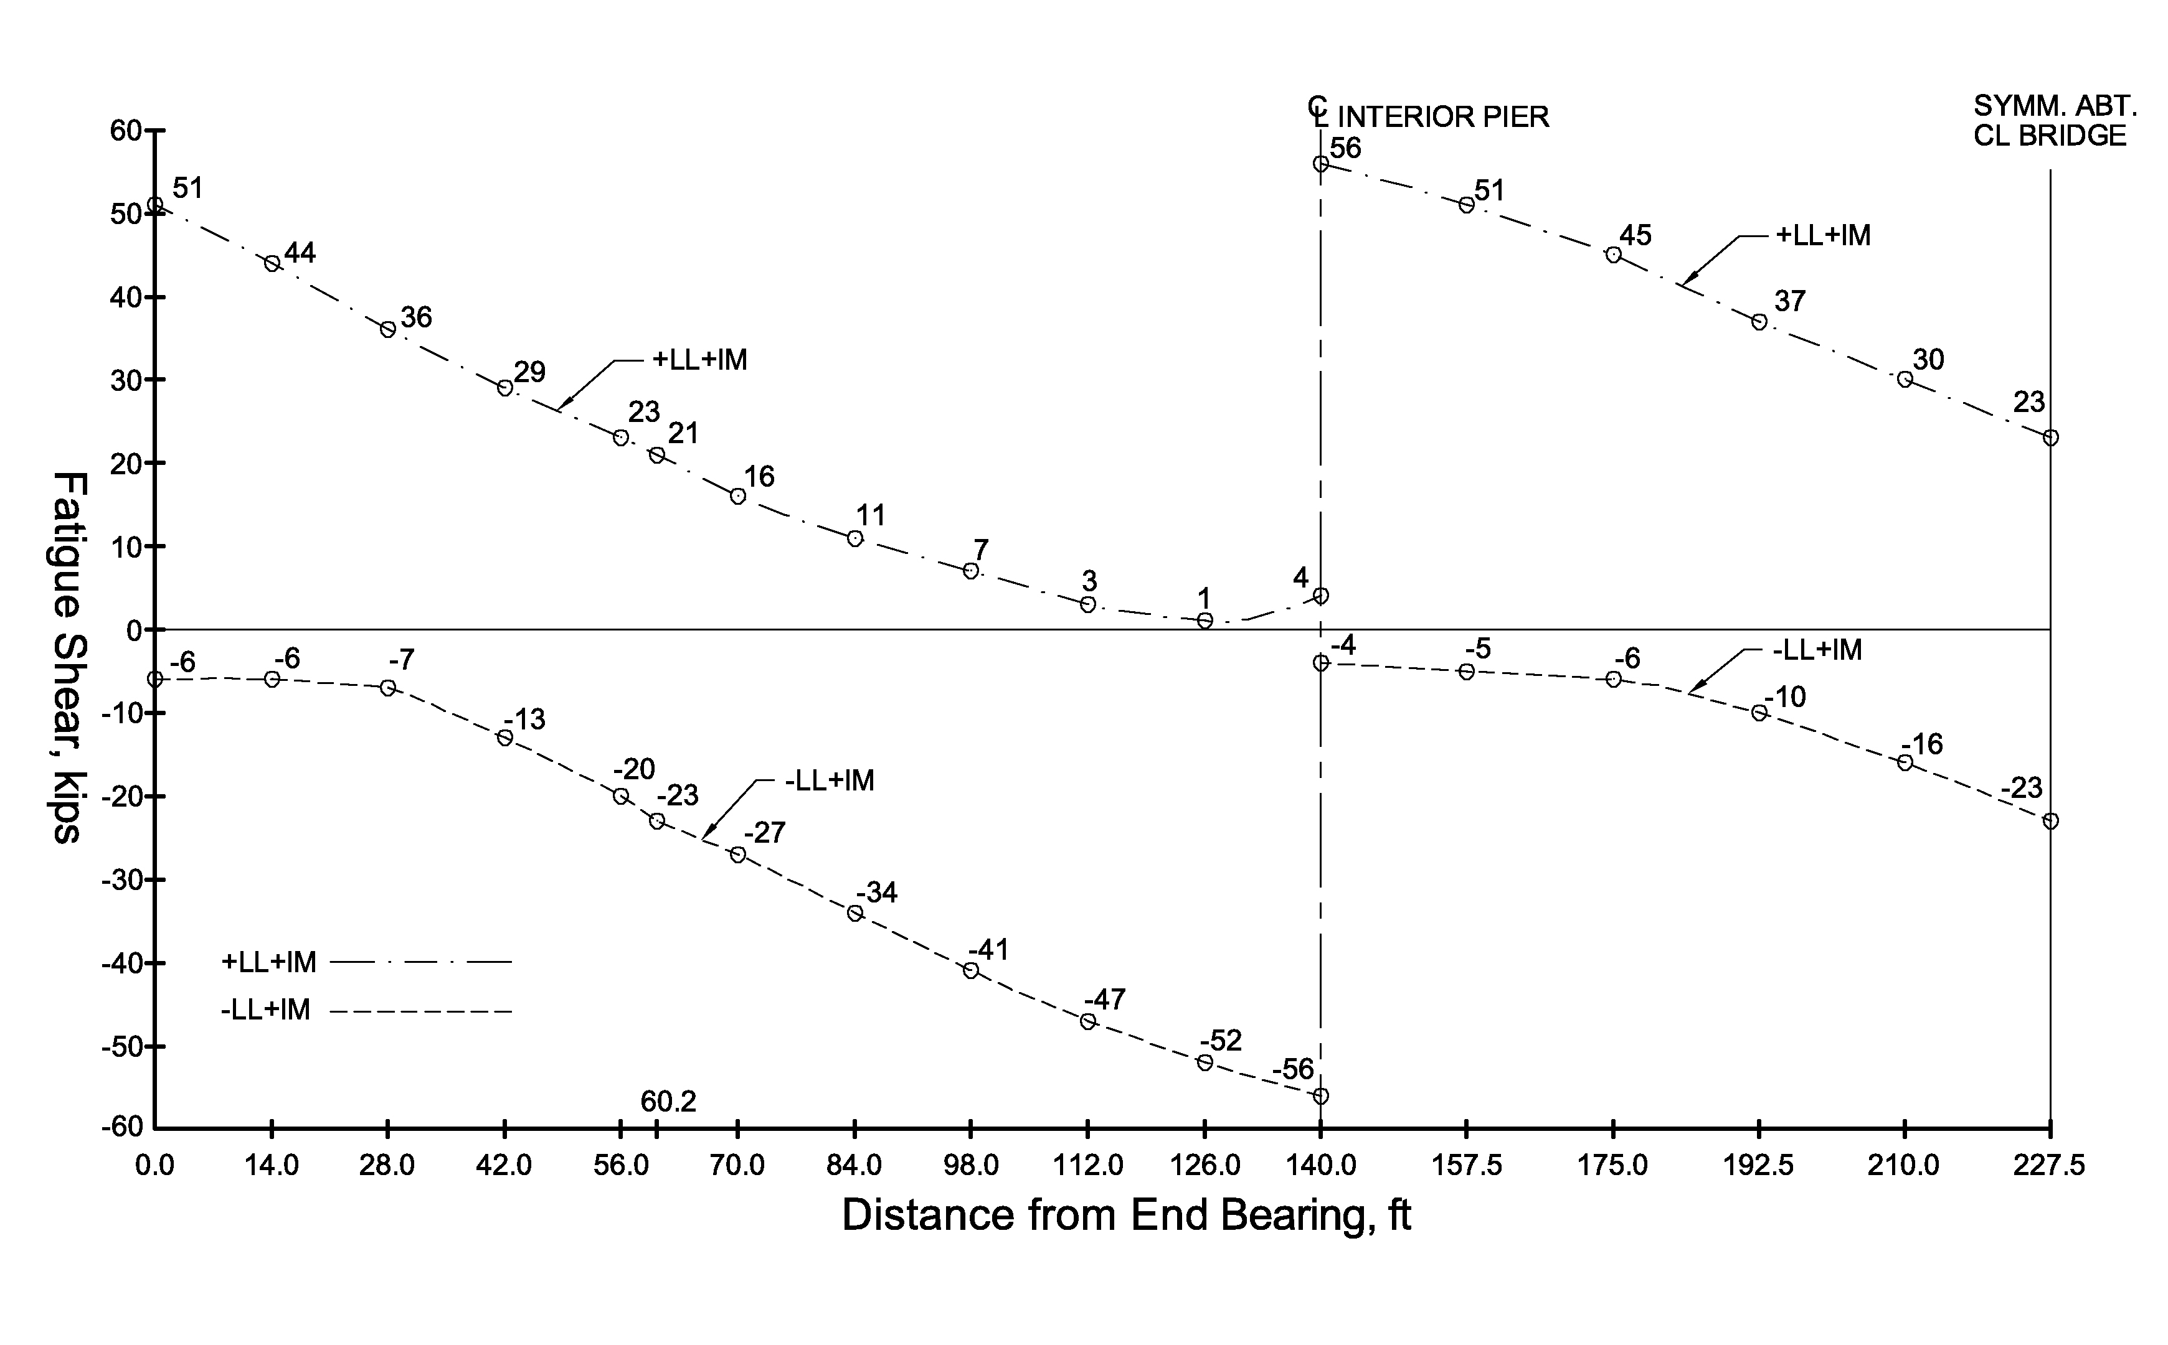
Shear Connectors
Pitch – Fatigue Limit State
Calculate the factored vertical shear force range, V_{f}, at the interior pier due to the fatigue live load:
V_{+LL+IM} = +56.0 kips (right-side)
V_{-LL+IM} = -4.0 kips (right-side)
V_{range} = +56.0 + |-4.0| = 60.0 kips
V_{f} = 0.80(60.0) = 48.0 kips (Fatigue II)
Notes:
Calculate the factored vertical shear force range, V_{f}, at the interior pier due to the fatigue live load. The unfactored vertical shears for the three-span continuous girder due to the fatigue live load (placed in a single lane) are shown on this slide at each span tenth point. The shears were determined using a line-girder analysis as discussed previously in Lesson 4. The shears are shown for one-half of the girder; the shears are symmetrical about the centerline of the bridge (which is located at the right-hand side of the plot). Since the fatigue live load is a moving load, shear envelopes are plotted for the LL + IM loads; the envelopes represent the maximum (+) and minimum (-) fatigue live-load plus impact shear values at each point. The plotted shear values include the exterior-girder distribution factor for one-lane loaded (which controls in this case), and the specified dynamic load allowance for fatigue of 15 percent.
The unfactored range of vertical shear force, V_{range}, at the interior pier due to the fatigue live load is computed from the values shown on this plot. At the interior pier, the maximum positive live load plus impact shear on the right-side of the pier is +56.0 kips and the maximum negative (or minimum) live load plus impact shear is -4.0 kips. The unfactored range of shear is equal to the algebraic sum of these two envelope values, or 60.0 kips. The same range of shear occurs on the left-side of the pier. The positive and negative shears due to major-axis bending are due to the fatigue vehicle located in Span 1 with the back axle on the left and then on the right of the interior pier. This means that the truck has to turn around to produce the computed shear range. This is not a realistic loading case but has been assumed to be practical and to be conservative. This use of two reversed positions was previously discussed on Slide 36 of this lesson as a source of conservatism.
The factored range of vertical shear force, V_{f}, is equal to the load factor for the Fatigue II load combination, equal to 0.80 (Lesson 3), times 60 kips, or 48.0 kips.
59

Slide 60
Shear Connectors
Pitch – Fatigue Limit State
Calculate the first moment of the transformed short-term area of the concrete deck about the neutral axis of the short-term composite section, Q:
Modular ratio n = 8
Notes:
Next, calculate the first moment of the transformed short-term area of the concrete deck about the neutral axis of the short-term (n) composite section at the interior pier, Q. The parameters I and Q for this example as determined using the deck within the effective flange width. AASHTO LRFD Article C6.10.10.1.2 does permit I and Q in regions of negative flexure in straight girders to be determined using only the longitudinal reinforcement within the effective flange width, unless the concrete deck is considered to be effective in tension for negative flexure in calculating the range of longitudinal stress, as permitted in AASHTO LRFD Article 6.6.1.2.1 (Lesson 7). Since the minimum required one-percent longitudinal reinforcement is provided in the deck according to the provisions of Article 6.10.1.7 and shear connectors are provided along the entire length of the member, the concrete deck is considered effective in tension for negative flexure when computing longitudinal stress ranges for fatigue in this example (Lesson 7), as will be demonstrated later in this example. Therefore, I and Q must be determined using the short-term area of the concrete deck along the entire girder.
The modular ratio, n, is equal to 8. Therefore, the transformed short-term area of the concrete deck is equal to the effective width of the deck, 114.0 inches, times the structural thickness of the deck, 9.0 inches, divided by the modular ratio, or 128.3 in.² The moment arm from the neutral axis of the short-term composite section to the centroid of the concrete deck is calculated as the distance of the neutral axis from the top of the top flange, given as 14.65 inches, minus the thickness of the top flange at the interior pier, 2.0 inches, plus the concrete haunch thickness (measured from the top of the web to the bottom of the deck), 3.5 inches, plus one-half the structural deck thickness, or 4.5 inches, which gives 20.65 inches. Q is then equal to the transformed deck area times the moment arm, or 2,649 in.³
60

Slide 61
Shear Connectors
Pitch – Fatigue Limit State Design
Longitudinal Fatigue Shear Range per Unit Length, V_{fat}:
Horizontal Fatigue Shear Range per Unit Length, V_{sr}:
Notes:
AASHTO LRFD Article 6.10.10.1.2 specifies that the longitudinal fatigue shear range per unit length, V_{fat}, is to be calculated from the equation shown at the top of this slide. V_{f} and Q were computed on the preceding two slides, 48.0 kips and 2,649 in.³, respectively, and the moment of inertia of the short-term (n) composite section, I, was given previously as 227,766 in.⁴ The resulting value of V_{fat} is 0.56 kips/in.
AASHTO LRFD Article 6.10.10.1.2 further specifies that the horizontal fatigue shear range per unit length, V_{sr}, is to be taken as the vector sum of the longitudinal and radial fatigue shear ranges per until length, V_{fat} and F_{fat}, respectively, as given by the equation shown at the bottom of this slide. Since the bridge in NSBA Design Example 1 is straight and there is no skew, the radial fatigue shear range, F_{fat}, is equal to zero. Therefore, in this case, V_{sr} is equal to V_{fat}, or 0.56 kips/in.

Slide 62
Shear Connectors
Pitch – Fatigue Limit State Design
Nominal Fatigue Resistance of the Shear Connector, (ΔF)_{n}:
Finite Life:
n = number of stress range cycles per truck passage (Table 6.6.1.2.3-1)
Notes:
As determined previously, the nominal fatigue resistance of the shear connector, (ΔF)_{n}, is to be computed for finite life in this case. AASHTO LRFD Article 6.6.1.2.5 specifies that the nominal fatigue resistance for finite life is to be computed from the equation shown on this slide.
The detail category constant, A, was discussed previously in Lesson 7. Condition 9.2 of AASHTO LRFD Table 6.6.1.2.3-1 (10th Edition) specifies that A for stud shear connectors is to be taken as 1040 x 10⁸ ksi⁵. The value of m is a fatigue growth constant, which is taken as 5 for stud shear connectors according to AASHTO LRFD Table 6.6.1.2.3-1 (see earlier slide). N is the total number of stress cycles in a single lane over a 75-year fatigue design life. If a fatigue design life other than 75 years is sought, a number other than 75 may be inserted in the equation for N. n is the number of stress range cycles per truck passage taken from AASHTO LRFD Table 6.6.1.2.3-1 (10th Edition), which was previously determined to be 1.5 at the interior pier.
For the projected 75-year (ADTT)_{SL} in this example of 1,600 trucks/day, N at the interior-pier is computed to be 65.7 x 10⁶ cycles over the 75-year fatigue design life. Therefore, the nominal fatigue resistance of the shear connector, (ΔF)_{n}, for finite life is computed to be 4.36 ksi.

Slide 63
Shear Connectors
Pitch – Fatigue Limit State Design
Fatigue Shear Resistance of an Individual Stud Shear Connector, Z_{r}:
Notes:
AASHTO LRFD Article 6.10.10.2 (10th Edition) specifies that the fatigue shear resistance of an individual stud shear connector, Z_{r} (kips), used to determine the required maximum pitch at the fatigue limit state is to be computed from the equation shown on this slide. The cross-sectional area of the stud shear connector, A_{sc}, is computed to be 0.60 in.² for a 7/8-inch-diameter stud. The nominal fatigue resistance of the shear connector, (ΔF)_{n}, was computed on the previous slide to be 4.36 ksi. Therefore, Z_{r} is computed to be 2.62 kips/stud.

Slide 64
Shear Connectors
Pitch – Fatigue Limit State Design
Regularly Spaced Shear Connectors:
Maximum Pitch: ≤ 48.0 inches for D ≥ 24.0 inches ok
Minimum Pitch: ≥ 4.0 x (Stud Diameter) ≥ 4.0(0.875) = 3.5 inches ok
Notes:
AASHTO LRFD Article 6.10.10.1.2 specifies that for regularly spaced shear connectors, the center-to-center pitch, p, between shear connectors at the fatigue limit state must not exceed the value given by the equation shown on this slide. n_{t} is the number of shear connectors in a transverse cross-section, which is equal to 3 in this case. Therefore, the maximum required pitch for the fatigue limit state at the interior pier for this example is equal to 3 times the fatigue shear resistance of an individual stud shear connector, Z_{r}, determined on the preceding slide to be 2.62 kips/stud, divided by the horizontal fatigue shear range per unit length, V_{sr}, determined previously to be 0.56 kips/in. The required maximum pitch, p, is 14.0 inches/row, which is less than the maximum permissible pitch of 48.0 inches for web depths, D, greater than or equal to 24.0 inches, and greater than the specified minimum pitch of 4.0 stud diameters or 3.5 inches for a 7/8-inch diameter stud.
The preceding computations would be repeated at intervals along the span, including in the positive moment regions, e.g., at span tenth points. In curved and/or skewed bridges, it is recommended that these computations be made as a minimum at all cross-frame locations.

Slide 65
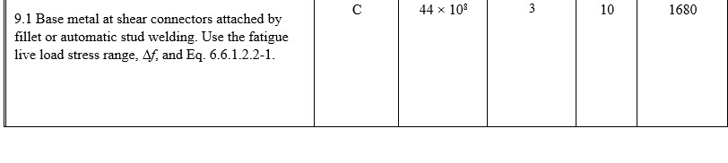
Shear Connectors
Fatigue Limit State – Load Induced Fatigue
Determine which Fatigue load combination applies:
Notes:
Next, check the base metal at the welded shear connectors at the interior pier for load-induced fatigue for Detail Category C, as specified in Condition 9.1 in AASHTO LRFD Table 6.6.1.2.3-1 (10th Edition). The checking of details subject to net tension for load-induced fatigue was discussed previously in Lesson 7. By inspection, the shear connectors on the top flange at the interior pier are subject to net tension under the Fatigue I load combination since the unfactored permanent loads do not produce compression in the top flange at the interior pier (refer to Lesson 7 and AASHTO LRFD Article 6.6.1.2.1).
First, determine which Fatigue load combination applies. According to Condition 9.1 in AASHTO LRFD Table 6.6.1.2.3-1 (10th Edition), the 75-year (ADTT)_{SL} Equivalent to Infinite Life is equal to 1,680 trucks per day for a fatigue Category C detail (Lesson 7). Again, this value is calculated from AASHTO LRFD Eq. C6.6.1.2.3-1 assuming a 75-year fatigue design life and one stress range cycle per truck passage (i.e., n = 1.0). For continuous spans, the number of stress cycles per truck passage, n, at the interior pier was previously determined to be 1.5. Therefore, the adjusted value of the 75-year (ADTT)_{SL} Equivalent to Infinite Life is equal to 1,680/1.5 = 1,120 trucks/day. Since the projected 75-year (ADTT)_{SL} of 1,600 trucks/day for this example is greater than 1,120 trucks/day, the Fatigue I load combination is to be used (i.e., a load factor of 1.75) for checking load-induced fatigue of the base metal at the shear connectors at the interior pier, and the nominal fatigue resistance of the base metal is to be determined for infinite life.
65

Slide 66
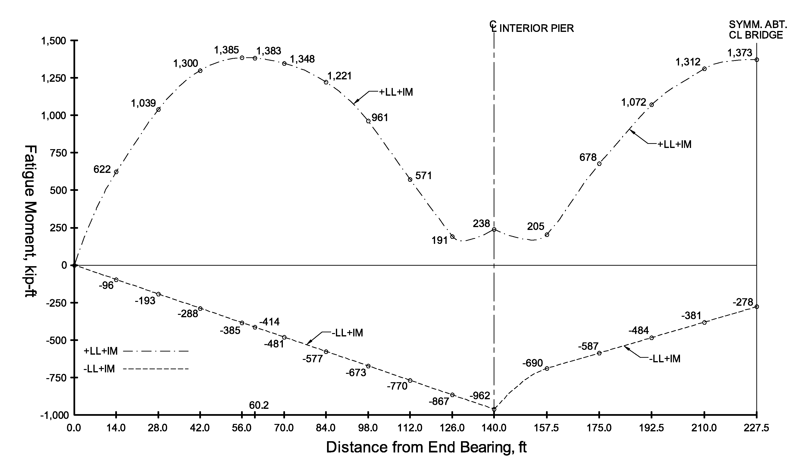
Shear Connectors
Fatigue Limit State – Load Induced Fatigue
Calculate the factored stress range, γ(Δf), at the interior pier due to the fatigue live load:
M_{+LL+IM} = +238 kip-ft
M_{-LL+IM} = -962 kip-ft
Notes:
Calculate the factored stress range, γ(Δf), at the interior pier due to the fatigue live load. The unfactored vertical major-axis bending moments for the three-span continuous girder due to the fatigue live load (placed in a single lane) are shown on this slide at each span tenth point. The moments were determined using a line-girder analysis as discussed previously in Lesson 4. The moments are shown for one-half of the girder; the moments are symmetrical about the centerline of the bridge (which is located at the right-hand side of the plot). Since the fatigue live load is a moving load, moment envelopes are plotted for the LL + IM loads; the envelopes represent the maximum (+) and minimum (-) fatigue live-load plus impact moment values at each point. The plotted moment values include the exterior-girder distribution factor for one-lane loaded (which controls in this case), and the specified dynamic load allowance for fatigue of 15 percent.
The factored stress range at the interior pier due to the fatigue live load is computed from the values shown on this plot. At the interior pier, the maximum positive live load plus impact moment is +238 kip-ft and the maximum negative (or minimum) live load plus impact moment is -962 kip-ft. The distance from the neutral axis of the short-term (n) composite section to the top of the top flange at the interior pier was given previously as 14.65 inches. The moment of inertia of the short-term composite section was also given previously as 227,766 in.⁴ The load factor for the Fatigue I load combination is 1.75 (Lesson 3). Since the minimum required one-percent longitudinal reinforcement is provided in the deck according to the provisions of Article 6.10.1.7 and shear connectors are provided along the entire length of the member, the concrete deck is considered effective in tension for negative flexure when computing longitudinal stress ranges for fatigue in this example. Therefore, the factored stress range is computed to be 1.62 ksi, as illustrated on this slide. AASHTO LRFD Article 6.6.1.2.5 specifies the nominal fatigue resistance, (ΔF)_{n}, is to be taken as the constant-amplitude fatigue threshold, (ΔF)_{TH}, for infinite life. According to Condition 9.1 as shown on the preceding slide, (ΔF)_{TH} is to be taken as 10.0 ksi for a fatigue Category C detail, which exceeds the factored stress range of 1.62 ksi. Therefore, the base metal at the welded stud shear connector at the interior pier is satisfactory for load induced fatigue.
66

Slide 67
Shear Connectors
Strength Limit State Design
Continuous Spans that are Composite for Negative Bending:
P = total nominal shear force between the point of maximum positive design live load plus impact moment and the centerline of an adjacent interior support (kips) taken as:
P_{T} = total longitudinal force in the concrete deck between the point of maximum positive design live load plus impact moment and the centerline of an adjacent interior support (kips) taken as:
Notes:
Next, determine the required maximum pitch of the shear connectors at the interior pier for the strength limit state (using the 10th Edition requirements). As discussed previously, for continuous spans that are composite for negative bending, which is the case in this example, the total nominal shear force, P, between the point of maximum design live load plus impact moment and the centerline of an adjacent interior support is to be computed as the vector sum of the forces P_{T} and F_{T}, as given by the equation shown at the top of this slide. P_{T} is the total longitudinal force in the concrete deck between the point of maximum positive design live load plus impact moment and the centerline of an adjacent interior support taken as the sum of the force P_{p} and the force P_{n.} P_{p} and P_{n} will be calculated for this example on subsequent slides.
F_{T} is the total radial force in the concrete deck between the point of maximum positive design live load plus impact moment and the centerline of an adjacent interior support. Since the bridge in NSBA SBDH Design Example 1 is straight and not horizontally curved, F_{T} is taken equal to zero.

Slide 68
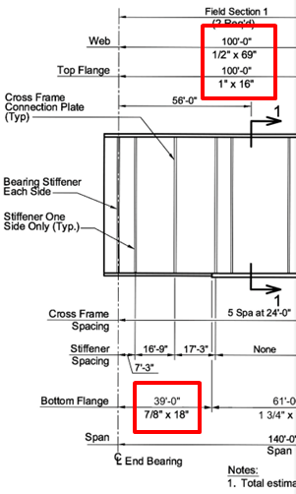
Shear Connectors
Strength Limit State Design
P_{p} = total longitudinal force in the concrete deck at the point of maximum positive design live load plus impact moment (kips) taken as the lesser of:
Notes:
As discussed previously, P_{p} is the total longitudinal force in the concrete deck at the point of maximum positive design live load plus impact moment taken as the lesser of the forces based on either the ultimate-strength properties of the concrete deck (P_{1p}), or the ultimate-strength properties of the steel girder (P_{2p}), as given by the equations shown at the top of this slide. In the equation for P_{1p}, b_{s} is the effective width of the concrete deck and t_{s} is the structural thickness of the deck. Substituting into the equation gives P_{1p} equal to 3,488 kips.
The steel section yielding the smallest force, P_{2p}, in the region between the point of maximum design live load plus impact moment and the adjacent end of the member (i.e., the abutment) is right at the abutment. The flange and web sizes at this section are shown in the figure on this slide. The section is a homogeneous section with the specified minimum yield strength of the flanges equal to 50 ksi. Substituting into the equation gives P_{2p} equal to 3,313 kips. Therefore, P_{p} is equal to the lesser of P_{1p} and P_{2p}, or P_{2p} = 3,313 kips.

Slide 69
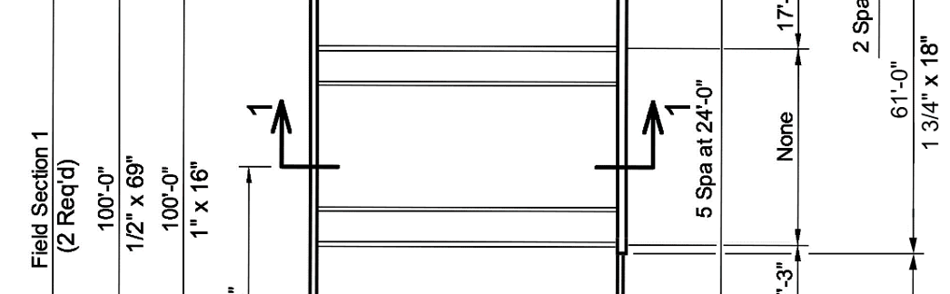
Shear Connectors
Strength Limit State Design
P_{n} = total longitudinal force in the concrete deck over an interior support (kips) taken as the lesser of:
Notes:
As discussed previously, P_{n} is the total longitudinal force in the concrete deck over an interior support taken as the lesser of the forces based on either the ultimate-strength properties of the steel girder (P_{1n}), or a conservative approximation of the combined contribution of both the longitudinal reinforcement and the concrete that remains effective in tension based on its modulus or rupture (P_{2n}), as given by the equations shown at the top of this slide. The steel section yielding the smallest force, P_{1n}, in the region between the point of maximum design live load plus impact moment and the centerline of the adjacent interior support is at the point of maximum positive design live load plus impact moment. The flange and web sizes at this section are shown in the figure on this slide. The section is a homogeneous section with the specified minimum yield strength of the flanges equal to 50 ksi. Substituting into the equation gives P_{1n} equal to 4,100 kips.
In the equation for P_{2n}, b_{s} is the effective width of the concrete deck and t_{s} is the structural thickness of the deck. Substituting into the equation gives P_{2n} equal to 1,847 kips. Therefore, P_{n} is equal to the lesser of P_{1n} and P_{2n}, or P_{2n} = 1,847 kips.

Slide 70
Shear Connectors
Strength Limit State Design
Notes:
The total longitudinal force in the concrete deck between the point of maximum positive design live load plus impact moment and the centerline of an adjacent interior support, P_{T}, is taken as the sum of the force P_{p} and the force P_{n}, or 5,160 kips. .
The total nominal shear force, P, between the point of maximum design live load plus impact moment and the centerline of an adjacent interior support is taken as the vector sum of the forces P_{T} and F_{T}. As mentioned previously, since the bridge in NSBA SBDH Design Example 1 is straight and not horizontally curved, the total radial force in the concrete deck between the point of maximum positive design live load plus impact moment and the centerline of an adjacent interior support, F_{T} is taken equal to zero. Therefore, in this case, P is equal to P_{T}, or 5,160 kips.

Slide 71
Shear Connectors
Strength Limit State Design
Nominal Shear Resistance of One Shear Connector, Q_{n} :
Factored Shear Resistance of One Shear Connector, Q_{r} :
Notes:
The nominal shear resistance of a single shear connector, Q_{n} is determined as 0.70 times the cross-sectional area of the stud shear connector, A_{sc}, which is equal to 0.60 in.² for a 7/8-inch diameter stud, times the specified minimum tensile strength of the stud shear connector, F_{u}. F_{u} is equal to 60 ksi for a typical stud shear connector (AASHTO LRFD Article 6.4.4). Therefore, Q_{n} is equal to 25.2 kips.
The factored shear resistance of a single shear connector, Q_{r}, is determined as the resistance factor for shear connectors, φ_{sc}, which is taken equal to 1.0, times the nominal resistance of the shear connector, Q_{n}. Therefore, Q_{r} is equal to 25.2 kips.

Slide 72
Shear Connectors
Pitch - Strength Limit State Design
Notes:
The minimum number of shear connectors, n, necessary to develop the total nominal shear force, P, in the region between the point of maximum positive design live load plus impact moment and the centerline of the adjacent interior pier at the strength limit state is equal to P divided by the factored shear resistance of a single shear connector, Q_{r}, which in this case is equal to 204.8 studs, rounded up to 205 studs.
The required minimum number of rows of shear connectors in this region, n_{rows}, is equal to n divided by the number of shear connectors in a transverse cross-section, n_{t}, which in this case is equal to 3. The required number of rows is 68.3 rows, which is rounded up to 69 rows.

Slide 73
Shear Connectors
Pitch - Strength Limit State Design
L_{n}
L_{n}
Maximum Pitch: ≤ 48.0 inches for D ≥ 24.0 inches ok
Minimum Pitch: ≥ 4.0 x (Stud Diameter)
≥ 4.0(0.875) = 3.5 inches ok
Notes:
For regularly spaced shear connectors, the required maximum pitch can then be computed as the length L_{n} in this case (in feet – since the example bridge is a straight bridge, the tangent length will be used for this distance rather than the arc length), times 12 to convert the length to inches, divided by (n_{rows} – 1).
The figure on this slide shows the moment envelopes for the three-span continuous example bridge girder, with span lengths of 140 ft – 175 ft – 140 ft. The moments are shown for one-half of the girder; the moments are symmetrical about the centerline of the bridge (which is located at the right-hand side of the plot). Determine the tangent length, L_{n}, in the end span from the point of maximum positive live load plus impact moment to the centerline of the adjacent interior pier. As indicated in the figure, the point of maximum live load plus impact moment in the end span is located 60.2 feet from the abutment. Therefore, L_{n} in this case is equal to the end span length of 140 feet minus 60.2 feet, or 70.8 feet. This will give a smaller required pitch at the interior pier than the value of L_{n} in the center span, which is equal to 175/2 = 87.5 feet. The resulting required maximum pitch in this region, including at the interior pier, at the strength limit state is 14.1 inches/row, which satisfies the specified maximum and minimum pitch requirements as indicated on the slide.
The required maximum pitch of 14.0 inches/row, determined previously for the fatigue limit state at the interior pier, controls in this case by a slight amount. As mentioned previously, the preceding example calculations would then be repeated at various intervals along the span, including in the positive moment regions, e.g., at span tenth points and/or at cross-frame locations, to determine several practical ranges of shear connector pitch along the member.
As an alternate approach to layout, at the completion of the fatigue limit state pitch determination, the engineer can develop a preliminary layout. There will be several changes in pitch along the span length but no need to change the pitch more than a few times. Once this layout for the fatigue limit state is complete, simply sum the number of connectors from the point of zero moment to the point of maximum positive live load moment and compare that number to the required number for the strength limit state (108 studs in this case – refer to NSBA SBDH Design Example 1 – calculation not shown here), and similarly sum the number of connectors from the point of maximum positive live load moment to the interior pier and compare that number to the required strength limit state demand (205 studs in this case). As long as the sum of the studs provided for the fatigue limit state layout is adequate, the strength limit state requirement is satisfied. Otherwise, the appropriate adjustments will need to be made.

Slide 74
Lesson 9 – Flexure Part 4
Strength Limit State: Composite Sections in Positive Bending and Shear Connectors
Composite Sections in Positive Bending
  Introduction
  Compact Sections
  Noncompact Sections
  Ductility Requirement
  Concrete Deck Stresses
Shear Connectors
Notes:
This slide summarizes the various topics that were covered in Lesson 9. This lesson covered the design of composite sections in positive bending at the strength limit state, including the design provisions for both compact and noncompact sections, the ductility requirement and concrete deck stress requirement associated with the design of these sections, and the design of shear connectors for composite girders in positive and negative bending regions according to new provisions appearing in the 10th Edition of the AASHTO LRFD BDS.
74

Slide 75
END

