Slide 1
Fundamentals of Steel Bridge Engineering
Lesson 10 – Flexure Part 5
Bracing for Flexure
Notes:
This presentation is part of the "Fundamentals of Steel Bridge Engineering" teaching aid, available at aisc.org/teachingaids. This set of (14) lessons was prepared by Frank Russo, PE, PhD and Michael Grubb, PE with support from the National Steel Bridge Alliance (NSBA) and AISC University Programs.
For questions or comments on these presentations, please contact:
AISC University Programs
universityprograms@aisc.org

Slide 2
Reference Materials
SBDH
  Vol 13 – Bracing System Design
  Vol 20 – Design Example 1
  AASHTO/NSBA Steel Bridge Collaboration G12.1 Guidelines to Design for Constructability and Fabrication
  AASHTO/NSBA Steel Bridge Collaboration Guidelines for the Design of Cross-Frame Members
  NSBA White Papers - Skewed and Curved Steel I-Girder Bridge Fit
  NCHRP Report 962 Proposed Modifications to AASHTO Cross-Frame Analysis and Design
Notes:
This lesson incorporates materials found in the various reference materials listed on this slide. The focus of this lesson is on the design of bracing for flexure (i.e., cross-frames, diaphragms, and lateral bracing) according to the requirements of the AASHTO LRFD Specifications.

Slide 3
Lesson 10 Roadmap – Flexure Part 5
Bracing for Flexure
Types of Bracing
Cross-Frames and Diaphragms
  Functions
  Spacing Requirements
  Configuration
  Layout
  Design Requirements
  Detailing and Fit
Lateral Bracing
  Functions
  Configuration & Detailing
Notes:
Lesson 10 is the fifth and last lesson dealing with the design of steel-bridge I-section flexural members. This lesson deals with the design of bracing for flexural members in steel I-girder bridges; namely, cross-frames, diaphragms, and lateral bracing.
Topics to be covered in this lesson include a discussion of the general types of bracing used for steel I-girder flexural members, that is, torsional and lateral bracing, and the distinction between these two types of bracing. Cross-frames and diaphragms, which fall under the category of torsional bracing, are discussed next. Topics on cross-frames and diaphragms to be covered in this lesson include the basic functions of these bracing members, spacing requirements, the typical configurations of these members, the efficient layout of the framing plan in skewed and horizontally curved I-girder bridges, design requirements for cross-frames and diaphragms (including a discussion of new stability bracing stiffness and strength requirements appearing in the 10th Edition AASHTO LRFD BDS), and important detailing and fit considerations for these bracing members.
Lastly, lateral bracing will be discussed. Topics to be covered include the basic functions of lateral bracing (i.e., when the provision of lateral bracing may be deemed necessary in an I-girder bridge), and the configuration and detailing of these bracing members.

Slide 4
Types of bracing
Notes:
The first topic in this lesson will be a discussion of the general types of bracing used for steel I-girder flexural members; namely, torsional and lateral bracing.

Slide 5
Types of Bracing
Flexural members are to be restrained against rotation about their longitudinal axis at brace points.
When a brace point is assumed in the design between points of support, torsional bracing, lateral bracing, or a combination of the two must be provided to limit the relative displacement of the top and bottom flanges (i.e., to resist twist of the member).
Points of permanent load contraflexure in continuous-span members are not to be considered brace points, unless bracing is provided at those locations (AASHTO LRFD Article C6.10.8.2.3).
Notes:
The next few slides will discuss types of bracing for flexural members in steel I-girder bridges. Flexural members are to be restrained against rotation about their longitudinal axis at brace points. When a brace point is assumed in the design between points of support of the member, torsional bracing, lateral bracing, or a combination of the two must be provided to limit the relative displacement of the top and bottom flanges (i.e., to resist twist of the member). If twist is prevented, a flexural member can be treated as braced at that point. Torsional and lateral bracing will be described on the next three slides. Another form of bracing known as “lean-on bracing” will be described later in this lesson (Slide 31).
Note that points of permanent load contraflexure in continuous-span members, where the member experiences reverse curvature, are not to be considered brace points, unless bracing is provided at those locations (AASHTO LRFD Article C6.10.8.2.3).

Slide 6
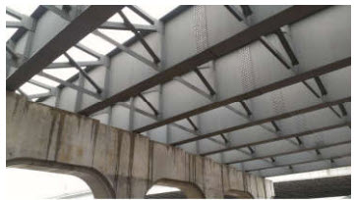
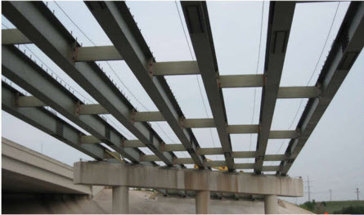
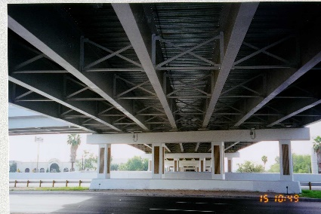
Types of Bracing
Torsional bracing can be provided as either point bracing (i.e., cross-frames or diaphragms) or as continuous bracing (e.g., by a hardened concrete deck anchored by shear connectors).
  Point bracing (also referred to as a “nodal brace” or a “discrete brace”) limits the movement of the brace point without direct interaction with adjacent brace points.
  Continuous bracing consists of bracing that is attached along the entire member length.
Notes:
Although both torsional and lateral bracing systems are used in practice, the most prevalent system that is used in bridge applications is torsional bracing. Torsional bracing can be provided as point bracing, i.e., by providing cross-frames at discrete intervals as shown in the left-hand picture in the middle of this slide or by providing diaphragms as shown in the right-hand picture in the middle of this slide. Point bracing (also referred to as a “nodal brace” or a “discrete brace”) limits the movement of the brace point without direct interaction with adjacent brace points. Although the brace point at the cross-frame or diaphragm is able to displace laterally, it is still considered a brace point because twist of the member is prevented at that point. A torsional brace is differentiated from a lateral brace in that twist of the cross-section is restrained directly.
Torsional bracing can also be provided by continuous bracing, which consists of bracing that is attached along the entire member length. In steel-girder bridges, continuous bracing of the top flange of the girders is provided by encasing the flange in concrete or by anchoring the concrete by shear connectors along the entire member length, as shown in the bottom picture on this slide. The concrete deck effectively acts as both a torsional and lateral brace since it controls both lateral movement and twist. Note that metal stay-in-place deck forms, whose diaphragm strength is limited by the capacity of the flexible clip angles welded to the edges of the top flanges that are typically used to attach the forms to the girders, are not to be treated as continuous bracing in steel-girder bridges (AASHTO LRFD Article 6.7.4.1).
Design provisions for continuously braced flanges were discussed previously in Lesson 8 and will not be discussed further in this lesson. This lesson will hereafter focus on the design provisions for point bracing and lateral bracing in steel I-girder bridges. The use of this bracing in steel closed box and tub-girder bridges is outside the scope of this course.
Photo Credits: High Steel Structures, HDR

Slide 7
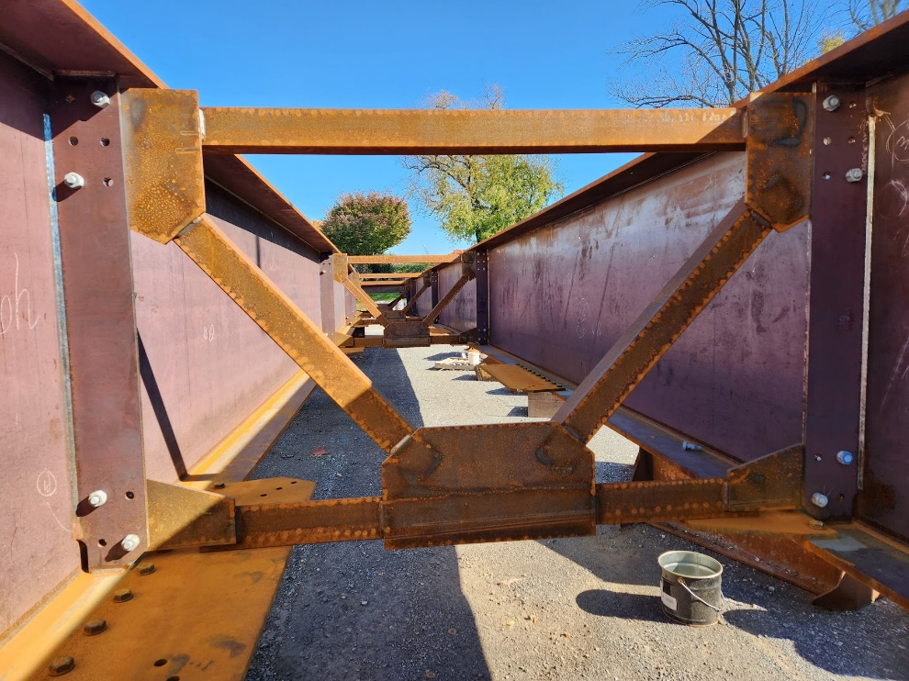
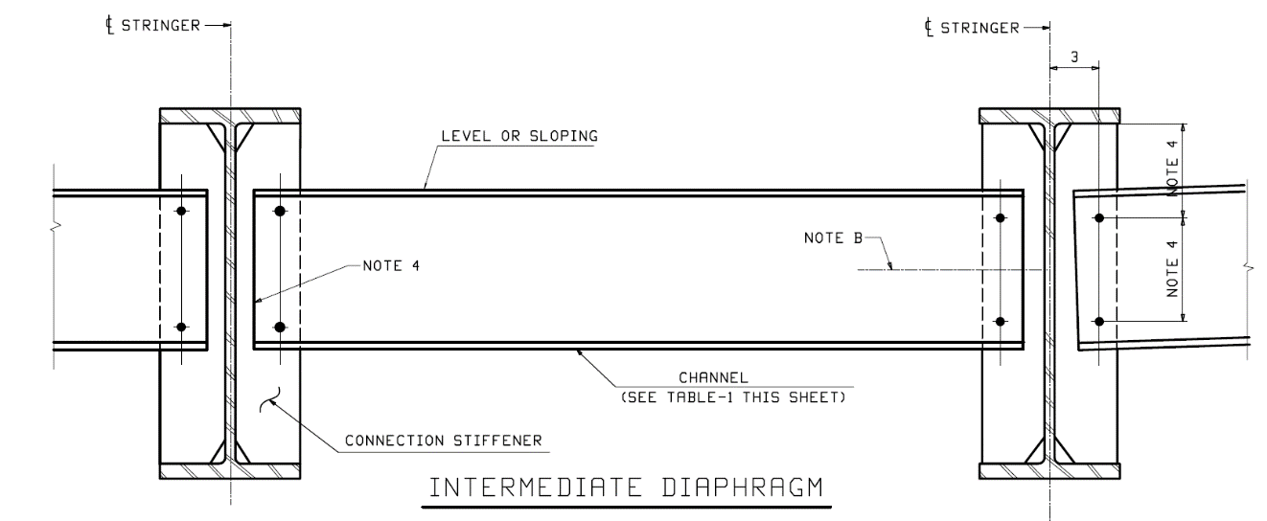
Torsional Bracing
Cross-frame: a transverse truss framework connecting adjacent longitudinal flexural components (or inside a closed box or tub section) used to transfer vertical and lateral loads and to provide stability to the compression flanges.
Diaphragm: a vertically oriented solid transverse member connecting adjacent longitudinal flexural components (or inside a closed box or tub section) used to transfer vertical and lateral loads and to provide stability to the compression flanges.
Notes:
In the AASHTO LRFD BDS, a cross-frame is defined as a transverse truss framework connecting adjacent longitudinal flexural components (or inside a closed box or tub section) used to transfer vertical and lateral loads and to provide stability to the compression flanges. The top right photograph shows transverse truss cross-frames connecting adjacent longitudinal steel-bridge I girders.
A diaphragm is defined as a vertically oriented solid transverse member connecting adjacent longitudinal flexural components (or inside a closed box or tub section) used to transfer vertical and lateral loads and to provide stability to the compression flanges. The bottom right photograph shows solid-web transverse diaphragms connecting adjacent longitudinal steel-bridge I girders.
Photo credit: Russo Structural Services (top)

Slide 8
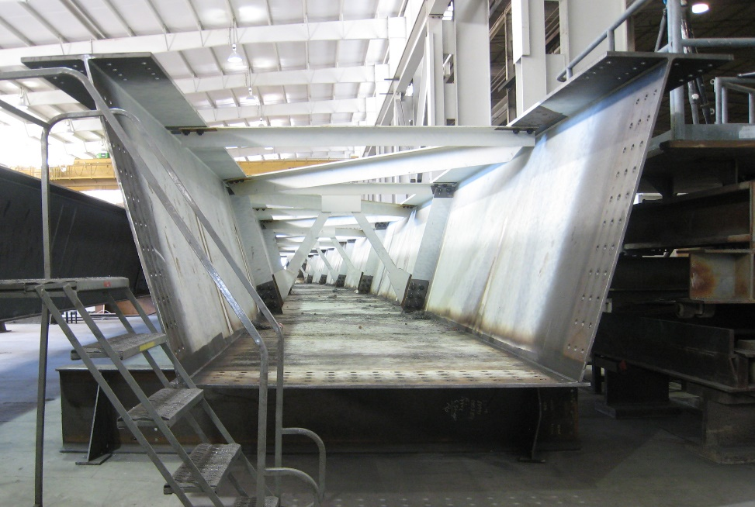
Lateral Bracing
Lateral bracing (also referred to as a “panel brace” or “relative bracing”) limits the angular deviation of a segment of the braced member between brace points; i.e., the lateral displacement of one end of the segment relative to the other.
Lateral bracing: a truss placed in the horizontal plane between two I-girders (or between the two top flanges of a tub girder) to maintain cross-sectional geometry and provide additional stiffness and stability to the bridge system.
Notes:
Lateral bracing restrains lateral displacement as its name implies. Lateral bracing, which is also referred to as a “panel brace” or “relative bracing”, limits the angular deviation of a segment of the braced member between brace points; i.e., the lateral displacement of one end of the segment relative to the other. The effectiveness of the lateral brace is related to the degree that twist of the cross-section is restrained. For a simply supported I-beam subjected to uniform moment, the center of twist is located at a point outside the tension flange; the top flange moves laterally much more than the bottom flange. Therefore, a lateral brace restricts twist best when it is located at the top flange. Lateral bracing attached at the bottom flange of a simply supported beam is almost totally ineffective by itself in restricting twist.
In the AASHTO LRFD BDS, lateral bracing is defined as a truss placed in the horizontal plane between two I-girders (or between the two top flanges of a tub girder) to maintain cross-sectional geometry and provide additional stiffness and stability to the bridge system.
Lateral bracing can be placed in the horizontal plane between the top flanges, the horizontal plane between the bottom flanges, or in both horizontal planes if deemed necessary. The bracing can either be full- or partial-length. The photograph on this slide shows a full-length lateral bracing system placed in the horizontal plane between the top flanges of a horizontally curved steel tub girder.
Photo credit: HDR

Slide 9
Cross-frames & diaphragms
Functions
Notes:
The next topic in this lesson will discuss the basic functions of cross-frames and diaphragms in steel I-girder bridges.

Slide 10
Cross-Frames & Diaphragms - Functions
Cross-frames or diaphragms may be placed at the end of the structure, across interior supports, and intermittently along the span.
The need for cross-frames or diaphragms is to be investigated for all stages of assumed construction procedures and the final condition (AASHTO LRFD Article 6.7.4.1).
At the end of the bridge and intermediate points where the continuity of the concrete deck is broken, the edges of the concrete deck and the wheel loads are to be supported by diaphragms or other suitable means as specified in AASHTO LRFD Article 9.4.4.
Although cross-frames and diaphragms account for only a small percentage of the total structure weight, they account for a significant portion of the total erected steel cost of the steel-girder superstructure. Therefore, careful attention should be paid to their design and detailing.
Notes:
Cross-frames or diaphragms may be placed at the end of the structure, across interior supports, and intermittently along the span. AASHTO LRFD Article 6.7.4.1 specifies that the need for cross-frames or diaphragms is to be investigated for all stages of assumed construction procedures and the final condition.
At the end of the bridge and intermediate points where the continuity of the concrete deck is broken, the edges of the concrete deck and the wheel loads are to be supported by diaphragms or other suitable means, such as nonintegral edge beams, as specified in AASHTO LRFD Article 9.4.4.
Although cross-frames and diaphragms account for only a small percentage of the total structure weight, they account for a significant portion of the total erected steel cost of the steel-girder superstructure. Therefore, careful attention should be paid to their design and detailing. The number, arrangement, member size, and spacing of cross-frames/diaphragms are important design considerations. These decisions influence not only the design of these members, but the design of the entire superstructure.

Slide 11
Cross-Frames & Diaphragms – Functions - cont.
Primary functions of intermediate cross-frames & diaphragms (I-girder bridges):
  Provide stability (i.e., lateral-torsional buckling resistance) to top flanges in compression prior to hardening of the concrete deck and to bottom flanges in compression;
  Provide geometric stability to the girders prior to hardening of the concrete deck;
  Help distribute vertical dead and live loads applied to the structure within the bridge system;
  Provide stability to the exterior girders and resist flange lateral bending effects when deck overhang bracket loads are applied;
  Transfer wind loads from the bottom of the girders to the concrete deck;
  Provide the primary resistance to torsion and resist flange lateral bending effects in horizontally curved bridges.
Notes:
This slide lists some of the primary functions of intermediate cross-frames and diaphragms (i.e., cross-frames or diaphragms located in-between the supports) in steel I-girder bridges. Traditionally, intermediate cross frames/diaphragms in I-girder bridges provide stability to top flanges in compression against lateral-torsional buckling prior to hardening of the deck (Lesson 7) and to bottom flanges in compression against lateral-torsional buckling (Lesson 8).
Intermediate cross-frames/diaphragms also provide geometric stability to the girders prior to the hardening of the deck. Without them, the girders would deflect independently of each other, making it very difficult to properly place the deck. Properly erected cross-frames/diaphragms ensure that the girders in right, straight I-girder bridges deflect nearly equally as the deck is placed. This ensures that the girders each resist about the same steel and deck noncomposite load. The cross-frames/diaphragms help transfer load between the girders and along with the concrete deck, provide restoring forces to ensure that this occurs. AASHTO LRFD Article 4.6.2.2.1 indicates that the total deck weight may be distributed equally to the girders when certain specified conditions are satisfied (i.e., straight I-girder bridges with limited skews – Lesson 4). Intermediate cross-frames/diaphragms, along with the deck, also distribute barrier weight and live load within the superstructure.
Intermediate cross-frames/diaphragms stabilize the exterior girders when overhang bracket loads are applied. The flanges act as a laterally loaded continuous beam supported by the cross-frames/diaphragms. Each flange of the exterior girder must resist lateral bending induced by the overhang brackets between each cross-frame/diaphragm (Lessons 6 and 7).
The intermediate cross-frames/diaphragms also transfer wind load from the superstructure through the bearings to the substructure. They also are effective in earthquakes in that they are part of the superstructure lateral load resisting system.
In horizontally curved I-girder bridges, the cross-frames/diaphragms serve all the above functions, as well as several additional critical functions. In horizontally curved I-girder bridges, the cross-frames/diaphragms provide the primary resistance to torsion and the resulting flange lateral bending effects (Lesson 6). Unlike their typical characterization as secondary members in straight bridges, cross-frames in a horizontally curved bridge with or without skewed supports, must be designed as primary load-carrying members as specified in AASHTO LRFD Article 6.7.4.1 since they transmit loads through a necessary as-designed load path.
Intermediate cross-frames/diaphragms also work with the concrete deck to resist transverse deck stresses and may also provide support for utilities and inspection walkways.

Slide 12
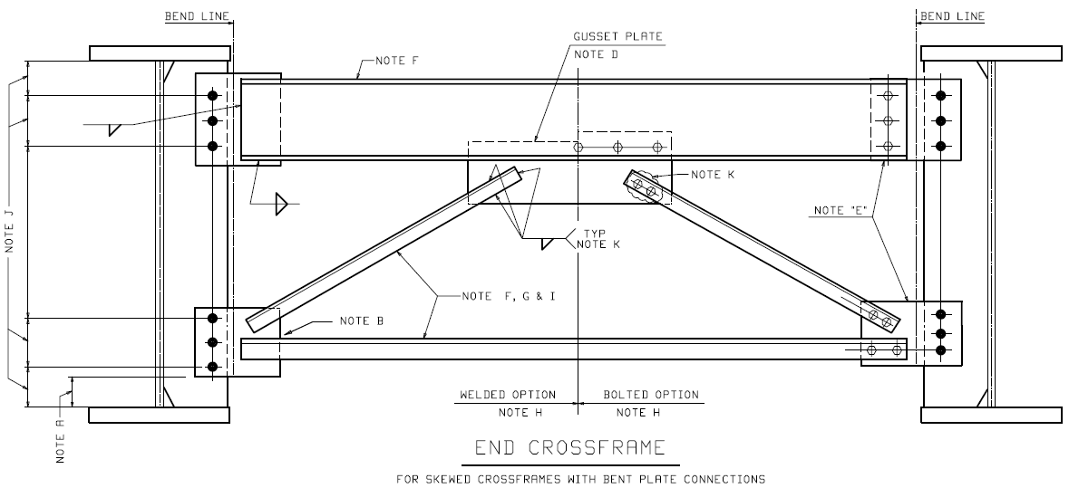
Cross-Frames & Diaphragms – Functions - cont.
Primary functions of support cross-frames & diaphragms (I-girder bridges):
  Transfer wind loads from the concrete deck down to the bearings;
  Provide end support for the concrete deck, wheel loads, and expansion joints at locations where the continuity of the concrete deck is broken;
  Provide opportunities for future jacking of bridges to allow for bearing replacement;
  Assist in providing global stability to the girder span during the erection and deck placement.
Notes:
This slide lists some of the primary functions of support cross-frames and diaphragms (i.e., cross-frames or diaphragms at end or interior supports) in steel I-girder bridges.
Support cross-frames/diaphragms transfer wind loads (and earthquake loads) from the concrete deck down to the bearings. They also provide end support for the concrete deck, wheel loads, and expansion joints at locations where the continuity of the concrete deck is broken. In an I-girder bridge, a rolled I-shape or a rolled or bent plate channel is typically used as the top chord of the end cross-frames to provide the necessary support, as shown in the figure on this slide. Support cross-frames/diaphragms also provide opportunities for future jacking to allow for bearing replacement.
Support cross-frames/diaphragms, along with the intermediate cross-frames/diaphragms, also assist in providing global stability to the girder span during the erection and deck placement. In certain cases, particularly for longer spans, the cross-frames/diaphragms alone cannot with certainty provide global stability to the steel girders before and during the deck placement. If the girders are permitted to move longitudinally with respect to each other, the angle between the cross-frames/diaphragms and the girders is no longer a right angle and the girders may become unstable. Some additional stability is required. Bearings may be locked against longitudinal movement and/or lateral bracing may be added over a portion of the length of a span or spans in such cases.

Slide 13
Cross-frames & diaphragms
Spacing requirements
Notes:
The next topic in this lesson will discuss the spacing requirements for cross-frames and diaphragms in steel I-girder bridges in the AASHTO LRFD BDS.

Slide 14
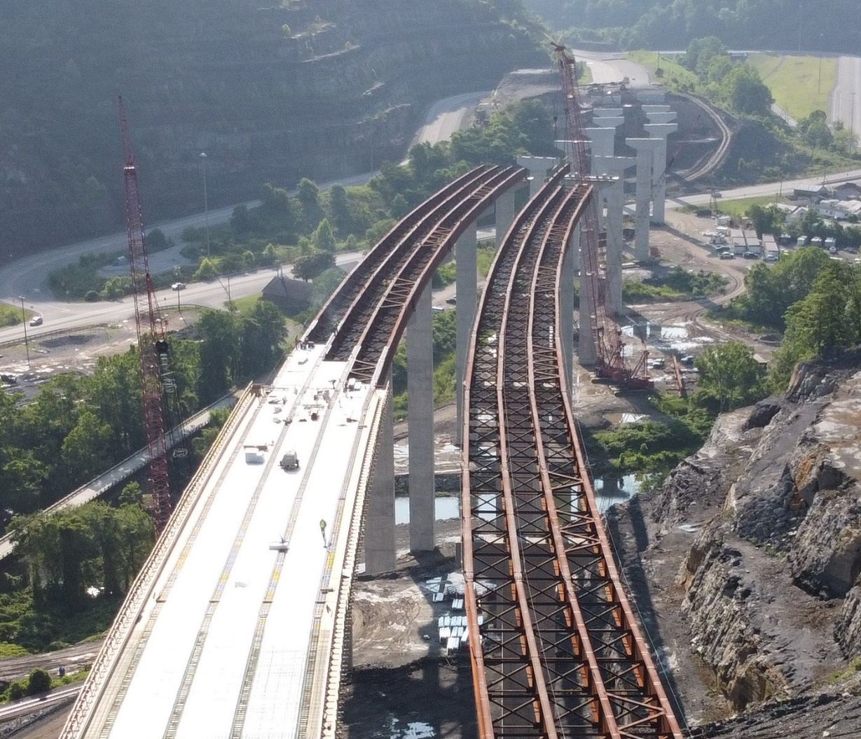
Cross-Frames & Diaphragms – Spacing Requirements
Establish a rational spacing considering construction and final conditions (AASHTO LRFD Article 6.7.4.1).
Consider factors like lateral torsional buckling of the girder compression flange; skew; wind load; lateral loads due to deck overhang brackets; and in the case of horizontally curved girders, flange lateral bending due to curvature.
There is no upper limit on the cross-frame/diaphragm spacing in straight I-girder bridges.
Cross-frames/diaphragms should be provided at nearly uniform spacing, particularly out in the spans away from the supports. A tighter spacing is usually desirable adjacent to interior supports.
Notes:
As mentioned previously, AASHTO LRFD Article 6.7.4.1 specifies that the spacing of cross-frames/diaphragms is to be established by rational investigation of critical construction stages and the final condition to meet the demands of design at each location. Factors determining cross-frame/diaphragm spacing in I-girder bridges are lateral torsional buckling of the girder compression flange; skew; wind load; lateral loads due to deck overhang brackets; and in the case of horizontally curved girders, flange lateral bending due to curvature.
In straight I-girder bridges, there is no upper limit on the cross-frame/diaphragm spacing. A long-standing requirement limiting the maximum cross-frame/diaphragm spacing in I-girder bridges to 25 feet was removed in the AASHTO LRFD BDS. An upper limit on the cross-frame/diaphragm spacing for horizontally curved I-girders will be discussed on a subsequent slide.
AASHTO LRFD Article C6.7.4.2 recommends that intermediate cross-frames/diaphragms be provided at nearly uniform spacing in I-girder bridges for constructibility, for efficiency of the design, and to allow the more accurate use of approximate methods of analysis for estimating lateral flange bending moments in curved bridges. The approximate equation for estimating the lateral flange bending moments due to curvature and deck overhang bracket loads (Lesson 6) assumes a uniform spacing of cross-frames/diaphragms. A more uniform spacing is particularly desirable out in the spans away from the supports. A tighter spacing may be desirable adjacent to interior piers to reduce the unbraced length of the compression (bottom) flange. There are other reasons (to be discussed later in this lesson) to vary the spacing of cross-frames/diaphragms; e.g., near skewed supports.
Photo Credit: Stupp Bridge Company

Slide 15
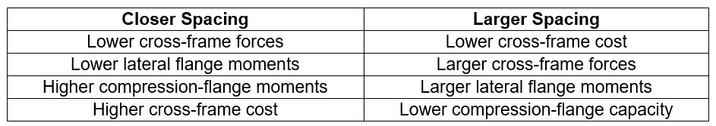
Cross-Frames & Diaphragms – Spacing Requirements - cont.
  The following table summarizes some of the trade-offs regarding cross-frame/diaphragm spacing:
  Relatively, the narrower the flanges, the closer the cross-frame/diaphragm spacing must be. However, cross-frames/diaphragms are more costly than flange steel, so wider flanges are usually desirable over additional cross-frames/diaphragms.
  By varying the spacing or increasing cross-frame spacing in some regions where excess capacity exists, while reducing the spacing in other regions where additional capacity is needed, economy in flange material can usually be gained.
Notes:
The table on this slide summarizes some of the trade-offs regarding cross-frame/diaphragm spacing. The importance of cross-frame/diaphragm spacing with regards to economy cannot be overemphasized. Although flange overstress can be addressed by using a larger flange in many cases, it can also be rectified by judicial arrangement of the cross-frames/diaphragms. Additional cross-frames/diaphragms often are less economical than heaver flanges. However, increasing spacing in some region(s) while reducing the spacing in other region(s) is often economical. For example, assume a uniform spacing of 25 feet on a straight bridge. For this spacing, analysis shows that the compression flange at the pier is overstressed for lateral-torsional buckling, but the top flange in the positive moment region has excess capacity. Thus, it may be possible to decrease the spacing adjacent to the pier and increase the spacing slightly beyond 25 feet in the positive moment region and still achieve a satisfactory design.
Some restraint should be exercised however when extending spacings beyond 25 feet. The total vertical shear within a span is nearly constant within a given span, regardless of the number of cross-frames/diaphragms. Hence, the shear per cross-frame/diaphragm is proportional to the number of cross-frames/diaphragms within a bay within a span. Where the major-axis bending moments in a girder are large, a smaller cross-frame/diaphragm spacing reduces the lateral flange bending moment and improves the lateral torsional buckling resistance of the compression flange. Simply increasing the spacing in regions where the major-axis bending moment is smaller and the lateral flange moment is less critical may be satisfactory in lieu of adding a row of cross-frames/diaphragms.

Slide 16

Spacing Requirements – Curved Girders
Horizontally Curved I-Girders
(AASHTO LRFD Article C6.7.4.2)
where:
L_{b} = cross-frame/diaphragm spacing (ft)
r_{σ} = desired bending stress ratio, |f/f_{bu}| ≤ 0.3
R = girder radius (ft)
b_{f} = flange width (ft)
For r_{σ} = 0.15; b_{f} = 18.0 in.:
Notes:
The top equation shown on this slide is provided in AASHTO LRFD Article C6.7.4.2 to use as a guide for determining preliminary cross-frame/diaphragm spacings, L_{b}, in horizontally curved I-girder bridges. The equation has been shown to yield good correlation with refined 3D finite element analysis results when the cross-frame spacing is relatively uniform and there is no skew. In the computation of the ratio r_{σ}, f is flange lateral bending stress, and f_{bu} is the largest value of the compressive stress due to major-axis bending within the unbraced length under consideration.
As an example, the table on this slide gives results from the top equation for r_{σ} = 0.15 and b_{f} = 18.0 in. for different girder radii. A subsequent check of the flange resistance requirements based on the initial cross- frame/diaphragm spacing determined from this equation will likely necessitate adjustments to either the flange size or to the cross-frame/diaphragm spacing. Spacing may be varied with flange size and moment. A wider flange reduces the lateral bending stress.
A change in the flange width to make a given cross-frame/diaphragm spacing work before additional cross-frames/diaphragms are added can be investigated by rearranging this equation to give the equation shown at the bottom of this slide written in terms of the flange width.

Slide 17
Spacing Requirements – Curved Girders
Horizontally Curved I-Girders
(AASHTO LRFD Article 6.7.4.2)
where:
L_{b} = cross-frame/diaphragm spacing (ft)
L_{r} = (ft) (Lesson 8)
R = minimum girder radius within the panel (ft)
In no case is L_{b} to exceed 30.0 feet.
Notes:
Although the AASHTO LRFD BDS does not prescribe a maximum cross-frame/diaphragm spacing for straight I-girder bridges, a maximum spacing requirement is specified for horizontally curved I-girder bridges in the erected condition in AASHTO LRFD Article 6.7.4.2. The requirement is given by the equation shown on this slide.
The limit of R/10 is consistent with past practice. L_{r} is the limiting unbraced length from AASHTO LRFD Eq. 6.10.8.2.3-5 (shown on this slide) to achieve the onset of nominal yielding in either flange under uniform bending with consideration of compression-flange residual stress effects prior to lateral-torsional buckling of the compression flange (Lesson 8). The terms r_{t} and F_{yr} are defined in Lesson 8. Limiting the cross-frame/diaphragm spacing to L_{r} theoretically precludes elastic lateral-torsional buckling of the compression flange. At unbraced lengths beyond L_{r}, significant lateral flange bending is likely to occur, and the amplification factor for lateral flange bending (Lesson 8) will tend to become large. The absolute upper limit on the cross-frame/diaphragm spacing in horizontally curved I-girder bridges has been established at 30.0 feet.

Slide 18
Cross-frames & diaphragms configuration
Notes:
The next topic in this lesson will describe the basic configurations used for cross-frames and diaphragms in steel I-girder bridges.

Slide 19
Cross-Frames & Diaphragms – Minimum Height
Depth Requirements for I-Girder Bridge Cross-Frames and Diaphragms (AASHTO LRFD Article 6.7.4.2):
  Rolled Beams:
    Cross-Frame or Diaphragm Depth ≥ 0.5 * Beam Depth
  Welded Plate Girders:
    Cross-Frame or Diaphragm Depth ≥ 0.75 * Girder Depth
Notes:
AASHTO LRFD Article 6.7.4.2 requires that cross-frames/diaphragms for rolled beams and plate girders should be as deep as practicable, but preferably not less than 0.5 of the beam depth for rolled beams and 0.75 of the girder depth for plate girders. This requirement ensures that the cross-frames/diaphragms provide adequate torsional resistance to the beam or girder. The deeper these members are, the lower the forces in them because the moments transferred through them are transferred more efficiently in a deeper section. However, as their sizes are increased, the forces in these members increase. The connection plates to attach the cross-frame/diaphragm to the beam or girder also need to be robust enough to transfer the loads to the girders.

Slide 20
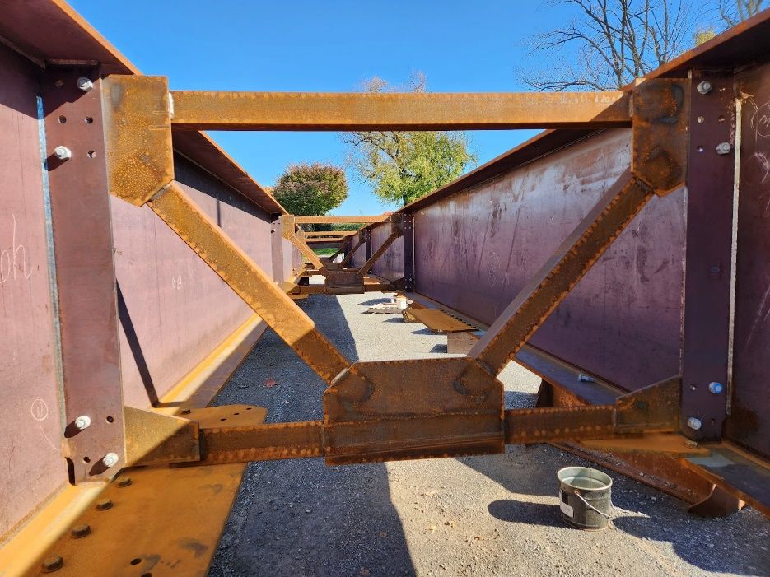
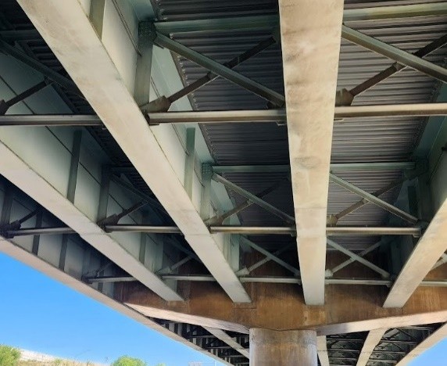
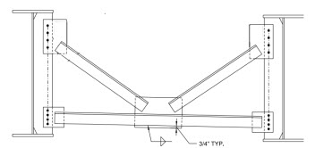
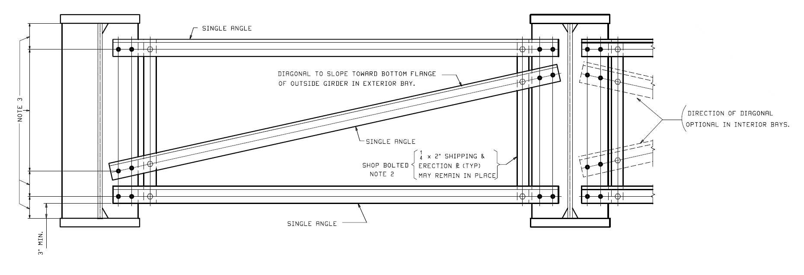
Cross-Frames & Diaphragms – Configurations
K-Type Cross-Frame
X-Type Cross-Frame
Z-Type Cross-Frame (Alternate)
Notes:
Shown on this slide are the most common types (i.e., configurations) of cross-frames used for steel I-girder bridges.
In the K-type configuration shown in the top left photo on this slide, the K-node can either be located in the top or bottom chord. The latter configuration is preferred so the diagonals can brace the bottom chord in the vertical direction. However, it is observed that the diagonals have equal and opposite forces hence their horizontal components of force accumulate in one-half of the bottom chord. For this reason, it may be desirable to place the K-node in the top chord to allow these horizontal diagonal forces to accumulate in the lower-stressed top chord (a so-called “inverted K-type” cross-frame). The top chord is lowly stressed because the deck assists the top chord for superimposed dead load and live load. As mentioned previously, at the ends of bridges, the edges of the concrete deck must be supported to support the wheel loads coming onto the deck. In an I-girder bridge, a rolled I-shape or a rolled or bent plate channel is typically used as the top chord of an inverted K-type end cross-frame to provide the necessary support. At end supports, locating the K-node in the center of the upper chord is preferred because it halves the span of the top chord, which must support the deck and the expansion device. The diagonals can also more efficiently carry the wind loads down to the bearings in this configuration; a similar configuration might be considered for the cross-frames at interior-pier supports for this reason. This configuration can also be used when jacks for future bearing removal can be placed under the girder flanges, and to allow for easier access to the abutment backwall for inspection purposes.
The X-type configuration shown in the top right photo on this slide consists of two diagonal members that are full width and approximately full height, along with top and bottom chords. X-type cross-frames without a top chord may be beneficial in some cases in straight bridges to soften undesirable stiffness effects. However, when the upper triangle of the cross-frame truss is eliminated, the stability of the cross-frame may be compromised and so a top chord should always be provided whenever X-type cross-frames are used on horizontally curved bridges. If a top chord is not used with K-type cross-frames (see the bottom left figure on this slide), the stability of the cross-frame prior to the deck hardening is dependent entirely on the bending stiffness of the bottom chord; this is an unstable condition. Thus, a top chord should always be provided with K-type cross-frames, as shown in the top left photo on this slide.
The Z-type cross-frame shown in the bottom right figure on this slide has been used in some cases as an alternative configuration to the K-type or X-type cross-frames. This cross-frame is basically an X-type cross-frame with a single diagonal removed. Vertical straps temporarily bolted to each end of the cross-frame can be used to maintain the cross-frame geometry and allow it to be shipped and erected as one piece. This configuration is recommended only for use on straight bridges.
Photo credit: Russo Structural Services

Slide 21
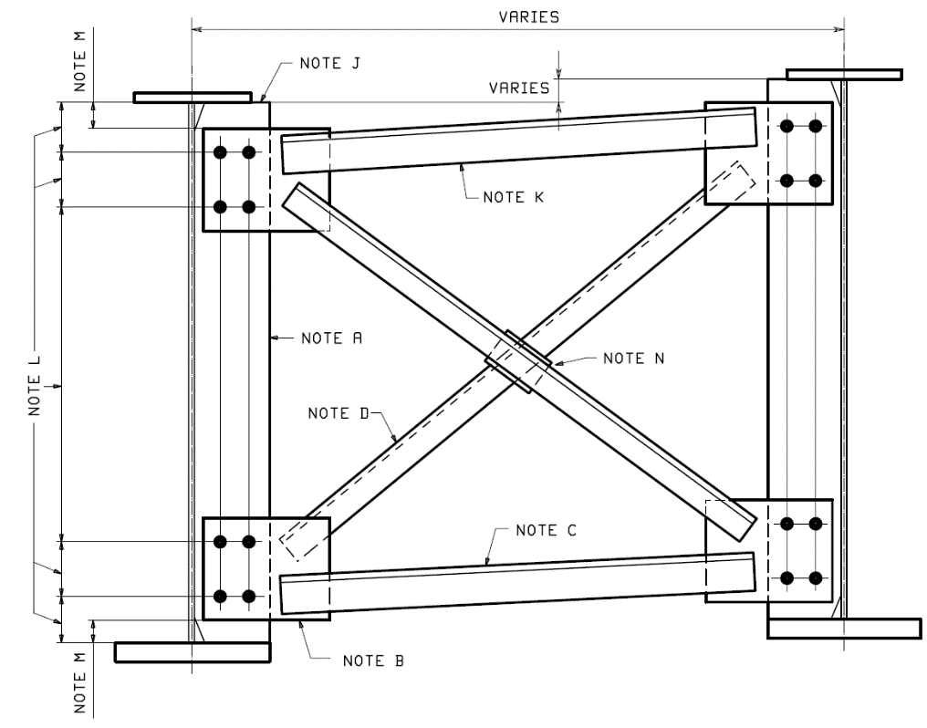
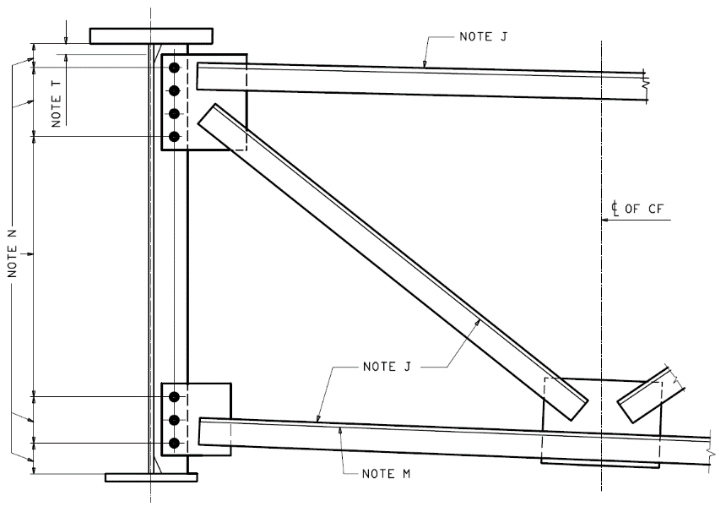
Cross-Frames & Diaphragms – Choice of Configuration
S
X-Type Typically Used:
  S/D < 1.0
D
K-Type Typically Used:
  S/D > 1.5
X-Type Cross-Frame
Either Type Used:
  1.0 < S/D < 1.5
Try and achieve an angle between the diagonal and horizontal members between 30-60°
K-Type Cross-Frame
Notes:
The selection of the cross-frame configuration is usually based on geometric factors such as girder depth, D, and girder spacing, S. Other factors that may influence the selection include support skew angle, variable girder spacing, location at interior or end supports, the amount of force required to be carried by the cross-frame, or the need to accommodate utilities or inspection walkways.
For intermediate cross-frames locations, the following guidelines are often employed to decide whether to use an X-type or K-type cross-frame: 1) X-type cross-frames are typically used in cases where the ratio of girder spacing (S) to girder depth (D) is 1.0 or less (i.e. S/D ≤ 1.0); 2) K-type cross-frames are typically used in cases where the ratio of girder spacing (S) to girder depth (D) is 1.5 or greater (i.e. S/D ≥ 1.5). In cases where the ratio of girder spacing (S) to girder depth (D) is between 1.0 and 1.5, either an X-type or K-type cross-frame may be used.
The designer should also consider the following goals: 1) achieve an angle between the cross-frame diagonal and the horizontal (chord/strut) members between 30-60 degrees. This is consistent with the S/D limits. Staying in this range also helps to limit either the depth, or length, of the gusset plate used to attach the cross-frame member to the girder connection plate; 2) minimize shop handling of cross-frames by using K-type cross-frames, which do not need to be removed from their fabrication jig and turned over to weld the second diagonal. Typically, K-type cross-frames will have all welds on the same side of the cross-frame, although some owners require welds to be placed on the back side of the cross-frame members for sealing purposes (refer to Slide 60 of Lesson 11 regarding the proper call-out of such welds). Sufficient clearance should be allowed between the members to allow for welding access, particularly for K-frames. Fillet welds larger than the minimum 5/16” fillet weld should not be used for cross-frames.

Slide 22
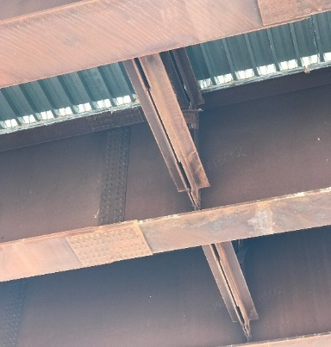
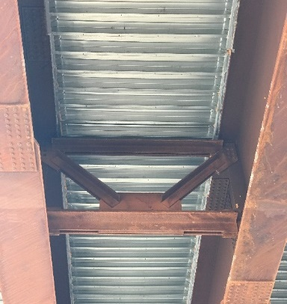
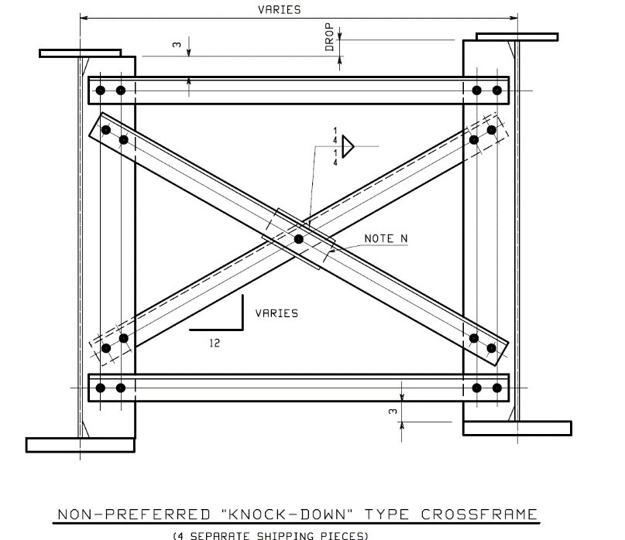
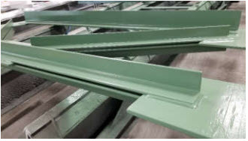
Cross-Frames & Diaphragms – Special Cases
Back-to-Back Cross-Frames
(for high-load applications):
Not recommended
“Knock-down” Cross-Frames
Double-Angle Cross-Frames
Notes:
For cross-frame members subjected to large axial forces, the designer may want to consider the use of back-to-back cross-frames at a single cross-frame location. In this application, a similar built-up cross-frame is placed on each side of the connection plate on the girder. One cross-frame is bolted to one side of the connection plate, and the other cross-frame is bolted to the other side of the same connection plate using the same bolts. As such, a back-to-back cross-frames can only be used for K-type cross-frames where members are all located on the same side of the gusset plates. A back-to-back cross-frame is illustrated in the top-right photographs on this slide. Since the same bolts connect the two cross-frames to the connection plate, these bolts are in double shear which in turn doubles their factored resistance from the typical single shear connection and can thus dramatically reduce the size of the connection. The use of back-to-back cross-frames also allows the individual member design forces to be reduced by half, which can result in the use of angle members instead of more expensive, and often wider, WT members. This type of cross-frame works best in weathering steel applications, where future painting of the bridge will not be required. Since the distance between the back-to-back cross-frames is only the thickness of the connection plate, the clearance is too tight to permit painting. The designer needs to check that both cross-frames can be installed at each back-to-back cross-frame location. In some situations, it may not be possible to swing both cross-frames in to position to be bolted to both sides of the cross-frame connection plate.
“Knock-Down” cross-frames use elements which are not connected at the ends with gusset plates. Instead, individual members are bolted directly to the girder connection plate, as shown in figure on the bottom left of this slide. This type of cross-frame generally consists of four pieces, a top chord, a bottom chord, and two diagonals. One of the diagonals includes a shop-installed fill plate at the intersection of the two diagonals. “Knock-down” cross-frames are difficult to erect, and do not help maintain cross-sectional geometry as well as a one-piece cross-frame (X-type or K-type). They require more shop and field handling and are costly to erect due to the increased number of different pieces to track, handle, and place in the steel superstructure. Additionally, when there are varying drops and varying distances between the girders, a “Knock-Down” cross-frame would require a different layout at each connection plate, each diagonal, each chord, and each fill plate. Thus, the chance for error in fabrication is greater than a one-piece cross-frame. Furthermore, if the forces in the individual members require more than two bolts, the connection plate will need to be widened as well. For these reasons, their use is not recommended.
The use of cross-frames which utilize members made of double angles (see the photo on the bottom right of this slide) is also not currently recommended, although they may be found on many older existing bridges still in service. These members are difficult to maintain because corrosive materials can become trapped between the double angles, pack rust can develop in this void, and the surface area between the angles cannot be adequately painted in the future. Additionally, the end connection gusset plates can become quite large since two angles need to be attached to the gusset. In lieu of double angles, designers can consider using single WT members. Also, when a thermal-sprayed (metalized) coating is used for the girders, consider galvanizing the cross-frames since cross-frames are better-suited for galvanizing.
Photo Credit: High Steel Structures, Lancaster, PA

Slide 23
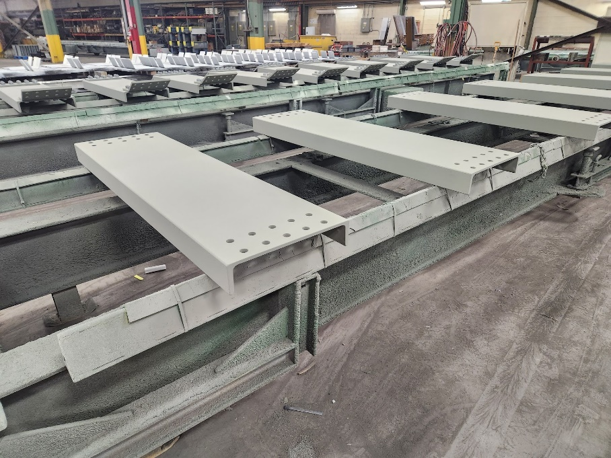
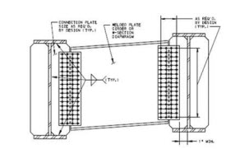
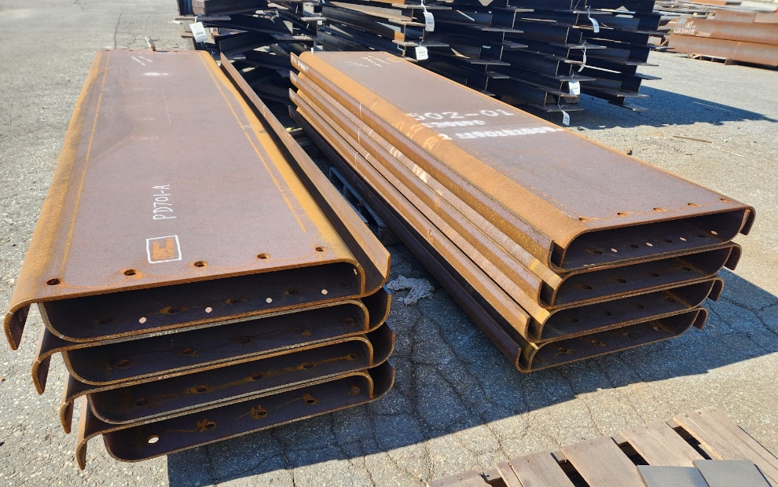
Cross-Frames & Diaphragms – Solid Diaphragms
Rolled Channel Diaphragm
Welded Plate Girder or Wide-Flange Beam Diaphragm
Bent-Plate Diaphragm
Notes:
Diaphragms are used most often in rolled-beam bridges or in plate-girder bridges when the girders are less than about 48 inches deep. They are used when the S/D is greater than about 3 – 3.5. C-shaped or channel sections are commonly used for diaphragms. Channel sections can either be rolled C or MC channels, or bent-plate channels attached directly to the connection plates or attached directly to the stringers using end angles. Bent-plate channels have been used on girders greater than 48 inches deep. The Engineer is encouraged to consult with local fabricators regarding their preference. The use of rolled MC channels should be avoided as they are generally more expensive. The minimum bend radius for bent plate channels is 5t, where t is the thickness of the plate in inches (refer to Article 10.2 of the AASHTO LRFD Steel Bridge Fabrication Specifications).
Welded plate girder or wide-flange beam diaphragms (see the bottom right figure on this slide) have also been used in special situations. The use of such diaphragms may be necessary to address high diaphragm force effects and when large diagonal and horizontal (chord/strut) members would otherwise be required for an X- or K-type diaphragm. Such diaphragms are also typically used when the girders are tightly spaced, where the angles of the diagonals of an X- or K-type diaphragm will not be efficient and large gusset plate connections are necessary, or in bays carrying utilities where the angles of the cross-frame diagonals do not provide sufficient space to pass the utilities. Rolled I-shapes can either be attached to connection plates using gusset plates, attached directly to the stringers using end angles, or attached directly to the connection plates. Attaching directly to the connection plates requires coping at the top and bottom.
An advantage of diaphragms for I-girder bridges is that there is typically minimal fabrication involved. Disadvantages are that they often are not full depth, and it is sometimes difficult to develop the moment in the connections.
Photo credit: Russo Structural Services

Slide 24
Cross-frames & diaphragms layout
Notes:
The next topic in this lesson will discuss efficient framing plan layout considerations, in particular for skewed and horizontally curved I-girder bridges.

Slide 25
Cross-Frames & Diaphragms – Layout
AASHTO LRFD Article 6.7.4.2 states that where supports are not skewed, intermediate cross-frames/diaphragms in I-girder bridges should be placed in contiguous lines normal to the girder tangents
Notes:
Judicious layout of the cross-frames/diaphragms can have a significant effect on the economy of I-girder bridges. Although the spacing of the cross-frames/diaphragms is important in controlling the number of cross-frames/diaphragms, their layout can influence the forces in the members and in the girders. The impact of layout is particularly important in I-girder bridges with skewed supports. Large cross-frame/diaphragm forces not only cause large members, but they can cause extremely expensive, even impractical connections in some cases.
Changing the number, size and arrangement of the cross-frames/diaphragms often has a significant effect on their forces. Hence, it is advisable to check the forces in these members early in the design, particularly for I-girder bridges with sharply skewed supports; that is, prior to resizing girders. If the forces are too large to design practical members or connections, their arrangement should be further investigated before proceeding with the resizing of the girders.
AASHTO LRFD Article 6.7.4.2 states that where supports are not skewed, intermediate cross-frames/diaphragms in I-girder bridges should be placed in contiguous lines (i.e., continuous in a line from one side of the bridge to the other) normal to the girder tangents, as shown in the figure on this slide. As discussed on Slide 15 of this lesson, the cross-frame spacing along the girders may be varied. Reducing the spacing in the center of the simple span shown on this slide while increasing spacing near the supports may improve the nominal flexural resistance of the flanges in the center of the span while not adding to the number of cross-frames, remembering that cross-frames are relatively more expensive compared to flange steel.

Slide 26
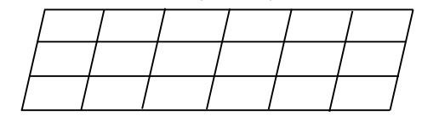
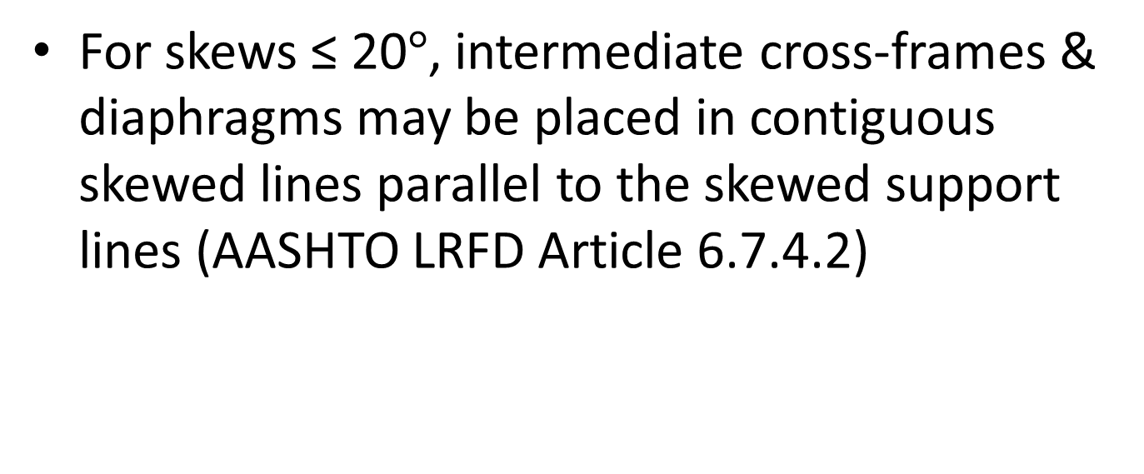
Cross-Frames & Diaphragms – Layout
For skews ≤ 20$°$, intermediate cross-frames & diaphragms may be placed in contiguous skewed lines parallel to the skewed support lines (AASHTO LRFD Article 6.7.4.2)
Notes:
AASHTO defines skew as the angle made by the support relative to a line normal to a local tangent to the longitudinal axis of the bridge; thus, a skew angle of 0° denotes a right (or radial) support.
AASHTO LRFD Article 6.7.4.2 permits cross-frames/diaphragms to be arranged in contiguous skewed lines parallel to the skewed supports, as shown in the figure on this slide, where both supports within a span are skewed not more than 20 degrees. This requirement is consistent with past practice and is likely based on welding access to the acute corner between the cross-frame/diaphragm connection plates and web. Intermediate cross-frames skewed at greater angles also begin to reduce the torsional bracing stiffness of the cross-frames/diaphragms, reducing their effectiveness to prevent lateral-torsional buckling of the girders. The forces in the cross-frames/diaphragms also affect the girder forces when the cross-frames/diaphragms are highly skewed because their actions have longitudinal components acting along the girders.
This arrangement permits the cross-frames/diaphragms to be attached to the girders at points of similar length along the girders, i.e., equal stiffness, thus reducing the relative deflections between cross-frame/diaphragm ends and the restoring forces in these members. Cross-frame/diaphragms with greater parallel skew angles have been used with no deleterious effects but are currently forbidden by the Specifications.

Slide 27
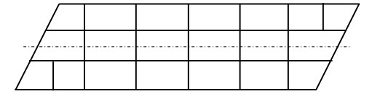
Cross-Frames & Diaphragms – Layout
For skews > 20°, intermediate cross-frames & diaphragms must be placed normal to the girders and may be placed in contiguous or discontinuous lines (AASHTO LRFD Article 6.7.4.2):
Notes:
Cross-frames/diaphragms must be placed normal to the girder tangents where one or both supports within a span are skewed more than 20 degrees. The term “normal” as it applies to horizontally curved girders is taken to mean normal to a local tangent. Cross-frames/diaphragms may be placed in a contiguous pattern within the span, as shown in the center-span region in the figure on this slide, with the cross-frames/diaphragms opposing each other on both sides of the interior girders. Or they may be placed in discontinuous lines as shown on Slides 29 and 30 of this lesson. At the bearings, a different arrangement is recommended, as discussed further on Slide 32. The cross-frame/diaphragm arrangement shown on this slide provides the greatest transverse stiffness; hence, the largest cross-frame/diaphragm forces.
In addition, with this cross-frame arrangement, the girders have differing deflections at points along a line perpendicular to the girders. This is due to the longitudinal shift of the girders resulting from the skewed supports, which results in the girders having different vertical stiffnesses along the line perpendicular to the girders. As such, two adjacent girders that have the same cross-section size and load deflect different amounts along any perpendicular line between them.
The cross-frames/diaphragms along the perpendicular lines going to the bearings at skewed supports act to transfer load across the bridge in proportion to the relative longitudinal and transverse stiffnesses of the bridge. Thus, the stiffer the transverse load path, the larger the load transferred to the bearings. This unwanted stiffness near skewed supports, producing undesirable load paths in the structural system, can produce dramatically increased cross-frame forces and can result in potential fit-up difficulties during the steel erection. Other attributes of the bridge geometry such as high span length-to-girder depth ratios, simply-supported spans, or poor span balance in continuous-spans, can lead to difficulties in assembling the bridge. Basically, substantial differences in stiffness of different portions of a large bridge structure can be problematic.
Another reason for higher cross-frame forces near bearings in skewed bridges is the restraint that they may provide. This restraint tends to forbid transverse movement; hence, causing higher cross-frame forces. Bearing restraint should be considered when computing cross-frame forces in severely skewed bridges. Changing bearing orientation and restraints often has a significant impact on cross-frame forces near supports. Thus, any investigation of cross-frame arrangement should consider including simultaneous consideration of bearing restraints. Implicit in this discussion is the use of an analysis that properly recognizes the effect of bearing restraints located off the neutral axis of the girders.

Slide 28
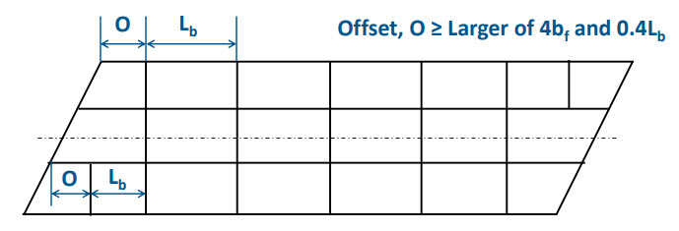
Cross-Frames & Diaphragms – Layout
Recommended minimum offset of the first intermediate cross-frame from a skewed support (AASHTO LRFD Article C6.7.4.2):
Notes:
AASHTO LRFD Article C6.7.4.2 recommends that when cross-frames/diaphragms are provided along a skewed support, the first intermediate cross-frame/diaphragm placed perpendicular to the girders adjacent to that support ideally be offset at least the distance, O, taken equal to the larger of 4b_{f} or 0.4L_{b} from the support (refer to the figure on this slide). b_{f} is the largest girder flange width within the unbraced lengths on either side of the first cross-frame or diaphragm from the support, and L_{b} is the unbraced length between the first and the second intermediate cross-frame or diaphragm from the support along the girder under consideration. Providing this minimum offset will reduce the potential for excessively large cross-frame forces adjacent to severely skewed supports in I-girder bridges resulting from the transverse stiffness effects. Elimination of such effects also tends to result in somewhat easier cross-frame installation along (and adjacent to) the skewed support line.
In some cases, the limit of 0.4L_{b} may be difficult to achieve, in which case the offset should be made as large as practicable but not less than 4b_{f}. At the acute corners of severely skewed bridge spans, the above requirements may result in an excessive unbraced length on the fascia girder. In this case, a cross-frame with top and bottom chords but without diagonal members can be framed from the first interior girder to the fascia girder at a small offset from the support, perpendicular to the girders, to avoid inducing a large transverse stiffness while also providing adequate lateral support to the fascia girder
Where practicable, the smallest unbraced lengths between intermediate diaphragm or cross-frame locations within the bridge spans should also not be less than 4b_{f} or 0.4L_{b}. The use of unbraced lengths smaller than 4b_{f} or 0.4L_{b} tends to result in the associated cross-frames working more like a contiguous cross-frame line rather than a discontinuous one. Similar to the selection of the offsets from the skewed supports, the limit of 0.4L_{b} may be difficult to achieve in certain cases. In these situations, the value 4b_{f} is the recommended lower limit for the smallest unbraced lengths, offsets, or stagger distances.

Slide 29
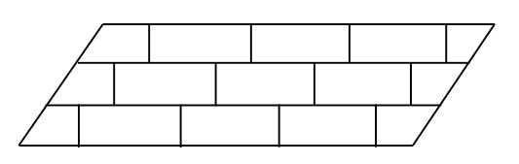
Cross-Frames & Diaphragms – Layout
For skews > 20°, it may be advantageous for straight bridges to stagger the cross-frames (i.e., provide discontinuous cross-frame lines):
Notes:
It may be advantageous in some cases for straight bridges to consider the use of non-contiguous (or discontinuous) cross-frame/diaphragm lines along the entire span as shown in the figure on this slide, which is also permitted in AASHTO LRFD Article 6.7.4.2. This pattern, which is often referred to as a staggered pattern, effectively reduces the transverse stiffness of the bridge.
The reduction of transverse stiffness that results whenever a discontinuous cross-frame/diaphragm arrangement is employed is accomplished by the transverse flex that occurs in the flanges. This reduction of stiffness is accompanied by a reduction in the cross-frame/diaphragm forces and associated connection cost. However, the flex of the flanges must also be accompanied by lateral flange bending, particularly near the locations where the lines are discontinued. However, often the lateral bending is not critical, and the net result is a desirable reduction in the cross-frame/diaphragm forces and resulting costs. The major-axis bending capacity of the flanges is reduced by the lateral bending as evidenced by the one-third rule resistance equation discussed in Lesson 8. As indicated in AASHTO LRFD Article C6.10.1, flange lateral bending effects due to skew should be considered in all regions of the girders where cross-frames/diaphragms are discontinuous. Lateral bending effects due to skew are typically less critical in regions where cross-frames/diaphragms are contiguous and may be ignored.
Simple methods to determine flange lateral bending moments and restoring forces in the cross-frames/diaphragms in skewed bridges do not currently exist. These actions are best determined by refined analysis. In the absence of calculated values, estimates for flange lateral bending stresses are provided in AASHTO LRFD Article C6.10.1, as discussed in greater detail on Slides 92 and 93 of Lesson 6.

Slide 30
Cross-Frames & Diaphragms – Layout
1.
2.
3.
Cross-frames adjacent to the bearing lines are placed at the same offset distance relative to the bearing lines.
The other intermediate cross-frames are placed at a constant spacing.
Every other cross-frame is intentionally omitted within the bays between the interior girders.
Notes:
This figure indicates a suggested beneficial staggered cross-frame framing arrangement for a straight bridge with parallel skew (AASHTO LRFD Article C6.7.4.2). This recommended framing arrangement provides the dual benefit of reducing the total number of cross-frames required within the bridge as well reducing the overall transverse stiffness effects.
In this arrangement, cross-frames adjacent to the bearing lines are all placed at the same offset distance relative to the skewed bearing lines, satisfying the preceding offset recommendations. The other intermediate cross-frames are placed at a constant spacing along the span length to satisfy the flange resistance requirements given in the specifications. In addition, every other cross-frame is intentionally omitted within the bays between the interior girders of the bridge plan. This relaxes the large transverse stiffness that would otherwise be developed in the short diagonal direction between the obtuse corners of the span. Note that each girder still has at least one side braced by a cross-frame. These points are considered to act as brace points. Distortion-induced fatigue (Lesson 7) is not a consideration as long as the cross-frame/diaphragm connection plates are positively attached to both flanges, as specified in AASHTO LRFD Article 6.6.1.3.1.

Slide 31
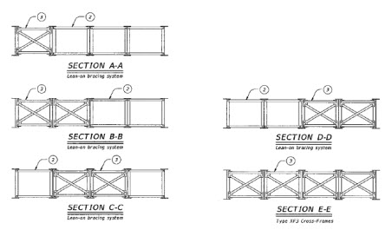
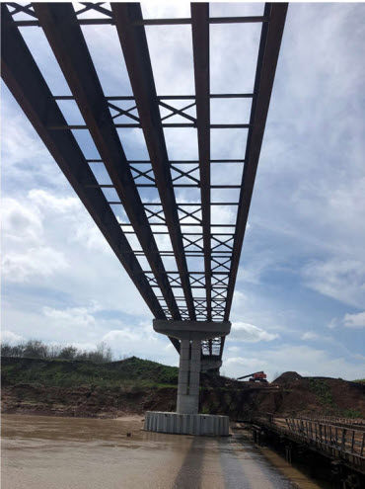
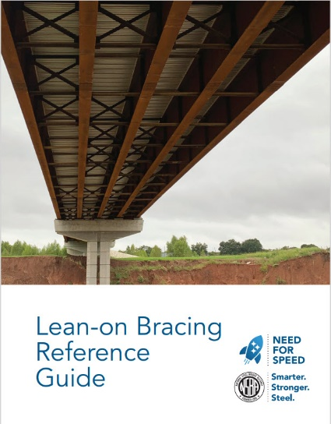
Lean-On Bracing
Lean-on Bracing: another option for cross-frame layout for straight bridges
Notes:
Another option for straight I-girder bridges (with or without skew) is the so-called “lean-on bracing system” in which certain bays within a cross-frame line contain only top and bottom struts (i.e., no diagonals), which lean-on other bays within that same line containing a typical X- or K-type cross-frame, as illustrated in the figures and photo on this slide. A lean-on system relies on the lateral buckling strength of lightly loaded adjacent girders to laterally support a more heavily loaded girder when all the girders are horizontally tied together. In a lean-on system all girders must buckle simultaneously. Lean-on bracing is not a new concept and has been used in non-bridge construction applications. The lean-on bracing concept allows for the optimization of cross-frame/diaphragm placement, especially for skewed I-girder bridges, with a goal to reduce undesirable stiffness and cross-frame forces. The system also has benefits in fabrication, erection, and in-girder service performance. The system should not be employed on horizontally curved I-girder bridges.
Lean-on bracing is beyond the scope of this course. Further information on the layout and design of lean-on bracing systems is contained in the NSBA publication entitled “Lean-on Bracing Reference Guide” (shown in the photo on this slide), which is available for free download from the NSBA website (www.aisc.org/nsba).
Additional options to reduce cross-frame/diaphragm forces in highly skewed bridges, such as leaving some cross-frames/diaphragms unconnected until after the deck has been cast, and/or providing vertical slotted holes in the cross-frame/diaphragm connections, are not recommended. Leaving some cross-frames/diaphragms unconnected has the disadvantage of the possibility of poorly braced girders until the deck hardens, and potential loss of geometry control during the deck casting. The Erector will also have to return to the site after the deck is cast and work from underneath the deck to tighten the bolts. Holes usually need to be drilled or at least reamed. If vertical slotted holes are provided and the bolts are tightened prior to the deck casting, the slots must be of the proper size and location to allow the computed deflections to occur freely without binding, which is unlikely to be the case. The resistance of the bolts will also be less in the slotted holes for all loads that are applied after the bolts are tightened.
Photo and Image Credit: Texas Department of Transportation

Slide 32
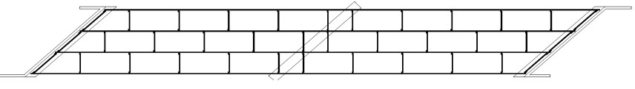
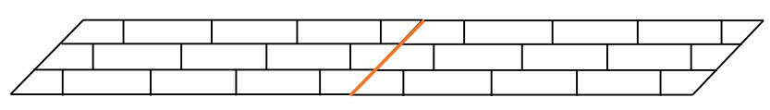
Cross-Frames & Diaphragms – Skewed Layout
Skewed Interior Support Lines
Not Recommended:
Recommended:
Notes:
At skewed interior piers in continuous-span bridges, framing of normal intermediate diaphragms or cross-frames into or near a bearing location along a skewed support line is not recommended (see the top figure on this slide) unless the cross-frame diagonals are omitted. it has been found that transverse stiffness effects are alleviated most effectively by placing diaphragms or cross-frames along the skewed bearing line and locating normal intermediate diaphragms or cross-frames at greater than or equal to the minimum offset from the bearing lines, as illustrated in the bottom figure on this slide. There are no rules for how to arrange the bearing restraints and cross-frames/diaphragms at these locations. Ingenuity and trial-and-error are the only tools. In critical cases, often only a least bad arrangement is available. The skewed cross-frames along the interior pier are considered to act as brace points for the girders because the cross-frames are located at a support and are not deflecting vertically.

Slide 33
Cross-Frames & Diaphragms – Skewed Layout
Skewed Support Lines at Abutments
  At skewed abutments (end supports), a row of cross-frames/diaphragms is always required along the support line to support the free edge of the deck.
  Tangential components of the skewed end support cross-frame/diaphragm forces act along each girder. To maintain static equilibrium, vertical bending moments and shears must develop in the girders at the end supports.
  AASHTO LRFD Article 6.7.4.2 requires that the effect of the tangential components of force transmitted by the skewed end support members be considered.
  Since these end moments are usually negative, they can potentially introduce tensile stresses in the deck or subject the bottom flange to compression adjacent to the supports.
Notes:
At skewed abutments (simple supports), a row of cross-frames/diaphragms is always required along the support line to support the free edge of the deck. Thus, a missing intermediate normal (radial) cross-frame/diaphragm is not a concern.
End rotations of the girders create forces in these cross-frames/diaphragms. Tangential components of the skewed end support cross-frame/diaphragm forces act along each girder. To maintain static equilibrium, vertical bending moments and shears must develop in the girders at the end supports. Note that the larger the rotation and deflection of the girders, the larger the end moments. In certain cases, these end moments may be important. Since these end moments are usually negative, they can potentially introduce tensile stresses in the deck or subject the bottom flange to compression adjacent to the supports. Generally, these moments cannot be avoided altogether. However, by placing the deck at the ends of the bridge last, the tensile stresses in the deck can be minimized. AASHTO LRFD Article 6.7.4.2 requires that the effect of the tangential components of force transmitted by the skewed end support members be considered.
The net components of the skewed end support cross-frame/diaphragm forces transverse to the girders introduce a torque at the girder ends. The effect of these transverse forces may need to be considered in the design of the transverse deck reinforcement, particularly when the end cross-frame/diaphragm forces are large.

Slide 34
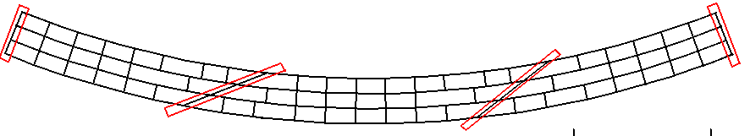
Cross-Frames & Diaphragms – Curved Layout
3.
1.
2.
Framing of a normal intermediate cross-frame into a bearing location along a skewed support line is discouraged (unless the cross-frame diagonals are omitted).
At skewed interior piers and abutments, place cross-frames or diaphragms along the skewed support line and offset adjacent intermediate cross-frames or diaphragms the recommended minimum offset distance from the skewed support line (Slide 28).
For curved and skewed I-girder bridges, provide contiguous intermediate cross-frame or diaphragm lines within the span in combination with the recommended minimum offset distance from the skewed support lines.
Notes:
This slide summarizes the framing layout arrangement recommendations for skewed I-girder bridges discussed on the previous slides.
Framing of a normal intermediate cross-frame into a bearing location along a skewed support line is discouraged (unless the cross-frame diagonals are omitted). At skewed interior piers and abutments, cross-frames or diaphragms should be placed along the skewed support line to brace the bottom flanges of the fascia girders and to match a cross-frame with each bearing that resists lateral force and then offset adjacent intermediate cross-frames or diaphragms the recommended minimum offset distance from the skewed support line (Slide 28).
Unlike straight skewed bridges, for curved and skewed I-girder bridges, contiguous intermediate cross-frame lines are recommended within the span, in lieu of staggered cross-frame lines, to develop the width of the bridge structural system to resist overall torsional effects, with the recommended minimum offsets provided only at the skewed support lines, as illustrated in the figure on this slide.

Slide 35
Cross-frames & diaphragms design requirements
Notes:
The next topic in this lesson will discuss the basic design requirements for cross-frames and diaphragms in the AASHTO LRFD BDS, including a discussion of new stability bracing stiffness and strength requirements appearing in the 10th Edition AASHTO LRFD BDS.

Slide 36
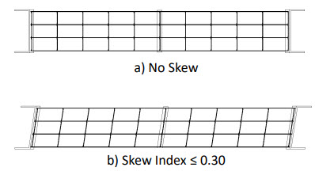
Cross-Frames & Diaphragms – Line Girder Design
Bridges that typically use a line-girder analysis for design
Straight bridges with a Skew Index, I_{s} ≤ 0.3 (Lesson 4 – Slide 54)
Horizontally curved bridges satisfying the requirements of AASHTO LRFD Article 4.6.1.2.4b for neglect of curvature effects (Lesson 4 – Slides 90 and 91)
  Cross-frames and diaphragms are not modeled
  Typically use Owner standard cross-frames and diaphragms
  Minimum design requirements (AASHTO LRFD Article 6.7.4.1):
    Transfer wind load force effects (AASHTO LRFD Article 4.6.2.7 – Lessons 3 and 7)
    Transfer overhang bracket force effects (Lesson 7)
    Satisfy applicable slenderness ratio requirements (Lesson 12) and minimum thickness requirements (AASHTO LRFD Article 6.7.3)
    Satisfy stability bracing stiffness and strength requirements (AASHTO LRFD Article 6.7.4.2.2 – 10th Edition)
    End connections are designed for the calculated factored member force effects or 75 percent of the factored axial resistance of the member (AASHTO LRFD Article 6.13.1 – Lessons 11 and 12)
Notes:
The design requirements for cross-frames and diaphragms are dependent on the type of analysis that is used for the design. Bridges that typically use a line-girder analysis for design include straight bridges with a Skew Index, I_{s}, less than or equal to 0.3 (including bridges with no skew) and horizontally curved bridges satisfying the requirements of AASHTO LRFD Article 4.6.1.2.4b for neglect of curvature effects. The Skew Index and the requirements for neglecting the effects of curvature were discussed previously in Lesson 4 (Slides 54, 90, and 91). The equation for the Skew Index is also given on Slide 99 of this lesson. In such cases, the cross-frames/diaphragms are not modeled in the analysis and Owner standard cross-frames and diaphragms are typically used.
The minimum design requirements for such cases are spelled out in AASHTO LRFD Article 6.7.4.1. At a minimum, the cross-frames/diaphragms are to be designed to transfer wind load force effects both during construction and in the final condition (AASHTO LRFD Article 4.6.2.7 – Lessons 3 and 7); to transfer overhang bracket force effects (Lesson 7); to satisfy applicable slenderness ratio requirements (to be discussed in Lesson 12) and minimum thickness requirements (AASHTO LRFD Article 6.7.3); and starting with the 10th Edition BDS, to satisfy stability bracing stiffness and strength requirements (AASHTO LRFD Article 6.7.4.2.2 – 10th Edition – to be discussed on subsequent slides). AASHTO LRFD Article 6.13.1 states that for cross-frames/diaphragms, if force effects are explicitly calculated from the results of a separate investigation, the end connections are to be designed for the calculated factored member force effects; otherwise, the end connections are to be designed for 75 percent of the factored axial resistance of the member (Lessons 11 and 12). Here the Engineer can perhaps exercise some judgment and design the end connections for the 75 percent resistance provision if the calculated force effects in the members (from the preceding loads) are deemed to be too low.

Slide 37

Cross-Frames & Diaphragms – Refined Model Design
Bridges that typically use a 2D or 3D refined analysis for design
Straight bridges with a Skew Index > 0.3 (Lesson 4)
Horizontally curved bridges not satisfying the requirements of AASHTO LRFD Article 4.6.1.2.4b for neglect of curvature effects (Lesson 4)
  Cross-frames and diaphragms are explicitly modeled
  May not use Owner standard cross-frames and diaphragms
  Design requirements:
    Design for all applicable limit states (for dead, live, and wind load force effects & for fatigue load force effects -> Lesson 11)
    Transfer overhang bracket force effects (Lesson 7)
    Satisfy applicable slenderness ratio requirements (Lesson 12) and minimum thickness requirements (AASHTO LRFD Article 6.7.3)
    Satisfy stability bracing stiffness and strength requirements (AASHTO LRFD Article 6.7.4.2.2 – 10th Edition) – strength requirements apply to straight bridges only
    End connections are designed for the calculated factored member force effects (AASHTO LRFD Article 6.13.1 - Lesson 11)
Notes:
Bridges that typically use a 2D or 3D refined analysis for design include straight bridges with a Skew Index greater than 0.3 and horizontally curved bridges not satisfying the requirements of AASHTO LRFD Article 4.6.1.2.4b for the neglect of curvature effects (Lesson 4). In such cases, the cross-frames and diaphragms are explicitly modeled. As a result, Owner standard cross-frames and diaphragms may not necessarily be used. Such analyses typically yield forces in the cross-frame/diaphragm members, which in the case of horizontally curved bridges are primary members. The stiffness and size of these members influences the magnitude of the computed actions in them. Disproportionately large cross-frame/diaphragm members will result in large forces that can be reduced by reducing the member sizes. It is best to initially investigate smaller member sizes and increase the sizes as necessary. Significant changes in cross-frame or diaphragm sizes are best investigated with another analysis to assure that the forces have not changed excessively.
The design requirements for such cases include design of the cross-frame/diaphragms for all applicable limit states for the dead, live, and wind load force effects, and for fatigue load force effects (fatigue design for cross-frame/diaphragms is discussed further in Lesson 11); transfer of overhang bracket force effects (Lesson 7); satisfaction of applicable slenderness ratio requirements (to be discussed in Lesson 12) and minimum thickness requirements (AASHTO LRFD Article 6.7.3); and starting with the 10th Edition BDS, satisfaction of stability bracing stiffness and strength requirements (AASHTO LRFD Article 6.7.4.2.2 – 10th Edition – to be discussed on subsequent slides). Note that the stability bracing strength requirements are only to be applied to straight bridges in these cases. AASHTO LRFD Article 6.13.1 states that where cross-frames or diaphragms are included in the structural model to determine the force effects, the end connections are to be designed for the calculated factored member force effects (Lesson 11). The 75 percent resistance provision discussed on the preceding slide does not apply to these cases since the force effects in these members for design are being explicitly calculated from a refined analysis model.

Slide 38
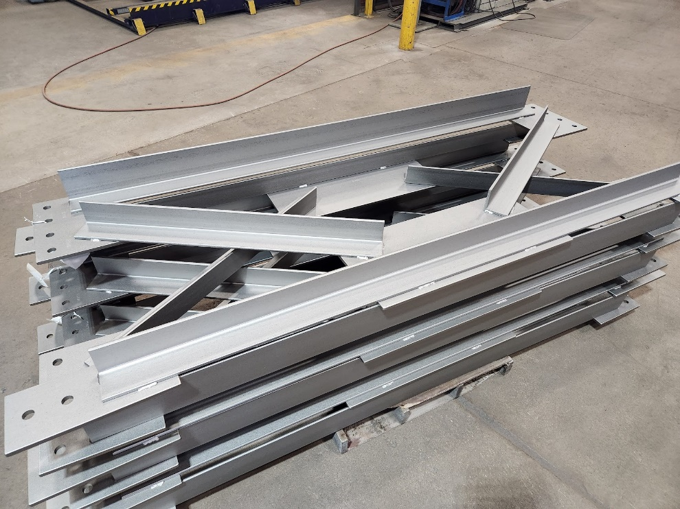
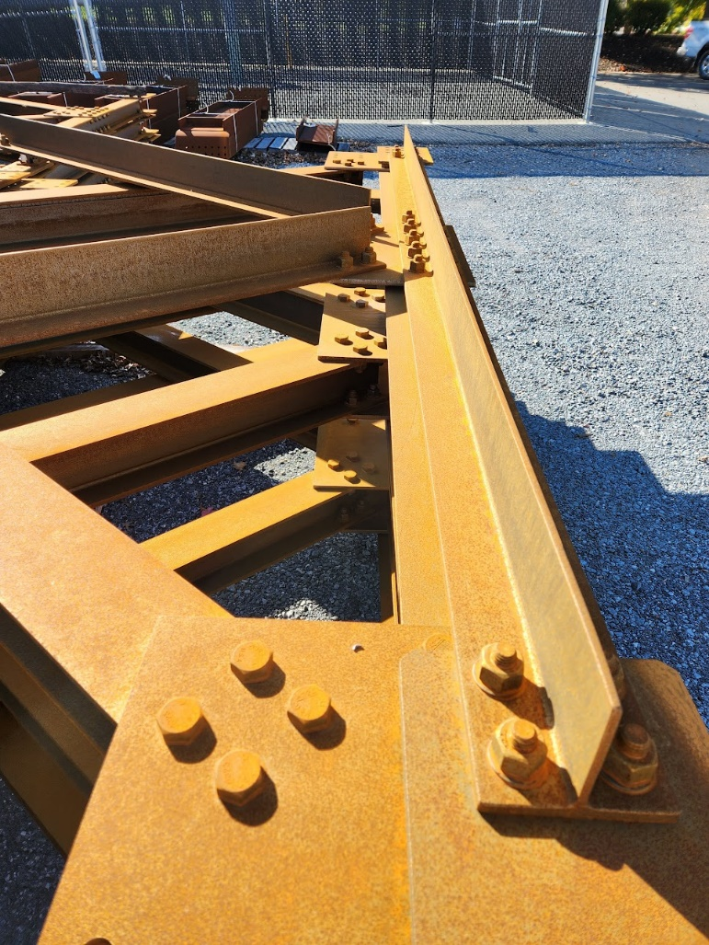
Cross-Frames & Diaphragms – Member Choices
Cross-Frame Member Selection
  Single angles and structural tees (WTs) are preferred over double angles.
  Single angles are preferred over WTs (angles are produced at steel mills & WTs need to be cut/split from wide-flange beams by the fabricator).
  Avoid 1/16-in. gage angles (typically require a mill order).
  The calculation of the factored tensile & compressive resistances of single-angle, double-angle and WT members is discussed in Lesson 12.
Notes:
In terms of cross-frame member selection, single angles, double angles and structural tees (WTs) are typically considered for use as cross-frame members. Double angles and WTs provide larger compressive and tensile resistances than single angles. Double angles also permit the bolts in their connections to work in double shear reducing the number. However, as mentioned previously, fabricators generally prefer single-element members (i.e., single angles or WTs) for cross-frame members. Double angles are more expensive to fabricate since they typically require more handling and some reverse-side welding. Fabricators generally prefer to perform one-side welding of individual single-element members to gusset plates in a jig. The assembled cross-frame can then be shipped for erection rather than shipping individual cross-frame members for assembly in the field. When double-angle members are used, a special coating application is also typically required for the backs of the two angles to provide corrosion resistance, which adds time and cost. Although double-angle members, where necessary, certainly can and have been painted, their use preferably should be limited to uncoated weathering steel applications. Therefore, unless the additional factored compressive or tensile resistance provided by double-angle members is absolutely required, fabricators generally prefer the use of single angles or WTs for cross-frame members.
In general, single angles are preferred over WTs whenever the factored tensile or compressive resistance of a single angle is adequate. Angles are produced at steel mills, whereas WTs need to be cut/split from wide-flange beams by the fabricator, which adds an additional step. However, WTs sometimes must be used to obtain the necessary factored compressive or tensile resistance, which is acceptable. Whenever single-angle members are used, avoid selecting 1/16-in. gage angles, which typically require a mill order and a significant minimum tonnage requirement that is typically much greater than required for a particular project. Also, the use of larger-size angles (e.g., 8-inch legs) should be avoided if possible as they are generally more expensive. Distortion of larger-size angle legs that can result during the rolling process can also lead to gaps between the angle and the gusset plate.
The calculation of the factored tensile and compressive resistance of single-angle, double-angle, and WT members is discussed in Lesson 12. The design of the member connections is discussed in Lesson 11.
Photo credit: Russo Structural Services

Slide 39
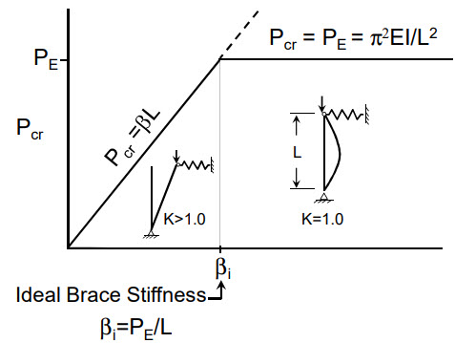
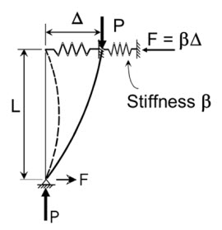
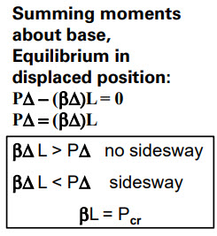
Cross-Frames & Diaphragms – Ideal Stiffness
Stability Bracing Requirements (AASHTO LRFD Article 6.7.4.2.2 – 10th Edition):
Notes:
A new Article 6.7.4.2.2 in the 10th Edition AASHTO LRFD BDS provides stability bracing requirements for torsional bracing related to the required stiffness and strength of cross-frames and diaphragms in I-girder bridges. The provided equations are intended to ensure that the stiffness and strength provided by these members is sufficient to ensure their ability to adequately function as brace points for the compression elements to which they are attached. Equations are given to ensure that the stiffness provided by the bracing satisfies the required stiffness of the bracing system that is used, and for computing stability bracing forces which are additive to the conventional bracing design forces determined from a first-order analysis. These requirements are enforced only for the case of the applicable noncomposite DC loads and any construction loads applied to the fully erected steelwork (i.e., during the deck-placement sequence). The provisions may be applied to skewed I-girder bridges with discontinuous cross-frames or diaphragms but should not be applied to straight skewed I-girder bridges utilizing lean-on bracing systems. Further information on these requirements may be found in NCHRP Report 962 Proposed Modifications to AASHTO Cross-Frame Analysis and Design (2021).
These requirements will be reviewed in detail on subsequent slides. First however, some fundamental requirements for all bracing systems will be discussed. Fundamental requirements for a relatively simple system will be established that are applicable to a wider range of bracing systems, including bracing systems for I-section flexural members.
Consider the column with a brace located at the top as shown in the picture on the left-hand side of this slide. If the top of the column displaces laterally some amount, Δ, the force in the brace is βΔ, where β is the stiffness of the brace. To determine the required properties of the brace to prevent the column from displacing laterally at the top, equilibrium of the displaced shape is enforced by summing moments about the base of the column, as shown on this slide. As a result, when Δ is not zero, the buckling capacity, P_{cr}, is a linear function of the brace stiffness, β, as shown in the plot on the right-hand side of this slide. For a perfectly straight member, when the so-called ideal brace stiffness, β_{i}, is reached, the member is forced to buckle between the brace points (i.e., where Δ = 0) and P_{cr} is equal to the Euler buckling capacity, P_{E} (Lesson 12). The ideal brace stiffness, β_{i}, is equal to P_{E}/L. Providing a stiffness larger than the ideal brace stiffness does not provide any increase in the buckling capacity for a perfectly straight member since the member buckles in a mode shape that does not involve displacement at the brace point.

Slide 40
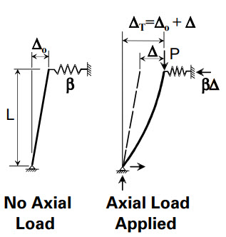
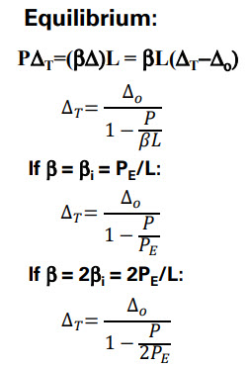
Cross-Frames & Diaphragms – Ideal Stiffness with Imperfections
Stability Bracing Requirements
Notes:
Perfectly straight members do not exist however; all members have some initial out-of-straightness that comes from fabrication or erection tolerances. Assume a column braced at the top with some initial out-of-straightness, Δ_{o}, in the unloaded condition as shown in the left-hand figure on this slide. With axial load applied, the column displaces an additional deformation, Δ, at the top of the column so that the total deformation, Δ_{T}, is equal to Δ_{o} + Δ, as shown in the second figure from the left on this slide.
Because the initial imperfection exists in the member with no axial force, the force in the brace will only be equal to βΔ, where Δ is the deformation that occurs under load. From equilibrium on the displaced shape summing moments about the base of the column, the total displacement at the top of the column, Δ_{T}, is determined for the case of providing the ideal brace stiffness, β_{i}, from the preceding slide and for the case of providing twice the ideal brace stiffness, 2β_{i}, is given by the equations shown on the right-hand side of this slide.

Slide 41
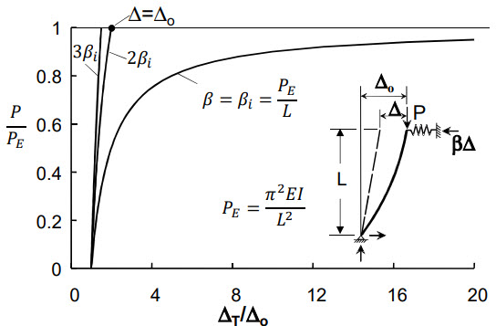
Cross-Frames & Diaphragms – Stiffness Requirements
Stability Bracing Requirements
Δ_{T} = Δ_{o}
Δ_{T}
Notes:
The graph on this slide shows a plot of P/P_{E} versus Δ_{T}/Δ_{o} for different multiples of the ideal brace stiffness, β_{i}. The graph demonstrates that if the ideal brace stiffness, β_{i}, is provided, large deformations occur as the buckling capacity between the ends of the member is approached. Providing twice the ideal brace stiffness, 2β_{i}, results in much better behavior; for this problem, the total deformation is nearly equal and only slightly greater than the initial imperfection, Δ_{o}, when the Euler buckling load, P_{E}, is reached. Providing a larger stiffness than twice the ideal brace stiffness (e.g., three times the ideal brace stiffness) results in even smaller amplification.

Slide 42
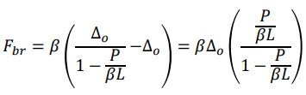
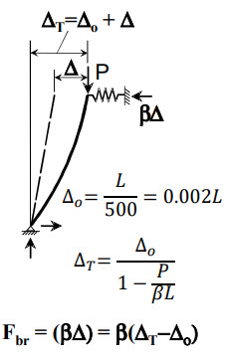

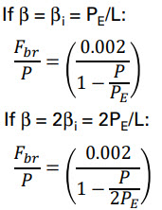

Cross-Frames & Diaphragms – Brace Strength Requirements
Stability Bracing Requirements
(Slide 40)
Notes:
This slide focuses on the strength behavior of the bracing system and builds off of the stiffness behavior illustrated on the preceding slides. For stability strength requirements, the impact of initial imperfections must be considered. A value that is often used for columns and frames is Δ_{o} equal to L/500 = 0.002L, which corresponds to a common erection tolerance. Summing moments about the base of the column, substituting the value of Δ_{T} taken from Slide 40 and the assumed value of Δ_{o} and rearranging allows for the computation of the brace force, F_{br}, for different values of the ideal brace stiffness, β_{i}, as given by the equations shown on the right-hand side of this slide. The brace force is a linear function of the magnitude of the initial imperfection; if the imperfection doubles, the brace force also doubles. Providing twice the ideal brace stiffness results in a brace force that is only 0.4 percent of the applied load, P, at an assumed initial imperfection of 0.002L.

Slide 43
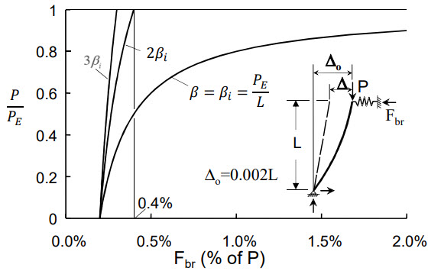
Cross-Frames & Diaphragms – Brace Strength Requirements
Stability Bracing Requirements
Δ_{T}
Notes:
Similar to the graph shown previously on Slide 41 of this lesson, the graph on this slide shows a plot of P/P_{E} versus the brace force, F_{br}, as a percentage of the load P for different multiples of the ideal brace stiffness, β_{i}. If the ideal brace stiffness is provided, the brace forces become very large as the load corresponding to buckling between the brace points (i.e., P_{E}) is approached. Providing twice the ideal brace stiffness, 2β_{i}, results in a brace force that is only 0.4 percent of the applied load. Historically, many engineers have used the 2 percent rule, which states that the bracing member and connections simply need to be designed for 2 percent of the applied load. While this is conservative if twice the ideal brace stiffness is provided, providing a stiffness close to the ideal brace stiffness will result in an unconservative solution. Therefore, it is imperative that adequate brace stiffness be provided to control brace forces and deformations.

Slide 44
Cross-Frames & Diaphragms – Design Requirements
Stability Bracing Requirements:
  Bracing of flexural members is more complicated than column bracing because column bracing (W-shapes) involves mainly bending whereas bracing of flexural members involves both bending and torsion. An effective brace for a flexural member resists twist of the cross-section.
  The AISC/AASHTO stiffness requirement for a torsional brace system is derived from the following critical buckling strength equation for a flexural member with a continuous torsional brace along its length modified to account for the effects of cross-section distortion, top-flange loading, and singly symmetric sections:
Ref.: Yura, J. A. Fundamentals of Beam Bracing. Engineering Journal, American Institute of Steel Construction, Chicago, IL, 2001.
Notes:
Bracing of flexural members is more complicated than column bracing because column bracing (W-shapes) involves mainly bending whereas bracing of flexural members involves both bending and torsion. An effective torsional brace for a flexural member resists twist of the cross-section.
The AISC/AASHTO stiffness requirement for a torsional brace system is derived from the critical buckling strength (M_{cr}) equation for a flexural member with a continuous torsional brace along its length, shown on this slide, modified to account for the effects of cross-section distortion, top-flange loading, and singly-symmetric sections. The terms in the equation are defined as follows:
β_{T}_bar = effective continuous torsional brace stiffness, accounting for the effects of cross-section web stiffness, in-plane girder system stiffness, and the stiffness of the attached brace (kip-in./radian/in. length)
C_{bu} = moment-gradient modifier for an unbraced girder (i.e., with very weak braces)
C_{b} = moment-gradient modifier for an effectively braced girder (i.e., buckling between the braces) (Lesson 8)
C_{T} = top-flange loading modification factor (= 1.2 for top-flange loading)
I_{eff} = effective moment of inertia (in.⁴) (see the next slide)
M_{o} = buckling capacity of the unbraced girder (kip-in.)
M_{y} = yield-moment resistance of the girder section (kip-in.)
Ref.: Yura, J. A. Fundamentals of Beam Bracing. Engineering Journal, American Institute of Steel Construction, Chicago, IL, 2001.

Slide 45
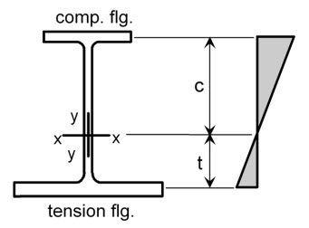
Cross-Frames & Diaphragms – Lateral Flange Stiffness
Stability Bracing Requirements
  The critical buckling strength equation was derived for doubly symmetric sections. The torsional bracing effect for singly symmetric sections can be approximated by replacing I_{y} with an effective out-of-plane moment of inertia, I_{yeff}, given as follows:
(Eq. 6.7.4.2.2-5)
where:
c = distance from the centroid of the girder section at the brace point under consideration to the centroid of the compression flange (in.). The distance is taken as positive.
I_{yc}, I_{yt}= moments of inertia of the girder compression and tension flange, respectively, about the vertical centroidal axis of the section at the brace point under consideration (in.⁴)
t = distance from the centroid of the girder section at the brace point under consideration to the centroid of the tension flange (in.). The distance is taken as positive.
Notes:
The critical buckling strength equation on the preceding slide was derived for doubly symmetric sections. The torsional bracing effect for singly symmetric sections can be approximated by replacing I_{y} with an effective out-of-plane moment of inertia, I_{yeff}, given by the equation shown on this slide (i.e., AASHTO LRFD Eq. 6.7.4.2.2-5 – 10th Edition). The terms in the equation are also defined on this slide. For a doubly symmetric section, I_{eff} is taken equal to I_{y} (i.e., AASHTO LRFD Eq. 6.7.4.2.2-4 – 10th Edition).

Slide 46
Cross-Frames & Diaphragms – Stiffness Requirements
Stability Bracing Requirements
  Stability bracing provisions are generally a function of the ideal brace stiffness, which is the stiffness required for a perfectly straight member to reach a load level corresponding to buckling between brace points (Slide 39). To account for the impact of imperfections, a stiffness larger than the ideal value is provided to control deformations and brace forces.
  It was shown previously (Slide 41) that providing twice the ideal stiffness limits the amount of deformation to a value equal to the initial imperfection.
  The required continuous torsional brace stiffness providing twice the ideal stiffness can be determined by rearranging the critical buckling equation on Slide 44 as follows:
Notes:
Stability bracing provisions are generally a function of the ideal brace stiffness, which is the stiffness required for a perfectly straight member to reach a load level corresponding to buckling between brace points, as discussed previously on Slide 39 of this lesson. To account for the impact of imperfections, a stiffness larger than the ideal value is provided to control deformations and brace forces. It was shown previously on Slide 41 of this lesson that providing twice the ideal stiffness limits the amount of deformation to a value equal to the initial imperfection, which is assumed equal to a twist imperfection in the case of a flexural member.
Therefore, the required continuous torsional brace stiffness providing twice the ideal stiffness can be determined by rearranging the critical buckling equation shown on Slide 44 of this lesson, resulting in the equation shown at the bottom of this slide.

Slide 47
Cross-Frames & Diaphragms – Required Brace Stiffness
Stability Bracing Requirements
  For point (discrete) bracing: where L is the span length and n is the number of intermediate brace points within the span. For top-flange loading, C_{T} = 1.2.
  Therefore, neglecting the C_{bu}M_{o} term which will be small compared to M_{cr} at full bracing, substituting the factored major-axis bending moment, M_{u}, for M_{cr}, and inserting a resistance factor for stability bracing, φ_{sb} = (0.80), into the equation on the preceding slide gives:
  The preceding equation applies when the cross-frames or diaphragms are at least 0.8 times the beam or girder depth and are attached to full-depth connection plates positively attached to both flanges.
(Eq. 6.7.4.2.2-2)
Notes:
For point (discrete) bracing, the required stiffness of the bracing system is equal to required stiffness of a continuous bracing system times the span length, L, divided by the number of intermediate brace points within the span, n (i.e., the number of brace points in-between the supports for that span). For top-flange loading, which is more critical than centroidal loading for stability bracing, the modification factor, C_{T}, is taken equal to 1.2.
Therefore, neglecting the C_{bu}M_{o} term which will be small compared to M_{cr} at full bracing, substituting the factored major-axis bending moment, M_{u}, for M_{cr}, and inserting a resistance factor for stability bracing, φ_{sb} (= 0.80), into the equation on the preceding slide gives the equation for the required stiffness of the torsional bracing system shown on this slide (which is given as AASHTO LRFD Eq. 6.7.4.2.2-2 in the 10th Edition).
This equation applies when the cross-frames or diaphragms are at least 0.8 times the beam or girder depth and are attached to full-depth connection plates positively attached to both flanges. Full-depth cross-frames generally result in significantly different imperfection shapes compared to the critical (twist) imperfection shape that is typically assumed in torsional stability bracing formulations that results in the largest brace forces. As discussed on the next slide, the resulting deformations and brace forces with the corresponding imperfection are not as large as the cases with the critical shape. Therefore, cross-frames with depths that are at least 0.8 times the beam or girder depth have stiffness requirements based upon twice the ideal stiffness as given by AASHTO LRFD Eq. 6.7.4.2.2-2.

Slide 48
Cross-Frames & Diaphragms – Required Brace Stiffness
Stability Bracing Requirements
  Otherwise:
  The preceding equation applies when the cross-frames or diaphragms are less than 0.8 times the beam or girder depth and/or are not attached to full-depth connection plates positively attached to both flanges.
(Eq. 6.7.4.2.2-3)
Analyses were conducted that started with girders possessing the critical shape imperfection followed by the simulated installation of full-depth cross-frames.
Although the girders started with a critical shape imperfection where the compression flange had a lateral sweep and the tension flange was straight, the final imperfection after cross-frame installation was closer to a pure sweep of the girders with significantly smaller brace forces.
Notes:
Further studies of torsional beam bracing have found that providing twice the ideal stiffness resulted in larger deformations for systems with the critical shape imperfection and therefore a value corresponding to three times the ideal stiffness is recommended for such cases, which is represented by AASHTO LRFD Eq. 6.7.4.2.2-3 (10th Edition) shown at the top of this slide with the constant equal to 3.6. Such cases typically occur when the cross-frames or diaphragms are less than 0.8 times the beam or girder depth and/or at not attached to full-depth connection plates positively attached to both flanges.
In the studies mentioned above, analyses were conducted that started with girders possessing the critical shape imperfection for torsional bracing shown in the figure on the right-hand side of this slide, i.e., in which the compression flange has a lateral translation, and the tension flange is straight, followed by the simulation installation of full-depth cross-frames. In the analysis, the imperfect girders were “pulled to a square position”, the cross-frame was installed, and the girders released. This process essentially simulated erection procedures for installing cross-frames. Although the girders started with a critical shape imperfection, the final imperfection after cross-frame installation was closer to a pure sweep of the girders with significantly smaller brace forces. Because most cross-frames in bridges are nearly full-depth, the effects of imperfections on brace forces will not be nearly as severe. As a result, requiring only two times the ideal stiffness (i.e., AASHTO LRFD Eq. 6.7.4.2.2-2) was felt to be warranted. For systems with relatively shallow braces, the braces will not “straighten” the girders and three times the ideal stiffness (i.e., AASHTO LRFD Eq. 6.7.4.2.2-3) was felt to be warranted in such cases.

Slide 49
Cross-Frames & Diaphragms – Additional Requirements
Stability Bracing Requirements
  Diaphragms in through-girder bridges and in rolled-beam bridges are typically less than 0.8 times the beam or girder depth and therefore AASHTO LRFD Eq. 6.7.4.2.2-3 (Slide 48) should be used to determine the required stiffness.
  A cross-frame or diaphragm on only one side of the beam or girder should be considered a brace point.
  In lieu of a more refined approach, for spans with discontinuous or staggered cross-frame or diaphragm layouts, the number of intermediate brace points, n, may be taken as the maximum of the total number of brace points on each side of the beam or girder within the span under consideration.
  At end supports, the stability bracing requirements for the cross-frames or diaphragms may be taken the same as for the intermediate cross-frames within the span under consideration. For spans without intermediate cross-frames, the stability bracing requirements for the support cross-frames may be computed assuming n equal to 1.
Notes:
For example, diaphragms in through-girder bridges and in rolled-beam bridges are typically less than 0.8 times the beam or girder depth and therefore AASHTO LRFD Eq. 6.7.4.2.2-3 (shown on the preceding slide) should be used to determine the required stiffness.
Note that a cross-frame or diaphragm on only one side of a beam or girder should be considered a brace point. In lieu of a more refined approach, for spans with discontinuous or staggered cross-frame or diaphragm layouts, the number of intermediate brace points, n, may be taken as the maximum of the total number of brace points on each side of the beam or girder within the span under consideration. As an example, for an interior girder with 8 brace points on one side and 7 brace points on the other, n is to be taken as 8. For a fascia girder with 8 brace points on only one side, n is also to be taken as 8.
At end supports, the stability bracing requirements for the cross-frames or diaphragms may be taken the same as for the intermediate cross-frames within the span under consideration. For spans without intermediate cross-frames, the stability bracing requirements for the support cross-frames may be computed assuming n equal to 1.

Slide 50
Cross-Frames & Diaphragms – Construction Stability Requirements
Stability Bracing Requirements
  In addition to the minimum design requirements specified in AASHTO LRFD Article 6.7.4.1 (Slides 36 & 37), diaphragms or cross-frames for all rolled-beam and plate-girder bridges are to satisfy the following stability bracing stiffness requirement for the applicable noncomposite DC loads and any construction loads applied to the fully erected steelwork:
  M_{u} is to be taken as factored major-axis bending moment for the limit-state load combination specified in Article 3.4.1 or 3.4.2.1, as applicable. In regions of positive flexure, use the maximum factored major-axis bending moment within the region. In regions of negative flexure, use the factored major-axis bending moment at the interior support under consideration.
  L is taken as the length of the span under consideration. For a cross-frame or diaphragm located at an interior support, the average length of the spans on either side of the interior support is to be used for L.
(Eq. 6.7.4.2.2-1)
Notes:
In addition to the minimum design requirements specified in AASHTO LRFD Article 6.7.4.1 (Slides 36 & 37), diaphragms or cross-frames for all rolled-beam and plate-girder bridges are to satisfy the stability bracing stiffness requirement shown on this slide (i.e., AASHTO LRFD Eq. 6.7.4.2.2-1 – 10th Edition) for the applicable noncomposite DC loads and any construction loads applied to the fully erected steelwork. (β_{T})_{act} is the actual overall stiffness of the torsional bracing system. The calculation of (β_{T})_{act} is discussed on subsequent slides.
Although the beam or girder bending moments during construction are smaller in magnitude than the bending moments acting on the completed structure, the critical stage for stability bracing is during construction, including when the fully erected steelwork supports the applicable DC loads and any construction loads acting on the noncomposite structure during the deck placement. Cross-frames and diaphragms typically serve as the only source of bracing to the beams or girders at this stage, although in some situations, lateral bracing may also be necessary to help control lateral deflections of the fully erected steelwork due to wind and/or to provide additional stability to the fully erected steelwork during construction (Lesson 7 and Slides 104 to 107 of this lesson).
Also, in the completed structure, the shear studs and composite deck provide continuous lateral and torsional restraint to the top compression flange in regions of positive flexure. Even in the negative moment regions, where shear studs may be omitted, the deck provides continuous lateral restraint to the top flange as well as some tipping restraint to limit flange twist. In this case, the demand on cross-frames and diaphragms is substantially reduced from the case where the deck is either not present or its stiffness is not yet fully effective; that is, when the stiffness of the deck is fully effective, the cross-frame diagonals mainly serve as struts that laterally restrain the bottom compression flange. The cross-frame brace stiffness in this case greatly exceeds the stiffness as a pure torsional brace. The bridge bearings and anchor bolts provide some additional lateral and torsional restraint to the bottom compression flange in these regions as well. Therefore, the stability bracing requirements for cross-frames or diaphragms are not considered to be critical for the design of the composite structure at the strength limit state. These requirements should instead be checked for the critical construction stage, which generally occurs during the placement of the concrete deck.
M_{u} in AASHTO LRFD Eqs. 6.7.4.2.2-2 and 6.7.4.2.2-3 is to be taken as factored major-axis bending moment for the limit-state load combination specified in Article 3.4.1 or 3.4.2.1, as applicable (Lessons 3 and 7). In regions of positive flexure, use the maximum factored major-axis bending moment within the region. In regions of negative flexure, use the factored major-axis bending moment at the interior support under consideration. L in the same equations is taken as the length of the span under consideration. For a cross-frame or diaphragm located at an interior support, the average length of the spans on either side of the interior support is to be used for L..

Slide 51
Cross-Frames & Diaphragms – Actual / Provided Stiffness
Stability Bracing Requirements
  In lieu of a more refined analysis, the actual overall stiffness of the torsional bracing system is to be calculated as follows:
β_{br} = brace stiffness of the diaphragm or cross-frame that restrains twisting of the beam or girder (kip-in./radian) (Slides 52 to 57)
β_{sec} = cross-sectional distortion stiffness for stability bracing (kip-in./radian) (Slide 58)
β_{g} = effective in-plane girder stiffness for stability bracing (kip-in./radian) (Slide 59)
(Eq. 6.7.4.2.2-6)
Notes:
In lieu of a more refined analysis, the actual overall stiffness of the torsional bracing system, (β_{T})_{act}, is to be calculated from the equation shown on this slide (i.e., AASHTO LRFD Eq. 6.7.4.2.2-6 – 10th Edition). β_{br} is the brace stiffness of the diaphragm or cross-frame that restrains twisting of the beam of girder (Slides 52 to 57). β_{sec} is the cross-sectional distortion stiffness for stability bracing (Slide 58). β_{g} is the effective in-plane girder stiffness for stability bracing (Slide 59). The units for each of these stiffness terms are in kip-in. per radian. Like springs in series, the actual overall stiffness will be less than the smallest of the three stiffness values.

Slide 52
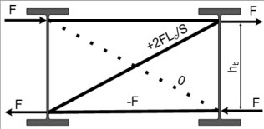
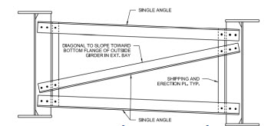
Cross-Frames & Diaphragms – Tension Only Stiffness
Stability Bracing Requirements
  Brace Stiffness, β_{br} -> X-type cross-frame (tension-only diagonal system), or a Z-type cross-frame with a single compression diagonal:
(Eq. 6.7.4.2.2-7)
where:
A_{d} = gross cross-sectional area of the cross-frame diagonal member (in.²). For single-angle and flange-connected tee-section members, the area is to be multiplied by 0.65 (Lesson 4).
A_{s} = gross cross-sectional area of the cross-frame strut (in.²). For single-angle and flange connected tee-section members, the area is to be multiplied by 0.65
h_{b} = height of the cross-frame measured between the centroids of the top and bottom struts (in.)
L_{d} = length of the diagonal member (in.)
S = beam or girder spacing (in.)
Notes:
The brace stiffness, β_{br}, of cross-frame systems is derived from elastic truss analyses. The equation for β_{br} shown on this slide is for tension-only X-type cross-frame systems and for a Z-type cross-frame with a single compression diagonal (AASHTO LRFD Eq. 6.7.4.2.2-7 – 10th Edition). The terms in the equation are defined on the slide. In a tension-only X-type cross-frame system, although there are two diagonals, it is conservatively assumed in the design that the compression diagonal (typically a single angle with a relatively low compressive resistance) has buckled and does not contribute to the stiffness of the brace.
In computing the brace stiffness on this slide and the next two slides, the softening effect of eccentric end connections on the stiffness of single-angle and flange-connected tee-section cross-frame members is to be considered in accordance with the provisions of AASHTO LRFD Article 4.6.3.3.4c; that is, the cross-sectional area of the cross-frame members is to be reduced by a factor of 0.65 to account for the inherent flexibility of the connections when investigating the noncomposite condition during construction (Lesson 4).

Slide 53
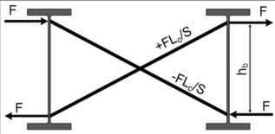
Cross-Frames & Diaphragms – Compression Diagonal Stiffness
Stability Bracing Requirements
  Brace Stiffness, β_{br} -> X-type cross-frame (compression-diagonal system):
(Eq. 6.7.4.2.2-8)
where:
A_{d} = gross cross-sectional area of the cross-frame diagonal member (in.²). For single-angle and flange-connected tee-section members, the area is to be multiplied by 0.65 (Lesson 4).
h_{b} = height of the cross-frame measured between the centroids of the top and bottom struts (in.)
L_{d} = length of the diagonal member (in.)
S = beam or girder spacing (in.)
Notes:
The equation for β_{br} shown on this slide is for X-type compression-diagonal cross-frame systems (AASHTO LRFD Eq. 6.7.4.2.2-8 – 10th Edition). The terms in the equation are defined on the slide. In a compression-diagonal X-type cross-frame system, the tensile and compressive resistance of the diagonals is considered in the design; the stiffness of the system is not sensitive to the size of the top and bottom struts.

Slide 54

Cross-Frames & Diaphragms – K-Frame Stiffness
Stability Bracing Requirements
  Brace Stiffness, β_{br} -> K-type cross-frame:
(Eq. 6.7.4.2.2-9)
where:
A_{d} = gross cross-sectional area of the cross-frame diagonal member (in.²). For single-angle and flange-connected tee-section members, the area is to be multiplied by 0.65 (Lesson 4).
A_{s} = gross cross-sectional area of the cross-frame strut (in.²). For single-angle and flange connected tee-section members, the area is to be multiplied by 0.65
h_{b} = height of the cross-frame measured between the centroids of the top and bottom struts (in.)
L_{d} = length of the diagonal member (in.)
S = beam or girder spacing (in.)
Notes:
The equation for β_{br} shown on this slide is for K-type cross-frame systems (AASHTO LRFD Eq. 6.7.4.2.2-9 – 10th Edition). The terms in the equation are defined on the slide. In a K-type cross-frame system, the top and bottom struts are required and contribute to the stiffness of the bracing system.

Slide 55

Cross-Frames & Diaphragms – Diaphragm Stiffness
Stability Bracing Requirements
  Brace Stiffness, β_{br} -> Diaphragm attached at or above mid-height of the beam or girder
(Eq. 6.7.4.2.2-10)
where:
I_{b} = moment of inertia of the diaphragm member about the horizontal centroidal axis of the section (in.⁴ )
S = beam or girder spacing (in.)
Notes:
The equation for β_{br} shown on this slide is for a diaphragm attached at or above mid-height of the beam or girder (AASHTO LRFD Eq. 6.7.4.2.2-10 – 10th Edition). The terms in the equation are defined on the slide. If the location of the diaphragm is such that the distance between the flanges of the girders is maintained constant (i.e., when the diaphragm is attached at or above the mid-height of the girder), then all the girders must sway in the same direction resulting in the brace stiffness equation shown.

Slide 56



Cross-Frames & Diaphragms – Diaphragm Stiffness
Stability Bracing Requirements
  Brace Stiffness, β_{br} -> Diaphragm attached below mid-height of the beam or girder:
(Eq. 6.7.4.2.2-11)
where:
I_{b} = moment of inertia of the diaphragm member about the horizontal centroidal axis of the section (in.⁴ )
S = beam or girder spacing (in.)
Notes:
The equation for β_{br} shown on this slide is for a diaphragm attached below mid-height of the beam or girder (AASHTO LRFD Eq. 6.7.4.2.2-11 – 10th Edition). The terms in the equation are defined on the slide. If the location of the diaphragm is such that the adjacent compression flanges can separate as shown in the figure on the bottom left of this slide (i.e., when the diaphragm is attached below mid-height of the beam or girder as in a through-girder bridge), the brace stiffness is given by the equation shown.
The torsional bracing stiffnesses shown in this slide and the preceding slide assume that the connection between the girder and the brace can support a bracing moment, M_{br}.

Slide 57
Cross-Frames & Diaphragms – Skew Considerations
Stability Bracing Requirements
  Brace Stiffness, β_{br} -> Effect of skew:
For skewed intermediate cross-frames or diaphragms, the stiffness, β_{br}, should be modified to account for the reduced effectiveness of a skewed cross-frame relative to the longitudinal axis of the girder and the additional member lengths in the skewed orientation.
In such cases, β_{br, skew} = β_{br}cos²θ, where θ is the angle of a skewed intermediate diaphragm or cross-frame relative to a line normal to the longitudinal axis of the bridge.
The calculation of β_{br,skew} does not need to be considered for skewed cross-frames or diaphragms at end or interior supports.
L_{d} should be taken as the actual length of the diagonal member; that is, the length of the member along the skew, and S should be taken as the beam or girder spacing measured along the skew.
Notes:
For skewed intermediate cross-frames or diaphragms, the stiffness, β_{br}, given by AASHTO LRFD Eqs. 6.7.4.2.2-7 through 6.7.4.2.2-11 (10th Edition – Slides 52 to 56) should be modified to account for the reduced effectiveness of a skewed cross-frame relative to the longitudinal axis of the girder and the additional member lengths in the skewed orientation. In such cases, β_{br, skew} = β_{br}cos²θ, where θ is the angle of a skewed intermediate diaphragm or cross-frame relative to a line normal to the longitudinal axis of the bridge. At skewed end or interior supports, cross-frames or diaphragms are routinely oriented about an axis parallel to the skewed support line, which can result in a skew angle that exceeds 20 degrees. In these instances, the effective brace stiffness can be significantly impacted by the skew angle, particularly when bent-plate connections are utilized (see Slide 101 in this lesson). Despite this apparent stiffness reduction, there are several mitigating factors at these support regions, including the tipping restraint provided by bridge bearings, that improve the effectiveness of the brace and the lateral-torsional buckling resistance of the girder. Therefore, the calculation of β_{br, skew} does not need to be considered for skewed cross-frames or diaphragms at end or interior supports. As an alternative to bent-plate connections, the use of half-round bearing stiffeners may be considered to increase the connection stiffness, the torsional warping restraint, and the lateral-torsional buckling resistance of the girder (see Slide 102 in this lesson).
For skewed intermediate and support cross-frames, L_{d} in Eqs. 6.7.4.2.2-7 through 6.7.4.2.2-9, as applicable, should be taken as the actual length of the diagonal member; that is, the length of the member along the skew, and S in Eqs. 6.7.4.2.2-7 through 6.7.4.2.2-11 for skewed intermediate and support cross-frames or diaphragms, as applicable, should be taken as the beam or girder spacing measured along the skew.

Slide 58



Cross-Frames & Diaphragms – Cross-Section Distortion
Stability Bracing Requirements
  Cross-Section Distortion Stiffness, β_{sec}:
h_{i}
h_{i}
D
h_{i}
h_{i}
where:
b_{s} = for a connection plate or end angle on only one side of the web, width of the connection plate or projecting leg size of the end angle (in.). For connection plates or end angles on both sides of the web, total combined width of the connection plates or projecting leg sizes of the end angles (in.)
D = web depth (in.)
h_{i} = for less than full-depth connection plates or end angles, distances along the web from the top and bottom of the connection plate or end angle to the adjacent flange; otherwise, distances along the web from the top and bottom of the cross-frame or diaphragm member to the adjacent flange (in.)
t_{s} = thickness of the connection plate or projecting leg of the end angle (in.)
t_{w} = web thickness (in.)
For diaphragms and cross-frames, whose depth is at least 0.8 times the beam or girder depth, attached to full-depth connection plates positively attached to both flanges:
Otherwise:
(Eq. 6.7.4.2.2-12)
Notes:
Cross-sectional distortion significantly impacts the behavior of beams with relatively shallow braces with respect to the beam or girder depth. The portion of the web that impacts distortion is the region above and below the brace. Therefore, web distortion essentially cannot occur for cross-frames or diaphragms that are nearly the full depth of the web. For braces that are less than the full web depth, distortion is controlled with the connection plates.
The impact of cross-sectional distortion stiffness is accounted for with the term, β_{sec}, in the calculation of the actual overall bracing system stiffness in Eq. 6.7.4.2.2-6 (10th Edition – Slide 51). For cross-frames or diaphragms whose depth is at least 0.8 times the beam or girder depth, attached to full-depth connection plates positively attached to both flanges as specified in AASHTO LRFD Article 6.6.1.3.1, the term, β_{sec}, is sufficiently large such that web distortion is generally not an issue. In such cases, β_{sec} is taken equal to infinity, and only the β_{br} and β_{g} terms need to be considered in the calculation of the actual overall bracing system stiffness. Otherwise, the equation shown at the bottom of the slide (AASHTO LRFD Eq. 6.7.4.2.2-12 - 10th Edition) is to be used to compute β_{seci} for the portions of the web above and below a less than full-depth connection plate or end angle, or above and below the cross-frame or diaphragm member, as applicable. The terms in the equation are defined on this slide (see also the figures at the top of this slide). The distance, h_{i}, is illustrated in these figures for the case of a full-depth connection plate, but with a diaphragm and cross-frame whose depth is less than 0.8 times the beam or girder depth. In such cases, 1/β_{sec} is equal to Σ(1/β_{seci}).

Slide 59


Cross-Frames & Diaphragms – In-Plane Girder Stiffness
Stability Bracing Requirements
  Effective In-Plane Girder Stiffness, β_{g}:
(Eq. 6.7.4.2.2-13)
where:
I_{x} = noncomposite girder moment of inertia about the horizontal centroidal axis of the section at the brace point under consideration (in.⁴ )
n_{g} = number of girders within the span under consideration connected by the diaphragms or cross-frames
Notes:
Stability-induced forces result in end moments acting on cross-frames or diaphragms due to the manner in which cross-frames and diaphragms restrain twist (i.e., reverse curvature bending in the brace). These end moments are equilibrated by vertical shear forces acting on the longitudinal girders. These vertical shear forces induce vertical deflections of the girders in addition to the deflections caused by the vertical load effects; i.e., one girder displaces up and the other displaces down as illustrated in the figures at the top left of this slide for a twin-girder system with a brace only at midspan. These additional deflections represent a reduction in the effective stiffness of the girder, which leads to a decrease in the effectiveness of the cross-frames or diaphragms as stability bracing. The magnitude of the shear forces and resulting girder deflections is related to the number of girders, their in-plane flexural stiffness, and the overall bridge width in AASHTO LRFD Eq. 6.7.4.2.2-13 (10th Edition) shown on this slide. The terms in the equation are shown on this slide (the terms S and L were defined on previous slides). Narrow I-girder bridge units are the most impacted by the in-plane girder effects. As the number of girders and the width of the system increase, the effect of the in-plane girder stiffness becomes less significant according to the equation (see the figure at the bottom left of this slide). Although the equation was developed for a twin-girder system with a single brace at midspan, the equation can be used when there is more than one brace along the span.
For cases in which the β_{g} term dominates the overall system stiffness in AASHTO LRFD Eq. 6.7.4.2.2-6 (10th Edition – Slide 51), such as I-girder bridge units with three or fewer girders, then global displacement amplification should also be checked based on the provisions specified in AASHTO LRFD Article 6.10.3.4.2 (Lesson 7).

Slide 60
Cross-Frames & Diaphragms – System Stiffening Recommendations
Stability Bracing Requirements:
  Should AASHTO LRFD Eq. 6.7.4.2.2-1 (10th Edition – Slide 50) not be satisfied, i.e., (β_{T})_{act} < (β_{T})_{req}, the following alternatives may be considered:
    The addition of flange level lateral bracing or a hardened placement of the concrete deck over a distance of 20 to 25 percent of the span length adjacent to each support of the span under consideration may be considered. When this alternative is used, (β_{T})_{req} in AASHTO LRFD Eq. 6.7.4.2.2-2 (Slide 47) or 6.7.4.2.2-3 (Slide 48), as applicable, is to be multiplied by 0.70;
    The effective out-of-plane moment of inertia of the girders may be increased and/or the diaphragm or cross-frame spacing may be decreased in the span under consideration until AASHTO LRFD Eq. 6.7.4.2.2-1 is satisfied; or
    An elastic buckling analysis using a three-dimensional shell-element model that captures the significant aspects of the nonprismatic geometry may be conducted to investigate the global lateral torsional buckling stability of the span under consideration for the applicable noncomposite DC loads and any construction loads applied to the fully-erected steelwork.
Notes:
Should AASHTO LRFD Eq. 6.7.4.2.2-1 (10th Edition – Slide 50) not be satisfied, i.e., (β_{T})_{act} < (β_{T})_{req}, the alternatives listed on this slide may be considered.
In longer-span bridges, if the girders and cross-frames within the span under consideration otherwise meet their pertinent design requirements, but do not satisfy the applicable stability bracing stiffness requirement given by AASHTO LRFD Eq. 6.7.4.2.2-1, one recommended alternative is to add flange-level lateral bracing or a hardened placement of the concrete deck extending over a portion of the length of the span adjacent to each support. The reference listed below suggests that appropriately sized top-flange lateral bracing provided over a distance of 20 percent of the span length at both ends of the span develops the equivalent of a fixed-end condition for global lateral torsional buckling; the same reference also includes equations that can be used to size the lateral bracing members. A range of 20 to 25 percent of the span length at both ends of the span is suggested herein to accommodate most typical cross-frame and diaphragm spacings. A similar range of the span is recommended for a hardened placement of the concrete deck at each end. The angle of the lateral bracing diagonal with respect to the horizontal should not be less than 30 degrees or greater than 60 degrees. For cross-sections with more than three girders, the lateral bracing should be placed in the outer bays only. When a partial-length top-flange lateral bracing system is provided, bottom-flange lateral bracing could also be provided to create a pseudo-closed box section and further increase the torsional stiffness of the girders. If bottom-flange lateral bracing is provided, the bracing system may be subject to significant live load forces and associated concerns with fatigue in the finished structure. Designs with top- and bottom-flange lateral bracing may also exhibit challenging constructability and fit-up issues.
Ref: Yura, J. A., T. Helwig, R. Herman, and C. Zhou. Global Lateral Buckling of I-Shaped Girder Systems. Journal of Structural Engineering, Vol 134, No. 9. American Society of Civil Engineers, Reston, VA, 2008

Slide 61
Cross-Frames & Diaphragms – Required Brace Strength
Stability Bracing Requirements
  In lieu of a more refined analysis, diaphragms or cross-frames in straight rolled-beam or plate-girder bridges with or without skew, and in horizontally curved rolled-beam or plate-girder bridges satisfying all the conditions specified in AASHTO LRFD Article 4.6.1.2.4b for neglecting the effects of curvature, are to also satisfy the following stability bracing strength requirement for the applicable noncomposite DC loads and any construction loads applied to the fully erected steelwork calculated as follows:
    For diaphragms and cross-frames, whose depth is at least 0.8 times the beam or girder depth, attached to full-depth connection plates positively attached to both flanges:
    Otherwise:
(Eq. 6.7.4.2.2-14)
(Eq. 6.7.4.2.2-15)
Notes:
Traditionally, Engineers have often designed diaphragms or cross-frames for bridges without significant skew or curvature based on wind loads and individual member slenderness criteria, as calculated force effects in these members are typically not available from the analysis. In most cases, standard diaphragm or cross-frame designs, based on generic calculations and/or successful past use, and requiring no bridge-specific analysis by the Engineer, have been utilized. While such approaches have proven adequate, the requirements herein are intended to provide a method for Engineers to ensure that these members have adequate strength and stiffness, in the absence of any calculated force effects other than wind, to act as effective torsional braces for the longitudinal beam or girder for loads applied to the fully erected steelwork during construction. Alternatively, stability bracing forces can be determined directly by a large-displacement analysis provided the effects of imperfections are considered.
As discussed previously on Slide 42 of this lesson for a column bracing system, the brace force is a linear function of the magnitude of the initial imperfection and is a product of the stiffness and the initial imperfection. For the bracing system for a flexural member, the brace force is expressed in terms of an end moment, M_{br}, and the initial imperfection is a twist imperfection. Therefore, the bracing strength requirement specified in AASHTO LRFD Eqs. 6.7.4.2.2-14 and 6.7.4.2.2-15 (10th Edition) shown on this slide is equivalent to the product of the required stiffness of the torsional brace system given by AASHTO LRFD Eq. 6.7.4.2.2-2 (Slide 47) and Eq. 6.7.4.2.2-3 (Slide 48), respectively, (to limit the magnitude of the bracing forces) and an initial twist imperfection, which is assumed to be the critical shape imperfection that results in the largest brace forces. The resistance factor in Eq. 6.7.4.2.2-2 and Eq. 6.7.4.2.2-3 is not included since a resistance factor is included when calculating the factored resistance of the bracing member. The assumed critical shape imperfection for torsional bracing consists of a lateral sweep of the compression flange equal to L_{b}/500 and a straight tension flange (Slide 48), producing an initial twist equal to L_{b}/500h_{o}, where L_{b} is the unbraced length and h_{o} is the distance between flange centroids. Use the average unbraced length in the equations when investigating a point adjacent to two unbraced segments. Other terms in these equations were defined on previous slides.

Slide 62
Cross-Frames & Diaphragms – Required Brace Strength
Stability Bracing Requirements:
  For simplicity, the web depth, D, may be conservatively substituted for h_{o} in AASHTO LRFD Eq. 6.7.4.2.2-14 and Eq. 6.7.4.2.2-15 (10th Edition – Slide 61), if desired. If the web depths of the adjacent girders are different at the two ends of the cross-frame or diaphragm under consideration, the average depth may be used.
  For skewed intermediate cross-frames or diaphragms, the required strength of a torsional brace given by Eq. 6.7.4.2.2-14 or Eq. 6.7.4.2.2-15, as applicable, should be modified to account for the additional brace forces developed in the skewed orientation. In such cases, M_{br}, skew = M/cos θ, where θ is the angle of a skewed intermediate diaphragm or cross-frame relative to a line normal to the longitudinal axis of the bridge.
  For a given span, the critical unbraced segment for each respective stability requirement is the segment that maximizes that requirement. The resulting maximum requirements, as applicable, should then be applied to all the cross-frames or diaphragms within that span. To determine the critical unbraced segment within the span under consideration, Eq. 6.7.4.2.2-2 or 6.7.4.2.2-3 and Eq. 6.7.4.2.2-14 or 6.7.4.2.2-15, as applicable, should be evaluated for the unbraced segment containing the point of maximum positive moment, or the segments adjacent to that point if a brace is located right at that point, and for the unbraced segments immediately adjacent to the interior piers.
Notes:
Although the depth to be used in computing the required strength of a torsional brace, M_{br}, from AASHTO LRFD Eq. 6.7.4.2.2-14 or Eq. 6.7.4.2.2-15 (10th Edition – Slide 61), as applicable, is theoretically equal to the distance, h_{o}, between the flange centroids of the girder section at the brace point under consideration, for simplicity, the web depth, D, may be conservatively substituted for h_{o} in Eq. 6.7.4.2.2-14 and Eq. 6.7.4.2.2-15, if desired. If the web depths of the adjacent girders are different at the two ends of the cross-frame or diaphragm under consideration, the average depth may be used.
For skewed intermediate cross-frames or diaphragms, the required strength of a torsional brace given by Eq. 6.7.4.2.2-14 or Eq. 6.7.4.2.2-15, as applicable, should be modified to account for the additional brace forces developed in the skewed orientation. In such cases, M_{br, skew} = M/cos θ, where θ is the angle of a skewed intermediate diaphragm or cross-frame relative to a line normal to the longitudinal axis of the bridge.
For a given span, the critical unbraced segment for each respective stability requirement is the segment that maximizes that requirement. The resulting maximum requirements, as applicable, should then be applied to all the cross-frames or diaphragms within that span. To determine the critical unbraced segment within the span under consideration, Eq. 6.7.4.2.2-2 or 6.7.4.2.2-3 and Eq. 6.7.4.2.2-14 or 6.7.4.2.2-15, as applicable, should be evaluated for the unbraced segment containing the point of maximum positive moment, or the segments adjacent to that point if a brace is located right at that point, and for the unbraced segments immediately adjacent to the interior piers. Regions of positive flexure have smaller moment magnitudes but typically have C_{b} values close to unity, especially for cases with many intermediate braces between the supports; for simplicity, C_{b}, may be taken equal to 1.0 for the evaluation of the segment or segments adjacent to the point of maximum positive moment. Regions of negative flexure adjacent to interior piers, although generally having larger moment magnitudes, are aided by steeper moment gradients, i.e., larger C_{b} factors, and restraint offered by the supports. An appropriate value of C_{b} should be calculated for the evaluation of the segments adjacent to interior piers. Regions subject to reverse-curvature bending do not significantly alter the torsional brace requirements.

Slide 63
Cross-Frames & Diaphragms – Required Brace Strength
Cross-frame Bracing Forces
The required bracing strength, M_{br}, from AASHTO LRFD Eq. 6.7.4.2.2-14 or Eq. 6.7.4.2.2-15, as applicable, is converted to stability bracing forces in cross-frame members by dividing M_{br} by the distance between the centroids of the top and bottom struts, h_{b}, to obtain the required stability strut forces, F_{br}.
The required stability forces in the diagonals may be obtained as shown in the figures on this slide.
The required stability bracing forces are combined with the force effects produced from other concurrently acting load cases during construction, as determined from a first-order elastic analysis, in accordance with the applicable limit-state load combination specified in AASHTO LRFD Article 3.4.1 or 3.4.2.1 (Lessons 3 and 7). An additional load factor is not applied to these forces.
Notes:
The required bracing strength, M_{br}, from AASHTO LRFD Eq. 6.7.4.2.2-14 or Eq. 6.7.4.2.2-15 (10th Edition – Slide 61), as applicable, is converted to stability bracing forces in cross-frame members by dividing M_{br} by the distance between the centroids of the top and bottom struts, h_{b}, to obtain the required stability strut forces, F_{br}. The required stability forces in the diagonals may be obtained as shown schematically in the figures on this slide for the different cross-frame bracing systems. Despite select top and bottom struts being represented as zero-force members, these members are essential to the effectiveness of the brace and the overall stability of the girder. Therefore, it is recommended to include both top and bottom strut members in X- and K-type cross-frames.
The required stability bracing forces are combined with the force effects produced from other concurrently acting load cases during construction, as determined from a first-order elastic analysis, in accordance with the applicable limit-state load combination specified in AASHTO LRFD Article 3.4.1 or 3.4.2.1 (Lessons 3 and 7). The stability bracing forces determined from Eq. 6.7.4.2.2-14 or Eq. 6.7.4.2.2-15, as applicable, or alternatively from a large-displacement analysis considering nonlinear geometry, are to be considered an independent load effect. Given that the stability bracing forces are based on the factored beam or girder moment, M_{u}, an additional load factor is not to be applied to these forces.

Slide 64

Cross-Frames & Diaphragms – Design Requirements
Example – taken from NSBA SBDH Design Example 1 (positive moment section)
Check the stability bracing stiffness and strength requirements in the end span for the deck placement for the K-type intermediate cross-frame shown.
Use a load factor = 1.4 (AASHTO LRFD Article 3.4.2.1).
F_{y} = 50 ksi
A_{s} = A_{d} = 2.86 in.²
S = 12.0 feet; L =140 feet; D = 69.0 in.
Notes:
In this example, the stability bracing stiffness and strength requirements in the end span for the deck placement for the K-type intermediate cross-frame shown in the figure on this slide will be checked. The cross-frame shown is assumed taken from Design Example 1 of the NSBA Steel Bridge Design Handbook (SBDH). As shown on the next slide, the cross-frame is assumed to be located in the positive moment region in the end span of the three-span continuous girder (48.0 ft from the abutment) and is located in an exterior bay. The girder spacing, S, is 12.0 feet. The bridge is a straight bridge with no skew. The web depth of the girders, D, is 69.0 inches. The length of the end span, L, is 140 feet.
A line-girder analysis is used for the design. Therefore, as discussed previously on Slide 36 of this lesson, assume the cross-frame members have been designed to satisfy the minimum design requirements specified in AASHTO LRFD Article 6.7.4.1; i.e., to transfer wind-load effects (Lessons 3 and 7), to transfer overhang bracket force effects (Lesson 7), and to satisfy the applicable slenderness ratio requirements (Lesson 12) and minimum thickness requirements specified in AASHTO LRFD Article 6.7.3. The area of the resulting L4 x 4 x 3/8 single-angle members used for the struts and diagonals is 2.86 in.² The specified minimum yield strength, F_{y}, of the angles is 50 ksi.
A load factor of 1.4 will be applied to the loads during the deck placement. AASHTO LRFD Article 3.4.2.1 specifies that in addition to the applicable strength load combinations, primary steel superstructure components are to be investigated for an additional load combination equal to 1.4 times the component dead loads, DC, and any construction loads that are applied to the fully erected steelwork (refer to Slide 15 in Lesson 7). The load modifier η is assumed to be 1.0. This load combination is assumed to control over the Strength I and Strength III load combinations for this case.

Slide 65


Cross-Frames & Diaphragms – Design Requirements
L_{b} = 24’-0”
Deck Placement Sequence: (Lesson 7 – Slide 35)
(M_{u})_{max} = 1.4 * 2,889 kip-ft
= 4,045 kip-ft
Overhang Bracket Lateral Force: (Lesson 6 – Slide 98)
F = 0.45 kips/ft (factored)
I_{x} = 68,970 in.⁴
(N.A.)_{bot of steel} = 29.49 in.
C_{b} = 1.0 n = 5 n_{g} = 4
(Lesson 6 – Slide 17)
Notes:
A plan view of the framing plan for the example bridge is shown at the top of this slide. The bridge has four girders in the cross section spaced at 12′-0✗. The framing plan shown is symmetrical about the centerline of Span 2. The top lateral bracing members adjacent to Pier 1 are shown only for reference in the NSBA Design Example and were not included in the final design.
As indicated on Slide 62 of this lesson, the critical unbraced length for investigating the stiffness and strength stability bracing requirements in regions of positive flexure is the unbraced segment containing the point of positive moment (or the segments adjacent to that point if the point is located right at the brace point). In this case, the critical segment containing the point of maximum moment in the end span (Span 1) is indicated on this slide with a red arrow; the unbraced length, L_{b}, or distance between the cross-frames in this segment is 24′-0”. The cross-frame of interest in this example is indicated on the slide with a blue arrow. As pointed out in the partial girder elevation of the end span shown at the bottom of this slide, the girder is prismatic within this unbraced length; i.e., the member cross-section does not vary within the unbraced length. The noncomposite girder moment of inertia about the horizontal centroidal axis of the section at the brace point under consideration, I_{x}, is 68,970 in.⁴ (Lesson 6 – Slide 17). The neutral axis of the noncomposite section is located 29.49 in. from the bottom of the bottom flange.
In regions of positive flexure, M_{u} for checking the stability bracing requirements is taken as the maximum factored positive moment within the region during the deck placement, or 1.4 times the maximum DC moment within the end span during the deck placement of 2,889 kip-ft (Lesson 7 – Slide 35). The deck overhang construction loads are not assumed to contribute to the maximum major-axis bending moment because these loads are usually much smaller in magnitude relative to other design loads on the bridge (Lesson 7 – Slide 44). The moment-gradient modifier, C_{b}, is conservatively taken equal to 1.0 in regions of positive flexure. The uniform factored lateral load, F, due to the DC loads and dead load construction loads (C) applied to the overhang brackets is 0.45 kips/ft (Lesson 6 – Slide 98). From the framing plan shown at the top of the slide, the number of intermediate cross-frames, n, within the end span is equal to 5. The number of girders within the span, n_{g}, is equal to 4.

Slide 66
Cross-Frames & Diaphragms – Design Requirements
  Check the stability bracing stiffness requirement (Slide 50):
  Since the cross-frame is at least 0.8 times the girder depth [i.e., (69.0 – 6.0 – 6.0)/69.0 = 0.83] and is attached to full-depth connection plates positively attached to both flanges, the required bracing system stiffness is computed as follows (Slide 47):
(Eq. 6.7.4.2.2-1)
(Eq. 6.7.4.2.2-2)
(Eq. 6.7.4.2.2-5) – Slide 45
Notes:
First, check the stability bracing stiffness requirement (Slide 50). Since the cross-frame is at least 0.8 times the girder depth – i.e., [(69.0 in. – 6.0 in. – 6.0 in.)/69.0 in.] = 0.83 (refer to Slide 64 of this lesson) – and is attached to full-depth connection plates positively attached to both flanges, AASHTO LRFD Eq. 6.7.4.2.2-2 (10th Edition – Slide 47) based on providing two times the ideal stiffness may be used to compute (β_{T})_{req}.
Since the girder section in this region is singly symmetric, calculate the effective out-of-plane moment of inertia, I_{yeff}, using AASHTO LRFD Eq. 6.7.4.2.2-5 (10th Edition – Slide 45). The calculation shown at the bottom of this slide gives I_{yeff} equal to 924 in.⁴

Slide 67
Cross-Frames & Diaphragms – Design Requirements
  Substituting:
  Calculate the actual overall stiffness of the bracing system (Slide 51). Since (Slide 58):
  Calculate the brace stiffness, β_{br}, of the K-type cross-frame system (Slide 54):
(Eq. 6.7.4.2.2-6)
(Eq. 6.7.4.2.2-9)
Notes:
Substituting the appropriate values into AASHTO LRFD Eq. 6.7.4.2.2-2 on the preceding slide gives (β_{T})_{req} equal to 8.86 x 10⁴ kip-in./radian.
Next, calculate the actual overall stiffness of the bracing system, (β_{T})_{act}. Since the cross-frame is at least 0.8 times the girder depth and is attached to a full-depth connection plates positively attached to both flanges, the cross-section distortion stiffness term, β_{sec}, in AASHTO LRFD Eq. 6.7.4.2.2-6 (10th Edition – Slide 51) is taken equal to infinity (Slide 58). Therefore, the β_{sec} term drops out of the equation leaving just the brace stiffness term, β_{br}, and the effective in-plane girder stiffness term, β_{g}, as shown in the equation in the middle of this slide.
The brace stiffness, β_{br}, of a K-type framing system is given by AASHTO LRFD Eq. 6.7.4.2.2-9 (10th Edition – Slide 54) shown at the bottom of this slide.

Slide 68
Cross-Frames & Diaphragms – Design Requirements
  Substituting:
  Calculate the effective in-plane girder stiffness, β_{g}, of the bridge system (Slide 59):
(Eq. 6.7.4.2.2-13)
Notes:
Calculate the height of the cross-frame measured between the centroids of the top and bottom struts, h_{b}. Referring to the figure of the cross-frame on Slide 64 of this lesson, h_{b} is computed to be 57.0 in. Referring to the same figure, the length of the diagonal, L_{d}, is computed to be 91.83 in. Substituting into AASHTO LRFD Eq. 6.7.4.2.2-13 shown on the preceding slide gives a brace stiffness, β_{br}, for the K-type cross-frame of 1.17 x 10⁶ kip-in./radian. Note that the area of the diagonal, A_{d}, and the area of the strut, A_{s}, were each multiplied by 0.65 in the equation to account for the inherent flexibility of the connections when investigating the noncomposite condition during construction (AASHTO LRFD Article 4.6.3.3.4c – Slide 54).
Next, calculate the effective in-plane girder stiffness, β_{g}, of the bridge system from AASHTO LRFD Eq. 6.7.4.2.2-13 (10th Edition – Slide 59). Substituting in the number of girders in the cross-section, n_{g}, and the noncomposite girder moment of inertia about the horizontal centroidal axis of the section at the brace point under consideration, I_{x}, from Slide 65 in this lesson gives β_{g} equal to 4.72 x 10⁵ kip-in./radian.

Slide 69
Cross-Frames & Diaphragms – Design Requirements
  The actual overall stiffness of the bracing system, (β_{T})_{act}, is therefore (Slide 67):
Notes:
The actual overall stiffness of the bracing system, (β_{T})_{act}, is then computed from the top equation shown on this slide (refer to Slide 67 of this lesson). Substituting the values of the brace stiffness, β_{br}, and the in-plane girder stiffness, β_{g}, from Slide 68, (β_{T})_{act} is computed to be 3.36 x 10⁵ kip-in./radian, which exceeds the required bracing system stiffness, (β_{T})_{req}, of 8.86 x 10⁴ kip-in./radian from Slide 67. Therefore, the cross-frames in the end span of the example I-girder bridge system satisfy the bracing stiffness requirement for the deck placement.
Options to consider had the stiffness requirement not been satisfied include: 1) increasing the size of the cross-frame members; 2) adding a cross-frame line; 3) changing the cross-frame configuration; 4) increasing the effective out-of-plane moment of inertia of the girders; or 5) for longer-span bridges, adding flange level lateral bracing or a hardened placement of the concrete deck over a distance of 20 to 25 percent of the span length adjacent to each support of the span. In many cases, cross-frame members in straight I-girder bridges designed to satisfy the minimum K/r requirements should satisfy the stiffness requirement.

Slide 70
Cross-Frames & Diaphragms – Design Requirements
  Check the stability bracing strength requirement (Slide 61):
(Eq. 6.7.4.2.2-14)
(Slide 63)
(Slide 63)
(Slide 63)
Notes:
Next, check the stability bracing strength requirement. Since the cross-frame is at least 0.8 times the girder depth and is attached to full-depth connection plates positively attached to both flanges, the required bracing strength, M_{br}, is computed using AASHTO LRFD Eq. 6.7.4.2.2-14 (10th Edition), which is the top equation shown on this slide taken from Slide 61 in this lesson. As discussed on Slide 62 of this lesson, for simplicity, the girder web depth, D, may be conservatively substituted for the depth between the flange centroids, h_{o}, in the equation. Substituting the remaining terms taken from the preceding slides in this example gives M_{br} equal to 591.9 kip-in.
Referring to the bottom figure for the K-type cross-frame on Slide 63 of this lesson, the force, F_{br}, is taken as M_{br} divided by the height of the cross-frame, h_{b}, measured between the centroids of the top and bottom struts. h_{b} was previously computed on Slide 68 of this lesson to be 57.0 in. Therefore, F_{br} is computed to be 10.4 kips. Referring again to the bottom figure on Slide 63, the force in the diagonal members, F_{diag}, is computed to be ±2F_{br}L_{d}/S, where L_{d} is the length of the diagonal member and S is the girder spacing. L_{d} was computed previously on Slide 68 of this lesson to be 91.83 in. The girder spacing, S, is 12.0 ft. Substituting gives F_{diag} equal to ±13.3 kips. The stability bracing force in the top chord member is equal to 0.0 kips and is equal to F_{br}, or ± 10.4 kips, in the bottom-chord members (see the bottom figure on Slide 63).
The top and bottom struts of the cross-frame also help to resist the factored lateral force from the overhang bracket, F, of 0.45 kips/ft (Slide 65) during the deck-placement sequence. From statics, the accumulated interior reaction in a uniformly loaded continuous beam (i.e., the top and bottom flanges) assumed to span between the cross-frames is 1.25L_{b}. Substituting gives a factored overhang bracket force at the cross-frame, F_{bracket}, equal to ±13.5 kips. Adding this force to the stability bracing forces in the top and bottom chords gives the total factored chord forces shown at the bottom of this slide. Since the stability bracing forces are based on the factored girder moment, M_{u}, an additional load factor is not to be applied to these forces. One of the bottom strut members is subject to a total maximum factored compressive force of -23.9 kips under this load combination. Using the design procedure for single-angle members discussed on Slides 89 to 95 of Lesson 12, the factored compressive resistance, P_{r}, of the L4 x 4 x 3/8 bottom-strut member is computed to be -28.2 kips. Therefore, the cross-frame also satisfies the stability bracing strength requirement for the deck-placement.

Slide 71
Cross-Frames & Diaphragms – General Requirements
Diaphragms (AASHTO LRFD Article 6.7.4.2):
  Diaphragms for I-girder bridges with span-to-depth ratios greater than or equal to 4.0 may be designed as beams.
  Diaphragms with span-to-depth ratios less than 4.0 act as deep beams and should be evaluated by considering principal stresses rather than by beam theory.
  The end moments in the diaphragm are also to be considered in the design of the connection between the girders and the diaphragm.
  End diaphragms must be designed for forces and distortion transmitted by the deck and deck joint. They also must be designed to support the deck and the wheel loads coming onto the ends of the deck.
Notes:
AASHTO LRFD Article 6.7.4.2 specifies that diaphragms for I-girder bridges with span-to-depth ratios greater than or equal to 4.0 may be designed as beams. Diaphragms with span-to-depth ratios less than 4.0 act as deep beams and should be evaluated by considering principal stresses rather than by beam theory. The end moments in the diaphragm are also to be considered in the design of the connection between the girders and the diaphragm. End diaphragms must be designed for forces and distortion transmitted by the deck and deck joint. They also must be designed to support the deck and the wheel loads coming onto the ends of the deck.

Slide 72
Cross-Frames & Diaphragms – Flexural Strength
Diaphragms
  Channel sections are commonly used for diaphragms on I-girder bridges. Channel sections can either be rolled channels (i.e., C or MC sections), or bent-plate channels (Slide 23).
  AASHTO LRFD Article 6.12.2.2.5 covers the calculation of the nominal flexural resistance, M_{n}, of channels. For channels in flexure about their strong or x-axis, M_{n} is to be taken as the smaller value based on yielding or lateral-torsional buckling.
    For yielding, the nominal flexural resistance is determined as:
(Eq. 6.12.2.2.5-1)
where:
F_{y} = specified minimum yield strength (ksi)
M_{p} = plastic moment (kip-in.)
Z_{x} = plastic section modulus about the x-axis (in.³)
Notes:
As discussed previously on Slide 23 of this lesson, channel sections are commonly used for diaphragms on I-girder bridges.
AASHTO LRFD Article 6.12.2.2.5 covers the calculation of the nominal flexural resistance, M_{n}, of channels. For channels in flexure about their strong or x-axis, M_{n} is to be taken as the smaller value based on yielding or lateral-torsional buckling.
For yielding, AASHTO LRFD Eq. 6.12.2.2.5-1 specifies that the nominal flexural resistance is to be taken as the plastic moment, M_{p}, which is equal to F_{y} times the plastic section modulus of the channel about the x-axis, Z_{x} (Lesson 6).

Slide 73
Cross-Frames & Diaphragms – Flexural Strength / LTB
Diaphragms
    Where the unbraced length, L_{b}, exceeds L_{p}, lateral-torsional buckling of the channel is to be checked. For lateral-torsional buckling, the nominal flexural resistance is determined as:
(Eq. 6.12.2.2.5-2)
(Eq. 6.12.2.2.5-3)
where:
Notes:
For lateral–torsional buckling, where the unbraced length, L_{b}, is less than or equal to the limiting length, L_{p}, given by the equation shown near the bottom of this slide, lateral–torsional buckling does not control and need not be checked. Otherwise, the nominal flexural resistance, M_{n}, based on lateral-torsional buckling is given by either AASHTO LRFD Eq. 6.12.2.2.5-2 or 6.12.2.2.5-3 shown on this slide depending on if L_{b} is less than or equal to or greater than the limiting length, L_{r}, given by the equation shown at the bottom of this slide. The remainder of the terms in these equations are shown on the next slide.
AASHTO LRFD Eqs. 6.12.2.2.5-2 and 6.12.2.2.5-3 assume that the channel is restrained at the brace points such that twisting of the member does not occur at those points.

Slide 74
Cross-Frames & Diaphragms – Flexural Strength / LTB
C_{b} = moment gradient modifier (Lesson 8)
b = distance between the toe of the flange and the centerline of the web (in.)
h_{o} = distance between flange centroids (in.)
I_{y} = moment of inertia about the y -axis (in.⁴)
J = St. Venant torsional constant (in.⁴)
r_{ts} = radius of gyration used in the determination of L_{r} (in.)
r_{y} = radius of gyration about the y-axis (in.)
S_{x} = elastic section modulus about the x-axis (in.³ )
t_{f} = thickness of the flange (in.); for rolled channels, use the average thickness
t_{w} = thickness of the web (in.)
C_{w} = warping torsional constant (in.⁶)
F_{cr} = elastic lateral-torsional buckling stress (ksi)
Notes:
This slide defines the remaining terms in AASHTO LRFD Eqs. 6.12.2.2.5-2 and 6.12.2.2.5-3 on the preceding slide for determining the lateral-torsional buckling resistance of channels.
For fabricated or bent-plate channels, the equation shown on this slide for the warping torsional constant, C_{w}, and the equation shown on Slide 34 of Lesson 8 for the St. Venant torsional constant, J, may be used. For rolled channels, values of the warping torsional constant, C_{w}, and the St. Venant torsional constant, J, including the effect of the sloping flanges and web-to-flange fillets, are tabulated in the AISC Manual of Steel Construction and may be used in lieu of the values from these equations.

Slide 75
Cross-Frames & Diaphragms – Local Buckling Requirements
Diaphragms
  The preceding lateral-torsional buckling equations assume that the channels have compact flanges and webs; hence, flange and web local buckling need not be checked.
  All the rolled channels given in the AISC Manual of Steel Construction shape property tables have compact flanges and webs for F_{y} ≤ 65 ksi.
  To qualify as compact, the flange slenderness, λ_{f} = b_{f}/t_{f}, of fabricated or bent-plate channels must not exceed the limiting slenderness for a compact flange, .
  To qualify as compact, the web slenderness, D/tw, of fabricated or bent-plate channels must not exceed the limiting slenderness for a compact web, .
Notes:
The lateral-torsional buckling equations given on the preceding slides assume that the channels have compact flanges and webs; hence, flange and web local buckling need not be checked. All the rolled channels given in the AISC Manual of Steel Construction shape property tables have compact flanges and webs for F_{y} less than or equal to 65 ksi. To qualify as compact, the flange slenderness, λ_{f} = b_{f}/t_{f}, of fabricated or bent-plate channels must not exceed the limiting slenderness for a compact flange, λ_{pf}. The web slenderness, D/t_{w}, of fabricated or bent-plate channels must not exceed the limiting slenderness for a compact web, λ_{pw}.

Slide 76
Cross-frames & diaphragms
Detailing and Fit
Notes:
The last topic related to cross-frames and diaphragms in this lesson deals with important detailing and fit considerations for cross-frames and diaphragms in I-girder bridges. Fit is an especially important topic for cross-frames and diaphragms in skewed and horizontally curved steel I-girder bridges.

Slide 77


Cross-Frames & Diaphragms – Detailing and Fit
Girders are fabricated to the tolerances specified in the AASHTO/AWS D1.5 Bridge Welding Code:
  Girder sweep: ± 1/8” in 10 ft
  Girder camber: + ¾”, -0” for spans up to 100 ft
  + 1.5”, -0” for spans over 100 ft
Fabrication of cross-frames and diaphragms must be accomplished such that fit of the cross-frames and diaphragms in the field is ensured.
Notes:
Steel girders are fabricated to the tolerances specified in the AASHTO/AWS D1.5 Bridge Welding Code. Tolerances on girder sweep and girder camber are specified as indicated on this slide. The fabrication of the cross-frames and diaphragms must be accomplished such that fit of the cross-frames and diaphragms in the field is ensured assuming the girders have been fabricated to the indicated tolerances.
Photo Credit: Russo Structural Services

Slide 78




Cross-Frames & Diaphragms – Fabrication Checking
Fit of the girders is checked in shop assembly. However, cross-frames and diaphragms are typically not included in shop assembly.
Fabricators will include cross-frames and diaphragms in shop assembly if there is not enough flexibility in the system to ensure fit otherwise, or if required by the Owner specifications.
Notes:
Fit of the girders is checked in shop assembly by assembling contiguous sections of the girders at the fabrication shop. However, cross-frames and diaphragms are typically not included in shop assembly, as shown in the top photos on this slide, as it is not usually cost-efficient or necessary to do so in many cases. Most I-girder bridges have enough flexibility such that drilling or checking in assembly is not needed.
Fabricators will include cross-frames and diaphragms in shop assembly in highly constrained situations where they may not be enough flexibility in the girder system to ensure fit otherwise, as indicated in the cases shown in the bottom photos on this slide, or if required to do so by the Owner specifications.
Thus, to summarize, shop assembly of the entire bridge or any significant portion of the bridge is not customary and is typically not needed, except possibly for highly complex framing, particularly if it is detailed for a No-Load Fit (NLF). Such a requirement adds unnecessary cost to projects that utilize less complex and more conventional framing. Full shop assembly cannot be done if the bridge has been detailed for a Total Dead Load Fit (TDLF). NLF and TDLF detailing are discussed on Slides 83 to 100 of this lesson.
Photo Credit: High Steel Structures, Lancaster, PA

Slide 79





Cross-Frames & Diaphragms – Detailing and Fabrication
The key to ensuring fit is matching each side of the cross-frame or diaphragm to the connection plates.
Computer Numerically Controlled (CNC) processing is typically used to build the parts of a cross-frame accurately.
CNC Code
Tool Path
Notes:
The key to ensuring fit is matching each side of the cross-frame or diaphragm to the connection plates. Computer Numerically Controlled (CNC) processing is typically used to build the parts of a cross-frame accurately in the fabrication shop. The figures at the bottom of this slide illustrate the typical steps that are required to layout and drill the bolt holes in a cross-frame connection plate using CNC processing.
Photo Credit: High Steel Structures, Lancaster, PA

Slide 80


Cross-Frames & Diaphragms – Detailing and Fit
Cross-frames will be built properly if the four points shown in the figure below are located properly, considering the cross-frame “drops” which vary along the length of the span.
Notes:
Cross-frames will be built properly if the four points shown in the figure on the right-hand side of this slide are located properly, considering the cross-frame “drops” which very along the length of the span. Cross-frame “drops” result when the vertical deflections of the adjacent girders differ at a cross-frame location due to curvature, skew, superelevation, etc.

Slide 81




Cross-Frames & Diaphragms – Detailing and Fabrication
Once the four corner gusset / connection plates are set to the proper distance, the bolt holes are aligned, the cross-frame “drops” are set, and the angles are properly positioned on the gusset plates, the cross-frame members are clamped, tacked, checked and welded.
Notes:
Once the four gusset plates are set to the proper distance, the bolt holes are aligned (refer to the photo on the left-hand side of this slide), the cross-frame “drops” are set (refer to the top photo and figure on the right-hand side of this slide), and the angles are properly positioned on the gusset plates, the cross-frame members are clamped, tacked, checked and welded (refer to the bottom photo on the right-hand side of this slide).
All welding, including tack welds and production fillet welds, is done in conformance with an approved Welding Procedure Specification (WPS), which must be approved in advance of the project.
Photo Credit: High Steel Structures, Lancaster, PA

Slide 82

Cross-Frames & Diaphragms – Layout and Work Points
Work points (WP) are typically identified on the cross-frame design drawings and serve as a reference point for dimensions for member lengths and location of bolt groups to be used by the detailer and fabricator. The work points are typically held constant for a given cross-frame type throughout the structure.
The work points typically show the intersection of the center of gravities of the cross-frame members, thus also indicating the member axial force vector assumed by the designer
Work point locations are preferred at a bolt hole on the gusset plate or at the centerline of the bolt group on the gusset plate, and not on the girder webs.
Notes:
Work points (WP) are typically identified on the cross-frame design drawings and serve as a reference point for dimensions for member lengths and location of bolt groups to be used by the detailer and fabricator. The work points are usually held constant for a given cross-frame type throughout the structure. The work points typically show the intersection of the center of gravities of the cross-frame members, thus also indicating the member axial force vector assumed by the designer (also referred to as the work lines). These force vectors are used to determine the forces acting on the bolt group used to connect the cross-frame gusset plate to the connection plate on the girder.
Work points are often shown in one of three locations. First, the work points can be located at the centerline of the girder web, as shown in the right-hand figure on the bottom of this slide. The work point is located at the intersection of the member center of gravities. Secondly, the work point can be located at a bolt within the connection, as shown in the left-hand figure on the bottom of this slide. For both of these cases, neither work point intersects the bolt group center of gravity, nor do the member force vectors intersect the bolt group center of gravity. Therefore, the individual axial force of the cross-frame members results in a moment on the bolt group that must be considered in the design of bolt group connection, in addition to the bolt shear design forces caused by the axial forces themselves (Lesson 11). Third, the work point could be located at the centroid of the bolt group. In this case, the work point intersects the member force vectors which also intersects the bolt group center of gravity resulting in no eccentricity and no moment on the bolt on the bolt group (Lesson 11).
While any work point location can be detailed by detailer and fabricator, most fabricators prefer to have the work point located at a bolt or somewhere on the gusset plate. This is because it is a point that can be physically located in the gusset plate when the cross-frame is on an assembly table, jig, or other assembly device used by the fabricator. When the work point is on the web, the detailer will need to locate an alternative work point location which can be used for the cross-frame assembly since the work point on the girder web is a non-physical point in space when the cross-frame is assembled on a table, jig, or other assembly device. Consultation with a fabricator or detailer with regard to work point location can help to find an efficient and economical connection.

Slide 83
Cross-Frames & Diaphragms – Skew and Curvature Effects
Skewed and horizontally curved I-girder bridges generally exhibit torsional displacements, or twisting, of the individual girders and of the overall bridge cross-section under load, including the loads during construction.
As a result, the girder webs can only be plumb under one load condition.
Also, the ends of the cross-frames or diaphragms in these bridges can experience significantly different vertical dead load deflections, which can affect the detailing of the cross-frames or diaphragms.
Notes:
Skewed and horizontally curved I-girder bridges generally exhibit torsional displacements, or twisting, of the individual girders and of the overall bridge cross-section under load, including the loads during construction, as indicated in the figures on this slide. As a result, the girder webs can only be plumb under one load condition. Also, the ends of the cross-frames or diaphragms in these bridges can experience significantly different vertical dead load deflections, which can affect the detailing of the cross-frames or diaphragms.
It should be noted that twisting of the girders in a skewed and/or curved I-girder bridge is not necessarily indicative of a structural problem or deficiency; it is a natural, predictable and controllable response of these types of structures to the gravity loads. Skewed and curved I-girder bridges have been successfully fabricated and erected for many years and have performed well in service. However, in some cases, failure to properly investigate potential outcomes of the cross-frame detailing has resulted in construction delays and claims.

Slide 84

Cross-Frames & Diaphragms – Skewed End Layover
At skewed supports, girders that are erected plumb in the no-load condition will rotate out-of-plumb under load.
The rotation capacity of the bearings must be able to accommodate the girder twist.
Potential errors in the final deck and railing position resulting from the girder twist should also be considered.
The lateral deflections and girder twist that occur in skewed and curved bridges must be considered during fabrication and construction and are important considerations when selecting the fit condition to be used to detail the cross-frames for a specified dead-load condition.
Notes:
At skewed supports, girders that are erected plumb in the no-load condition will rotate out-of-plumb under load. The no-load condition refers to the typical case where the girders are erected with the webs plumb under a zero-stress condition; i.e., supported such that the girder self-weight stresses are negligible. For horizontally curved girders, temporary towers or holding cranes may be necessary to erect the girders in the no-load condition.
The rotation, or twist, of the girders and the cross-frame at a skewed support is evident from the figure shown at the top of this slide. If the girders had instead been supported on radial supports, there would have been essentially no rotation or twisting of the girders at the supports. The twist observed in this case is due to the required maintenance of the cross-frame member lengths; that is, the truss action of the cross-frame, as the girder top flanges deflect in the positive x direction due to the rotation of the girders about the y-axis (refer to the axes shown at the bottom left of the figure). Because the axis of cross-frame rotation is not parallel to the axis of girder rotation in this case and because the cross-frame member lengths must be maintained, the observed twisting of the girders at the supports must occur.
Observe also the twist of the bottom flanges, which can cause significant issues for bearings if the girders are allowed to rotate out-of-plumb; the rotation capacity of the bearings must be able to accommodate the out-of-plane rotation or twist of the girders in this case. Potential errors in the roadway alignment resulting from the girder rotations should also be considered.
These girder rotations about their longitudinal axes will occur at skewed end supports whether the girders are straight or horizontally curved. Larger vertical deflections of the girders increase the effect. The lateral deflections and girder twist that occur in skewed and curved bridges must be considered during fabrication and construction and are important considerations when selecting the fit condition to be used to detail the cross-frames for a specified dead-load condition. Consideration of the system behavior in the analysis of these bridges using more refined analysis methods leads to more accurate predictions of these effects.

Slide 85
Cross-Frames & Diaphragms – Skewed End Layover - cont.
Layover (LO) at skewed supports:
Example:
d = 70.75 in.
θ = 0.0083 radians due to DC₁ loads
α = 30° = 0.524 radians
where:
d = girder depth (in.)
α = skew angle with respect to the girder longitudinal axis (radians)
θ = girder dead load end rotation (radians)
From 3D analysis: LO = 1.015 in.
Notes:
When the girders are allowed to rotate out-of-plumb at skewed supports, the twist and resulting girder layover, LO, is typically largest at skewed end supports where the vertical bending rotations of the girders are largest. LO is equal to the relative transverse displacement between the top and bottom flanges resulting from the torsional rotation of the girder, as shown in the figure at the top left of this slide. This slide provides an equation to estimate the girder layover at skewed cross-frames based on a geometric approximation in lieu of a refined analysis. The equation is determined from basic geometry. Note that for small angles, the top-flange longitudinal deflection can be reasonably estimated as the vertical dead load bending rotation, θ, times the depth of the girder, d.
An example shown at the bottom of this slide predicts a girder layover, LO, of 1.016 in. from the approximate equation. A refined 3D analysis for this case yielded a LO value of 1.015 in.

Slide 86
Cross-Frames & Diaphragms – Choice of Fit
Fit Condition – deflected girder geometry associated with a targeted dead load condition for which the cross-frames are detailed to connect to the girders.
  A fit decision must always be made for certain specified skewed and curved bridges so the Fabricator/Detailer can complete the shop drawings & successfully fabricate the bridge components – allows Erector/Contractor to assemble the steel & achieve the desired geometry in the field.
  The fit decision also affects design decisions regarding rotation demands on the bearings, and internal force effects for which the cross-frames and girders must be designed.
  The fit condition should ideally be selected by the Engineer in consultation with experienced fabricators and erectors.
Notes:
The fit condition is defined as the deflected girder geometry associated with a targeted dead load condition for which the cross-frames are detailed to connect to the girders. To account for the effects of the twisting that occurs in certain specified skewed and curved bridges (to be discussed later in this lesson) and achieve a desired geometry in the field, a fit condition must be specified for the detailing of the cross-frames in these bridges that is appropriate for the situation at hand. The girder geometry used by the Detailer to detail the cross-frames or diaphragms in these bridges is based on the deflections provided by the Engineer in the contract documents that are associated with the targeted dead load condition. In addition to the desired fit condition, this is all that the Engineer need provide.
A fit decision must always be made for these bridge types so that the Fabricator and Detailer can complete the shop drawings and fabricate the bridge components in a way that allows the Erector to assemble the steel and achieve a desired geometry in the field. The fit decision also influences the rotation demands on the bearings, as well as the internal forces for which the cross-frames and girders must be designed. Since the fit decision directly influences the cross-frame fabricated geometry, as well as the bridge constructability and subsequent internal forces, the fit condition should ideally be selected by the Engineer, who best knows the loads and capacities of the structural members. To facilitate an informed decision regarding detailing and constructability, the engineer can consult with experienced fabricators, and/or erectors prior to completing the contract documents.

Slide 87

Cross-Frames & Diaphragms – Choice of Fit
Fit Conditions
Notes:
This slide shows the three most common fit conditions; No-Load Fit (NLF), Steel Dead Load Fit (SDLF), and Total Dead Load Fit (TDLF). Designers tend to be more familiar with the names in the first column associated with the loading conditions. Fabricators and detailers tend to be more familiar with the terms in the second column associated with stages of construction; the names are used interchangeably in practice.

Slide 88

Cross-Frames & Diaphragms – Choice of Fit, Impact on Layover
Girder Web Positions
Notes:
When a No-Load Fit (NLF) is specified, the cross-frames are detailed to fit to the girders in their fabricated, plumb, fully-cambered geometry under zero load. In this case, the girder webs will not be plumb, except at any radial supports, once the bridge is subjected to the steel and total dead loads. It is important to note that conventional analyses that that are done assume a NLF. When a Steel Dead Load Fit (SDLF) is specified, the cross-frames are detailed to fit to the girders in their ideally plumb as-deflected positions under the self-weight of the steel at the completion of the erection. Thus, a SDLF gives approximately plumb girder webs once the erection of the steel is completed. The girder webs will not be plumb, except at any radial supports, under zero load and when the remaining dead loads are applied. When a Total Dead Load Fit (TDLF) is specified, the cross-frames are detailed to fit to the girders in their ideally plumb as-deflected positions under the total dead load. The term “Total Dead Load” in this case typically refers to the self-weight of the steel plus the self-weight of the concrete deck. A TDLF gives approximately plumb girder webs once the bridge is subjected to its Total Dead Load. In this case, the girder webs will not be plumb, except at any radial supports, under zero load and under the self-weight of the steel at the completion of the erection; that is, when the Erector leaves the site.
When either a SDLF or a TDLF is specified, the girders are fabricated plumb and must be twisted out-of-plumb by the Erector during the steel erection in the opposite direction that they tend to twist under the application of the corresponding targeted dead load to connect them with the cross-frames. This compensating twist in the girders is achieved by introducing locked-in internal forces in the system during the erection. Due to common construction tolerances and other factors - for example, early set-up of the concrete during staged deck placement, stiffness of the deck forms and reinforcement, and friction at supports, the girders may not be truly plumb under the Total Dead Load when a TDLF is specified. Except in unusual cases involving substantial global displacement amplification of a slender I-girder bridge unit in its noncomposite condition during the deck placement due to stability effects, such as discussed in AASHTO LRFD Article 6.10.3.4.2 (Lesson 7), deviation from the ideal plumb condition due to the deflection of the structure generally has a negligible influence on the structural resistance. The plumbness condition should not be specified by the Engineer; plumbness is dictated by the chosen fit condition, which is what should instead be specified.

Slide 89
Cross-Frames & Diaphragms – Lack of Fit
For SDLF or TDLF detailing, since the cross-frames are detailed to connect to an ideal plumb deflected position of the girders, they do not fit with the girders in the initial fully-cambered No Load geometry.
The displacement compatibility on the right-hand side of the cross-frame is referred to as a “lack-of-fit”.
Notes:
For SDLF or TDLF detailing, since the cross-frames are detailed to connect to an ideal plumb deflected position of the girders, they do not fit to the girders in the initial fully-cambered No-Load geometry. Shown in the figure on this slide is a hypothetical cross-frame and girder configuration under no-load or zero dead load. For this example, the cross-frame is assumed to be at a location where the girders eventually will be at the same elevation in the total dead load condition, and it is assumed that the cross-frames are detailed for a TDLF. The sketch corresponds to a case where the cross-frame is normal to the girder tangent lines. Since the girders are assumed to be at the same elevation under the total dead load in this example, i.e., the deck cross slope is ignored, the cross-frame chords are horizontal in the sketch. The cross-frame is assumed to be attached to the girder on the left. Since the cross-frame is detailed to fit between the girders only after the total dead load is applied to the bridge in this case, the cross-frame does not “fit up” with the girder on the right. This displacement incompati­bil­ity on the right-hand side of the cross-frame is referred to in structural mechanics as a “lack-of-fit.”

Slide 90
Cross-Frames & Diaphragms – Force Fitting
Some straining must be induced in the structure to resolve the displacement incompatibility. When the girders and cross-frames are forced to fit together by the Erector, the initial lack-of-fit results in twisting of the girders.
The twisting is generally in the opposite direction from which the girders want to twist under the targeted dead load.
Notes:
Since the No-Load geometry is the reference from which all strains in the structural system are measured, this means that some straining must be induced in the structure to resolve the preceding “lack of fit”. For this simple two-girder case, typically the cross-frame is relatively rigid compared to the torsional stiffness of the girders. Therefore, when the girders and cross-frames are forced to fit together, the initial lack-of-fit results in a twisting of the girders. The twisting of the girders due to the above lack-of-fit is generally in the opposite direction from which the girders want to twist under the targeted dead load.

Slide 91
Cross-Frames & Diaphragms – Locked-In Forces
Once these twist rotations are combined with the twist rotations caused by the targeted dead load, the girders deflect into an approximately plumb position under the targeted dead load condition.
Internal forces associated with the resolution of the lack-of-fit are referred to as “locked-in forces”, which may be opposite in direction (i.e., beneficial), or additive to the internal forces caused by the targeted dead load.
Notes:
Therefore, once these rotations are combined with the rotations caused by the targeted dead load, the girders deflect into an approximately plumb position. The figure again assumes that the cross-frame has been detailed for a TDLF so that the girders are at the same elevation under the total dead load, neglecting any consideration of the roadway profile and deck cross slope.
The internal forces associated with the resolution of the initial “lack of fit” are referred to as “locked-in forces”. In some cases, namely straight skewed bridges, the locked-in forces are opposite in sign to the internal forces caused by the targeted dead load. In other cases, namely horizontally curved bridges, the locked-in forces tend to be additive with the internal force effects due to the dead load. This increase can be significant in some cases.
Targeting the girder webs to be plumb under the total dead load might seem to be the obvious choice. However, the total dead load deflections can be substantially larger than the steel dead load deflections in many bridges. Furthermore, since even the steel dead load is not fully applied to the bridge until all the steelwork is in place, the use of TDLF detailing may require the Erector to apply relatively large forces during the steel erection in some cases to twist the girders out-of-plumb so that the connections of the steel components can be made. Cranes, jacks or come-alongs are typically used. This issue can be particularly problematic in bridges involving combinations of longer spans, sharper skews, and/or tighter horizontal curves.

Slide 92
Cross-Frames & Diaphragms – Straight Skewed Bridge Fit
When cross-frames are connected in straight skewed bridges, the girders deflect vertically and simultaneously twist under the dead loads.
If detailed for SDLF using these deflections, cross-frame connections to the girders can be completed with little forcing.
If detailed for TDLF, Erector may need to apply force to complete the connections. In many cases, however, the girders can be twisted out-of-plumb with minimal force.
Notes:
In selecting a particular fit condition, it is important to keep in mind that the behavior of straight skewed bridges is fundamentally different than the behavior of curved bridges. In straight-skewed I-girder bridges, the girders only deflect vertically under their self-weight as long as the cross-frames are not connected to the girders. Once the cross-frames are connected to the girders, the intercon­nected girders deflect as a three-dimensional system under all subsequent loads. The cross-frames brace the girders, but also serve as an additional transverse load path in the system. As a result, the girders deflect vertically and simultaneously twist under the dead loads. The twisting occurs primarily because of the differential vertical deflections between the girders at each of the intermediate cross-frames perpendicular to the girders, since these cross-frames connect to different positions within the span of each of the girders. Along the skewed bearing lines where the vertical deflections of the girders are zero, the girders must also twist to maintain rotational continuity between the support cross-frames and the girders.
If the cross-frames are detailed for a SDLF, the connections to the girders typically can be completed with little force-fitting assuming the framing arrangement is such that any transverse stiffness effects are minimized (refer to Slides 24 to 34 of this lesson). In this case, the cross-frame internal forces are reduced substantially but will not be theoretically zero.
More force is required for a TDLF because the girders must be twisted out-of-plumb to overcome the fact they are not yet subjected to the Total Dead Load deflections. However, in many cases with straight skewed bridges, the girders are relatively weak in torsion and can be twisted out-of-plumb with minimal force during the cross-frame installation.

Slide 93
Cross-Frames & Diaphragms – Straight Skewed Bridge Locked-In Forces
Once installed, the cross-frames are typically able to hold the girders in their intended plumb position with relative ease under the targeted dead load.
Locked-in forces due to the lack-of-fit detailed between the cross-frames and girders in the base No-Load geometry are reduced substantially (approximately offset) by the dead load effects.
No-Load Fit (NLF) detailing is not typically used and should be avoided for straight skewed bridges.
(TDLF only)
Notes:
Once installed, the cross-frames are typically able to hold the girders in their intended plumb position with relative ease under the targeted dead load. As such, in a straight skewed bridge, the locked-in forces that result due to the lack-of-fit detailed between the cross-frames and the girders in the base no-load geometry tend to be reduced substantially, or substantially offset, by the dead load effects. The locked-in forces tend to be largely opposite in sign to the internal dead load forces and stresses.
For straight skewed I-girder bridges that are detailed for TDLF, the total dead load cross-frame or diaphragm forces and flange lateral bending stresses, when determined from a refined analysis not including the influence of dead load fit detailing, may be reduced to account for the corresponding locked-in force effects introduced into the structural system during the steel erection. In this case, a net reduced load factor, (γ_{p})_{red}, to be applied to the unfactored total dead load cross-frame or diaphragm forces and flange lateral bending stresses given by the equation shown on this slide (AASHTO LRFD Eq. C6.7.2-1) may be conservatively applied, where γ_{p} is the maximum load factor for DC load effects specified in AASHTO LRFD Table 3.4.1-2 or Article 3.4.2.1, as applicable (Lessons 3 and 7). In straight skewed bridges detailed for TDLF, the Engineer should also check the cross-frame or diaphragm forces and the flange lateral bending stresses for the fit-up force effects during the steel erection. These effects may be estimated as the negative of the corresponding unfactored concrete dead load force effects, which should then be multiplied by γ_{p}. The full specified load factor, γ_{p}, should be applied directly to the DC cross-frame or diaphragm forces and flange lateral bending stresses for straight skewed bridges detailed for SDLF. Significant cross-frame or diaphragm force and flange lateral bending stress reductions are achievable in straight skewed bridges detailed for SDLF; however, in the most extreme cases, incidental and elastic deformation effects in the structural system lead to negligible corresponding locked-in force effects for SLDF.
No-Load Fit (NLF) detailing is not typically used and should be avoided for straight skewed bridges. This is because, with NLF detailing, there is no compensation for the twist rotations that occur at skewed bearing lines. This increases the total rotation demands on the bearings under the dead and live loads, as discussed previously in this lesson, and can cause potential alignment difficulties at deck joints and barrier rails at skewed end supports.

Slide 94
Cross-Frames & Diaphragms – Curved Bridge Fit
In horizontally curved I-girder bridges, the cross-section is subjected to significant internal torsional moments because the resultant of the bridge vertical loads within the spans has an eccentricity relative to a straight chord between the supports.
The resistance to the internal torsion is developed by interconnecting the girders by cross-frames.
Since the overall bridge cross-section wants to rotate torsionally, some type of intermediate vertical support within the span is typically needed during the erection.
Notes:
The bridge cross-section in horizontally-curved I-girder bridges is subjected to significant internal torsion­al moments because the resultant of the bridge vertical loads within the spans has an eccentricity relative to a straight chord between the supports. The internal torsion in curved bridges exists independently of the interconnection of the girders by the cross-frames. If the curved I-girders are not connected to the overall bridge system by the cross-frames, the girders would still tend to exhibit large torsional deflections.
The predominant resistance to the internal torsion in horizontally-curved I-girder bridges is devel­oped by interconnecting the girders across the entire bridge width by the cross-frames. Vertical forces are applied to the girders by the cross-frames. This produces a shift in the internal vertical forces toward the girders on the outside of the horizontal curve. Associated radial forces are applied from the cross-frames to the girders that prevent excessive individ­ual girder torsional rotations by attaching the girders to the overall bridge cross-section.
Because the girders and the overall bridge cross-section want to rotate torsionally, curved I-girders and curved I-girder bridge units often cannot be erected without providing some type of intermediate vertical support within the spans, typically via holding cranes or temporary shoring at critical stages of the erection.

Slide 95
Cross-Frames & Diaphragms – Curved Bridge Fit
Significant coupling exists between major-axis bending displacements and twisting or torsional displacements, which can exacerbate fit-up problems in some cases since it is more difficult to adjust the twist of the girders to connect them with the cross-frames.
For SDLF or TDLF detailing, cross-frames are fabricated such that they twist the girders back in the opposite direction that they and the bridge cross-section want to roll. As such, SDLF and TDLF detailing tend to increase cross-frame forces, particularly in the diagonals.
Locked-in cross-frame forces tend to be additive with the general cross-frame dead load effects.
Notes:
In addition, horizontally curved I-girders generally exhibit significant coupling between their major-axis bending displacements and their torsional rotations. Major-axis bending of curved girders cannot occur without also inducing twisting of the girders, and twisting of curved girders cannot occur without inducing major-axis bending. This behavior can exacerbate fit-up problems in curved girder bridges since it is more difficult to adjust the twist of the girders to connect them with the cross-frames.
In horizontally curved bridges built with either SDLF or TDLF detailing, the lack-of-fit fabricated into the cross-frames twists the girders back an additional amount in the direction opposite from the twist rotations of the bridge cross-section such that the girders are approximately plumb, at the cross-frame locations, under steel dead load or total dead load. As such, both SDLF and TLDF detailing tend to increase the cross-frame forces in curved girder bridges, particularly the forces in the cross-frame diagonals.
That is, unlike straight skewed bridges, the locked-in cross-frame forces associated with SDLF and TDLF detailing tend to be additive with the general dead load effects in the cross-frames in horizontally curved bridges.

Slide 96
Cross-Frames & Diaphragms – Curved Bridge Fit
For SDLF detailing, the additional forces usually are not particularly large, and the cross-frame installation can be completed successfully in most cases.
For TDLF detailing, the additional forces required to twist the girders and the resulting additive locked-in force effects can be more substantial.
TDLF detailing should not be specified for horizontally curved I-girder bridges unless the supports are skewed, the spans are relatively small, and the horizontal curvature is minor.
Notes:
Fortunately, for SDLF detailing, the additional forces usually are not particularly large. As such, it is common that the cross-frame installation can be com­pleted successfully. This fact has been demonstrated extensively in practice, since SDLF is the most common detailing practice used for curved bridges.
For the case of TDLF de­tail­ing of curved bridges, the additional forces required to twist the girders back in the opposite direction from which they and the bridge cross-section want to roll, and the resulting additive locked-in force effects, can be more substantial. This is because TDLF aims to over­come the rotations caused by the total dead load. Also, the total dead load is not yet in place on the structure when the steel is being erected.
As such, TDLF detailing should not be specified for curved bridges unless the supports are skewed, the spans are relatively small, and the horizontal curvature is minor.

Slide 97


Cross-Frames & Diaphragms – Engineer’s Responsibility
The contract documents should state the fit condition for which the cross-frames or diaphragms are to be detailed for the following I-girder bridges (AASHTO LRFD Article 6.7.2):
  Straight bridges where one or more support lines are skewed more than 20 degrees from normal;
  Horizontally curved bridges where one or more support lines are skewed more than 20 degrees from normal and with an L/R in all spans less than or equal to 0.03; and
  Horizontally curved bridges with or without skewed supports and with a maximum L/R greater than 0.03.
References:
  NCHRP Project 12-79: “Guidelines for Analysis Methods and Construction Engineering of Curved and Skewed Steel Girder Bridges” (NCHRP Report 725)
  NCHRP Project 20-07, Task 355: “Guidelines for Reliable Fit-Up of Steel I-Girder Bridges”
Notes:
AASHTO LRFD Article 6.7.2 indicates the specific I-girder bridge types for which the fit condition for the cross-frames should be specified in the contract documents. These bridge types include: 1) straight bridges where one or more support lines are skewed more than 20 degrees from normal; 2) horizontally curved bridges where one or more support lines are skewed more than 20 degrees from normal and with L/R in all spans less than or equal to 0.03, where L is the actual span length along the centerline of the bridge and R is the girder radius at the centerline of the bridge; and 3) horizontally curved bridges with or without skewed supports and with a maximum L/R greater than 0.03. A fit condition need not be specified for bridge types other than those listed on this slide.
The intent of this specification provision is to ensure that the preferences of the Owner and Engineer of Record regarding the fit condition are clearly conveyed to those involved in the fabrication and construction of the bridge. Early communication between all parties can help to ensure that a reasonable and proper fit decision is made for a particular bridge project.
This provision incorporates and reflects various findings gained from research studies on analysis methods, construction engineering, and cross-frame fit-up in curved and skewed steel I-girder bridges, specifically NCHRP Project 12-79 and NCHRP Project 20-07, Task 355.

Slide 98


Cross-Frames & Diaphragms – Additional Fit Guidance
4
32
www.aisc.org/nsba
Notes:
To assist engineers with the selection of the appropriate fit condition for a given situation, two industry white paper have been developed. The development of these industry white papers was guided by a special NSBA Technical Subcommittee. The documents consist of a standalone summary paper (4 pages), and a complimentary full document (32 pages) containing more detailed information.
The standalone summary paper contains the basic and fundamental “need to know” information. The paper discusses the basics of the issue and offers recommendations to ensure a trouble-free project. It includes information on effects of twisting girders as well as detailing of cross bracing and diaphragms when differential deflection is present in the I-girders. The larger complimentary full document expands on the information given in the standalone summary paper for those who are interested in learning more about fit and the associated issues.
Both papers are available for free download at the NSBA website using the web address shown at the bottom of this slide. Click on ‘Design and Estimating’ and then click on “Technical Resources and Research’ to download the papers.

Slide 99

Cross-Frames & Diaphragms – Recommended Fit Conditions
Recommended fit conditions for straight I-girder bridges, including curved I-girder bridges with L/R in all spans ≤ 0.03:
Notes:
The NSBA white papers discussed on the preceding slide each contain two tables of recommended fit conditions; the one shown on this slide is for straight I-girder bridges and curved I-girder bridges with L/R in all spans less than or equal to 0.03. The recommendations are based on balancing the pros and cons of the different fit conditions to: 1) facilitate fit-up during the erection; 2) limit the girder dead-load twist rotations at skewed end supports; 3) limit the chances of deck joints and barrier rails not lining up properly; and 4) alleviate additive locked-in force effects in horizontally curved bridges. The skew index, I_{s}, given in AASHTO LRFD 4.6.3.3.2 and shown at the bottom of this slide (Lesson 4) was found to be a useful parameter to describe the overall bridge geometry and the influence of skew. A strong correlation was found between the skew index and the general magnitude of the resulting cross-frame dead load and compensating locked-in force effects. In the equation for I_{s}, w_{g} is the maximum width between the girders on the outside of the bridge cross-section at the completion of the construction or at an intermediate stage of the steel erection, θ is the maximum skew angle of the bearing lines at the end of a given span measured from a line taken perpendicular to the span centerline, and L_{s} is the span length at the centerline.
SDLF is common and effective for straight I-girder bridges and for most horizontally curved I-girder bridges. SDLF is favored for ease of construction of these types of bridges since the steel dead load corresponds to the condition where all the girders are erected, and all the cross-frames are connected. Straight bridges detailed for this condition generally require less forced fit-up of the cross-frames; particularly if the girders are allowed to deflect under their self-weight before installing the cross-frames. For the bridges covered by this table, a TDLF can be effective for span lengths up to about 200 feet. Practice has demonstrated that the use of a TDLF for longer-span bridges in this category can potentially render the bridge unconstructable because the girders cannot be twisted as readily in these bridges by the Erector to facilitate the erection. Also, note in the right-hand column of the table, that a NLF should be avoided for the bridges in this category, as discussed previously.

Slide 100

Cross-Frames & Diaphragms – Curved Bridge Recommended Fit
Recommended fit conditions for horizontally curved I-girder bridges, with (L/R)_{max} > 0.03:
TDLF should not be specified for curved I-girder bridges with or without skew and with a maximum L/R greater than 0.03.
Detail for a SDLF, unless than maximum L/R is greater than or equal to 0.2.
Notes:
This second table from the NSBA white papers shown on this slide gives the recommended fit conditions for horizontally curved I-girder bridges with a maximum L/R greater than 0.03. As mentioned previously, a SDLF is common for most horizontally curved I-girder bridges. A TDLF should not be specified for horizontally curved I-girder bridges with or without skew and with a maximum L/R greater than 0.03. Practice and the research has demonstrated that the use of a TDLF in such cases can potentially render the bridge unconstructable. Such bridges may be detailed for a SDLF or a NLF, unless the maximum L/R is greater than or equal to 0.2. In this case, either the bridge should be detailed for a NLF, or the additive locked-in force effects associated with the SDLF detailing should be considered as discussed below.
As discussed previously, in horizontally curved I-girder bridges detailed for a SDLF or a TDLF, the locked-in force effects at the completion of the steel erection tend to be additive with the corresponding dead load effects. Detailing horizontally curved I-girder bridges with or without skew and with a maximum L/R greater than or equal to 0.2 for a NLF avoids the introduction of these additional locked-in force effects. Should it be desired to detail such bridges for a SDLF, the larger full NSBA white paper on fit provides an approximate approach for estimating the additional locked-in force effects if these effects are not determined as part of a refined analysis. For bridges with smaller L/R that are detailed for a SDLF, the research showed that the horizontal curvature effects are smaller, and hence the additive locked-in force effects are also smaller and may be neglected. Since the locked-in force effects from SDLF and TDLF detailing associated with horizontal curvature tend to be additive with the corresponding dead load force effects, the optional reduction of the total dead load cross-frame or diaphragm forces and flange lateral bending stresses discussed previously on Slide 93 of this lesson is not applicable to horizontally curved or curved and skewed bridges with a maximum L/R greater than 0.03.

Slide 101

Cross-Frames & Diaphragms – Connection of Skewed Bracing
Connection of skewed cross-frame or diaphragms
Notes:
For cross frames at bearing connections, or in cases where intermediate cross frames must be skewed, it is suggested that the Fabricator be given the option to use either a skewed connection plate or bent gusset plates.
Many Fabricators prefer to bend the gusset plates rather than skew the connection plate when connecting skewed cross-frames to girders. Skewed connection plates create fitting and welding problems, especially as the degree of skew increases. If the skew angle exceeds 30 degrees (from perpendicular), welds will probably have to be done manually using shielded metal arc welding (SMAW), and special qualification of the joint is required. If the skew angle exceeds 60 degrees, the weld is no longer considered a fillet weld but rather a partial joint penetration groove weld (Lesson 11), and more time-consuming procedure and welder qualification may be required. Weld size will need to increase, and stiffeners may need to be burned on a bevel. Precise fitting becomes more complex because connection plates on opposite sides of the web are different distances from the girder ends. However, cross frames with bent gussets can be fit using jigs or templates to provide accurate connections. If bent gusset plates are used, they should be designed appropriately (that is, consider out-of-plane bending effects, etc.). Additional checks are required for the bending moment in the bent gusset plate since the load in the gusset plate resulting from the cross-frame member axial force needs to transmit through the bend in the gusset plate (Ref: Kloiber, L. and Thornton, W., “Design of Skewed Connections,” Engineering Journal, AISC, Third Quarter, 2011). A thicker plate should be considered to minimize those effects. Another option is to use a bent connection plate. When a bent connection plate is used, the out of plane bending occurs in the bent connection plate, which is supported on three edges (by welded connection to the girder web and flanges) and the gusset plates themselves are straight. In certain circumstances (such as extreme sharp skews at end diaphragms) this detail may offer some advantages.
Ref: AASHTO/NSBA Collaboration G12.1 – Guidelines to Design for Constructability and Fabrication (www.aisc.org/nsba).

Slide 102

Cross-Frames & Diaphragms – Half-Round Stiffeners
Connection of skewed cross-frame or diaphragms
Notes:
Another recent option for connection of skewed cross-frames or diaphragms at bearings, which will be incorporated in the 10th Edition AASHTO LRFD BDS, is the use of a half-round bearing stiffener in which the connection plate is fillet welded normal to a half round which is in turn fillet welded to the web and flanges. All welds should be continuous to seal the interior of the half-round stiffeners. The connection plates should not be attached to the flanges of the cross-section.
Half-round bearing stiffeners are typically fabricated by splitting a pipe but can also be fabricated from plate. Fillet welds used to attach and seal half-round bearing stiffeners fabricated from plate and to attach connection plates to the half-round bearing stiffeners may be made according to the requirements of the AASHTO/AWS D1.5M/D1.5 Bridge Welding Code (Lesson 11). Fillet welds used to attach and seal half-round bearing stiffeners fabricated by splitting a pipe should be made according to the requirements of the AWS D1.1/D1.1M Structural Welding Code – Steel. Corrosion due to any moisture trapped in the half-round during fabrication or any accumulated condensation inside the half-round is not possible in the absence of oxygen once the pipe is sealed by welding; once the oxygen is consumed, any corrosion will stop. Half-round bearing stiffeners should not be used in galvanized structures since the vent holes required to prevent rupture from the expansion of the trapped air during galvanizing will allow the cleaning solutions to be trapped in the stiffener resulting in subsequent corrosion. Design requirements for half-round bearing stiffeners are given in AASHTO LRFD Articles 6.10.11.2.2 and 6.10.11.2.4b (10th Edition). The fatigue category of the fillet welds connecting the half-round to the girder is Category C’ (Lesson 7), as given by Condition 4.2 in AASHTO LRFD Table 6.6.1.2.3-1 (10th Edition).
The use of half-round I-girder bearing stiffeners at supports can also provide increased torsional warping restraint at one or more ends of an unbraced length containing such stiffeners resulting in an increased elastic lateral-torsional buckling resistance, which may be particularly beneficial when investigating stability during construction, and also a smaller effective unbraced length for computing the nominal lateral-torsional buckling resistance, F_{nc} (Lesson 8). The increased elastic lateral-torsional buckling resistance can also result in smaller amplification of first-order flange lateral bending stresses in the compression flange within the unbraced length under consideration according to the provisions of AASHTO LRFD Article 6.10.1.6 (Lesson 8). When such stiffeners are utilized, a lower-bound effective length factor of 0.8 for lateral-torsional buckling may be assumed when half-round bearing stiffeners are present at both ends of the unbraced length under consideration, or 0.9 when half-round bearing stiffeners are present at only one end of the unbraced length.

Slide 103
Lateral bracing functions
Notes:
The next topic in this lesson will discuss the basic functions of lateral bracing members, which is useful to help determine when the provision of lateral bracing may be deemed necessary in an I-girder bridge.

Slide 104

Lateral Bracing - Functions
Lateral bracing may be used to maintain cross-sectional geometry and provide additional stiffness and stability to the bridge system. Lateral bracing limits the angular deviation of a segment of the braced member between brace points.
Lateral bracing forces the girders it connects to act as a truss. Hence, the two flanges have roughly the same stress. Frequently, the cross-frame forces are slightly elevated in the bay with lateral bracing because their diagonals provide the means to transfer the balancing load between the girders.
In I-girder bridges, lateral bracing is generally used at the discretion of the Engineer.
According to AASHTO LRFD Article 6.7.5.1, the need for lateral bracing on I-girder bridges is to be investigated for all stages of construction and the final condition. Each individual situation is unique and requires investigation and sound judgment.
Notes:
Lateral bracing was defined previously on Slide 8 of this lesson as a truss placed in the horizontal plane between two I-girders (or between the two top flanges of a tub girder) to maintain cross-sectional geometry and provide additional stiffness and stability to the bridge system. Lateral bracing limits the angular deviation of a segment of the braced member between brace points; i.e., the lateral displacement of one end of the segment relative to the other (therefore, it has also been referred to as a “panel brace” or as “relative bracing”). The function, configuration, and detailing of lateral bracing for I-girder systems (only) will be discussed in this course.
Lateral bracing forces the girders it connects to act as a truss. Hence, the two flanges that are connected have roughly the same stress. Frequently, the cross-frame forces are slightly elevated in the bay with lateral bracing because their diagonals provide the means to transfer the balancing load between the girders. In I-girder bridges, lateral bracing is generally used at the discretion of the Engineer. According to AASHTO LRFD Article 6.7.5.1, the need for lateral bracing on I-girder bridges is to be investigated for all stages of construction and the final condition. Each individual situation is unique and requires investigation and sound judgment.

Slide 105
Lateral Bracing – Functions - cont.
Global Stability During Construction:
  For smaller-span straight I-girder bridges, cross-frames or diaphragms acting alone in plan with the girders through truss action may be sufficient to prevent longitudinal translation of the girders.
  The system is globally stable if the cross-frames/diaphragms and their connection plates have sufficient bending capacity to restrain the girders longitudinally, or if the bearings are adequately restrained at all the girders.
  In larger spans, the bending strength of the cross-frames or diaphragms alone may be insufficient and multi-girder systems may not be globally stable without some form of longitudinal restraint when the deck is not present.
  Frequently, the erector will lock down the bearings to prevent longitudinal movement of the girders, providing another means of obtaining stability. Nevertheless, in larger straight bridges, in narrow bridge units, and in sharply curved bridges, locking down the bearings alone may not be adequate.
Notes:
One important function of lateral bracing in I-girder bridges is to provide global stability during construction in certain situations, particularly during the deck placement on the erected steel frame. This becomes a more important consideration on longer spans and/or narrow bridge units (i.e., with three or fewer girders).
For smaller-span straight I-girder bridges, cross-frames or diaphragms acting alone in plan with the girders through truss action may be sufficient to prevent longitudinal translation of the girders. The system is globally stable if the cross-frames/diaphragms and their connection plates have sufficient bending capacity to restrain the girders longitudinally, or if the bearings are adequately restrained at all the girders. In larger spans, the bending strength of the cross-frames or diaphragms alone may be insufficient and multi-girder systems may not be globally stable without some form of longitudinal restraint when the deck is not present. Frequently, the erector will lock down the bearings to prevent longitudinal movement of the girders, providing another means of obtaining stability. Nevertheless, in larger straight bridges, in narrow bridge units, and in sharply curved bridges, locking down the bearings alone may not be adequate.
Radial forces in cross-frames of curved-girder bridges cause longitudinal forces in the bridge that may not be balanced out by other cross-frames. Hence, the longitudinal forces may not be in equilibrium, causing potential loss of equilibrium during erection and in any condition before the deck hardens, particularly in more sharply curved bridges.

Slide 106

Lateral Bracing – Functions - cont.
Global Stability During Construction
Lateral bracing is a means of preventing a global lateral torsional buckling failure of the system prior to hardening of the concrete deck. Lateral bracing between at least one pair of girders in one or more panels adjacent to the supports can provide the necessary shear restraint.
Lateral bracing can also help control deflections, provide stability and minimize girder out-of-plumbness during construction.
The need for lateral bracing adjacent to supports of I-girder bridges to provide rigidity during construction should be considered (AASHTO LRFD Article 6.7.5.2).
Lateral bracing should be considered to prevent significant relative horizontal movement of I-girders in spans greater than 200 feet. Individual circumstances, such as significant horizontal curvature or skew, or high wind loads acting on the noncomposite structure, may warrant inclusion of lateral bracing for smaller spans (AASHTO LRFD Article C6.7.5.2).
Notes:
Lateral bracing is a means of preventing a global lateral torsional buckling failure of the system prior to hardening of the concrete deck. Lateral bracing between at least one pair of girders in one or more panels adjacent to the supports can provide the necessary shear restraint. For continuous-span bridges, such bracing would only be necessary adjacent to interior supports and should also be considered at the free ends of continuous units.
Lateral bracing can also help control deflections, provide stability and minimize girder out-of-plumbness during construction. The outside girder of an I-girder bridge is usually the most highly loaded. This is particularly true with the convex girder of a curved bridge (i.e., the girder furthest from the center of curvature). The outside (convex) girder of these bridges often requires heavier flange plates which, in turn, causes increased stiffness drawing even more load, leading to more deflection and increased cross-frame forces. Lateral flange bracing in the outside bay of curved bridges can reduce the load in the convex girder and its deflection as well, if necessary, because it forces the adjacent girder to share the superimposed dead load and live load. If steel weight and deck weight are causing the convex girder to be highly loaded, top and bottom lateral bracing may be required to create the pseudo box for the noncomposite loads, which may be advantageous in a phased construction situation. Or possibly in situations when the curvature is sharp and temporary supports are not practical. Should a bridge be constructed by incremental launching, lateral bracing will likely be required in one or more bays along significant portions of each span to provide the necessary geometry control of the bridge cross-section during the launch.
AASHTO LRFD Article 6.7.5.2 specifies that the need for lateral bracing adjacent to supports of I-girder bridges to provide rigidity during construction be considered. The Commentary further states that lateral bracing should be considered to prevent significant relative horizontal moment of I-girders in spans greater than 200 feet. Individual circumstances, such as significant horizontal curvature or skew, or high wind loads acting on the noncomposite structure, may warrant inclusion of lateral bracing for smaller spans. The provision of lateral bracing is one option should the stability bracing stiffness requirement discussed previously in this lesson not be satisfied (Slide 60). Lateral bracing is also an option to prevent global lateral-torsional buckling of narrow I-girder bridge units during the deck placement (Lesson 7).

Slide 107
Lateral Bracing – Functions - cont.
Wind Loading on the Erected Steel Frame
  AASHTO LRFD Article 4.6.2.7.3 requires that the need for wind bracing to resist wind loads acting on the noncomposite structure prior to placing the concrete deck be investigated
  Evaluate the fully erected steel framework for wind loads prior to the deck placement and during the deck placement if desired (see Lesson 7 –> Slides 45 to 56). Longer spans with deeper girders are of greater concern.
  Lateral deflections and their effect on the bearings are of greatest concern. Lateral moments and stresses are of less concern but should still be checked.
  Lateral bracing is not as effective in resisting wind load on a completed multi-girder composite bridge. The lateral wind force on completed girder bridges is resisted primarily by the deck as the cross-frames/diaphragms transfer the force to the deck, which is much stiffer than any lateral bracing system.
Notes:
Another important function of lateral bracing in I-girder bridges is to resist wind loads acting on the fully erected noncomposite structure prior to placing the concrete deck (AASHTO LRFD Article 4.6.2.7.3). Lateral bracing can provide additional stiffness to markedly reduce the lateral deflections and flange lateral bending stresses due to wind load acting on the noncomposite bridge system (Lessons 4 and 7). Lateral bracing together with the cross-frames provides a rigid truss action to resist the lateral wind force. Slides 45 to 56 of Lesson 7 discuss the evaluation of the fully erected steel framework for wind loads prior to the deck placement and during the deck placement (if desired) to determine the potential need for lateral wind bracing. Longer spans with deeper girders are of greater concern. The lateral deflections and their effect on the bearings are of greatest concern. Lateral moments and stresses are of less concern but should still be checked.
Lateral bracing is not as effective in resisting wind load on a completed multi-girder composite bridge. The lateral wind force on completed girder bridges is resisted primarily by the deck as the cross-frames/diaphragms transfer the force to the deck, which is much stiffer than any lateral bracing system. The deck resists the wind force as a large diaphragm in shear and bending. The wind force is transferred from the deck to the laterally-restrained bearings through the end cross-frames/diaphragms.

Slide 108
Lateral bracing configuration & Detailing
Notes:
The last topic in this lesson will discuss some important configuration and detailing considerations for lateral bracing in steel I-girder bridges.

Slide 109

Lateral Bracing – Configuration & Detailing
Lateral bracing in the plane of the bottom flange:
  Bottom flange lateral bracing creates a pseudo-closed section formed by the I-girders connected with the cross-frames/diaphragms and the hardened concrete deck. As such, the lateral bracing members generally are subject to significant live load forces if left in place.
  Permanent bottom flange lateral bracing members are to be considered primary load-carrying members (AASHTO LRFD Article 6.7.5.1).
Lateral bracing in the plane of the top flange:
  In a finished composite structure, top flange lateral bracing is subject to much lower live load forces; therefore, a single plane of top lateral bracing contributes little to the behavior of the bridge after the deck has hardened. Fatigue stresses are far less critical on the top of the girder than at the bottom.
Notes:
This topic will cover the configuration and detailing of lateral bracing. Lateral bracing can be placed in the plane of either the top or bottom flanges or in both planes. Continuously braced flanges do not require lateral bracing.
Bottom flange lateral bracing creates a pseudo-closed section formed by the I-girders connected with the cross-frames/diaphragms and the hardened concrete deck. As such, the lateral bracing members generally are subject to significant live load forces should the members be left in place. Therefore, AASHTO LRFD Article 6.7.5.1 states that if permanent lateral bracing members are included in the structural model used to determine live load force effects, they must be considered primary load-carrying members. Since bottom lateral bracing carries significant live load, it must also be detailed very carefully with respect to fatigue if it is left in place in the finished structure.
In a finished composite structure, top flange lateral bracing is subject to much lower live load forces; therefore, a single plane of top lateral bracing contributes little to the behavior of the bridge after the deck has hardened. In this location, it senses little effect from live loads and so fatigue is unlikely, and the bracing members most likely need not be considered in the analysis of the final bridge. Welding the gusset plates to the flanges presents fatigue issues that are expensive to address. This is another reason that top flange lateral bracing is appealing. Fatigue stresses are far less critical on the top of the girder than at the bottom. Although not preferred, lateral connection plates can usually be welded to the top flange with minor changes to handle fatigue. When bolted to the top flange (which is preferred), top flange lateral bracing will have smaller stresses so fewer bolts will be required. Placing the lateral bracing in the plane of the top flange is particularly beneficial for wind on the noncomposite structure as it need not be designed to resist live load. Removal of top lateral bracing members after the deck has hardened may be expensive and problematic if bolted to the top flange.

Slide 110
Lateral Bracing – Configuration & Detailing - cont.
Lateral bracing in the plane of both flanges:
  Where a further increase in torsional stiffness is required; e.g., where the curvature of the bridge is very sharp and the use of temporary shoring is not practical, it may be desirable to consider providing top and bottom lateral bracing to provide greater stability to curved I-girder pairs during construction.
Lateral bracing members not required for the final condition should not be considered primary members and may be removed at the Owner’s discretion (AASHTO LRFD Article 6.7.5.1).
In I-girder bridges, lateral bracing is rarely used in all bays of the bridge. Typically, it is used in one or both exterior bays. The bracing need not necessarily extend over the full length of a span or the bridge in most cases. The typical configuration is one or two panels adjacent to the supports.
A Warren or Pratt type configuration is preferred (i.e., a single-diagonal bracing system). The angle of the lateral bracing diagonal with respect to the horizontal should not be less than 30 degrees or greater than 60 degrees.
Notes:
Where a further increase in torsional stiffness is required; e.g., where the curvature of the bridge is very sharp and the use of temporary shoring is not practical, it may be desirable to consider providing top and bottom lateral bracing to provide greater stability to curved I-girder pairs during construction. Designs with top- and bottom-flange lateral bracing may exhibit some challenging constructability and fit-up issues, however.
AASHTO LRFD Article 6.7.5.1 specifies that lateral bracing members not required for the final condition should not be considered primary members and may be removed at the Owner’s discretion. If temporary bracing is used, the analysis method used must be able to recognize the influence of the lateral bracing.
In I-girder bridges, lateral bracing is rarely used in all bays of the bridge. Typically, it is used in one or both exterior bays. The bracing need not necessarily extend over the full length of a span or the bridge in most cases. The typical configuration is one or two panels adjacent to the supports.
A Warren or Pratt type configuration is preferred for the lateral bracing truss. These single-diagonal lateral bracing systems are preferred over X-type systems because there are fewer pieces to fabricate and erect and fewer connections. The angle of the lateral bracing diagonal with respect to the horizontal should not be less than 30 degrees or greater than 60 degrees.

Slide 111

Lateral Bracing – Member Choices and Attachment
Single angles and structural tees (WTs) are typically used for lateral bracing members.
  If permanent lateral bracing members are included in the structural model used to determine live load force effects, the force effects in the members are to be computed and considered in the design of the members and their connections for all applicable limit states.
The most desirable connection of lateral bracing members to the girders is to bolt the lateral connection (or gusset) plates to the flanges (fatigue Category B). Welding of the connection plates to the flanges or web typically results in a fatigue Category E detail with a low fatigue resistance (Lesson 7).
  Fill plates between the gusset plates and the underside of the top flange may be used to keep clear of stay-in-place form installation.
Ref: PennDOT BD-620M
Notes:
Single angles and structural tees (WTs) are typically used for lateral bracing members. The calculation of the factored tensile and compressive resistance of single-angle and WT members Is discussed in Lesson 12. The design of the member connections is discussed in Lesson 11. AASHTO LRFD Article 6.7.5.1 specifies that if permanent lateral bracing members are included in the structural model used to determine live load force effects, the force effects in the members are to be computed and considered in the design of the members and their connections for all limit states.
As mentioned previously, the most desirable connection of lateral bracing members to the girders is to bolt the lateral connection (or gusset) plates to the flanges (fatigue Category B). Note however that when the bracing members are bolted to a flange subject to tension, AASHTO LRFD Eq. 6.10.1.8-1 must be satisfied at the strength limit state to ensure that fracture on the net section of the flange is prevented (Lesson 6 – Slide 112). Welding of the connection plates to the flanges or web typically results in a fatigue Category E detail with a low fatigue resistance unless an expensive radiused transition is provided at the ends of the lateral connection plate (Lesson 7). When bolting the lateral connection plates to the top flange, which again is preferred, fill plates between the gusset plates and the underside of the top flange may be used to keep clear of stay-in-place form installation. A suggested detail taken from the PennDOT Standard BD-620M Steel Girder Bridges Lateral Bracing Criteria and Details is shown at the bottom right-hand side of this slide.

Slide 112
Lateral Bracing – Attachment and Detailing
Where it is not practical to attach lateral connection plates to the flanges, the connection plates should be located a minimum specified distance from the flanges to minimize the effect of out-of-plane distortion stresses on the fatigue resistance of the base metal adjacent to the welds (AASHTO LRFD Article 6.6.1.3.2 – see Lesson 7 –> Slide 140).
At intersections of lateral connection plates and vertical stiffeners welded to the web in a region subject to tension, compression, or reversal under load combination Strength I, the recommended details shown in AASHTO LRFD Table 6.6.1.2.4-2 should also be used to avoid conditions susceptible to constraint-induced fracture, or CIF (see Lesson 7 -> Slides 146 to 148).
Field installation of bolted lateral bracing connections may be problematic because the girders are usually erected and stressed due to self-weight, which may change the bolt-hole positions enough that fit-up is difficult.
  Holes in the lateral connection plate may be field drilled to match the holes in the flanges, or
  Oversize holes may be provided in the connection of the bracing member to the lateral connection plate or to the flange. Design as a slip-critical connection for the factored loads during the deck placement (AASHTO LRFD Article 6.13.2.1.1 10th Edition - see Lesson 11 -> Slides 64 to 67).
Notes:
Where it is not practical to attach lateral connection plates to the flanges, the connection plates should be located a minimum specified distance from the flanges to minimize the effect of out-of-plane distortion stresses on the fatigue resistance of the base metal adjacent to the welds (AASHTO LRFD Article 6.6.1.3.2 – see Lesson 7 –> Slide 140).
At intersections of lateral connection plates and vertical stiffeners welded to the web in a region subject to tension, compression, or reversal under load combination Strength I, the recommended details shown in AASHTO LRFD Table 6.6.1.2.4-2 should also be used to avoid conditions susceptible to constraint-induced fracture, or CIF (see Lesson 7 -> Slides 146 to 148).
Field installation of bolted lateral bracing connections may be problematic because the girders are usually erected and stressed due to self-weight, which may change the bolt-hole positions enough that fit-up is difficult. Two possible options are: 1) field drilling of the holes in the lateral connection plate to match the holes in the flange, or 2) provision of oversize holes in the connection of the bracing member to the lateral connection plate or to the flange. In the latter case, the connection must be designed as a slip-critical connection for the factored loads during the deck placement (AASHTO LRFD Article 6.13.2.1.1 10th Edition - see Lesson 11 -> Slides 64 to 67).

Slide 113
Lesson 10 Summary – Flexure Part 5
Bracing for Flexure
Types of Bracing
Cross-Frames and Diaphragms
  Functions
  Spacing Requirements
  Configuration
  Layout
  Design Requirements
  Detailing and Fit
Lateral Bracing
  Functions
  Configuration & Detailing
Notes:
This slide summarizes the various topics that were covered in Lesson 10. This lesson covered the types of bracing used for flexural members in steel I-girder bridges, the functions and important design, detailing and fit requirements for cross-frame and diaphragm members in these bridges, and the functions, configuration and detailing considerations for lateral bracing members whenever it is deemed necessary to provide these members in an I-girder bridge.

Slide 114
END

