Slide 1
Fundamentals of Steel Bridge Engineering
Lesson 11A – General Concepts and Welded Connections
Notes:
This presentation is part of the "Fundamentals of Steel Bridge Engineering" teaching aid, available at aisc.org/teachingaids. This set of (14) lessons was prepared by Frank Russo, PE, PhD and Michael Grubb, PE with support from the National Steel Bridge Alliance (NSBA) and AISC University Programs.
For questions or comments on these presentations, please contact:
AISC University Programs
universityprograms@aisc.org

Slide 2
Reference Materials
FHWA Bridge Welding Reference Manual
AASHTO D1.5M/D1.5 Bridge Welding Code
Salmon and Johnson, Steel Structures: Design and Behavior, Fifth Edition, 2009
RCSC Specification for Structural Joints Using High-Strength Bolts
NBSA Bolted Field Splices for Steel Bridge Flexural Members - Overview and Design Examples and the NSBA Splice Spreadsheet
AISC Steel Design Guide 21 – Welded Connections – A Primer for Engineers
AISC Steel Design Guide 17 – High Strength Bolts – A Primer for Structural Engineers
SBDH
  Vol 20 – Design Example 1
Notes:
This lesson incorporates materials found in in the various reference materials listed on this slide. The focus of this lesson is on the design of splices and connections (i.e., welded and bolted joints) according to the requirements of the AASHTO LRFD Specifications.

Slide 3
Lesson 11A Roadmap
Splices and Connections
Splices and Connections
  General concepts for welded and bolted connections
Design of Welded Joints
  General
  Groove-Welded Joints
  Fillet-Welded Joints
Notes:
Lesson 11A provides a general overview of the design of welded and bolted joints, and a detailed presentation of welded joints. The detailed presentation of bolted joints is in Lesson 11B. First, some general information on the design of splices and connections according to the provisions of the AASHTO LRFD Specifications will be discussed.
Specific topics to be covered next on the design of welded joints include some general considerations; namely, examples of some typical welded joints in steel-girder bridges, the types of welds, the types of welded joints, the control of welding distortion, potential weld defects, weld inspection and control, the fatigue resistance of welded connections, and a general discussion on the factored resistance of welded connections. The design of groove-welded joints will be covered next, with the topics to include some general considerations regarding groove-welded joints, the types of groove-welded joints, the effective area of these joints, the calculation of the factored resistance of groove-welded joints, and the design provisions for welded splices. Next, the design of fillet-welded joints will be covered, with the topics to include some general considerations regarding fillet-welded joints, size requirements for fillet welds, the minimum effective length of a fillet-welded joint, fillet welds used for sealing, the calculation of the factored resistance of fillet-welded joints, and design examples illustrating the design of girder flange-to-web fillet welds, bearing stiffener-to-web fillet welds, an eccentrically loaded fillet-welded bracket connection, and a fillet-welded cross-frame member to gusset plate connection.

Slide 4
Splices and connections
GENERAL
Notes:
The first topic in this lesson will review some general information on the design of splices and connections according to the provisions of the AASHTO LRFD Specifications.

Slide 5
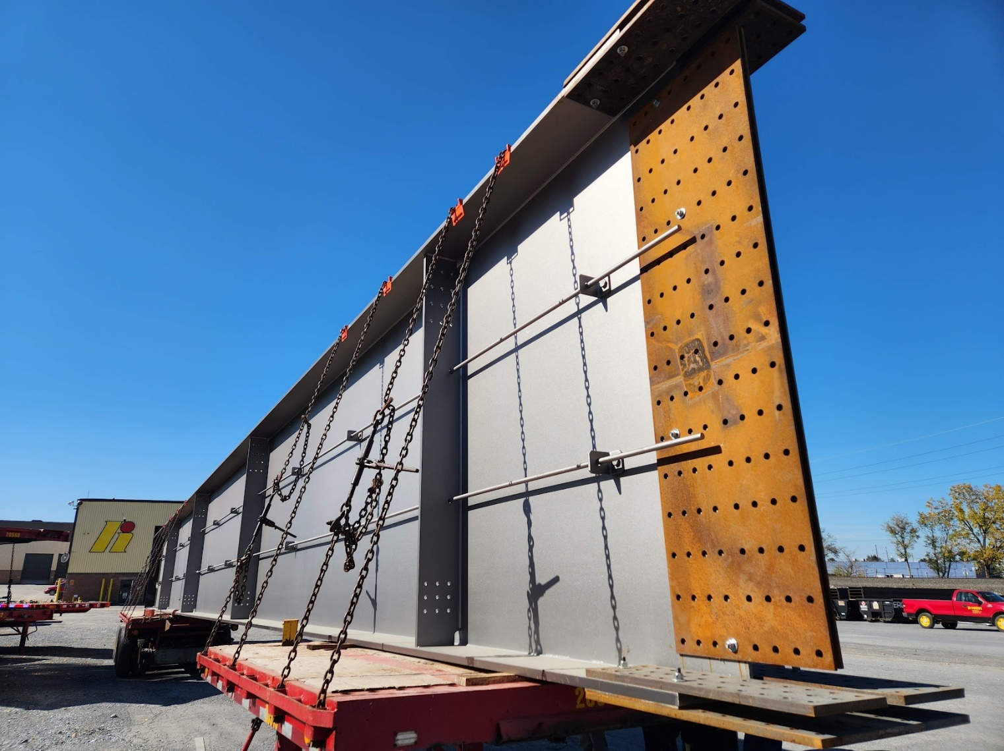
Splices and Connections – General (LRFD 6.13)
Bolted connections, LRFD 6.13.2. Welded connections, LRFD 6.13.3.
Articles 6.13.4 and 6.13.5 deal with the topics of block shear rupture resistance and the design of connection elements (e.g., splice plates, gusset plates and lateral connection plates) for tension and shear, respectively (Lesson 12).
Where practical, connections should be made symmetrical about the axis of the members.
Members, including bracing, should be connected so that their gravity axes will intersect at a point.
Eccentric connections should be avoided, however, where this is not possible, the members and connections must be designed for the combined effects of the shear and moment due to the eccentricity.
Bolted connections, except for connections on lacing and handrails, are to contain not less than two bolts.
Notes:
The design of splices and connections is covered in AASHTO LRFD Article 6.13. The design of bolted connections is covered in AASHTO LRFD Article 6.13.2. The design of welded connections is covered in AASHTO LRFD Article 6.13.3. AASHTO LRFD Articles 6.13.4 and 6.13.5 deal with the topics of block shear rupture resistance and the design of connection elements (e.g., splice plates, gusset plates and lateral connection plates) for tension and shear, respectively. These topics are covered in greater detail in Lesson 12.
Where practical, connections should be made symmetrical about the axis of the members. Members, including bracing, should be connected so that their gravity axes will intersect at a point. Eccentric connections should be avoided, however, where this is not possible, the members and connections must be designed for the combined effects of the shear and moment due to the eccentricity. Bolted connections, except for connections on lacing and handrails, are to contain not less than two bolts.
End connections of stringers, floorbeams and girders should be connected with high-strength bolts. Where bolting is not practical, welded connections may be used, but they must be designed for the vertical loads and any bending moment resulting from restraint against end rotation. The thickness of end connection angles of stringers, floorbeams, and girders is not to be less than 0.375 in. End connections for stringers, floorbeams, and girders should be made with two angles.
There are some additional requirements that should also be considered for diaphragms (Lesson 10). As specified in AASHTO LRFD Article 6.7.4.2, end moments in diaphragms must be considered in the design of the connection between the beam or girder and the diaphragm.
A bolted field splice for a welded plate girder is shown in the photo on this slide along with miscellaneous connections for an inspection handrail and the connection plate for a cross-frame.
Photo credit: Russo Structural Services

Slide 6
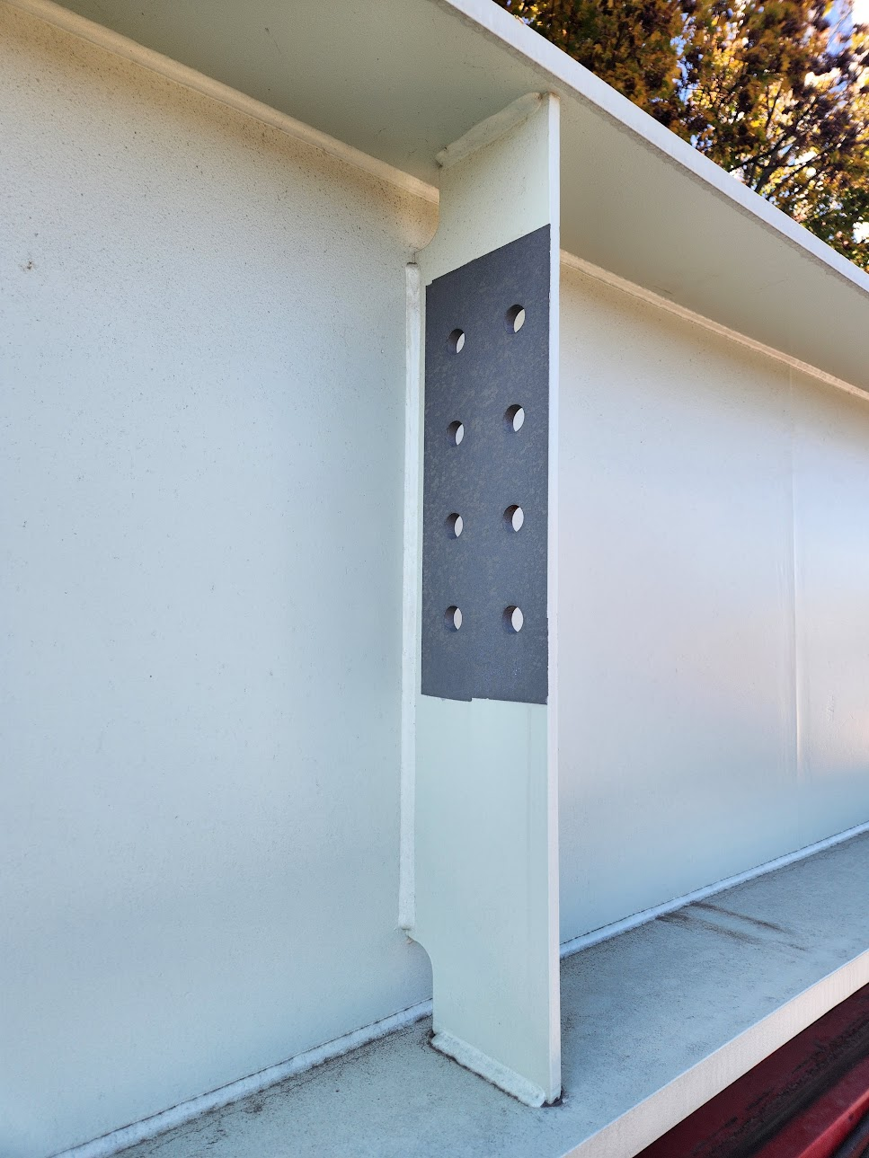
Splices and Connections - General
Except as specified in the succeeding bulleted items on this slide and the next, connections and splices for primary members subject only to axial tension or compression are to be designed at the strength limit state for not less than the larger of (AASHTO LRFD Article 6.13.1):
  The average of the factored axial force effect at the point of splice or connection and the factored axial resistance of the member or element at the same point, or
  75 percent of the factored axial resistance of the member or element
Connections and splices for primary members subjected to combined force effects, other than splices for flexural members, are to be designed at the strength limit state for the larger of (AASHTO LRFD Article 6.13.1):
  The calculated combined factored force effects, or
  75 percent of the factored axial resistance of the member determined as specified in AASHTO LRFD Articles 6.8.2 or 6.9.2, as applicable (Lesson 12).
Notes:
AASHTO LRFD Article 6.13.1 specifies that except as specified in the succeeding bulleted items (on this slide and the following slide), connections and splices for primary members subject only to axial tension or compression are to be designed at the strength limit state for not less than the larger of: 1) the average of the factored axial force effect at the point of splice or connection and the factored axial resistance of the member or element at the same point; or 2) 75 percent of the factored axial resistance of the member or element.
Furthermore, connections and splices for primary members subjected to combined force effects, other than splices for flexural members, are to be designed at the strength limit state for the larger of: 1) the calculated combined force effects; or 2) 75 percent of the factored axial resistance of the member determined as specified in AASHTO LRFD Articles 6.8.2 or 6.9.2, as applicable (Lesson 12). Connections and splices for primary members subjected to force effects acting in multiple directions due to combined loading, such as members in rigid frames, arches, and trusses, are to be designed for the larger of the calculated combined factored force effects, preferably determined using concurrent forces or conservatively determined using envelope forces if only such forces are available, or 75 percent of the factored axial resistance of the member.
The 75 percent resistance requirement is retained from past specifications to provide a minimum level of stiffness and to be consistent with past practice for the design of connections and splices for axially loaded members.
The connection for a diaphragm is shown in the photo on this slide. The faying surface is not painted to provide a better friction coefficient for a slip-critical connection (discussed later in this lesson).
Photo credit: Russo Structural Services

Slide 7
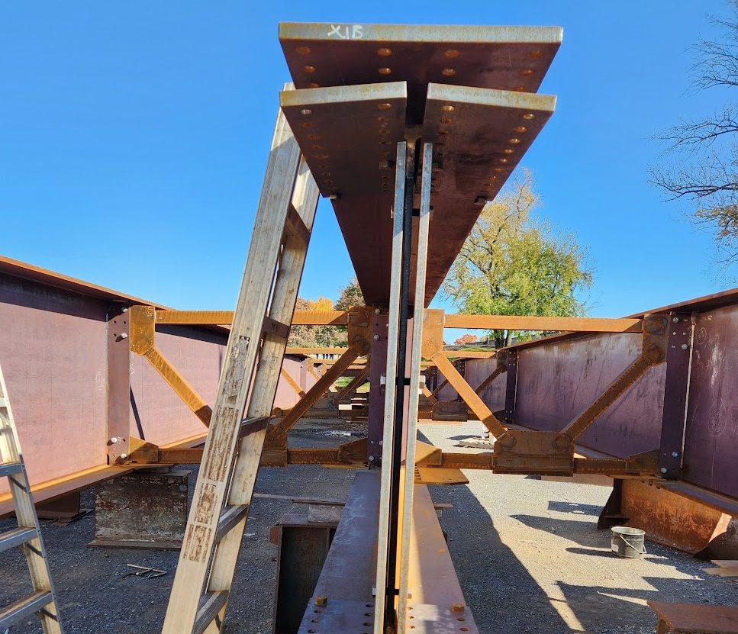
Splices and Connections - General
Bolted splices for flexural members are to be designed at the strength limit state as specified in AASHTO LRFD Article 6.13.6.1.3.
Welded splices for flexural members are to be designed at the strength limit state as specified in AASHTO LRFD Article 6.13.6.2.
Where diaphragms, cross-frames, lateral bracing, stringers, or floorbeams for straight or horizontally-curved flexural members are included in the structural model used to determine force effects, or alternatively, are designed for explicitly calculated force effects from the results of a separate investigation:
  End connections for these bracing members are to be designed for the calculated factored member force effects.
  Otherwise, the end connections for these members are to be designed according to the 75 percent resistance provision.
Notes:
AASHTO LRFD Article 6.13.1 further specifies that bolted splices for flexural members are to be designed at the strength limit state as specified in AASHTO LRFD Article 6.13.6.1.3 (discussed in lesson 11B). Welded splices for flexural members are to be designed at the strength limit state as specified in AASHTO LRFD Article 6.13.6.2.
Where diaphragms, cross-frames, lateral bracing, stringers, or floorbeams for straight or horizontally curved flexural members are included in the structural model used to determine force effects, or alternatively, are designed for explicitly calculated force effects from the results of a separate investigation: 1) End connections for those bracing members are to be designed for the calculated factored member force effects. 2) Otherwise, the end connections for the members are to be designed according to the 75 percent resistance provision.
The preceding exception for bracing members in straight or horizontally curved girder bridges that are included in the structural model used to determine force effects is a result of previous experience with end connection details for these members that were developed according to past specifications, which had invoked the 75 percent and average load provisions given on the preceding slide for the design of the end connection details. These details tended to become so large as to be unwieldy resulting in large eccentricities and force concentrations. It was decided that the negatives associated with these connections justified the permitted exception. Cross-frames and diaphragms are typically included in the structural model when refined analysis methods are employed. An example of “explicitly calculated force effects resulting from a separate investigation” might be a case where wind-load forces effects in the bracing members are estimated from separate hand calculations.
A bolted field splice for a welded I-girder is shown in the photo on this slide. The splice plates for the top flange include a single outer pate and two inner plates. Two web plates are used. They are loosely connected to the girder with bolts for shipping. Cross-frames are bolted to the girder in the background to check for fit.
Photo credit: Russo Structural Services

Slide 8
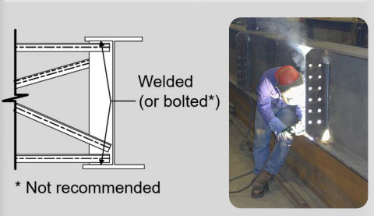
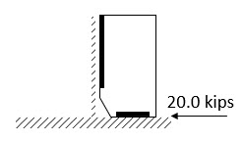
Connection Plates
The term connection plate is given to a transverse stiffener attached to the girder to which a cross-frame or diaphragm is connected.
Transverse connection plates for cross-frames and diaphragms must be positively attached to both flanges of the cross-section (AASHTO LRFD Article 6.6.1.3.1 – Lesson 7). An exception shown on the next slide is permitted.
Fillet weld connections are preferred. Bolted connections to the flanges may also be used but these are not recommended as they are generally more expensive to fabricate.
The welded or bolted connection in straight, nonskewed bridges should be designed for a minimum of a factored 20-kip lateral force, unless the lateral force is available from a structural analysis model. For straight, skewed bridges, or for curved bridges, it is recommended that the force be determined instead by analysis (AASHTO LRFD Article 6.6.1.3.1 – Lesson 7).
Source: NHI Web-Based Training Course (Lesson 130081D)
Notes:
The term connection plate is given to a transverse stiffener attached to the girder to which a cross-frame or diaphragm is connected. AASHTO LRFD Article 6.6.1.3.1 specifies that transverse connection plates for cross-frames and diaphragms must be positively attached to both flanges of the cross-section to provide rigid load paths that preclude the development of significant distortional bending stresses in web gaps that could potentially induce fatigue crack growth (Lesson 7). An exception to this requirement for diaphragm connections is discussed on the next slide.
Fillet weld connections are preferred. Previously, welding to tension flanges was forbidden, but these welds have been shown to provide Category C′ fatigue resistance (Lesson 7). Bolted connections to the flanges may also be used (Category B) but these are not recommended as they are generally more expensive to fabricate, and the load-induced fatigue performance is not significantly improved as the connection plate-to-web weld termination immediately above or below the bolted connection is also a Category C′ detail. Transverse connection plates attached to both flanges also contribute to the overall torsional resistance of the cross-section at the brace points, which is particularly important when more shallow diaphragm sections are used.
It is also important to ensure that where the cross-frame chords or diaphragm flanges are not attached directly to the girder flanges that provisions be made to transfer the calculated horizontal force in the cross-frame chords or diaphragm flanges to the girder flanges through the connection plates, which must be positively attached to both girder flanges. This is particularly significant when large restoring forces are developed in the transverse bracing members. The eccentricity between the cross-frame chords or diaphragm flanges and the girder flanges should be recognized in the design of the connection plates and their connection to the web and flanges of the girders. To ensure that the connection is not undersized, particularly at locations where larger out-of-plane forces may develop, it is recommended in AASHTO LRFD Article 6.6.1.3.1, that the welded or bolted connection in straight, nonskewed bridges be designed for a minimum of a factored 20-kip lateral force, unless the lateral force is available from a structural analysis model (Lesson 7). For straight, skewed bridges, or for curved bridges, it is recommended that the force be determined instead by analysis.

Slide 9
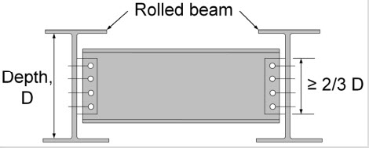
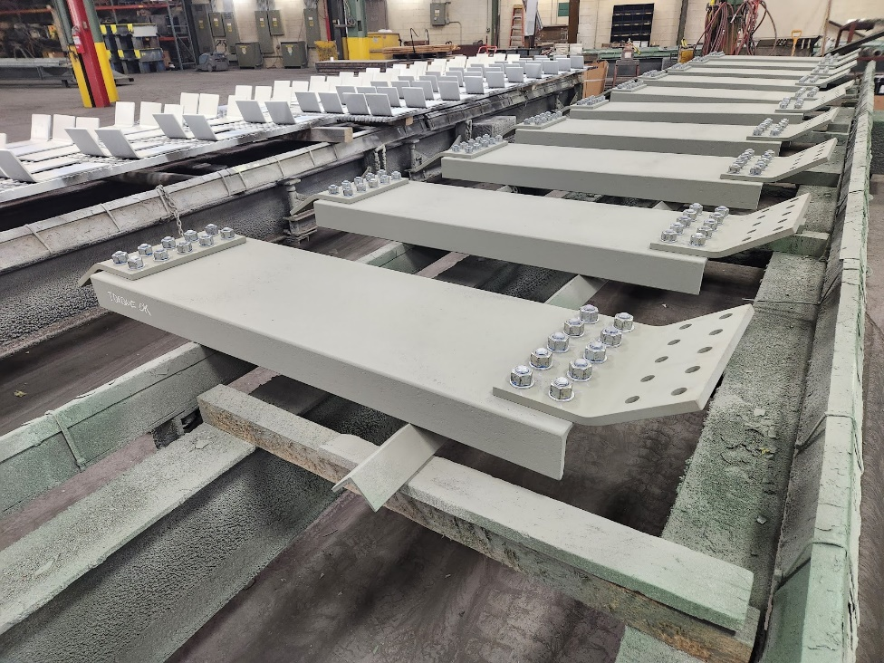
Diaphragm Connections
Some states still prefer attaching end angles to diaphragm sections in the shop for field bolting directly to the beam web, which eliminates the need for transverse connection plates.
AASHTO LRFD Article 6.6.1.3.1 permits the use of this detail for intermediate diaphragms on straight rolled-beam bridges.
The supports must be normal or skewed not more than 10 degrees from normal, and the intermediate diaphragms must be placed in contiguous lines parallel to the supports. In this case, the end connection angles must be at least two-thirds the depth of the web to provide some additional torsional resistance to the beam.
Some additional requirements are also spelled out for these connections in the specifications (AASHTO LRFD Article 6.6.1.3.1).
For more highly skewed connections, a bent plate is commonly used.
Source: NHI Web-Based Training Course (Lesson 130081D)
Notes:
Some states still prefer attaching end angles to diaphragm sections in the shop for field bolting directly to the beam web, which eliminates the need for transverse connection plates. AASHTO LRFD Article 6.6.1.3.1 permits the use of this detail for intermediate diaphragms on straight rolled-beam bridges. The supports must be normal or skewed not more than 10 degrees from normal, and the intermediate diaphragms must be placed in contiguous lines parallel to the supports. In this case, the end connection angles must be at least two-thirds the depth of the web to provide some additional torsional resistance to the beam.
Some additional requirements are also spelled out for these connections in the specifications. For bolted angles, a minimum gap of 3.0 in. is to be provided between the top and bottom bolt holes and each flange. Bolt spacing requirements specified in AASHTO LRFD Article 6.13.2.6. For welded angles or plates, a minimum gap of 3.0 in. is to be provided between the top and bottom of the end-angle or plate welds and each flange; the heel and toe of the end angles or both sides of the connection plate, as applicable, is to be welded to the beam web. Welds are not to be placed along the top and bottom of the end angles or connection plates.
For more highly skewed connections, a bent plate is commonly used as shown in the photo on this slide.

Slide 10
Design of Welded Joints
GENERAL
Notes:
The lesson will now move on to focus specifically on the design of welded joints. This portion of the lesson will discuss some general considerations related to the design of welded joints; namely, examples of some typical welded joints in steel-girder bridges, the types of welds, the types of welded joints, the control of welding distortion, potential weld defects, weld inspection and control, the fatigue resistance of welded connections, and a general discussion on the factored resistance of welded connections.

Slide 11
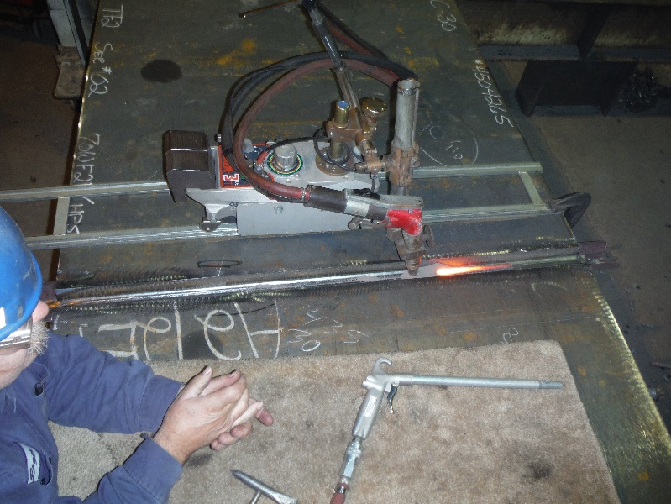
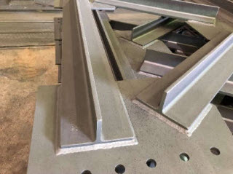
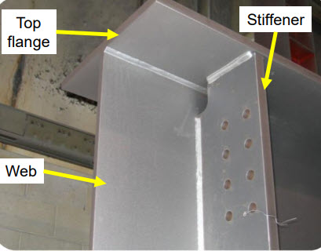
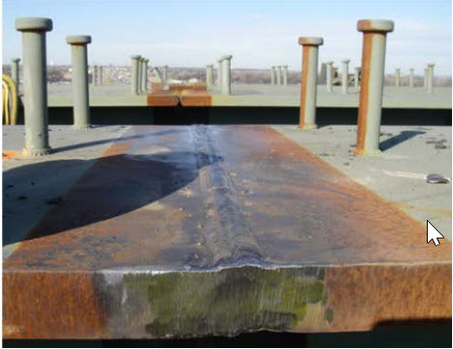
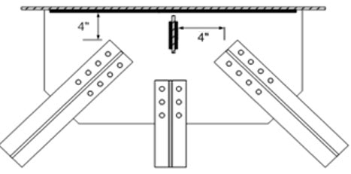
Typical Welded Joints
Shop-welded butt (CJP) weld
Cross-frame member to gusset plate weld
(fillet welds)
Flange-to-web weld; transverse stiffener-to-flange weld; transverse stiffener-to-web weld
(fillet welds)
Field-welded flange splice
(CJP weld)
Lateral bracing connection plate to web and to stiffener welds (fillet welds)
Notes:
This slide illustrates some typical welded joints in a steel bridge, including a flange-to-web weld, a transverse stiffener-to-flange weld and a transverse stiffener-to-web weld (all fillet welds – the most common weld used in the steel-bridge construction); a cross-frame member to gusset plate weld (fillet welds); a lateral bracing connection plate to web and to stiffener welds (fillet welds); a shop-welded flange butt weld (a complete joint penetration or CJP weld); and a field-welded flange splice (a CJP weld).
The introduction of welding has led to significant advancements in steel-bridge design and fabrication. Welding is now used for the vast majority of shop connections. Welded connections are usually neater in appearance than bolted connections. Welded connections also allow the Engineer more freedom to be innovative and build-up cross-sections to transmit the loads in the most efficient manner.

Slide 12
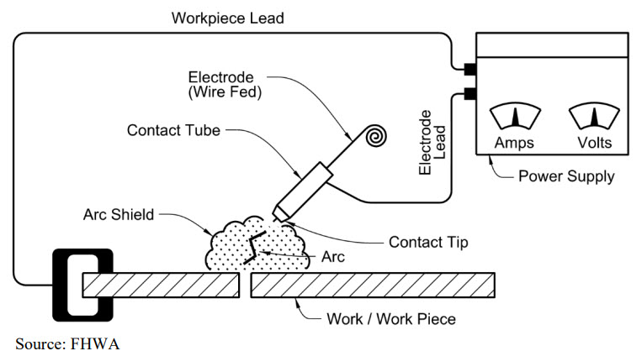

Design of Welded Joints – General
Welded connections are used to join two or more structural elements together using welds such that the connected element is sufficient to transfer the design moment, shear, or axial force between the two structural elements.
There are approximately forty different welding processes. However, arc welding is the most common process used in steel-bridge fabrication.
When using arc welding, electrical energy in the form of an electric arc is introduced to generate the heat necessary for welding. The heat of the electric arc melts a consumable electrode and the parts of the material being joined. A welded joint results from the cooling and solidification of the fused material.
To protect the molten region from impurities, the zone to be welded is typically shielded in an atmosphere supplied by a flux, which may be a fusible coating on the welding rod, a fusible powder spread over the line of the weld, or a gas sprayed over the weld.
www.fhwa.dot.gov/bridge/steel.cfm
Notes:
Welded connections are used to join two or more structural elements together using welds such that the connected element is sufficient to transfer the design moment, shear, or axial force between the two structural elements.
Although there are some forty different welding processes, arc welding, in which electrical energy in the form of an electric arc is introduced to generate the heat necessary for welding of carbon and low-alloy steels, is the most common process used in steel-bridge fabrication. The heat of the electric arc as the current passes through the system simultaneously melts a consumable electrode (deposited as filler material) and the parts of the material being joined, with the joint resulting from the cooling and solidification of the fused material. To protect the molten region from impurities, the zone to be welded is typically blanketed in an atmosphere supplied by a flux, which may be a fusible coating on the welding rod, a fusible powder spread over the line of the weld, or a gas sprayed over the weld. To produce a weld of the desired quality, the properties of the electrode must be carefully controlled. Proper control of the current and voltage along with a skilled welder are also required to produce a quality weld.
The figure on this slide shows a typical arc-welding circuit with a wire-fed electrode; such processes include submerged arc welding (SAW), flux-cored arc welding (FCAW), and gas metal arc welding (GMAW). A similar circuit is used for a manual (stick) electrode – a process known as shielded metal arc welding (SMAW). Other processes that are used on steel bridges include narrow-gap improved electroslag welding (NGI-ESW), and stud welding (SW). Note that the Engineer does not typically specify the welding process to be used or the exact filler metal (electrode/flux material) to be employed. These decisions are usually left with the fabricator. However, a basic understanding of the commonly used welding processes and corresponding AWS filler-metal designations is helpful.
More in-depth information on the various welding processes, welding positions, and AWS filler-metal designations is contained in the FHWA Bridge Welding Reference Manual shown on this slide (www.fhwa.dot.gov/bridge/steel.cfm). This Manual is a comprehensive resource on all aspects of bridge welding and is a valuable reference to supplement and expand on the material provided herein.

Slide 13
Weldability
The weldability of structural steel is primarily controlled by its carbon content. While carbon (C) is beneficial to the strength of the steel, it is detrimental to ductility. A high carbon content combined with the heat generated during welding may cause a brittle zone in which weld cracks may develop. A carbon content of about 0.20 percent results in a very weldable steel.
In certain steels, the addition of alloys to enhance the strength and/or corrosion resistance can increase the hardness of the steel. Increased hardness results in an increased likelihood of brittle zones forming. The carbon equivalent (%CE) is the most common guide used to approximately evaluate the weldability of alloy steels against that of plain carbon steels:
Most of the bridge steels specified in the ASTM A709 Specification can be welded without special precautions or procedures. However, special procedures should be followed to improve weldability and ensure high-quality welds when high-performance steels (HPS) and ASTM A709 Grade 50CR steel are used (Lesson 1).
Notes:
The weldability of a steel is a measure of the ease of producing a crack-free and sound structural joint. The weldability of structural steel is primarily controlled by its carbon content. While carbon (C) is beneficial to the strength of the steel, it is detrimental to ductility. A high carbon content combined with the heat generated during welding may cause a brittle zone in which weld cracks may develop. A carbon content of about 0.20 percent results in a very weldable steel.
In certain steels, the addition of alloys to enhance the strength and/or corrosion resistance can increase the hardness of the steel. Increased hardness results in an increased likelihood of brittle zones forming. Higher concentrations of carbon and other alloying elements such as manganese (Mn), chromium (Cr), silicon (Si), molybdenum (Mo), vanadium (V), copper (Cu) and nickel (Ni) tend to increase the hardness and decrease the weldability of the steel. Each of these alloying elements tends to influence the hardness and weldability of the steel to different magnitudes. The carbon equivalent (%CE), given by the equation shown on this slide, is the most common guide used to approximately evaluate the weldability of alloy steels against that of plain carbon steels. For %CE less than 14 percent, the steel is considered to have excellent weldability. For %CE between 14 and 45 percent, modest preheat and low hydrogen electrodes become necessary. For %CE greater than 45 percent, weld cracking is likely; therefore, larger preheats and low hydrogen electrodes are required. Weldability should be determined on the basis of actual rather than specified chemical compositions as compositions listed on actual mill certification reports are typically below the maximum alloy contents set by the specifications.
Most of the bridge steels specified in the ASTM A709 Specification can be welded without special precautions or procedures. However, special procedures should be followed to improve weldability and ensure high-quality welds when high-performance steels (HPS) and ASTM A709 Grade 50CR (and other grades of stainless steels) are used (Lesson 1).

Slide 14
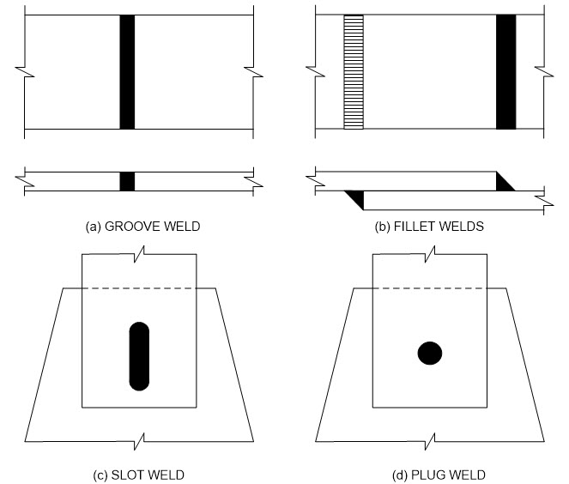
Types of Welds
There are four basic types of welds – groove, fillet, slot, and plug. Fillet welds represent the largest percentage of welds used in welded bridge construction and are the most common welds for bracing member connections.
Because of fatigue concerns, slot and plug welds are rarely (if ever) used in bridge construction, and then, only to resist compression or shear stress.
The Engineer will typically use welding symbols to convey a minimum amount of information to the fabricator/detailer regarding the welded connection on the design drawings (e.g., type and size of weld, etc.).
Notes:
There are four basic types of welds – groove, fillet, slot, and plug, as shown in the figure on this slide. Fillet welds represent the largest percentage of welds used in welded construction and are the most common welds for bracing member connections in steel-girder bridges. Slot and plug welds are primarily used in lap joints in combination with fillet welds to assist in transmitting the shear when the size of the connection limits the length available for fillet or other edge welds. Slot and plug welds can also help prevent the overlapping parts from buckling. However, because of fatigue concerns, slot and plug welds are rarely (if ever) used in bridge construction, and then, only to resist compression or shear stress; therefore, they are not covered any further in this course. Groove and fillet welds will be discussed in more detail later in this topic.
The Engineer will typically use welding symbols to convey a minimum amount of information to the fabricator/detailer regarding the welded connection on the design drawings (e.g., type and size of weld, etc.). The fabricator/detailer will then provide welding symbols for the same connection, often conveying more detailed information about the connection, on the shop drawings for review and approval by the Engineer (Lesson 1). Therefore, the Engineer should have a complete understanding of weld symbols. Welding symbols should be used to communicate and not to confuse. AASHTO LRFD Article 6.13.3.1 specifies that all welding symbols must conform to those specified in the American Welding Society (AWS) A2.4. More detailed information on weld symbols may be found in the FHWA Bridge Welding Reference Manual (Slide 12), the AASHTO/AWS D1.5M/D1.5 Bridge Welding Code (Slide 25), and most any structural steel textbook.
If a particular welded connection is used in many different parts of the structure, it may only be necessary to show a typical detail utilizing the welding symbols. For special complex or confusing connections, additional sketches may be necessary to indicate what is required.

Slide 15
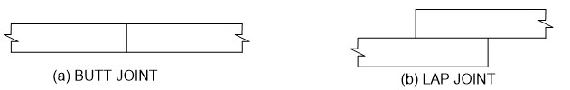
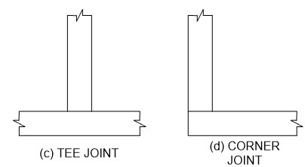
Types of Welded Joints
There are four basic types of welded joints commonly used in steel-bridge construction – butt, lap, tee, and corner joints.
  Butt Joints - used to join the ends of flat plates together (e.g., girder flange and web shop splices).
  Lap Joints – primary joint type used in bracing member connections.
  Tee Joints - used to fabricate built-up sections, or in general, any pieces framing in at right angles (e.g., plate girder web-to-flange connections, stiffener-to-web connections, hangers, brackets).
  Corner Joints - typically used to form built-up noncomposite rectangular closed box sections.
Notes:
There are four basic types of welded joints commonly used in steel-bridge construction – butt, lap, tee, and corner joints. The joint type does not necessarily imply a specific type of weld. The selection of the weld type for certain types of joints (e.g., tee and corner joints) is usually dictated by the loading type and magnitude.
Butt joints are used to join the ends of flat plates together (e.g., girder flange and web shop splices). Butt joints in tension subject to fatigue loading are best made with complete penetration groove welds with the weld reinforcement removed. When subject to compression or shear only, partial penetration groove welds may be used providing adequate throats can be developed. Complete and partial penetration groove welds will be discussed later in this lesson. The principal disadvantage of butt joints is that the connected edges typically require special preparation (i.e., beveling or grinding), and must be carefully aligned prior to welding.
Lap joints do not require quite the preciseness in fabrication as other types of joints. The edges of the joined pieces are usually sheared or flame cut and do not require any special edge preparation. Lap joints utilize fillet welds and are the primary joint type for bracing member connections.
Tee joints are used to fabricate built-up sections, or in general, any pieces framing in at right angles (e.g., plate girder web-to-flange connections, stiffener-to-web connections, hangers, brackets). For tee joints subject to longitudinal shear, fillet welds are usually the most economical option when the fillet weld leg size is less than ¾ in. As larger throats are required, partial penetration groove welds are the most cost-effective option. Complete penetration groove welds are not recommended for use in tee joints because of the relatively high cost and resulting welding deformations.
Corner joints are typically used to form built-up noncomposite rectangular closed box sections. For corner joints, internal access to the box section has a major influence on the weld selection. The AASHTO/NSBA Steel Bridge Collaboration G12.1 Guideline document (www.aisc.org/nsba) discusses suggested details for welding of corner joints in closed box configurations. Corner joints should be carefully detailed to prevent the possibility of lamellar tearing (Lesson 1 – Slide 81).

Slide 16
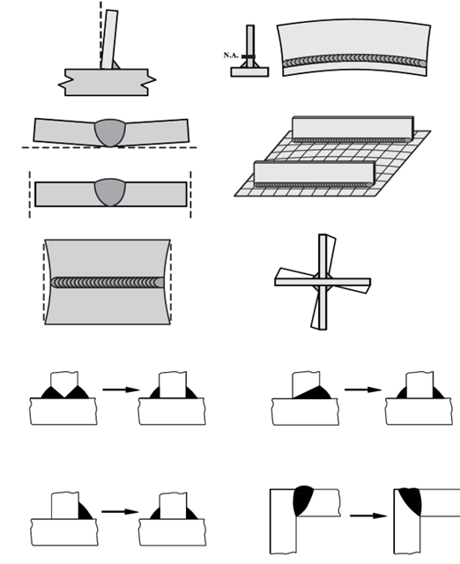
Control of Distortion
Weld metal shrinkage can result in distortion due to the non-uniform expansion and contraction of the weld metal and the adjacent base metal during the heating and cooling cycles of the welding process. In heavily restrained materials, the strains induce stresses that can potentially lead to cracking.
The Engineer can design welded assemblies to help minimize the amount of distortion. Reducing the amount of weld metal will decrease the amount of distortion. Therefore, the smallest acceptable weld size should be used. Symmetry in welding is also important in minimizing distortion. Consider using double-sided joints versus single-sided joints where practical.
The Fabricator can also use techniques to help minimize distortion. Using as few weld passes as possible can help limit the number of heating and cooling cycles and the resulting accumulation of shrinkage stresses. A well-planned welding sequence can help to balance the shrinkage forces. To help minimize shrinkage and ensure adequate ductility, the AWS has established minimum preheat and minimum and maximum interpass temperatures.
Notes:
Weld metal shrinkage can result in distortion due to the non-uniform expansion and contraction of the weld metal and the adjacent base metal during the heating and cooling cycles of the welding process. As the weld metal cools and contracts, the resulting strains can cause distortion if the surrounding base material is free to move. In heavily restrained materials, the strains induce stresses that can potentially lead to cracking.
The Engineer can design welded assemblies to help minimize the amount of distortion. Reducing the amount of weld metal will decrease the amount of distortion. Therefore, the smallest acceptable weld size should be used. Symmetry in welding is also important in minimizing distortion. Consider using double-sided joints versus single-sided joints where practical. Balancing welds about the planes of symmetry of the cross-section can help the shrinkage forces from one set of welds counteract the shrinkage forces from the other set. Unbalanced welds removed from the neutral axis can cause longitudinal camber or sweep of the member.
The Fabricator can also use techniques to help minimize distortion. Using as few weld passes as possible can help limit the number of heating and cooling cycles and the resulting accumulation of shrinkage stresses. A well-planned welding sequence can help to balance the shrinkage forces. Parts to be welded may be pre-cambered prior to welding so that the parts will be drawn back into the proper alignment as weld shrinkage occurs. Use of low heat input welding procedures that utilize high currents and high travel speeds can reduce the size of the heat affected zone and the amount of distortion.
To help minimize shrinkage and ensure adequate ductility, the AWS has established minimum preheat and minimum and maximum interpass temperatures. Preheat refers to the temperature of the steel immediately before the arc is struck on the steel. Preheat slows the cooling rates in the heat affected zone to prevent hardening and potential heat affected zone cracking. Interpass temperatures are measured after the welding (or the welding for each pass) has begun. The required minimum interpass temperature should be the same as the minimum specified preheat. The minimum interpass temperature is the temperature below which welding should not be done unless additional heat is added to raise the temperature of the steel. Large weldments and long joints can fall below the minimum interpass temperature before starting the next pass necessitating the addition of more heat before welding can resume. The maximum interpass temperature is the temperature beyond which welding should not be performed. Small weldments and short joints can exceed the maximum interpass temperature, in which case welding must stop until the joint is cooled down to an acceptable level.

Slide 17
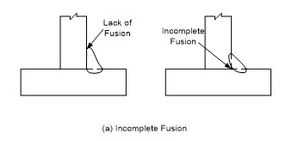
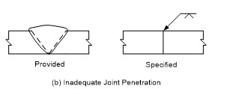
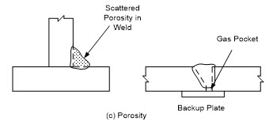
Potential Weld Defects
Discontinuities within a weld may result from a number of potential defects unless good welding techniques and practices are followed. The most common defects are reviewed in the following:
  Incomplete fusion - results due to failure of the base metal and weld metal to fuse together properly.
  Inadequate joint penetration - associated primarily with groove welds and occurs when CJP groove welds are specified, and the weld extends a shallower distance through the depth of the groove than specified.
  Porosity - occurs when voids or a number of small gas pockets are trapped in the weld during cooling.
Notes:
Discontinuities within a weld may result from a number of potential defects unless good welding techniques and practices are followed. The most common defects are reviewed on this slide and the next.
Incomplete fusion results due to failure of the base metal and weld metal to fuse together properly. Potential causes of incomplete fusion include the use of welding equipment with insufficient current so that the base metal does not reach its melting point, too rapid a rate of welding, and surfaces to be joined that are contaminated or coated with mill scale, slag, oxides or other foreign material.
Inadequate joint penetration is associated primarily with groove welds and occurs when CJP groove welds are specified, and the weld extends a shallower distance through the depth of the groove than specified. This defect can result from the use of insufficient welding current, too rapid a rate of welding, excessively large electrodes, or the use of an improper groove design for the selected welding process. The use of the pre-qualified joints given by AWS, or joints that have a proven history of acceptable performance that can be used without again proving their adequacy by test, can help to minimize such defects. The specified combination of root opening, included angle, applicable thickness, etc. in a pre-qualified joint helps to ensure adequate fusion, welder access and joint penetration. Specified tolerances may be applied to pre-qualified joints. When the actual joint detail fits within those tolerances, the joint is considered pre-qualified. Otherwise, the joint requires qualification by test. The fabricator/detailer will typically select the proper pre-qualified joint for a particular application and show it on the shop drawings.
Porosity in a weld occurs when voids or a number of small gas pockets are trapped in the weld during cooling. The porosity may be scattered through the weld or concentrated as a large pocket at the root of a fillet weld, or at the root of a groove weld adjacent to a backup plate. Porosity typically results from using too long of an arc or an excessively high current.

Slide 18
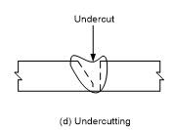
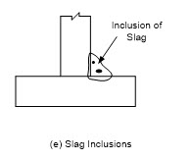
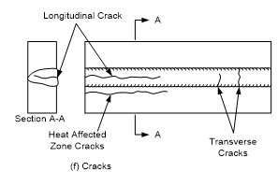
Potential Weld Defects
  Undercutting - results when a groove is melted into the base material adjacent to a fillet weld toe or into the weld itself and is left unfilled by weld metal.
  Slag inclusions - result when the slag that forms during the welding process, which has a lower density than the molten weld metal and normally floats to the surface, is trapped within the weld due to too rapid a cooling of the joint.
  Weld cracks - result from internal shrinkage strains that occur as the weld metal cools.
Notes:
Undercutting results when a groove is melted into the base material adjacent to a fillet weld toe or into the weld itself and is left unfilled by weld metal. This defect usually results from the use of excessive current, or too long of an arc, and can usually be corrected by depositing additional weld metal.
Slag inclusions result when the slag that forms during the welding process, which has a lower density than the molten weld metal and normally floats to the surface, is trapped within the weld due to too rapid a cooling of the joint. In multiple pass welds, the slag must be removed by the welder in-between each pass. Otherwise, slag inclusions may result. Overhead welds are particularly susceptible to slag inclusions.
Weld cracks, which are the most significant of the weld defects, result from internal shrinkage strains that occur as the weld metal cools. Weld cracks, as distinguished from weld failures that may occur due to underdesign, overload or fatigue, typically occur close to the time of fabrication. Hot cracks are cracks that occur at elevated temperatures and are usually related to solidification as cooling begins to occur and can usually be prevented by more uniform heating and slower cooling. Cold cracks are cracks that occur after the weld metal has cooled to ambient temperature and may be related to the effects of hydrogen, restraint to shrinkage and distortion, and the formation of a brittle martensite microstructure. Cold cracking typically occurs in low-alloy steels and can be minimized through the use of low-hydrogen electrodes, use of the proper preheating and interpass temperatures, careful attention to welding sequences and procedures, use of the proper filler material, and in some cases, post-weld heat treatment.
Weld cracks may be characterized as centerline (or longitudinal) cracks, heat affected zone cracks, and transverse cracks, as shown in the bottom right figure on this slide. Centerline cracking is a separation occurring in the center of a given weld bead. Heat affected zone cracking (also known as delayed or underbead cracking) is a separation occurring immediately adjacent to the weld bead in the base material. This region, termed the heat affected zone (HAZ), results from the thermal cycle experienced by this region during welding. In base material with higher carbon and carbon equivalency levels, the HAZ is susceptible to increased hardness and reduced ductility upon cooling, which can increase the probability of HAZ cracking. Hydrogen on the steel, electrode, shielding material or in the atmosphere that is dissolved in the molten weld metal can also contribute to HAZ cracking in low-alloy steels that are subject to such cracking. Transverse cracking is a separation occurring within the weld metal perpendicular to the direction of travel. It is generally associated with weld metal that is high in strength that significantly overmatches the base metal and is the least frequently encountered type of cracking. More detailed information on these potential weld defects may be found in the FHWA Bridge Welding Reference Manual (Slide 12).

Slide 19
Inspection and Control
Welding Procedure Specifications (WPS) are developed by welding engineers or technicians to communicate to the welders and inspectors the various parameters under which the welding is to be performed. The procedures are then tested to ensure their validity.
The supporting test data for a particular welding procedure is contained in a Procedure Qualification Record (PQR). All welders should be pre-qualified; that is, they must pass an AWS Qualification Test prior to making a structural connection. Fabricators must also be certified according to the AISC quality certification program for steel structure fabricators and erectors.
Welds must be inspected to ensure that they comply with the requirements of a given specification. Discontinuities are irregularities in the weld that may or may not be acceptable according to a given specification, whereas defects are discontinuities that are rejectable according to a given specification.
A qualified welding inspector can utilize six primary non-destructive evaluation (NDE) methods to locate and evaluate weld discontinuities, which are described briefly on the next three slides.
Notes:
The success of welding in steel bridge construction can be attributed to the inspection and control procedures that have been implemented to ensure the production of a sound quality weld.
Welding Procedure Specifications (WPS) are developed by welding engineers or technicians to communicate to the welders and inspectors the various parameters under which the welding is to be performed. The WPS is essentially the recipe for making a particular weld and should be made available to the welder and inspector near the point of welding for easy referral. The procedures are then tested to ensure their validity.
The supporting test data for a particular welding procedure is contained in a so-called Procedure Qualification Record (PQR). The tests typically include bend tests, transverse tension tests, all-weld-metal tension tests, Charpy impact tests, and a macroetch specimen. PQRs are typically filed in the fabrication office and are not made available to the welders. All welders should be pre-qualified; that is, they must pass an AWS Qualification Test prior to making a structural connection. The AASHTO/AWS D1.5M/D1.5 Bridge Welding Code (Slide 25) and State DOT Standard Specifications also require that fabricators be certified according to the AISC quality certification program for streel structure fabricators and erectors. The certification program includes categories and associated requirements for fabrication of simple, intermediate, and advanced bridges. Certification ensures that the fabricator meets certain minimum requirements associated with achieving quality and has those practices in place.
Welds must be inspected to ensure that they comply with the requirements of a given specification. Discontinuities are irregularities in the weld that may or may not be acceptable according to a given specification, whereas defects are discontinuities that are rejectable according to a given specification. A qualified welding inspector can utilize six primary non-destructive evaluation (NDE) methods to locate and evaluate weld discontinuities. Each method has unique advantages and disadvantages, and each is described briefly on the next three slides.

Slide 20
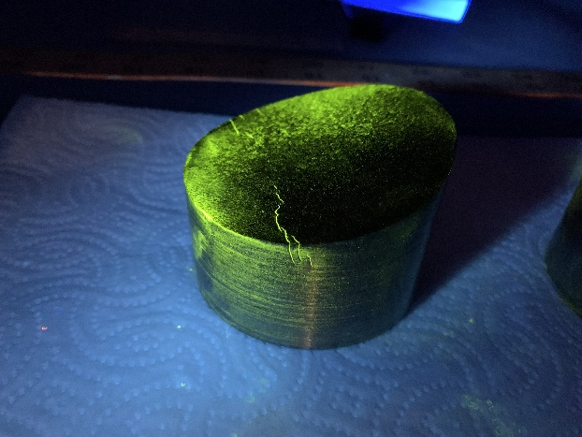
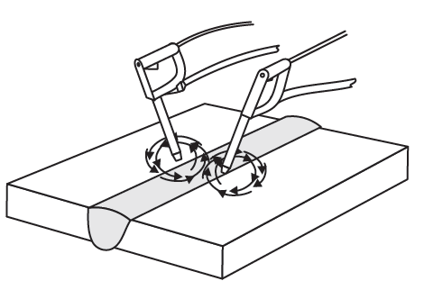
Inspection and Control
Visual Testing (VT):
All welds are required to be visually inspected.
Visual inspection must take place before, during, and after welding.
Dye Penetrant Testing (PT):
Involves the application of a liquid dye penetrant to the weld, which is drawn to a surface discontinuity (i.e., porosity or a crack) by capillary action.
Used by fabricators to check surface conditions, particularly a surface prepared for subsequent welding.
Magnetic Particle Testing (MT):
Involves the application of magnetic iron powders to the surface of the part. When a magnetic field is then applied, the change in magnetic flux that occurs in the presence of a discontinuity shows up as a different pattern within the powders.
Required for fillet and partial-joint penetration (PJP) groove welds.
MT is most effective in locating surface discontinuities, and those that are slightly subsurface and is typically used to enhance visual inspection.
Notes:
Visual Testing (VT) is the simplest inspection method. Visual inspection commences well before welding begins by examining the materials to be welded, the alignment and fit-up of the parts, joint preparation and procedural data. During welding, visual inspection can ensure compliance with procedural requirements. Upon completion of welding, the size, appearance, bead profile and surface quality of the weld can be visually inspected. All welds are required to be visually inspected.
Dye Penetrant Testing (PT) involves the application of a liquid dye penetrant to the weld, which is drawn to a surface discontinuity (i.e., porosity or a crack) by capillary action. A developer is then applied which absorbs the penetrant within the discontinuity and results in a stain indicating the presence of the discontinuity. PT is used by fabricators to check surface conditions, particularly a surface prepared for subsequent welding. A fluorescent dye penetrant photo is shown. This is used in lab settings when conducting testing on suspected cracks.
Magnetic Particle Testing (MT) involves the application of magnetic iron powders to the surface of the part. When a magnetic field is then applied, the change in magnetic flux that occurs in the presence of a discontinuity shows up as a different pattern within the powders. MT is most effective in locating surface discontinuities and those that are slightly subsurface. It is typically used to enhance visual inspection. MT is required for fillet welds and for partial-joint penetration (PJP) groove welds.

Slide 21
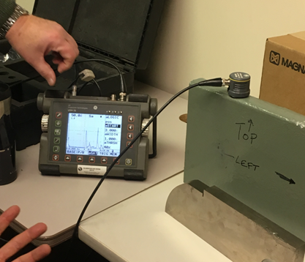
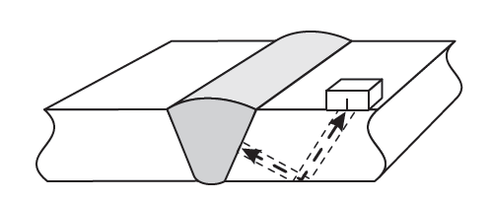
Inspection and Control
Radiographic Testing (RT):
Utilizes X-rays or gamma rays that are passed through a groove weld to expose a photographic film on the opposite side of the joint producing a permanent record for future reference.
Required for flange and web transverse complete-joint penetration (CJP) groove-welded butt splices, including splices on Nonredundant Steel Tension Members (NSTMs).
Ultrasonic Testing (UT):
Utilizes high frequency sound waves that are transmitted through the materials.
Required for complete-joint penetration (CJP) tee and corner joints. Required for flange and web groove-welded butt splices on NSTMs.
Used by fabricators to discover the depth of defects detected with RT.
Used by some Owners as an alternative to RT for flange and web groove-welded butt splices.
Notes:
Radiographic inspection (RT) utilizes X-rays or gamma rays that are passed through a groove weld to expose a photographic film on the opposite side of the joint producing a permanent record for future reference. Lower density parts (e.g., porosity, slag, and cracks) absorb less radiation than homogeneous parts and therefore will appear darker on the radiograph, which is in effect a negative. RT is required for flange and web transverse complete-joint penetration (CJP) groove-welded butt splices, including splices on Nonredundant Steel Tension Members (NSTMs). RT is generally most effective in detecting porosity and slag inclusions and requires significant skill to properly interpret the radiograph. Significant safety precautions must also be put into place in the fabrication shop since X-rays are being used.
Ultrasonic inspection (UT) utilizes high frequency sound waves that are transmitted through the materials. Discontinuity-free material will transmit the sound through the part in an uninterrupted fashion. A receiver hears the sound reflected off the back surface of the part being examined. A discontinuity between the transmitter and the back surface of the part will result in an intermediate signal being sent to the receiver. The magnitude of the signal indicates the size of the discontinuity, and the location of the discontinuity is indicated by the relationship of the signal with respect to the back surface. UT can be used to spot even small discontinuities and is generally most sensitive to cracks. UT is required for CJP tee and corner joints, and for flange and web groove-welded butt splices on NSTMs. It is often used by fabricators to discover the depth of defects detected with code-mandated RT. UT is also used by some Owners as an alternative to RT for flange and web groove-welded butt splices.
In the photo on this slide, an inspector is testing a steel plate as part of prequalification testing. UT testing is being used. A transducer is on the top edge of the plate, and the technician is reviewing the results. There are three peaks on the screen. The left peak is the echo from the transducer interface with the plate, called the initial pulse. The right-most peak is the bottom of the plate, called the backwall echo. The center peak is an internal discontinuity the inspector is evaluating.
Photo credit: Russo Structural Services

Slide 22

Inspection and Control
Phased Array Ultrasonic Testing (PAUT):
  Enhanced method of UT permitted by the AASHTO/AWS D1.5M/D1.5 Bridge Welding Code as a substitute for UT.
  Two fundamental differences between PAUT and UT are the use of multiple transducers resulting in phased sound transmission and encoding such that the inspection results are recorded electronically providing a permanent record of the examination results.
  Used by some Owners as an alternative to RT for flange and web groove-welded butt splices.
  Used on some projects for special joints, as the Owner may require.
More detailed information on each of these NDE methods of inspection is contained in the FHWA Bridge Welding Reference Manual.
www.fhwa.dot.gov/bridge/steel.cfm
Notes:
Phased Array Ultrasonic Testing (PAUT) is an enhanced method of UT permitted by the AASHTO/AWS D1.5M/D1.5 Bridge Welding Code as a substitute for UT. Two fundamental differences between PAUT and UT are the use of multiple transducers resulting in phased sound transmission and encoding such that the inspection results are recorded electronically providing a permanent record of the examination results. PAUT is used by some Owners as an alternative to RT for flange and web groove-welded butt splices. PAUT is also used on some projects for special joints, as the Owner may require.
More information on each of these NDE methods of inspection is contained in the FHWA Bridge Welding Reference Manual (www.fhwa.dot.gov/bridge/steel.cfm).

Slide 23
Fatigue Resistance of Welded Connections
LRFD Table 6.6.1.2.3-1 specifies the appropriate fatigue detail category (Lesson 7) for various types of fillet-welded connections and groove-welded connections as follows:
  Section 3 – Welded joint joining components of built-up members
  Section 4 – Welded stiffener connections
  Section 5 – Welded joints transverse to the direction of primary stress
  Section 6 – Transversely loaded welded attachments
  Section 7 – Longitudinally loaded welded attachments
  Section 8 – Orthotropic deck details
Notes:
AASHTO LRFD Table 6.6.1.2.3-1 specifies the appropriate fatigue detail category (Lesson 7) for various types of fillet-welded connections and groove-welded connections within the Sections of Table 6.6.1.2.3-1 listed on this slide.
Note that AASHTO LRFD Eq. 6.6.1.2.5-4 should also be considered in the fatigue design for base metal and weld metal at details where loaded discontinuous plate elements are connected with a pair of fillet welds or partial joint penetration groove welds on opposite sides of the plate normal to the direction of primary stress, or where partial joint penetration groove welds are transversely loaded in tension, to account for the potential of a crack initiating from the weld root.

Slide 24

Fatigue Resistance of Welded Connections
Where force effects in cross-frames or diaphragms in I-girder bridges are computed from a refined analysis, fatigue details on these members subjected to a net tensile force as specified in Article 6.6.1.2.1 are to be investigated for load-induced fatigue (AASHTO LRFD Article 6.6.1.2.2 – 10th Edition).
To determine the range of force in the cross-frame or diaphragm member under consideration from such an analysis, the single fatigue truck is to be positioned as specified in AASHTO LRFD Article 3.6.1.4.3a, but with the truck confined to a single transverse position during each passage of the truck along the bridge.
$$Δf=\frac{ΔP}{A_{e}}=\frac{ΔP}{UA_{g}}$$
E′
where:
A_{e} = effective net area of the member = UA_{g} (in.²)
A_{g} = gross cross-sectional area of the member (in.²)
ΔP = range of axial force in the member under the applicable Fatigue load combination multiplied by 0.65 (kips)
U = shear-lag reduction factor =
′
Notes:
Where force effects in cross-frames or diaphragms in I-girder bridges are computed from a refined analysis, fatigue details on these members subjected to a net tensile force as specified in AASHTO LRFD Article 6.6.1.2.1 (Lesson 7) are to be investigated for load-induced fatigue (AASHTO LRFD Article 6.6.1.2.2 – 10th Edition). To determine the range of force in the cross-frame or diaphragm member under consideration from such an analysis, the single fatigue truck is to be positioned as specified in AASHTO LRFD Article 3.6.1.4.3a (Lesson 3), but with the truck confined to a single transverse position during each passage of the truck along the bridge. The effect of positioning the fatigue truck in two different transverse positions located directly over the adjacent connected girder usually creates the largest range of force in these bracing members. However, there is an extremely low probability of trucks being simultaneously located in these two critical relative transverse positions over millions of cycles. Also, field observations have not indicated a significant problem with the details on these members caused by load-induced fatigue.
For single-angle, double-angle, or tee-section members connected to a gusset or connection plate by longitudinal fillet welds along both sides of the connected element of the member cross-section, as shown in the figure on this slide, the fatigue stress range, Δf, in the member is to be calculated using the equation shown on this slide. ΔP is the range of axial force in the member under the applicable Fatigue load combination (Lessons 3 and 7) multiplied by 0.65 (AASHTO LRFD Article 3.4.5 – 10th Edition). Evaluation of the maximum and effective stress ranges in cross-frame members of steel I-girder systems has demonstrated that the respective use of 1.75 and 0.80 load factors for Fatigue I and II is overly conservative for these members. The factor of 0.65 is based on weigh-in-motion data and analytical evaluation of cross-frames and is largely attributed to the sensitivity of transverse load position on cross-frame force response. The shear-lag reduction factor, U (Lesson 12), is multiplied by the gross area of the member, A_{g}, to provide an effective area to indirectly account for the effect of the load eccentricities in the connection. When the effective area, A_{e}, is employed, the effect of the moment due to the eccentricities in the connection may be ignored in computing the stress range. x_bar is to be taken as the distance from the centroid of the member to the surface of the gusset or connection plate, and L is to be taken as the average length of the longitudinal welds (10th Edition) in the calculation of the shear-lag reduction factor, U.

Slide 25
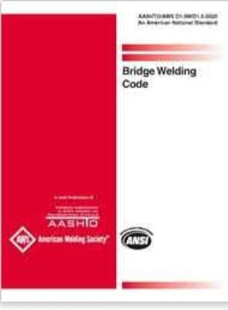
Factored Resistance
The design of welded connections is covered in AASHTO LRFD Article 6.13.3. AASHTO LRFD Article 6.13.3.1 requires that all base metal, weld metal, and weld design details conform to the requirements of the AASHTO/AWS D1.5M/D1.5 Bridge Welding Code.
The factored resistance of a welded connection, R_{r}, at the strength limit state in the AASHTO LRFD BDS is based on either the factored resistance of the base metal, or the product of the weld metal strength and the effective area of the weld that resists the load.
The weld metal strength is the capacity of the weld metal itself, typically given in units of ksi. The effective area of the weld that resists the load is the product of the effective length and the effective throat of the weld. The effective throat is the shortest distance from the joint root to the weld face.
Notes:
The design of welded connections is covered in AASHTO LRFD Article 6.13.3. AASHTO LRFD Article 6.13.3.1 requires that all base metal, weld metal, and weld design details conform to the requirements of the AASHTO/AWS D1.5M/D1.5 Bridge Welding Code, which is shown on this slide.
The factored resistance of a welded connection, R_{r}, at the strength limit state in the AASHTO LRFD BDS is based on either the factored resistance of the base metal, or the product of the weld metal strength and the effective area of the weld that resists the load. The weld metal strength is the capacity of the weld metal itself, typically given in units of ksi. The effective area of the weld that resists the load is the product of the effective length and the effective throat of the weld. The effective throat is the shortest distance from the joint root to the weld face. The computation of the effective throat, effective length, and the factored resistance of groove-welded and fillet-welded connections will be discussed later in this lesson.

Slide 26
Weld Metal and Consumables
AASHTO LRFD Article 6.13.3.1 specifies that matching weld metal must be used in groove and fillet welds, except that undermatching weld metal is permitted for fillet welds if the welding procedure and weld metal are selected to ensure the production of sound welds.
Matching weld has a specified minimum tensile strength that is the same as or higher than the lower-strength base metal. Matching strengths for various weld and base metal combinations are specified in the AASHTO/AWS D1.5M/D1.5 Bridge Welding Code.
Matching consumables for ASTM A709 Grade 50W base metal are considered matching strength for hybrid designs, where ASTM A709 Grade HPS 70W base metal is joined to ASTM A709 Grade 50W base metal.
According to AASHTO LRFD Article C6.13.3.1, the use of undermatched weld metal is strongly encouraged for fillet welds connecting steels with specified minimum yield strength greater than 50 ksi. Lower strength weld metal will generally be more ductile than higher strength weld metal.
Notes:
AASHTO LRFD Article 6.13.3.1 specifies that matching weld metal must be used in groove and fillet welds, except that undermatching weld metal is permitted for fillet welds if the welding procedure and weld metal are selected to ensure the production of sound welds.
Matching weld has a specified minimum tensile strength that is the same as or higher than the lower-strength base metal. Matching strengths for various weld and base metal combinations are specified in the AASHTO/AWS D1.5M/D1.5 Bridge Welding Code. For example, matching weld metal for ASTM A709 Grade 50 steel would be E70 filler material, where the specified minimum weld/base metal properties for yield strength are 60/50 ksi and for tensile strength are 70/65 ksi. Although the weld metal has slightly higher properties than the base metal in this case, this is considered a matching combination. Matching consumables for ASTM A709 Grade 50W base metal are considered matching strength for hybrid designs (Lesson 6), where ASTM A709 Grade HPS 70W base metal is joined to ASTM A709 Grade 50W base metal.
According to AASHTO LRFD Article C6.13.3.1, the use of undermatched weld metal is strongly encouraged for fillet welds connecting steels with specified minimum yield strength greater than 50 ksi. Lower strength weld metal will generally be more ductile than higher strength weld metal. Since the residual stresses in a welded connection are assumed to be on the order of the yield point of the weaker material in the connection, using lower strength weld metal will lower the level of residual stresses in the base metal at the connection reducing the cracking tendencies. Therefore, undermatched welds will be much less sensitive to delayed hydrogen cracking and are more likely to consistently produce sound welds.
Overmatching weld metal offers no significant advantages and increases the level of residual stresses and distortion at the connection. Higher yield strength weld metal is typically less ductile and more crack sensitive. Overmatching weld metal may also force the failure plane into the heat affected zone, or fusion boundary, which is an undesirable condition. Slight overmatching is acceptable in some cases. For example, in the process of adding alloys for improved atmospheric corrosion resistance, most filler metals for welding ASTM A709 Grade 50W weathering steel will deposit weld metal with a specified minimum tensile strength of 80 ksi, versus the specified minimum tensile strength of 70 ksi for the base metal. Since this combination performs well, and there are limited alternatives, this slight overmatch is acceptable. Since some acceptable weld metals for weathering steel applications are classified as E70, basing the weld design calculations on E70 will give the fabricator the flexibility of using either E70 or E80 weld metal.

Slide 27
Design of Welded Joints
Groove-welded joints
Notes:
The design of groove-welded joints will be covered next, with the topics to include some general considerations regarding groove-welded joints, the types of groove-welded joints, the effective area of these joints, the calculation of the factored resistance of groove-welded joints, and the design provisions for welded splices.

Slide 28
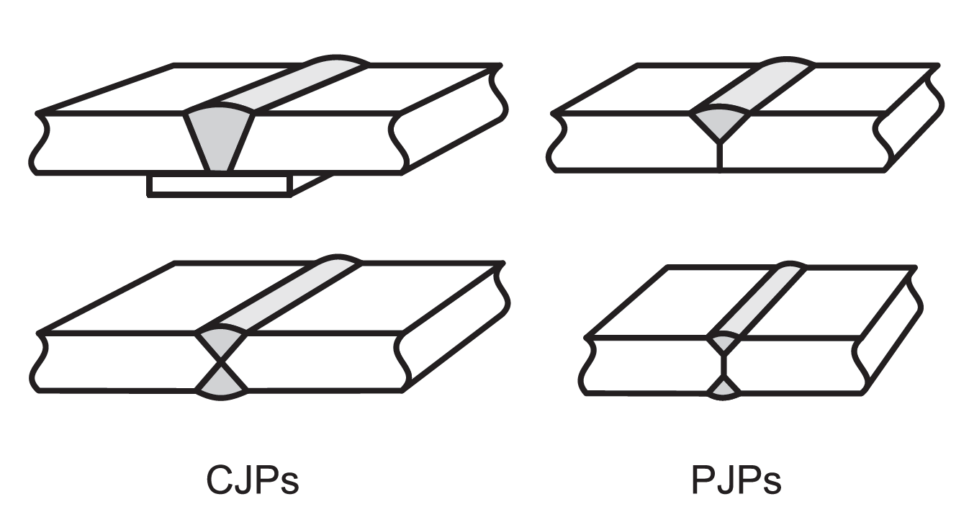
Groove-Welded Joints
Groove welds are most often used to connect structural members that are aligned in the same plane (i.e., butt joints). They can also be used in tee and corner joints.
There are two basic subcategories of groove welds: complete penetration groove welds (CJP) and partial penetration groove welds (PJP). Both types may be single-sided or double-sided welds.
CJP groove welds have the same factored resistance as the pieces joined and are intended to transmit the full load of the members that are joined. PJP groove welds do not extend completely through the thickness of the pieces being joined and are subject to special design requirements.
Notes:
Groove welds are most often used to connect structural members that are aligned in the same plane (i.e., butt joints). They can also be used in tee and corner joints. As shown in the figure on this slide, there are two basic subcategories of groove welds; complete penetration groove welds (CJP) and partial penetration groove welds (PJP). As also shown in the figure, note that both types of welds may be single- or double-sided welds. Double-sided welds, which require access to both sides of the joint, may require less weld metal and result in less distortion and are of particular importance when joining thick members.
CJP groove welds have the same resistance as the pieces joined and are intended to transmit the full load of the members that are joined. PJP groove welds do not extend completely through the thickness of the pieces being joined and are subject to special design requirements. PJP welds are sometimes used when stresses are low and there is no need to develop the complete strength of the base material.

Slide 29
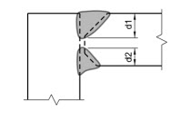
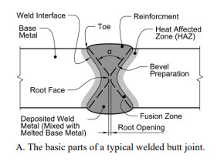
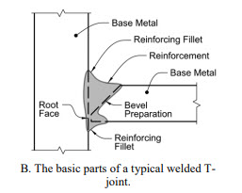
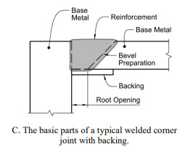
Groove-Welded Joint Types
Typical CJP details and key components for a butt joint, tee joint, and corner joint:
PJP weld in a corner joint:
Source: FHWA
Source: FHWA
Notes:
The figures on the left of this slide show typical CJP details and key components for a butt joint, tee joint, and corner joint. In the figures, the dotted lines represent the steel surfaces prior to welding; after welding and associated fusion, these surfaces no longer exist.
The figure on the right of this slide shows an example PJP weld in a corner joint. The groove weld size of the PJP weld in the figure is the sum of the two joint penetrations, d1 + d2.

Slide 30
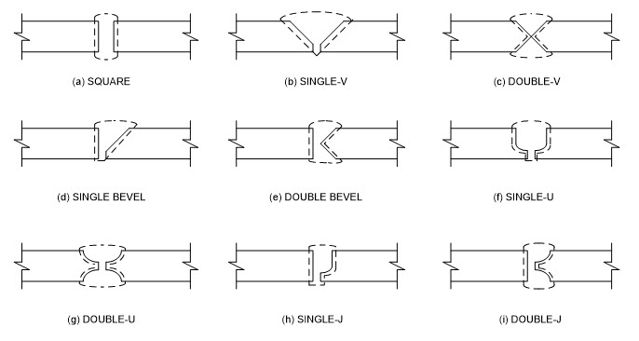
Groove-Welded Joint Types
Groove welds are classified according to their particular shape. Most groove welds require a specific edge preparation and are named accordingly.
The selection of the proper groove weld is dependent on the cost of the edge preparations, the welding process used, and the cost of making the weld.
The decision as to which groove type to use is usually left to the fabricator/detailer, who will select the type of groove that will generate the required quality at a reasonable cost.
Notes:
Groove welds are classified according to their particular shape. Most groove welds require a specific edge preparation and are named accordingly. Example types of groove welds are shown in the figure on this slide. The square groove requires no edge preparation and is rarely used in bridge construction, except for thin sections. For the bevel grooves, one plate is cut at a 90-degree angle and the second plate is provided with a bevel cut. The V groove is similar to the bevel groove, except that both plates are bevel cut. The J groove resembles a bevel groove, except that the root has a radius instead of a straight cut. The U groove is similar to two J grooves put together. In all grooves but the square groove, the small opening or separation of the pieces being joined is called the root opening, which is provided for electrode access to the base of the joint. Note that the smaller the root opening, the larger the angle of the bevel that must be provided.
The selection of the proper groove weld is dependent on the cost of the edge preparations, the welding process used, and the cost of making the weld. The decision as to which groove type to use is usually left to the fabricator/detailer, who will select the type of groove that will generate the required quality at a reasonable cost.

Slide 31
Groove-Welded Joints – Effective Area
The resistance of welds is based on the effective area of the weld, which is taken as the effective length of the weld times the effective throat (AASHTO LRFD Article 6.13.3.3).
The effective throat is defined nominally as the shortest distance from the joint root to the face of the weld (neglecting any weld reinforcement or convexity), or the minimum width of the expected failure plane.
By definition, the effective throat of a CJP weld is equal to the thickness of the thinner part joined, with no increase allowed for any weld reinforcement or convexity.
The effective throat of a PJP weld is defined in the AASHTO/AWS D1.5M/D1.5 Bridge Welding Code.
The effective length of a groove weld is the width of the part joined perpendicular to the direction of stress.
Notes:
As mentioned previously in this lesson, the factored resistance of welds is based on the effective area of the weld, which is taken as the effective length of the weld times the effective throat according to AASHTO LRFD Article 6.13.3.3. The effective throat is defined nominally as the shortest distance from the joint root to the face of the weld (neglecting any weld reinforcement or convexity), or the minimum width of the expected failure plane.
By definition, the effective throat of a CJP groove weld is equal to the thickness of the thinner part joined, with no increase allowed for any weld reinforcement or convexity. To ensure fusion throughout the thickness of the part being joined, backing is usually required if the CJP weld is made from one side, and back gouging is usually required from the second side if the CJP weld is made from both sides. Otherwise, qualification testing is required to show that the full throat can be developed.
The effective throat of PJP groove welds is defined in the AASHTO/AWS D1.5M/D1.5 Bridge Welding Code. The effective throat of PJP groove welds depends on the probable depth of fusion that will be achieved; that is, the depth of groove preparation and depth of penetration that can be achieved by the selected welding process and welding position. Minimum effective throat thickness requirements for PJP welds are also given in the AASHTO/AWS D1.5M/D1.5 Bridge Welding Code.
The effective length of a groove weld is the width of the part joined perpendicular to the direction of stress.

Slide 32
Groove-Welded Joints – Factored Resistance
The factored resistance of complete penetration (CJP) groove-welded connections subjected to tension or compression normal to the effective area or parallel to the axis of the weld is to be taken as the factored resistance of the base metal (AASHTO LRFD Article 6.13.3.2.2a).
The factored resistance of partial penetration (PJP) groove-welded connections subjected to tension or compression parallel to the axis of the weld or compression normal to the effective area is to be taken as the factored resistance of the base metal (AASHTO LRFD Article 6.13.3.2.3a).
The factored resistance for partial penetration (PJP) groove-welded connections subjected to tension normal to the effective area is be taken as the lesser of either the value given by either AASHTO LRFD Eq. 6.13.3.2.3a-1 or the factored resistance of the base metal.
Groove welds are typically not designed by the Engineer. Rather, the Engineer merely identifies the need for and location of a groove weld on the contract plans.
Notes:
The factored resistance of complete penetration (CJP) groove-welded connections subjected to tension or compression normal to the effective area or parallel to the axis of the weld is to be taken as the factored resistance of the base metal (AASHTO LRFD Article 6.13.3.2.2a).
The factored resistance of partial penetration (PJP) groove-welded connections subjected to tension or compression parallel to the axis of the weld or compression normal to the effective area is to be taken as the factored resistance of the base metal (AASHTO LRFD Article 6.13.3.2.3a). The factored resistance for partial penetration (PJP) groove-welded connections subjected to tension normal to the effective area is be taken as the lesser of either the value given by either AASHTO LRFD Eq. 6.13.3.2.3a-1 or the factored resistance of the base metal.
In groove welds, the maximum forces are usually tension or compression. Tests have shown that groove welds of the same thickness as the connected parts are adequate to develop the factored resistance of the connected parts. Groove welds are rarely subjected to shear parallel to the axis of the weld. However, the factored resistances for CJP and PJP welds in such cases are specified in AASHTO LRFD Articles 6.13.3.2.2b and 6.13.3.2.3b, respectively.
Groove welds are typically not designed by the Engineer. Rather, the Engineer merely identifies the need for and location of a groove weld on the contract plans.

Slide 33
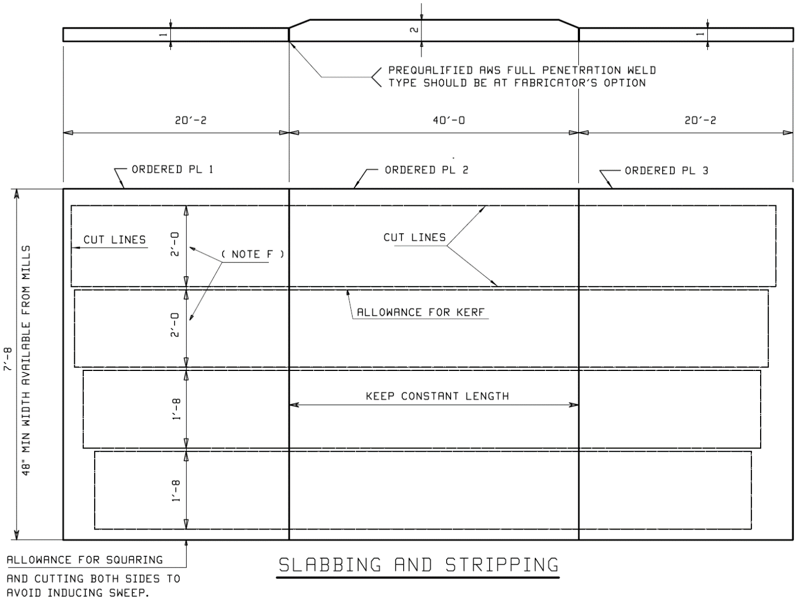
Groove-Welded Joints – Welded Splices
The design of welded splices is covered in AASHTO LRFD Article 6.13.6.2. Welded splices must also conform to the requirements given in the latest edition of the AASHTO/AWS D1.5M/D1.5 Bridge Welding Code.
Welded butt splices for tension, compression, and flexural members are to be designed using complete penetration (CJP) groove welds (10th Edition). The use of splice plates should be avoided.
Changing flange widths at welded shop splices should be avoided if at all possible. Should it become necessary to splice material of different widths using welded butt joints, symmetric transitions must be used that conform to one of the details shown in AASHTO LRFD Figure 6.13.6.2-1.
At welded butt splices joining material of different thicknesses, the transition (including the weld) must be ground to a uniform slope between the offset surfaces of not more than 1 in 2.5.
Welded field splices are less commonly used than bolted field splices. If used, they should be arranged to minimize overhead welding.
Notes:
The design of welded splices is covered in AASHTO LRFD Article 6.13.6.2. Welded splices must also conform to the requirements given in the latest edition of the AASHTO/AWS D1.5M/D1.5 Bridge Welding Code.
Welded butt splices for tension, compression, and flexural members are to be designed using complete penetration (CJP) groove welds (10th Edition). The use of splice plates should be avoided. Fatigue should be checked at all welded splices subject to an applied net tensile stress (determined as specified in AASHTO LRFD Article 6.6.1.2.1) based on the appropriate fatigue detail category for the splice configuration given in AASHTO LRFD Table 6.6.1.2.3-1 (Lesson 7).
Changing flange widths at welded shop splices should be avoided if at all possible. Should it become necessary to splice material of different widths using welded butt joints, symmetric transitions must be used that conform to one of the details shown in AASHTO LRFD Figure 6.13.6.2-1. The type of transition selected is to be consistent with the fatigue detail categories of AASHTO LRFD Table 6.6.1.2.3-1 for the groove-welded splice connection used in the design of the member. Note that AASHTO LRFD Figure 6.13.6.2-1 shows a preferred detail in which the butt splice is located a minimum of 3.0 in. from the transition for greater ease in fitting the run-off tabs. At welded butt splices joining material of different thicknesses, the transition (including the weld) must be ground to a uniform slope between the offset surfaces of not more than 1 in 2.5.
Welded field splices are less commonly used than bolted field splices, which are covered later in this lesson. If used, they should be arranged to minimize overhead welding.

Slide 34
Design of Welded Joints
Fillet-welded joints
Notes:
Next, the design of fillet-welded joints will be covered, with the topics to include some general considerations regarding fillet-welded joints, size requirements for fillet welds, the minimum effective length of a fillet-welded joint, fillet welds used for sealing, the calculation of the factored resistance of fillet-welded joints, and design examples illustrating the design of girder flange-to-web fillet welds, bearing stiffener-to-web fillet welds, an eccentrically loaded fillet-welded bracket connection, and a fillet-welded cross-frame member to gusset plate connection.

Slide 35
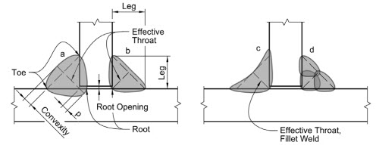
Fillet-Welded Joints - General
Fillet welds are the most widely used welds due to their ease of fabrication and overall economy and are certainly the most widely used welds for bracing member connections.
Fillet welds generally require less precision during fit-up and the edges of the joined pieces seldom need special preparation such as beveling or squaring.
Source: FHWA
Effective throat = 0.707 * Leg Size
The size of a fillet weld is given as the leg size of the fillet. The effective area of a fillet weld is taken equal to the effective length of the weld times the effective throat (AASHTO LRFD Article 6.13.3.3). The effective length is to be taken as the overall length of the full-size fillet. The effective throat dimension of a fillet weld for a typical fillet weld with equal legs of nominal size is taken equal to 0.707 times the leg size.
Notes:
Fillet welds are the most widely used welds due to their ease of fabrication and overall economy and are certainly the most widely used welds for bracing member connections. Fillet welds generally require less precision during fit-up and the edges of the joined pieces seldom need special preparation such as beveling or squaring.
The size of a fillet weld is given as the leg size of the fillet. The effective area of a fillet weld is taken equal to the effective length of the weld times the effective throat (AASHTO LRFD Article 6.13.3.3). The effective length is to be taken as the overall length of the full-size fillet. The effective throat dimension of a fillet weld for a typical fillet weld with equal legs of nominal size is taken equal to 0.707 times the leg size. The figure on this slide illustrates the effective throat of fillet welds. The effective throat is defined as the minimum distance from the fillet weld face, minus any weld reinforcement or convexity, to the weld root. The convexity in fillet welds “a”, “b”, and “d” in the figure does not contribute to the length of the effective throat. For the concave fillet weld in “c”, the minimum distance is measured to the root from the fillet weld surface. The figure also illustrates penetration in fillet welds. Fillet weld “b” penetrates right to the root; the fillet weld “a” penetrates beyond the root by “p” amount.

Slide 36
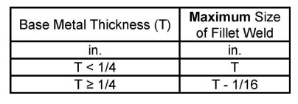
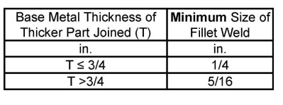
Fillet-Welded Joints – Size Requirements
The size of a fillet weld that may be assumed in the design of a connection is to be such that the factored forces do not exceed the factored resistance of the connection (AASHTO LRFD Article 6.13.3.4)
Maximum size of a fillet weld:
Minimum size of a fillet weld:
Note: a 5/16-in. fillet weld is the largest that can be deposited in a single pass by a manual process.
Notes:
AASHTO LRFD Article 6.13.3.4 specifies the fillet weld size requirements. The size of a fillet weld that may be assumed in the design of a connection is to be such that the factored loads do not exceed the factored resistance of the connection.
As indicated in the top table on this slide, the maximum size of a fillet weld that may be used along the edges of a connected part is to be taken as the base metal thickness, T, for material less than ¼-in. in thickness. For material greater than or equal to ¼-in. in thickness, the maximum size is 1/16-in. less than T, unless the weld is designated in the contract documents to be built out to obtain the full throat thickness. These requirements prevent melting of the base metal where the fillet would meet the corner of the plate if the fillet were made the full plate thickness.
As indicated in the bottom table on this slide, the minimum size of a fillet weld is to be taken as ¼-in. for T less than or equal to 3/4-in. For T greater than ¾ in., the minimum size fillet weld is to be taken as 5/16 in. The weld thickness need not exceed the thickness of the thinner part joined. Smaller fillet welds may be approved by the Engineer based upon applied stress and the use of the appropriate preheat. Minimum size requirements for fillet welds are based on preventing too rapid a rate of cooling to prevent a loss of ductility and a lack of fusion. The thicker the plate joined the faster heat is removed from the welding area. As a minimum, a weld of sufficient size is needed to prevent the thicker plate from removing heat at a faster rate than it is being supplied to cause the base metal to become molten. Also, restraint to weld metal shrinkage provided by thicker material may result in weld cracking if welds are too small.
A 5/16-in. fillet weld is the largest that can be deposited in a single pass by a manual process. Minimum preheat and interpass temperatures (Slide 15) are to be provided by the fabricator according to the AASHTO/AWS D1.5M/D1.5 Bridge Welding Code.

Slide 37
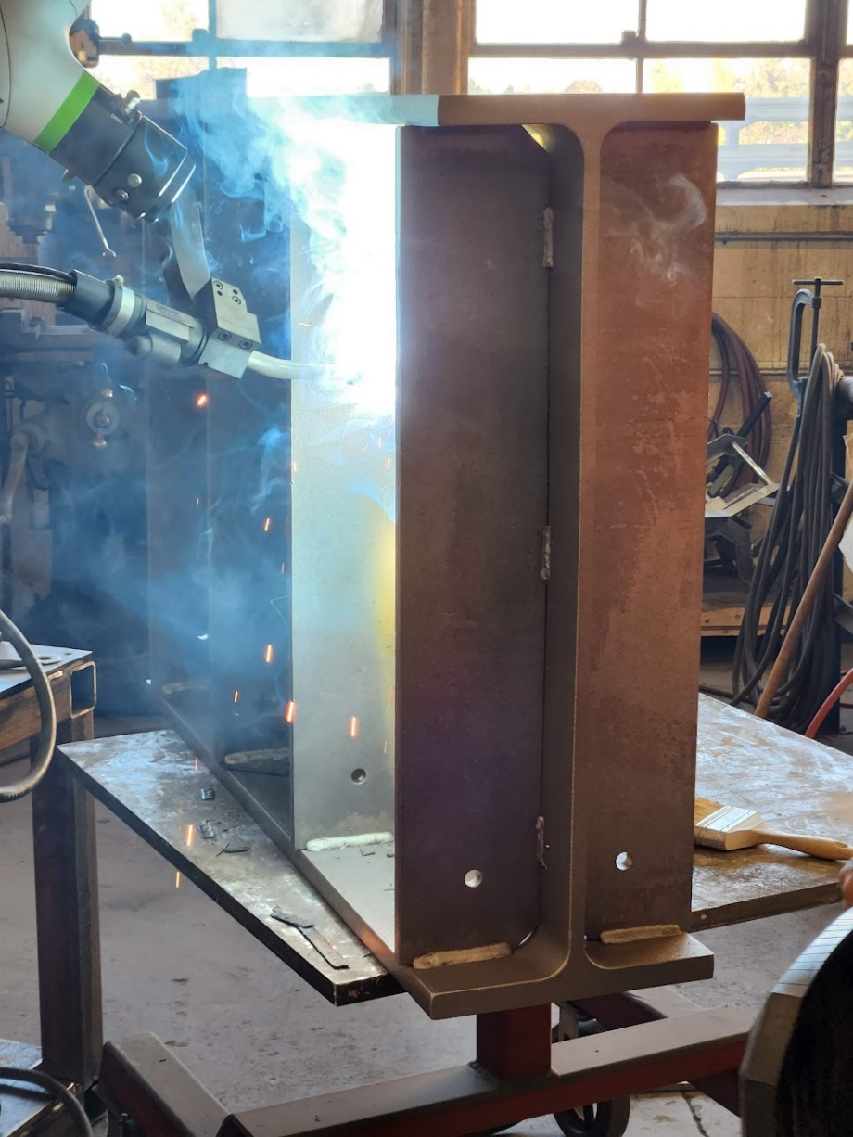
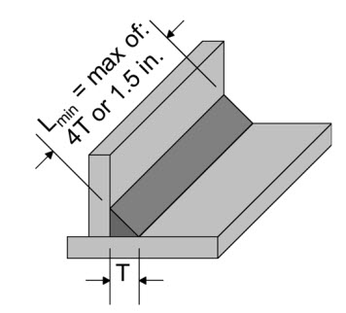
Fillet-Welded Joints – Minimum Effective Length
The minimum effective length of a fillet weld is to be taken as four times its size, but in no case less than 1.5 in. (AASHTO LRFD Article 6.13.3.5).
Notes:
When placing a fillet weld, the welder builds up the weld to the full dimension as near the beginning of the weld as possible. However, there is always a slight tapering off of the weld where it starts and ends. Therefore, a minimum effective length is specified.
AASHTO LRFD Article 6.13.3.5 specifies that the minimum effective length of a fillet weld is to be taken as four times its size, T, but in no case less than 1.5 in.
In the photo on this slide, a transverse stiffener is shown being welded to a plate girder. Robot-assisted welding is used.
Photo credit: Russo Structural Services

Slide 38
Fillet-Welded Joints – Fillet Welds for Sealing
Fillet welds for sealing should be continuous welds combining the functions of sealing and strength (AASHTO LRFD Article 6.13.3.7).
The portion of fillet welds wrapping the ends of a transverse, longitudinal or bearing stiffener, connection plate, or a lap splice connection, are simply for sealing and are not to be included in the calculation of the resistance of the connection and are also exempt from the minimum size requirements (Slide 36).
The ends of fillet welded connections in galvanized structures should be sealed to prevent the acids used to prepare the steel for galvanizing from being trapped in-between the components and then leaching out. Vent holes or an unwelded length around the adjoining surfaces should be provided to allow the trapped air and moisture to escape and prevent destructive pressures from developing between the surfaces if the overlapped area is greater than or equal to 16.0 in.² for plates ½-in. or less in thickness or greater than or equal to 64.0 in.² for plates greater than ½-in. in thickness.
Notes:
Fillet welds may be wrapped around the end of a transverse, longitudinal or bearing stiffener, connection plate, or a lap splice connection for sealing. The welds may also be wrapped around the inside of the cope of a stiffener or a connection plate, if desired. As noted in AASHTO LRFD Article C6.13.3.7, the undercutting of the corner of the stiffener or connection plate, even when severe, does not reduce the fatigue performance of the weld, which is controlled by the toe of the transverse fillet weld connecting the stiffener or connection plate to the flange.
Fillet welds for sealing should be continuous welds combining the functions of sealing and strength (AASHTO LRFD Article 6.13.3.7). The portion of fillet welds wrapping the ends of a transverse, longitudinal or bearing stiffener, connection plate, or a lap splice connection, are simply for sealing and are not to be included in the calculation of the resistance of the connection and are also exempt from the minimum size requirements (Slide 36).
The ends of fillet welded connections in galvanized structures should be sealed to prevent the acids used to prepare the steel for galvanizing from being trapped in-between the components and then leaching out. Vent holes or an unwelded length around the adjoining surfaces should be provided to allow the trapped air and moisture to escape and prevent destructive pressures from developing between the surfaces if the overlapped area is greater than or equal to 16.0 in.² for plates ½-in. or less in thickness or greater than or equal to 64.0 in.² for plates greater than ½-in. in thickness. Tables 1 and 2 in ASTM A385/A385M provide further guidance along with the size of the vent holes or the unwelded length that is required when the overlapped area exceeds the preceding values.

Slide 39
Fillet-Welded Joints – Factored Resistance
For design purposes, fillet welds are assumed to transfer loads through shear on the effective area of the weld regardless of whether the shear transfer is parallel or perpendicular to the axis of the weld.
The factored resistance is actually greater for shear transfer perpendicular to the weld, but there is less deformation capability.
Notes:
For design purposes, fillet welds are assumed to transfer loads through shear on the effective area of the weld regardless of whether the shear transfer is parallel or perpendicular to the axis of the weld. The factored resistance is actually greater for shear transfer perpendicular to the weld, but there is less deformation capability. In both cases, although the weld fails in shear, the plane of rupture is not the same. However, in the AASHTO LRFD BDS, the additional factored resistance of fillet welds loaded perpendicular to the axis of the weld is ignored and both loading situations are treated the same.
The figure on the left of this slide shows qualitatively a typical elastic shear stress distribution in the longitudinal fillet welds in a lap joint (i.e., for shear transfer parallel to the weld axis). The actual variation of shear stress from Point A to Point B depends on the ratio of the widths of the plates being joined and the length of the weld. The figure on the right of this slide shows a typical elastic shear distribution for fillet welds loaded perpendicular to the weld axis.
Shear yielding is not critical in the welds because strain hardening occurs without significant overall deformation occurring in either case. Although the elastic shear stress distributions along the length of the weld are not uniform, the available ductility or plastic deformation capability permits lines of fillet weld loaded parallel or perpendicular to the weld to be assumed to resist the load equally along their lengths.

Slide 40
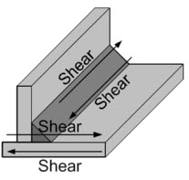
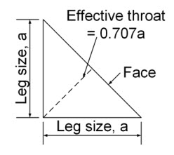
Fillet-Welded Joints – Factored Resistance
Flange-to-web fillet welded connections are designed for shear and may be designed without regard to the tensile or compressive stress parallel to the axis of the weld.
The factored resistance in shear at the strength limit state is taken as the smaller of the factored shear rupture resistance of the connected material adjacent to the weld leg (AASHTO LRFD Article 6.13.5.3) and the product of the effective area and the factored resistance of the weld metal, R_{r}, taken as (AASHTO LRFD Article 6.13.3.2.4):
where:
φ_{e2} = resistance factor for shear on the throat of the weld metal in fillet welds specified in AASHTO LRFD Article 6.5.4.2 (= 0.80)
F_{exx} = classification strength of the weld metal (ksi)
Notes:
Flange-to-web fillet welded connections are designed for shear, as shown in the top right figure on this slide and may be designed without regard to the tensile or compressive stress parallel to the axis of the weld.
The factored resistance of the fillet-welded joint in shear at the strength limit state is taken as the smaller of the factored shear rupture resistance of the connected material adjacent to the weld leg (AASHTO LRFD Article 6.13.5.3), and the product of the effective area and the factored resistance of the weld metal, R_{r}. The factored shear resistance of the weld metal is based on the shear resistance of the weld metal (0.6F_{exx}) multiplied by a resistance factor to ensure that the connected part will develop its full strength without premature failure of the weldment. The resistance factor for shear on the throat of the weld metal in fillet welds, φ_{e2}, is equal to 0.80 (AASHTO LRFD Article 6.5.4.2). The classification strength of the weld metal, F_{exx}, is taken as the specified minimum tensile strength of the weld metal in ksi, which is reflected in the classification designation of the electrode. For example, the “70” in E70XX (SMAW) or the “7” in F7XX (SAW) indicate a specified minimum tensile strength of 70 ksi. The effective area of a fillet weld is equal to the length of the weld times the effective throat. For a typical fillet weld with equal legs of nominal size, a, the effective throat is equal to 0.707 times a, as illustrated in the bottom right figure on this slide. The resistance applies to welds made with matched or undermatched weld metal.
It is seldom that weld failure will ever occur at the weld leg in the base metal. The applicable effective area for the base metal is the weld leg which is 30 percent greater than the weld throat. If overstrength weld metal is used or the weld throat has excessive convexity, the capacity can be governed by the weld leg and the shear rupture resistance of the base metal (i.e., R_{r} = φ_{vu}0.58F_{u}).
If a certain size fillet weld must be used in adjacent areas of a particular joint, it is desirable to use the same size weld to allow the same electrodes and welding equipment to be used for that joint and to simplify the inspection.

Slide 41
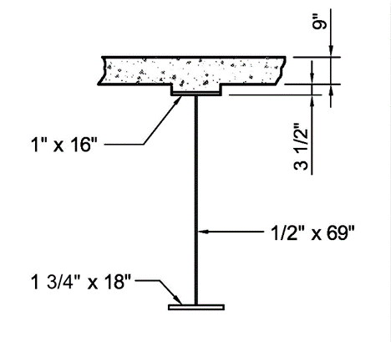
Fillet-Welded Joints – Example 1
Design the flange-to-web fillet welds for the composite girder section taken from NSBA SBDH Design Example 1 (positive moment section – exterior girder).
The steel for the flanges and web is ASTM A709 Grade 50W steel with a specified minimum tensile strength, F_{u} = 70 ksi (AASHTO LRFD Table 6.4.1-1).
Assume E70 electrodes (i.e., matching weld metal) with a classification strength, F_{exx}, equal to 70 ksi.
The maximum unfactored vertical design shears acting on this section are:
V_{DC1} = 87 kips V_{DC2} = 13 kips
V_{DW} = 13 kips V_{LL+IM} = 139 kips
n = 8
From Lesson 6:
I_{steel} = 68,970 in.⁴
I_{3n} = 137,445 in.⁴
I_{n} = 191,209 in.⁴
b_{eff} = 114.0 in.
Notes:
In this first example (Example 1), the flange-to-web fillet welds for the composite-girder section shown in the figure on this slide will be designed The section is in the positive-moment region of the end span of the three-span continuous exterior girder taken from NSBA SBDH Design Example 1. The steel for the flanges and web is ASTM A709 Grade 50W steel with a specified minimum tensile strength, F_{u}, of 70 ksi (AASHTO LRFD Table 6.4.1-1).
For the fillet welds, matching weld metal (i.e., E70 electrodes) will be used with a classification strength, F_{exx}, equal to 70 ksi.
The maximum unfactored vertical design shears in the positive-moment region of the end span acting on this section are given as: V_{DC1} = 87 kips; V_{DC2} = 13 kips; V_{DW} = 13 kips; and V_{LL+IM} = 139 kips (refer to NSBA SBDH Design Example 1).
The moments of inertia for this section were computed previously on the following slides in Lesson 6 and are summarized on this slide as follows: I_{steel} = 68,970 in.4 (Slide 17); I_{3n} = 137,445 in.4 (Slide 28); I_{n} = 191,209 in.4 (Slide 30). The effective width of the concrete deck, b_{eff}, was computed previously on Slide 27 of Lesson 6 to be 114.0 in. The modular ratio, n, is equal to 8.
From AASHTO LRFD Table 6.6.1.2.3-1 (Condition 3.1), the nominal fatigue resistance for base metal connected by continuous fillet-welded connections parallel to the direction of applied stress is based on fatigue Detail Category B (Lesson 7). Although not illustrated here, for flange-to-web welds subject to a net applied tensile stress, the longitudinal stress range due to the factored fatigue load plus impact should be checked against the nominal fatigue resistance based on fatigue Detail Category B.

Slide 42
Fillet-Welded Joints – Example 1
Flange-to-web welds are designed for the factored shear flow along the welds; i.e., s = VQ/I, where Q is the first moment of the cross-sectional areas above and below the respective flange-to-web welds about the corresponding neutral axes.
For shear applied to the noncomposite steel section (i.e., V_{DC1}):
For shears applied to the long-term composite (3n) section (i.e., V_{DC2} and V_{DW}):
Top Flange:
Concrete Deck:
Bottom Flange:
Top Flange:
Bottom Flange:
Total = 1,782.3 in.³
Notes:
The flange-to-web welds are designed for the factored shear flow along the welds, i.e., s = VQ/I, where Q is the first moment of the cross-sectional areas above and below the respective flange-to-web welds about the corresponding neutral axes.
For the shear applied to the noncomposite steel section (i.e., V_{DC1}), Q for the top flange is computed as the cross-sectional area of the top flange times the distance from the neutral axis of the steel section to the centroid of the top flange, which is equal to 41.76 in. (refer to Slide 17 in Lesson 6: 42.26 in. – 1.0 in./2 = 41.76 in.). For the bottom flange, Q is computed as the cross-sectional area of the bottom flange times the distance from the neutral axis of the steel section to the centroid of the bottom flange (refer again to Slide 17 in Lesson 6: 29.49 in. – 1.75 in./2 = 28.62 in.). The resulting values of Q for the top and bottom flange are 668.2 in.³ and 901.5 in.³, respectively.
For the shears applied to the long-term composite (3n) section (i.e., V_{DC2} and V_{DW}), Q for the top flange is computed as the cross-sectional area of the top flange times the distance from the neutral axis of the long-term composite (3n) section to the centroid of the top flange, which is equal to 24.88 in. (refer to Slide 28 in Lesson 6: 25.38 in. – 1.0 in./2 = 24.88 in.). Q for the concrete deck is computed as the cross-sectional area of the long-term (3n) transformed structural concrete deck (9.0 * 114.0/24) times the distance from the neutral axis of the long-term composite (3n) section to the centroid of the concrete deck, including the concrete haunch, which is equal to 32.38 in. (refer to Slide 28 in Lesson 6: 25.38 in. – 1.0 in. + 3.5 in. + 9.0 in./2 = 32.38 in.). The total Q for the top welds is Q for the top flange (398.1 in.³) plus Q for the concrete deck (1,384.2 in.³), which is equal to 1,782.3 in.³ For the bottom flange, Q is computed as the cross-sectional area of the bottom flange times the distance from the neutral axis of the long-term composite (3n) section to the centroid of the bottom flange (refer again to Slide 28 in Lesson 6: 46.37 in. – 1.75 in./2 = 45.50 in.). Q for the bottom flange is 1,433.3 in.³

Slide 43
Fillet-Welded Joints – Example 1
For shear applied to the short-term composite (n) section (i.e., V_{LL+IM}):
Top Flange:
Concrete Deck:
Bottom Flange:
Total = 2,651.1 in.³
Calculate the total factored Strength I shear flow at the top and bottom welds (η = 1.0):
Notes:
For the shear applied to the short-term composite (n) section (i.e., V_{LL+IM}), Q for the top flange is computed as the cross-sectional area of the top flange times the distance from the neutral axis of the short-term composite (n) section to the centroid of the top flange, which is equal to 11.71 in. (refer to Slide 30 in Lesson 6: 12.21 in. – 1.0 in./2 = 11.71 in.). Q for the concrete deck is computed as the cross-sectional area of the short-term (n) transformed structural concrete deck (9.0 * 114.0/8) times the distance from the neutral axis of the short-term composite (n) section to the centroid of the concrete deck, including the concrete haunch, which is equal to 19.21 in. (refer to Slide 30 in Lesson 6: 12.21 in. – 1.0 in. + 3.5 in. + 9.0 in./2 = 19.21 in.). The total Q for the top welds is Q for the top flange (187.4 in.³) plus Q for the concrete deck (2,463.7 in.³), which is equal to 2,651.1 in.³ For the bottom flange, Q is computed as the cross-sectional area of the bottom flange times the distance from the neutral axis of the short-term composite (n) section to the centroid of the bottom flange (refer again to Slide 30 in Lesson 6: 59.54 in. – 1.75 in./2 = 58.67 in.). Q for the bottom flange is 1,848.1 in.³
At the bottom of this slide, the total factored Strength I shear flow at the top and bottom welds is computed using the appropriate values of Q calculated on the preceding slide and this slide, and the corresponding values of the moment of inertia, I, from Slide 41. The load modifier, η, is taken equal to 1.0. The factored shear flow at the top welds is 4.89 kips/in. The factored shear flow at the bottom welds is 4.15 kips/in.

Slide 44
Fillet-Welded Joints – Example 1
The shear flow in the top welds governs. For flange-to-web welds on both sides of the web, the shear flow at each weld is 4.89/2 = 2.45 kips/in.
The factored resistance of the fillet weld in shear (kips/in.) is taken as the smaller of the factored shear rupture resistance of the connected material adjacent to the weld leg and the product of the effective throat and the factored resistance of the weld metal, R_{r} (Slide 40). Assume a minimum-size 5/16-in. fillet weld (Slide 36).
Factored shear rupture resistance of the connected material:
Factored resistance of the weld metal times the effective throat:
Notes:
The shear flow at the top welds governs. For flange-to-web welds on both sides of the web, the shear flow at each weld is 4.89/2 = 2.45 kips/in.
The factored resistance of the fillet weld in shear (in kips/in.) at the strength limit state is taken as the smaller of the factored shear rupture resistance of the connected material adjacent to the weld leg, and the product of the effective throat and the factored resistance of the weld metal, R_{r}, given by the equation on Slide 40 of this lesson. Assume a minimum-size 5/16-in. fillet weld for the welds. According to AASHTO LRFD Table 6.13.3.4-1 (refer to the bottom table on Slide 36 of this lesson), the minimum size fillet weld is 5/16 in. when the base metal thickness, T, of the thicker part joined is greater than ¾ in. The top flange is 1” thick and the bottom flange is 1-3/4” thick (the web is ½” thick). Therefore, use the minimum size fillet weld equal to 5/16 in. for both the top and bottom flange welds. The minimum size weld will often control the size of flange-to-web welds. The maximum size requirement shown in the top table on Slide 36 of this lesson is also satisfied (i.e., T – 1/16-in. = 0.5 – 0.0625 = 0.4375 in., which is greater than 5/16 in. = 0.3125 in.).
The factored shear rupture resistance of the connected material, R_{r}, (in kips/in.) is taken from an equation presented in AASHTO LRFD Article 6.13.5.3. The resistance is taken as the resistance factor for shear rupture, φ_{vu} (= 0.80), specified in AASHTO LRFD Article 6.5.4.2 times the specified minimum tensile strength of the steel, F_{u}, equal to 70 ksi, times the thickness of the thinnest connected part, which is the web (1/2 in.), or 16.24 kips/in. The factored shear resistance of the weld metal, R_{r} (in kips/in.), is taken as 0.6 times the resistance factor for shear on the throat of the weld metal, φ_{e2} (= 0.80), specified in AASHTO LRFD Article 6.5.4.2 times the classification strength of the weld metal, F_{exx}, equal to 70 ksi (Slide 41), times the effective throat of the fillet weld. The effective throat is equal to 0.707a, where a is the weld leg size equal to 5/16 in. (Slide 40). The resulting value of R_{r} is 7.42 kips/in., which governs over the factored shear rupture resistance of the connected material of 16.24 kip/in. Since the factored shear flow, s_{u}, of 2.45 kips/in. is less than R_{r} equal to 7.42 kips/in., the 5/16-in. web-to-flange fillet welds are satisfactory for the strength limit state.

Slide 45
Fillet-Welded Joints – Example 2
Design the bearing stiffener-to-web fillet welds for the composite girder section taken from NSBA SBDH Design Example 1 (end abutment– exterior girder).
The steel for the flanges and web is ASTM A709 Grade 50W steel with a specified minimum tensile strength, F_{u} = 70 ksi (AASHTO LRFD Table 6.4.1-1).
Assume E70 electrodes (i.e., matching weld metal) with a classification strength, F_{exx}, equal to 70 ksi.
The maximum factored Strength I end reaction is:
The bearing stiffeners are 5/8-in. thick. The clips to clear the top and bottom flange-to-web welds are 2.5 in.
R_{u} = 388 kips
Clips, typ.
5/8”
Notes:
In this second example (Example 2), the bearing stiffener-to-web fillet welds for the composite-girder section shown in the figure on this slide will be designed The section is at the abutment in the end span of the three-span continuous exterior girder taken from NSBA SBDH Design Example 1. The steel for the flanges and web is ASTM A709 Grade 50W steel with a specified minimum tensile strength, F_{u}, of 70 ksi (AASHTO LRFD Table 6.4.1-1).
For the fillet welds, matching weld metal (i.e., E70 electrodes) will be used with a classification strength, F_{exx}, equal to 70 ksi. The bearing stiffeners are each 5/8-in. thick. The clips to clear the top and bottom flange-to-web fillet welds are 2.5 in.
The maximum factored Strength I end reaction, R_{u}, is 388 kips (refer to NSBA SBDH Design Example 1).
From AASHTO LRFD Table 6.6.1.2.3-1 (Condition 4.1), the nominal fatigue resistance for base metal at the toe of stiffener-to-web welds subject to a net applied tensile stress is based on fatigue Detail Category C′ (Lesson 7). However, since the bearing stiffeners in this example are located at an abutment, the stress range is zero and fatigue of the base metal adjacent to these welds need not be checked.

Slide 46
Fillet-Welded Joints – Example 2
The total length of a single bearing stiffener-to-web weld, allowing for the clips, is:
The factored resistance of the fillet weld in shear (kips/in.) at the strength limit state is taken as the smaller of the factored shear rupture resistance of the connected material adjacent to the weld leg and the product of the effective throat and the factored resistance of the weld metal, R_{r} (Slide 40). Assume a minimum-size 1/4-in. fillet weld (Slide 36).
Factored shear rupture resistance of the connected material:
Factored resistance of the weld metal times the effective throat:
Notes:
The total length of a single bearing stiffener-to-web weld, allowing for the 2.5-in. clips at the top and bottom of the 69.0-in-deep web to clear the flange-to-web fillet welds is 64.0 in.
The factored resistance of the fillet weld in shear (kips/in.) is taken as the smaller of the factored shear rupture resistance of the connected material adjacent to the weld leg, and the product of the effective throat and the factored resistance of the weld metal, R_{r}, given by the equation on Slide 40 of this lesson. Assume a minimum-size 1/4-in. fillet weld for the welds. According to AASHTO LRFD Table 6.13.3.4-1 (refer to the bottom table on Slide 36 of this lesson), the minimum size fillet weld is ¼ in. when the base metal thickness, T, of the thicker part joined is less than or equal to ¾ in. The web is ½-in. thick, and the bearing stiffeners are 5/8-in. thick. Therefore, use the minimum size fillet weld equal to ¼ in. for the bearing stiffener-to-web welds. The minimum size weld will often control the size of these welds. The maximum size requirement given in the top table on Slide 36 is also satisfied.
The factored shear rupture resistance of the connected material, R_{r}, (in kips/in.) is taken from an equation given in AASHTO LRFD Article 6.13.5.3. The resistance is taken as the resistance factor for shear rupture, φ_{vu} (= 0.80), specified in AASHTO LRFD Article 6.5.4.2 times the specified minimum tensile strength of the steel, F_{u}, equal to 70 ksi, times the thickness of the thinnest connected part, which is the web (1/2 in.), or 16.24 kips/in. The factored shear resistance of the weld metal, R_{r} (in kips/in.), is taken as 0.6 times the resistance factor for shear on the throat of the weld metal, φ_{e2} (= 0.80), specified in AASHTO LRFD Article 6.5.4.2 times the classification strength of the weld metal, F_{exx}, equal to 70 ksi (Slide 45), times the effective throat of the fillet weld. The effective throat is equal to 0.707a, where a is the weld leg size equal to ¼ in. (Slide 40). The resulting value of R_{r} is 5.94 kips/in., which governs over the factored shear rupture resistance of the connected material of 16.24 kip/in. Since the factored end reaction, R_{u}, of 388 kips is less than R_{r} equal to 4 welds times 5.94 kips/in/weld times the length of the welds equal to 64.0 in., which is equal to 1,521 kips. the 1/4-in. bearing stiffener-to-web fillet welds are satisfactory for the strength limit state.

Slide 47
Fillet-Welded Joints – Eccentrically Loaded Joints
If fillet welds are subject to eccentric loads that produce a combination of shear and bending stresses, they are to be proportioned based on a direct vector addition of the shear forces on the weld (AASHTO LRFD Article C6.13.3.2.4).
Eccentric shear can result, for example, when the loading of fillet welds is neither parallel to nor transverse to the axis of the welds. Basically, eccentric shear conditions occur when the welds are subject to pure torsion, a combination of shear and torsion, or a combination of shear and bending.
The resistance of an eccentrically-loaded fillet-welded joint subject to a combination of shear and torsion, or to a combination of shear and bending, can be conservatively determined using a traditional elastic vector analysis approach, as illustrated in the following example.
Notes:
As indicated in AASHTO LRFD Article 6.13.1, eccentric connections should be avoided, but where they cannot be avoided, members and connections are to be designed for the combined effects of shear and moment due to the eccentricity.
AASHTO LRFD Article C6.13.3.2.4b indicates that if fillet welds are subject to eccentric loads that produce a combination of shear and bending stresses, they are to be proportioned based on a direct vector addition of the shear forces on the weld. Eccentric shear can result, for example, when the loading of fillet welds is neither parallel to nor transverse to the axis of the welds. Basically, eccentric shear conditions occur when the welds are subject to pure torsion, a combination of shear and torsion, or a combination of shear and bending.
The resistance of an eccentrically-loaded fillet-welded joint subject to a combination of shear and torsion, or to a combination of shear and bending can be conservatively determined using a traditional elastic vector analysis approach. The following assumptions are made in this approach: 1) assuming each segment of weld is of the same size, it is assumed that concentrically applied load (i.e. direct shear) is resisted equally by each weld segment; 2) any rotation caused by a torsional moment is assumed to occur about the centroid of the weld configuration; 3) load on a weld segment caused by a torsional moment is assumed proportional to the distance of that segment from the centroid of the weld configuration; 4) the direction of the force on a weld segment caused by a torsional moment is assumed perpendicular to the radial distance of the segment from the centroid of the weld configuration; and 5) the resultant force is obtained by combining vectorially the components of the forces caused by direct shear and torsion. Also, for computing forces or stresses on the weld segments, the segment lines are assumed defined by the edges along which the fillets are placed, rather than to the center of the effective throats. This approach is demonstrated in the following example.
The traditional elastic vector analysis method can also be used for the case where the applied load is eccentric to the plane of the weld configuration subjecting the configuration to combined shear and bending moment. In essence, the weld configuration in this case is loaded in shear and tension. The compression force from the bending is typically assumed carried by direct compression of the pieces being welded rather than through the welds. Refer to the Reference Manual for National Highway Institute (NHI) Course 130081: LRFD Superstructure Design for further information along with a design example (available for free download at www.nhi.fhwa.dot.gov).

Slide 48
Eccentrically Loaded Joints – Example 1
Using the elastic vector analysis method, design the fillet welds for the eccentrically loaded bracket configuration shown in the figure for the strength limit state.
The bracket is subject to combined shear and torsion.
Assume E70 electrodes with a classification strength, F_{exx}, equal to 70 ksi.
Assume that minimum size 5/16-in. fillet welds may be used (Slide 36).
5/8✗
The steel for the bracket is ASTM A709 Grade 50W steel with a specified minimum tensile strength, F_{u} = 70 ksi (AASHTO LRFD Table 6.4.1-1).
Notes:
In this example (Example 1), using the elastic vector analysis method, design the fillet welds for the eccentrically loaded bracket configuration shown in the figure on this slide, which is subject to combined shear and torsion, for the strength limit state. The factored force, P_{u}, acting on the bracket is 25 kips. Assume E70 electrodes with a classification strength, F_{exx}, equal to 70 ksi. Assume that minimum size 5/16-in. fillet welds may be used (Slide 36). The bracket is 5/8-in. thick. The steel for the bracket is ASTM A709 Grade 50W steel with a specified minimum tensile strength, F_{u} = 70 ksi (AASHTO LRFD Table 6.4.1-1).

Slide 49
Eccentrically Loaded Joints – Example 1
It becomes convenient in these calculations to treat the welds as lines having length, but with an effective throat thickness (width), t_{e}, equal to unity, and using the general terms b and d, as illustrated below for the two horizontal welds in the example bracket configuration:
Properties for other common weld line configurations are commonly tabulated in steel design textbooks and references such as the AISC Steel Construction Manual
Notes:
It becomes convenient in these calculations to treat the welds as lines having length, but with an effective throat thickness (width), t_{e}, equal to unity, and using the general terms b and d, as illustrated in the figure on this slide for the two horizontal welds in the example bracket configuration.
Properties for other common weld line configurations are tabulated in textbooks and steel design references including the AISC Steel Construction Manual

Slide 50
Eccentrically Loaded Joints – Example 1
Salmon and Johnson (2009) provide the following formulas for computing the location of the centroid (from the vertical weld) and polar moment of inertia of the example weld configuration treating the welds as lines of unit thickness:
Notes:
One such common reference is used for this example. The steel design textbook by Salmon and Johnson, Steel Structures: Design and Behavior, Fifth Edition, provides the formulas shown on this slide for computing the location of the centroid (from the vertical weld) and the polar moment of inertia of the example weld configuration treating the welds as lines of unit thickness. The general formula for the polar moment of inertia of the weld group is also shown, where I_{x} and I_{y} are the moments of inertia of each weld segment about their own centroidal axes, A is the effective area of each weld segment (i.e., the effective throat times the length of the weld), and x_bar and y_bar are the distances from the centroid of the weld configuration to each individual weld segment.
Using the approximate formulas shown on this slide, the centroid is located from the vertical weld a distance of x_bar equal to 1.8 in. (refer to the figure on Slide 48 of this lesson). The polar moment of inertia of the weld group is computed to be 314 in.³

Slide 51
Eccentrically Loaded Joints – Example 1
The maximum resultant force, R, on the weld configuration is at Points A and B (Slide 48). Compute the vertical force on the weld line configuration due to the direct factored shear , R_{v}:
Referring to the figure on Slide 48, compute the x- and y-components of force due the torsion acting on the weld line configuration, R_{Tx} and R_{Ty}, and the maximum resultant force, R:
Notes:
The maximum resultant force, R, acting on the weld configuration is at Points A and B (refer to Slide 48 of this lesson).
The vertical force on the weld line configuration due to the direct factored shear, R_{v}, is calculated as the factored force, P_{u}, acting on the bracket, equal to 25 kips, divided by the total length of the weld line, L_{w}, equal to 20 in. The resulting value of R_{v} is 1.25 kips/in.
Next, the x- and y-components of force due to the torsion acting on the weld line configuration, R_{Tx} and R_{Ty}, are computed. Referring to the figure on Slide 48 of this lesson, the torsion, T, acting on the weld line configuration is equal to the factored force, P_{u}, of 25 kips times 12.2 in., which is equal to the distance from the centroid of the weld line configuration to the force. The x-component of force, R_{Tx}, is equal to T times the vertical distance y from Point A (or Point B) to the centroid of the weld line configuration, equal to 4.0 in., divided by the polar moment of inertia of the weld line configuration, I_{p}, equal to 314 in.³ (Slide 50). The resulting value of R_{Tx} is 3.89 kips/in. The y-component of force, R_{Ty}, is equal to T times the horizontal distance x from Point A (or Point B) to the centroid of the weld line configuration, equal to 4.2 in., divided by the polar moment of inertia of the weld line configuration, I_{p},. The resulting value of R_{Ty} is 4.08 kips/in. The vector resultant force, R, at Point A (or Point B) is computed by taking the vector sum of the horizontal and vertical components of force, as shown in the equation at the bottom of this slide. R is computed to be 6.60 kips/in.

Slide 52
Eccentrically Loaded Joints - Example 1
The factored resistance of the fillet weld in shear (kips/in.) at the strength limit state is taken as the smaller of the factored shear rupture resistance of the connected material adjacent to the weld leg and the product of the effective throat and the factored resistance of the weld metal, R_{r} (Slide 40).
Factored shear rupture resistance of the connected material:
Factored resistance of the weld metal times the effective throat:
Notes:
The factored resistance of the fillet weld in shear (kips/in.) at the strength limit state is taken as the smaller of the factored shear rupture resistance of the connected material adjacent to the weld leg and the product of the effective throat and the factored resistance of the weld metal, R_{r}, given by the equation on Slide 40 of this lesson.
The factored shear rupture resistance of the connected material, R_{r}, (kips/in.) is taken from an equation given in AASHTO LRFD Article 6.13.5.3. The resistance is taken as the resistance factor for shear rupture, φvu (= 0.80), specified in AASHTO LRFD Article 6.5.4.2 times the specified minimum tensile strength of the steel, F_{u}, equal to 70 ksi, times the thickness of the thinnest connected part, which is assumed to be the bracket (5/8 in.), or 20.30 kips/in. The factored shear resistance of the weld metal, R_{r} (in kips/in.), is taken as 0.6 times the resistance factor for shear on the throat of the weld metal, φ_{e2} (= 0.80), specified in AASHTO LRFD Article 6.5.4.2 times the classification strength of the weld metal, F_{exx}, equal to 70 ksi (Slide 48), times the effective throat of the fillet weld. The effective throat is equal to 0.707a, where a is the weld leg size equal to 5/16 in. (Slide 40). The resulting value of R_{r} is 7.42 kips/in., which governs over the factored shear rupture resistance of the connected material of 20.30 kip/in. Since the maximum resultant force on the weld line configuration, R, at Points A and B of 6.60 kips/in. (Slide 51) is less than R_{r} equal to 7.42 kips/in., the 5/16-in. fillet welds for the weld line configuration are satisfactory for the strength limit state.
A less conservative alternative approach to determine the resistance of a weld configuration subject to eccentric shear is provided in the AISC Manual of Steel Construction. In this approach, an instantaneous center of rotation is located, and the load-deformation relationship of a fillet weld is used. Since that approach is less commonly employed in bridge design practice, it is not covered any further herein.

Slide 53
Fillet-Welded Joints – Balanced Connections
Balanced Connections: in lap joints connecting members subject to in-plane axial stress, eccentricities usually result in the fillet-welded connections. Designing these fillet welds to eliminate eccentric shear effects in the plane of the connection is referred to as balancing the welds.
Balancing the welds is accomplished by specifying weld lengths such that the shear force resisted in the welds transfers the load between the connected parts without creating an eccentric moment.
This situation occurs most commonly in steel bridges when bracing or other members are fillet welded to gusset plates.
Notes:
In lap joints connecting members subject to in-plane axial stress, eccentricities usually result in the fillet-welded connections. Designing these fillet welds to eliminate eccentric shear effects in the plane of the connection is referred to as balancing the welds. The effect of the out-of-plane eccentricity is typically ignored when balancing the welds.
Balancing the welds is accomplished by specifying weld lengths such that the shear force resisted in the welds transfers the load between the connected parts without creating an eccentric moment. This situation occurs most commonly in steel bridges when bracing or other members are fillet welded to gusset plates.

Slide 54
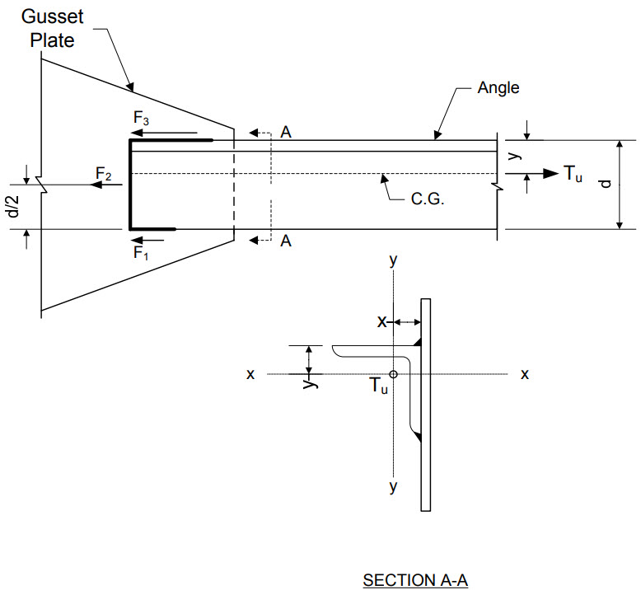
Fillet-Welded Joints – Balanced Connections
A
where:
Notes:
To balance the welds, consider a single-angle tension member fillet welded to a gusset plate, as shown in the figure on this slide. The tensile force, T_{u}, acts along the centroid of the member and is resisted by the forces F₁, F₂ and F₃ developed by the fillet welds. Note that a full-length end weld is assumed. The force F₂ acts at the centroid of the transverse weld length, which is located at d/2 where d is the width of the connected angle leg. For simplicity, F₁ and F₃ are assumed to act at the edges of the angle rather than at the center of the effective weld throat.
To eliminate the eccentric moment about the axis perpendicular to the gusset plate (i.e., the x-x axis), the forces in the weld group must act about the axis of the angle. Taking moments about Point A located at the top of the angle gives the equation shown at the top of this slide, where y is the distance from the centroid of the angle to the top of the angle. Solving for the force, F₁, gives the second equation on this slide, where the force, F₂, is equal to the factored shear resistance of the weld, R_{r}, given by the equation shown on Slide 40 of this lesson times the effective throat dimension, t_{e} (= 0.707a), times the length of the end weld, L_{w2}.
Summing the forces in the horizontal direction and substituting F₁ from the second equation shown on this slide, and then solving for the force, F₃, gives the second equation from the bottom of this slide.
Therefore, to balance the welds: 1) compute the force F₂ resisted by the end weld (if any) from the equation on this slide, 2) compute the force F₁ from the equation on this slide, 3) compute the force F₃ from horizontal equilibrium or using the equation on this slide, 4) compute the required lengths of weld lines 1 and 3 as L_{w1} = F₁/R_{r}t_{e} and L_{w3} = F₃/R_{r}t_{e}, respectively, as given by the equations shown at the bottom of this slide. When there is no end weld, set F₂ equal to zero in the above equations. Should the end weld not be full-length, a different set of equations would need to be developed.

Slide 55
Fillet-Welded Joints – Balanced Welds
A simpler alternative approach for balancing the welds when there is no end weld is to calculate the total length of weld, L_{w}, required to carry the load (i.e., L_{w} = T_{u}/R_{r}t_{e}), and then allocate that length to F₁ and F₃ in inverse proportion to the distance of each weld from the centroid of the member. However, this option leads to longer weld lines and perhaps a larger gusset plate.
Detailing excessively oversized or odd-shaped gusset plates solely to allow for the unequal length longitudinal welds necessary to achieve a balanced weld configuration is generally impractical and is discouraged. Instead, consider using equal length longitudinal welds and evaluate the connection as an eccentrically loaded weld group, which causes additional shear loading of the welds, as demonstrated in the following example.
Notes:
A simpler alternative approach for balancing the welds when there is no end weld is to calculate the total length of weld, L_{w}, required to carry the load (i.e., L_{w} = T_{u}/R_{r}t_{e}), and then allocate that length to F₁ and F₃ in inverse proportion to the distance of each weld from the centroid of the member. However, this option leads to longer weld lines and perhaps a larger gusset plate.
As discussed in AASHTO LRFD Article C6.13.1 (10th Edition), detailing excessively oversized or odd-shaped gusset plates solely to allow for the unequal length longitudinal welds necessary to achieve a balanced weld configuration is generally impractical and is discouraged. Instead, consider using equal-length longitudinal welds and evaluate the connection as an eccentrically loaded weld group, which causes additional shear loading of the welds, as demonstrated in the following example.

Slide 56
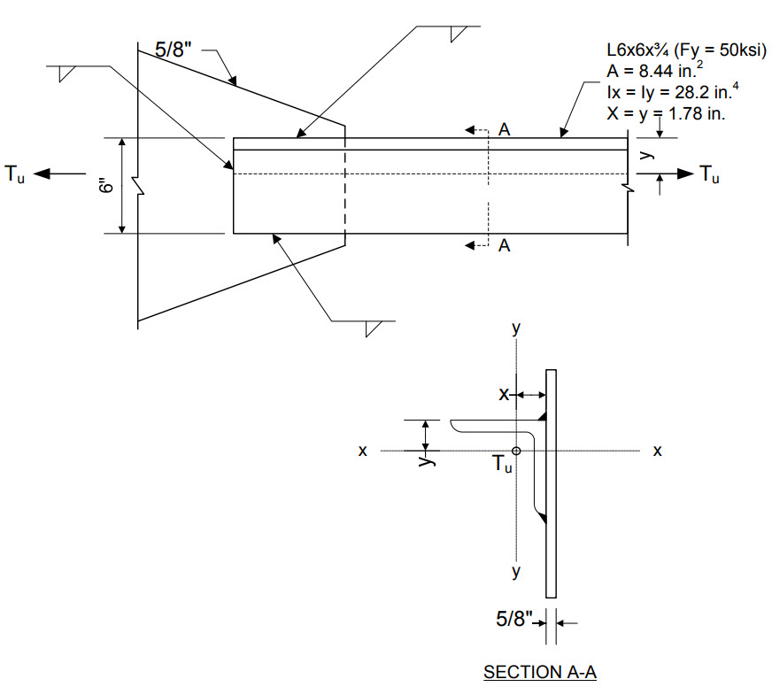
Eccentrically Loaded Joints – Example 2
Design the fillet-welded connection of the L6x6x3/4 single-angle tension member shown in the figure to a 5/8-in. thick gusset plate at the strength limit state.
Assume a full-length end weld and two-equal-length longitudinal welds (i.e., an unbalanced connection).
Assume E70 electrodes with a classification strength, F_{exx}, equal to 70 ksi.
Assume that 5/16-in. fillet welds are used.
The factored tensile force, T_{u}, is 115.0 kips.
A
B
ASTM A709 Grade 70W steel; F_{u} = 70 ksi
Notes:
In this example (Example 2), the fillet-welded connection of a L6x6x3/4 single-angle tension member to a 5/8-in.-thick gusset plate will be designed for the strength limit state. The factored tensile force at the strength limit state, T_{u}, is 115.0 kips.
A full-length end weld and two equal-length longitudinal welds will be assumed. Although this is an unbalanced connection, the use of equal-length longitudinal welds is desirable to avoid the potential need for a larger gusset plate to accommodate the unequal-length welds necessary to achieve a balanced weld configuration. As a result, the connection will need to be evaluated as an eccentrically loaded weld group subjected to combined shear and torsion (i.e., in-plane bending about the x-x axis). The effect of the out-of-plane eccentricity (i.e., bending about the y-y axis) is considered relatively minor and is typically ignored.
Assume E70 electrodes with a classification strength, F_{exx}, equal to 70 ksi. Assume that 5/16-in. fillet welds are used. According to AASHTO LRFD Table 6.13.3.4-1 (refer to the bottom table on Slide 36 of this lesson), the minimum size fillet weld is 1/4 in. when the base metal thickness, T, of the thicker part joined is less than or equal to ¾ in., which is the case in this example. However, slightly larger 5/16-in. welds will be used to help reduce the overall length of the welds. The maximum size requirement given in the top table on Slide 36 is satisfied. The steel for the angle and gusset plate is assumed to be ASTM A709 Grade 50W steel, with a specified minimum tensile strength, F_{u}, of 70 ksi (AASHTO LRFD Table 6.4.1-1).
If the factored force, T_{u}, in this cross-frame member from an I-girder bridge is computed from a refined analysis, the base metal at the weld terminations on this member subjected to a net tensile force as specified in AASHTO LRFD Article 6.6.1.2.1 is also to be investigated for load-induced fatigue (AASHTO LRFD Article 6.6.1.2.2 – 10th Edition). Refer to Lesson 7 and to Slide 24 of this lesson for further information on performing this check.

Slide 57
Eccentrically Loaded Joints - Example 2
The factored resistance of the fillet weld in shear (kips/in.) at the strength limit state is taken as the smaller of the factored shear rupture resistance of the connected material adjacent to the weld leg and the product of the effective throat and the factored resistance of the weld metal, R_{r} (Slide 40).
Factored shear rupture resistance of the connected material:
Factored resistance of the weld metal times the effective throat:
Try 8.0 in. welds for the longitudinal welds
Notes:
The factored resistance of the fillet weld in shear (kips/in.) at the strength limit state is taken as the smaller of the factored shear rupture resistance of the connected material adjacent to the weld leg and the product of the effective throat and the factored resistance of the weld metal, R_{r}, given by the equation on Slide 40 of this lesson.
The factored shear rupture resistance of the connected material, R_{r}, (kips/in.) is taken from the equation given on Slide 157 of this lesson (AASHTO LRFD Article 6.13.5.3). The resistance is taken as the resistance factor for shear rupture, φ_{vu} (= 0.80), specified in AASHTO LRFD Article 6.5.4.2 times the specified minimum tensile strength of the steel, F_{u}, equal to 70 ksi, times the thickness of the thinnest connected part, which is assumed to be the bracket (5/8 in.), or 20.30 kips/in. The factored shear resistance of the weld metal, R_{r} (in kips/in.), is taken as 0.6 times the resistance factor for shear on the throat of the weld metal, φ_{e2} (= 0.80), specified in AASHTO LRFD Article 6.5.4.2 times the classification strength of the weld metal, F_{exx}, equal to 70 ksi (Slide 56), times the effective throat of the fillet weld. The effective throat is equal to 0.707a, where a is the weld leg size equal to 5/16 in. (Slide 40). The resulting value of R_{r} is 7.42 kips/in., which governs over the factored shear rupture resistance of the connected material of 20.30 kip/in.
The total length of weld required, L_{w}, is equal to the factored tensile force, T_{u}, of 115.0 kips divided by the governing R_{r} of 7.42 kips/in., or 15.5 in. The end weld is 6.0 in. in length, which leaves a total required length of 9.5 in., or 4.75 in. each of the longitudinal welds. Since the weld configuration is subject to eccentric shear, try 8.0 in for longitudinal welds.

Slide 58
Eccentrically Loaded Joints – Example 2
Evaluate the unbalanced connection for the eccentric shear. Compute the location of the centroid (from the vertical end weld) and the polar moment of inertia of the example weld configuration from the equations given previously on Slide 50 of this lesson treating the welds as lines of unit thickness:
Notes:
Next, evaluate the unbalanced connection for the eccentric shear. Use the formulas given previously on Slide 50 of this lesson for computing the location of the centroid (from the vertical end weld) and the polar moment of inertia of the example weld configuration treating the welds as lines of unit thickness. The general formula for the polar moment of inertia of the weld group is also shown on this slide, where I_{x} and I_{y} are the moments of inertia of each weld segment about their own centroidal axes, A is the effective area of each weld segment (i.e., the effective throat times the length of the weld), and x_bar and y_bar are the distances from the centroid of the weld configuration to each individual weld segment.
Using the approximate formulas shown on this slide, the centroid is located from the vertical end weld a distance of x_bar equal to 2.91 in. The polar moment of inertia of the weld group, I_{p}, is computed to be 317 in.³

Slide 59
Eccentrically Loaded Joints – Example 2
The maximum resultant force, R, on the weld configuration is at Points A and B (Slide 56). Compute the horizontal force on the weld line configuration due to the direct factored shear, R_{h}:
Referring to the figure on Slide 56, compute the x- and y-components of force due the torsion acting on the weld line configuration, R_{Tx} and R_{Ty}, and the maximum resultant force, R:
Notes:
The maximum resultant force, R, acting on the weld configuration is at Points A and B at the end of the longitudinal welds (refer to Slide 56 of this lesson).
The horizontal force on the weld line configuration due to the direct factored shear, R_{h}, is calculated as the factored force, T_{u}, equal to 115.0 kips, divided by the total length of the weld line, L_{w}, equal to 22 in. The resulting value of R_{h} is 5.23 kips/in.
Next, the x- and y-components of force due to the torsion acting on the weld line configuration, R_{Tx} and R_{Ty}, are computed. Referring to the figure on Slide 56 of this lesson, the torsion, T, acting on the weld line configuration is equal to the factored force, T_{u}, of 115.0 kips times the distance (3.0 in. - 1.78 in.), which is equal to the vertical distance from the centroid of the weld line configuration to the force. The x-component of force, R_{Tx}, is equal to T times the vertical distance y from Point A (or Point B) to the centroid of the weld line configuration, equal to 3.0 in., divided by the polar moment of inertia of the weld line configuration, I_{p}, equal to 317 in.³ (Slide 58). The resulting value of R_{Tx} is 1.33 kips/in. The y-component of force, R_{Ty}, is equal to T times the horizontal distance x from Point A (or Point B) to the centroid of the weld line configuration, equal to (8.0 in. – 2.91 in.), divided by the polar moment of inertia of the weld line configuration, I_{p}. The resulting value of R_{Ty} is 2.25 kips/in. The vector resultant force, R, at Point A (or Point B) is computed by taking the vector sum of the horizontal and vertical components of force, as shown in the equation at the bottom of this slide. R is computed to be 6.94 kips/in., which is less than R_{r} equal to 7.42 kips/in. (Slide 57). Therefore, the weld configuration utilizing 5/16-in. fillet welds is satisfactory for the strength limit state.

Slide 60
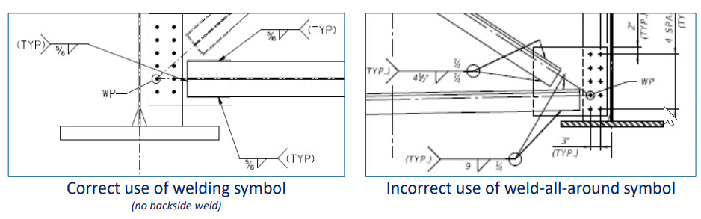
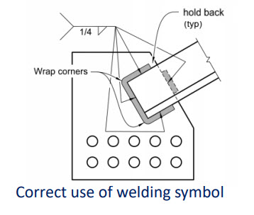
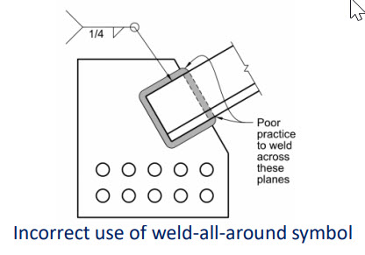
Eccentrically Loaded Joints – Example 2
Notes:
With regard to the detailing of these fillet-welded cross-frame member connections to gusset plates, this slide shows the correct use of the welding symbols to call out the welds on the design drawings. The figure on the top left of this slide shows the correct use of the welding symbols when there is no backside weld provided for sealing. The figure on the bottom left of this slide shows the correct use of the welding symbols when a backside weld is provided for sealing, with the backside weld shown held back from the edges of the member. The figures on the top and bottom right of this slide illustrate the incorrect use of the weld all-around symbol for these connections. As illustrated in the figure on the bottom right of this slide, when a backside weld is provided for sealing, it is considered poor practice to weld across the planes shown.
Figure Source: FHWA Bridge Welding Reference Manual

Slide 61
END

