Slide 1
Fundamentals of Steel Bridge Engineering
Lesson 11B – Bolted Connections and Girder Field Splices
Notes:
This presentation is part of the "Fundamentals of Steel Bridge Engineering" teaching aid, available at aisc.org/teachingaids. This set of (14) lessons was prepared by Frank Russo, PE, PhD and Michael Grubb, PE with support from the National Steel Bridge Alliance (NSBA) and AISC University Programs.
For questions or comments on these presentations, please contact:
AISC University Programs
universityprograms@aisc.org

Slide 2
Reference Materials
FHWA Bridge Welding Reference Manual
AASHTO D1.5M/D1.5 Bridge Welding Code
Salmon and Johnson, Steel Structures: Design and Behavior, Fifth Edition, 2009
RCSC Specification for Structural Joints Using High-Strength Bolts
NBSA Bolted Field Splices for Steel Bridge Flexural Members - Overview and Design Examples and the NSBA Splice Spreadsheet
AISC Steel Design Guide 21 – Welded Connections – A Primer for Engineers
AISC Steel Design Guide 17 – High Strength Bolts – A Primer for Structural Engineers
SBDH
  Vol 20 – Design Example 1
Notes:
Lesson 11 Parts A and B incorporates materials found in in the various reference materials listed on this slide. The focus of Lesson 11B is on the design of bolted connections and girder field splices.

Slide 3
Lesson 11B Roadmap
Bolted Connections and Field Splices
Design of Bolted Joints
  General
  Shear Resistance
  Slip Resistance
  Bearing Resistance at Bolt Holes
  Tensile Resistance
  Eccentrically Loaded Connections
  Bolted Field Splices
Notes:
Lesson 11B deals with the design of bolted joints. Specific topics to be covered on the design of bolted joints include some general considerations; namely, examples of some typical bolted joints in steel-girder bridges, slip-critical vs. bearing-type connections, high-strength bolts (including discussions of types, coating options, and installation methods), low-strength steel bolts, the fatigue resistance of bolted connections in shear, bolt holes, bolt spacing, and edge and end distance requirements. This will be followed by discussions on the calculation of the shear resistance, slip resistance, bearing resistance, and tensile resistance of bolted joints (along with some illustrative examples). The design of eccentrically loaded bolted connections will be discussed next; again, with two examples illustrating the importance of the connection work-point location. Finally, the AASHTO LRFD design requirements for the design of bolted field splices will be reviewed in detail and a complete design example will be provided illustrating the application of those requirements.

Slide 4
Design of Bolted Joints
GENERAL
Notes:
Included in this portion of the lesson is a discussion of some general considerations related to the design of bolted joints; namely, examples of some typical bolted joints in steel-girder bridges, slip-critical vs. bearing-type connections, high-strength bolts (including discussions of types, coating options, and installation methods), low-strength steel bolts, the fatigue resistance of bolted connections in shear, bolt holes, bolt spacing and edge and end distance requirements.

Slide 5
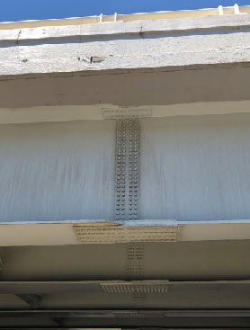
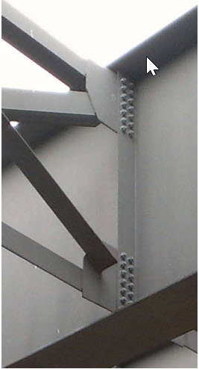
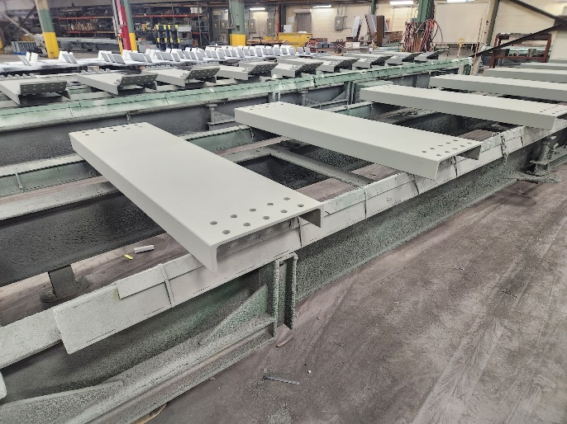
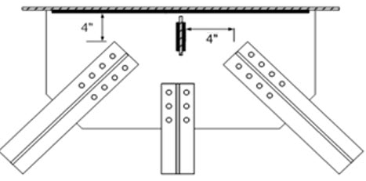
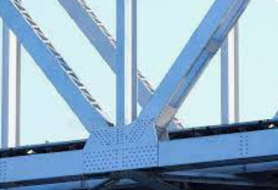
Design of Bolted Joints - General
Typical Bolted Joints
Lateral Bracing Connection
Diaphragm or Floorbeam Connection
Field Splice
Cross-Frame Connection
Truss Gusset Plate
Notes:
This slide illustrates some typical bolted joints in a steel bridge, including a bolted field splice in a flexural member, a cross-frame connection, a diaphragm (or floorbeam) connection, a lateral bracing connection, and a truss gusset plate connection.
The design of bolted gusset plates is considered outside the scope of this course. The design of gusset plates is covered in AASHTO LRFD Article 6.14.2.8.

Slide 6
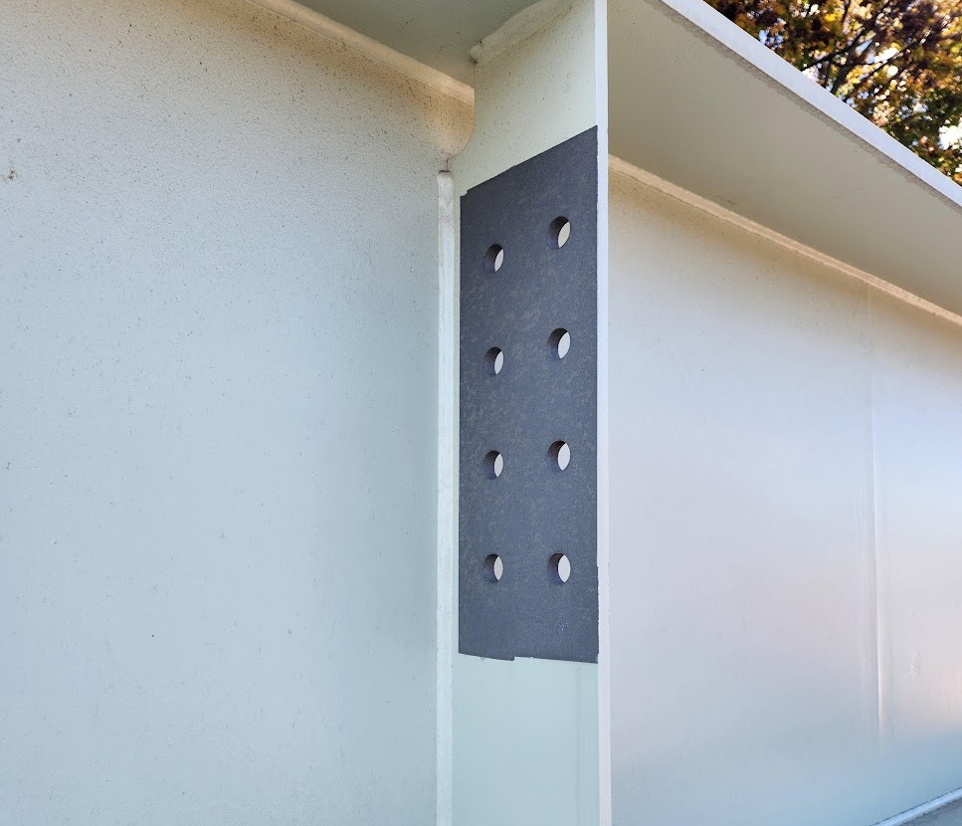
Design of Bolted Joints - General
The design of bolted connections is covered in AASHTO LRFD Article 6.13.2. AASHTO LRFD Article 6.13.2.1 specifies that bolted steel parts must fit solidly together after the bolts are tightened. All material within the grip of the bolt must be steel.
The bolted parts may be coated or uncoated. It must be specified in the contract documents that all joint surfaces, including surfaces adjacent to the bolt head and nut, be free of scale (except for tight mill scale), dirt or other foreign material.
High-strength bolts are to be installed to have a specified initial tension, which results in an initial precompression between the joined parts.
The AASHTO LRFD BDS recognize two types of bolted connections: slip-critical connections and bearing-type connections. The resistance of all high-strength bolted connections in transmitting shear across a shear plane between bolted steel parts is the same whether the connection is a slip-critical or bearing-type connection.
Notes:
The design of bolted connections is covered in AASHTO LRFD Article 6.13.2. AASHTO LRFD Article 6.13.2.1 specifies that bolted steel parts must fit solidly together after the bolts are tightened. All material within the grip of the bolt must be steel.
The bolted parts may be coated or uncoated. It must be specified in the contract documents that all joint surfaces, including surfaces adjacent to the bolt head and nut, be free of scale (except for tight mill scale), dirt or other foreign material.
High-strength bolts are to be installed to have a specified initial tension, which results in an initial precompression between the joined parts. At service load levels, the transfer of the loads between the joined parts may then occur entirely via friction with no bearing of the bolt shank against the side of the hole. Until the friction force is overcome, the shear resistance of the bolt and the bearing resistance of the bolt hole will not affect the ability to transfer the load across the shear plane between the joined parts.
The AASHTO LRFD BDS recognize two types of high-strength bolted connections: slip-critical connections (refer to Slides 7 to 10 of this lesson) and bearing-type connections (refer to Slide 11 of this lesson). The resistance of all high-strength bolted connections in transmitting shear across a shear plane between bolted steel parts is the same whether the connection is a slip-critical or bearing-type connection. Slip-critical connections in beam and girder bridges have additional requirements that slip must not occur between the joined parts at service load levels and during the deck placement.

Slide 7
Slip-Critical Connections
In high-strength bolted slip-critical connections subject to shear, the load is transferred between the joined parts by friction up to a level of force that is dependent upon the clamping force and the coefficient of friction of the faying surfaces.
The coefficient of friction depends on the faying surface condition, with mill scale, paint or other surface treatments determining the value of the friction coefficient.
Once the load exceeds the frictional resistance between the faying surfaces, slip occurs; that is, the friction bond is broken, and the two surfaces slip with respect to one another by a relatively large amount. Therefore, the connection can continue resisting an even greater load through the shear resistance of the bolts and the bearing resistance against the connected material.
Final failure of the connection will be by shear failure of the bolts, yielding or tear-out of the connected material or by an unacceptable deformation around the holes; the ultimate resistance of the connection is not related to the slip load.
Notes:
In high-strength bolted slip-critical connections subject to shear, the load is transferred between the joined parts by friction up to a level of force that is dependent upon the clamping force and the coefficient of friction of the faying surfaces. The coefficient of friction depends on the faying surface condition, with mill scale, paint or other surface treatments determining the value of the friction coefficient. Because a high tensile force on the bolt is required to develop a significant resisting friction force, only bolts with a high tensile yield strength (i.e., ASTM F3125 Grade A325 and A490 or ASTM F3148 bolts high-strength bolts – refer to Slides 12 to 14 of this lesson) can be used in slip-critical connections.
Prior to joint slip, the bolts are not subject to shear nor are the joined parts subject to bearing stress. Once the load exceeds the frictional resistance between the faying surfaces, slip occurs; that is, the friction bond is broken, and the two surfaces slip with respect to one another by a relatively large amount. A rupture failure does not occur. Therefore, the connection is able to continue resisting an even greater load through the shear resistance of the bolts and the bearing resistance against the connected material. Final failure of the connection will be by shear failure of the bolts, yielding or tear-out of the connected material, or by an unacceptable deformation around the holes; the ultimate resistance of the connection is not related to the slip load.
The slip and bearing resistances are computed separately for application at different load combinations (the calculation of the slip, shear and bearing resistances of bolted connections and the resistance of the connected material is discussed in more detail in Slides 26 to 53 of this lesson). Because the combined effect of frictional resistance with shear or bearing has not been systematically studied and is uncertain, any potential greater resistance due to combined effect is ignored.

Slide 8
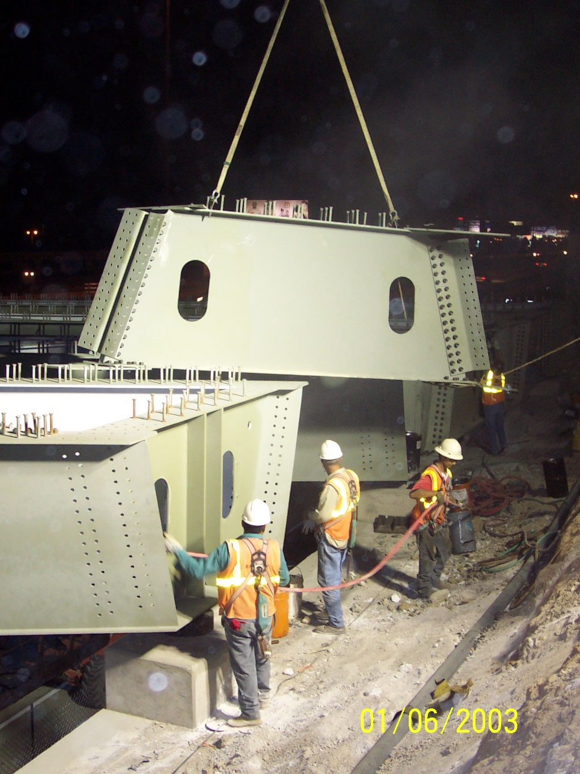
Slip-Critical Connections
Pretensioned high-strength bolted joints located where stress and strain due to joint slippage would be detrimental to the serviceability of the structure or may adversely affect the geometry of the structure are to be designated in the contract documents as slip-critical connections, including (AASHTO LRFD Article 6.13.2.1.1 - 10th Edition):
  Bolted field splices in flexural members;
  Joints in shear with bolts installed in oversize holes;
  Joints in shear with bolts installed in short- and long-slotted holes where the force in the joint is in a direction other than perpendicular to the axis of the slot;
  Joints in which welds and bolts share in transmitting load at a common faying surface;
  Joints in axial tension or combined axial tension and shear;
  Joints in axial compression only, with standard or slotted holes in only one ply of the connection with the direction of the load perpendicular to the direction of the slot, except for connections designed according to the provisions of Article 6.13.6.1.2; and
  Joints in which, in the judgment of the Engineer, any slip would be critical to the performance of the joint or the structure and which are so designated in the contract documents.
Notes:
Pretensioned high-strength bolted joints located where stress and strain due to joint slippage would be detrimental to the serviceability of the structure or may adversely affect the geometry of the structure are to be designated in the contract documents as slip-critical connections (AASHTO LRFD Article 6.13.2.1.1 - 10th Edition). The joints listed on the slide, including bolted field splices in flexural members, are to be designed as slip-critical connections (10th Edition).
For slotted holes, perpendicular to the slot is defined as an angle between approximately 80 to 100 degrees to the axis of the slot. The third case listed on this slide related to slotted holes applies except when the Engineer intends otherwise and so indicates in the contract documents.
An external end diaphragm between steel tub girders is shown in the photo on this slide. It is bolted to the girder webs in the field using high-strength bolted connections.
Photo credit: HDR

Slide 9
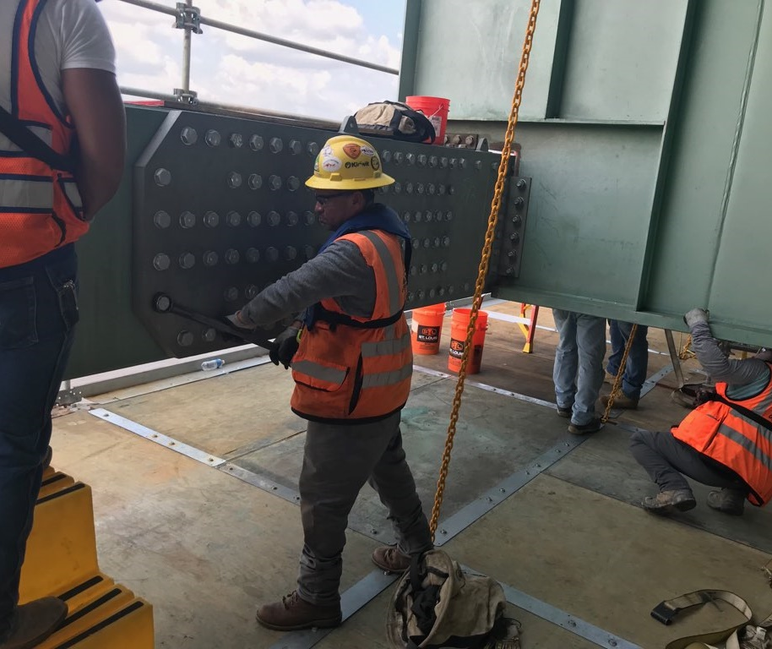
Slip-Critical Connections
Pretensioned high-strength bolted connections in beam or girder bridges that are designed as slip-critical connections are to be proportioned to prevent slip under the factored loads during the concrete deck placement [1.25DC + 1.5C – AASHTO LRFD Article 3.4.2.1 – 10th Edition and Lesson 7].
Such connections, except for connections of lateral bracing members, are also to be proportioned to prevent slip under Load Combination Service II [1.0DC + 1.0DW + 1.3(LL+IM) – Lesson 3], and to provide bearing, shear, and tensile resistance at the applicable strength limit state load combinations assuming the connection has slipped and gone into bearing against the connected material (AASHTO LRFD Article 6.13.2.2).
Notes:
To control deformations during the deck placement caused by slip in the joints that could adversely affect the geometry of the structure, pretensioned high-strength bolted connections in beam or girder bridges that are designed as slip-critical connections, i.e., diaphragm, cross-frame or lateral bracing members that are provided with oversize or slotted holes in the connections and bolted field splices, are to be proportioned to prevent slip under the factored loads during the deck placement. The Strength I load combination specified in AASHTO LRFD Article 3.4.2.1 is to be applied for the investigation of connection slip during the deck placement (10th Edition). The use of only the Strength I load combination of (1.25DC + 1.5C) specified in Article 3.4.2.1 is felt to be more reasonable for checking slip than also considering the additional load combination of 1.4(DC + C) specified in the same article, where C represents any construction loads including any dynamic effects (if applicable) (Lesson 7). Wind load for the active work zone condition during the deck placement as defined in the AASHTO Guide Specifications for Wind Loads on Bridges During Construction should also be considered in proportioning such connections in diaphragm, cross-frame, and lateral bracing members (using the Strength III load combination – Lessons 3 and 7).
To control permanent deformations under overloads caused by slip in joints that could adversely affect the serviceability of the structure, pretensioned high-strength bolted connections in beam or girder bridges that are designed as slip-critical connections, except for connections of lateral bracing members, are also to be proportioned to prevent slip under Load Combination Service II [1.0DC + 1.0DW + 1.3(LL+IM) – Lesson 3]. This provision need not be applied to slip-critical connections in lateral bracing members as the consequence of any slip in the connections of these members is not likely to be detrimental to the serviceability of the structure under this load condition. The connections affected by this provision must also be checked for the applicable strength limit state load combinations specified in AASHTO LRFD Table 3.4.1-1, assuming the connection has slipped at these high loads and gone into bearing against the connected material (AASHTO LRFD Article 6.13.2.2).
The photo on this slide shows an ironworker holding the head of a high-strength bolt while it is being tensioned from the inside of a box member.
Photo credit: Michael Baker International

Slide 10
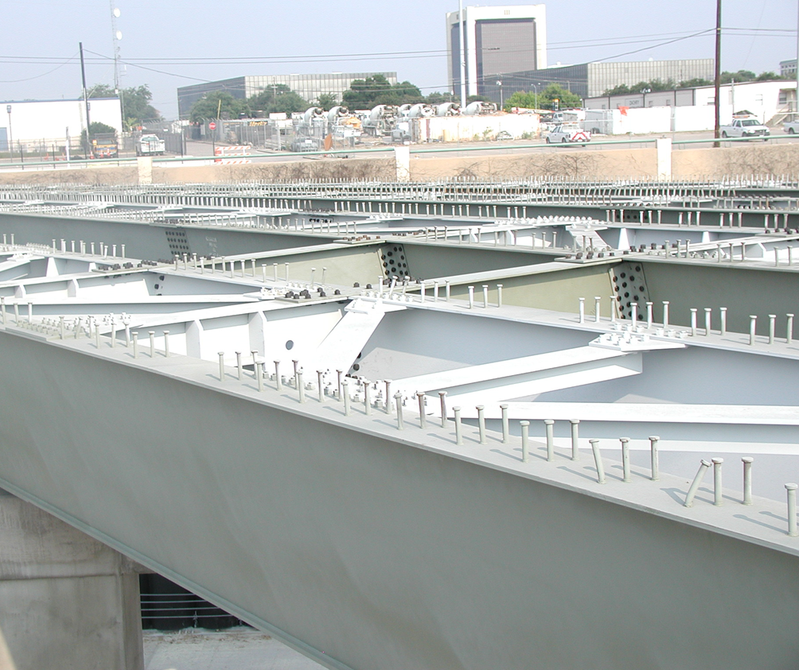
Slip-Critical Connections
Joints of diaphragm, cross-frame, and lateral bracing members in beam or girder bridges with pretensioned high-strength bolts installed in standard holes should be designed only as bearing-type connections (AASHTO LRFD Article 6.13.2.1.1 - 10th Edition).
Field experience has indicated that slip in these connections is not likely and that any slip that may occur in these connections is not anticipated to be detrimental to the geometry or serviceability of the structure.
Faying surfaces of joints that are designed as bearing-type connections need not satisfy the surface condition preparation specified in AASHTO LRFD Article 6.13.2.8 for slip-critical connections; coatings are permitted in bearing-type connections.
Notes:
AASHTO LRFD Article 6.13.2.1.1 (10th Edition) specifies that joints of diaphragm, cross-frame, and lateral bracing members in beam or girder bridges with pretensioned high-strength bolts installed in standard holes do not need to be designed as slip-critical connections as field experience has indicated that slip is not likely and that any slip that may occur in these connections is not anticipated to be detrimental to the geometry or serviceability of the structure.
Faying surfaces of joints that are designed as bearing-type connections need not satisfy the surface condition preparation specified in AASHTO LRFD Article 6.13.2.8 for slip-critical connections; coatings are permitted in bearing-type connections.
Top-flange lateral bracing members in steel tub girders (refer to the photo on this slide) are typically shop-installed with standard holes provided in the connections, and therefore need not be designed as slip-critical connections unless specified otherwise by the Owner. Field-installed lateral bracing members in beam or girder bridges with oversize holes provided in the connection of the bracing member to the lateral connection plate or to the flange, as applicable, to aid in fit-up are to be designed as slip-critical connections under the factored loads during the deck placement.
Photo credit: HDR

Slide 11
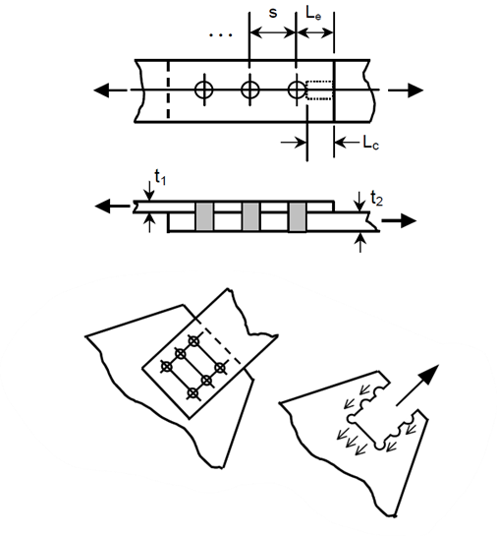
Bearing-Type Connections
In bolted bearing-type connections, the load is resisted by shear in the bolt and bearing on the connected material, plus some uncertain amount of friction between the faying surfaces.
The final failure will be by shear failure of the connectors, by tear out of the connected material, or by unacceptable ovalization of the holes. The final failure load is independent of the clamping force provided by the bolts.
Bearing-type connections are permitted only for joints subjected to axial compression, or for joints of diaphragm, cross-frame, or lateral bracing members in beam or girder bridges with high-strength bolts installed in standard holes (AASHTO LRFD Article 6.13.2.1.2 – 10th Edition).
The factored resistance, R_{r}, of bearing-type connections is determined as specified in AASHTO LRFD Article 6.13.2.2 for bolted connections at the strength limit state. High-strength bolted bearing-type connections are to be fully pretensioned.
Notes:
In bolted bearing-type connections, the load is resisted by shear in the bolt and bearing on the connected material, plus some uncertain amount of friction between the faying surfaces. The final failure of a bearing-type connection will be by shear failure of the connectors, by tear out of the connected material, or by unacceptable ovalization of the holes. The final failure load is independent of the clamping force provided by the bolts.
AASHTO LRFD Article 6.13.2.1.2 (10th Edition) specifies that bearing-type connections are permitted only for joints subjected to axial compression, or for joints of diaphragm, cross-frame, or lateral bracing members in beam or girder bridges with high-strength bolts installed in standard holes. The factored resistance, Rr, of bearing-type connections is determined as specified in AASHTO LRFD Article 6.13.2.2 for bolted connections at the strength limit state. High-strength bolted bearing-type connections are to be fully pretensioned.
Where permissible, connections using ASTM A307 bolts (Slide 18) or nonpretensioned high-strength bolts are to be designed as bearing-type connections.

Slide 12
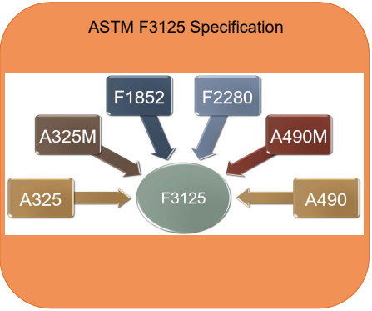
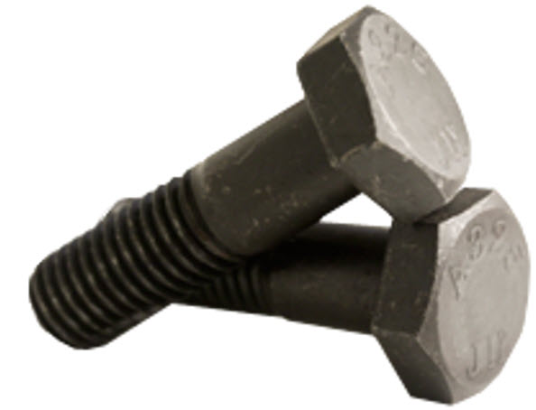
High-Strength Bolts - ASTM F3125 Specification
Notes:
High-strength bolts are heavy hexagon-head bolts used with heavy semi-finished hexagon nuts that were first introduced in the early 1950s as a replacement for rivets. The threaded portion of high-strength bolts is typically shorter than for bolts used for nonstructural applications, which reduces the probability of having the threads present in the shear plane. High-strength bolts produce large and predictable tension when tightened. Initial tensioning of high-strength bolts results in more rigid joints and greater assurance against nut loosening in connections subject to slip or vibration.
The ASTM F3125 specification is a structural bolt specification first introduced in January 2015 that bundles the former six separate ASTM specifications for high-strength bolts together into a single specification. The intent of the ASTM F3125 specification was to streamline and unify language and requirements for structural bolts and to simplify specification maintenance. The ASTM F3125 specification contains nearly all the previous technical requirements, but adds numerous needed changes, simplifications, and improvements, and does so in a very efficient manner. The specification includes a coating Annex A1 and nut over-tap guidance for recently added fastener coatings and includes an Appendix A2 giving required rotational capacity testing requirements for the fastener assemblies by the Manufacturer.
Figure Source: C.M. Larsen, LeJeune Bolt Company

Slide 13
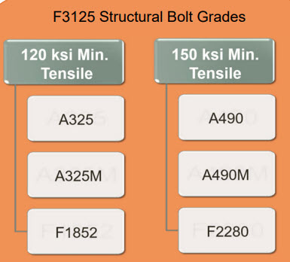
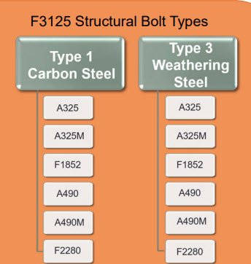
High-Strength Bolts - ASTM F3125 Specification
Notes:
The grades within the ASTM F3125 specification are called names that were used in previous specifications. For example, an A325 bolt is designated as Grade A325. Therefore, such a bolt is specified as an ASTM F3125 Grade A325 bolt. The “M” designation on Grade A325M and A490M bolts represents the metric version of these bolts, which are not typically utilized in steel bridge construction. ASTM F3125 bolts will have head markings reflecting the grade of the bolts; therefore, an ASTM F3125 Grade A325 bolt will look identical to a bolt meeting the old ASTM A325 standard.
Tension-control or so-called "twist-off fasteners“ rely on a controlled torque-to-tension relationship to automatically provide the required tension or indirectly indicate the bolt tension during the installation. The splined end of the fastener shears off during installation when the required tension has been achieved. ASTM specifications for the twist-off equivalent for A325 and A490 bolts have existed for several years and are referred to as Grades F1852 and F2280, respectively, in the ASTM F3125 standard.
As specified in AASHTO LRFD Table 6.4.3.1.1-1 (Slide 15), a single specified minimum tensile strength level of 120 ksi applies for Grade A325 bolts and their twist-off equivalents. For Grade A490 bolts and their twist-off equivalents, the single specified minimum tensile strength level is 150 ksi.
Both Type 1 and Type 3 bolts are specified in the standard. Type 1 bolts are to be used with steels other than weathering steels and is the type of bolt furnished if not otherwise specified. Type 3 bolts have an atmospheric corrosion resistance and weathering characteristics comparable to weathering steels and are to be used only in weathering steel applications.
Figure Source: C.M. Larsen, LeJeune Bolt Company

Slide 14
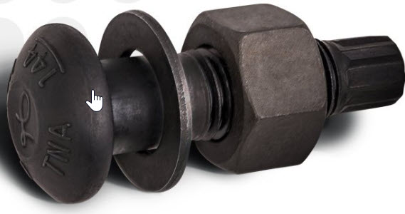
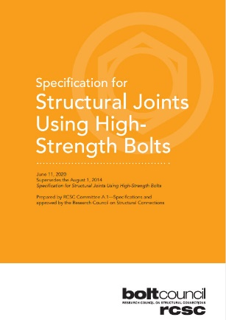
High-Strength Bolts - ASTM F3148 Specification
ASTM F3148 high-strength torque-and-angle bolts first became an ASTM Standard in 2015, were included in the 2020 RCSC Specification, and are included in the 10th Edition AASHTO LRFD BDS.
ASTM F3148 bolts look like twist-off bolts, however, the splined end is not intended to shear off.
The splined end is for torque reaction to permit one-side tensioning; installed by a torque-and-angle method, or the so-called “combined method” of installation.
The specified minimum tensile strength of the bolts is 144 ksi.
Notes:
ASTM F3148 high-strength torque-and-angle bolts first became an ASTM Standard in 2015. The 2020 Research Council on Structural Connections (RCSC) Specification for Structural Joints Using High-Strength Bolts shown on this slide (available for free download from AISC at aisc.org/standards) includes ASTM F3148 bolts, and they are also included in the 10th Edition AASHTO LRFD BDS. Both Type 1 and Type 3 bolts are available.
ASTM F3148 bolts look like a twist-off bolt, however, the splined end is not intended to shear off, and its presence is for torque reaction for one-side tensioning, which is a distinct advantage. Additionally, these bolts are meant to be tensioned via a torque-and-angle method only – also referred to as the so-called “combined method” of installation. Rotation capacity testing of ASTM F3148 fastener assemblies by the Manufacturer is required in accordance with Annex A1 of the ASTM F3148 Specification.
The specified minimum tensile strength of ASTM F3148 bolts of 144 ksi is in-between the strength levels of ASTM F3125 Grade A325 and A490 bolts, as shown on the next slide.
Figure Source: C.M. Larsen, LeJeune Bolt Company

Slide 15
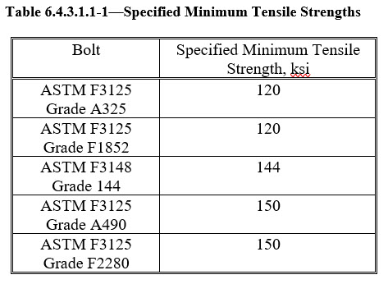
High-Strength Bolts – Tensile Strength
Nuts and hardened washers used with high-strength bolts are as listed in ASTM F3125 or ASTM F3148 as recommended or suitable for the bolt. Specific requirements for hardened washers used in high-strength bolted connections are specified in Article 17.7.4.1 of the AASHTO LRFD Steel-Bridge Fabrication Specifications.
Notes:
This slide shows AASHTO LRFD Table 6.4.3.1.1 (10th Edition), which lists the specified minimum tensile strengths, F_{ub}, in ksi for the different grades of ASTM F3125 and ASTM F3148 bolts. Note that the latest 2022 AISC Specification groups high-strength bolts according to their material strength (i.e., Group 120, Group 144, and Group 150 bolts) instead of using the “Grade” designations shown in the table on this slide. The designations are equivalent.
Nuts and hardened washers used with high-strength bolts are as listed in the ASTM F3125 or ASTM F3148 Specifications as recommended or suitable for the bolt. Different grades of high-strength bolts are combined with various heavy hexagon-shaped nuts, which guarantee failure by bolt yielding rather than by stripping of the nut threads. Specific requirements for hardened washers used in high-strength bolted connections are specified in Article 17.7.4.1 of the AASHTO LRFD Steel-Bridge Fabrication Specifications. Note that ASTM F436 weathering steel washers should be used in conjunction with Type 3 high-strength bolts.
Alternative fasteners satisfying the requirements of the ASTM F3125, or ASTM F3148 Specifications, may be used subject to the approval of the Engineer.

Slide 16
High-Strength Bolts – Coating Options
The Engineer should refer to the latest versions of the ASTM F3125 and ASTM F3148 Specifications for permissible corrosion-resistant coating options for high-strength bolts.
High-strength bolts with a specified minimum tensile strength of 120 ksi may be:
  Mechanically galvanized per the ASTM B695 Specification;
  Hot-dip galvanized per the ASTM F2329 Specification, or;
  Coated with zinc/aluminum coatings per the ASTM F1136, ASTM F2833, or ASTM F3019 Specifications.
High-strength bolts with a specified minimum tensile strength of 144 ksi may be:
  Mechanically galvanized per the ASTM B695 Specification, or;
  Coated with zinc/aluminum coatings per the ASTM F1136 or ASTM F2833 Specifications.
High-strength bolts with a specified minimum tensile strength of 150 ksi may be:
  Coated with zinc/aluminum coatings per the ASTM F1136, ASTM F2833, or ASTM F3019 Specifications.
  Galvanizing is not an acceptable option due to the potential for hydrogen embrittlement.
Notes:
This slide reviews the various corrosion-resistant coating options for high-strength bolts. The Engineer should refer to the latest versions of the ASTM F3125 and ASTM F3148 Specifications for permissible coating options. High-strength bolts with a specified minimum tensile strength of 120 ksi may be mechanically galvanized per the ASTM B695 Specification, hot-dip galvanized per the ASTM F2329 Specification, or coated with zinc/aluminum coatings per the ASTM F1136, ASTM F2833, or ASTM F3019 Specifications. High-strength bolts with a specified minimum tensile strength of 144 ksi may be mechanically galvanized per the ASTM B695 Specification or coated with zinc/aluminum coatings per the ASTM F1136 or ASTM F2833 Specifications. High-strength bolts with a specified minimum tensile strength of 150 ksi may be coated with zinc/aluminum coatings per the ASTM F1136, ASTM F2833, or ASTM F3019 Specifications. Galvanizing is not an acceptable for high-strength bolts with a specified minimum tensile strength of 150 ksi due to the potential for hydrogen embrittlement.
When galvanized ASTM F3125 Grade A325 bolts (i.e., 120 ksi bolts) are used on weathering steel projects, only hot-dip galvanized bolts should be used as the relatively thin sacrificial coating on mechanically galvanized bolts will corrode too quickly in an uncoated weathering steel application. Galvanized bolts must be tension tested after galvanizing. The bolts, nuts, and washers in any assembly must be galvanized using the same process. Nuts to be galvanized must be heat-treated Grade DH nuts and must be lubricated with a lubricant containing a visible dye. To accommodate the relatively thick non-uniform zinc coatings on bolt threads during hot-dip galvanizing, the blank nut is typically hot-dip galvanized and then tapped over-size. This results in a reduction in the thread engagement and the resulting stripping strength. Only the stronger hardened nuts (Grade DH) have adequate strength to meet ASTM thread-strength requirements after over-tapping. Less over-tapping is usually required for mechanically galvanized nuts. Galvanizing increases the friction between the bolt and nut threads, as well as the variability of the torque-induced pretension. If the nuts are lubricated, a lower required torque and more consistent results are obtained. Therefore, the Manufacturer must test a galvanized bolt, lubricated galvanized nut, and a galvanized washer in an assembled steel joint prior to shipment (i.e., rotational capacity testing) to show that the galvanized nut with the lubricant provided can be rotated from the snug-tight condition well beyond the rotation required for pretensioned installation without stripping. Black bolts should be oily to the touch when delivered and installed.

Slide 17
High-Strength Bolts – Installation Methods
Pretensioning Methods:
Calibrated Wrench Method―pretensioning technique that relies upon application of an installation wrench that has been calibrated to provide the required pretension in a bolting assembly.
Combined Method―pretensioning technique that relies upon application of an installation wrench that has been calibrated to provide the initial torque to attain the required initial tension, followed by the application of the determined relative rotation between a bolt and nut.
Direct Tension Indicator (DTI) Method―pretensioning technique that relies upon deformation of the protrusions of a direct tension indicator.
Turn-of-Nut Method―pretensioning technique that relies upon application of a designated amount of relative rotation between bolt and nut.
Twist-Off Tension Control Bolt Method―Pretensioning technique that relies upon the application of torque to the nut that causes the removal of the spline by the installation wrench.
Notes:
High-strength bolts must be installed to the minimum required pretension values specified in AASHTO LRFD Table 6.13.2.8-1 (Slide 40). The 2020 RCSC Specification recognizes five different pretensioning methods for the installation of high-strength bolts that are used in practice and defines them as shown on this slide. The original installation method for high-strength bolts was the Calibrated Wrench Method, followed by the introduction of the Turn-of-Nut Method in 1960, which is commonly used in practice. The Turn-of-Nut Method obtains the pretension by a specified rotation of the nut from the “snug tight condition,” which is defined as the condition in which the plies have been brought into firm contact and each bolting assembly has at least the tightness attained with either a few impacts of an impact wrench, resistance to a suitable non-impacting wrench, or the full effort of an ironworker using an ordinary spud wrench.
Direct Tension Indicators (DTIs) are washer-shaped devices with protrusions on one face that measure load by compressing the protrusions on the DTI during the installation with a proportional reduction in the gap in the spaces between the protrusions. DTIs must conform to the ASTM F959 Specification and may be used in conjunction with bolts, nuts, and washers. Attaining the required tension is verified by the number of “gauge refusals,” which are gaps that are too tight to permit the insertion of a feeler gauge of the prescribed thickness. A DTI affixed to a hardened heavy hex nut by the fastener manufacturer is referred to as a captive DTI/nut. An assembly which incorporates a self-indicating feature to signal sufficient compression of the protrusions is referred to as a self-indicating DTI. Both are permitted for use in the AASHTO LRFD BDS (Article 6.4.3.1.4).
Regardless of the method used, the final tightening sequence should proceed in an orderly fashion from the most rigid part of the connection progressing systematically toward the less rigid areas or free edges. ASTM F3125 Grades A490, F1852, and F2280 fasteners, and galvanized ASTM F3125 Grade A325 fasteners are not to be reused. Other ASTM F3125 Grade A325 bolts may be reused if approved by the Engineer.
Additional more detailed information on each of these high-strength bolt installation procedures and bolt inspection procedures (including required rotational-capacity testing) may be found in the 2020 RCSC Specification and in the AASHTO LRFD Steel-Bridge Fabrication Specifications.

Slide 18
Low-Strength Steel Bolts
Low-strength steel bolts used as structural fasteners, also referred to as unfinished, common, machine, ordinary, or rough bolts, manufactured from low-carbon steel are to conform to ASTM A307 Grade A or B or an equivalent alternative subject to the approval of the Engineer (AASHTO LRFD Article 6.4.3.2).
The specified minimum tensile strength of ASTM A307 bolts (Grade A and B) is to be taken as 60 ksi.
These bolts are typically tightened using long-handled manual wrenches (i.e., they are not pretensioned) and hardened steel washers are not generally used.
These bolts should only be used for connecting relatively light auxiliary components or members subject to light static loads or for temporary fit-up. These bolts should not be used in connections subject to slip, vibration, or fatigue in axial tension because they are not pretensioned and there is a tendency of the nuts to loosen.
Notes:
AASHTO LRFD Article 6.4.3.2 specifies that low-strength steel bolts used as structural fasteners, also referred to as unfinished, common, machine, ordinary, or rough bolts, manufactured from low-carbon steel are to conform to ASTM A307 Grade A or B or an equivalent alternative subject to the approval of the Engineer. The specified minimum tensile strength of ASTM A307 bolts (Grade A and B) is to be taken as 60 ksi. These bolts are typically tightened using long-handled manual wrenches (i.e., they are not pretensioned) and hardened steel washers are not generally used. These bolts should only be used for connecting relatively light auxiliary components or members subject to light static loads or for temporary fit-up. These bolts should not be used in connections subject to slip, vibration, or fatigue in axial tension because they are not pretensioned and there is a tendency of the nuts to loosen.
AASHTO LRFD Article 6.13.2.5 specifies some specific requirements regarding the size of bolts. Bolts are not to be less than 0.625 in. in diameter. Bolts 0.625 in. in diameter are not to be used in primary members, except for 2.5-in. legs of angles and in flanges of sections whose dimensions require 0.625-in. bolts to satisfy other detailing provisions given in the specifications. Structural shapes that do not permit the use of 0.625-in. bolts are to be limited to use in handrails.

Slide 19
Fatigue Resistance of Bolted Connections (Shear)
High-strength bolted slip-critical connections subjected to shear and designed based on the gross section (i.e., stress ranges in the base metal computed on the gross section) and bearing-type connections subjected to shear and designed based on the net section (i.e., stress ranges in the base metal computed on the net section) provide approximately the same nominal fatigue resistance (i.e., Detail Category B – Lesson 7).
The preceding assumes the connections are made with pretensioned high-strength bolts and that the bolts are installed in holes drilled full size or subpunched and reamed to size.
Should the bolts be installed in holes punched full size, the connection for each of the above cases is instead to be designed for fatigue based on Detail Category D.
The base metal at the net section of other mechanically fastened joints, except for eyebars and pin plates; e.g., joints using ASTM A307 bolts or non-pretensioned high-strength bolts is also to be designed for fatigue based on Detail Category D.
Notes:
The behavior of a bolted connection under fatigue loading in shear is influenced by the type of load transfer in the connection. In tests of slip-critical lap joints subject to in-plane cyclic loading, crack initiation and growth typically occurred in the gross section in front of the first bolt hole of the connection. The cracks initiated on the faying surfaces. Failures that occur at the interface of metallic surfaces that are in contact and that slip a small amount relative to each other under an oscillating load are referred to as fretting failures. In bearing-type connections where the load is transmitted primarily by shear and bearing, the crack typically initiates instead at the edge of the bolt hole and grows in the region of the net section, with failure eventually occurring due to fracture of the net section. However, it was observed that slip-critical connections designed based on the gross section (i.e., stress ranges in the base metal computed on the gross section) and bearing-type connections designed based on the net section (i.e., stress ranges in the base metal computed on the net section) provide approximately the same nominal fatigue resistance. It was determined that fatigue Detail Category B (AASHTO LRFD Table 6.6.1.2.3-1 – Section 2 - Conditions 2.1 and 2.2 – Lesson 7) provides a reasonable and conservative lower bound to the test data in both cases. The preceding assumes the connections are made with pretensioned high-strength bolts and that the bolts are installed in holes drilled full size or subpunched and reamed to size.
Should the bolts be installed in holes punched full size (e.g., bracing member connections), the connection for each of the above cases is instead to be designed for fatigue based on Detail Category D (AASHTO LRFD Table 6.6.1.2.3-1 – Condition 2.3). The base metal at the net section of other mechanically fastened joints, except for eyebars and pin plates; e.g., joints using ASTM A307 bolts or non-pretensioned high-strength bolts is also to be designed for fatigue based on Detail Category D (Condition 2.3).
Axially loaded joints subject to fatigue loading in direct tension (versus shear), in addition to prying action, are treated differently according to the provisions of AASHTO LRFD Article 6.13.2.10.3 (Slide 57).

Slide 20
Bolt Holes - Types
Standard holes are to be used in high-strength bolted connections, unless specified otherwise (AASHTO LRFD Article 6.13.2.4.1a). Unless expressly permitted otherwise by the contract documents, standard holes are to be used in connections in horizontally curved bridges (AASHTO LRFD Article 6.13.1).
Oversize holes may be used in any or all plies of slip-critical connections but are not to be used in bearing-type connections (AASHTO LRFD Article 6.13.2.4.1b).
Short-slotted holes may be used in any or all plies of slip-critical or bearing-type connections. The slots may be used without regard to direction of loading in slip-critical connections, but the length must be normal to the direction of the load in bearing-type connections (AASHTO LRFD Article 6.13.2.4.1c).
Long-slotted holes may be used in only one ply of either a slip-critical or bearing-type connection. Long-slotted holes may be used without regard to direction of loading in slip-critical connections but must be normal to the direction of load in bearing-type connections (AASHTO LRFD Article 6.13.2.4.1d).
Notes:
AASHTO LRFD Article 6.13.2.4.1a specifies that standard holes are to be used in high-strength bolted connections, unless specified otherwise. AASHTO LRFD Article 6.13.1 states that unless expressly permitted otherwise by the contract documents, standard holes are to be used in connections in horizontally curved bridges. This helps to ensure that the steel fits together in the field during erection. Curved girders depend on their connections to adjacent girders through bracing members for their stability. Therefore, cross-frames/diaphragms on curved girders should be firmly connected to the girders in order for the girders to remain stable during erection. Loosely connected cross-frames/diaphragms and oversize or slotted holes are not recommended for use in horizontally curved bridges as they may compromise the girder alignment and plumbness, making cross-frame/diaphragm fit-up difficult.
AASHTO LRFD Article 6.13.2.4.1b specifies that oversize holes may be used in any or all plies of slip-critical connections but are not to be used in bearing-type connections.
AASHTO LRFD Article 6.13.2.4.1c specifies that short-slotted holes may be used in any or all plies of slip-critical or bearing-type connections. The slots may be used without regard to direction of loading in slip-critical connections, but the length must be normal to the direction of the load in bearing-type connections.
AASHTO LRFD Article 6.13.2.4.1d specifies that long-slotted holes may be used in only one ply of either a slip-critical or bearing-type connection. Long-slotted holes may be used without regard to direction of loading in slip-critical connections but must be normal to the direction of load in bearing-type connections.
Vertical slotted holes for cross-frame connections have sometimes been used in straight skewed I-girder bridges in an attempt to minimize the twist of the girders to aid in fit-up and to reduce the cross-frame forces. Such an approach is not recommended as it becomes difficult to control the vertical deflections during the deck placement and care must be taken to ensure the construction plan reflects the analysis assumptions made as to when the bolts are to be tightened.

Slide 21
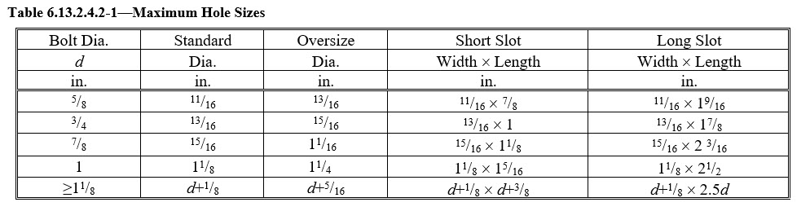
Bolt Holes - Size
The maximum permitted size of standard, oversize, short-slotted, and long-slotted holes is given in AASHTO LRFD Table 6.13.2.4.2-1. In the table, d is the nominal diameter of the bolt.
For design calculations, the width of standard bolt holes is to be taken as the nominal diameter of the hole. The width of oversize and slotted holes is to be taken as the nominal diameter or width of the hole, as applicable (AASHTO LRFD Article 6.8.3).
Notes:
The maximum permitted size of standard, oversize, short-slotted and long-slotted holes is specified in AASHTO LRFD Table 6.13.2.4.2-1, as shown on this slide. In the table, d is the nominal diameter of the bolt.
AASHTO LRFD Article 6.8.3 specifies that for design calculations, the width of standard bolt holes is to be taken as the nominal diameter of the hole. The width of oversize and slotted holes is to be taken as the nominal diameter or width of the hole, as applicable, as given in AASHTO LRFD Table 6.13.2.4.2-1.
For bolts greater than or equal to 1 in. in diameter, the maximum size of the hole is equal to the nominal diameter of the bolt plus 1/8 in., which eliminates the need to field ream holes to fit large-diameter hot-forged bolts, which often have a longitudinal forging seam that interferes with holes 1/16 in. larger than the bolt diameter.

Slide 22
Bolt Spacing – Minimum Spacing & Clear Distance
The minimum spacing between centers of bolts in standard holes is not to be less than 3.0d, where d is the nominal diameter of the bolt (AASHTO LRFD Article 6.13.2.6.1).
The minimum clear distance, L_{c}, between the edges of adjacent bolt holes in the direction of the force and transverse to the direction of the force is not to be less than 2.0d when oversize or slotted holes are used.
Notes:
AASHTO LRFD Article 6.13.2.6.1 specifies that the minimum spacing between centers of bolts in standard holes is not to be less than 3.0d, where d is the nominal diameter of the bolt.
The minimum clear distance, L_{c}, between the edges of adjacent bolt holes in the direction of the force and transverse to the direction of the force is not to be less than 2.0d when oversize or slotted holes are used.

Slide 23
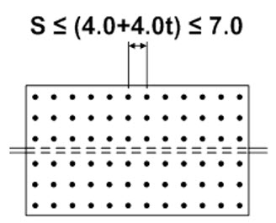
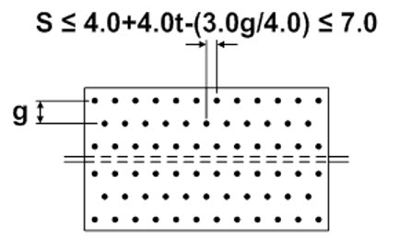
Bolt Spacing –Sealing Requirements
To seal against the penetration of moisture in joints, the spacing, s, of a single line of bolts adjacent to a free edge of an outside plate or shape must satisfy the following requirement (AASHTO LRFD Article 6.13.2.6.2):
Where there is a second line of bolts uniformly staggered with the line adjacent to the free edge, at a gage less than 1.5 + 4.0t, the staggered spacing, s, in the two lines considered together must satisfy the following requirement:
where:
g = gage between bolts (in.)
where:
t = thickness of the thinner outside plate or shape (in.)
Notes:
AASHTO LRFD Article 6.13.2.6.2 specifies that to seal against the penetration of moisture in joints, the spacing, s, of a single line of bolts adjacent to a free edge of an outside plate or shape must satisfy the top equation shown on this slide, where t is the thickness of the thinner outside plate or shape in inches. Where there is a second line of bolts uniformly staggered with the line adjacent to the free edge, at a gage less than 1.5 + 4.0t, the staggered spacing, s, in the two lines considered together must satisfy the bottom equation shown on this slide, where g is the gage between bolts. The staggered spacing need not be less than one-half the requirement for a single line. The maximum permissible spacing in both cases is 7.0 inches.
In uncoated weathering steel structures, it is critical that the bolt spacing be such that the connection joint is tight and excess moisture cannot enter between the plies of material. If sufficient moisture enters the joint, the resulting corrosion may cause prying, or pack-out, of the joint or bolt failure. The maximum spacing requirements for sealing bolts, given on this slide, automatically satisfy bolt spacing guidelines that were separately developed to ensure proper tightness and stiffness of uncoated weathering steel bolted joints to avoid joint prying and corrosion pack-out.

Slide 24
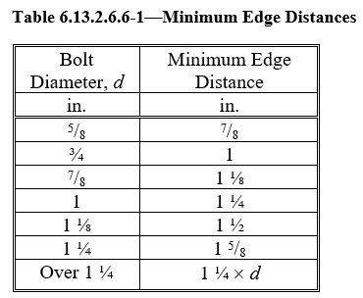
Bolt Spacing – Edge & End Distance
The edge distance of bolts is defined as the distance perpendicular to the line of force between the center of a hole and the edge of a component. The minimum edge distance is a function of the nominal diameter of the bolt, d (AASHTO LRFD Article 6.13.2.6.6).
The maximum edge distance is not to be more than the lesser of eight times the thickness of the thinnest outside plate and 5.0 in.
The end distance of bolts is defined as the distance along the line of force between the center of a hole and the end of the component. The minimum and maximum end distances are to be taken the same as specified for the edge distance (AASHTO LRFD Article 6.13.2.6.5).
Notes:
As shown in the figure on this slide, the edge distance of bolts is defined as the distance perpendicular to the line of force between the center of a hole and the edge of the component. The minimum edge distance is a function of the nominal diameter of the bolt, d, as specified in AASHTO LRFD Table 6.13.2.6.6-1 (also shown on this slide). AASHTO LRFD Article 6.13.2.6.6 specifies that the maximum edge distance is not to be more than the lesser of eight times the thickness of the thinnest outside plate and 5.0 inches.
As shown in the figure on this slide, the end distance of bolts is defined as the distance along the line of force between the center of a hole and the end of a component. AASHTO LRFD Article 6.13.2.6.5 specifies that the minimum and maximum end distances are to be taken the same as specified for the edge distance. Further, when oversize or slotted holes are used, the minimum clear end distance, which is defined as the distance between the edge of the bolt hole and the end of the member, must not be less than the bolt diameter.
The minimum edge and end distance requirements specified in AASHTO LRFD Table 6.13.2.6.6-1 are based on standard fabrication practices and workmanship tolerances and are equivalent to the requirements given in the AISC Specification. The provisions of AASHTO LRFD Article 6.13.2.9 related to the bearing resistance of bolt holes (refer to Slides 45 to 63 of this lesson) must be satisfied for all bolt holes and are used to ensure that sufficient end distances are provided such that bearing and tear-out limits are not exceeded for holes adjacent to all types of edges. It is recommended that edge and end distances larger than these specified minimum edge distances, but not exceeding the maximum edge and end distances specified herein, be permitted to help ensure that the specified minimum distances are not violated during fabrication after allowing for unavoidable workmanship tolerances.

Slide 25
Bolt Spacing – Maximum Pitch for Stitch Bolts
Stitch bolts are used to fasten together built-up compression or tension members where two or more plates or shapes are in contact (Lesson 12). A maximum pitch of the bolts is specified to ensure that the parts act as a unit and to prevent buckling of compression members. The pitch is not to exceed the maximum spacing specified for sealing bolts (Slide 23).
The pitch, p, of stitch bolts in built-up compression members is also not to exceed 12.0t, and the gage, g, between adjacent lines of bolts is not to exceed 24.0t. For two adjacent lines of staggered holes, the staggered pitch, p, of the stitch bolts must satisfy the following requirement (AASHTO LRFD Article 6.13.2.6.3):
At the ends of built-up compression members, the pitch, p, of the stitch bolts must not exceed 4.0d for a length equal to 1.5 times the maximum width of the member, where d is the nominal diameter of the bolt. Beyond this length, p may be increased gradually over a length equal to 1.5 times the maximum width of the member until the preceding maximum pitch requirements are reached (AASHTO LRFD Article 6.13.2.6.4).
Notes:
Stitch bolts are used to fasten together built-up compression or tension members where two or more plates or shapes are in contact (Lesson 12). A maximum pitch of the bolts, or distance between the centers of adjacent bolt holes along the line of force, is specified to ensure that the parts act as a unit and to prevent buckling of compression members. The pitch is not to exceed the maximum spacing specified for sealing bolts (Slide 23).
AASHTO LRFD Article 6.13.2.6.3 specifies that the pitch, p, of stitch bolts in built-up compression members is also not to exceed 12.0t, and the gage, g, between adjacent lines of bolts is not to exceed 24.0t. For two adjacent lines of staggered holes, the staggered pitch, p, of the stitch bolts must satisfy the requirement given by the equation shown on this slide. AASHTO LRFD Article 6.13.2.6.4 specifies that at the ends of built-up compression members, the pitch, p, of the stitch bolts must not exceed 4.0d for a length equal to 1.5 times the maximum width of the member, where d is the nominal diameter of the bolt. Beyond this length, p may be increased gradually over a length equal to 1.5 times the maximum width of the member until the preceding maximum pitch requirements are reached.
For built-up tension members, the pitch, p, must not exceed twice the maximum pitch specified above for compression members, and the gage, g, between adjacent lines of bolts must not exceed 24.0t. Again, the pitch is not to exceed the maximum specified for sealing bolts (Slide 23).
The pitch of the fasteners in the compression and tension flanges of built-up I-section flexural members should satisfy the maximum pitch requirements for stitch bolts in built-up compression members and tension members, respectively (AASHTO LRFD Article 6.10.1 – 10th Edition).

Slide 26
Design of Bolted Joints
Shear Resistance
Notes:
The next topic in this lesson will discuss the calculation of the factored shear resistance of bolted joints.

Slide 27
Shear Resistance
The factored shear resistance, R_{r}, of a bolt at the strength limit state is taken as (AASHTO LRFD Article 6.13.2.2):
where:
φ_{s} = resistance factor for bolts in shear = 0.80 for high-strength bolts and 0.75 for ASTM A307 bolts (AASHTO LRFD Article 6.5.4.2)
R_{n} = nominal shear resistance of the bolt determined as specified in AASHTO LRFD Article 6.13.2.7 (kips)
Notes:
AASHTO LRFD Article 6.13.2.2 specifies that the factored shear resistance, R_{r}, of a bolt at the strength limit state (in a slip-critical or bearing-type connection – Slides 7 to 11) is to be taken as the resistance factor for bolts in shear, φ_{s}, specified in AASHTO LRFD Article 6.5.4.2 (equal to 0.80 for ASTM F3125 and ASTM F3148 bolts and 0.75 for ASTM A307 bolts) times the nominal shear resistance of the bolt determined as specified in AASHTO LRFD Article 6.13.2.7. The shear failure of a bolt is illustrated in the figure at the bottom of this slide. The factored resistance equals the nominal shear resistance multiplied by a resistance factor less than that used to determine the factored resistance of a component. This ensures that the maximum strength of the bridge is limited by the strength of the main members rather than by the connections. The shear resistance of bolts is not affected by pretension in the fasteners, provided that the connected material is in contact at the faying surfaces.
Note that the shear resistance of anchor rods, which are not covered in this course, is specified in AASHTO LRFD Article 6.13.2.12. Anchor rods are covered in a separate article so that other requirements for high-strength bolts are not applied to anchor rods. The term “anchor rods,” which is used in the AASHTO LRFD Specifications, is considered synonymous with the term “anchor bolts,” which has also been used. Anchor rods conform to the ASTM F1554 specification.

Slide 28
Shear Resistance
The nominal shear resistance, R_{n}, of a bolt at the strength limit state in joints whose length between extreme fasteners measured parallel to the line of action of the force is less than or equal to 38.0 in. is taken as (AASHTO LRFD Article 6.13.2.7):
Where threads are excluded from the shear plane:
Where threads are included in the shear plane:
where:
A_{b} = area of the bolt corresponding to the nominal diameter (in.²)
F_{ub} = specified minimum tensile strength of the bolt determined as specified in AASHTO LRFD Table 6.4.3.1.1-1 for ASTM F3125 bolts and AASHTO LRFD Article 6.4.3.2 for ASTM A307 bolts (ksi)
N_{s} = number of shear planes per bolt
Notes:
AASHTO LRFD Article 6.13.2.7 specifies that the nominal shear resistance, R_{n}, of a high-strength bolt (ASTM F3125 or ASTM F3148 bolt) or an A307 bolt at the strength limit state in joints whose length between extreme fasteners measured parallel to the line of action of the force is less or equal to 38.0 in. is to be given by the equations shown on this slide. The equation to use depends on whether the threads are excluded from or included in the shear plane. The terms in the equations are as defined on the slide. When bolts are positioned so that they cross two planes of contact (i.e., N_{s} = 2), this is referred to as ′double shear.′ Double shear is a symmetrical loading situation with regard to the shear planes and direction of shear transfer. When there is a single plane of contact involved in the load transfer (i.e., N_{s} = 1), this is referred to as ′single shear,′ which is an unsymmetrical loading situation.
The nominal resistance in shear is based upon the observation that the shear resistance of a single high-strength bolt is about 0.625 times the tensile strength of that bolt. However, in lap splice tension or compression connections with more than two bolts in the line of force, deformation of the connected material causes nonuniform bolt shear force distribution so that the strength of the connection in terms of the average bolt strength decreases as the joint length increases. Rather than provide a function that reflects this decrease in average fastener strength with joint length, a single reduction factor of 0.90 is applied to the 0.625 multiplier (0.90 x 0.625 = 0.56). This accommodates bolts in joints up to 38.0 in. in length without seriously affecting the economy of very short joints.
The average value of the nominal resistance for bolts with threads in the shear plane has been determined by a series of tests to be 0.833 (0.6F_{ub}), with a standard deviation of 0.03. A value of about 0.80 was selected for the specification formula based upon the area corresponding to the nominal body area of the bolt (0.56 x 0.80 = 0.45). If the threads of a bolt are included in the shear plane in the joint, the shear resistance of the bolt in all shear planes of the joint is to be taken as the value for threads included in the shear plane. This is because of the uncertainty of the manner of sharing the load between the two shear areas. It also recognizes that knowledge about the bolt placement, which might leave both shear planes in the threaded section, is not ordinarily available to the designer.
For ASTM A307 bolts, shear design is to be based on the equation assuming threads are included in the shear plane. The threaded length of an ASTM A307 bolt is not as predictable as that of a high-strength bolt. Also, when the grip length of an ASTM A307 bolt exceeds 5.0 diameters, the nominal resistance is to be lowered one percent for each 1/16 in. of grip in excess of 5.0 diameters. This is because ASTM A307 bolts with a long grip tend to bend, thus reducing their resistance.

Slide 29
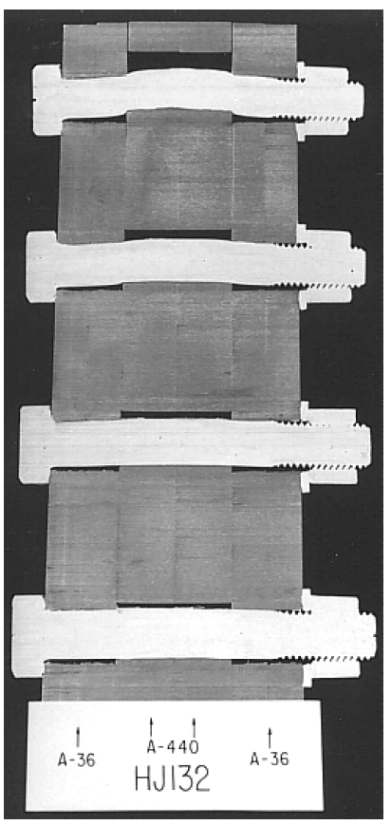
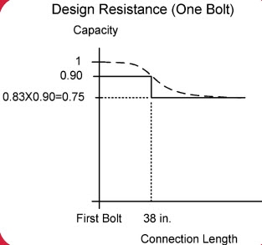
Shear Resistance – Long Connections
The nominal shear resistance, R_{n}, of a bolt in lap splice tension and compression connections greater than 38.0 in. in length is taken as 0.83 times the value from the preceding slide.
Notes:
For lap splice tension and compression connections, the shear resistance equations presented on the previous slide apply for connections whose length between extreme fasteners measured parallel to the line of action of the force is less than or equal to 38.0 in. For such connections, a single joint-length reduction factor of 0.90 is intrinsically applied to the 0.625 tensile-strength multiplier in the shear resistance equations to conservatively reflect the actual nonuniform bolt shear force distribution along the length of the connection moving away from the first bolt closest to the force, as reflected by the dashed curve shown in the plot. In lap splice tension and compression connections greater than 38.0 in. in length between extreme fasteners, in which the bolt force drops off more substantially, an overall joint-length reduction factor of 0.75 is conservatively applied. Thus, the nominal shear resistance values for the bolts given on the previous screen are externally multiplied by a factor of 0.83, or 0.75/0.90 in this case.
For flange splices, the 38.0-in. length is measured between the extreme bolts on only one side of the connection. The length reduction applies only to lap splice tension and compression connections and not to web shear-type connections; e.g., web splices. The reduction factor of 0.90 is retained for web shear-type connections since the distribution of the bolt forces is not necessarily uniform. However, a further reduction in the shear resistance based on the joint length is not necessary.
The photo on this slide of a sawn connection illustrates the bending that occurs in bolts in long connections. It is this bending that is accounted for by imposing a reduction in bolt strength on long connections.

Slide 30
Shear Resistance
Shear planes located in the transition length of high-strength bolts should be considered shear planes with the threads included (AASHTO LRFD Article 6.13.2.7 - 10th Edition).
The following guidance is provided for determining whether threads are excluded from or included in the shear plane considering the bolt transition length (AASHTO LRFD Article C6.13.2.7 – 10th Edition):
  Unless the use and position of washers and DTIs (Slide 17) is clearly identified in the contract documents, consider evaluating conditions with one washer and one DTI positioned under the bolt head adjacent to the thicker outer ply. The nominal thickness of the typical standard washer is 5/32 in. (or refer to ASTM F436/F436M for washer thicknesses). Refer to ASME B18.2.6 or manufacturer data for DTI dimensions. If DTIs will not be used, they need not be considered.
Notes:
High-strength bolts are commonly cold-formed with rolled threads. The manufacturing process requires a transition area between the bolt body and the rolled threads. The transition area is smaller than the shank of the bolt. If the shear plane falls in this area and the design calls for threads excluded from the shear plane, there may be a reduced nominal shear resistance. Shear planes located in the transition length of high-strength bolts have traditionally been treated as if the threads were excluded from the shear plane. Further evaluation of the transition area and the variations permitted in the manufacturing of bolts in the ASME B18.2.6 Specification have caused a more conservative approach to be taken in the 2020 RCSC Specification, such that shear planes located in the transition length of high-strength bolts should now be considered shear planes with the threads included, as stated in AASHTO LRFD Article 6.13.2.7 (10th Edition).
The 10th Edition AASHTO LRFD Article C6.13.2.7 provides some conservative guidance for determining whether threads are excluded from or included in the shear plane considering the bolt transition length. The 1st step is shown on this slide; the remaining steps follow on the next slide:
1. Unless the use and position of washers and DTIs (Slide 17) is clearly identified in the contract documents, consider evaluating conditions with and without one washer and one DTI positioned under the bolt head adjacent to the thicker outer ply. Refer to ASTM F436/F436M for washer thicknesses; the nominal thickness of the typical standard washer is 5/32 in. Refer to ASME B18.2.6 or manufacturer data for the appropriate DTI dimensions. If DTIs will not be used, they need not be considered.

Slide 31
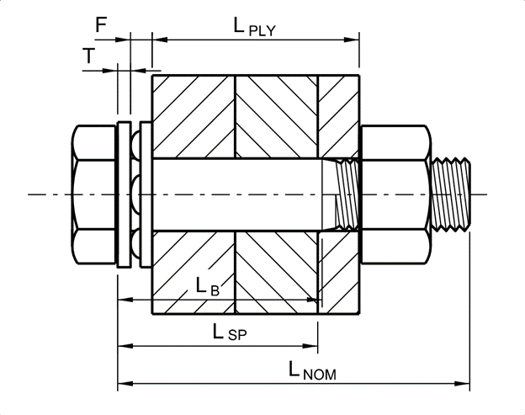
Shear Resistance
Transition length
Sum the grip length of the connection, i.e., the total nominal thickness of the connection plies, L_{PLY}, the thickness of the assumed washer, T, and DTI, F, if considered, plus an additional value specified in Table C-2.2 of the 2020 RCSC Specification for Structural Joints Using High-Strength Bolts.
Round up the sum to the next ¼-in. increment up to a bolt length of 6.0 in. and to the next ½-in. increment for longer bolts to determine the minimum nominal bolt length, L_{NOM}.
Determine the minimum bolt body length, i.e., the distance from the bolt head to the beginning of the transition length, L_{B MIN}, and compare that length to the location of the furthest shear plane measured from the bolt head, L_{SP}, to determine whether threads are excluded or included. L_{B MIN} may be calculated by subtracting the appropriate thread length, L_{T}, and transition thread length, Y, found in Table C-2.1 of the RCSC Specification from the calculated minimum nominal bolt length, L_{NOM}.
Notes:
Guidance for determining whether threads are excluded from or included in the shear plane considering the bolt transition length is continued from the preceding slide on this slide. Refer to the figure on this slide for illustration of the dimensions referred to in the following steps. The use of this guidance will be demonstrated in the example to follow:
2. Sum the grip length of the connection, i.e., the total nominal thickness of the connection plies, L_{PLY}, the thickness of the assumed washer, T, and DTI, F, if considered, plus an additional value specified in Table C-2.2 of the 2020 RCSC Specification.
3. Round up the sum to the next ¼-in. increment up to a bolt length of 6.0 in. and to the next ½-in. increment for longer bolts (per 2020 RCSC Article 2.7 Commentary) to determine the minimum nominal bolt length, L_{NOM}.
4. Determine the minimum bolt body length, i.e., the distance from the bolt head to the beginning of the transition length, L_{B MIN}, and compare that length to the location of the furthest shear plane measured from the bolt head, L_{SP}, to determine whether threads are excluded or included. L_{B MIN} may be calculated by subtracting the appropriate thread length, L_{T}, and transition thread length, Y, found in Table C-2.1 of the RCSC Specification from the calculated minimum nominal bolt length, L_{NOM}. L_{B MIN} can alternatively be determined directly from Table 2.1.9.2-1 of ASME B18.2.6 using the nominal bolt diameter and the calculated value of L_{NOM}.
Note that short high-strength bolts with lengths indicated in Table 2.5 of the 2020 RCSC Specification are fully threaded in accordance with ASME B18.2.6 and thus should be designed for threads included in the shear plane.

Slide 32
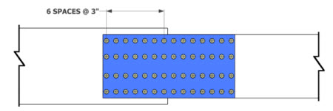
Shear Resistance - Example
Determine the factored shear resistance, R_{r}, of the high-strength bolts in the bottom-flange splice of a flexural member shown in the figure.
The splice is taken from the bolted field splice design example provided later on in this lesson (Slides 101 to 130).
The bolts are 7/8” diameter ASTM F3125 Grade A325 bolts (120 ksi bolts) placed in standard-size 15/16” diameter holes.
20” x 1-7/16”
24” x 2-1/4”
9” x 7/8”
20” x 13/16”
20” x 13/16”
Assume one standard-size washer is placed under the bolt head and that DTIs are not used.
Notes:
In this example, the factored shear resistance, R_{r}, will be determined for the high-strength bolts in the bottom flange splice of a flexural member shown in the figure on this slide. The splice is taken from the bolted field splice design example provided later on in this lesson (Slides 101 to 130). The bolts are 7/8-in. diameter ASTM F3125 Grade A325 bolts (120 ksi bolts) placed in standard-size 15/16” diameter holes. Assume one standard-size washer is placed under the bolt head and that DTIs are not used.
The bottom flange on the left-hand side of the splice is 20” x 1-7/16”. The bottom flange on the right-hand side of the splice is 24” x 2-1/4”. The outer flange splice plate is 20” x 13/16” (shown in blue). There are two 9” x 7/8” inner flange splice plates on either side of the girder web (also shown in blue). On the left-hand side of the splice, there is a 20” x 13/16” filler plate (shown in purple).
The longitudinal spacing of the bolts is 3.0 in., as shown in the plan view of the splice in the bottom figure on this slide. The total length of the connection on one side of the splice is 18.0 in., which is less than 38.0 in. Therefore, the joint length reduction factor of 0.83 (Slide 29) need not be applied in this case.

Slide 33
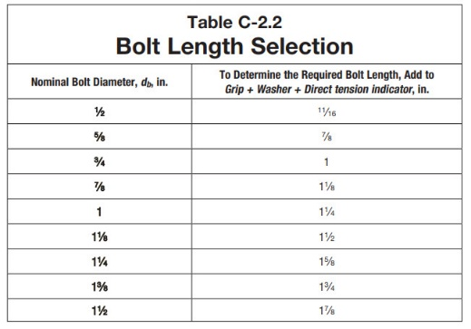
Shear Resistance - Example
Determine whether the threads are excluded from or included in the shear plane considering the bolt transition length.
20” x 1-7/16”
24” x 2-1/4”
9” x 7/8”
20” x 13/16”
20” x 13/16”
DTI shown but not used.
Notes:
First, determine whether the threads are excluded from or included in the shear plane considering the bolt transition length using the suggested guidance provided previously on Slides 30 and 31 of this lesson (AASHTO LRFD Article C6.13.2.7 – 10th Edition).
Compute the grip length of the connection i.e., the total nominal thickness of the connection plies, L_{PLY}. Referring to the figure of the splice in the upper right-hand corner of this slide, L_{PLY} is equal to the inner splice plate thickness of 7/8 in. plus the thickness of the bottom flange (or the bottom flange plus the filler plate) equal to 2-1/4 in. plus the thickness of the outer splice plate equal to 13/16 in. for a total of 3.9375 in.
The minimum bolt length, L_{MIN}, is taken equal to the grip length of the connection, L_{PLY}, plus the thickness of assumed standard-size washer equal to 5/32 in. plus an additional value of 1-1/8 in. specified in Table C-2.2 of the 2020 RCSC Specification for a 7/8-in. diameter bolt to allow for manufacturing tolerances and sufficient thread engagement with a heavy hex nut. The resulting L_{MIN} of 5.21875 in. is then rounded up to the nearest ¼ in., or 5-1/4 in., since the bolt length is less than 6.0 in. (per 2020 RCSC Commentary Article 2.7) to give the minimum nominal bolt length, L_{NOM}.
Note that subtracting the thickness, T, of the standard-size washer equal to 5/32 in. from the minimum nominal bolt length, L_{NOM}, gives a length of the bolt equal to 5.09 in., which is greater than the length of 2.0 in. for a fully threaded 7/8-in. diameter bolt taken from 2020 RCSC Specification Table 2.5. Therefore, the bolts are not fully threaded in this case.

Slide 34
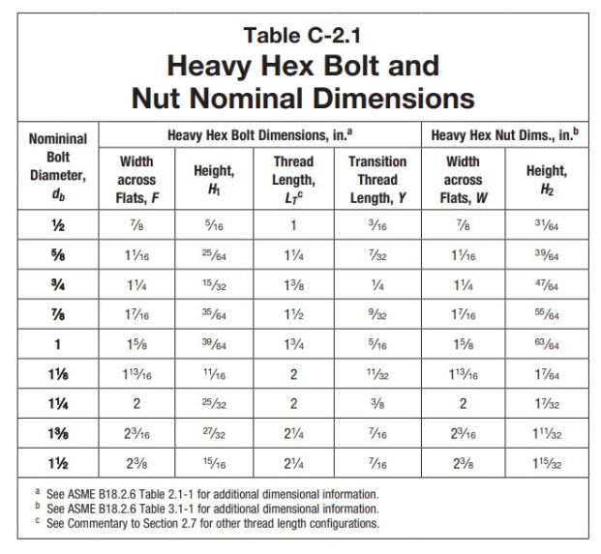
Shear Resistance - Example
20” x 1-7/16”
24” x 2-1/4”
9” x 7/8”
20” x 13/16”
20” x 13/16”
DTI shown but not used
∴ threads are excluded from the shear plane.
Notes:
Determine the minimum bolt body length, i.e., the distance from the bolt head to the beginning of the transition length, L_{B} _{MIN}, and compare that length to the location of the furthest shear plane measured from the bolt head, L_{SP}, to determine whether threads are excluded or included from the shear plane.
L_{B MIN} may be calculated by subtracting the appropriate thread length, L_{T}, and transition thread length, Y, found in Table C-2.1 of the RCSC Specification from the calculated minimum nominal bolt length, L_{NOM}. For a 7/8-in. diameter bolt, from 2020 RCSC Specification Table C-2.1, L_{T} is equal to 1-1/2 in. and Y is equal to 9/32 in. Subtracting these values from L_{NOM} of 5-1/4 in. from the preceding slide gives L_{B MIN} equal to 3.47 in. This agrees with the value of L_{B MIN} of 3.47 in. taken directly from Table 2.1.9.2-1 of ASME B18.2.6 using the nominal bolt diameter and the calculated value of L_{NOM}.
Determine the length to the location of the furthest shear plane measured from the bolt head, L_{SP}. Referring to the two figures on this slide, L_{SP} is equal to the thickness of the standard-size washer equal to 5/32 in. plus the thickness of the inner splice plate equal to 7/8 in. plus the thickness of the flange (or the flange plus the filler plate) of 2-1/4 in. for a total length of 3.28 in. Since L_{SP} is less than L_{B MIN}, the threads are excluded from the shear plane.

Slide 35
Shear Resistance - Example
Where threads are excluded from the shear plane:
(Slide 31)
(AASHTO LRFD Table 6.4.3.1.1-1)
(Slide 27)
Notes:
As discussed previously on Slide 28 of this lesson, the nominal shear resistance of a bolt, R_{n}, where threads are excluded from the shear plane is given by the equation shown at the top of this slide (AASHTO LRFD Article 6.13.2.7).
In the equation, A_{b} is the nominal area of the bolt, which is computed to be 0.601 in.² for a 7/8-in. diameter bolt. F_{ub} is the specified minimum tensile strength of the bolt, which is 120 ksi for an ASTM F3125 Grade A325 bolt (AASHTO LRFD Table 6.4.3.1.1-1 – Slide 15). N_{s} is the number of shear planes, which is two for a bolted flange splice (refer to the figure of the flange splice on the preceding slide). Substituting into the equation gives R_{n} equal to 80.8 kips.
As discussed previously on Slide 27 of this lesson, the factored shear resistance of a bolt, R_{r}, is taken as the resistance factor for shear on bolts, φ_{s} (= 0.80), times R_{n}. R_{r} is computed to be 64.6 kips.

Slide 36
Design of Bolted Joints
Slip resistance
Notes:
The next topic in this lesson will discuss the calculation of the factored slip resistance of a bolt in a slip-critical connection.

Slide 37
Slip Resistance
For slip-critical connections, the factored resistance, R_{r}, of a bolt is taken as (AASHTO LRFD Article 6.13.2.2):
where:
R_{n} = nominal slip resistance of the bolt determined as specified in AASHTO LRFD Article 6.13.2.8 (kips)
Notes:
AASHTO LRFD Article 6.13.2.2 specifies that for slip-critical connections (Slides 7 to 10), the factored slip resistance, R_{r}, of a bolt is to be taken as the nominal slip resistance of the bolt, R_{n}, determined as specified in AASHTO LRFD Article 6.13.2.8. Slip is a service limit state criterion for which the resistance factor is implicitly taken as 1.0 and, hence, a resistance factor is not shown in the equation.

Slide 38
Slip Resistance
The nominal resistance, R_{n}, of a bolt in a slip-critical connection is taken as (AASHTO LRFD Article 6.13.2.8):
(10th Edition)
where:
K_{c} = creep factor taken equal to 0.80 for Class C galvanized faying surfaces or for duplex coated faying surfaces utilizing a coating over a galvanized subsurface, and taken equal to 1.0 for all other surface conditions
K_{h}= hole size factor specified in AASHTO LRFD Table 6.13.2.8-2 (Slide 41)
K_{s}= surface condition factor specified in AASHTO LRFD Table 6.13.2.8-3 (Slide 42)
N_{s}= number of slip planes per bolt
P_{t} = minimum required bolt tension specified in AASHTO LRFD Table 6.13.2.8-1 (kips) (Slide 40)
Notes:
The nominal resistance, R_{n}, of a bolt in a slip-critical connection is given by the equation shown on this slide (10th Edition AASHTO LRFD BDS). Two principal variables, bolt pretension and coefficient of friction, i.e., the surface condition factor of the faying surfaces, were found to have the greatest effect on the slip resistance of connections. The criteria for slip resistance are for the case of connections subject to a coaxial load. For cases in which the load tends to rotate the connection in the plane of the faying surface, refer to AASHTO LRFD Article C6.13.2.8 for a reference to a modified formula accounting for the placement of bolts relative to the center of rotation.
In the equation, P_{t} is the minimum required bolt tension (in kips) during the bolt installation specified in AASHTO LRFD Table 6.13.2.8-1, which will be discussed further on Slides 39 and 40. The coefficient of friction, or surface condition factor K_{s}, is specified in AASHTO LRFD Table 6.13.2.8-3 and will be discussed further on Slide 42. K_{h} is a hole size factor specified in AASHTO LRFD Table 6.13.2.8-2 and will be discussed further on Slide 41. Since all locations must develop the slip resistance before a total joint slip can occur at that plane, the assumption is made that the slip resistance at each bolt is equal and additive with the slip resistance at the other bolts in the connection. It is also assumed that the full slip resistances must be mobilized at each slip plane before full joint slip can occur, although the forces at each slip plane do not necessarily develop simultaneously. The equation for R_{n} is formulated for the case of a single slip plane. Therefore, the total slip resistance of a joint with multiple slip planes can be taken equal to the resistance of a single slip plane multiplied by the number of slip planes, N_{s}.
The thickness of hot-dip galvanizing on faying surfaces is not limited. Instead, the nominal slip resistance for a bolt in a slip-critical connection with a Class C galvanized faying surface, or with a duplex coated faying surface utilizing a coating producing a higher slip coefficient over a galvanized subsurface, is reduced by 20 percent using the creep factor, K_{c}, which is introduced in the 10th Edition AASHTO LRFD BDS. The creep of the galvanized surfaces within the grip of the bolt results in a loss of bolt tension, which is accounted by the 20 percent reduction in the design nominal slip resistance. A similar creep loss occurs for both duplex coated faying surfaces and for galvanized faying surfaces alone. The slip coefficient of duplex coating systems would need to be established by test (see the Notes for Slide 42).

Slide 39
Slip Resistance
For high-strength bolts used in slip-critical connections, pretensioning of the bolt should be as high as possible without causing permanent deformation or failure of the bolt.
The stress-strain or load-elongation behavior of bolt material in a direct-pull tension test has no well-defined yield point.
Instead, a so-called proof load is used in lieu of directly specifying a yield stress. The proof load is obtained by multiplying the tensile stress area of the bolt by a yield stress obtained by using either a 0.2% offset strain or a 0.5% extension under load.
For ASTM F3125 Grade A325 and A490 bolts, the proof load stress is approximately a minimum of 70% and 80%, respectively, of the minimum tensile strength of the bolt, which is also established in a direct-pull tension test.
Notes:
For high-strength bolts used in slip-critical connections, pretensioning of the bolt should be as high as possible without causing permanent deformation or failure of the bolt. As shown in the figure on this slide, the stress-strain or load-elongation behavior of bolt material in a direct-pull tension test has no well-defined yield point. Instead, a so-called proof load is used in lieu of directly specifying a yield stress. The proof load is obtained by multiplying the tensile stress area of the bolt by a yield stress obtained by using either a 0.2% offset strain or a 0.5% extension under load. The tensile stress area is a function of the bolt diameter and the number of threads per inch.
For ASTM F3125 Grade A325 and A490 bolts (120 ksi and 150 ksi bolts), the proof load stress is approximately a minimum of 70% and 80%, respectively, of the minimum tensile strength of the bolt, which is also established in a direct-pull tension test. Establishing pretension in the bolt by turning the nut results in elongation of the bolt. Because of the torsional stresses in the bolt caused by tightening in this manner, the tensile strength and total elongation induced in the bolt by turning the nut are somewhat less than in a direct-pull tension test, as indicated in the figure on this slide.

Slide 40
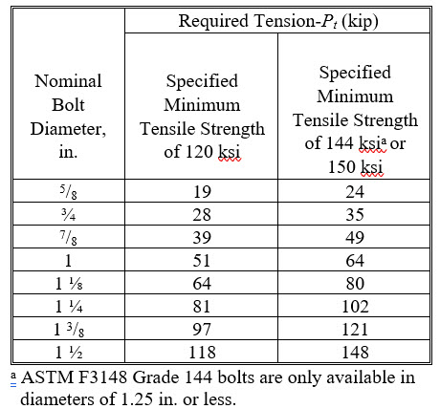
Slip Resistance
The minimum required bolt tension, P_{t}, for high-strength bolts is specified in AASHTO LRFD Table 6.13.2.8-1 (10th Edition) as follows:
Notes:
Shown on this slide are the minimum required bolt tension values, P_{t} (kips), specified in the 10th Edition AASHTO LRFD Table 6.13.2.8-1 to be used in the equation for the nominal slip resistance, R_{n} (Slide 38). The minimum bolt tension values are equal to 70 percent of the minimum tensile strength for 120 ksi and 150 ksi bolts computed as the product of their tensile strengths and tensile stress areas, rounded to the nearest kip. Minimum bolt tension values for bolts with a minimum tensile strength of 144 ksi are the same as for 150 ksi bolts for convenience.
While slip-critical connections with bolts pretensioned to the levels specified in AASHTO LRFD Table 6.13.2.8-1 do not ordinarily slip into bearing when subject to anticipated loads, it is required that they meet the requirements for shear (AASHTO LRFD Article 6.13.2.7 – Slides 26 to 35) and bearing (AASHTO LRFD Article 6.13.2.9 – Slides 45 to 53) to maintain a factor of safety of 2.0 if the bolts should slip into bearing as a result of large, unforeseen loads.

Slide 41
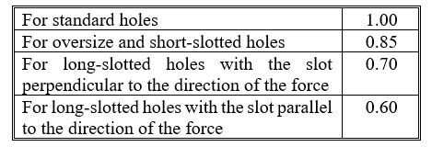
Slip Resistance
The hole size factor, K_{h}, is specified in AASHTO LRFD Table 6.13.2.8-2 as follows:
Notes:
Shown on this slide is the hole size factor, K_{h}, specified in AASHTO LRFD Table 6.13.2.8-2 to be used in the equation for the nominal slip resistance, R_{n} (Slide 38). Hole size factors, less than 1.0 are provided for bolts in oversize or slotted holes because of the greater possibility of significant deformation occurring in joints with oversize or slotted holes. For long-slotted holes, even though the slip load is the same for bolts loaded transverse or parallel to the axis of the slot, the hole size factor for loading parallel to the axis has been reduced, based upon judgment, because of the greater consequences of slip in this case.

Slide 42
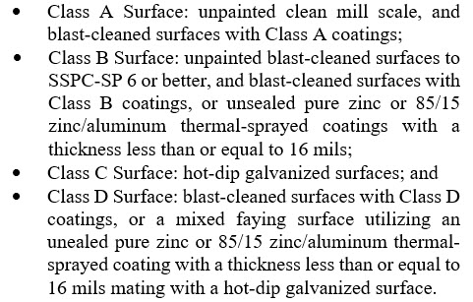
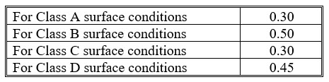
Slip Resistance
The surface condition factor, K_{s}, is specified in AASHTO LRFD Table 6.13.2.8-3 as follows:
Notes:
Shown on this slide is the slip coefficient or surface condition factor, K_{s}, specified in AASHTO LRFD Table 6.13.2.8-3 to be used in the equation for the nominal slip resistance, R_{n} (Slide 38). The contract documents must specify the minimum required value of the surface condition factor. They must also specify that in uncoated joints, paint, including any inadvertent overspray, be excluded from areas closer than one bolt diameter but not less than 1.0 in. from the edge of any hole and all areas within the bolt pattern. Refer to AASHTO LRFD Article C6.13.2.8 for further information on the effect of overspray on the slip resistance.
The mean value of slip coefficients from many tests on clean mill scale, blast-cleaned steel surfaces, unsealed thermal sprayed (i.e., metalized) surfaces, zinc-rich primers, and galvanized surfaces were taken as the basis for the four classes of surfaces. Class A applies for unpainted clean mill scale and for blast-cleaned surfaces with Class A coatings. Class B applies for unpainted blast-cleaned surfaces to SSPC-SP 6 or better, for blast-cleaned surfaces with Class B coatings, and for unsealed pure-zinc or 85/15 zinc/aluminum thermal-sprayed coatings with a thickness less than or equal to 16 mils. Class C applies for hot-dipped galvanized surfaces. Research has found that hot-dip galvanized surfaces and clean mill scale demonstrate the same slip coefficients; however, to avoid confusion, separate categories are maintained. The specified slip coefficient of 0.30 for galvanized surfaces is a lower bound based upon tests of bridge steels without any surface treatment and with varying silicon contents after galvanizing. Class D applies for blast-cleaned surfaces with Class D coatings (e.g., organic zinc-rich coatings) and for a mixed faying surface utilizing an unsealed pure zinc or 85/15 zinc/aluminum thermal-sprayed coating with a thickness less than or equal to 16 mils mating with a hot-dip galvanized surface (10th Edition). Blast cleaning as referred to herein means the removal of all mill scale. The minimum SSPC blast cleaning standard that will remove all mill scale is SSPC-SP 6. Tightly adhering rust that forms after blast cleaning will not reduce the slip coefficient. Most high-performance coatings require blast cleaning to near-white metal, or SSPC-SP 10. Since faying surfaces (that are not galvanized) are typically blast-cleaned as a minimum, a Class A surface condition should only be used to compute the slip resistance when Class A coatings are applied or when unpainted mill scale is left on the faying surface. Most commercially available primers will qualify as Class B coatings. Refer to AASHTO LRFD Article C6.13.2.8 (10th Edition) for further information on galvanized, thermal-sprayed (metalized), and mixed faying surfaces.
A test method to determine the slip coefficient for coatings used in bolted joints is provided in Appendix A of the 2020 RCSC Specification. The method includes long-term creep test requirements to ensure reliable performance for qualified coatings. The method, which requires requalification if an essential variable is changed, is the sole basis for qualification of any coating to be used under the AASHTO LRFD Specifications. Any other faying surface preparation not described in the specification, e.g., sealed thermal-sprayed coatings, thermal-sprayed coatings thicker than 16 mils, zinc-rich primer over hot-dip galvanizing, etc., can be qualified to one of the surface condition classifications in accordance with Appendix A of the 2020 RCSC Specification and may be used subject to the approval of the Engineer.

Slide 43
Slip Resistance
The nominal slip resistance of a bolt in a slip-critical connection subjected to combined axial tension and shear under service loads (i.e., Load Combination Service II) must not exceed R_{n} times the following factor (AASHTO LRFD Article 6.13.2.11):
(10th Edition)
where:
K_{c} = creep factor taken equal to 0.80 for Class C galvanized faying surfaces or for duplex coated faying surfaces utilizing a coating over a galvanized subsurface, and taken equal to 1.0 for all other surface conditions
T_{u}= factored tensile force under Load Combination Service II (kips)
P_{t} = minimum required bolt tension specified in AASHTO LRFD Table 6.13.2.8-1 (kips) (Slide 40)
Notes:
In a slip-critical connection subject to combined axial tension and shear, the tensile force reduces the contact pressure between the connected plates thereby reducing the slip resistance to the shear forces. The reduction in slip resistance is approximately proportional to the ratio of the applied tensile force to the bolt installation tension. Therefore, according to AASHTO LRFD Article 6.13.2.11 (10th Edition), the nominal slip resistance of a bolt in a slip-critical connection subjected to combined axial tension and shear under service loads (i.e., under Load Combination Service II) must not exceed the nominal slip resistance given by the nominal slip resistance, R_{n} (Slide 38), times the factor shown on this slide.
The resistance to combined tension and shear once the connection slips and goes into bearing at the strength limit state is discussed later in this lesson (Slides 58 and 59).

Slide 44
Slip Resistance - Example
Calculate the factored slip resistance for a 7/8-in. diameter ASTM F3125 Grade A325 (120 ksi) high-strength bolt assuming a Class B surface condition for the faying surface, standard-size holes, and two slip planes per bolt.
(Slide 38)
For a 7/8” Grade A325 (120 ksi bolt): P_{t} = 39.0 kips (Slide 40)
For standard-size holes: K_{h} = 1.0 (Slide 41)
For a Class B surface condition: K_{s} = 0.50 (Slide 42)
K_{c} =1.0
For two slip planes: N_{s} = 2
Notes:
In this example, the factored slip resistance for a 7/8-in. diameter ASTM F3125 Grade A325 (120 ksi) high-strength bolt will be computed. A Class B surface condition is assumed for the faying surface, the bolt is assumed placed in a standard-size hole, and two slip planes per bolt are assumed.
The equation for the nominal slip resistance, R_{n}, is repeated from Slide 38. From Slide 40, the minimum required bolt tension, P_{t}, for a 7/8-in. diameter Grade A325 (120 ksi) high-strength bolt is 39.0 kips. For standard-size holes, the hole size factor, K_{h}, is equal to 1.0 (Slide 41). For a Class B surface condition, the surface condition factor (i.e., slip coefficient), K_{s}, is equal to 0.50 (Slide 42) and the creep factor, K_{c}, is equal to 1.0 since the faying surface is not galvanized. For two slip planes, N_{s} is equal to 2. Substituting into the equation for R_{n} gives R_{n} equal to 39.0 kips/bolt.
From Slide 37, the factored slip resistance, R_{r}, is equal to the nominal slip resistance, R_{n}, and so R_{r} is also equal to 39.0 kips/bolt. Subsequent examples in this course will only calculate the nominal slip resistance, R_{n}.

Slide 45
Design of Bolted Joints
Bearing resistance at bolt holes
Notes:
The next topic in this lesson will discuss the calculation of the factored bearing resistance at bolt holes in a bolted connection.

Slide 46
Bearing Resistance at Bolt Holes
The factored bearing resistance of the connected material, R_{r}, in a bolted connection at the strength limit state is taken as (AASHTO LRFD Article 6.13.2.2):
where:
φ_{bb} = resistance factor for bearing on connected material = 0.80 (AASHTO LRFD Article 6.5.4.2)
R_{n} = nominal resistance for bearing on connected material as specified in AASHTO LRFD Article 6.13.2.9 (kips)
Notes:
AASHTO LRFD Article 6.13.2.2 specifies that the factored bearing resistance of the connected material, R_{r}, in a bolted connection at the strength limit state (in a slip-critical or bearing-type connection – refer to Slides 7 to 11 in this lesson) is to be taken as the resistance factor for bearing on connected material, φ_{bb}, specified in AASHTO LRFD Article 6.5.4.2 times the nominal resistance for bearing on connected material determined as specified in AASHTO LRFD Article 6.13.2.9. A bearing failure relates generally to either deformation of the bolt or deformation around a bolt hole, as illustrated in the figures at the bottom of this slide. The factored resistance equals the nominal shear resistance multiplied by a resistance factor less than that used to determine the factored resistance of a component. This ensures that the maximum strength of the bridge is limited by the strength of the main members rather than by the connections.
After a major slip has occurred in a slip-critical connection, one or more bolts are in bearing against the side of the hole. The contact pressure between the bolt and connected material can be expressed as the bearing stress on the bolt or connected material. Tests have always shown that the bearing stress on the bolt is not critical. For simplicity, the bearing stress is assumed to be a uniform stress distribution equal to the load transmitted by the bolt divided by the bearing area taken as the bolt diameter times the thickness of the connected material. AASHTO LRFD Article 6.13.2.9 specifies that the effective thickness of connected material with countersunk holes is to be taken as the thickness of the connected material minus one-half the depth of the countersink.
The actual failure mode depends on the end distance or clear distance between bolts, the bolt diameter, and the thickness of the connected material. Either the bolt will split out through the end of the plate because of insufficient end distance, or else excessive deformations are developed in the connected material adjacent to the bolt hole, as illustrated in the bottom right figure on this slide, because of insufficient clear distance between the bolts.

Slide 47
Bearing Resistance at Bolt Holes
The end distance required to prevent the plate from splitting out can be approximated by equating the maximum load, R_{n}, transmitted by the end bolt to the force corresponding to shear failure of the plate material of thickness, t, along the dotted Lines 1-1 and 2-2 shown in the figure.
Although actual splitting would occur along the Lines 1-1 and 2-2, the angle, α, will be assumed equal to zero in order to compute a lower-bound resistance and failure will be assumed to occur along the two solid lines instead:
Substituting 0.75F_{u} for τ_{u} and the clear distance, L_{c}, from the edge of the hole to the end of the plate in the direction of the force for (L - d/2) gives:
Notes:
The end distance required to prevent the plate from splitting out can be approximated by equating the maximum load, R_{n}, transmitted by the end bolt to the force corresponding to shear failure of the plate material of thickness, t, along the dotted Lines 1-1 and 2-2 shown in the figure shown on this slide. Although actual splitting would occur along the Lines 1-1 and 2-2 in the figure, the angle, α, will be assumed equal to zero to compute a lower-bound resistance and failure will be assumed to occur along the two solid lines instead. This results in the equation for the nominal bearing resistance, R_{n}, shown in the middle of this slide, where τ_{u} is the ultimate shear resistance of the plate material.
For commonly used steels, τ_{u} can be assumed approximately equal to 0.75F_{u}, where F_{u} is the ultimate tensile strength of the plate material. Therefore, substituting 0.75F_{u} for τ_{u} and the clear distance, L_{c}, from the edge of the hole to the end of the plate in the direction of the force for (L – d/2) in the center equation (to simplify the calculations for oversize and slotted holes) gives the equation for R_{n} shown at the bottom of this slide. This equation can be used to determine the bearing resistance between bolt holes by substituting the clear distance between adjacent holes for the clear end distance. The same bearing resistance applies regardless of the bolt shear resistance or the presence or absence of bolt threads in the bearing area.

Slide 48
Bearing Resistance at Bolt Holes
An alternative equivalent relationship relating the bearing stress r_{n} to F_{u} as a function of the L/d ratio based conservatively on test results of finger-tight bolts is given in AASHTO LRFD Article C6.13.2.9 as follows:
The ratio of r_{n}/F_{u} is limited to 3.0 to limit deformations under the factored loads. Substituting r_{n} = R_{n}/dt in this ratio and rearranging gives an upper-bound bearing resistance of:
These equations are given as the bearing resistance equations in the 2020 RCSC Specification for cases where deformation at the bolt holes at service load is not a design consideration for standard holes, oversize holes, or short-slotted holes loaded in any direction and long-slotted holes loaded parallel to the applied bearing force.
Notes:
Using finger-tight bolts, it has been shown that a connected plate will not fail by tearing through the free edge of the material if the distance L, measured parallel to the line of applied force from a single bolt to the free edge of the member toward which the force is directed, is not less than the diameter of the bolt multiplied by the ratio of the bearing stress to the tensile strength of the connected part. The alternative equivalent relationship relating the bearing stress, r_{n} to the tensile strength. F_{u}, of the connected part as a function of the L/d ratio based conservatively on test results of finger-tight bolts is given by the top equation on this slide (AASHTO LRFD Article C6.13.2.9).
The ratio of r_{n}/F_{u} is limited to 3.0 to limit deformations under the factored loads. Substituting r_{n} = R_{n}/dt in this ratio and rearranging gives an upper-bound bearing resistance given by the bottom equation on this slide. This equation and the equation at the bottom of the preceding slide are given as the bearing resistance equations in the 2020 RCSC Specification for cases where deformation at the bolt holes at service load is not a design consideration for standard holes, oversize holes, or short-slotted holes loaded in any direction and long-slotted holes loaded parallel to the applied bearing force.

Slide 49
Bearing Resistance at Bolt Holes
The more conservative equations from the 2020 RCSC Specification for the preceding cases when deformation at the bolt holes at service load is a design consideration are instead specified as follows in AASHTO LRFD Article 6.13.2.9, and are to be applied under the factored loads at the strength limit state:
  For standard holes, oversize holes, short-slotted holes loaded in any direction, and long-slotted holes parallel to the applied bearing force, the nominal resistance of interior and end bolt holes at the strength limit state, R_{n}, is to be taken as:
    With bolts spaced at a clear distance between holes not less than 2.0d and with a clear end distance not less than 2.0d:
    If either the clear distance between holes is less than 2.0d, or the clear end distance is less than 2.0d:
Notes:
The more conservative equations from the 2020 RCSC Specification for the preceding cases when deformation at the bolt holes at service load is a design consideration are instead specified in AASHTO LRFD Article 6.13.2.9 as shown on this slide, and are to be applied under the factored loads at the strength limit state.
For standard holes, oversize holes, short-slotted holes loaded in any direction, and long-slotted holes parallel to the applied bearing force, the nominal resistance of interior and end bolt holes at the strength limit state, R_{n}, with bolts spaced at a clear distance between holes not less than 2.0d and with a clear end distance not less than 2.0d, is to be taken as 2.4dtF_{u}. If either the clear distance between holes is less than 2.0d, or the clear end distance is less than 2.0d, then R_{n} is to be taken as 1.2L_{c}tF_{u}. These equations are derived based on tests that showed that the total elongation of a standard hole that is loaded to obtain the maximum recommended bearing resistance given by the equation 3.0dtF_{u} on the preceding slide is on the order of the diameter of the bolt. Based on these tests, to prevent elongations exceeding 0.25 inches, a reduced upper limit on the bearing resistance of 2.4dtF_{u} is specified.
As shown in the box on the right-hand slide of this slide, a simpler equivalent interpretation of these requirements is to take R_{n} as 1.2L_{c}tF_{u}, but not to exceed 2.4dtF_{u}.

Slide 50
Bearing Resistance at Bolt Holes
  For long-slotted holes perpendicular to the applied bearing force, the nominal resistance of interior and end bolt holes at the strength limit state, R_{n}, is to be taken as:
    With bolts spaced at a clear distance between holes not less than 2.0d and with a clear end distance not less than 2.0d:
    If either the clear distance between holes is less than 2.0d, or the clear end distance is less than 2.0d:
The nominal bearing resistance of the connected member may be taken as the sum of the smaller of the nominal shear resistance of the individual bolts and the nominal bearing resistance of the individual bolt holes parallel to the line of the force.
Notes:
For long-slotted holes perpendicular to the applied bearing force, the bending component of the deformation in the connected material becomes more critical. Therefore, for this case, the bearing resistance is further limited. For this case, the nominal resistance of interior and end bolt holes at the strength limit state, R_{n}, with bolts spaced at a clear distance between holes not less than 2.0d and with a clear end distance not less than 2.0d, is to be taken as 2.0dtF_{u}. If either the clear distance between holes is less than 2.0d, or the clear end distance is less than 2.0d, then R_{n} is to be taken as L_{c}tF_{u}. Again, as shown in the box on the right-hand side of this slide, a simpler equivalent interpretation of these requirements is to take R_{n} as L_{c}tF_{u}, but not to exceed 2.0dtF_{u}.
The design bearing resistance is expressed in terms of a single bolt, although it is truly for the connected material adjacent to the bolt. Therefore, in calculating the nominal bearing resistance for the connected part, the total bearing resistance may be taken as the sum of the bearing resistances of the individual bolts (holes) parallel to the line of the applied force. The nominal bearing resistance of an interior hole is based on the clear distance between the hole and the adjacent hole in the direction of the bearing force. The nominal bearing resistance of an end hole is based on the clear distance between the hole and the end of the member. The nominal bearing resistance cannot be larger than the nominal shear resistance of the bolt. Therefore, if the nominal bearing resistance of a bolt hole exceeds the nominal shear resistance of the bolt determined as specified in AASHTO LRFD Article 6.13.2.7 (Slides 26 to 35), the nominal bearing resistance of the bolt hole must be limited to the nominal shear resistance of the bolt.

Slide 51
Bearing Resistance at Bolt Holes - Example
Calculate the total factored bearing resistance, R_{r}, of the bolted flange splice plate connection shown below subject to a tensile force, P. The plate material is ASTM A709 Grade 50W steel (F_{u} = 70 ksi – AASHTO LRFD Table 6.4.1-1). The bolts are 7/8-in. diameter ASTM F3125 Grade A325 (120 ksi) high-strength bolts placed in standard-size holes.
Notes:
In this example, the total factored bearing resistance, R_{r}, of the bolted flange splice plate connection subject to a tensile force, P, shown in the figure on this slide, will be calculated. The plate material is ASTM A709 Grade 50W steel. The specified minimum tensile strength, F_{u}, of the plate material is 70 ksi (AASHTO LRFD Table 6.4.1-1). The bolts are 7/8-in. diameter ASTM F3125 Grade A325 (120 ksi) high-strength bolts placed in standard-size holes. The splice plate is assumed to control the bearing resistance of the connection in this example.

Slide 52
Bearing Resistance at Bolt Holes - Example
For standard-size holes, the nominal bearing resistance, R_{n}, parallel to the applied bearing force is taken as (Slide 49):
For the four bolts adjacent to the end of the splice plate, the end distance is 1.5 in. Therefore, the clear end distance, L_{c}, between the edge of the bolt holes and the end of the splice plate is:
Notes:
The bearing resistance of the connected part is calculated as the sum of the bearing resistances of the individual bolt holes parallel to the line of the applied force. As specified in AASHTO LRFD Article 6.8.3, for design calculations, the width of standard bolt holes is to be taken as the nominal diameter of the hole. Therefore, the width of the holes is to be taken as 0.9375 in. (AASHTO LRFD Table 6.13.2.4.2-1). For standard-size holes, the nominal bearing resistance, R_{n}, parallel to the applied bearing force is given by the equation on this slide (taken from Slide 49).
For the four bolts adjacent to the end of the splice plate, the end distance is 1.5 in. Therefore, the clear end distance, L_{c}, between the edge of the bolt holes and the end of the splice plate is calculated to be 1.03 in. The nominal bearing resistance, R_{n}, of the 4 end bolt holes computed from the equation using the clear end distance, L_{c}, the thickness of the splice plate, t, and the tensile strength of the splice plate, F_{u}, is 216.3 kips. The nominal bearing resistance, R_{n}, of the 4 end bolt holes computed from the equation using the nominal diameter of the bolt, d, the thickness of the splice plate, t, and the tensile strength of the splice plate, F_{u}, is 367.5 kips. The first equation governs.

Slide 53
Bearing Resistance at Bolt Holes - Example
For the other twenty bolts in the connection, the center-to-center distance between the bolt holes in the direction of the applied force is 3.0 in. Therefore, the clear distance, L_{c}, between the edges of the adjacent bolt holes is:
(Slide 46)
The factored shear resistance of the 24 bolts, assuming no filler plate & threads excluded is:
∴ Bearing does not control
Notes:
For the other twenty bolts in the connection, the center-to-center distance between the bolt holes in the direction of the applied force is 3.0 in. Therefore, the clear distance, L_{c}, between the edges of the adjacent bolt holes is calculated to be 2.0625 in. The nominal bearing resistance, R_{n}, of the other 20 bolt holes computed from the equation using the clear end distance, L_{c}, the thickness of the splice plate, t, and the tensile strength of the splice plate, F_{u}, is 2,165 kips. The nominal bearing resistance, R_{n}, of the other 20 bolt holes computed from the equation using the nominal diameter of the bolt, d, the thickness of the splice plate, t, and the tensile strength of the splice plate, F_{u}, is 1,837 kips, which governs. The factored bearing resistance, R_{r}, is equal the resistance factor for bearing on connected material, φ_{bb} (= 0.80), times R_{n}, or 1,642 kips.
The nominal bearing resistance cannot be larger than the nominal shear resistance of the bolt. The factored shear resistance, R_{r}, of the 7/8-in. diameter 120 ksi high-strength bolt for double shear, assuming no filler plate and threads excluded from the shear plane, was computed previously in this lesson to be 64.6 kips/bolt (Slide 35). Therefore, the total factored shear resistance of the 24 bolts in the connection is 1,550 kips, which is less than the factored bearing resistance of the connection equal to 1,642 kips. Thus, bearing does not control for this connection.

Slide 54
Design of Bolted Joints tensile resistance
Notes:
The next topic in this lesson will discuss the calculation of the factored tensile resistance of a bolt, including the calculation of the tensile fatigue resistance and the resistance of bolted connections subject to combined tension and shear.

Slide 55
Tensile Resistance
The factored tensile resistance of a bolt, T_{r}, at the strength limit state is taken as (AASHTO LRFD Article 6.13.2.2):
where:
φ_{t} = resistance factor for bolts in tension = 0.80 (AASHTO LRFD Article 6.5.4.2)
R_{n} = nominal resistance for bolts in axial tension as specified in AASHTO LRFD Article 6.13.2.10, or nominal resistance for bolts in combined axial tension and shear as specified in AASHTO LRFD Article 6.13.2.11 (kips)
The applied tensile force must be taken as the force due to externally applied loads plus any tension resulting from prying action produced by deformation of the connected parts.
Notes:
AASHTO LRFD Article 6.13.2.2 specifies that the factored tensile resistance of a bolt, T_{r}, at the strength limit state is to be taken as the resistance factor bolts in tension, φ_{t} (= 0.80 – AASHTO LRFD Article 6.5.4.2), times the nominal resistance for bolts in axial tension, T_{n}, as specified in AASHTO LRFD Article 6.13.2.10, or the nominal tensile resistance for bolts in combined axial tension and shear, T_{n}, as specified in AASHTO LRFD Article 6.13.2.11. The tensile failure of a bolt is illustrated in the figure on the left-hand side of this slide.
Axial tension occurring without simultaneous shear occurs in bolts for tension members such as hangers or other members whose line of action is perpendicular to the member to which it is fastened. The applied tensile force must be taken as the force due to externally applied loads plus any tension resulting from prying action produced by deformation of the connected parts. Prying action is considered beyond the scope of this course and is not covered; further information on prying action may be found in AASHTO LRFD Article 6.13.2.10.4 and in Part 9 of the AISC Manual of Steel Construction. The tensile resistance of bolts must sometimes be considered in combination with simultaneous shear for certain bolted bracing member connections.

Slide 56
Tensile Resistance
AASHTO LRFD Article 6.13.2.10.1 specifies that high-strength bolts subject to axial tension must be pretensioned to the initial tension specified in AASHTO LRFD Table 6.13.2.8-1 (Slide 40) regardless of whether the connection is a slip-critical or bearing-type connection.
The nominal tensile resistance, T_{n}, of a bolt independent of any initial tightening force is to be taken as (AASHTO LRFD Article 6.13.2.10.2):
where:
A_{b} = area of the bolt corresponding to the nominal diameter (in.²)
F_{ub} = specified minimum tensile strength of the bolt specified in AASHTO LRFD Table 6.4.3.1.1-1 (ksi)
Notes:
AASHTO LRFD Article 6.13.2.10.1 specifies that high-strength bolts subject to axial tension must be pretensioned to the level given in AASHTO LRFD Table 6.13.2.8-1 (Slide 40) regardless of whether the connection is a slip-critical or a bearing-type connection. According to AASHTO LRFD Article 6.13.2.10.2, the nominal tensile resistance of a bolt, T_{n}, independent of any initial tightening force is to be computed from the equation given on this slide, where A_{b} is the area of the bolt corresponding to the nominal diameter, and F_{ub} is the specified minimum tensile strength of the bolt specified in AASHTO LRFD Table 6.4.3.1.1-1.
The tensile resistance of a bolt is the product of the tensile strength of the bolt and the tensile stress area through the threaded portion of the bolt. The tensile stress area is approximately 76 percent of the nominal cross-sectional area of the bolt for the usual sizes of structural bolt (refer to the 2020 RCSC Specification). Hence, the nominal tensile resistance per unit area (based on the nominal area of the bolt) is taken as 76 percent of the tensile strength of the bolt. The specified nominal tensile resistance is approximately equal to the initial tightening force specified in AASHTO LRFD Table 6.13.2.8-1 (Slide 40). Thus, when a tensile force is applied to a high-strength bolt that has been properly pretensioned, the increase in the bolt tension is generally much smaller than the applied load. There will be little increase in bolt force above the pretension load at service load levels. After the parts separate, the bolt will act as a tension member with the applied force equaling the bolt tension. As a result, bolts in connections subject to axial tension are required to be fully pretensioned.
Pretensioning imposes a small axial elongation of the bolt. A joint subsequently loaded in tension, shear, or combined tension and shear imposes significant deformations in the bolt prior to failure that override the small initial elongation and remove the pretensioning. Tests confirm that the initial pretension that would be sustained after the applied load is removed is essentially zero before the bolts fail in shear. Therefore, the tensile and shear resistances of the bolt are unaffected by the initial pretensioning of the bolt. Any residual torsion induced in the bolt during installation is also small and will be removed when the bolt is loaded to the point of plate separation. Hence, any effect of torsion on the tensile resistance of the bolt need not be considered.

Slide 57
Tensile Resistance - Fatigue
As specified in AASHTO LRFD Article 6.13.2.10.3, where high-strength bolts in axial tension are subject to fatigue, the stress range, Δf, in the bolt, due to the fatigue design live load, plus the dynamic load allowance for fatigue loading specified in AASHTO LRFD Article 3.6.1.4, plus the prying force resulting from cyclic application of the fatigue load, must satisfy:
(Lesson 7)
where:
γ = load factor specified in AASHTO LRFD Table 3.4.1-1 for the Fatigue load combination under consideration (Lesson 3)
(Δf) = force effect, live load stress range due to the passage of the fatigue load specified in AASHTO LRFD Article 3.6.1.4 (Lesson 3) (ksi)
(ΔF)_{n} = nominal fatigue resistance of the bolt under axial tension – refer to Condition 9.3 in AASHTO LRFD Table 6.6.1.2.3-1 (10th Edition) (ksi)
In no case is the calculated prying force to exceed 30 percent of the externally applied load.
Notes:
As specified in AASHTO LRFD Article 6.13.2.10.3, properly pretensioned high-strength bolts subject to fatigue in axial tension must satisfy the equation shown on this slide (i.e., AASHTO LRFD Equation 6.6.1.2.2-1 – Lesson 7). γ is the load factor specified in AASHTO LRFD Table 3.4.1-1 for the Fatigue load combination under consideration (Lesson 3). The stress range (Δf) in the equation is to be taken as the stress range in the bolt due to the passage of the 72-kip fatigue design load (plus the 15 percent dynamic load allowance) specified in AASHTO LRFD Article 3.6.1.4 (Lesson 3), plus any prying force resulting from the cyclic application of the fatigue load (the initial tension in the bolts is not to be included). The stress range is to be computed using the nominal diameter of the bolt. The nominal fatigue resistance, (ΔF)_{n}, is to be computed from Condition 9.3 in AASHTO LRFD Table 6.6.1.2.3-1 (10th Edition) when the bolts are fully pretensioned and all threads are located within the grip. Otherwise, Condition 9.4 in AASHTO LRFD Table 6.6.1.2.3-1 (10th Edition) applies.
Tests of various single-bolt assemblies and joints with bolts in tension subjected to repeated external loads that resulted in eventual failure of the pretensioned high-strength bolts indicated that properly tightened high-strength bolts are not adversely affected by repeated application of service-load tensile stress; that is, the nominal fatigue resistance of the bolts in such applications is relatively high. However, since a limited range of prying effects was investigated in these studies, the assumption is made that the connected material is sufficiently stiff that any prying force is a relatively small part of the applied tension. AASHTO LRFD Article 6.13.2.10.3 limits the calculated prying force to 30 percent of the externally applied load when bolts are subject to tensile fatigue loading. As indicated in the 2020 RCSC Specification, this limit is based on limited investigations of prying effects under fatigue loading.
Since low carbon ASTM A307 bolts (Slide 28) are of lower strength and are not pretensioned, AASHTO LRFD Article 6.13.2.10.3 prohibits their use in connections subjected to fatigue loading in axial tension.

Slide 58
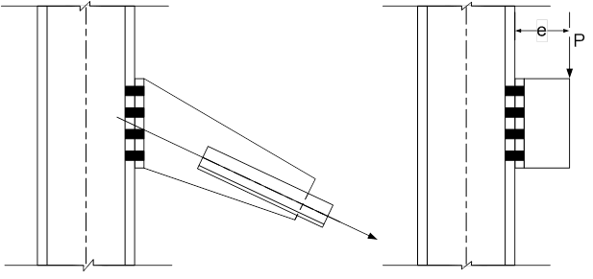
Combined Tension and Shear
Examples of connections in which the bolts would be subject to combined tension and shear are shown below:
Once a bolt slips and goes into bearing, the bolt yields under the effects of combined tension and shear at a lower load than if only shear or tension were present.
Tests have determined that when both shear and tensile forces act on a high-strength bolt at the strength limit state, the interaction can be conveniently expressed by an elliptical interaction relationship (2020 RCSC Specification).
Notes:
Examples of connections in which the bolts would be subject to combined tension and shear are shown on this slide. Once a bolt slips and goes into bearing, the bolt yields under the effects of combined tension and shear at a lower load than if only shear or tension were present. Tests on single high-strength bolts subject to various combinations of tension and shear in this condition were conducted at the University of Illinois in the 1960s. From these tests, it was determined that when both shear and tensile forces act on a high-strength bolt at the strength limit state, the interaction can be conveniently expressed by an elliptical interaction relationship, which is given in the 2020 RCSC Specification. The interaction relationship accounts for the connection length effect on bolts loaded in shear, the ratio of shear resistance to tension resistance of threaded bolts, and the ratios of root area to nominal body area and tensile stress area to nominal body area.

Slide 59
Combined Tension and Shear
A conservative simplification of the interaction relationship in the 2020 RCSC Specification is used in AASHTO LRFD Article 6.13.2.11. The nominal tensile resistance, T_{n}, of a bolt subjected to combined shear and axial tension is given as:
where:
φ_{s} = resistance factor for bolts in shear (AASHTO LRFD Article 6.5.4.2)
A_{b} = area of the bolt corresponding to the nominal diameter (in.²)
F_{ub} = specified minimum tensile strength of the bolt specified in AASHTO LRFD Article 6.4.3.1.1 (ksi)
P_{u} = factored shear force on the bolt (kips)
R_{n} = nominal shear resistance of the bolt determined as specified in AASHTO LRFD Article 6.13.2.7 (kips)
Notes:
The resistance of bolts under combined axial tension and shear is covered in AASHTO LRFD Article 6.13.2.11. A conservative simplification of the interaction relationship given in the 2020 RCSC Specification is used in AASHTO LRFD Article 6.13.2.11. The nominal tensile resistance, T_{n}, of a bolt subjected to combined shear and axial tension is given by the equations shown on this slide. In other words, no reduction in the nominal tensile resistance of the bolt is required when the factored shear force does not exceed 33 percent of the nominal shear resistance of the bolt.
The nominal resistance of a bolt in a slip-critical connection subject to combined tension and shear under service loads (i.e., under Load Combination Service II) was discussed previously on Slide 43 of this lesson.
Since the types of bolted connections shown on the preceding slide that are subjected to combined shear and axial tenson are less commonly used on steel beam and girder bridges, examples illustrating the application of these provisions are not provided herein. An example illustrating the application of these provisions to the design of the bracket connection shown in the right-hand figure on the preceding slide may be found in the National Highway Institute (NHI) Reference Manual for the 130081 LRFD Superstructure Design course (available for free download at www.nhi.fhwa.dot.gov).

Slide 60
Design of Bolted Joints eccentrically loaded connections
Notes:
The next topic in this lesson will discuss the design of eccentrically loaded bolted connections. Two illustrative examples are provided illustrating the importance of the connection work point location on the overall economy of the connection.

Slide 61
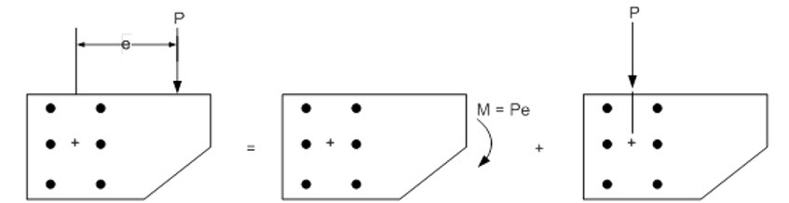
Eccentrically Loaded Connections
In the figure below, the force, P, is applied on a line of action that does not pass through the center of gravity of the bolt group. The resultant action may be represented as a moment (torque) equal to P times the eccentricity, e, and a concentric force, P, acting on the connection.
Since both the moment and concentric force cause shears on the bolt group, this particular situation is referred to as eccentric shear. A common example of a bolted connection in a steel bridge subject to eccentric shear is a cross-frame gusset plate-to-connection plate connection.
Notes:
The left figure on this slide shows a force, P, applied on a line of action that does not pass through the center of gravity of the bolt group. The resultant action may be represented as a moment (torque) equal to P times the eccentricity, e, as shown in the center figure on this slide, and a concentric force, P, acting on the connection, as shown in the right figure on this slide.
Since both the moment and concentric force cause shears on the bolt group, this particular situation is referred to as eccentric shear. A common example of a bolted connection in a steel bridge subject to eccentric shear is a cross-frame gusset plate-to-connection plate connection. In such connections, the location of the working point (Lesson 10) is a critical factor in determining the overall economy of the connection.

Slide 62
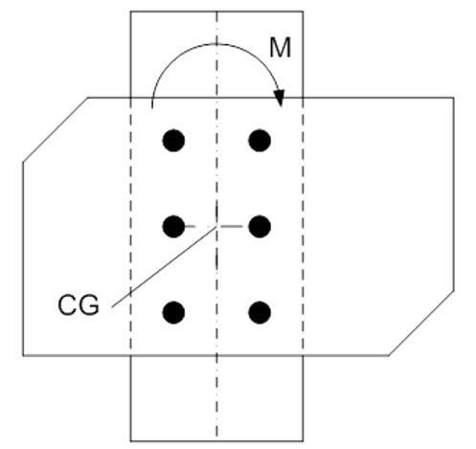
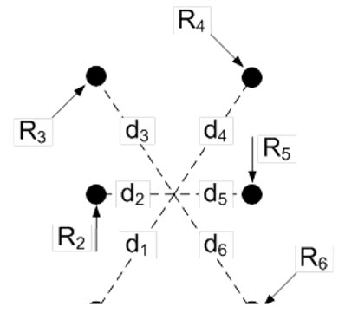
Eccentrically Loaded Connections
Rearranging and substituting the polar moment of inertia, I_{p}′, for the term gives:
Letting I_{p}′ = A = AI_{p} gives:
Since :
(Slide 63)
Notes:
Bolt groups subject to eccentric shear have typically been analyzed using a traditional elastic vector analysis assuming no friction, that the bolts are elastic and that the plates are rigid ensuring a linear strain variation on the bolts. The concentric force, P, is assumed to stress the bolts uniformly and the stress due to the torsion is then superimposed vectorially. The torque has traditionally been treated using an adaptation of the theory of twisting of circular steel shafts, as discussed below.
Consider the bolt group acted on by a torque, M, as shown in the top figure on this slide. Assume the plate, which transmits the torque to the bolts, rotates about an axis through the centroid of the bolt group, and that the bolts all have different areas. It is assumed that constraints on the members or connection do not force rotation about some point other than the centroid of the bolt group, which is typically the case in most practical connections. Neglecting friction between the plates, the torque on the bolt group is given by the top equation on this slide. Assume that the shear stress in each bolt due to the torque acts normal to the radius drawn from the centroid and that the stresses vary linearly with the distance from the centroid. Thus, the bolt furthest removed from the centroid (say Bolt 6 in the bottom figure on this slide) is the one most heavily stressed. The shear force in Bolt 6 is equal to R₆ = τ₆A₆. The stresses in the other bolts are then proportional to the stress in Bolt 6. Therefore, the forces acting on the other bolts can be computed as shown in the second equation on this slide. Substituting these forces into the first equation gives the third equation shown on this slide, where n is the total number of bolts in the connection (n = 6 in this case).
Rearranging the third equation on this slide and substituting the polar moment of inertia, I_{p}′, for the term in the summation results in the stress in the most heavily stressed bolt in the group (Bolt 6) given by the fourth equation on this slide, which is analogous to the equation for the shear stress in a circular shaft subject to pure torsion.
In most cases, the bolts in the connection will be the same size. Therefore, it becomes convenient to factor the bolt cross-sectional area, A, out of I′_{p}. Therefore, letting I′_{p} = AΣd_{i}² = AI_{p} results in the expression given by the next-to-the-last equation on this slide for the shear force in the most heavily stressed bolt, R₆. Referring to the figure on the next slide, since d² = x² + y², the expression for the polar moment of inertia, I_{p}, of the bolt group is given by the boxed-in equation shown at the bottom of this slide.

Slide 63
Eccentrically Loaded Connections
where:
m = number of vertical rows of bolts s = vertical pitch of the bolts (in.)
n = number of bolts in one vertical row g = horizontal pitch of the bolts (in.)
Referring to the figure, since R₆ = R_{y}d₆/x₆ and R₆ = R_{x}d₆/y₆:
:
Notes:
An alternative formula for computing the polar moment of inertia, I_{p}, about the centroid of the connection assuming a uniform vertical pitch of the bolts is given by the expression at the top of this slide, which is taken from the 1963 AISC Specification.
To facilitate combination with the direct shear in each bolt due to concentric vertical and horizontal forces, P_{v} and P_{h}, it becomes convenient to use the x and y components of the bolt shears due to torsion. Referring to the figure on this slide, R₆ = R_{y}d₆/x₆ and R₆ = R_{x}d₆/y₆. Substituting into the fourth equation on the preceding slide gives the equations shown on this slide for the x and y components of the bolt shears due to torsion, R_{x} and R_{y}.
The direct shear forces, R_{v} and R_{h}, on a bolt in an eccentric shear connection due to the concentric forces, P_{v} and P_{h}, can be computed as the force divided by the number of bolts in the connection, n.
The total resultant force, R, on the most heavily stressed bolt in the connection is then computed from the vector sum of the direct shear forces and the x and y components of the shear force due to torsion, as given by the equation shown at the bottom of this slide.
An alternative ultimate strength approach in which the translation and rotation of the bolt group is reduced to a pure rotation about a point referred to as the instantaneous center of rotation is given in the Part 7 of the AISC Manual of Steel Construction. An empirical load-deformation relationship is used to relate the shear resistance of each bolt to its deformation. Since that approach is less commonly employed in bridge design practice, it is not covered any further herein.

Slide 64
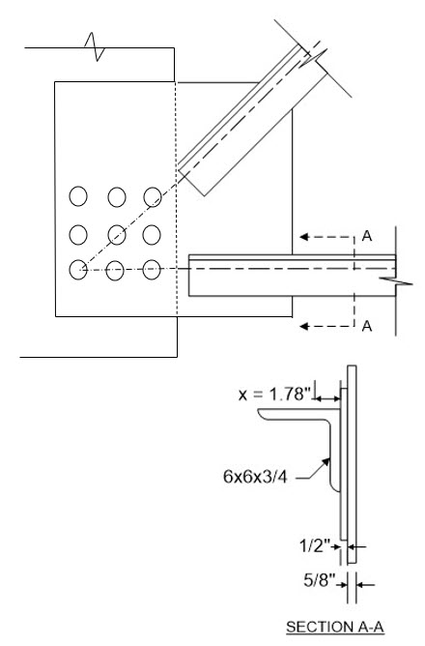
Eccentrically Loaded Connections - Example
Check the eccentrically loaded high-strength bolted cross-frame connection of a 1/2-in. gusset plate to a 5/8-in. connection plate shown in the figure for the resultant factored Strength I cross-frame forces shown.
The cross-frame connection is a bearing-type connection. The factored shear resistance of the bolts will be checked at the strength limit state.
Assume all bolt spacing and edge and end distance requirements are satisfied, and that the bearing resistance of the bolt holes at the strength limit state has been checked and does not control.
The bolts are 7/8-in. diameter ASTM F3125 Grade A325 (120 ksi) bolts placed in standard holes.
½” gusset plate
2 @ 3”
-46.4 k
2 @ 3”
W.P.
-126.3 k
5/8” connection plate
Option 1: Working Point (W.P.) located at lower left bolt hole (n = 9).
Notes:
In this example, the eccentrically loaded high-strength bolted cross-frame connection of a 1/2-in. gusset plate to a 5/8-in. connection plate, shown in the figure on this slide, will be checked for the resultant factored Strength I cross-frame forces shown. The resultant vertical force is -46.4 kips, and the resultant horizontal force is -126.3 kips. The cross-frame connection is a bearing-type connection (Slide 11). The factored shear resistance of the bolts will be checked at the strength limit state. There are 9 bolts in the connection. The bolts are spaced at 3 inches both horizontally and vertically. It is assumed that all bolt spacing and edge and end distance requirements are satisfied, and that the bearing resistance of the bolt holes at the strength limit has been checked and does not control. The bolts are 7/8-in. diameter ASTM F3125 Grade A325 (120 ksi) bolts placed in standard holes.
As mentioned previously, in such connections, the location of the working point (Lesson 10) is a critical factor in determining the overall economy of the connection. In Option 1 in this example, the working point (W.P. in the figure) of the connection has been placed at the lower left bolt hole of the connection. The selection of efficient working points for cross-frame connections can be determined in consultation with a fabricator/detailer. As discussed in Lesson 10, fabricators generally prefer that the working point be located at a bolt hole or on the gusset plate rather than on the centerline of the girder web.
In this connection, the bolts are subject to both in-plane eccentricity (i.e., eccentric shear), and out-of-plane eccentricity (i.e., combined shear and tension). The effect of the out-of-plane eccentricity is typically minimal and is generally ignored.

Slide 65
Eccentrically Loaded Connections - Example
(A_{b} = 0.601 in.²; F_{ub} = 120 ksi; N_{s} = 1)
Notes:
For the eccentric shear (in-plane eccentricity), the traditional elastic vector method is used for calculating the maximum resultant bolt force on the extreme bolt using the equations shown on Slide 63 of this lesson.
First, since the vertical pitch of the bolts is uniform, the polar moment of inertia, I_{p}, of the bolts with respect to the centroid of the connection is computed using the equation shown at the top of the slide. For the example connection (referring to the figure on the preceding slide), n = 3; m = 3; s = 3.0 in.; and g = 3.0 in. Therefore, I_{p} is computed to be 108 in.² The vertical bolt force, R_{v}, is determined by dividing the absolute value of the vertical resultant cross-frame force (i.e., 46.4 kips) by the number of bolts (9), which gives a value of 5.16 kips/bolt. The horizontal bolt force, R_{h}, is determined by dividing the absolute value of the horizontal resultant cross-frame force (i.e., 126.3 kips) by the number of bolts, which gives a value of 14.03 kips/bolt. The total moment about the centroid of the bolted connection, M_{tot}, is computed to be 239.7 kip-in. (accounting for the sign of the moments due to each resultant cross-frame force). The horizontal force component, R_{x}, on the extreme bolt due to M_{tot} is computed to be 6.66 kips/bolt. The vertical force component, R_{y}, in the extreme bolt due to M_{tot} is also computed to be 6.66 kips/bolt. Therefore, the vector resultant force, R, on the extreme bolt is computed to be 23.8 kips.
Following the guidance given previously on Slides 30 and 31 of this lesson for determining whether the threads are excluded from or included in the shear plane, separate computations for this connection determine that the threads are included in the shear plane. Where threads are included in the shear plane, the nominal shear resistance of the bolts, R_{n}, is given by the equation shown near the bottom of this slide. In this connection, there is one shear plane (i.e., N_{s} = 1). Therefore, R_{n} is computed to be 32.4 kips. The factored shear resistance of the bolts, R_{r}, is equal to the resistance factor for shear on high-strength bolts, φ_{s} (=0.80), times R_{n}, or 26.0 kips, which exceeds the resultant force, R, of 23.8 kips acting on the extreme bolt. Thus, the connection is satisfactory.

Slide 66
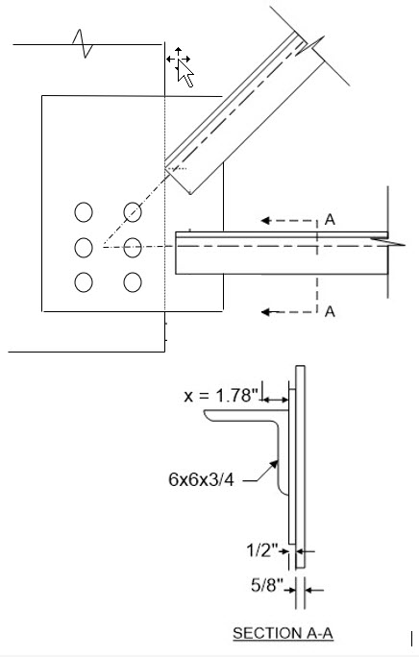
Eccentrically Loaded Connections - Example
Option 2: Working Point (W.P.) located on gusset plate at center of the bolt group (n = 6).
½” gusset plate
-46.4 k
-126.3 k
2 @ 3”
W.P.
3”
5/8” connection plate
Notes:
Next, a second option (Option 2) will be examined. Assume that enough space is available to move the bottom row of bolts down (or move the bottom cross-frame member up) such that the working point can now be located at the center of the bolt group. If there is enough space to place the working point closer to the center of the bolt group, it is desirable since there will be little or no moment (torque) on the bolt group. In this case, this allowed for a reduction in the number of bolts in the connection from 9 in Option 1 to 6 in Option 2.
The vertical bolt force, R_{v}, is determined by dividing the absolute value of the vertical resultant cross-frame force (i.e., 46.4 kips) by the number of bolts (6), which gives a value of 7.73 kips/bolt. The horizontal bolt force, R_{h}, is determined by dividing the absolute value of the horizontal resultant cross-frame force (i.e., 126.3 kips) by the number of bolts, which gives a value of 21.05 kips/bolt. The total moment about the centroid of the bolted connection, M_{tot}, is computed to be zero since the resultant forces are acting through the centroid of the bolt group. Therefore, the polar moment of inertia, I_{p}, does not need to be computed, and the horizontal and vertical components of force in the extreme bolt due to M_{tot}, R_{x} and R_{y}, are both equal to zero. Therefore, the vector resultant force, R, on the extreme bolt is computed to be 22.4 kips.
The factored shear resistance, R_{r}, of a 7/8-in. diameter bolt in one shear plane (i.e., N_{s} = 1) where threads are included in the shear plane was computed on the preceding slide to be 26.0 kips, which exceeds the resultant force, R, of 22.4 kips acting on the extreme bolt. Thus, the connection is satisfactory.

Slide 67
Design of Bolted Joints
Bolted Field Splices
Notes:
The last topic in this lesson will review in detail the AASHTO LRFD design requirements for the design of bolted field splices. A complete design example is provided illustrating the application of those requirements.

Slide 68
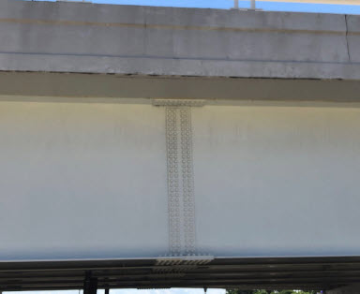

Bolted Field Splices - Introduction
Bolted Splice―A group of bolted connections sufficient to transfer the moment, shear, axial force, or torque between two structural elements joined at their ends to form a single, longer element.
Field Section―pieces of the bridge girder that are fabricated as a unit and shipped to the bridge site in that manner, and then are erected and joined together by field splices.
Notes:
A bolted splice is a group of bolted connections sufficient to transfer the moment, shear, axial force, or torque between two structural elements joined at their ends to form a single, longer element. Bolted splices may be used in tension members, compression members, and flexural members. This topic will focus on bolted splices for flexural members only, which are covered in AASHTO LRFD Article 6.13.6.1.3. This topic will also focus on the design of bolted splices for I-section flexural members only. Design provisions for bolted splices in tension members are provided in AASHTO LRFD Article 6.13.6.1.1, and design provisions for bolted splices in compression members are provided in AASHTO LRFD Article 6.13.6.1.2.
Field sections are pieces of a bridge girder that are fabricated as a unit and shipped to the bridge site in that manner, and then are erected and joined together by field splices (Lessons 1 and 2). Splices are often required for steel girder bridges due to limitations in the girder shipping lengths. If the shipping length limitations are less than the required girder length for the completed bridge, then girder field sections are provided that satisfy the shipping length limitations. The choice of field splice locations and the corresponding field section lengths is in many ways project specific. The weight and length of field sections should be determined after consultation with fabricators who are expecting to be bidding the work. The two major considerations are handling in the shop and shipping.
Curvature affects the feasibility of shipping curved girders and must be taken into account when laying out the splice locations. Generally, the curvature limits the length of a shipping field section to a length less than what would be practical for a similar size straight field section. Of course, this may entail the need for additional field splices to reduce the length; the Engineer may provide optional splices that may be eliminated at the discretion of the Fabricator. In design-build situations, the Engineer usually works closely with the team in making the decision regarding the size of field sections. The selection of field section lengths and sizes was discussed previously in greater detail in Lessons 1 and 2.

Slide 69
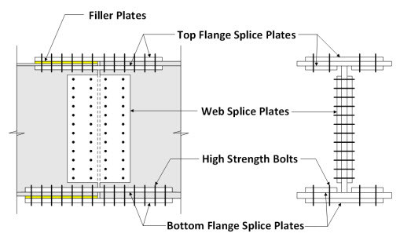
Flexural Members - General
For flexural members, bolted splices generally include top flange splice plates, web splice plates, and bottom flange splice plates.
If the flange thicknesses on one side of the joint are different than those on the other side, then filler plates are needed.
For the flange splice plates, there is generally one plate on the outside of the flange and two smaller plates on the inside, one on each side of the web.
For the web splice plates, there are two plates, one on each side of the web.
High strength bolts are generally used to connect the splice plates to the girder members.
Notes:
For flexural members, bolted splices generally include top flange splice plates, web splice plates, and bottom flange splice plates. In addition, if the flange thicknesses on one side of the joint are different than those on the other side, then filler plates are needed. For the flange splice plates, there is generally one plate on the outside of the flange and two smaller plates on the inside, one on each side of the web. This is illustrated in the cross-section shown on this slide. For the web splice plates, there are two plates, one on each side of the web. High-strength bolts are generally used to connect the splice plates to the girder members being spliced together.

Slide 70
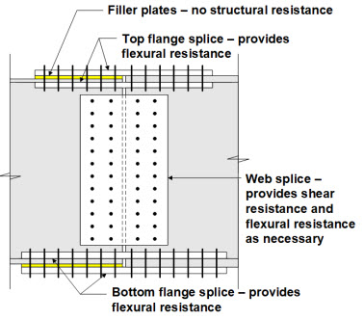
Flexural Members - General
For flexural members, bolted field splices are generally designed to resist both moment and shear.
The flexural resistance of a bolted field splice is assumed provided by the top flange splice and the bottom flange splice, as well as the web splice if the moment resistance provided by the flanges is not sufficient to resist the factored moment at the strength limit state at the point of splice.
The shear resistance of a bolted field splice is assumed provided exclusively by the web splice.
Filler plates are assumed to provide no structural resistance.
Notes:
For flexural members, bolted field splices are generally designed to resist both moment and shear. The flexural resistance of a bolted field splice is assumed provided by the top flange splice and the bottom flange splice, as well as the web splice if the moment resistance provided by the flanges is not sufficient to resist the factored moment at the strength limit state at the point of splice. The shear resistance of a bolted field splice is assumed provided exclusively by the web splice. Filler plates are assumed to provide no structural resistance.

Slide 71
Flexural Members - General
Preferably, locate splices near points of permanent load contraflexure.
Flange splices are designed to develop as a minimum the smaller full design yield resistance of the flanges on either side of the splice, and web splices are designed as a minimum to develop the smaller full factored shear resistance of the web on either side of the splice.
Web and flange splices in areas of stress reversal must be investigated for both positive and negative flexure.
Fatigue generally does not govern splice design.
Notes:
Bolted splices in flexural members preferably should be located in regions of lower moment near points of permanent load contraflexure to reduce the size of the splice. This may not always be possible in certain situations, such as in longer-span bridges or in cases where additional field splices may be needed to reduce the size of a shipping piece; for example, in a sharply curved member or where shipping lengths start to exceed a practical upper limit.
Since the actual factored force effects are relatively small near points of contraflexure, flange splices are designed to develop as a minimum the smaller full design yield resistance of the flanges on either side of the splice, and web splices are designed as a minimum to develop the smaller full factored shear resistance of the web on either side of the splice. This is done to provide a longitudinal stiffness at the splice that is consistent with the stiffness assumed at that point in the structural analysis. It also allows for possible unintended shifts in girder moment and for differences between the actual and predicted moment at the splice, which are certain to be more significant near points of permanent load contraflexure.
Web and flange splices in areas of stress reversal must be investigated for both positive and negative flexure. This ensures that the splice is properly designed for the governing condition.
Fatigue will generally not govern the design of splice plates. This is because the areas of the flange and web splice plates are often equal to or exceed the areas of the flange and web to which they are attached, and the flanges and web are checked separately for either equivalent or more critical fatigue category details.

Slide 72

Flexural Members - General
Design the bolted splice connection as a slip-critical connection.
For I-section members, the factored flexural resistance of the flanges at the point of splice at the strength limit state is to satisfy the provisions of AASHTO LRFD Article 6.10.6.2.
Do not use oversize or slotted bolt holes in the splice connection.
Provide at least two rows of bolts on each side of the joint.
Notes:
Bolted splice connections for flexural members must be designed as slip-critical connections. Slip-critical connections were discussed previously in this lesson (Slides 7 to 10). Slip-critical connections are proportioned to prevent slip under Load Combination Service II and to provide bearing and shear resistance under the applicable strength limit state load combinations. In addition, bolted connections for flange and web splices in flexural members are proportioned to prevent slip during the placement of the concrete deck to provide geometry control.
For I-section members, the factored flexural resistance of the flanges at the point of splice at the strength limit state is to satisfy the provisions of AASHTO LRFD Article 6.10.6.2 (Lessons 8 and 9).
Oversize or slotted holes cannot be used in either the girder member or the splice plates at bolted splices. This requirement improves geometry control during erection before the bolts are tightened.
In both web and flange splices, there must be at least two rows of bolts on each side of the joint. This requirement ensures proper alignment and stability of the girder during construction.

Slide 73
Flexural Members – Flange Splices
Flange Design Force – Strength Limit State (AASHTO LRFD Article 6.13.6.1.3b):
Design Yield Resistance
Eq. 6.13.6.1.3b-1
where:
A_{e} = effective area of the flange under consideration (in.²)
=
φ_{u} = resistance factor for fracture of tension members as specified in AASHTO LRFD Article 6.5.4.2 (= 0.80) (Lesson 12)
φ_{y} = resistance factor for yielding of tension members as specified in AASHTO LRFD Article 6.5.4.2 (= 0.95) (Lesson 12)
A_{g} = gross area of the flange under consideration (in.²)
A_{n} = net area of the flange under consideration (in.²)
F_{u} = specified minimum tensile strength of the flange under consideration (ksi)
Eq. 6.13.6.1.3b-2
Notes:
First, the AASHTO LRFD design requirements for flange splices will be discussed, focusing first on the calculation of the flange design force at the strength limit state. The requirements for the design of flange splices are specified in AASHTO LRFD Article 6.13.6.1.3b. The basis of the design method for flange splices at the strength limit state is to design each flange splice to develop the smaller full design yield resistance of the flanges, P_{fy}, on either side of the splice. The design yield resistance of each flange is calculated as the specified minimum yield strength of the flange, F_{yf}, times the effective area of the flange, A_{e}, given by Eq. 6.13.6.1.3b-2 shown on this slide. The effective flange area cannot exceed the gross area of the flange, A_{g}. The web load-shedding factor, R_{b}, and the hybrid factor, R_{h}, (Lesson 6) are not included in the equation for P_{fy} since they are included in the calculation to determine the flange sizes. The flange splice connection is designed to carry the full design yield resistance of the flanges.
The effective flange area is used rather than the gross flange area to account for the loss in section causing a reduction in the fracture resistance of the net section at the connection for loading conditions in which the flange is subject to tension. That is, the flange splices are designed for a lower design force to ensure that net section fracture will not occur at the connection. Strictly speaking, the effective flange area only applies to tension flanges, but it is conservatively applied to both flanges in the design method since each flange may potentially be subject to tension and the resulting design force will conservatively provide a lower moment resistance of the flanges at the strength limit state as described later. In the equation for A_{e}, φ_{u} is the resistance factor for fracture of tension members (= 0.80), and φ_{y} is the resistance factor for yielding of tension members (= 0.95) (Lesson 12). A_{n} is the net area of the flange under consideration, and F_{u} is the specified minimum tensile strength of the flange under consideration (AASHTO LRFD Table 6.4.1-1).

Slide 74
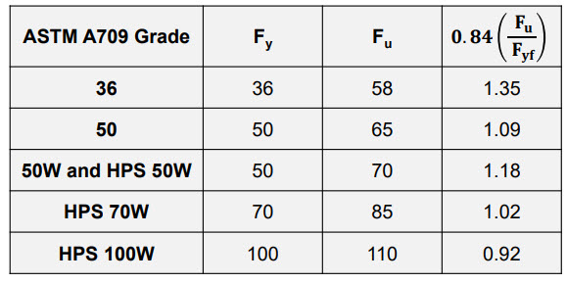
Flexural Members – Flange Splices
Effective Area Coefficient:
Notes:
If the specified values of the resistance factors, φ_{u} equal to 0.80 and φ_{y} equal to 0.95, are substituted into Eq. 6.13.6.1.3b-2 for the effective area of the flange, A_{e}, the resulting coefficient in front of the net area, A_{n}, is equal to 0.84 times the ratio of F_{u} divided by F_{yf}. The value of this coefficient for the various grades of steel is shown in the table given on this slide. The values are close 1.0 for ASTM A709 Grade 50 and stronger steels; therefore, in most cases the effective flange area will be less the gross area.

Slide 75
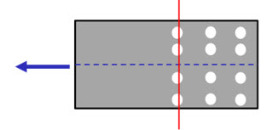
Flexural Members – Flange Splices
Net Area, A_{n}:
where:
b_{f} = flange width (in.)
d_{h} = diameter of a standard-size bolt hole specified in AASHTO LRFD Table 6.13.2.4.2-1 (in.)
t_{f} = flange thickness (in.)
Notes:
For most girder splices, 4 rows of bolts in each flange are sufficient to meet the connection design requirements of the flange and continuity of the flange lateral stiffness. The net area, A_{n}, of the flange assuming 4 bolt holes in a row across the flange without staggered bolt lines is given by the equation shown on this slide. The calculation of the net area for the case of staggered bolt lines is discussed in Lesson 12.
In the calculation of the net area, the diameter of a standard-size bolt hole, d_{h}, is specified to be 1/16 inch larger than the diameter of the bolt.
For flanges with one web in straight girders and in horizontally curved girders, the effects of flange lateral bending need not be considered in the design of the bolted flange splices since the combined areas of the flange splice plates must equal or exceed the area of the smaller flanges to which they are attached. The flange is designed so that the yield stress of the flange is not exceeded at the flange tips under combined major-axis and lateral bending for constructability and at the strength limit state (Lessons 7 through 9). Flange lateral bending is also less critical at locations in between the cross-frames or diaphragms where bolted splices are located. The rows of bolts provided in the flange splice on each side of the web provide the necessary couple to resist the lateral bending.

Slide 76
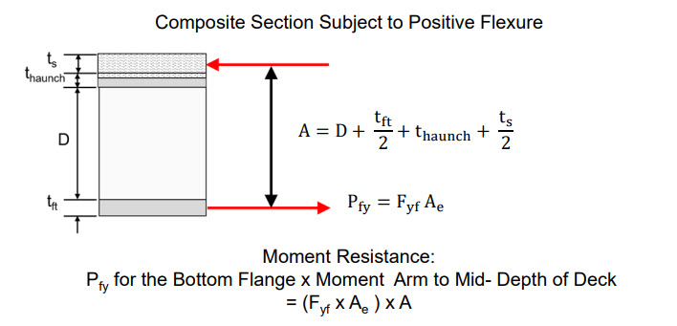
Flexural Members – Flange Splices
Moment Resistance Provided by the Flanges:
Notes:
The moment resistance provided by the flanges, neglecting the web and considering only the flange force, is next to be checked against the factored moment at the strength limit state at the point of splice. Should the factored moment exceed the moment resistance provided by the flanges, the additional moment is to be resisted by the web, as will be described later in this lesson.
For composite sections subject to positive flexure, the moment resistance provided by the flanges at the point of splice is computed as the design yield resistance, P_{fy}, for the bottom flange times the moment arm, A. A is taken as the vertical distance from the mid-thickness of the bottom flange to the mid-thickness of the structural concrete deck (i.e., minus any integral wearing surface) including the concrete haunch. Although not shown in the figure on the screen, the thickness of the concrete haunch is assumed measured from the top of the web to the bottom of the concrete deck. Note that if the haunch is not considered or taken equal to zero, t_{haunch} in the equation for A shown on this slide is to be replaced by the sum of the thickness of the filler plate, if present, and the thickness of the top compression flange, or (t_{filler} + t_{fc}).

Slide 77
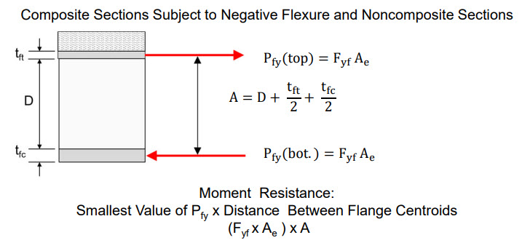
Flexural Members – Flange Splices
Moment Resistance Provided by the Flanges - cont:
Notes:
For composite sections subject to negative flexure at the strength limit state and for noncomposite sections subject to positive or negative flexure, the moment resistance provided by the flanges at the point of splice is computed as the design yield resistance, P_{fy}, for the top or bottom flange, whichever is smaller, times the moment arm, A, taken as the vertical distance between the mid-thickness of the top and bottom flanges, as shown by the equation on this slide. The tensile strength of the longitudinal reinforcement in the deck is ignored in this particular computation.
As permitted in the 10th Edition AASHTO LRFD BDS, for composite sections where shear connectors are provided in regions of negative flexure such that the longitudinal reinforcement may be considered part of the composite section, as permitted in AASHTO LRFD Article 6.10.10.1, and where the longitudinal reinforcement is considered for calculating flexural stresses in composite sections subject to negative flexure as specified in AASHTO LRFD Article 6.10.1.1.1c (Lesson 6), or for computing the factored moment resistance of the composite section subject to negative flexure, as applicable, the moment resistance provided by the flanges at the strength limit state at the point of splice for composite sections subject to negative flexure can potentially be increased if desired by including the additional moment resistance provided by the design yield resistance of the longitudinal deck reinforcement, P_{rs} = A_{rs}F_{yr}. A_{rs} is the total area of the longitudinal reinforcement included in the composite section satisfying the size, spacing, and placement requirements specified in AASHTO LRFD Article 6.10.1.7 (Lesson 7), but not to exceed one percent of the total cross-sectional area of the concrete deck assumed distributed within the appropriate effective width of the concrete deck acting with the girder under consideration (Lesson 6), and F_{yr} is the specified minimum yield strength of the longitudinal reinforcement. This may be done to increase the moment resistance provided by the flanges for composite sections subject to negative flexure at a bolted splice and can potentially lead to a decrease in the required number of web splice bolts; in particular, for deeper girders. In determining the moment resistance provided by the longitudinal reinforcement, P_{rs} should be applied at the centroid of the longitudinal deck reinforcement. If the sum of P_{rs} and P_{fy(top)} is smaller than P_{fy(bot),} then the moment resistance is computed as the sum of P_{rs} and P_{fy(top)} times the moment arm from the centroid of the combined area of P_{rs} and P_{fy(top)} to the mid-thickness of the bottom flange. Otherwise, the moment resistance is computed as P_{fy(bot)} times the moment arm from the mid-thickness of the bottom flange to the centroid of the combined area of P_{rs} and P_{fy(top)}.

Slide 78
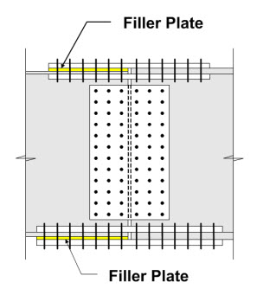
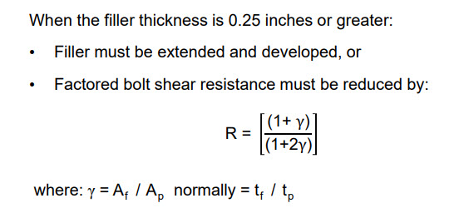
Flexural Members – Flange Splices
Filler Plates (AASHTO LRFD Article 6.13.6.1.4):
Notes:
Filler plates are used when the thickness of adjoining plates are different. They are most frequently used with flange splice plates where it is common to have a transition in plate thickness. The requirements for filler plates are covered in AASHTO LRFD Article 6.13.6.1.4.
Filler plates thicker than 0.25 inches must be developed, or secured by additional bolts to ensure that the fillers are an integral part of the connection; that is, to ensure that the shear planes are well defined, and that the presence of fillers does not require a reduction in the factored shear resistance of the bolts (due to bending of the bolts). For the first alternative, the fillers must be extended beyond the splice material, and the filler extension must be secured by enough additional bolts to distribute the total stress in the member uniformly over the combined section of the member and the filler.
For the second alternative, which is more commonly employed, the fillers do not need to be extended and developed. However, the factored resistance of the bolts in shear at the strength limit state must be reduced by a factor, R, given by the equation on this slide. This reduction factor applies only on the side of the connection with the fillers. For practical reasons, however, consideration should be given to using the same number of bolts on either side of the splice. This equation was developed mathematically and was also verified experimentally. The sum of the area of the fillers on the top and bottom of the connected plate is known as A_{f}. The smaller of either the connected plate area or the sum of the splice plate areas on the top and bottom of the connected plate is known as A_{p}. Normally, the splice plate widths, filler plate widths, and flange widths will be equal in the splice and the connected plate area will be smaller than the sum of the splice plate areas such that the area ratio is only a function of the thickness of the filler, t_{f}, and the thickness of the connected plate, t_{p}.

Slide 79
Flexural Members – Flange Splices
Filler Plates (AASHTO LRFD Article 6.13.6.1.4) - cont:
Additional requirements for filler plates:
  The factored slip resistance of the connection under the Service II load combination should not be adjusted for the effect of the fillers.
  Fillers 0.25 in. or more in thickness should not consist of more than two plates. The actual total filler thickness may exceed the total filler thickness shown in the contract documents by up to a maximum of 0.25 in.
  F_{y} of fillers 0.25 in. or more in thickness must not be less than the larger of 36.0 ksi and 70% of F_{y} of the connected plate.
Notes:
Some additional requirements are specified for filler plates in AASHTO LRFD Article 6.13.6.1.4 and are summarized on this slide.
For slip-critical connections, the factored slip resistance of the connection at the Service II load combination should not be adjusted for the effect of the fillers. The slip resistance between the filler and either connected part is comparable to the slip resistance between the connected parts if the fillers were not present.
Unless approved by the Engineer, fillers with a thickness of 0.25 inches or more should not consist of more than two plates. The actual total filler thickness may exceed the total filler thickness shown in the contract documents by up to a maximum of 0.25 in. A tolerance of up to 0.25 in. on the total filler thickness is permitted should fabrication or rolling tolerances require the use of an additional filler not shown in the contract documents to adequately mate the fillers with the outer surface of the flange on the other side of the splice. A reduction in the specified filler thickness is permitted without restriction. Test results have shown that a 0.25- in-thick filler does not significantly reduce the resistance of the connection
The specified minimum yield strength, F_{y}, of fillers with a thickness of 0.25 inches or greater should not be less than the larger of: 70 percent of the specified minimum yield strength, F_{y}, of the connected plate and 36 ksi. This limit prevents excessive deformation of the connection at the strength limit state and addresses thinner filler-plate material availability issues when higher strength steels are used.

Slide 80
Flexural Members – Flange Splices
Minimum Number of Bolts:
where:
P_{fy} = design yield resistance of the flange = F_{yf}A_{e} (kips) (Slide 73)
R_{r} = factored shear resistance of the bolts (kips) (Slides 26 to 35)
R = reduction factor due to the presence of any filler plates (Slide 78)
Notes:
The minimum number of bolts required on one side of the flange splice at the strength limit state is found by dividing the design yield resistance of the flange, P_{fy} = F_{yf}A_{e} (Slide 73), by the factored shear resistance of the bolts, R_{r}, determined as described previously in this lesson (Slides 26 to 35), including the reduction factor, R, applied to the factored shear resistance of the bolts due to any necessary fillers (Slide 78). The resulting connection will develop the full design yield resistance for each flange. As discussed previously in this lesson, the factored shear resistance of the bolts, R_{r}, depends on whether the threads are excluded from or included in the shear plane (Slide 28), and on the length of the connection between the extreme fasteners measured parallel to the line of action of the force on one side of the splice (Slides 28 and 29). The suggested guidance to determine whether threads are excluded from or included in the shear plane considering the bolt transition length provided in AASHTO LRFD Article C6.13.2.7 (10th Edition) was described previously on Slides 30 and 31 of this lesson.

Slide 81
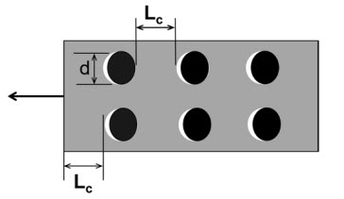
Flexural Members – Flange Splices
Bearing Resistance of the Flange Splice Bolt Holes:
where:
L_{c} = clear distance between the edges of adjacent holes or between the edge of a hole and the end of the member in the direction of the applied force (in.)
d = nominal diameter of the bolt (in.)
R_{n} = nominal bearing resistance of the bolt holes (kips) (Slide 49)
Notes:
The factored bearing resistance of the flange splice bolt holes, R_{r}, is also to be checked at the strength limit state. The factored bearing resistance of the bolt holes in the connection is taken as the sum of the smaller of the factored shear resistance of the individual bolts, and the nominal bearing resistance of the individual bolt holes parallel to the line of the design force, R_{n}, times the resistance factor for bolts bearing on material, φ_{bb} (= 0.80). If the factored bearing resistance of the bolt holes exceeds the factored shear resistance of the bolts, the factored bearing resistance is limited to the shear resistance. The calculation of the nominal bearing resistance, R_{n}, was discussed previously in this lesson (Slide 49). The calculation of the factored shear resistance of the individual bolts was also discussed previously in this lesson (Slides 26 to 35).
Assuming the sum of the flange splice-plate thicknesses exceeds the thickness of the thinner flange at the point of splice, and the splice plate areas satisfy the 10 percent rule described later on in this lesson (Slide 85), the factored bearing resistance of the bolt holes in the connection will be governed by the flange on either side of the splice with the smaller product of the thickness and specified minimum tensile strength, F_{u} (AASHTO LRFD Table 6.4.1-1), of the flange. Otherwise, the bearing resistance of each individual component should be checked to determine the component governing the factored bearing resistance of the connection.
Bolt spacing requirements must also be satisfied. These requirements were described previously in this lesson (Slides 22 to 35).

Slide 82
Flexural Members – Flange Splices
Slip-Critical Connections:
High-strength bolted flange and web splices for flexural members must be designed as slip-critical connections (AASHTO LRFD Article 6.13.6.1.3a).
The connections must be designed to prevent slip under Load Combination Service II [1.0DC + 1.0DW + 1.3(LL + IM)].
The connections must also be proportioned to prevent slip during placement of the concrete deck [1.25DC + 1.5C – AASHTO LRFD Article 3.4.2.1 – 10th Edition].
The connections must also provide adequate shear and bearing resistance at the strength limit state.
Notes:
AASHTO LRFD Article 6.13.6.1.3a specifies that high-strength bolted flange and web splices for flexural members must be designed using slip-critical connections. A slip-critical connection is a type of bolted connection which relies on friction between the two connected elements. Four categories of surface conditions to be used in slip-critical connections are recognized in AASHTO LRFD Article 6.13.2.8, as described previously in this lesson (Slide 42).
Slip-critical connections must be proportioned to prevent slip under the Service II load combination shown on this slide (Lesson 3). This requirement is intended to control permanent deformations under overloads caused by slip in joints that could adversely affect the serviceability of the structure. In addition, the connections must be proportioned to prevent slip under the maximum (factored) actions induced during the placement of the concrete deck to control deformations during the deck placement caused by slip in the joints that could adversely affect the geometry of the structure. The Strength I load combination specified in AASHTO LRFD Article 3.4.2.1 is to be applied for the investigation of connection slip during the deck placement (10th Edition). The use of only the Strength I load combination of (1.25DC + 1.5C) specified in Article 3.4.2.1 is felt to be more reasonable for checking slip than also considering the additional load combination of 1.4(DC + C) specified in the same article, where C represents any construction loads including any dynamic effects (if applicable) (Lesson 7).
Finally, the connections must also provide adequate shear and bearing resistance at the strength limit state assuming the connections have slipped and gone into bearing at the strength limit state.

Slide 83
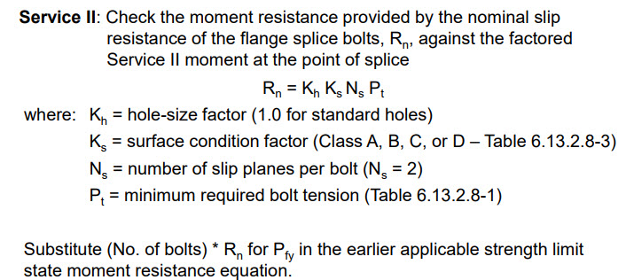
Flexural Members – Flange Splices
Moment Resistance Provided by the Slip Resistance of the Flange Splice Bolts:
(10th Edition)
K_{c} = creep factor (1.0 for non-galvanized faying surface)
Notes:
To check slip of the flange splices, the moment resistance provided by the nominal slip resistance of the flange splice bolts is checked against the factored moments for checking slip. The factored moments for checking slip are taken as the moment at the point of splice under the Service II load combination, and the factored moment at the point of splice due to the deck placement sequence (AASHTO LRFD Article 6.13.6.1.3b).
When checking the nominal slip resistance, R_{n}, of the bolts for a typical flange splice with inner and outer splice plates, which is again given in the 10th Edition AASHTO LRFD BDS by the equation shown on this slide (Slide 38), the flange slip force is assumed divided equally to the two slip planes regardless of the ratio of the splice plate areas. Unless slip occurs on both planes, slip of the connection cannot occur. Therefore, in this case, the slip resistance of the bolted connection should always be computed assuming two slip planes (i.e., N_{s} equals 2). The hole size factor, K_{h}, is taken equal to 1.0 for standard size holes.
The moment resistance provided by the nominal slip resistance of the flange splice bolts is computed using the same moment resistance equations that were described previously in this lesson for the strength limit state (Slides 76 and 77). The number of flange splice bolts times the computed nominal slip resistance per bolt, R_{n}, is substituted for P_{fy} in computing the moment resistance provided by the nominal slip resistance of the flange splice bolts, which is then checked against the corresponding factored moment for checking slip; in this case, the factored Service II moment at the point of splice.

Slide 84
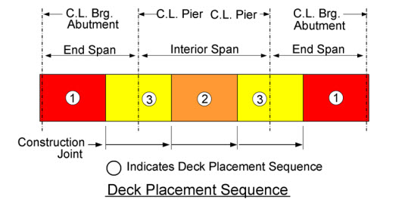
Flexural Members – Flange Splices
Moment Resistance Provided by the Slip Resistance of the Flange Splice Bolts - cont:
Deck Placement: Check the moment resistance provided by the slip resistance of the flange splice bolts, R_{n}, against the factored deck placement moment at the point of splice.
Notes:
For checking slip due to the factored deck placement moment at the point of splice, the strength limit state moment resistance equation for composite sections subject to negative flexure and noncomposite sections subject to positive or negative flexure that was previously described in this lesson is used (Slide 77). Again, the number of flange splice bolts times the computed nominal slip resistance per bolt, R_{n}, is substituted for P_{fy} in computing the moment resistance provided by the nominal slip resistance of the flange splice bolts, which is then checked against the corresponding factored moment for checking slip; in this case, the factored deck placement moment at the point of splice (computed using the Strength I load combination specified in AASHTO LRFD Article 3.4.2.1).
Should the flange bolts not be sufficient to resist the factored moments for checking slip at the point of splice, the additional moment is to be resisted by the web, as described later in this lesson. Should the web bolts not be sufficient to resist the additional moment, only then should consideration be given to adding additional bolts to the flange splices.
For straight girders and for horizontally curved girders, the effects of flange lateral bending need not be considered in checking the bolted connections of the flange splices for slip. Flange lateral bending will increase the flange slip force on one side of the splice and decrease the slip force on the other side of the splice; slip cannot occur unless it occurs on both sides of the splice.

Slide 85
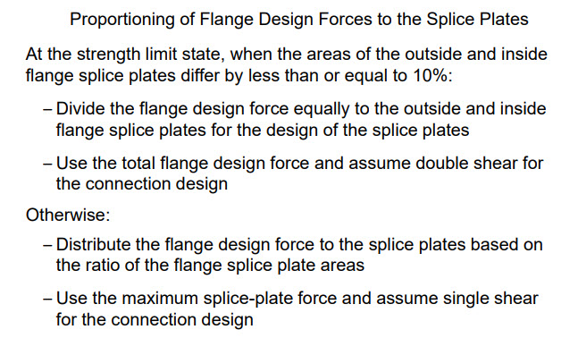
Flexural Members – Flange Splices
Flange Splice Plates:
Notes:
Next, the proportioning and design of the flange splice plates will be discussed. For a flange with inside and outside splice plates, the design force must be distributed to each splice plate appropriately.
As discussed in AASHTO LRFD Article C6.13.6.1.3b, when the areas of the inside and outside splice plates do not differ by more than 10 percent, the flange design force at the strength limit state may be assumed to be divided equally to the inside and outside splice plates for the design of the spice plates. For this case, the connections are proportioned for the total flange design force assuming double shear.
When the areas of the inside and outside splice plates differ by more than 10 percent, the design force for the splice-plate design at the strength limit state should be determined by multiplying the flange design force by the ratio of the area of the splice plate being considered to the total area of the inside and outside splice plates. For this case, the factored shear resistance of the connection is checked for the maximum calculated splice-plate force acting on a single shear plane.
As mentioned previously, the slip resistance should always be determined by dividing the flange design force equally to the two slip planes, regardless of the proportions of the splice plate areas. Slip of the connection cannot occur unless slip occurs on both planes.

Slide 86

Flexural Members – Flange Splices
Flange Splice Plates - cont:
(Lesson 12)
Notes:
At the strength limit state, the design force in flange splice plates subjected to tension cannot exceed the factored resistance in tension, R_{r}. The corresponding equations for each of these checks are shown on this slide. Refer to Lesson 12 for more detailed information on each of these checks. The resistance factors in these equations, φ_{y}, φ_{u}, and φ_{bs} are equal to 0.95, 0.80, and 0.80, respectively (AASHTO LRFD Article 6.5.4.2).
For fracture on the net section, the reduction factor to account for shear lag, U, and the reduction factor, R_{p}, to account for bolt holes punched full size should be taken as 1.0 for splice plates. Splice plates are fully connected so there is no shear lag effect and holes in field splices are not allowed to be punched full size.
In addition, the net area of the plate, A_{n}, should not be taken as greater than 85 percent of the gross area of the plate, A_{g}, to provide a reserve capacity in recognition of the limited inelastic deformation capacity of these shorter elements (AASHTO LRFD Article 6.13.5.2). Should the net area equal or exceed 85 percent of the gross area, then 85 percent of the gross area should be substituted for the net area in the equation; otherwise, the net area is used.
Block shear rupture will usually not govern for flange splices of typical proportion.
The factored yield resistance of the splice plates in compression is the same as the factored yield resistance of the splice plates in tension given by the first equation on this slide, and therefore, need not be checked. Buckling of the splice plates in compression is not a concern since the unsupported length of the plates is limited by the maximum bolt spacing and end distance requirements.

Slide 87

Flexural Members – Flange Splices
Flange Splice Plates - cont:
Notes:
This slide provides some useful practical flange splice plate design guidelines.
The splice plate thickness, t_{splice}, should be greater than or equal to half the thickness of the flange, t_{flange}, plus 1/16 of an inch. As a result, the flange will typically control the bearing resistance and the block shear rupture resistance rather than the splice plates. Note that this same guideline can be applied to the web splice plate thickness using the thickness of the web, t_{web}, in place of t_{flange}.
The outside flange splice plate should, at a minimum, be as wide as the width of the narrowest flange at the splice.
The minimum clearance distance, C, between the inside flange splice plates to adequately clear the flange-to-web welds should be greater than or equal to the thickness of the web, t_{web}, plus two times the weld size plus a one-eighth of an inch clearance distance between the weld and the splice plates.

Slide 88

Flexural Members – Flange Splices
Flange Splice Plates - cont:
Notes:
An earlier slide in this lesson (Slide 85) discussed proportioning of the flange design force to the inside and outside flange splice plates at the strength limit state. That is, in cases where the areas of the inside and outside flange splice plates do not differ by more than 10 percent, the total flange design force at the strength limit state may be assumed divided equally to the inside and outside flange splice plates and the connections may then be proportioned for the total flange design force assuming double shear.
Given the width of the flange, b_{f}, and the minimum clearance distance, C, computed as shown on the preceding slide, the width of the inside splice plates, b_{i}, can be computed from the middle equation shown on this slide. Then, given the outside flange splice plate thickness, t_{o}, the minimum clearance distance, C, and the flange width, b_{f}, the bottom equation on this slide can be used to solve for an inside splice plate thickness, t_{i}, that will satisfy the 10 percent rule described previously on Slide 85 allowing for a double shear connection and an equal distribution of the total flange design force at the strength limit state to the inside and outside flange splice plates.

Slide 89

Flexural Members – Flange Splices
Flange Splice Plates - cont:
Notes:
It is recommended that a minimum ½-inch wide gap be provided between the girder field sections at the splice to allow for adequate drainage and fit up.
It is also recommended that the end distances for the end bolts in the girder flange and web splices be increased ¼ inch from their required design values to provide a tolerance for fabricators when trimming the girder flange and web plates.

Slide 90
Flexural Members – Flange Splices
Girder Tension Flanges with Holes (AASHTO LRFD Article 6.10.1.8):
Eq. 6.10.1.8-1
Prevents a bolted splice in a flexural member from being located where the factored flexural resistance of the section at the strength limit state exceeds the moment at first yield, M_{y}, unless the factored stress in the tension flange, f_{t}, is limited to the value given by Eq. 6.10.1.8-1.
Notes:
AASHTO LRFD Eq. 6.10.1.8-1 shown on this slide and discussed previously in Lesson 6 (Slide 112), provides a limit on the maximum factored major-axis bending stress on the gross area of the tension flange, f_{t}, at the strength limit state, and for constructability considering the loss of area due to the holes in the girder tension flange at the splice. The girder tension flange at a bolted splice must be checked using this equation.
This requirement will likely prevent a bolted splice in a flexural member from being located at a section where the factored flexural resistance of the section at the strength limit state exceeds the moment at first yield, M_{y} (Lesson 6 – Slides 57 through 61), unless the factored stress in the tension flange is limited to the value given by Eq. 6.10.1.8-1.

Slide 91
Flexural Members – Web Splices
Web Design Force – Strength Limit State (AASHTO LRFD Article 6.13.6.1.3c):
Factored Shear Resistance
where:
φ_{v} = resistance factor for shear as specified in AASHTO LRFD Article 6.5.4.2 (= 1.0)
V_{n} = nominal shear resistance of the web (kips) (Lesson 5)
Notes:
Next, the AASHTO LRFD design requirements for web splices will be discussed, focusing first on the calculation of the web design force at the strength limit state. The requirements for the design of web splices are specified in AASHTO LRFD Article 6.13.6.1.3c.
The basis of the design method for web splices at the strength limit state is to design the web splice as a minimum for a web design force taken equal to the smaller factored shear resistance of the web, V_{r}, on either side of the splice. The factored shear resistance of the web is calculated as the resistance factor for shear, φ_{v} equal to 1.0 (AASHTO LRFD Article 6.5.4.2), times the nominal shear resistance of the web, V_{n}, determined for I-sections as specified in AASHTO LRFD Article 6.10.9 (Lesson 5). The nominal shear resistance depends on the depth and thickness of the web and the transverse stiffener spacing adjacent to the splice.
Since the web splice is being designed to develop the full factored shear resistance of the web as a minimum and the eccentricity of the shear is small relative to the depth of the connection, the effect of the small moment introduced by the eccentricity of the web connection is ignored at all limit states.

Slide 92
Flexural Members – Web Splices
Web Design Force – Strength Limit State (AASHTO LRFD Article 6.13.6.1.3c) - cont:
  If the moment resistance provided by the flanges (Slides 76 and 77) is not sufficient to resist the factored moment at the strength limit state at the point of splice, the web splice connections are to instead be designed for the following resultant design force, R:
where:
V_{r} = factored shear resistance of the web = φ_{v}V_{n} (kips) (Lesson 5)
H_{w} = horizontal force in the web at the point of splice that provides the required moment resistance in conjunction with the flange splices = (Web Moment/A_{w}) (kips) (see the next two slides for the computation of the moment arm, A_{w})
Notes:
If the moment resistance provided by the flanges (Slides 76 and 77) is not sufficient to resist the factored moment at the strength limit state at the point of splice, the web splice connections are to instead be designed for a resultant web design force, R, taken equal to the vector sum of the smaller factored shear resistance, V_{r} = φ_{v}V_{n} (Lesson 5), and a horizontal force, H_{w}, in the web that provides the required moment resistance in conjunction with the flange splices. That is, the web splice is designed in this case to carry the design moment in conjunction with the flange splices plus the factored shear resistance of the web simultaneously.
The horizontal force in the web, H_{w}, is computed as the web moment, or the portion of the factored moment at the strength limit state at the point of splice that exceeds the moment resistance provided by the flanges, divided by the appropriate web moment arm, A_{w}. The computation of the moment arm, A_{w}, will be illustrated on the next two slides.

Slide 93

Flexural Members – Web Splices
Web Design Force – Strength Limit State (AASHTO LRFD Article 6.13.6.1.3c) - cont:
Notes:
Next, we will introduce the computation of the moment arm, A_{w}, and the horizontal web force, H_{w}, described on the preceding slide.
The required moment resistance in the web is provided by a horizontal tensile force, H_{w}, assumed acting at the mid-depth of the web in this case that is in equilibrium with an equal and opposite horizontal compressive force in the concrete deck. The horizontal web force, H_{w}, is equal to the web moment, or the factored design moment minus the moment resistance provided by the flanges, divided by the web moment arm, A_{w}.
For composite sections subject to positive flexure, the web moment arm, A_{w}, is taken as the vertical distance from the mid-depth of the web to the mid-thickness of the structural concrete deck including the concrete haunch. Although not shown in the figure on the screen, the concrete haunch is assumed measured from the top of the web to the bottom of the concrete deck. If the haunch is not considered or taken equal to zero, t_{haunch} in the equation for A_{w} is to be replaced by the thickness of the filler plate if present, t_{filler}, plus the thickness of the top (compression) flange, t_{fc}.
In certain extreme cases (e.g., long simple spans with splices located in higher moment areas with a relatively small effective concrete deck), the tensile demand, i.e., the sum of H_{w} and the bottom-flange design yield resistance, P_{fy}, may exceed the compressive resistance of the concrete deck (i.e., 0.85f’_{c}b_{eff}t_{s}). In such cases, consideration may be given to designing the splice conservatively assuming a noncomposite section (see the next slide).

Slide 94

Flexural Members – Web Splices
Web Design Force – Strength Limit State (AASHTO LRFD Article 6.13.6.1.3c) - cont:
Notes:
For composite sections subject to negative flexure at the strength limit state and for noncomposite sections subject to positive or negative flexure, the web moment arm, A_{w}, is taken as one-quarter of the web depth, D. The resisting web moment is provided by two equal and opposite horizontal tensile and compressive forces, H_{w} divided by 2, assumed acting at a distance, D divided by 4, above and below the mid-height of the web. There is no net horizontal force acting on the section. The horizontal web force, H_{w}, in this case is equal to the web moment, or the factored design moment minus the moment resistance provided by the flanges, divided by (D divided by 4).
Because the resultant web force, R, is assumed divided equally to all the bolts, the traditional vector analysis is not applied in the design of the web connection.

Slide 95
Flexural Members – Web Splices
Minimum Number of Bolts:
where:
Web Design Force = V_{r} or R, as applicable (kips) (Slides 91 and 92)
R_{r} = factored shear resistance of the bolts (kips) (Slides 26 to 35)
For most common web splices, threads will typically be included in the shear planes in the calculation of R_{r}.
Provide two rows of bolts at the maximum spacing for sealing (Slide 23), as a minimum.
Provide a closer spacing and/or additional rows only as needed.
Notes:
The minimum number of bolts required on one side of the web splice at the strength limit state is found by dividing the computed web design force by the factored shear resistance of the bolts, R_{r}. The web design force will either be the factored shear resistance of the web, V_{r} (Slide 91), or the resultant web design force, R (Slide 92), if the moment resistance provided by the flanges is not sufficient to resist the factored moment at the splice at the strength limit state. The factored shear resistance of the bolts, R_{r}, is calculated as described in Slides 26 to 35 of this lesson.
For most common web splices, the factored shear resistance will most always be calculated assuming the threads are included in the shear planes according to the guidance described previously on Slides 30 and 31 of this lesson. As a minimum, two vertical rows of bolts spaced at the maximum spacing for sealing bolts (Slide 23) should be provided, with a closer spacing and/or additional rows provided only as needed. Note that the greater than 38.0-inch joint-length reduction factor for the shear resistance of the bolts discussed previously (Slide 29) only applies to lap-splice tension and compression connections and not to web shear-type connections (e.g., web splices), and therefore should not be applied in the design of the web splice.

Slide 96

Flexural Members – Web Splices
Bearing Resistance of the Web Splice Bolt Holes:
where:
R_{n} = nominal bearing resistance of the bolt holes (kips) (Slide 49)
Notes:
The factored bearing resistance of the web splice bolt holes, R_{r}, is also to be checked at the strength limit state. The calculation of the nominal bearing resistance of the bolt holes, R_{n}, was described previously in this lesson on Slide 49.
The bearing resistance may be calculated as the sum of the smaller of the shear resistance of the individual bolts and the bearing resistance of the individual bolt holes parallel to the line of the design force. If the bearing resistance of a bolt hole exceeds the shear resistance of the bolt, the bolt resistance is limited to the shear resistance.
When a moment contribution from the web is required, the resultant forces causing bearing on the web bolt holes are inclined as shown in the figures on this slide; that is, with a horizontal component of force equal to H_{w} divided by the number of web bolts and a vertical component of force equal to V_{r} divided by the number of web bolts. The bearing resistance of each bolt hole in the web can conservatively be calculated in this case using the clear edge distance, as shown in the left figure on the screen. This calculation is conservative since the resultant forces act in the direction of inclined distances that are larger than the clear edge distance. This calculation is also likely to be a conservative calculation for the bolt holes in the adjacent rows.
Should the bearing resistance be exceeded, it is recommended that the clear edge distance be increased slightly in lieu of increasing the number of bolts or thickening the web. Other options would be to calculate the bearing resistance based on the inclined distances, resolve the resultant forces in the direction parallel to the clear edge distance, or to refine the calculation for the bolt holes in the adjacent rows. In cases where the bearing resistance is controlled by the web splice plates, the smaller of the clear edge or end distance on the splice plates can be conservatively used to compute the bearing resistance of each hole as shown in the right figure on this slide.
Bolt spacing requirements must also be satisfied. These requirements were described previously in this lesson (Slides 22 to 25).

Slide 97

Flexural Members – Web Splices
Slip Resistance of the Web Splice Bolts:
(10th Edition)
K_{c} = creep factor (1.0 for non-galvanized faying surface)
Notes:
As a minimum, web splices are to be checked for slip under a web slip force taken equal to the factored shear in the web at the point of splice. The factored shear for checking slip is taken as the shear in the web at the point of splice under Load Combination Service II (Lesson 3), or the factored shear at the point of splice due to the deck placement sequence, whichever governs. The Strength I load combination specified in AASHTO LRFD Article 3.4.2.1 is to be applied for the investigation of connection slip during the deck placement (10th Edition). The use of only the Strength I load combination of (1.25DC + 1.5C) specified in Article 3.4.2.1 is felt to be more reasonable for checking slip than also considering the additional load combination of 1.4(DC + C) specified in the same article, where C represents any construction loads including any dynamic effects (if applicable) (Lesson 7). The nominal slip resistance, R_{n}, for the web splice bolts is computed from the equation shown on the screen, which was described in more detail previously in this lesson (Slide 38).

Slide 98
Flexural Members – Web Splices
Slip Resistance of the Web Splice Bolts - cont:
  If the flange bolts are not sufficient to resist the factored moment for checking slip, the web splice connections are to instead to be checked for slip under the resultant web slip force, R:
where:
Factored Shear = factored Service II or deck casting shear for checking slip, whichever governs (kips)
H_{w} = horizontal force in the web at the point of splice = (Web Slip Moment/A_{w}) (kips)
Notes:
Should the flange bolts not be sufficient to resist the factored moment for checking slip at the point of splice, the web splice bolts should instead be checked for slip under a resultant web slip force, R, taken equal to the vector sum of the factored shear for checking slip (i.e., the factored Service II or deck casting shear, whichever governs) and a horizontal force, H_{w}, located at mid-depth of the web that provides the necessary slip resistance in conjunction with the flange splices.
The horizontal force in the web, H_{w}, is computed as the portion of the factored moment for checking slip at the point of splice that exceeds the moment resistance provided by the nominal slip resistance of the flange splice bolts, or the web slip moment, divided by the appropriate web moment arm, A_{w}. The web moment arm is computed as described previously in this lesson on Slides 93 and 94. The computed resultant web slip force, R, is then divided by the nominal slip resistance of the bolts, R_{n}, to determine the number of web splice bolts required on one side of the splice to resist slip.
In cases where the moment resistance provided by the flange splice bolts is sufficient at the strength limit state, but a moment contribution from the web is required to resist slip, the number of flange splice bolts may be increased to increase the moment resistance provided by the nominal slip resistance of the flange-splice bolts to prevent having to add an additional row of web splice bolts to resist the resultant web slip force.

Slide 99

Flexural Members – Web Splices
Web Splice Plates:
  Splice symmetrically with plates on each side of the web.
  Splice plates must extend nearly the full web depth without impinging on bolt assembly clearances or fillet area on rolled beams.
  No filler plates are needed if the difference in web thickness on each side of the splice is 1/16” or less.
Notes:
Next, the proportioning and design of the web splice plates will be discussed. Webs must be spliced symmetrically by plates on each side of the web. The splice plate thickness, t_{splice}, should be greater than or equal to half the thickness of the web, t_{web}, plus 1/16 of an inch (Slide 87). As a result, the web will typically control the bearing resistance rather than the splice plates.
The splice plates must extend as near as practical for the full depth between the flanges without impinging on bolt assembly clearances or fillet areas on rolled beams. The required bolt assembly clearances are presented in the AISC Manual of Steel Construction, Tables 7-15 and 7-16. For bolted web splices with web thickness differences on each side of the splice of 1/16 inch or less, no filler plates are required.

Slide 100
Flexural Members – Web Splices
Web Splice Plates - cont:
Factored Resistance of the Web Splice Plates
Shear Yielding (AASHTO LRFD Article 6.13.5.3):
Shear Rupture (AASHTO LRFD Article 6.13.5.3):
Block Shear Rupture (AASHTO LRFD Article 6.13.4):
(Lesson 12)
Notes:
At the strength limit state, the factored shear resistance of the web, V_{r}, cannot exceed the factored resistance of the web splice plates, R_{r}, taken as the smaller value based on shear yielding, shear rupture, or block shear rupture. The corresponding equations for each of these checks are shown on this slide.
For shear yielding, the factored shear resistance of the web splice plates, R_{r}, is conservatively based on the shear yield stress, which is equal to 0.58 times the specified minimum yield strength of the web splice plates, F_{y} (AASHTO LRFD Article 6.13.5.3 – Lesson 1 – Slide 89). The shear yield stress is multiplied by the resistance factor for shear, φ_{v} (= 1.0), and the gross area of the web splice plates, A_{vg}, to compute the factored shear yield resistance.
For shear rupture, the factored shear resistance of the web splice plates, R_{r}, is equal to 0.58 times the resistance factor for shear rupture of connected elements, φ_{vu} (= 0.80), times the tensile strength of the web splice plates, F_{u} (AASHTO LRFD Table 6.4.1-1), times the net area of the web splice plates, A_{vn}, times the reduction factor for holes punched full size, R_{p} (AASHTO LRFD Article 6.13.5.3). The reduction factor, R_{p}, to account for bolt holes punched full size (Lesson 12) should be taken as 1.0 for splice plates. Splice plates are fully connected so there is no shear lag effect and holes in field splices are not allowed to be punched full size.
Refer to Lesson 12 for more detailed information on the block shear rupture check (φ_{bs} = 0.80; U_{bs} is equal to 1.0 for splice plates). Because of the overall length of the connection, the block shear rupture resistance normally does not control for web splice plates of typical proportion.

Slide 101


Flexural Members – Example
Resources for designing bolted field splices:
  NBSA Bolted Field Splices for Steel Bridge Flexural Members - Overview and Design Examples
  NSBA Splice design spreadsheet
  Resources available free of charge on the NSBA website – www.aisc.org/nsba. Click on ′Design and Estimating′ and then on ′Design Resources and Software′
Notes:
In the remainder of this lesson, a design example for a bolted field splice will be presented, illustrating the application of the AASHTO LRFD design requirements for bolted splices that were described on the preceding slides.
Several resources for designing bolted field splices are available from the NSBA, including the Bolted Field Splices for Steel Bridge Flexural Members reference document shown on this slide, which provides an overview of the design requirements along with three design examples, and the NSBA Splice spreadsheet which allows the user to quickly analyze various bolted splice connections and determine the most efficient design configuration that satisfies all the AASHTO LRFD requirements. These resources are available free of charge on the NSBA website (www.aisc.org/nsba); on the website, click on ′Design and Estimating′ and then click on ′Design Resources and Software′ to access these resources. The following illustrative example is Design Example 2 taken from the NSBA reference document.

Slide 102
Flexural Members – Example
Design the bolted field splice in the end span of the exterior girder of a three-span continuous I-girder bridge:
  Spans: 234 ft – 300 ft – 234 ft
  Splice is located near a point of permanent load contraflexure in the end span.
  Bolts: 7/8”diameter ASTM F3125 Grade A325 bolts in standard-size 15/16” diameter holes
  Unfactored design moments: M_{DC1} = -1,564 kip-ft M_{+LL+IM} = +5,627 kip-ft
        M_{DC2} = -242 kip-ft M_{-LL+IM} = -7,117 kip-ft
        M_{DW} = -315 kip-ft M_{deck placement} = +3,006 kip-ft
        The factored Strength I design moments at the point of splice are:
          Positive Moment = 0.9(-1,564 + -242) + 0.65(-315) + 1.75(+5,627)
          = +8,017 kip-ft
          Negative Moment = 1.25(-1,564 + -242) + 1.50(-315) + 1.75(-7,117)
          = -15,185 kip-ft
Notes:
In this design exercise, the bolted field splice in the end span of the exterior girder of a three-span continuous I-girder bridge will be designed. There are three spans of 234 feet, 300 feet and 234 feet. The splice is located near the point of permanent load contraflexure. For this splice, 7/8” diameter ASTM F3125 Grade A325 bolts (120 ksi bolts) placed in standard-size 15/16” diameter holes will be used.
The unfactored design moments are as follows: M_{DC1} is -1,564 kip-feet; M_{DC2} is -242 kip-feet; M_{DW} is -315 kip-feet; M_{+LL+IM} is +5,627 kip-feet; M_{-LL+IM} is -7,117 kip-feet; and M_{deck casting} is +3,006 kip-feet. The deck casting moment at the point of splice was determined from a separate deck casting analysis (Lesson 7). In addition to the weight of the wet concrete, the deck-casting moment includes the self-weight of the steel and the weight of the stay-in-place deck forms. The moment due to any construction loads (C) is not considered in this example.
As shown on this slide, the factored Strength I positive moment at the point of splice is computed as +8,017 kip-feet. The factored Strength I negative moment at the point of splice is computed as -15,185 kip-feet. Note that for the computation of the factored Strength I positive moment, since the splice is located near a point of permanent load contraflexure and the dead and live load moments are of opposite sign, the specified (minimum) permanent load factors, γ_{p}, of 0.90 and 0.65 (AASHTO LRFD Table 3.4.1-2) are applied to the DC and DW moments, respectively (Lesson 3).

Slide 103

Flexural Members – Example
Design Example Girder Plate Dimensions (all material ASTM A709 Grade 50):
Notes:
This slide shows the girder plate dimensions at the point of splice for the design example. On the left side of the splice, the top flange is 19 inches wide and 1 inch thick, and the bottom flange is 20 inches wide and 1-7/16 inches thick. On the right side of the splice, the top flange is 22 inches wide and 2 inches thick, and the bottom flange is 24 inches wide and 2-1/4 inches thick. The web on both sides of the splice is 109 inches deep and ¾ inches thick. All material is ASTM A709 Grade 50 steel.
By inspection, the left side has the smallest flanges which will control the design. Also, a one-inch filler is required for the top flange splice, and a 13/16-inch filler is required for the bottom flange splice.
The structural concrete deck thickness is 8.0 inches, and the deck haunch height is conservatively ignored in this example.

Slide 104
Flexural Members – Example
Top Flange Splice Bolt Design – Strength Limit State:
  Calculate the design yield resistance, P_{fy}, of the top flange. First, calculate the top flange effective area, A_{e} (Slide 73). Assume 4 bolts in a row across the flange:
  Calculate the reduction on bolt shear resistance due to the 1” filler plate (Slide 78):
Notes:
The application of the AASHTO LRFD flange splice design requirements will now be illustrated. First, will be an illustration of the design of the top flange splice bolts at the strength limit state.
Calculate the design yield resistance of the top flange. The top flange effective area needs to be determined first and cannot be greater than the gross area of the flange. Assume there are four bolts in a row across the width of the flange. The top flange effective area, A_{e}, (Slide 73) is equal to the ratio of the resistance factor for fracture on the net section in tension, φ_{u} (= 0.80), times the tensile strength of the flange, F_{u} (AASHTO LRFD Table 6.4.1-1), divided by the resistance factor for yielding on the gross section in tension, φ_{y} (= 0.95), times the yield strength of the flange, F_{yf}, multiplied by the net area of the flange, A_{n} (Slide 75). In computing A_{n}, the width of the bolt holes is used. For a 7/8-inch diameter bolt, the width of a standard-size bolt hole is 15/16 inches. In this case, the effective area of the flange is computed to be 16.6 in.² This value needs to be compared to the gross area of the flange which is 19 in.² The effective area is taken as the lesser of the two values; therefore, the effective area of the flange is 16.6 in.² The design yield resistance of the flange, P_{fy}, is equal to the yield strength of the flange, F_{yf}, times the effective area of the flange, A_{e}, which is computed to be 830 kips.
Next, the reduction in the factored bolt shear resistance, R, due to the presence of the one-inch top-flange splice filler plate must be calculated (Slide 78). R is equal to the ratio of one plus gamma divided by one plus two times gamma. Since the plates are all the same width and the top flange area is assumed to be less than the sum of the top-flange splice plate areas, gamma may simply be taken as the thickness of the filler plate, t_{f}, divided by the thickness of the connected plate, t_{p}, or the top flange in this case, which are both equal to 1.0 inch in this example. The reduction factor, R, is computed to be 0.67.

Slide 105
Flexural Members – Example
Top Flange Splice Bolt Design – Strength Limit State - cont:
  Calculate the factored shear resistance, R_{r}, of the bolts in double shear (N_{s} = 2). Threads are excluded from the shear plane.
(AASHTO LRFD Table 6.4.3.1.1-1)
(Slide 80)
Use 4 rows with 5 bolts per row = 20 bolts on each side of the splice.
Notes:
Next, calculate the factored shear resistance, R_{r}, of the bolts in double shear; that is, when the number of shear planes, N_{s}, equals 2. Separate calculations similar to those demonstrated on Slides 32 to 34 determine that the threads are excluded from the shear plane.
As discussed previously in this lesson, the factored shear resistance, R_{r}, equals the resistance factor for shear on bolts, φ_{s} (= 0.80), times the nominal shear resistance, R_{n} (Slide 27). To determine the nominal shear resistance, the following must be determined: 1) the nominal bolt area A_{b}, which is computed to be 0.60 in.² for a 7/8-inch diameter bolt as illustrated on this slide; 2) the specified minimum tensile strength, F_{ub}, which is 120 ksi for a 7/8-inch diameter bolt (AASHTO LRFD Table 6.4.3.1.1-1 – Slide 15); and 3) the number of shear planes, N_{s}, which is equal to 2 for a bolted splice. Using that information, the factored shear resistance of the bolts, R_{r}, is computed to be 64.6 kips.
The minimum number of bolts required for the top-flange splice at the strength limit state (Slide 80) is equal to the design yield resistance of the top flange, P_{fy}, divided by the factored shear resistance of the bolts, R_{r}, and the reduction factor, R, due to the presence of the filler plate, which were both determined on the preceding slide. Substituting, the minimum number of bolts required for the top-flange splice is 19.2 bolts. For this design example, use 4 rows with 5 bolts per row in the top-flange splice for a total of 20 bolts on each side of the splice.

Slide 106
Flexural Members – Example
Bottom Flange Splice Bolt Design – Strength Limit State:
  Repeat the preceding calculations for the bottom flange splice. Assume 4 bolts in a row across the flange:
  Calculate the reduction on bolt shear resistance due to the 13/16” filler plate (Slide 78)
Notes:
Repeat the preceding calculations for the bottom-flange splice assuming again there are four bolts in a row across the width of the flange.
Using the resistance factors, the yield and tensile strength values from the preceding calculation for the top flange, the bottom flange width of 20 inches, the bottom flange thickness of 1.4375 inches, and 15/16 inch bolt holes, the bottom flange effective area, A_{e}, equals 25.5 in.² This value is then compared to the bottom flange gross area, A_{g}, which is the bottom flange width times the bottom flange thickness and equals 28.8 in.²; the bottom flange effective area of 25.5 in.² is the lesser of the two values and therefore controls.
The design yield resistance of the bottom flange, P_{fy}, is equal to the yield strength of the flange times the effective area of the flange and is computed to be 1,275 kips. The bottom flange splice requires a 13/16-inch filler plate which will reduce the factored bolt shear resistance by a factor, R, which is calculated to be 0.73 as illustrated on this slide.

Slide 107
Flexural Members – Example
Bottom Flange Splice Bolt Design – Strength Limit State - cont:
  Calculate the factored shear resistance, R_{r}, of the bolts in double shear (N_{s} = 2). Threads are excluded from the shear plane.
(Slide 105)
(Slide 80)
Use 4 rows with 7 bolts per row = 28 bolts on each side of the splice.
Notes:
The example calculations given on Slides 32 to 34 of this lesson for the bottom-flange splice in this example indicate that the threads are excluded from the shear plane. Using the value calculated previously for the top-flange splice (Slide 105), the factored shear resistance of the bolts, R_{r}, in double shear with the threads excluded from the shear plane is 64.6 kips. The minimum number of bolts required for the bottom-flange splice at the strength limit state (Slide 80) is equal to the design yield resistance of the bottom flange, P_{fy}, divided by the factored shear resistance of the bolts and the reduction factor due to the presence of the filler plate. The minimum number of bolts required for the bottom-flange splice is 27.0 bolts. For this design example on the bottom flange, use 4 rows with 7 bolts per row in the bottom-flange splice for a total of 28 bolts on each side of the splice.

Slide 108

Flexural Members – Example
Moment Resistance Provided by the Flanges – Positive Flexure:
t_{s}
t_{filler}
(t_{haunch}) = 0
t_{fc}
D
t_{ft}
The flanges have adequate moment resistance to resist the factored Strength I positive design moment at the splice.
Notes:
Next, determine if the moment resistance provided by the flanges for composite sections in positive flexure is adequate to resist the factored Strength I positive design moment at the point of splice, which was previously determined to be +8,017 kip-ft (Slide 102). There is no concrete haunch assumed for this example (i.e., it is conservatively ignored). Since the haunch is assumed to be zero in this example, the moment arm, A, is equal to the depth of the girder web, D, plus one half the thickness of the bottom (tension) flange, t_{ft}, plus the thickness of the filler plate, t_{filler}, plus the thickness of the top (compression) flange, t_{fc}, plus one half the thickness of the structural concrete deck, t_{s}, and is equal to 115.72 inches. The design yield resistance of the bottom flange, P_{fy (bot.)}, was previously computed to be 1,275 kips (Slide 106). The moment resistance of the flange, M_{flange}, is equal to the design yield resistance of the bottom flange, P_{fy}, times the moment arm, A, and is computed to be 12,295 kip-feet which is greater than 8,017 kip-feet. The flanges have adequate moment resistance to resist the factored Strength I positive design moment at the splice.

Slide 109

Flexural Members – Example
Moment Resistance Provided by the Flanges – Negative Flexure:
The flanges do not have adequate moment resistance to resist the factored Strength I negative design moment at the splice.
Notes:
Next, determine if the moment resistance provided by the flanges for composite sections in negative flexure is adequate to resist the factored Strength I negative design moment at the point of splice, which was previously determined to be -15,185 kip-feet (Slide 102). The moment arm, A, is equal to the depth of the girder web, D, plus one half the thickness of the top (tension) flange, t_{ft}, plus one half the thickness of the bottom (compression) flange, t_{fc}. The moment arm is equal to 110.22 inches. The moment resistance provided by flanges is equal to the design yield resistance, P_{fy}, for the top or bottom flange, whichever is smaller, times the moment arm, A. From previous computations, the design yield resistance of the top flange is 830 kips and for the bottom flange it is 1,275 kips; therefore, the top flange controls. The moment resistance of the flange, M_{flange}, is equal to the design yield resistance of the top flange times the moment arm, A, and is equal to 7,624 kip-feet, which is less than the absolute value of -15,185 kip-feet. The flanges do not have adequate moment resistance to resist the factored Strength I negative design moment at the splice. The difference of 7,561 kip-feet must be carried by the web and is considered later on in this example in the design of the web splice at the strength limit state.

Slide 110

Flexural Members – Example
Bearing Resistance of the Bottom Flange Bolt Holes:
The factored shear resistance of the 4 end bolts, accounting for the presence of the filler is:
Bearing does not control for the end bolt holes
Notes:
Check the bearing resistance of the bolt holes for the bottom flange. The bearing resistance of the end bolt holes will be calculated on this slide. The bearing resistance of the interior bolt holes will be checked on the next slide.
Assume the bolt pattern shown in the figure on this slide for the bottom flange splice. Earlier it was determined that 4 rows of bolts with 7 bolts per row is required (Slide 107). The center-to-center spacing of the bolts of 3.0 inches is greater than the required minimum spacing of three times the nominal diameter of the bolt (Slide 22). Since the length between the extreme bolts on one side of the splice of 18 inches measured parallel to the line of action of the applied force is less than 38.0 inches, no joint-length reduction in the factored shear resistance of the bolts is required. The maximum spacing of the bolts along the free edges of the thinner outside splice plate satisfies the requirements for sealing described previously in this lesson (Slide 23). The edge and end distances satisfy the minimum and maximum requirements specified for a 7/8-inch diameter bolt and the thinner outside splice plate, as also described previously in this lesson (Slide 24).
Since the flange and splice plates have the same tensile strength, F_{u}, of 65.0 ksi (AASHTO LRFD Table 6.4.1-1) and the sum of the inner and outer splice plate thicknesses (designed later in this example) exceeds the thickness of the thinner flange at the splice, and the splice plate areas satisfy the 10 percent rule for the splice plates described previously in this lesson (Slide 85), the flange controls the bearing resistance of the connection.
For the end bolt holes, the clear end distance, L_{c}, is computed to be 1.28 inches from the end of the member to the edge of the end bolt holes in the direction of the line of force. The nominal bearing resistance, R_{n}, of the 4 end bolt holes computed from the equation using the clear end distance, L_{c}, the thickness of the bottom flange, t, and the tensile strength of the flange, F_{u}, is 574 kips. The nominal bearing resistance, R_{n}, of the 4 end bolt holes computed from the equation using the nominal diameter of the bolt, d, the thickness of the bottom flange, t, and the tensile strength of the flange, F_{u}, is 785 kips. The first equation governs. Therefore, the factored bearing resistance, R_{r}, is equal to the resistance factor for bearing on bolt holes, φ_{bb} (= 0.80), times R_{n}, or 459 kips. Since R_{r} for bearing is greater than the factored shear resistance, R_{r}, of the 4 end bolts, which is computed as 4 times the reduction factor, R, of 0.73 to account for the presence of the filler plate (Slide 106) times the factored shear resistance of the bolts of 64.6 kips computed previously (Slide 105), or 189 kips, bearing does not control for the end bolt holes.

Slide 111
Flexural Members – Example
Bearing Resistance of the Bottom Flange Bolt Holes - cont:
The factored shear resistance of the 24 interior bolts, accounting for the presence of the filler is:
Bearing does not control for the interior bolt holes
Notes:
For the interior bolt holes, the clear distance, L_{c}, is computed to be 2.0625 inches between the edge of adjacent holes in the direction of the line of force. The nominal bearing resistance, R_{n}, of the 24 interior bolt holes computed from the equation using the clear end distance, L_{c}, the thickness of the bottom flange, t, and the tensile strength of the flange, F_{u}, is 5,550 kips. The nominal bearing resistance, R_{n}, of the 24 interior bolt holes computed from the equation using the diameter of the bolt, d, the thickness of the bottom flange, t, and the tensile strength of the flange, F_{u}, is 4,709 kips, which governs The factored bearing resistance, R_{r}, is equal to φ_{bb} (= 0.80) times R_{n}, or 3,767 kips. Since R_{r} for bearing is greater than the factored shear resistance, R_{r}, of the 24 interior bolts, which is computed as 24 times the reduction factor, R, of 0.73 to account for the presence of the filler plate (Slide 106) times the factored shear resistance of the bolts of 64.6 kips computed previously (Slide 105 ), or 1,132 kips, bearing does not control for the interior bolt holes.

Slide 112
Flexural Members – Example
Flange Splice Slip Resistance Check – Service II (Positive Flexure):
Assume a Class B surface condition factor (K_{s} = 0.50) and 2 slip planes (N_{s} = 2).
(standard holes)
(Slide 38)
Bottom flange connection slip resistance (28 bolts):
Flange moment arm (same as strength limit state calculation – Slide 108):
Flange slip moment:
Notes:
Next, check the slip resistance of the flange splices. Check to see if the moment resistance provided by the slip resistance of the flange splice bolts is sufficient to resist the factored positive Service II moment (Lesson 3) at the point of the splice, which is computed to be +5,194 kip-feet (refer to Slide 102 of this lesson for the unfactored bending moments).
To compute the nominal slip resistance of the connection, R_{n} (Slide 38), assume a Class B surface condition factor, K_{s}, of 0.50 (AASHTO LRFD Table 6.13.2.8-3 – Slide 42), and two slip planes, or N_{s} equal to two. The minimum required bolt tension, P_{t}, for a 7/8-inch diameter high-strength bolt is 39.0 kips as specified in AASHTO LRFD Table 6.13.2.8-1 (Slide 40). The hole size factor, K_{h}, for a standard-size hole is 1.0 (AASHTO LRFD Table 6.13.2.8-2 – Slide 41). The creep factor, K_{c}, is equal to 1.0 since the faying surface is not galvanized. Therefore, R_{n} is computed to be 39.0 kips.
Similar to the previous calculation of the moment resistance provided by the flanges at the strength limit state, for positive flexure (Slide 108), use the nominal slip resistance of the bottom-flange splice bolts in the calculation of the flange slip moment for positive flexure. The total nominal slip resistance, R_{n}, of the 28 bottom-flange splice bolts is 1,092 kips. The flange moment arm, A, is taken to be the same as that computed for positive flexure at the strength limit state on Slide 108 of this lesson, or 115.72 inches. Therefore, the flange slip moment, M_{flange}, is taken as the total R_{n} times the moment arm, A, or 10,530 kip-feet, which exceeds the factored Service II positive moment of 5,194 kip-feet. Thus, the moment resistance provided by the slip resistance of the flange splice bolts is sufficient to resist the factored positive Service II moment at the splice.

Slide 113
Flexural Members – Example
Flange Splice Slip Resistance Check – Service II (Negative Flexure):
Top flange connection slip resistance (20 bolts):
Flange moment arm (same as strength limit state calculation – Slide 109):
Flange slip moment:
The slip resistance of the flange splice bolts is not adequate to prevent slip under the Service II negative moment at the splice.
Notes:
Check to see if the moment resistance provided by the slip resistance of the flange splice bolts is sufficient to resist the factored negative Service II moment at the point of the splice, which is computed to be -11,373 kip-feet (refer to Slide 102 of this lesson for the unfactored bending moments).
For negative flexure, use the nominal slip resistance of the top-flange or bottom-flange splice bolts, whichever is smaller. The total nominal slip resistance, R_{n}, of the 20 top-flange splice bolts of 780 kips is smaller than the total nominal slip resistance, R_{n}, of the bottom-flange splice bolts of 1,092 kips computed on the preceding slide; therefore, the top-flange splice bolts govern. The flange moment arm, A, is taken to be the same as that computed for negative flexure at the strength limit state on Slide 109 of this lesson, or 110.22 inches. Therefore, the flange slip moment, M_{flange}, is taken as the total R_{n} times the moment arm, A, or 7,164 kip-feet, which is less than the absolute value of the factored Service II negative moment of 11,373 kip-feet.
The flange splice bolts do not have adequate slip resistance to prevent slip under the factored Service II negative moment at the splice. The difference between the absolute value of -11,373 minus 7,164 is equal to 4,209 kip-feet, which must be carried by the web and is considered later in this design example in checking the slip resistance of the web splice bolts.

Slide 114
Flexural Members – Example
Flange Splice Slip Resistance Check – Deck Placement:
The deck placement moment is applied to the noncomposite section. Use the nominal slip resistance of the top or bottom flange splice bolts, whichever is smaller.
Top flange connection slip resistance (20 bolts):
Flange moment arm (same as strength limit state calculation – Slide 109):
Flange slip moment:
Notes:
Lastly, check to see if the moment resistance provided by the slip resistance of the flange splice bolts is sufficient to resist the factored deck placement moment applied to the noncomposite section at the point of splice, which is computed to be +4,208 kip-feet (refer to Slide 102 of this lesson for the unfactored bending moment). The Strength I load combination specified in AASHTO LRFD Article 3.4.2.1 (Lesson 7) is applied to the unfactored moment of +3,006 kip-feet at the splice determined from a separate deck-placement analysis. The moment due to any construction loads (C) is not considered in this example.
For moments applied to the noncomposite section, the nominal slip resistance of the top or bottom flange splice bolts is used, whichever is smaller. The total nominal slip resistance, R_{n}, of the 20 top-flange splice bolts of 780 kips is smaller than the total nominal slip resistance, R_{n}, of the bottom-flange splice bolts of 1,092 kips computed previously on Slide 112 of this lesson; therefore, the top-flange splice bolts govern. The flange moment arm, A, is taken to be the same as that computed for negative flexure at the strength limit state and for noncomposite sections subject to positive or negative flexure on Slide 109 of this lesson, or 110.22 inches. Therefore, the flange slip moment, M_{flange}, is taken as the total R_{n} times the moment arm, A, or 7,164 kip-feet, which exceeds the factored deck casting moment of 3,758 kip-feet. Thus, the moment resistance provided by the slip resistance of the flange splice bolts is sufficient to resist the factored deck-placement moment at the splice.

Slide 115

Flexural Members – Example
Bottom Flange Splice Plate Design:
Outside flange splice plate thickness:
(Slide 87)
Outside flange splice plate width:
Use narrowest bottom flange width at the splice = 20 in. = b_{o}
Inside flange splice plates:
Assume 5/16” flange-to-web welds are used.
(Slide 87)
¾”
C
(Slide 88)
Notes:
Next, design the bottom flange splice plates. The outside flange splice plate thickness should be greater than one half the thickness of the bottom flange plus one sixteenth of an inch (Slide 87) or 0.78 inches; therefore, for the outside flange splice plate thickness, t_{o}, use 13/16 inches. The outside flange splice plate width, b_{o}, should be at a minimum equal to the width of the narrowest bottom flange width at the splice, which is 20 inches.
For the inside flange splice plates, assume 5/16-inch flange-to-web welds are used. The minimum clearance distance, C, between the inside flange splice plates should be greater than or equal to the web thickness of 0.75 inches plus two times the weld size plus one eighth of an inch (Slide 87). The minimum clearance distance equals 1.625 inches, so use 2.0 inches for this example. The width of the inside flange splice plates, b_{i}, equals one half the difference of the width of the flange minus the minimum clearance distance, C (Slide 88). The inside flange splice plate width is 9 inches.

Slide 116
Flexural Members – Example
Bottom Flange Splice Plate Design - cont:
Inside flange splice plates (cont):
To proportion for double shear (i.e., the 10% rule):
(Slide 88)
∴ P_{fy} can be assumed equally divided to the inside and outside splice plates at the strength limit state and the connection can be designed for double shear.
Use t_{i} = 7/8” for the inside splice plates.
Notes:
Next, proportion the inside and outside flange splice plates using the 10 percent rule as described on a previous slide in this lesson (Slide 85) to allow the flange splice connection to be designed for double shear.
The value of 1 minus the ratio of the minimum clearance distance, C, of 2.0 inches computed on the preceding slide divided by the bottom flange width of 20 inches times the thickness of the inner flange splice plate, t_{i}, should be within a 10 percent range of the outside flange splice plate thickness of 0.8125 inches (Slide 88). Working through the equations on this slide, the thickness of the inside flange splice plates, t_{i}, should be greater than or equal to 0.81 inches, or less than or equal to 0.99 inches. For the thickness of the inside flange splice plates, use 7/8 inches.
As a result, the design yield resistance of the bottom flange, P_{fy}, can be assumed equally divided between the inside and outside flange splice plates at the strength limit state, and the connection can be designed for double shear to resist P_{fy}. Otherwise, P_{fy} would need to be distributed to the splice plates based on the ratio of the spice plate areas and the connection would be designed for the maximum calculated splice plate force acting in single shear.

Slide 117
Flexural Members – Example
Bottom Flange Splice Plate Design - cont:
Check the factored yield resistance of the bottom flange splice plates in tension (Slide 86):
Outside flange splice plate:
Inside flange splice plates:
Notes:
Check the factored yield resistance of the bottom flange splice plates in tension, R_{r}, for the outside and inside plates by multiplying the resistance factor for yielding in tension, φ_{y} (= 0.95), times the yield strength of the flange, F_{y}, times the gross area of the flange, A_{g} (Slide 86 and Lesson 12). This needs to be greater than one half the design yield resistance of the flange, P_{fy}, which in this case is 638 kips. One-half of P_{fy} is used because the flange splice plate areas satisfy the 10 percent rule, as demonstrated on the preceding slide, so P_{fy} can be assumed equally divided to the inside and outside splice plates.
The factored yield resistance, R_{r}, of the outside flange splice plate is 772 kips, which is greater than one-half of P_{fy} or 638 kips and therefore is satisfactory.
The factored yield resistance of the inside splice plates is 748 kips, which is greater than one-half of P_{fy} or 638 kips and therefore is also satisfactory.

Slide 118
Flexural Members – Example
Bottom Flange Splice Plate Design - cont:
Check the factored net section fracture resistance of the bottom flange splice plates in tension (Slide 86).
For splice plates in tension:
Outside flange splice plate:
Inside flange splice plates:
Notes:
Next, check the factored net section fracture resistance of the bottom flange splice plates in tension, R_{r}, for the outside and inside plates (Slide 86). This check will be performed on the following slide.
First however, for splice plates in tension, it must be determined whether the net area of the splice plates, A_{n}, exceeds 0.85 times the gross area of the splice plates, A_{g} (refer to the discussion in the Notes Page for Slide 86 in this lesson). For the outside splice plate, 0.85 times the gross area of the outside splice plate is equal to 13.8 in.² After deducting the area of the four bolt holes across the width of the plate, the net area of the splice plate equals 13.2 in.², which is less than 85 percent of the gross area of the outside splice plate.
For the inside splice plates, 0.85 times the gross area of the inside splice plates is equal to 13.4 in.² After deducting the area of the bolt holes, the net area of the splice plates equals 12.5 in.², which is less than the 85 percent of the gross area of the inside splice plates.
Had the splice plate areas exceeded 85 percent of their gross area, then 85 percent of their gross area would be substituted for the net area in the net section fracture resistance check to be shown on the following slide.

Slide 119
Flexural Members – Example
Bottom Flange Splice Plate Design - cont:
Check the factored net section fracture resistance of the bottom flange splice plates in tension - cont.
∴ Use A_{n} to check the factored net section fracture resistance:
Outside flange splice plate:
Inside flange splice plates:
Notes:
As shown on the preceding slide, since the flange splice plate areas did not exceed 85 percent of their gross area, the net area of the plates, A_{n}, is used to check the factored net section fracture resistance.
Check the factored net section fracture resistance of the bottom flange splice plates in tension, R_{r}, (Slide 86 and Lesson 12) for the outside and inside plates by multiplying the resistance factor for net section fracture in tension, φ_{u} (= 0.80), times the tensile strength of the flange, F_{u} (AASHTO LRFD Table 6.4.1-1), times the net area of the flange, A_{n}, times the reduction factor for punched bolt holes, R_{p}, taken equal to 1.0 for drilled holes, times the reduction factor to account for shear lag, U, taken equal to 1.0 for splices (AASHTO LRFD Article 6.13.5.2). This needs to be greater than one half the design yield resistance, P_{fy}, of the bottom flange, which in this case is 638 kips.
The net section fracture resistance of the outside flange splice plate equals 686 kips, which is greater than one-half of P_{fy} or 638 kips and therefore is satisfactory. The net section fracture resistance of the inside flange splice plates equals 648 kips, which is greater than one-half of P_{fy} or 638 kips and therefore is also satisfactory.

Slide 120

Flexural Members – Example
Bottom Flange Splice:
Assume the flange controls the factored block shear rupture resistance check.
Notes:
Next, check the factored block shear rupture resistance of the smaller bottom flange at the splice. It is assumed that the flange controls the block shear rupture resistance rather than the splice plates since the combined area of the splice plates exceeds the area of the flange. The block shear failure plane shown on the figure on this slide is assumed for the bottom flange at the splice.
As will be discussed further in Lesson 12 (Slides 16 and 17), the factored block shear rupture resistance, R_{r}, is computed as the resistance factor for block shear, φ_{bs} (= 0.80), times the reduction factor for punched bolt holes, R_{p}, taken equal to 1.0 for drilled holes, times the sum of the net section rupture resistance along the assumed shear failure planes through the holes plus the net section rupture resistance along the assumed tensile failure planes through the holes. The term 0.58 times F_{y} times the net area along the shear planes, A_{vn}, is limited to 0.58 times F_{y} times the gross area along the shear planes, A_{vg}, to prevent gross yielding on the shear planes when rupture on the tensile planes commences. The factor, U_{bs}, in the block shear rupture resistance equation is a separate reduction factor for block shear rupture taken equal to 1.0 for splices.
The governing calculated factored block shear rupture resistance, R_{r}, of the bottom flange of 2,020 kips exceeds the design yield resistance, P_{fy}, of the bottom flange of 1,275 kips computed previously (Slide 106). Therefore, the block shear rupture resistance of the bottom flange at the splice is satisfactory.
Similar calculations (not shown) confirm that a 9 /16 in. x 19 in. outside splice plate with two ⅝ in. x 8-½ in. inside splice plates are sufficient to resist the design yield resistance of the top flange, P_{fy} = 830 kips. A 1 in. x 19 in. filler plate is required on the outside. All plates are again ASTM A709 Grade 50 steel.
Separate computations also indicate that the requirement for checking the factored major-axis bending stress on the gross area of the tension flange at the strength limit state considering the loss of area due to the holes (discussed previously on Slide 90 of this lesson) is satisfied at the splice.
Also, since the combined area of the inside and outside flange splice plates is greater than the area of the smaller flange at the point of splice, fatigue of the base metal of the splice plates adjacent to the slip-critical bolted connections does not need to be checked. Similarly, the flexural stresses in the splice plates at the service limit state under the Service II load combination (Lesson 7) need not be checked.

Slide 121
Flexural Members – Example
Web Splice Bolt Design – Strength Limit State:
Calculate the web design force at the strength limit state:
  Horizontal web force, H_{w}, for negative flexure:
  Resultant web design force, R:
(Slides 94 and 109)
(Slide 92)
The ¾ in. x 109 in. web on the left side of the splice is unstiffened. The ¾ in. x 109 in. web on the right side of the splice is stiffened with a transverse stiffener spacing of 3 times the web depth. The web on the left side of the splice controls since it has the smaller factored shear resistance: V_{r} = φ_{v}V_{n} = 511 kips (Lesson 5)
Notes:
Next, design the web splice. First, calculate the minimum number of web bolts required at the strength limit state. To do this, the web design force at the strength limit state must be calculated.
As shown earlier in this design example (Slide 109), since the moment resistance provided by the flanges for the case of negative flexure was not sufficient to resist the factored moment at the strength limit state, calculate the horizontal web force, H_{w}, that provides the required moment resistance in conjunction with the flange splices (Slide 94). For the case of negative flexure, the horizontal web force is equal to the web moment divided by one fourth of the web depth and is equal to 3,330 kips. The web moment was computed earlier in this design example as the difference between the absolute value of the factored Strength I moment of -15,185 kip-feet at the splice minus the moment resistance provided by the flanges of 7,624 kip-feet.
Next, calculate the resultant web design force, R, which is the square root of the factored shear resistance, V_{r}, squared, plus the horizontal web force, H_{w}, squared (Slide 92). The ¾ in. x 109 in. web on the left side of the splice is unstiffened. The ¾ in. x 109 in. web on the right side of the splice is stiffened with a transverse stiffener spacing of 3 times the web depth. The web on the left side of the splice controls since it has the smaller factored shear resistance. The factored shear resistance, V_{r}, of the unstiffened web is calculated separately to be 511 kips (refer to Lesson 5). Therefore, the resultant web design force is equal to 3,369 kips. If the moment resistance provided by the flanges had been sufficient, the web design force at the strength limit state would have simply been taken as V_{r} (or 511 kips).

Slide 122
Flexural Members – Example
Web Splice Bolt Design – Strength Limit State - cont:
(Slide 95)
Calculate the factored shear resistance of the bolts in double shear (i.e., N_{s} = 2). Assume the threads are included in the shear plane:
(Slides 27 and 28)
Notes:
With the resultant web design force calculated, now compute the minimum number of web splice bolts required at the strength limit state by dividing the resultant web design force by the factored shear resistance of the bolts, R_{r} (Slide 95).
As discussed previously on Slide 27 of this lesson, R_{r} equals the resistance factor for shear on bolts, φ_{s} (= 0.80), times the nominal shear resistance of the bolts, R_{n}, calculated for web splices assuming threads are included in the shear plane (Slide 28). To determine R_{n}, determine the following: 1) the nominal bolt area A_{b}, which is pi times the bolt diameter of 0.875 inches squared divided by 4 and equals 0.601 in.²; 2) the specified minimum tensile strength, F_{ub}, for a 7/8-inch diameter bolt, which is 120 ksi (AASHTO LRFD Table 6.4.3.1.1-1 – Slide 15); and 3) the number of shear planes, N_{s}, which is 2 for a bolted splice. The joint length reduction factor of 0.83 for lap splice tension connections discussed previously in this lesson (Slide 29) is not to be applied in the design of the web splice. Using this information, the factored shear resistance, R_{r}, is computed to be 51.9 kips.
The minimum number of web-splice bolts required at the strength limit state is equal to the resultant web design force of 3,369 kips calculated on the preceding slide divided by the factored shear resistance of the bolts, R_{r}, of 51.9 kips, or 64.9 bolts.

Slide 123
Flexural Members – Example
Web Splice Bolt Design – Strength Limit State - cont:
At least two rows of bolts are required in the web splice over the depth of the web.
The maximum permitted spacing of bolts for sealing is:
(Slide 23)
where: t = thickness of the web splice plate
(Slide 87)
Try a 3-1/8-in. spacing, allow a 4-1/2-in. gap at the top and bottom of the web:
Notes:
On the preceding slide, it was determined that a minimum of 64.9 bolts is required to satisfy the strength limit state. Now, calculate the maximum and minimum required bolt spacings.
At least two rows of bolts are required in the web over the depth of the web. As discussed previously on Slide 23 of this lesson, the maximum permitted spacing of bolts for sealing is equal to 4 inches plus 4 times the thickness of the web splice plate, t_{splice}, which is determined to be 7/16 of an inch using the flange splice plate design guideline shown previously on Slide 87 in this lesson substituting the thickness of the web, t_{w}, for the thickness of the flange in that guideline; therefore, the maximum bolt spacing is equal to 5.75 inches. The minimum bolt spacing is equal to 3 times the diameter of the bolt, d, which is 0.875 inch; therefore, the minimum bolt spacing is equal to 2.625 inches.
With the minimum and maximum bolt spacings determined, try using a 3-1/8-inch spacing while allowing a 4.5-inch gap at both the top and bottom of the web so as not to impinge on the bolt assembly clearances (refer to Tables 7-15 and 7-16 in the AISC Manual of Steel Construction). The total web depth of 109 inches minus the 4.5-inch gaps at the top and bottom of the web leaves 100 inches for the bolts. When spaced at 3-1/8 inches, 33 bolts are required in two vertical rows on each side of the splice for a total of 66 bolts. This meets the minimum requirement of 64.9 bolts determined on the preceding slide.

Slide 124

Flexural Members – Example
Bearing Resistance of the Web Bolt Holes:
Calculate the factored bearing resistance of each web bolt hole for the inclined resultant forces.
The distance from the centers of the outer line of holes to the edge of the field section is 2.0 in.
Compute the clear edge distance, L_{c}, as follows:
The total factored shear resistance of the 66 bolts is 66(51.9) = 3,425 kips < 4,726 kips ∴ bearing does not control.
Notes:
Next, check the bearing resistance of the web bolt holes at the strength limit state. In this example, the web on each side of the splice has the same thickness and specified minimum tensile strength, F_{u}. Since in this case the thickness of the web at the point of splice is less than the sum of the web splice-plate thicknesses, the web controls the bearing resistance of the connection.
Since a moment contribution from the web is required in this case, the resultant forces causing bearing on the web bolt holes are inclined as shown in the figure on this slide; that is, with a horizontal component of force equal to H_{w} divided by the number of web bolts and a vertical component of force equal to V_{r} divided by the number of web bolts. To calculate the bearing resistance of each bolt hole in the web for inclined resultant forces, the clear edge distance can conservatively be used. Since the resultant forces act in the direction of inclined distances that are larger than the clear edge distance, the check is conservative.
Based on the edge distance from the centers of the outer line of holes to the edge of the field section of 2.0 inches, the clear edge distance, L_{c}, is computed to be 1.53 inches. The factored bearing resistance of the 66 bolt holes in the web splice, R_{r}, is calculated to be 4,726 kips using the equations from a previous slide in this lesson (Slide 49). The total factored shear resistance of the 66 bolts in the web splice, acting in double shear assuming threads are included in the shear plane, is 66 times 51.9 kips, which equals 3,425 kips and is less than 4,726 kips. Therefore, the factored shear resistance of the bolts controls and bearing does not control. The factored shear resistance of the bolts equal to 3,425 kips is greater than the resultant force, R, equal to 3,369 kips and so the design is satisfactory.
Had bearing controlled and the bearing resistance been exceeded, the preferred option would be to increase the edge distance slightly in lieu of increasing the number of bolts or thickening the web.

Slide 125
Flexural Members – Example
Web Splice Slip Resistance Check:
The unfactored shears at the point of splice are given as follows:
V_{DC1} = -147 kips V_{DC2} = -28 kips
V_{DW} = -37 kips V_{+LL+IM} = +19 kips
V_{-LL+IM} = -126 kips V_{deck placement} = -79 kips
The Service II negative shear = 1.0(-147 + -28) + 1.0(-37) + 1.3(-126) = -376 kips (controls)
> V_{deck placement} = 1.25(-79) + 1.5(0) = -99 kips
For the case of negative flexure:
Notes:
Next, perform the slip resistance check for the web splice bolts. The unfactored shears at the point of splice are listed on the slide. In addition to the weight of the wet concrete, the deck-placement shear includes the self-weight of the steel and the weight of the stay-in-place deck forms and was determined from a separate deck-placement analysis (Lesson 7).
Calculations shown on this slide indicate that the factored Service II negative shear controls over the factored deck-placement shear for checking slip. Note that in the calculation for the deck-placement shear, the Strength I load combination during construction was obtained from AASHTO LRFD Article 3.4.2.1 (Lesson 7). This load factor of 1.25 is applied to the unfactored shear of -79 kips at the splice determined from the separate deck-casting analysis. The shear due to any construction loads (C) is not considered in this example.
Since the moment resistance provided by the nominal slip resistance of the flange splice bolts for the case of negative flexure was not sufficient to resist the factored moment for checking slip at the point of splice in this case as determined earlier in this design example (Slides 112 and 113), the web splice bolts are checked for slip under a resultant web slip force, R, taken equal to the vector sum of the governing factored shear in the web at the point of splice for checking slip and a horizontal force in the web, H_{w}, that provides the necessary slip resistance in conjunction with the flanges. As shown on the slide, H_{w} and R are computed to be 1,854 kips and 1,892 kips, respectively (Slides 94 and 98).
In the flange splice example, the nominal slip resistance was determined to be 39.0 kips per bolt for a 7/8–inch bolt (Slide 112). The total slip resistance of a web splice with 66 bolts, R_{n}, equals 66 times 39.0 kips per bolt, or 2,574 kips, which exceeds the resultant web slip force, R, or 1,892 kips. Thus, the slip resistance of the web splice bolts is satisfactory.
Note that when a moment contribution from the web is required to resist slip, the number of additional web bolts (if required to resist slip) may be reduced by increasing the number of flange splice bolts resisting slip of the flange to increase the moment resisted by the flange.

Slide 126
Flexural Members – Example
Web Splice Plate Design:
The web splice plates are 7 /16 in. x 103.5 in. The plates are ASTM A709 Grade 50 steel.
No filler is required since the web thicknesses are the same on each side of the splice.
Check the factored shear yielding resistance of the web splice plates (Slide 100):
Check factored shear rupture resistance of the web splice plates (Slide 100):
Check the block shear rupture resistance of the web splice plates (Slide 100):
Separate computations indicated the block shear rupture resistance of the web splice plates
significantly exceed V_{r} = 511 kips and is unlikely to control for web splice plates.
Notes:
Lastly, check the web splice plates. The web splice plates are 7/16 in. by 103.5 in.; the plates are ASTM A709 Grade 50 steel; bolt end distances of 1-3/4 in. are assumed at the top and bottom of the web splice plates to arrive at the total depth of the splice plates; and no filler is required since the web thicknesses are the same on each side of the splice.
The factored shear yielding and shear rupture resistances (Slide 100) calculated for this design exercise are both greater than the factored shear resistance of the web, V_{r}, and satisfy the strength limit state requirements. Separate computations indicate that the block shear rupture resistance of the web splice plates (Slide 100) also significantly exceeds the factored shear resistance of the web at the strength limit state, V_{r}, which equals 511 kips. Block shear rupture is unlikely to control for web splice plates. For further details on the block shear rupture check for web splice plates, refer to the NSBA bolted field splice reference document mentioned previously on Slide 101 in this lesson.
Since the combined area of the web splice plates is greater than the area of the web at the point of splice, the fatigue stresses in the base metal of the web splice plates adjacent to the slip-critical bolted connections need not be checked. Also, the flexural stresses in the splice plates at the service limit state under the Service II load combination (Lesson 7) need not be checked.

Slide 127


Flexural Members – Example
Notes:
This schematic shows the final splice design for the design example.

Slide 128

Flexural Members – Example
Notes:
Shown on this slide is a partial listing of the Input sheet for the preceding design example taken from the NSBA Splice design spreadsheet, mentioned previously on Slide 101 of this lesson. The Input sheet is continued on the next slide. The user-input cells are denoted in orange on the sheets. The input data on this slide consists of the unfactored moments and shears at the point of splice, the girder properties on each side of the splice, bolt and concrete deck properties, and bolt spacing and clearance values. Spreadsheet status cells are denoted in green, yellow, or magenta on the sheets. Spreadsheet calculated cells are denoted with grey on the sheets.

Slide 129


Flexural Members – Example
Notes:
This slide represents a continuation of the NSBA Splice Input sheet for the design example from the preceding slide. Girder property and bolt spacing, and clearance values are continued from the preceding slide. Also included are deck haunch properties, splice plate properties for the top flange, bottom flange and web, miscellaneous properties, calculated bolt counts for the splice, and any error counts based on the input by the user. The small red triangles shown in the corners of some of the cells may be clicked on by the user to provide further description of the required input for that cell.

Slide 130


Flexural Members – Example
Notes:
Shown here is the NSBA Splice Design Result Summary sheet for the design example. The cells on this sheet are all grey indicating that all values have been computed by the spreadsheet based on the input by the user. The calculated values match the values calculated previously in the design example.
Additional sheets are available in NSBA Splice that provide a Design Check Summary to indicate potential errors and provide important notices to the user, along with sheets summarizing the details of the design calculations performed by NSBA Splice for the flange and web splice designs.

Slide 131
Lesson 11 Summary – Splices and Connections
Splices and Connections
  General
Design of Bolted Joints
  General
  Shear Resistance
  Slip Resistance
  Bearing Resistance at Bolt Holes
  Tensile Resistance
  Eccentrically Loaded Connections
  Bolted Field Splices
Design of Welded Joints
  General
  Groove-Welded Joints
  Fillet-Welded Joints
Notes:
This slide summarizes the major topics that were covered in Lesson 11. This lesson covered the AASHTO LRFD BDS design requirements for splices and connections, including the requirements for the design of welded joints and bolted joints, along with several illustrative design examples illustrating the application of the requirements. The proper design of splices and connections is critical to ensure adequate safety and performance of a steel-girder bridge.

Slide 132
END

