Slide 1
Fundamentals of Steel Bridge Engineering
Lesson 14 – Bridge Decks
Notes:
This presentation is part of the "Fundamentals of Steel Bridge Engineering" teaching aid, available at aisc.org/teachingaids. This set of (14) lessons was prepared by Frank Russo, PE, PhD and Michael Grubb, PE with support from the National Steel Bridge Alliance (NSBA) and AISC University Programs.
For questions or comments on these presentations, please contact:
AISC University Programs
universityprograms@aisc.org

Slide 2


Reference Materials
Notes:
Two separate references are listed on this slide that provide useful information on bridge deck design. Chapter 17 of the NSBA SBDH provides general information on topics such as concrete decks, steel grid decks, orthotropic steel decks, wood decks, and other deck systems. No specific design information is presented, rather, the chapter focuses on many of the general attributes of these various decks, important considerations, has illustrations and photos, and is a good general introduction to the various types of decks that are used on steel bridges.
An additional reference are the design examples provided by the Federal Highway administration as a companion to the National Highway Institute course 130081 entitled Load and Resistance Factor Design for Highway Bridge Superstructures. These design examples were archived by FHWA because they are no longer up-to-date with the latest version of the bridge design specifications. However, a highly detailed design example is presented for a reinforced concrete deck supported by steel girders. The NHI example, with only a few exceptions, still follows the AASHTO LRFD BDS. This lesson will mirror many of the design elements from this NHI example.

Slide 3
Lesson 14 Roadmap – Bridge Decks
Review of deck types
Present design requirements for concrete bridge decks
Design Example for a concrete bridge deck
LRFD Section 9: Decks and Deck Systems
Notes:
This lesson includes several major topics. The various types of decks that are used for steel bridges will be reviewed. This will include discussion of less common deck types such as metal grid decks and timber decks. The lesson will focus primarily on the detailed analysis and design requirements for a concrete bridge deck contained in Section 9 of the AASHTO LRFD BDS. A complete design example of the main longitudinal and transverse reinforcing steel for NSBA SBDH Design Example 1 is provided.

Slide 4
Introduction to bridge decks
Notes:
In this section we will introduce the general design requirements for decks as well as the governing limit states. Requirements for strength, service, fatigue and extreme event limit states will be introduced but covered in greater detail in later slides. The empirical deck method of design and construction will be introduced.

Slide 5
LRFD Section 9
Decks and Deck Systems
General design requirements
Limit States
Analysis
Concrete deck slabs
Metal decks
Wood decks
Notes:
AASHTO LRFD Section 9 presents the requirements for various decks in the sequence listed on this slide. General design requirements, the applicable limit states for each deck type, and the method of analysis for determining forces are provided. Individual sections covering the design requirements for concrete deck slabs, metal decks, and wood decks are provided. In this lesson we will focus primarily on the analysis and design of concrete decks. Only a brief introduction of two metal and wood decks is provided since they are used occasionally on new bridges and will still be found on a selection of existing bridges.

Slide 6
General Design Requirements (LRFD 9.4)
Composite decks (other than wood and open grid) are strongly encouraged by AASHTO
Shear connectors are to be proportioned based on full composite action
Provide proper drainage slopes
Provide structurally continuous appurtenances (railings, curbs, etc.)
Notes:
In the general requirements section, the specifications express a strong preference for the use of composite concrete decks acknowledging however that some other deck types may be used for specific situations. When a composite concrete deck is used, it is to be connected to the underlying superstructure with sufficient shear connectors to develop full composite action. The concept of partial composite action, which exists in building structures, is not used for bridges. Bridges are designed to take full advantage of the contribution of the composite slab and therefore the connection between the slab and the beams must be able to develop the full horizontal shear force across the interface plane. The general requirements section also discusses the need for bridges to have proper drainage and expresses a preference that all appurtenances attached to the bridge deck, for instance railings or curbs, are made structurally continuous.

Slide 7
Limit States (LRFD 9.5)
Service Limit State (9.5.2)
  Decks shall remain elastic and be designed to the requirements of the respective deck material (concrete, wood, steel, etc.)
  Consider effects of deflection in flexible decks (metal grid, other lightweight decks)
    Not required for concrete decks
Notes:
Depending on the deck type, all limit states: service, fatigue and fracture, strength, and extreme event, may apply. AASHTO LRFD Article 9.5 introduces the various limits states that may apply to the design of a deck. In Article 9.5.2, the service limit state requirements are presented. At the service limit state, decks are to be designed to remain elastic. The requirements for elastic behavior vary depending upon which material is used for the deck. For concrete decks, given their overall stiffness, no check of deflection of the deck is required. For other deck types such as metal grid, timber, or other lightweight deck systems, Article 9.5.2 discusses service deflection limits for these more flexible deck systems.

Slide 8
Limit States (LRFD 9.5)
Fatigue and Fracture Limit State (9.5.3)
  Does not apply to concrete or wood decks
  Grid decks, aluminum decks, steel orthotropic decks, all must be designed considering fatigue
Notes:
The fatigue and fracture limit state is discussed in AASHTO LRFD Article 9.5.3. Concrete and wood decks are specifically exempt from fatigue and fracture checks. Other deck types such as grid decks, aluminum decks, and steel orthotropic decks, must all be designed considering fatigue. These deck systems generally have a much more complicated flow of stress, involve intersecting steel elements in multiple planes, joined with welds or mechanical fasteners, and require a more detailed analysis of the potential for fatigue cracking in these deck systems. These metal deck systems have been prone to cracking in the past and therefore specific design provisions are presented both in Section 9 and in Section 6 of the AASHTO LRFD BDS covering the specific details that are commonly used in metal deck systems.

Slide 9
Limit States (LRFD 9.5)
Strength Limit State (9.5.4)
  Design the deck according to the strength limit state requirements for the deck material
  Concrete decks are most common. Section 5 applies
Extreme Event Limit State (9.5.5)
  Design deck to support collision / impact loads on barrier rails and appurtenances
Notes:
The strength limit state design of decks is addressed in AASHTO LRFD Article 9.5.4. The deck provisions rely on the underlying strength provisions covered in other sections. For instance, the strength design of a concrete deck will be governed by the provisions of Section 5 of the AASHTO LRFD BDS. A steel deck would be governed by the strength design provisions of Section 6. Concrete decks are by far the most common deck system used for new bridge design.
The extreme event limit state also applies to the design of decks because the deck supports the barrier rail which is designed for impact loading from a vehicular collision. This collision is an extreme event load and is covered in part through provisions of multiple chapters. For instance, the loading and analysis requirements for the railing are governed by Section 13 of the specifications, the deck is governed by Section 9 of the specifications, and if the deck is made for instance of reinforced concrete, Section 5 applies.

Slide 10
Empirical Concrete Deck (LRFD 9.7.2)
Empirical decks are “deemed to satisfy” the requirements of all limit states of LRFD 9.5
  Exception – overhang regions
More on this deck type later
Notes:
There is a special type of deck for which explicit satisfaction of the various limits states is not required. This is known as an empirical concrete deck, addressed by AASHTO LRFD Article 9.7.2. An empirical deck is a reinforced concrete deck whose behavior and design are based on extensive physical testing and analytical modeling. Whereas traditional concrete decks are designed as flexural members as will be illustrated later in this lesson, the concept of an empirical deck is that the deck behaves like a plate subjected to punching shear loads and develops its resistance by a complex internal mechanism that is more complicated than a simple flexural model. An empirical deck designed to the various requirements of Article 9.7.2, is deemed to be sufficient to meet all applicable limit states. There is no need to perform strength calculations for the deck, nor to perform any serviceability checks. An exception is overhanging regions of the deck, which still require explicit design. The empirical deck will be discussed later in this lesson.

Slide 11
Metal Deck Systems
Notes:
A brief introduction to metal decks is provided including open and closed grids and steel orthotropic decks. These topics are only covered briefly in this course.

Slide 12
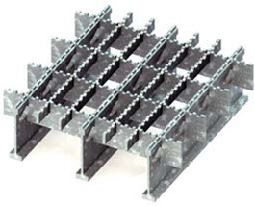
Open Grid Decks
An all-steel assembly of primary and secondary members
Primary members span between the support beams
Secondary members span in the longitudinal and transverse direction
The specifications require that every primary member be attached to the support beams by welding or bolts.
The deck is lightweight but also leaves the supporting structure exposed to the elements.
Notes:
An open grid deck consists of the primary and secondary steel members only, as the system does not include any reinforced concrete. The figure on this slide shows a section of an open steel grid deck. In this figure, the primary supporting bars are I-shaped, while the secondary members are simple rectangular bars that are perpendicular but interlock with the primary members. Additional simple rectangular members interlock with the secondary members and run parallel to the primary members. These members help to provide the ride surface of the open metal grid deck. With open grid decks, serrations are typically provided on the top of the grid members to enhance vehicle traction.
Per Article 9.8.2.2 of the AASHTO LRFD BDS, open metal grid decks must be connected to the supporting components (i.e., girders, stringers, cross beams, etc.) by welds or mechanical fasteners at each primary member of the grid deck system. Using shear studs and a narrow, full depth concrete pour over the supports is another method of connecting open grids, if the minimal additional weight is permitted. Furthermore, welding within the open grid decks should typically be considered as a Category E detail.
An advantage of the open steel grid deck is that it is lightweight compared to conventional reinforced concrete deck slabs or filled metal grid decks. However, it also has several disadvantages including a perceived unpleasant ride quality, additional noise, possible safety issues when wet, and debris, road salts, and water passing through the deck and onto the features below the bridge. Also, open metal grid decks are prone to fatigue issues, both internally and in their connections to girders or stringers. Open grid decks are rarely specified on new construction projects and are typically only used for in-kind replacements. The use of open metal grid decks is typically limited to situations in which weight savings is the main driver to increase the live load carrying capacity of the structure, or where these systems were installed many years ago. Older truss bridges and movable bridges are examples of where one may see these systems employed.

Slide 13
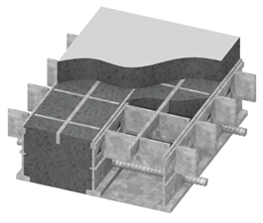
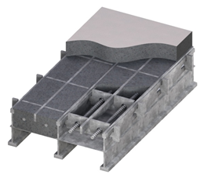
Filled or Partially Filled Grid Decks
Notes:
A filled metal grid deck is a deck in which the entire depth of the grid system is completely filled with concrete, as shown in the left-hand figure on this slide. Filled grid systems were first introduced in the 1930’s as a method to increase speed of construction on large scale bridge projects. Filled grid decks can utilize precast or cast-in-place methods for the reinforced concrete. Mild reinforcement is required to satisfy concrete serviceability and durability requirements and is typically located perpendicular to the main supporting bars. Thin gage sheet metal rests between the bottom flanges to support the full depth concrete.
A partially filled metal grid deck is a deck in which only a portion of the depth of the grid system is filled with concrete, as shown in the right-hand figure on this slide. Partially filled grid systems were first introduced in the 1950’s as a method to further reduce weight by eliminating concrete from the bottom of the deck which is in tension in simple-span applications. Partially filled grid decks can utilize precast or cast-in-place methods for the reinforced concrete. Mild reinforcement may be used to satisfy concrete serviceability and durability requirements and is typically located parallel to and in between the main supporting bars. A rib, located near the mid depth of the primary I-beam in the deck system is used to support thin gage sheet metal. The thin gage sheet metal supports the wet concrete, creating a partially filled system.
Per Article 9.8.2.3.1 of the AASHTO LRFD BDS, a 1.75-inch-thick structural overfill should be provided, when possible, on filled and partially filled metal grid decks, although a 2-inch overfill is more common. Overfill is taken as the concrete thickness above the metal portion of the grid deck. The concrete overfill provides protection for the steel portion of the grid deck from chloride ion attack. The steel grid deck should also be galvanized or painted to further protect the deck system. The overfill and galvanizing (or painting) limits the corrosion in the grid deck steel. Heavy corrosion of the grid deck can lead to a phenomenon often called “grid growth,” which impacts the performance of the grid deck.
Filled and partially filled grid decks can be attached to the supporting components (i.e., girders, stringers, cross beams, etc.) by welding, or more commonly by shear stud connectors, to transfer the shear between the deck and the supporting component. If shear studs are employed on the supporting components, a haunch should be provided so that the shear studs are completely encased in concrete. The shear studs should extend into the grid deck similar to a conventional reinforced concrete deck slab, but typically do not need to extend into the overfill.

Slide 14
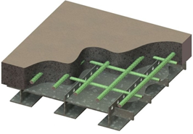
Unfilled Metal Grid Deck Composite with Reinforced Concrete Slab
Deck system combines elements of an open grid and a reinforced concrete deck
Primary members span between the beams
Secondary members are perpendicular to primary members and support a thin steel sheet which forms the bottom of a reinforced concrete deck
Notes:
An unfilled metal grid deck composite with reinforced concrete slab consists of a reinforced concrete slab that is cast on top of an unfilled grid deck and is made to be composite with the unfilled grid deck. An Exodermic_{TM} deck, shown in the figure on this slide, is a specific manufactured type of unfilled metal grid deck which is composite with a reinforced concrete slab. In this type of deck, WT sections are used as the primary members, spanning from the supporting components (i.e., girders, stringers, cross beams, etc.). Secondary members are perpendicular to and interlock with the WT sections. The secondary members support thin gage sheet metal, which in turn supports the wet concrete of the reinforced slab. Negative flexural capacity is provided by the mild reinforcement located within the concrete deck slab.
Composite action between the unfilled grid deck and the concrete slab must be provided by shear connectors or other means capable of resisting horizontal and vertical components of interface shears. Article 9.8.2.4.2 of the AASHTO LRFD BDS states that acceptable methods of shear connection include tertiary bars to which 0.5-inch diameter reinforcement or round studs have been welded, or the punching of holes at least 0.75 inch in size in the top portion of the main bars of the grid which are embedded in the reinforced concrete slab by a minimum of 1 inch. The steel decking should also be galvanized or painted to protect the steel members from corrosion.
These types of decks are often attached to the main supporting components by shear stud connectors. Shear studs are welded to the main supporting components and a haunch is provided so that the shear studs are completely encased in concrete.
This type of grid deck can be used where the distance between supports is greater than 10 feet. On rehabilitation projects, the use of this deck type may permit the removal of stringers between floor beams.

Slide 15
Grid Deck Range of Applicability
 | Partial Depth | Full Depth | Unfilled w/ Composite Slab
Primary Member Component | Rolled I-shape | Rolled I-shape or WT | WT4, 5, 6
Maximum Span Length | Up to 10 ft | Up to 10 ft | Greater than 10 ft
Weight Range (psf) | 65 – 75 | 70 – 110 | 60 – 70
Total Thickness (in.) | 7.25 | 5 – 7.25 | 6.5 – 9.5
A comparable concrete slab spanning 10 ft is about 9” thick, and 110 psf
Notes:
Chapter 17 of the NSBA SBDH contains a discussion of these various grid deck systems. A table from that chapter is repeated on this slide. The table summarizes the three metal deck systems, presents commonly accepted maximum span lengths, and presents a range of deck weights and the total thickness of the deck system. Since each of the grid deck systems can span approximately 10 feet, a comparison was made to a comparable reinforced concrete deck. A reinforced concrete deck used to span between beams spaced approximately 10 feet on center is commonly in the range of nine inches thick. When normal weight concrete is used, this deck weighs approximately 110 pounds per square foot. Additionally, an approximate load of an additional 10 to 15 pounds per square foot would also be added to this weight to account for the weight of stay-in-place metal form systems including concrete in the valley of those forms. Despite the heavier weight, the reinforced concrete deck is still the most common solution. They are familiar to contractors and easy to construct.

Slide 16
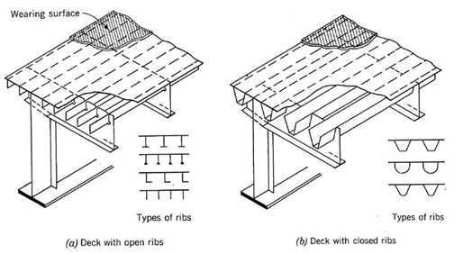
Orthotropic Steel Decks
Notes:
A more complex steel deck is the orthotropic steel deck. An orthotropic steel deck consists of a flat, thin steel plate which is stiffened by a series of closely spaced longitudinal ribs that run parallel to traffic, placed orthogonal to transverse floor beams. The deck stiffness is considerably different in the longitudinal and transverse direction, hence orthotropic steel decks are structurally anisotropic. The name orthotropic comes from the fact that the ribs and floor beams are orthogonal, and the elastic section properties are different, or anisotropic, in both directions; thus, the system became known as orthogonal-anisotropic, which shortens to orthotropic. Typically, an orthotropic steel deck is made integral with the supporting superstructure component, such as the top flanges of girders or floor beams. A sketch of an orthotropic deck made integral to a plate girder is provided in NBSA SBDH Chapter 17 and repeated here.
In an orthotropic steel deck system, live loads are transferred through the wearing surface and top steel deck plate, to the longitudinal ribs, and then to the transverse floor beams. The load in the floor beam is then transferred to the main load carrying system, such as a longitudinal plate girder. Per Article 9.8.3.1 of the AASHTO LRFD BDS, the deck plate is to act as a common flange of the ribs, the floor beams, and the main longitudinal components of the bridge. With proper maintenance, experience has shown that a steel superstructure system that employs the use of an orthotropic steel deck can have a long service life.
The use of orthotropic steel decks has been limited in the United States for a variety of reasons, but mainly due to issues related to the complex design and fabrication associated with them, as opposed to the use of a conventional reinforced concrete deck slab. Orthotropic steel decks also require a different set of inspection and maintenance techniques. Orthotropic steel decks have had problems related to fatigue cracking and performance of wearing surfaces in the past, which have made bridge owners wary of specifying the use of these decks. Many of these problems are related to limitations of design and analytical methods used in the past, as well as reliance on trial and error with regard to detailing and fabrication.
The construction and fabrication techniques employed are very important to the successful use of orthotropic steel bridge decks. Orthotropic steel decks typically require detailed construction specifications and special quality control procedures during fabrication. Current designs typically are not standardized, and thus repetition does not currently help to improve construction and fabrication techniques.

Slide 17
TIMBER Deck Systems
Notes:
A brief introduction to timber decks is provided in the next two slides. The remainder of the lesson will then focus exclusively on concrete deck construction.

Slide 18
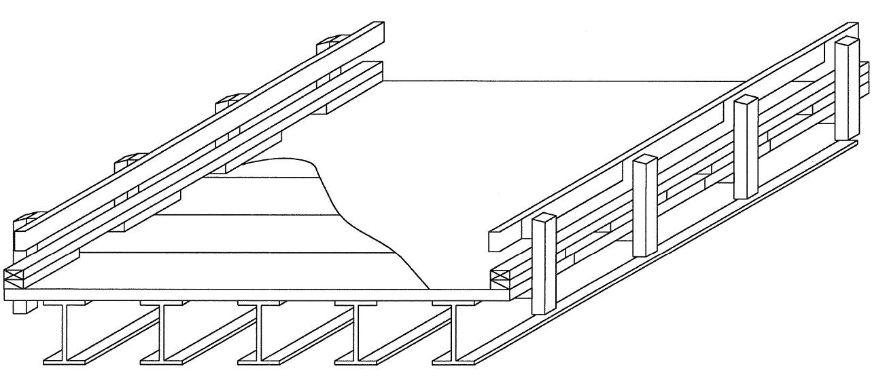
Timber Decks
Notes:
Timber decks are also occasionally used for steel bridges. Their use is more common on park service roads, logging roads, and other similar lower volume locations such as rural bridges. In a remote project site, a timber deck may be one of the few viable deck types. It may be difficult to obtain ready-mix-concrete for a cast-in-place concrete deck in a remote / rural location. A timber deck could be easily fabricated and shipped, with the beams, for installation in a remote site. It is possible with small construction equipment to lift in a small number of timber deck panels to complete the construction of a steel bridge in a remote setting. The United States Department of Agriculture’s Forest Products Laboratory developed a series of standard timber decks that can be used for bridges. Their timber decks are of two varieties: a longitudinally spanning deck which can be used to replace a very short span, or as shown on this slide, transversely spanning timber decks which can be used with steel beams.

Slide 19
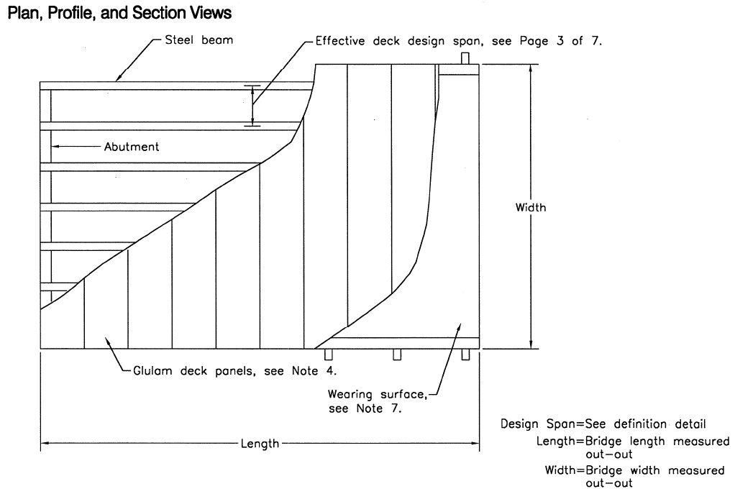
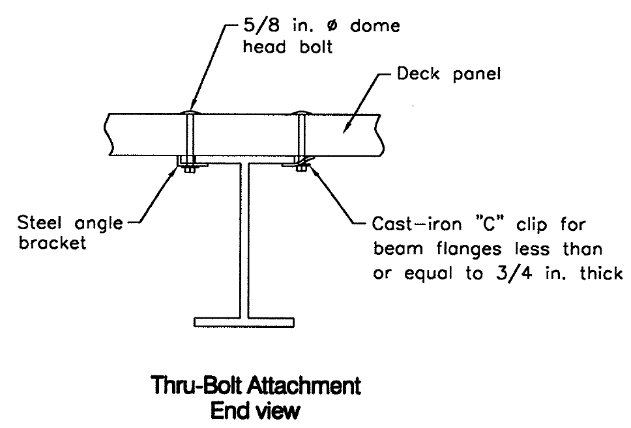
Timber Decks
USDA Forest Product Laboratory has pre-engineered glulam deck systems
Designed for use with steel beams spaced between 2 to over 9 ft
Deck thickness varies from 5 to almost 9 inches
Notes:
Two details from the USDA plan set are shown on this slide. On the right is a plan view of a typical installation. A series of longitudinal beams span between the abutments and on top of these beams are multiple glue-laminated timber deck panels spanning in the transverse direction. The USDA standard plans provide deck designs for beams spaced between two and nine feet on center. The standard timber deck varies in thickness between five and nine inches depending on the span. It is attached to the steel beams with bolts and clips. This is a noncomposite design. The bolts are provided to hold the deck to the beam but there is no reliable way to achieve composite action between the deck system and the steel stringers.

Slide 20
Concrete Bridge Deck Construction
Notes:
Elements of concrete deck construction are highlighted in this section. This section includes various photos and figures depicting the common deck construction practices for a reinforced concrete deck. Deck forming methods as well as sample deck reinforcing drawings are provided.

Slide 21
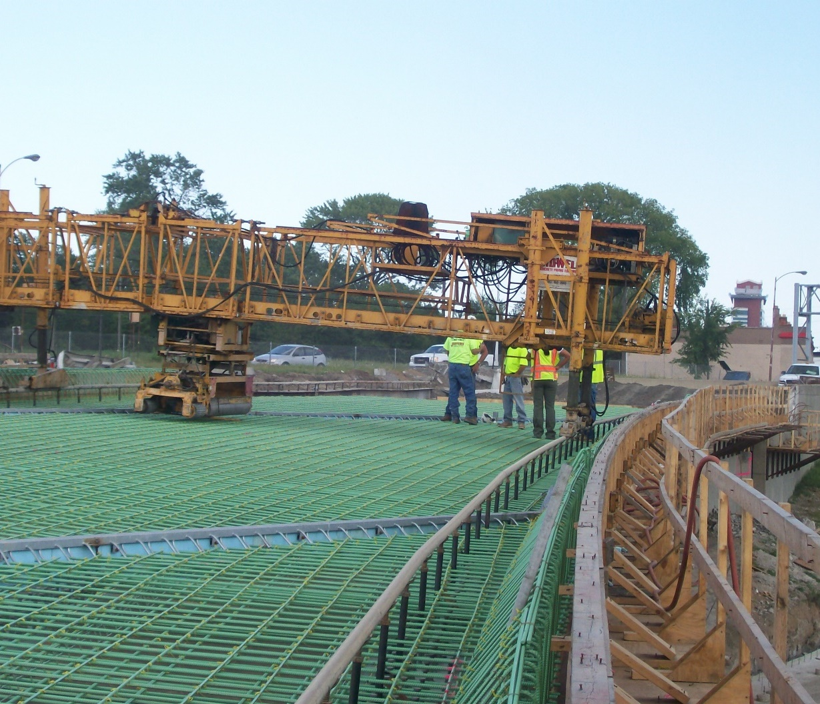
Deck Construction
Epoxy coated steel used for deck construction (common)
Barrier rail reinforcing
Overhang brackets and walkway
Deck finishing machine / screed supported on a steel pipe rail
Notes:
The discussion of concrete deck design will begin with several photos illustrating some of the common construction features of a reinforced concrete bridge deck. In this photo, the reinforcing for the slab and the barrier have been placed. This photo shows the use of epoxy coated reinforcing steel. The epoxy coating provides a barrier between water and deicing chemicals initiating corrosion of the reinforcing steel. Also shown on this picture is the overhang and construction walkway. The deck finishing machine has been installed. This machine rides longitudinally on the steel pipe rails and provides the proper finish and cross slope to the completed bridge.
Photo Credit: Genesis Structures

Slide 22

Overhang Brackets
Brackets spaced regularly (typ. 3-4 ft) to support wood forms for overhang slab
Brackets and wood forms removed after deck cures
Notes:
Deck overhang brackets are required to construct the cantilever portion of the deck slab that extends beyond the exterior girders. The deck overhang brackets always support the overhang formwork and wet concrete and will typically support a construction walkway and the concrete paving machine when the rails are installed above the bracket. The deck overhang brackets are typically selected from manufacturer catalogues and prefabricated components. The contractor is responsible for selecting the proper deck overhang bracket and spacing, as well as the design of any additional formwork. In some states, the contractor is required to submit computations sealed by a Professional Engineer, verifying the selection and spacing of the deck overhang brackets to be used to construct the concrete deck slab. The design of the beams/girders for the effect of the deck overhang loads was covered previously in Lessons 6 and 7 of this course.
Photo Credit: HDR

Slide 23
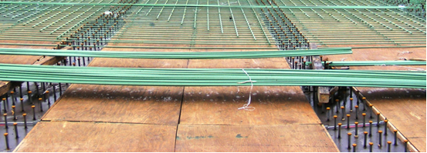
Deck Forming
Notes:
Temporary formwork is often constructed from wood components and is removed once the cast-in-place concrete deck has hardened. This photo shows temporary wood formwork constructed in between the girder top flanges of a steel I-girder bridge. The use of temporary or permanent formwork is an owner preference and is reflected in the design drawings. In most cases, the contractor is responsible for the design of the temporary formwork. A benefit of using temporary wood formwork is that the bottom of the concrete deck slab is visible once the formwork is removed, and any signs of distress can be noted during routine bridge inspections. A disadvantage of using temporary formwork is the fact that removing the forms will require additional construction time.
Photo Credit: HDR

Slide 24
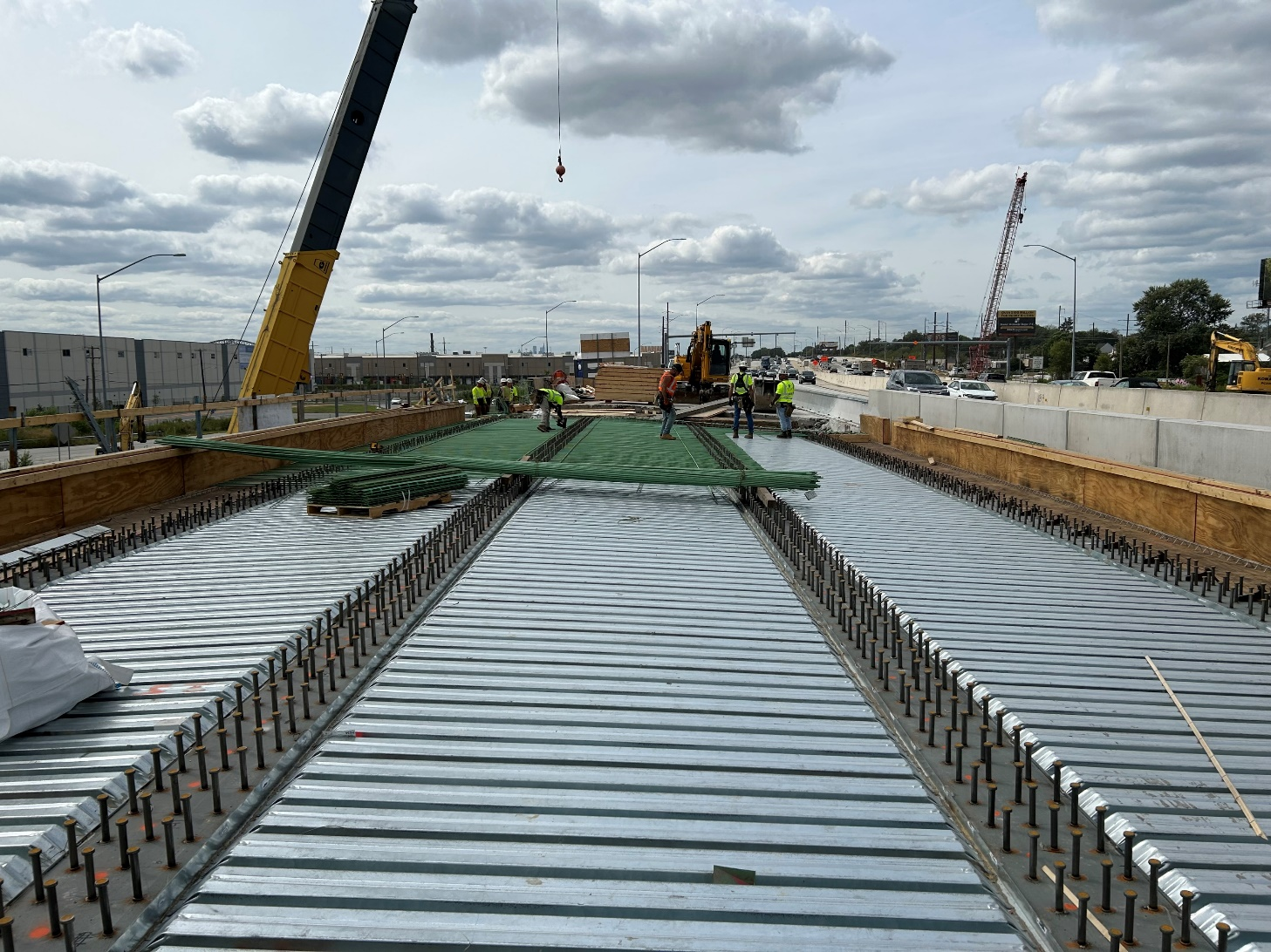
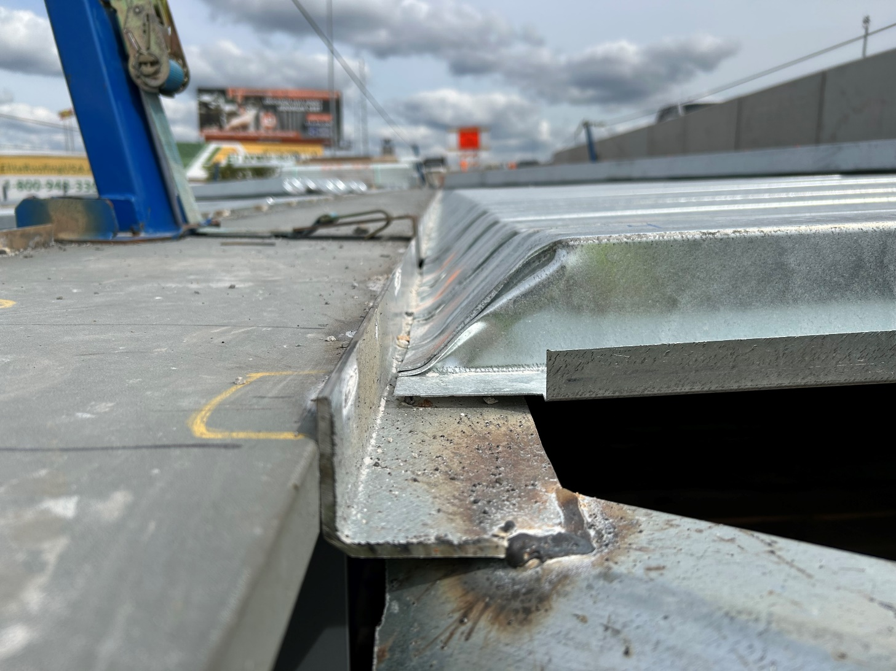
Deck Forming
Notes:
Stay-in-place formwork can consist of concrete or steel components. Partial-depth precast concrete panels are structural components that also act as stay-in-place concrete formwork. The partial-depth precast panels become an integral part of the full-depth deck slab. When concrete formwork is specified by the bridge designer, the designer is typically responsible for the design of the formwork as it is made composite with the bridge system. Article 9.7.4 of the AASHTO LRFD BDS specifies the design requirements for partial-depth concrete deck panels. Partial-depth precast concrete panels are discussed in Chapter 17 of the NSBA SBDH but are not covered in this lesson.
Steel stay-in-place forms are not to be considered composite with the concrete slab, per Article 9.7.4.2. This photo shows stay-in-place formwork installed on a steel I-girder bridge, prior to the placement of the deck slab steel reinforcement. The bridge designer is typically not responsible for the design of the steel stay-in-place formwork, which is instead the responsibility of the contractor or steel stay-in-place formwork provider. However, the designer must consider the additional weight caused by the use of steel stay-in-place formwork in the design of the bridge. A customary allowance of 0.015 ksf is often used by designers, which accounts for the weight of the steel formwork and the additional concrete in the “valleys” of the stay-in-place forms. The weight of formwork is typically provided in the contract documents, and if the allowance is exceeded by the contractor’s choice, the contractor is responsible for showing that the effects on the bridge are acceptable, or providing additional strengthening as needed at no cost to the Owner. Additionally, the steel stay-in-place formwork should not be welded to the top flanges of the girders subject to tensile stresses. Welding is permissible in areas where the top flange is always in compression. The stay-in-place steel deck forms are often attached to an angle, which is attached to the girder top flange by welding or via mechanical attachment, such as a hanger or strap over the top flange of the girder. In regions where the top flange is subject to tension, welding the stay-in-place forms, or their supporting components, directly to the girder can result in a fatigue detail not considered during the design of the steel superstructure. Therefore, to facilitate installation of steel stay-in-place forms, the designer should indicate the top flange tension and compression zones on the contract plans (this may be done by showing the CVN testing limits as well.)
Sometimes to reduce weight, the valleys of these stay-in-place forms are filled with foam. This is not common and if intended would need to be shown on the design plans since this is a special detail.
Photo Credits: Buckley and Company

Slide 25
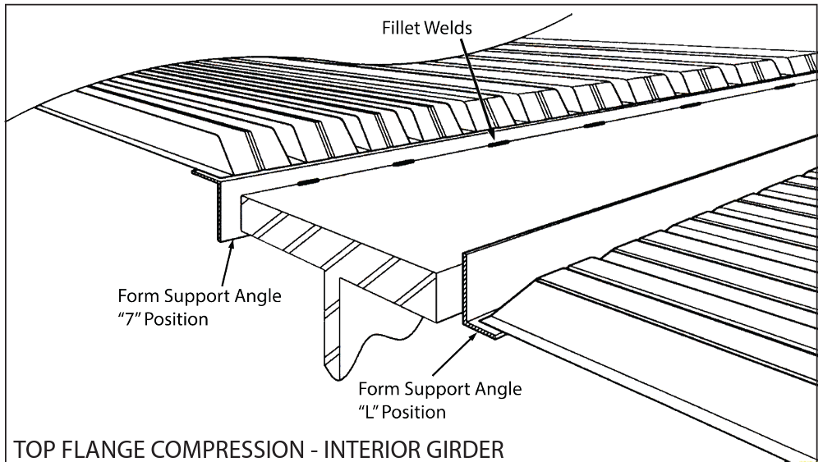
Deck Form Attachment, +M Regions
Notes:
This slide illustrates the common attachment of steel stay-in-place forms to a flange in a region of the bridge where the top flange is in compression. The steel stay-in-place forms are attached to light gage steel support angles and they in turn are welded to the top flange with small, intermittent fillet welds. It is because of the light gage of the support angles and the intermittent connection of the forms to the angles that engineers do not consider these forms as providing lateral support of the compression flange when the beams are designed. Welding is permitted in the positive moment region of the span because there is no possibility for fatigue cracking in these regions of permanent compression in the flange.
Photo Credit: L B Foster

Slide 26
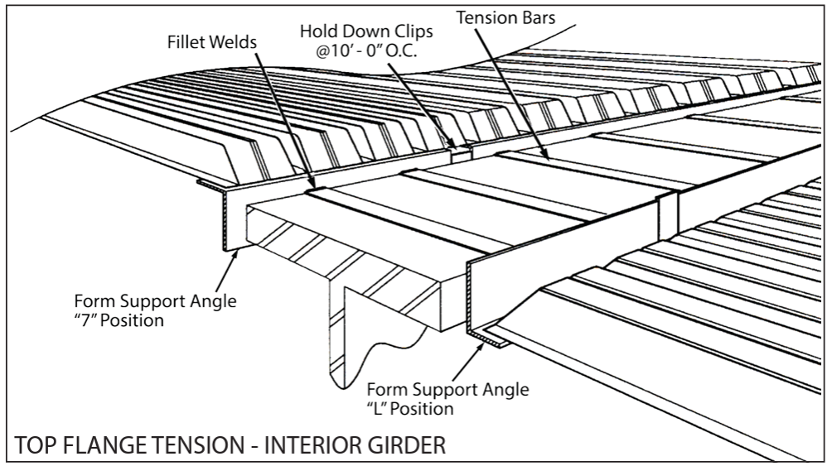
Deck Form Attachment, -M Regions
Notes:
In a portion of the bridge where the top flange is in tension, an alternate means of supporting the deck forms is provided. Because welding to the top flange in a tension region could be the source of a fatigue crack, an alternate attachment is used. This illustration shows one such possible attachment. Instead of welding the support angles directly to the flange, the support angles are connected to each other with a steel strap, labeled the tension bar in this image. There are no welds that connect this assembly to the top flange. The tension bars, or straps, are welded to the support angles but this entire assembly simply rests on top of the top flange and is held down against the possibility of uplift with specified hold down clips spaced at regular intervals along the length of the top flange.
Photo Credit: L B Foster

Slide 27
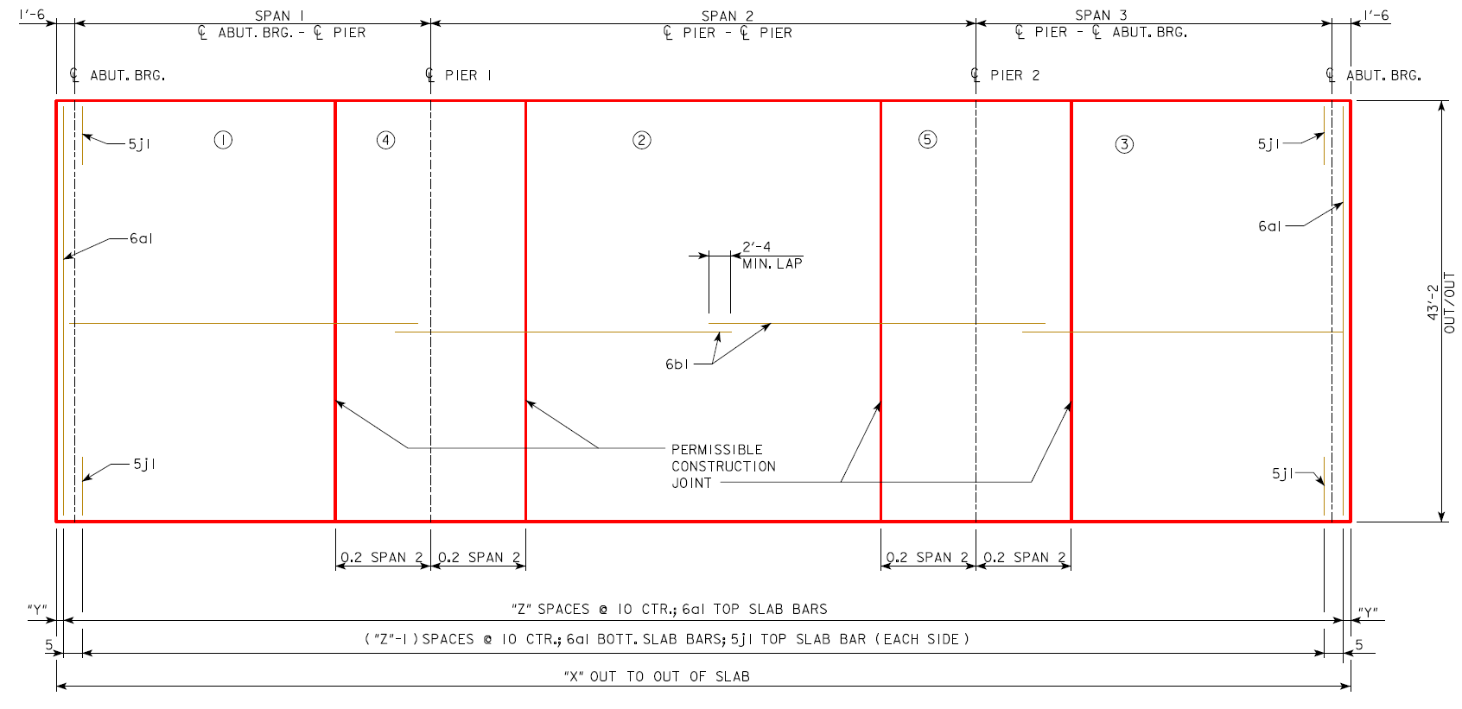
Sample Deck Reinforcing Plan
Notes:
A plan view for a reinforced concrete deck is taken from the Iowa Department of Transportation standard plans for a three-span rolled beam steel bridge. It shows a common way of depicting the geometry of the bridge deck slab as well as the internal reinforcing. The reinforced concrete bridge deck will typically have four layers of reinforcing. The primary reinforcing spans perpendicular to the beams, the short direction of this slab. The primary layers are closest to the surfaces of the slab to maximize their lever arms and ability to carry flexure in the slab. Additional longitudinal reinforcing to distribute the wheel loads in the slab and to control shrinkage and temperature cracking are also provided. Each Department of Transportation, or owner, has a unique labeling system for identifying the various reinforcing bars in their bridge deck. In this image, the main transverse steel is a series of bars spaced 10 inches on center running in the transverse axis of the bridge. The longitudinal steel needed for wheel load distribution and crack control runs the full length of the bridge in two mats, one near the top of the slab, and one near the bottom of the slab.
The bars labeled “6a1” are the main top and bottom transverse bars. The “6” generally indicates the bar size, #6, and they are spaced 10” on center. The same bars are used in the top and bottom mat. Additional reinforcing steel is needed in the overhang to resist collision loads on the barrier. These bars are labeled “5j1” and they are spaced at 10” centers. The longitudinal bars are “6b1” and the required lap splice lengths are shown.
Photo Credit: Iowa DOT Standard Plans

Slide 28
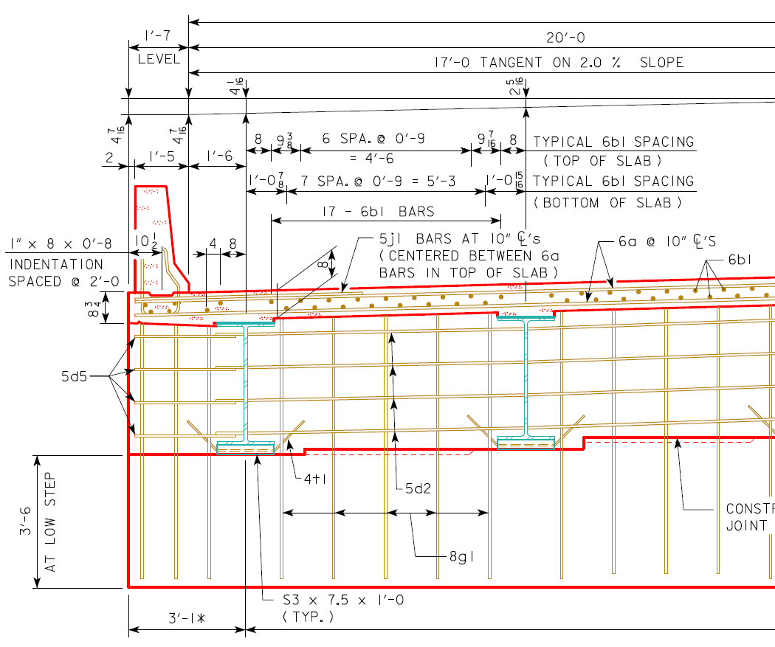
Sample Deck Reinforcing Section
6a top and bottom transverse bars @ 10”
6b1 bars top and bottom longitudinal, spacing varies
5j1 overhang bars spaced between 6a bars
Notes:
The reinforcing steel shown in plan on the prior slide is presented in a typical section view on this slide. This presentation is a common way of depicting the reinforcing steel. The transverse reinforcing steel size and spacing is presented, and coordinates with the plan view. The location of the longitudinal bars is shown in this view.

Slide 29
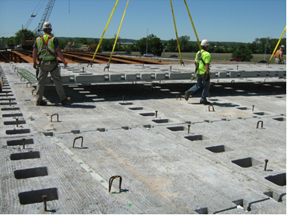
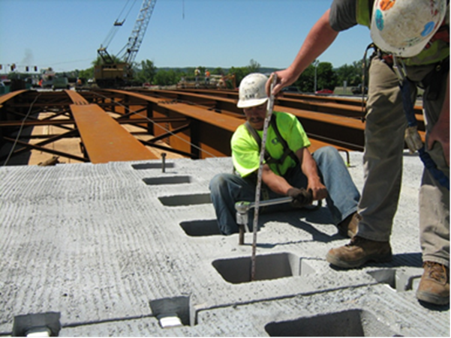
Precast Full-Depth Deck Panels
Notes:
Full-depth precast concrete deck panels may be used in place of a cast-in-place concrete slab. These typically span the width of a bridge (or width of a stage if the bridge has a longitudinal stage line) and are placed longitudinally adjacent to one another. The transverse joints between adjacent panels are grouted, and post-tensioning may also be used to keep the transverse joint in compression. The deck panels are made composite with the steel girders through the use of shear studs. Block-outs in the panels are provided to allow for the placement of shear studs onto the top flange of the steel girder. The left photo on this slide shows a bridge deck being constructed with full depth precast concrete deck panels, where the block-outs for the shear studs can be seen above the steel girders. Also shown are block-outs for connecting the post-tensioning strands. The block-outs for the post-tensioning strands are at the panel joints, transversely across the width of the bridge.
After the precast deck panel is installed, it is set to the correct elevation with the use of leveling bolts that bear on the girder top flange, as shown in the right photo. The transverse joints are then filled with grout. Once the grout reaches the required compressive strength the longitudinal post-tensioning strands are tightened (if post-tensioning is used in the design of the deck system). The shear studs are then welded to the girder top flange in the provided block-outs. The shear stud block-out, the haunch between the girder top flange and deck panel, and the post-tensioning ducts are filled with grout. A wearing surface or overlay is typically installed on top of the deck panel after all installation is complete, providing the necessary riding surface.

Slide 30
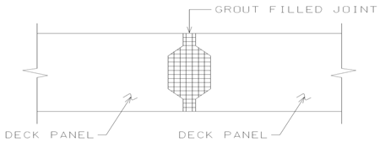
Precast Full-Depth Deck Panels
Notes:
Most precast panel deck joints are female-to-female shear key type joints that are filled with grout prior to post-tensioning taking place. Female-to-female joints allow for some adjustment related construction tolerances in the field, as the joint is not interlocking. A sketch of a typical female-to-female joint is shown on this slide. The full depth of the female-to-female joint should be filled with grout. Grout used in the transverse joint should be of high quality and have a high early strength, high bond capability, and low shrinkage. Article 9.7.5.3 of the AASHTO LRFD BDS states that the transverse joints are to be filled with a non-shrink grout having a minimum compressive strength of 5.0 ksi at 24 hours. Once the joint is grouted, longitudinal post tensioning can be tightened. Per Article 9.7.5.3 of the AASHTO LRFD BDS, the minimum average effective prestress from the post-tensioning should not be less than 250 psi. The effective prestress is typically interpreted as the net prestress under loading. The post-tensioning places the joint in compression, which can help to prevent cracking due to applied loads and shrinkage, help prevent leakage of corrosive materials through the joint, and help to keep the panels in compression under loading. In continuous-span designs, the designer may elect to increase the post-tensioning to achieve the 250 psi effective stress under all loading conditions.

Slide 31
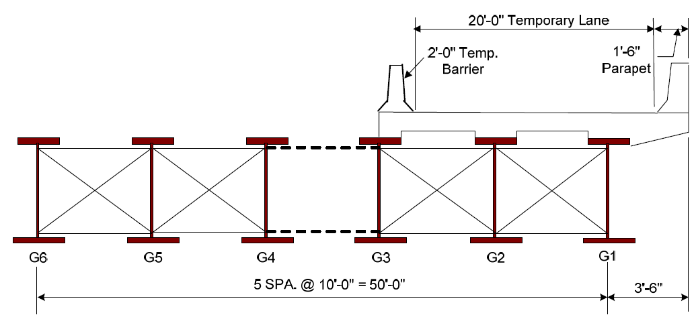
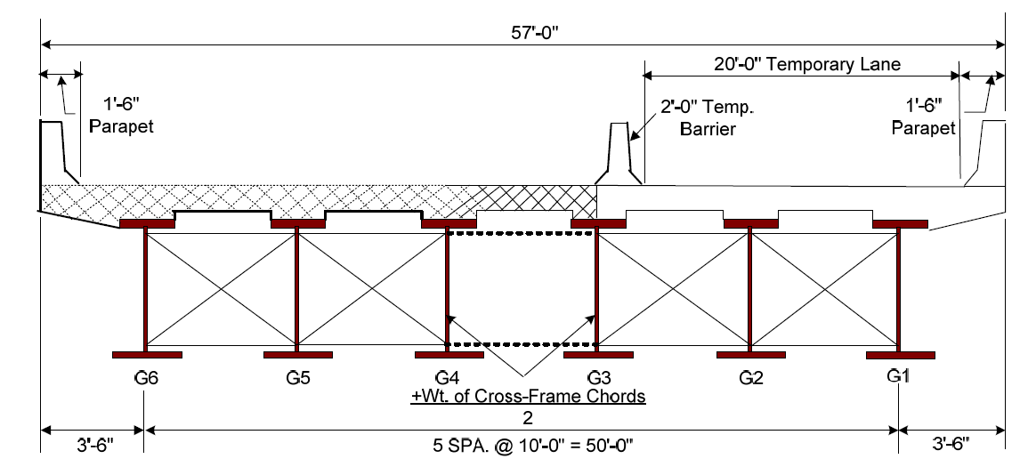
Staged Deck Construction
Notes:
Sometimes a deck is not cast over its full width. Common cases would be redecking of an existing bridge where portions of a deck are removed in longitudinal strips so that traffic can be maintained in some lanes while others are rebuilt, or in a widening project where the bridge is built in pieces next to / or overlapping the existing alignment.
In this scenario assume that the framing plan shown on this slide is being used to replace an existing, but narrower bridge. Beams G1 – G3 are built next to the existing bridge. Once the steel is erected and a portion of the deck is cast, traffic can be shifted from the old bridge in the general location of existing beams G4-G6, to the new partially completed bridge. The new deck has a temporary railing over beam line G3 and one permanent railing. The existing bridge is demolished and new beams G4 – G6 are erected. These new beams cannot be immediately connected to G1-G3 since they are in a very different profile. New beams G1 – G3 have been deflected by self weight, the weight of the slab, barrier rails, and live load, while beams G4-G6 are only subjected to self weight. Installing a full cross-frame between G3 and G4 would be impractical and instead a lean-on brace, having only top and bottom struts, can be used to hold the spacing between the beams, but having no shear stiffness it allows the new and existing work to deflect independently. Once the next deck section is cast from G3-G6, the girders will have roughly the same elevation. In order for the deck to work as a single unit, the first deck section extending from G3-G1 must have transverse steel projecting from it, or cast inserts, so that the reinforcing steel can be made continuous across the width of the deck. The deflection during deck casting may be significant and making sure the formwork remains intact, does not leak, and the reinforcing steel stays properly connected from the new to old phases is essential. Experienced contractors are aware of these complications and are able to achieve a successful end product in most cases. The engineer must be aware of these complications, however, and be prepared to work with the field staff to incorporate details that lead to successful construction. It is common that the new and existing deck do not achieve a final / even surface. Consideration might be given to providing a deck with additional top cover so that final grinding can be used to achieve a smooth riding surface.

Slide 32
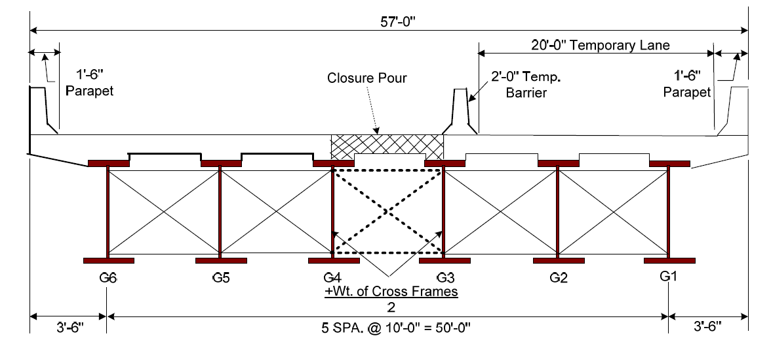
Staged Deck Construction
Notes:
An alternate strategy is to pour the deck in three stages, two major pours and a single bay closure pour. This allows G1–G3 and G4–G6 to function as two independent bridges during construction. Once the deck is cast on G1-3 and G4-G6, each has deflected but an open bay remains between G3-G4. In this bay, cross-frames can be installed, and a final closure pour installed. The distribution of these dead loads to the various beam lines is somewhat more complex than if the bridge is cast at once in the full width, The closure pour directly loads beams G3-G4 but these are connected by deck and bracing to beams G1, G2, G5, and G6, all of which will share some portion of this load. The result is that G3 and G4 will experience slightly less dead load than in a single-pour slab and beams G1, G2, G5, and G6 will experience slightly more load.

Slide 33
Concrete Bridge Deck analysis
Notes:
The method of analysis and analysis assumptions for concrete deck and overhang design are provided in this section. Focus is on the conventional strip-based method of analysis for concrete decks and overhangs.

Slide 34
Methods of Analysis
LRFD permits several approaches
  Approximate methods of analysis (4.6.2.1)
  Refined methods of analysis (4.6.3.2)
  Empirical design (9.7)
Notes:
The analysis of bridge decks may be performed by several different methods described in the specifications. In the approximate method of analysis, a deck is subdivided into a series of transverse strips perpendicular to the supporting beams. These strips are subjected to various dead loads and live loads and the forces are combined using various strength or service load combinations. Discretization of the deck into a series of transverse strips is analogous to the use of a distribution factor for the determination of shear and bending moments in longitudinal beams. In the longitudinal direction, multiple parallel beams carry dead and live loads, yet the distribution factor assigns a portion of that total load to a particular beam for design. The use of the equivalent strip is similar for the design of the deck. A defined width of slab in the longitudinal direction is assumed to span transversely between the main supporting elements and resists the application of wheel loads from the vehicle axles as well as barrier and wearing surface loads.
A method of refined analysis for bridge decks is described in the specifications but it is rarely used. In a refined analysis, the equivalent strips are no longer used and instead a computer model is used to capture the distribution of loads throughout the bridge deck. The guidance on refined analysis discusses conversion of wheel loads into pressures applied to the deck, the need to consider flexural and torsional stresses and how to account for cracking and discontinuities in the deck slab.
Finally, a third method of analysis known as the empirical design method is permitted by the specifications. In this method of analysis, the design of the slab, except for the overhang, follows a simple “recipe” and is prescribed in the specifications. There is no need for analysis of forces nor for the design of reinforcing. In the empirical deck design approach, design of the overhangs is not covered. The overhang must still be designed commonly using the same assumptions as in the approximate method of analysis.

Slide 35
Approximate Method (LRFD 4.6.2.1)
Called the equivalent strip method
A transverse strip spanning between beams is assumed to carry the wheel loads
The strip is a continuous beam with cantilevers for the overhangs
Notes:
The approximate method of analysis will be covered in detail in this lesson as it is the most common way to design a reinforced concrete bridge deck. This approximate method is frequently called the equivalent strip method. As described on the previous slide, the continuous slab is instead conceptualized as a transverse strip of a defined longitudinal width spanning between the beams. The flexural stiffness of the slab and the spacing of the supporting beams determines the internal bending moments in the deck. Barrier rails are generally idealized as point loads applied on the overhang. The future wearing service is modeled as a uniformly distributed load extending between the barrier rails. The force effects due to self weight of the slab are modeled as a gravity load. These loads are then combined with various placements of live load on the deck, simulating maximum positive and negative bending moments in the slab, for purposes of completing the design.

Slide 36
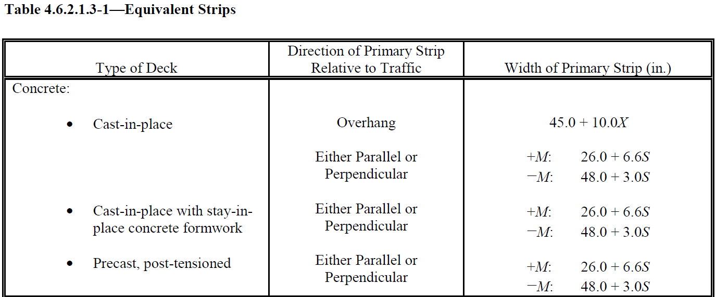
Approximate Method (LRFD 4.6.2.1)
Notes:
The table on the slide provides the guidance given in the AASHTO LRFD BDS relative to the longitudinal dimension of the equivalent transverse deck strips. A row in the table is highlighted corresponding to the strip dimensions of a cast-in-place concrete deck slab. Notice that multiple strip widths are provided. In a typical slab and a girder bridge, the primary strip is perpendicular to the direction of traffic. This is called a one-way slab and spans in the transverse direction. In the table, strip widths are given for positive bending moment, negative bending moment, and for loads placed on the overhang. For instance, a tire load on an overhanging slab would be distributed using the overhang strip width equation presented on this slide. The purpose of these strip widths is to convert the bending moments due to live load into design forces on a per foot of slab basis. Then they are easily combined with the bending moment effects from uniform loads such as self weight, wearing surface, barrier rail loads. The dead loads are uniform along the entire length of bridge and therefore every foot of slab has the same design forces. The purpose of the strip width is to define a tributary length of slab that participates in distributing the wheel live loads transversely to the beams where they are supported.

Slide 37
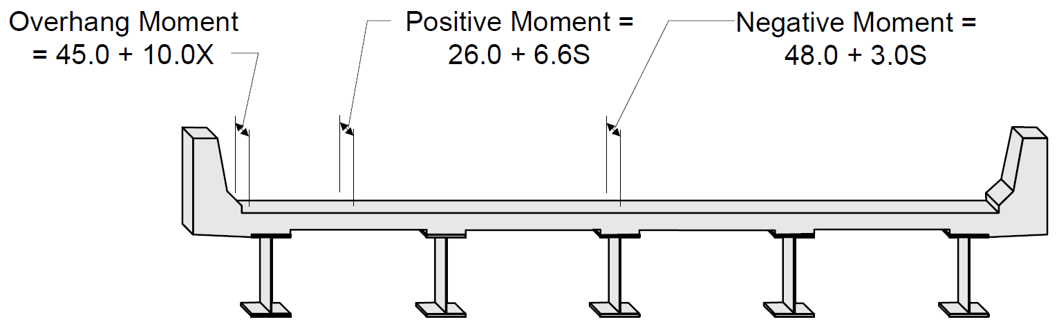
Approximate Method (LRFD 4.6.2.1)
Strip width is computed in INCHES
S, beam spacing, FEET
X, distance from a wheel load on an overhang to a point of support, FEET
Notes:
This slide illustrates various strip widths for a reinforced concrete deck supported by parallel longitudinal beams. Positive bending moments, negative bending moments, and negative bending moments on the overhangs are treated separately. The designer could build a simple model of the slab as a continuous beam supported on point supports and place live loads on that slab. Once the critical transverse location of a truck, or multiple trucks, is found to maximize the intensity of the bending moments, the resultant moment from analysis, say in the units of foot kips, would be divided by the longitudinal strip and converted into a bending moment on a per inch or per foot basis in the longitudinal direction. Note that when using these strip width equations that the strip calculation produces a length in inch units, but the input involves dimensions S and X measured in feet. The AASHTO LRFD specifications require for the design of overhangs that a wheel load be placed 1-ft from the inside edge of the barrier rail (Article 3.6.1.3.1). This position is used to define the dimension “X”.

Slide 38
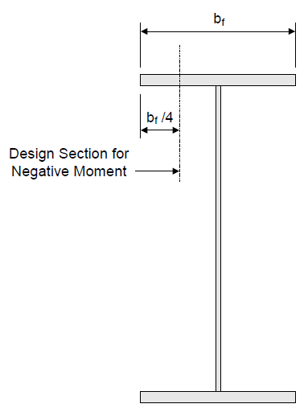
Critical Force Locations
For +M, the maximum force is between beams
For –M the critical force is taken at the ¼ point of a steel beam flange
Notes:
When modeling the slab as a continuous beam in the transverse direction, it is important to understand where the critical design forces act. For positive bending, the critical force is the largest positive bending moment in the slab between the supporting beams. For negative moment, the analysis model assumes that the slab is supported at point supports having no lateral dimension. In reality, the slab is supported by a steel or concrete beam with a defined top flange width. Because the slab is supported not by a point but by a flange with a finite width, the critical design section for negative moment is taken at the quarter point of the projecting flange. The analysis method used to predict dead and live load forces should be able to capture this quarter-point moment. Adding a node to the transverse model is one simple way of capturing the forces at these critical locations. Several well-distributed nodes between the beams ensure that the maximum positive moment is determined as well.

Slide 39
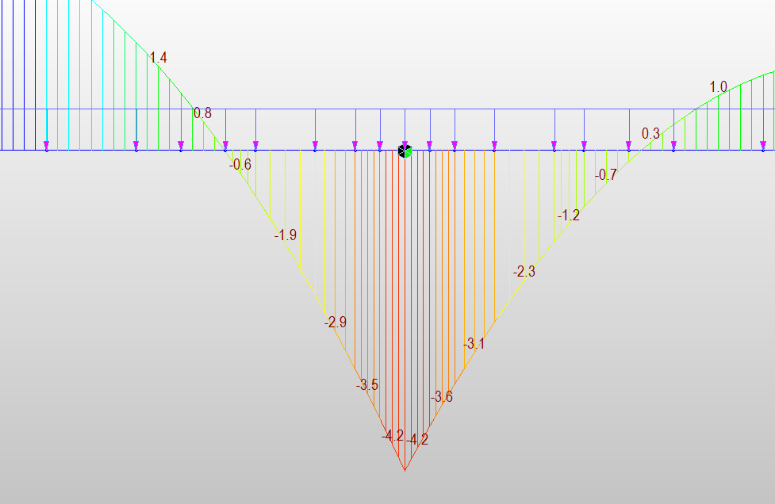
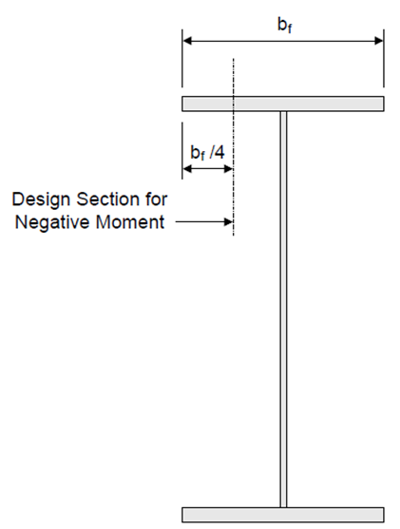
Critical Force Locations
Notes:
A portion of a bending moment diagram for a slab span is shown on this slide to illustrate the critical negative moment region forces. In this model, nodes were added at the flange quarter-point locations specifically to simplify extraction of the critical forces from the model.

Slide 40
Design of concrete bridge decks
Notes:
The detailed design of concrete decks is discussed in this section. The section includes a discussion of slab thickness determination, DL and LL force demands, load combinations and design for positive and negative flexure, and a discussion of detailing practices.

Slide 41
Detailed Steps
Determine slab thickness
DL and LL forces
Load Combinations
Positive moment design
Negative Moment design
Distribution reinforcing
Shrinkage and temperature reinforcing
Continuity reinforcing
Overhang considerations
Notes:
The design of a reinforced concrete bridge deck requires multiple steps. First, the slab thickness must be selected. Bridge decks are commonly 8 inches thick as a minimum though some states have even thinner decks. The thickness of the deck increases with beam spacing. Some common deck thicknesses for various beam spacings are shown below.
Beam Spacing 8 ft, Deck thickness, 8 in.
Beam Spacing 10 ft, Deck thickness, 8.5-9 in.
Beam Spacing 12 ft, Deck thickness 9-9.5 in.
Beam Spacing 14 ft, Deck thickness, 10-10.5 in.
Once the deck thickness is chosen, the DL and LL forces are computed from models, by approximations, or a combination of these approaches. Different methods of computing the DL and LL forces are illustrated in this lesson.
Once the forces are determined, load combinations for Strength and Service are computed and the design of the transverse (main) flexural steel for positive and negative flexure is performed. Design of distribution reinforcing (bottom of slab longitudinal steel) and shrinkage / temperature steel (top of slab longitudinal steel) is next performed. If the bridge is a continuous steel (or concrete) beam bridge, additional longitudinal steel in the “negative moment regions” is needed. Finally, special design of the overhang is necessary to support vehicle loads and collision loads with the barriers.

Slide 42
Concrete Deck Slabs (LRFD 9.7)
Minimum Cover LRFD 5.10.1
  Min cover to any main bar, 1 in.
  Top cover: Decks subject to tire stud and chain wear, 2.5 in. for uncoated, epoxy, galvanized reinforcing bars
Minimum deck thickness, 7 in.
  Owners commonly have tables of preferred slab thickness and pre-designed reinforcing
Notes:
The bridge design specifications require that a concrete deck be at least 7 inches thick. Many owners have tables in their bridge design manuals or standard plans with preferred deck thicknesses based on beam spacing. There are minimum cover requirements for the reinforcing steel. The minimum cover to any main bar is required to be at least one inch. This would commonly be the cover for main bars in the bottom of a slab. Increased cover is required for bars in the top of a slab subject to wear from tire studs or snow chains. A top cover of 2.5 inches clear beyond the main reinforcing steel is required for decks using uncoated, epoxy coated, or galvanized reinforcing bars. A thinner cover, two inches, is permissible if the deck is not subject to aggressive abrasion from snow chains or tire studs.

Slide 43
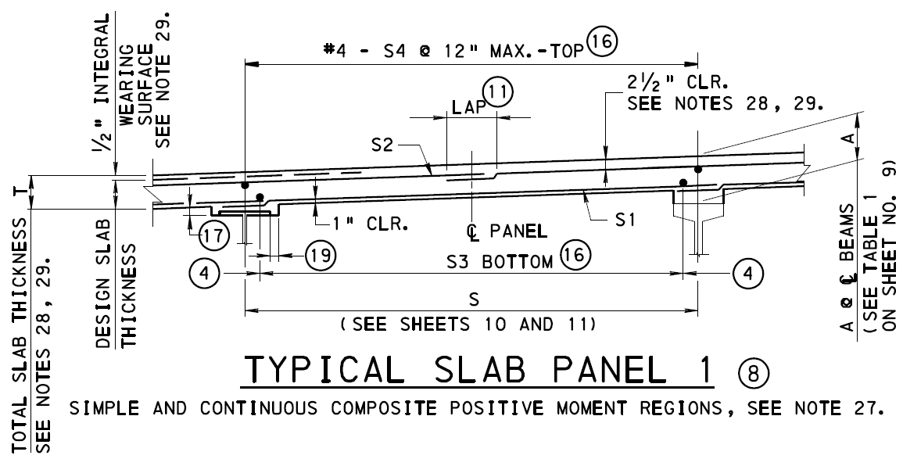
Sample DOT Standard Details
Notes:
A typical deck detail from a Pennsylvania Department of Transportation standard plan is shown. This is a typical detail from their bridge design standards for a reinforced concrete slab supported on either steel or concrete longitudinal beams. The drawing has a series of bar marks that correspond to bar sizes and spacings that are found in a companion table.
Several important details are worth noting. The slab total thickness is not the design thickness. An assumed 1/2 inch of concrete should be assumed to be worn away for any structural strength calculations, but it is included in the calculation of the self weight effects of the slab. Pennsylvania specifies 2-1/2 inches clear cover above the top transverse reinforcing steel and 1-inch clear cover for the bottom transverse reinforcing steel. Bars that are labeled as “S4” in the top longitudinal mat are provided for shrinkage and temperature reinforcement. The bars labeled “S3” in the bottom longitudinal mat are called distribution reinforcement. They help to distribute wheel load effects in the longitudinal direction and are related fundamentally to the use of a strip width approach for flexural design.

Slide 44
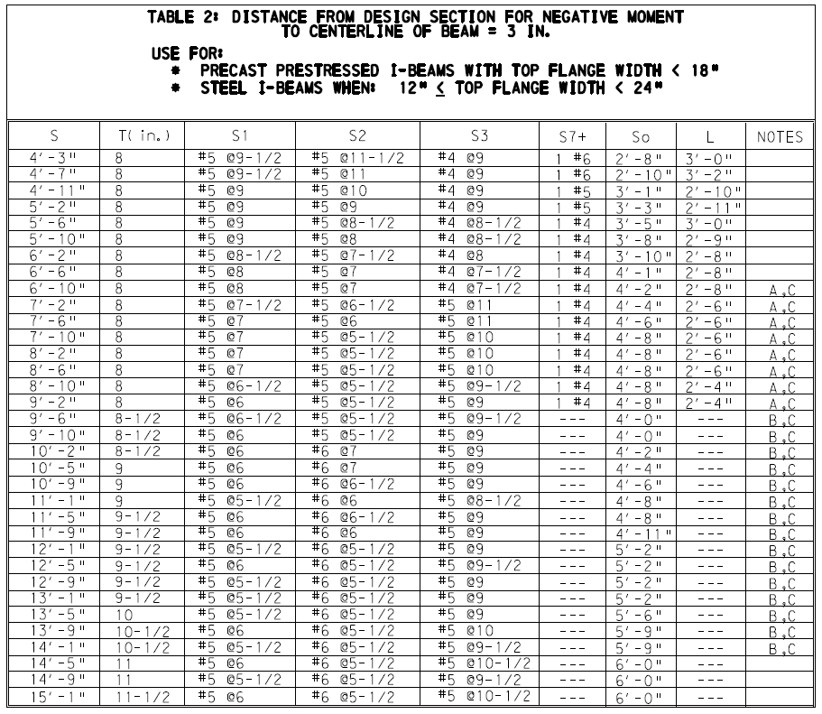
Sample DOT Standard Details
Example – 12 ft girder spacing with 16” wide top flanges
Slab = 9.5 in.
Bottom transverse bar, S1, #5 @ 5.5”
Top transverse bar, S2, #6 @ 5.5”
Bottom longitudinal bar, S3, #5 @ 9”
Top longitudinal bar, #4 @ 12”
Notes:
This table provides the bar size and spacing for the various reinforcing bars depicted in the Pennsylvania standard plans. For an example bridge with the main beams spaced 12 feet on center and a 16-inch-wide top flange, the table provides a pre-engineered deck design. The slab thickness of 9.5 inches is given as well as the bar sizes and spacing for bars S1 through S4. No design is required by the engineer. Most states have similar tables. These tables expedite design, meet the individual agencies requirements for exposure conditions, limit states, and load combinations that they consider, and promote uniformity in construction.

Slide 45
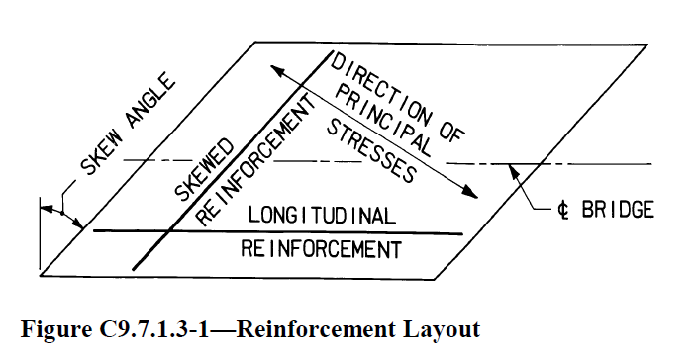
Reinforcing Orientation (LRFD 9.7.1.3)
For skews up to 25 degrees, reinforcing may parallel the skew
Above 25 degrees, reinforcing must be perpendicular to girders
Notes:
Many bridge decks are skewed. For skews up to 25 degrees the transverse reinforcing bars are permitted to follow the skew. No corrections to the design forces or design resistance is required. For skews in excess of 25 degrees the reinforcing steel must be perpendicular to the beams. This results in numerous bars of unique length located in the end region of the slab. At the acute corners, a large number of relatively short bars may be required, and it is questionable if they truly reinforce that region of the slab. Many departments of transportation adjust the geometry of the slab at the acute and obtuse corners to eliminate the sharp angles. They also provide special reinforcing details for the acute and obtuse corners to ensure they are properly reinforced. This special reinforcing detailing is used to resist flexure but also significant torsional forces that can develop in slabs due to differential deflection and rotation of beams at skewed substructure lines.

Slide 46
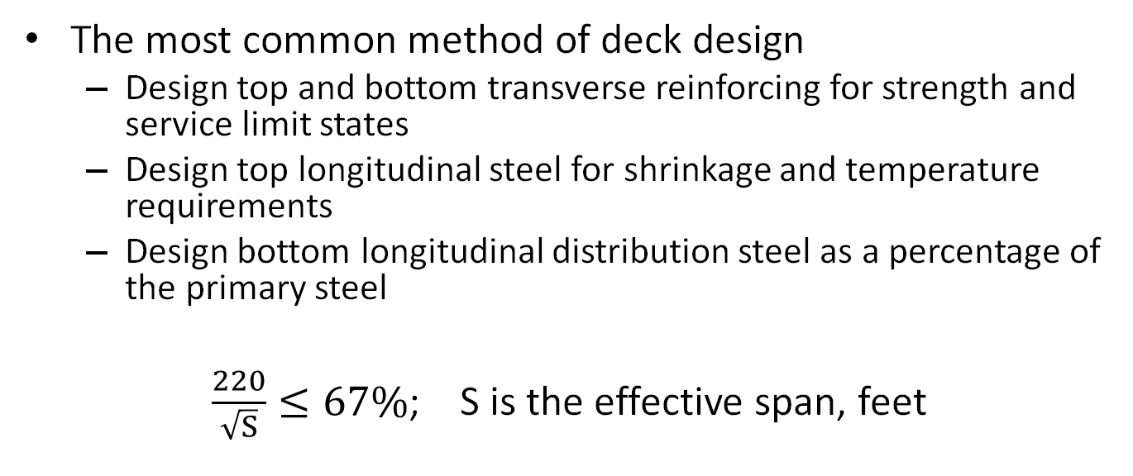
Traditional Strip Design (LRFD 9.7.3)
The most common method of deck design
  Design top and bottom transverse reinforcing for strength and service limit states
  Design top longitudinal steel for shrinkage and temperature requirements
  Design bottom longitudinal distribution steel as a percentage of the primary steel
$\frac{220}{\sqrt{S}}≤67\%$; S is the effective span, feet
Notes:
Once the main flexural reinforcement is designed, the longitudinal reinforcement is computed. The longitudinal steel in the bottom of the slab is called distribution reinforcement. The purpose of the distribution reinforcement is to work with the transverse reinforcement and engage a length of slab to resist the wheel loads that is much larger than the contact region between the tire and deck. It is the combination of the transverse and longitudinal reinforcement that allows for the engineer to use equivalent strip widths in design. The calculation of the longitudinal bottom distribution steel is a simple one, it is simply a percentage of the transverse steel not to exceed 67%. This reinforcing steel is uniformly distributed between the beams in the longitudinal direction at the bottom of the slab.

Slide 47
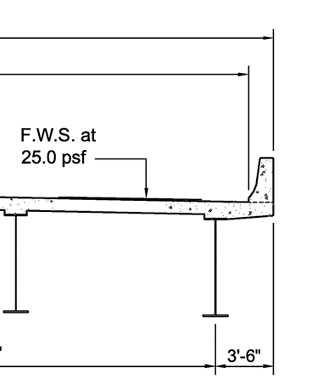
Effective Span (LRFD 9.7.3.2)
LRFD 9.7.3.2, refers to 9.7.2.3
Effective length of slab
  “The distance between flange tips plus the overhang…to the face of web”
  Simple and common way to interpret this is distance between adjacent beam quarter points
OH
CLR DIST
EFFECTIVE
SPAN
Notes:
To compute this distribution steel, an effective span length, S, is used. This slide describes the calculation of the effective span. The specifications describe the effective length of slab as “the distance between the flange tips plus the overhang” (overhang, singular) “measured to the face of web.” This is depicted in the sketch as the clear distance between flange tips plus ONE overhanging flange. It is easier to visualize this effective span as being the distance between the quarter points of adjacent overhanging flange tips. That is how most designers interpret this provision.

Slide 48
Empirical Design (LRFD 9.7.2)
Applies only to deck slabs supported by longitudinal beams
Does not require calculation of forces or reinforcing requirements
  Exception – overhangs
Preferred by default by some states (WV, ID, TX as examples)
Generally, not widely used otherwise
Notes:
As an alternative to the design of deck slabs to meet specific force requirements, the AASHTO LRFD BDS provides a companion approach known as the empirical deck design method. This method applies only to deck slabs supported by longitudinal beams. In other words, it cannot be used to design the deck spanning between parallel floor beams or for the design of a slab of a segmental box girder. When the empirical deck design method is chosen, there is no calculation of forces except for the overhang regions of the slab which require special consideration. This method of design is the default deck design for some states, for example, West Virginia, Idaho, and Texas. It is not used widely, however.

Slide 49
Survey of 10 States
Alabama – silent
Alaska – do not use
Arizona – only traditional discussed
Colorado – strip is default, designer may propose empirical for approval
Georgia – empirical design not allowed
Iowa – only with permission of chief bridge engineer
Michigan – strip is the default. Empirical may be approved as an alternate
New Jersey – only traditional discussed
South Carolina – use is prohibited
Virginia – empirical shall not be used
Notes:
A random sample of 10 states in various climates and geographies was chosen to determine what their bridge design policy said about the use of empirical decks. As noted on the slide, there are states such as Georgia, South Carolina, and Virginia, that explicitly prohibit the use of the empirical deck. Several other states, Colorado, Iowa, Michigan, permit the use of empirical decks as alternatives and after approval by the Department. Several other design manuals, Alabama, Arizona, New Jersey, only discuss the design of deck slabs using the traditional strip method. Lack of coverage of empirical decks (i.e., silence), was interpreted as disapproval / disallowed.

Slide 50
Empirical Deck Requirements
Diaphragms / cross-frames at every support line
Support beams are steel or concrete
Deck is fully cast-in-place and water cured
Uniform depth except for haunches and local thickening
Ratio of effective length to design depth not less than 6, not more than 18
Core depth of slab not less than 4 in.
Effective length does not exceed 13.5 ft
Minimum slab depth 7 in. excluding sacrificial wearing surface
Notes:
Should the empirical deck method be used, a number of conditions for its use are set forth in the AASHTO LRFD BDS. Only if a design meets all these requirements is an empirical deck design even permitted.

Slide 51
Core Depth
Core depth is the thickness between upper and lowermost transverse reinforcing bars, 4 in. minimum
Notes:
Empirical deck design requires a 4-inch minimum core depth. The core is the distance between the outermost fibers of the main transverse reinforcing steel. For an owner that requires 2.5 inches of cover above the top reinforcing steel and 1 inch of cover below the bottom reinforcing steel, the thinnest possible deck slab would be 7.5 inches holding to this 4-inch core dimension. Recall many states use 8 inches as a minimum deck thickness.

Slide 52
Empirical Deck Requirements
Overhang beyond centerline of beam at least 5 times the depth of slab; or 3 times the depth of slab with a structurally continuous composite barrier rail
28-day strength not less than 4 ksi
Deck is composite
Notes:
There are additional requirements that mandate minimum overhangs beyond the exterior beam, a minimum concrete strength of 4 ksi, and require the deck to be composite with the supporting beams.

Slide 53
Empirical Deck Reinforcing
4 layers of steel required placed as close as possible to the deck surfaces
Outermost layers are oriented in the direction of the slab span
Minimum steel
  0.27 in²/ft in each bottom layer
    (#4 @ 8.5” or #5 @ 13.5”)
  0.18 in²/ft in each top layer
    (#4 @ 13” or #5 @ 18”)
  Spacing not to exceed 18 in.
  Grade 60 or better reinforcing
  If skew exceeds 25 degrees, double the reinforcing in the deck end zones
Notes:
If all the requirements for an empirical deck design are satisfied, the designer must only meet the minimum steel requirements in the right-hand column. There is no design or calculation of moments required. The minimum reinforcing steel is 0.27 square inches per foot in both directions of the bottom layers and 0.18 square inches per foot in each direction of the top layers. The bar spacing is not to exceed 18 inches and reinforcing steel having a yield strength of at least 60 KSI is required. When the skew exceeds 25 degrees, additional reinforcing is required in the deck end zones.

Slide 54
AASHTO LRFD REINFORCED CONCRETE DESIGN
Notes:
The essential calclatuons for reinforced concrete design are presented in this section. Included is a review of the principles of reinforced concrete design at the service and strength limit states, determination of the strength of singly reinforced concrete sections in flexure, requirements for minimum reinforcement, the control of cracking, and the need for shrinkage and temperature reinforcing.

Slide 55
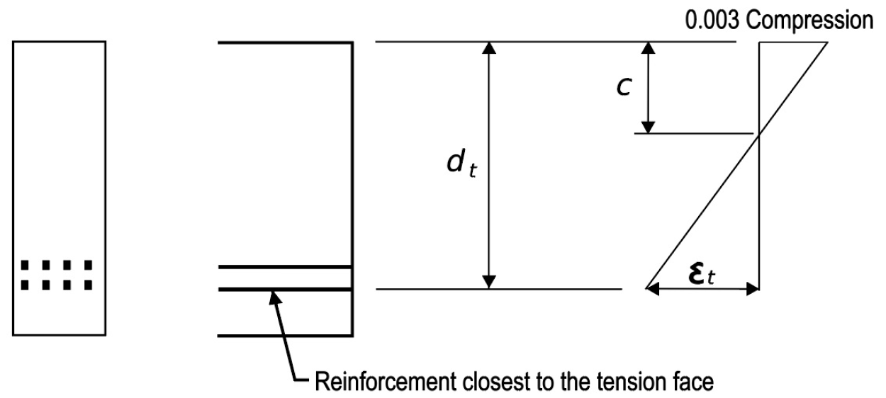
Reinforced Concrete Design
Review of AASHTO reinforced concrete design
Focus on singly reinforced rectangular sections
Notes:
The AASHTO LRFD design requirements for reinforced concrete are presented in the following slides. Focus will be on the analysis and design of singly reinforced rectangular concrete sections. In order to design a concrete slab, the concrete design provisions are first discussed.

Slide 56
Reinforced Concrete Design
Key assumptions
  Section cracks
  Strains vary linearly
  Maximum compression strain in concrete 0.003 in./in.
  Gr 60 reinforcing steel yields at ε=0.002 in./in.
Notes:
Several important assumptions are needed to design a reinforced concrete section. It is assumed that the level of flexural stress is sufficient to crack the concrete on the flexural tension side of the section. When that happens, the reinforcing steel on the flexural tension side forms a force couple with an internal compression resultant on the compression side to carry the bending moments. It is assumed that strains vary linearly from the neutral axis location. It is a common assumption in concrete design that concrete reaches its specified compression strength at a strain of 0.003 in./in. Reinforcing steel with a yield strength of 60 KSI can be assumed to reach its yield strength at a strain of 0.002 in./in.

Slide 57
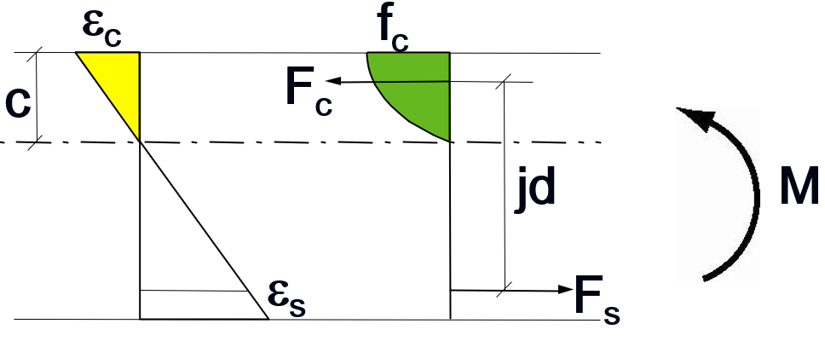
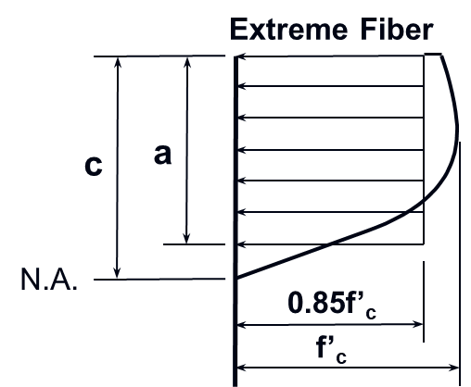
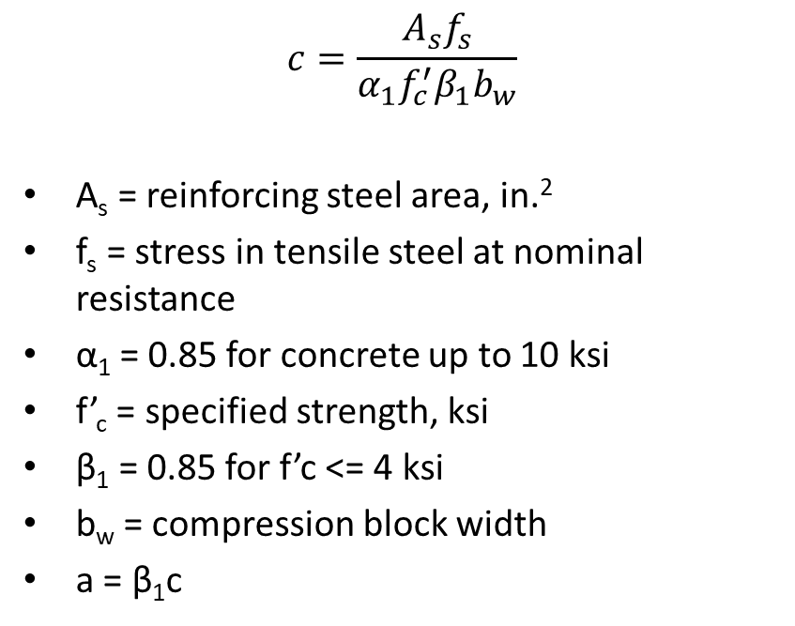
Flexural Strength (LRFD 5.6.3)
$$c=\frac{A_{s}f_{s}}{α_{1}f_{c}^{′}β_{1}b_{w}}$$
A_{s} = reinforcing steel area, in.²
f_{s} = stress in tensile steel at nominal resistance
α₁ = 0.85 for concrete up to 10 ksi
f’_{c} = specified strength, ksi
β₁ = 0.85 for f’c <= 4 ksi
b_{w} = compression block width
a = β₁c
Notes:
The flexural resistance of a reinforced concrete section is provided through a force couple of internal tensile and compressive resultants. The tensile resultant is the product of a stress and an area of reinforcing steel. On the compression side, the strains vary linearly but because concrete has a nonlinear stress-strain behavior the stresses follow a nonlinear profile. An equation is provided in Article 5.6.3 of the AASHTO LRFD BDS that locates the neutral axis depth, c. The location of the neutral axis is a function of the area of steel, the stress in the steel, the strength of the concrete, the width of the compression block, a factor α₁ which relates to the assumed uniform intensity of the compression stress, and a factor of β which relates the neutral axis depth c, to the height of Whitney's stress block, a.

Slide 58
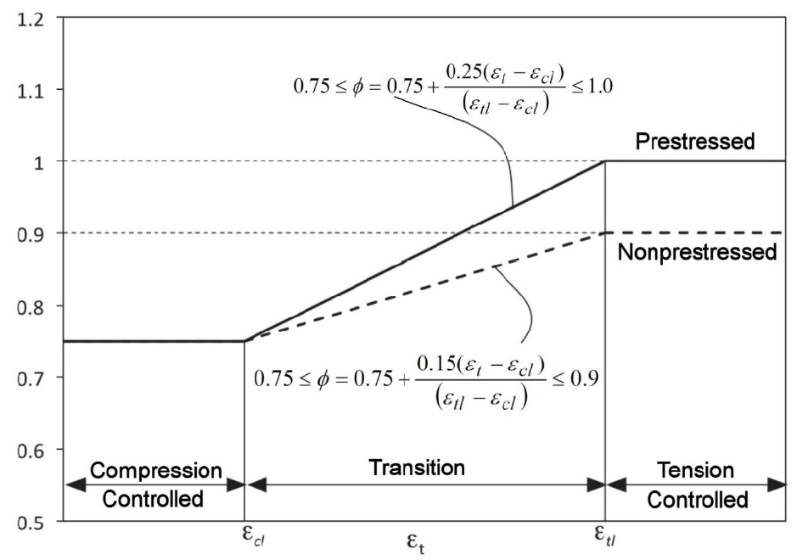
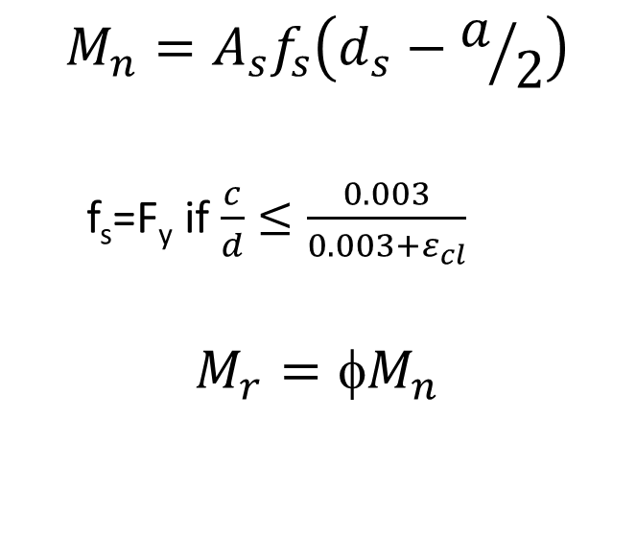
Flexural Resistance (LRFD 5.6.3.2)
$$M_{n}=A_{s}f_{s}\left(d_{s}−a/2\right)$$
  f_{s}=F_{y} if $\frac{c}{d}≤\frac{0.003}{0.003+ε_{cl}}$
$$M_{r}=M_{n}$$
ε_{cl} = 0.002 for Gr 60 rebar
ε_{tl} = 0.005 for Gr 60 rebar
Notes:
The equation for the nominal flexural resistance M_{n} shown on this slide is a simplified version of that found in the specifications. The equation in the specifications contains many more terms that allow for a combination of mild and prestressing steel to be used for tensile reinforcement and allows for the inclusion of compression reinforcement. The equation on the slide is simply the detailed equation in the specifications with the terms that do not apply removed. This equation for nominal resistance is simply the internal flexural strength from a force couple of a tension and compression resultant with the location of the compression resultant being at the centroid of Whitney's stress block. The stress of the reinforcing steel, f_{s}, is permitted to be taken as a F_{Y} as long as the conditions on the slide are met. The resisting moment M_{r} is equal to φM_{n} where φ is found from the graph on the right side of the screen.

Slide 59
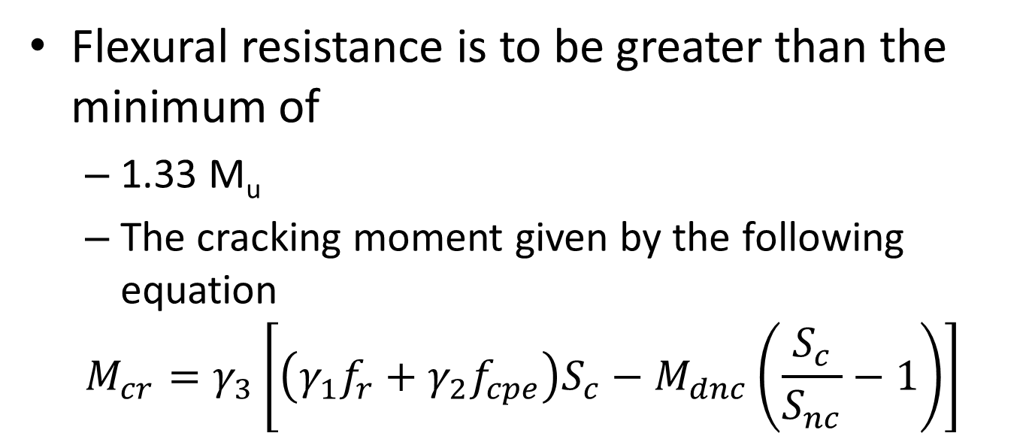
Minimum Reinforcement (LRFD 5.6.3.3)
Flexural resistance is to be greater than the minimum of
  1.33 M_{u}
  The cracking moment given by the following equation
  $$M_{cr}=γ_{3}\left[\left(γ_{1}f_{r}+γ_{2}f_{cpe}\right)S_{c}−M_{dnc}\left(\frac{S_{c}}{S_{nc}}−1\right)\right]$$
Notes:
In order to prevent sudden failure of concrete sections that are lightly reinforced (subjected to low loads relative to their geometry) the specifications have a minimum reinforcement requirement check. The flexural resistance of a reinforced section must be greater than 1.33 times the factored moment or the cracking moment of the section given by the equation shown on this slide. The specifications allow for the lesser of these two values to be used in defining the minimum reinforced strength.

Slide 60
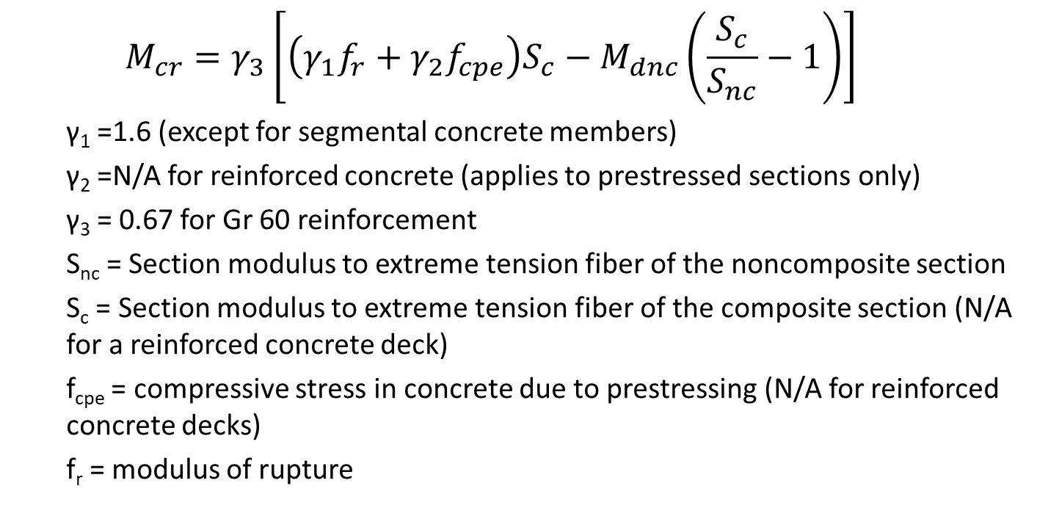
Minimum Reinforcement (LRFD 5.6.3.3)
  $$M_{cr}=γ_{3}\left[\left(γ_{1}f_{r}+γ_{2}f_{cpe}\right)S_{c}−M_{dnc}\left(\frac{S_{c}}{S_{nc}}−1\right)\right]$$
  γ₁ =1.6 (except for segmental concrete members)
  γ₂ =N/A for reinforced concrete (applies to prestressed sections only)
  γ₃ = 0.67 for Gr 60 reinforcement
  S_{nc} = Section modulus to extreme tension fiber of the noncomposite section
  S_{c} = Section modulus to extreme tension fiber of the composite section (N/A for a reinforced concrete deck)
  f_{cpe} = compressive stress in concrete due to prestressing (N/A for reinforced concrete decks)
  f_{r} = modulus of rupture
Notes:
The various terms in the cracking moment equation are presented on this slide. There are three different γ terms that relate to the type of structure, whether or not the section has prestressing, and to the grade of the mild reinforcing steel. The equation presumes that a section may have certain loads applied to it in a noncomposite condition and additional loads applied to it in a composite condition. Where this would be common would be in a bridge composed of prestressed concrete beams and a concrete deck. The cracking moment strength of that prestressed concrete beam would be a function of how much load was applied to the noncomposite section, the amount of precompression due to prestressing present in the beam, and how much additional load is applied to the composite section. In the case of a reinforced concrete element such as a deck slab, a footing, a wall, a pier cap, there is no distinction between loads applied to a composite and a noncomposite section, there is only one resisting section for all loads. This complicated equation will be simplified on the next slide for application to a reinforced concrete section.

Slide 61
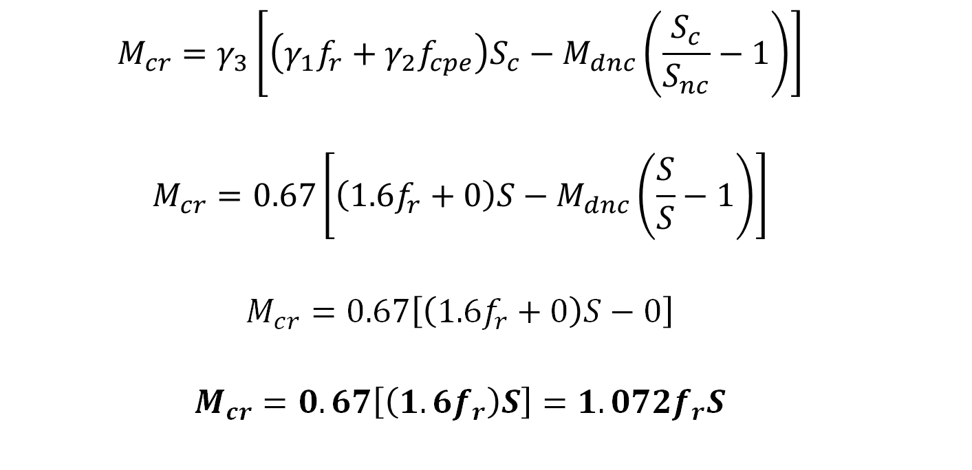
Minimum Reinforcement (LRFD 5.6.3.3)
  $$M_{cr}=γ_{3}\left[\left(γ_{1}f_{r}+γ_{2}f_{cpe}\right)S_{c}−M_{dnc}\left(\frac{S_{c}}{S_{nc}}−1\right)\right]$$
  $$M_{cr}=0.67\left[\left(1.6f_{r}+0\right)S−M_{dnc}\left(\frac{S}{S}−1\right)\right]$$
  $$M_{cr}=0.67\left[\left(1.6f_{r}+0\right)S−0\right]$$
  $$M_{cr}=0.67\left[\left(1.6f_{r}\right)S\right]=1.072f_{r}S$$
Notes:
The complex form of the cracking moment equation shown on the preceding slide is reduced to a simpler form shown on this slide that applies for reinforced concrete. The section is not prestressed so the effective compression term, f_{cpe}, is zero. As there is no distinction between a noncomposite and a composite section, the section modulus terms are the same. With those substitutions, the equation at the bottom of the slide is the reduced form and will be used to calculate the cracking strength of a reinforced concrete section.

Slide 62
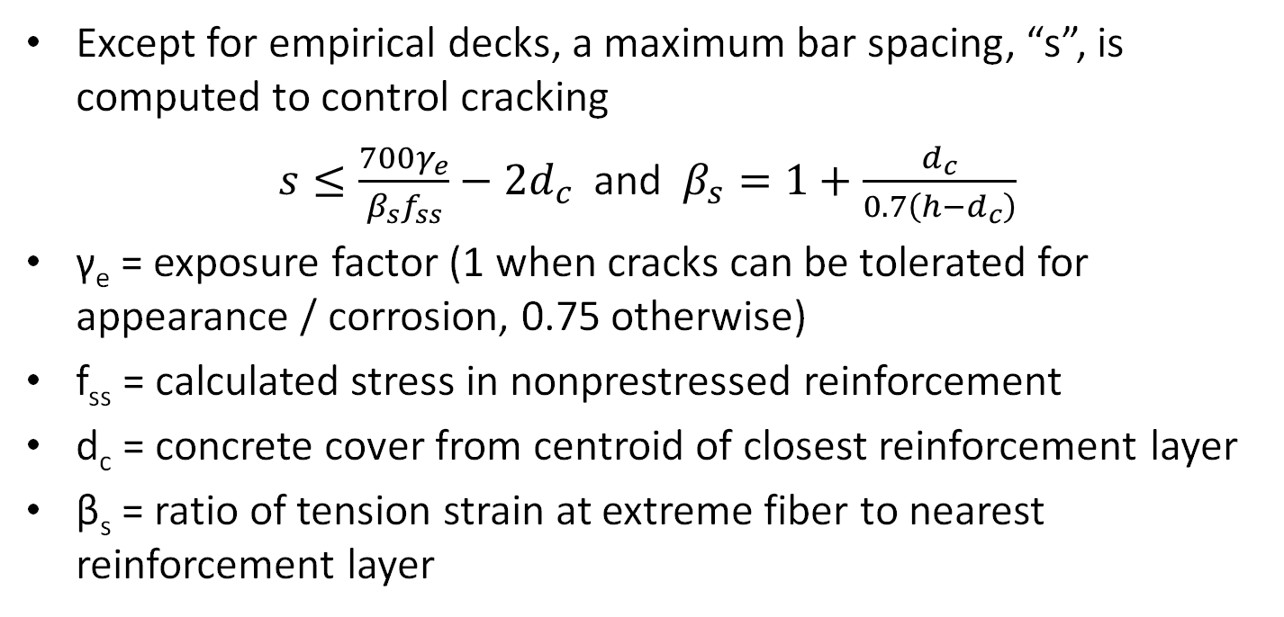
Control of Cracking (LRFD 5.6.7)
Except for empirical decks, a maximum bar spacing, “s”, is computed to control cracking
$s≤\frac{700γ_{e}}{β_{s}f_{ss}}−2d_{c}$ and $β_{s}=1+\frac{d_{c}}{0.7\left(h−d_{c}\right)}$
γ_{e} = exposure factor (1 when cracks can be tolerated for appearance / corrosion, 0.75 otherwise)
f_{ss} = calculated stress in nonprestressed reinforcement
d_{c} = concrete cover from centroid of closest reinforcement layer
β_{s} = ratio of tension strain at extreme fiber to nearest reinforcement layer
Notes:
Serviceability in a cracked concrete section is enforced through an equation that restricts the maximum reinforcing bar spacing for those bars closest to the tensile face. The calculation of the maximum bar spacing involves an exposure factor related to whether or not cracks can be tolerated from an aesthetic or a durability perspective. Additionally, the maximum bar spacing is related to the computed tensile stress in the reinforcing. It is logical that as the magnitude of the stress in the reinforcing increases or decreases that this leads to wider or narrower cracks in the adjoining concrete. The β factor relates the strains at the top of the cover to those at the level of the tensile reinforcement. The calculations for stress are performed at the level of the reinforcing yet the objective is to control cracking at the surface of the concrete. The β factor captures the distinction between these two dimensions.

Slide 63
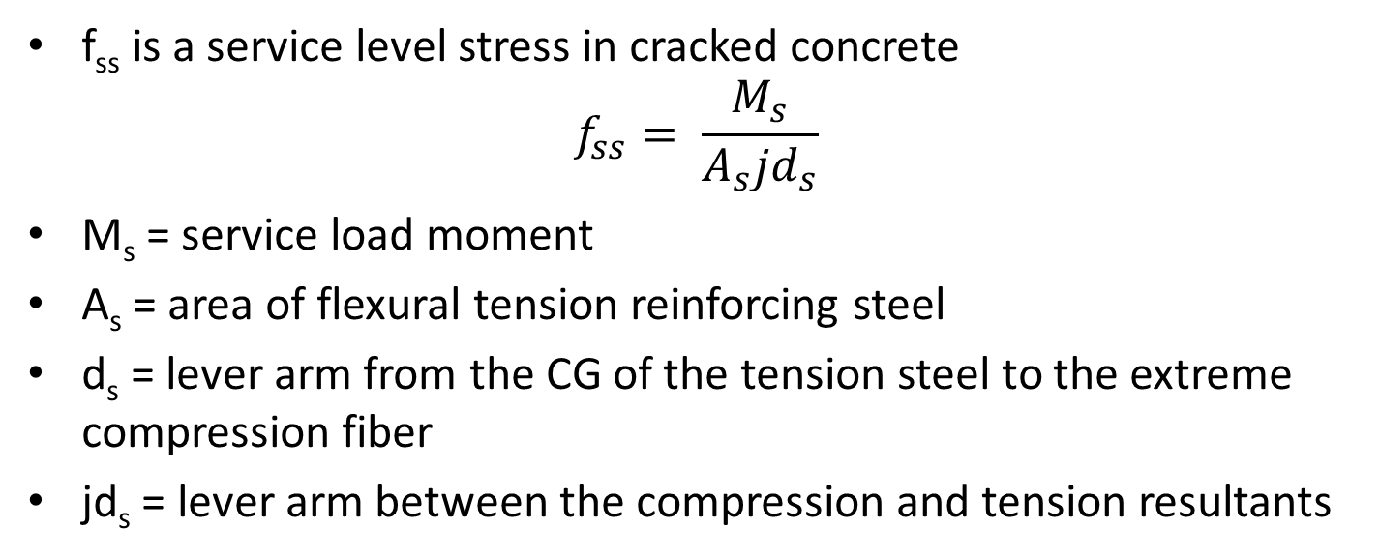
Control of Cracking (LRFD 5.6.7)
f_{ss} is a service level stress in cracked concrete
$$f_{ss}= \frac{M_{s}}{A_{s}jd_{s}}$$
M_{s} = service load moment
A_{s} = area of flexural tension reinforcing steel
d_{s} = lever arm from the CG of the tension steel to the extreme compression fiber
jd_{s} = lever arm between the compression and tension resultants
Notes:
The crack control bar spacing checks are based on stresses computed at the service limit state. The stress in the reinforcing steel in the cracked concrete section is required. The equation presented on this slide computes the stress in the reinforcing steel based on the applied service moment, a lever arm, and the area of steel.

Slide 64

Control of Cracking (LRFD 5.6.7)
$$ρ= \frac{A_{s}}{bd}$$
$$k= \sqrt{{\left(ρn\right)}^{2}+2ρn}−ρn$$
$$j=1−k/3$$
f_{c}
kd
C
d
jd
f_{ss}
T
Notes:
The principles of service load analysis of cracked reinforced concrete sections are used to compute the stresses in the reinforcing steel at the service limit state. The reinforcing ratio ρ is computed as shown in the first equation. The value for ρ is used to determine the depth of the service limit state compression block, “kd”. With an assumed triangular stress distribution at the service limit state, the lever arm between the tension and compression resultants is called “jd”. The value for j is equal to 1 - k / 3. It is this value of “jd” that is used to compute the stress in the flexural tension reinforcing steel.

Slide 65
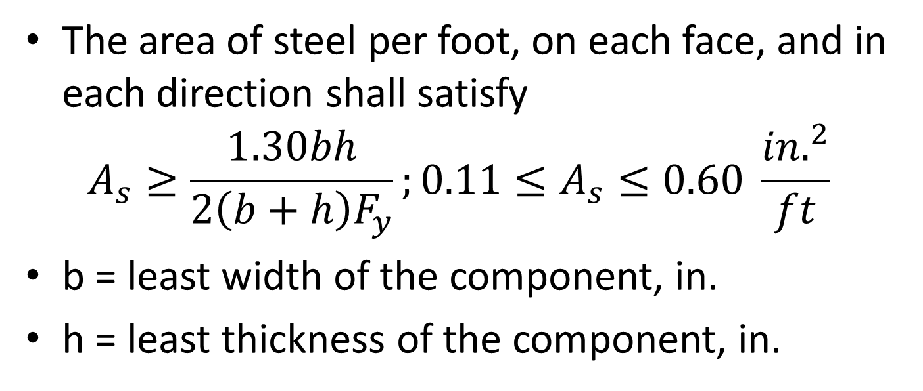
Shrinkage and Temperature Reinforcing (LRFD 5.10.6)
The area of steel per foot, on each face, and in each direction shall satisfy
$$A_{s}≥\frac{1.30bh}{2\left(b+h\right)F_{y}};0.11≤A_{s}≤0.60 \frac{{in.}^{2}}{ft}$$
b = least width of the component, in.
h = least thickness of the component, in.
Notes:
The specifications require that at a minimum all faces of reinforced concrete elements have at least the minimum amount of reinforcing steel required by the shrinkage and temperature reinforcing provisions. The provisions compute an area of steel in each direction of each face and compare it to a minimum and a maximum requirement. This shrinkage and temperature reinforcing is commonly used in the longitudinal direction at the top of a reinforced concrete bridge slab.

Slide 66
NSBA SBDH Design Example 1 Deck Design
Notes:
The detailed design of a deck for the bridge shown in NSBA SBDH Example 1 is provided. A complete design for positive and negative flexure, including overhang effects is provided. A design that satisfies all applicable limit states is shown.

Slide 67
Detailed Steps
Determine slab thickness
DL and LL forces
Load Combinations
Positive moment design
Negative Moment design
Distribution reinforcing
Shrinkage and temperature reinforcing
Continuity reinforcing
Overhang considerations
Notes:
The detailed steps for slab design will be reviewed starting with the selection of slab thickness.

Slide 68
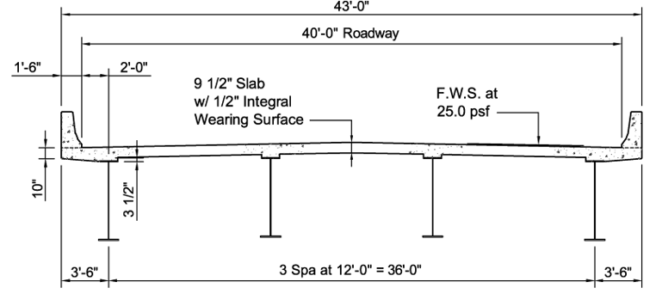
Deck Thickness
NSBA SBDH Ex. 1 uses a 9.5 in. thick deck
½ in. integral wearing thickness
  Thickness is used for weight, not structural capacity
4 ksi concrete
60 ksi reinforcing steel
Notes:
The first step in the design of the bridge deck is to select the deck thickness. NSBA SBDH Design Example #1 already specifies that a 9.5-inch-thick deck is used. Had this dimension not been specified, the designer would generally consult with the bridge design manual or standard plans from the governing agency and select that agencies preferred minimum slab thickness. It is likely that all the reinforcing would also be provided in the standard plans. This example will show the rigorous calculation of the reinforcing.
Several state DOT design manuals were consulted to determine the reasonableness of this deck thickness selection.
Pennsylvania – 9.5 in.
Utah – 9 in.
Massachusetts – 10.0 in.
Therefore the 9.5-inch deck is reasonable and within the range of practical thicknesses.

Slide 69
Detailed Steps
Determine slab thickness
DL and LL forces
Load Combinations
Positive moment design
Negative Moment design
Distribution reinforcing
Shrinkage and temperature reinforcing
Continuity reinforcing
Overhang considerations
Notes:
The next step is to determine the dead load and live load forces. For this example, the slab was modeled as a transverse beam supported by pins at each support location. The weight of the slab was modelled as 9.5 inches thick between the beams and increased to a 10-inch-thick section in the overhang consistent with the typical section for the example. The self weight was applied. The future wearing service load of 25 psf between the barrier rails was applied. A point load representing the weight of the barrier rail was applied. The design example indicates these barrier rails weigh 520 pounds per lineal foot and have a base width of 18 inches. A point load of 520 pounds located 9 inches from the edge of slab was applied. Other designers may choose to apply the weight of the barrier rigorously under the center of gravity of the barrier cross section. For simplicity, this load was simply applied at the mid-width of the base of the barrier. Excess precision in such calculations is not warranted. Any set of reasonable assumptions is sufficient.

Slide 70
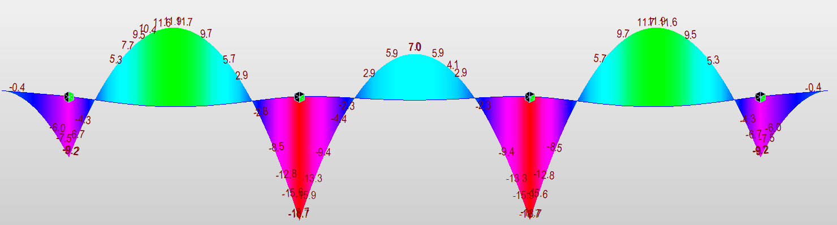
Self Weight
Moments are in-kips per foot width of slab
Notes:
The self weight bending moments for the full width of the bridge are plotted. The peak negative moments are at each beam support line. The positive moments peak midway between the beam lines. Nodes were added to this model at the flange quarter point locations so that the design negative moment critical section forces could be extracted directly from the analysis.

Slide 71
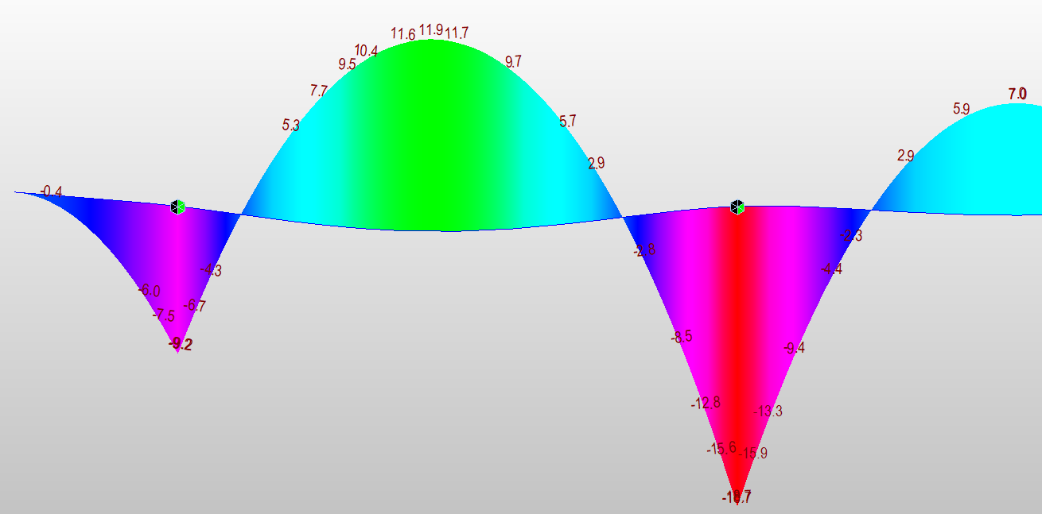
Self Weight Detailed
Notes:
A more detailed look at these self weight bending moments is included on this slide. The values that are circled represent the peak positive bending moments and the bending moments at the flange quarter points and these values will be used for analysis and design. These values are in in-kips and represent the values for a 1-ft width of the slab measured longitudinally.

Slide 72
Alternate DL Procedures
Some owners, example Virginia DOT, use a simple formula, wl²/10, to estimate the DL moments for a slab having at least three continuous spans
M = (9.5”/12)(0.15kcf)(12’)²/10
  = 1.71 ft-kips (20.5 in.-kips)
    This is a moment at CL of beam, not the design section (the quarter point). Comparable CL support moment from FEA = 18.7 in.-kips
    FEA allows for direct calculation at the design section, 15.9 in.-kips
    FEA has significantly lower +M design moments (+11.9 in.-kips)
    VDOT uses the same approximate moment for +M and -M
Notes:
As an alternative procedure to analyzing the bridge slab as a continuous beam, some designers and agencies use a simple approach to estimate bending moments due to uniformly distributed loads such as the self weight of the slab and the bending moment effects from the future wearing surface. The positive and negative bending moments are assumed to be equal to WL²/10, this value being a middle ground between the peak positive and negative bending moments that would exist for simply supported and completely fixed end conditions. Virginia DOT is one such agency that uses this approach. For the calculation, the span length is taken equal to the beam spacing. The resulting value is a bending moment at the center line of support and is therefore naturally higher than the bending moments that would exist at the critical section for negative moment, the flange quarter point. It is a conservative estimate for the negative moment. It is a significantly conservative estimate for the positive moment.
The estimated bending moment, 20.5 inch-kips, is comparable to the bending moment from the finite element model at the center line of support, 18.7 inch-kips. But the estimate is conservative. When the estimated force is compared to the quarter point critical design moment the conservatism is even greater, approximately 30%. The estimated positive moment, taken equal to the estimated negative moment, is 70% greater than the value from the finite element analysis. Use of the estimated moments will result in a conservative design. The purpose of these slides is to show the rigorous calculation of the design forces.

Slide 73
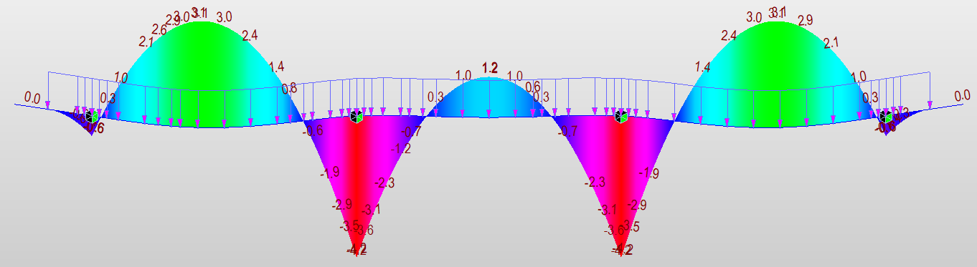
Wearing Surface
Notes:
This slide shows the application of the 25 psf future wearing surface load between the limits of the barrier rail. Since only a small portion of the overhanging slab is subjected to the wearing surface load, notice that the moments at the exterior beams are practically zero. The moment diagram is almost exactly that of a three-span continuous beam of equal spans subjected to a uniform load.
A three-span beam, without overhangs, subjected to a load of 25 psf (plf) would have a bending moment at the supports of 0.1wl² = 0.36 ft-kips (4.3 in.-kips) compared to 4.2 in.-kips from the FEA model. The positive moment would be 0.08wl² = 3.5 ft-kips. Moment diagrams from the AISC Steel Construction Manual, shown below, are used to verify the FEA results.

Slide 74
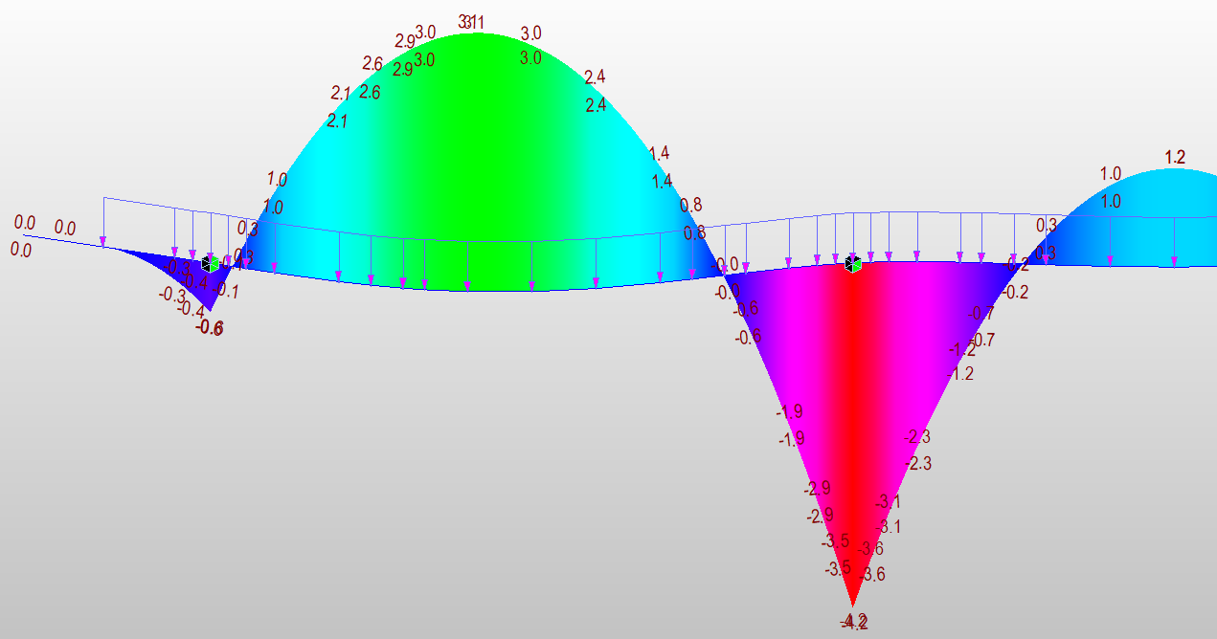
Wearing Surface Detailed
Notes:
Similar to the diagram for self weight, a detailed version of the wearing surface bending moment diagram is provided. The critical positive and negative design moments are circled. These moments are in.-kips per foot of length units.

Slide 75
Alternate DL Procedures
W = (25 psf)(1 ft)(12’)²/10
  = 0.36 ft-kips (4.3 in.-kips)
    This is a moment at CL of beam, not the design section (the quarter point).
    Comparable CL support moment from FEA = -4.2 in.-kips
    FEA allows for direct calculation at the design section
    FEA has significantly lower +M design moments (+3.1 in.-kips)
    VDOT uses the same moment for +M and -M
Notes:
This slide again makes a comparison between the FEA bending moments and those obtained from a simple expression for estimating the magnitude of the positive and negative bending moments. As was previously shown, the future wearing surface bending moment diagram is very nearly the bending moment diagram from a three-span continuous uniformly loaded beam. The estimated bending moments agree very closely with those from the FEA model.

Slide 76

Barrier Rail Moments
Notes:
The bending moment diagram from the barrier rail point loads is presented on this slide. There are two equal point loads, 520 pounds each, located 9 inches inward from the edge of slab at the center of the 18-inch-wide barrier rail base. The peak negative bending moments are simply the product of the weight of the barrier rail and the lever arm on the overhang. A hand calculation of the bending moment in the overhang results in a value of 17.16 inch-kips (520# * 2.75 ft = 17.16 in-kips). This is rounded on the slide to 17.2 inch-kips. The effect of the overhang barrier rail load is like the application of two concentrated negative bending moments at beams one and four. Those negative bending moments result in the moment diagram shown on this slide. Other than the moment in the overhang, there is no simple estimate of the moments in the rest of the slab, some analysis is required.

Slide 77

Barrier Rail Detailed
Notes:
A detailed view of the bending moments created by the barrier rail load is provided on this slide. The critical design values are circled. These moments are in-kips per foot of length.

Slide 78
Detailed Steps
Determine slab thickness
DL and LL forces
Load Combinations
Positive moment design
Negative Moment design
Distribution reinforcing
Shrinkage and temperature reinforcing
Continuity reinforcing
Overhang considerations
Notes:
With moments that vary in each slab span, the selection of the governing design locations requires that the forces be combined and compared at several possible critical locations.

Slide 79
Positive Moments
Between Beam 1 and 2
Between Beam 2 and 3
DC1 Self Wt = +11.9 in-kips
DW wearing surface = +3.1 in-kips
DC2 railing = -6.9 in-kips
STR 1 (DL ONLY) = 1.25 (11.9-6.9)+1.5(3.1)
= 10.9 in-kips
DC1 = +7 in-kips
DW = +1.2 in-kips
DC2 = +3.4 in-kips
STR1 (DL ONLY) = 1.25(7+3.4)+1.5(1.2)
= 14.8 in-kips
Notes:
Because of the shape and magnitude of the bending moment diagrams due to the various dead load components, it is not always obvious where the peak positive and negative bending moments will be located. A Strength (STR) I load combination including only the dead load components was computed for the positive moment region between beams one and two and for the region between beams two and three. The highest factored dead load moment was between beams two and three.

Slide 80
Negative Moments
At Beam 1 quarter point
At Beam 2 quarter point
DC1 Self Wt = -6.7 in-kips
DW wearing surface = -0.1 in-kips
DC2 railing = -16.6 in-kips
STR 1 (DL ONLY) = 1.25 (-6.7-16.6)+1.5(-0.1)
= -29.3 in-kips
DC1 = -15.9 in-kips
DW = -3.6 in-kips
DC2 = +2.9 in-kips
STR1 (DL ONLY) = 1.25(-15.9+2.9)+1.5(-3.6)
= -21.7 in-kips
Notes:
A similar calculation was performed for the negative bending moments at the flange quarter points. The maximum negative bending moment was found at the flange on the inside of beam one.

Slide 81

STR 1 DL Combination
Notes:
A load combination was created in the FEA program to verify the hand calculations. The peak negative and positive bending moments agree in magnitude and location with the hand calculations. This diagram also depicts the complete shape and magnitude of the dead load bending moment diagram factored with the STR I load factors. These moments are in in.-kip per foot of length units.

Slide 82

SER 1 DL Combination
Notes:
Because service load combinations will also be needed for the crack control and bar spacing checks, a service load combination was also created in the program. These moments are in in.-kips per foot of length units.

Slide 83


+M LL+I Between Beam 1 and 2
Multiply by 1.33 Impact and 1.2 Multiple Presence
Notes:
A live load case was created to demonstrate one of several live load placements that would be needed to determine the maximum positive and negative bending moments in the slab as vehicles are moved transversely across the deck. A single truck with two 16-Kip wheel loads is shown placed between beams one and two. The intent of this placement is to generate positive bending moments in that slab span. The dynamic load allowance of 1.33 must be manually added to the results and because this is a refined analysis and the engineer is responsible for the application of multiple presence factors, a multiple presence factor of 1.2 is applied. The resulting moment is shown on the bottom of the slide. A single truck positioned between beams one and two, with impact and multiple presence considered, produces a maximum positive bending moment of 69 ft-kips between beams one and two. An additional positive moment load case could be created by moving this truck to the left and to the right to ensure that the peak positive bending moment was captured. The engineer could also add a second truck between beams three and four further adding to the positive bending moment. When this is done, the multiple presence factor would be reduced to 1.0. In a similar way, two closely spaced trucks could be placed straddling beams one and two to create peak negative bending moments in the slab. Several critical placements of live load would be needed to maximize the peak of positive and negative bending moments if the live load forces are to be determined through the use of a refined model.

Slide 84
+M Between Beam 1 and 2
Maximum +M from 1 truck, including impact and multiple presence is 69 ft-kips
Strip = 26 + 6.6(12) = 105.2 inches
M = 69 (105.2/12) = 7.87 ft kips per foot
Notes:
Once the peak positive or negative bending moments are found, they are combined with the strip width equations to determine the bending moments on a unit length basis. Using the positive bending moment of 69 ft-kips from the prior slide, and computing the positive moment strip width, 105.2 inches, the bending moment on a per foot basis is 7.87 foot-kips.

Slide 85

Live Load Moments
For a 12’ girder spacing
Max +M = 8.01 ft-kips per foot
compare to 7.87 for one load case considered (2% difference)
For a 16” wide flange, the ¼ point is 4”. For simplicity use the 3” column
Max –M = -9.40 ft-kips per foot
Notes:
The AASHTO LRFD BDS has an appendix to Section 4 that eliminates the need for the moving live load analysis for deck design. A table is provided whereby a designer enters this table with the beam spacing and the distance from the center line of the beam to the critical negative moment section. The positive and negative design moments are read directly from the table. This table was created by enveloping the results of many analytical models with different beam spaces and different overhang widths. Because it is an envelope, it will be conservative for specific designs, but only slightly so. It also eliminates the need to conduct the live load analysis. Dead loads can either be determined by an analysis, or as shown previously, with simple estimate equations. By using this table of design moments and simple estimates of dead load, the governing forces in a bridge slab can be determined very quickly and with a reduced chance for error. Or, even if a refined analysis is conducted, this table is useful as a checking tool.
For the NSBA SBDH Design Example 1 bridge, this table provides a design moment of 8.01 ft-kips. This includes all considerations for impact and multiple presence. No other manipulation of these values is needed. The FEA load placement computed a bending moment of 7.87 ft-kips. Several other placements of the live load were applied, shifting slightly left and right and the peak moment remained relatively constant. The values from the table can be easily used with little conservatism. For the negative design moment, the critical section is 4” from the CL of web. No value is provided in the table, but a design section only 1” away is provided. The negative moment will be based on the -9.4 ft-kip / ft value from this table. A moment close to this value was obtained analytically.

Slide 86
Unfactored Bending Moments
Positive Bending
Negative Bending
DC1 = +7 in-kips
DW = +1.2 in-kips
DC2 = +3.4 in-kips
LL+I = +8.01 ft-kips (note units)
DC1 = -6.7 in-kips
DW = -0.1 in-kips
DC2 = -16.6 in-kips
LL+I = -9.40 ft-kips (note units)
Notes:
This slide summarizes the dead load and live load bending moments presented on prior slides for the positive moment region and the negative moment critical section. When the live load tables from the prior slide are used, that magnitude live load is assumed equal in all slab spans. Therefore, the engineer need only find the peak dead load moments and add the live load values from the table to determine the critical design values. All positive moment regions are designed for the peak value and a similar process is repeated for all negative moment regions.

Slide 87
Strength I and Service I Bending Moments
Positive Bending
Negative Bending
STR 1 =
  1.25(7+3.4)
  + 1.5(1.2)
  + 1.75(8.01*12)
  = 183 in-kips
  = 15.25 ft-kips per foot of slab
SER 1 =
= 107.72 in-kips
= 8.98 ft-kips per foot
Str 1 =
1.25(-6.7-16.6)
+1.5(-0.1)
+1.75(-9.40*12)
= -227 in-kips
= -18.89 ft-kips per foot
Ser 1 =
= -136.2 in-kips
= -11.35 ft-kips per foot
Notes:
The STR I and SER I limit state load combinations are computed for the critical positive and negative bending moment regions. These bending moments are used for strength design and the maximum bar spacing / crack control checks in subsequent steps.

Slide 88
Detailed Steps
Determine slab thickness
DL and LL forces
Load Combinations
Positive moment design
Negative Moment design
Distribution reinforcing
Shrinkage and temperature reinforcing
Continuity reinforcing
Overhang considerations
Notes:
The positive moment design will be performed first, followed by the negative moment design.

Slide 89

Singly Reinforced Concrete Design
$M_{u}≤M_{n}$
$M_{n}=A_{s}f_{s}\left(d−a/2\right)$
$a=β_{1}c=\frac{A_{s}f_{s}}{0.85f_{c}^{′}b}$
$∴M_{n}=A_{s}f_{s}\left(d−\frac{A_{s}f_{s}}{2(0.85f_{c}^{′}b)}\right)$
This is a quadratic equation and can be solved for A_{s}. Assume that f_{s} = F_{y} and that φ=0.9 and verify later.
Notes:
The nominal strength equation for a singly reinforced concrete section in flexure is presented. The equation for the nominal bending strength M_{n} includes the variable “a”, the height of Whitney’s stress block. The equation for “a” is also provided on the third line of this slide. Combining the equations for M_{n} and “a” results in the bottom equation, a quadratic equation with the only unknown being the area of steel, A_{s},. This equation can be solved for the required steel area to resist a specific moment, M_{n,required}.

Slide 90

+M Region Flexural Design
$\text{Positive} \text{moment} \text{Design} \text{for} \text{Mu}\text{=183 }\text{in}\text{.}\text{−}\text{kips}$
M_{n} required (assuming φ = 0.9) = 183 / 0.9 = 203 in.-kips
Assume a #5 transverse bar
d = 9.0” (9.5 – 0.5 for wear) – 1” cover – 0.5(0.625”) = 7.6875”
$203=A_{s}(60)\left(7.6875−\frac{A_{s}(60)}{2(0.85)(4)(12)}\right)$
A_{s} = 0.46 in.²/ft = #5 @ 8” for strength
Notes:
For the factored STR I design moment of 183 in.-kips, a required nominal strength of 203 in.-kips is computed. A #5 bar is assumed for the bottom transverse reinforcing steel. The lever arm from the extreme compression fiber to the centroid of the tension steel, “d”, is computed. The gross slab thickness of 9.5 in. is reduced by 0.5 in. for wear, grinding, grooving, and deck profiling. The bottom mat is permitted to have 1” cover to the main bars. The distance “d” is 7.6875”. The area of steel is computed and a spacing of 8” is chosen for the #5 assumed bars to provide the required steel area on a per-foot basis.

Slide 91

Singly Reinforced Concrete Design
$c=\frac{A_{s}f_{s}}{α_{1}f_{c}^{′}β_{1}b}= \frac{0.31(\frac{12}{8})(60)}{0.85(4)(0.85)(12)}=0.804$”
c/d = 0.804 / 7.6875 = 0.105
Check if $\frac{c}{d}≤\frac{0.003}{0.003+ε_{cl}}$
ε_{cl} = 0.002 for 60 ksi rebar
$0.105≤\frac{0.003}{0.003+0.002}=0.6$ therefore f_{s} = F_{y}
Notes:
Several assumptions in the prior calculations need to be verified. The prior calculations assumed that the reinforcing steel yields. The calculations on this slide demonstrate that the as-designed c/d value of 0.105 is less than the balanced strain condition, 0.6, and therefore it is proven that the reinforcing steel yields.

Slide 92

Reinforced Concrete Design
Check strain in the extreme tension steel to verify the selection of φ
$\frac{0.003}{c}= \frac{ε_{t}}{d_{t}−c}$
$ε_{t}=\frac{0.003\left(d−c\right)}{c}$
$$= \frac{0.003\left(7.6875−0.804\right)}{0.8}=0.026 ≫0.005$$
φ =0.9
Notes:
An additional assumption that needs to be verified is the selection of 0.9 for the φ value. This is a linear strain distribution check of the strain in the extreme tension steel when the compression strain in the concrete reaches its limiting value of 0.003 in./in. The computed strain in the bottom mat tension steel is 0.026, over five times greater than the minimum strain for tension-controlled behavior and therefore the use of φ=0.9 is valid.

Slide 93
Compute Flexural Strength
A_{s} = #5 @ 8” = 0.465 in.² /ft
a = 0.68”
M_{r} = φM_{n} = 184 in.-kips = 15.37 ft-kips
Demand, M_{u}, 15.25 ft-kips. Design is adequate
Notes:
The final step is to compute the provided flexural strength. Because the area of steel was originally solved for, and a higher quantity of steel was provided, this check will pass automatically. It is performed for completeness of the design.

Slide 94

Minimum Reinforcement (LRFD 5.6.3.3)
$M_{cr}=0.67\left[\left(1.6f_{r}\right)S\right]=1.072f_{r}S$
$f_{r}=0.24\sqrt{f_{c}^{′}}=0.48 ksi$
$S= \frac{bd^{2}}{6}=\frac{12{\left(9.5\right)}^{2}}{6}=181 in.3$
$M_{cr}=1.072\left(0.48 ksi\right)\left(181 in.3\right)=93 in.−kips$
φ M_{n} = 184 in.-kips >> 93 in.-kips. Check satisfied
Notes:
A final check of flexural strength is to verify that the minimum reinforcement checks are satisfied. The AASHTO LRFD requirement is that the strength of the section exceed either 1.33M_{u} or the cracking moment. Since the reinforcing steel selected was just slightly greater than required by design, the 1.33M_{u} check will not be satisfied. Therefore, the engineer must show that the resistance of the slab is greater than the cracking moment strength.
The modulus of rupture is given in Section 5 of the AASHTO LRFD BDS. This is an estimate of the level of flexural stress at which point a concrete section will crack. The section modulus for a rectangle is computed and then the cracking moment. The cracking moment is predicted as 93 in.-kips. The factored strength of the slab is 184 in.-kips, about double the required value. The bottom reinforcing steel has been designed and passes all strength checks.

Slide 95


Control of Cracking (LRFD 5.6.7)
$ρ= \frac{A_{s}}{bd}= \frac{0.465}{(12)(7.6875)}$ = 0.005
$n= {E_{s}}/{E_{c}}= {29000}/{3640}=8$
$k= \sqrt{{\left(ρn\right)}^{2}+2ρn}−ρn=0.247$
$j=1−k/3=0.918$
Notes:
The next step in design is to check the bar spacing / crack control requirements. Recall the goal of this check is to control cracking and promote deck durability by using an equation that involves the bar stress and dimensions / calculations related to the thickness of the cover concrete which is prone to cracking. The reinforcing ratio ρ is needed to compute the location of the neutral axis “kd” and the flexural lever arm “jd” at the service limit state.

Slide 96

Control of Cracking (LRFD 5.6.7)
f_{ss} is a service level stress in cracked concrete
$$f_{ss}= \frac{M_{s}}{A_{s}jd_{s}}$$
$$f_{ss}= \frac{108 in.−kips}{(0.465)(0.918)(7.6875)}=32.9 ksi$$
Notes:
The stress in the bottom mat #5 bars is computed at the service limit state. Using the SER I load combination moment, 108 in.-kips, and the properties of the reinforced section, the stress is the reinforcing steel is computed to be 32.9 ksi.

Slide 97

Control of Cracking (LRFD 5.6.7)
$s≤\frac{700γ_{e}}{β_{s}f_{ss}}−2d_{c}$ and $β_{s}=1+\frac{d_{c}}{0.7\left(h−d_{c}\right)}$
γ_{e} = use 0.75 for a deck
f_{ss} = 32.9 ksi
d_{c} = 1” + 0.5(0.625”) = 1.3125”
h = 9.5 – 0.5 = 9”
β_{s} = 1.24
S ≤ 10.2 in. compared to s provided = 8”
Bottom transverse steel, #5 @ 8”
Notes:
With the stress in the reinforcing steel of 32.9 ksi and assuming the deck is in an aggressive exposure environment, γ_{e} = 0.75. It could be argued that the underside of the deck is protected from direct exposure and for the use of γ_{e} = 1.0. This was not done. The depth of cover measured to the mid-plane of the reinforcing steel is 1.3125 in, the reduced gross height is 9 in., and a maximum spacing of 10.2 in is computed. The meaning of this calculation is that bars with the computed stress, and the geometry inputs of this problem, could be spaced as far as 10.2 in. apart and still meet the crack control requirements. This design uses bars at 8 in. centers and therefore satisfies the design provisions.

Slide 98

+M Region Design Summary
#5 @ 8” on center
  Satisfies strength requirement
    M_{r} = 15.27 ft kip
    M_{u} = 15.25 ft-kips
  Satisfies minimum reinforcement requirement
    Min strength = 93 in.-kips (7.8 ft-kips)
  Satisfies spacing requirements
    Max spacing = 10.2” vs 8” provided
#5@8”Bottom Primary Reinforcement
Notes:
This slide summarizes the various design checks for the bottom mat transverse reinforcing steel and details the design on a sketch.

Slide 99
Detailed Steps
Determine slab thickness
DL and LL forces
Load Combinations
Positive moment design
Negative Moment design
Distribution reinforcing
Shrinkage and temperature reinforcing
Continuity reinforcing
Overhang considerations
Notes:
The same approach used for positive moment design is repeated for negative moment design.

Slide 100

-M Region Flexural Design
$\text{Negative} \text{moment} \text{design} \text{for} \text{Mu}\text{=−227 }\text{in}\text{.}\text{−}\text{kips}$
M_{n} required (assuming φ = 0.9) = -227 / 0.9 = -252 in.-kips
Assume a #5 transverse bar
d = 9.5” – 2.5” cover – 0.5(0.625”) = 6.6875”
$252=A_{s}(60)\left(6.6875−\frac{A_{s}(60)}{2(0.85)(4)(12)}\right)$
A_{s} = 0.679 in.²/ft = #5 @ 5.0” for strength
Notes:
The negative moment design process mirrors the positive moment design process with different inputs for the controlling moment and with a change in cover to the main steel since the top mat is exposed to an aggressive environment. Again assuming #5 bars, the required spacing is now 5 in., mainly due to the reduced lever arm for flexure.

Slide 101

Singly Reinforced Concrete Design
$c=\frac{A_{s}f_{s}}{α_{1}f_{c}^{′}β_{1}b}= \frac{0.31(\frac{12}{5.0})(60)}{0.85(4)(0.85)(12)}=1.287$”
c/d = 1.287 / 6.6875 = 0.192
Check if $\frac{c}{d}≤\frac{0.003}{0.003+ε_{cl}}$
ε_{cl} = 0.002 for 60 ksi rebar
$0.192≤\frac{0.003}{0.003+0.002}=0.6$ therefore f_{s} = F_{y}
Notes:
The assumption of yielding is confirmed on this slide similar to the calculation for the positive moment design.

Slide 102

Reinforced Concrete Design
Check strain in the extreme tension steel to verify the selection of φ
$\frac{0.003}{c}= \frac{ε_{t}}{d_{t}−c}$
$ε_{t}=\frac{0.003\left(d−c\right)}{c}$
$$= \frac{0.003\left(6.6875−1.287\right)}{1.287}=0.013 ≫0.005$$
φ =0.9
Notes:
A tension-controlled failure is verified on this slide and the assumption that φ=0.9 is again confirmed.

Slide 103
Compute Flexural Strength
A_{s} = #5 @ 5” = 0.744 in.² /ft
a = 1.094”
M_{r} = φM_{n} = 247 in.-kips = 20.5 ft-kips
Demand, M_{u}, 18.9 ft-kips. Design is adequate
Notes:
The computed flexural strength of the section shows that the provided reinforcing steel is sufficient. The flexural strength exceeds the demand by about 8% because of how the bar spacing is chosen to a rounded spacing dimension.

Slide 104

Minimum Reinforcement (LRFD 5.6.3.3)
$M_{cr}=0.67\left[\left(1.6f_{r}\right)S\right]=1.072f_{r}S$
$f_{r}=0.24\sqrt{f_{c}^{′}}=0.48 ksi$
$S= \frac{bd^{2}}{6}=\frac{12{\left(9.5\right)}^{2}}{6}=181 in.3$
$M_{cr}=1.072\left(0.48 ksi\right)\left(181 in.3\right)=93 in.−kips$
φ M_{n} = 247 in.-kips >> 93 in.-kips. Check satisfied
Notes:
The cracking moment strength is the same for negative flexure as it is for positive flexure. The provided strength is substantially greater than the required strength and the section meets the minimum strength requirements.

Slide 105


Control of Cracking (LRFD 5.6.7)
$ρ= \frac{A_{s}}{bd}= \frac{0.744}{(12)(6.6875)}$ = 0.009
$n= {E_{s}}/{E_{c}}= {29000}/{3640}=8$
$k= \sqrt{{\left(ρn\right)}^{2}+2ρn}−ρn=0.318$
$j=1−k/3=0.894$
This sketch is inverted for negative flexure
Notes:
Crack control calculations are repeated for the negative moment design section. The negative moment section has more reinforcing than the positive moment region resulting in a taller “k” dimension and a reduced “j” dimension.

Slide 106

Control of Cracking (LRFD 5.6.7)
f_{ss} is a service level stress in cracked concrete
$$f_{ss}= \frac{M_{s}}{A_{s}jd_{s}}$$
$$f_{ss}= \frac{136 in.−kips}{(0.744)(0.894)(6.6875)}=30.6 ksi$$
Notes:
The SER I stress due to negative bending is computed using previously determined values for the bending moments, the area, and lever arm terms.

Slide 107

Control of Cracking (LRFD 5.6.7)
$s≤\frac{700γ_{e}}{β_{s}f_{ss}}−2d_{c}$ and $β_{s}=1+\frac{d_{c}}{0.7\left(h−d_{c}\right)}$
γ_{e} = use 0.75 for a deck
f_{ss} = 30.6 ksi
d_{c} = 2.5” + 0.5(0.625”) = 2.8125”
h = 9.5”
β_{s} = 1.6
s ≤ 5.1 in. vs 5.0 in. provided. Design is adequate
Top transverse steel #5 @ 5”
Notes:
The control of cracking check is performed for the negative moment region. The resulting required spacing of 5.1 in, just slightly greater than the provide spacing of 5 in. is largely driven by the thicker cover dimension in which cracks must be controlled. The stress in the negative moment region bars, 30.6 ksi, is lower than the positive regions bars, 32.9 ksi, but the thickness of cover to be reinforced is much greater. It is common in bridge decks and in other reinforced concrete elements with large cover (i.e., footings, retaining walls, pier caps) for the cracking / bar spacing requirement to control the design. This underlies the need for a designer to completely check all applicable limit states and not assume that passing the strength checks will result in an adequate design. The engineer should check all the applicable limit states before continuing on to other design and detailing calculations.

Slide 108

-M Region Design Summary
#5 @ 5” on center
  Satisfies strength requirement
    M_{r} = 20.5 ft kip
    M_{u} = 18.9 ft-kips
  Satisfies minimum reinforcement requirement
    Min strength = 93 in.-kips (7.8 ft-kips)
  Satisfies spacing requirements
    Max spacing = 5.1” vs 5” provided
#5@5”Top Primary Reinforcement
Notes:
A summary of the negative moment / top transverse reinforcing is provided.

Slide 109
Detailed Steps
Determine slab thickness
DL and LL forces
Load Combinations
Positive moment design
Negative Moment design
Distribution reinforcing
Shrinkage and temperature reinforcing
Continuity reinforcing
Overhang considerations
Notes:
The longitudinal reinforcing steel in the bottom slab, the distribution steel, is now designed along with the longitudinal shrinkage and temperature reinforcing steel in the top of the slab.

Slide 110


Distribution Reinforcing (LRFD 9.7.3.1)
Design bottom longitudinal distribution steel as a percentage of the primary steel
$$\frac{220}{\sqrt{S}}≤67\%$$
S = effective span
= Spacing – ½ flange width
= 12’ – (16”/12/2) = 11.33 ft
Notes:
The next step is the calculation of the bottom mat longitudinal reenforcing steel, called the distribution steel. This is a simple calculation and is taken as a percentage of the main (bottom transverse) reinforcing steel not to exceed 67% of the bottom mat transverse steel. The effective span is computed as the distance between the flange quarter points.

Slide 111


Distribution Reinforcing (LRFD 9.7.3.1)
$$\frac{220}{\sqrt{11.22}}=65.67\% ≤67\%$$
Provide longitudinal steel = 65.67% of primary bottom transverse steel
=0.6567 (#5@8”) = 0.305 in.²
Use #5 @ 12”
#5@12” Distribution Reinforcement
Notes:
The required longitudinal steel is computed as slightly less than 2/3 of the main reinforcing steel. With a required area of 0.305 in.²/ft, and the area of a #5 bar being 0.31 in.², a #5 bar at 12” spacing is recommended. These bars are placed inside the bottom mat transverse bars and are distributed across the entire width of the deck slab.

Slide 112


Shrinkage and Temperature Reinforcing (LRFD 5.10.6)
#4@18” S&T Reinforcement
$A_{s}≥\frac{1.30bh}{2\left(b+h\right)F_{y}}$
$0.11≤A_{s}≤0.60 \frac{{in.}^{2}}{ft}$
$A_{s}≥\frac{1.30\left(12\right)\left(9.5\right)}{2\left(12+9.5\right)60}=0.057<0.11$
Use 0.11 in.²/ft minimum.
Use #4 @ 18” (0.13 in.²/ft)
Notes:
The shrinkage and temperature steel requirements govern the top mat longitudinal bars. For every 12” strip of slab (transversely) the value for b=12 in. and h=9.5 in. The computed area of steel is less than the minimum required so the minimum value of 0.11 in.²/ft is used. This is satisfied by a #4 bar @ 18 in. centers longitudinally. Some owners / standard drawings do not permit such a wide spacing of small bars even though permitted by the Specifications. Some standard plans / owners never use a bar spacing greater than 12 in. Consult with the specific deck design and detailing requirements of specific owners / agencies during deck design and detailing.

Slide 113

Reinforcing Summary
#4 @ 18” S&T Reinforcement
#5 @ 5” Top Primary Reinforcement
Summary of reinforcing design
Main flexural reinforcing, top, #5 @ 5”
Main flexural reinforcing, bottom, #5 @ 8”
Bottom longitudinal (distribution) reinforcing, #5 @ 12”
Top Longitudinal, shrinkage and temperature, reinforcing, #4 @ 18”
#5 @ 8” Bottom Primary Reinforcement
#5 @ 12” Distribution Reinforcement
Notes:
A sketch of the final reinforcing pattern for a typical slab pattern is provided.

Slide 114
Detailed Steps
Determine slab thickness
DL and LL forces
Load Combinations
Positive moment design
Negative Moment design
Distribution reinforcing
Shrinkage and temperature reinforcing
Continuity reinforcing
Overhang considerations
Notes:
The next step in the design of the slab is to provide additional reinforcement in the longitudinal direction in the negative moment regions of the main girders.

Slide 115
Longitudinal Steel Over Piers (LRFD 6.10.1.7)
When the deck stress due to construction or Service II loads exceeds 0.9f_{r}, provide 1% longitudinal steel in the slab
F_{y} ≥ 60 ksi
Bar size should not exceed #6
Place in two layers
Provide 2/3 in the top mat
Bar spacing ≤ 12 in.
Notes:
A continuous steel girder bridge has regions of the deck slab that will eventually be in tension due to the application of superimposed dead loads and live loads on the completed bridge slab. When these computed deck stresses due to construction load combinations or the SER II limit state exceed 90% of the modulus of rupture, the specifications require that the longitudinal steel in the slab be at least 1% of the area of the slab (AASHTO LRFD Article 6.10.1.7). Additional requirements include requiring a yield strength of at least 60 KSI, bar size preferably not exceeding #6, and reinforcing placed in two layers with 2/3 of the required steel preferably in the top mat (note that the 10th Edition AASHTO LRFD Specification will permit the reinforcement to be placed in a single layer when partial-depth precast deck panels are used). The bars should not be spaced further apart than 12 inches. The reinforcing steel is not designed for any specific load, it is a prescriptive requirement. The objective of this reinforcement requirement is to control the size and frequency of transverse deck cracks in regions of the bridge where the deck is subjected to longitudinal tension during construction or under heavy overload vehicles.

Slide 116

Longitudinal Reinforcement
Longitudinal reinforcement already designed
  Top shrinkage & temperature #4 @ 18” (0.133 in.²/ft)
  Bottom distribution #5 @ 12” (0.31 in.²/ft)
Compute reinforcing percentage
$$\frac{0.133+0.31}{(12)(9.5)}=0.39\%$$
Must add additional steel to supplement current arrangement
Notes:
This slide provides a summary of the quantity of longitudinal reinforcing provided in the deck that has already been designed. Recall that the longitudinal reinforcing steel already designed includes shrinkage and temperature reinforcing in the top mat and distribution steel in the bottom mat. Combined, this reinforcing steel is less than 40% of the required quantity. Additional steel must be added to the section.

Slide 117
Longitudinal Reinforcement
Required 2/3 of 1% in top mat
  0.67*0.01*12*9.5 = 0.76 in.²/ft
  Existing #4 @ 18 = 0.13 in.²/ft
  Need additional 0.63 in.²/ft
  Add #5 @ 6” (0.62 in.²/ft) to existing #4@18”
    A_{s} total = 0.75 in.²/ft
  Or switch to #5 @ 5”
    A_{s} = 0.74 in.²/ft Choose this option
Notes:
Meeting the specification requirements means that that 2/3 of this 1% steel “should be placed” in the top mat. The reinforcing quantity for the top mat is computed. Two possible options are computed. Given that number four bars at 18 inches on center are already included for the shrinkage and temperature reinforcement, a #5 at six-inch spacing could be added to this steel. This would result in a #4 bar every 18 inches and #5 bars at six inches on center across the width of the top mat. Another option was investigated, and that is simply changing the bar size and the bar spacing for the top mat. A #5 bar spaced 5 inches on center roughly provides the required reinforcement. The specifications use the word “should” when describing the two-thirds requirement for the top mat. This design practically meets that preference. The remainder of the required 1% steel will be placed in the bottom mat.

Slide 118
Longitudinal Reinforcement
Provide remaining in bottom mat
  0.01*12*9.5 = 1.14 in.²/ft
  Top mat contains 0.74 in.²/ft
  Bottom mat requires 1.14 - 0.74 = 0.40 in.²/ft
  Distribution steel already provided = #5 @ 12 = 0.31
  Tighten distribution steel spacing to 9” where the 1% steel is required, A_{s} = 0.41 in.²/ft
Notes:
Like the calculations performed for the top mat, the required longitudinal reinforcing steel area for the bottom mat is computed on this slide. It is a given that 1% steel distributed among two mats is required. From the required area of steel, the area of steel provided in the top longitudinal mat is deducted. That leaves the required longitudinal steel in the bottom mat. The design decision was made to tighten the spacing of the distribution steel from 12 to 9 inches to meet the longitudinal area of steel requirement for the bottom mat.

Slide 119

Longitudinal Steel Over Piers (LRFD 6.10.1.7)
Provide #5 @ 5” top mat
  0.744 in.²/ft (0.65%)
Provide #5 @ 9” bottom mat
  0.413 in.²/ft (0.36%)
Total, 1.015%
  Distribution practically meets the 2/3 top and 1/3 bottom requirement
#5 @ 5” Reinforcement
#5 @ 9” Reinforcement
Notes:
A design sketch summarizing the longitudinal steel requirements for regions where the deck is subject to significant tension is provided. At the location where this steel meets up with the shrinkage and temperature and distribution steel of the typical slab section, the reinforcing will overlap for some distance so that each pattern is fully developed.

Slide 120
Detailed Steps
Determine slab thickness
DL and LL forces
Load Combinations
Positive moment design
Negative Moment design
Distribution reinforcing
Shrinkage and temperature reinforcing
Continuity reinforcing
Overhang considerations
Notes:
The last step in the slab design is to investigate the special requirements for the overhanging slab.

Slide 121
Overhang Considerations (LRFD 9.7.1.5)
Overhangs must be designed for railing impact loads
Design for vehicular loads per LRFD 3.6.1.3.4
Notes:
Overhanging slabs must be designed for the more typical case of a wheel load being on the overhang, for instance a vehicle driving or parked in the shoulder of a bridge, or the more unusual but still possible occurrence of a vehicular impact with the barrier system.

Slide 122

Overhang Impact Loading
Barriers must be designed, and crash tested
Primary purpose is to contain and redirect vehicles
Other objectives
  Protect occupants
  Protect other vehicles from redirected vehicles
Forces transmitted form a railing to a deck are used for deck design
  These are considered extreme event loads
  A bending moment and tension force are created in the deck
Notes:
Bridge barriers are unique in that they are subject to both static design as well as full-scale crash testing for approval and use on highway bridges. The primary purpose of the bridge barrier is to contain a vehicle and to redirect it safely in the event of a collision. The geometry of barriers, their strength, and their overall performance, must also meet other objectives such as protecting the occupants of a vehicle and ensuring that in the event of a collision, vehicles do not get redirected back out into traffic where they could become a hazard to other vehicles. The forces from a vehicle impact against a bridge barrier are transmitted into the deck. The lateral load applied at the top of the barrier rail results in tension in the bridge deck as well as a bending moment applied at the tip of the cantilever where the railing system is anchored to the bridge deck. The design of the railing and the supporting deck for these impacts is considered an extreme event load combination.

Slide 123

Railing Test Levels
TL1 - Low volume low speed local streets
TL2 - Local roads, low number of heavy vehicles
TL3 - High speed arterial, low truck counts
TL4 - High speed freeway with a mixture of trucks
TL5 - Same roadways as TL4 but with high truck percentages or unfavorable site geometrics
TL6 - High percentage of tanker trucks, high center of gravity trucks, poor geometric conditions
Notes:
Bridge barriers are subjected to various design and performance requirements. A TL system is the common nomenclature used to designate various test levels (TL) for bridge barriers. In ascending order, a TL1 barrier is used on low volume roads with low speeds and favorable site conditions. At the other end of the spectrum, a TL6 barrier is intended to contain tall, heavy trucks, on roadways with unfavorable geometric conditions in which collisions and rollover may be possible. This table is provided in the AASHTO LRFD specifications and outlines the characteristics of the crash test vehicle, its weight, the speed at which the barrier is to be tested, and even the impact angle that the vehicle is to strike the barrier.

Slide 124


Railing Design Forces
F_{t} = 124 kips required resistance for TL-5
Impact Length, L_{t} = 8 ft
Railing Height = 42 in. minimum
Notes:
Another important table is shown on this slide. It provides the transverse load for barrier design, F_{t}, along with the transfer length, L_{t}, the length of the barrier rail over which the impact load is to be applied. Assuming that a bridge is on a facility where a TL5 barrier is warranted, the transverse design load is 124 kips spread longitudinally over eight feet. The minimum height of the railing is 42 inches.

Slide 125

Example TL5 Railing
Example TXDOT TL5 railing
42” tall
Width varies 9 - 17 in. from top to bottom
Longitudinally reinforced on front and back faces
Vertically reinforced with stirrups
Tied to the deck with embedded bars cast with the slab
Notes:
An example TL5 railing from the Texas DOT standard plans is provided. There are other railings that have been certified by testing to meet the TL5 requirements, this is just one example. The railing meets the minimum height requirement of 42 in. Note that the railing geometry varies in width from 9 – 17 in. from top to bottom. When one considers that an impact load is applied at the top of the railing, the bending moment at the base of the rail is equal to the impact force times the railing height. A railing that is wider at the base is naturally needed for structural strength and likely for safety reasons as well. The railing is longitudinally reinforced on the front and back faces. It is vertically reinforced with stirrups. The railing is anchored to the deck with stirrups embedded in the deck and then cast into the railing when it is poured.

Slide 126


Calculation of Railing Strength
Notes:
These sketches show the failure pattern of a concrete railing when the impact occurs at a region other than at the end of the bridge. The failure patterns at the end of the bridge are different but are also covered in the AASHTO LRFD specifications. When the railing is impacted, the failure is assumed to follow a pattern of yield lines, i.e., plastic hinges that develop inside the concrete barrier railing. Along the vertical crack, the moment strength of the wall is mobilized with the back face bars in tension. This is strength M_{w} computed with the back face bars in tension. On the diagonal failure lines, a combination of the flexural strength of the wall about a vertical axis with the front face bars in tension, M_{w}, and the strength about a horizontal axis, M_{c}, is mobilized. At the base of the wall the strength of the wall about the plane of the deck is computed, M_{c}. If the railing has a reinforced “beam section” at the top, the strength M_{b} is also included. A detailed calculation of the strength of a concrete railing and the overhanging slab can be found in FHWA-NHI-15-058, the design examples for the NHI course on LRFD design of bridge superstructures.

Slide 127
Example TL5 Railing
M_{w}
M_{b} N/A – no discrete beam at the top
M_{w} is computed for two cases
  Back face in tension
  Front face in tension
  These can be averaged since both front and back face tension will exist when yield lines form
M_{c} is taken at the base of the wall. It is computed based on the stirrups anchored in the deck
M_{c}
M_{w}
Notes:
Using the TxDOT TL5 railing as an example, the various components of barrier strength are illustrated. There is no top beam to this barrier, and so the M_{b} term is zero. The strength M_{w} is computed two ways, once with the front face bars in tension and once with the back face bars in tension. An average value is commonly used in subsequent calculations. The term M_{c} is taken at the base of the wall.

Slide 128


Strength of a Barrier for Impact Within a Wall Segment
A critical wall length L_{c} resists the impact
$$L_{c}=\frac{L_{t}}{2}+\sqrt{{\left(\frac{L_{t}}{2}\right)}^{2}+\frac{8H\left(M_{b}+M_{w}\right)}{M_{c}}}$$
Once the critical length is known, the resistance of the wall, R_{w} in kips, is found as
$$R_{w}= \left(\frac{2}{2L_{c}−L_{t}}\right)\left(8M_{b}+8M_{w}+\frac{M_{c}L_{c}^{2}}{H}\right)$$
Notes:
Once the various bending strengths of the barrier are computed they are used to compute two important terms, L_{c}, the critical length of wall engaged in resisting the collision, and once this length is known, the resistance of the barrier to lateral loads, R_{w}. Though seemingly complex, these calculations arise from the principle of virtual work. External work is created by the collision load, F_{t}, acting through a displacement, Δ. The internal work is the work produced by the reinforcing bars yielding, yield lines forming, and rotations occurring as the failed barrier rail segments rotate away from the bridge. By writing an equilibrium equation for external and internal work the critical failure length L_{c} and resistance R_{w} are found.

Slide 129

Transmission of Collision Loads to Deck
Example from the FHWA-NHI-130081 Reference Manual
L_{c} is determined as 7.3 ft
Load is assumed to spread at 30 degrees until reaching the flange quarter point critical section
Tension must also be distributed. Approaches vary. Some follow the 30-degree dispersion. Others take L_{c} + H. No firm guidance is given in AASHTO
At the critical section, forces are combined with the self weight bending moments of the slab and railing.
Notes:
Once the barrier rail resistance is determined along with the critical length, these are treated as applied loads acting on the cantilever slab. An example from the Federal Highway administration LRFD superstructure design reference manual is used to illustrate some other important concepts about collision load design. In the FHWA example, the critical length was determined as 7.3 feet. The engineer must then decide how this load distributes into the overhanging bridge slab. Multiple published examples use a 30-degree angle to represent the spread of load. This is a common value to estimate how the moments spread out as they move towards the fascia beam. The designer must also decide how the tension load is to be resisted in the slab. The tension in the slab is created by the lateral impact load at the top of the railing. Some published design examples spread the impact load, F_{t}, acting on a length L_{t} at the top of the rail down through the height of the rail and longitudinally an additional distance H so that at the base of rail the tension force is distributed over a length of L_{c} + H. This load then also spreads at a 30-degree angle through the slab toward the fascia beam. The LRFD bridge design specifications do not provide any specific guidance on this analysis, but published examples and industry consensus are in general agreement with the approach described therein.

Slide 130

Transmission of Collision Loads to Deck
Example from the FHWA-NHI-130081 Reference Manual
Collision load spreads into the first bay at the same time continuing to spread longitudinally
Overhang slabs generally require extra bars to carry this load in addition to the transverse steel previously designed
Notes:
One additional element of the load path that requires investigation is how that bending moment dissipates as it moves from the overhang, past the fascia beam, and into the remainder of the slab. A designer can model the overhang movement as a concentrated moment and draw the resulting moment diagram for a continuous beam to determine how those moments vary in the first slab span. It is important to understand the magnitude of the cantilever moments and how they project into the first slab span because it is common for engineers to add supplemental reinforcing bars in the overhang to resist the collision moments. Those supplemental bars can only be terminated when the traditional deck reinforcing steel can resist the remaining applied collision moments in addition to moments from the self weight of the slab and barrier rail. It is also important that as the load moves further inward towards the fascia beam, and then towards the interior beams, the load continues to spread at the assumed 30-degree angle and becomes less significant.

Slide 131

Transmission of Collision Loads to Deck
Bar mark S7 in this PennDOT standard detail is a supplemental reinforcing bar to resist the railing collision loads
Notes:
Supplemental reinforcing added to an overhang is shown on this slide. This slide is a Pennsylvania Department of Transportation standard detail. This is also a TL5 railing but note that the details are different than the Texas standard railing shown previously. Regardless, for this railing to properly transmit the collision load to the overhanging slab, additional reinforcing is needed. The added bar is highlighted on this drawing. The length of bar past the exterior beam is noted with a dimension “L”. That dimension is specified in the Pennsylvania standard plans but would need to be computed by an engineer if their design is not covered by a standard detail. The termination of this bar is based on the dissipation of the collision moments as it relates to the strength of the normal slab reinforcing. Rules regarding reinforcing termination in tension zones, development, length, etc. apply to the design and detailing of this bar.

Slide 132
Design for Vehicular Loading
LRFD 3.6.1.3.4
For bridges with a structurally continuous railing
Replace point loads with a 1 klf line load at 1 ft from the railing
1’
Notes:
One additional design consideration for an overhang is to design the overhang for wheel loads located between the barrier rail and the exterior beam. AASHTO LRFD Article 3.6.1.3.4 has a simplified way of approaching this problem. Instead of requiring the engineer to compute bending moments and determine equivalent strip widths, the specifications permit the loading to be taken as a line load having an intensity of 1 kip per linear foot with that load being applied 1 foot from the barrier rail. If a structurally continuous railing is not used, or an agency requires the use of the traditional strip method, this approach is detailed on subsequent slides.

Slide 133
Design for Vehicular Loading
Strip procedure (LRFD 3.6.1.3.3)
  16-kip wheel load
  1’ from barrier (LRFD 3.6.1.3.1)
  16” narrowest flange
  Lever arm = 8” to ¼ point of flange
  M = (16k)(8”)(1.2)(1.33) = 204 in.-kips
1’
Notes:
The design of the overhang is like the design of the interior slab spans. Moments are computed and then distributed over an equivalent strip width. For the NSBA SBDH Design Example 1 bridge, the distance from the base of the barrier rail to the CL of the exterior beam is two feet. The AASHTO LRFD specifications require that for the design of overhangs, the wheel loads be placed one foot from the barrier rail, i.e., one foot from the exterior beam. Using the narrowest flange, the bending moment in the slab at the flange quarter point is computed to be 204 in.-kips after considering impact and multiple presence factors.

Slide 134
Overhang Live Load Design
Overhang strip width = 45 + 10(1’) = 55”
Moment per foot (per inch) = 204 in.-kips / 55” =
3.7 in.-kips per inch = 44.6 in.-kips / ft
Compared to alternate procedure, 1 kip/ft @ 8” lever arm =
8 in.-kips / ft * 1.2 * 1.33 = 12.8 in.-kips / ft
Notes:
The overhang strip width is computed as 55 inches. A resulting bending moment of 45 in.-kips per foot results from this analysis. This is compared to the alternate procedure bending moment of 12.8 in.-kips per foot, a near 4x difference exists in these results. Although large differences result from these two approaches, the overhang is generally governed by the collision load provisions and this difference becomes irrelevant to the final design.

Slide 135
Lesson 14 Summary – Bridge Decks
General requirements for slab design were reviewed
Various bridge deck types were described
Design of singly reinforced concrete sections was reviewed
Detailed design of a concrete deck was provided
Special requirements for railings and overhangs were reviewed
Notes:
Summary of lesson topics:
The general requirements for slab design were reviewed. This included selection of deck materials and systems, application of limit states and load combinations, and a review of the detailed design steps for various deck types.
Steel grid, orthotropic, and timber decks were briefly discussed. Concrete bridge decks are most common, and the majority of this lesson focuses on these deck types.
The design requirements for singly reinforced concrete sections were provided. The calculation of flexural strength, ductility checks, minimum reinforcement checks, and bar spacing / crack control provisions were introduced. Additional requirements also apply such as development length and lap splice requirements. These were not covered in this example.
The application of the AASHTO analysis and design provisions was demonstrated through the detailed design of the concrete bridge deck from NSBA SBDH Design Example 1.
An overview of the design of barrier rails and bridge overhangs for collision and vehicular live loads was provided. A detailed example of these requirements can be found in the FHWA NHI Design Examples.

Slide 136
END

