Slide 1
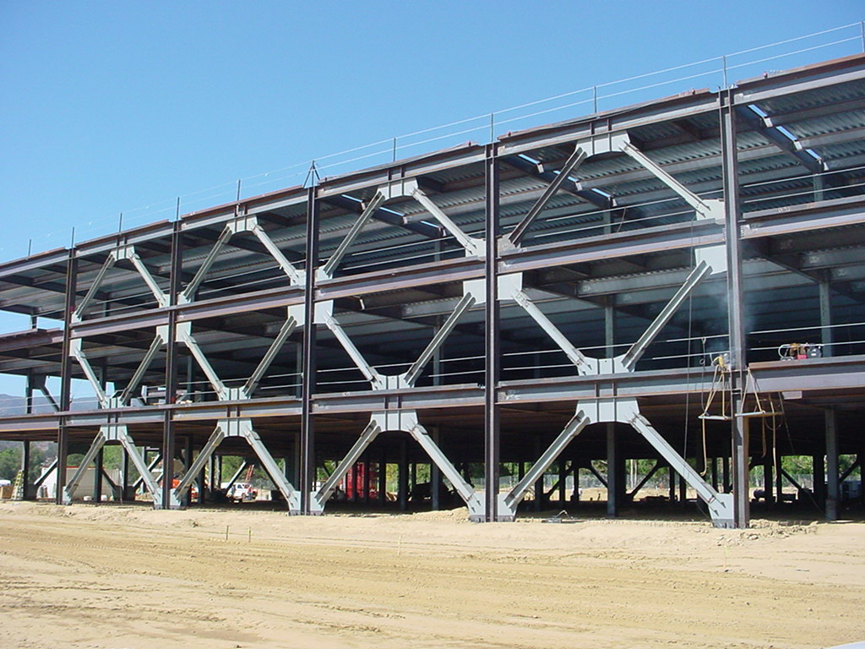
Design of Seismic-Resistant Steel Building Structures
Brief Overview
Version 3 (December 2024)
Notes:
This series of PowerPoint presentations covers the fundamentals of the design of seismic-resistant steel building structures. The primary focus of the material is on ductile detailing of steel structures for seismic resistance, rather than on calculation of lateral forces, dynamic analysis, or other general topics on earthquake engineering. The material is intended primarily for use at the graduate level, although many portions of the presentations are appropriate for undergraduates.
The presentations are closely tied to the 2022 AISC Seismic Provisions for Structural Steel Buildings (referred to herein as the AISC Seismic Provisions). The presentations discuss basic principles of the behavior of seismic response of steel structures, and show how these principles are treated in the AISC Seismic Provisions. The presentations are most effective if the students have a copy of the AISC Seismic Provisions. A free copy can be downloaded from the AISC website, at: www.aisc.org.
For basic steel design topics, the presentation refers to the 2022 AISC Specification for Structural Steel Buildings (herein referred to as the AISC Specification). Both the 2022 AISC Seismic Provisions and AISC Specification are written in the combined LRFD - ASD format. These PowerPoint presentations, however, present only the LRFD format. For seismic-resistant design, the LRFD format is preferable, in that it more closely follows the element capacity concepts used seismic design.
For code related seismic-design topics not covered in the AISC Seismic Provisions (seismic design categories, R-factors, seismic overstrength factors, etc.), the presentations refer to ASCE 7-22 - Minimum Design Loads for Buildings and Other Structures.
For questions, comments, corrections, or suggestions on these presentations, please contact:
AISC University Programs
Email: universityprograms@aisc.org
Acknowledgments:
These presentations were originally prepared by Michael D. Engelhardt (University of Texas at Austin) with support from the AISC Educator Career Enhancement Award. The author also gratefully acknowledges contributions and review provided by the AISC Task Group for this project:
Mark Bowman - Purdue University
Steve Mahin - University of California at Berkeley
Brett Manning - PMB 200
Carol Pivonka - AISC
Larry Reaveley - University of Utah
Rafael Sabelli - Dasse Design, San Francisco
Tom Sabol - Englekirk & Sabol Consulting Engineers, Los Angeles
Chia-Ming Uang - University of California at San Diego
The module on Special Plate Shear Walls was prepared by Rafael Sabelli. The contributions of Prof. Sharon Wood of the University of Texas at Austin to Module 1 are also gratefully acknowledged.
Version 2 (Updates to 2016 AISC Seismic Design Provisions):
Patricia Clayton – Wake Forest University
Larry Fahnestock – University of Illinois at Urbana-Champaign
Matthew Eatherton – Virginia Tech
Paul Richards – DuraFuse Frames

Slide 2
Design of Seismic-Resistant
Steel Building Structures: Brief Overview
Earthquake Effects on Structures
Performance of Steel Buildings in Past Earthquakes
Building Code Philosophy for Earthquake-Resistant Design and Importance of Ductility
Design Earthquake Forces: ASCE-7
Steel Seismic Load Resisting Systems
AISC Seismic Provisions
Notes:
This PowerPoint series is divided into 6 modules.

Slide 3
Design of Seismic-Resistant
Steel Building Structures: Brief Overview
Earthquake Effects on Structures
Performance of Steel Buildings in Past Earthquakes
Building Code Philosophy for Earthquake-Resistant Design and Importance of Ductility
Design Earthquake Forces: ASCE-7
Steel Seismic Load Resisting Systems
AISC Seismic Provisions
Notes:
The next series of slides discuss some basic ideas of earthquakes, and how they affect structures.
Very useful educational materials on earthquakes is available at the USGS (US Geological Survey) website: www.usgs.gov.

Slide 4

Notes:
The earth's outer layer consists of a number of plates that slide relative to one another. Movement at plate boundaries is the primary cause of earthquakes. Earthquakes can also occur within plates, although these are less common than earthquakes at plate boundaries.
Slide is courtesy of US Geological Survey. See www.usgs.gov

Slide 5
Notes:
Earthquake ground motion is generated by sudden movement at geologic faults. A fault is a fracture zone between two blocks of the earth's crust.
Faults are generally classified as normal faults, thrust faults or strike-slip faults, depending on the direction of relative motion between the two blocks of rock. Pictured here is a strike-slip fault.

Slide 6

Notes:
This is a photo of the San Andreas fault in central California.
Photo is courtesy of US Geological Survey. See www.usgs.gov.

Slide 7

Notes:
This slide illustrates the seismic hazard in different areas of the US. Note that areas of high seismic hazard include the western US, a portion of the central US (in the region surrounding New Madrid, Missouri), a portion of the southeast (in the region surrounding Charleston, South Carolina), and significant portions of Alaska and Hawaii. There is also a moderate seismic hazard in the northeastern area of the US.
Based on this map, it is clear that earthquake-resistant design of structures is important in many areas of the US.
Slide is courtesy of US Geological Survey. See www.usgs.gov

Slide 8
Notes:
When an earthquake occurs, very intense ground shaking can occur. Ground motion is often characterized in terms of ground acceleration versus time. This slide shows a measured ground acceleration record from the 1994 Northridge Earthquake in southern California.
Note that the motion is cyclic in nature; i.e. the ground shakes back and forth many times during an earthquake.

Slide 9
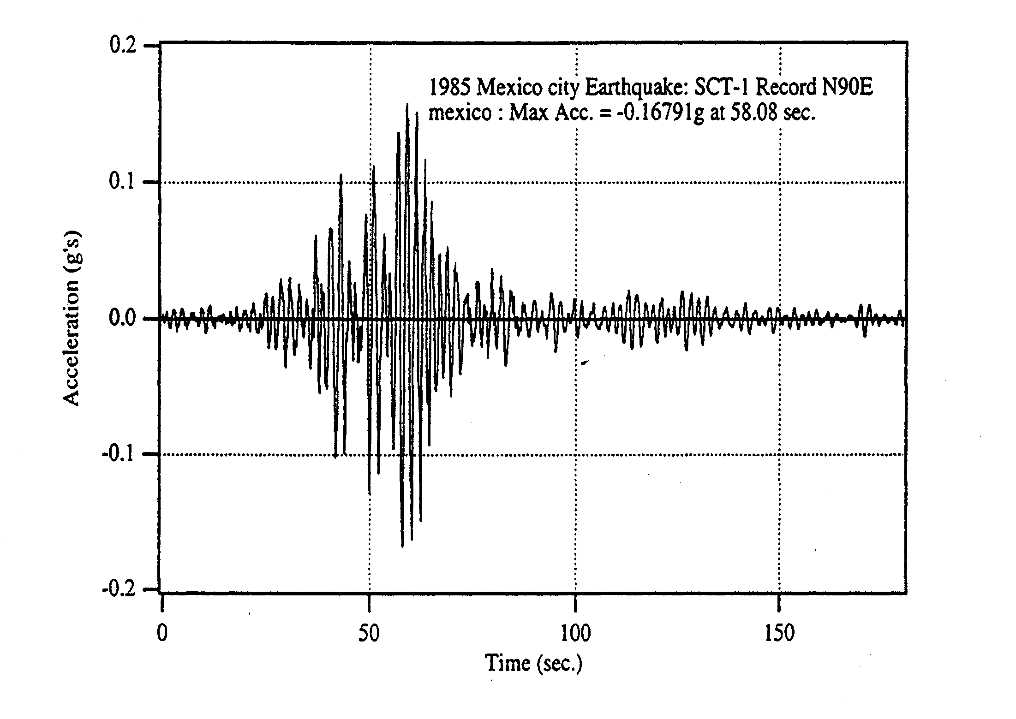
Notes:
This is another example of a recorded ground motion record. This ground acceleration record is from the 1985 Mexico City Earthquake; an earthquake that killed thousands.

Slide 10
Building Acceleration
Building:
Mass = m
Ground Acceleration
Notes:
This slide illustrates, in a very simple way, how earthquakes affect structures.
Since the structure is connected to the ground, when the ground shakes in an earthquake, the building also shakes. The ground, and therefore the building, shake in both the horizontal and vertical directions. In general, the horizontal shaking, as shown in this slide, has the most damaging effects on the structure.
As shown in the slide, the structure will experience a time varying acceleration during an earthquake. However, since structures are not rigid, the acceleration versus time history of the structure will be different than the acceleration versus time history of the ground. Some structures will amplify the ground motion, and experience much higher acceleration levels than the ground. Other structures will de-amplify the ground motion, and experience much lower acceleration levels than the ground.
If a structure is viewed as a "single degree of freedom" system, then the peak acceleration of the structure during an earthquake is referred to as "spectral acceleration."
The spectral acceleration for any given ground motion will depend on many factors, including:
- The fundamental natural period of vibration of the structure, and how close this is to the dominant period of the ground motion. Structures with a natural period of vibration that is close to the dominant period of the ground motion will experience a resonance effect, and will greatly amplify the ground acceleration. That is, such structures will experience peak accelerations much larger than the peak ground acceleration.
- Damping in the structure.
- Stiffness of the soil supporting the structure. Soil deposits can significantly alter the nature of the ground acceleration record.
- Other factors.

Slide 11
F = ma
Earthquake Forces on Buildings:
Inertia Force Due to Accelerating Mass
Notes:
As discussed in the previous slide, the structure will experience acceleration during an earthquake. When the mass of the structure "m" undergoes an acceleration "a", an inertia force F = ma is experienced by the structure. Thus, during an earthquake, the structure will experience lateral force, that is simply an inertia force.
Note that the lateral force that a structure experiences during an earthquake depends on the structure's peak acceleration (i.e. the spectral acceleration) and on its mass.
Building code formulas for earthquake loads on structures are normally expressed as a coefficient multiplied by the weight of the structure. This basic approach reflects that fact that earthquake loads are inertia forces, and are proportional to the mass (or weight) of the structure.

Slide 12
Design of Seismic-Resistant
Steel Building Structures: Brief Overview
Earthquake Effects on Structures
Performance of Steel Buildings in Past Earthquakes
Building Code Philosophy for Earthquake-Resistant Design and Importance of Ductility
Design Earthquake Forces: ASCE-7
Steel Seismic Load Resisting Systems
AISC Seismic Provisions
Notes:
The next section of this module will briefly examine the performance of steel buildings in past earthquakes.

Slide 13
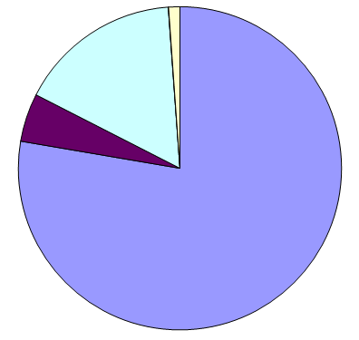
Missing
Tsunami
Landslides
Shaking
(partial or total building collapse)
Earthquake Fatalities: 1968 - 2008
1,442,342 Fatalities
(Marano et al., 2010)
Earthquake Fatalities: 1950 - 1990
583,000 Fatalities
(Coburn et al., 1992)
Causes of Earthquake Fatalities
Notes:
Performance of Steel Buildings in Past Earthquakes:
When considering the performance of steel buildings in past earthquakes, it is instructive to first look at what causes fatalities in earthquakes. This slide shows an analysis of the cause of fatalities in earthquakes in the latter half of the 20th century, and into the 21st century.
The figure on the left shows the proportions of earthquake fatalities from 1968-2008 broken down by primary causes due to shaking (e.g., partial or total building collapse) and other secondary causes.
Some observations:
The primary cause of earthquake fatalities (78%) is collapse or partial collapse of buildings. Consequently, Structural Engineers play a leading role in preventing earthquake fatalities.
Other causes of fatalities include landslides (5%), tsunamis (16%), other causes (0.03%), and those listed as missing or presumed dead (1%). Note that of the 238,385 tsunami deaths in this dataset, 227,000 (95%) were from the December 26, 2004 Great Sumatra–Andaman Islands earthquake and tsunami.
The figure on the right shows a different dataset from fatalities from 1950 to 1990, where the deaths due to shaking are broken down into different types of structural systems, such as reinforced concrete (RC) buildings, masonry buildings, and timber buildings.
Some observations:
- Among building collapses, the primary cause of fatalities is collapse of masonry buildings. These are primarily unreinforced masonry or non-engineered masonry buildings (adobe, etc.).
- When reinforced concrete and reinforced masonry structures are designed and detailed for seismic resistance per current building codes, their performance in earthquakes is very good. The data in these slides reflects masonry and RC buildings that are not well engineered for seismic resistance.
- Steel structures have historically performed well in earthquakes, and little loss of life can be attributed to collapse of steel buildings in earthquakes. This good track record can likely be attributed to several causes:
a. Steel structures are generally lighter than masonry or RC. Lower weight translates to lower seismic forces.
b. Steel structures typically show good ductility, even when they are not specifically designed or detailed for seismic resistance.
c. Many of the highly destructive earthquakes around the world have occurred in areas where there are very few steel structures. Thus, the exposure of steel structures to strong earthquakes has been perhaps somewhat less than other types of construction.
Despite showing overall good performance in past earthquakes, modern welded steel buildings have shown an increasing number of problems in recent earthquakes. The next few slides illustrate some examples.
References:
Marano, K.D., Wald, D.J., and Allen, T.I., (2010) “Global earthquake casualties due to secondary effects: a quantitative analysis for improving rapid loss analyses,” Natural Hazards, 52:319-328. DOI: 10.1007/s11069-009-9372-5.
Coburn, A.W., Spence, R.J.S. and Pomonis, A., "Factors Determining Human Casualty Levels in Earthquakes: Mortality Prediction in Building Collapse," Proceedings of the 10th World Conference on Earthquake Engineering, Madrid, Spain, 1992

Slide 14
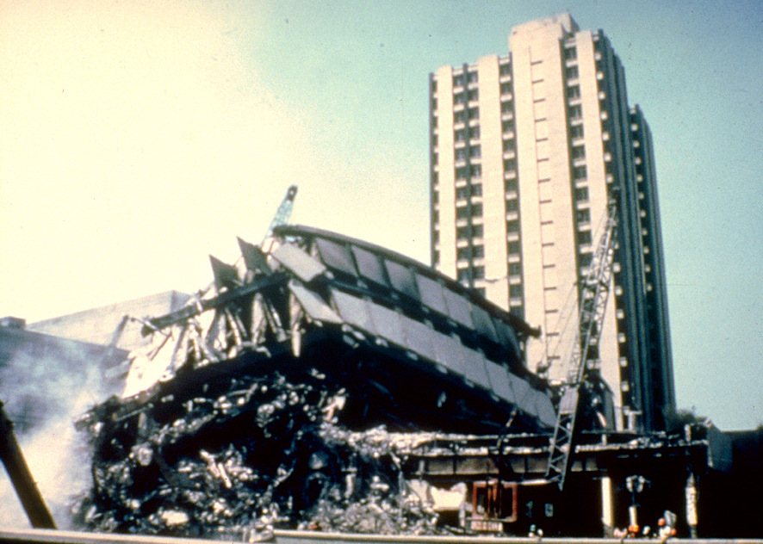
Notes:
1985 Mexico City Earthquake.
The Pino Suarez Complex in Mexico City consisted of 5 steel buildings: three 21-story buildings and two 14-story buildings. One of the 21-story steel buildings completed collapsed on the adjacent 14-story building.
This case illustrates that modern steel buildings are not invulnerable to collapse in earthquakes.
Photo source:
National Geophysical Data Center - Hazard Slides http://www.ngdc.noaa.gov/seg/hazard/slideset/
Original photo credit: E.V. Leyendecker, National Bureau of Standards

Slide 15
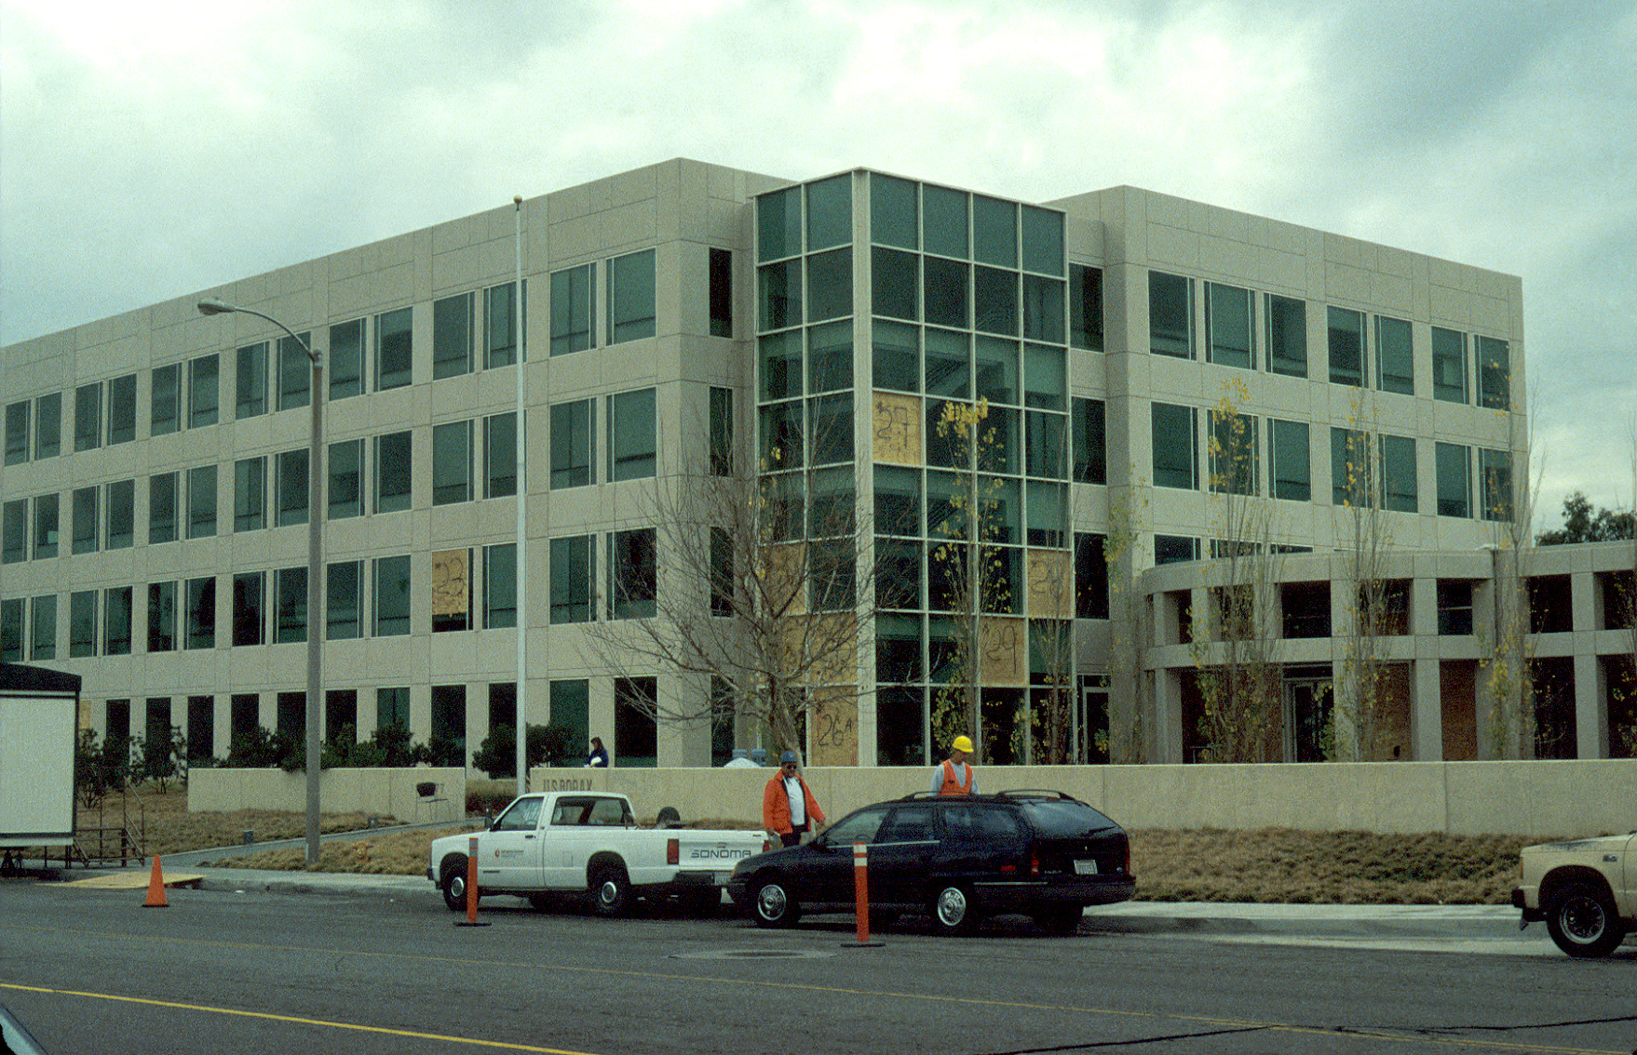
Notes:
1994 Northridge Earthquake.
The January 17, 1994 earthquake caused widespread damage to steel moment frame structures in the Los Angeles area. While no steel buildings collapsed, many modern steel buildings exhibited unexpected damage. The unexpected damage was the widespread occurrence of fractures at moment-resisting beam-to-column connections.
The design intent for a seismic-resistant steel moment frame is that in the event of a strong earthquake, ductile flexural yielding develop at the beam ends without the occurrence of fracture at the connections. The fractures observed after the Northridge Earthquake was clearly contrary to the design intent of a ductile moment frame.
Shown above is a four-story steel office building that was constructed shortly before the Northridge Earthquake. Although there was little damage apparent from the outside, the majority of beam-to-column moment connections in this building experienced fracture.
Photo by M.D. Engelhardt

Slide 16
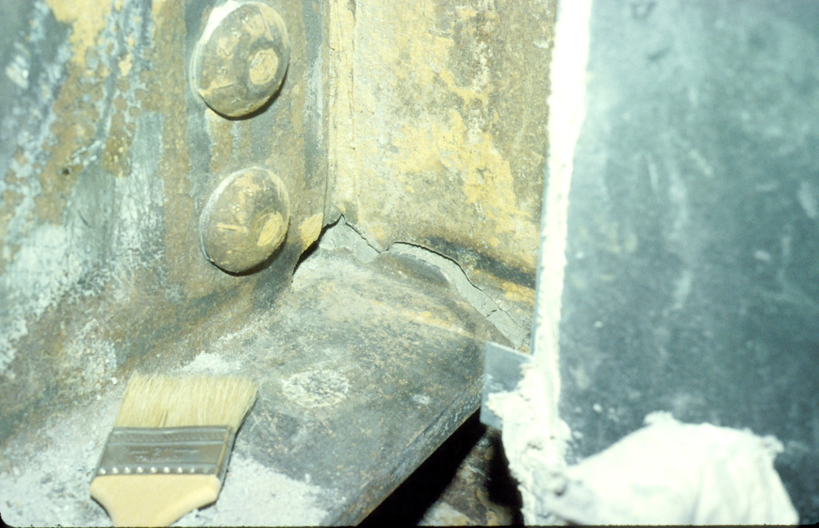
Notes:
1994 Northridge Earthquake
Typical example of a fracture at a moment connection. The paint brush is sitting on top of the bottom flange of a moment frame beam. The fracture is in the area of the groove weld that connects the beam bottom flange to the column flange.
Photo by: M.D. Engelhardt

Slide 17
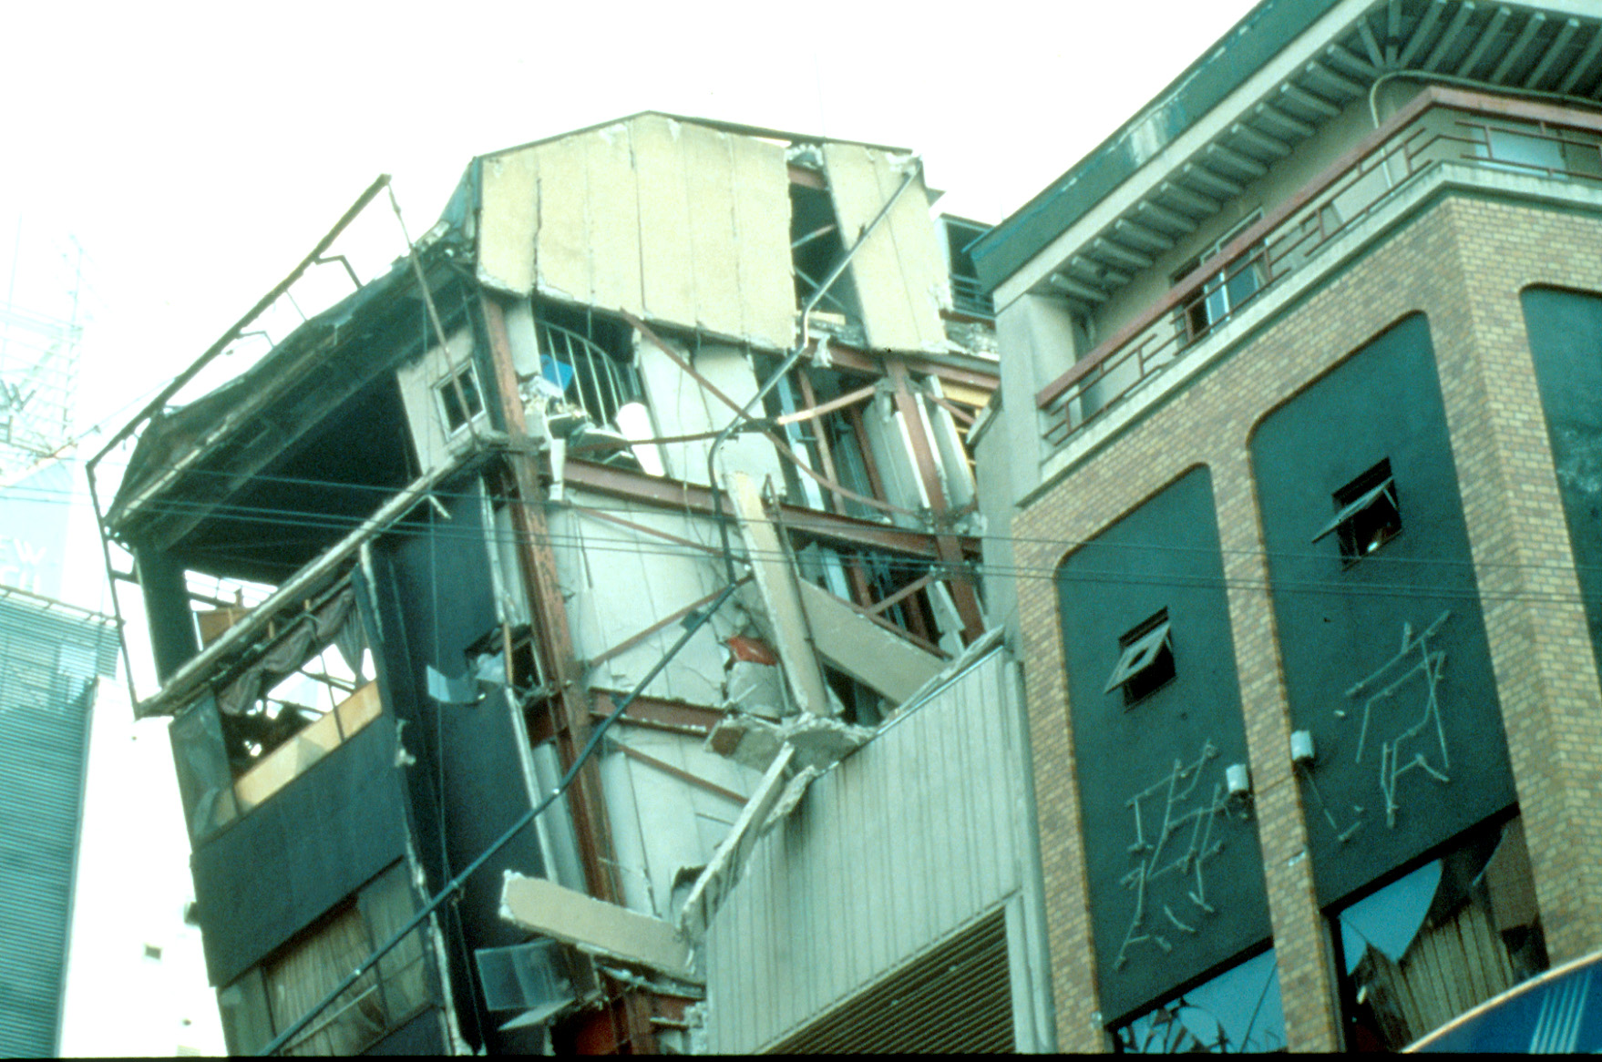
Notes:
1995 Hyogoken-Nanbu (Kobe) Earthquake.
The January 17, 1995 Hyogoken-Nanbu Earthquake caused large loss of life (about 6000 fatalities) and extensive damage and collapse of many engineered structures.
Many steel buildings were heavily damaged in this earthquake, and approximately 90 steel buildings collapsed. This slide shows a heavily damage steel building.
The steel buildings that were most heavily damaged and those that collapsed were constructed before Japan's current seismic design code was adopted in 1981. Modern steel buildings constructed after 1981 showed much better performance (showing that buildings codes can make an important difference).
Nonetheless, even very modern steel buildings showed unexpected damage in the 1995 Hyogoken-Nanbu. This included the discovery of fractures at welded beam-to-column connections in moment frames, similar to the US experience in the 1994 Northridge Earthquake.
References:
Nakashima, M., Inoue, K., and Tada, M., "Classification of Damage to Steel Buildings Observed in the 1995 Hyogoken-Nanbu Earthquake," Engineering Structures , Vol 20, No 4-6, Apr-June 1998, p 271-281
"Reconnaissance Report on Damage to Steel Building Structures Observed from the 1995 Hyogoken-Nanbu (Hanshin/Awaji) Earthquake," by the Steel Committee of the Kinki Branch, Architectural Institute of Japan (AIJ), May 1995.
"Preliminary Reconnaissance Report of the 1995 Hyogoken-Nanbu Earthquake - English Edition," Architectural Institute of Japan, April 1995.
"A Survey Report for Building Damages Due to the 1995 Hyogoken Nanbu Earthquake," Published by the Building Research Institute, Ministry of Construction, Japan, March 1996.
Photo credit: "A Survey Report for Building Damages Due to the 1995 Hyogoken Nanbu Earthquake," Published by the Building Research Institute, Ministry of Construction, Japan, March 1996.

Slide 18
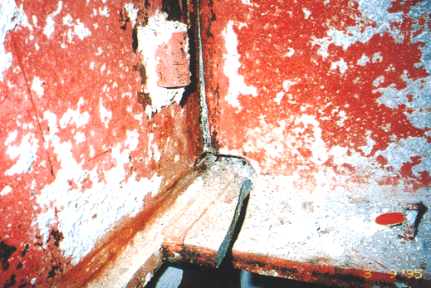
Notes:
1995 Hyogoken-Nanbu (Kobe) Earthquake.
Fracture at welded beam-to-column connection in steel moment frame.
Photo credit: "Reconnaissance Report on Damage to Steel Building Structures Observed from the 1995 Hyogoken-Nanbu (Hanshin/Awaji) Earthquake," by the Steel Committee of the Kinki Branch, Architectural Institute of Japan (AIJ), May 1995.

Slide 19
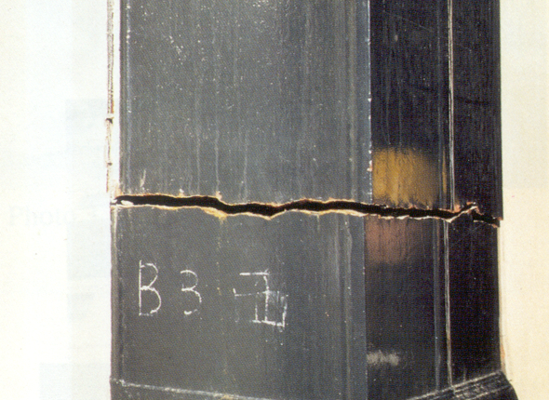
Notes:
1995 Hyogoken-Nanbu (Kobe) Earthquake.
Fracture of steel box column in modern steel high rise building.
Photo credit: "Preliminary Reconnaissance Report of the 1995 Hyogoken-Nanbu Earthquake - English Edition," Architectural Institute of Japan, April 1995.
While the performance of steel buildings in earthquakes has historically been quite good, recent earthquakes (1985 Mexico City; 1994 Northridge; 1995 Hyogoken-Nanbu) have exposed problems with modern welded steel structures, particularly in regard to our understanding of fracture phenomena.
Further, it is clear that care in the design, detailing, and construction of steel structures is needed to assure satisfactory performance in strong earthquakes. This has led to the development of building code regulations that specifically address seismic detailing of steel building structures. The development of seismic detailing regulations in the US is discussed next.

Slide 20
Design of Seismic-Resistant
Steel Building Structures: Brief Overview
Earthquake Effects on Structures
Performance of Steel Buildings in Past Earthquakes
Building Code Philosophy for Earthquake-Resistant Design and Importance of Ductility
Design Earthquake Forces: ASCE-7
Steel Seismic Load Resisting Systems
AISC Seismic Provisions
Notes:
The next section of this module will briefly examine the basic design philosophy of building codes with respect to earthquake-resistant design of buildings, and also discusses the important role of ductility in earthquake-resistant design.

Slide 21
Conventional Building Code Philosophy for Earthquake-Resistant Design
Objective:
Prevent collapse in the extreme earthquake likely to
occur at a building site.
Objectives are not to:
    limit damage
    maintain function
    provide for easy repair
Notes:
Before going further, it is instructive to review the basic philosophy of building codes for seismic design of ordinary structures. The basic intent is to prevent collapse of a structure in the event of an extreme earthquake, in order to prevent loss of life.
More specifically, the performance goal of current codes for most ordinary structures is to produce an acceptably low likelihood of collapse in the risk-adjusted maximum considered earthquake (MCE_{R}), which is based on the maximum considered earthquake (MCE). In most of the western US, the MCE is based on the largest earthquake that can be generated by known faults. In the rest of the US, the MCE is defined as an earthquake with a 2-percent probability of exceedance in 50 years (which translates to a recurrence interval of about 2500 years). The “risk-adjusted” MCE_{R} was introduced in building codes in 2010 to target a uniform collapse probability of 1% likelihood of collapse in 50 years. The MCE_{R} ground shaking values used in modern building codes are similar to the MCE shaking levels previously used, with some minor reduction in the central and eastern US, and some slight increases in the western US.
More information on the risk-adjusted MCE values used in design can be found in:
Luco, N., Ellingwood, B.R., Hamburger, R.O., Hooper, J.H., Kimball, J.K., Kircher, C.A. (2007) “Risk-targeted versus Current Seismic Design Maps for the Conterminous United States,” Structural Engineers Association of California (SEAOC) 2007 Convention Proceedings.
In the event of the MCE, the objective is to prevent collapse in order to prevent loss of life. The objectives are not to limit damage to the building, maintain the function of the building, or to provide for easy repair of the building. Thus, the primary goal is to protect lives, not property.
If a code-compliant building sees a very strong earthquake, one would expect substantial and costly damage to the structure. If a higher level of performance is desired, then it is necessary to go beyond a basic code design.
A useful analogy is as follows......
We design buildings for extreme (but rare) events like strong earthquakes like a car manufactures designs a vehicle for an extreme event like a head-on collision. In the event of a major collision, the design goal is to protect the occupants of the car; not to protect the car itself. In fact, for a major collision, the car is used in a sacrificial manner to absorb the energy of the impact, thereby protecting the occupants. In a similar way, in the event of a major earthquake, a building is used in a sacrificial manner to absorb the energy of the earthquake, in order to prevent collapse and protect the occupants.
If we designed cars to withstand a head-on collision without damage to the car, probably most of us could not afford to buy a car. Similarly, if we designed buildings to withstand an extreme earthquake without damage, we couldn't afford to construct most buildings.
Additional comment.....
This slide discusses building code philosophy for seismic resistant design from a highly simplified perspective. A more comprehensive view of seismic design philosophy is considered under the broad field of "performance-based" earthquake engineering. See, for example:
"Vision 2000 - Performance Based Seismic Engineering of Buildings," Final Report, Structural Engineers Association of California, April 3, 2005.
“FEMA P-58: Seismic Performance Assessment of Buildings,” Federal Emergency Management Agency (FEMA), December 2018.

Slide 22
To Survive Strong Earthquake without Collapse:
Design for Ductile Behavior
Notes:
In order to economically design a building to withstand a very strong earthquake, the key is not provide to a building with high strength, but rather to provide a building with high ductility.
Ductility is the key to building survival in strong earthquakes. The key objective of the AISC Seismic Provisions is to provide steel building structures with high ductility.

Slide 23
H
Ductility = Inelastic Deformation
H
Notes:
This slide reviews the basic concept of ductility.
Ductility is the ability of a structure (or element of a structure) to withstand large inelastic deformations without significant loss of strength.
Ductility = inelastic deformation capacity

Slide 24
H
H
Δ_{yield}
Δ_{failure}
Δ_{failure}
Ductility Factor μ =
Δ_{yield}
Notes:
For a simple, elastic - perfectly plastic structure subject to monotonic loading, ductility can be quantified using the ductility factor, μ. In the definition of μ, Δ_{yield} is the displacement when the structure yields (i.e. when the structure has reached its plastic lateral capacity), and Δ_{failure} is the displacement at which the structures begins to lose lateral load carrying capacity.

Slide 25
H
H
H_{elastic}
3/4 *H_{elastic}
1/2 *H_{elastic}
Strength
Req’d Ductility
1/4 *H_{elastic}
MAX
Notes:
A basic concept of seismic-resistant design is the trade-off between strength and ductility. This concept is illustrated (in a highly simplified manner) by this slide.
The plot shows the relationship between lateral force and lateral displacement for a simple single-degree-of-freedom structure, with an elastic-perfectly plastic response. The plot can be viewed as the force-displacement response of the structure for a half-cycle of loading during an earthquake.
The solid line represents the response of a structure that remains elastic during the earthquake. The maximum lateral force experienced by the elastic structure is H_{elastic} and the maximum displacement experienced by the structure is Δ_{max.} Thus, if we wanted the structure to remain elastic during the earthquake, we would need to design our structure to remain elastic under a lateral load equal to H_{elastic}.
Say we designed the structure to have a lateral strength of only 3/4*H_{elastic}. If the structure sees the same earthquake as above (which will generate a force of H_{elastic} in an elastic structure), the structure will yield when the lateral force reaches 3/4*H_{elastic}. At this point, the lateral force on the structure can no longer increase. Rather, the effect of the earthquake on the structure beyond this point will be to impose inelastic displacement. That is, the earthquake will demand ductility of the structure rather than strength. The earthquake will continue to deform the structure in the inelastic range until the total displacement is about the same as for the elastic structure. Thus, a structure with a lateral strength less than H_{elastic} can still survive the earthquake, as long as the structure can supply the needed inelastic deformation. i.e., can supply the needed ductility.
Similarly, we can design our structure with even lower levels of lateral strength, say 1/2 or 1/4 of the lateral force that an elastic structure would see. In each case, when the lateral strength of the structure ( 1/2*H_{elastic} or 1/4*H_{elastic} ) is reached, the structure will be incapable of resisting any additional lateral force. As before, the effect of the earthquake beyond this point will be to impose additional displacement upon the structure, rather than additional force. In each case, the maximum displacement will be about same as for the structure that remains elastic. That is, regardless of the structure's lateral strength, Δ_{max} will be approximately the same.
Some observations on seismic response......
A structure can be designed with a lateral strength significantly less than that which will be seen by an elastic structure in an earthquake. However, to survive the earthquake without collapse, the structure must supply ductility. In the plot, ductility (inelastic deformation capacity) is represented by the horizontal dotted lines).
As illustrated by the plot, the lower the lateral strength of the structure, the greater will be the required ductility. Thus, in seismic design, we can trade strength for ductility. We can give our structure a high lateral strength, in which case we need to provide little ductility. Alternatively, we can give our structure very low lateral strength (by designing for very low lateral forces), but then we must detail our structure to supply high levels of ductility. Building codes permit us (within a limited extent) to make this trade off between strength and ductility.
Ductility means damage. That is, when we use ductility to survive an earthquake, we have to expect damage.
For a structure that is designed to yield in an earthquake (the usual case), the maximum lateral force that the structure will see during the earthquake is defined by the structure's own lateral strength.
Code specified seismic lateral forces are generally much smaller than would be required for the structure to remain elastic. That is, they are usually much less than H_{elastic}. Thus, a typical code based design uses ductility to survive an earthquake. In this sense, the code specified seismic lateral forces do not represent the actual lateral force that an earthquake would generate in an elastic structure. Thus, in cases where code specified wind forces are greater than code specified earthquake forces, it is still necessary to provide ductility. Even though the lateral strength of the structure will be larger as a result of the fact that "wind controls," the resulting lateral strength of the structure is still likely well below H_{elastic}, and therefore ductility will be needed. Thus, even when code specified wind forces are larger than code specified earthquake forces, ductile detailing requirements in building codes must still be satisfied.
Note: The concept that Δ_{max} remains the same, regardless of the lateral strength of the structure, and regardless of whether the structure responds elastically or inelastically, is a simplification. It is a useful simplification to understand the basic concept of trading strength for ductility in seismic design.
More extensive discussions of the relationship between strength and ductility demand can be found in the literature. A useful reference is: "The Seismic Design Handbook," Edited by Farzad Naeim, 2nd Edition, Kluwer Academic Publishers, 2001.

Slide 26
Ductility in Steel Structures: Yielding
Nonductile Failure Modes: Fracture or Instability
H
Ductility = Yielding
Failure =
Fracture
or
Instability
Notes:
As discussed in the previous slides, detailing structures to supply ductility is a basic objective in seismic resistant design.
In the case of steel structures, ductility is usually achieved by yielding of selected elements of the frame. Yielding of steel is a ductile phenomenon. That is, when steel yields, it can maintain it's yield strength through large inelastic deformations.
Thus, to obtain a ductile global response of a steel structure (i.e. to make the plateau in the load-deflection curve above as long as possible), we want to obtain as much yielding as possible, before non-ductile limit states occur.
For steel structures, non-ductile limits states are associated with fracture or instability. These are the limit states that will cause a steel element or structure to lose load carrying capacity.
Note that yielding will not cause a steel structure to collapse. Yielding will only cause a plateau in the load-deformation curve. For the load capacity to decline, fracture or instability must occur.
Thus, a goal in seismic resistant design is to permit as much yielding to occur in the frame as possible, while preventing or delaying fracture or instability limit states until sufficient ductility is achieved.

Slide 27
Developing Ductile Behavior
Choose frame elements (“fuses”) that will yield in an earthquake (e.g. beams in moment resisting frames, braces in concentrically braced frames, links in eccentrically braced frames, etc.)
Detail "fuses" to sustain large inelastic deformations prior to the onset of fracture or instability (i.e. detail fuses for ductility).
Design all other frame elements to be stronger than the fuses, (i.e. design all other frame elements to develop the plastic capacity of the fuses).
Notes:
Ductile response of a steel frame is achieved by yielding of steel. Nonductile response of steel systems is the result of fracture or instability. Consequently, a key design objective is to maximize the yielding of steel frame elements, while at the same time delaying the onset of fracture or instability until large inelastic deformations are achieved. To achieve this objective, it is first necessary to choose the frame locations where yielding is intended to occur, i.e., the locations of plastic hinges. This is typically the beam ends in moment resisting frames, links in eccentrically braced frames, and the braces in braced frames.
It is possible to control the location of yielding in a steel frame by assuring that the element where the yielding is intended to occur is the weakest element in the frame. Conversely, this can be achieved by assuring that all other frame elements (i.e. elements where inelastic action should not occur) are stronger, through the application of capacity design concepts. With this approach, the element in which yielding is intended to occur is designed based on code specified lateral forces. All other frame elements are then designed to develop the capacity of the yielding element. For example, in a steel moment frame, the beams are typically the frame element intended to yield during an earthquake. Thus, the beams are sized based on code level forces. However, the beam-to-column connections and the columns are designed for the maximum forces that can be generated by the fully yielded and strain hardened beams. That is, the beam-to-column connections and the columns are designed to develop the capacity of the beams. This design approach assures that the desired mechanism, i.e., a mechanism with yielding in the beams, will actually form.
The concept of capacity design can also be understood through an analogy to electrical wiring in a building. Electrical wiring is protected by a fuse, so that in case of an electrical overload, the fuse burns out before the wiring is damaged, thereby protecting the wiring. This protection can only be achieved if the fuse is weaker than the wiring. In a seismic-resistant steel frame, the plastic hinge locations serve as a fuse to protect against overload. In an earthquake, the plastic hinge “fuses” (beams in moment frames, links in EBFs, etc.) limit the forces that can be transferred to the remainder of the frame, thereby protecting the remainder of the frame. However, this can only be achieved if the plastic hinge locations are the weakest elements of the frame, to assure ductile yielding occurs in the beam ends, before say fracture of a connection or buckling of a column.
The fundamental goal of the designer is to understand and control the inelastic response of a steel frame, to permit the development of a plastic mechanism under lateral load that is capable of sustaining large inelastic deformations, i.e., possessing large ductility. Effective seismic-resistant design requires an understanding of inelastic frame behavior. To this end, an understanding of classical methods of plastic analysis and design is highly beneficial.

Slide 28
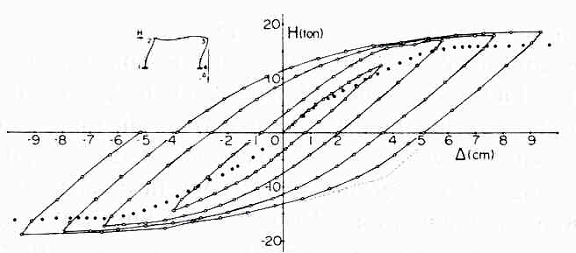
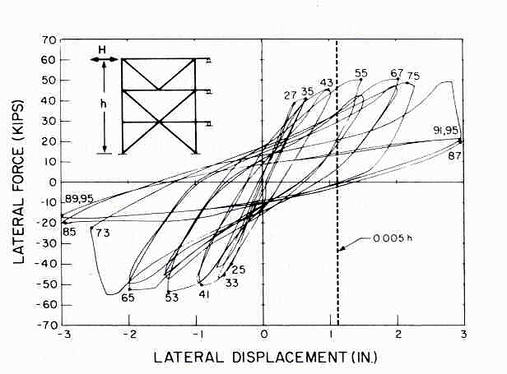
(a)
(b)
Examples of:
  More Ductile Behavior
  Less Ductile Behavior
Notes:
The degree to which lateral design forces can be reduced (from the level required to remain elastic) depends on the ductility of the structure. As described earlier, for a simple elastic perfectly plastic structure, ductility can be characterized by the ductility factor μ. The response of real steel frames under cyclic lateral load is more complex than an elastic perfectly plastic system. Consequently, it is more difficult to quantify the ductility of real frames.
The difficulty in quantifying ductility is illustrated by the experimental lateral load versus lateral deflection plots for a concentrically braced frame (on the right) and a moment resisting frame (on the left). It is difficult to quantify the ductility of these frames using a simple parameter such as ductility factor. Thus, we often treat ductility in a qualitative and comparative manner. For example, the moment frame is considered to be "more ductile" than the braced frame, due to its fuller "hysteretic loops." The braced frame exhibits deterioration in strength and stiffness, and shows "pinching" in the hysteretic loops (indicating less energy dissipation).

Slide 29
Design of Seismic-Resistant
Steel Building Structures: Brief Overview
Earthquake Effects on Structures
Performance of Steel Buildings in Past Earthquakes
Building Code Philosophy for Earthquake-Resistant Design and Importance of Ductility
Design Earthquake Forces: ASCE-7
Steel Seismic Load Resisting Systems
AISC Seismic Provisions
Notes:
The following slides provide a brief look at the base shear equation for computing seismic lateral loads in ASCE-7.
Computing design earthquake loads on structures is a complex and involved topic. The purpose of these slides is to simply to illustrate a few basic ideas:
- Lateral loads are proportional to building weight (reflecting that earthquake loads are inertia forces)
- Lateral loads are dependent on dynamic properties of the structure - the structure's fundamental natural period of vibration
- Lateral loads can be reduced based on ductility; and this reduction is system dependent. This reflects the ability to trade strength for ductility.

Slide 30
Design EQ Loads – Base Shear per ASCE 7-22
V = seismic base shear
W = effective seismic weight of building
C_{S} = seismic response coefficient
V
Notes:
In ASCE-7, the seismic base shear is taken as a fraction of the weight of the building. Over a broad range of building types and locations, the value of C_{S} might be in the range of about 0.05 to 0.5. That is, the design lateral earthquake force might be in the range of 5-percent to 50-percent of the building weight. Typical values for steel building systems in areas of high seismic hazard might be 10-percent to 25-percent of the weight of the building.
The seismic base shear, V, is distributed over the height of the building, with a portion of V assigned to each floor level. Specific rules are provided by ASCE-7. In general, V is distributed according to weight of each floor level and the height.

Slide 31
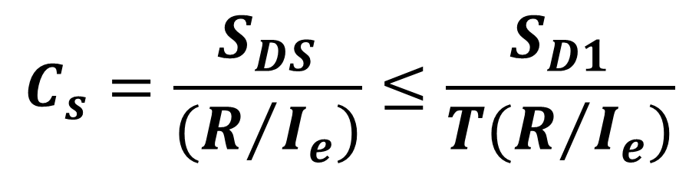

Design EQ Loads – Base Shear per ASCE 7-22
$$V= C_{s}W$$
$$C_{s}=\frac{S_{DS}}{(R/{I_{e}})}≤\frac{S_{D1}}{T(R/{I_{e}})}$$
for T ≤ T_{L}
S_{DS} = design spectral acceleration at short periods
I_{e} = importance factor
T = fundamental period of building
S_{D1} = design spectral acceleration at 1-second period
T_{L} = long period transition period
R = response modification coefficient
Notes:
This slide provides the equations for computing design lateral earthquake forces, using the "equivalent lateral force" procedure. Terms are defined in the slide. See ASCE-7 for further details.
In the equations above, if the factor R is removed (or R is taken as 1.0), what remains is an estimate of the lateral force a structure would experience in a design level earthquake, if the structure remains elastic. (This is what we called H_{elastic} in previous slides).
The factor R is called the "response modification coefficient." This factor allows the design seismic lateral load to be reduced, from that required to keep the structure elastic.
It is through the R factor that codes make the trade off between strength and ductility. For structures that are detailed to provide high levels of ductility, large R factors are permitted; up to 8. That is, structures that can provide high levels of ductility can be designed for very low lateral forces. For structures with less ductility, smaller values of R are used. That is, structures with lower levels of ductility must be designed for larger lateral forces.

Slide 32
R factors for Selected Steel Systems (ASCE 7):
SMF (Special Moment Resisting Frames): R = 8
IMF (Intermediate Moment Resisting Frames): R = 4.5
OMF (Ordinary Moment Resisting Frames): R = 3.5
EBF (Eccentrically Braced Frames): R = 8
SCBF (Special Concentrically Braced Frames): R = 6
OCBF (Ordinary Concentrically Braced Frames): R = 3.25
BRBF (Buckling Restrained Braced Frame): R = 8
SPSW (Special Plate Shear Walls): R = 7
CC-PSW/CF (Coupled Composite Plate Shear Walls – Conc. Filled): R = 8
Undetailed Steel Systems in
Seismic Design Categories A, B or C R = 3
(AISC Seismic Provisions not needed)
Notes:
R factors are given in ASCE 7. Shown in this slide are R factors for the major types of steel lateral force resisting systems. Larger R factors imply systems that can supply larger levels of ductility.
Major type of steel seismic lateral force resisting systems:
Moment Frames (Special, Intermediate, and Ordinary)
Concentrically Braced Frames (Special and Ordinary)
Eccentrically Braced Frames
Buckling Restrained Braced Frames
Special Plate Shear Walls
Composite Plate Shear Walls (i.e. SpeedCore)
Where the descriptors "Special," "Intermediate," and "Ordinary" are used, these refer to different detailing options for a particular system. "Special" systems (Special Moment Frames and Special Concentrically Braced Frames) provide the highest levels of ductility, and are accordingly assigned larger R factors. They also have the most demanding ductile detailing requirements.
"Ordinary" systems (Ordinary Moment Frames and Ordinary Concentrically Braced Frames) provide lower levels of ductility and are therefore assigned lower R factors (i.e. must be designed for higher lateral forces). The "Ordinary" systems, however, have less onerous ductile detailing requirements.
"Intermediate" systems (Intermediate Moment Frames) are in between Special and Ordinary systems in terms of ductility and design lateral forces.
Eccentrically Braced Frames and Buckling Restrained Braced Frames are assigned R=8. Coupled Composite Plate Shear Walls – Concrete Filled are also assigned R = 8.
The system names shown in this slide (SMF, EBF, BRBF, etc.) are the manner in which the requirements of ASCE 7 are coordinated with the AISC Seismic Provisions. For example, if a designer chooses to use a Special Moment Frame as the seismic lateral force resisting system, ASCE 7 specifies the R factor and the design seismic lateral force. The designer must then go to the AISC Seismic Provisions and follow all detailing requirements for Special Moment Frames.
Not all systems shown above can be used in every case. For example, in the higher Seismic Design Categories (buildings with higher seismic risk), ASCE 7 limits the use of the lower ductility systems to buildings with specified heights limits.
For steel buildings in Seismic Design Categories A, B, or C (buildings with lower seismic risk), ASCE 7 provides designers with the option of using R=3 to compute the design seismic lateral force, but then providing no special seismic detailing. In this case, the designer must use a relatively large lateral force, but need not follow the requirements of the AISC Seismic Provisions. The structure can be designed just using the main AISC Specification.
The R=3 option is a very useful alternative in lower seismic areas. This availability of this option reflects the view that a steel structure, even without special seismic detailing, will generally exhibit some reasonable degree of ductility.

Slide 33
Design of Seismic-Resistant
Steel Building Structures: Brief Overview
Earthquake Effects on Structures
Performance of Steel Buildings in Past Earthquakes
Building Code Philosophy for Earthquake-Resistant Design and Importance of Ductility
Design Earthquake Forces: ASCE-7
Steel Seismic Load Resisting Systems
AISC Seismic Provisions
Notes:
The following section of this module illustrates the basic types of seismic load resisting systems that can be used in structural steel buildings.

Slide 34
Seismic Force Resisting Systems
for Steel Buildings
Moment Resisting Frames
Concentrically Braced Frames
Eccentrically Braced Frames
Buckling Restrained Braced Frames
Special Plate Shear Walls
Notes:
These are the five basic types of structural steel seismic force resisting systems. In the following slides, each system will be briefly described. Items that are discussed for each system is the basic mechanism for resisting lateral forces (frame action, truss action, etc), the elements of the frame that are intended to yield in an earthquake, i.e. the "fuse" elements.

Slide 35
Moment Resisting Frame (MRF)
Beams and columns with moment resisting connections; resist lateral forces by flexure and shear in beams and columns - i.e. by frame action.
Develop ductility primarily by flexural yielding of the beams:
  Advantages
    Architectural Versatility
    High Ductility and Safety
  Disadvantages
    Low Elastic Stiffness
Notes:
Basic concepts of MRFs:
- and MRF is a rigid frame - beams rigidly attached to columns with moment resisting connections;
- resist lateral force by rigid frame action;
- dominant forces developed in frame members: flexure and shear;
- ductility in MRFS is normally achieved by flexural yielding at the ends of the beams.

Slide 36
Moment Resisting Frame (MRF)
Notes:
A simple MRF - rectangular arrangement of columns and beams - with beams attached to columns with moment resisting connections.

Slide 37
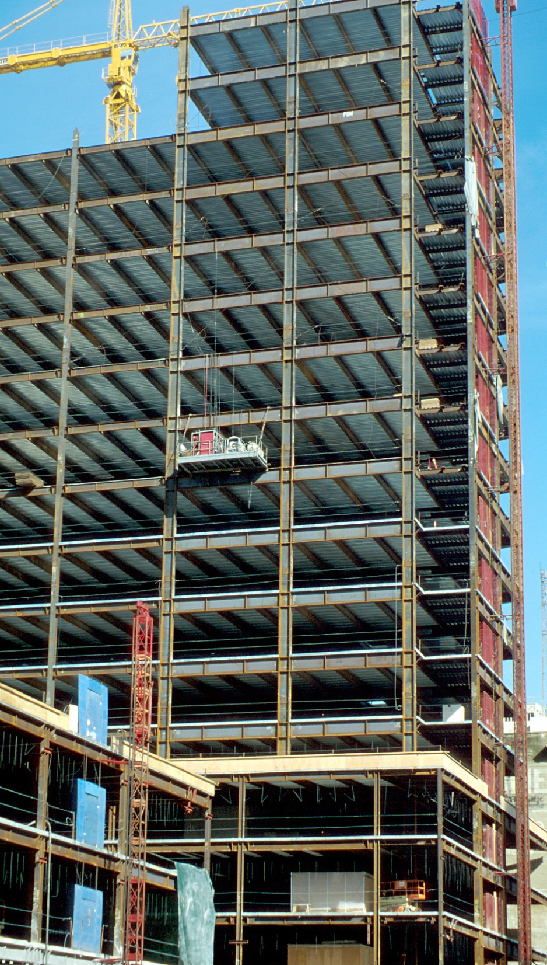
Notes:
An example of a steel MRF under construction in Oakland, California. Note that the MRFs are the two frames on the right (observe the deeper columns and beams in the MRFs).

Slide 38
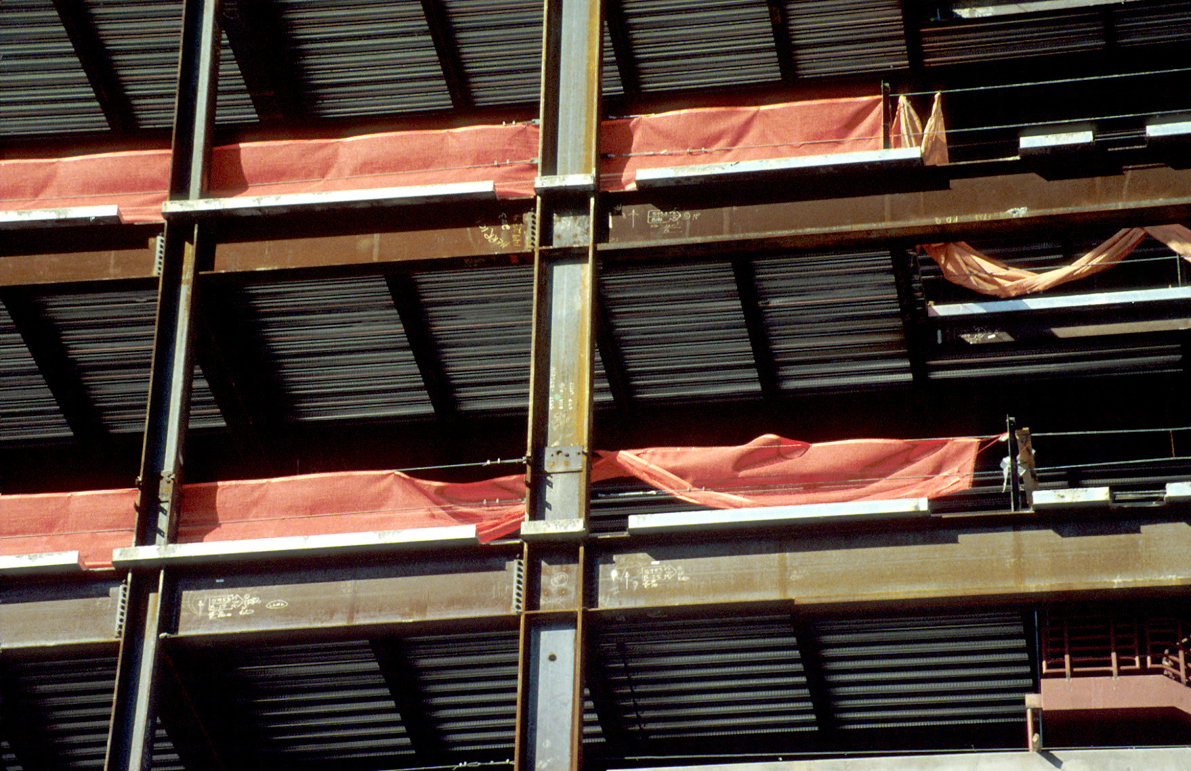
Notes:
A closer view of an MRF.

Slide 39
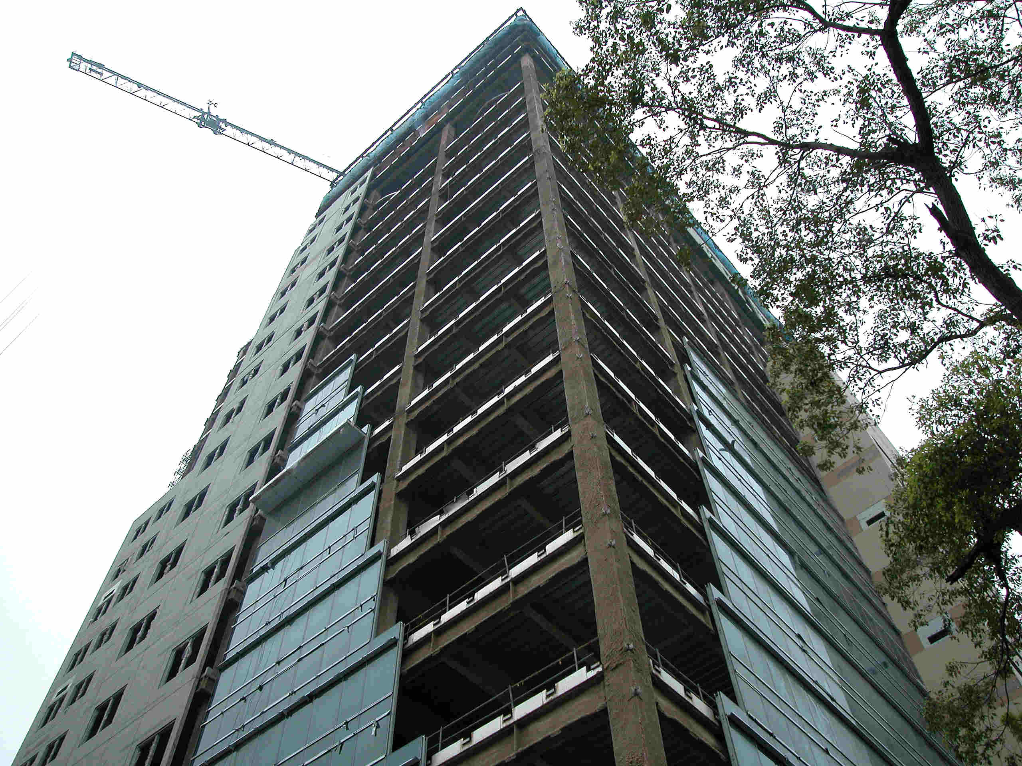
Notes:
An steel building under construction in Taipei, Taiwan. Perimeter frames are moment resisting. Columns are steel box columns.

Slide 40
Inelastic Response of a Steel Moment Resisting Frame
Notes:
Yielding in a moment resisting frame during an earthquake is generally intended to occur primarily at the beam ends. "Plastic hinges" will form at the beam ends, and the inelastic frame response is dominated by flexural yielding at the beam ends.

Slide 41
Concentrically Braced Frames (CBFs)
Beams, columns and braces arranged to form a vertical truss. Resist lateral earthquake forces by truss action.
Develop ductility through inelastic action in braces.
  braces yield in tension
  braces buckle in compression
Advantages
high elastic stiffness
Disadvantages
less ductile than other systems (SMFs, EBFs, BRBFs)
reduced architectural versatility
Notes:
A concentrically braced frame (CBF) can be viewed as a vertical truss. In the elastic range of behavior, a concentrically braced frame resists lateral earthquake forces by truss action. That is, in the elastic range, axial forces are the dominant type of force in the members.
A CBF develops ductility through inelastic action in the braces: yielding in tension and buckling in compression. Thus, the braces are the "fuses" in a CBF. The beams and columns are intended to remain essentially elastic.
CBFs offer the advantage of high elastic stiffness, thereby permitting code specified drift limits to be satisfied with relatively light members, especially compared to moment frames.
A disadvantage of CBFs is that this system is viewed as being less ductile than most other steel seismic load resisting systems, and is therefore assigned lower R factors.
An additional disadvantage of a CBF is that the bracing may block openings in the frame, resulting reduced architectural versatility.

Slide 42
Types of CBFs
Single Diagonal
Inverted V- Bracing
V- Bracing
X- Bracing
Two Story X- Bracing
Notes:
A variety of different bracing arrangements are possible for CBFs. This slide illustrates several common types of CBFs.

Slide 43
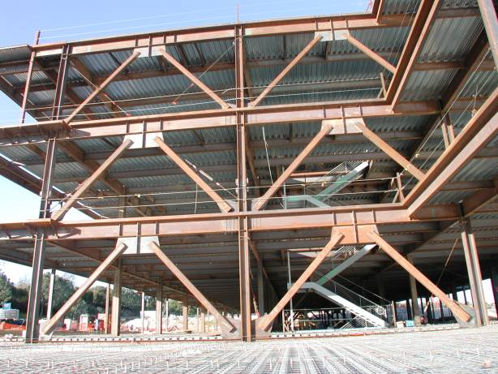
Notes:
Inverted V-bracing.
Slide courtesy of C.M. Uang

Slide 44
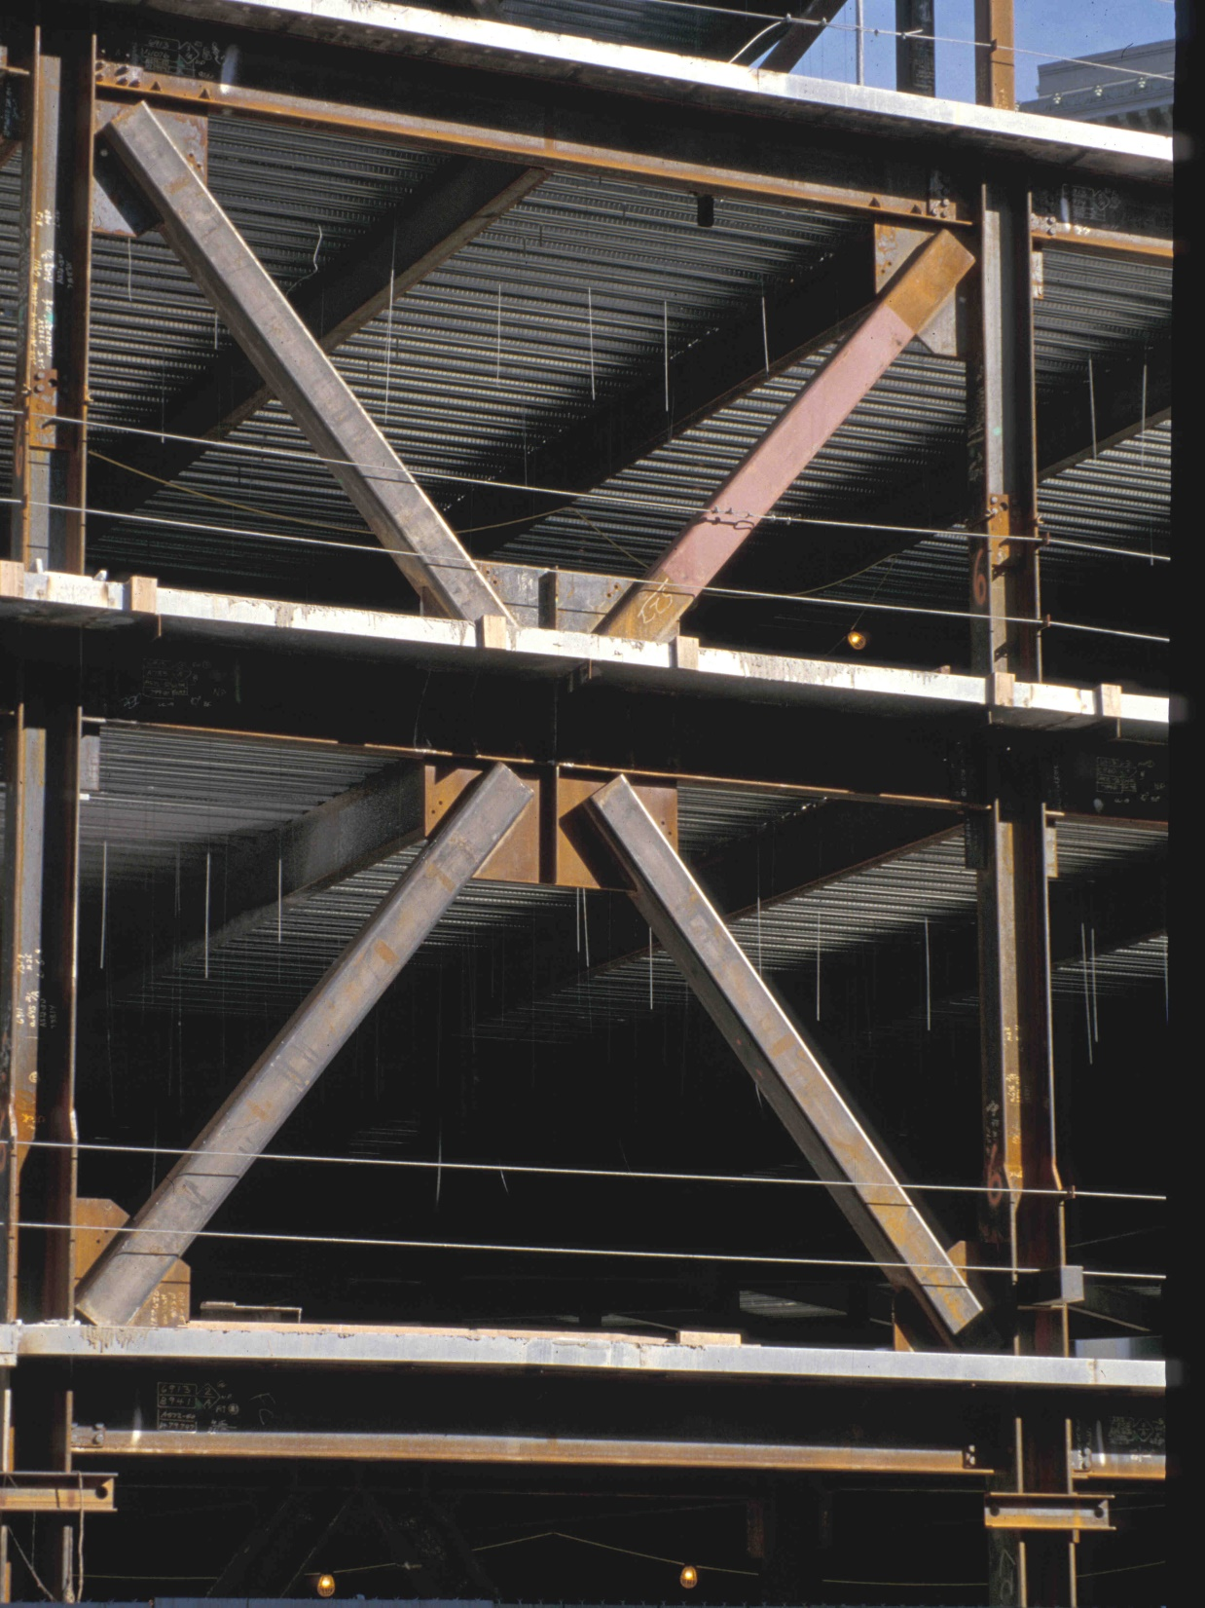
Notes:
Two story X-bracing.

Slide 45
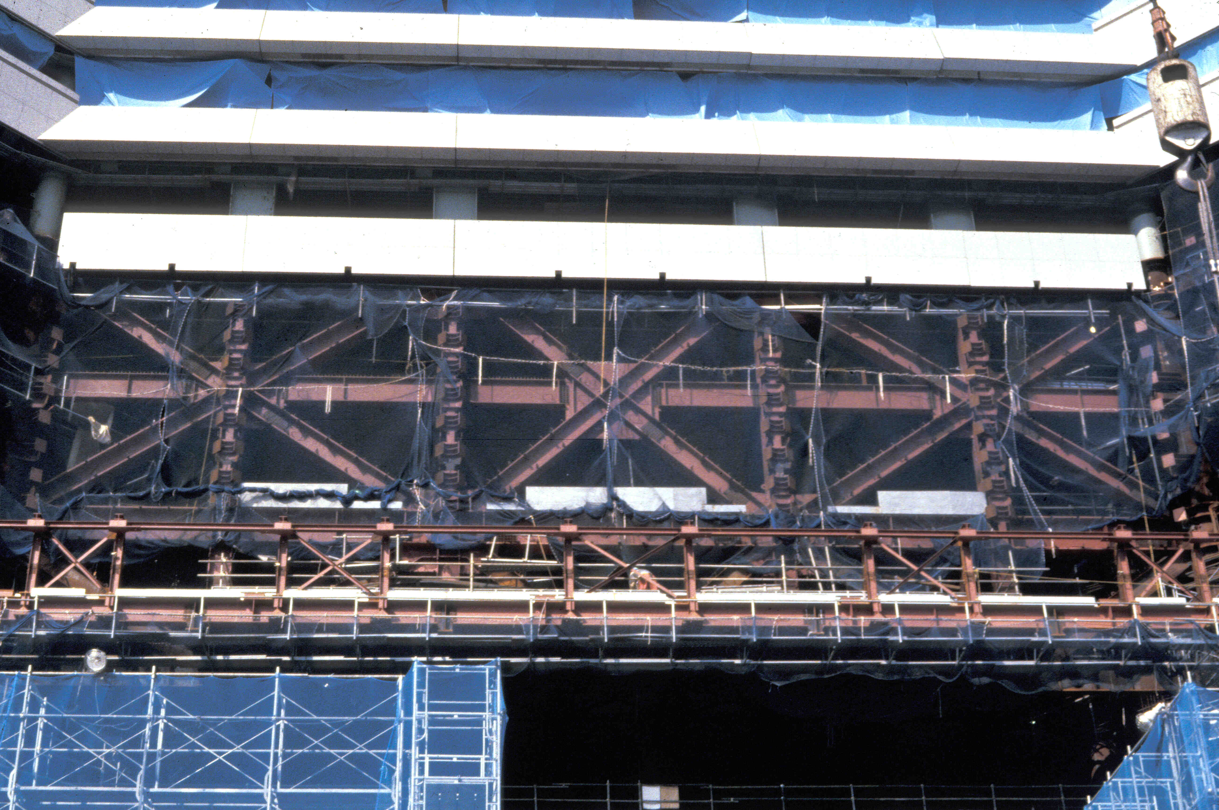
Notes:
An example of very heavy two-story X-bracing.
This photograph is of the 70-story Landmark Tower in Yokohama, Japan.

Slide 46
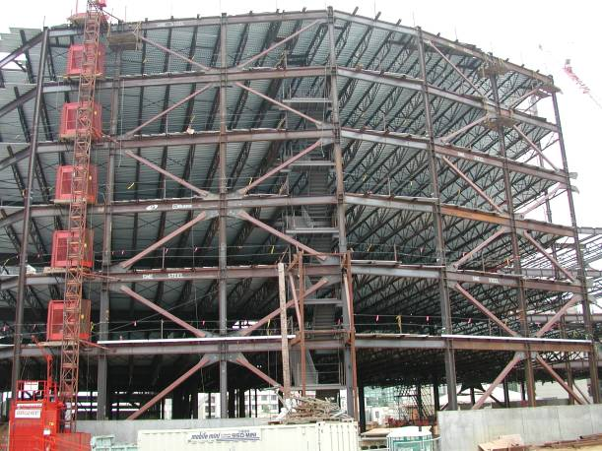
Notes:
Two story X-bracing.
Slide courtesy of C.M. Uang

Slide 47
Notes:
Two story X-braced frame for bottom stories, with a inverted V-braced frame at the top story.
Photo courtesy of Russel Kehl and Wayne Chang, Structural Focus, Gardena, CA

Slide 48
Inelastic Response of CBFs under Earthquake Loading
Notes:
The next two slides illustrate the basic inelastic response of a CBF under lateral load. Recall that inelastic action is intended to occur in the bracing members.
In this frame, when the load is acting towards the right, the left brace will be in tension and the right brace will be in compression.

Slide 49
Inelastic Response of CBFs under Earthquake Loading
Tension Brace: Yields
(ductile)
Compression Brace: Buckles
(nonductile)
Columns and beams: remain essentially elastic
Notes:
The expected behavior of a CBF as the frame goes inelastic is that the compression brace will buckle and the tension brace will yield. The beams and columns are intended to remain essentially elastic, as the braces yield and buckle. When the compression braced buckles, it will generally rapidly lose compressive strength. Consequently brace buckling is a relatively non-ductile phenomena. On the other hand, yielding of a brace in tension can be a highly ductile phenomena. Consequently, the primary source of ductility in CBFs under lateral load is yielding of tension braces.

Slide 50
Inelastic Response of CBFs under Earthquake Loading
Compression Brace (previously in tension): Buckles
(nonductile)
Tension Brace (previously in compression): Yields
(ductile)
Columns and beams: remain essentially elastic
Notes:
When the lateral load reverses direction, the brace that had previously buckled in compression will now go into tension, and will supply ductility through tension yielding. The brace that was previously yielded in tension will now buckle in compression.
Thus, in a CBF subject to an earthquake, the braces will undergo alternate tension yielding and compression buckling. As the cyclic yielding and buckling takes place in the braces, the beams and columns are intended to remain essentially elastic.
A primary goal in ductile detailing of CBFs is to permit the cyclic yielding and buckling to occur in the braces for many loading cycles, without failure of a brace end connection, and without fracture of the bracing member.
After an earthquake, one would expect to see buckled braces in a properly designed CBF.

Slide 51
Eccentrically Braced Frames (EBFs)
Framing system with beam, columns and braces. At least one end of every brace is connected to isolate a segment of the beam called a link.
Resist lateral load through a combination of frame action and truss action. EBFs can be viewed as a hybrid system between moment frames and concentrically braced frames.
Develop ductility through inelastic action in the links.
EBFs can supply high levels of ductility (similar to MRFs), but can also provide high levels of elastic stiffness (similar to CBFs)
Notes:
Eccentrically Braced Frames (EBFs) are braced frames, consisting of beams, columns, and braces. Unlike conventional concentrically braced frames, an intentional eccentricity is introduced in EBFs, so that the brace-beam-column centerlines do not meet at a single point. The framing is arranged so as to isolate a short segment of beam at one of each brace. This isolated beam segment is called a "link."
EBFs are designed so that inelastic action occurs within the links. The links, in turn, can be designed and detailed to provide very high levels of ductility. The braces, columns and beam segments outside of the links are designed to remain essentially elastic, by designing these elements to be stronger than the links.
A well designed EBF can combine high stiffness in the elastic range (similar to a concentrically braced frame), with high ductility in the inelastic range (similar to a moment resisting frame). Because of the high elastic stiffness of an EBF, beam and column sizes are generally much smaller than in a moment resisting frame.

Slide 52
e
Link
e
Link
Notes:
This is an example of an EBF. The links are located at mid-span of the beams. Link length, which is a critical design parameter in EBFs, is denoted by the letter "e."
The link is introduced in an EBF for improved seismic performance. However, an additional benefit of the link is that it permits larger frame openings for doors, windows, etc, and therefore can provide some additional architectural flexibility compared to a conventional concentrically braced frame.
A common feature of EBFs, shown in this slide, are the stiffeners located within the links. These stiffeners are provided to enhance the ductility of links by delaying shear buckling of the link webs.

Slide 53
e
Link
e
Link
Notes:
Another example of an EBF. In this case, the links are located adjacent to columns.

Slide 54
Some possible bracing arrangement for EBFS
e
e
e
e
e
Notes:
There are many possible framing arrangements for EBFs, as illustrated in this slide.
The next several slides are photos of actual EBFs.

Slide 55
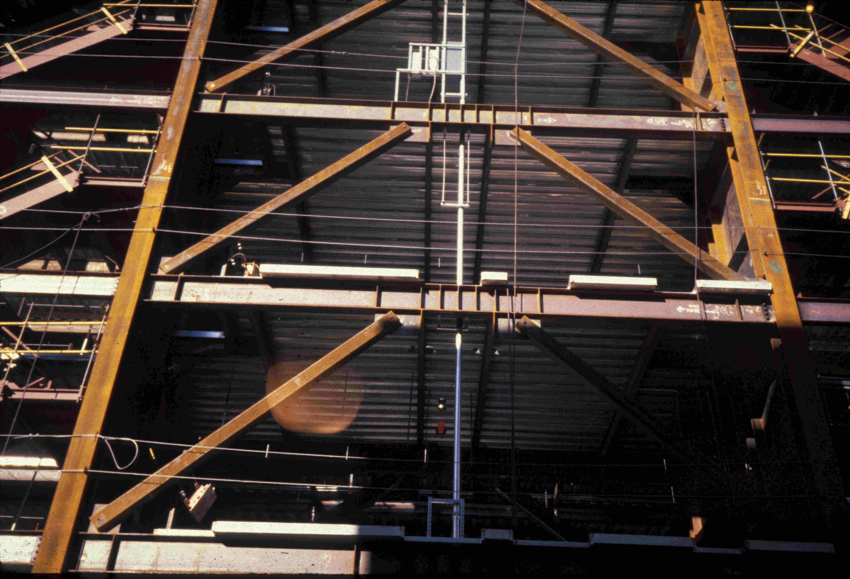
Notes:
An EBF with the links at mid-span of the beams. This building is located in San Francisco.

Slide 56
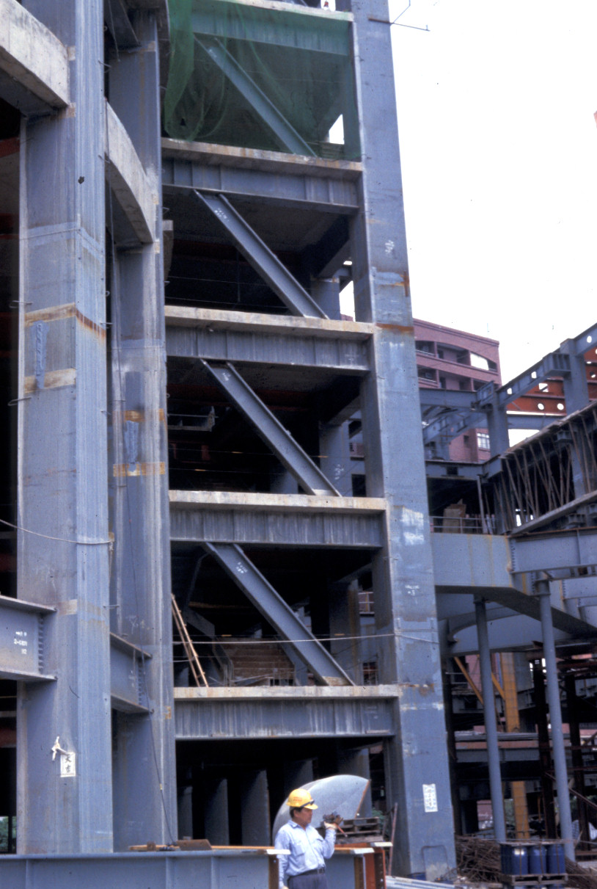
Notes:
An example of a single diagonal EBF is a high-rise steel office building located in Taipei, Taiwan. Columns are steel box sections.
A close-up of the link region of this frame is shown on the next slide.

Slide 57
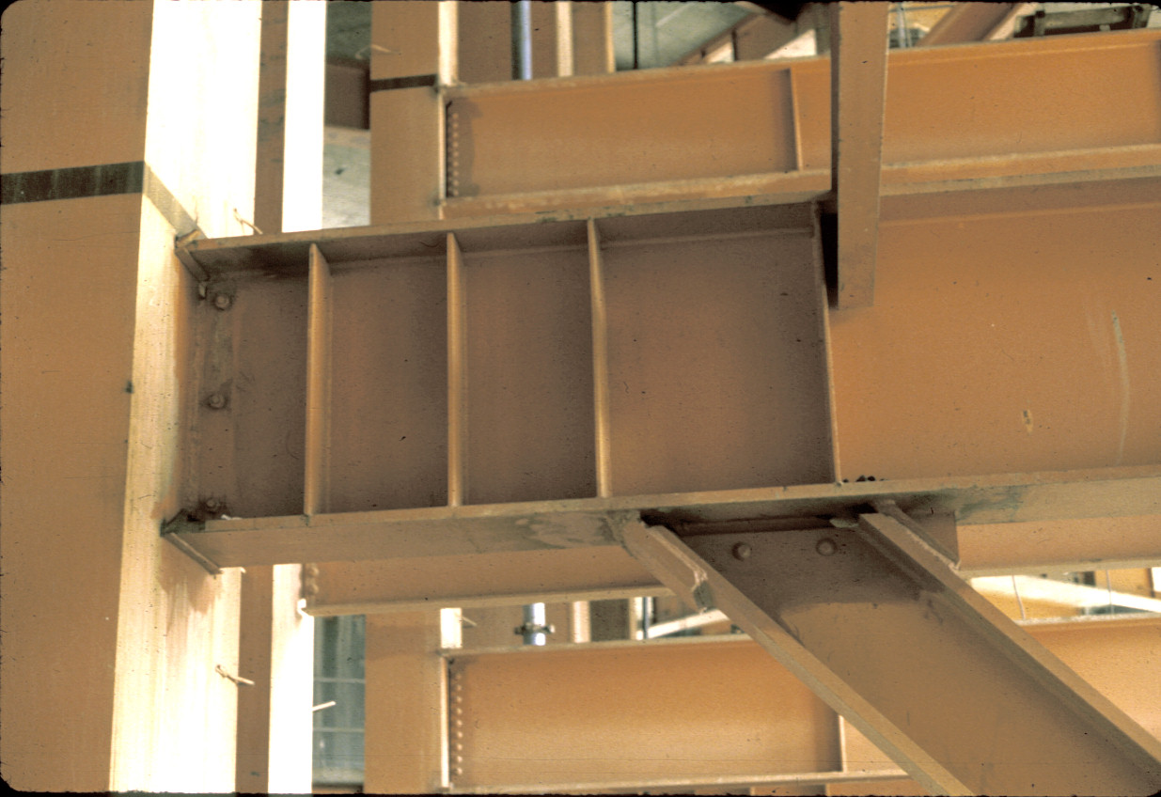
Notes:
The link is attached to the steel box column with a fully welded connection.

Slide 58
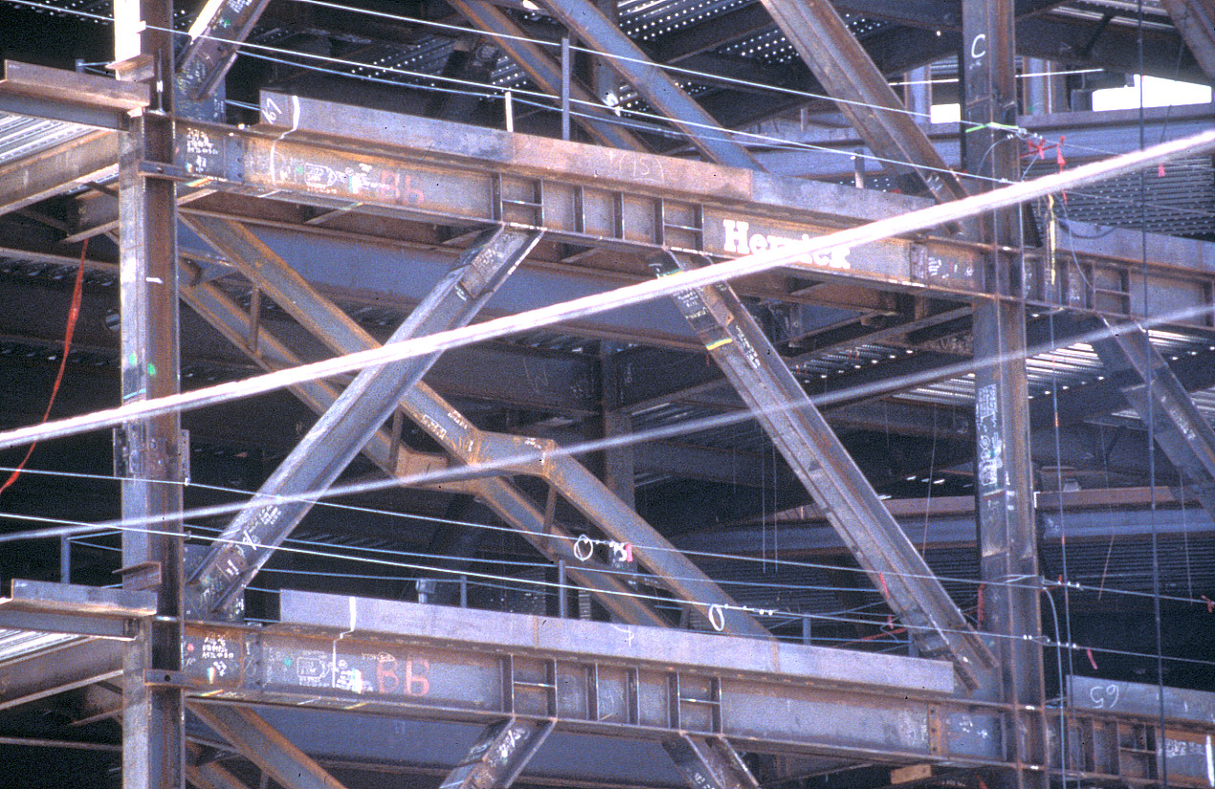
Notes:
An EBF with the links at mid-span of the beams. This building is located in the San Francisco area.
Note the brace to link connections for the wide flange braces. Small segments of the braces were shop welded to the bottom of the beam, with a welded splice provided in the field for connection of the remaining portion of the brace.
The adjoining bay to the right is also an EBF, with links attached to the columns.

Slide 59
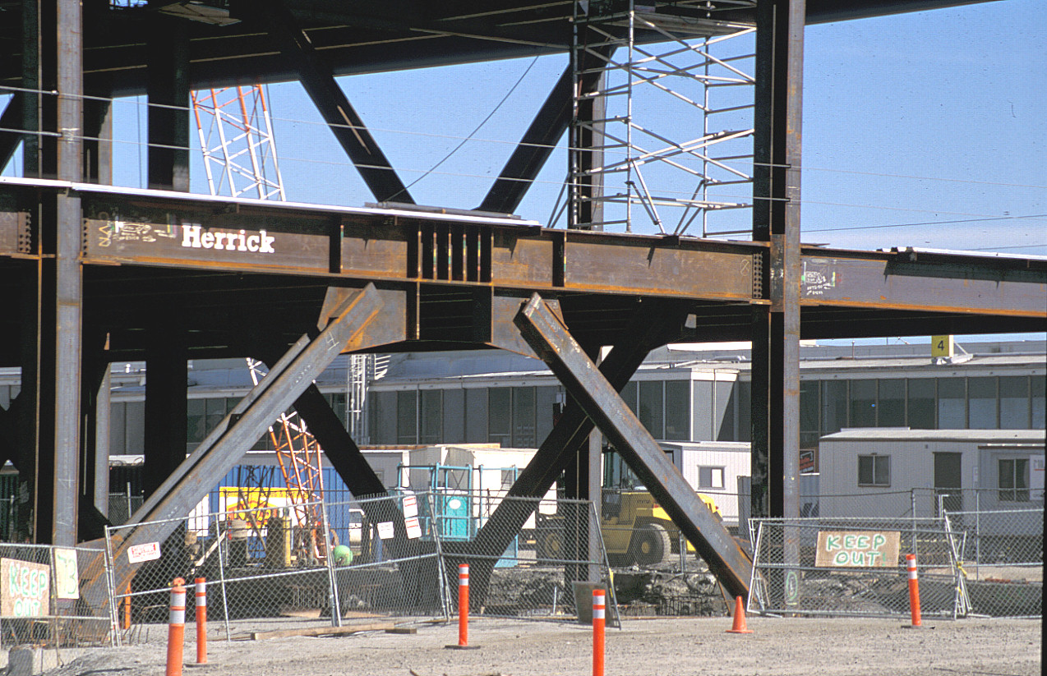
Notes:
An EBF with links at mid-span of the beams. This photo was taken during construction of the International Terminal at San Francisco airport.

Slide 60
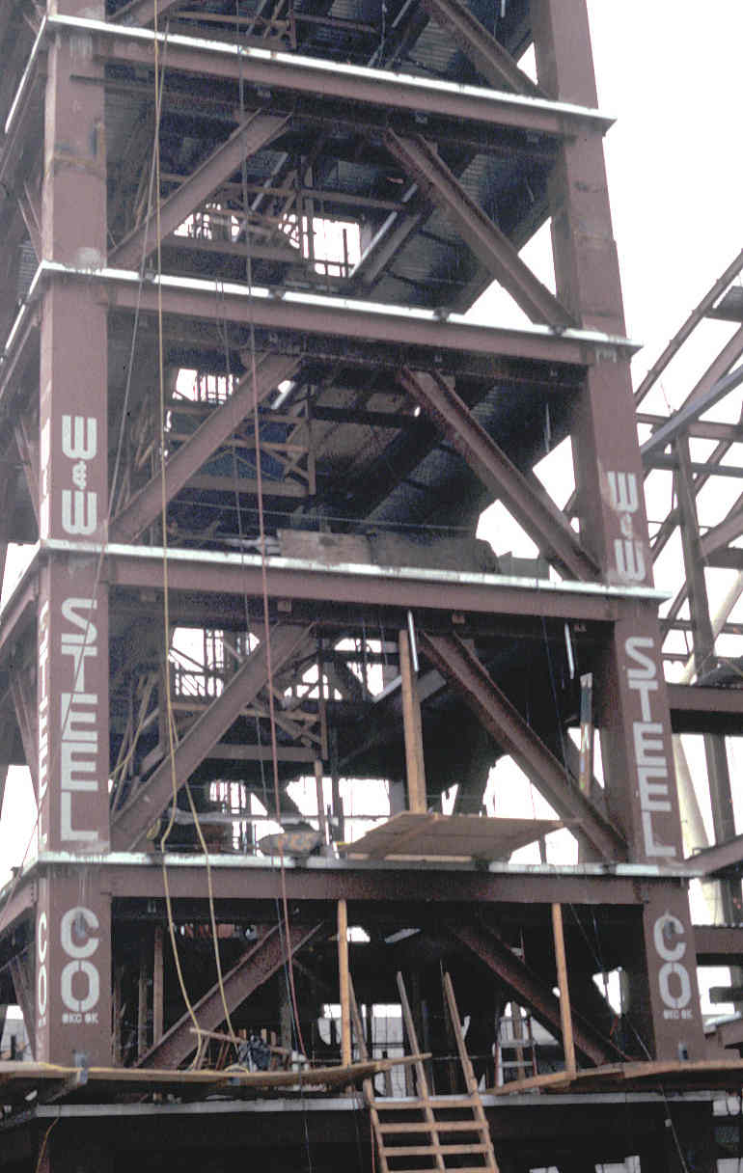
Notes:
Another EBF with links at mid-span. This is a control tower at Los Angeles airport.

Slide 61
Inelastic Response of EBFs
Notes:
The next several slides illustrate the intended inelastic response of an EBF under lateral loading. Inelastic deformation patterns are shown in the form of a rigid-plastic mechanism.

Slide 62
Inelastic Response of EBFs
Notes:
Yielding is an EBF is intended to occur within the links. The braces, columns, and beam segments outside of the links are intended to remain essentially elastic.

Slide 63
Inelastic Response of EBFs
Notes:
Loading in the reverse direction.

Slide 64
Buckling-Restrained Braced Frames (BRBFs)
Type of concentrically braced frame.
Beams, columns and braces arranged to form a vertical truss. Resist lateral earthquake forces by truss action.
Special type of brace members used: Buckling-Restrained Braces (BRBs). BRBS yield both in tension and compression - no buckling !!
Develop ductility through inelastic action (cyclic tension and compression yielding) in BRBs.
System combines high stiffness with high ductility.
Notes:
BRBFs are concentrically braced frames, consisting of beams, columns and braces arranged to form a truss. BRBFs resist lateral load primarily through truss action, with member response dominated by axial force (tension and compression).
Unlike conventional concentrically braced frames, BRBFs are constructed with a special type of brace member: Buckling-Restrained Braces (BRBs).
BRBs have the unique quality that they do not buckle when loaded in compression. Consequently, BRBs yield in a ductile manner in both tension and compression. The use of BRBs results in a frame that combines high elastic stiffness with excellent ductility.
BRBFs are considered to be a high ductility framing system, and is assigned high R-factors in ASCE-7.
Per ASCE 7-22, the R-factor for BRBFs is R=8.

Slide 65
Buckling-Restrained Brace
Buckling- Restrained Brace:
Steel Core
+
Casing
Casing
Steel Core
Notes:
The key feature of a BRBF is the use of Buckling-Restrained Braces (BRBs).
A BRB consists of a steel core and a casing. The casing covers the steel core.

Slide 66

Buckling-Restrained Brace
Buckling- Restrained Brace:
Steel Core
+
Casing
A
A
Casing
Steel Core
Steel jacket
Mortar
Debonding material
Section A-A
Notes:
The are a number of different configurations for BRBs. This slide shows one possibility. The steel core is simply a rectangular plate. The casing, which restrains buckling of the core, is typically constructed of a mortar filled steel tube. The steel core is surrounded by a debonding material that decouples the steel core from the casing, for purposes of resisting axial force. That is, the debonding material is intended to prevent transfer of axial stress from the steel core to the casing. Consequently, the casing essentially "floats" on the steel core.
There are a number of possible configurations for the shape of the steel core. In addition to a single plate, BRBs have been constructed using cruciform shaped plates, or a pair of plates or shapes.

Slide 67
Buckling-Restrained Brace
P
P
Steel core resists entire axial force P
Casing is debonded from steel core
  casing does not resist axial force P
  flexural stiffness of casing restrains buckling of core
Notes:
The concept of the BRB is that the steel core resists the applied axial force P. The debonding material that surrounds the core is intended to prevent the casing from carrying axial force. Since the casing has no (or very little) axial force, its full flexural stiffness is available to resist buckling of the steel core.

Slide 68
Buckling-Restrained Brace
Buckling- Restrained Brace:
Steel Core
+
Casing
Steel Core
Yielding Segment
Core projection and brace connection segment
Notes:
The central section of the steel core, as shown in the slide, is intended to be the portion of the core that yields in tension and in compression. At the ends of the BRB, the core projects outside of the casing. This core projection typically has a significantly larger cross-sectional area than the yielding segment, and is usually reinforced to prevent buckling of the projection. Further, the core projection is normally prepared with bolt holes or other features that allow connection of the BRB to the remainder of the frame.
A building designer using a BRBF does not normally develop the detailed design of a buckling restrained brace, such the shape of the core and core projections, the details of the casing and debonding material, and the connection details provided on the core projection.
Rather, there are companies that manufacture and sell BRBs. These are proprietary and patented designs which have undergone design development and testing by the manufacturers. Thus, the building designer will normally specify the required strength and stiffness of the BRBs, and the manufacturer will supply BRBs that meet these specifications.
CoreBrace (http://www.corebrace.com/) is a manufacturer that markets BRBs in the US.

Slide 69
Bracing Configurations for BRBFs
Single Diagonal
Inverted V- Bracing
V- Bracing
X- Bracing
Two Story X- Bracing
Notes:
Various bracing arrangements are possible for BRBFs, as is the case with conventional braced frames.
Single story X-bracing is generally not possible for BRBFs because of the difficulty in crossing the two BRBs at their centers.

Slide 70
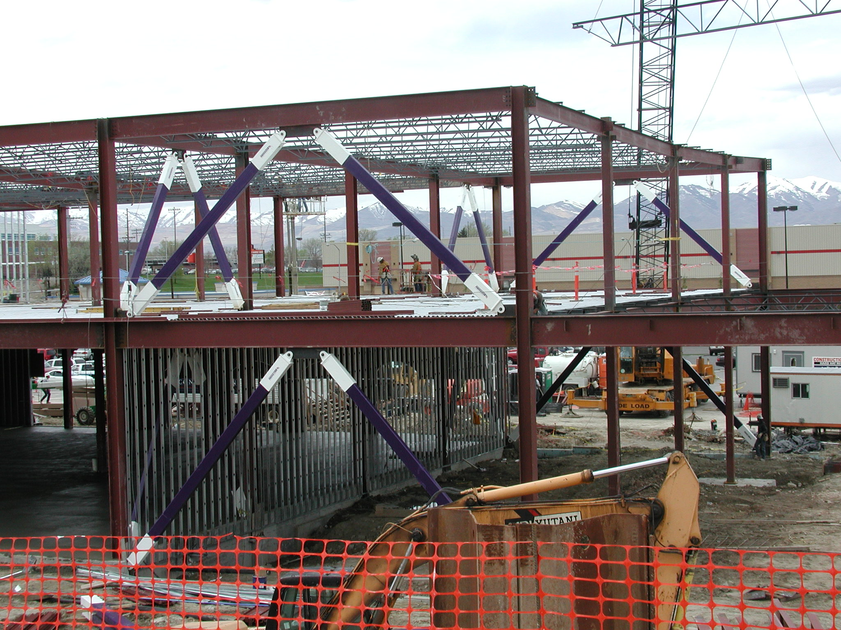
Notes:
The next several slides show steel framed buildings with BRBFs during construction.
This photo is courtesy of Star Seismic. Star Seismic calls their BRBs "Powercat" braces.

Slide 71
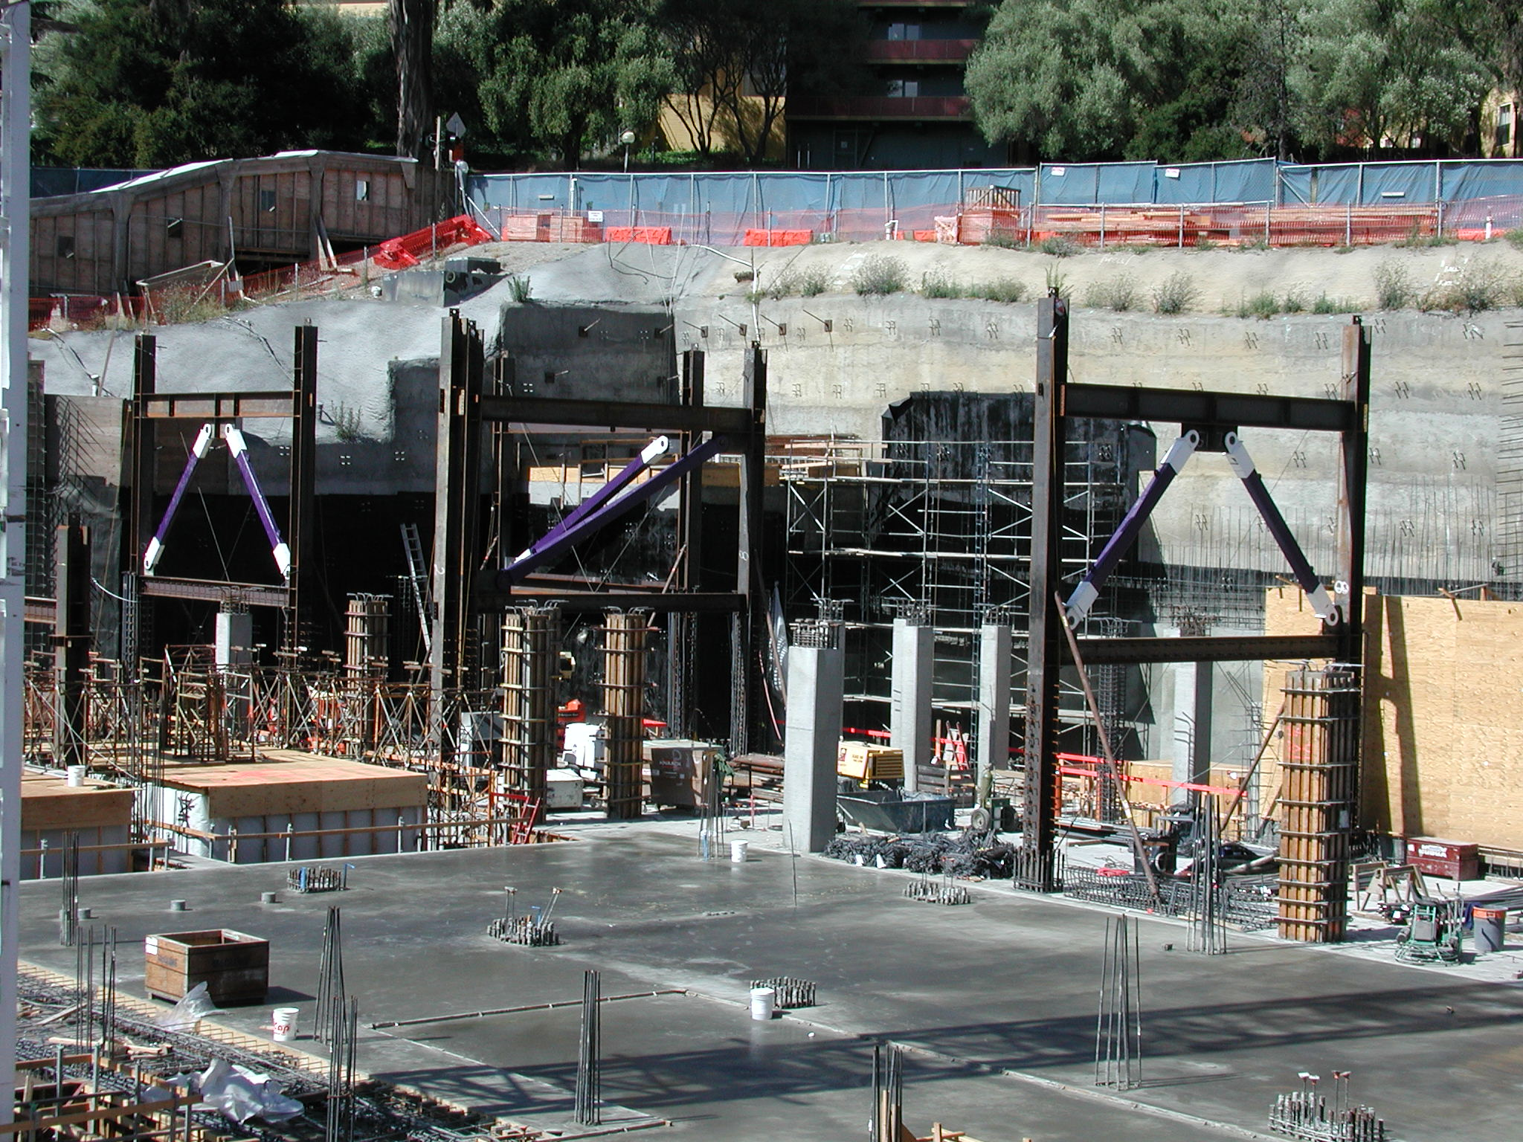
Notes:
Photo courtesy of Star Seismic.

Slide 72
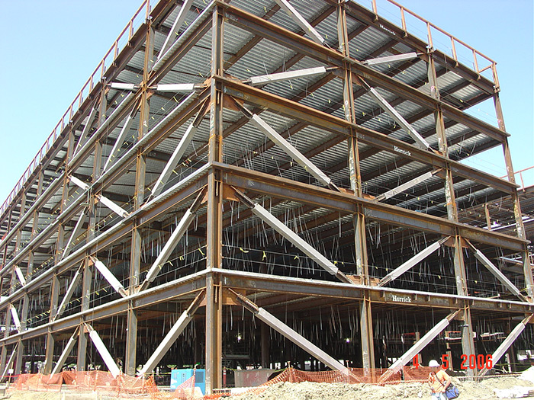
Notes:
Photo courtesy of CoreBrace.

Slide 73

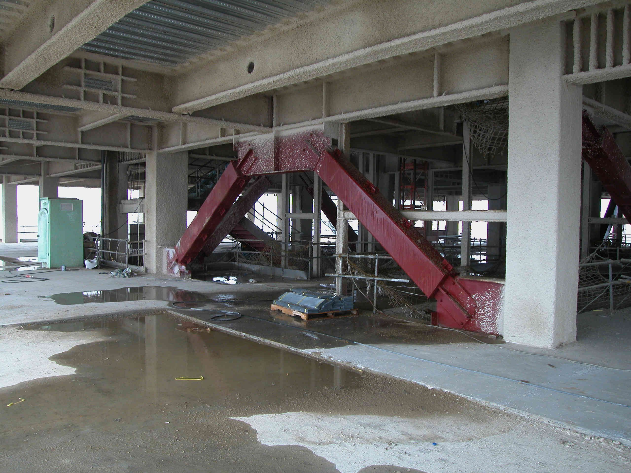
Notes:
This is a high-rise steel framed building under construction in Taipei, Taiwan. The photo shows an inverted V-type BRBF.
The BRBs used in this building are "double core" braces, developed at the National Center for Research in Earthquake Engineering (NCREE) in Taiwan.

Slide 74
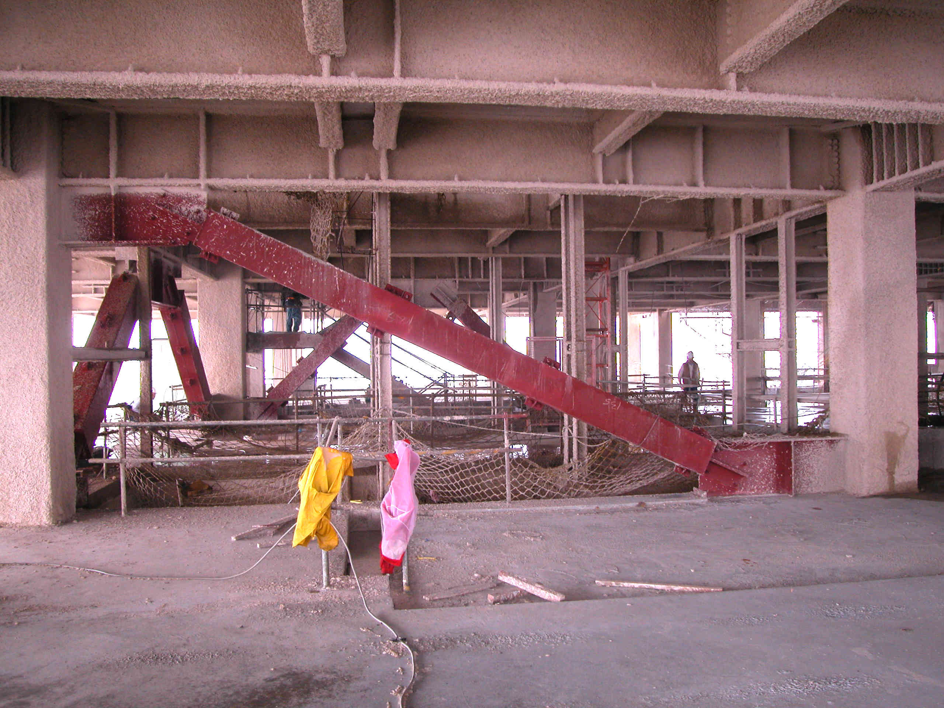
Notes:
An example of a single-diagonal type BRBF, in the same building in Taipei as shown on the previous slide.

Slide 75
Inelastic Response of BRBFs under Earthquake Loading
Notes:
The following slides illustrate the intended inelastic behavior of a BRBF under lateral loading, in the form of rigid-plastic mechanisms.

Slide 76
Inelastic Response of BRBFs under Earthquake Loading
Tension Brace: Yields
Compression Brace: Yields
Columns and beams: remain essentially elastic
Notes:
The basic rigid-plastic mechanism of a BRBF is quite simple. The braces yield in a ductile manner in both compression and tension, resulting in a plastic mechanism. The beams and columns remain essentially elastic.
The lateral strength of the BRBF is directly related to the strength of the BRBs.

Slide 77
Inelastic Response of BRBFs under Earthquake Loading
Compression Brace: Yields
Tension Brace: Yields
Columns and beams: remain essentially elastic
Notes:
The inelastic behavior of the BRBF is the same for either direction of lateral load.

Slide 78
Special Plate Shear Walls (SPSW)
Assemblage consisting of rigid frame, infilled with thin steel plates.
Under lateral load, system behaves similar to a plate girder. Wall plate buckles under diagonal compression and forms tension field.
Develop ductility through tension yielding of wall plate along diagonal tension field.
System combines high stiffness with high ductility.
Notes:
Special plate shear walls (SPSW) consist of rigid beam-column framing, with thin steel plates infilled within the regions between the beams and columns.
SPSWs resist load in a manner similar to a steel plate girder. The columns (also known as Vertical Boundary Elements) of the SPSW are somewhat analogous to the flanges of a plate girder; the beams (also known as Horizontal Boundary Elements) are somewhat analogous to the stiffeners of a plate girder, and the wall plate in a SPSW is analogous to the web of a plate girder.
SPSW systems are usually provided with very thin web plates...on the order of 1/8-inch to 1/2-inch. Under lateral load, these web plates buckle under diagonal compression, and then develop tension field action. Yielding then occurs along the tension field, which is the source of ductility in SPSW systems.
The remaining slides on SPSW are from the module on SPSW prepared by Rafael Sabelli of Walter P. Moore

Slide 79
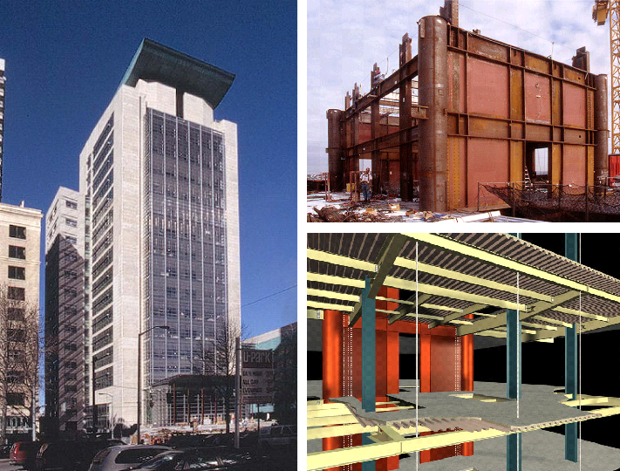
Notes:
The core for the U.S. Federal Courthouse 23-story building in Seattle employs SPSW in the North-South direction. Braced frames are used in the East-West direction.
Photos are courtesy of John Hooper, MKA Seattle

Slide 80
Notes:
A series of SPSW located around elevator shafts were used to resist lateral load on six-story building with irregular floor plan that provided a 39,830 sq. ft. expansion to the Canam Manac Group headquarters in St., Georges, Quebec.
Courtesy of Richard Vincent, Canam Manac Group, St. George, Quebec, Canada

Slide 81
Notes:
A SPSW system was also selected for the seven-story ING building in Ste-Hyacinthe, Quebec.
Courtesy of Louis Crepeau and Jean-Benoit Ducharme, Groupe Teknika, Montreal, Canada

Slide 82
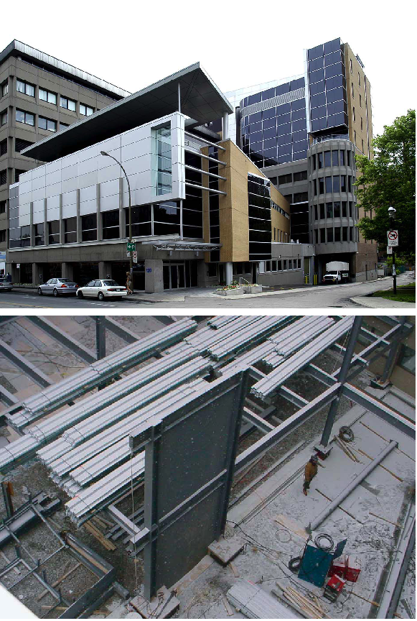
Notes:
SPSW were also used for a two-story addition to an existing single-story building of the Institut de Recherches Cliniques de Montréal (ICRM) in Montreal.
Courtesy of Louis Crepeau and Jean-Benoit Ducharme, Groupe Teknika, Montreal, Canada

Slide 83
Plate-Girder Analogy
Notes:
Steel plate shear walls can also be likened to a plate girder. Tension-field action in the web plate provides the resistance to lateral forces. This analogy is incomplete, however, as the “flanges” of walls (the columns) have significant transverse stiffness, and the tension field can develop across the entire width of the wall.

Slide 84
Inelastic Response of a SPSW
Development of tension diagonals
Frame flexure
Shear buckling
Notes:
In the non-linear range, slender-web shear walls experience elastic shear buckling at low drifts. The strength realized in compression is negligible. Shear buckling is followed by development of a tension field anchored by the beams and columns (causing inward flexure). Also, as beams and columns are rigidly connected, they experience additional flexure.
The primary mechanism for developing ductility in a SPSW is yielding along the tension diagonals.

Slide 85
Design of Seismic-Resistant
Steel Building Structures: Brief Overview
Earthquake Effects on Structures
Performance of Steel Buildings in Past Earthquakes
Building Code Philosophy for Earthquake-Resistant Design and Importance of Ductility
Design Earthquake Forces: ASCE-7
Steel Seismic Load Resisting Systems
AISC Seismic Provisions

Slide 86
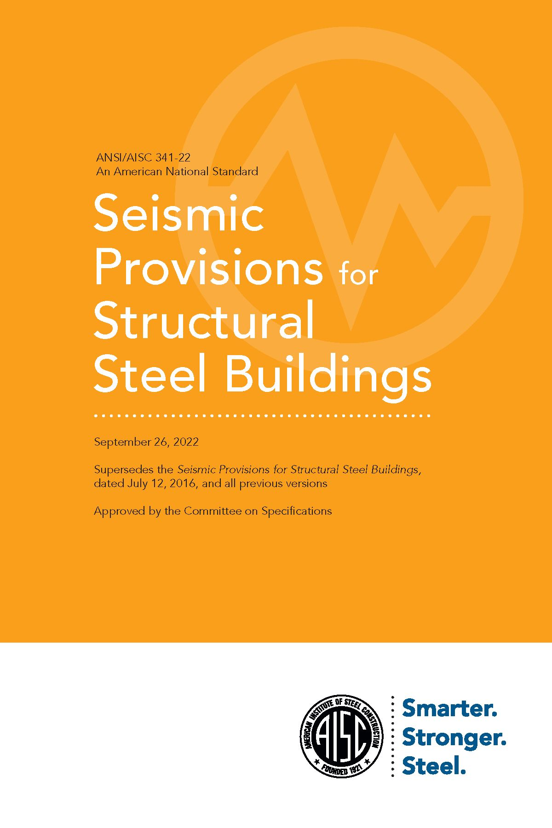
2022 AISC Seismic Provisions
Notes:
The 2022 AISC Seismic Provisions for Structural Steel Buildings provides comprehensive detailing requirements for seismic-resistant steel building structures. These Provisions are adopted by the International Building Code.
The 2022 AISC Seismic Provisions can be downloaded for free at www.aisc.org.
This completes our very brief look at seismic-resistant design of steel building structures.
More detailed discussion of this topic is available in the following PowerPoint modules that accompany this module:
1- Introduction and Basic Principles
2- Moment Resisting Frames
3-Concentrically Braced Frames
4-Eccentrcially Braced Frames
5-Buckling Restrained Braced Frames
6-Special Plate Shear Walls

