Slide 1
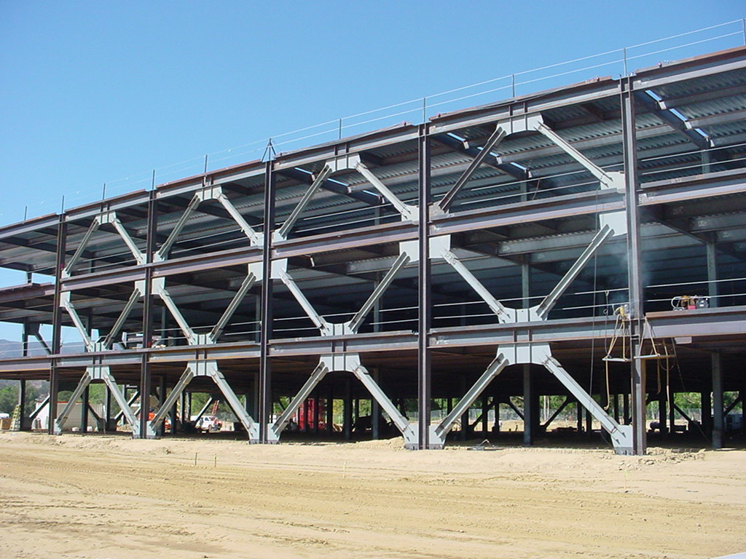
Design of Seismic-Resistant Steel Building Structures
3. Concentrically Braced Frames
Version 3 (December 2024)
Notes:
This series of PowerPoint presentations covers the fundamentals of the design of seismic-resistant steel building structures. The primary focus of the material is on ductile detailing of steel structures for seismic resistance, rather than on calculation of lateral forces, dynamic analysis, or other general topics on earthquake engineering. The material is intended primarily for use at the graduate level, although many portions of the presentations are appropriate for undergraduates.
The presentations are closely tied to the 2022 AISC Seismic Provisions for Structural Steel Buildings (referred to herein as the AISC Seismic Provisions). The presentations discuss basic principles of the behavior of seismic response of steel structures, and show how these principles are treated in the AISC Seismic Provisions. The presentations are most effective if the students have a copy of the AISC Seismic Provisions. A free copy can be downloaded from the AISC website, at: www.aisc.org.
For basic steel design topics, the presentation refers to the 2022 AISC Specification for Structural Steel Buildings (herein referred to as the AISC Specification). Both the 2022 AISC Seismic Provisions and AISC Specification are written in the combined LRFD - ASD format. These PowerPoint presentations, however, present only the LRFD format. For seismic-resistant design, the LRFD format is preferable, in that it more closely follows the element capacity concepts used seismic design.
For code related seismic-design topics not covered in the AISC Seismic Provisions (seismic design categories, R-factors, seismic overstrength factors, etc.), the presentations refer to ASCE 7-22 - Minimum Design Loads for Buildings and Other Structures.
For questions, comments, corrections, or suggestions on these presentations, please contact:
AISC University Programs
Email: universityprograms@aisc.org
Acknowledgments:
These presentations were originally prepared by Michael D. Engelhardt (University of Texas at Austin) with support from the AISC Educator Career Enhancement Award. The author also gratefully acknowledges contributions and review provided by the AISC Task Group for this project:
Mark Bowman - Purdue University
Steve Mahin - University of California at Berkeley
Brett Manning - PMB 200
Carol Pivonka - AISC
Larry Reaveley - University of Utah
Rafael Sabelli - Dasse Design, San Francisco
Tom Sabol - Englekirk & Sabol Consulting Engineers, Los Angeles
Chia-Ming Uang - University of California at San Diego
The module on Special Plate Shear Walls was prepared by Rafael Sabelli - Dasse Design, San Francisco. The contributions of Prof. Sharon Wood of the University of Texas at Austin to Module 1 are also gratefully acknowledged.
Version 2 (Updates to 2016 AISC Seismic Design Provisions):
Patricia Clayton – University of Texas at Austin
Larry Fahnestock – University of Illinois at Urbana-Champaign
Matthew Eatherton – Virginia Tech
Paul Richards – DuraFuse Frames

Slide 2
Design of Seismic-Resistant
Steel Building Structures
Introduction and Basic Principles
Moment Resisting Frames
Concentrically Braced Frames
Eccentrically Braced Frames
Buckling-Restrained Braced Frames
Special Plate Shear Walls
Notes:
This PowerPoint series is dividing into 6 modules. This is Module Number 3 on: "Concentrically Braced Frames."

Slide 3
3 - Concentrically Braced Frames
Description and Types of Concentrically Braced Frames
Basic Behavior of Concentrically Braced Frames
AISC Seismic Provisions for Special Concentrically Braced Frames
Notes:
This module is divided into three areas.
First, different types of concentrically braced frames are described and illustrated with photographs.
Next, key issues related to the behavior of concentrically braced frames under cyclic loading are discussed.
Finally, the module will go through the requirements for detailing of Special Concentrically Braced Frames as presented in the AISC Seismic Provisions.

Slide 4
3 - Concentrically Braced Frames
Description and Types of Concentrically Braced Frames
Basic Behavior of Concentrically Braced Frames
AISC Seismic Provisions for Special Concentrically Braced Frames
Notes:
This module is divided into three areas.
First, different types of concentrically braced frames are described and illustrated with photographs.
Next, key issues related to the behavior of concentrically braced frames under cyclic loading are discussed.
Finally, the module will go through the requirements for detailing of Special Concentrically Braced Frames as presented in the AISC Seismic Provisions.

Slide 5
Concentrically Braced Frames (CBFs)
Beams, columns and braces arranged to form a vertical truss. Resist lateral earthquake forces by truss action.
Develop ductility through inelastic action in braces.
  braces yield in tension
  braces buckle in compression
Advantages
high elastic stiffness
Disadvantages
less ductile than other systems (SMFs, EBFs, BRBFs)
reduced architectural versatility
Notes:
A concentrically braced frame (CBF) can be viewed as a vertical truss. In the elastic range of behavior, a concentrically braced frame resists lateral earthquake forces by truss action. That is, in the elastic range, axial forces are the dominant type of force in the members.
A CBF develops ductility through inelastic action in the braces: yielding in tension and buckling in compression. Thus, the braces are the "fuses" in a CBF. The beams and columns are intended to remain essentially elastic.
CBFs offer the advantage of high elastic stiffness, thereby permitting code specified drift limits to be satisfied with relatively light members, especially compared to moment frames.
A disadvantage of CBFs is that this system is viewed as being less ductile than most other steel seismic load resisting systems, and is therefore assigned lower R factors.
An additional disadvantage of a CBF is that the bracing may block openings in the frame, resulting reduced architectural versatility.

Slide 6
Types of CBFs
Single Diagonal
Inverted V- Bracing
V- Bracing
X- Bracing
Two Story X- Bracing
Notes:
A variety of different bracing arrangements are possible for CBFs. This slide illustrates several common types of CBFs.

Slide 7
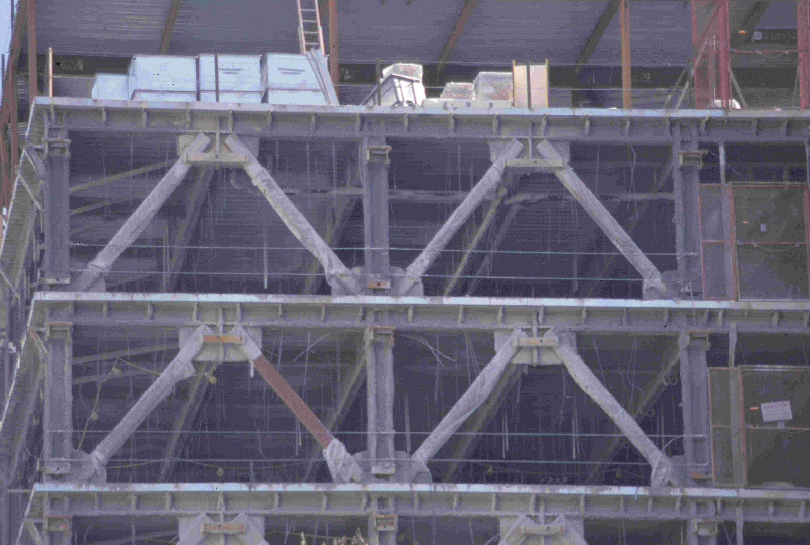
Notes:
Inverted V-bracing.

Slide 8
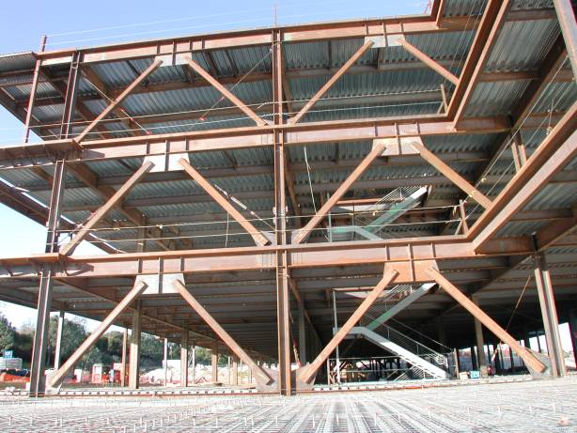
Notes:
Inverted V-bracing.
Slide courtesy of C.M. Uang

Slide 9
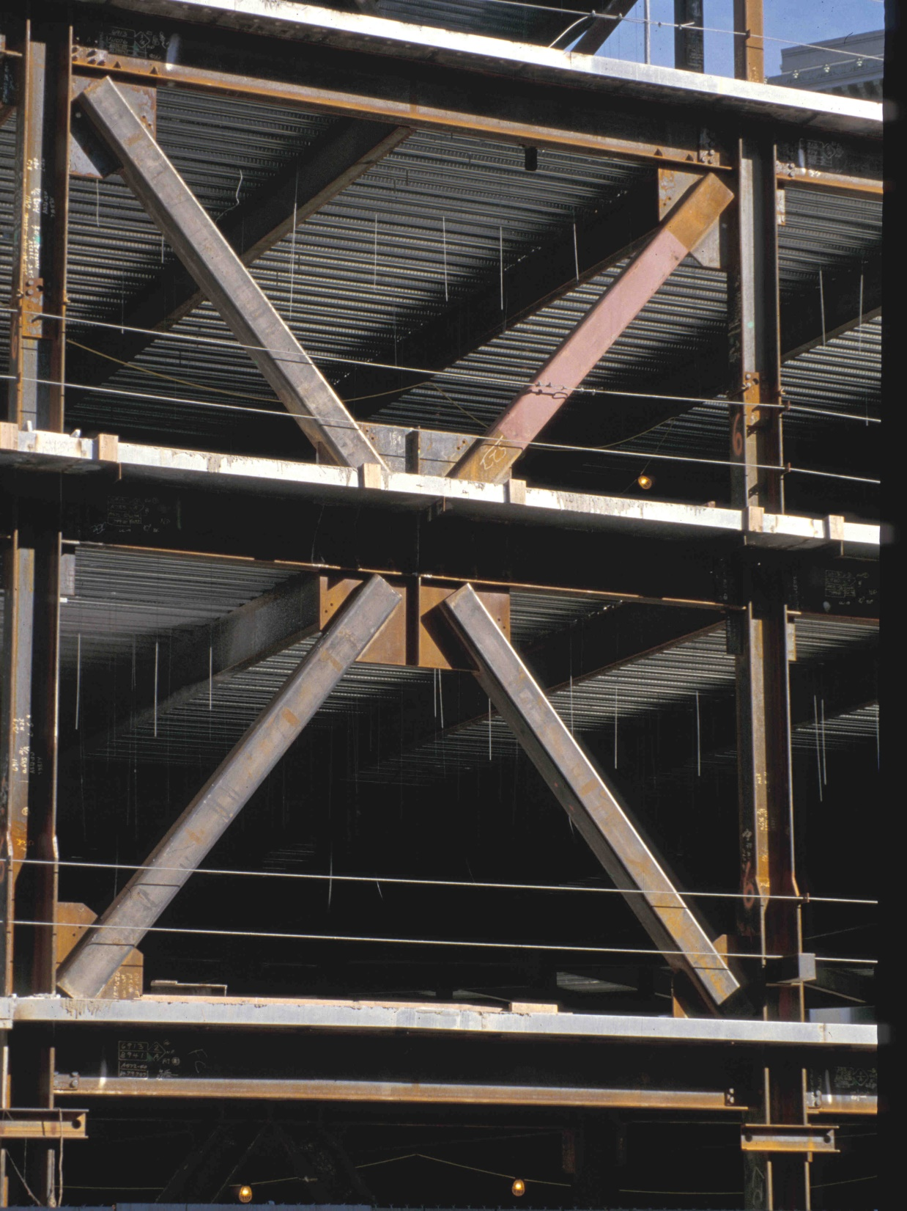
Notes:
Two story X-bracing.

Slide 10
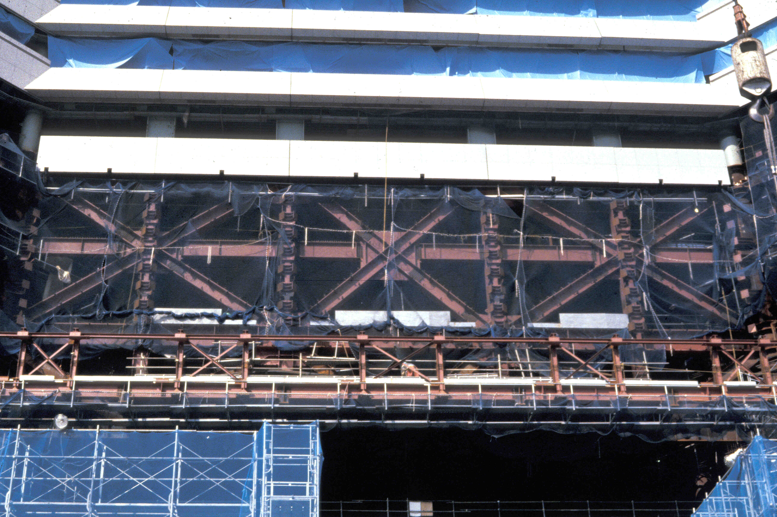
Notes:
An example of very heavy two-story X-bracing.
This photograph is of the 70-story Landmark Tower in Yokohama, Japan.

Slide 11
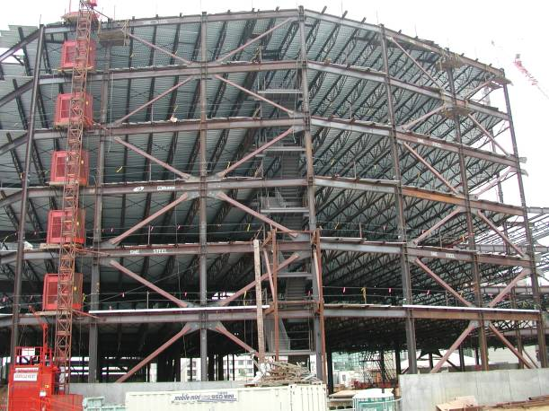
Notes:
Two story X-bracing.
Slide courtesy of C.M. Uang

Slide 12
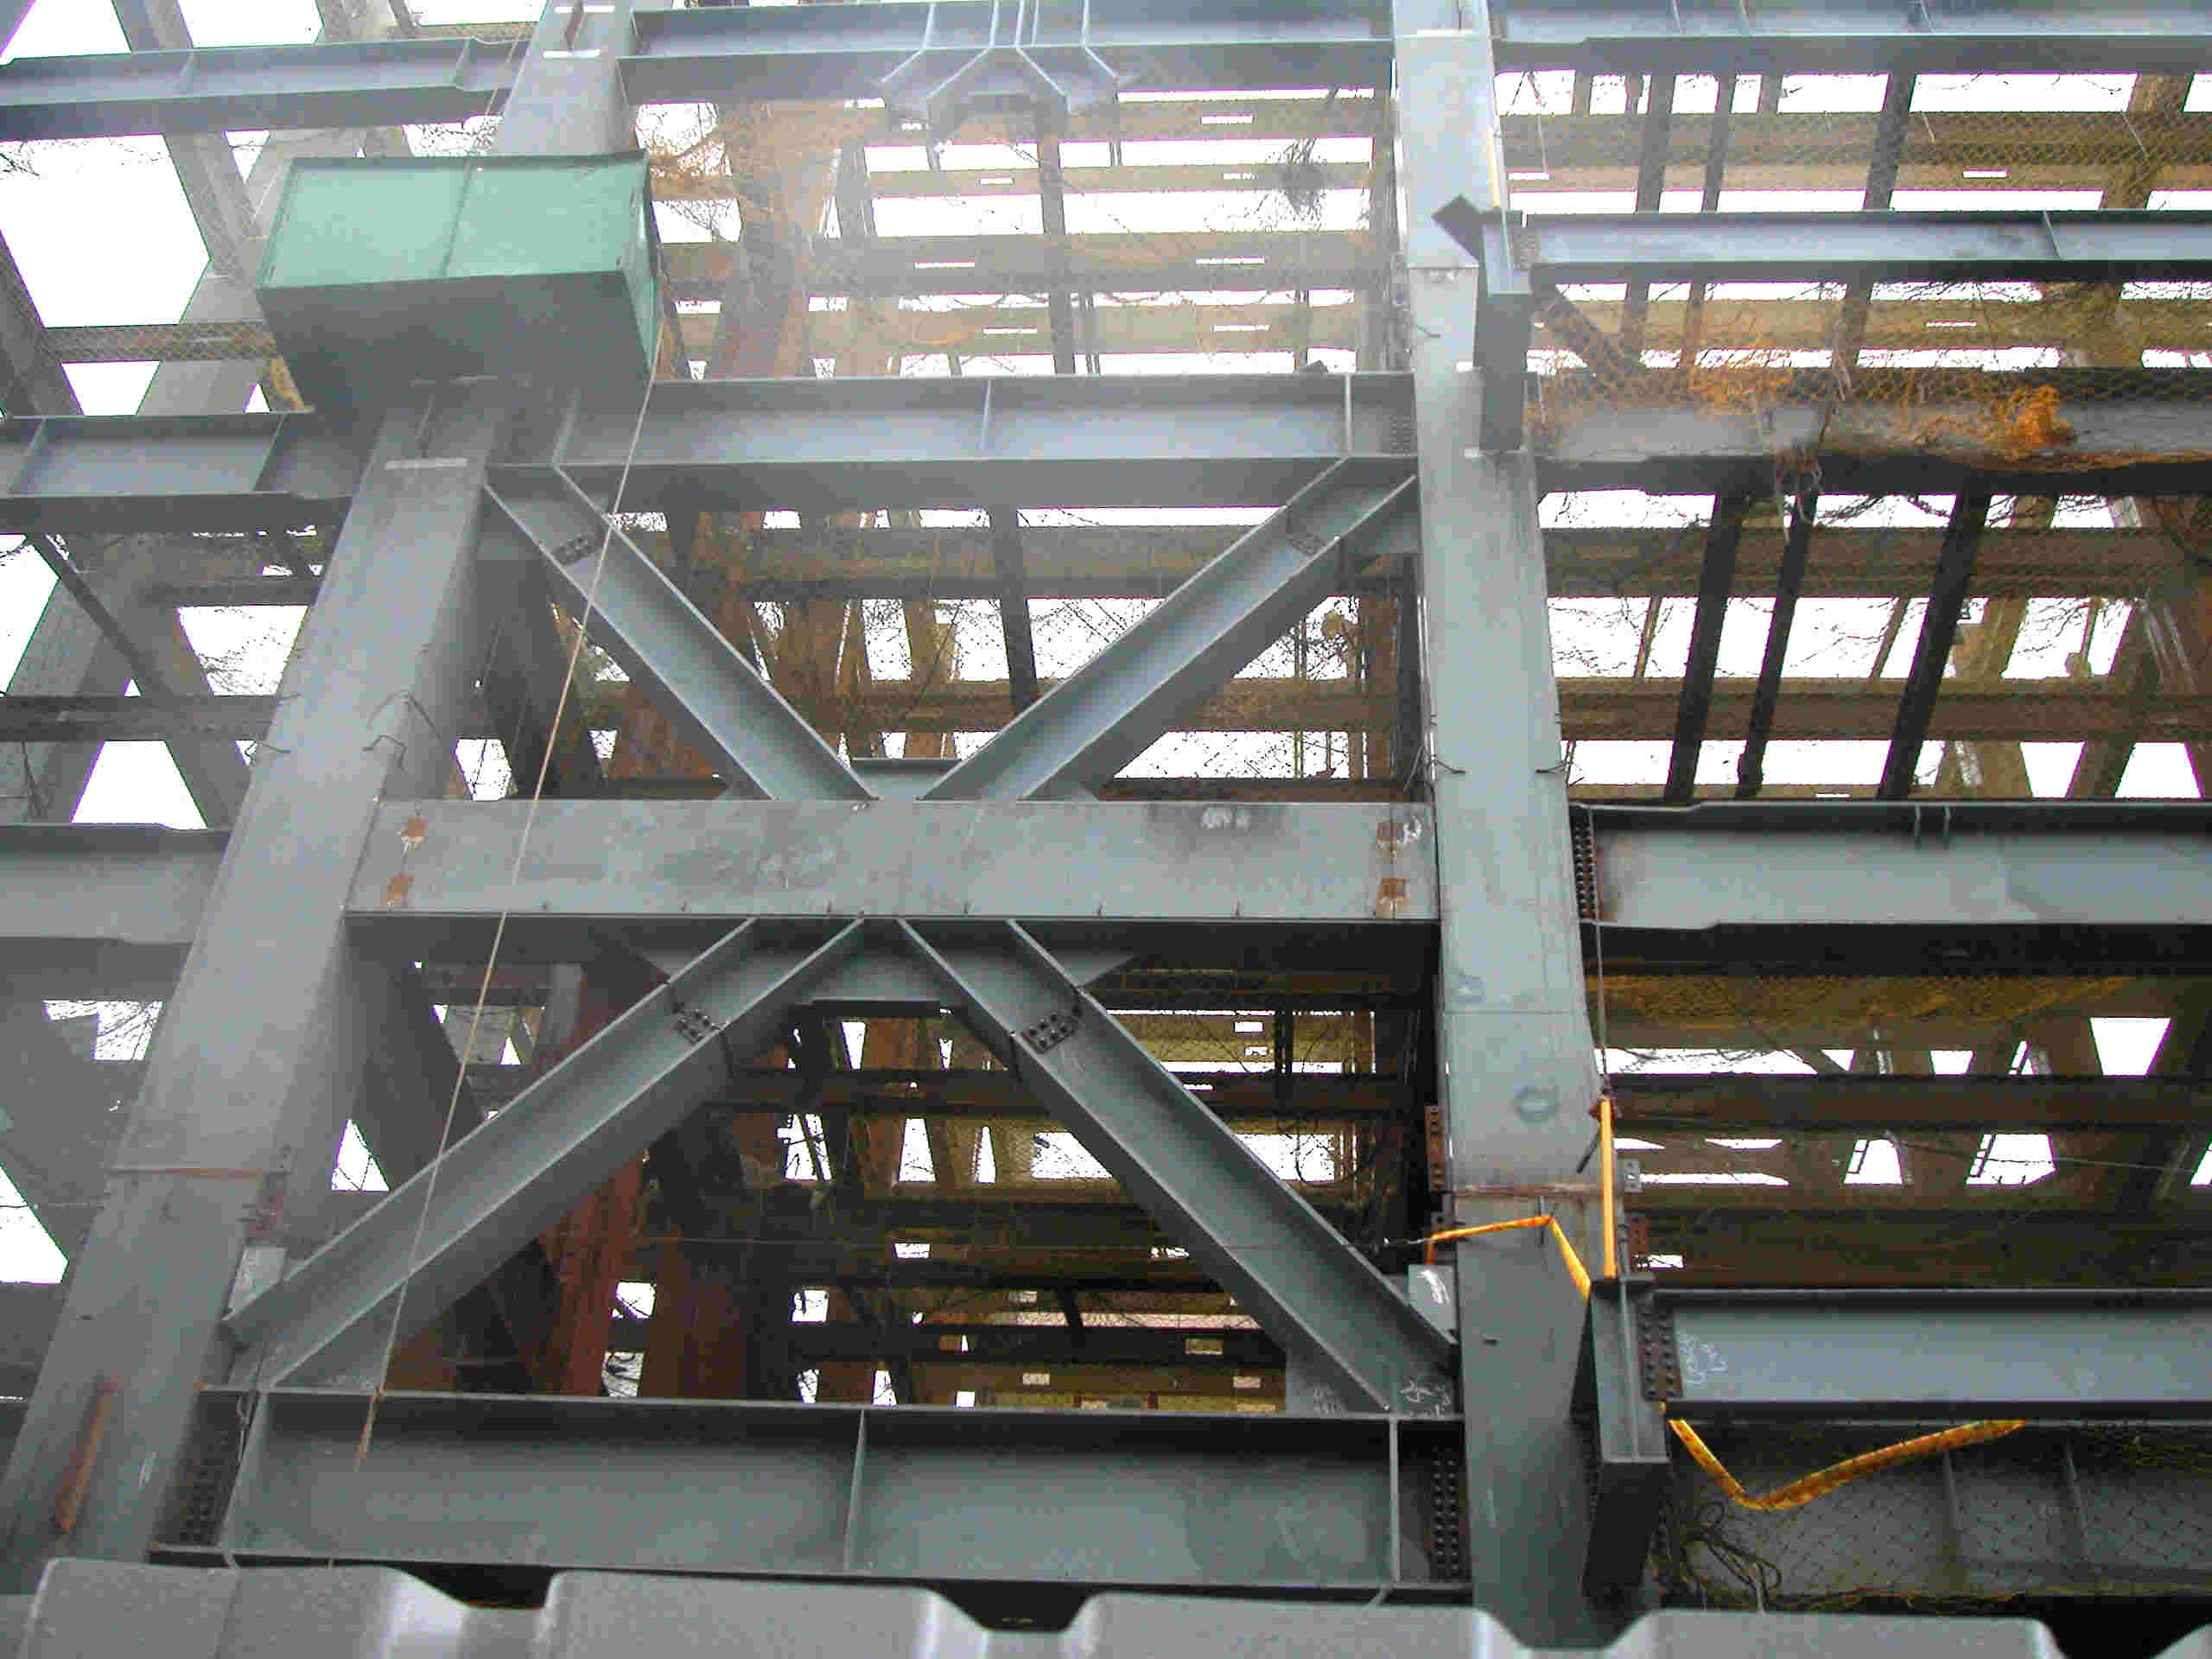
Notes:
Two story X-bracing.
This building is located in Taipei, Taiwan. The columns are steel boxes.

Slide 13
Notes:
Two story X-braced frame for bottom stories, with a inverted V-braced frame at the top story.
Photo courtesy of Russel Kehl and Wayne Chang, Structural Focus, Gardena, CA

Slide 14
3 - Concentrically Braced Frames
Description and Types of Concentrically Braced Frames
Basic Behavior of Concentrically Braced Frames
AISC Seismic Provisions for Special Concentrically Braced Frames
Notes:
In the next part of this module, we will discuss the basic inelastic behavior of CBFs under seismic loading.

Slide 15
Inelastic Response of CBFs under Earthquake Loading
Notes:
The next several slides illustrate the basic inelastic response of a CBF under lateral load. Recall that inelastic action is intended to occur in the bracing members.
In this frame, when the load is acting towards the right, the left brace will be in tension and the right brace will be in compression.

Slide 16
Inelastic Response of CBFs under Earthquake Loading
Tension Brace: Yields
(ductile)
Compression Brace: Buckles
(nonductile)
Columns and beams: remain essentially elastic
Notes:
The expected behavior of a CBF as the frame goes inelastic is that the compression brace will buckle and the tension brace will yield. The beams and columns are intended to remain essentially elastic, as the braces yield and buckle. When the compression braced buckles, it will generally rapidly lose compressive strength. Consequently brace buckling is a relatively non-ductile phenomena. On the other hand, yielding of a brace in tension can be a highly ductile phenomena. Consequently, the primary source of ductility in CBFs under lateral load is yielding of tension braces.

Slide 17
Inelastic Response of CBFs under Earthquake Loading
Compression Brace (previously in tension): Buckles
(nonductile)
Tension Brace (previously in compression): Yields
(ductile)
Columns and beams: remain essentially elastic
Notes:
When the lateral load reverses direction, the brace that had previously buckled in compression will now go into tension and will supply ductility through tension yielding. The brace that was previously yielded in tension will now buckle in compression.
Thus, in a CBF subject to an earthquake, the braces will undergo alternate tension yielding and compression buckling. As the cyclic yielding and buckling takes place in the braces, the beams and columns are intended to remain essentially elastic.
A primary goal in ductile detailing of CBFs is to permit the cyclic yielding and buckling to occur in the braces for many loading cycles, without failure of a brace end connection, and without fracture of the bracing member.
After an earthquake, one would expect to see buckled braces in a properly designed CBF. The following slides show examples of braced frames after an earthquake.

Slide 18
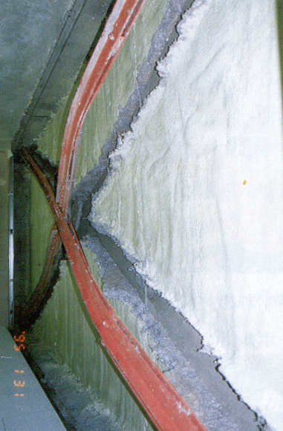
Notes:
This photograph, as well as the following photos, are of steel braced frames after the January 17, 1995 Hyogoken-Nanbu Earthquake in Kobe Japan.
This photo illustrates the intended behavior of a CBF. The braces have yielded and buckled, and the building remains standing.
Photos are from the following two reports:
"Reconnaissance Report on Damage to Steel Building Structures Observed from the 1995 Hyogoken-Nanbu (Hanshin/Awaji) Earthquake," by the Steel Committee of the Kinki Branch, Architectural Institute of Japan (AIJ), May 1995.
"Preliminary Reconnaissance Report of the 1995 Hyogoken-Nanbu Earthquake - English Edition," Architectural Institute of Japan, April 1995.

Slide 19
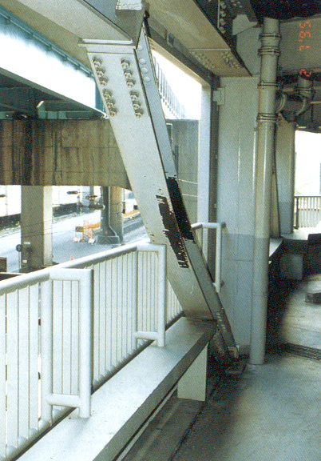
Notes:
Another example of good behavior of a CBF with heavy wide-flange braces. This brace has buckled, as intended, but remains connected to the rest of the frame.

Slide 20
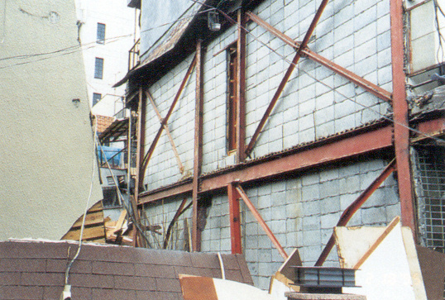
Notes:
An example of light bracing members that have buckled.

Slide 21
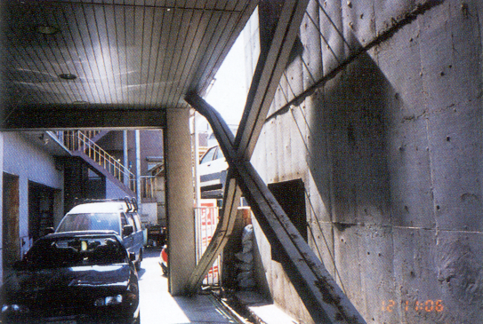
Notes:
Another example of a CBF that has performed as intended.

Slide 22
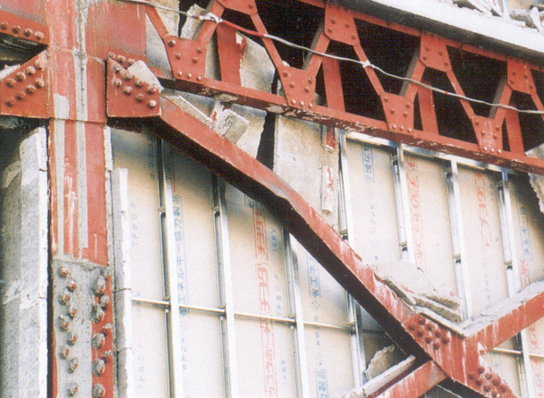
Notes:
An X-braced CBF with wide flange braces that have buckled in-plane.
Note that depending on the orientation of the bracing member and the end connection details, braces may buckle either in-plane or out-of-plane.

Slide 23
Brace Behavior Under Cyclic Axial Loading
P
Tension
δ
Shortening
Elongation
δ
P
Compression
Notes:
Bracing members are the critical elements of a CBF. The bracing members are the "fuses" in a CBF. That is, inelastic action is intended to occur in the bracing members. Consequently, it is important to understand the fundamental behavior of bracing members subjected to large cyclic axial loads.
The next several slides qualitatively illustrate the behavior of a bracing member, idealized as a pin-ended strut, under cyclic axial loading. The behavior of the strut will be illustrated in terms of the relationship between axial force and axial deformation. In the slides that follow, axial force is considered positive when it is in tension. Axial deformation is considered positive when it produces elongation with respect to the initial length of the strut.

Slide 24
Brace Behavior Under Cyclic Axial Loading
P
Brace loaded in compression to peak compression capacity (buckling).
δ
P_{CR}
P
1
Notes:
Assume the brace is first loaded in axial compression. As compression is applied to the brace, the brace will bow out-of-plane due to the P-Δ moments produced by the axial force.
Compression loading will continue until the brace reaches its buckling load, P_{cr}. The value of P_{cr} will depend on the effective slenderness of the brace, L_{c} / r and on the grade of steel used. For design purposes, the value of P_{cr} can be computed from the column strength equations provided in Chapter E of the AISC Specification.

Slide 25
Brace Behavior Under Cyclic Axial Loading
P
Brace loaded in compression to peak compression capacity (buckling).
Continue loading in compression. Compressive resistance drops rapidly. Flexural plastic hinge forms at mid-length (due to P-Δ moment in member).
δ
2
plastic hinge
P_{CR}
P
1
Δ
Notes:
If compressive loading continues, the compressive resistance of the brace drops sharply after reaching the initial buckling capacity P_{cr}. This rapid loss of capacity is typical for steel struts loaded in compression.
In its post-buckled configuration, the brace continues to bow outwards, with increasing lateral deflection Δ. At some point, the P-Δ moment generated at mid-span of the member will be large enough to form a flexural plastic hinge. That is, the P-Δ moment will be reach M_{p} of the bracing member.
Observe that buckling of a brace is a fundamentally non-ductile phenomenon. That is, once the compressive capacity of the member is reached at P_{cr}, this capacity is not maintained through large inelastic deformations. Rather, the capacity drops off rapidly in a non-ductile manner.
Observe also that after the brace has buckled, its behavior is dominated by flexure rather than by axial force.

Slide 26
Brace Behavior Under Cyclic Axial Loading
P
Brace loaded in compression to peak compression capacity (buckling).
Continue loading in compression. Compressive resistance drops rapidly. Flexural plastic hinge forms at mid-length (due to P-Δ moment in member).
Remove load from member (P=0). Member has permanent out-of-plane deformation.
3
δ
2
P_{CR}
1
Notes:
Assume that at Point 2, the brace is unloaded. In the unloaded state (point 3), the brace has a permanent axial deformation (axial shortening) and a permanent out-of-plane deformation.

Slide 27
Brace Behavior Under Cyclic Axial Loading
P
Brace loaded in tension to yield.
4
P_{y}
3
δ
2
P_{CR}
P
P_{CR}
1
Notes:
The brace is next loaded in tension. The applied tension force will cause the bowed member to straighten. If tension loading is continued, the member will yield in tension at an axial force of P_{y} = AF_{y}. Note that tension yielding is a ductile phenomenon. That is, the brace will maintain its tension yield capacity P_{y} through large deformations (assuming no connection failure).

Slide 28
Brace Behavior Under Cyclic Axial Loading
P
Brace loaded in tension to yield.
Remove load from member (P=0).
Member still has permanent out-of-plane deformation.
4
P_{y}
3
δ
5
2
P_{CR}
P_{CR}
1
Notes:
After Point 4, the load is removed. In its unloaded configuration (Point 5), the brace now has a permanent axial deformation (elongation). The brace will also still have a permanent out-of-plane deformation. The out-of-plane deformation created by buckling of the brace can never be completed removed by subsequent tension loading. The brace will always have a permanent out-of-plane "kink" at mid-span.

Slide 29
Brace Behavior Under Cyclic Axial Loading
P
Brace loaded in tension to yield.
Remove load from member (P=0).
Member still has permanent out-of-plane deformation.
Brace loaded in compression to peak compression capacity (buckling). Peak compression capacity reduced from previous cycle.
4
P_{y}
3
δ
5
2
6
P_{CR}
P
P_{CR}
Notes:
The brace is now loaded a second time in compression. This time, the brace buckles (at Point 6) at a much smaller load. This reduced buckling capacity is due to two reasons. One is the permanent out-of-plane displacement that was present at the start of this compressive loading cycle. This serves as a very large initial crookedness and significantly reduces the buckling capacity.
The second reason for the reduced buckling capacity in the second cycle is the Bauschinger Effect. The Bauschinger Effect describes changes that occur to the stress-strain relationship of steel under cyclic loading. The stiffness of the material is reduced under cyclic loading. That is, the effective modulus of the material is reduced, thereby reducing the buckling strength.

Slide 30
Brace Behavior Under Cyclic Axial Loading
P
Brace loaded in tension to yield.
Remove load from member (P=0).
Member still has permanent out-of-plane deformation.
Brace loaded in compression to peak compression capacity (buckling). Peak compression capacity reduced from previous cycle.
Continue loading in compression. Flexural plastic hinge forms at mid-length (due to P-Δ moment in member).
4
P_{y}
3
δ
5
7
2
6
P_{CR}
P
P_{CR}
1
Notes:
If compressive loading is continued, the compressive capacity of the member will drop. As was the case for the first compressive loading cycle, a flexural plastic hinge will form at mid-span due to large P-Δ moments.
The residual post buckling capacity (Point 7) will be similar to post-buckling capacity from the first cycle.
For member cross-sections with large width-thickness (b/t) ratios, local buckling can occur at location of the mid-span flexural hinge. After several cycles of loading, fracture can occur at the location of local buckling.

Slide 31
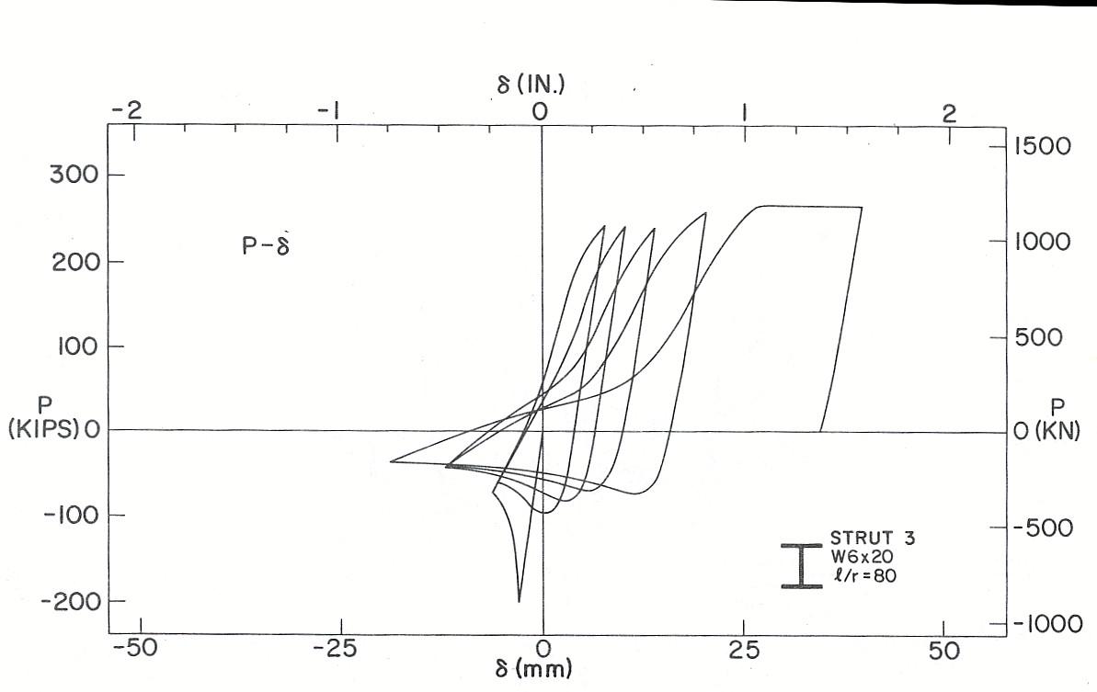
Experimental Behavior of Brace - Cyclic Axial Loading
W6x20 Kl/r = 80
δ
P
Notes:
This is a plot of axial force vs axial elongation from a cyclic loading experiment on a pin-ended steel bracing member. This member was an A36 W6x20, with kL/r=80.
Observe that the initial buckling capacity, P_{cr}, in the first compression loading cycle is about 200 kips. Note the sharp drop in compressive capacity after buckling, clearly showing the non-ductile nature of buckling.
In subsequent cycles, the compressive capacity of the member is significantly reduced.
Observe also that when loaded to large displacements in tension, the brace exhibits ductile behavior.

Slide 32
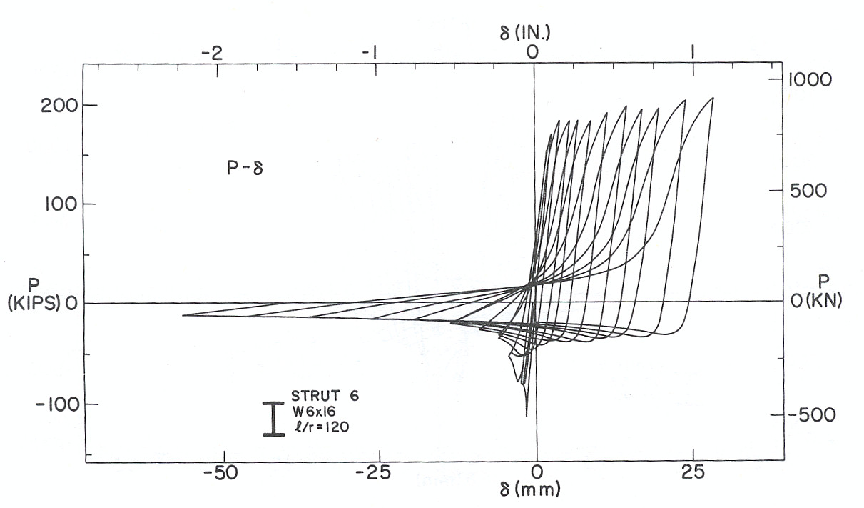
Experimental Behavior of Brace - Cyclic Axial Loading
W6x16 Kl/r = 120
δ
P
Notes:
This is an experimental result for an A36 W6x16 strut with kL/r=120. This strut is more slender than the W6x20 shown in the previous slide.
Note that with increasing slenderness:
1. Energy dissipation is reduced (loops are more "pinched"); and
2. There is a larger difference between tension capacity and compression capacity of the brace.

Slide 33
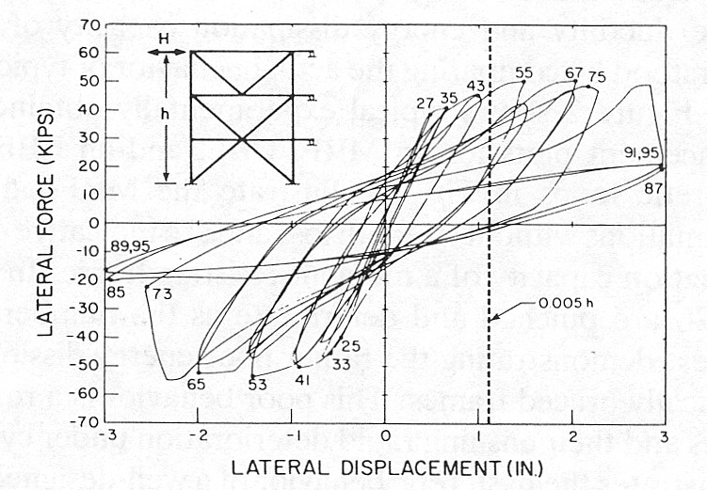
Experimental Behavior of Brace - Cyclic Loading
Notes:
As illustrated in the previous slides, braces have poor strength and ductility when loaded in compression, but exhibit higher strength and good ductility when loaded in tension. Thus, the tension braces are the primary contributors to frame lateral strength and ductility. Consequently, a brace frame should be configured so that about half of the braces will always be in tension, regardless of the direction of lateral load on the frame.
This slide shows an experimental result for a braced frame. The figure shows a plot of lateral load versus lateral deflection at the roof level. Since braces are deployed in both directions, the frame lateral strength and overall behavior is about the same in both directions of loading. Thus, even though brace behavior, by itself, is highly unsymmetrical (drastically different behavior in tension and compression), overall frame behavior of a CBF can be quite symmetrical, and exhibit overall good ductility.
Reference:
Wakabayashi, M, et al, "Inelastic Behavior of Full-Scale Steel Frames With and Without Bracings." Bulletin of the Disaster Prevention Research Institute, No. 24, Part 1, Kyoto University, Kyoto, Japan, 1974.

Slide 34
Developing Ductile Behavior in CBFs
General Approach
Design frame so that inelastic behavior is restricted to braces.
  Braces are "fuse" elements of frame.
  Braces are weakest element of frame. All other frame elements (columns, beams, connections) are stronger than braces.
Choose brace members with good energy dissipation capacity and fracture life (limit kL/r and b/t).
Notes:
The next several slides outline the basic approach for developing ductile behavior of CBFs.
The key idea is that the braces are designed to be the fuse elements in the frame. Consequently, the braces must be the weakest element in the frame.
Also, the braces must be designed and detailed to provide good energy dissipation capacity under cyclic loading.

Slide 35
Developing Ductile Behavior in CBFs
General Approach
Design brace connections for maximum forces and deformations imposed by brace during cyclic yielding/buckling
Notes:
Brace connections must be designed to withstand the maximum forces and deformations that will be imposed upon them by the braces, as the braces do through cycles of tension yielding and compression buckling. A key goal in ductile detailing of CBFs is that the brace connections should not fail.

Slide 36
Developing Ductile Behavior in CBFs
General Approach
Design beams and columns (and column splices and column bases) for maximum forces imposed by braces
Notes:
Beams and columns in CBFs must be stronger than the braces, to assure that inelastic action is restricted to the braces.

Slide 37
Developing Ductile Behavior in CBFs
General Approach
Design braces based on code specified earthquake forces.
Design all other frame elements for maximum forces that can be developed by braces.
Notes:
The basic design approach for CBFs:
1. Design the braces for code specified earthquake forces. The size of brace members will be controlled by their compression capacity.
2. Design all other frame elements (brace connections, beams, columns, column splices, column bases, etc) for the maximum forces that can be generated by the braces. This requires an estimate of the maximum forces that can be generated by a brace as it undergoes cyclic tension yielding and compression buckling. These maximum forces are considered in the following slides.

Slide 38
Maximum Forces Developed by Braces
Braces in Tension - Axial Force:
δ
P
P
For design:
Take P_{max} = R_{y} F_{y} A_{g}
P_{max} = P_{y}
δ
Notes:
For design, the maximum force generated by a brace in tension can be computed as tension yield force of the member: R_{y}F_{y}A_{g}, where R_{y}F_{y} is the expected yield stress of the brace material, and A_{g} is the gross cross-sectional area of the brace.

Slide 39
Maximum Forces Developed by Braces
Braces in Compression - Axial Force:
δ
P
δ
For design:
Take P_{max} = (F_{ne} / 0.877) A_{g}
Take P_{residual} = 0.3 P_{max}
P_{residual} ≅ 0.3 P_{max}
P_{max}
Notes:
1. F_{ne} = F_{n} from AISC 360 Ch. E using R_{y}F_{y}
2. P_{max} does not need to exceed R_{y}F_{y}A_{g}
P
Notes:
For a brace under axial compression, the maximum force generated by the brace can be considered at two levels: the maximum compression strength, P_{max}, and the residual post-buckling strength P_{residual}.
The maximum compression strength is taken as the lesser of (F_{ne} / 0.877) A_{g} and R_{y}F_{y}A_{g} according the AISC Seismic Provisions. In this equation, F_{ne} is equal to the nominal stress of the member, F_{n} , computed per Chapter E of the AISC Specification, but using RyFy in place of Fy.
For computing the residual compressive capacity, the AISC Seismic Provisions takes 30% of the expected brace strength in compression, i.e., 0.3P_{max}.

Slide 40
Maximum Forces Developed by Braces
Braces in Compression - Bending Moment:
Plastic Hinges
P
P
M
M
For "fixed" end braces: flexural plastic hinges will form at mid-length and at brace ends. Brace will impose bending moment on connections and adjoining members.
For design:
Take M_{max} = 1.1 R_{y} F_{y} Z_{brace} (for critical buckling direction)
Notes:
If the brace ends are "fixed" against rotation, large end moments will develop at the brace ends in the post-buckling condition. This, in turn, can impose large moments on brace connections and on the adjoining beam and column.
To compute the maximum moment that a fixed end brace can impose on the connection and adjoining members, the AISC Seismic Provisions specify that this moment should be taken as 1.1 R_{y}M_{p} of the brace member.

Slide 41
Maximum Forces Developed by Braces
Braces in Compression - Bending Moment:
P
P
Plastic Hinge
P
P
For "pinned" end braces: flexural plastic hinge will form at mid-length only. Brace will impose no bending moment on connections and adjoining members.
Must design brace connection to behave like a "pin"
Notes:
For "pinned" brace ends, no bending moments will be developed at the brace ends. For this case, no bending moment need be considered coming from the brace when designing the brace connection or adjoining members.
For this to be the case, the brace connection must be designed and detailed so that it will, in fact, behave like a "pin." Approaches for accomplishing this will be illustrated later.

Slide 42
Maximum Forces in Columns and Beams
To estimate maximum axial forces imposed by braces on columns and beams:
Braces in Tension:
Take P = R_{y} F_{y} A_{g}
Braces in Compression:
P_{c} = min { (F_{ne} / 0.877) A_{g} , R_{y}F_{y}A_{g} }
Use:
OR
P = 0.3 P_{c}
whichever produces critical design case
Notes:
Columns and beams should be designed for the maximum forces that can be generated by the yielded and buckled braces.
For this purpose, the axial force in tension braces can be taken as R_{y}F_{y}A_{g}.
The axial force in compression braces can be taken as P_{c} =min{ (F_{ne} / 0.877) A_{g} and R_{y}F_{y}A_{g} }, or as 0.3P_{ne}, whichever gives a critical case in the beam or column. In general, if a beam or column is receiving forces from both tension braces as well as from compression braces, the tension braces can be assumed to be at R_{y}F_{y}A_{g} and the compression braces at 0.3P_{c}. This is because braces in compression will buckle at lower levels of frame drift, than when braces yield in tension. Consequently, by the time the braces have yielded in tension, the compression braces have already likely buckled and are only carrying their residual compressive capacity.

Slide 43
Example
θ
Find maximum axial compression in column.
Tension Braces:
Take P = R_{y} F_{y} A_{g}
Compression Braces:
Take P = P_{c}
Notes:
To estimate the maximum compression force that can be developed in the first story column, assume all the tension braces are at R_{y}F_{y}A_{g} and all the compression braces are at P_{c}.
The calculation is shown on the next slide.

Slide 44
Example
R_{y} F_{y} A_{g}
θ
P_{c}
R_{y} F_{y} A_{g}
Column Axial Compression =
[ Σ (R_{y} F_{y} A_{g} ) cos θ + Σ (P_{c}) cos θ ] + P_{gravity}
P_{c}
(sum brace forces for all levels above column)
R_{y} F_{y} A_{g}
P_{c}
Notes:
This procedure provides a reasonable bound on the maximum compression force that will be seen by the first story column, after all of the tension braces have yielded and all of the compression braces are at their buckling strength.
Note that this approach is likely to be very conservative for frames with many stories, since it is unlikely that all braces will simultaneously yield and buckle over the entire height of the frame.

Slide 45
Example
θ
Find maximum axial tension in column.
Tension Braces:
Take P = R_{y} F_{y} A_{g}
Compression Braces:
Take P = P_{c}
Notes:
This is a similar example. In this case, the maximum tension in the first story column will be estimated.

Slide 46
Example
P_{c}
θ
R_{y} F_{y} A_{g}
P_{c}
Column Axial Tension =
R_{y} F_{y} A_{g}
[ Σ (R_{y} F_{y} A_{g} ) cos θ + Σ (P_{c}) cos θ ] - P_{gravity}
P_{c}
(sum brace forces for all levels above column)
R_{y} F_{y} A_{g}
Notes:
This procedure provides a reasonable bound on the maximum tension force that will be seen by the first story column, after all of the tension braces have yielded and all of the compression braces have buckled.
This tension force will not likely control the column size. The column size will likely be controlled by the maximum compression force, as computed in the earlier slides. However, the maximum tension force in the column will be important for the design of column splices and the column base connections.

Slide 47
Example
Find maximum axial compression in column.
Tension Braces:
Take P = R_{y} F_{y} A_{g}
θ
Compression Braces:
Take P = 0.3P_{c}
Notes:
This slide illustrates the approach for estimating the maximum axial compression in the center column.

Slide 48
Example
Column Axial Compression =
0.3 P_{c}
(R_{y} F_{y} A_{g} ) cos θ + (0.3 P_{c}) cos θ + P_{gravity}
R_{y} F_{y} A_{g}
θ
Note
Based on elastic frame analysis:
Column Axial Force = P_{gravity}
Notes:
An elastic frame analysis would show that the center column carries only tributary gravity load, and sees no force as a result of lateral load on the frame. This is because, in the elastic range, the axial forces in the two braces are equal in magnitude (and opposite in sign). Consequently, the vertical components of the brace forces cancel each other out, and no force is transferred to the center column.
However, in the inelastic range, the axial forces in the two braces will be significantly different. The tension brace will be carrying R_{y}F_{y}A_{g}, whereas the compression brace will only be carrying its residual post-buckling capacity, 0.3P_{c}. For this condition, there will be a large unbalanced vertical force where the two braces meet, which will generate a large axial compression force in the center column.
This slide illustrates an important point. The forces developed in the beams and columns of a CBF after braces have yielded and buckled is generally drastically different than the forces in these members when the frame is elastic. Consequently, an elastic frame analysis can be very misleading for a CBF. It is preferable to design beams and columns using the capacity design approach illustrated here.

Slide 49
Example
Find maximum bending moment in beam.
Tension Brace:
Take P = R_{y} F_{y} A_{g}
θ
Compression Brace:
Take P = 0.3 P_{c}
Notes:
This inverted V-braced frame is similar to the previous frame, but with no center column. This slide shows the basis for estimating the maximum moment in the beam of this frame.

Slide 50
Example
θ
0.3 P_{c}
R_{y} F_{y} A_{g}
Notes:
An elastic analysis of this inverted V-braced frame would show essentially no bending moment in the beam, as a result of lateral load. This is because, in the elastic range, the axial forces in the two braces are equal in magnitude (and opposite in sign). Consequently, the vertical components of the brace forces cancel each other out, and no vertical force is transferred to the beam.
However, in the inelastic range, the axial forces in the two braces will be significantly different. The tension brace will be carrying R_{y}F_{y}A_{g}, whereas the compression brace will only be carrying its residual post-buckling capacity, 0.3P_{c}. For this condition, there will be a large unbalanced vertical force where the two braces meet, which will generate a large vertical force at the center of the beam, which in turn will generate a large bending moment in the beam.

Slide 51
Example
Compute moment in beam resulting from application of concentrated load at midspan:
( R_{y} F_{y} A_{g} - 0.3 P_{c} ) sin θ
and add moment due to gravity load
( R_{y} F_{y} A_{g} - 0.3 P_{c} ) sin θ
Note
Based on elastic frame analysis: Moment in beam ≅ 0
Notes:
This is the unbalanced vertical load that the braces will transfer to the beam. Designing the beam to resist this large unbalanced load will often result in very heavy beams in V and inverted V-braced frames.

Slide 52
Example
Find maximum axial tension and compression that will be applied to gusset plate.
θ
Tension Brace:
Take P = R_{y} F_{y} A_{g}
Compression Brace:
Take P = P_{c}
Notes:
In this example, we will look at the maximum axial forces that the braces can impose on the brace connections.

Slide 53
Example
Check gusset yield, gusset net section fracture, gusset block shear fracture, local beam web yielding, etc.
Check gusset buckling, beam web crippling, etc.
R_{y} F_{y} A_{g}
min { (F_{ne} / 0.877) A_{g} , R_{y}F_{y}A_{g} }
Notes:
The maximum axial tension that the brace imposes on the connection can be taken as R_{y}F_{y}A_{g}. This force will be used to check limits states such as gusset yield, gusset net section fracture, gusset block shear fracture, fracture of brace to gusset welds, etc.
The maximum axial compression that the brace imposes on the connection can be taken as the lesser of (F_{ne} / 0.877) A_{g} and R_{y}F_{y}A_{g}. This force will be used to check limit states such as gusset plate buckling and beam web crippling.

Slide 54
3 - Concentrically Braced Frames
Description and Types of Concentrically Braced Frames
Basic Behavior of Concentrically Braced Frames
AISC Seismic Provisions for Special Concentrically Braced Frames
Notes:
The previous slides looked at some basic concepts and approaches for developing ductile behavior in CBFs. The remainder of this module will look at how these concepts are implemented in the AISC Seismic Provisions for Special Concentrically Braced Frames.

Slide 55
2022 AISC Seismic Provisions
Section F1
Ordinary Concentrically Braced Frames (OCBF)
Section F2
Special Concentrically Braced Frames (SCBF)
Notes:
The AISC Seismic Provisions define two types of concentrically braced frames:
Special Concentrically Braced Frames (SCBF) and
Ordinary Concentrically Braced Frames (OCBF).
SCBF systems are detailed to provide higher levels of ductility that OCBF. SCBF systems consequently are assigned a higher R-factor than for OCBF.
This module will only cover SCBF detailing provisions.

Slide 56
2022 AISC Seismic Provisions
Section F2. Special Concentrically Braced Frames (SCBF)
F2.1 Scope
F2.2 Basis of Design
F2.3 Analysis
F2.4 System Requirements
F2.5 Members
F2.6 Connections
Notes:
SCBF detailing requirements are in Section F2 of the AISC Seismic Provisions. Section F2 is divided into 6 sections, as shown on the slide.

Slide 57
AISC Seismic Provisions - SCBF
Basis of Design
F2.2 Basis of Design
This section is applicable to braced frames that consist of concentrically connected members. Eccentricities less than the beam depth are permitted if the resulting member and connection forces are addressed in the design and do not change the expected source of inelastic deformation capacity.
SCBF designed in accordance with these provisions are expected to provide significant inelastic deformation capacity primarily through brace buckling and yielding of the brace in tension.
Notes:
Section F2.2 is a scope statement for SCBF. This section states that SCBF are expected to withstand significant inelastic deformations, which means the detailing provisions for SCBF are intended to result in a ductile system.

Slide 58
AISC Seismic Provisions - SCBF
Analysis
F2.3 Analysis
The required strength of columns, beams, struts and connections in SCBF shall be determined using the capacity-limited seismic load effect. The capacity-limited horizontal seismic load effect, E_{cl}, shall be taken as the larger force determined from the following analyses:
All braces at expected strength (R_{y}F_{y}A_{g} in tension and P_{c} for compression) P_{c} = min { (1/ 0.877) A_{g} F_{ne} , R_{y}F_{y}A_{g} }
All tension braces at expected strength (R_{y}F_{y}A_{g}) and all compression braces at their post-buckling strength (0.3P_{c})
Special requirements for multi-tiered braced frames
Notes:
Section F2.3 describes the method for obtaining the required strength of columns, beams, and connections in SCBF. For typical SCBF, two scenarios must be considered: a) when the tension braces are yielding and the compression braces reach their expected compression buckling strength, and b) when the tension braces are yielding, and the compression braces are resisting their post-buckling force. The required strength for columns, beams, and connections are the worst case produced by the two scenarios.
For multi-tiered braced frames, the progression of yielding and buckling must be considered as described in the special requirements in c).

Slide 59
Example
Find required axial compression strength and flexure in beam.
Notes:
This shows the forces for which the beam must be designed. This includes the gravity load on the beam, as well as the unbalanced brace forces.

Slide 60
Example
L
w_{gravity} = (1.2 + 0.2 S_{DS}) D + 0.5L
θ
R_{y} F_{y} A_{g}
Beam-to-column connections: simple framing
0.3 P_{c} for flexure
P_{c} for beam axial
Notes:
This shows the forces for which the beam must be designed. This includes the gravity load on the beam, as well as the unbalanced brace forces.

Slide 61
Example
Forces acting on beam:
L
Find required axial compression strength and flexure in beam.
w_{gravity} = (1.2 + 0.2 S_{DS}) D + 0.5L
( R_{y} F_{y} A_{g} + P_{c} ) cos θ
( R_{y} F_{y} A_{g} - 0.3 P_{c} ) sin θ
Notes:
This shows the forces applied to the beam.
Note that there is both an unbalanced vertical force on the beam (which produces bending and shear in the beam) as well as an unbalanced horizontal force on the beam (which produces axial force in the beam). Consequently, the beam must be designed as a member under combined axial force and bending (i.e., a beam-column).
Accommodating these large unbalanced brace forces will often result in very heavy beams in V-Type and Inverted V-Type braced frames.

Slide 62
AISC Seismic Provisions - SCBF
System Requirements
F2.4a Lateral Force Distribution
Along any line of braces, braces shall be deployed in alternate directions such that, for either direction of force parallel to the bracing, at least 30% but not more than 70% of the total horizontal force along that line is resisted by braces in tension…
Notes:
As lateral earthquake load is applied to an SCBF, the compression braces will buckle and tension braces will yield. As described earlier, the buckled compression braces lose strength rapidly after buckling. Consequently, it is the tension braces that provide the predominant lateral strength and stiffness for the braced frame.
Ideally, the braces should be arranged so that about half of the applied lateral load is resisted by tension braces, for either direction of loading on the frame. Section F2.4a states that the portion of the lateral load resisted of tension braces should be in the range of 30-percent to 70-percent.

Slide 63
F2.4a Lateral Force Distribution
Deploy braces so that about half are in tension (and the other half in compression)
All braces in tension (or compression) No Good
OK
Notes:
An example of applying the requirements of Section F2.4a.
Note that the top frame in this slide is a highly undesirable arrangement of bracing (and prohibited by Section F2.4a). For this arrangement, when the lateral load points towards the left, all the braces will be in compression and will buckle. The frame will be very weak in this condition. Further, the frame at the top will have a highly nonsymmetrical response, because the strength, stiffness and ductility of the frame will be drastically different for the two different directions of loading on the frame.

Slide 64
AISC Seismic Provisions - SCBF
System Requirements
F2.4b V- and Inverted V- Braced Frames
Notes:
Section F2.4b addresses special requirements for V-Type and Inverted-V Type bracing configurations.
As discussed earlier, an elastic analysis of this type of braced frame would show essentially no bending moment in the beam, as a result of lateral load. This is because, in the elastic range, the axial forces in the two braces are equal in magnitude (and opposite in sign). Consequently, the vertical components of the brace forces cancel each other out, and no vertical force is transferred to the beam.
However, in the inelastic range, the axial forces in the two braces will be significantly different. The tension brace will be carrying R_{y}F_{y}A_{g}, whereas the compression brace will only be carrying its residual post-buckling capacity, 0.3P_{c}. For this condition, there will be a large unbalanced vertical force where the two braces meet, which will generate a large vertical force at the center of the beam, which in turn will generate a large bending moment in the beam.
The unbalanced force in the beam, if not considered in the beam design, can result in the formation of a flexural plastic hinge at mid-span of the beam, which can result in a soft-story mechanism, which in turn may lead to frame collapse.

Slide 65
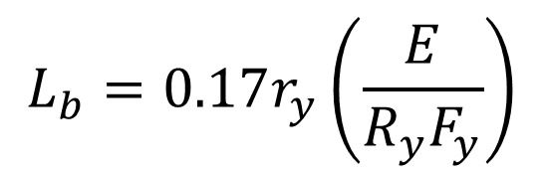
F2.4b V- and Inverted V- Braced Frames
Beam must be continuous between columns
Brace the beam at the point of intersection of the braces
Brace the rest of the beam per D1.2a for moderately ductile members
$$L_{b}=0.17r_{y}\left(\frac{E}{R_{y}F_{y}}\right)$$
Notes:
To avoid hinge formation in the beam, and therefore to avoid the potential for a soft story, the beam must be designed to resist the unbalanced forces from the braces as specified in Section F2.3. Section F2.4b includes additional requirements for these beams.

Slide 66
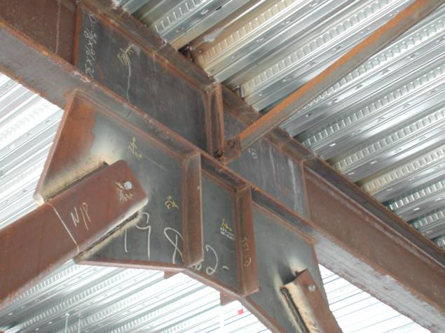
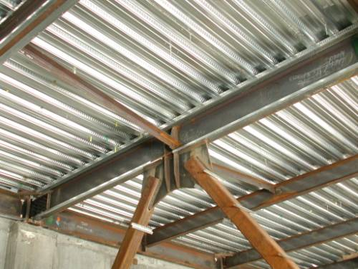
Notes:
Examples of lateral braces in an inverted V-type braced frame.
Photos courtesy of Prof. Chia-Ming Uang, University of California at San Diego.

Slide 67
AISC Seismic Provisions - SCBF
System Requirements
F2.4c K-Braced Frames
K-Type braces are not permitted for SCBF
Notes:
K-type bracing, as shown in the slide, is not permitted in SCBF. The unbalanced forces at the point where the two braces meet the column could destabilize the column.

Slide 68
AISC Seismic Provisions - SCBF
Members
F2.5a Basic Requirements
Columns, beams and braces shall meet requirements of Section D1.1 for highly ductile members
i.e. Columns, beams and braces must be extra compact to have ductility after reaching plastic strength: λ ≤ λ_{hd}
Notes:
Section F2.5a requires that columns, beams, and braces of SCBF have width-to-thickness ratios (section slenderness) that satisfy the requirements for highly ductile sections. This is to assure that these members can develop their plastic flexural strength, M_{p} and maintain this strength through large inelastic deformations, without excessive strength loss due to local buckling.
An elastic analysis of a braced frame generally shows that the columns and braces only carry axial force, and so flexural strength and ductility are not an issue in the elastic range.
However, when a braced frame goes inelastic in an earthquake, the columns and braces may see very large bending moments, so flexural strength and ductility become important.

Slide 69
AISC Seismic Provisions - SCBF
System Requirements
F2.4d Tension-Only Frames
F2.4e Multi-Tiered Braced Frames
Roof
No floor here
Not allowed
Special requirements
Notes:
The design procedures for SCBF in Section F2 were developed with consideration of compression strength of the braces. The design procedures are not applicable to tension-only braced frames in which the compression strength is neglected in design.
Multi-tiered braced frames are defined as braced frames with two or more tiers of bracing between horizontal diaphragm levels or locations of out-of-plane support. The braces can apply substantial force to the columns at the intermediate panel point locations where there is no lateral bracing against out-of-plane deformations. Special requirements, particularly for the column, are necessary to prevent failure modes associated with drift concentration in individual tiers or buckling of the column.

Slide 70
F2.5a Width-Thickness Limitations
Beams: λ ≤ λ_{hd}
Braces: λ ≤ λ_{hd}
Columns: λ ≤ λ_{hd}
Notes:
This slide schematically illustrates how the beams and columns may see significant bending after braces buckle. These column moments are not usually explicitly considered in the design of an SCBF. However, the requirement for seismically compact columns is intended to help allow columns to carry large moments, should such large moments occur in an earthquake.

Slide 71
F2.5a Width-Thickness Limitations
plastic hinge
P
Δ
Braces: form plastic hinge during buckling
With high b/t --- local buckling leads to creasing
and fracture at plastic hinge region
Notes:
As discussed earlier, braces will form a plastic flexural hinge in the post-buckling condition, due to P-Δ moments in the member. Brace members with high b/t ratios will suffer local buckling at these hinge locations. The high localized strains in the local buckle regions, in turn, may result in fracture of the brace member after just a few cycles of loading. The requirement for seismically compact brace members is intended to delay the onset of local buckling, and thereby delay fracture of the brace at the hinge region.

Slide 72
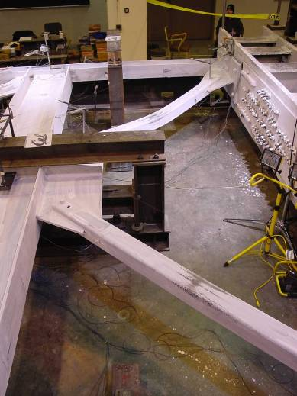
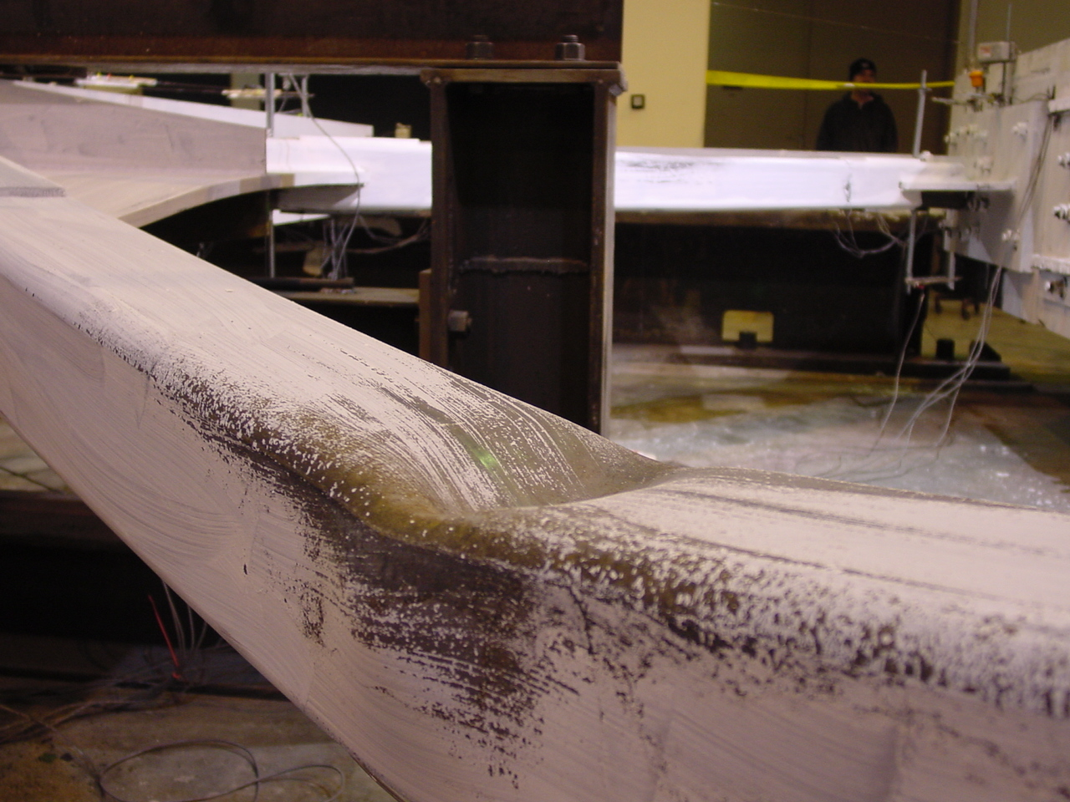
Notes:
This slide shows photos from a laboratory cyclic loading test on a braced frame constructed with HSS braces. The photo in the lower left shows a buckled HSS brace. Note the plastic flexural hinge that has formed at mid-span of the brace (as evidenced by flaking of whitewash) and the local buckle that has formed.
Photo courtesy of Prof. Steven Mahin - Univ of California at Berkeley

Slide 73
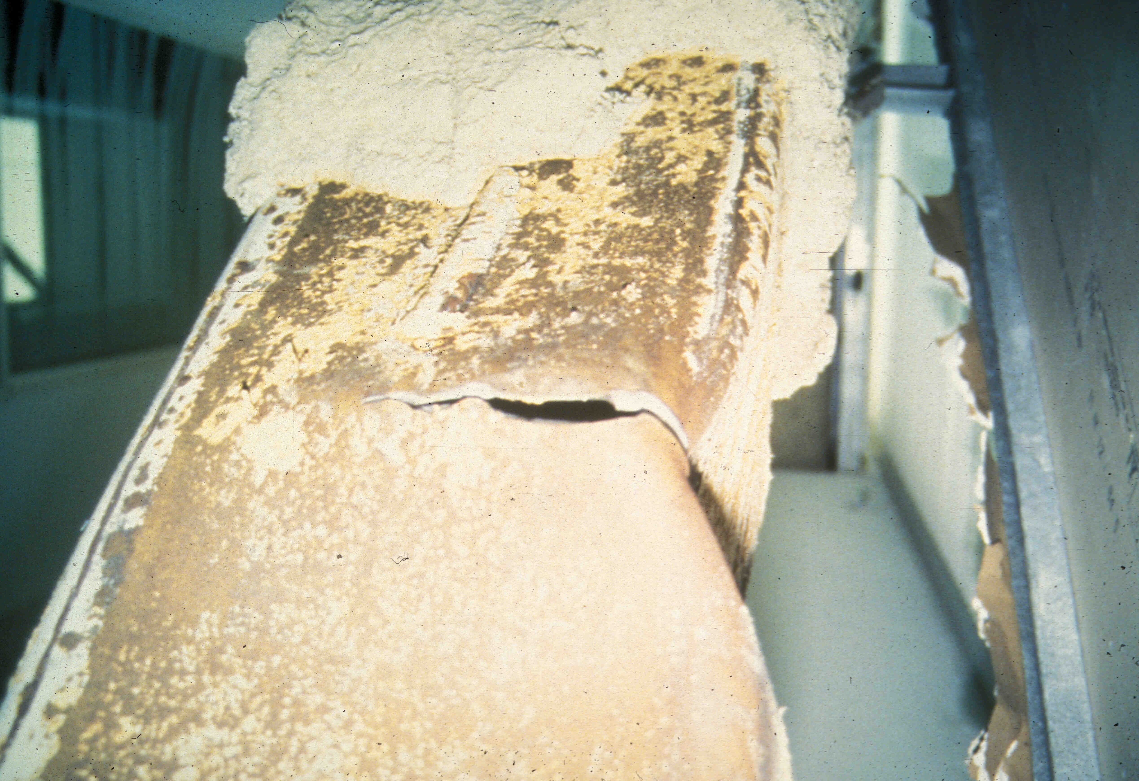
Notes:
This photo was taken in a braced frame building following the 1994 Northridge Earthquake. The braces were constructed using HSS members.
The photo shows a local buckle in the brace, that resulted in fracture of the brace. The requirement that brace members be seismically compact is intended to preclude this poor behavior.
Photo courtesy of James Malley - Degenkolb Associates, San Francisco

Slide 74
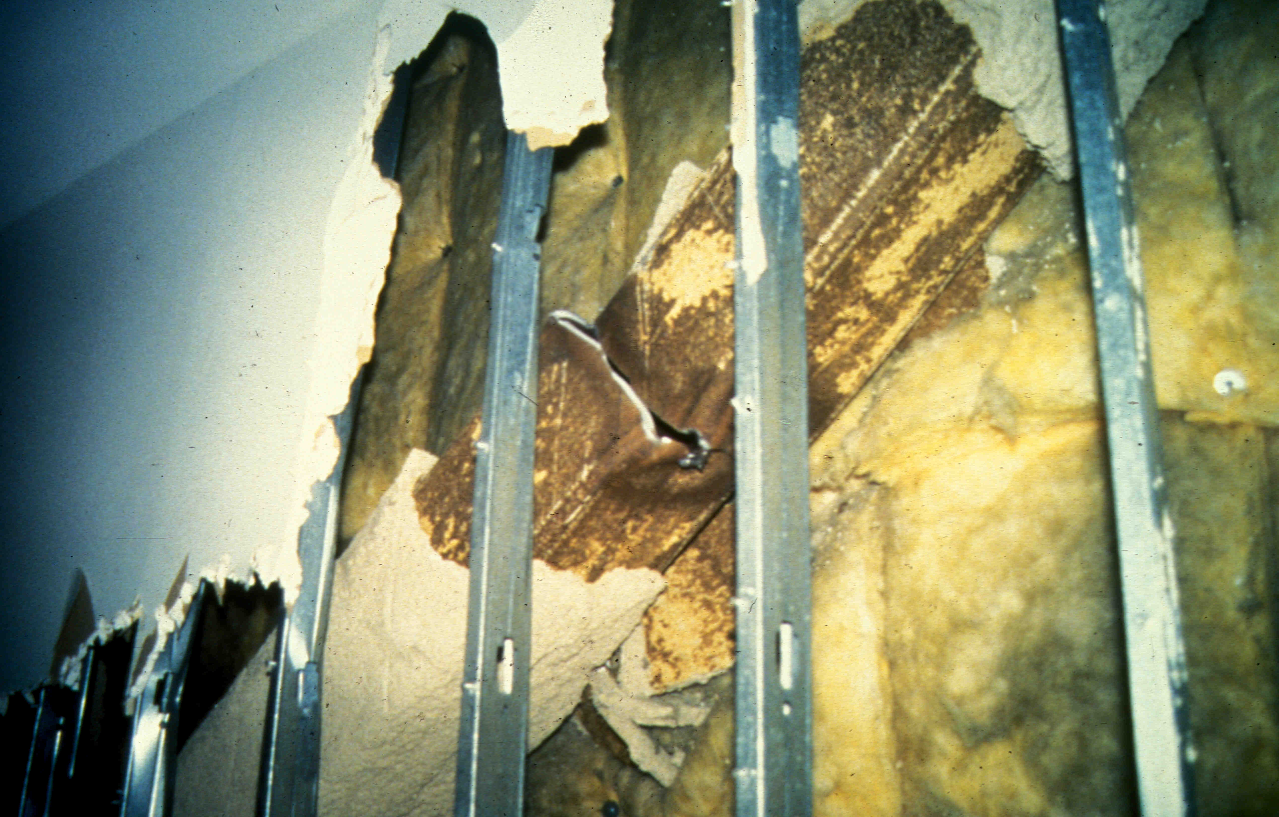
Notes:
Another view of an HSS brace following the 1994 Northridge Earthquake. The brace has suffered local buckling at the mid-span hinge which then caused fracture.
Photo courtesy of James Malley - Degenkolb Associates, San Francisco

Slide 75
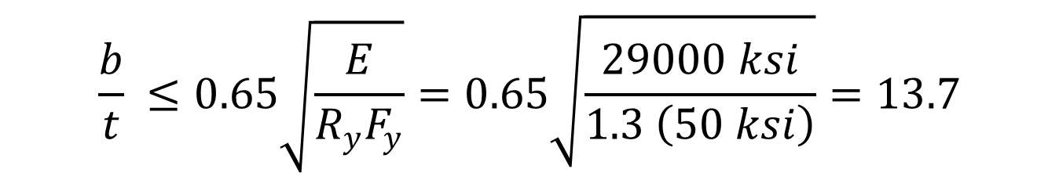
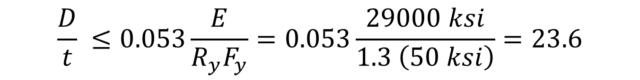
F2.5a Width-Thickness Limitations
Bracing Members: λ ≤ λ_{hd}
For rectangular HSS (A500 Gr C steel):
$$\frac{b}{t} ≤0.65\sqrt{\frac{E}{R_{y}F_{y}}}=0.65\sqrt{\frac{29000 ksi}{1.3 \left(50 ksi\right)}}=13.7$$
For round HSS (A500 Gr C steel):
$$\frac{D}{t} ≤0.053\frac{E}{R_{y}F_{y}}=0.053\frac{29000 ksi}{1.3 \left(50 ksi\right)}=23.6$$
Notes:
For rectangular HSS members of A500 Gr C steel, the highly ductile width-to-thickness limit for any wall of the member is 13.7.
For round HSS members of A500 Gr C steel, the highly ductile width-to-thickness limit for any wall of the member is 23.6.

Slide 76
F2.5a Width-Thickness Limitations
AISC Seismic Design Manual Table 1-5b
Notes:
Only a small number of square HSS members listed in the AISC Manual satisfy the highly ductile width-to-thickness requirement. The sections that are highly ductile (and therefore can be used in SCBF) are given in Table 1-5b of the Seismic Design Manual.

Slide 77
F2.5a Width-Thickness Limitations
AISC Seismic Design Manual Table 1-6
Notes:
Only a small number of round HSS members listed in the AISC Manual satisfy the highly ductile width-to-thickness requirement. The sections that are highly ductile (and therefore can be used in SCBF) are given in Table 1-6 of the Seismic Design Manual.

Slide 78

AISC Seismic Provisions - SCBF
Members
F2.5b(a) Slenderness
$$\frac{L_{c}}{r} ≤ 200$$
Bracing members shall have:
Limit slenderness to prevent unwanted dynamic effects
Notes:
Section F2.5b specifies requirements and limitations for bracing members.
Section F2.5b provides an upper limit for the effective slenderness of brace members in SCBF.
Stockier braces (low effective slenderness ratios) generally provide better energy dissipation capacity than slender braces.
Further, the imbalance between the tension and compression capacity for stocky braces is less than for more slender braces.

Slide 79
AISC Seismic Provisions - SCBF
Members
F2.5b(c) Effective Net Area
The brace effective net area shall not be less than the brace gross area. Where reinforcement on braces is used, the following requirements shall apply:
  The specified minimum yield strength of the reinforcement shall be at least equal to the specified minimum yield strength of the brace.
  The connections of the reinforcement to the brace shall have sufficient strength to develop the expected reinforcement strength on each side of a reduced section.
Objective: Yield of gross section of brace prior to fracture of net section
Notes:
A basic goal of SCBF detailing is to force tension yielding on the gross section instead of a fracture limit state in the brace connection or within the brace member itself.
For typical connections, the effective net area of the member is usually less than the gross area. The reduction in effective cross-sectional area can result from holes in the members (bolts holes or holes made to facilitate welding) and can also result from shear lag. Reductions of cross-sectional area can also occur along the length of the member if holes are made in the member for stitches in built-up members or for other attachments to the bracing member.
Section F2.5b(c) states that the effective net area shall not be less than the brace gross area. In this way, net section fracture is prevented and the preferred limit state of yielding is expected to occur.
The next two slides illustrate bracing members that have fractured at net sections.

Slide 80
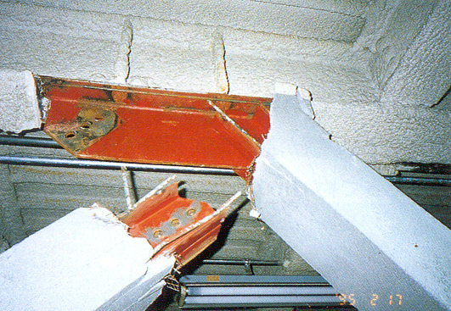
Notes:
This slide and the next slide are from steel braced frame buildings following the 1995 Hyogoken-Nanbu Earthquake in Kobe Japan. In these photos, the bracing members have fractured at bolted connections, where the effective cross-sectional area is reduced by bolt holes and by shear lag.
Once a brace member fractures, the lateral load resisting ability of the braced frame is compromised, and the building is vulnerable to collapse.
The requirements of Section 13.2b are intended to preclude brace member fractures at net sections.
Photos are from the following two reports:
"Reconnaissance Report on Damage to Steel Building Structures Observed from the 1995 Hyogoken-Nanbu (Hanshin/Awaji) Earthquake," by the Steel Committee of the Kinki Branch, Architectural Institute of Japan (AIJ), May 1995.
"Preliminary Reconnaissance Report of the 1995 Hyogoken-Nanbu Earthquake - English Edition," Architectural Institute of Japan, April 1995.

Slide 81
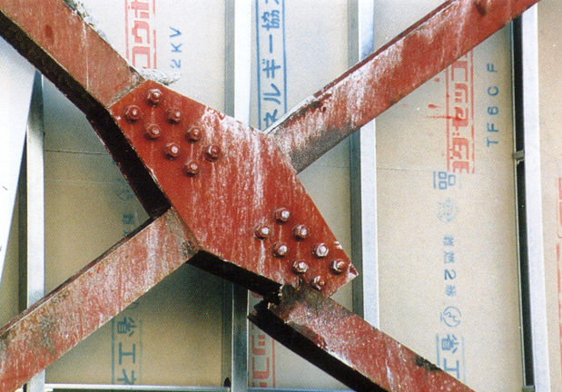
Notes:
Another example of net section fracture of a bracing member.

Slide 82
Example
gusset plate
double angle bracing member
Check if effective net area ≥ gross area
Notes:
The next series of slides will illustrate application of the requirements of F2.5b(c).
As an example, we will consider a double angle bracing member bolted to a gusset plate. We will show that the effective net section area is less than the gross area, and propose a reinforcement detail.

Slide 83
Example
Gross Area A_{g}
Effective Net Area
A_{e} = U A_{n}
A_{e} < A_{g} due to:
bolt hole (A_{n} < A_{g} ), and
shear lag (U < 1)
Need to Reinforce Net Section
Notes:
The critical net section of the brace member is the section at the first bolt hole. This cross-section has the minimum effective net area, and is the location where a net-section fracture would occur.
The effective net area at this critical net section is smaller than the gross-area, due to the presence of bolt holes and due to shear lag. The effective net area of the brace member can be computed according to Section D3 of the AISC Specification.

Slide 84
Example
Reinforcing net section of bracing member....
Notes:
Satisfying Section F2.5b(c) will generally require reinforcing of the brace member so that its effective net area is at least equal to its gross area.
This slide shows schematically how the net section of the angles might be increased by welding reinforcing plates to the angles.

Slide 85
Example - HSS
gusset plate
rectangular HSS bracing member
Check if effective net area ≥ gross area
Notes:
This is another example of applying the requirements of Section F2.5b(c).
This is a common type of connection for HSS brace members. The end of the member is slotted, and then welded to a gusset plate along the slot edges.
Generally, the slot is made longer than needed, to facilitate fit-up in the field.
Per Section F2.5b(c), the effective net area needs to be greater than the gross area.

Slide 86
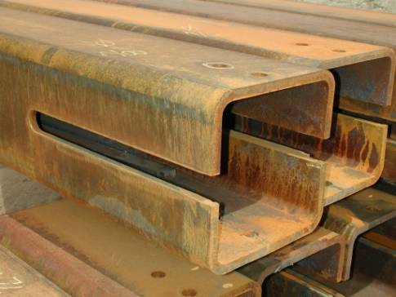
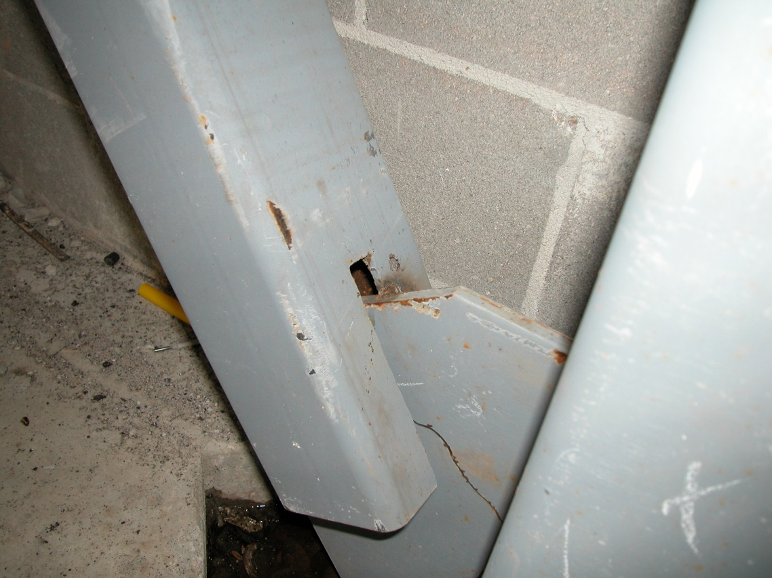
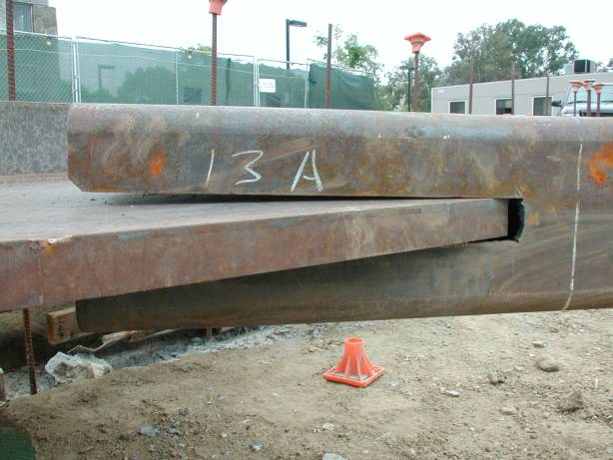
Notes:
Some examples of slotted HSS brace connections to gusset plates.

Slide 87
Example - HSS
P_{u} = R_{y} F_{y} A_{g}
Critical Net Section
A_{e} = U A_{n}
A_{e} < A_{g} due to:
slot (A_{n} < A_{g} ), and
shear lag (U < 1)
Need to Reinforce Net Section
Notes:
The critical net section of the brace member is the section just beyond the end of the gusset. This cross-section has the minimum effective net area, and is the location where a net-section fracture would occur.
The effective net area at this critical net section is smaller than the gross-area, due to the presence of slot and due to shear lag. The effective net area of the brace member can be computed according to Section D3 of the AISC Specification.
Per Section F2.5b(c), the HSS section must be reinforced.

Slide 88
Example - HSS
Reinforcing net section of bracing member....
Notes:
Satisfying Section F2.5b(c) will generally require reinforcing of the brace member so that its effective net area is at least equal to its gross area.
This slide shows schematically how the net section of the HSS member might be increased by welding reinforcing plates to member.

Slide 89
AISC Seismic Provisions - SCBF
Members
F2.5c Protected Zone
Protected Zones
B = brace depth in plane of buckling
L
L/4
B
Notes:
In locations where inelasticity is expected, there are restrictions against attachments and defects. Section F2.5c defines the locations of the protected zone for SCBF which includes the gusset plates, the ends of the braces, and the middle of the brace. The Seismic Provisions Section D1.3 states that the defects and attachments described in Section I2.1 are prohibited. Things like welds, powder actuated fasteners, and notches are not permitted.

Slide 90
AISC Seismic Provisions - SCBF
Connections
F2.6b Beam-to-Column Connections
Option (a) Design as simple connection
Allow rotation per Specification B3.4a
Notes:
Where a brace frames into a beam-to-column connection, the gusset plate often creates some amount of rotational fixity for the beam end. It is necessary to either detail the beam-to-column connection to allow some rotation (simple connection), or consider the beam end moment in design and detail the connection for ductility.
This slide and the following two slides show the three options for beam-to-column connection.
This slide shows the first option listed in Section F2.6b which is to detail the beam-to-column connection to have some rotational flexibility and thus consider the connection pinned. These figures are taken from the Seismic Provisions commentary.

Slide 91
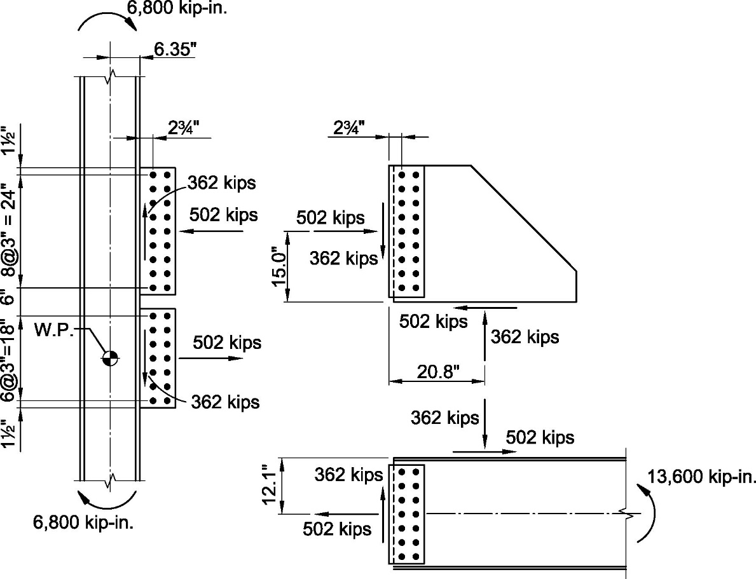
AISC Seismic Provisions - SCBF
Connections
F2.6b Beam-to-Column Connections
Example of loads associated with required moment
4th Ed. SDM Ex. 5.3.12
Option (b) Design as moment connection
Design for 1.1R_{y}M_{p} of beams or columns
Notes:
The second option for beam-to-column connection is to design the connection for a moment equal to 1.1RyMp so that a plastic hinge develops in the beam outside the connection region. An example of this approach is provided in the 4th Edition Seismic Design Manual, example 5.3.12.

Slide 92
AISC Seismic Provisions - SCBF
Connections
F2.6b Beam-to-Column Connections
Option (c) Detail similar to WUF-W
Notes:
The third option is to detail the beam-to-column connection as a ductile moment connection so that the connection is capable of some ductile rotation. Section F2.6b(c) states that the connection must satisfy Section E1.6b(c) which are some of the same detailing requirements used in the WUF-W connection in AISC 358.

Slide 93
AISC Seismic Provisions - SCBF
Connections
F2.6c.1 Required Tensile Strength
The required tensile strength of bracing connections (including beam-to-column connections if part of the braced-frame system) shall be the lesser of the following:
R_{y} F_{y} A_{g} of the bracing member.
The maximum load effect, indicated by analysis, that can be transferred to the brace by the system.
Few practical applications of Item 2.
Note that Ω_{o}Q_{E} is NOT an acceptable method to establish "maximum load effect"
Notes:
Section F2.6 defines the required strength of bracing connections. A fundamental goal of SCBF design is that the braces should be able to undergo many cycles of yielding and buckling without failure of the brace connection. More simply stated, the brace connection should be stronger than the brace.
Note that Section F2.6c defines the required strength of the brace connection, i.e. what forces the brace connection must be designed for. The actual design of the brace connection is then accomplished in accordance with the main AISC Specification.
Section F2.6c.1 defines the required axial tensile strength of the brace connection. The basic requirement is that the required axial tensile strength of the brace connection is taken as R_{y}F_{y}A_{g}.
There is an exception that the required axial tensile strength of the brace connection need not exceed "the maximum load effect, indicated by analysis that can be transferred to the system." There are likely few practical applications of this exception. Note that using the amplified seismic load is not an acceptable method to establish the "maximum load effect." In general, the braces in an SCBF can be expected to yield in an earthquake, and so the brace connection must be designed for the expected yield strength of the brace, i.e. for R_{y}F_{y}A_{g}.

Slide 94
Brace Connection Design
R_{y} F_{y} A_{g}
Notes:
This illustrates the required axial tensile strength of the brace connection.

Slide 95
Brace Connection Design
P_{u} = R_{y} F_{y} A_{g}
Consider load path through connection region
θ
P_{u} cos θ
P_{u} sin θ
Notes:
When designing the brace connection, it is important to consider the load path through the connection. This is important not only for seismic design, but also when designing brace connections for any other type of load (wind, for example).
For the arrangement shown here, the horizontal component of the brace force must be transferred to the beam, and the vertical component must be transferred to the column.

Slide 96
Brace Connection Design
P_{u} = R_{y} F_{y} A_{g}
Consider load path through connection region:
Uniform Force Method –
Vertical Component of P_{u} transferred to column.
V_{uc}
V_{ub}
V_{uc} + V_{ub} = P_{u} sin θ
V_{ub}
P_{u} cos θ
V_{uc} is transferred directly to column
V_{ub} is transferred indirectly to column ithrough beam and beam to column iconnection
P_{u} sin θ
Notes:
Brace connection design, be it for seismic loads or wind, can be complex. There are many methods for approaching brace connection design. One of the more common methods is the "Uniform Force Method." which is described in the AISC Manual.
This slide shows the load path for transferring the vertical component of the brace force to the column, as defined by the Uniform Force Method. A portion of the vertical component (V_{uc}) of the brace force is transferred directly to the column through the gusset plate. The remaining portion of the vertical component (V_{ub}) of the brace force is transferred to the beam, and then from the beam to the column.
Many other load paths can be assumed and designed for. The key is to provide sufficient strength along the chosen load path. For example, one could assume that the entire vertical component of the brace force is transferred directly to the column through the gusset plate (i.e. take V_{uc} = P_{u} sin θ, and V_{ub} =0). For this case, the gusset plate area at the column-gusset interface and the gusset to column welds must be adequate to transmit a force of V_{uc} = P_{u} sin θ).

Slide 97
Brace Connection Design
P_{u} = R_{y} F_{y} A_{g}
Consider load path through connection region:
Uniform Force Method –
Horizontal Component of P_{u} transferred to beam.
H_{uc}
H_{ub}
H_{uc} + H_{ub} = P_{u} cos θ
H_{uc}
P_{u} cos θ
H_{ub} is transferred directly to beam
H_{uc} is transferred indirectly to beam ithrough column and beam to icolumn connection
P_{u} sin θ
Notes:
This slide shows the load path for transferring the horizontal component of the brace force to the beam, as defined by the Uniform Force Method. A portion of the horizontal component (H_{ub}) of the brace force is transferred directly to the beam through the gusset plate. The remaining portion of the horizontal component (H_{uc}) of the brace force is transferred to the column, and then from the column to the beam.
As noted in the previous slide, many other load paths can be assumed and designed for. The key is to provide sufficient strength along the chosen load path. For example, one could assume that the entire horizontal component of the brace force is transferred directly to the beam through the gusset plate (i.e. take H_{ub} = P_{u} cos θ, and H_{uc} =0). For this case, the gusset plate area at the beam-gusset interface and the gusset to beam welds must be adequate to transmit a force of H_{ub} = P_{u} cos θ).

Slide 98
Brace Connection Design
P_{u} = R_{y} F_{y} A_{g}
Consider load path through connection region:
Use caution in use of bolts and welds.
Section D2.2(b):
"Bolts and welds shall not be designed to share force in a joint or the same force component in a connection."
P_{u} cos θ
P_{u} sin θ
Notes:
When choosing a load path for the brace connection design, it is important to recall the requirement of Section D2.2(b), which states that bolts and welds shall not be designed to share force in a joint or the same force component in a connection.
An example is described on the next slide.

Slide 99
Brace Connection Design
P_{u} = R_{y} F_{y} A_{g}
If designed by uniform force method - this connection violates Section D2.2(b)
Bolts and welds must transfer same force components.
P_{u} cos θ
P_{u} sin θ
Notes:
For this connection, the gusset is welded to both the column and the beam. However, the beam end is bolted to the column.
If this connection was designed by the Uniform Force Method, the connection would violate Section D2.2(b). This is because, with the Uniform Force Method, a portion of the vertical component of the brace force is transferred to the column by the gusset to column welds, and the remainder is transferred to the column through the bolted beam end connection. Thus, bolts and welds must share the same force component, which is prohibited by Section D2.2(b).
Similarly, with the Uniform Force Method, a portion of the horizontal component of the brace force is transferred to the beam by the gusset to beam welds, and the remainder is transferred to the beam through the bolted beam end connection. Thus, bolts and welds must again share the same force component, which is prohibited by Section D2.2(b).

Slide 100
AISC Seismic Provisions - SCBF
Connections
F2.6c.2 Required Compressive Strength
The required compressive strength of bracing connections shall be at least min { (1/ 0.877) F_{ne} A_{g} , R_{y}F_{y}A_{g} }
F_{ne} is the critical buckling stress (F_{cr}) from Chapter E of AISC Specification using R_{y}F_{y} as the yield stress
Notes:
Section F2.6c.2 defines the required axial compressive strength of the brace connection as the lesser of (F_{cre} / 0.877) A_{g} and R_{y}F_{y}A_{g} in accordance with Seismic Provisions Section F2.3. In this equation, F_{ne} is equal to the nominal stress of the member, F_{n} , computed per Chapter E of the AISC Specification, but using RyFy in place of Fy.

Slide 101
Brace Connection Design
min { (F_{ne} / 0.877) A_{g} , R_{y}F_{y}A_{g} }
Check:
buckling of gusset plate
web crippling for beam and column
Notes:
This slide illustrates the Required axial compressive strength of the brace connection.
As with the required axial tension strength and required flexural strength of the connection, the AISC Seismic Provisions simply defines the required strength of the connection. That is, the Seismic Provisions define what forces the brace connection must be designed for. Once the required strength the brace connection is defined, the actual design of the brace connection (sizing gussets, bolts, welds, etc) is accomplished following the main AISC Specification.
The required axial compression strength is intended to assure that the brace connection is stronger then the brace in compression. The required axial compression strength is used to check limit states such as buckling of the gusset plate, and web crippling of the beam and column.
Providing a 2t fold line in the gusset will often result in a large unsupported length of gusset that may be prone to buckling when the brace is in compression. Gusset buckling is often checked by assuming the unsupported segment of gusset behaves as a column.

Slide 102
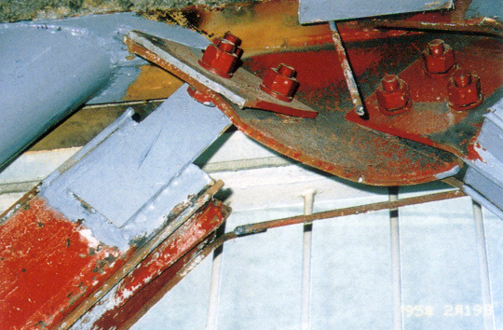
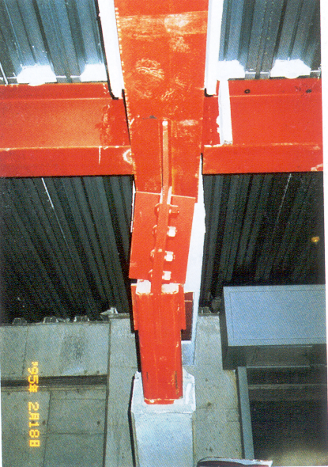
Notes:
This slide shows photos of steel braced frame buildings following the 1995 Hyogoken-Nanbu Earthquake in Kobe Japan. In these cases, brace connection elements have buckled.
Photos are from:
"Reconnaissance Report on Damage to Steel Building Structures Observed from the 1995 Hyogoken-Nanbu (Hanshin/Awaji) Earthquake," by the Steel Committee of the Kinki Branch, Architectural Institute of Japan (AIJ), May 1995.

Slide 103
AISC Seismic Provisions - SCBF
Connections
F2.6c.3 Accommodation of Brace Buckling
The required flexural strength of bracing connections is 1.1R_{y} M_{p} of the bracing member.
Notes:
The connection at the end of the brace can either be designed so that (a) the connection is flexurally stronger than the brace so that a plastic hinge forms in the brace, or (b) the connection (such as the gusset plate) is capable of rotating.
Section F2.6c.3 describes the first option wherein the required flexural strength of the brace connection is 1.1 R_{y}M_{p} of the brace. As the brace buckles, this requirement will force the plastic hinge to occur in the brace, not in the connection.

Slide 104
F2.6c.3 Accommodation of Brace Buckling
Plastic Hinges
P
M
M
For "fixed" end braces: flexural plastic hinges will form at mid-length and at brace ends. Brace will impose bending moment on connections and adjoining members.
M_{u} = 1.1 R_{y} M_{p} = 1.1 R_{y} F_{y} Z_{brace}
(for critical buckling direction)
Notes:
If the brace ends are fixed against rotation, then the brace will form flexural plastic hinges mid-span and at its ends. For this case, the brace connection must be designed to resist the large moments that will be generated at the brace ends in the post-buckled configuration of the brace.

Slide 105
1.1 R_{y} M_{p-brace}
Notes:
This is a photo of a buckled brace following the 1995 Hyogoken-Nanbu Earthquake in Kobe Japan. The deformed shape of the buckled brace indicates the large bending moments that were likely generated at the brace end.
Photo is from:
"Preliminary Reconnaissance Report of the 1995 Hyogoken-Nanbu Earthquake - English Edition," Architectural Institute of Japan, April 1995.

Slide 106
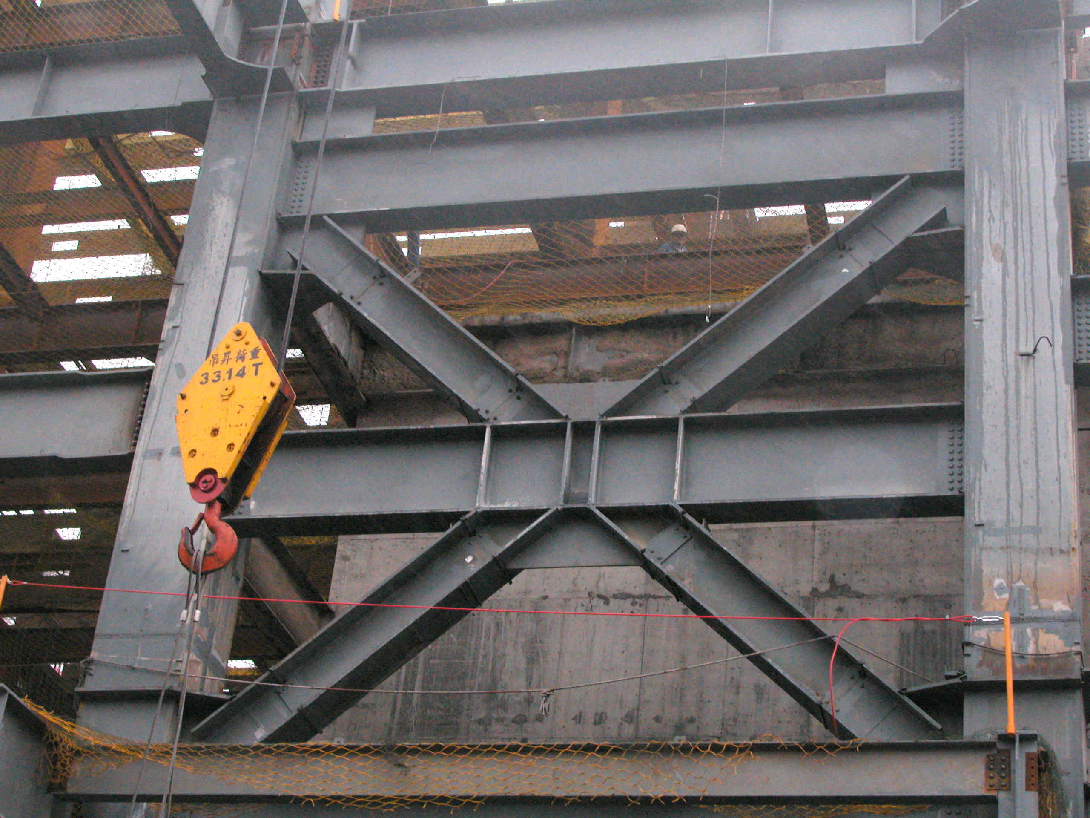
Notes:
This is an example of braced frame with heavy wide-flange braces. The brace end connections appear to provide a high degree of rotational restraint.
If these braces buckle during an earthquake, they are likely to buckle out-of-plane, based on the orientation of the brace members. Consequently, the brace connections, and adjoining members, must be capable of resisting the weak-axis plastic moment capacity ( 1.1 R_{y} F_{y} Z_{y}) of the brace. Resisting this large out-of-pane moment may be problematic for the frame shown in the photo. The brace connection details do not appear adequate for this purpose. Further, the out-of-plane moment at the connection will generate torsional moments in the beams and columns, which may be difficult to design for.
In general, if a "fixed" brace connection is to be used in the critical buckling direction, it may be preferable to orient the brace and to detail the brace connection to force in-plane buckling (as was done in the previous slide of the building in Kobe, Japan). In this manner, the large brace end moments can be resisted by in-plane bending of the adjoining beams and columns.

Slide 107
AISC Seismic Provisions - SCBF
Connections
F2.6c.3 Accommodation of Brace Buckling
Rotation Capacity: Brace connections designed to withstand the rotations imposed by brace buckling shall have sufficient rotation capacity to accommodate the required rotation at the design story drift. Inelastic rotation of the connection is permitted.
Notes:
Section F2.6c.3 describes the second option wherein the brace connection is detailed to accommodate rotations of the brace ends, when the brace buckles.
That is, it is not necessary to design the brace connection for bending moment, if the brace connection is designed to behave as a "pin" when the brace buckles.
Brace connections are commonly detailed to accommodate brace rotation.

Slide 108
F2.6c.3 Accommodation of Brace Buckling
P
P
Plastic Hinge
P
P
For "pinned" end braces: flexural plastic hinge will form at mid-length only. Brace will impose no bending moment on connections and adjoining members.
Must design brace connection to behave like a "pin"
Notes:
This slide illustrates the concept of a "pinned" brace end connection. If the brace connection truly behaves as a pin and can accommodate very large rotations at the brace end, then little or no moment will be generated at the brace end.

Slide 109
F2.6c.3 Accommodation of Brace Buckling
To accommodate brace end rotation: provide "fold line"
Buckling perpendicular to gusset plate
Line of rotation ("fold line") when the brace buckles out-of-plane
(thin direction of plate)
Notes:
The most common strategy to provide rotational flexibility at the brace connection is the "fold line" concept. With this approach, rotation of the brace end is permitted by allowing a line of rotation (the fold line) in the gusset plate.
Slide courtesy of Tom Sabol - Englekirk and Sabol, Los Angeles.

Slide 110
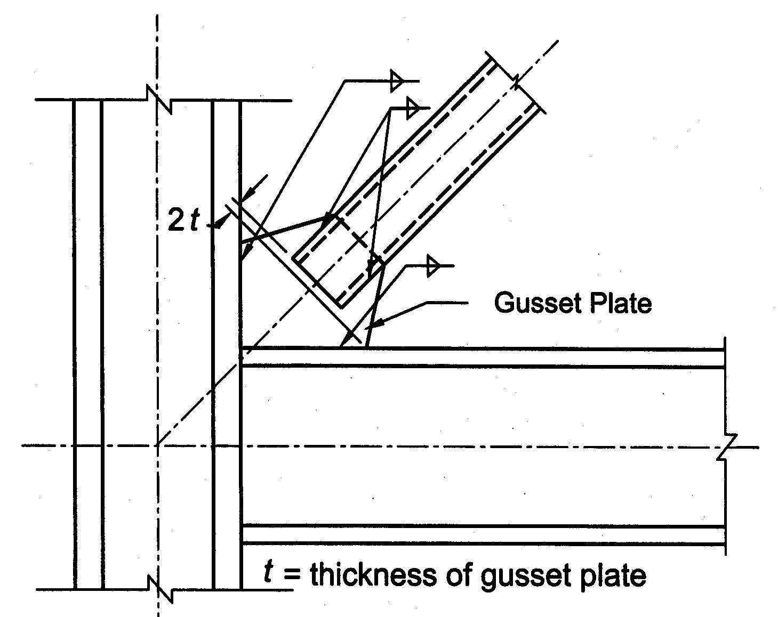
Notes:
This slide, taken from the Commentary of the AISC Seismic Provisions, illustrates the fold line approach.
To create a fold line (a line about which the gusset will bend out-of-plane), the brace is located on the gusset to permit a clear distance of at least 2t ( t = gusset thickness), as shown in the sketch. The 2t distance is measured from a line that is perpendicular to the brace centerline, and passes through the closest intersection of the gusset, with either the beam or the column.
When the brace in this sketch buckles out-of-plane, the gusset plate can fold along the 2t fold line, thereby acting as a "pin."

Slide 111
2t
Notes:
The 2t fold line if the case of a brace with a shallow angle with the beam.

Slide 112
2t
Notes:
The 2t fold line if the case of a brace with a steep angle with the beam.

Slide 113

2t
Concrete floor slab
Notes:
If a concrete floor slab is present, then the fold line must be located so that the slab does not interfere with the out-of-plane bending of the gusset along the fold line.

Slide 114
Concrete floor slab
2t
Styrofoam
Notes:
Alternatively, when a concrete floor slab is present, a cut-out in the floor slab can be provided to preclude interference the fold line.

Slide 115
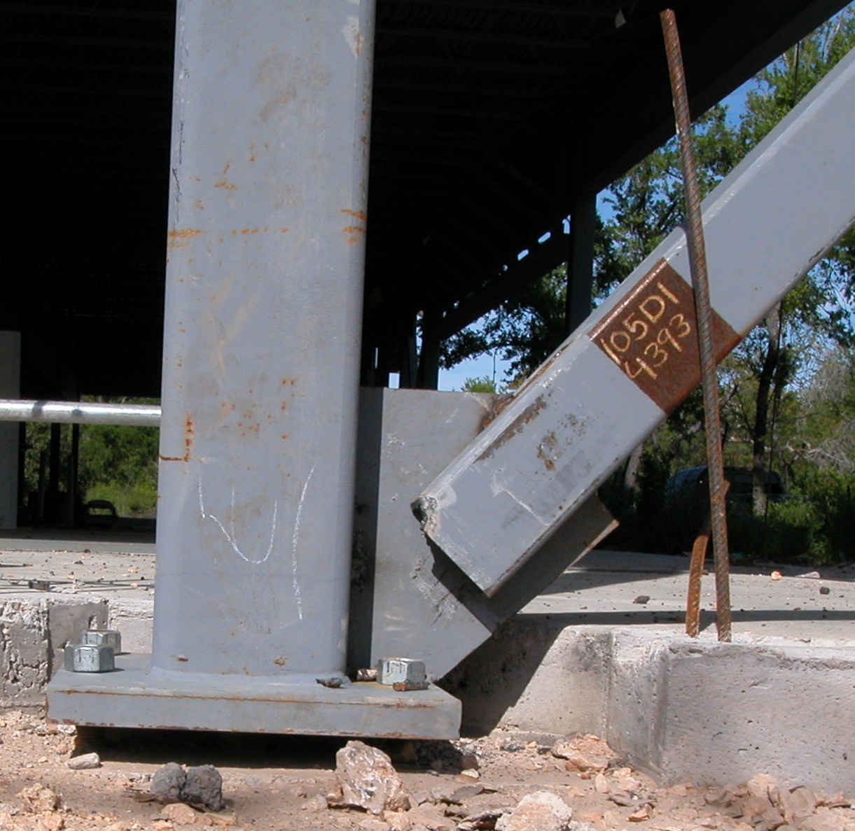
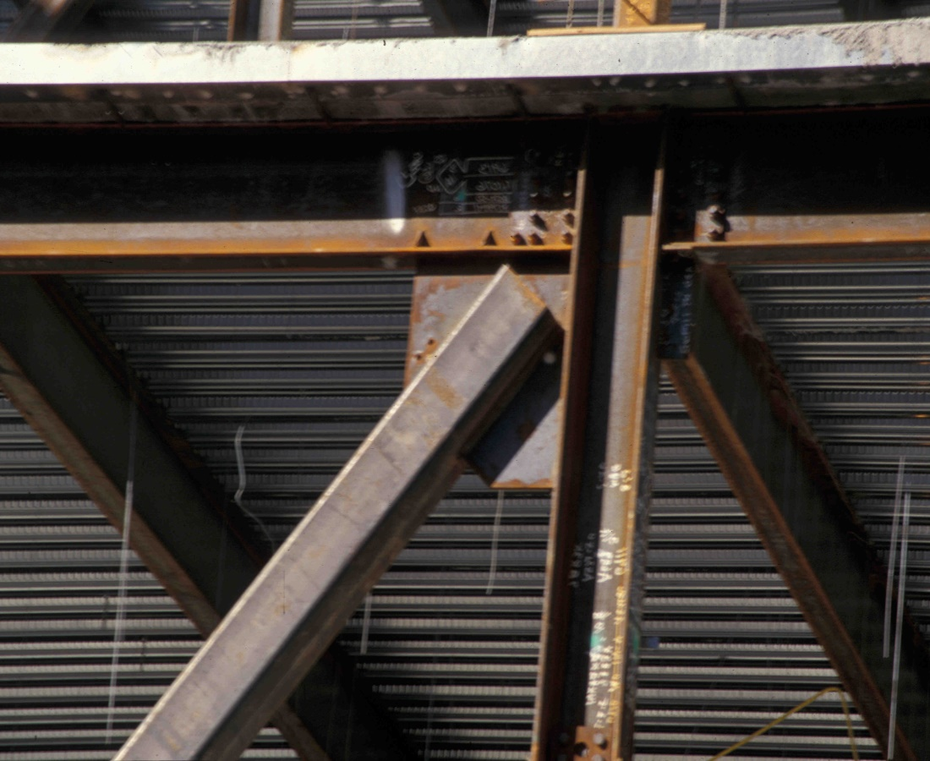
Notes:
These are examples of brace connections which are not provided with a fold line. If these braces buckle out-of-plane (which they are likely to do), the brace end rotations will likely tear apart the connections.

Slide 116
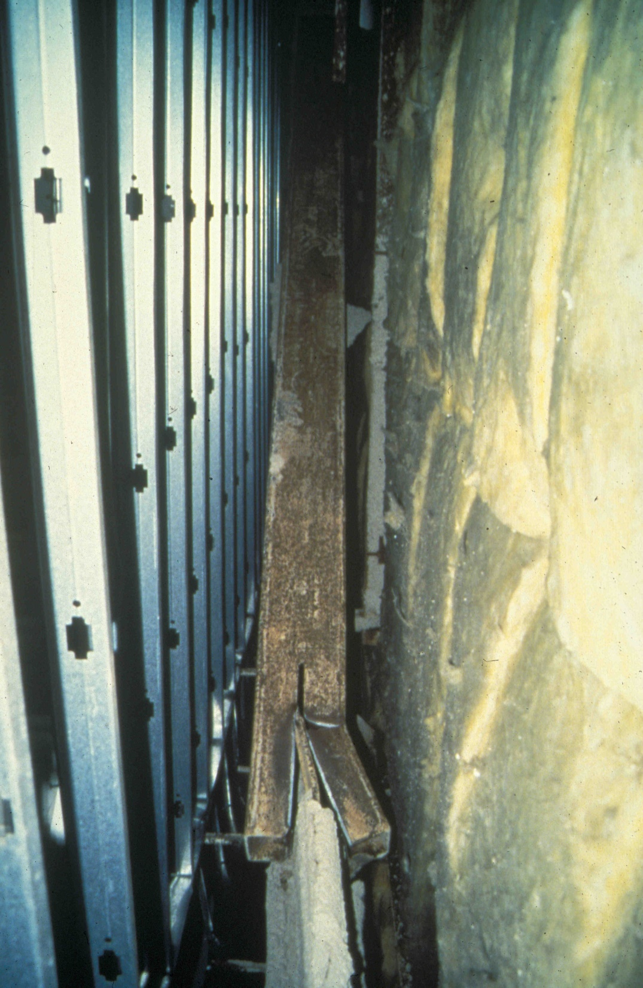
Notes:
This photo is from a braced frame building following the 1994 Northridge Earthquake. The brace is an HSS member, with a slotted end connection to a gusset plate. The connection was not detailed with a fold line. When this brace buckled out-of-plane, the absence of rotational flexibility in the connection caused the brace end to fracture.
Section F2.6b of the AISC Seismic Provisions state that the designer has two choices in brace connection design:
1. Design the connection to resist moment, or
2. Design the connection to permit free rotation (i.e. behave as a pin).
In the connection shown in this figure, neither of these two options was done. The connection was not designed for the out-of-plane bending capacity of the brace, and the connection was not detailed to permit rotation. The result was failure of the brace connection.

Slide 117
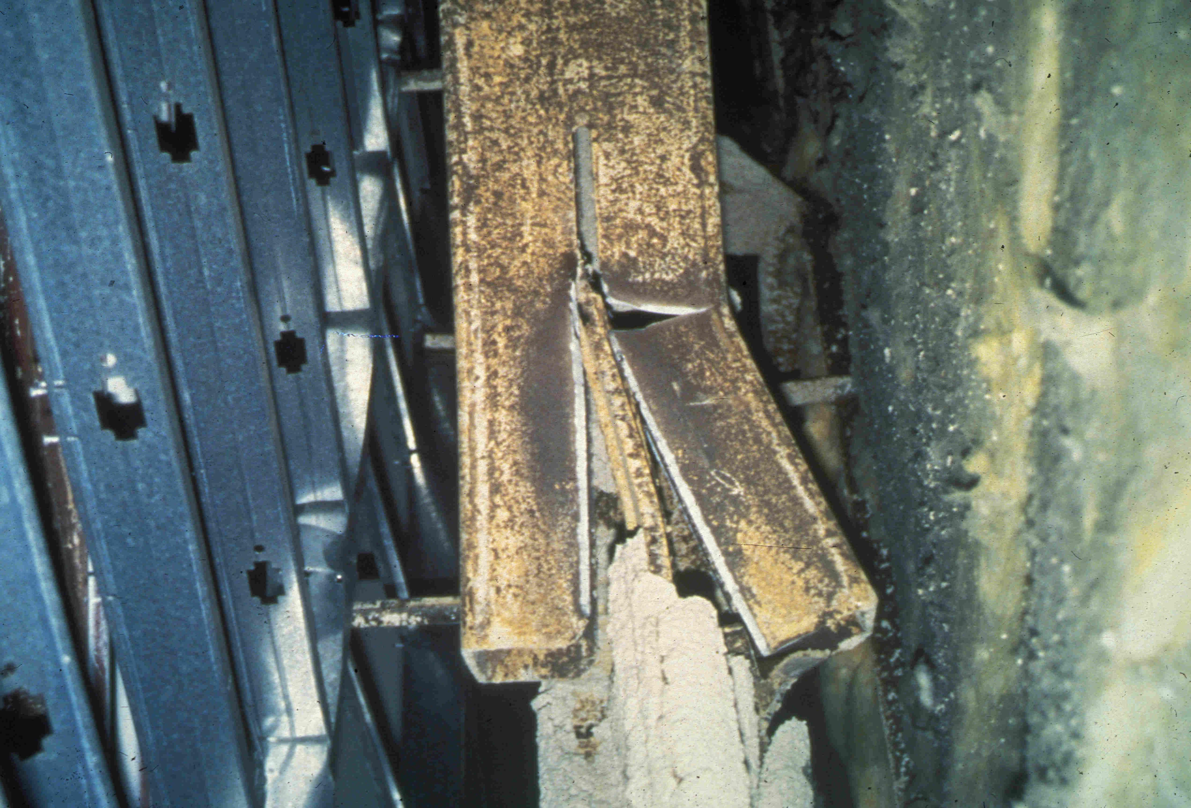
Notes:
A close-up of the connection failure shown in the previous slide.

Slide 118
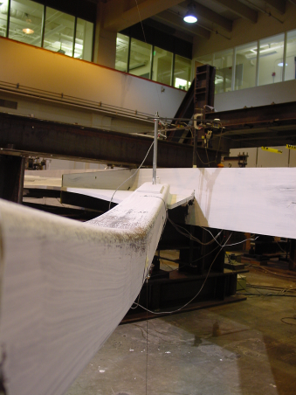
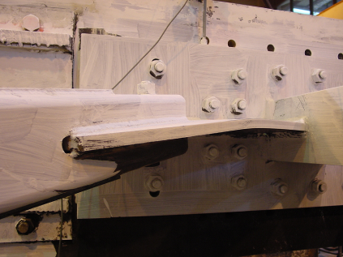
Notes:
This slide shows photos from a laboratory cyclic loading test on a braced frame constructed with HSS braces. The HSS brace has buckled out-of-plane. The brace connection was detailed with a fold line. Consequently, the gusset plate behaved as a "pin" for out-of-plane buckling, and permitted the buckling to occur without damage to the connection.
Photo courtesy of Prof. Steven Mahin - Univ of California at Berkeley

Slide 119
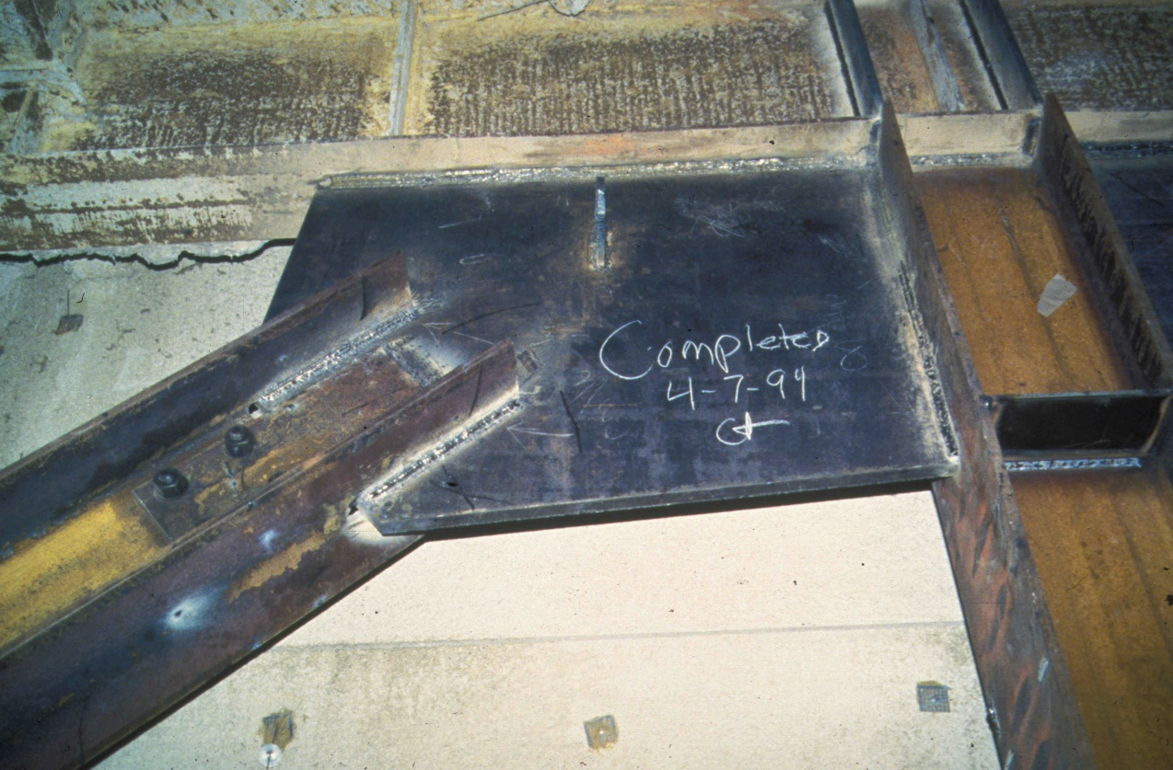
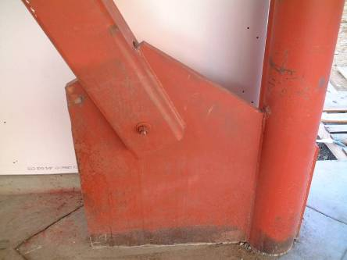
> 2t
>2t
Notes:
Examples of brace connections detailed with fold lines.
Top photo courtesy of James Malley, Degenkolb Associates, San Francisco.
Bottom photo courtesy of Prof. Chia-Ming Uang- University of California at San Diego

Slide 120
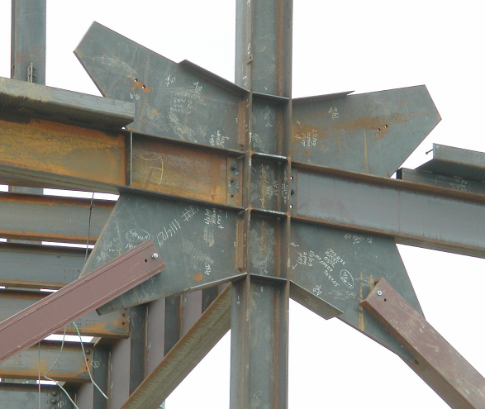
>2t
Notes:
Example of brace connection detailed with fold lines.
Photo courtesy of Prof. Chia-Ming Uang- University of California at San Diego.

Slide 121
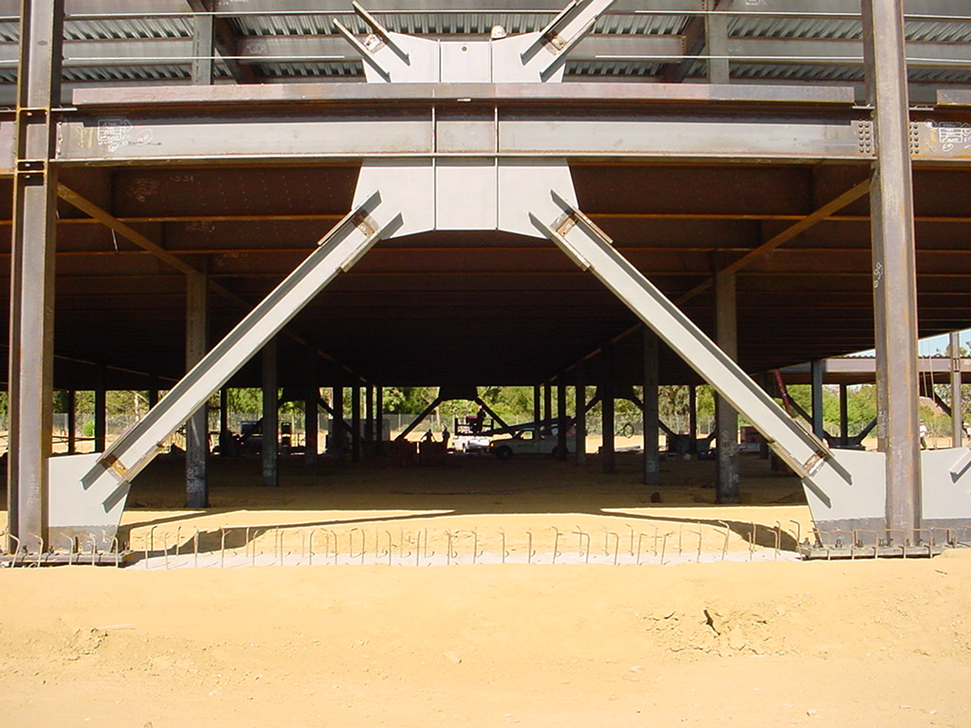
> 2t
Notes:
Example of brace connection detailed with fold lines.
Photo courtesy of Russel Kehl and Wayne Chang, Structural Focus, Gardena, CA

Slide 122
AISC Seismic Provisions - SCBF
Connections
F2.6c.3 Accommodation of Brace Buckling
Other Options for Allowing Rotation
Elliptical Fold Line
Knife Plate Detail
Notes:
Besides the 2t fold line detail, two other options have been studied and shown capable of accommodating brace buckling. The elliptical fold line allows for more compact gusset plates and connections because the brace can extend closer to the beam-column joint. The knife plate detail creates an in-plate buckling mode. Design examples for all three details (2t fold line, elliptical fold line, and knife plate) are contained in the AISC Seismic Design Manual.

Slide 123
2022 AISC Seismic Provisions
Section F2. Special Concentrically Braced Frames (SCBF)
F2.1 Scope
F2.2 Basis of Design
F2.3 Analysis
F2.4 System Requirements
F2.5 Members
F2.6 Connections
Notes:
This completes our overview of the requirements for SCBF in the AISC Seismic Provisions.

