Slide 1
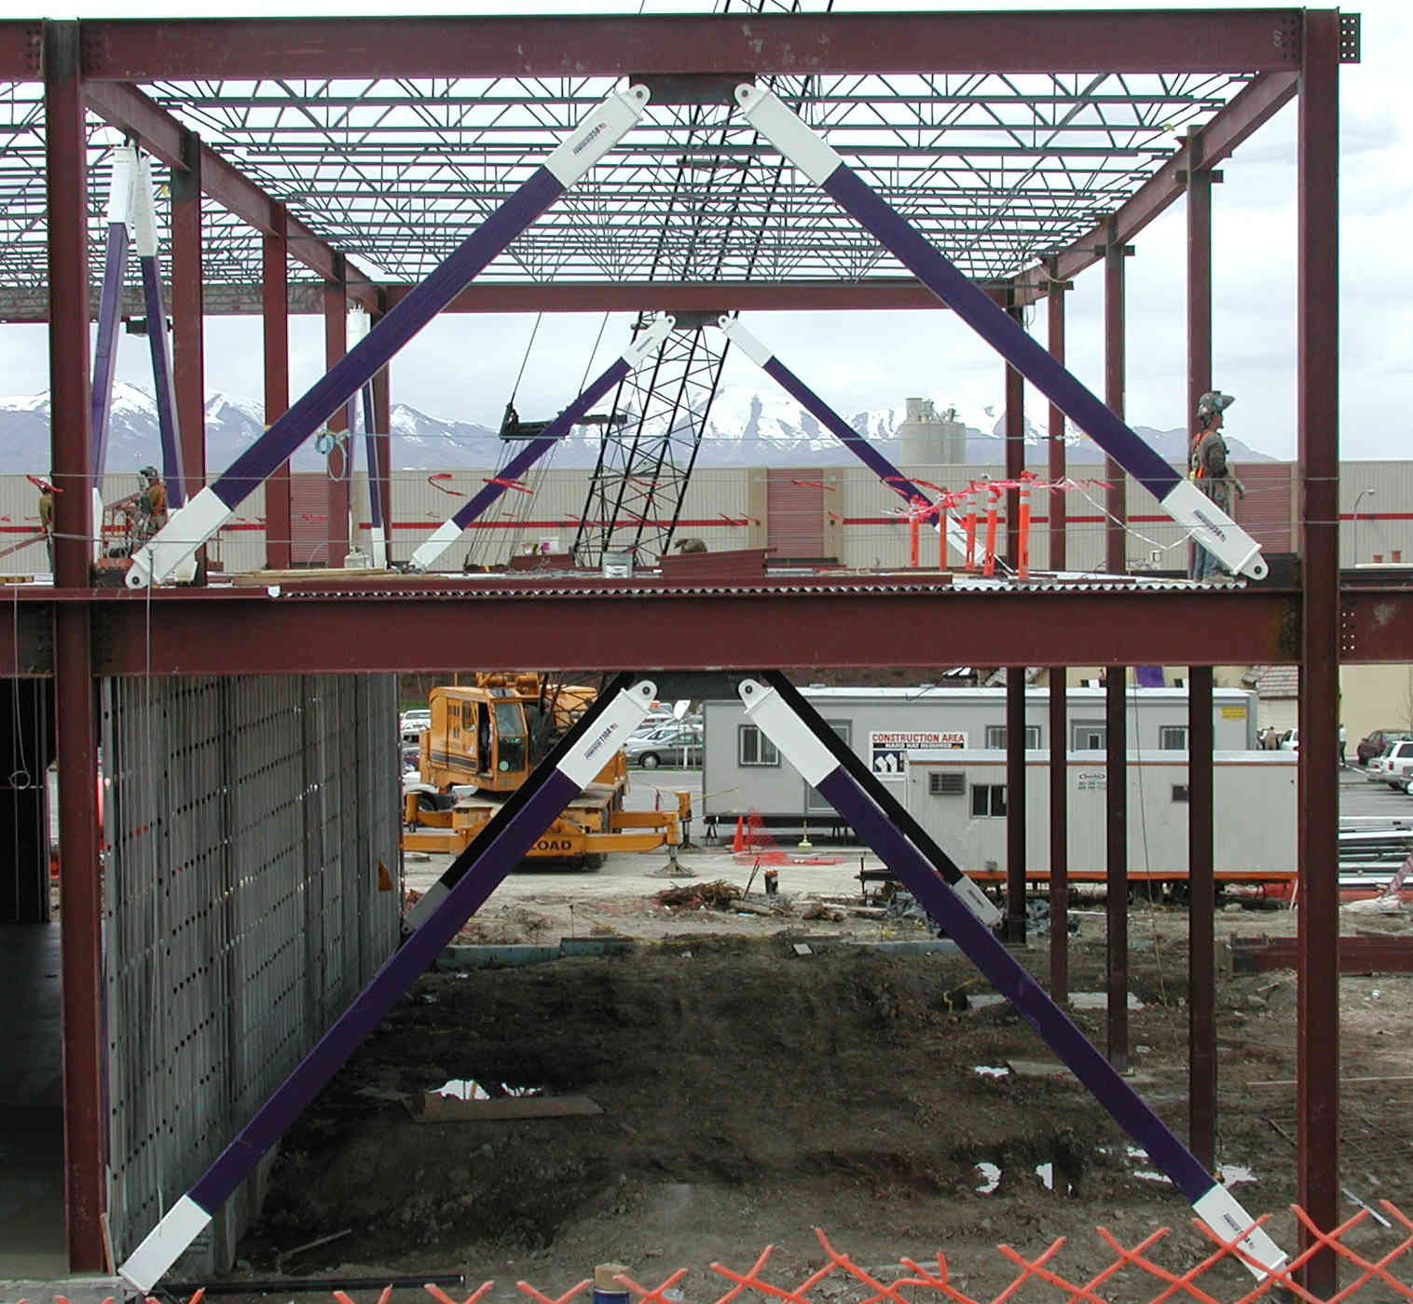
Design of Seismic-Resistant Steel Building Structures
5. Buckling-Restrained Braced Frames
Version 3 (December 2024)
Notes:
This series of PowerPoint presentations covers the fundamentals of the design of seismic-resistant steel building structures. The primary focus of the material is on ductile detailing of steel structures for seismic resistance, rather than on calculation of lateral forces, dynamic analysis, or other general topics on earthquake engineering. The material is intended primarily for use at the graduate level, although many portions of the presentations are appropriate for undergraduates.
The presentations are closely tied to the 2022 AISC Seismic Provisions for Structural Steel Buildings (referred to herein as the AISC Seismic Provisions). The presentations discuss basic principles of the behavior of seismic response of steel structures and show how these principles are treated in the AISC Seismic Provisions. The presentations are most effective if the students have a copy of the AISC Seismic Provisions. A free copy can be downloaded from the AISC website, at: www.aisc.org.
For basic steel design topics, the presentation refers to the 2022 AISC Specification for Structural Steel Buildings (herein referred to as the AISC Specification). Both the 2022 AISC Seismic Provisions and AISC Specification are written in the combined LRFD - ASD format. These PowerPoint presentations, however, present only the LRFD format. For seismic-resistant design, the LRFD format is preferable, in that it more closely follows the element capacity concepts used seismic design.
For code related seismic-design topics not covered in the AISC Seismic Provisions (seismic design categories, R-factors, seismic overstrength factors, etc.), the presentations refer to ASCE 7-22 - Minimum Design Loads for Buildings and Other Structures.
For questions, comments, corrections, or suggestions on these presentations, please contact:
AISC University Programs
universityprograms@aisc.org
---------------
Acknowledgments:
These presentations were originally prepared with support from the AISC Educator Career Enhancement Award. Overall coordination of this effort was provided by Fromy Rosenberg at AISC. The author gratefully acknowledges support provided by AISC and the coordination and oversight provided by Mr. Rosenberg.
The author also gratefully acknowledges contributions and review provided by the AISC Task Group for this project:
Mark Bowman - Purdue University
Steve Mahin - University of California at Berkeley
Brett Manning - PMB 200
Carol Pivonka - AISC
Larry Reaveley - University of Utah
Tom Sabol - Englekirk & Sabol Consulting Engineers, Los Angeles
Chia-Ming Uang - University of California at San Diego
Rafael Sabelli - Dasse Design, San Francisco
The module on Special Plate Shear Walls was prepared by Rafael Sabelli - Dasse Design, San Francisco

Slide 2
Design of Seismic-Resistant
Steel Building Structures
Introduction and Basic Principles
Moment Resisting Frames
Concentrically Braced Frames
Eccentrically Braced Frames
Buckling-Restrained Braced Frames
Special Plate Shear Walls
Notes:
This PowerPoint series is dividing into 6 modules. This is the Module No.5 on: "Buckling-Restrained Braced Frames."

Slide 3
5 - Buckling-Restrained Braced Frames
Description and Basic Behavior of Buckling-Restrained Braced Frames and Buckling-Restrained Braces
AISC Seismic Provisions for Buckling-Restrained Braced Frames
Notes:
The module will begin with a general description and a number of photos of Buckling-Restrained Braced Frames. This is followed by a description and discussion of Buckling-Restrained Braces, and a description of the overall inelastic behavior of a BRBF. Finally, the module will cover highlights of BRBF detailing requirements in the AISC Seismic Provisions.

Slide 4
5 - Buckling-Restrained Braced Frames
Description and Basic Behavior of Buckling-Restrained Braced Frames and Buckling-Restrained Braces
AISC Seismic Provisions for Buckling-Restrained Braced Frames
Notes:
The first part of this module provides a description of BRBFs and a discussion of the basic inelastic behavior of this system.

Slide 5
Buckling-Restrained Braced Frames (BRBFs)
Type of concentrically braced frame.
Beams, columns and braces arranged to form a vertical truss. Resist lateral earthquake forces by truss action.
Special type of brace members used: Buckling-Restrained Braces (BRBs). BRBS yield both in tension and compression - no buckling !!
Develop ductility through inelastic action (cyclic tension and compression yielding) in BRBs.
System combines high stiffness with high ductility.
Notes:
BRBFs are concentrically braced frames, consisting of beams, columns and braces arranged to form a truss. BRBFs resist lateral load primarily through truss action, with member response dominated by axial force (tension and compression).
Unlike conventional concentrically braced frames, BRBFs are constructed with a special type of brace member: Buckling-Restrained Braces (BRBs).
BRBs have the unique quality that they do not buckle when loaded in compression. Consequently, BRBs yield in a ductile manner in both tension and compression. The use of BRBs results in a frame that combines high elastic stiffness with excellent ductility.
BRBFs are considered to be a high ductility framing system and is assigned high R-factors in ASCE-7.
Per ASCE 7-22, the R-factor for BRBFs is R=8.

Slide 6
Buckling-Restrained Brace
Buckling- Restrained Brace:
Steel Core
+
Casing
Casing
Steel Core
Notes:
The key feature of a BRBF is the use of Buckling-Restrained Braces (BRBs).
A BRB consists of a steel core and a casing. The casing covers the steel core.

Slide 7

Buckling-Restrained Brace
A
Buckling- Restrained Brace:
Steel Core
+
Casing
A
Casing
Steel Core
Steel jacket
Mortar
Debonding material
Section A-A
Notes:
The are a number of different configurations for BRBs. This slide shows one possibility. The steel core is simply a rectangular plate. The casing, which restrains buckling of the core, is typically constructed of a mortar filled steel tube. The steel core is surrounded by a debonding material that decouples the steel core from the casing, for purposes of resisting axial force. That is, the debonding material is intended to prevent transfer of axial stress from the steel core to the casing. Consequently, the casing essentially "floats" on the steel core.
There are a number of possible configurations for the shape of the steel core. In addition to a single plate, BRBs have been constructed using cruciform shaped plates, or a pair of plates or shapes.

Slide 8
Buckling-Restrained Brace
P
P
Steel core resists entire axial force, P
Casing is debonded from steel core
  casing does not resist axial force P
  flexural stiffness of casing restrains buckling of core
Notes:
The concept of the BRB is that the steel core resists the applied axial force P. The debonding material that surrounds the core is intended to prevent the casing from carrying axial force. Since the casing has no (or very little) axial force, its full flexural stiffness is available to resist buckling of the steel core.

Slide 9
Buckling-Restrained Brace
Buckling- Restrained Brace:
Steel Core
+
Casing
Steel Core
Yielding Segment
Core projection and brace connection segment
Notes:
The central section of the steel core, as shown in the slide, is intended to be the portion of the core that yields in tension and in compression. At the ends of the BRB, the core projects outside of the casing. This core projection typically has a significantly larger cross-sectional area than the yielding segment, and is usually reinforced to prevent buckling of the projection. Further, the core projection is normally prepared with bolt holes or other features that allow connection of the BRB to the remainder of the frame.
A building designer using a BRBF does not normally develop the detailed design of a buckling restrained brace, such the shape of the core and core projections, the details of the casing and debonding material, and the connection details provided on the core projection.
Rather, there are companies that manufacture and sell BRBs. These are proprietary and patented designs which have undergone design development and testing by the manufacturers. Thus, the building designer will normally specify the required strength and stiffness of the BRBs, and the manufacturer will supply BRBs that meet these specifications.
CoreBrace (http://www.corebrace.com/) is a manufacturer that markets BRBs in the US.

Slide 10
Brace Behavior Under Cyclic Axial Loading
P
Conventional Brace:
P_{y}
yields in tension (ductile)
buckles in compression (nonductile)
significantly different strength in tension and compression
δ
δ
P_{CR}
P
Notes:
This slide reviews the behavior of a conventional brace when subjected to cyclic axial load (see Module 3 on SCBF for further discussion).
A conventional brace buckles when loaded in compression, resulting in deterioration of strength and stiffness. A conventional brace exhibits significantly different strengths in compression and tension.

Slide 11
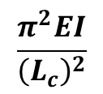

Brace Behavior Under Cyclic Axial Loading
Buckling-Restrained Brace:
Core slenderness is nearly zero (L_{c} ≈ 0), so yield can be achieved in compression
Casing axial stress is nearly zero, so elastic buckling capacity is provided
Compression Strength
Slenderness

Slide 12
Brace Behavior Under Cyclic Axial Loading
P
Buckling-Restrained Brace:
P_{y}
Yields in tension (ductile)
Yields in compression (ductile)
Similar strength in tension and compression (slightly stronger in compression)
δ
P_{CR}
δ
P_{y}
P
Notes:
A buckling-restrained brace yields in a ductile manner, both in tension and in compression. As a result, a BRB exhibits highly desirable behavior as an energy-dissipating element in a seismic-resistant frame.
A BRB also exhibits very similar strengths in compression and in tension. This avoids many of the difficulties that result from large unbalanced brace forces in SCBFs, such as the difficulty in designing beams in inverted-V braced SCBFs.
Tests show that BRBs exhibit slightly higher strength in compression than in tension. The maximum compression strength of a BRB may be on the order of 3 to 10-percent greater than the maximum tension strength of the BRB. This higher measured compression strength may be due to partial engagement of the casing in resisting axial force, when the BRB is loading in compression. This partial engagement of the casing may be due to imperfect debonding, resulting from expansion of the core in compression (Poisson's effect) and higher mode buckles (ripples) in the core that casue the core to press against the casing.

Slide 13
Bracing Configurations for BRBFs
Single Diagonal
Inverted V- Bracing
V- Bracing
X- Bracing
Two Story X- Bracing
Notes:
Various bracing arrangements are possible for BRBFs, as is the case with conventional braced frames.
Single story X-bracing is generally not possible for BRBFs because of the difficulty in crossing the two BRBs at their centers. Also, K-braced BRBFs are not permitted (see Section F4.4b).

Slide 14
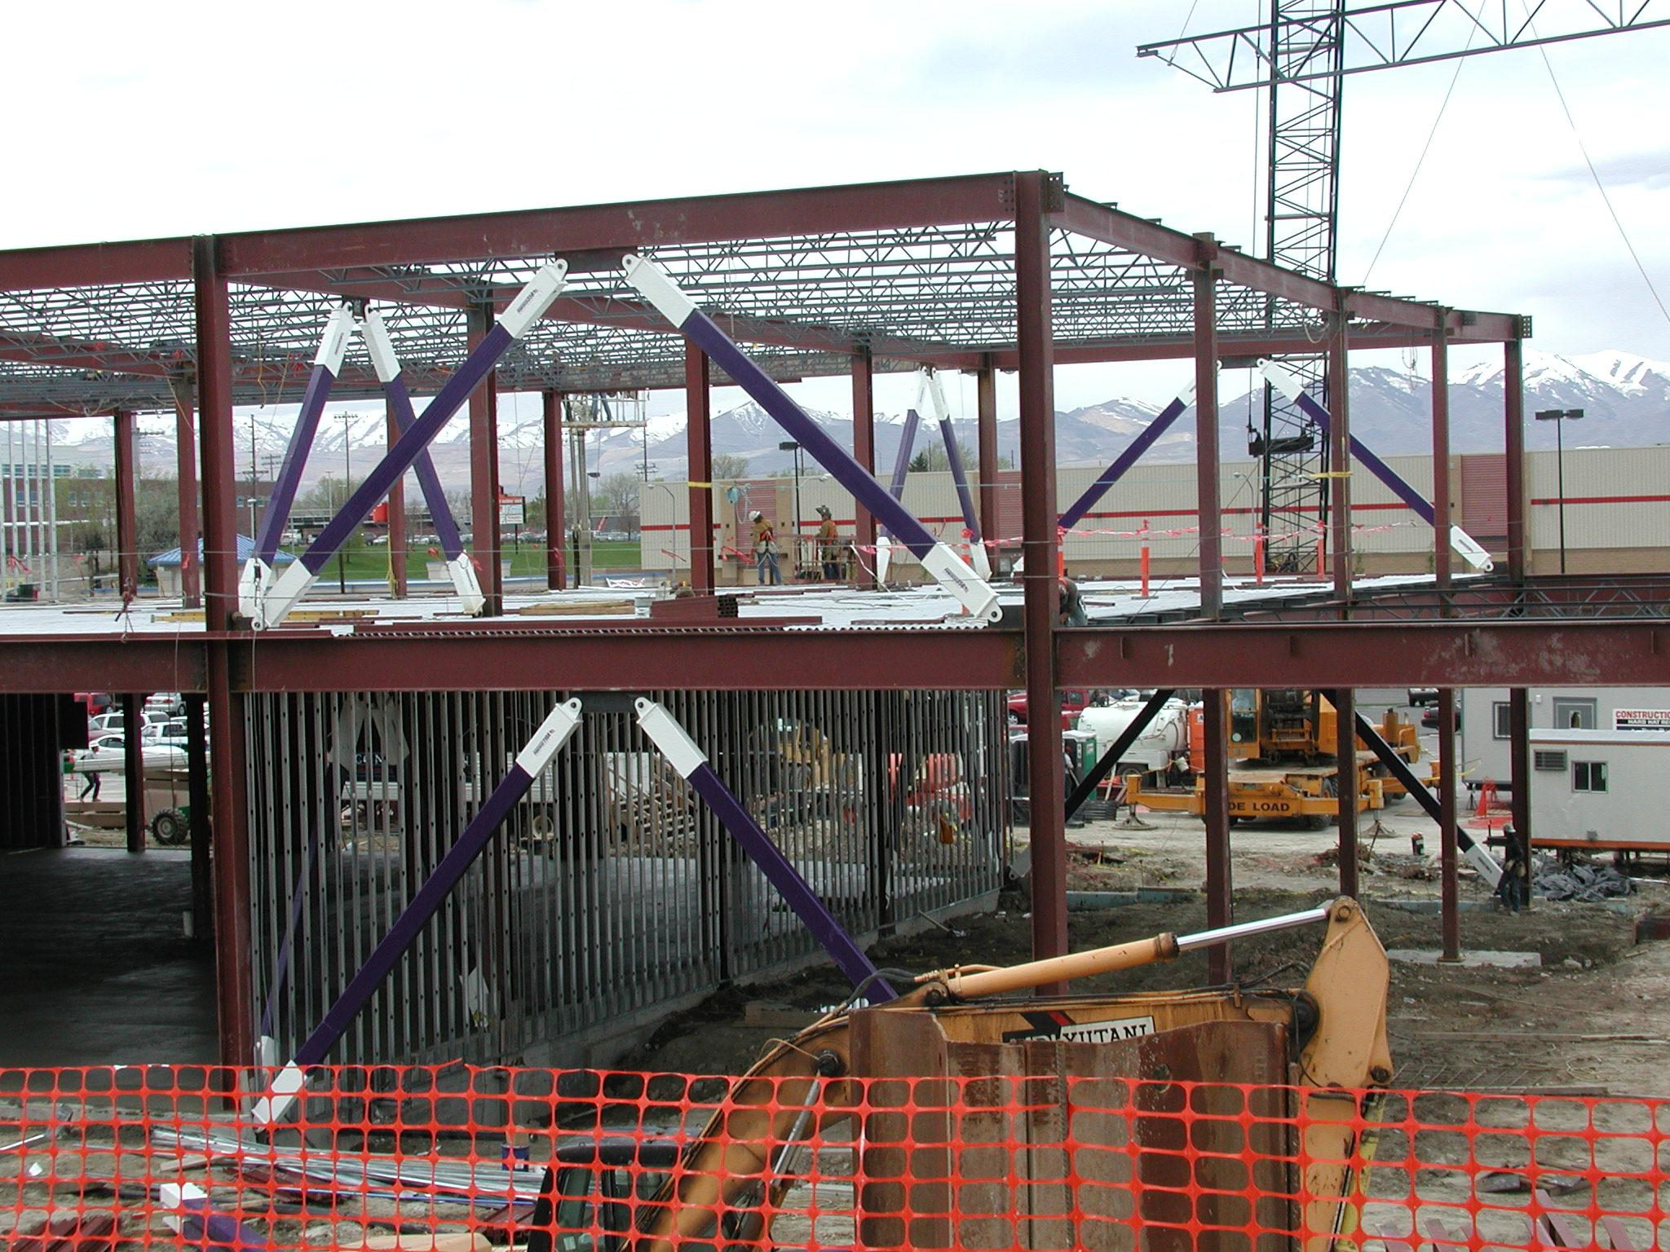
Notes:
The next several slides show steel framed buildings with BRBFs during construction.
This photo is courtesy of Star Seismic. Star Seismic calls their BRBs "Powercat" braces.

Slide 15
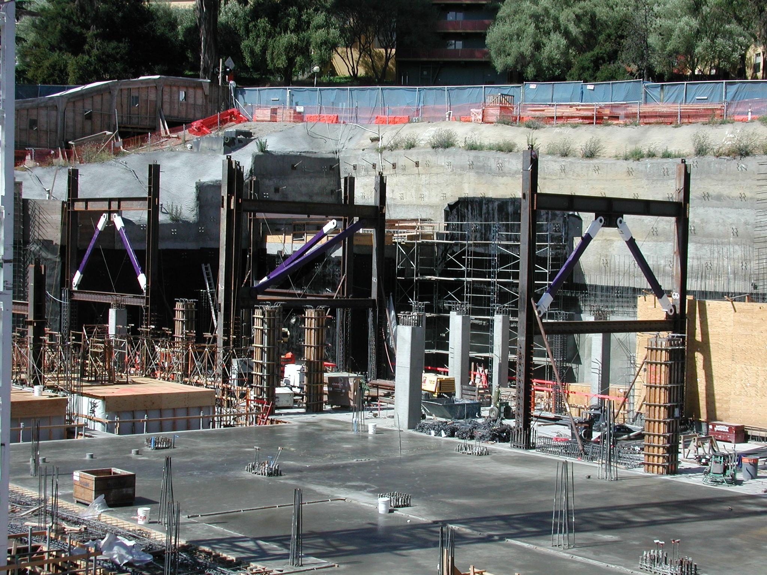
Notes:
Photo courtesy of Star Seismic.

Slide 16
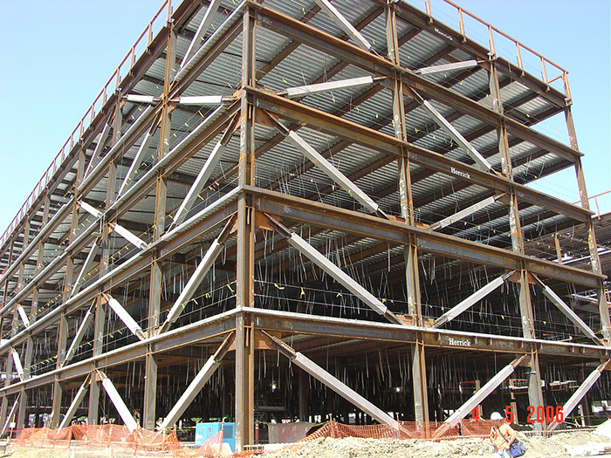
Notes:
Photo courtesy of CoreBrace.

Slide 17
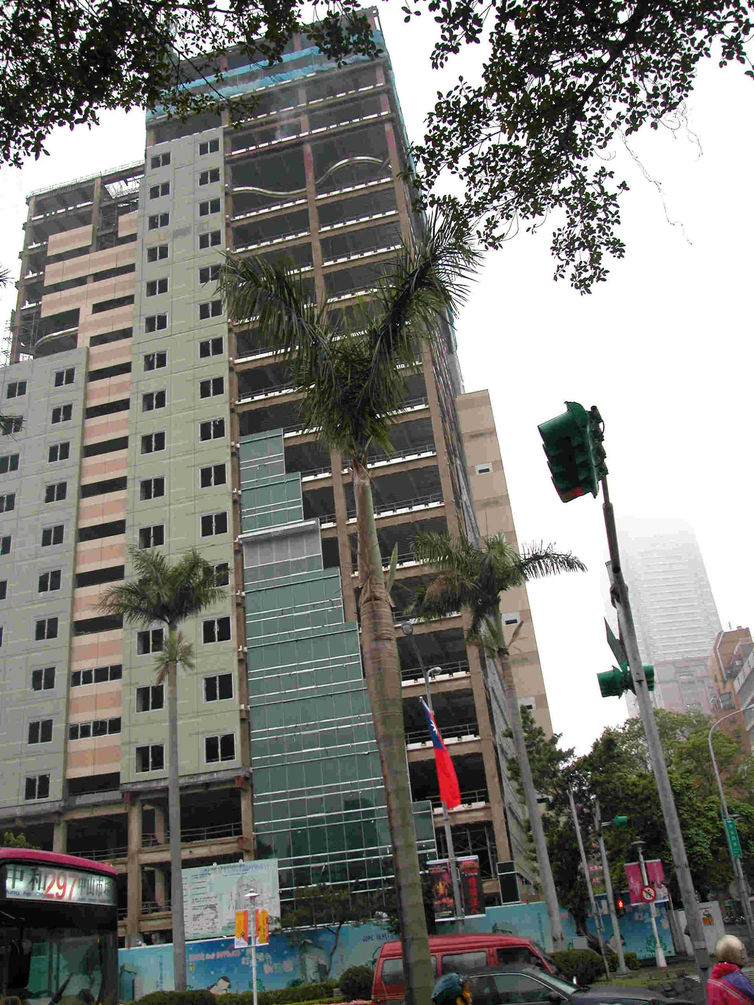
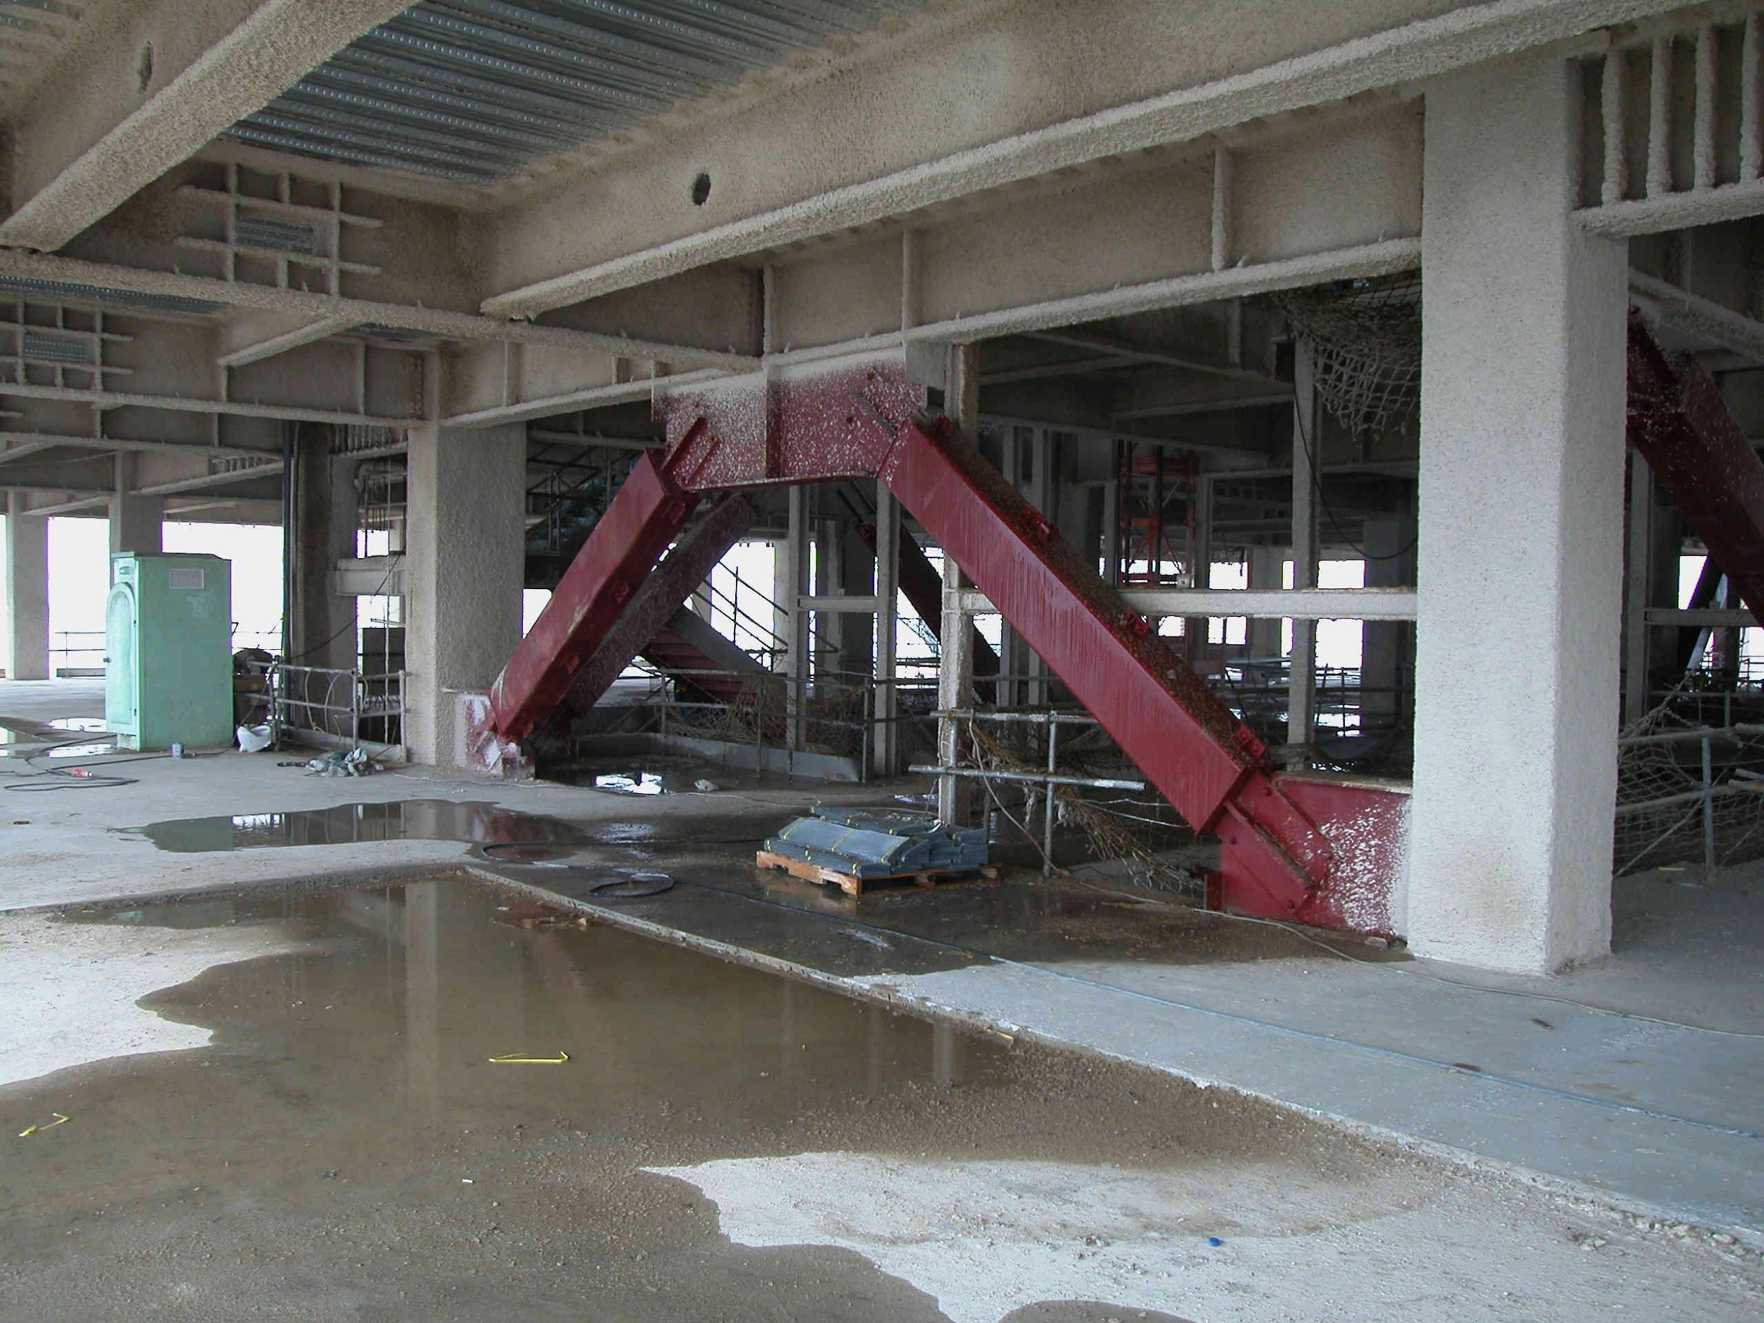
Notes:
This is a high-rise steel framed building under construction in Taipei, Taiwan. The photo shows an inverted V-type BRBF.
The BRBs used in this building are "double core" braces, developed at the National Center for Research in Earthquake Engineering (NCREE) in Taiwan.

Slide 18
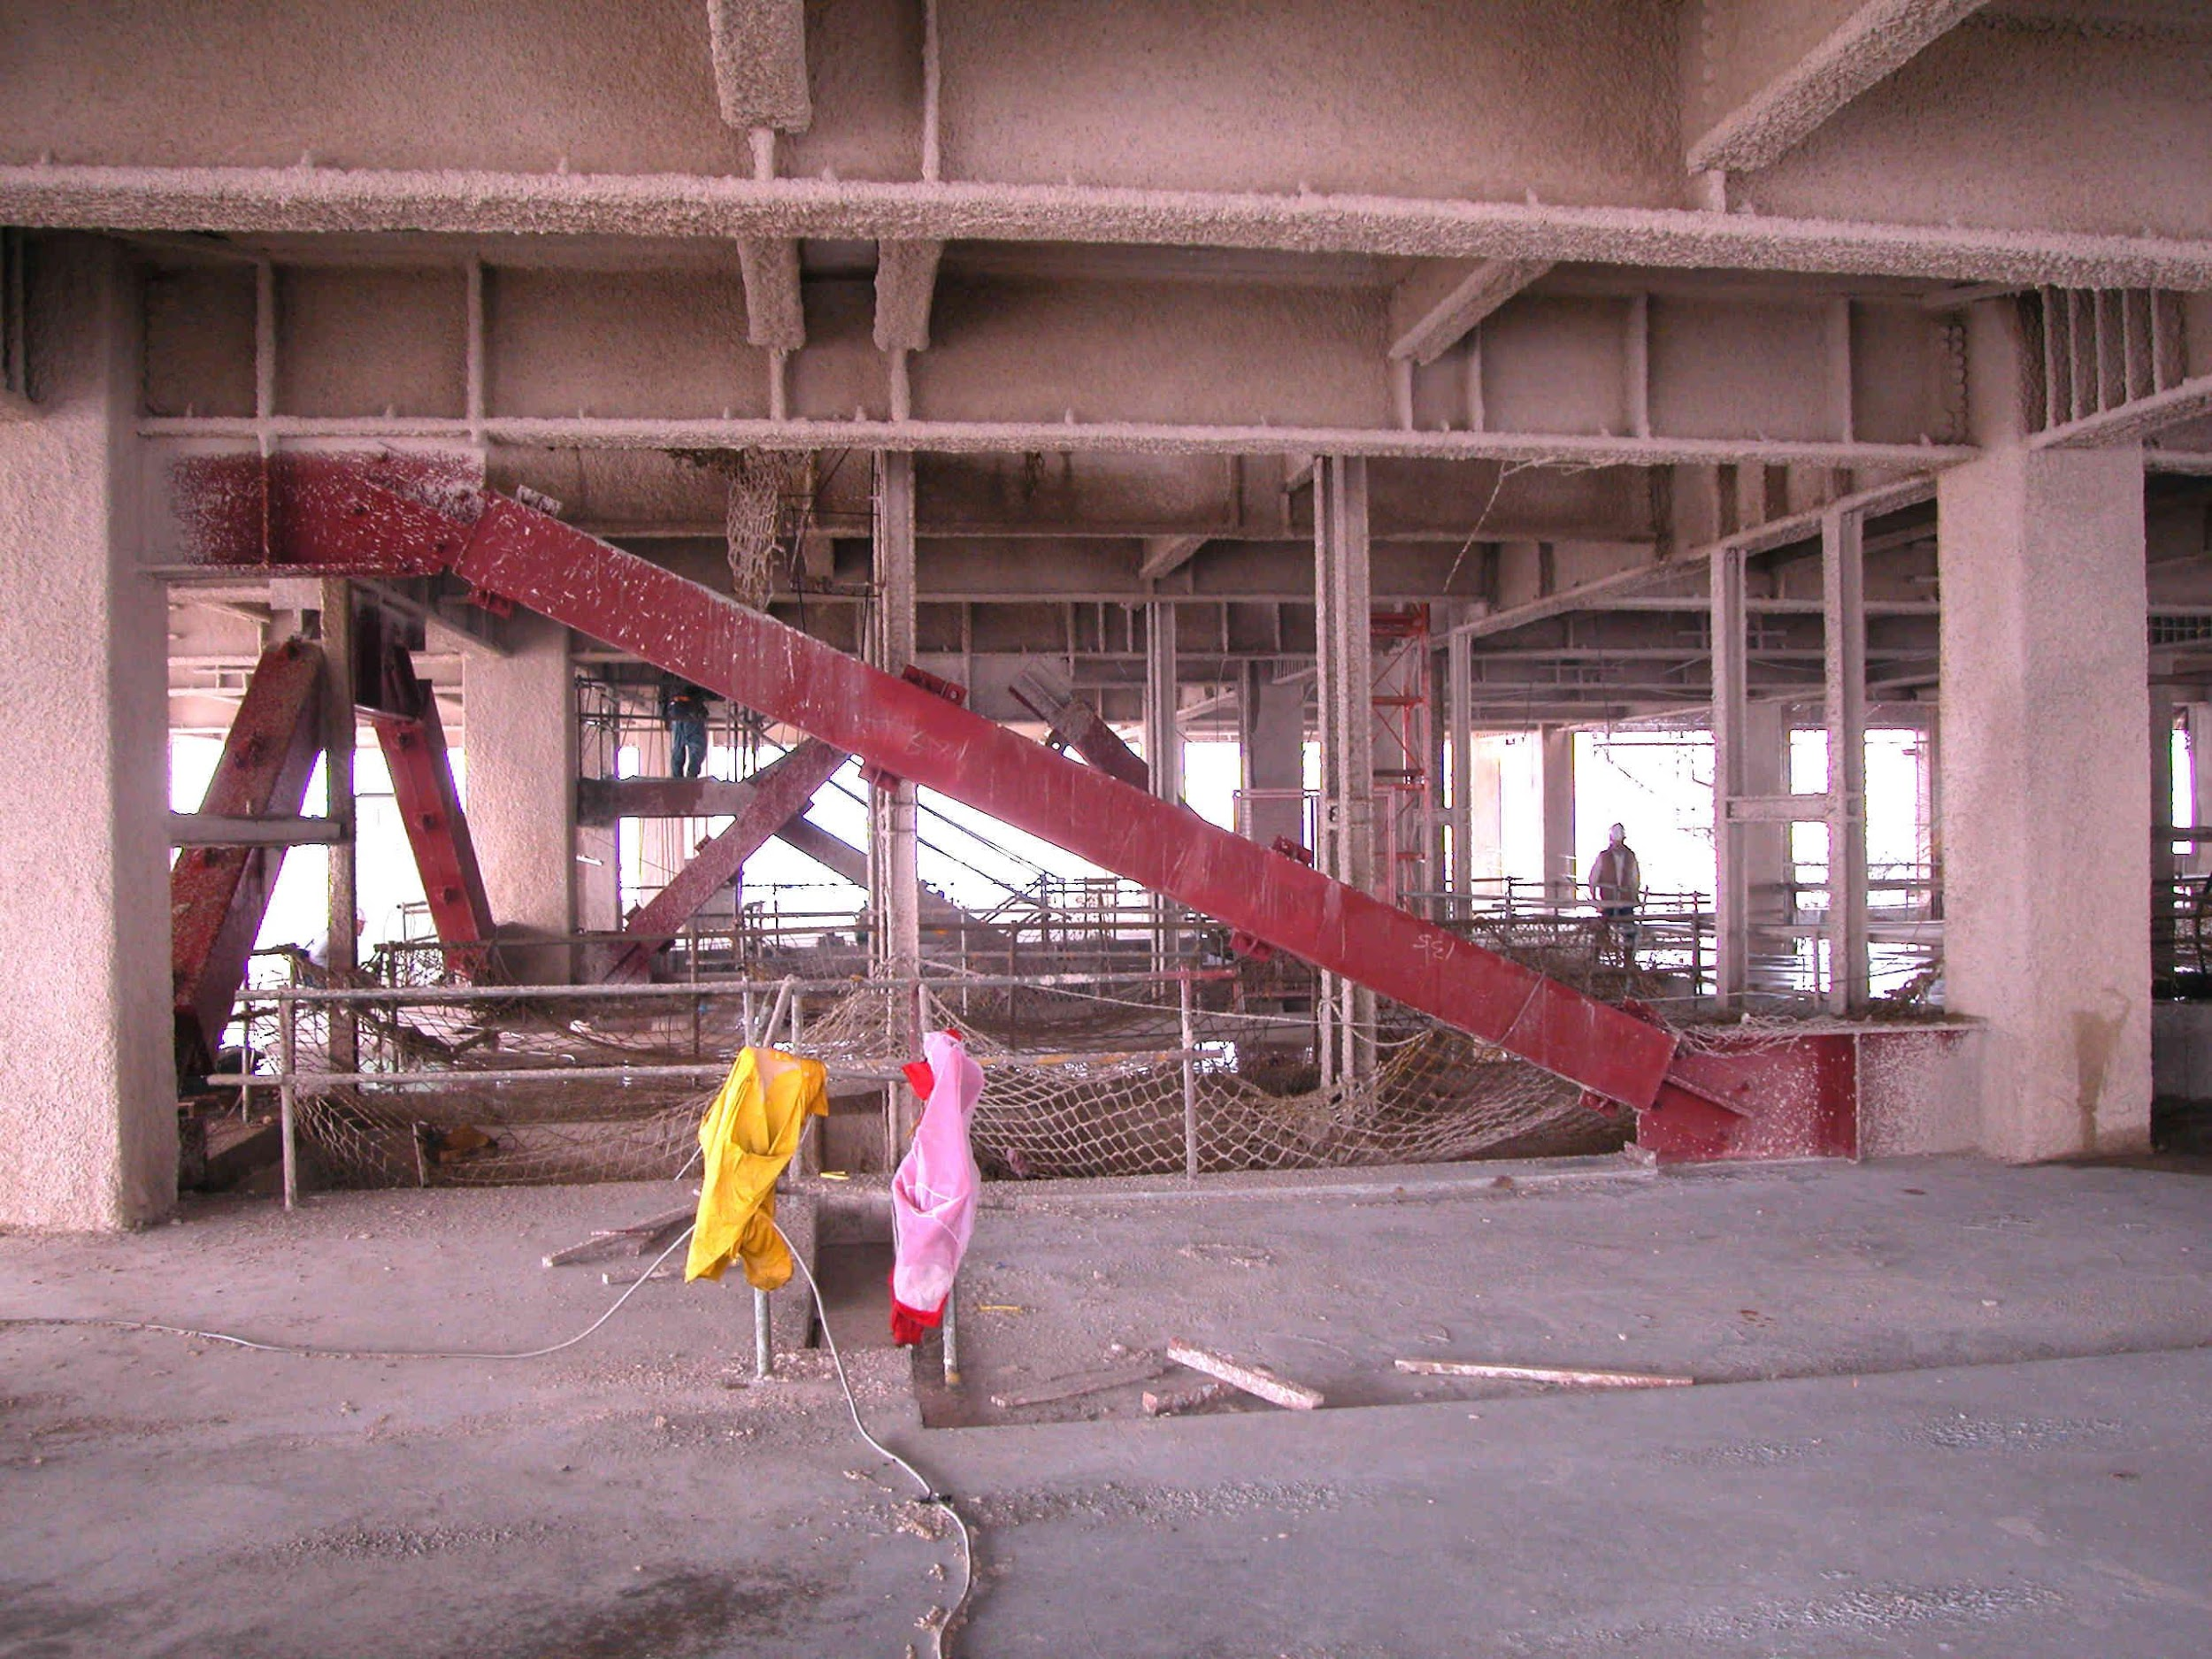
Notes:
An example of a single-diagonal type BRBF, in the same building in Taipei as shown on the previous slide.

Slide 19
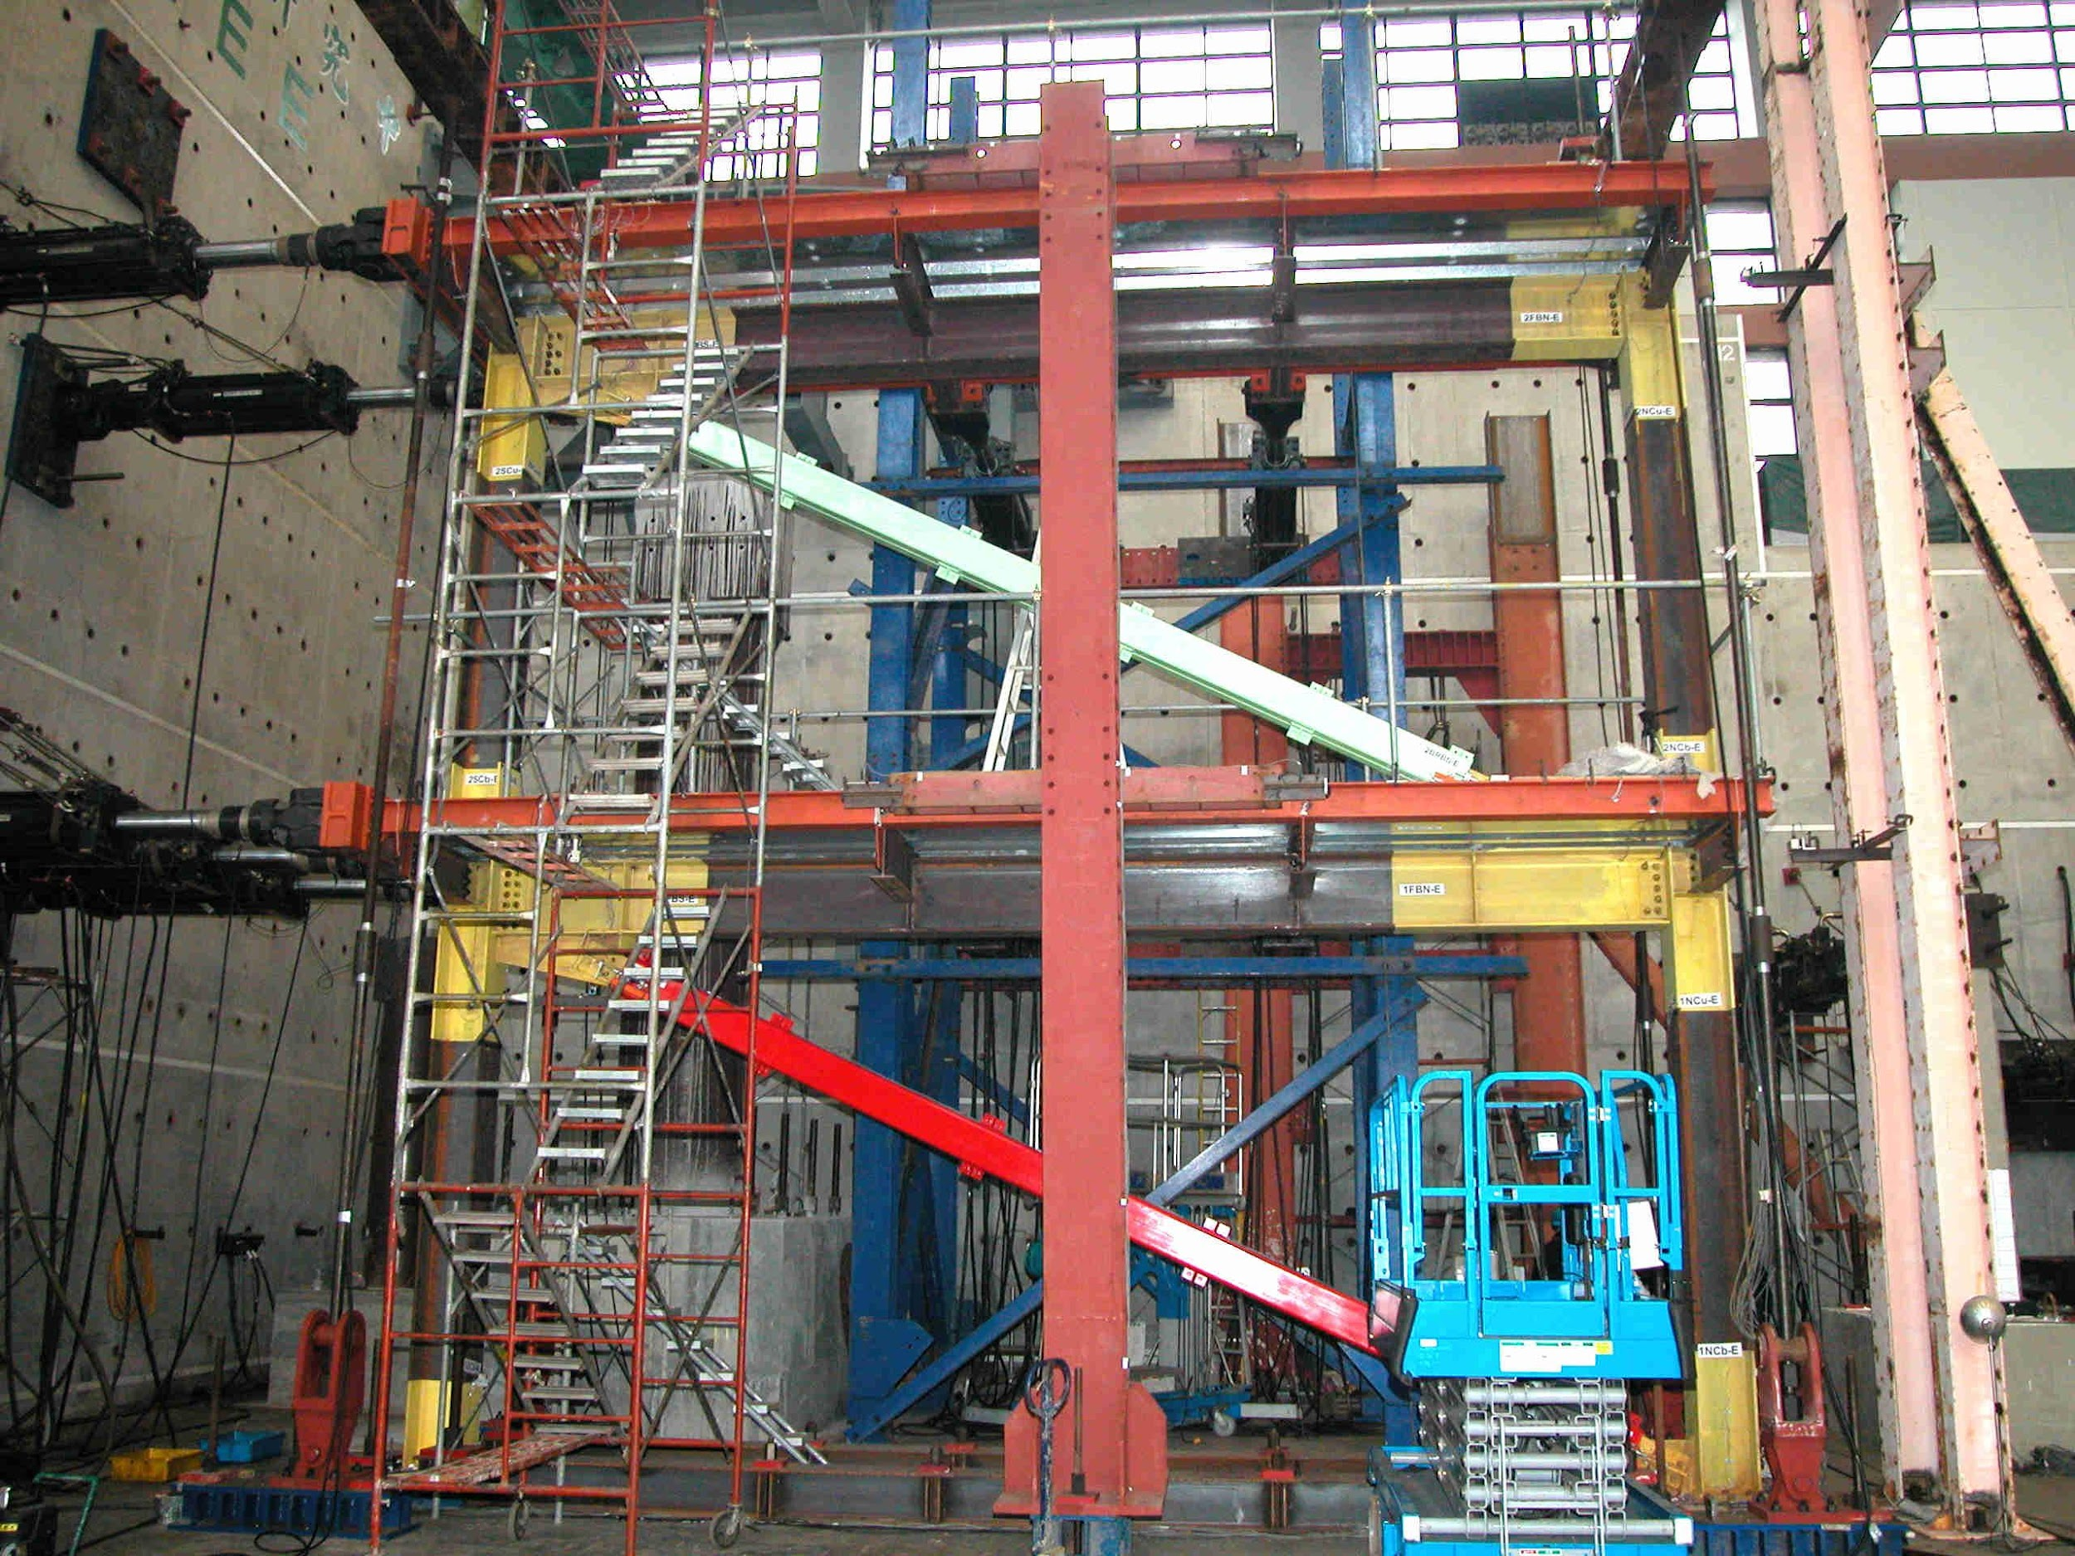
Notes:
This is a full-scale BRBF undergoing testing at NCREE in Taipei.

Slide 20
Inelastic Response of BRBFs under Earthquake Loading
Notes:
The following slides illustrate the intended inelastic behavior of a BRBF under lateral loading, in the form of rigid-plastic mechanisms.

Slide 21
Inelastic Response of BRBFs under Earthquake Loading
Tension Brace: Yields
Compression Brace: Yields
Columns and beams: remain essentially elastic
Notes:
The basic rigid-plastic mechanism of a BRBF is quite simple. The braces yield in a ductile manner in both compression and tension, resulting in a plastic mechanism. The beams and columns remain essentially elastic.
The lateral strength of the BRBF is directly related to the strength of the BRBs.

Slide 22
Inelastic Response of BRBFs under Earthquake Loading
Compression Brace: Yields
Tension Brace: Yields
Columns and beams: remain essentially elastic
Notes:
The inelastic behavior of the BRBF is the same for either direction of lateral load.

Slide 23
Design of BRBFs - General Approach
Size BRB core for code specified forces (strength and stiffness)
Choose BRB design with performance verified by testing
(Per Chapter K)
Design all other frame elements (beams, columns, brace connections, column bases) for maximum forces that can be generated by fully yielded and strain hardened BRBs
Notes:
This slide summarizes the basic design approach for a BRBF.
The BRBs are the "fuse" elements of the frame and are designed for code level earthquake forces. All other frame members (columns and beams) and connections are designed to be stronger than the BRBs. Thus, the other frame members and connections are not designed for code level earthquake forces. Rather they are designed for the maximum forces generated by the BRBs.
The BRBs must be designed to supply high levels of ductility under cyclic loading. The AISC Seismic Provisions requires that the performance of BRBs be verified by large-scale testing, per Section K3 of the Seismic Provisions.

Slide 24
5 - Buckling-Restrained Braced Frames
Description and Basic Behavior of Buckling-Restrained Braced Frames and Buckling-Restrained Braces
AISC Seismic Provisions for Buckling-Restrained Braced Frames
Notes:
The previous slides looked at some basic concepts on the behavior of BRBFs. The remainder of this module will look at how these concepts are implemented in the AISC Seismic Provisions.

Slide 25
2022 AISC Seismic Provisions
Section F4. Buckling-Restrained Braced Frames (BFBF)
F4.1 Scope
F4.2 Basis of Design
F4.3 Analysis
F4.4 System Requirements
F4.5 Members
F4.6 Connections
Notes:
BRBF detailing requirements are covered in Section F4 of the Seismic Provisions. The following slides will cover selected key highlights of Section F4.

Slide 26
AISC Seismic Provisions - BRBF
Scope
F4.1 Scope
Buckling-restrained braced frames (BRBF) of structural steel shall be designed in conformance with this section.
Notes:
Section F4.1 is a scope statement for BRBFs. This section states that BRBFs are expected to withstand significant inelastic deformations, which means the detailing provisions for BRBFs are intended to result in a ductile system.

Slide 27
AISC Seismic Provisions - BRBF
Basis of Design
F4.2 Basis of Design
BRBF designed in accordance with these provisions are expected to provide significant inelastic deformation capacity primarily through yielding in tension and compression.

Slide 28
AISC Seismic Provisions - BRBF
Members
F4.5b Diagonal Braces
Braces shall be composed of a structural steel core and a system that restrains the steel core from buckling.
Notes:
Section F4.5b covers requirements for Buckling-Restrained Braces. As stated, a BRB consists of two basic components: the steel core and the buckling restraining system.

Slide 29
AISC Seismic Provisions - BRBF
Members
F4.5b.2 Diagonal Braces – Available Strength
The steel core shall be designed to resist the entire axial force in the brace.
The brace design axial strength = ϕ P_{ysc}
ϕ = 0.9 (LRFD) P_{ysc} = F_{ysc} A_{sc}
(Eqn F4-1)
Notes:
Section F4.5b.2 defines the design axial strength of the steel core.

Slide 30
AISC Seismic Provisions - BRBF
Members
F4.5b.2 Diagonal Braces – Available Strength
ϕ P_{ysc} = (0.9) F_{ysc} A_{sc}
Yielding Segment
A_{sc} = area of steel core (yielding segment)
F_{ysc} = specified minimum yield stress of core, or actual yield stress from coupon test
Notes:
F_{ysc} is the yield stress of the steel core and A_{sc} is the area of the steel core. For design of the BRB, F_{ysc} can be taken either as the minimum specified yield stress of the core material, or the actual yield stress as determined by coupon tests of the core material.
Manufactures that supply BRBs can often provide coupon values of F_{ysc} for the core material that will be used for the BRBs for a particular project. This permits designers to predict BRB yield strength P_{ysc} with reasonable certainty, minimizing uncertainties associated with material yield strength variations that occur in more conventional structural steel members.
The required axial strength of a BRB is determined by elastic analysis of the BRBF using LRFD load combinations with code specified earthquake forces (1.2D+0.5L+E+0.2S and 0.9D+E). Since the BRBF behaves as a truss, determining the axial forces in the BRBs is usually straightforward. The design axial strength of the BRB, as defined in Section 16.2a, must at least equal the required axial strength.
Note that the required steel core area, A_{sc}, may be controlled by frame stiffness requirements rather than frame strength. Due to the fact that BRBs achieve their full yield strength in both compression and tension, the core area A_{sc} of the BRB will normally be less than the cross-sectional area of a conventional brace in an SCBF. Consequently, BRBFs generally exhibit somewhat lower elastic stiffness than SCBFs, and so the design of BRBs may be stiffness controlled.
When computing the axial stiffness of a BRB, it is important to recognize that the area A_{sc} of the yielding segment of the core does not occur over the full length of the brace. The area of the core projections and the connection regions will be substantially greater than A_{sc} and will serve to increase the brace stiffness. Data on the actual elastic stiffness of BRBs is available from manufacturers.

Slide 31
AISC Seismic Provisions - BRBF
Members
F4.5b.1 Diagonal Braces – Assembly
The buckling-restraining system shall consist of the casing for the steel core. In stability calculations, beams, columns, and gussets connecting the core shall be considered part of this system.
The buckling-restraining system shall limit local and overall buckling of the steel core for the expected deformations.
Casing
Notes:
Section F4.5b.1 specifies requirements for the Buckling Restraining System.
The casing of the BRB is the primary element responsible for restraining buckling of the core. However, instability of the BRB can also occur in the core projection and connection region of the brace. Consequently, Section F4.5b.1 broadly defines the Buckling Restraining System to include the connection regions at the brace ends.

Slide 32
AISC Seismic Provisions - BRBF
Basis of Design
F4.2 Basis of Design
Braces shall be designed, tested and detailed to accommodate expected deformations.
Expected deformations are those corresponding to a story drift of at least 2% of the story height, h_{sx}, or two times the design earthquake displacement, whichever is larger, in addition to brace deformations resulting from deformation of the frame due to gravity loading.
Δ = design story drift = C_{d} Δ_{E}
Δ_{E} = story drift under code specified earthquake forces
C_{d} = 5 for BRBF
Notes:
Section F4.2 specifies that the BRB should not buckle under forces and deformations that will occur when the frame is displaced to two times the design earthquake displacement Δ. The design earthquake displacement Δ is computed by multiplying C_{d} times the elastic drift under code specified earthquake forces. Typically, the design earthquake displacement Δ is an estimate of the maximum drift the frame is expected to see under a design basis earthquake.
Requiring that BRBs be capable of sustaining 2 times the design earthquake displacement reflects the view that actual drifts in severe earthquakes may exceed the design earthquake displacement. Although conservative, this is not a particularly punitive requirement, in that experiments show that BRBs can easily meet this requirement.

Slide 33
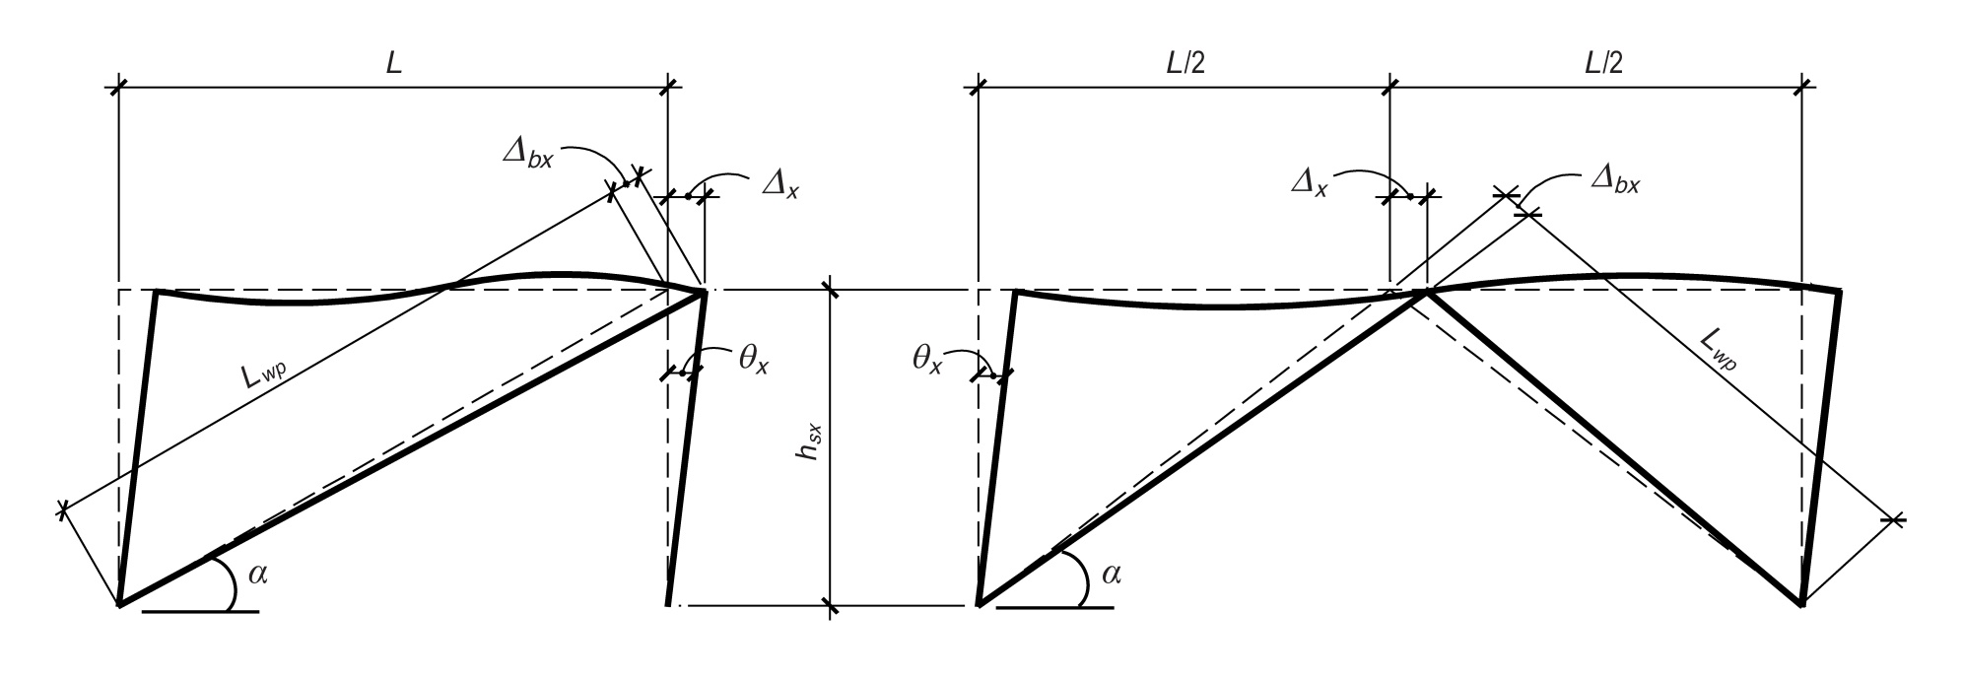
AISC Seismic Provisions - BRBF
Basis of Design
F4.2 Basis of Design
In story x, brace deformation, Δ_{bx} , is related to story drift, Δ_{x} , through kinematics.
Δ_{x} = maximum (C_{d} Δ_{E} , 0.02h_{sx})
Δ_{bx} = Δ_{x} cos(α)
Notes:
Figure from Kersting, Fahnestock and Lopez (NIST GCR 15-917-34)
Free download:
https://nvlpubs.nist.gov/nistpubs/gcr/2015/NIST.GCR.15-917-34.pdf

Slide 34
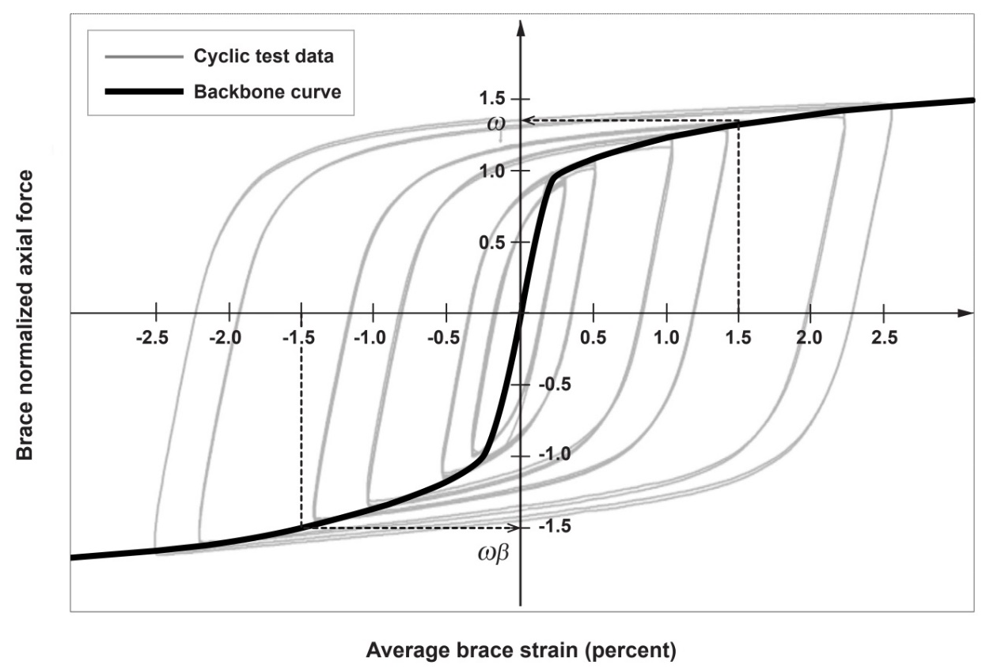
AISC Seismic Provisions - BRBF
Basis of Design
F4.2a Brace Strength
F4.2b Adjustment Factors
F4.2c Brace Deformations
Brace deformation must be checked against qualifying cyclic tests and is used to determine adjustment factors that quantify strain hardening.
Notes:
Figure from Kersting, Fahnestock and Lopez (NIST GCR 15-917-34)
Free download:
https://nvlpubs.nist.gov/nistpubs/gcr/2015/NIST.GCR.15-917-34.pdf

Slide 35
AISC Seismic Provisions - BRBF
Members
F4.5b.3 Diagonal Braces – Conformance Demonstration
The design of braces shall be based upon results from qualifying cyclic tests in accordance with the procedures and acceptance criteria of Section K3 "Cyclic Tests for Qualification of Buckling Restrained Braces"
Notes:
The AISC Seismic Provisions require that BRB performance be verified by testing. The requirements for testing are specified in Section K3 of the AISC Seismic Provisions.
Several options are available for testing:
- Project specific tests can be conducted.
- Test data developed for other projects or reported in the literature can be used, as long as the tests conform to the requirements of Section K3.
- Test data may be available from the BRB manufacturer that satisfies the requirements of Section K3 for the project under consideration. This is likely to be the most common case in the future, as BRB manufacturers develop a database of test data for their braces.

Slide 36
AISC Seismic Provisions - BRBF
K3 - Cyclic Tests for Qualification of BRBs
Purpose of Testing:
Verify brace performance under cyclic loading up to deformation levels corresponding to
2 x design earthquake displacement
Determine strength of brace in tension and compression at a deformation level corresponding to 2 x design earthquake displacement
Notes:
Before we continue with Section F4, we will first take a brief look at the BRB testing requirements in Section K3.
As noted in the slide, a primary purpose of testing is to verify that the braces meet the requirements of Section F4.2, i.e., that the brace can perform satisfactorily up to 2 times the design earthquake displacement.
An additional purpose of testing is to determine the amount of strain hardening and compression overstrength exhibited by the brace at 2 times the design earthquake displacement. This provides an estimate of the maximum strength of the brace in tension and compression, which will later be used to design brace connections, beams, and columns.

Slide 37
AISC Seismic Provisions - BRBF
K3 - Cyclic Tests for Qualification of BRBs
K3.1 Scope
Two tests required to qualify brace:
1. Brace Test Specimen
Verify ability to sustain large cyclic axial tension and compression without buckling or fracture
2. Subassemblage Test Specimen
Verify ability of brace and connections to accommodate axial and rotational demands imposed by frame
Notes:
Section K3 requires that two tests be conducted to qualify a BRB.
The first test, on a Brace Test Specimen, applies direct axial tension and compression to the brace, to verify its ability to sustain cyclic axial forces and deformations without buckling or fracture.
The second test must be on a Subassemblage Test Specimen. This specimen must subject the brace to both axial deformations and rotations, to simulate more realistically the actual deformations the brace will see in the BRBF.
If we think of the BRBF as a pin-connected truss, then the brace would not be subjected to any end moment or rotation, just axial force. In reality, however, there is considerable rotational fixity at the beam-column connections in a BRBF (or any other braced frame for that matter) because the rigidity at the joint produced by the gusset plate. Consequently, a braced frame will develop a significant degree of frame action (i.e. behave like a moment frame), particularly at large drifts. This frame action will cause bending of beams and columns and generate rotations at the beam-column-gusset plate connection region. Since there is also generally a considerable degree of rotational fixity at the connection between the brace and the gusset, the rotation of the gusset plate due to frame action will impose moments and rotations on the brace ends. These moments and rotations imposed on the ends of the BRB may impair the performance brace, may cause buckling in the gusset-brace connection region, or produce other problems. The purpose of the Subassemblage Test Specimen is to assure the BRB can sustain these end rotations and still perform satisfactorily.

Slide 38
AISC Seismic Provisions - BRBF
K3 - Cyclic Tests for Qualification of BRBs
1. Brace Test Specimen
Uniaxial Loading
Notes:
This figure is a schematic representation of a Brace Test Specimen. The BRB is subjected to uniaxial tension and compression, with no intentional eccentricity.

Slide 39
AISC Seismic Provisions - BRBF
K3 - Cyclic Tests for Qualification of BRBs
2. Subassemblage Test Specimen
Axial + Rotational Loading
Notes:
These figures are a schematic representations of possible Subassemblage Test Specimens. The BRB is subjected to both axial force and rotations, that replicate in a reasonable way the rotations that will be seen by the BRB in the actual frame under consideration.

Slide 40
AISC Seismic Provisions - BRBF
K3 - Cyclic Tests for Qualification of BRBs
K3.2 Subassemblage Test Specimen
Scale Requirements for Test Specimens:
1. Brace Test Specimen (K3.3c)
0.5 [ P_{ysc} ]_{prototype} ≤ [ P_{ysc} ]_{specimen} ≤ 1.5 [ P_{ysc} ]_{prototype}
2. Subassemblage Test Specimen (K3.2b)
[ P_{ysc} ]_{specimen} ≥ 0.9 [ P_{ysc} ]_{prototype}
Notes:
Section K3.2 specifies a number of requirements that are intended to assure that the test specimen is a reasonable representation of the actual construction.
One of the important requirements is on the size of the test specimens. For the Brace Test Specimen, the axial yield strength of the steel core, P_{ysc} of the brace test specimen cannot be less than 50% nor more than 150% of the prototype. Thus, if the actual brace will have a core yield strength of 1000 kips, then the core yield strength of the specimen must be between 500 and 1500 kips.
For the Subassemblage Test Specimen, the specimen must be at least as strong as the prototype.
There are additional requirements for the test specimens in Section K3.2.

Slide 41
AISC Seismic Provisions - BRBF
K3 - Cyclic Tests for Qualification of BRBs
K3.4c Loading Sequence
Definitions:
Δ_{b} = deformation quantity used to control test
= total brace axial deformation for the brace test specimen
= total brace end rotation for the subassemblage test specimen
Δ_{bm} = value of deformation quantity, Δ_{b}, corresponding to the design earthquake displacement
Δ_{by} = value of deformation quantity, Δ_{b}, at first significant yield of the test specimen
Notes:
This slide defines several terms used for test control in Section K3. Note that the terms Δ_{b}, Δ_{bm} and Δ_{by} denote axial deformations of the brace for the Brace Test Specimen, and brace end rotations for the Subassemblage Test Specimen.

Slide 42
AISC Seismic Provisions - BRBF
K3 - Cyclic Tests for Qualification of BRBs
K3.4c Loading Sequence
When calculating Δ_{bm}, the design earthquake displacement shall not be taken less that 0.01 × story height
C_{d} × Δ_{E}
Design earthquake displacement
= larger of
0.01 × story height
Notes:
Braces must be tested to deformation levels corresponding to two times the design story drift.
The design earthquake displacement Δ is computed as C_{d} ×Δ_{E}. Section K3.4c adds the requirement that the design earthquake displacement cannot be taken less that 0.01 times the story height.

Slide 43
AISC Seismic Provisions - BRBF
K3 - Cyclic Tests for Qualification of BRBs
K3.4c Loading Sequence
2 cycles at: Δ_{b} = ± Δ_{by}
2 cycles at: Δ_{b} = ± 0.5 Δ_{bm}
2 cycles at: Δ_{b} = ± 1.0 Δ_{bm}
2 cycles at: Δ_{b} = ± 1.5 Δ_{bm}
2 cycles at: Δ_{b} = ± 2.0 Δ_{bm}
Continue with additional cycles at Δ_{b} = ± 1.5 Δ_{bm}
for the brace test specimen to achieve cumulative axial deformation at least 200 times Δ_{by}
(not required for subassemblage test specimen)
Notes:
This is the specified cyclic loading protocol for BRBs. Specimens are tested to deformation levels corresponding to two times the design earthquake displacement (2×C_{d} Δ_{E} or 0.02 × story height, whichever is greater).
Once the maximum deformation is achieved, the loading is continued for the brace test specimen at a deformation level corresponding to 1.5 times the design earthquake displacement . This loading is continued until a cumulative axial deformation of 200 × Δ_{by} has been imposed on the brace. This requirement investigates the BRBs ability to resist low-cycle fatigue failure.

Slide 44
AISC Seismic Provisions - BRBF
K3 - Cyclic Tests for Qualification of BRBs
K3.8 Acceptance Criteria
No rupture, brace instability, or brace end connection failure
Positive incremental stiffness (no strength degradation)
For Brace Test Specimen:
    T_{max} ≥ P_{ysc} and C_{max} ≥ P_{ysc}
    C_{max} ≤ 1.5 T_{max}
Notes:
The basic acceptance criteria for testing is the specimen should not exhibit fracture, buckling or connection failure within the specified loading protocol.
Further, the brace cannot exhibit strength degradation (as strength degradation is generally indicative of fracture or buckling somewhere within the specimen).
The maximum tension and compression forces developed by the brace must at least equal the core yield strength, P_{ysc}. A brace which does not meet this requirement is not functioning properly as a BRB.
Finally, states that the maximum compression force developed by the brace cannot exceed 1.5 times the maximum tension force. Excessive compression overstrength suggests that the core is not adequately decoupled from the casing.

Slide 45
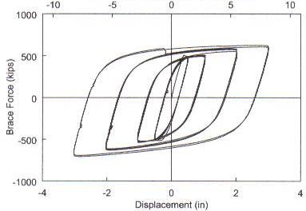
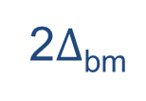
AISC Seismic Provisions - BRBF
K3 - Cyclic Tests for Qualification of BRBs
Example of Results for Brace Test Specimen
T_{max}
C_{max}
-2Δ_{bm}
Notes:
This is an example of a successful test result for a BRB Brace Test Specimen. Note the excellent hysteretic behavior in both tension and compression.
The maximum tension and compression forces developed by the brace are measured at a deformation corresponding to two times the design story drift.
Plot courtesy of Rafael Sabelli - Dasse Design, San Francisco

Slide 46
AISC Seismic Provisions - BRBF
Basis of Design
F4.2a Brace Strength
Tension
Adjusted Brace Strength = ω R_{y} P_{ysc}
Compression
Adjusted Brace Strength = β ω R_{y} P_{ysc}
ω = strain-hardening adjustment factor
β = compression strength adjustment factor
Determine from Section K3 brace tests
Take R_{y} = 1.0 if P_{syc} is computed using coupon values of F_{ysc}
Notes:
We will now return to Section F4.
Section F4.2a defines the Adjusted Brace Strength in tension and compression. Determining these adjusted strengths requires determining a strain-hardening factor ω and a compression strength adjustment factor (to account for compression overstrength) β. These factors are established from BRB test data.
The adjusted brace strengths are intended to provide an estimate of the maximum tension and compression forces that can be developed by the BRB. The adjusted brace strengths will subsequently be used as a basis for designing the brace connections, beams and columns.
As noted in the slide, if coupon values of the core yield strength are available for the BRBs to be used on an actual project, then R_{y} =1.0 is used when computing the adjusted brace strength.

Slide 47
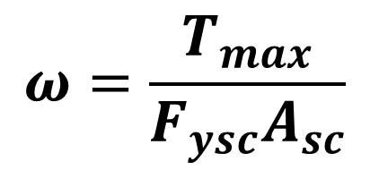
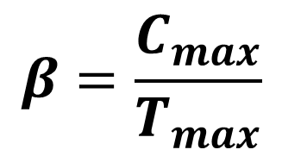
AISC Seismic Provisions - BRBF
Basis of Design
F4.2a Brace Strength
ω = strain-hardening adjustment factor
β = compression strength adjustment factor
Determine from Section K3 brace tests
Notes:
This slide shows how ω and β are obtained from test data. T_{max} and C_{max} are the maximum tension and compression forces developed by the brace, at a deformation level corresponding to two times the design story drift.
The values of ω and β should be taken as the larger of values determined from the two different brace qualification tests (Brace Test Specimen, and Subassemblage Test Specimen).

Slide 48
AISC Seismic Provisions - BRBF
Connections
F4.6c.1 Required Strength
The required strength of bracing connections in tension and compression shall be adjusted brace strength in compression divided by α_{s}.
P_{u} = β ω R_{y} P_{ysc} / α_{s}
F4.6c 2. Gusset Plate Requirements
Lateral bracing consistent with that used in the tests upon which the design is based is required.
Notes:
Section F4.6c.1 states that brace connections must be designed for the maximum force that can be expected from the brace.
Section F4.6c.2 states that the design of connections and gusset plates should consider buckling limit states. This is true for a brace connection in any type of braced frame: SCBF, OCBF, EBF or BRBF. Section 16.3b also states that any bracing or stiffening used to stabilize the gusset plate and connection region in the qualifying tests for the BRB must also be used in the actual construction.
Unlike SCBFs, it is not necessary to use the fold-line concept in the design of gusset plates for BRBFs, since the braces are not expected to buckle.

Slide 49
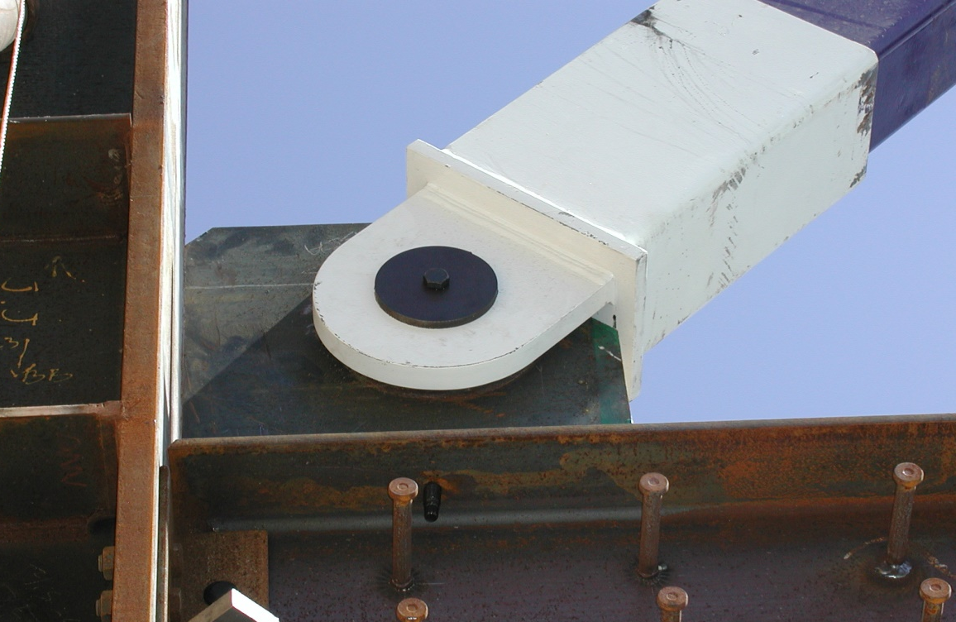
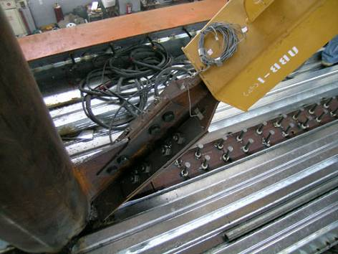
Notes:
Examples of BRB connections:
Top right: BRB with clevise pin connection. Photo courtesy of Star Seismic
Lower left: BRB with bolted connection. Photo courtesy of K.C. Tsai - National Taiwan University

Slide 50
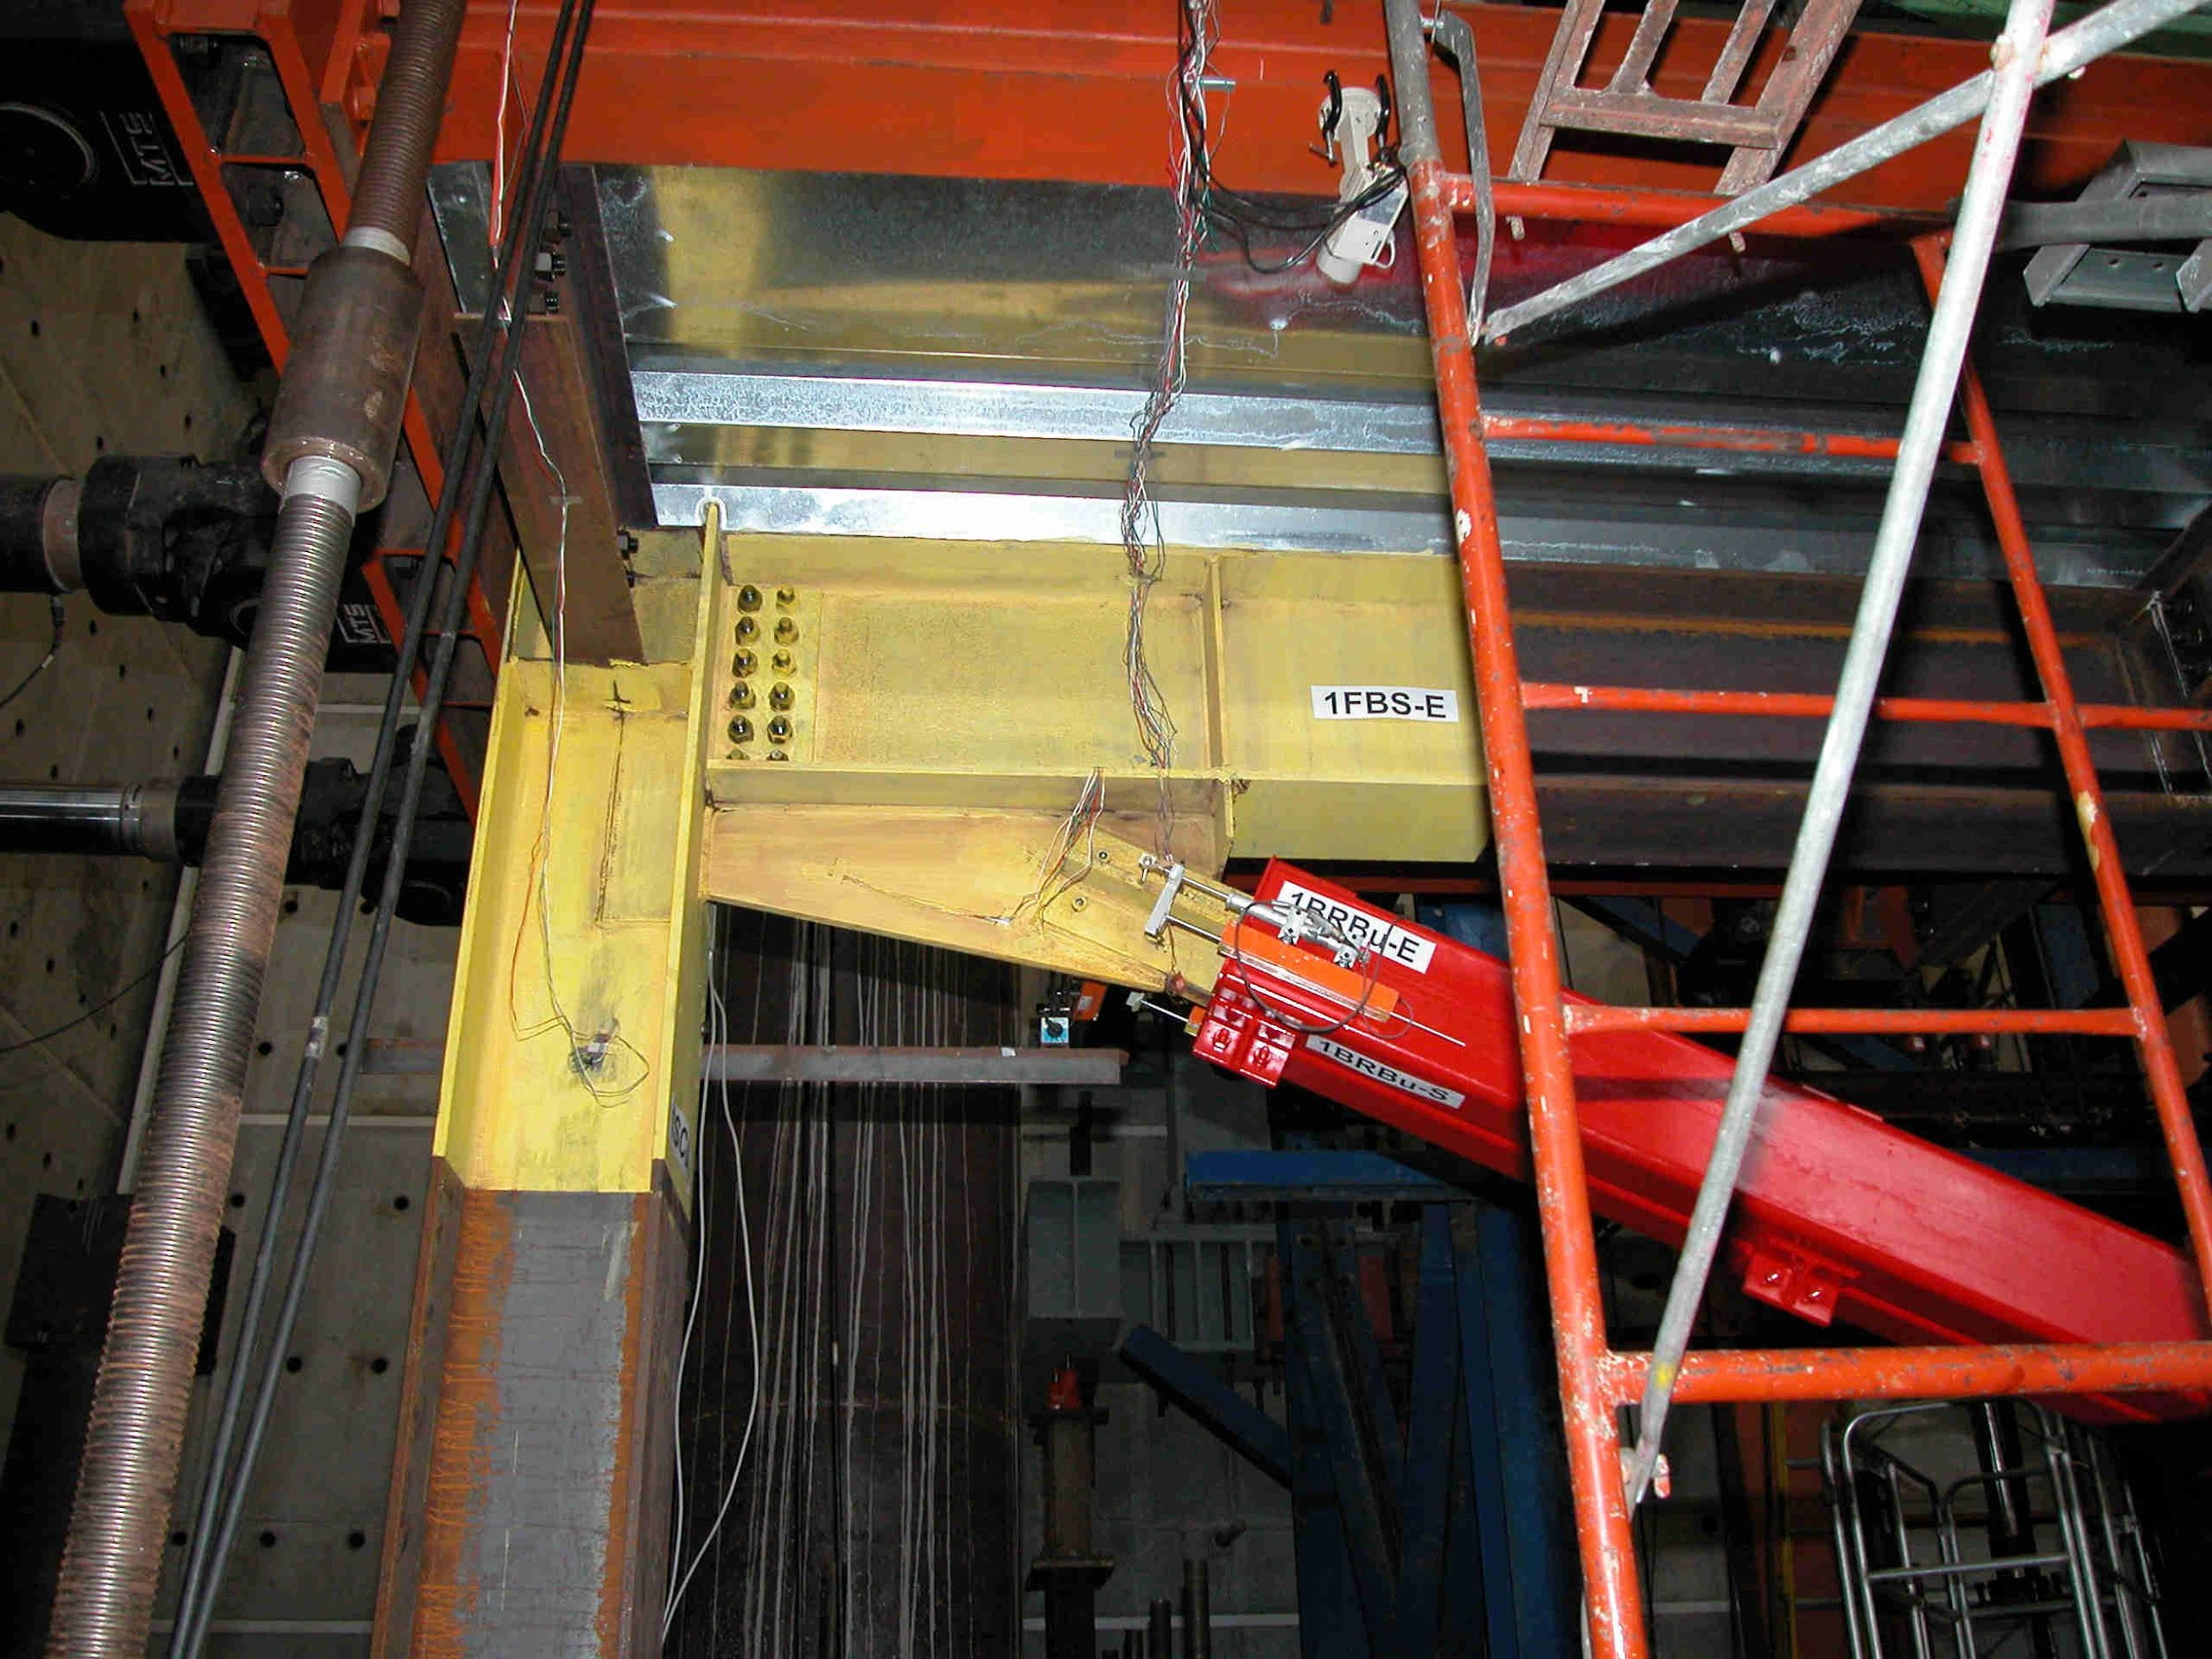
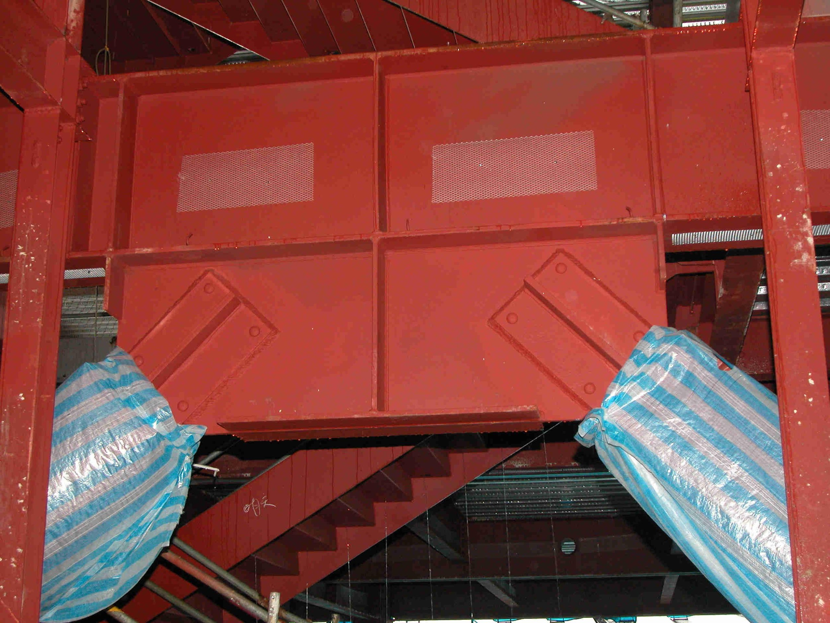
Notes:
Upper left: BRB connection used in test frame at National Center for Research in Earthquake Engineering - Taipei
Lower right: Welded BRB connection in building in Taipei

Slide 51
AISC Seismic Provisions - BRBF
Systems Requirements
F4.4a V-and Inverted V-Brace Frames
For V-type and Inverted V-type bracing:
(a) Design beams for unbalanced load resulting from the adjusted brace strengths in tension and compression.
Take force in tension brace: ω R_{y} P_{ysc}
Take force in compression brace: β ω R_{y} P_{ysc}
Assume beam has no vertical support between columns.
Notes:
Section F4.4a provides additional requirements for V-type and inverted V-type BRBFs. These provisions are similar to the requirements for V and inverted V-type SCBFs. In both cases, the beam must be designed for the unbalanced load from the braces.
In the case of a SCBF, the unbalanced load on the beam can be very large, since the difference between tension strength (R_{y}F_{y}A_{g}) and compression strength ( 0.3 F_{cr}A_{g}) of a conventional brace can be very large.
In the case of a BRBF, the unbalanced load on the beam is generally much smaller, since the tension and compression strength of a BRB are very similar. They only differ by the value of β.

Slide 52
AISC Seismic Provisions - BRBF
Systems Requirements
F4.4a V-and Inverted V-Brace Frames
L
w_{gravity} = (1.2 + 0.2 S_{DS}) D + 0.5L
θ
ω R_{y} P_{ysc}
β ω R_{y} P_{ysc}
Beam-to-column connections: simple framing
Notes:
This shows the loading used to design the beam in an inverted v-type BRBF.

Slide 53
AISC Seismic Provisions - BRBF
Systems Requirements
F4.4a V-and Inverted V-Brace Frames
Forces acting on beam:
L
w_{gravity} = (1.2 + 0.2 S_{DS}) D + 0.5L
( β -1) ω R_{y} P_{ysc} sin θ
( β -1) ω R_{y} P_{ysc} cos θ
Notes:
This shows the vertical and horizontal components of the unbalanced brace force acting on the beam.

Slide 54
AISC Seismic Provisions - BRBF
Systems Requirements
F4.4a V-and Inverted V-Brace Frames
Beam deflection due to unbalanced loads:
Δ_{v} = vertical beam deflection due to unbalanced load
( β -1) ω R_{y} P_{ysc} sin θ
When testing braces per Section K3:
Include additional brace elongation resulting from vertical beam deflection when determining Δ_{bm}
Notes:
In an inverted V-type SCBF, the unbalanced brace force pulls the beam down, since tension strength is greater than compression strength for a conventional brace.
In an inverted V-type BRBF, the unbalanced brace force pushes the beam up, since compression strength is greater than tension strength for a BRB.
When established the expected brace elongation at the design story drift of the BRBF, for purposes of Section K3 testing, the additional deformation of the brace resulting from beam deflection should be included.

Slide 55
AISC Seismic Provisions - BRBF
Systems Requirements
F4.4a V-and Inverted V-Brace Frames
For V-type and Inverted V-type bracing:
(b) Beams and struts shall be continuous between columns. Beams and struts shall be braced to meet the requirement of moderately ductile members in Section D1.2a.1.
Notes:
Section F4.4a also specifies lateral bracing requirements for beams in V-type and inverted V-type BRBFs.
The required location of lateral braces are determined according to the main AISC Specification, so that the beam has an adequate design strength to resist the forces generated in the beam based on application of unbalanced BRB forces plus gravity loads.
In addition, beam lateral bracing should be provided at the point of intersection of the BRBs.

Slide 56
AISC Seismic Provisions - BRBF
Members
F4.5a Basic Requirements
Beam and column members shall meet the requirements of Section D1.1.
Beams and Columns: Moderately Ductile
b/t ≤ λ_{md}
Notes:
Section F4.5a specifies requirements for beams and columns in BRBFs.
Section F4.5a specifies beam and column sections must be seismically compact for local buckling.
Beams and columns in BRBFs are intended to remain elastic, so it may appear unjustified to require these members to be seismically compact. However, at large drifts, a BRBF may exhibit considerable frame action, generating bending moments in the beams and column that have not been considered in design. Requiring the beams and columns to be seismically compact permits these members to develop their full flexural strength to resist these unanticipated bending moments, and also permits these members to respond in a ductile manner if the unanticipated moments become large.
Since the beams and columns of BRBFs will normally be rolled wide-flange sections, satisfying the requirement for seismically compact sections normally poses little difficulty.

Slide 57
AISC Seismic Provisions - BRBF
Analysis
F4.3 Analysis
The required strength of beams, columns, struts and connections in BRBF shall be determined using the capacity-limited seismic load effect.
The capacity-limited horizontal seismic load effect, E_{cl}, shall be taken as the forces developed in the member assuming the forces in all braces correspond to their adjusted strength in compression or in tension.
1.2D + 0.5L + 0.15S + E
0.9D + E
"E" from adjusted brace strengths in tension and compression
Notes:
Section F4.3 specifies that the beams and columns should be designed for the maximum forces generated by the braces (defined as the adjusted brace strengths), plus appropriate gravity loads. This follows the fundamental capacity design philosophy for BRBFs, that all members and connections in the frame should be stronger than the BRBs.

Slide 58
AISC Seismic Provisions - BRBF
Analysis
1.2D + 0.5L + 0.15S
or
0.9D
F4.3 Analysis
ω R_{y} P_{ysc}
β ω R_{y} P_{ysc}
θ
ω R_{y} P_{ysc}
β ω R_{y} P_{ysc}
ω R_{y} P_{ysc}
β ω R_{y} P_{ysc}
Notes:
This slide shows the adjusted brace strengths applied as loads to the remainder of the frame, together with factored gravity loads.
While the capacity design requirement for beams and columns is conceptually straightforward (as indicated by this slide), determining the forces in the beams and columns resulting from the adjusted brace strengths can sometimes be difficult, and require considerable judgment.

Slide 59
AISC Seismic Provisions - BRBF
Connections
F4.6d Column Splices
Splice Requirements:
Satisfy requirements of Section D2.5
Required flexural strength = 0.5 x (M_{pc} / α_{s} )
Required shear strength = Σ M_{pc} / α_{s} H
Notes:
Requirements for splices in BRBF columns are specified in Section F4.6d.
BRBF column splices must satisfy the general requirements for column splices given in Section D2.5. In addition to other requirements, Section D2.5 states that the required axial strength of the splice be taken to be at least the required axial strength of the column. Thus, like the column, the column splice must be designed for the axial forces generated when the BRBs have achieved their maximum strength. That is, the column splices must also develop the capacity of the BRBs.
Section F4.6d also defines the required flexural and shear strength of column splices. These account for the fact that the columns (and therefore the column splices) may see some bending as the BRBF goes to large interstory drifts.

Slide 60
AISC Seismic Provisions - BRBF
Basic Requirements
F4.5c Protected Zones
The protected zone shall include the steel core of braces and elements that connect the steel core to the beams and columns and shall satisfy the requirements of Section D1.3.
No welded, bolted, screwed or shot in attachments for perimeter edge angles, exterior facades, partitions, duct work, piping, etc.
Notes:
Finally, Section F4.5c defines the protected zone for a BRBF. The protected zone is the steel core of the BRB and the brace connection areas.
Note that the BRB casing is not considered to be part of the protected zone, since the casing is not expected to be yielding element of the system. Nonetheless, any attachments to the casing that may adversely affect the performance of the BRB should certainly be avoided.

Slide 61
AISC Seismic Provisions - BRBF
Basic Requirements
F4.5c Protected Zones
Protected Zones
Protected Zones
Notes:
This figure highlights the protected zones for a BRBF.

Slide 62
2022 AISC Seismic Provisions
Section F4. Buckling-Restrained Braced Frames (BFBF)
F4.1 Scope
F4.2 Basis of Design
F4.3 Analysis
F4.4 System Requirements
F4.5 Members
F4.6 Connections
Notes:
BRBF detailing requirements are covered in Section F4 of the Seismic Provisions.

