Slide 1

Design and Material Optimization in Sustainable Steel Buildings
From a Whole Life Cycle Perspective
Presented by Dr. Ming Hu
Notes:
Structural steel buildings present unique challenges to designers trying to reduce embodied carbon, requiring specialized techniques to improve environmental performance without compromising the building performance.
This lecture will focus on Design and Material Optimization in Sustainable Steel Building from a Whole Life Cycle Perspective.

Slide 2



Course Learning Objectives
Upon completion, participants will know the fundamentals of life cycle assessment methodology and related tools.
Upon completion, participants will gain an introductory understanding of sustainable steel building design strategies.
Upon completion, participants will be able to define embodied carbon emission and major contributing components in steel buildings.
Upon completion, participants will understand the basics of design optimization strategies and tools used in structural steel building design with the goal to reduce embodied carbon.
Notes:
The course learning objectives are four:
Upon completion, participants will know the fundamentals of life cycle assessment methodology and related tools.
Upon completion, participants will gain an introductory understanding of sustainable steel building design strategies.
Upon completion, participants will be able to define embodied carbon emission and major components in steel buildings.
Upon completion, participants will understand the basics of design optimization strategies and tools used in structural steel building design with the goal to reduce embodied carbon.

Slide 3
Agenda
Part one (25 mins)
Introduction of domestic steel with a focus on sustainability
Embodied carbon of steel buildings
Sustainable steel building design practice
Part Two (25 mins)
Life cycle assessment and EPD
Measurement of embodied carbon
Design of sustainable steel buildings using LCA tools
Notes:
This presentation is comprised two parts, and you can choose to take 5 mins break between the modules if you are watching this presentation online.
Part one covers three topics
Introduction of domestic steel with a focus on sustainability
Embodied carbon of steel buildings
Sustainable steel building design practice
Part two covers three topics
Life cycle assessment and EPD
Measurement of embodied carbon and EPD
Design of sustainable steel buildings using LCA tools

Slide 4
Agenda
Part one (25 mins)
Introduction of domestic steel with a focus on sustainability
Embodied carbon of steel buildings
Sustainable steel building design practice
Part Two (25 mins)
Life cycle assessment and EPD
Measurement of embodied carbon
Design of sustainable steel buildings using LCA tools
Notes:
Let’s dive into the first topic: steel production.

Slide 5
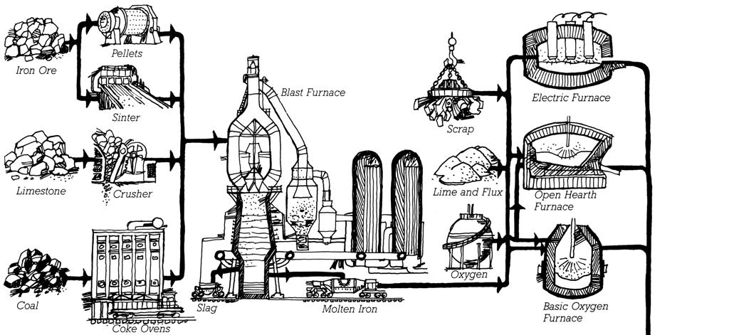
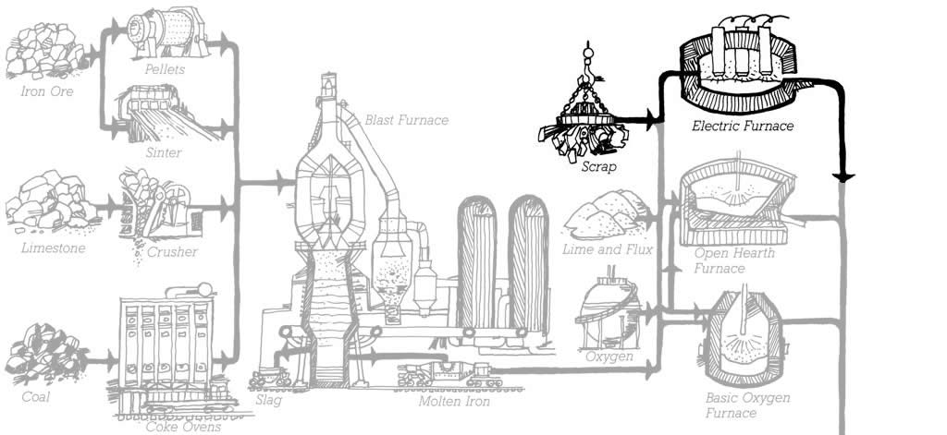

INTRODUCTION | DOMESTIC STEEL MANUFACTURING
Steelmaking: Large traditional mill
Iron ore is the raw ingredient, first processed into molten iron in a blast furnace, followed by conversion to steel in a second operation
Steelmaking: Mini-Mill
In the North America today, most steel is made from recycled steel scrap in "mini-mills" using electric arc furnaces. Steel scrap is converted directly to new steel, bypassing the need to make iron from ore.
Image Credit: Allen, E., & Iano, J. (2019). Fundamentals of Building Construction: materials and methods. John Wiley & Sons.
BASIC OXYGEN FURNACES (BOFs)
ELECTRIC ARC FURNACES (EAFS)
Notes:
Steel is manufactured in two types of factories. Large steel mills typically use basic oxygen furnaces (BOFs), which burn coal or natural gas to melt iron-ore to extract the iron, and then mix the iron with scraps of iron and steel to make new steel. Most of the inputs to a BOF are mined, raw materials, so the recycled content level for BOFs is typically between 25%-37%. Recycled content is important because virgin steel, or steel made in a BOF using raw materials like iron ore, can have an embodied carbon footprint that is up to five times greater than high-recycled content steel [1].
Smaller factories normally use electric arc furnaces (EAFs) to melt scrap iron and steel into new steel. These factories don’t have the ability to process raw iron ore. As a result, the steel manufactured on EAFs has high levels of recycled content, up to 100%, with an average recycled content of 93% for hot rolled shapes [2]. Structural steel does not lose any of its metallurgical properties (the physical and chemical behavior of the alloys) when it is recycled, making the properties and performance characteristics of recycled steel equivalent to virgin steel [3]. EAFs are powered by electricity, rather than coal and natural gas, and therefore have the ability to be powered using renewable energy sources.
It is worthy to mention difference and relation between mill vs fabrication vs erector.
A mill is a factory that produces steel. A fabricator is a company that cuts, shapes, and welds steel to create structural components for buildings and other structures. An erector is a company that assembles steel structures on construction sites.

Slide 6
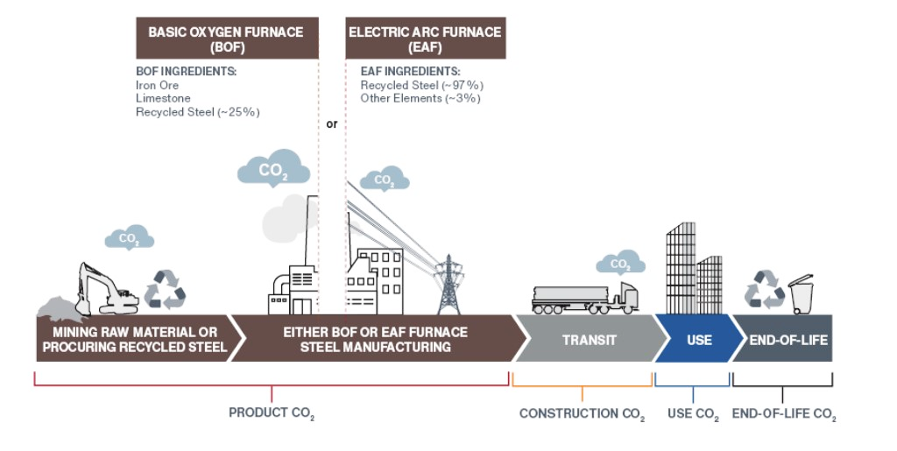
INTRODUCTION | DOMESTIC STEEL MANUFACTURING
ELECTRIC ARC FURNACE
(EAF)
OVER 50% FEWER CO₂ EMISSIONS
OTHER ELEMENTS
25% RECYCLED
RECYCLED CONTENT 93-98%
30% US BOF, 70% GLOBALLY
70% US EAF, 30% GLOBALLY
Image courtesy of Hines
Notes:
Using steel from electric arc furnaces is a very effective way to reduce embodied emissions in steel, because EAFs uses high levels of recycled material and can be powered by renewable energy sources.

Slide 7
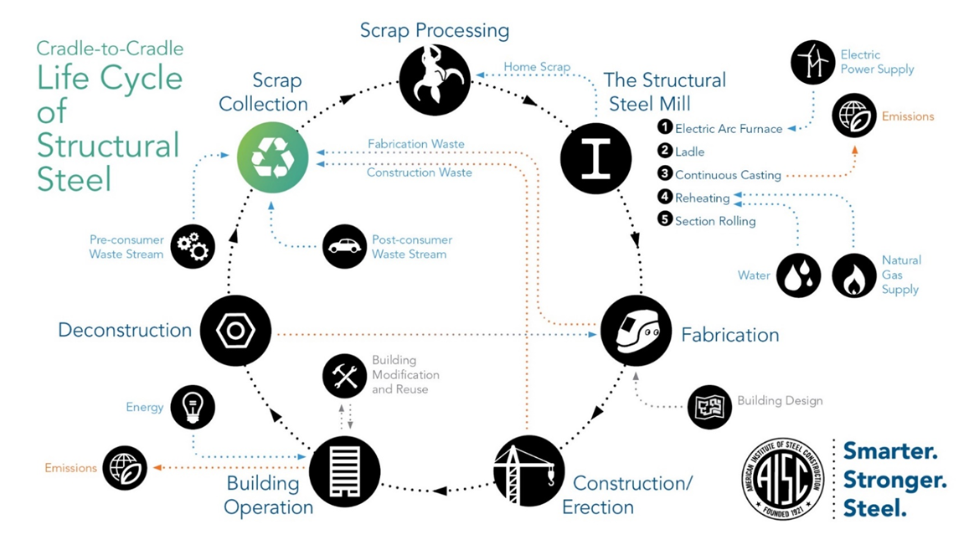
INTRODUCTION | DOMESTIC STEEL MANUFACTURING
LIFE CYCLE OF DOMESTIC RECYCLED STRUCTURAL STEEL
Notes:
This graph shows the cradle-to-cradle life cycle of a structural steel production using recycled steel., steelmaking (conversion of hot metal into steel using BOF or EAF), casting (pouring liquid steel into molds), rolling (hot or cold rolling to shape and reduce thickness), finishing (heat treatment, surface treatments, machining), distribution for fabrication and use, and eventually recycling of end-of-life products to close the loop.

Slide 8
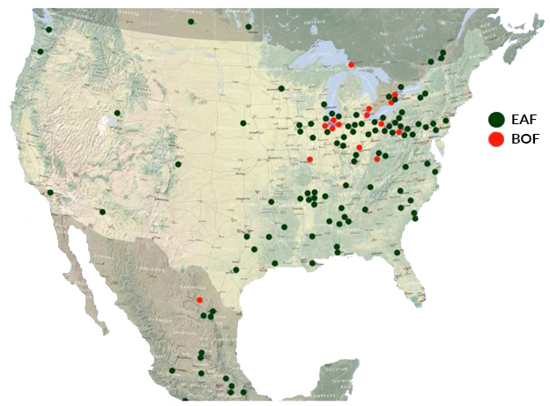
INTRODUCTION | DOMESTIC STEEL MANUFACTURING
The majority of steel for U.S buildings is from North America
Over 70% of U.S domestic steel is EAF
Some BOF plants have been idled
https://www.steel.org/wp-content/uploads/2020/07/AMM-Steel-Producers-Map-2018.pdf
Notes:
Probably not a lot of people realize this, vast majority of steel for U.S buildings is from North America. As illustrated on the map in this slide, according to the American Iron and Steel Institute (AISI), in 2021, the United States imported 31.4 million net tons (NT) of steel, including 22.7 million NT of finished steel. In the same year, the United States produced 116.3 million NT of steel. This means that in 2021, the United States imported 26% of the steel it used. And over 70% of U.S domestic steel is EAF and Some BOF plants have been idled. Architects and engineers can specify that the source of steel used on a project must originate from an EAF source.
The energy grid impacts the global warming potential of EAF steel production in a number of ways. First, the type of electricity that is used to power the EAF has a significant impact on the carbon emissions associated with steel production. For example, EAFs that are powered by coal-fired electricity have a much higher carbon footprint than EAFs that are powered by renewable energy sources such as solar or wind power. The location of the EAF also has a significant impact on the global warming potential of steel production. EAFs that are located in areas with a high proportion of renewable energy in the electricity grid have a lower carbon footprint than EAFs that are located in areas with a high proportion of fossil fuel-based electricity in the electricity grid.
Second, the efficiency of the EAF also has a significant impact on the global warming potential of steel production. More efficient EAFs use less electricity, which in turn reduces the carbon emissions associated with steel production.

Slide 9
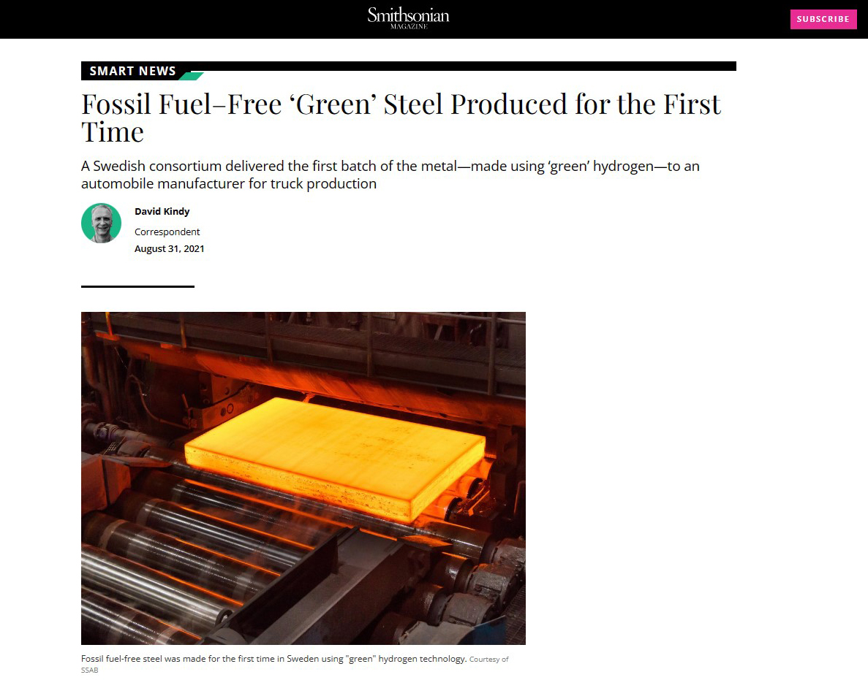
INTRODUCTION | DOMESTIC STEEL MANUFACTURE
ZERO CARBON (Fossil Fuel Free) STEEL IS HERE!
Notes:
It is worthy to point out that with the innovative technology, zero carbon steel is possible.
There are a number of different methods that can be used to produce zero carbon steel, including:
Using hydrogen: Hydrogen can be used to reduce iron ore to iron, without emitting carbon dioxide. This process is still in the development stage, but it has the potential to be a major breakthrough in the production of zero carbon steel.
Using biomass: Biomass can be used to produce a type of energy called biochar, which can then be used in the steelmaking process. Biochar emits less carbon dioxide than fossil fuels, and it can also help to improve the quality of the steel.
Zero carbon steel is still in its early stages of development, but it has the potential to revolutionize the steel industry. As the cost of producing zero carbon steel comes down, it is likely to become more widely used. This would have a major impact on the fight against climate change on a global scale. What you are seeing on the slide is a Zero carbon steel product developed and produced by a Swedish company, SSAB. [4]

Slide 10
Agenda
Part one (25 mins)
Introduction of domestic steel with a focus on sustainability
Embodied carbon of steel buildings
Sustainable steel building design practice
Part Two (25 mins)
Life cycle assessment and EPD
Measurement of embodied carbon
Design of sustainable steel buildings using LCA tools
Notes:
Now, let’s understand the embodied carbon of a steel building.

Slide 11
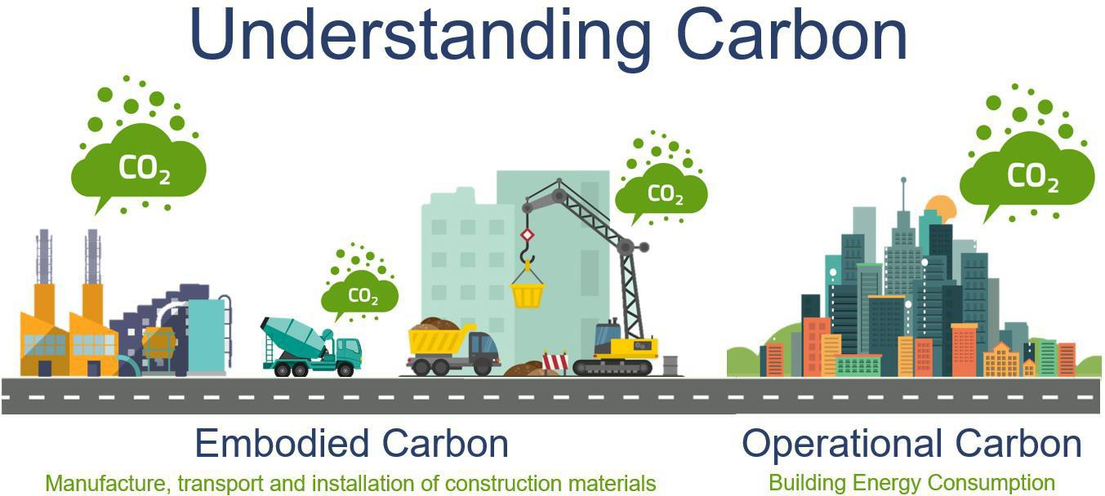
INTRODUCTION | Embodied Carbon | DEFINITION
Image Credit: Carbon Leadership Forum
Notes:
Embodied carbon refers to the greenhouse gas emissions arising from the manufacturing, transportation, installation, maintenance, and disposal of building material. Operational carbon is the carbon associated with the carbon emitted during the operational phase of the building.

Slide 12
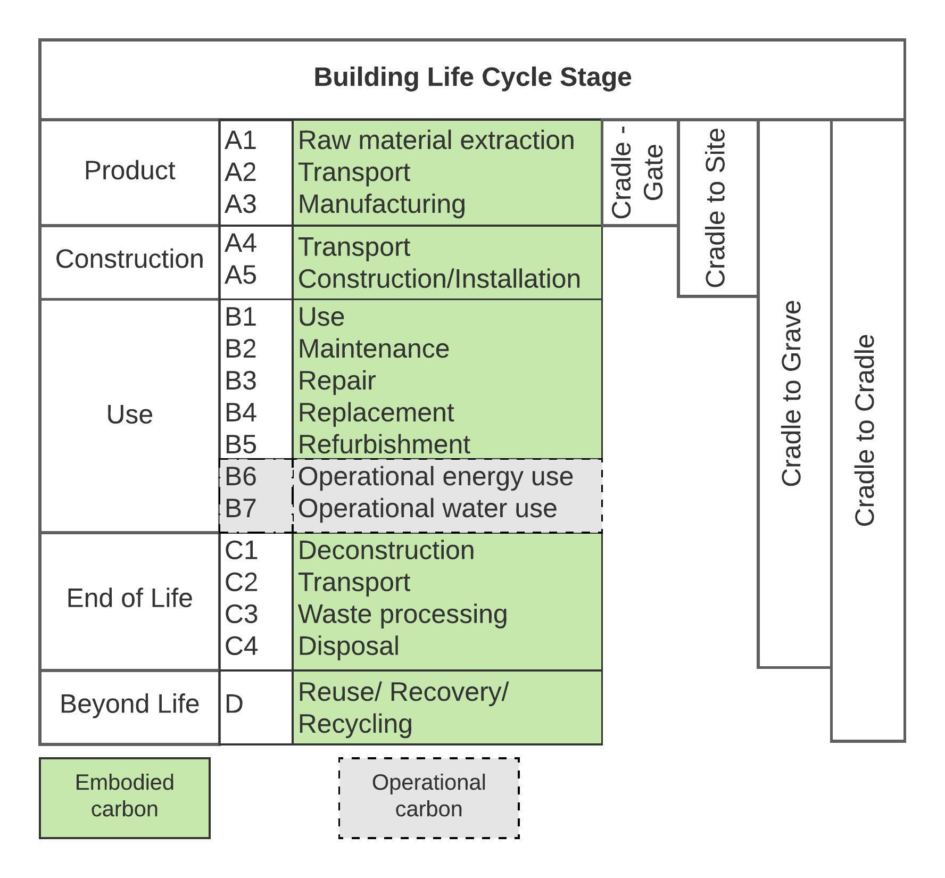
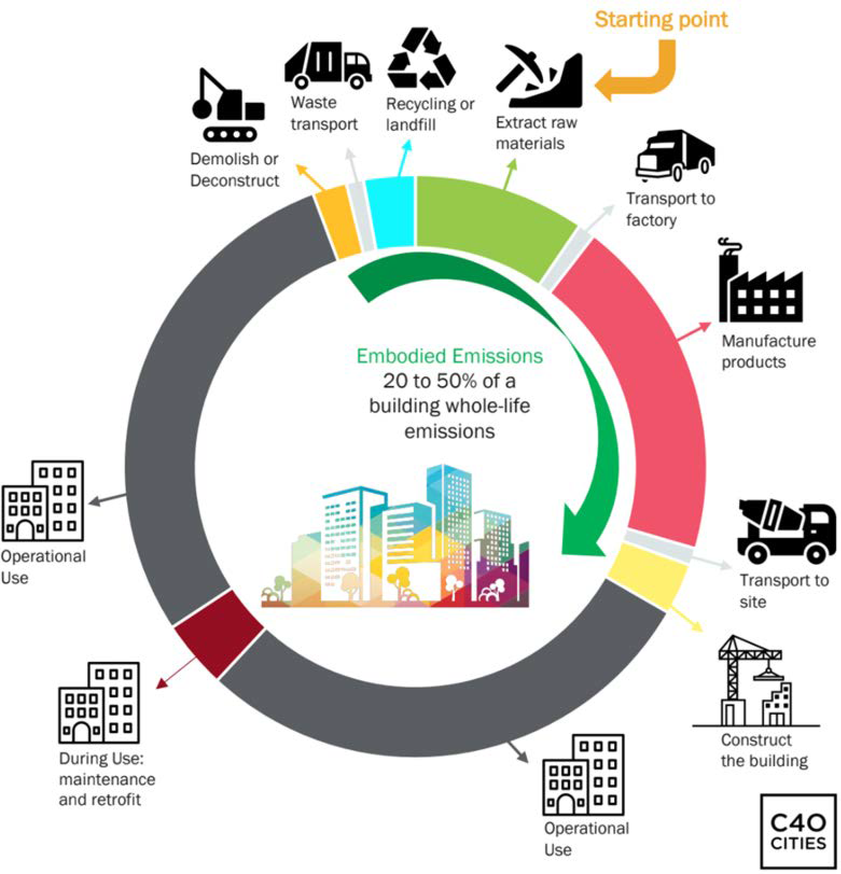
INTRODUCTION | Embodied Carbon | DEFINITION
Image Credit: Carbon Leadership Forum
Notes:
To begin, let's define embodied carbon as the greenhouse gas emissions generated during the production, transportation, installation, maintenance, and disposal of building materials. In contrast, operational carbon refers to emissions produced during the operational phase of a building, like the energy used in a building.
The left side image is the whole life cycle of a building presented as a closed cycle. When considering the entire life cycle of a building, it becomes apparent why embodied carbon is often overlooked. The life cycle can be divided into several stages: A1-A3 involves extracting raw materials and processing them into building products, which is known as "Cradle to Gate" carbon. A4-A5 includes transporting and assembling these products on the construction site, known as "Cradle to Site" carbon.
B1-B7 covers the building's operational phase, with B6-B7 accounting for operational carbon emissions and the rest for embodied carbon, such as carbon associated with repair and replacement. C1-C4 encompasses the end-of-life phase, including deconstruction, transport, waste processing, and disposal, known as "Cradle to Grave" carbon. Finally, the D stage includes reuse, recovery, and recycling, and other process outside the defined system boundary
Currently, building codes focus on and have well-established requirements for operational carbon emissions during the B6-B7 phase. However, there is a growing need and demand to improve design practices by understanding and quantifying embodied carbon emissions.

Slide 13



EMBODIED CARBON | DEFINITION
Embodied carbon is the sum impact of all the greenhouse gas emissions attributed to the materials throughout their life cycle.
It includes extraction from the ground, manufacturing, construction, maintenance, and end-of-life disposal.
- Embodied Carbon Network
Embodied carbon is the carbon footprint of a material. It considers how many greenhouse gases (GHGs) are released throughout the supply chain and is often measured from cradle-to-(factory) gate, or cradle-to-site (of use).
- Circular Ecology
Carbon emissions associated with materials and construction processes throughout the whole lifecycle of a building or infrastructure.
Embodied carbon therefore includes: material extraction, transport to manufacturer, manufacturing, transport to site, construction, use phase (e.g., concrete carbonation but excluding operational carbon), maintenance, repair, replacement, refurbishment, deconstruction, transport to end-of-life facilities, processing, and disposal.
- WorldGBC
Notes:
There are many definitions of embodied carbon. Here are three commonly used definitions.
First, Carbon emissions are associated with materials and construction processes throughout the whole lifecycle of a building or infrastructure. Embodied carbon therefore includes: material extraction, transport to manufacturer, manufacturing, transport to site, construction, use phase (e.g. concrete carbonation but excluding operational carbon), maintenance, repair, replacement, refurbishment, and end of life processing. Here I want to draw your attention to the use phase, use is different from operation in life cycle assessment. Use focuses on the usage of building or building products, for example, how often we need to re-caulk the joints. Operation is focused on the building or product’s performance, such as how much electricity this building consumes.
Second definition, in a similar way defines embodied carbon as the sum impact of all the greenhouse gas emissions attributed to the materials throughout their life cycle.
The third definition, Embodied carbon is the carbon footprint of a material.
The first definition is the most comprehensive.

Slide 14
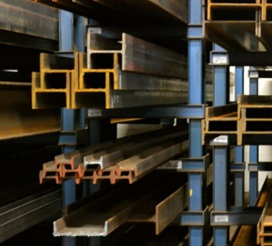
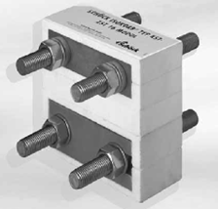
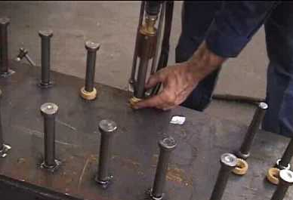
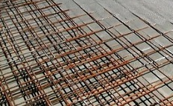
SUSTAINABLE STEEL BUILDING DESIGN | CONTRIBUTORS
What contributes to embodied carbon emissions in steel buildings?
Structural steel members
Connections (plate, bolts, welds, etc)
Shear connectors
Metal decking
Concrete topping
Concrete topping reinforcement
Steel fireproofing
Surface treatment
Structural steel members
Connections
80% - 90% embodied carbon is from the product stage (A1-A3)
Shear connector
Concrete topping and reinforcement
Notes:
All building materials can contribute to a building’s embodied carbon, but according to Urban Land Institute, structural systems can comprise up to 80 percent of a building's embodied carbon, depending on building type, so the most significant factor in a building's embodied carbon is whether the development uses an existing building or constructs a new one. Therefore designing/selecting a structural system with flexibility that accounts for future adaptive reuse should be an important factor to consider. And steel structural can provide such flexibility.
Focusing on the embodied carbon of the steel structure, there are different pieces that contribute to the embodied carbon of steel buildings: structural steel members; the connections, such as plates, bolts, welds, and angles; the shear connectors; and the metal decking with the concrete topping and its reinforcement. In addition, any types of fireproofing and surface treatment also contribute to embodied carbon, such as paint and priming.
Lastly, we should mention as current practice, 80-90% embodied carbon is from the product stage (A1-A3). And a vast majority of CO2 emission in the product stage comes from the furnace phase of steel production, as we mentioned before there are two primary furnace types: Basic Oxygen Furnace (BOF) and Electric Arc Furnace (EAF). So it’s important to understand where the steel comes from- not all sources are created equally.

Slide 15
Agenda
Part one (25 mins)
Introduction of domestic steel with a focus on sustainability
Embodied carbon of steel buildings
Sustainable steel building design practice
Part Two (25 mins)
Life cycle assessment and EPD
Measurement of embodied carbon
Design of sustainable steel buildings using LCA tools
Notes:
How do we reduce the embodied carbon in steel buildings.- what can architects and engineers do?

Slide 16
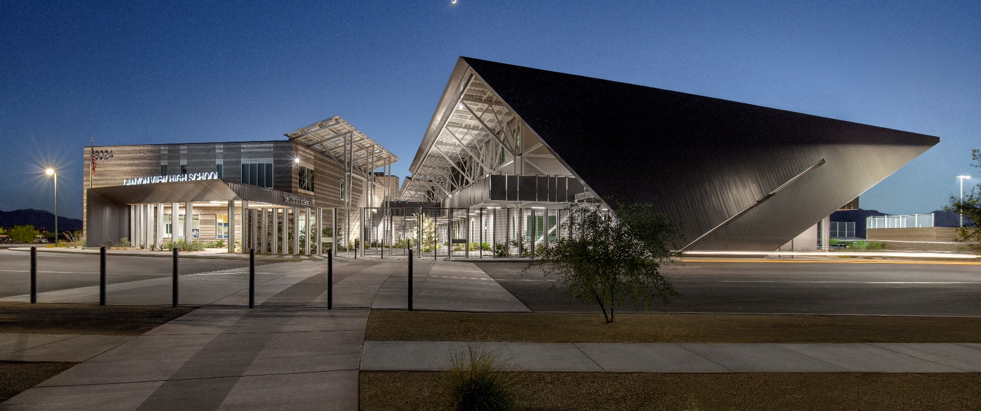
SUSTAINABLE STEEL BUILDING DESIGN | REDUCTION PRINCIPLES
How can we reduce the embodied carbon in steel buildings?
Material Optimization
Design Optimization
Life Cycle Optimization
Canyon View High School
Image by © Bill Timmerman
Notes:
There are three categorical strategies you can use in your design practice: Material optimization, design optimization and life cycle optimization.

Slide 17
SUSTAINABLE STEEL BUILDING DESIGN | MATERIAL
Material Optimization
Use steel that comes from electric arc furnaces (EAFs)
Use recycled steel
Use higher grade steel where appropriate
Notes:
For material optimization, there are three ways to optimize the making and selection of steel materials with the aim to reduce the carbon:
First, use steel that comes from electric arc furnaces (EAFs)
EAFs produce less than half as much CO₂ as basic oxygen furnaces (BOFs) [5], and even less when the source energy has a high percentage of renewable energy. Use structural steel that comes from EAFs instead of steel from BOFs whenever possible.
Second, use steel with a high recycled-content
Virgin steel can have an embodied carbon footprint that is up to five times greater than high-recycled content steel. EAFs use an average of 93% recycled content, where BOFs use an average of 25% recycled content [6]. Use high-recycled content steel whenever possible.
Third, use a higher grade steel
Use higher grade steel when appropriate for safety, which can accomplish the same structural task using less material without increasing emissions.

Slide 18
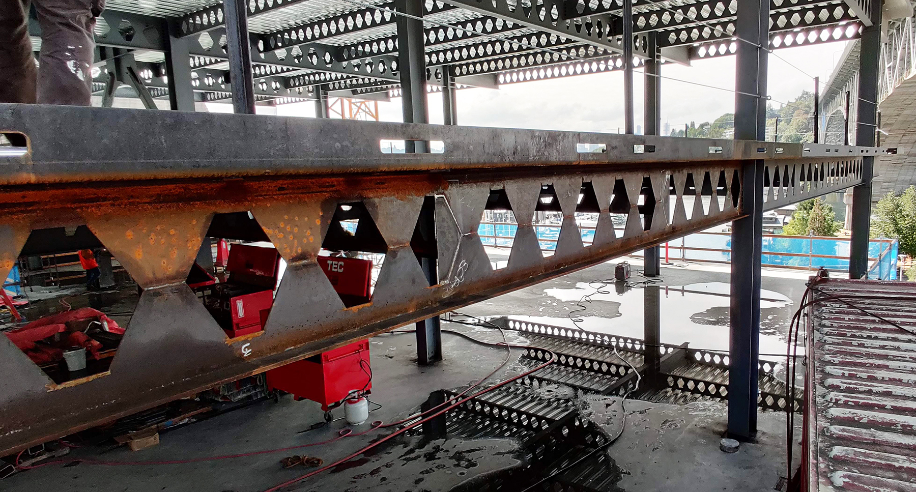
SUSTAINABLE STEEL BUILDING DESIGN | DESIGN
Design Optimization
Use braced frames instead of moment-resisting frames
Minimize transfer
Maximize deck spans
Maximize structural depth with less material
Rightsize: one size does not fit all
Use reinforcement only when needed
Work with fabricators and engineers to increase the efficiency of your design
Only fireproof necessary members
Castellated beams
Image by © DCI Engineers, Watershed Building
Notes:
For design optimization, there are design principles you can consider. Two design practices particularly relevant to architect and designers include (1) Using braced frames instead of moment-resisting frames and (2) Minimizing transfer conditions, and we will elaborate in later slides.
Let’s first quickly go through the rest of the design optimization strategies that are more appliable to structural engineers.
Maximize deck span
In general, maximizing steel deck span can lead to a number of benefits, including: (1) reduced quantity of material costs: By using longer spans, you can use less steel deck, which can lead to less embodied carbon. (2) Increased efficiency: Longer spans can lead to faster construction times and lower labor costs, hence less embodied carbon associated with construction activities. (3) Improved performance: Longer spans can provide greater stiffness and strength, which can improve the overall performance of your structure.
However, there are also some potential drawbacks to maximizing steel deck span, such as
increased deflection, increased stress and increased complexity. Therefore to maximize deck span within the optimized range together with structure engineers is the design strategy to be considered.
Maximize depth of structural shapes using smaller pieces and less material
Trussed members are often lighter and can support the same weight compared to heavier rolled shapes. Using trussed members of smaller-sized steel elements or castellated beams may reduce the overall quantity of steel required thus reducing the embodied carbon impact of the structure (for example, see resources). Keep in mind that the production of hot-rolled wide flange elements in the US is 100% EAF-produced, and US-produced wide flange has reduced its carbon by 12% in the past few years and increased its speed of production by 50%, and those numbers continue to improve.
Rightsize: one size does not fit all
Right-sizing steel members reduces excess material and thus reduces the embodied carbon impact of a project. Plan ahead and size each member precisely, instead of using set sizes for the whole project.
Use reinforcement only when needed
Some applications of concrete (e.g. some slabs on grade) can be used without steel reinforcement as long as alternate crack control measures are taken. Whenever possible eliminate steel reinforcement from concrete to reduce the project’s overall embodied carbon footprint.
Work with fabricators and engineers to increase the efficiency of your design
Work with steel fabricators and engineers, explaining your objective for low carbon emissions by reducing steel waste and optimizing design.

Slide 19
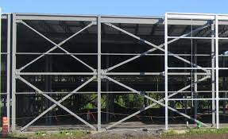
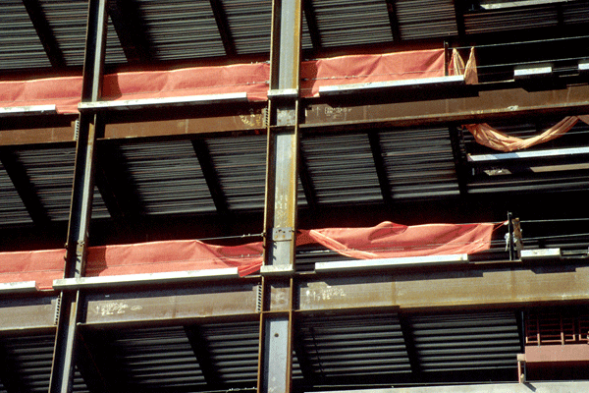
SUSTAINABLE STEEL BUILDING DESIGN | DESIGN
Use braced frames instead of moment-resisting frames
Braced frame
Moment-resisting frame
Notes:
Use braced frames instead of moment-resisting frames
The increase in frame stiffness is what makes the braced frame a better option. For the building’s lateral-load-resisting system, a recent study found that using braced frames instead of moment frames in a 3-story building reduced the embodied carbon impact of the building structure by 12% . This is because moment-resisting frames and beams tend to be significantly heavier and require more material than braced frames in order to transfer forces and resist lateral loads. Additionally, a greater number of moment-resisting frames are often needed, compared to braced frames, to support the same load.

Slide 20
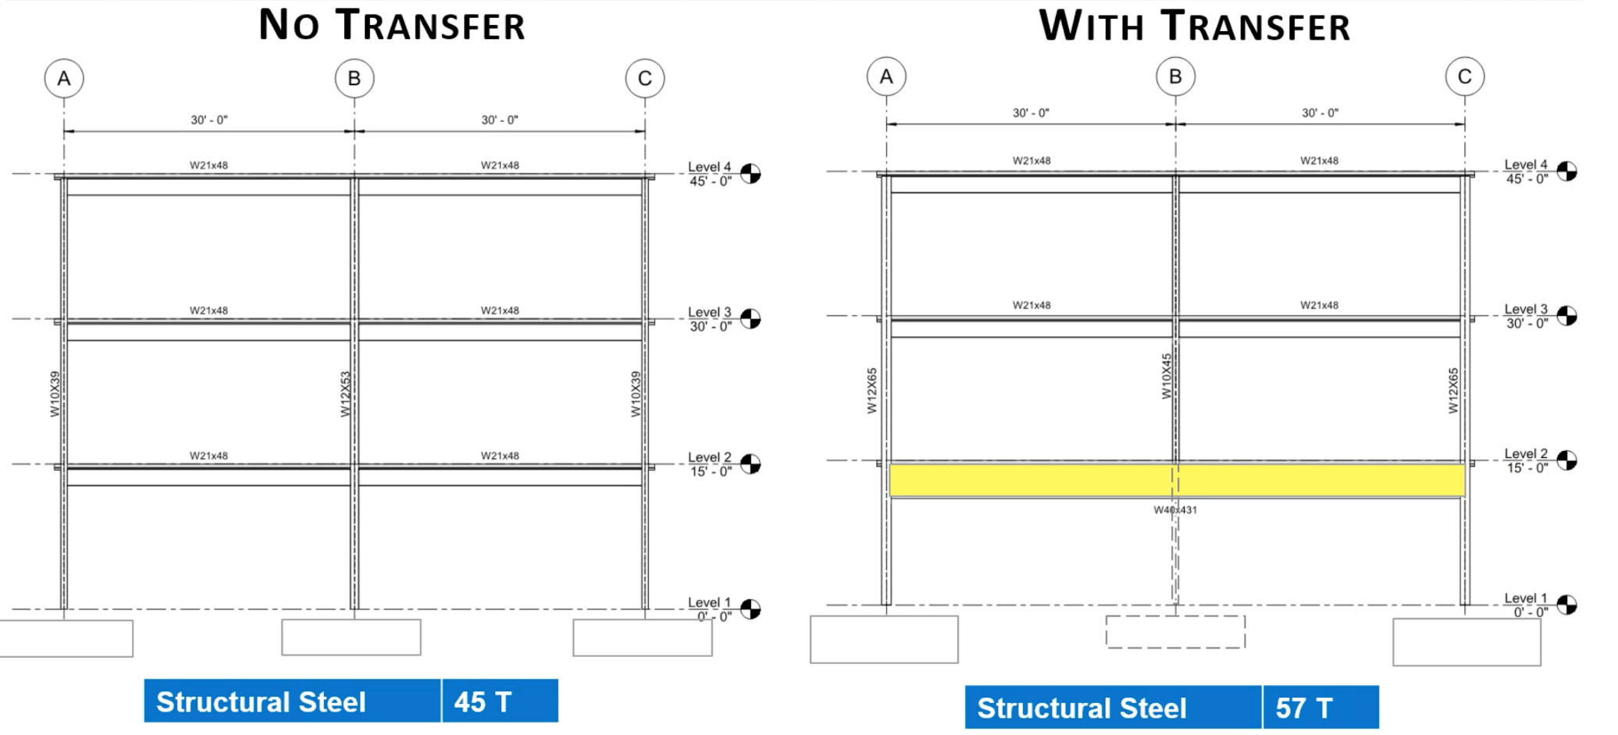
SUSTAINABLE STEEL BUILDING DESIGN | DESIGN
Minimize transfer
Notes:
Minimize transfer is supposed to be a low-hanging fruit since it does not cost a lot or take a long time to do. It just requires the integration of architecture and structure. Architects should integrate a structural system early in the design process to avoid situations that might cause unnecessary complexity without compromising the image or function of the building. Here is one example, three-story buildings with all columns coming down to the foundation. On the right, if we just remove the lower column in the middle, then the load has to be transferred to the 60 feet span, the tonnage of the transfer beam goes up by 12 tons, highlighted in yellow, so that causes a significant increase in structural steel. In addition, although you are removing the footing in the middle, the relative increase of footing on the left and right will offset the decrease.
Now let’s look at another example

Slide 21
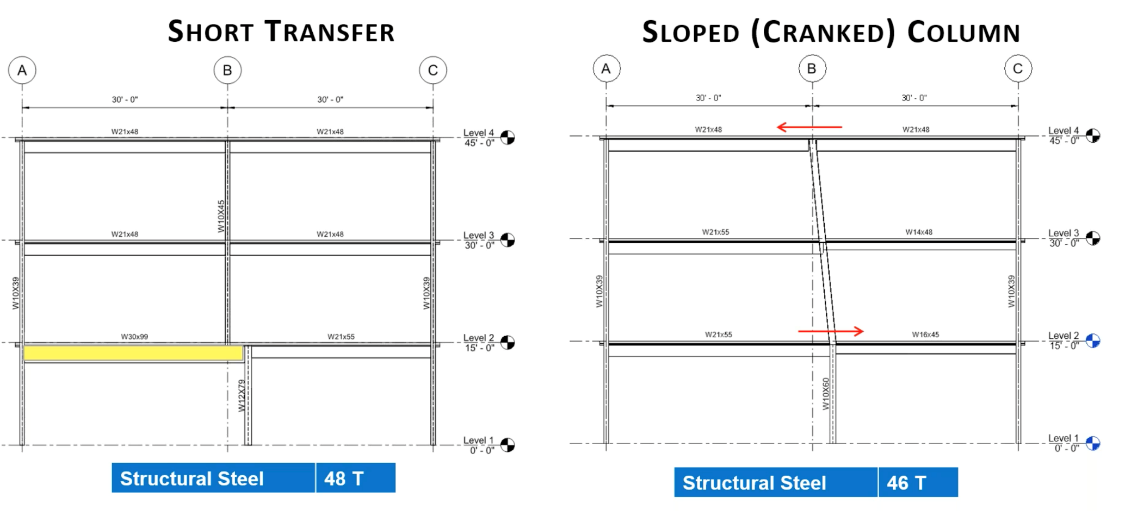
SUSTAINABLE STEEL BUILDING DESIGN | DESIGN
Strategies to Minimize transfer
Notes:
In another example on the left, you see a short transfer with transfer steel beam highlighted in yellow. This is one of the most common things you can find in buildings, and sometimes it is hard to avoid. For example, when you have retail at the bottom and residential unit on the top, because the column spacing of the two different functions are different, you might end up with two different column grid dimensions. Even in this case we still want strive to minimize the transfer. Perhaps the continuous columns could be integrated into an architectural element like defining circulation or storage areas. One thing an architect can consider together with a structural engineer is to slope the column as show in right image. Of course, this may not work for all cases, it is better used in short transfer, 1 to 2 feet. And there is a requirement of out of plane thrust force that needs to be considered and calculated, meaning there is upper limits of the sloped angle. For that, the architect needs the structural engineers’ input. As you can see from the images, by sloping the column you can minimize the carbon emission from reducing the size and needs for a transfer beam.

Slide 22
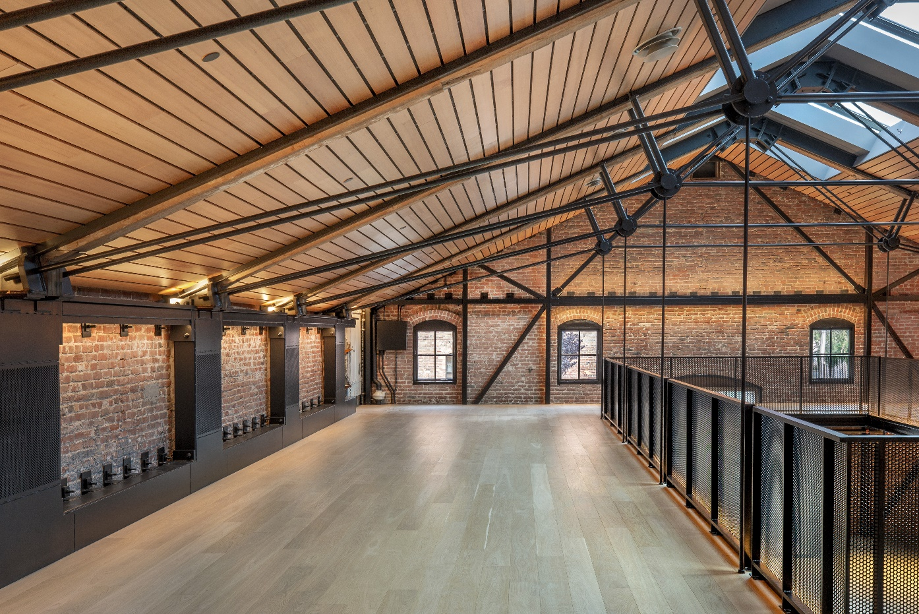
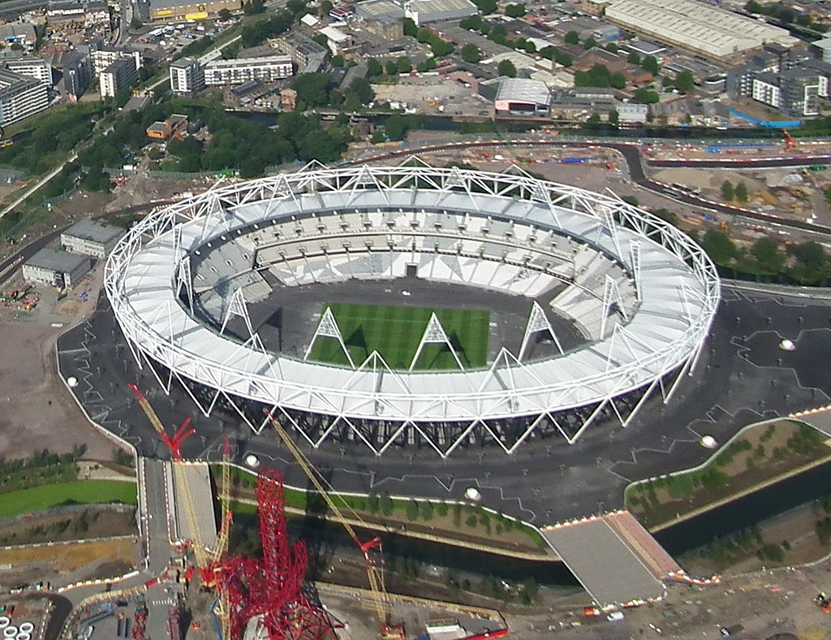
STEEL | SUSTAINABLE STEEL BUILDING DESIGN
Life Cycle Optimization
Design for adaptability and deconstruction
Design with flexibility
Image by © Bill Hustace
London Olympic Stadium: By Arne Müseler www.arne-mueseler.com, CC BY SA 3.0 de
MacLac Building D
Adaptive reuse
London Olympic Stadium
Designed to be deconstructed
Notes:
The final categorical strategy for achieving sustainable steel building design and reducing embodied carbon is life cycle optimization. This strategy can be implemented by following two principles: designing for adaptability and deconstruction and designing with flexibility in mind.
Structural steel framing is particularly well-suited for deconstruction and reuse due to its metal fasteners and standardized design. To implement this strategy, it is important to plan for the recycling or reuse of structural steel members at the end of the building's life, thus ensuring adaptability for future needs in the initial design. Additionally, consider designing the space to be multifunctional from the outset to minimize the need for renovations or rebuilding in the future.

Slide 23
Agenda
Part one (25 mins)
Introduction of domestic steel with a focus on sustainability
Embodied carbon of steel buildings
Sustainable steel building design practice
Part Two (25 mins)
Life cycle assessment and EPD
Measurement of embodied carbon
Design of sustainable steel buildings using LCA tools
Notes:
Part two covers three topics:
Life cycle assessment and EPD
Measurement of embodied carbon
Design of sustainable steel buildings using LCA tools
Taken together, part two provide in-depth explanation on how to optimize design using LCA to reduce the embodied carbon in steel buildings, and how the current LCA database is linked to EPDs. Part two sets up a foundation for a following exercise that is focusing on learning/using the EC3 tool to extract sustainable steel product information and understanding the embodied carbon emission range of different steel products.

Slide 24


EMBODIED CARBON | STANDARDS
Definition of the goal and scope
LCI and LCIA phase
Interpretation phase
Reporting and critical review
Limitation
Relation between LCA phase
Condition for use
Notes:
What is embodied carbon?
As we discussed in Part one, Embodied carbon refers to the greenhouse gas emissions arising from the manufacturing, transportation, installation, maintenance, and disposal of building material. The development of embodied carbon counting/calculation is intertwined with the development of life cycle assessment (LCA) of buildings, since the embodied carbon is the part of whole life cycle carbon from a building project.
There are two gold standards for LCA, ISO 14040 standard: Environmental Management - Life Cycle Assessment - Principles and Framework, and ISO 14044 standard: Environmental Management - Life Cycle Assessment - Requirements and Guidelines. They were published in 2006 as LCA international building standards. So, all LCA needs to comply with standards and follow the guidelines and steps set in those standards.
ISO 14040 and ISO 14044 together describe the LCA principles, framework, requirements and procedures including: definition of the goal and scope of the LCA, the life cycle inventory analysis (LCI) phase, the life cycle impact assessment (LCIA) phase, the life cycle interpretation phase, reporting and critical review of the LCA, limitations of the LCA, the relationship between the LCA phases, and conditions for use of value choices and optional elements. Together, the two standards cover life cycle assessment (LCA) studies and life cycle inventory (LCI) studies. And the life cycle inventory studies are closely tied to embodied carbon assessment.

Slide 25

EMBODIED CARBON | STANDARDS
It does not describe the LCA technique in detail, nor does it specify methodologies for the individual phases of the LCA
Notes:
But, the two standards do not describe the LCA technique in detail, nor does it specify methodologies for the individual phases of the LCA, which was done intentionally to leave the space for people to develop variety LCA tools and techniques. However, such openness does create certain confusion in embodied carbon accounting. As we mentioned in previous slides, there are different types of Embodied carbon measured: “Cradle to Gate", “Cradle to Site”and “Cradle to Cradle” carbon. Therefore, it is imperative to understand /clarify what type of embodied carbon people refer to before we even start the conversation. For the same reason when we talk about Environmental Product Declarations (EPD), we also need to understand whether the EPD measures Cradle to Gate embodied carbon or Cradle to Cradle embodied carbon.

Slide 26
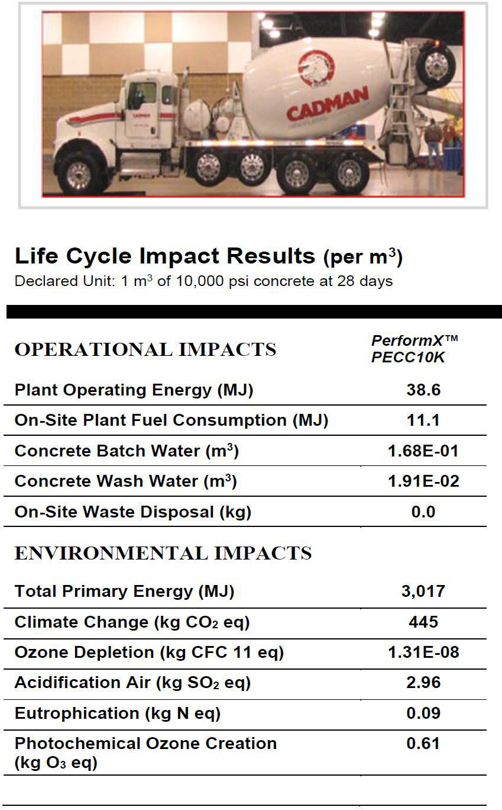
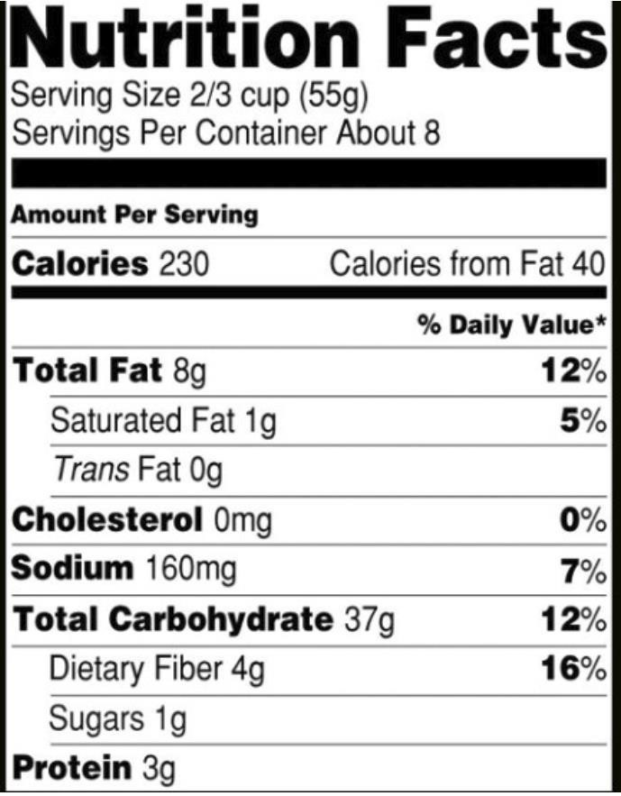
EMBODIED CARBON | EPDs
Environmental Product Declarations (EPD)
Have Transparency Like Nutrition Labels
Notes:
Now, let’s look at what an EPD is. Environmental product declarations (EPDs) are essentially labels that represent the embodied carbon of a product. The embodied carbon could be cradle to gate, cradle to site, or cradle to cradle. Just like a food label communicates the nutrition facts of a food product, EPDs represent the environmental impact of a product measured by embodied carbon.
EPDs can also indicate a manufacturer's commitment to measuring and reducing the environmental impact of its products and services, and they report these impacts in a transparent way. With an EPD, manufacturers have the opportunity to report comparable, objective, and third-party verified data that show the environmental performance of their products and services.

Slide 27
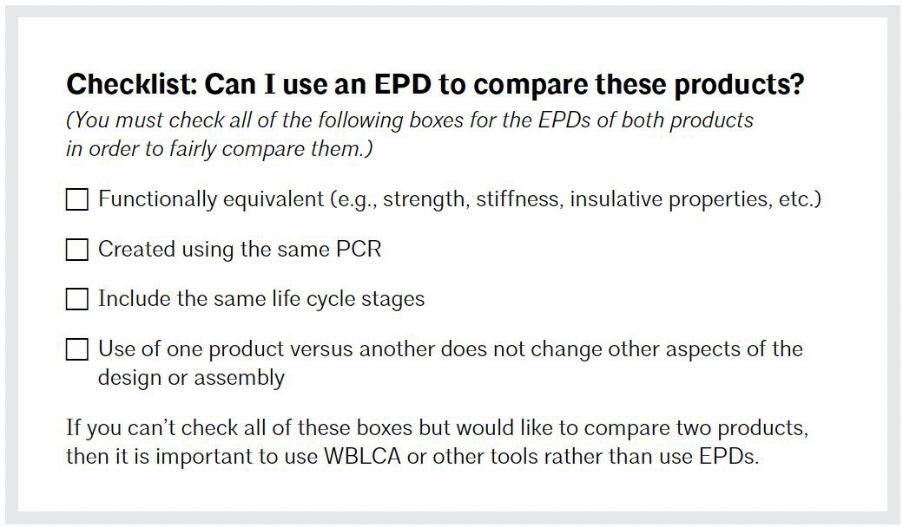
EMBODIED CARBON | EPDs
27
Notes:
Obtaining an EPD requires submitting standardized documents that report the results of an LCA for a particular material or product based on a product LCA. Report documents and procedures are governed by product category rules (PCRs) set up by regulation agents, such as ISO. And the report must be verified by a third party, meaning a steel manufacturer can hire a consultant to produce and submit EPD documents, and a third-party expert must verify the truthfulness and accuracy of the report. Overall, EPDs and their procedures are well-suited to capture manufacturing and supply chain strategies that prioritize material and energy efficiency and low-carbon energy sources.
EPDs can be a separate course, so in this lecture we will not get into lots of details. But you should be aware of a few things before you consider using EPDs to inform your design decisions. First, you should decide what you are going to use EPDs for. On the slide, you will find a checklist of basic questions to ask yourself when deciding whether you can use EPDs to compare different products, for example, steel girders produced by two manufacturers. At a minimum, EPDs can be used throughout the design process to check embodied carbon, just as a budget is assessed throughout design.

Slide 28
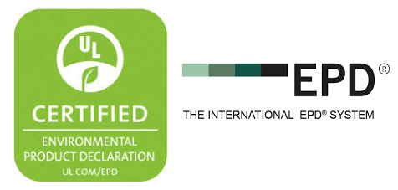
TYPES OF EPDs
There are several “flavors” of EPDs:
Industry-wide EPDs
Product-specific EPDs
Facility-specific EPDs
These types of EPDs vary primarily across two criteria:
Which facilities and companies contributed data?
How specific is the data to the supply chain of the product? In other words, how well does the data represent the actual supply chain?
Notes:
And you should be aware of the three different types of EPDs: Industry-wide EPDs, Product-specific EPDs, Facility-specific EPDs.
Industry-wide EPDs represent typical manufacturing impacts for a range of products for a group of manufacturers. Industry-wide EPDs provide the least-specific data on a products’ embodied carbon footprint and cannot be used to compare similar products. However, they are helpful in understanding the typical impact of a product.
Product-specific EPDs represent the impacts for a specific product and manufacturer across multiple facilities.
Facility-specific EPDs are product-specific EPDs in which the environmental impacts can be attributed to a single manufacturer and manufacturing facility. This type of EPD was introduced by the Buy Clean California Act in 2017.
Three types of EPDs vary primarily across two criteria: (1) Which facilities and companies contributed data? (2) How specific is the data to the supply chain of the product? In other words, how well does the data represent the actual supply chain?
As architects and engineers, most of the time we work with Product-specific EPDs, because designers are responsible for the integration of the product selections while coming up with the design solution for the building.

Slide 29
Agenda
Part one (25 mins)
Introduction of domestic steel with a focus on sustainability
Embodied carbon of steel buildings
Sustainable steel building design practice
Part Two (25 mins)
Life cycle assessment and EPD
Measurement of embodied carbon
Design of sustainable steel buildings using LCA tools
Notes:
How do we measure embodied carbon and EPD data?

Slide 30
How To Assess Embodied Carbon?
EMBODIED CARBON | HOW TO MEASURE EMBODIED CARBON
1. Calculation Method
2. Database
3. Calculator (Tool)
Notes:
LCA is often regarded as a support for decision-making within product comparison and optimization applied in the context of the ‘environmental pillar’ of sustainability.
In order to assess embodied carbon of a building using LCA, three components are necessary: a calculation method, a database of embodied carbon, and a calculator (tool) that will convert the material qualities and properties to the carbon output.
Next, we will go through those three components quickly to give you an overview.

Slide 31
EMBODIED CARBON | HOW TO MEASURE EMBODIED CARBON
Existing Calculation Method
1. Economic Input-Output Method (top-down)
  Most widely used method
  Created to study US economy
  “Black box” approach
2. Process method (bottom-up)
  Data and knowledge from industrial process (EPD)
  Incomplete system boundary
  Most incomplete outcomes
3. Hybrid Method (emerging)
  Merge of the Economic Inout/Output Method and the Process Method
Notes:
There are three commonly used, recognized and agreed-upon LCA methods.
The first is the Economic Input-Output (EIO) method, which is the most widely used method. It was developed by economist Wassily Leontief in the 1930s for the United States economy [7]. Leontief received the Nobel Prize in Economics in 1973 for this work. EIO models were popular in the mid-20th century for high-level economic planning purposes, and later on were introduced as an LCA method used in the building and construction sector. By appending data on energy, environmental, and other flows to the input-output table, non-economic impacts can be predicted, such as carbon emissions. However, EIO analysis is generally used as a "black box," with little understanding of the values being assumed in the model for each process.
Compared to I-O method as a top-down approach, the second method, process-based method is a bottom-up approach. The data are derived from the knowledge about industrial processes within the life cycle of a product, and the physical flows connecting them. However, this method may result in the most incomplete outcomes, primarily due to the complexity of the upstream requirements for goods and services. The magnitude of this incompleteness varies with the type of product or process and depth of study, but can be 50% or more.
The third method is an emerging method as a hybrid of the two above.

Slide 32
EMBODIED CARBON | EXISTING DATA AND DATABASE
LIFE CYCLE INVENTORY (LCI)
Primary data: collected directly from the source, such as from manufacturing plants or from surveys of consumers (EPD)
Secondary data: collected from existing sources, such as government databases or industry reports
Expert judgment: collected from experts in the field, such as engineers or scientists
Notes:
As for the database, what you are seeing on the screen are a few sample databases we currently have in the United States. The NREL LCI database is US specific data, while Gabi is an international database including US specific data. We call those data Life cycle inventory (LCI) data. Where does that data come from?
Life cycle inventory (LCI) data comes from a variety of sources, including:
Primary data: This is data that is collected directly from the source, such as from manufacturing plants or from surveys of consumers. EPD has become a primary resource for primary data in recent years
Secondary data: This is data that is collected from existing sources, such as government databases or industry reports.
Expert judgment: This is data that is collected from experts in the field, such as engineers or scientists.
LCI data is used to create life cycle assessments (LCAs), which are used to evaluate the environmental impacts of products and services. LCAs are a valuable tool for businesses and organizations that want to reduce their environmental impact.

Slide 33






EMBODIED CARBON | TOOLS
Athena
Tally
BEES (NIST)
Gabi
SimaPro
Embodied Carbon Calculator for Construction
Notes:
There are a number of LCA tools available, each with its own associated database. Some of these databases overlap, while others are unique. For example, Tally uses Gabi’s database, while BEES uses NREL’s database. As an architecture designer, you will need to select an LCA tool first, and the database is typically a part of the tool’s package.
There are also a number of industry leaders developing their own tools. For example, SOM, Cannon Design, and Arup are all working on their own tools, or working with others to develop tools. This is similar to the 1980s, when Computer-Aided Design (CAD) entered the building and construction industry. At the time, each firm rushed to develop its own programs, and almost every single big player had their own CAD tool. However, over time, CAD has been standardized, and Autodesk Revit has become the industry gold standard. This is the direction that embodied carbon calculators and LCA tools are moving.

Slide 34
Agenda
Part one (25 mins)
Introduction of domestic steel with a focus on sustainability
Embodied carbon of steel buildings
Sustainable steel building design practice
Part Two (25 mins)
Life cycle assessment and EPD
Measurement of embodied carbon
Design of sustainable steel buildings using LCA tools
Notes:
With the high-level understanding of LCA and EPD, the last topic of this lecture is to address how we can utilize those tools to design sustainable steel buildings with the aim to reduce embodied carbon.

Slide 35
EMBODIED CARBON | DESIGN PROCESS
EARLY-PHASE WHOLE BUILDING LCA
Part-to-whole, rough estimate with a focus on typologies, assemblies, and materials, not products
DESIGN OPTION MODELS
Targeted design questions and detailed comparisons
END-OF-PROJECT BENCHMARKING
Construction documentation, project narratives, and assessment
Notes:
LCA tools can be used in the early design stage as whole building LCA. At this stage, designers mainly focused on building typology analysis, assemblies and materials comparisons rather than specific products. For example, at an early design stage, the project team and client might want to consider whether to use steel or concrete for the structural system. Conducting LCA at early design stage is extremely important, but we don’t focus on the precision of the results. Rather as a designer we should focus on the delta of embodied carbon of design choices.
LCA tools can be used in schematic design or even during the design development stage as well. The design decisions needed to be made are more targeted, for example, whether a refinement of the structural steel framing design has reduced the embodied carbon. So detailed comparisons can be done using LCA tools. Contractors will likely begin to be involved at this point if architects specify that EPDs are required for their bid packages.
Lastly, LCA tools can be used at the end of a project as a benchmarking tool. Project details can run a full and detailed life cycle assessment of the entire building to understand how the project is doing against an industry average or bottom line.

Slide 36
BUILDING VS. PRODUCT LCA
Building LCA
Use Whole Building LCA tools or early-design estimators to measure performance
Product/Material LCA
Use Environmental Product Declarations to measure performance
Analysis led by Designers (architects, engineers, consultants)
Focuses on lower carbon building designs
Captures strategies like:
  Building/material reuse
  Use of bio-based materials
  Eﬀicient structural design
Analysis led by Manufacturers
Product selection led by Contractors
Captures strategies like:
  Concrete mix designs
  Mfg plant eﬀiciency/fuel source
  Low carbon procurement
Notes:
Depending on the design stage and the design questions you want to answer, architects typically use two ways to measure embodied carbon: whole building LCA and product LCA. Product LCA is closely tied to EPDs.
For building LCA, data analysis is typically done by designers, architects, engineers, and building consultants. The whole building LCA can capture the entire design process, for example if you work closely with structural engineers to optimize the steel building design using strategies such as minimizing transfers and sizing steel members appropriately. Those types of design strategies can be captured and analyzed using whole building LCA. You can build two models, one representing the conventional approach and the second representing your design approach. You can run two LCA analyses and compare the results.
On the other hand, Product/material LCA is mainly done for a particular product. It is often done by consultants or manufacturers if they have in-house consultants.
Since whole building LCA is more for designers, let’s dive into it.

Slide 37
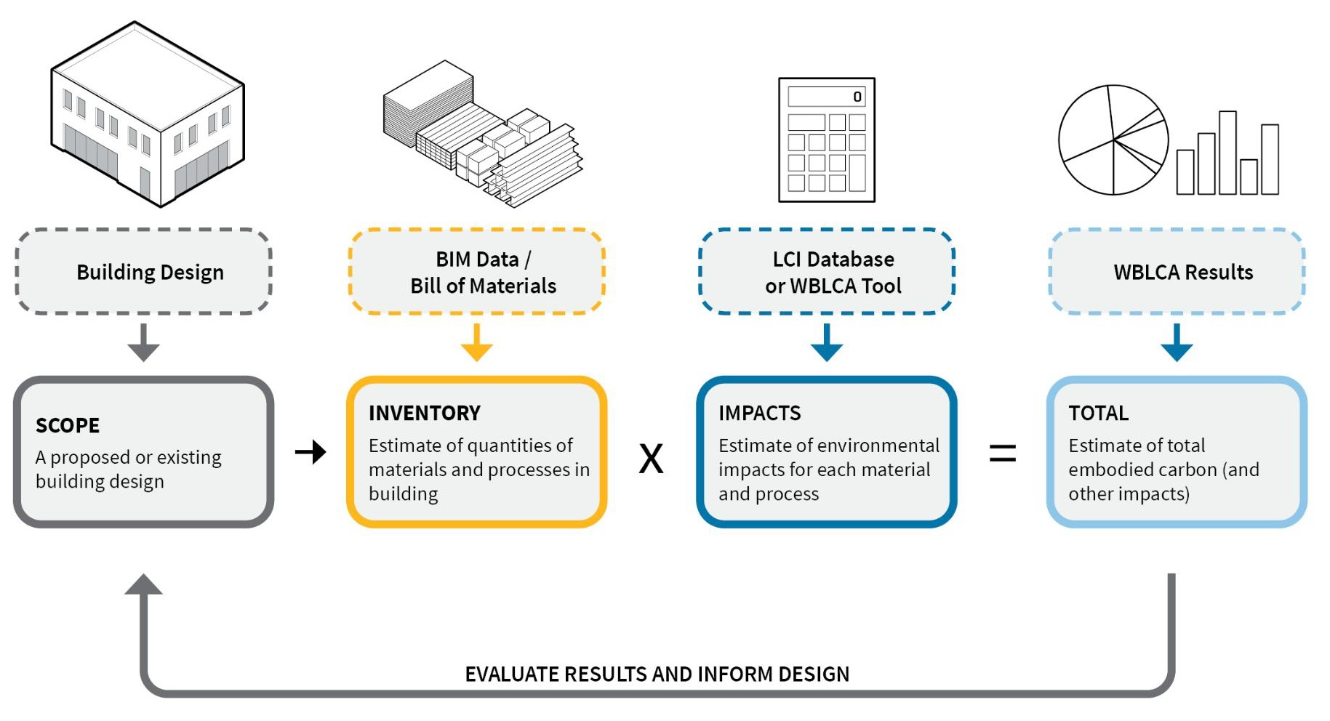
WHOLE BUILDING LIFE CYCLE ASSESSMENT
Image Credit: Brad Benke, Carbon Leadership Forum, 2021
Notes:
The whole building LCA process is fairly straightforward. After you define the LCA scope that is the design proposal of a building; you first will quantify the list and amount of building materials used in your design. Then, you will use life cycle inventory (LCI) data to calculate the embodied carbon of those materials in the whole building. As mentioned, LCI data is typically built into LCA tools, so the LCA tool you choose will help you do the calculation. Finally, as the designer and decision-maker, you will need to interpret the LCA results.

Slide 38
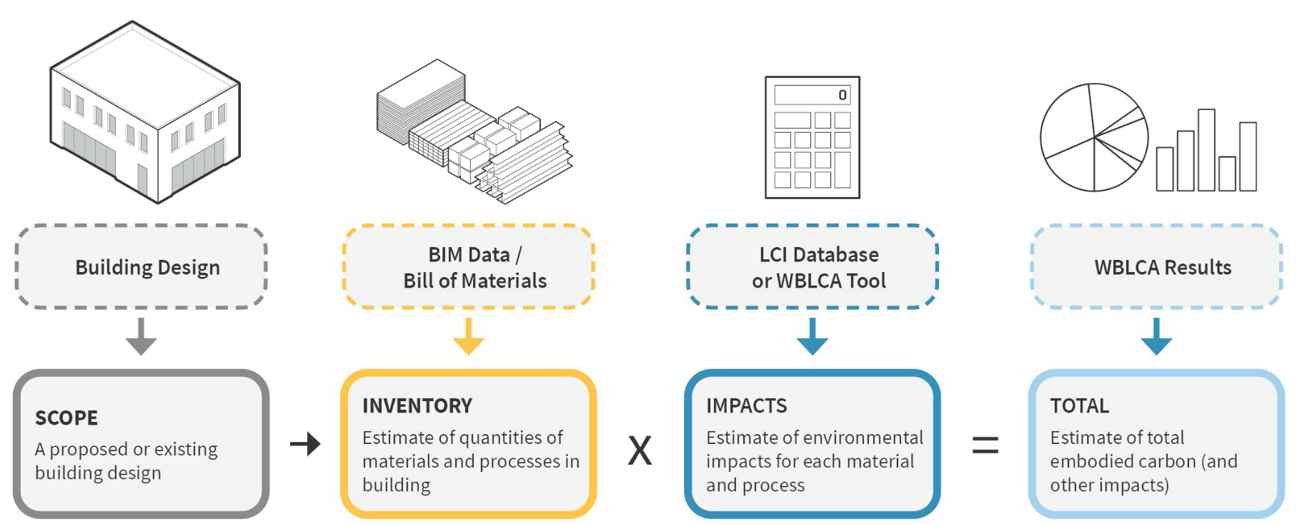
WHOLE BUILDING LIFE CYCLE ASSESSMENT
Ex.
Ex.
100 kg steel
X
X
0.43 kg CO₂e per kg steel
=
=
43 kg CO₂e
50 kg glass
1.063 kg CO₂e per kg glass
53.2 kg CO₂e
Image Credit: Brad Benke, Carbon Leadership Forum, 2021
Notes:
A simple example is this: you have 100 kg steel, and you look at the life cycle inventory data, there is 0.43 kg CO2 equivalent per kg steel, then you get total embodied carbon is 43 kg CO2eq. The same idea applies to glass.
Now I am going to walk you through each of the steps of whole building LCA.

Slide 39
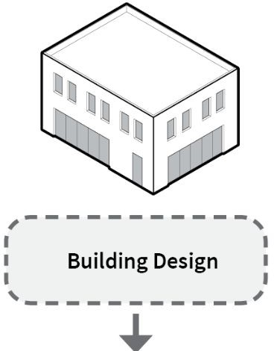
WHOLE BUILDING LIFE CYCLE ASSESSMENT
What is the goal of performing the assessment?
For example:
Comparing EC footprints of multiple
Meet regulatory/certification requirements
Benchmark a buildingʼs embodied carbon performance
Step 1: Define Goal & Scope
What is the scope of the assessment?
Functional description
Reference unit
Physical scope
Study period
Life cycle scope
Image Credit: Brad Benke, Carbon Leadership Forum, 2021
Notes:
The first step is to define the goal and scope. Here are some examples of what the LCA goals can be. For example, comparing embodied carbon footprint of multiple designs to choose the lowest one. Maybe you want to meet the LEED certification, or maybe you want to benchmark your building, Depending on the goals, the assessment will look different.
Also, the goal will determine what scope will be for the assessment. There are five big components of understanding the scope of LCA.
Functional description includes project types, technical requirements, functional requirements and expected life span of the building.
Reference unit refers to the measurement unit you use for the embodied carbon. The most common unit is kg CO2/m2.
Physical scope means what building system you want to include in assessment. Is it structure only, or structure and envelope?
Reference study period is the temporary boundary of the LCA, typically in LCA assessment, 50 years, 65 years building life span are used.
Life cycle scope means which life cycle assessment stages are included.

Slide 40
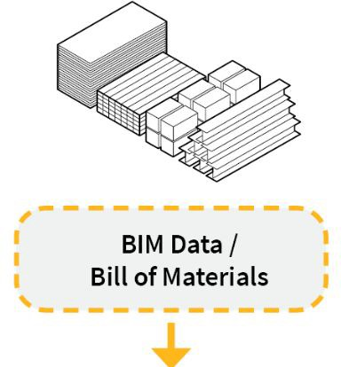
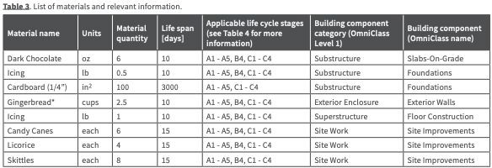
WHOLE BUILDING LIFE CYCLE ASSESSMENT
  Revit / Design-integrated LCA tools
  Contractor may be able to provide a bill of materials
Step 2: Collect Inventory
Example (from ʻGingerbread House LCA Example, LCA Practice Guide 2018)
Key for knowing how many times you have to replace a product over a bldg life
(= higher embodied carbon impact)
Image Credit: Brad Benke, Carbon Leadership Forum
Notes:
The second step is collecting material inventory, and this can be done in two ways. You can either get it from using Autodesk Revit or other tools to help you as you’re building the information model to assess total amount of building materials. Or if you work with the contractors, they may be able to provide a bill of materials depending on the project stage and delivery method. Typically what you will get from a contractor is a spread sheet.
Here is an example of what the bill of materials can look like. This is provided by carbon leadership forum, and it is for a gingerbread house.

Slide 41
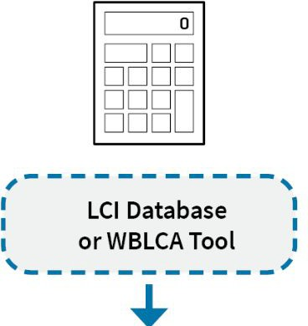
WHOLE BUILDING LIFE CYCLE ASSESSMENT
Material quantities from Step 2 are multiplied by environmental impact factors for each material
Ex. 100 kg steel
Ex. 50 kg glass
X 0.43 kg CO₂e per kg steel
X 1.063 kg CO₂e per kg glass
= 43 kg CO e
=
2
53.2 kg CO₂e
Step 3: Perform Impact Assessment
Notes:
Once you have the material quantities, you can multiply them by an environmental factor, and the environmental factor is mostly coming from the tool you will be using. So the third step is to perform impact assessment and this is the part where you will find the impact of a building. This step often requires using LCA tools. Some LCA practitioners use a life cycle inventory database and excel sheet to do the assessment. But for the Architect and engineer, this means most likely you will be using some kind of LCA software that has embedded life cycle inventory data. In the next exercise module, we will introduce one of those LCA tools, called EC3. Be sure to use the same tool consistently across projects – that is important if you want to compare any results from different assessments.
What is listed on this slide shows using 100kg steel on exterior results 43kg CO2 equivalent emission, because the LCI of steel is 0.43 kg CO2 equivalent emission per kg steel. Same logic applied to the glass. One kg glass is associated with 1.063kg carbon emission, therefore 50kg glass equal to 53.2 kg CO2 equivalent emission. Using LCA tools, the quantity of building materials will be automatically calculated, and then multiply by unit carbon emission, to get to the total carbon emission of the building.

Slide 42
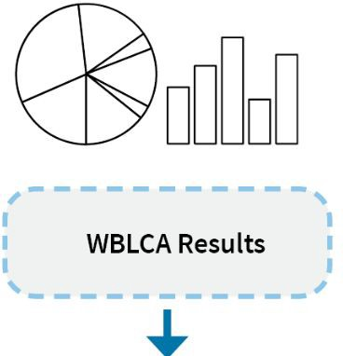
WHOLE BUILDING LIFE CYCLE ASSESSMENT
Perform a “Hotspot Analysis”
After an initial overview of the LCA results, a good first step is to break down the environmental impacts by building component, material type, and/or life-cycle stage, and visualize the results.
Check for errors
“Reality-checking” your results to see if high-impact and high-quantity items make a significant contribution to the overall impacts.
Understand the results
Perform a sensitivity analysis (or uncertainty analysis) to understand which variables have the greatest impact on results.
Develop conclusions
Step 4: Interpet Results
Notes:
The last step is to interpret the results. LCA should be an iterative process; usually you will do this multiple times. For example, after initial LCA results you will check for errors. Did you miss a large quantity of materials, did you put in the wrong quantify in the Revit Model, did you specify the correct products, or use the wrong factor, etc.? After that you can conduct a sensitivity analysis. During the design decision-making process, you want to know how a certain product, for example, the window you choose, can affect the total carbon emission from the building during its full life cycle, Originally you specify that the aluminum window product has 30 year service life span (meaning the window can last 30 years before any repair and replacement), but if later on you find another product that has a service life span of 50 years, you can go back to change the product to see the impact of that change. This time of iterative process and sensitivity analysis can help an architect and engineer to make more informed design decisions.
During this step, one of the most important things is “hotspot analysis”.

Slide 43
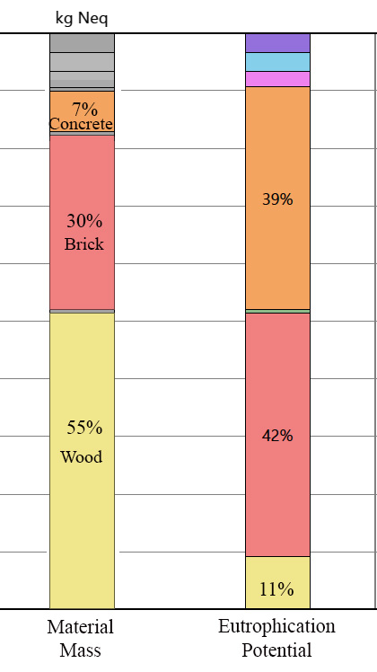
WHOLE BUILDING LIFE CYCLE ASSESSMENT
Concrete
Step 4: Interpet Results
Brick
Wood
Notes:
You can think of Hot spot analysis as a “Embodied carbon to do” list. It is where you look at the results of LCA, and you identify the top three to five materials that contribute the most to carbon emission or other environmental impact categories. What you are viewing is the bar graph of LCA result from a LCA software called Tally, a whole building LCA tool. The left grey bar represents the total environmental impact from all materials included in the study, in this case the environmental impact is Eutrophication Potential. There are quite a lot of materials that produce such a small impact that you can even ignore, but meanwhile there are top three materials that produce a lot of impact as illustrated in the right bar. They are brick (42%), concrete(39%),and wood (11%).
So as an architect, you can decide to spend most of your time and energy to improve those three materials/ products, or to lower the eutrophication potential. Things you can do include reducing the use of those materials by optimizing the design and select better products. In a typical project, usually there are less than 10 of those materials/products an architect should concentrate on since they make largest contribution to the environmental footprint of the building.

Slide 44

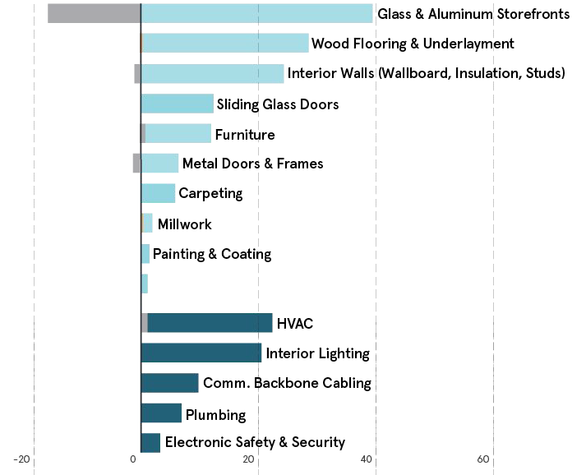


CASE STUDY I HOT SPOT ANALYSIS
Reuse
Existing Materials & Spaces
Global Warming Potential (kg CO2e/m2)
Reduce
Total Amount of Carbon Intensive Materials
Replace
Carbon Intensive Materials with Alternatives
Product / Material Category
Tiling
Building System Category
Optimize
Optimizing the design
Structure
Notes:
Here is a case study of hot spot analysis. We studied the hot spots of global warming potential, which is measured in CO2 emissions per square meter of the building.
The lighter blue bars represent building product categories, and glass, aluminum storefront, wood flooring & underlayment, and interior walls are the top three contributors. Darker blue bars represent building system categories, and structure and interior lighting are the top two contributors.
After understanding the top contributors, or "hot spots," architects and designers can then consider mitigation strategies. The yellow dots on the left side represent the potential embodied carbon to-do list that can be used to reduce the carbon emissions of the building.
First, reuse. You can consider whether you can reuse existing building components. Since this case project is new construction, "reuse" here means reusing some of the storefront or wood flooring from another building to avoid using new products.
Second, you can reduce carbon emissions by minimizing the use of carbon-intensive materials or replacing them with alternatives. For interior walls, you can either reduce the quantity of interior walls or change the materials used. And for interior lighting, you can consider reducing the number of interior lights by optimizing the use of daylight and choosing more efficient light fixtures.
Lastly, optimization, specifically optimizing design. Previously, we have talked about how to optimize steel building design by minimizing transfers, using braced frames rather than moment-resisting frames, and sizing the steel members appropriately.

Slide 45
Conclusion
Introduction of domestic steel with a focus on sustainability
Embodied carbon of steel buildings
Sustainable steel building design practice
Life cycle assessment and EPD
Measurement of embodied carbon
Design of sustainable steel buildings using LCA tools
Notes:
In conclusion, this presentation has covered the following topics:
Introduction to domestic steel with a focus on sustainability
Embodied carbon of steel buildings
Sustainable steel building design practices
Life cycle assessment and EPD
Measure embodied carbon
Design sustainable steel building using LCA tools
I hope you have found this class informative and that you will consider using steel in your future construction projects. Steel is a sustainable material with a low embodied carbon footprint, and it can be used to create beautiful and functional buildings.

Slide 46
References and links
[1] 10 Steps to Reducing Embodied Carbon, Larry Strain
[2] More than Recycled Content: The Sustainable Characteristics of Structural Steel, AISC 2017
[3] Recycled Content in Steel, Building Green 2009
[4] https://www.ssab.com/en/fossil-free-steel/hybrit-a-new-revolutionary-steelmaking-technology#video
[5] Proctor, D. M., Fehling, K. A., Shay, E. C., Wittenborn, J. L., Green, J. J., Avent, C., ... & Zak, M. A. (2000). Physical and Chemical Characteristics of Blast Furnace, Basic Oxygen Furnace, and Electric Arc Furnace Steel Industry Slags. Environmental Science & Technology, 34(8), 1576-1582.
[6] Pellegrino, C., & Faleschini, F. (2016). Sustainability Improvements in the Concrete Industry: Use of Recycled Materials for Structural Concrete Production. Springer.
[7] Leontief, W. (Ed.). (1986). Input-output economics. Oxford University Press.

