Slide 1

Hands-on Exercise
Design and Material Optimization in Sustainable Steel Buildings
From a Whole Life Cycle Perspective
Presented by Ming Hu
1

Slide 2



Agenda
EC3 Tool and Database (10 mins)
Breakout Exercise/ Answers and questions (10 mins)
Notes:
The program we are using for this exercise is EC3 and its related database.
The Embodied Carbon in Construction Calculator (EC3) tool, is a free, cloud-based, easy to use tool that allows benchmarking, assessment, and reductions in embodied carbon, focused on the upfront supply chain emissions of construction materials.
The EC3 tool was incubated at the Carbon Leadership Forum with input from nearly 50 industry partners and utilizes building material quantities from construction estimates and/or BIM models and a robust database of digital, third-party verified Environmental Product Declarations (EPDs). Powered by this data, the EC3 tool can be implemented in both the design and procurement phases of a construction project to look at a project’s overall embodied carbon emissions, enabling the specification and procurement of the low carbon options.

Slide 3
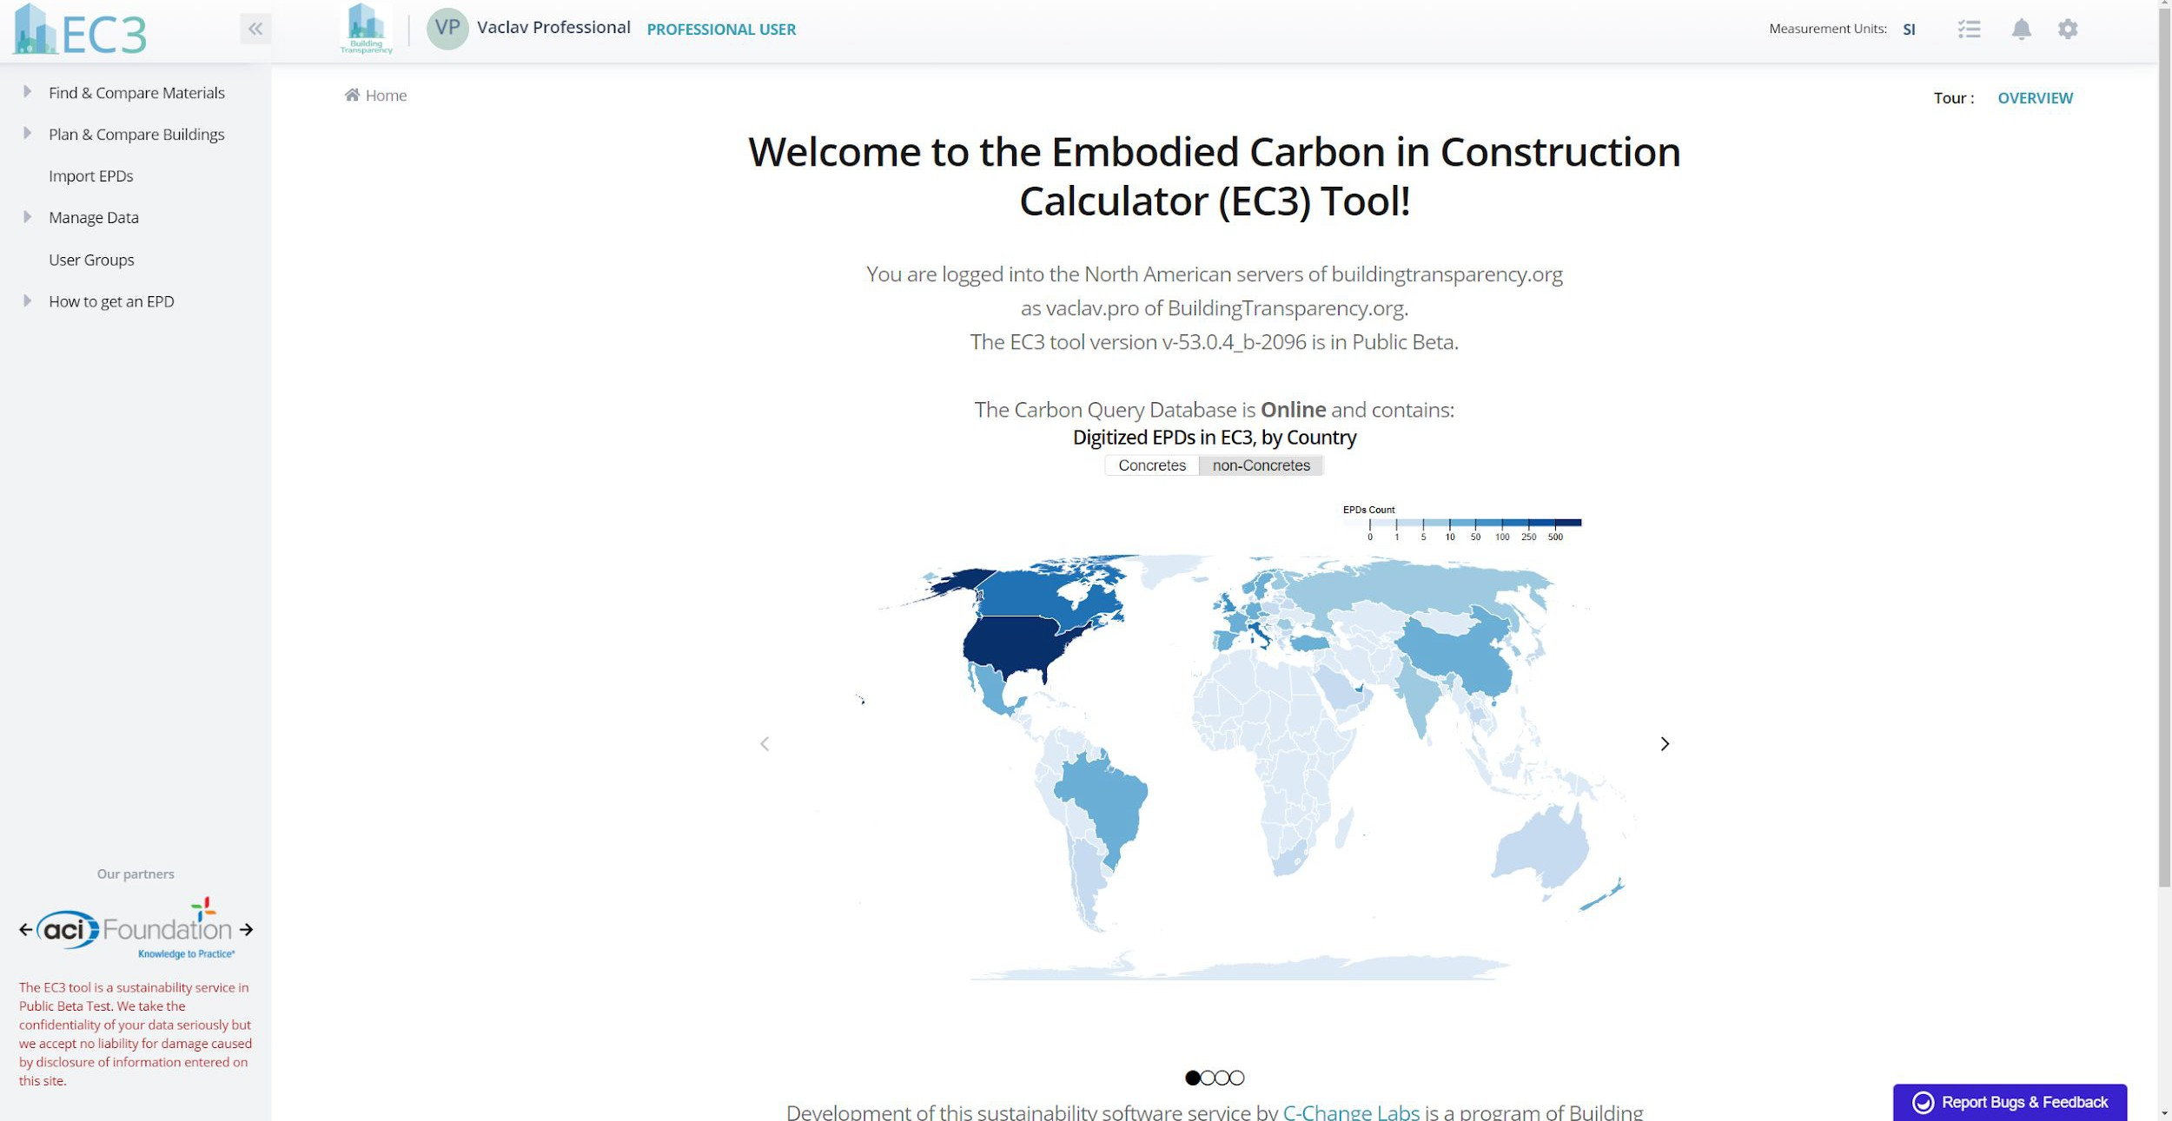

https://buildingtransparency.org/ec3
https://buildingtransparency.org/ec3
Notes:
If you are interested to learn more about EC3 story you can look it up from their website after this class and exercise.
Now, we are going to use your computer to check out EC3 and its related database. This requires a quick registration step. Where you can register a free account on this website is listed on this slide. Type in https://buildingtransparency.org/ec3. the registration takes couple minutes, very quick.
After you register, you can go to the EC3 frontpage, where it shows the EPD location.

Slide 4
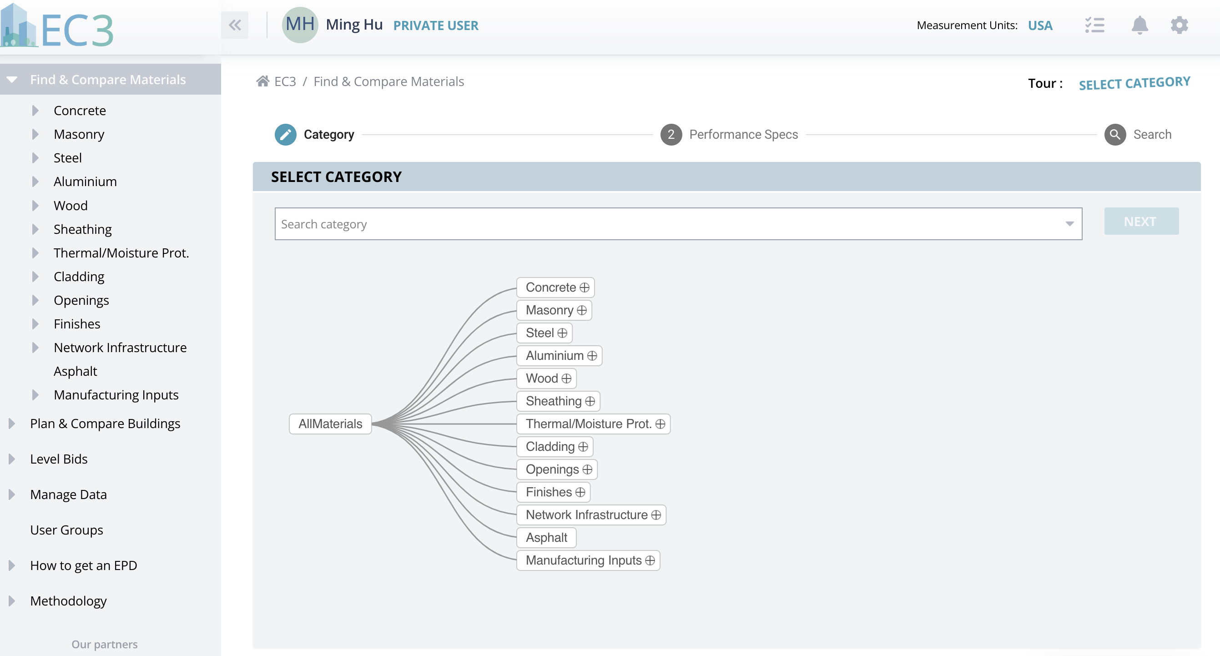
4
Notes:
On the top left corner, you see “Find & Compare Materials”. When you click on that, it shows you all kinds of materials that have EPDs in the database. Let’s focus on Steel today.
Let’s say you are working on a project in Illinois, and you want to see the carbon footprint range of a steel product.
You can go into the steel category by clicking the “+” sign,

Slide 5
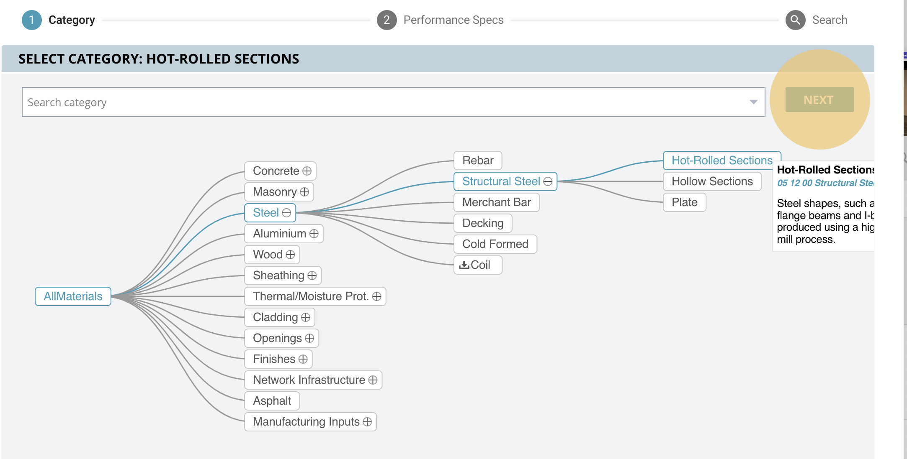
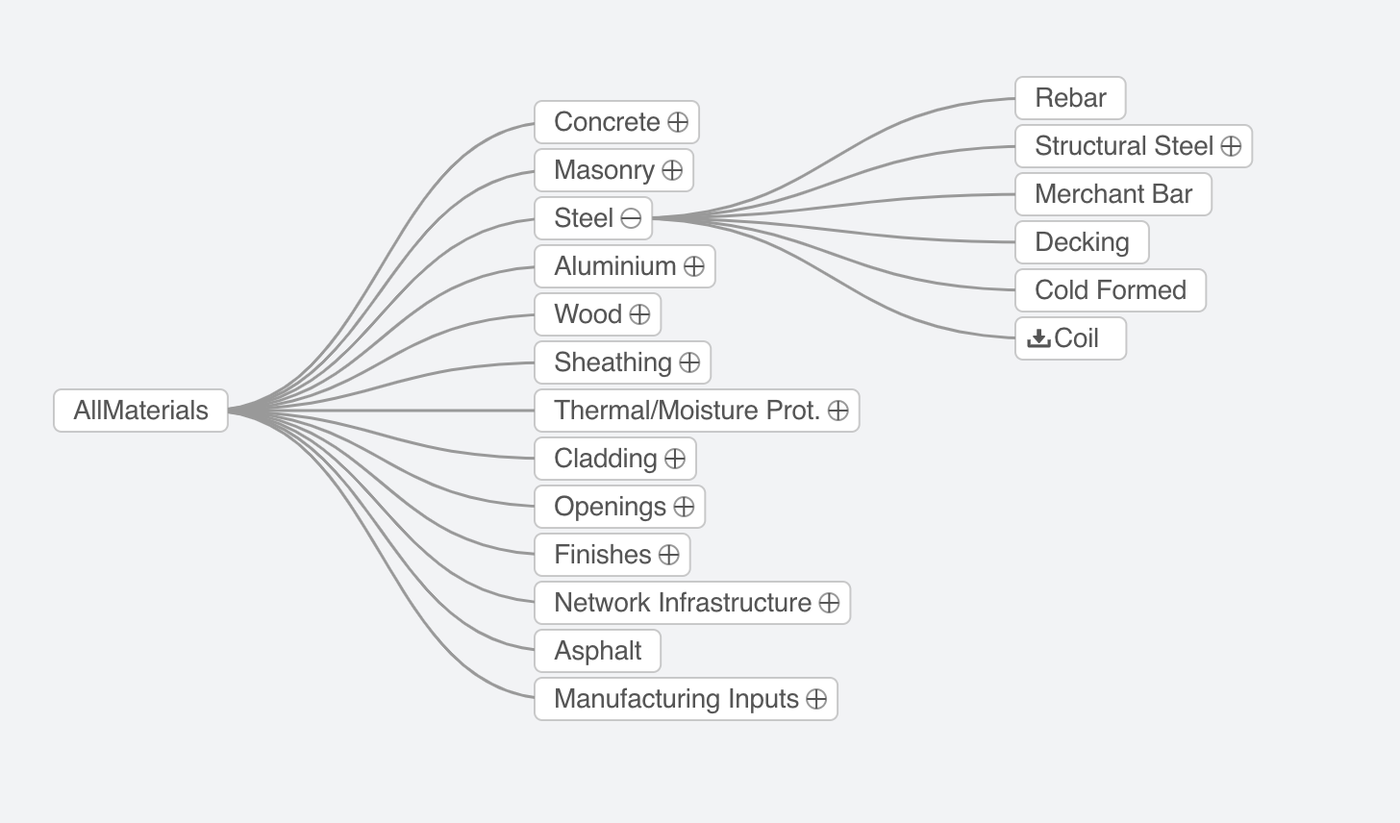
5
Notes:
Now you can see subcategories under the steel, including “rebar”, “structural steel”, “merchant bar”, “decking”, “cold formed steel”, and “coil”.
You can choose to look into more sub-subcategories within “Structural Steel” by clicking the “+” sign again. There are three sub-subcategories: “hot-rolled sections”, “hollow sections”, and “plate”. What you are interested in are the hot-rolled sections”. Once you select this type of product, you can click the next button, (upper right corner)

Slide 6
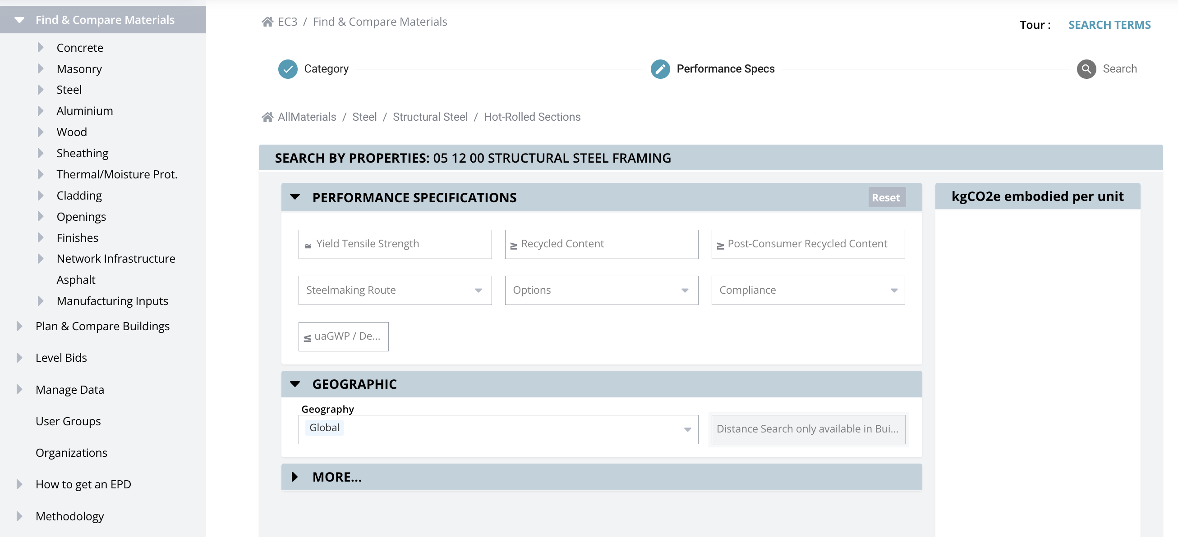
6
Notes:
It will pull up another window that asks me for more input for the product you want to look into. Let’s Zoom in a little bit into this new window.

Slide 7
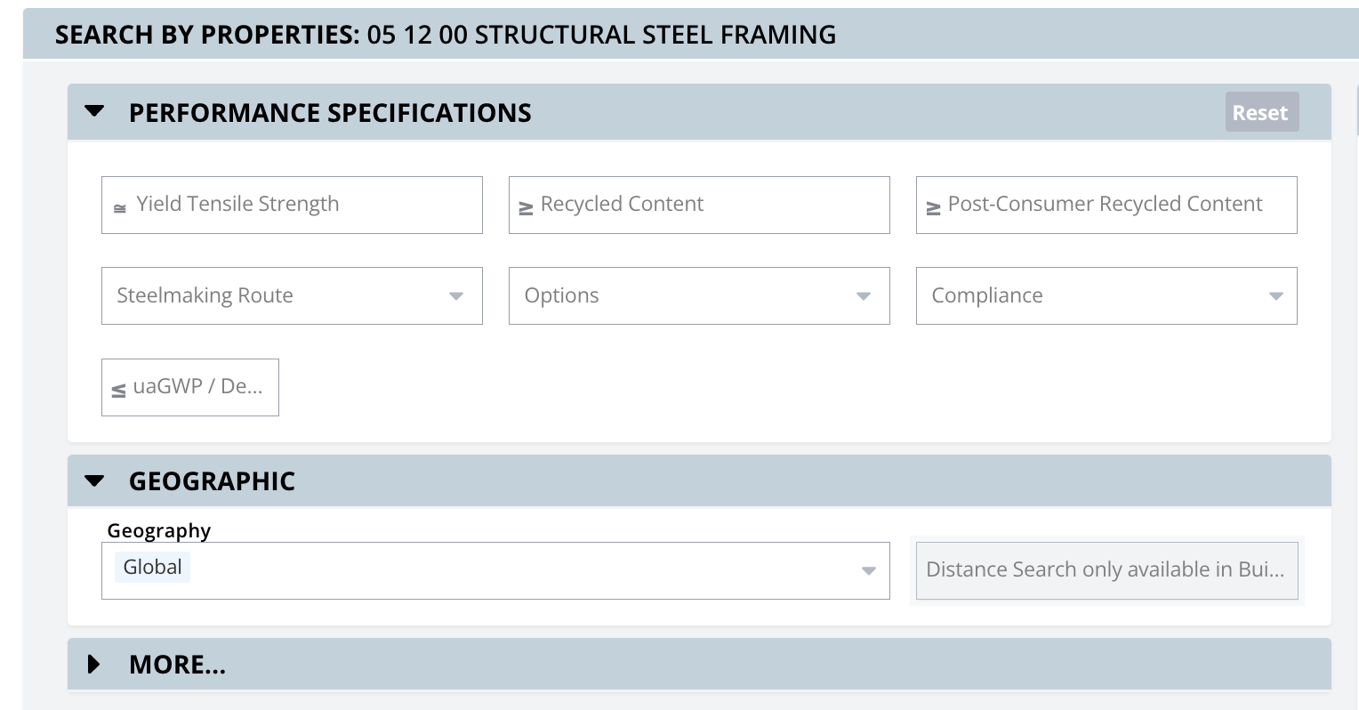
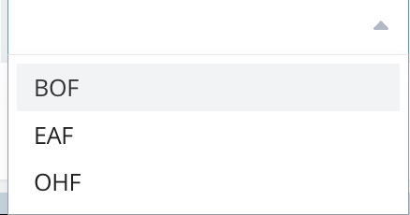
7
Notes:
First you define the “Steelmaking Route”, as explained in the lecture portion. You can choose any specific method. EAF or BOF OHF stands for Open hearth furnace, that is rarely used in United States now. Typically, you want to leave it as default, meaning it will search all products with EPDs.

Slide 8
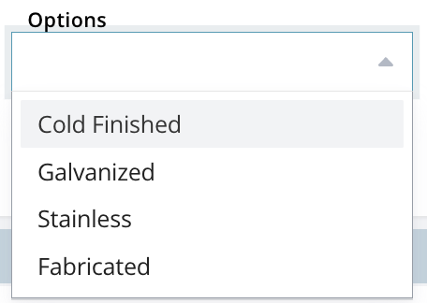
8
Notes:
And you also need to define whether the steel is fabricated vs unfabricated. You can leave it as default as well.

Slide 9
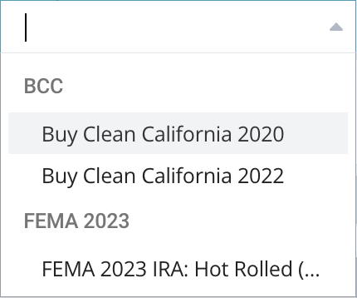
9
Notes:
For “Compliance”, so far there are only two options built in EC3 tool, either “Buy Clean California” or FEMA 2023, since you are working on a project located in Chicago, you can leave it as default.
You can leave the rest of the boxes under ‘Performance Specifications” as is.

Slide 10
10
Notes:
Next, you need to choose the geographic location, by default it sets as global, meaning it will pull up all products from around the world that have an EPD. Since your project is in US, then you can pick US.
You can click “More” to add items such as the EPD types, but for this exercise, you can leave some options blank.

Slide 11
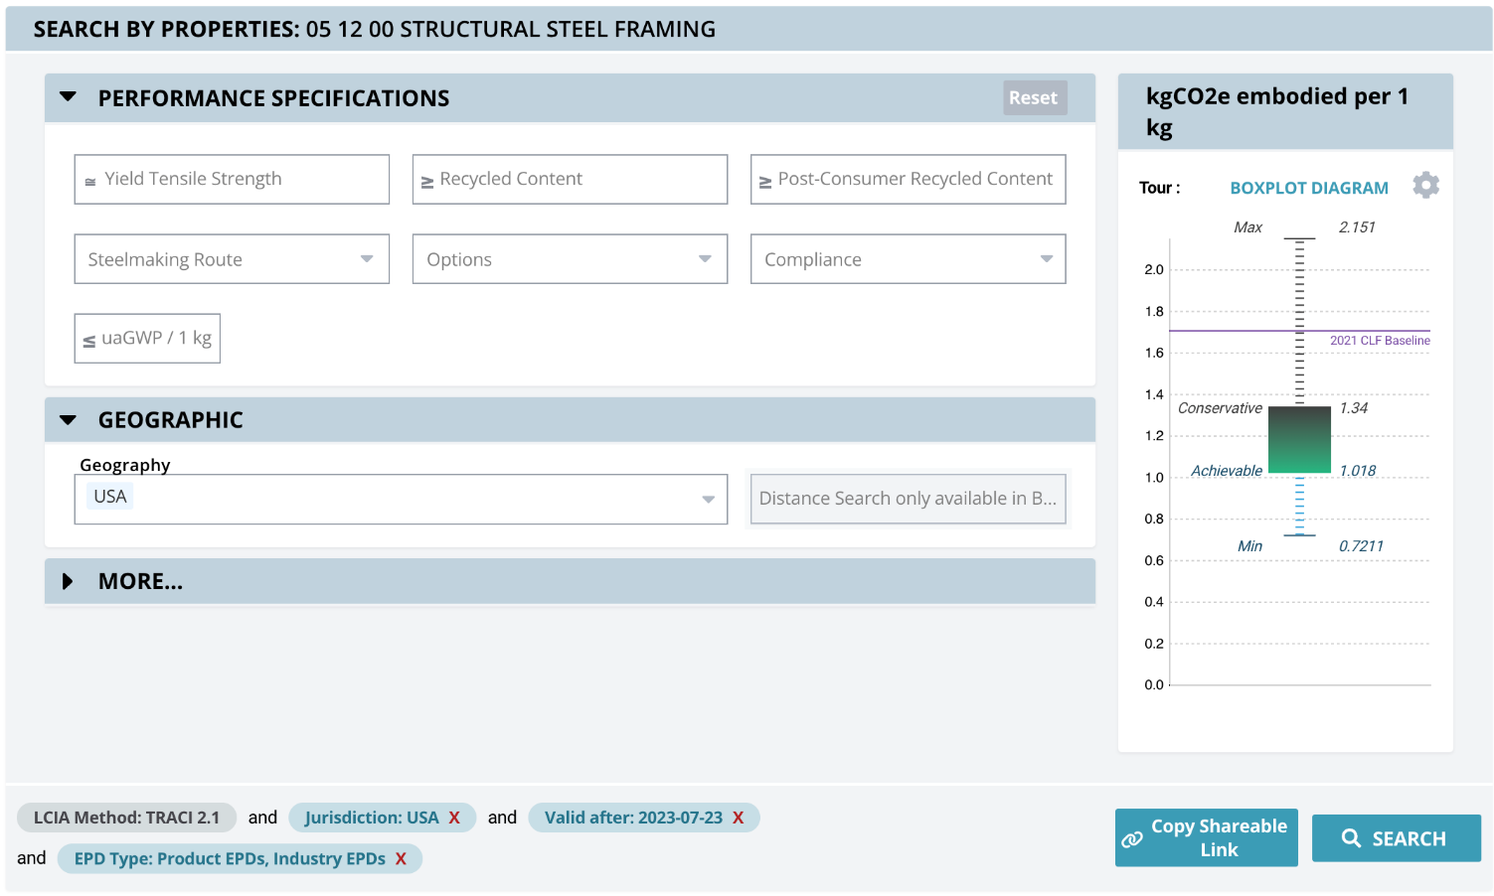
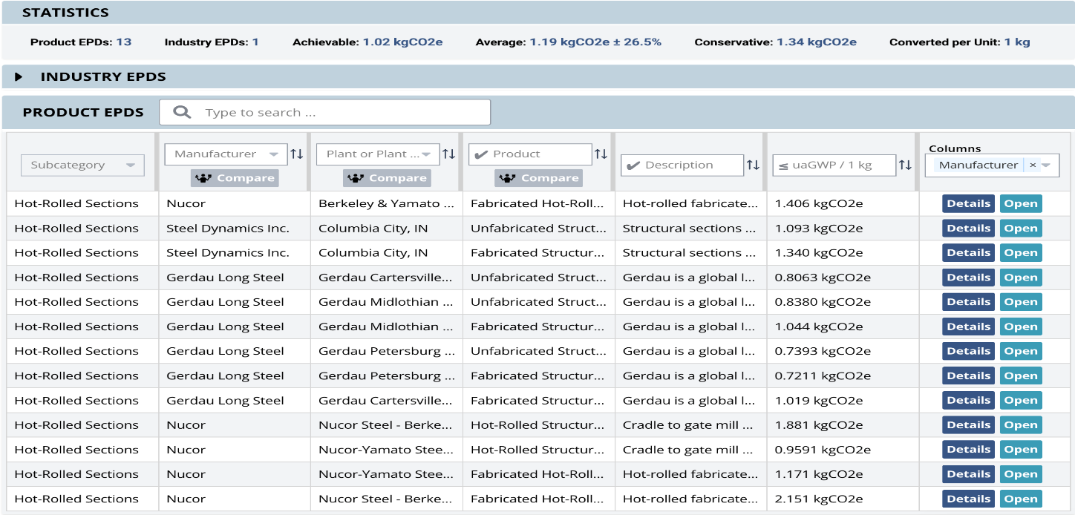
Search
Search Results
11
Notes:
After you finish inputting the information, you click the “Search” button in the lower right corner. Next you will see the “Search Results”. Let’s zoom into the search results.

Slide 12
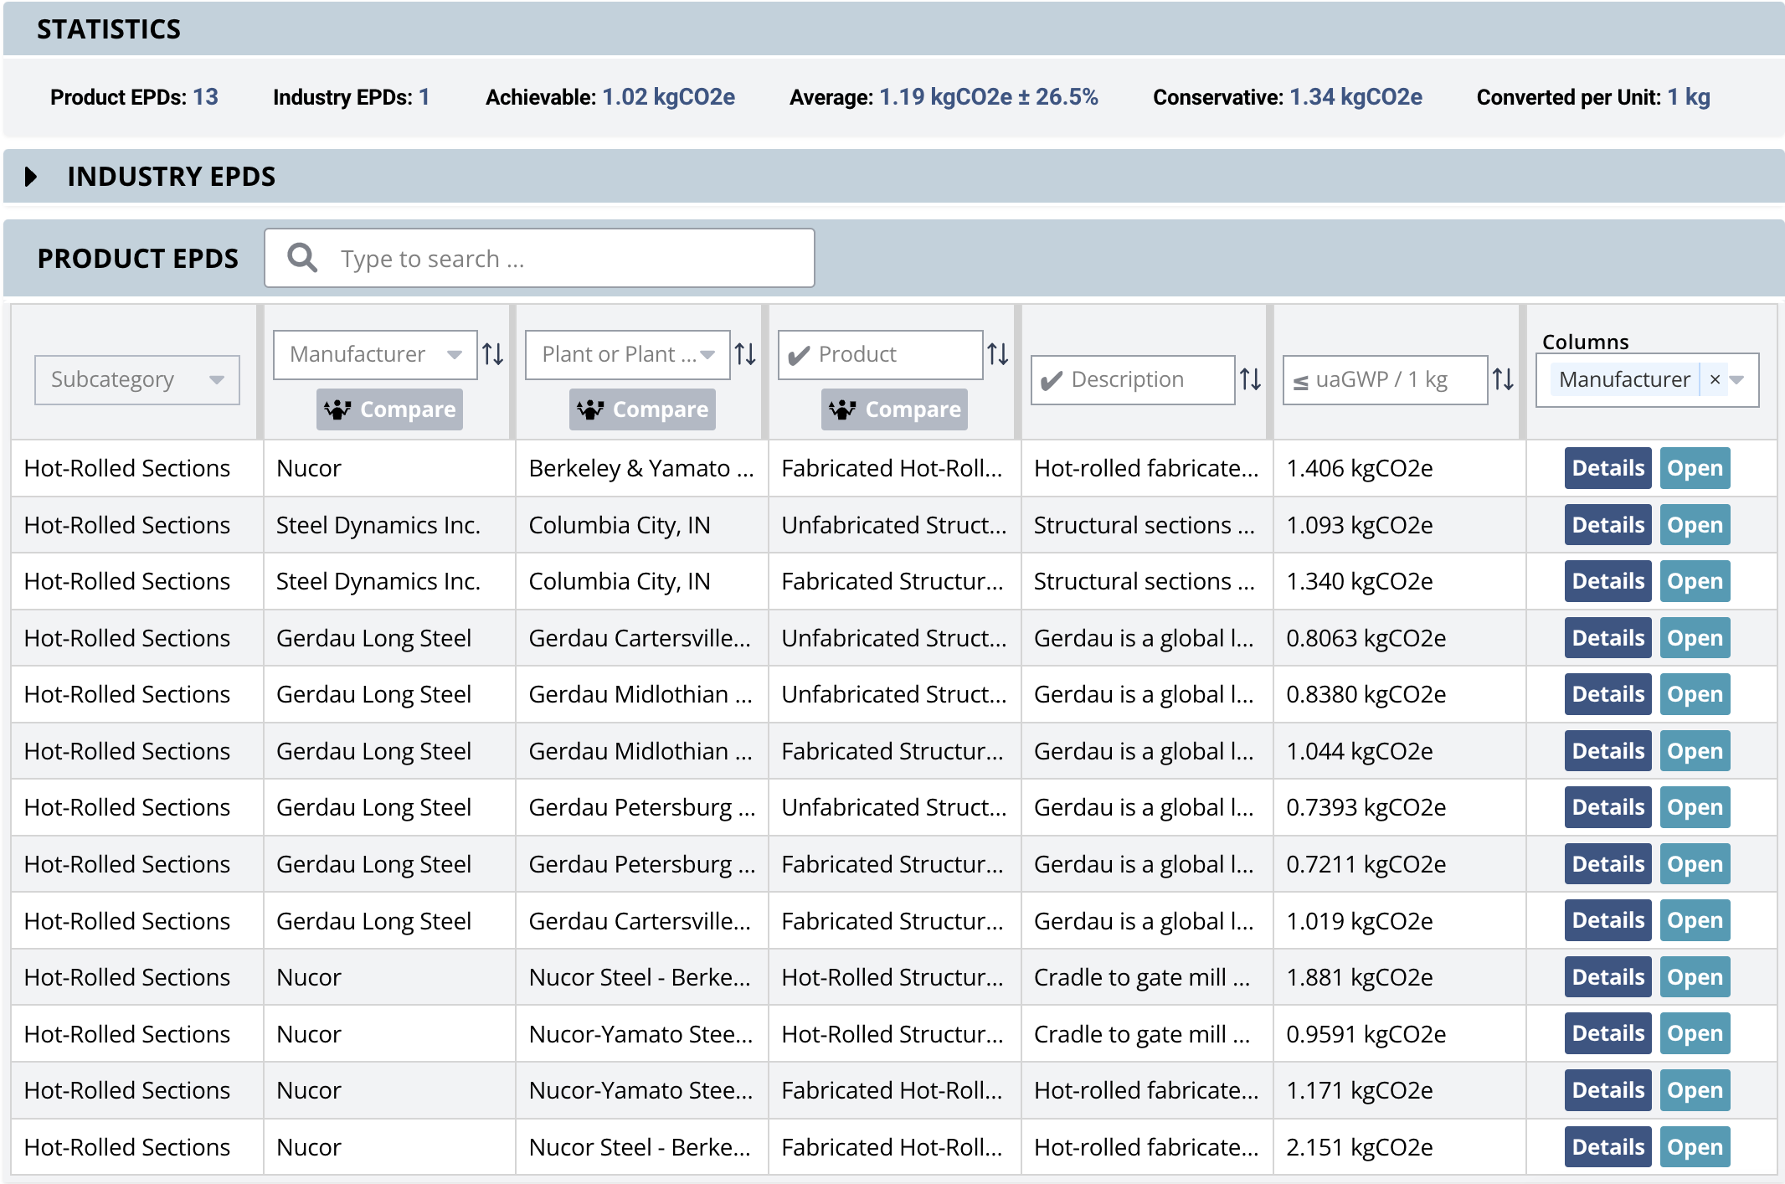
12
Notes:
The statistics shows there are 13 products of structural steel “hot-rolled sections” with EPD information that we can find in this database in the United States. It also gives you a range of carbon footprint of those products, in other words, the range of embodied carbon emission from those products.

Slide 13
13
Notes:
The range is from achievable to conservative.
The conservative range means among the 13 products, 80% of them have embodied carbon of 1.34 kg CO2eq/kg or higher.
The achievable means 20% of the products have embodied carbon of 1.02 kg CO2eq/kg or below. Just a reminder, the lower embodied carbon, the less the environmental impact potential.
On average, those 13 products have an average embodied carbon of 1.19 kg CO2eq/kg.

Slide 14

14
Notes:
If you want to pick a low embodied carbon steel product, using the information extracted from this database, you can start to understand if one product has higher than 1.34kg CO2e per kg, then it is pretty bad. So, you need to go back to the product selection. At a minimum, you need to select a product that has an average value.
Since searching in US only gives you 13 products with EPDs, you can go to look outside to US, to see whether you can find more products.

Slide 15
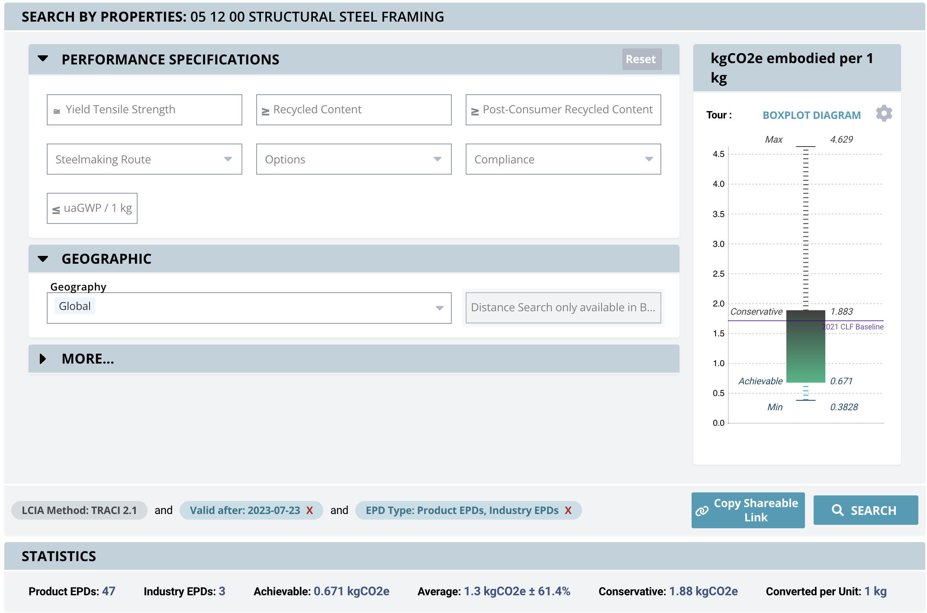
15
Notes:
Now, you change the Geography from USA to Global, then do another search.
See here, you get 53 products, and the range changed, all numbers changed, from achievable to conservative, both showed in BoxPlot diagram and lower row.
For example, now the conservative number is 1.88 kg CO2eq/kg, higher than US’ 1.34 kg CO2eq/kg. But the achievable of global product is 0.67 kg CO2eq/kg, that is lower than that of US’ 1.02 kg CO2eq/kg.

Slide 16
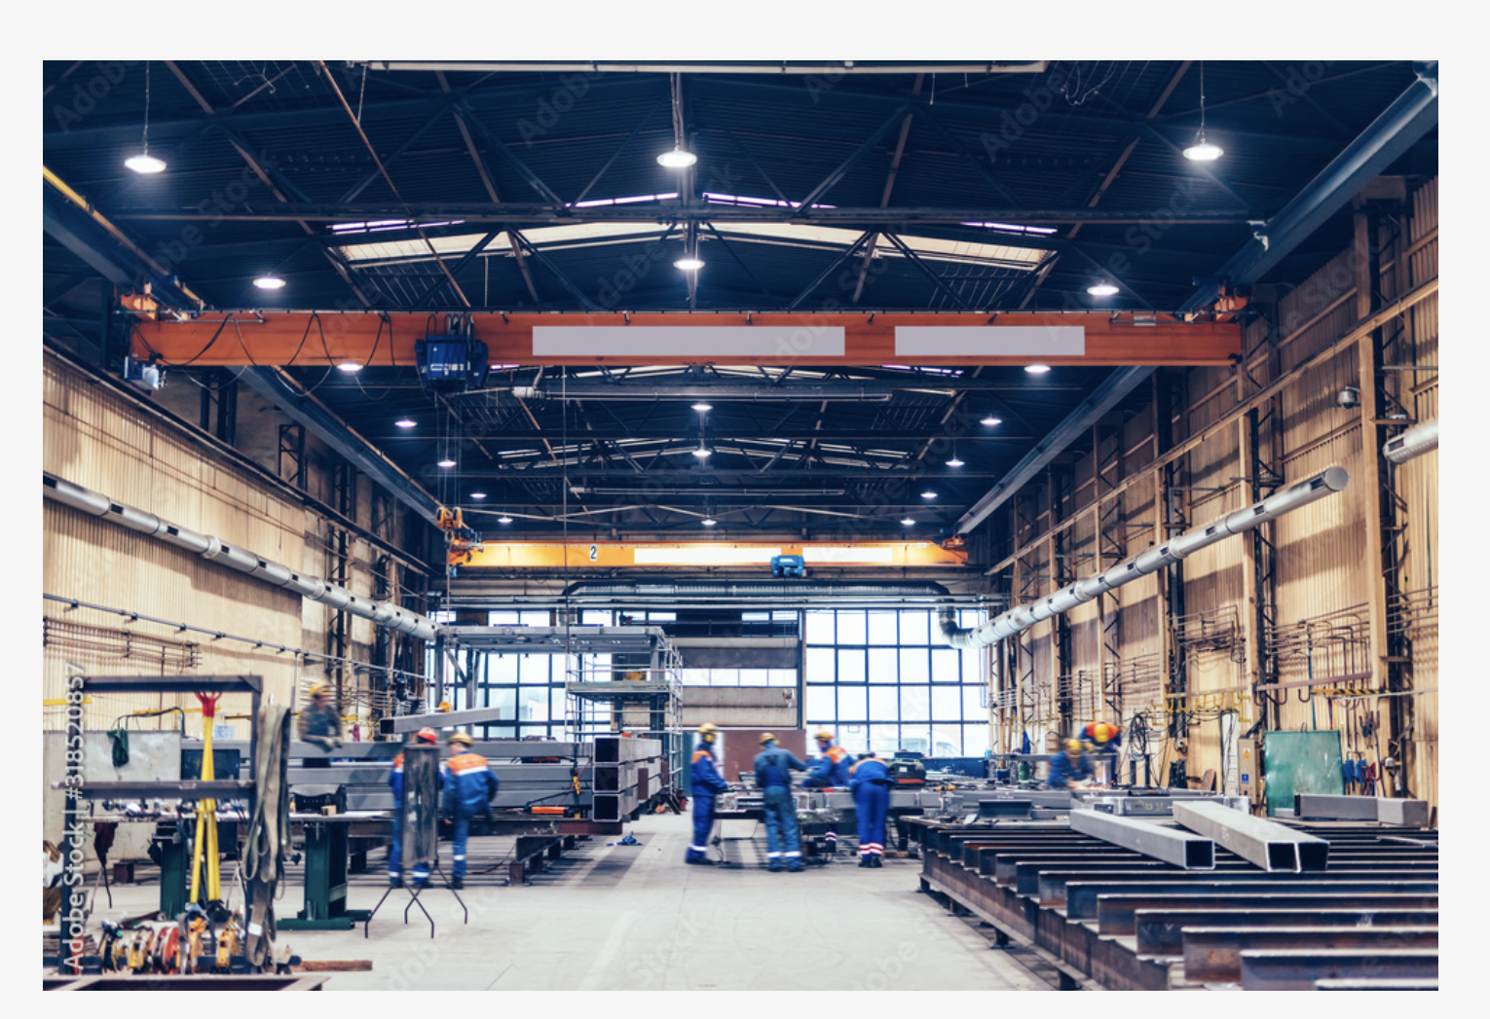
Domestic steel production
16
Notes:
This is an indication that the American made structural steel “hot-roll section” products in general are sustainable with lower embodied carbon. The reason behind could be the higher recycled content used, the production method, or a more sustainable energy grid.
Now you as an architect or engineer, with that information, the first decision you should make is that whether you use domestic steel or an imported steel product. However, since the global achievable value is lower, it means that there are products have lower embodied carbon than US product, so for US steel industry, there is space to improve.

Slide 17
GWP
17
Notes:
If you jump back to US products, you can find where those products are made and the company name. The sixth column highlighted in red box represents the global warming potential (GWP) impact of those steel products, measured by kgCO2eq. You can also refer this to as the embodied carbon of the product.
You can then select an individual product and click “open” to see more information.

Slide 18
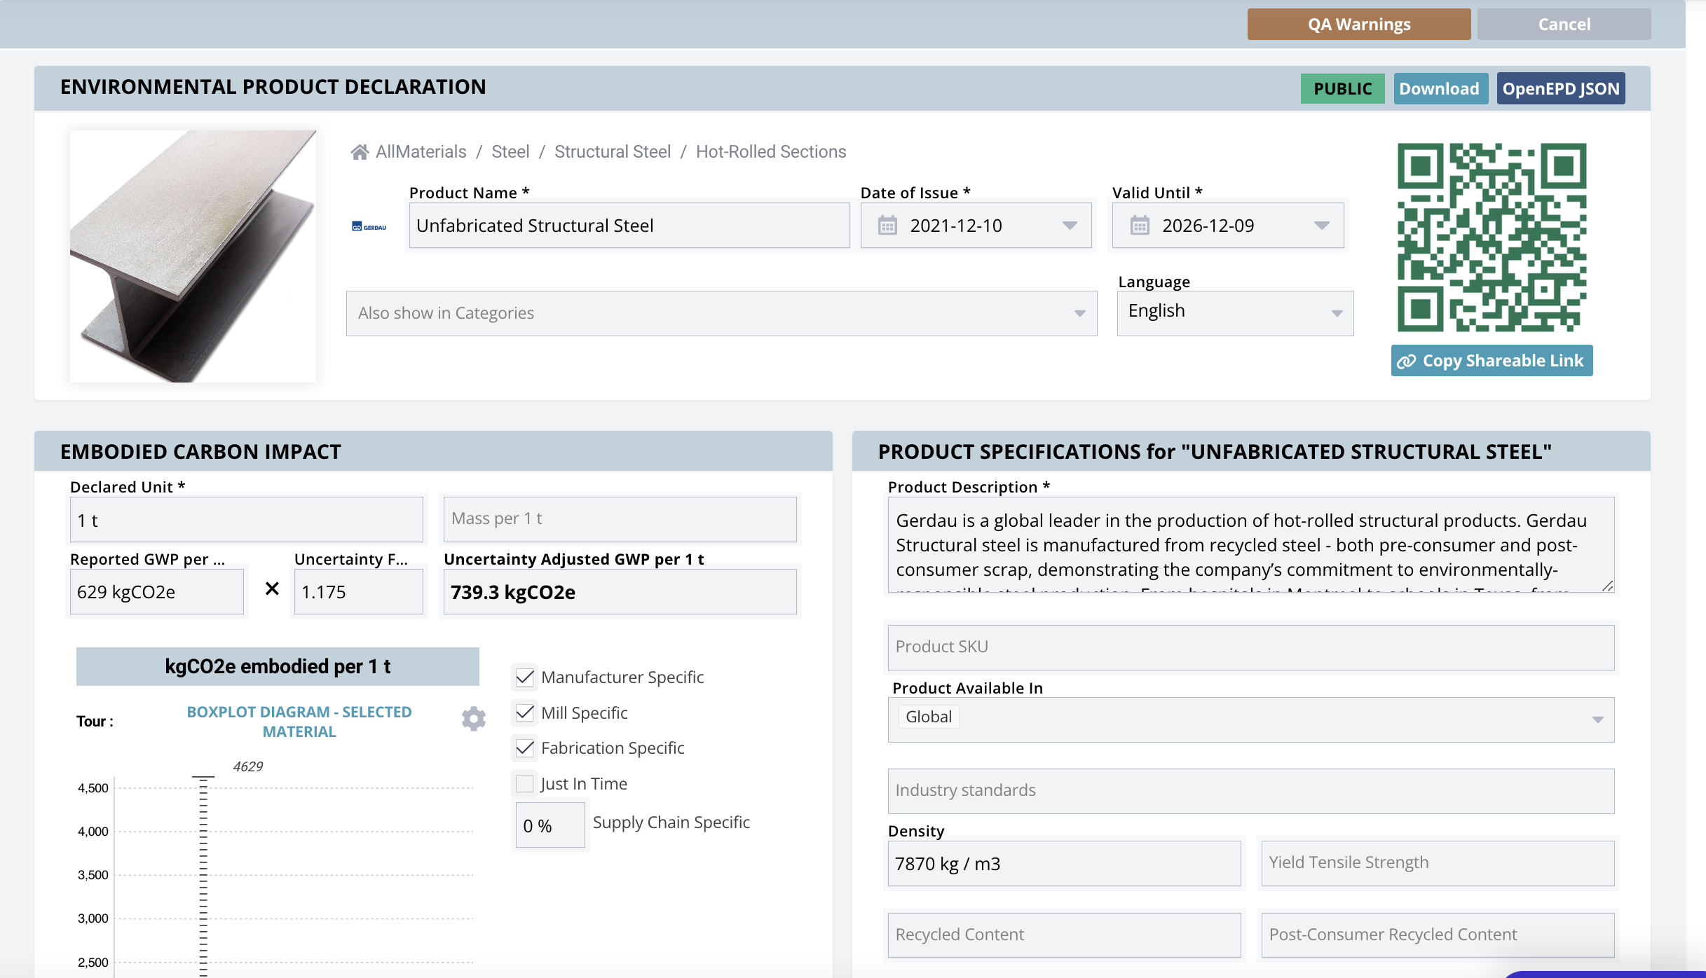
18
Notes:
Here is additional information you can extract from clicking the “open” button; you can download the actual EPD (in PDF format) by clicking the “download” button in the upper right corner.
It also tells you the location of the facility and who verified the EPD. That is the type of information the architect will need in the actual projects to make informative decisions.
After getting a quick overview on how to find product information, let’s do three exercises. Play with the EC3 database on your own.

Slide 19
Exercise: Playing with the EC3 Database (10 mins)
Structural Steel
1. What is the GWP of the average carbon footprint (embodied carbon) of a Fabricated Wide Flange Beam you can find in North America?
2. How many EPDs can you can find?
Notes:
The two exercises are about Structural Steel. You should follow the steps/instruction showed in the previous slides to find the answer. You have 10 mins for the two exercises.
What is the GWP of the average carbon footprint (embodied carbon) of a Fabricated Wide Flange Beam, can you find in North America?
How many EPDs can you find?

Slide 20
Exercise: Answers
Structural Steel
1. What is the GWP of the average carbon footprint (embodied carbon) of a Fabricated Wide Flange Beam you can find in North America?
1.15 Kg CO2e.
2. How many EPDs can you find?
13
Notes:
Here are the answers to the two questions.
You should be aware that the results shown here might be different from what you get since EC3 is constantly integrating newly published EPDs. With new and updated EPD numbers, those values will change.

